Slide 1
EP
EDEXCEL IAL MATHS
P3.1 Algebraic fractions and functions
The full notes page in 12 sections · practice questions with answers · simulations
ExaminerPrep is an independent tutoring service. It has been developed independently from and is not endorsed by the International Baccalaureate Organization. "International Baccalaureate", "IB" and "IB Diploma Programme" are registered trademarks of the IBO, used here for descriptive purposes only.
Pearson Edexcel and Cambridge are trademarks of their owners; ExaminerPrep is not affiliated with any exam board.
Notes:
P3.1 Algebraic fractions and functions. Notes for this topic: https://examinerprep.com/notes/edexcel-ial-maths/algebraic-fractions-and-functions/

Slide 2
What this page covers
Overview
Simplifying algebraic fractions by factorising and cancelling common factors
Multiplying, dividing, adding and subtracting algebraic fractions with linear or quadratic denominators
Algebraic division of an improper fraction by a linear or quadratic expression
Functions: domain, range, one-one and many-one mappings, and why a one-many mapping is not a function
Composite functions: fg(x) means apply g first, then f
Inverse functions, their domain and range, and the reflection of the graph in y = x
Restricting a domain so that an inverse exists
Notes:
What this page covers. Full notes: https://examinerprep.com/notes/edexcel-ial-maths/algebraic-fractions-and-functions/

Slide 3
In one minute
Key points
1. Algebraic fractions follow the same rules as number fractions provided you factorise first and cancel only factors, and a function is a rule together with its domain, so every range, composite and inverse depends on which inputs are allowed.
2. Combine: for × and ÷, factorise and cancel (÷ means × by the reciprocal); for + and -, use the lowest common denominator, then simplify the numerator.
3. Divide: if the numerator's degree is at least the denominator's, write N(x)/D(x) ≡Q(x) + R(x)/D(x) with the degree of R less than the degree of D.
4. Function: every input in the domain has exactly one output. The range is the set of outputs, written in terms of f(x).
5. Composite: fg(x) = f(g(x)), so g acts first.
6. Inverse: exists only for a one-one function. Domain of f⁻¹ = range of f; its graph is the reflection of y = f(x) in y = x.
Notes:
In one minute. Full notes: https://examinerprep.com/notes/edexcel-ial-maths/algebraic-fractions-and-functions/

Slide 4
How do I simplify and combine algebraic fractions?
Section 1 of 12
Nearly every later topic in P3 and P4 produces fractions with x in them: the quotient rule, partial fractions, parametric gradients. Handling them confidently rests on one idea you already use with numbers: (6/8) = (2 ×3)/(2 ×4) = ¾ works because 2 is a factor of both top and bottom.
Algebraic (rational) fraction. One polynomial divided by another, defined for every value of x that does not make the denominator zero.
Operation | Method | Example
Simplify | factorise top and bottom fully; cancel common factors | (x² - 4)/(x² + 2x) = ((x-2)(x+2))/(x(x+2)) = (x-2)/x
Multiply | factorise everything, cancel across the fractions, then multiply | 3/(x+1) ×(x²-1)/6 = (x-1)/2
Divide | multiply by the reciprocal of the second fraction | a/b ÷c/d = a/b ×d/c
Notes:
How do I simplify and combine algebraic fractions?. Full notes: https://examinerprep.com/notes/edexcel-ial-maths/algebraic-fractions-and-functions/

Slide 5
How do I simplify and combine algebraic fractions? (continued)
Section 1 of 12
Operation | Method | Example
Add or subtract | use the lowest common denominator; expand and collect the numerator; check whether it now factorises and cancels | 1/x + 2/(x+1) = (3x+1)/(x(x+1))
Notes:
How do I simplify and combine algebraic fractions?. Full notes: https://examinerprep.com/notes/edexcel-ial-maths/algebraic-fractions-and-functions/

Slide 6
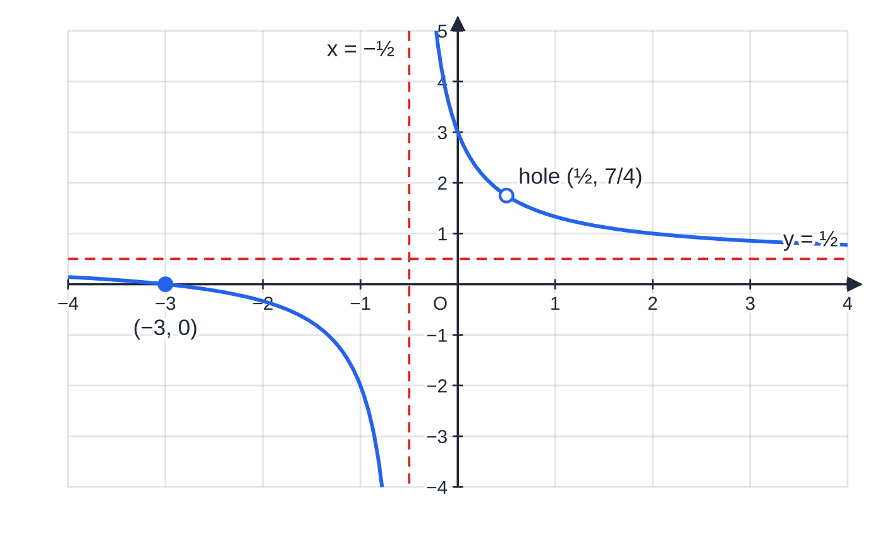
How do I simplify and combine algebraic fractions? (continued)
Section 1 of 12 · Worked example 1 · Medium · Simplify
WORKED EXAMPLE · QUESTION
(a) Simplify fully (2x² + 5x - 3)/(4x² - 1). (b) Simplify fully (x² - 9)/(x² + 2x - 15) ÷(2x + 6)/(x + 5).
SOLUTION
(a) Factorise top and bottom (the bottom is a difference of two squares): ((x+3)(2x-1))/((2x-1)(2x+1)). Cancel the common factor (2x - 1). (x+3)/(2x+1)
(b) Turn the division into multiplication by the reciprocal and factorise everything: ((x-3)(x+3))/((x-3)(x+5)) ×(x+5)/(2(x+3)). Cancel (x - 3), (x + 3) and (x + 5). ½
The graph of y = (2x² + 5x − 3)/(4x² − 1). It is the same curve as y = (x + 3)/(2x + 1) except at x = ½, where the original fraction is undefined: cancelling (2x − 1) leaves a single missing point, the hole at (½, 7/4). The asymptotes are x = −½ and y = ½.
Notes:
How do I simplify and combine algebraic fractions?: Worked example 1. Full notes: https://examinerprep.com/notes/edexcel-ial-maths/algebraic-fractions-and-functions/

Slide 7
How do I simplify and combine algebraic fractions? (continued)
Section 1 of 12 · Worked example 1 · Medium · Simplify (continued)
The answer to (b) is a constant: every factor cancels. It holds for every x for which the original expression is defined (x ≠3, -3, -5).
Notes:
How do I simplify and combine algebraic fractions?: Worked example 1. Full notes: https://examinerprep.com/notes/edexcel-ial-maths/algebraic-fractions-and-functions/

Slide 8
How do I simplify and combine algebraic fractions? (continued)
Section 1 of 12
Common error
Cancelling terms instead of factors: (x+3)/(x+5) is not (3/5), and (x²+4)/x² is not 4. You can only cancel something that multiplies the whole numerator and the whole denominator.
Notes:
How do I simplify and combine algebraic fractions?. Full notes: https://examinerprep.com/notes/edexcel-ial-maths/algebraic-fractions-and-functions/

Slide 9
How do I simplify and combine algebraic fractions? (continued)
Section 1 of 12 · Worked example 2 · Medium · Show that
WORKED EXAMPLE · QUESTION
Show that 2/(x - 3) - (x + 7)/(x² - x - 6) can be written as 1/(x + 2).
SOLUTION
Factorise the quadratic denominator to find the lowest common denominator: x² - x - 6 = (x - 3)(x + 2), so the common denominator is (x - 3)(x + 2).
Rewrite the first fraction over it and subtract:
(2(x+2) - (x+7))/((x-3)(x+2)) = (2x + 4 - x - 7)/((x-3)(x+2)) = (x - 3)/((x-3)(x+2))
Cancel the common factor. = 1/(x+2) as required
Put the subtracted numerator in brackets: -(x + 7) = -x - 7. Losing that bracket is the classic slip.
Notes:
How do I simplify and combine algebraic fractions?: Worked example 2. Full notes: https://examinerprep.com/notes/edexcel-ial-maths/algebraic-fractions-and-functions/

Slide 10
What do I do when the numerator's degree is too high?
Section 2 of 12
Improper algebraic fraction. One whose numerator has degree greater than or equal to the degree of its denominator. Like (7/3) = 2 + ⅓ for numbers, it can be split into a whole part and a proper fraction.
The division identity for fractions
(not in the formulae booklet: learn it):
N(x)/D(x) ≡Q(x) + R(x)/D(x), equivalently N(x) ≡Q(x)D(x) + R(x)
Q(x) is the quotient; R(x) is the remainder, with degree less than the degree of D(x): a constant for a linear divisor, at most linear (px + q) for a quadratic divisor.
Find Q and R by long division or by comparing coefficients in N(x) ≡Q(x)D(x) + R(x).
Notes:
What do I do when the numerator's degree is too high?. Full notes: https://examinerprep.com/notes/edexcel-ial-maths/algebraic-fractions-and-functions/

Slide 11
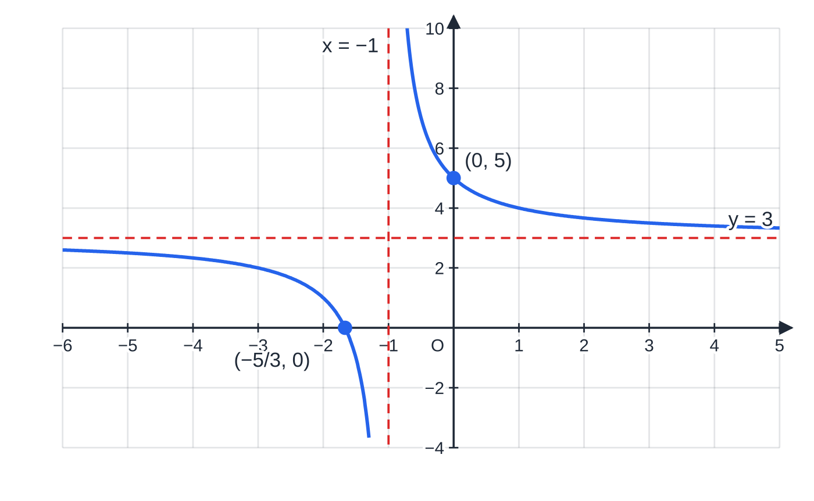
What do I do when the numerator's degree is too high? (continued)
Section 2 of 12
A linear denominator
For (3x + 5)/(x + 1), write the top in terms of the bottom: 3x + 5 = 3(x + 1) + 2, so (3x+5)/(x+1) = 3 + 2/(x+1). The divided form shows the behaviour at once. As x →±∞ the fraction part tends to 0, so y →3, a horizontal asymptote; and the fraction part is never 0, so y = 3 is never reached. That will be useful when finding a range.
A quadratic denominator
y = (3x + 5)/(x + 1) = 3 + 2/(x + 1). The quotient 3 gives the horizontal asymptote y = 3; the zero of the denominator gives the vertical asymptote x = −1. Intercepts: (−5/3, 0) and (0, 5).
Notes:
What do I do when the numerator's degree is too high?. Full notes: https://examinerprep.com/notes/edexcel-ial-maths/algebraic-fractions-and-functions/

Slide 12
What do I do when the numerator's degree is too high? (continued)
Section 2 of 12
Long division works exactly as for a linear divisor: divide the leading terms, multiply back, subtract, repeat. Keep a 0 in place of any missing power in the divisor or the dividend (for example x² + 0x + 2), and stop as soon as what is left has degree less than 2: that linear (or constant) expression is the remainder.
Notes:
What do I do when the numerator's degree is too high?. Full notes: https://examinerprep.com/notes/edexcel-ial-maths/algebraic-fractions-and-functions/

Slide 13
What do I do when the numerator's degree is too high? (continued)
Section 2 of 12 · Worked example 3 · Medium · Express
WORKED EXAMPLE · QUESTION
Express (2x⁴ - x³ + 7x² - x + 2)/(x² + 2) in the form ax² + bx + c + (dx + e)/(x² + 2), where a, b, c, d and e are constants.
SOLUTION
2x⁴ ÷x² = 2x²; subtract 2x²(x² + 2) = 2x⁴ + 4x², leaving -x³ + 3x² - x + 2.
-x³ ÷x² = -x; subtract -x(x² + 2) = -x³ - 2x, leaving 3x² + x + 2.
3x² ÷x² = 3; subtract 3(x² + 2) = 3x² + 6, leaving x - 4, which has degree 1 < 2, so it is the remainder.
2x² - x + 3 + (x - 4)/(x² + 2) (a = 2, b = -1, c = 3, d = 1, e = -4)
Quick check at x = 1: left = (2 - 1 + 7 - 1 + 2)/3 = 3; right = 2 - 1 + 3 + (-3)/3 = 3 ✓
Notes:
What do I do when the numerator's degree is too high?: Worked example 3. Full notes: https://examinerprep.com/notes/edexcel-ial-maths/algebraic-fractions-and-functions/

Slide 14
What do I do when the numerator's degree is too high? (continued)
Section 2 of 12
Exam tip
Comparing coefficients is a reliable alternative: expand (ax² + bx + c)(x² + 2) + dx + e and match x⁴, x³, x², x and the constant one at a time, starting from the highest power.
Notes:
What do I do when the numerator's degree is too high?. Full notes: https://examinerprep.com/notes/edexcel-ial-maths/algebraic-fractions-and-functions/

Slide 15
What are the domain and range of a function?
Section 3 of 12
Function. A mapping in which every member of the domain (the set of allowed inputs) is mapped to exactly one output; the set of all outputs is the range.
Notation: f(x) = 3x - 1, or f: x ↦3x - 1, together with a domain such as x ∈ℝ or x > 2.
The domain is part of the function: the same rule with a different domain is a different function.
The range is a set of outputs, so write it with f(x) (or y): "f(x) ≥3", not "x ≥3".
One-one: different inputs always give different outputs. Many-one: at least two inputs share an output. Both are functions.
One-many (one input, several outputs) is not a function.
Graph test: a vertical line meets the graph of a function at most once; a horizontal line meets the graph of a one-one function at most once.
Notes:
What are the domain and range of a function?. Full notes: https://examinerprep.com/notes/edexcel-ial-maths/algebraic-fractions-and-functions/

Slide 16
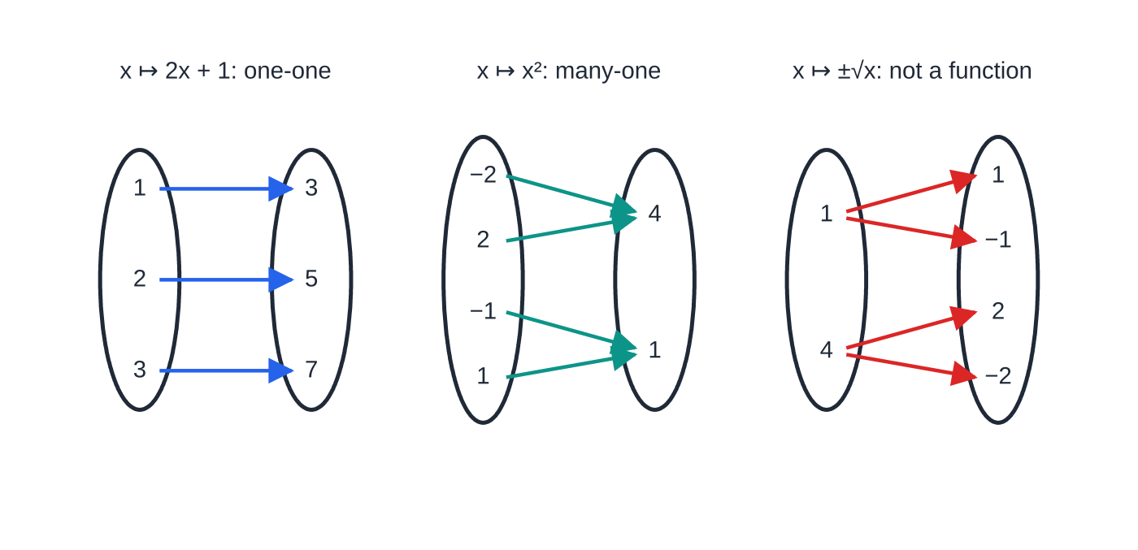
What are the domain and range of a function? (continued)
Section 3 of 12
Finding a range
Sketch the graph over the domain only, then read off the y-values it covers.
For a quadratic, complete the square to find the vertex.
For a fraction, divide first: asymptotes show values that are approached but never reached.
Check the end points of the domain: is the end value included (≤, ≥) or not (<, >)?
Mapping diagrams on small domains. Left: x ↦ 2x + 1 sends each input to its own output (one-one). Centre: x ↦ x² sends −2 and 2 to the same output 4 (many-one, still a function). Right: "x ↦ ±√x" sends 1 to two outputs (one-many, so it is not a function).
Notes:
What are the domain and range of a function?. Full notes: https://examinerprep.com/notes/edexcel-ial-maths/algebraic-fractions-and-functions/

Slide 17
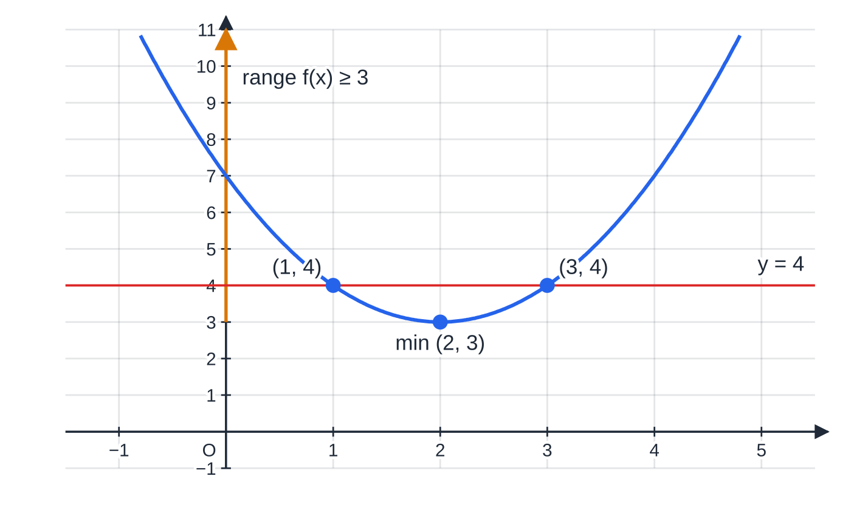
What are the domain and range of a function? (continued)
Section 3 of 12 · Worked example 4 · Medium · Find / Explain
WORKED EXAMPLE · QUESTION
(a) f(x) = x² - 4x + 7, x ∈ℝ. Find the range of f and explain whether f is one-one or many-one. (b) g(x) = 3 + 2/(x + 1), x ≥0. Find the range of g.
(a) y = x² − 4x + 7 on x ∈ ℝ. The amber arrow on the y-axis is the range f(x) ≥ 3, starting at the minimum point (2, 3). The line y = 4 meets the curve twice, at x = 1 and x = 3, so the function is many-one.
Notes:
What are the domain and range of a function?: Worked example 4. Full notes: https://examinerprep.com/notes/edexcel-ial-maths/algebraic-fractions-and-functions/

Slide 18
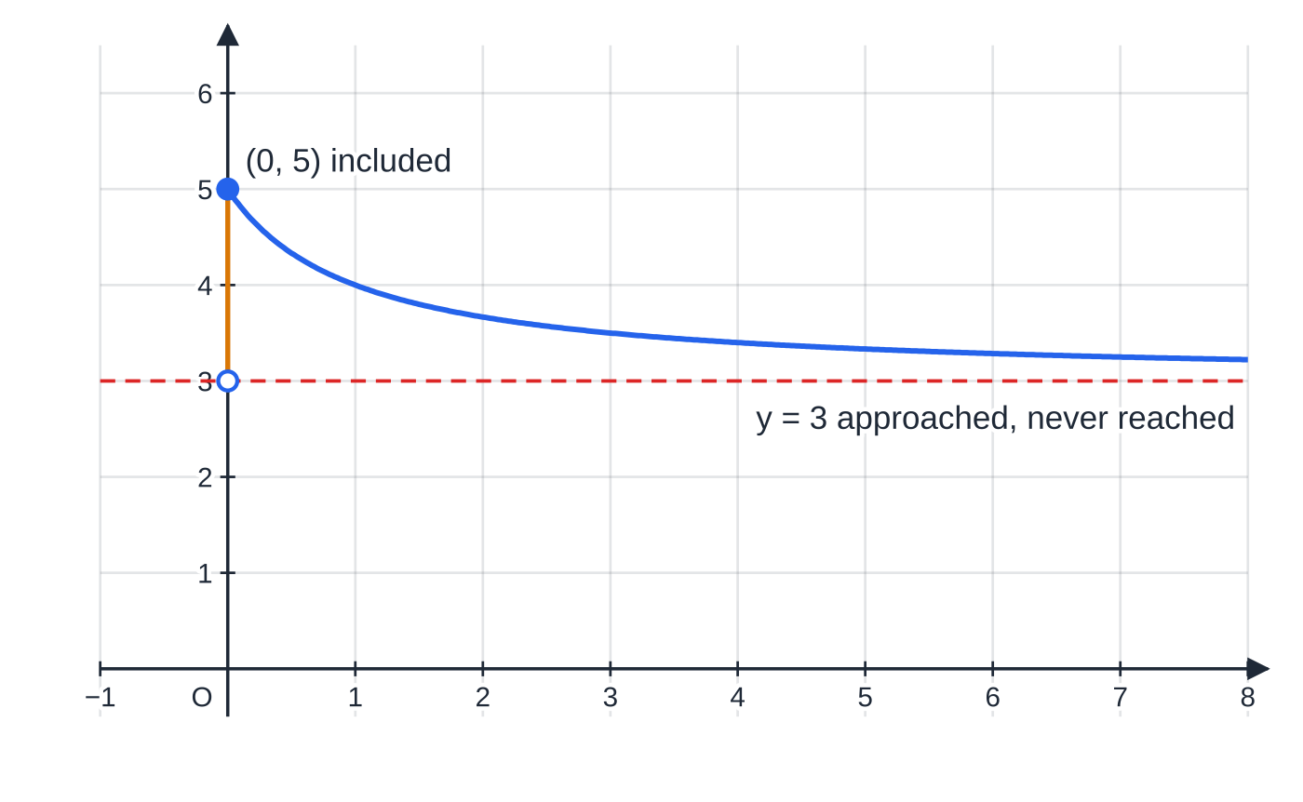
What are the domain and range of a function? (continued)
Section 3 of 12 · Worked example 4 · Medium · Find / Explain (continued)
SOLUTION
(a) Complete the square: f(x) = (x - 2)² + 3, and (x - 2)² ≥0 with equality at x = 2. f(x) ≥3 Two inputs with the same output: f(1) = f(3) = 4, so f is many-one.
(b) Use the domain. For x ≥0, x + 1 ≥1, so 0 < 2/(x+1) ≤2. The largest value is g(0) = 5; as x →∞, g(x) →3 but never equals 3. 3 < g(x) ≤5
(b) g(x) = 3 + 2/(x + 1) on x ≥ 0 only. The curve starts at the included end point (0, 5) and falls towards the asymptote y = 3, so the range (amber) is 3 < g(x) ≤ 5.
Notes:
What are the domain and range of a function?: Worked example 4. Full notes: https://examinerprep.com/notes/edexcel-ial-maths/algebraic-fractions-and-functions/

Slide 19
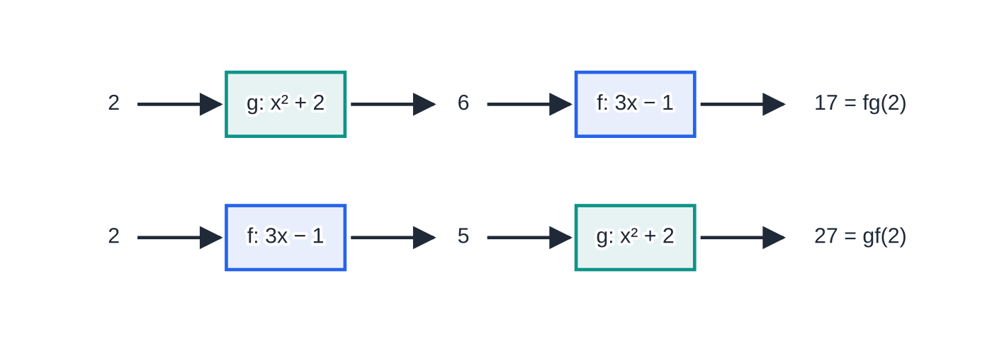
How do I form a composite function?
Section 4 of 12
Composite function
(not in the formulae booklet: learn it):
fg(x) = f(g(x))
g acts first, then f acts on the output of g. f²(x) means ff(x) = f(f(x)). In general fg ≠gf.
fg can only be formed if every output of g is an allowed input of f: the range of g must lie inside the domain of f. The domain of fg is the domain of g.
Following the input 2 through both orders with f(x) = 3x − 1 and g(x) = x² + 2. Applying g then f gives fg(2) = 17; applying f then g gives gf(2) = 27.
Notes:
How do I form a composite function?. Full notes: https://examinerprep.com/notes/edexcel-ial-maths/algebraic-fractions-and-functions/

Slide 20
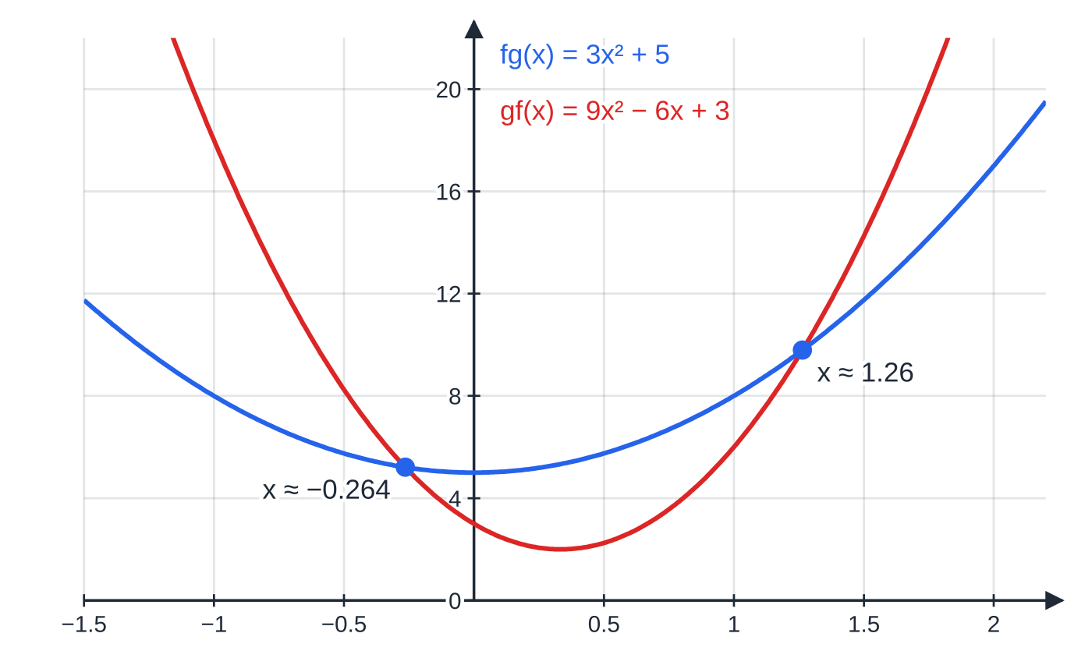
How do I form a composite function? (continued)
Section 4 of 12 · Worked example 5 · Medium · Find / Solve
WORKED EXAMPLE · QUESTION
The functions f and g are defined by f(x) = 3x - 1, x ∈ℝ, and g(x) = x² + 2, x ∈ℝ. (a) Find fg(2) and gf(2). (b) Find fg(x) and gf(x). (c) Solve fg(x) = gf(x), giving exact answers.
SOLUTION
(a) Innermost function first: fg(2) = f(6) = 17; gf(2) = g(5) = 27. 17 and 27
(b) Substitute the whole of the inner function: fg(x) = 3(x² + 2) - 1 = 3x² + 5; gf(x) = (3x - 1)² + 2 = 9x² - 6x + 3. fg(x) = 3x² + 5, gf(x) = 9x² - 6x + 3
fg and gf are different functions, so their graphs are different parabolas. They meet only where fg(x) = gf(x), at x = (3 ± √21)/6.
Notes:
How do I form a composite function?: Worked example 5. Full notes: https://examinerprep.com/notes/edexcel-ial-maths/algebraic-fractions-and-functions/

Slide 21
How do I form a composite function? (continued)
Section 4 of 12 · Worked example 5 · Medium · Find / Solve (continued)
(c) Equate and rearrange: 9x² - 6x + 3 = 3x² + 5 ⇒6x² - 6x - 2 = 0 ⇒3x² - 3x - 1 = 0. Quadratic formula: x = (3 ±√(9 + 12))/6. x = (3 ±√21)/6 (≈1.26 or -0.264)
Notes:
How do I form a composite function?: Worked example 5. Full notes: https://examinerprep.com/notes/edexcel-ial-maths/algebraic-fractions-and-functions/

Slide 22
How do I form a composite function? (continued)
Section 4 of 12
Common error
Reading fg(x) from left to right and applying f first. The function written next to x acts first, exactly as in f(g(x)). Another slip: multiplying the two rules, f(x) ×g(x), which is a product, not a composite.
Notes:
How do I form a composite function?. Full notes: https://examinerprep.com/notes/edexcel-ial-maths/algebraic-fractions-and-functions/

Slide 23
How do I find an inverse function?
Section 5 of 12
Inverse function. The function f⁻¹ that reverses f: if f(a) = b then f⁻¹(b) = a, so f⁻¹f(x) = x and ff⁻¹(x) = x.
Only a one-one function has an inverse: if two inputs shared an output, the reverse mapping would be one-many.
Method: write y = f(x); rearrange to make x the subject; then write f⁻¹(x) by replacing y with x.
Domain of f⁻¹ = range of f, and range of f⁻¹ = domain of f. Always state the domain of the inverse.
Graph: y = f⁻¹(x) is the reflection of y = f(x) in the line y = x: the point (a, b) becomes (b, a), and a vertical asymptote x = k becomes a horizontal asymptote y = k.
Notes:
How do I find an inverse function?. Full notes: https://examinerprep.com/notes/edexcel-ial-maths/algebraic-fractions-and-functions/

Slide 24
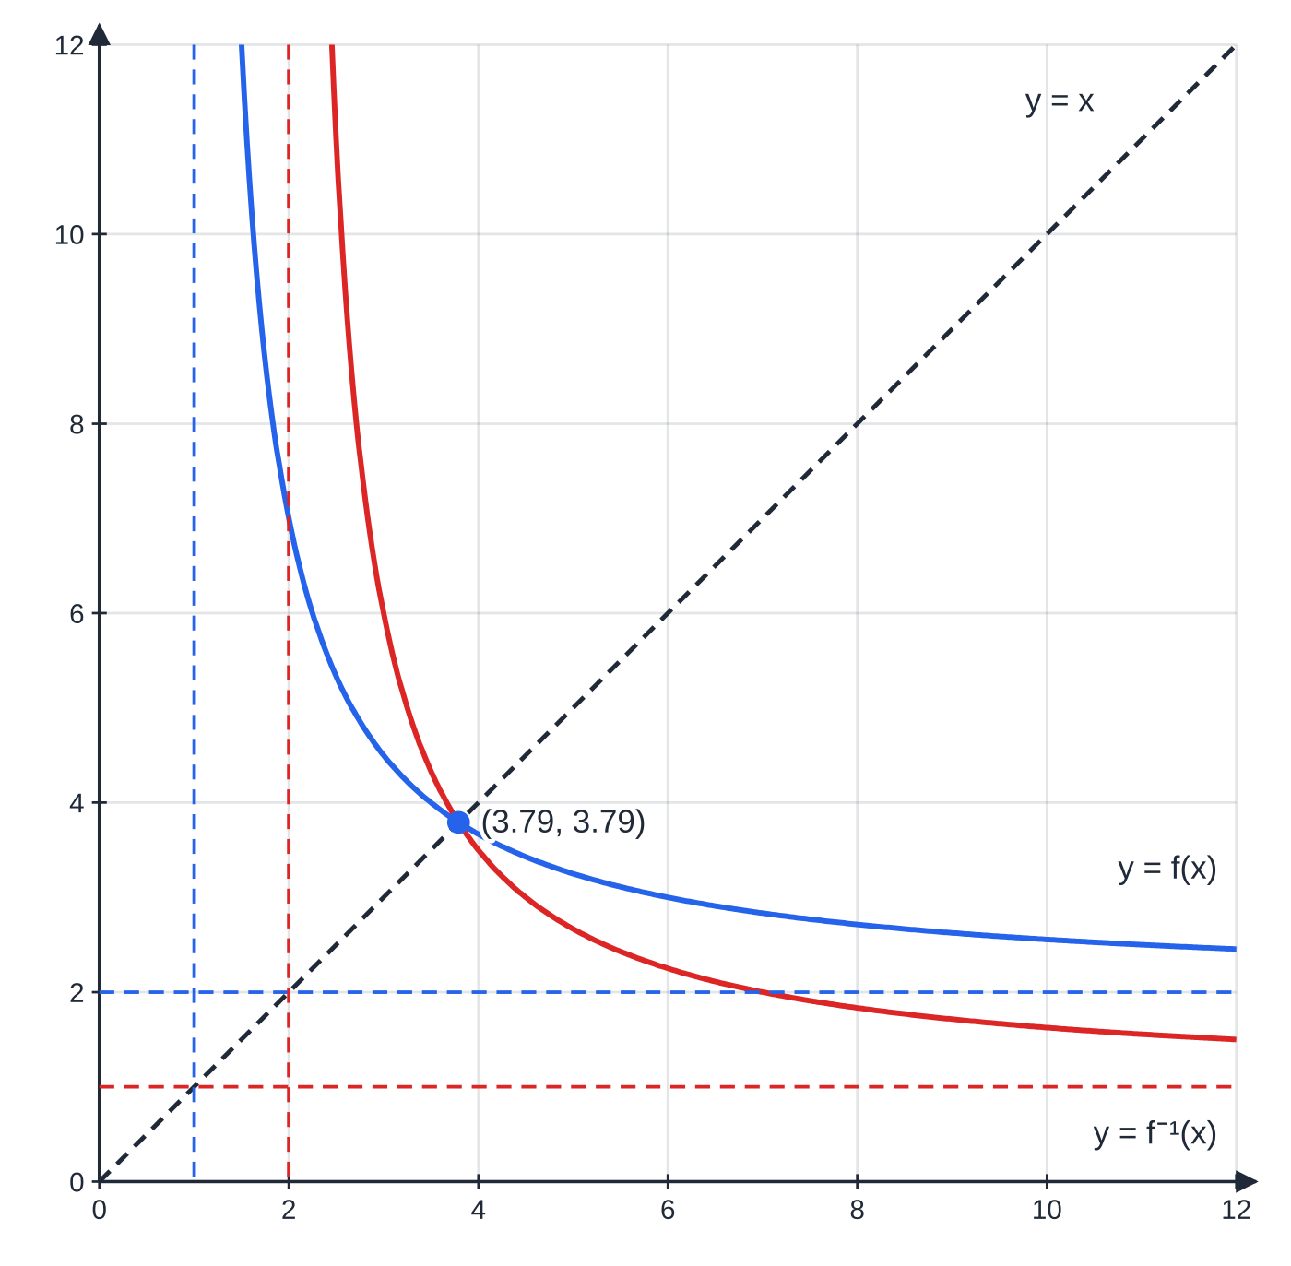
How do I find an inverse function? (continued)
Section 5 of 12 · Worked example 6 · Hard · Show that / Find / Solve
WORKED EXAMPLE · QUESTION
f(x) = (2x + 3)/(x - 1), x > 1. (a) Show that f(x) = 2 + 5/(x - 1) and hence find the range of f. (b) Find f⁻¹(x), stating its domain. (c) Solve f(x) = f⁻¹(x).
SOLUTION
(a) Write the numerator in terms of the denominator: 2x + 3 = 2(x - 1) + 5, so f(x) = 2 + 5/(x-1). For x > 1, x - 1 takes every positive value, so 5/(x-1) takes every positive value. f(x) > 2
(b) Let y = (2x+3)/(x-1) and make x the subject: y(x - 1) = 2x + 3 ⇒xy - 2x = y + 3 ⇒x = (y+3)/(y-2). f⁻¹(x) = (x+3)/(x-2), x > 2 (domain = range of f)
(c) Equate (both sides are defined for x > 2) and cross-multiply: (2x + 3)(x - 2) = (x + 3)(x - 1) ⇒2x² - x - 6 = x² + 2x - 3 ⇒x² - 3x - 3 = 0. So x = (3 ±√21)/2; only (3 + √21)/2 ≈3.79 satisfies x > 2. x = (3 + √21)/2
y = f(x) for x > 1 (blue) and y = f⁻¹(x) for x > 2 (red). Each is the reflection of the other in y = x: the asymptotes x = 1, y = 2 swap to y = 1, x = 2, and the curves meet on the mirror line at x = (3 + √21)/2 ≈ 3.79.
Notes:
How do I find an inverse function?: Worked example 6. Full notes: https://examinerprep.com/notes/edexcel-ial-maths/algebraic-fractions-and-functions/

Slide 25
How do I find an inverse function? (continued)
Section 5 of 12 · Worked example 6 · Hard · Show that / Find / Solve (continued)
The solution lies on y = x: here f(x) = x gives the same equation x² - 3x - 3 = 0.
Notes:
How do I find an inverse function?: Worked example 6. Full notes: https://examinerprep.com/notes/edexcel-ial-maths/algebraic-fractions-and-functions/

Slide 26
How do I restrict a domain so that an inverse exists?
Section 6 of 12
A many-one function has no inverse, but a restricted version of it can. Choose a domain on which the graph is always increasing or always decreasing; then every horizontal line meets it at most once.
For a quadratic, split at the vertex: the domain x ≥ (vertex x-value) or x ≤ (vertex x-value).
The restricted domain decides the sign when you take a square root in the inverse: the outputs of f⁻¹ must lie in the restricted domain of f.
Notes:
How do I restrict a domain so that an inverse exists?. Full notes: https://examinerprep.com/notes/edexcel-ial-maths/algebraic-fractions-and-functions/

Slide 27
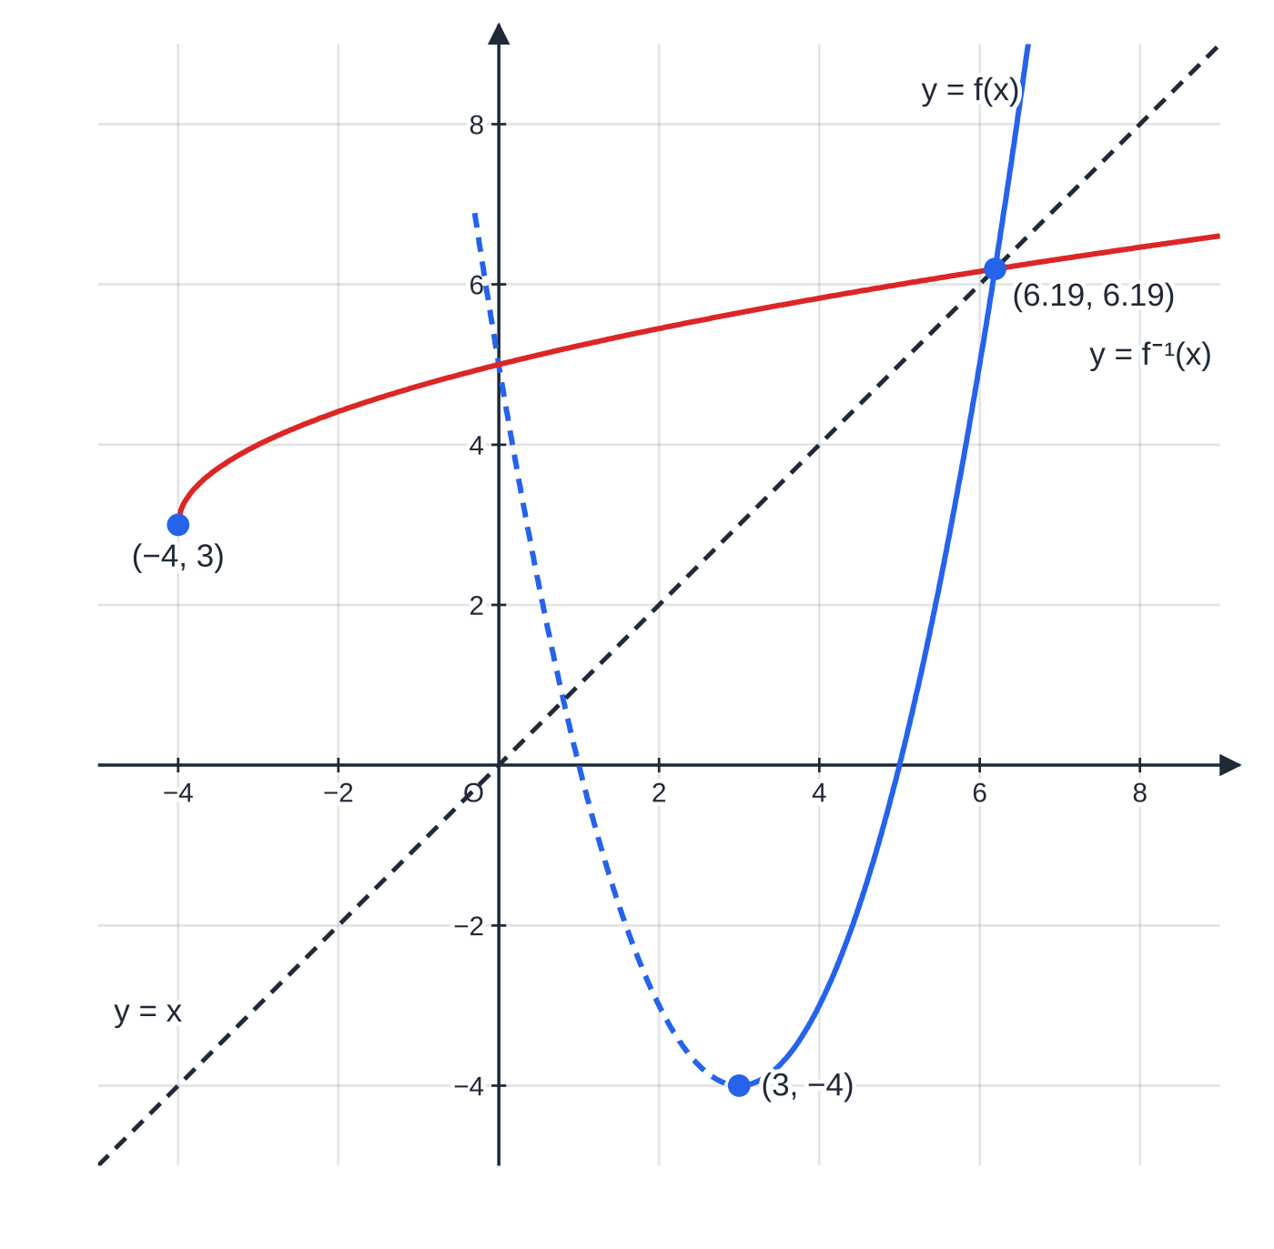
How do I restrict a domain so that an inverse exists? (continued)
Section 6 of 12 · Worked example 7 · Hard · Explain / Find
WORKED EXAMPLE · QUESTION
f(x) = x² - 6x + 5. (a) Write f(x) in the form (x - p)² + q. (b) Explain why f, with domain x ∈ℝ, has no inverse. (c) With the domain x ≥k, f is one-one. State the least value of k. (d) For that domain, find f⁻¹(x) and state its domain and range.
SOLUTION
(a) Complete the square. f(x) = (x - 3)² - 4
(b) f(2) = f(4) = -3, so f is many-one on ℝ and has no inverse.
(c) The vertex is at x = 3; to the right of it the graph only increases. k = 3
(d) Let y = (x - 3)² - 4 and rearrange: (x - 3)² = y + 4 ⇒x - 3 = +√(y + 4) (positive root, since x ≥3). f⁻¹(x) = 3 + √(x + 4), x ≥-4; range f⁻¹(x) ≥3
The domain of f⁻¹ is the range of the restricted f, which is f(x) ≥-4.
y = x² − 6x + 5: the part x ≥ 3 (solid blue) is one-one; the dashed part is excluded. Its inverse y = 3 + √(x + 4) (red) starts at (−4, 3), the reflection of the vertex (3, −4), and meets the curve on y = x at x = (7 + √29)/2 ≈ 6.19.
Notes:
How do I restrict a domain so that an inverse exists?: Worked example 7. Full notes: https://examinerprep.com/notes/edexcel-ial-maths/algebraic-fractions-and-functions/

Slide 28
How do I restrict a domain so that an inverse exists? (continued)
Section 6 of 12
Common error
Writing f⁻¹(x) = 3 ±√(x + 4). A function gives one output, and the restricted domain x ≥3 tells you which sign: the outputs of f⁻¹ must be at least 3, so take +. With the domain x ≤3 instead you would take -.
Notes:
How do I restrict a domain so that an inverse exists?. Full notes: https://examinerprep.com/notes/edexcel-ial-maths/algebraic-fractions-and-functions/

Slide 29
How do these ideas combine in a full question?
Section 7 of 12
Longer questions chain the skills on this page. Simplify the fraction first; it makes the range, the inverse and any composite much easier. Use the divided form (constant + proper fraction) to find the range from the domain. Each part usually feeds the next: "hence" means use the result you have just found.
Notes:
How do these ideas combine in a full question?. Full notes: https://examinerprep.com/notes/edexcel-ial-maths/algebraic-fractions-and-functions/

Slide 30
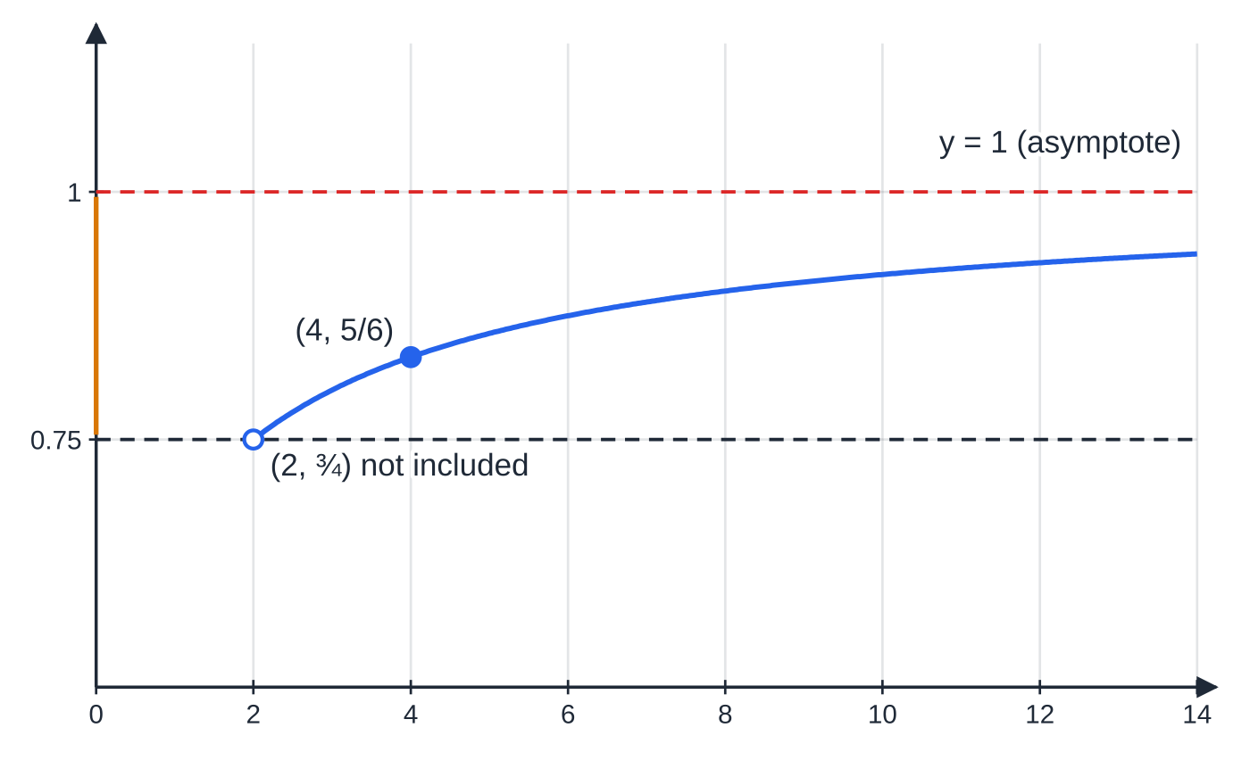
How do these ideas combine in a full question? (continued)
Section 7 of 12 · Worked example 8 · Hard · Show that / Find / Solve
WORKED EXAMPLE · QUESTION
The function f is defined by f(x) = (x² - x - 2)/(x² - 4), x > 2. (a) Show that f(x) = (x+1)/(x+2) and hence that f(x) = 1 - 1/(x+2). (b) Find the range of f. (c) Find f⁻¹(x), stating its domain. (d) The function g is defined by g(x) = 4x - 3, x ∈ℝ. Show that gf(x) = (x - 2)/(x + 2) and solve gf(x) = ⅓.
SOLUTION
(a) Factorise and cancel: ((x-2)(x+1))/((x-2)(x+2)) = (x+1)/(x+2) (allowed, as x - 2 ≠0 for x > 2). Then x + 1 = (x + 2) - 1, so f(x) = 1 - 1/(x+2).
(b) x > 2 ⇒x + 2 > 4 ⇒0 < 1/(x+2) < ¼. ¾ < f(x) < 1
f(x) = (x + 1)/(x + 2) for x > 2. The curve starts just above ¾ (the end point x = 2 is excluded, so the hollow dot is not part of the graph) and rises towards the asymptote y = 1 without reaching it, giving the range ¾ < f(x) < 1 (amber).
Notes:
How do these ideas combine in a full question?: Worked example 8. Full notes: https://examinerprep.com/notes/edexcel-ial-maths/algebraic-fractions-and-functions/

Slide 31
How do these ideas combine in a full question? (continued)
Section 7 of 12 · Worked example 8 · Hard · Show that / Find / Solve (continued)
(c) y = (x+1)/(x+2) ⇒xy + 2y = x + 1 ⇒x(y - 1) = 1 - 2y. f⁻¹(x) = (2x - 1)/(1 - x), ¾ < x < 1
(d) f acts first, then g: gf(x) = 4 ·(x+1)/(x+2) - 3 = (4x + 4 - 3x - 6)/(x+2) = (x-2)/(x+2) ✓. Solve (x-2)/(x+2) = ⅓: 3(x - 2) = x + 2 ⇒2x = 8. x = 4 (which satisfies x > 2)
Check (c): f(4) = (5/6) and f⁻¹(5/6) = (2/3)/(1/6) = 4 ✓
Notes:
How do these ideas combine in a full question?: Worked example 8. Full notes: https://examinerprep.com/notes/edexcel-ial-maths/algebraic-fractions-and-functions/

Slide 32
How do these ideas combine in a full question? (continued)
Section 7 of 12
Exam tip
After solving an equation involving a function, check each answer against the domain. A root that falls outside the domain must be rejected, with a reason: "x = -0.79 is rejected because x > 1".
Notes:
How do these ideas combine in a full question?. Full notes: https://examinerprep.com/notes/edexcel-ial-maths/algebraic-fractions-and-functions/

Slide 33
Exam tips for P3.1
Section 8 of 12
Exam tip 1 — factorise before anything else
Whether you are simplifying, multiplying or adding, factorise every numerator and denominator first. The common factors and the lowest common denominator are then visible, and the final answer is already in its simplest form.
Exam tip 2 — show the long division
For "express in the form …" questions, show each subtraction line, or set out the comparison of coefficients clearly. Then state every constant asked for, and check by substituting a simple value such as x = 0 or 1 into both sides.
Notes:
Exam tips for P3.1. Full notes: https://examinerprep.com/notes/edexcel-ial-maths/algebraic-fractions-and-functions/

Slide 34
Exam tips for P3.1 (continued)
Section 8 of 12
Exam tip 3 — ranges use f(x), and the ends matter
Write a range as an inequality in f(x), and decide carefully between < and ≤ at each end: a value reached at an included domain end point is included; a value approached along an asymptote is not.
Exam tip 4 — every inverse needs a domain
Finding the rule for f⁻¹ is only part of the answer. Its domain is the range of f, so find the range first, and use the original domain to choose the sign of any square root.
Exam tip 5 — sketching f and its inverse
Draw y = x lightly first, then reflect key points: intercepts (0, c) ↔(c, 0), end points (a, b) ↔(b, a), and swap the asymptotes. Any intersection of an increasing function with its inverse lies on y = x.
Notes:
Exam tips for P3.1. Full notes: https://examinerprep.com/notes/edexcel-ial-maths/algebraic-fractions-and-functions/

Slide 35
Common misconceptions
Section 9 of 12
Misconception | Why it is wrong | Correct idea
(x+6)/(x+2) simplifies to 3. | 6 and 2 are terms, not factors of the whole numerator and denominator; at x = 1 the fraction is (7/3). | Cancel only common factors after factorising completely.
fg(x) means "do f, then g". | fg(x) = f(g(x)): g is applied to x first. | Work from the inside out: the function next to x acts first.
f⁻¹(x) is the same as 1/f(x). | The inverse reverses the mapping; the reciprocal divides 1 by the output. For f(x) = 2x, f⁻¹(x) = x/2 but 1/f(x) = 1/2x. | f⁻¹(x) undoes f: f⁻¹f(x) = x.
Every function has an inverse. | A many-one function would need its inverse to send one input to two outputs. | Only one-one functions have inverses; restrict the domain if necessary.
The domain of f⁻¹ is the same as the domain of f. | The roles of inputs and outputs are swapped. | Domain of f⁻¹ = range of f; range of f⁻¹ = domain of f.
Notes:
Common misconceptions. Full notes: https://examinerprep.com/notes/edexcel-ial-maths/algebraic-fractions-and-functions/

Slide 36
Common misconceptions (continued)
Section 9 of 12
Misconception | Why it is wrong | Correct idea
The graph of y = f⁻¹(x) is the reflection of y = f(x) in the x-axis or y-axis. | Reversing a mapping swaps the coordinates (a, b) →(b, a). | Reflect in the line y = x.
Notes:
Common misconceptions. Full notes: https://examinerprep.com/notes/edexcel-ial-maths/algebraic-fractions-and-functions/

Slide 37
How this topic connects
Section 10 of 12
Earlier pure units (P1, P2)
Factorising quadratics, completing the square and polynomial division by (ax + b) are the tools used throughout this page; sketching curves with asymptotes (P1) is how ranges are found.
The rest of P3, and P4
The modulus function and transformations of graphs extend the function ideas here; eˣ and ln x are a function–inverse pair whose graphs reflect in y = x; differentiating with the chain rule is differentiating a composite function; the quotient rule needs simplified algebraic fractions. In P4, partial fractions start from a proper fraction, so an improper fraction is first divided as above; the results feed binomial expansions and integration.
Notes:
How this topic connects. Full notes: https://examinerprep.com/notes/edexcel-ial-maths/algebraic-fractions-and-functions/

Slide 38
How this topic connects (continued)
Section 10 of 12
Mechanics and Physics
Models such as v = a/(t + b) + c in M2 and IAL Physics have a range set by an asymptote (a terminal value that is approached but never reached), found exactly as in Worked example 4.
Notes:
How this topic connects. Full notes: https://examinerprep.com/notes/edexcel-ial-maths/algebraic-fractions-and-functions/

Slide 39
Key formulae
Section 11 of 12
Formula | Use | In the formulae list?
a/b ÷c/d = a/b ×d/c; a/b + c/d = (ad + bc)/bd | dividing and adding algebraic fractions (use the lowest common denominator where possible) | No — learn it
N(x)/D(x) ≡Q(x) + R(x)/D(x), deg R < deg D | dividing an improper fraction by a linear or quadratic denominator | No — learn it
fg(x) = f(g(x)) | composite function: g first | No — learn it
f⁻¹f(x) = ff⁻¹(x) = x | defining and checking an inverse | No — learn it
domain of f⁻¹ = range of f; range of f⁻¹ = domain of f | stating the domain and range of an inverse | No — learn it
y = f⁻¹(x) is the reflection of y = f(x) in y = x | sketching an inverse; swapping coordinates and asymptotes | No — learn it
Notes:
Key formulae. Full notes: https://examinerprep.com/notes/edexcel-ial-maths/algebraic-fractions-and-functions/

Slide 40
Key formulae (continued)
Section 11 of 12
Formula | Use | In the formulae list?
ax² + bx + c = a(x + b/2a)² + c - b²/4a | range of a quadratic; choosing a restricted domain at the vertex | No — derive it
Notes:
Key formulae. Full notes: https://examinerprep.com/notes/edexcel-ial-maths/algebraic-fractions-and-functions/

Slide 41
Check your understanding
Section 12 of 12
1. Simplify fully (x² - 5x + 6)/(x² - 9).
2. f(x) = 2x + 1 and g(x) = x², both with domain ℝ. Find fg(x) and gf(x).
3. Find the inverse of f(x) = 5/(x - 3), x > 3, and state its domain.
4. Explain why f(x) = x², x ∈ℝ, has no inverse, and give a domain on which it does.
5. Write (x² + 3x + 5)/(x + 1) in the form Ax + B + C/(x + 1).
6. h(x) = 1/x, x ≠0. Show that hh(x) = x, and explain what this says about h⁻¹.
Notes:
Check your understanding: questions. Full notes: https://examinerprep.com/notes/edexcel-ial-maths/algebraic-fractions-and-functions/

Slide 42
Check your understanding · answers
Section 12 of 12
1. ((x-2)(x-3))/((x-3)(x+3)) = (x-2)/(x+3), for x ≠±3.
2. fg(x) = f(x²) = 2x² + 1; gf(x) = g(2x + 1) = (2x + 1)² = 4x² + 4x + 1. They are different.
3. y = 5/(x-3) ⇒x - 3 = 5/y ⇒f⁻¹(x) = 3 + 5/x. The range of f is f(x) > 0, so the domain of f⁻¹ is x > 0.
4. It is many-one: f(-2) = f(2) = 4. Restricting to x ≥0 (or x ≤0) makes it one-one; then f⁻¹(x) = √x (or -√x), x ≥0.
5. x² + 3x + 5 = (x + 1)(x + 2) + 3, so the fraction is x + 2 + 3/(x+1): A = 1, B = 2, C = 3.
6. hh(x) = h(1/x) = 1/(1/x) = x. Applying h twice returns the input, so h undoes itself: h⁻¹(x) = 1/x = h(x). Its graph is symmetric in y = x.
Notes:
Check your understanding: answers. Full notes: https://examinerprep.com/notes/edexcel-ial-maths/algebraic-fractions-and-functions/

Slide 43
Practice questions
2 original exam-style questions. Answers at the end of the deck.

Slide 44
Question 1
6 marks
This question is about adding and subtracting algebraic fractions.
(a) Express 5/(2x − 1) − 3/(x + 2) as a single fraction in its simplest form. [3]
(b) Show that x/(x − 2) − 8/(x² − 4) = (x + 4)/(x + 2), for x ≠ ±2. [3]
Notes:
Online with the full mark scheme: https://examinerprep.com/ial-maths-p3-1-algebraic-fractions-and-functions-questions#IALM-P3-1-B-02

Slide 45
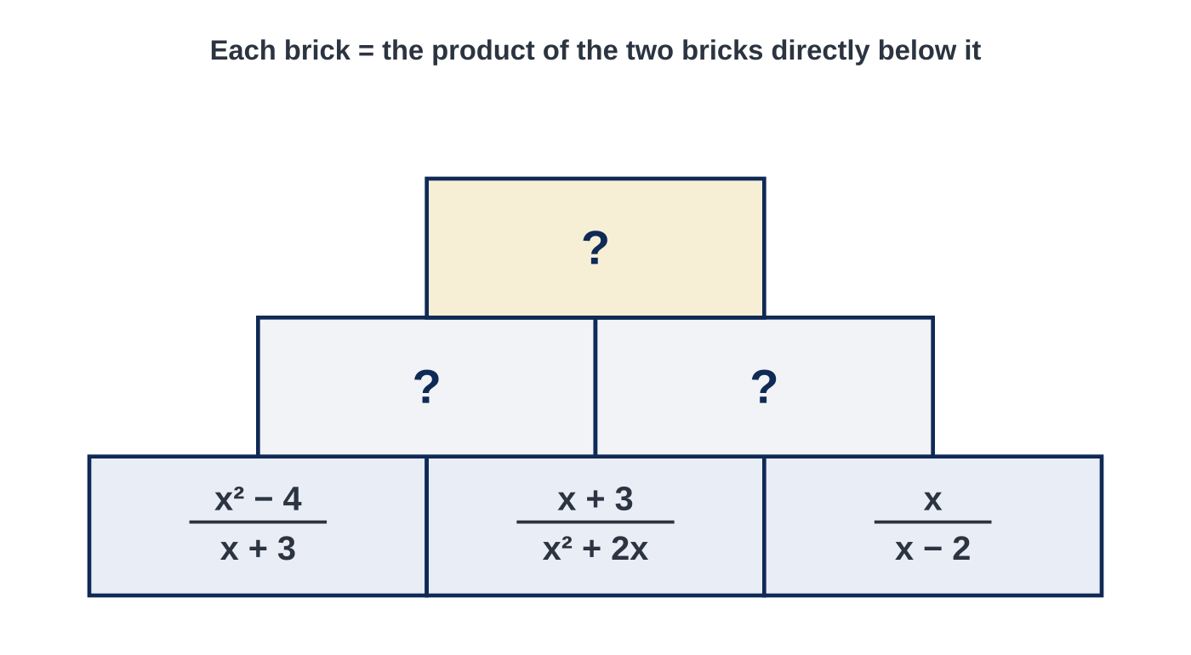
Question 2
6 marks
Figure 1 shows a pyramid of algebraic fractions. Each brick is equal to the product of the two bricks directly below it. Assume that x takes only values for which every denominator is non-zero (x ≠ 0, ±2, −3).
(a) Find, in its simplest form, the left-hand brick of the middle row. [2]
(b) Find, in its simplest form, the right-hand brick of the middle row. [2]
(c) Show that the top brick is equal to the middle brick of the bottom row. [2]
Notes:
Online with the full mark scheme: https://examinerprep.com/ial-maths-p3-1-algebraic-fractions-and-functions-questions#IALM-P3-1-FB-02

Slide 46
Answers

Slide 47
Question 1 · answer
Mark scheme
common denominator (2x − 1)(x + 2)
numerator 5(x + 2) − 3(2x − 1) = 5x + 10 − 6x + 3
= (13 − x) / ((2x − 1)(x + 2))
x² − 4 = (x − 2)(x + 2) used as the common denominator
numerator x(x + 2) − 8 = x² + 2x − 8
= (x + 4)(x − 2), and cancelling (x − 2) gives (x + 4)/(x + 2)
Notes:
Full mark scheme: https://examinerprep.com/ial-maths-p3-1-algebraic-fractions-and-functions-questions#IALM-P3-1-B-02

Slide 48
Question 2 · answer
Mark scheme
(x − 2)(x + 2)/(x + 3) × (x + 3)/(x(x + 2))
= (x − 2)/x
(x + 3)/(x(x + 2)) × x/(x − 2)
= (x + 3)/((x + 2)(x − 2)) (accept (x + 3)/(x² − 4))
(x − 2)/x × (x + 3)/((x + 2)(x − 2))
= (x + 3)/(x(x + 2)) = (x + 3)/(x² + 2x), the middle brick of the bottom row
Notes:
Full mark scheme: https://examinerprep.com/ial-maths-p3-1-algebraic-fractions-and-functions-questions#IALM-P3-1-FB-02

Slide 49
Keep practising
Notes for this topic
Questions on this topic
Build a printable test
ExaminerPrep is an independent tutoring service. It has been developed independently from and is not endorsed by the International Baccalaureate Organization. "International Baccalaureate", "IB" and "IB Diploma Programme" are registered trademarks of the IBO, used here for descriptive purposes only.
Pearson Edexcel and Cambridge are trademarks of their owners; ExaminerPrep is not affiliated with any exam board.

