Slide 1
EP
EDEXCEL IAL MATHS
D1.1 Algorithms: sorting, searching and packing
The full notes page in 12 sections · practice questions with answers · simulations
ExaminerPrep is an independent tutoring service. It has been developed independently from and is not endorsed by the International Baccalaureate Organization. "International Baccalaureate", "IB" and "IB Diploma Programme" are registered trademarks of the IBO, used here for descriptive purposes only.
Pearson Edexcel and Cambridge are trademarks of their owners; ExaminerPrep is not affiliated with any exam board.
Notes:
D1.1 Algorithms: sorting, searching and packing. Notes for this topic: https://examinerprep.com/notes/edexcel-ial-maths/algorithms-sorting-searching-and-packing/

Slide 2
What this page covers
Overview
What an algorithm is; carrying out an algorithm given as written instructions, with a trace table
Following a flow chart and counting how many times a box is used
Bubble sort: passes, comparisons and swaps, and when to stop
Quick sort with the middle item of each sublist as the pivot, ascending or descending
Binary search in an ordered list, including an item that is not there
Bin packing: first fit, first-fit decreasing and full bins, and the lower bound
The order of an algorithm (linear, quadratic, cubic) and estimating run times
Notes:
What this page covers. Full notes: https://examinerprep.com/notes/edexcel-ial-maths/algorithms-sorting-searching-and-packing/

Slide 3
In one minute
Key points
1. An algorithm is a finite sequence of precise instructions that solves a problem; in D1 you carry algorithms out accurately and show that you did, tracing them in a table with one column per variable and one row per change.
2. Bubble sort: compare neighbours left to right, swap if out of order; after pass k the last k items are fixed. Stop after a pass with no swaps.
3. Quick sort: the middle item of each sublist (right of centre if there is an even number) is the pivot; items that belong before it go to its left, the others to its right, in their original order. Repeat on every sublist.
4. Binary search: on an ordered list, compare with the item in position ⌈(first + last)/2⌉ and discard the half that cannot contain the target.
5. Bin packing: lower bound = total ÷ capacity, rounded up. First fit takes items in the given order; first-fit decreasing sorts them first; full bins looks for exact fills. A packing that meets the lower bound is optimal.
Notes:
In one minute. Full notes: https://examinerprep.com/notes/edexcel-ial-maths/algorithms-sorting-searching-and-packing/

Slide 4
What is an algorithm, and how do you trace one?
Section 1 of 12
D1 algorithm questions never ask you to invent a sort. They ask you to carry one out pass by pass, keep track of comparisons and swaps, find the middle item correctly, pack bins in the right order and say how good the answer is. So the skill is accuracy plus a clear layout of working.
An algorithm is a finite sequence of precise instructions which, followed exactly, solves a problem or carries out a task.
Every instruction must be unambiguous: two people following it get the same result. It must stop after a finite number of steps, and it usually takes an input and produces an output. Algorithms can be written as numbered instructions ("Step 3: if N < k, go to Step 7"), as a flow chart, or in a simple code-like form. You only follow them, never program them.
A trace table records the value of every variable each time it changes. Start a new row each time the algorithm goes round its loop, and write the output at the end.
Notes:
What is an algorithm, and how do you trace one?. Full notes: https://examinerprep.com/notes/edexcel-ial-maths/algorithms-sorting-searching-and-packing/

Slide 5
What is an algorithm, and how do you trace one? (continued)
Section 1 of 12
When asked "what does the algorithm do?", look at your input–output pairs and describe the general result (for example "it finds the highest common factor of A and B"), not the particular numbers.
Notes:
What is an algorithm, and how do you trace one?. Full notes: https://examinerprep.com/notes/edexcel-ial-maths/algorithms-sorting-searching-and-packing/

Slide 6
What is an algorithm, and how do you trace one? (continued)
Section 1 of 12 · Worked example 1 · Medium · Trace, state
WORKED EXAMPLE · QUESTION
Step 1: Input a positive integer N. Step 2: Let k = 1 and c = 0. Step 3: If N < k, go to Step 7. Step 4: Replace N by N − k. Step 5: Replace c by c + 1 and k by k + 2. Step 6: Go to Step 3. Step 7: Output c.
(a) Carry out the algorithm with N = 40, showing the values in a table. (b) State what the algorithm finds. (c) How many times is Step 4 carried out when N = 150?
SOLUTION
(a) One row for the starting values, then one row per time round the loop:
N | k | c
40 | 1 | 0
39 | 3 | 1
36 | 5 | 2
Notes:
What is an algorithm, and how do you trace one?: Worked example 1. Full notes: https://examinerprep.com/notes/edexcel-ial-maths/algorithms-sorting-searching-and-packing/

Slide 7
What is an algorithm, and how do you trace one? (continued)
Section 1 of 12 · Worked example 1 · Medium · Trace, state (continued)
N | k | c
31 | 7 | 3
24 | 9 | 4
15 | 11 | 5
4 | 13 | 6
At N = 4, k = 13 the test 4 < 13 is true, so the output is c = 6.
(b) The amounts subtracted are 1, 3, 5, 7, … and 1 + 3 + …+ (2c-1) = c². The algorithm counts how many odd numbers can be removed, so it finds the integer part of √N (√40 = 6.32…).
(c) Step 4 runs once for each odd number removed, and the output for 150 is the integer part of √150: 12² = 144 ≤ 150 < 169 = 13², so 12 times.
Notes:
What is an algorithm, and how do you trace one?: Worked example 1. Full notes: https://examinerprep.com/notes/edexcel-ial-maths/algorithms-sorting-searching-and-packing/

Slide 8
What is an algorithm, and how do you trace one? (continued)
Section 1 of 12
Common error
Updating c but forgetting to update k in the same step, or recording a row for only some of the variables. When an instruction changes two variables, both change in the same row.
Notes:
What is an algorithm, and how do you trace one?. Full notes: https://examinerprep.com/notes/edexcel-ial-maths/algorithms-sorting-searching-and-packing/

Slide 9
How do you follow a flow chart?
Section 2 of 12
Box shape | Meaning
Rounded (oval) box | Start or stop
Rectangle | An instruction: input, output or a calculation such as "Let P = P + B"
Diamond | A decision: a yes/no question, with one arrow out for each answer
Follow the arrows, one box at a time. A "Let" box replaces the old value of a variable with the new one.
Boxes are usually numbered so a question can ask, for example, how many times box 4 is used.
INT(x) means the integer part of x: INT(37 ÷ 2) = 18.
A loop is an arrow that goes back up the chart; the decision box that controls it is the stopping condition. Check that it is eventually met.
Notes:
How do you follow a flow chart?. Full notes: https://examinerprep.com/notes/edexcel-ial-maths/algorithms-sorting-searching-and-packing/

Slide 10
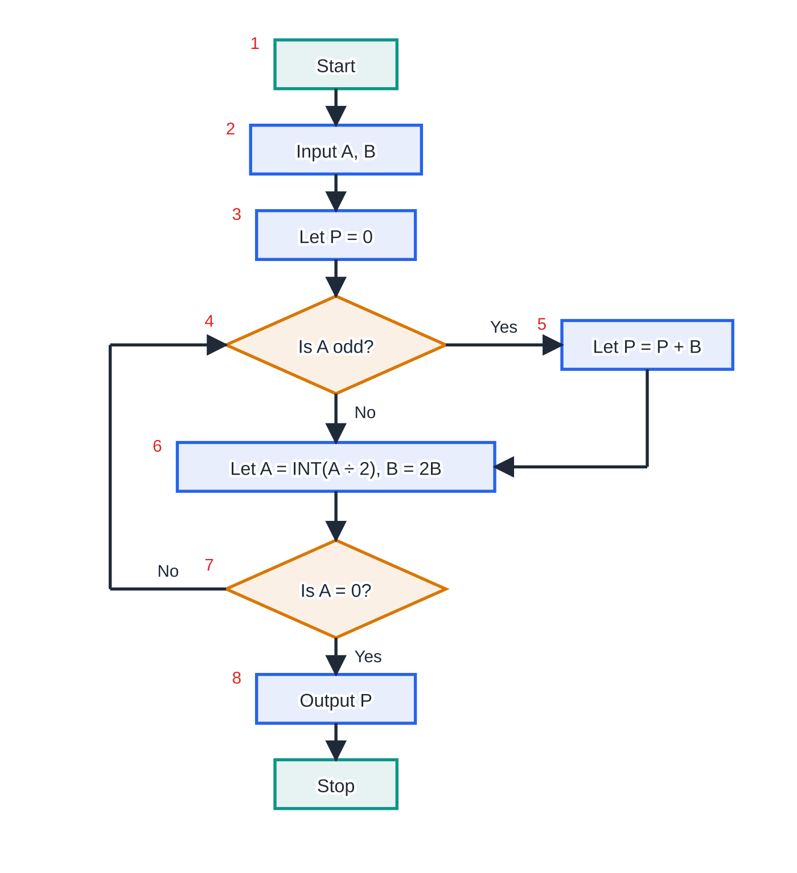
How do you follow a flow chart? (continued)
Section 2 of 12
The flow chart for worked example 2. Box 4 decides whether to add B to the running total P; box 7 sends the algorithm back to box 4 until A reaches 0.
Notes:
How do you follow a flow chart?. Full notes: https://examinerprep.com/notes/edexcel-ial-maths/algorithms-sorting-searching-and-packing/

Slide 11
How do you follow a flow chart? (continued)
Section 2 of 12 · Worked example 2 · Medium · Trace, suggest
WORKED EXAMPLE · QUESTION
Use the flow chart above. (a) Complete a trace table for the input A = 37, B = 23 and state the output. (b) Suggest what the algorithm calculates. (c) For the input A = 100, B = 7, how many times is box 4 used?
SOLUTION
(a) One row each time box 4 is reached, showing P after box 5:
A | B | Is A odd? | P
37 | 23 | yes | 23
18 | 46 | no | 23
9 | 92 | yes | 115
4 | 184 | no | 115
Notes:
How do you follow a flow chart?: Worked example 2. Full notes: https://examinerprep.com/notes/edexcel-ial-maths/algorithms-sorting-searching-and-packing/

Slide 12
How do you follow a flow chart? (continued)
Section 2 of 12 · Worked example 2 · Medium · Trace, suggest (continued)
A | B | Is A odd? | P
2 | 368 | no | 115
1 | 736 | yes | 851
0 | 1472
At box 7, A = 0, so the output is P = 851. The last row shows the values after box 6 on the final pass; only P matters.
(b) 37 × 23 = 851, so the algorithm finds the product A × B.
(c) A is halved (rounding down) each time round: 100 → 50 → 25 → 12 → 6 → 3 → 1 → 0, so box 4 is used 7 times.
Notes:
How do you follow a flow chart?: Worked example 2. Full notes: https://examinerprep.com/notes/edexcel-ial-maths/algorithms-sorting-searching-and-packing/

Slide 13
How does a bubble sort work?
Section 3 of 12
In each pass, compare the 1st and 2nd items, then the 2nd and 3rd, and so on, swapping any pair in the wrong order. Equal items are not swapped. For ascending order the largest item "bubbles" to the end in pass 1, so pass 2 can stop one place earlier: pass k makes n − k comparisons for a list of n items.
Stop after a pass with no swaps, or after n − 1 passes, whichever comes first. The pass with no swaps must be shown: it is how you know the list is sorted.
The most comparisons possible are (n-1) + (n-2) + …+ 1 = ½ n(n-1), when the list starts in reverse order.
For descending order, swap whenever the left item is smaller; then the smallest item moves to the end.
Notes:
How does a bubble sort work?. Full notes: https://examinerprep.com/notes/edexcel-ial-maths/algorithms-sorting-searching-and-packing/

Slide 14
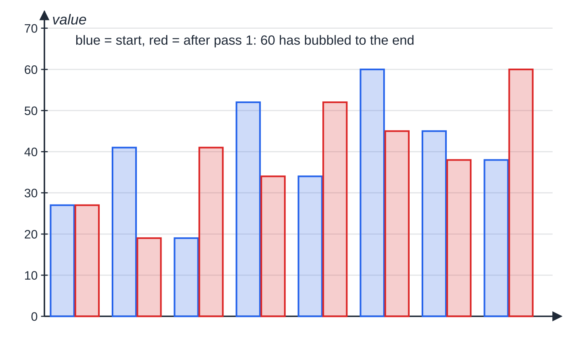
How does a bubble sort work? (continued)
Section 3 of 12
Pass 1 of worked example 3 as bar heights. Each swap moves the larger of a pair one place right, so the largest value, 60, ends in last place after one pass.
Notes:
How does a bubble sort work?. Full notes: https://examinerprep.com/notes/edexcel-ial-maths/algorithms-sorting-searching-and-packing/

Slide 15
How does a bubble sort work? (continued)
Section 3 of 12 · Worked example 3 · Medium · Sort, state
WORKED EXAMPLE · QUESTION
Use a bubble sort to arrange 27, 41, 19, 52, 34, 60, 45, 38 in ascending order. (a) Show the first pass in full. (b) Show the list after each later pass. (c) State the total number of comparisons and swaps.
SOLUTION
(a) Pass 1, one comparison at a time:
Compare | Swap? | List after the comparison
27 and 41 | no | 27, 41, 19, 52, 34, 60, 45, 38
41 and 19 | yes | 27, 19, 41, 52, 34, 60, 45, 38
41 and 52 | no | 27, 19, 41, 52, 34, 60, 45, 38
52 and 34 | yes | 27, 19, 41, 34, 52, 60, 45, 38
52 and 60 | no | 27, 19, 41, 34, 52, 60, 45, 38
Notes:
How does a bubble sort work?: Worked example 3. Full notes: https://examinerprep.com/notes/edexcel-ial-maths/algorithms-sorting-searching-and-packing/

Slide 16
How does a bubble sort work? (continued)
Section 3 of 12 · Worked example 3 · Medium · Sort, state (continued)
Compare | Swap? | List after the comparison
60 and 45 | yes | 27, 19, 41, 34, 52, 45, 60, 38
60 and 38 | yes | 27, 19, 41, 34, 52, 45, 38, 60
(b) Each pass is one comparison shorter. Pass 2: 19, 27, 34, 41, 45, 38, 52, 60. Pass 3: 19, 27, 34, 41, 38, 45, 52, 60. Pass 4: 19, 27, 34, 38, 41, 45, 52, 60. Pass 5: 19, 27, 34, 38, 41, 45, 52, 60 (no swaps: sort complete).
(c) Comparisons 7 + 6 + 5 + 4 + 3 = 25; swaps 4 + 4 + 1 + 1 + 0 = 10. The list was in order after pass 4, but the algorithm cannot know that until pass 5 finds nothing to swap.
Notes:
How does a bubble sort work?: Worked example 3. Full notes: https://examinerprep.com/notes/edexcel-ial-maths/algorithms-sorting-searching-and-packing/

Slide 17
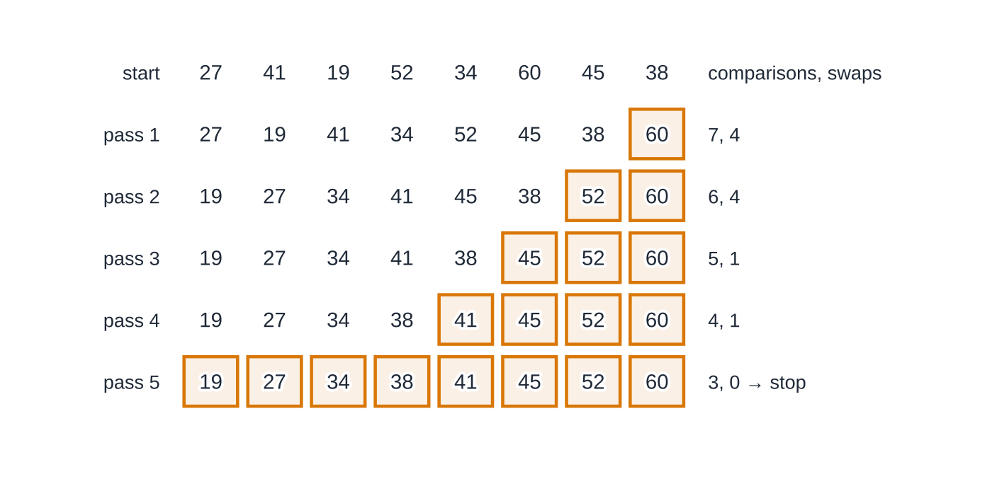
How does a bubble sort work? (continued)
Section 3 of 12
The whole sort, pass by pass. Gold items are known to be in their final places. Pass 5 makes no swaps, so it is the last pass: 25 comparisons and 10 swaps in total.
Notes:
How does a bubble sort work?. Full notes: https://examinerprep.com/notes/edexcel-ial-maths/algorithms-sorting-searching-and-packing/

Slide 18
How does a quick sort work?
Section 4 of 12
Quick sort works by splitting rather than by neighbour swaps. Choose a pivot: the middle item of the list. With n items it is in position ⌈(n + 1)/2⌉, so for an even number you take the one just right of centre (the 6th of 10). This page uses that convention throughout; whichever you use, use it consistently.
Write the items that belong before the pivot to its left, in the order they appear, then the pivot, then the rest in the order they appear. The pivot is now in its final position.
Each later pass chooses a pivot in every sublist of two or more items. Show the list after each pass and mark the pivots (underline or circle them).
The sort ends when every item has been a pivot or is alone in its sublist.
For descending order, items larger than the pivot go to its left. For words, "before" means earlier in the alphabet.
Notes:
How does a quick sort work?. Full notes: https://examinerprep.com/notes/edexcel-ial-maths/algorithms-sorting-searching-and-packing/

Slide 19
How does a quick sort work? (continued)
Section 4 of 12 · Worked example 4 · Medium · Sort
WORKED EXAMPLE · QUESTION
Use a quick sort to arrange 48, 73, 15, 62, 56, 37, 81, 24, 90 in descending order. Show the result of each pass and identify the pivots.
SOLUTION
Pass 1 9 items, so the pivot is the 5th, 56. Larger items go left, in their original order: 73, 62, 81, 90, 56, 48, 15, 37, 24.
Pass 2 Two sublists of 4; each pivot is the 3rd item (right of centre): [73, 62, 81, 90] → pivot 81; [48, 15, 37, 24] → pivot 37. List: 90, 81, 73, 62, 56, 48, 37, 15, 24.
Pass 3 Remaining sublists [73, 62] and [15, 24]; the pivot of a two-item sublist is its 2nd item. List: 90, 81, 73, 62, 56, 48, 37, 24, 15 (pivots 62 and 24).
Every item is now a pivot or alone in a sublist, so the sort is complete after 3 passes.
Notes:
How does a quick sort work?: Worked example 4. Full notes: https://examinerprep.com/notes/edexcel-ial-maths/algorithms-sorting-searching-and-packing/

Slide 20
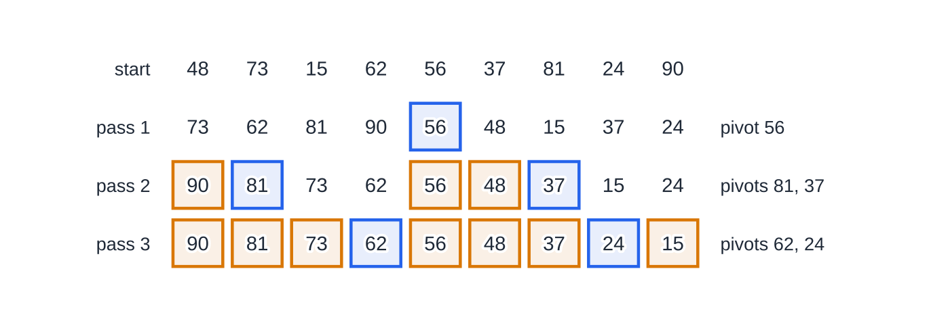
How does a quick sort work? (continued)
Section 4 of 12
Common error
Rearranging items inside a sublist while partitioning, for example writing 90, 81, 73, 62 to the left of 56 in pass 1. Items keep the order in which they appeared; only their side of the pivot changes.
Worked example 4. Blue items are the pivots chosen in that pass; gold items are already fixed (an earlier pivot, or alone in a sublist) and do not move again.
Notes:
How does a quick sort work?. Full notes: https://examinerprep.com/notes/edexcel-ial-maths/algorithms-sorting-searching-and-packing/

Slide 21
How does a binary search find an item?
Section 5 of 12
Checking every item in turn is slow for a long list. A binary search halves the problem each time, but it only works on a list that is already in order (numerical or alphabetical); sort it first if it is not.
Number the positions 1 to n and track the first and last positions still in play. The middle position is ⌈(first + last)/2⌉ (round up).
Compare the target with the middle item. If they match, stop. If the target comes before it, the new last is middle − 1; if after, the new first is middle + 1. Either way the middle item and one half are discarded.
If the list runs out (first > last) the item is not in the list; say so.
Each iteration roughly halves what is left, so n items need at most ⌊log₂ n⌋ + 1 iterations: the smallest k with 2ᵏ > n.
Notes:
How does a binary search find an item?. Full notes: https://examinerprep.com/notes/edexcel-ial-maths/algorithms-sorting-searching-and-packing/

Slide 22
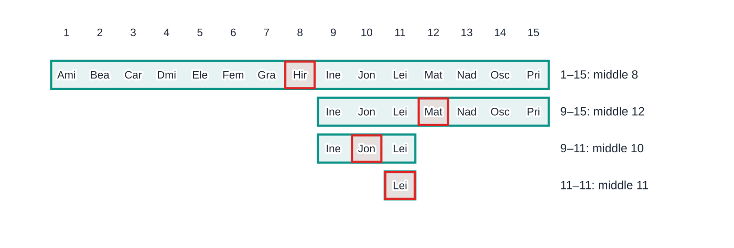
How does a binary search find an item? (continued)
Section 5 of 12
Binary search for Leila among 15 names (first three letters shown). The shaded block is still in play; the red cell is the middle item. It takes 4 iterations, the most a 15-item list can need.
Notes:
How does a binary search find an item?. Full notes: https://examinerprep.com/notes/edexcel-ial-maths/algorithms-sorting-searching-and-packing/

Slide 23
How does a binary search find an item? (continued)
Section 5 of 12 · Worked example 5 · Easy · Search
WORKED EXAMPLE · QUESTION
The names Amir, Bea, Carlos, Dmitri, Elena, Femi, Grace, Hiro, Ines, Jonas, Leila, Mateo, Nadia, Oscar, Priya are in positions 1 to 15. Use a binary search to (a) find Leila, (b) search for Kofi. Show each iteration.
SOLUTION
(a) ⌈(1 + 15)/2⌉ = 8, Hiro: Leila is after Hiro, so the list becomes 9–15. ⌈(9 + 15)/2⌉ = 12, Mateo: Leila is before Mateo, so 9–11. ⌈(9 + 11)/2⌉ = 10, Jonas: after, so 11–11. ⌈(11 + 11)/2⌉ = 11, Leila: found in position 11 after 4 iterations.
(b) Kofi is compared with the same names: Hiro (after) → Mateo (before) → Jonas (after) → Leila: Kofi is before Leila, so last = 10 < first = 11. The list is empty, so Kofi is not in the list.
Notes:
How does a binary search find an item?: Worked example 5. Full notes: https://examinerprep.com/notes/edexcel-ial-maths/algorithms-sorting-searching-and-packing/

Slide 24
How do the bin-packing algorithms work?
Section 6 of 12
Items of known sizes go into identical bins of fixed capacity, using as few bins as possible. "Bins" can be lorries, CDs, time slots, lengths of timber: anything with a capacity.
Lower bound for the number of bins: ⌈(total of the item sizes)/(capacity of one bin) ⌉, where ⌈ ⌉ means round up to the next whole number, even if the decimal part is small. No packing can use fewer bins; a packing that uses exactly the lower bound is optimal.
The lower bound is not always reachable. Three items of size 11 in bins of 20 have a lower bound of ⌈33/20⌉ = 2, but no two fit together, so 3 bins are needed.
Notes:
How do the bin-packing algorithms work?. Full notes: https://examinerprep.com/notes/edexcel-ial-maths/algorithms-sorting-searching-and-packing/

Slide 25
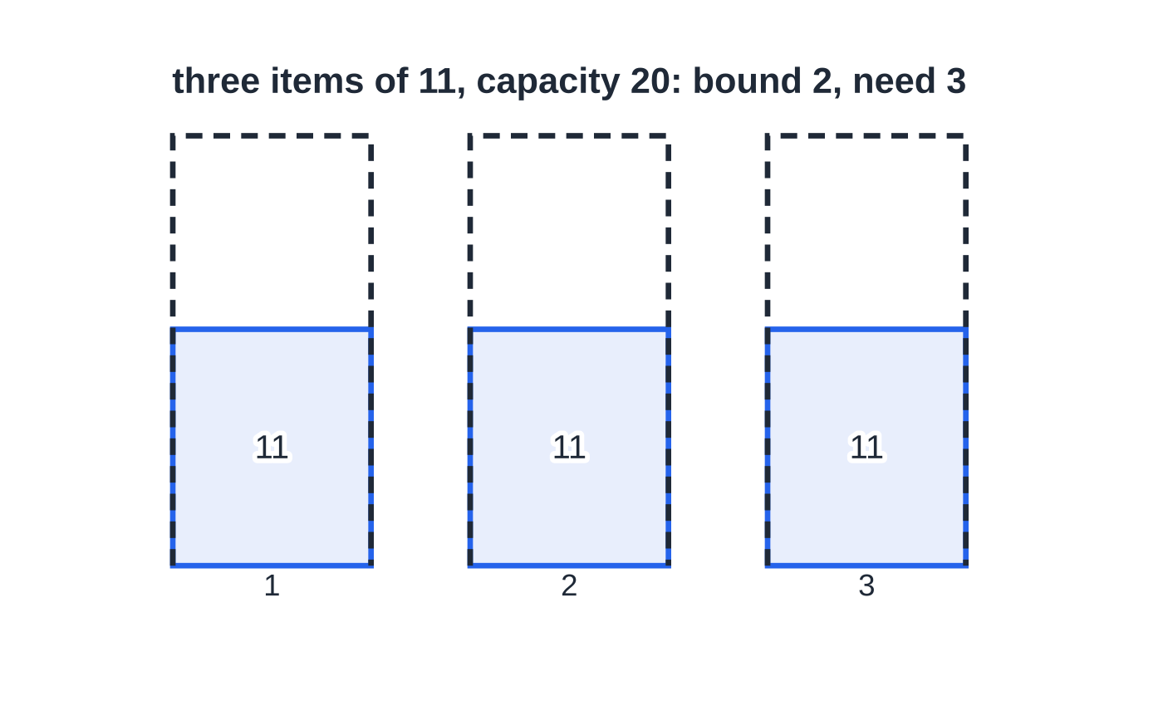
How do the bin-packing algorithms work? (continued)
Section 6 of 12
The lower bound ignores how sizes fit together: 33 units would fit in two bins of 20 by total, but no two 11s share a bin.
Notes:
How do the bin-packing algorithms work?. Full notes: https://examinerprep.com/notes/edexcel-ial-maths/algorithms-sorting-searching-and-packing/

Slide 26
How do the bin-packing algorithms work? (continued)
Section 6 of 12
Method | What you do | Comment
First fit | Take items in the order given; put each into the first (lowest-numbered) bin with room | Quick, but often wastes space: big items late in the list end up alone
First-fit decreasing | Sort into descending order first (state which sort), then apply first fit | Usually good, but not always optimal
Full bins | Find combinations that fill a bin exactly (by inspection); pack those, then first fit the rest | Often optimal, but can miss one and is hard for many items
Notes:
How do the bin-packing algorithms work?. Full notes: https://examinerprep.com/notes/edexcel-ial-maths/algorithms-sorting-searching-and-packing/

Slide 27
How do the bin-packing algorithms work? (continued)
Section 6 of 12 · Worked example 6 · Medium · Find, explain
WORKED EXAMPLE · QUESTION
Parcels of mass (kg) 7, 4, 12, 9, 3, 8, 6, 11, 5, 10 are loaded onto trolleys, each carrying at most 20 kg. (a) Find a lower bound for the number of trolleys. (b) Use first fit. (c) Use first-fit decreasing. (d) Explain whether (c) is optimal.
SOLUTION
(a) Total 75; 75 ÷ 20 = 3.75, so 4 trolleys.
(b) Items in the given order, each into the first trolley with room: T1: 7, 4, 9 · T2: 12, 3, 5 · T3: 8, 6 · T4: 11 · T5: 10, so 5 trolleys. The 9 goes into trolley 1 (7 + 4 + 9 = 20), not trolley 3: always check from the first bin.
(c) Sorted: 12, 11, 10, 9, 8, 7, 6, 5, 4, 3. T1: 12, 8 · T2: 11, 9 · T3: 10, 7, 3 · T4: 6, 5, 4, so 4 trolleys.
(d) 4 trolleys = the lower bound, so the solution is optimal.
Notes:
How do the bin-packing algorithms work?: Worked example 6. Full notes: https://examinerprep.com/notes/edexcel-ial-maths/algorithms-sorting-searching-and-packing/

Slide 28
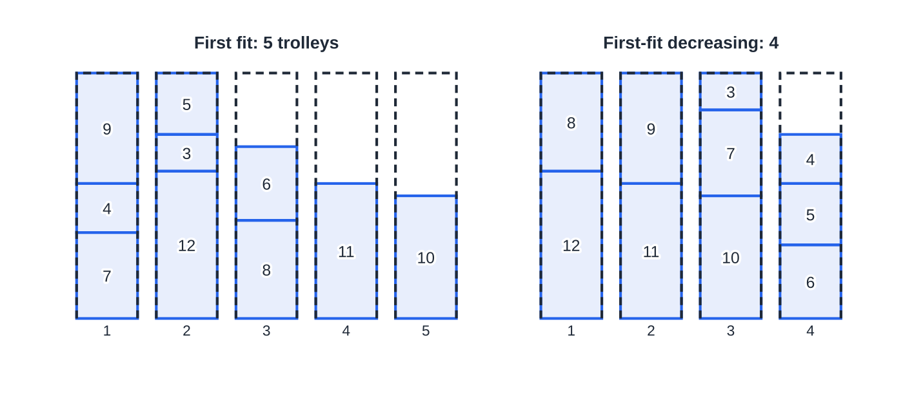
How do the bin-packing algorithms work? (continued)
Section 6 of 12
Common error
Writing 75 ÷ 20 = 3.75 and giving a lower bound of 3 (or 4 "to the nearest whole number", which happens to agree). Always round up: 3 trolleys carry at most 60 kg. With a total of 61 kg the bound would still be 4.
Worked example 6 to scale (bin height = 20 kg). First fit leaves 6, 9 and 10 kg of space in three trolleys; sorting first packs into 4, the lower bound.
Notes:
How do the bin-packing algorithms work?. Full notes: https://examinerprep.com/notes/edexcel-ial-maths/algorithms-sorting-searching-and-packing/

Slide 29
What is the order of an algorithm?
Section 7 of 12
The size of a problem is the number of items, n. The order of an algorithm describes how the amount of work (and so the run time) grows with n.
Linear (order n): doubling n doubles the time, for example adding up a list.
Quadratic (order n²): doubling n multiplies the time by 4: bubble sort, first fit and first-fit decreasing.
Cubic (order n³): doubling n multiplies the time by 8.
A binary search grows only like log₂ n: each extra iteration doubles the list it can handle. 1000 items need at most 10 iterations; a million at most 20.
To estimate a time for an algorithm of order nᵏ: t₂ ≈t₁ ×(n₂ ÷n₁)ᵏ. A bubble sort taking 2.4 s for 300 items takes about 2.4 × 4² = 38.4 s for 1200 items. These are estimates for large n; the exact count depends on the particular list (a sorted list needs only one bubble-sort pass).
Notes:
What is the order of an algorithm?. Full notes: https://examinerprep.com/notes/edexcel-ial-maths/algorithms-sorting-searching-and-packing/

Slide 30
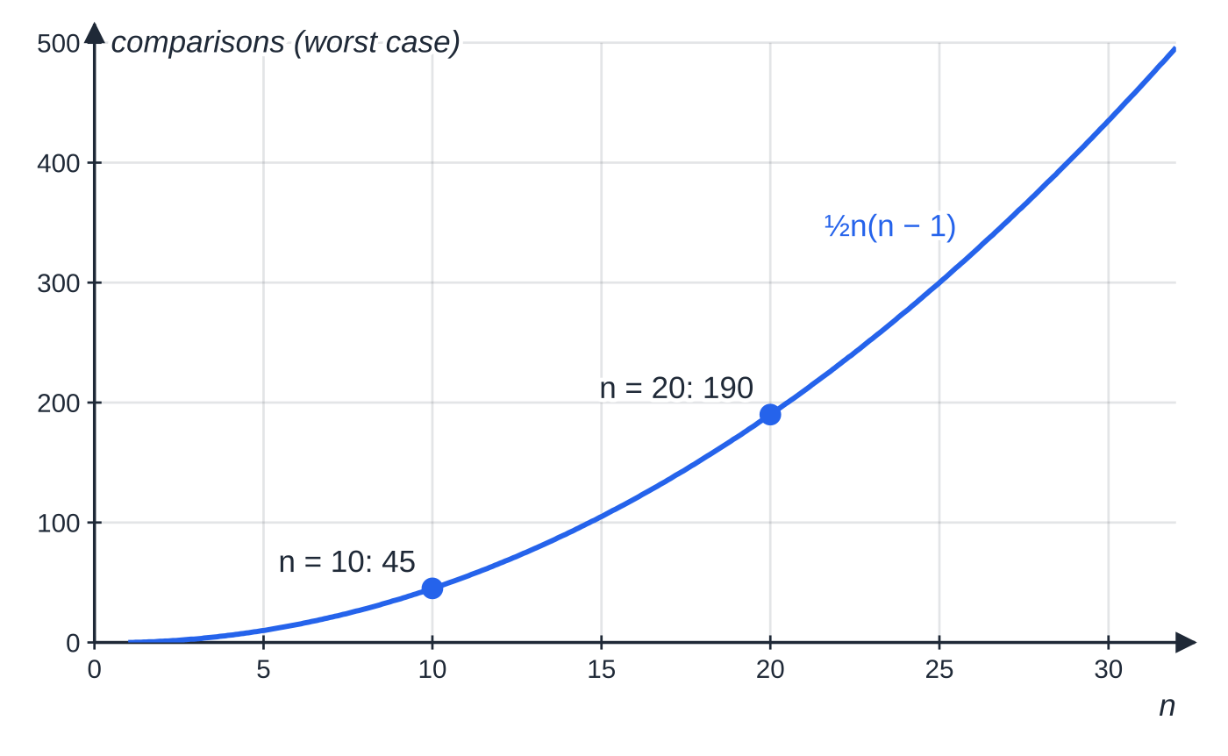
What is the order of an algorithm? (continued)
Section 7 of 12
The most comparisons a bubble sort can make, ½n(n − 1), lie on a parabola: 45 for 10 items but 190 for 20.
Notes:
What is the order of an algorithm?. Full notes: https://examinerprep.com/notes/edexcel-ial-maths/algorithms-sorting-searching-and-packing/

Slide 31
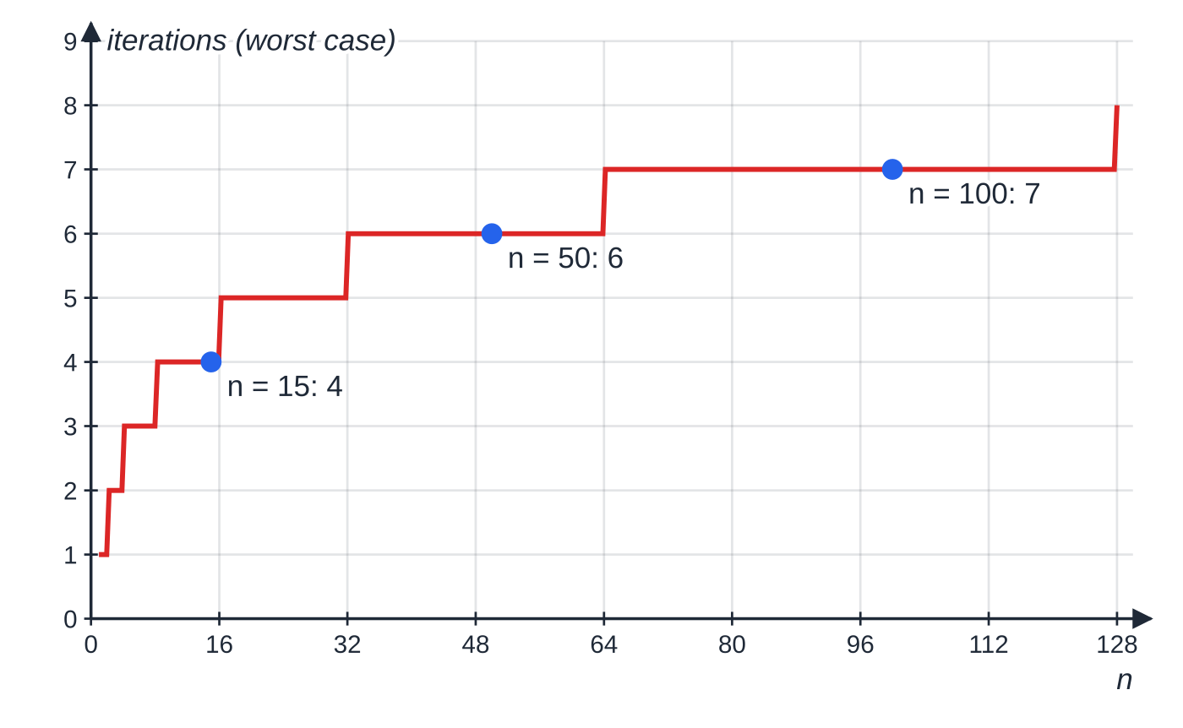
What is the order of an algorithm? (continued)
Section 7 of 12
The most iterations a binary search can need, ⌊log₂ n⌋ + 1: it rises by one only when n doubles.
Notes:
What is the order of an algorithm?. Full notes: https://examinerprep.com/notes/edexcel-ial-maths/algorithms-sorting-searching-and-packing/

Slide 32
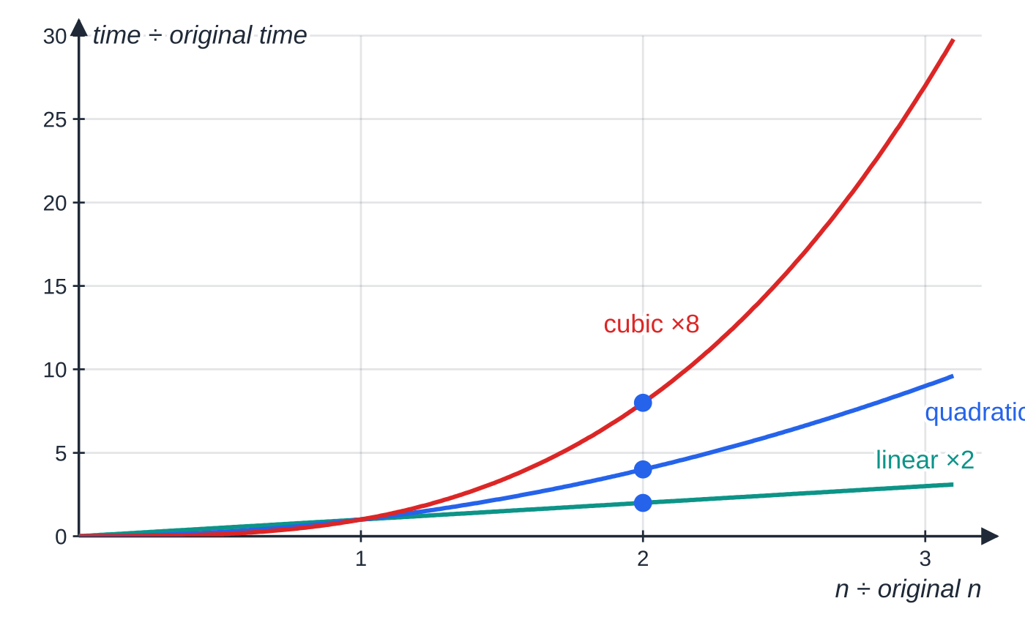
What is the order of an algorithm? (continued)
Section 7 of 12
Doubling n multiplies the time by 2, 4 or 8 for linear, quadratic and cubic order.
Notes:
What is the order of an algorithm?. Full notes: https://examinerprep.com/notes/edexcel-ial-maths/algorithms-sorting-searching-and-packing/

Slide 33
What is the order of an algorithm? (continued)
Section 7 of 12 · Worked example 7 · Hard · Find, explain, estimate
WORKED EXAMPLE · QUESTION
A radio station has ten segments of lengths (minutes) 5, 15, 13, 14, 5, 10, 6, 17, 19, 16 to put into 30-minute slots; a segment cannot be split. (a) Find a lower bound for the number of slots. (b) Use first-fit decreasing. (c) Use full bins to find an allocation using the fewest slots, and explain why it is optimal. (d) First-fit decreasing has quadratic order; a program applies it to 250 items in 0.9 seconds. Estimate the time for 1000 items.
SOLUTION
(a) 120 ÷ 30 = 4, so 4 slots.
(b) Sorted: 19, 17, 16, 15, 14, 13, 10, 6, 5, 5. S1: 19, 10 · S2: 17, 13 · S3: 16, 14 · S4: 15, 6, 5 · S5: 5, so 5 slots.
(c) Combinations totalling exactly 30: 19 + 6 + 5 · 17 + 13 · 16 + 14 · 15 + 10 + 5, so 4 slots, equal to the lower bound, so optimal.
Notes:
What is the order of an algorithm?: Worked example 7. Full notes: https://examinerprep.com/notes/edexcel-ial-maths/algorithms-sorting-searching-and-packing/

Slide 34
What is the order of an algorithm? (continued)
Section 7 of 12 · Worked example 7 · Hard · Find, explain, estimate (continued)
The total is exactly 4 × 30, so an optimal allocation must fill every slot, which is why full bins works so well here.
(d) n is multiplied by 4: 0.9 × (1000 ÷ 250)² = 0.9 × 16 = 14.4 seconds.
Notes:
What is the order of an algorithm?: Worked example 7. Full notes: https://examinerprep.com/notes/edexcel-ial-maths/algorithms-sorting-searching-and-packing/

Slide 35
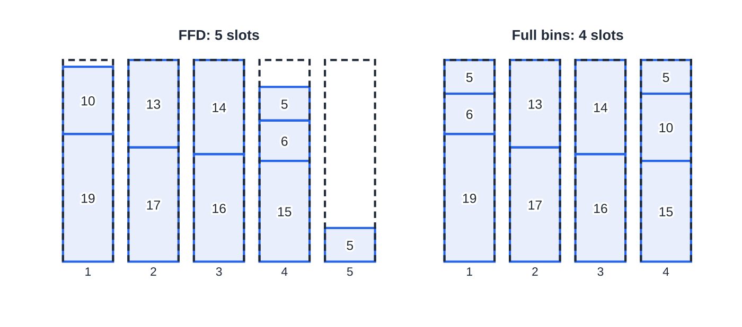
What is the order of an algorithm? (continued)
Section 7 of 12
Exam tip
When a lower bound is reached, say so in words: "4 slots = lower bound, so optimal". If it is not reached, you cannot conclude that the packing is not optimal: the bound may be impossible to achieve.
Worked example 7 to scale (slot height = 30 minutes). First-fit decreasing strands the second 5-minute segment in a fifth slot; the full-bin combinations fill four slots exactly.
Notes:
What is the order of an algorithm?. Full notes: https://examinerprep.com/notes/edexcel-ial-maths/algorithms-sorting-searching-and-packing/

Slide 36
Exam tips for D1.1
Section 8 of 12
Exam tip 1 — show every pass
For bubble sort and quick sort, write the whole list after each pass, including items that did not move. For quick sort, mark the pivots used in that pass. The sorted list alone shows nothing about the algorithm.
Exam tip 2 — the last bubble-sort pass
Unless told to stop when the list is sorted, include the final pass with no swaps and say "no swaps, so the list is sorted". For numbers of comparisons or swaps, list them pass by pass before adding.
Exam tip 3 — write the middle calculation
In a binary search write ⌈(first + last)/2⌉ = … each time, the item in that position, and which half you keep. Finish an unsuccessful search with "so the item is not in the list".
Notes:
Exam tips for D1.1. Full notes: https://examinerprep.com/notes/edexcel-ial-maths/algorithms-sorting-searching-and-packing/

Slide 37
Exam tips for D1.1 (continued)
Section 8 of 12
Exam tip 4 — bins as lists
Present a packing as "Bin 1: 7, 4, 9 · Bin 2: 12, 3, 5 · …", keeping the order in which items went in. For first-fit decreasing, write the sorted list first.
Exam tip 5 — scaling run times
Write the scale factor in full: (new size ÷ old size)ᵖᵒʷᵉʳ. Bubble sort and the bin-packing algorithms are quadratic, so the power is 2 unless the question gives a different order.
Notes:
Exam tips for D1.1. Full notes: https://examinerprep.com/notes/edexcel-ial-maths/algorithms-sorting-searching-and-packing/

Slide 38
Common misconceptions
Section 9 of 12
Misconception | Why it is wrong | Correct idea
A lower bound of 3.75 rounds to 4 because 0.75 is more than a half. | The decimal part is irrelevant: 3 bins cannot hold the total. | Always round up: a total of 61 in bins of 20 still needs at least 4.
The lower bound is the number of bins needed. | It ignores how the item sizes fit together. | It is a minimum that may not be reachable (three items of 11 in bins of 20 need 3, not 2).
First-fit decreasing always gives the best packing. | It is a heuristic: worked example 7 uses 5 slots where 4 are possible. | Compare with the lower bound; full bins may do better.
Binary search works on any list. | Discarding half relies on everything before the middle coming first. | The list must be in order first.
A bubble sort can stop as soon as the list looks sorted. | The algorithm only knows it is finished when a pass makes no swaps. | Show the final pass with no swaps.
Notes:
Common misconceptions. Full notes: https://examinerprep.com/notes/edexcel-ial-maths/algorithms-sorting-searching-and-packing/

Slide 39
Common misconceptions (continued)
Section 9 of 12
Misconception | Why it is wrong | Correct idea
Doubling the number of items doubles the time for any algorithm. | That is only true for linear order. | Quadratic order: × 4; cubic: × 8.
Notes:
Common misconceptions. Full notes: https://examinerprep.com/notes/edexcel-ial-maths/algorithms-sorting-searching-and-packing/

Slide 40
How this topic connects
Section 10 of 12
D1.2 Graphs, minimum spanning trees and Dijkstra
Kruskal's algorithm starts by sorting the arcs by weight (a sorting job), and Prim's and Dijkstra's algorithms are traced step by step exactly like the flow charts here.
Critical path analysis (D1)
The lower bound for the number of workers, ⌈total activity time ÷ critical time⌉, is the bin-packing lower bound in disguise, and allocating activities to workers is a packing problem.
P2 and P3
The binary search's ⌊log₂ n⌋ + 1 iterations come from solving 2ᵏ > n with logarithms (P2); iterative methods for equations in P3 are algorithms with a stopping condition, traced in a table just like worked example 1.
Notes:
How this topic connects. Full notes: https://examinerprep.com/notes/edexcel-ial-maths/algorithms-sorting-searching-and-packing/

Slide 41
Key formulae
Section 11 of 12
Formula | Use | In the formulae list?
lower bound = ⌈total size ÷ bin capacity⌉ | minimum possible number of bins | No — learn it
middle position = ⌈(first + last)/2⌉ | item to compare with in a binary search | No — learn it
pivot position = ⌈(n + 1)/2⌉ | middle item of a sublist of n items in a quick sort (right of centre when n is even) | No — learn it
pass k: n − k comparisons; at most ½n(n − 1) in total | counting comparisons in a bubble sort of n items | No — derive it
at most ⌊log₂ n⌋ + 1 iterations (smallest k with 2ᵏ > n) | longest possible binary search of n items | No — derive it
t₂ ≈ t₁ × (n₂ ÷ n₁)ᵏ | estimating the run time of an algorithm of order nᵏ | No — derive it
Notes:
Key formulae. Full notes: https://examinerprep.com/notes/edexcel-ial-maths/algorithms-sorting-searching-and-packing/

Slide 42
Check your understanding
Section 12 of 12
1. What is the largest number of comparisons a bubble sort can make on a list of 12 items, and how many passes can it need?
2. What is the largest number of iterations a binary search can need for an ordered list of 50 items?
3. Items of sizes 8, 7, 6, 5 and 4 are packed into bins of capacity 10. Show that the lower bound is 3 but that 4 bins are needed.
4. A sublist in a quick sort has 10 items. Which item is the pivot?
5. An algorithm of cubic order takes 5 seconds for 20 items. Estimate the time for 60 items.
6. Use first fit to pack 9, 6, 5, 8, 2, 4 into bins of capacity 12, and state whether the result is optimal.
Notes:
Check your understanding: questions. Full notes: https://examinerprep.com/notes/edexcel-ial-maths/algorithms-sorting-searching-and-packing/

Slide 43
Check your understanding · answers
Section 12 of 12
1. 11 + 10 + … + 1 = ½ × 12 × 11 = 66 comparisons, in at most 11 passes.
2. 2⁵ = 32 ≤ 50 < 64 = 2⁶, so at most 6 iterations.
3. Total 30, 30 ÷ 10 = 3. But 8 and 7 cannot share a bin with any other item (the smallest is 4), so each needs its own bin, and 6, 5 and 4 (total 15) need two more: 4 in all.
4. The 6th item, ⌈(10 + 1)/2⌉ = 6: the one just right of centre.
5. 5 × (60 ÷ 20)³ = 5 × 27 = 135 seconds.
6. Bin 1: 9, 2 · Bin 2: 6, 5 · Bin 3: 8, 4. Total 34, lower bound ⌈34/12⌉ = 3, so 3 bins is optimal.
Notes:
Check your understanding: answers. Full notes: https://examinerprep.com/notes/edexcel-ial-maths/algorithms-sorting-searching-and-packing/

Slide 44
Practice questions
2 original exam-style questions. Answers at the end of the deck.

Slide 45
Question 1
6 marks
An algorithm is given below.
Step 1: Input two positive integers A and B.
Step 2: Let Q = 0.
Step 3: If A < B, go to Step 6.
Step 4: Let A = A − B and let Q = Q + 1.
Step 5: Go to Step 3.
Step 6: Output Q and A. Stop.
(a) Carry out the algorithm with A = 47 and B = 6. Show the values of A and Q in a table and state the output. [3]
(b) State what the two outputs represent in terms of the inputs. [2]
(c) Write down how many times Step 4 is carried out when A = 1000 and B = 7. [1]
Notes:
Online with the full mark scheme: https://examinerprep.com/ial-maths-d1-1-algorithms-sorting-searching-and-packing-questions#IALM-D1-1-B-01

Slide 46
Question 2
6 marks
The times, in seconds, of seven swimmers in a 100 m race are
63, 58, 71, 60, 66, 55, 69
The times are to be sorted into ascending order using a bubble sort.
(a) Carry out the first pass. State the list at the end of the pass, and the number of comparisons and swaps made. [3]
(b) Complete the sort, giving the list at the end of each further pass. State clearly how you know the sort is complete. [3]
Notes:
Online with the full mark scheme: https://examinerprep.com/ial-maths-d1-1-algorithms-sorting-searching-and-packing-questions#IALM-D1-1-B-02

Slide 47
Answers

Slide 48
Question 1 · answer
Mark scheme
repeated subtraction of 6 recorded, with Q increasing by 1 each time
A: 47, 41, 35, 29, 23, 17, 11, 5 and Q: 0, 1, 2, 3, 4, 5, 6, 7
output Q = 7, A = 5
Q is the quotient (whole number of times B goes into A)
A is the remainder when the input A is divided by B
1000 = 142 × 7 + 6, so 142 times
Notes:
Full mark scheme: https://examinerprep.com/ial-maths-d1-1-algorithms-sorting-searching-and-packing-questions#IALM-D1-1-B-01

Slide 49
Question 2 · answer
Mark scheme
compares neighbouring pairs from the left, swapping any pair in the wrong order
58, 63, 60, 66, 55, 69, 71
6 comparisons and 5 swaps
pass 2: 58, 60, 63, 55, 66, 69, 71 and pass 3: 58, 60, 55, 63, 66, 69, 71
pass 4: 58, 55, 60, 63, 66, 69, 71 and pass 5: 55, 58, 60, 63, 66, 69, 71
pass 6: no swaps (or 6 passes, the most needed for 7 items), so the list is sorted: 55, 58, 60, 63, 66, 69, 71
Notes:
Full mark scheme: https://examinerprep.com/ial-maths-d1-1-algorithms-sorting-searching-and-packing-questions#IALM-D1-1-B-02

Slide 50
Keep practising
Notes for this topic
Questions on this topic
Build a printable test
ExaminerPrep is an independent tutoring service. It has been developed independently from and is not endorsed by the International Baccalaureate Organization. "International Baccalaureate", "IB" and "IB Diploma Programme" are registered trademarks of the IBO, used here for descriptive purposes only.
Pearson Edexcel and Cambridge are trademarks of their owners; ExaminerPrep is not affiliated with any exam board.

