Slide 1
EP
EDEXCEL IAL MATHS
S2.1 Binomial and Poisson distributions
The full notes page in 12 sections · practice questions with answers · simulations
ExaminerPrep is an independent tutoring service. It has been developed independently from and is not endorsed by the International Baccalaureate Organization. "International Baccalaureate", "IB" and "IB Diploma Programme" are registered trademarks of the IBO, used here for descriptive purposes only.
Pearson Edexcel and Cambridge are trademarks of their owners; ExaminerPrep is not affiliated with any exam board.
Notes:
S2.1 Binomial and Poisson distributions. Notes for this topic: https://examinerprep.com/notes/edexcel-ial-maths/binomial-and-poisson-distributions/

Slide 2
What this page covers
Overview
The conditions for a binomial model B(n,p), stated in the context of a question
Binomial probabilities from the probability function and from the cumulative tables, including the switch for p>0.5
Turning P(X=r), P(X>r) and P(a≤X<b) into cumulative probabilities
The conditions for a Poisson model Po(λ), and scaling λ to the length of the interval
Adding independent Poisson variables
Means and variances (quoted, not derived), and using "mean ≈ variance" to judge whether a Poisson model is sensible
Approximating B(n,p) by Po(np) when n is large and p is small
Chaining the two models, and "least n" questions solved with logarithms
Notes:
What this page covers. Full notes: https://examinerprep.com/notes/edexcel-ial-maths/binomial-and-poisson-distributions/

Slide 3
In one minute
Key points
1. The binomial distribution counts successes in a fixed number of independent trials, the Poisson distribution counts random events in an interval of time or space, and almost every question is the same three moves: name the distribution with its parameters, turn the event into cumulative probabilities, then use the tables or the formula.
2. Binomial X~B(n,p): fixed n; success or failure; independent trials; constant p. P(X=r)=C(n, r)pʳ(1-p)ⁿ⁻ʳ. Mean np, variance np(1-p).
3. Poisson X~Po(λ): events occur singly, independently, at random and at a constant mean rate. P(X=r)=(e^(-λ)λʳ)/r!. Mean = variance = λ.
4. Tables give P(X≤x): P(X≥r)=1-P(X≤r-1) and P(X=r)=P(X≤r)-P(X≤r-1).
5. Rates scale: 3 per hour gives Po(1.5) for 30 minutes and Po(9) for 3 hours. Independent Poissons add: Po(λ)+Po(μ)=Po(λ+μ).
6. Approximation: n large, p small ⇒B(n,p)≈Po(np).
Notes:
In one minute. Full notes: https://examinerprep.com/notes/edexcel-ial-maths/binomial-and-poisson-distributions/

Slide 4
When is a binomial model suitable?
Section 1 of 12
A binomial situation is a repeated experiment where you only care about one outcome. Flip a seed into a tray and ask "does it germinate?"; take an email from an inbox and ask "is it spam?". Repeat a fixed number of times and count the yeses.
The binomial distribution B(n,p) models the number of successes in a fixed number n of independent trials, each with the same probability p of success.
Learn the four conditions as a list, and then say them in the context of the question:
a fixed number of trials, n;
each trial has two outcomes, success or failure;
the trials are independent;
the probability of success, p, is the same for every trial.
Notes:
When is a binomial model suitable?. Full notes: https://examinerprep.com/notes/edexcel-ial-maths/binomial-and-poisson-distributions/

Slide 5
When is a binomial model suitable? (continued)
Section 1 of 12
X can take the values 0,1,2,…,n and no others. Write the model in full every time: "Let X be the number of …; X~B(8,0.35)".
Binomial probability function
(in the formulae booklet)
P(X=r)=C(n, r)pʳ(1-p)ⁿ⁻ʳ, r=0,1,…,n.
C(n, r)=n!/(r!(n-r)!) counts the orders in which the r successes can appear among the n trials, and pʳ(1-p)ⁿ⁻ʳ is the probability of any one such order.
Use the formula for a single value, or for a sum of two or three values when the parameters are not in the tables. The bar chart below shows a whole binomial distribution, every bar computed from the formula.
Notes:
When is a binomial model suitable?. Full notes: https://examinerprep.com/notes/edexcel-ial-maths/binomial-and-poisson-distributions/

Slide 6
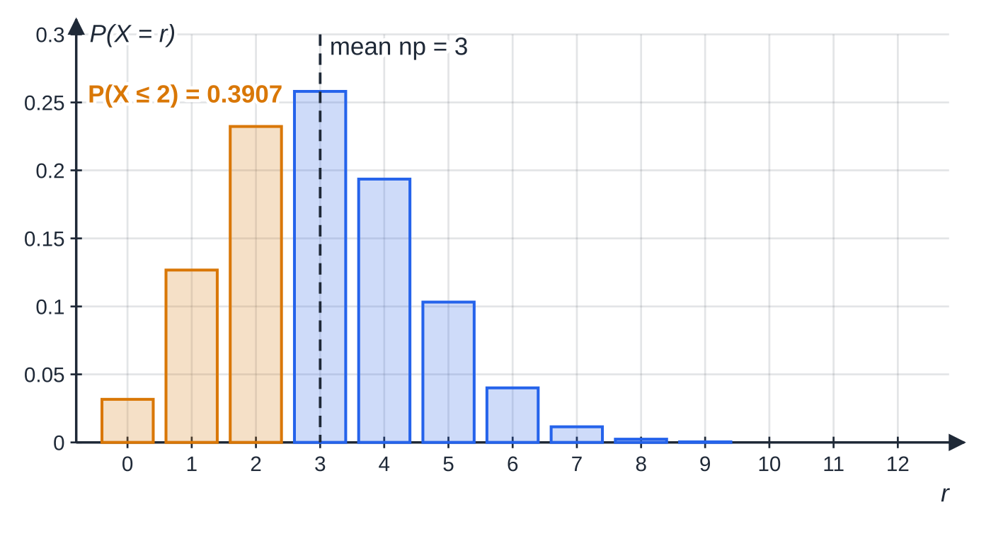
When is a binomial model suitable? (continued)
Section 1 of 12
X~B(12,0.25). The shape peaks at the mean np=3 and is skewed to the right because p<0.5. The amber bars together are P(X≤2)=0.3907 — exactly the number a cumulative table prints.
Notes:
When is a binomial model suitable?. Full notes: https://examinerprep.com/notes/edexcel-ial-maths/binomial-and-poisson-distributions/

Slide 7
When is a binomial model suitable? (continued)
Section 1 of 12 · Worked example 1 · Easy · Find, state
WORKED EXAMPLE · QUESTION
A climber completes a particular route on any one attempt with probability 0.35, independently of other attempts. She makes 8 attempts. (a) Find the probability that she completes the route exactly 3 times. (b) Find the probability that she completes it at least twice. (c) State, in context, two assumptions needed for your model. Give probabilities to 4 significant figures.
SOLUTION
Define the model: X = number of completed attempts; X~B(8,0.35).
(a) P(X=3)=C(8, 3)(0.35)³(0.65)⁵=56×0.042875×0.11603= 0.2786
(b) "At least 2" is everything except 0 and 1:
P(X≥2)=1-(0.65)⁸-8(0.35)(0.65)⁷=1-0.03186-0.13726=
Notes:
When is a binomial model suitable?: Worked example 1. Full notes: https://examinerprep.com/notes/edexcel-ial-maths/binomial-and-poisson-distributions/

Slide 8
When is a binomial model suitable? (continued)
Section 1 of 12 · Worked example 1 · Easy · Find, state (continued)
0.8309
(c) The attempts are independent of each other; the probability of completing the route is 0.35 on every attempt.
"Trials are independent" on its own is generic. Name the trials: attempts. In reality tiredness or practice could change p — which is exactly why it is an assumption.
Notes:
When is a binomial model suitable?: Worked example 1. Full notes: https://examinerprep.com/notes/edexcel-ial-maths/binomial-and-poisson-distributions/

Slide 9
How do you use the cumulative binomial tables?
Section 2 of 12
The tables give P(X≤x) for chosen n and for p=0.05,0.10,…,0.50, to 4 decimal places. Because X is a whole number, every inequality can be rewritten with "≤": X<7 is X≤6, and X>5 is the complement of X≤5. That one idea handles every event.
You want | Write it as | Example, X~B(20,0.15)
P(X≤r) | read directly | P(X≤4)=0.8298
P(X<r) | P(X≤r-1) | P(X<5)=P(X≤4)=0.8298
P(X=r) | P(X≤r)-P(X≤r-1) | P(X=4)=0.8298-0.6477=0.1821
P(X>r) | 1-P(X≤r) | P(X>5)=1-0.9327=0.0673
P(X≥r) | 1-P(X≤r-1) | P(X≥6)=1-0.9327=0.0673
P(a≤X≤b) | P(X≤b)-P(X≤a-1) | P(2≤X≤6)=0.9781-0.1756=0.8025
Notes:
How do you use the cumulative binomial tables?. Full notes: https://examinerprep.com/notes/edexcel-ial-maths/binomial-and-poisson-distributions/

Slide 10
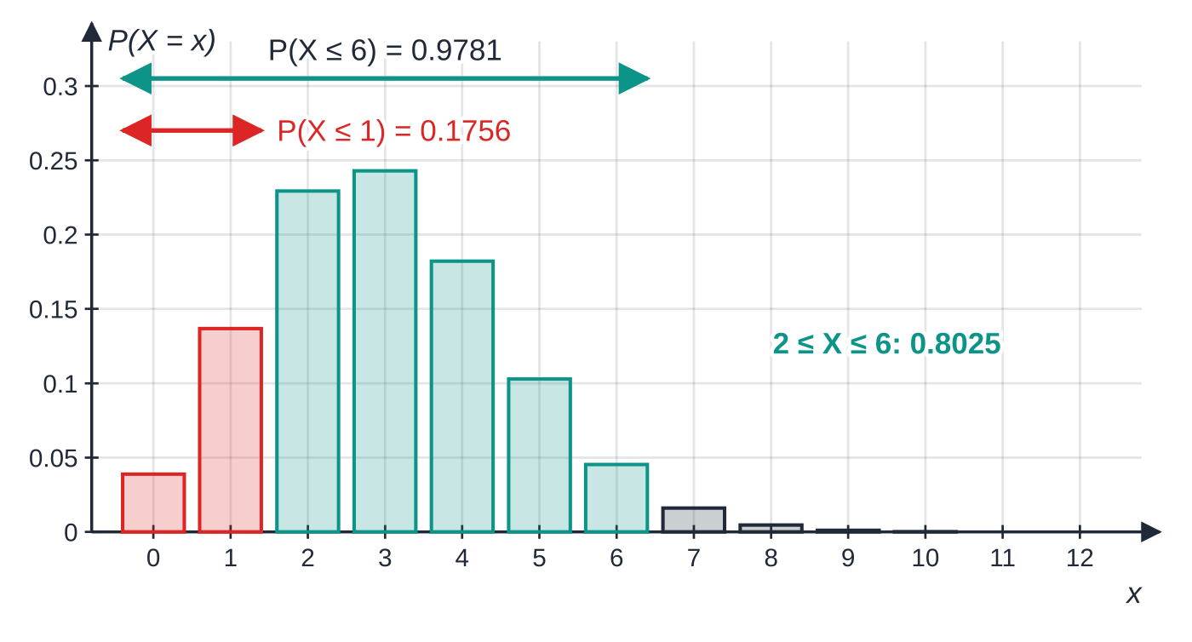
How do you use the cumulative binomial tables? (continued)
Section 2 of 12
Why P(2≤X<7)=P(X≤6)-P(X≤1) for X~B(20,0.15). Everything up to 6, minus everything up to 1 (red), leaves exactly the teal values 2, 3, 4, 5, 6. Writing out the values like this settles every "≤ or <?" question.
Notes:
How do you use the cumulative binomial tables?. Full notes: https://examinerprep.com/notes/edexcel-ial-maths/binomial-and-poisson-distributions/

Slide 11
How do you use the cumulative binomial tables? (continued)
Section 2 of 12 · Worked example 2 · Easy · Find
WORKED EXAMPLE · QUESTION
Of the emails arriving at an office inbox, 15% are spam, independently of each other. A random sample of 20 emails is taken. Find the probability that the number of spam emails is (a) at most 4, (b) exactly 4, (c) more than 5, (d) at least 2 but fewer than 7.
SOLUTION
Model: X~B(20,0.15).
(a) P(X≤4)= 0.8298 (b) P(X=4)=0.8298-0.6477= 0.1821
(c) "More than 5" starts at 6: P(X>5)=1-P(X≤5)=1-0.9327= 0.0673
(d) List the values: 2, 3, 4, 5, 6. P(2≤X≤6)=P(X≤6)-P(X≤1)=0.9781-0.1756= 0.8025
Notes:
How do you use the cumulative binomial tables?: Worked example 2. Full notes: https://examinerprep.com/notes/edexcel-ial-maths/binomial-and-poisson-distributions/

Slide 12
How do you use the cumulative binomial tables? (continued)
Section 2 of 12
What if p is bigger than 0.5?
The tables stop at p=0.5. If X~B(n,p) counts successes, then Y=n-X counts failures and Y~B(n,1-p). Translate the event: "X≥12 out of 15" is the same as "Y≤3". Large values of X are small values of Y.
Notes:
How do you use the cumulative binomial tables?. Full notes: https://examinerprep.com/notes/edexcel-ial-maths/binomial-and-poisson-distributions/

Slide 13
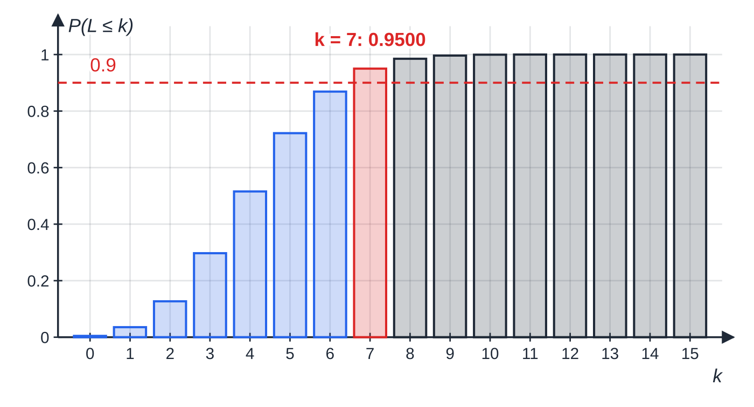
How do you use the cumulative binomial tables? (continued)
Section 2 of 12 · Worked example 3 · Medium · Find
WORKED EXAMPLE · QUESTION
A ferry leaves on time on 70% of crossings, independently. (a) For 15 crossings, find the probability that at least 12 leave on time. (b) For 15 crossings, find the smallest value of k such that the probability of at most k late departures is at least 0.9. (c) Find the least number of crossings for which the probability of at least one late departure exceeds 0.95.
SOLUTION
(a) Switch to late departures: L = number late, L~B(15,0.3). "At least 12 on time" = "at most 3 late", so P(L≤3)= 0.2969
Part (b): the cumulative probabilities P(L≤k) for L~B(15,0.3). The first bar to reach the 0.9 line is at k=7.
Notes:
How do you use the cumulative binomial tables?: Worked example 3. Full notes: https://examinerprep.com/notes/edexcel-ial-maths/binomial-and-poisson-distributions/

Slide 14
How do you use the cumulative binomial tables? (continued)
Section 2 of 12 · Worked example 3 · Medium · Find (continued)
(b) Scan the B(15,0.3) column for the first value ≥0.9: P(L≤6)=0.8689<0.9 and P(L≤7)=0.9500≥0.9, so k=7
(c) P(at least one late)=1-P(none late)=1-0.7ⁿ.
1-0.7ⁿ>0.95⇒0.7ⁿ<0.05⇒n>ln 0.05/ln 0.7=8.40
so n=9 (check: 1-0.7⁸=0.9424, 1-0.7⁹=0.9596). Dividing by ln 0.7, which is negative, reverses the inequality — the check line confirms the direction.
Notes:
How do you use the cumulative binomial tables?: Worked example 3. Full notes: https://examinerprep.com/notes/edexcel-ial-maths/binomial-and-poisson-distributions/

Slide 15
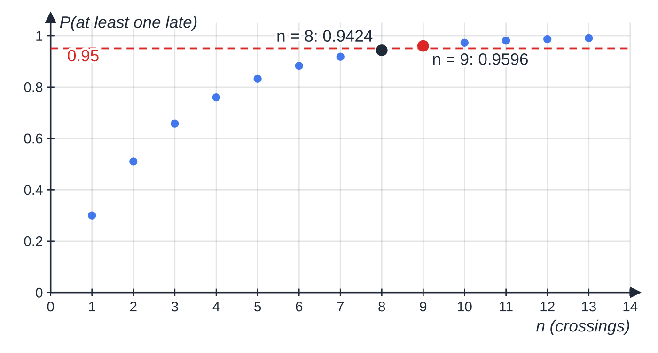
How do you use the cumulative binomial tables? (continued)
Section 2 of 12
Common error — the wrong complement
Writing P(X≥6)=1-P(X≤6). The complement of "X≥6" is "X≤5", so P(X≥6)=1-P(X≤5). List the values on each side whenever you are unsure.
Part (c): 1-0.7ⁿ climbs towards 1 as n grows. It is still below 0.95 at n=8 and first exceeds it at n=9.
Notes:
How do you use the cumulative binomial tables?. Full notes: https://examinerprep.com/notes/edexcel-ial-maths/binomial-and-poisson-distributions/

Slide 16
When is a Poisson model suitable?
Section 3 of 12
Some counts have no fixed number of trials: calls to a help desk in an hour, flaws in a metre of cloth, clicks of a Geiger counter in a minute. There is no "n", just events scattered at random through time or space.
The Poisson distribution Po(λ) models the number of events in a fixed interval of time or space, when events occur singly, independently, at random and at a constant mean rate of λ per interval.
State the conditions in context, for example "calls arrive one at a time", "calls arrive independently of one another", "calls arrive at a constant average rate". X can take the values 0,1,2,… with no upper limit.
Poisson probability function
Notes:
When is a Poisson model suitable?. Full notes: https://examinerprep.com/notes/edexcel-ial-maths/binomial-and-poisson-distributions/

Slide 17
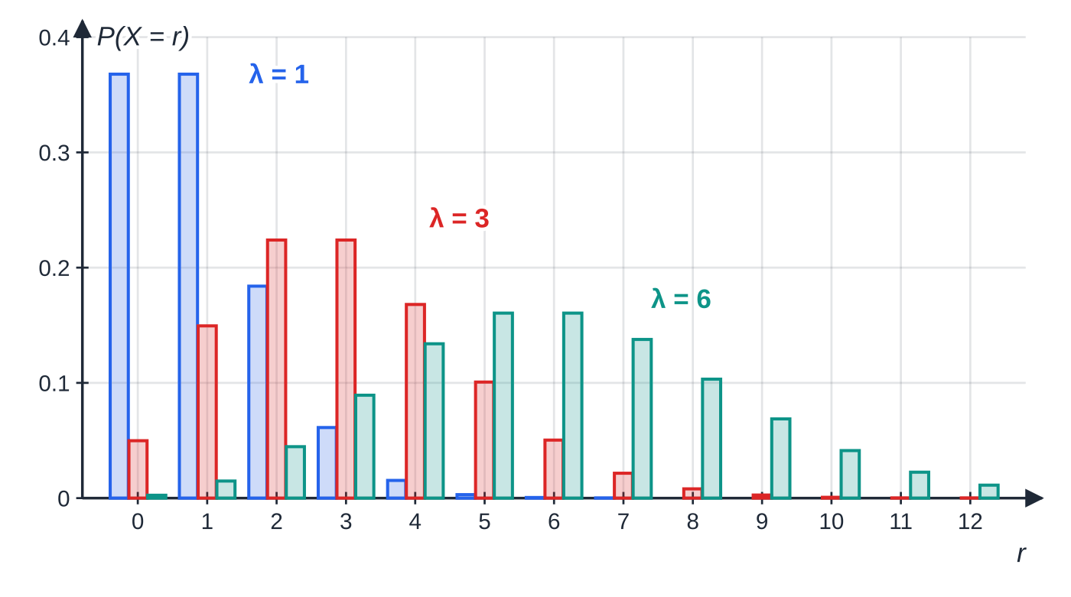
When is a Poisson model suitable? (continued)
Section 3 of 12
(in the formulae booklet, with cumulative Poisson tables for λ=0.5,1.0,1.5,…)
P(X=r)=(e^(-λ)λʳ)/r!, r=0,1,2,…
P(X=0)=e^(-λ), and each next term multiplies the previous one by λ/r.
Scaling. The parameter is proportional to the size of the interval. A rate of 3 per 10 minutes gives Po(0.6) for 2 minutes and Po(9) for 30 minutes. This is the single most important habit on the topic.
Poisson distributions computed from the probability function. With λ=1 the most likely values are 0 and 1 (they are equal); with λ=3 the peak is at 2 and 3; with λ=6 at 5 and 6. As λ grows the distribution becomes more symmetrical — a hint of the Normal approximation in S2.3.
Notes:
When is a Poisson model suitable?. Full notes: https://examinerprep.com/notes/edexcel-ial-maths/binomial-and-poisson-distributions/

Slide 18
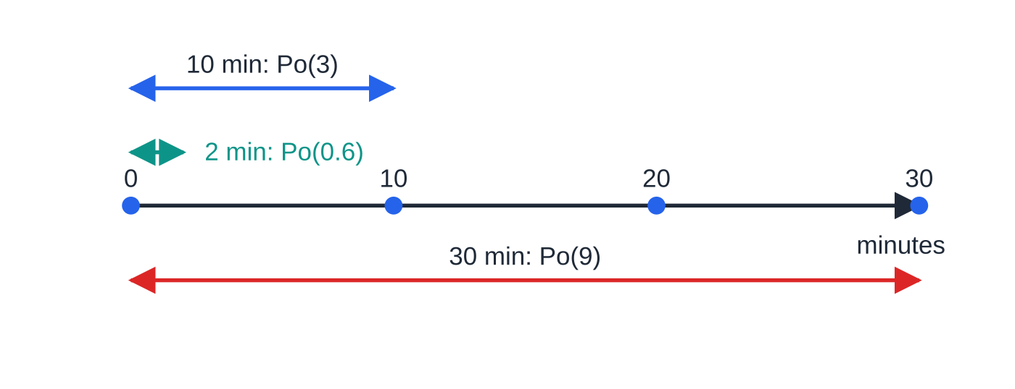
When is a Poisson model suitable? (continued)
Section 3 of 12
The same stream of calls, viewed through windows of different lengths. The mean count is proportional to the length of the window.
Notes:
When is a Poisson model suitable?. Full notes: https://examinerprep.com/notes/edexcel-ial-maths/binomial-and-poisson-distributions/

Slide 19
When is a Poisson model suitable? (continued)
Section 3 of 12 · Worked example 4 · Medium · State, find
WORKED EXAMPLE · QUESTION
Calls arrive at a help desk at a mean rate of 3 every 10 minutes. (a) State two conditions, in context, for a Poisson model of the number of calls. (b) Find the probability of exactly 5 calls in a 10-minute period. (c) Find the probability of more than 8 calls in half an hour. (d) Find the probability of no calls in a 2-minute period.
SOLUTION
(a) Calls arrive independently of each other; calls arrive at a constant mean rate (and one at a time).
(b) X~Po(3): P(X=5)=e⁻³3⁵/5!= 0.1008
(c) 30 minutes is three 10-minute periods, so Y~Po(9): P(Y>8)=1-P(Y≤8)=1-0.4557= 0.5443
(d) 2 minutes is 0.2 of a period, so W~Po(0.6): P(W=0)=e^(-0.6)= 0.5488
Notes:
When is a Poisson model suitable?: Worked example 4. Full notes: https://examinerprep.com/notes/edexcel-ial-maths/binomial-and-poisson-distributions/

Slide 20
When is a Poisson model suitable? (continued)
Section 3 of 12
Exam tip — scale first
Before any calculation, write the scaled distribution for the interval in the question: "in 30 minutes, Y~Po(9)". Using the original λ for a different interval is the most expensive slip on this topic, because every later part depends on it.
Notes:
When is a Poisson model suitable?. Full notes: https://examinerprep.com/notes/edexcel-ial-maths/binomial-and-poisson-distributions/

Slide 21
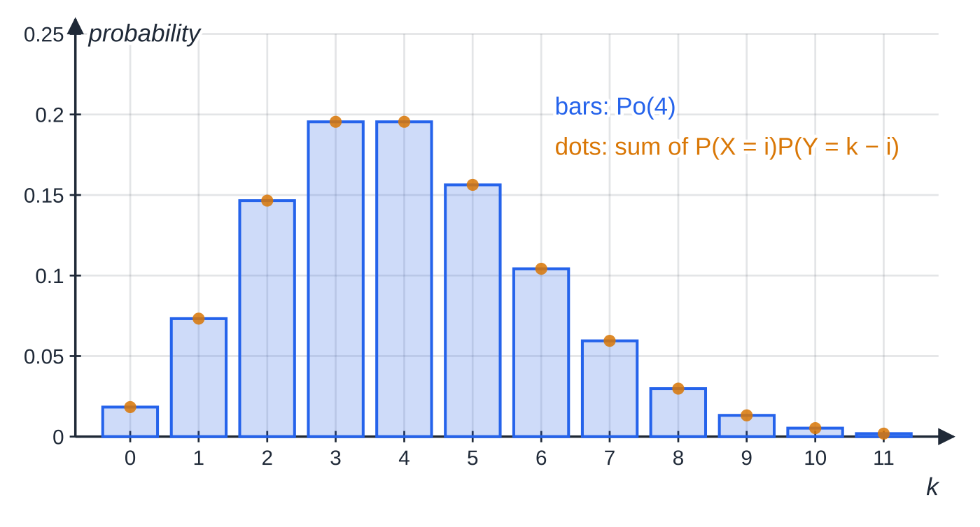
How do Poisson variables combine?
Section 4 of 12
Additive property (not in the formulae booklet — learn it). If X~Po(λ) and Y~Po(μ) are independent, then X+Y~Po(λ+μ).
Two independent streams of random events merge into one stream whose rate is the sum of the rates. Scaling a rate is the same idea: three independent 10-minute periods, each Po(3), add to Po(9). Independence is essential and must be stated. The difference X-Y is not Poisson (it can be negative).
Checking the additive property numerically with X~Po(2.5) and Y~Po(1.5) independent. For each total k, the amber dot adds P(X=i)P(Y=k-i) over every split i=0,1,…,k. Every dot lands on top of the bar for Po(4).
Notes:
How do Poisson variables combine?. Full notes: https://examinerprep.com/notes/edexcel-ial-maths/binomial-and-poisson-distributions/

Slide 22
How do Poisson variables combine? (continued)
Section 4 of 12 · Worked example 5 · Medium · Find
WORKED EXAMPLE · QUESTION
A bakery receives online orders at a mean rate of 2.5 per hour and phone orders at a mean rate of 1.5 per hour, independently, each following a Poisson distribution. (a) Find the probability that the bakery receives at least 6 orders in total in an hour. (b) Find the probability that, in an hour, it receives exactly 2 online orders and exactly 1 phone order. (c) Find the probability of exactly 10 orders in total in a 2-hour period.
SOLUTION
(a) Add the rates: T = total orders in an hour, T~Po(2.5+1.5)=Po(4). P(T≥6)=1-P(T≤5)=1-0.7851= 0.2149
(b) Independent, so multiply: e^(-2.5)2.5²/2!×e^(-1.5)1.5¹/1!=0.2565×0.3347= 0.08585
(c) Scale the total rate to 2 hours, Po(8): P=e⁻⁸8¹⁰/10!= 0.09926
In (b) the total is 3 orders, but P(T=3) would be wrong: it includes 3 online and 0 phone, 1 online and 2 phone, and so on.
Notes:
How do Poisson variables combine?: Worked example 5. Full notes: https://examinerprep.com/notes/edexcel-ial-maths/binomial-and-poisson-distributions/

Slide 23
What are the mean and variance, and how do they help you choose a model?
Section 5 of 12
Distribution | Mean E(X) | Variance Var(X) | Standard deviation
B(n,p) | np | np(1-p) | √(np(1-p))
Po(λ) | λ | λ | √λ
These are quoted results: S2 does not ask you to derive them. They are more useful than they look:
For a binomial, the variance is always less than the mean, since 1-p<1.
For a Poisson, mean = variance. So if a sample of counts has a mean and a variance that are close, a Poisson model is plausible; if the variance is much bigger or smaller than the mean, it is not.
Given a binomial mean and variance, divide: (np(1-p))/np=1-p gives p, then n=mean÷p.
Notes:
What are the mean and variance, and how do they help you choose a model?. Full notes: https://examinerprep.com/notes/edexcel-ial-maths/binomial-and-poisson-distributions/

Slide 24
What are the mean and variance, and how do they help you choose a model? (continued)
Section 5 of 12 · Worked example 6 · Medium · Find, explain
WORKED EXAMPLE · QUESTION
(a) X~B(n,p) has mean 6 and variance 4.2. Find n and p, and hence find P(X>6). (b) The numbers of surface flaws on 100 ceramic tiles are recorded.
Flaws, x | 0 | 1 | 2 | 3 | 4 | 5 | 6
Tiles, f | 16 | 30 | 26 | 16 | 8 | 3 | 1
Find the mean and variance of the number of flaws per tile and explain whether a Poisson model is reasonable.
SOLUTION
(a) 1-p=(4.2/6)=0.7⇒p=0.3; n=(6/0.3)=20. Then P(X>6)=1-P(X≤6)=1-0.6080= 0.3920
(b) Σf=100, Σfx=183, Σfx²=517. Mean =(183/100)=1.83; variance =(517/100)-1.83²=1.8211.
Notes:
What are the mean and variance, and how do they help you choose a model?: Worked example 6. Full notes: https://examinerprep.com/notes/edexcel-ial-maths/binomial-and-poisson-distributions/

Slide 25
What are the mean and variance, and how do they help you choose a model? (continued)
Section 5 of 12 · Worked example 6 · Medium · Find, explain (continued)
Mean ≈ variance, which is a property of the Poisson distribution, so Po(1.83) is a reasonable model. With the model, the expected number of tiles with no flaws is 100e^(-1.83)=16.0, against 16 observed.
Notes:
What are the mean and variance, and how do they help you choose a model?: Worked example 6. Full notes: https://examinerprep.com/notes/edexcel-ial-maths/binomial-and-poisson-distributions/

Slide 26
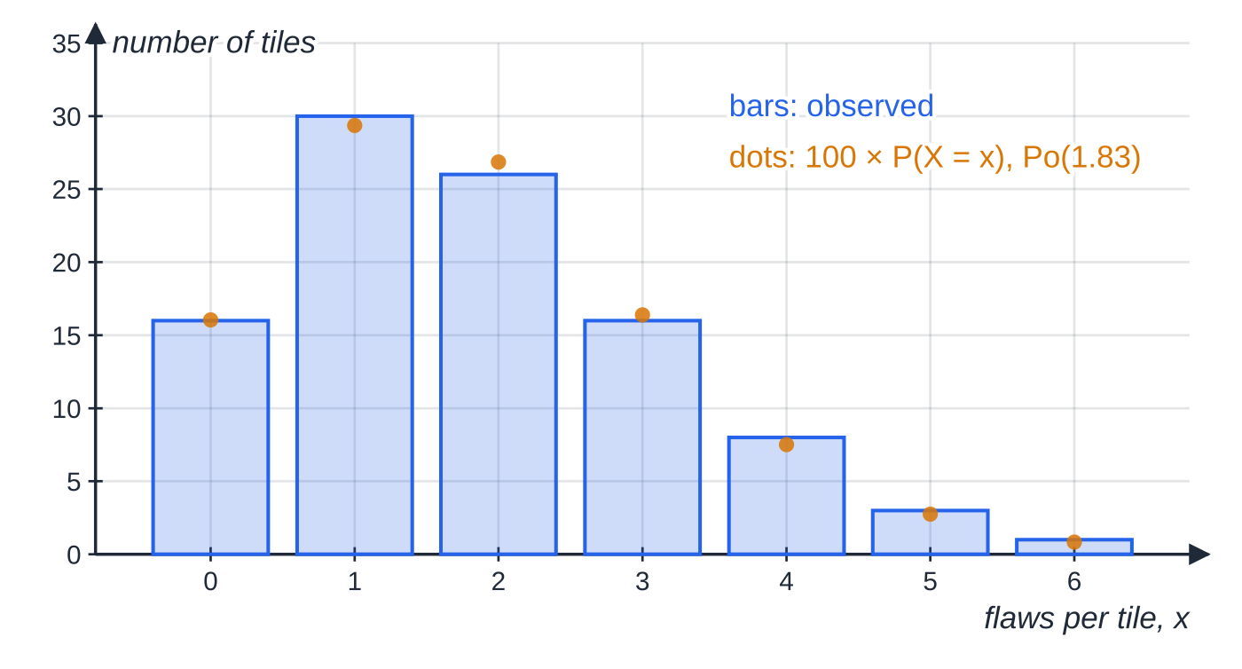
What are the mean and variance, and how do they help you choose a model? (continued)
Section 5 of 12
The tile data (bars) with the expected frequencies 100×P(X=x) for X~Po(1.83) (dots). The sample mean (1.83) and variance (1.82) are almost equal, and the fitted values track the bars closely.
Notes:
What are the mean and variance, and how do they help you choose a model?. Full notes: https://examinerprep.com/notes/edexcel-ial-maths/binomial-and-poisson-distributions/

Slide 27
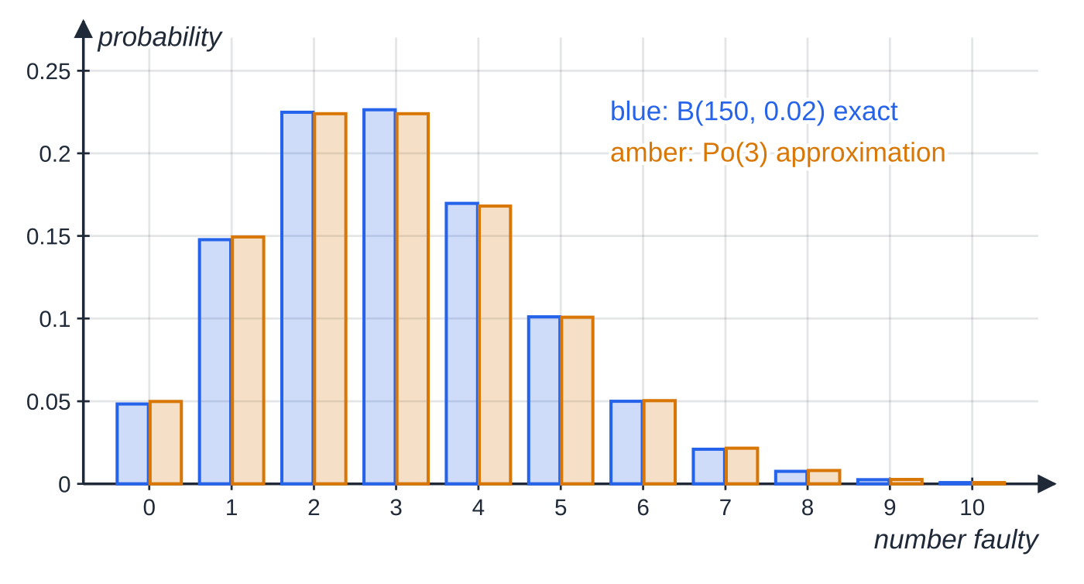
When can a Poisson distribution approximate a binomial?
Section 6 of 12
Poisson approximation to the binomial (not in the formulae booklet — learn it). If X~B(n,p) with n large and p small, then X≈Po(np).
Keep the mean the same: λ=np. It works because the binomial variance np(1-p)≈np when p is small — mean and variance nearly equal, just like a Poisson. A common rule of thumb is n>50 and np<5; it is still fair a little beyond this, as long as p is small. If p is close to 1, approximate the number of failures, B(n,1-p), instead.
Exact B(150,0.02) probabilities (blue) beside Po(3) probabilities (amber), both computed. The largest difference between a pair of bars is about 0.0023.
Notes:
When can a Poisson distribution approximate a binomial?. Full notes: https://examinerprep.com/notes/edexcel-ial-maths/binomial-and-poisson-distributions/

Slide 28
When can a Poisson distribution approximate a binomial? (continued)
Section 6 of 12 · Worked example 7 · Medium · Explain, find
WORKED EXAMPLE · QUESTION
2% of the components made by a machine are faulty, independently. A batch of 150 components is checked. (a) Explain why a Poisson distribution can be used to approximate the number of faulty components, and state its parameter. (b) Use it to find the probability of at most 2 faulty components. (c) Use it to find the probability of more than 5 faulty components.
SOLUTION
(a) X~B(150,0.02); n=150 is large and p=0.02 is small, so X≈Po(150×0.02)=Po(3)
(b) Poisson table, λ=3: P(X≤2)≈ 0.4232 (the exact binomial value is 0.4209)
(c) P(X>5)≈1-P(X≤5)=1-0.9161= 0.0839 (exact: 0.08188)
B(150,0.02) is not in any table, and the exact sum would need six binomial terms; the approximation turns it into one table look-up.
Notes:
When can a Poisson distribution approximate a binomial?: Worked example 7. Full notes: https://examinerprep.com/notes/edexcel-ial-maths/binomial-and-poisson-distributions/

Slide 29
When can a Poisson distribution approximate a binomial? (continued)
Section 6 of 12
Common error — large n is not enough
Using the Poisson approximation just because n is large. With B(60,0.4), n is large but p is not small: the mean is 24 and the variance 14.4, far from equal, so a Poisson model with λ=24 would be far too spread out.
Notes:
When can a Poisson distribution approximate a binomial?. Full notes: https://examinerprep.com/notes/edexcel-ial-maths/binomial-and-poisson-distributions/

Slide 30
How do these ideas combine in a full question?
Section 7 of 12
Longer questions often chain the two distributions: a Poisson probability becomes the p of a binomial ("how many of the 12 months have no breakdowns?"). Keep that p unrounded in your calculator and round only the final answer. "Least number of …" questions lead to an inequality with a power or an exponential — solve with logarithms, then check the integers either side.
Notes:
How do these ideas combine in a full question?. Full notes: https://examinerprep.com/notes/edexcel-ial-maths/binomial-and-poisson-distributions/

Slide 31
How do these ideas combine in a full question? (continued)
Section 7 of 12 · Worked example 8 · Hard · Find
WORKED EXAMPLE · QUESTION
Breakdowns of a lift occur at random at a mean rate of 1.5 per month. (a) Find the probability of exactly 2 breakdowns in a month. (b) Find the probability of more than 4 breakdowns in a 3-month period. (c) Find the probability that in a year (12 months) there are exactly 3 months with no breakdowns. (d) Find the least whole number of months for which the probability of at least one breakdown exceeds 0.99.
SOLUTION
(a) X~Po(1.5): P(X=2)=e^(-1.5)1.5²/2!= 0.2510
(b) Scale to 3 months, Y~Po(4.5): P(Y>4)=1-P(Y≤4)=1-0.5321= 0.4679
(c) The probability that a given month has no breakdowns is P(X=0)=e^(-1.5)=0.22313…. Months are independent, so M = number of months with no breakdowns, M~B(12,e^(-1.5)):
P(M=3)=C(12, 3)(e^(-1.5))³(1-e^(-1.5))⁹=
Notes:
How do these ideas combine in a full question?: Worked example 8. Full notes: https://examinerprep.com/notes/edexcel-ial-maths/binomial-and-poisson-distributions/

Slide 32
How do these ideas combine in a full question? (continued)
Section 7 of 12 · Worked example 8 · Hard · Find (continued)
0.2519
(d) In m months the number of breakdowns is Po(1.5m): 1-e^(-1.5m)>0.99⇒e^(-1.5m)<0.01⇒m>ln 100/1.5=3.07, so 4 months (3 months gives 0.9889; 4 months gives 0.9975).
Notes:
How do these ideas combine in a full question?: Worked example 8. Full notes: https://examinerprep.com/notes/edexcel-ial-maths/binomial-and-poisson-distributions/

Slide 33
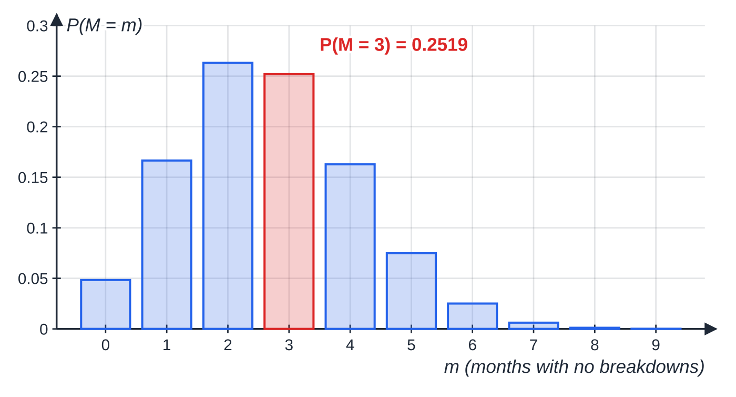
How do these ideas combine in a full question? (continued)
Section 7 of 12
Exam tip — two variables, two lines
When one distribution feeds another, write both definitions on separate lines: "X~Po(1.5), breakdowns in a month" and "M~B(12,0.2231…), months with none". It makes clear which variable each probability belongs to.
Part (c): the distribution of M~B(12,e^(-1.5)), the number of breakdown-free months in a year. The red bar is the answer, 0.2519.
Notes:
How do these ideas combine in a full question?. Full notes: https://examinerprep.com/notes/edexcel-ial-maths/binomial-and-poisson-distributions/

Slide 34
Exam tips for S2.1
Section 8 of 12
Exam tip 1 — define, then calculate
Start every part with the random variable in words and its distribution with parameters: "X = number of spam emails, X~B(20,0.15)". It is often worth credit in itself, and it stops you using the wrong n or λ later.
Exam tip 2 — convert before you look up
Rewrite the event as P(X≤…) or 1-P(X≤…) before opening the tables, and show that line. If p>0.5, switch to the other outcome first.
Exam tip 3 — conditions must be in context
"The trials are independent" is a definition, not an answer. Write "whether one seed germinates does not affect whether another does". Give exactly as many conditions as the question asks for.
Notes:
Exam tips for S2.1. Full notes: https://examinerprep.com/notes/edexcel-ial-maths/binomial-and-poisson-distributions/

Slide 35
Exam tips for S2.1 (continued)
Section 8 of 12
Exam tip 4 — know which values come from where
Table values are quoted to 4 decimal places. Use the probability function when the parameters are not in the tables (for example p=0.35 or λ=1.83), and give those answers to 4 significant figures unless told otherwise.
Exam tip 5 — "least n" questions
Solve the inequality with logarithms, round up to the next whole number, and show a check at n and n-1. Remember that dividing by the log of a number less than 1 reverses the inequality.
Notes:
Exam tips for S2.1. Full notes: https://examinerprep.com/notes/edexcel-ial-maths/binomial-and-poisson-distributions/

Slide 36
Common misconceptions
Section 9 of 12
Misconception | Why it is wrong | Correct idea
P(X<4)=P(X≤4). | X is discrete, so the value 4 itself makes a difference: for B(10,0.4) these are 0.3823 and 0.6331. | P(X<4)=P(X≤3).
P(X≥4)=1-P(X≤4). | That subtracts the value 4, which should be included. | P(X≥4)=1-P(X≤3).
A Poisson rate is the same whatever the interval. | Twice the time means twice as many events on average. | Scale λ in proportion to the length (or area) of the interval.
Any two Poisson variables add to a Poisson. | The result needs the variables to be independent. | Independent: X+Y~Po(λ+μ); state the independence.
Counting trials until the first success is binomial. | A binomial needs a fixed number of trials decided in advance. | Check all four conditions, starting with a fixed n.
Notes:
Common misconceptions. Full notes: https://examinerprep.com/notes/edexcel-ial-maths/binomial-and-poisson-distributions/

Slide 37
Common misconceptions (continued)
Section 9 of 12
Misconception | Why it is wrong | Correct idea
The Poisson approximation works whenever n is large. | p must also be small, so that np(1-p)≈np. | Use Po(np) when n is large and p is small.
Notes:
Common misconceptions. Full notes: https://examinerprep.com/notes/edexcel-ial-maths/binomial-and-poisson-distributions/

Slide 38
How this topic connects
Section 10 of 12
S1 discrete random variables
Discrete random variables, E(X) and Var(X) from a probability table, and the mean and variance of a frequency table (Worked example 6) all come from S1; the binomial and Poisson are special discrete distributions with ready-made formulae.
Pure mathematics (P1–P4)
C(n, r) is the same coefficient as in the binomial expansion of (1+x)ⁿ in P2; logarithms solve the "least n" questions; the series for e^λ is why Poisson probabilities add up to 1. In IAL Physics, counts from a radioactive source in a fixed time are a textbook Poisson process, which is why repeated counts vary by about √(mean).
Notes:
How this topic connects. Full notes: https://examinerprep.com/notes/edexcel-ial-maths/binomial-and-poisson-distributions/

Slide 39
How this topic connects (continued)
Section 10 of 12
The rest of S2
Normal approximations to the binomial and Poisson, with a continuity correction (S2.3), are used when n or λ is too large for the tables; hypothesis tests about p and λ (S2.4) use the cumulative tables exactly as in this page's second section.
Notes:
How this topic connects. Full notes: https://examinerprep.com/notes/edexcel-ial-maths/binomial-and-poisson-distributions/

Slide 40
Key formulae
Section 11 of 12
Formula | Use | In the formulae list?
P(X=r)=C(n, r)pʳ(1-p)ⁿ⁻ʳ | binomial probability of exactly r successes | Yes
E(X)=np, Var(X)=np(1-p) | mean and variance of B(n,p) | Yes
P(X=r)=(e^(-λ)λʳ)/r! | Poisson probability of exactly r events | Yes
E(X)=Var(X)=λ | mean and variance of Po(λ); judging whether data fit a Poisson model | Yes
P(X≤x) from cumulative binomial and Poisson tables | probabilities for tabulated n, p and λ | Yes
P(X=r)=P(X≤r)-P(X≤r-1); P(X≥r)=1-P(X≤r-1) | turning any event into cumulative probabilities | No – derive it
X~B(n,p)⇒n-X~B(n,1-p) | using the tables when p>0.5 | No – learn it
rate λ per unit ⇒Po(tλ) for an interval of t units | scaling the Poisson parameter | No – learn it
Notes:
Key formulae. Full notes: https://examinerprep.com/notes/edexcel-ial-maths/binomial-and-poisson-distributions/

Slide 41
Key formulae (continued)
Section 11 of 12
Formula | Use | In the formulae list?
X~Po(λ), Y~Po(μ) independent ⇒X+Y~Po(λ+μ) | combining independent Poisson variables | No – learn it
B(n,p)≈Po(np) for n large, p small | Poisson approximation to the binomial | No – learn it
Notes:
Key formulae. Full notes: https://examinerprep.com/notes/edexcel-ial-maths/binomial-and-poisson-distributions/

Slide 42
Check your understanding
Section 12 of 12
1. X~B(25,0.2). Write down the mean and the variance of X.
2. Write P(4<X≤9) in terms of cumulative probabilities.
3. Particles are detected at a mean rate of 2 per minute. Find the probability that none is detected in a 30-second interval.
4. Why is Po(24) not a good approximation to B(40,0.6)?
5. X~Po(3) and Y~Po(5) are independent. State the distribution of X+Y and its variance.
6. A seed germinates with probability 0.9, independently. 10 seeds are planted. Find the probability that at least 9 germinate.
Notes:
Check your understanding: questions. Full notes: https://examinerprep.com/notes/edexcel-ial-maths/binomial-and-poisson-distributions/

Slide 43
Check your understanding · answers
Section 12 of 12
1. Mean np=25×0.2=5; variance np(1-p)=5×0.8=4.
2. The values are 5, 6, 7, 8, 9, so P(4<X≤9)=P(X≤9)-P(X≤4).
3. In 30 seconds the count is Po(1), so P(0)=e⁻¹=0.3679.
4. p=0.6 is not small: the binomial mean is 24 but its variance is only 9.6, whereas a Poisson has variance equal to its mean.
5. X+Y~Po(8), so its variance is 8 (equal to its mean).
6. Switch to failures: F~B(10,0.1), and "at least 9 germinate" = "at most 1 fails". P(F≤1)=0.7361 from the tables (or 0.9¹⁰+10(0.1)(0.9)⁹=0.3487+0.3874=0.7361).
Notes:
Check your understanding: answers. Full notes: https://examinerprep.com/notes/edexcel-ial-maths/binomial-and-poisson-distributions/

Slide 44
Practice questions
2 original exam-style questions. Answers at the end of the deck.

Slide 45
Question 1
7 marks
The first draft of a novel contains typing errors, scattered randomly through the text with an average of 0.6 errors per page.
(a) Find the probability that a given page has no errors. [1]
(b) Find the probability that a 5-page chapter has more than 4 errors. [2]
(c) For the same 5-page chapter, find the probability that exactly 2 of the pages have no errors. [3]
(d) Give one reason why a Poisson model might not be suitable for errors in a whole draft. [1]
Notes:
Online with the full mark scheme: https://examinerprep.com/ial-maths-s2-1-binomial-and-poisson-distributions-questions#IALM-S2-1-B-05

Slide 46
Question 2
8 marks
A courier company finds that 1.5% of parcels are damaged in transit, independently of each other. A van carries 200 parcels and X is the number of damaged parcels in the van.
(a) Explain why the distribution of X can be approximated by a Poisson distribution, and state its parameter. [2]
(b) Use the approximation to find the probability that exactly 4 parcels are damaged. [2]
(c) Use the approximation to find the probability that at most 1 parcel is damaged. [2]
(d) Calculate the exact binomial value of P(X ≤ 1) and comment on the approximation. [2]
Notes:
Online with the full mark scheme: https://examinerprep.com/ial-maths-s2-1-binomial-and-poisson-distributions-questions#IALM-S2-1-B-06

Slide 47
Answers

Slide 48
Question 1 · answer
Mark scheme
e^(−0.6) = 0.5488
Po(3), 1 − P(≤ 4)
= 1 − 0.8153 = 0.1847
number of error-free pages ~ B(5, e^(−0.6))
⁵C₂(0.5488…)²(0.4511…)³
= 0.2766
e.g. errors may cluster (on difficult pages or when the writer is tired), so they are not independent or the rate is not constant
Notes:
Full mark scheme: https://examinerprep.com/ial-maths-s2-1-binomial-and-poisson-distributions-questions#IALM-S2-1-B-05

Slide 49
Question 2 · answer
Mark scheme
X ~ B(200, 0.015), with n large and p small
X ≈ Po(3), since np = 3
e⁻³ 3⁴/4!
= 0.1680
P(X ≤ 1) from the Po(3) table, or e⁻³(1 + 3)
= 0.1991
0.985²⁰⁰ + 200(0.015)(0.985)¹⁹⁹ = 0.1969
the approximation differs by about 0.002, so it is good
Notes:
Full mark scheme: https://examinerprep.com/ial-maths-s2-1-binomial-and-poisson-distributions-questions#IALM-S2-1-B-06

Slide 50
Keep practising
Notes for this topic
Questions on this topic
Build a printable test
ExaminerPrep is an independent tutoring service. It has been developed independently from and is not endorsed by the International Baccalaureate Organization. "International Baccalaureate", "IB" and "IB Diploma Programme" are registered trademarks of the IBO, used here for descriptive purposes only.
Pearson Edexcel and Cambridge are trademarks of their owners; ExaminerPrep is not affiliated with any exam board.

