Slide 1
EP
EDEXCEL IAL MATHS
M2.3 Centres of mass
The full notes page in 13 sections · practice questions with answers · simulations
ExaminerPrep is an independent tutoring service. It has been developed independently from and is not endorsed by the International Baccalaureate Organization. "International Baccalaureate", "IB" and "IB Diploma Programme" are registered trademarks of the IBO, used here for descriptive purposes only.
Pearson Edexcel and Cambridge are trademarks of their owners; ExaminerPrep is not affiliated with any exam board.
Notes:
M2.3 Centres of mass. Notes for this topic: https://examinerprep.com/notes/edexcel-ial-maths/centres-of-mass/

Slide 2
What this page covers
Overview
The centre of mass of particles on a line and in a plane, x̄=Σmx/Σm, including the vector form
Using symmetry, and the standard results for a rectangle, triangle, semicircle, sector and circular arc
Composite laminas, including holes and parts removed, using a table of areas and positions
Uniform wire frameworks, where mass is proportional to length
A lamina suspended from a point: the angle a given line makes with the vertical
A lamina free to rotate about a fixed horizontal axis, with particles attached
A lamina on a rough inclined plane: about to topple, and toppling versus sliding
Notes:
What this page covers. Full notes: https://examinerprep.com/notes/edexcel-ial-maths/centres-of-mass/

Slide 3
In one minute
Key points
1
The centre of mass of a body is the point where its whole weight can be taken to act, and it is found as a weighted mean of positions.
4
If a uniform body has a line of symmetry, its centre of mass lies on that line.
2
Particles: x̄=Σmᵢ xᵢ/Σmᵢ and ȳ=Σmᵢ yᵢ/Σmᵢ.
5
Hanging freely from a point, a body rests with its centre of mass vertically below that point.
3
Uniform lamina: mass is proportional to area. Uniform wire: mass is proportional to length. A removed piece goes in the table with a negative area.
6
On a slope, a body is about to topple when the vertical through its centre of mass passes through the lowest point of contact.
Notes:
In one minute: the key points of this topic.

Slide 4
Where is the centre of mass of particles on a straight line?
Section 1 of 13
Centre of mass: the point at which the whole weight of a body or system of particles can be taken to act.
Imagine several particles fixed to a light rod lying along the x-axis. Each particle has a weight mᵢ g acting at its position xᵢ. If we replace all of them by a single weight (Σmᵢ)g at one point x̄, that single weight must have the same turning effect about the origin as all the separate weights together. Taking moments about the origin gives
(Σmᵢ) g x̄=Σmᵢ g xᵢ .
The g cancels on both sides, which is why the centre of mass does not depend on the strength of gravity. Dividing by the total mass gives the result that the whole topic is built on.
x̄=(Σmᵢ xᵢ)/Σmᵢ
Notes:
Where is the centre of mass of particles on a straight line?. Full notes: https://examinerprep.com/notes/edexcel-ial-maths/centres-of-mass/

Slide 5
Where is the centre of mass of particles on a straight line? (continued)
Section 1 of 13
Here mᵢ is the mass of particle i and xᵢ is its position measured from a chosen origin. You can choose any fixed point as the origin, but positions on the other side of it must be negative. This result is not in the formulae booklet: learn it, because every later idea on this page is the same equation in disguise.
It is often more useful in the rearranged form (Σm)x̄=Σmx: total mass times the position of the centre of mass equals the sum of the individual moments. When a question gives the centre of mass and asks for an unknown mass or position, this form gives a linear equation straight away.
Notes:
Where is the centre of mass of particles on a straight line?. Full notes: https://examinerprep.com/notes/edexcel-ial-maths/centres-of-mass/

Slide 6
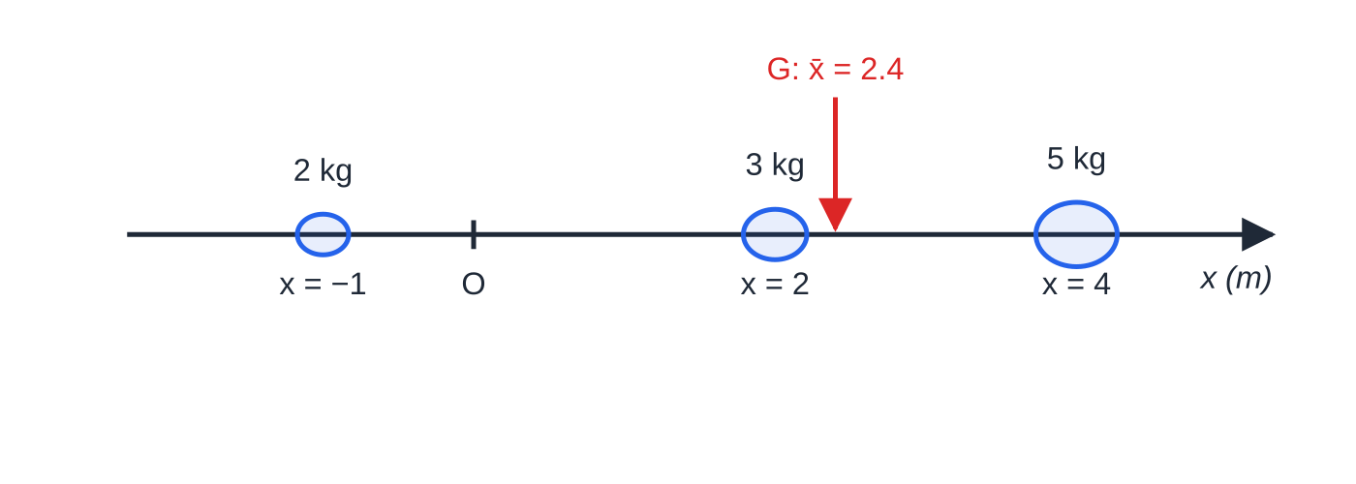
Where is the centre of mass of particles on a straight line? (continued)
Section 1 of 13
Worked example 1(a): the three particles and their centre of mass. G sits closer to the heavy 5 kg particle, as a weighted mean should.
Notes:
Where is the centre of mass of particles on a straight line?. Full notes: https://examinerprep.com/notes/edexcel-ial-maths/centres-of-mass/

Slide 7
Where is the centre of mass of particles on a straight line? (continued)
Section 1 of 13 · Worked example 1 · Easy · Find
WORKED EXAMPLE · QUESTION
Particles of mass 2 kg, 3 kg and 5 kg lie on the x-axis at the points where x=-1, x=2 and x=4 respectively (distances in metres). (a) Find the position of the centre of mass of the three particles. (b) A fourth particle, of mass k kg, is added at the point where x=-1. The centre of mass of the four particles is at x=1.5. Find k.
SOLUTION
(a) Sum of moments: Σmx=2(-1)+3(2)+5(4)=24. Total mass: Σm=10. So x̄=24÷10= 2.4 m (the point where x=2.4)
(b) Write the same equation with k included: (10+k)×1.5=24+k(-1), so 15+1.5k=24-k, giving 2.5k=9 and k=3.6
Check: adding mass at x=-1 should pull the centre of mass to the left of 2.4, and 1.5 is to the left.
Notes:
Where is the centre of mass of particles on a straight line?: Worked example 1. Full notes: https://examinerprep.com/notes/edexcel-ial-maths/centres-of-mass/

Slide 8
How do you find the centre of mass of particles in a plane?
Section 2 of 13
In two dimensions nothing new is needed. Apply the one-dimensional result twice: once using the x-coordinates and once using the y-coordinates. The two calculations are completely independent.
x̄=(Σmᵢ xᵢ)/Σmᵢ, ȳ=(Σmᵢ yᵢ)/Σmᵢ or r̄=Σmᵢrᵢ/Σmᵢ
The vector form is the same thing written with position vectors rᵢ. If the positions are given as ai+bj, work with the i and j components separately: it is exactly the coordinate calculation. None of these forms is in the formulae booklet, so learn them.
Because there are two separate equations, a question can contain two unknowns, such as an unknown mass and an unknown coordinate. The skill is spotting which equation contains only one of them.
Notes:
How do you find the centre of mass of particles in a plane?. Full notes: https://examinerprep.com/notes/edexcel-ial-maths/centres-of-mass/

Slide 9
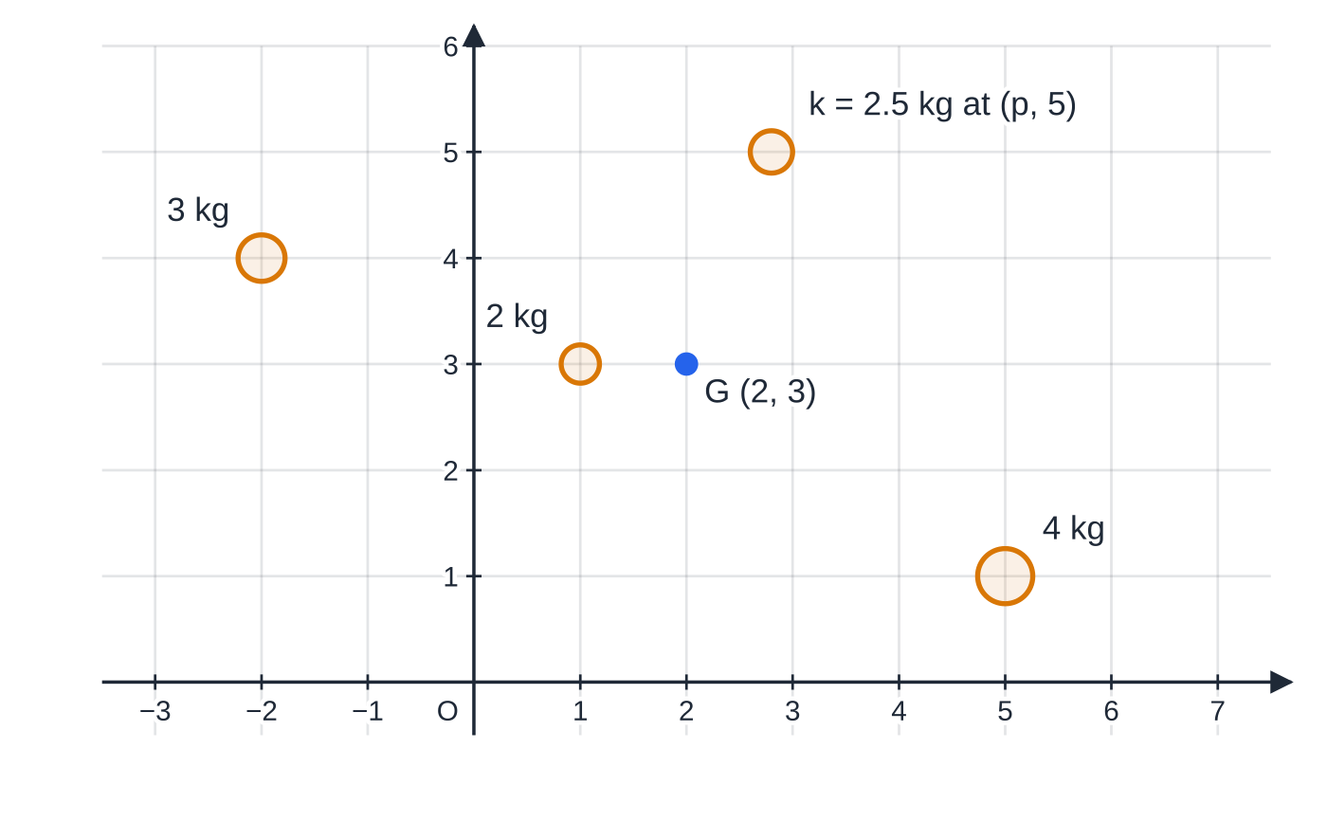
How do you find the centre of mass of particles in a plane? (continued)
Section 2 of 13
Worked example 2, drawn to scale. Dot size grows with mass. The fourth particle (2.5 kg at (2.8, 5), in amber) is the one whose mass and position were found.
Notes:
How do you find the centre of mass of particles in a plane?. Full notes: https://examinerprep.com/notes/edexcel-ial-maths/centres-of-mass/

Slide 10
How do you find the centre of mass of particles in a plane? (continued)
Section 2 of 13 · Worked example 2 · Medium · Find
WORKED EXAMPLE · QUESTION
Particles of mass 2 kg, 4 kg and 3 kg are at the points (1, 3), (5, 1) and (−2, 4) respectively. A fourth particle, of mass k kg, is placed at the point (p, 5). The centre of mass of the four particles is at (2, 3). Find k and p.
SOLUTION
Step 1 Totals for the three known particles: Σm=9, Σmx=2+20-6=16, Σmy=6+4+12=22.
Step 2 The y-equation contains only k, so solve it first: (9+k)×3=22+5k, so 27+3k=22+5k and k=2.5
Step 3 Now the x-equation: (9+2.5)×2=16+2.5p, so 23=16+2.5p and p=2.8
Notes:
How do you find the centre of mass of particles in a plane?: Worked example 2. Full notes: https://examinerprep.com/notes/edexcel-ial-maths/centres-of-mass/

Slide 11
How do you find the centre of mass of particles in a plane? (continued)
Section 2 of 13
Exam tip
When there are two unknowns, look for the equation with only one of them in it. Here the y-coordinate of the new particle was given, so the y-equation found k straight away, and then the x-equation gave p.
Notes:
How do you find the centre of mass of particles in a plane?. Full notes: https://examinerprep.com/notes/edexcel-ial-maths/centres-of-mass/

Slide 12
Where are the centres of mass of the standard uniform shapes?
Section 3 of 13
A lamina is a flat body whose thickness is ignored. Uniform means its mass per unit area is constant, so the mass of any piece is proportional to its area. That single fact lets us treat areas as if they were masses.
Symmetry does a lot of the work. If a uniform body has a line of symmetry, its centre of mass lies on that line, because every bit of mass on one side is matched by an equal bit on the other side. Two lines of symmetry fix the centre of mass at their intersection, so a uniform rectangle or circle has its centre of mass at its centre, and a uniform straight rod has it at its midpoint.
For a triangular lamina, the centre of mass is where the three medians meet, ⅔ of the way along each median from the vertex. With coordinates this is simply the mean of the three vertices:
((x₁+x₂+x₃)/3, (y₁+y₂+y₃)/3).
Notes:
Where are the centres of mass of the standard uniform shapes?. Full notes: https://examinerprep.com/notes/edexcel-ial-maths/centres-of-mass/

Slide 13
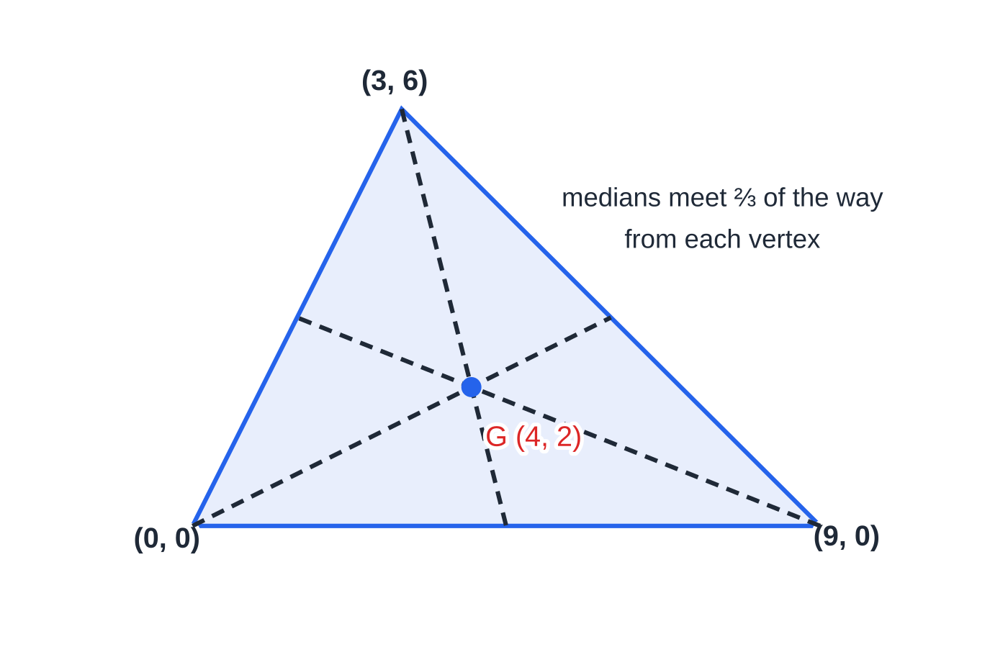
Where are the centres of mass of the standard uniform shapes? (continued)
Section 3 of 13
Curved shapes have results that come from integration, and these are given in the formulae booklet. For a sector of radius r with angle 2α at the centre, the centre of mass lies on the axis of symmetry at a distance 2rsin α/3α from the centre O. A semicircle is the case α=π/2, which gives 4r/3π. For a circular arc (a curved wire) of radius r and angle 2α, the distance is rsin α/α, and a semicircular arc gives 2r/π. In every case α is half the angle at the centre and must be in radians.
The triangle with vertices (0, 0), (9, 0) and (3, 6). The medians (dashed) meet at G = (4, 2), the mean of the three vertices.
Notes:
Where are the centres of mass of the standard uniform shapes?. Full notes: https://examinerprep.com/notes/edexcel-ial-maths/centres-of-mass/

Slide 14
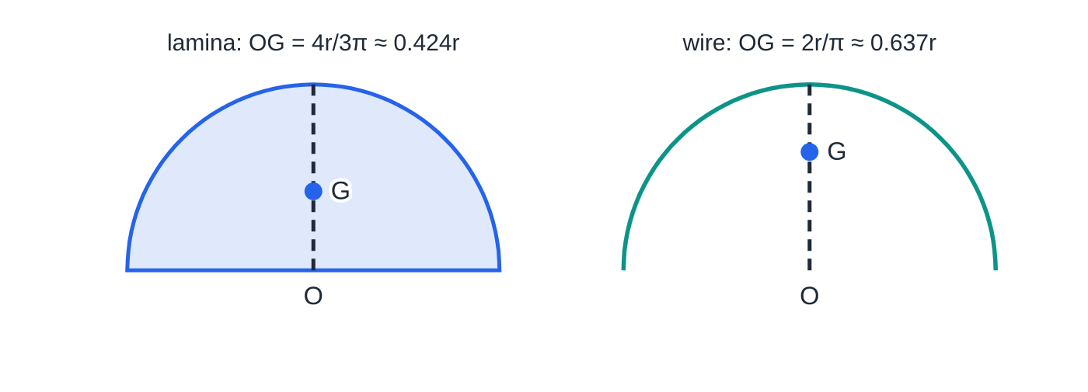
Where are the centres of mass of the standard uniform shapes? (continued)
Section 3 of 13
A semicircular lamina and a semicircular wire of the same radius. The wire has all its mass on the rim, so its centre of mass is further from O; neither G lies on the straight edge.
Notes:
Where are the centres of mass of the standard uniform shapes?. Full notes: https://examinerprep.com/notes/edexcel-ial-maths/centres-of-mass/

Slide 15
Where are the centres of mass of the standard uniform shapes? (continued)
Section 3 of 13
Uniform body | Position of the centre of mass | In the formulae booklet?
Rectangle, circle (lamina); straight rod | at the centre / midpoint, by symmetry | No — use symmetry
Triangular lamina | ⅔ along each median from the vertex; mean of the vertices | Yes
Sector of a circle, radius r, angle 2α | 2rsin α/3α from the centre, on the axis of symmetry | Yes
Semicircular lamina, radius r | 4r/3π from the centre, on the axis of symmetry | Yes — the sector with α=π/2
Circular arc (wire), radius r, angle 2α | rsin α/α from the centre, on the axis of symmetry | Yes
Semicircular arc (wire), radius r | 2r/π from the centre, on the axis of symmetry | Yes — the arc with α=π/2
Notes:
Where are the centres of mass of the standard uniform shapes?. Full notes: https://examinerprep.com/notes/edexcel-ial-maths/centres-of-mass/

Slide 16
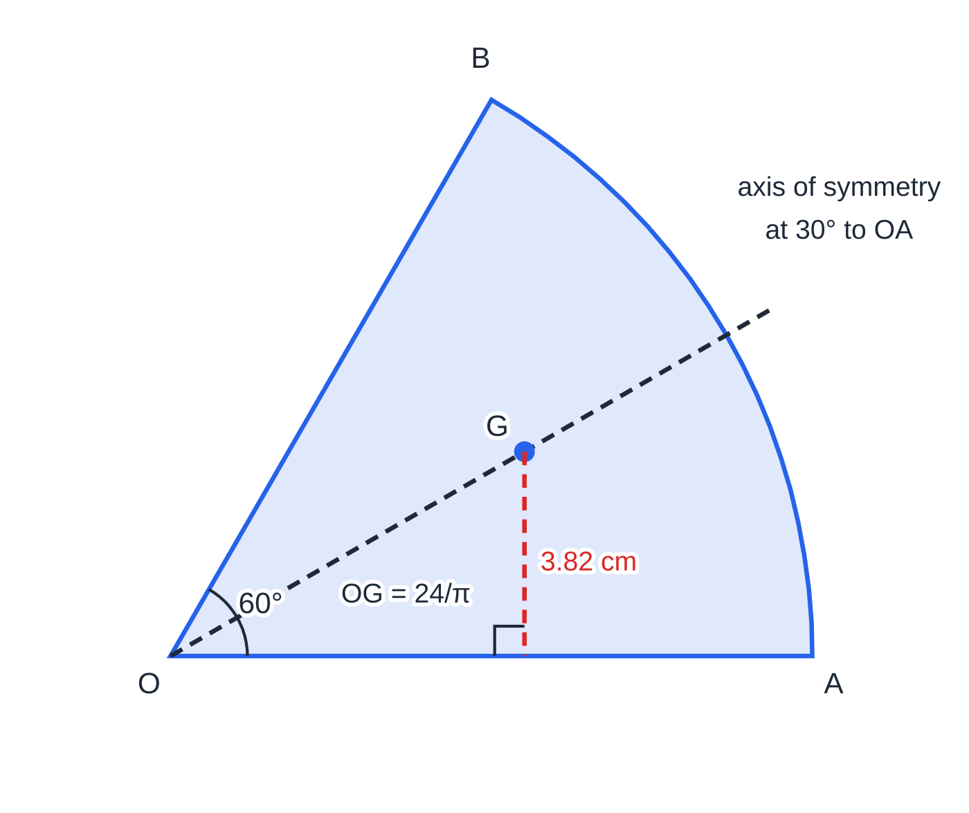
Where are the centres of mass of the standard uniform shapes? (continued)
Section 3 of 13 · Worked example 3 · Medium · Find
WORKED EXAMPLE · QUESTION
A uniform lamina OAB is a sector of a circle with centre O, radius 12 cm and angle AOB = 60°. G is its centre of mass. (a) Find the exact distance OG. (b) Find the distance of G from the edge OA, correct to 3 significant figures.
SOLUTION
(a) The angle at the centre is 2α=60°, so α=π/6. Then OG=(2×12×sin(π/6))/(3×π/6)=12/(π/2)= 24/π cm (7.64 cm)
(b) G lies on the line of symmetry, at 30° to OA. Distance from OA =OGsin 30°=12/π= 3.82 cm
The 60° sector. G lies on the axis of symmetry, which makes 30° with OA, so its distance from OA is OG sin 30°.
Notes:
Where are the centres of mass of the standard uniform shapes?: Worked example 3. Full notes: https://examinerprep.com/notes/edexcel-ial-maths/centres-of-mass/

Slide 17
Where are the centres of mass of the standard uniform shapes? (continued)
Section 3 of 13
Common error
Using the whole angle at the centre (60° here) as α, or putting α in degrees. With α=60 in the denominator the answer is wildly too small; with α=π/3 it is the centre of mass of a 120° sector.
Notes:
Where are the centres of mass of the standard uniform shapes?. Full notes: https://examinerprep.com/notes/edexcel-ial-maths/centres-of-mass/

Slide 18
How do you deal with a composite lamina or a part removed?
Section 4 of 13
Most lamina questions use a shape made from standard pieces. The method is to split the lamina into pieces whose centres of mass you know. Each piece then behaves like a particle placed at its own centre of mass, with "mass" proportional to its area. After that it is the particle calculation again.
Organise the working in a table: one row for each piece (area, x, y) and a final row for the whole lamina (total area, x̄, ȳ). Then write one moment equation for each direction you need.
A hole or a removed piece is handled by thinking of it as (whole) − (removed) = (remaining). In the table the removed piece gets a negative area, so the moment equation reads: moment of remainder = moment of whole − moment of removed piece. Before any of this, use symmetry: it often gives one coordinate with no working at all.
If the lamina has mass M, each piece has mass M× (its area ÷ total area). For the position of the centre of mass only the areas matter, but you will need actual masses later when weights appear in a moments equation.
Notes:
How do you deal with a composite lamina or a part removed?. Full notes: https://examinerprep.com/notes/edexcel-ial-maths/centres-of-mass/

Slide 19
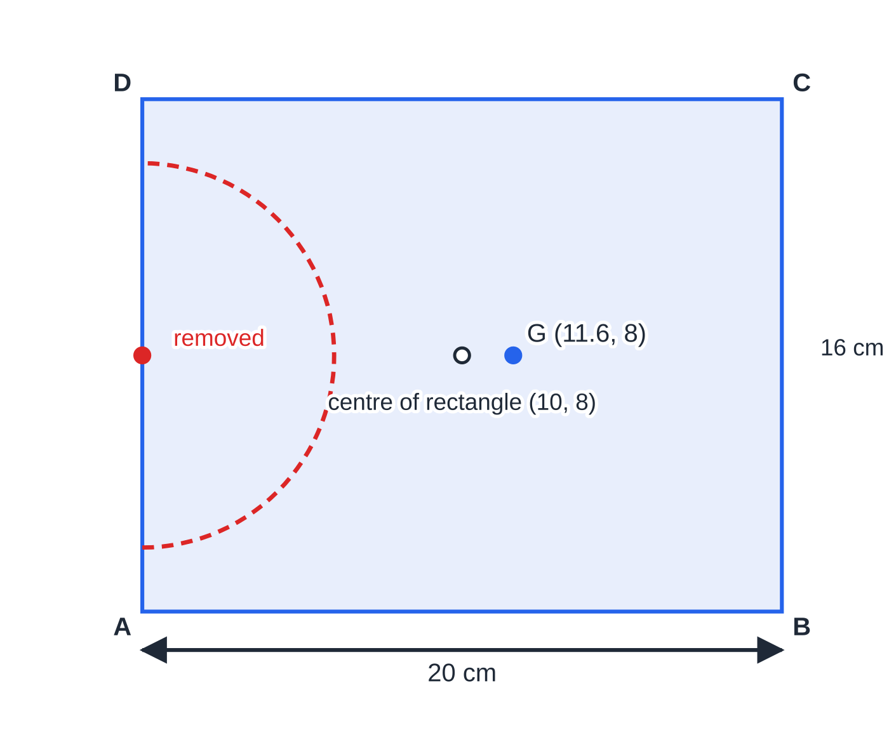
How do you deal with a composite lamina or a part removed? (continued)
Section 4 of 13
Worked example 4 to scale. Removing material from the left-hand side moves the centre of mass to the right of the centre of the rectangle, from x = 10 to x ≈ 11.6.
Notes:
How do you deal with a composite lamina or a part removed?. Full notes: https://examinerprep.com/notes/edexcel-ial-maths/centres-of-mass/

Slide 20
How do you deal with a composite lamina or a part removed? (continued)
Section 4 of 13 · Worked example 4 · Medium · Find
WORKED EXAMPLE · QUESTION
A uniform rectangular lamina ABCD has AB = 20 cm and AD = 16 cm. A semicircle of radius 6 cm, whose diameter lies along AD and whose centre is the midpoint of AD, is removed. Find the exact distance of the centre of mass of the remaining lamina from AD, and give it to 3 significant figures.
SOLUTION
Step 1 Symmetry about the line through the midpoints of AD and BC gives ȳ=8 cm (measured from AB). Take x as the distance from AD.
Piece | Area (cm²) | Distance from AD (cm)
rectangle | 320 | 10
semicircle (removed) | -½π(6)²=-18π | 4(6)/3π=8/π
remainder | 320-18π | x̄
Notes:
How do you deal with a composite lamina or a part removed?: Worked example 4. Full notes: https://examinerprep.com/notes/edexcel-ial-maths/centres-of-mass/

Slide 21
How do you deal with a composite lamina or a part removed? (continued)
Section 4 of 13 · Worked example 4 · Medium · Find (continued)
Step 2 Moments about AD: (320-18π)x̄=320×10-18π×8/π=3200-144=3056.
So x̄=3056/(320-18π)= 1528/(160-9π) cm =11.6 cm (3 s.f.)
Notice how the π cancels in the moment of the semicircle: area × distance =18π×8/π=144. That always happens with a semicircle, so exact answers stay tidy.
Notes:
How do you deal with a composite lamina or a part removed?: Worked example 4. Full notes: https://examinerprep.com/notes/edexcel-ial-maths/centres-of-mass/

Slide 22
How do you deal with a composite lamina or a part removed? (continued)
Section 4 of 13
Exam tip
For "show that" and "find the exact distance" questions, keep π in the working until the very last line. A table with a heading row is clear method even if an arithmetic slip follows.
Notes:
How do you deal with a composite lamina or a part removed?. Full notes: https://examinerprep.com/notes/edexcel-ial-maths/centres-of-mass/

Slide 23
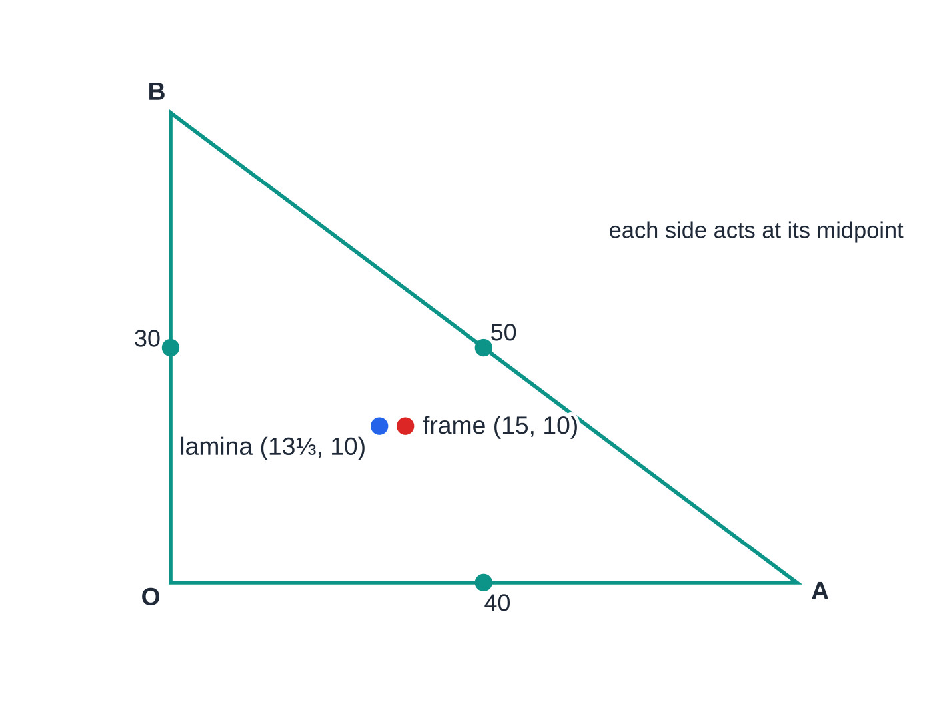
How is a wire framework different from a lamina?
Section 5 of 13
A framework is made from uniform wire or thin uniform rods. The mass of each piece is proportional to its length, not to any area, because there is no material inside the outline. Each straight piece acts at its midpoint, and each curved piece acts at the arc result rsin α/α from its centre.
This changes the answer. A triangular framework does not have its centre of mass at the centroid of the triangle unless the triangle is equilateral: the longest side carries the most mass and pulls the centre of mass towards itself. Pieces described as "light" have no mass and are left out, and a particle fixed to a framework is just another row in the table.
The same right-angled triangle as a uniform wire framework (red point) and as a uniform lamina (blue point). The framework's centre of mass is pulled towards the long side AB.
Notes:
How is a wire framework different from a lamina?. Full notes: https://examinerprep.com/notes/edexcel-ial-maths/centres-of-mass/

Slide 24
How is a wire framework different from a lamina? (continued)
Section 5 of 13 · Worked example 5 · Medium · Find
WORKED EXAMPLE · QUESTION
A uniform wire of length 120 cm is bent into the shape of a triangle OAB with OA = 40 cm, OB = 30 cm, AB = 50 cm and angle AOB = 90°. Taking O as origin, OA along the x-axis and OB along the y-axis, find the coordinates of the centre of mass of the framework, and compare it with the centre of mass of a uniform triangular lamina OAB.
SOLUTION
Step 1 Each side acts at its midpoint, with mass proportional to its length.
Side | Length (cm) | Midpoint
OA | 40 | (20, 0)
OB | 30 | (0, 15)
AB | 50 | (20, 15)
Notes:
How is a wire framework different from a lamina?: Worked example 5. Full notes: https://examinerprep.com/notes/edexcel-ial-maths/centres-of-mass/

Slide 25
How is a wire framework different from a lamina? (continued)
Section 5 of 13 · Worked example 5 · Medium · Find (continued)
Step 2 Moments: 120x̄=40(20)+30(0)+50(20)=1800, so x̄=15. 120ȳ=40(0)+30(15)+50(15)=1200, so ȳ=10. The framework's centre of mass is at (15, 10)
Step 3 The lamina's centre of mass is the mean of the vertices: ((0+40+0)/3,(0+0+30)/3)=(13⅓, 10). The framework's centre of mass is 1⅔ cm further from OB than the lamina's: a different body, a different answer.
Notes:
How is a wire framework different from a lamina?: Worked example 5. Full notes: https://examinerprep.com/notes/edexcel-ial-maths/centres-of-mass/

Slide 26
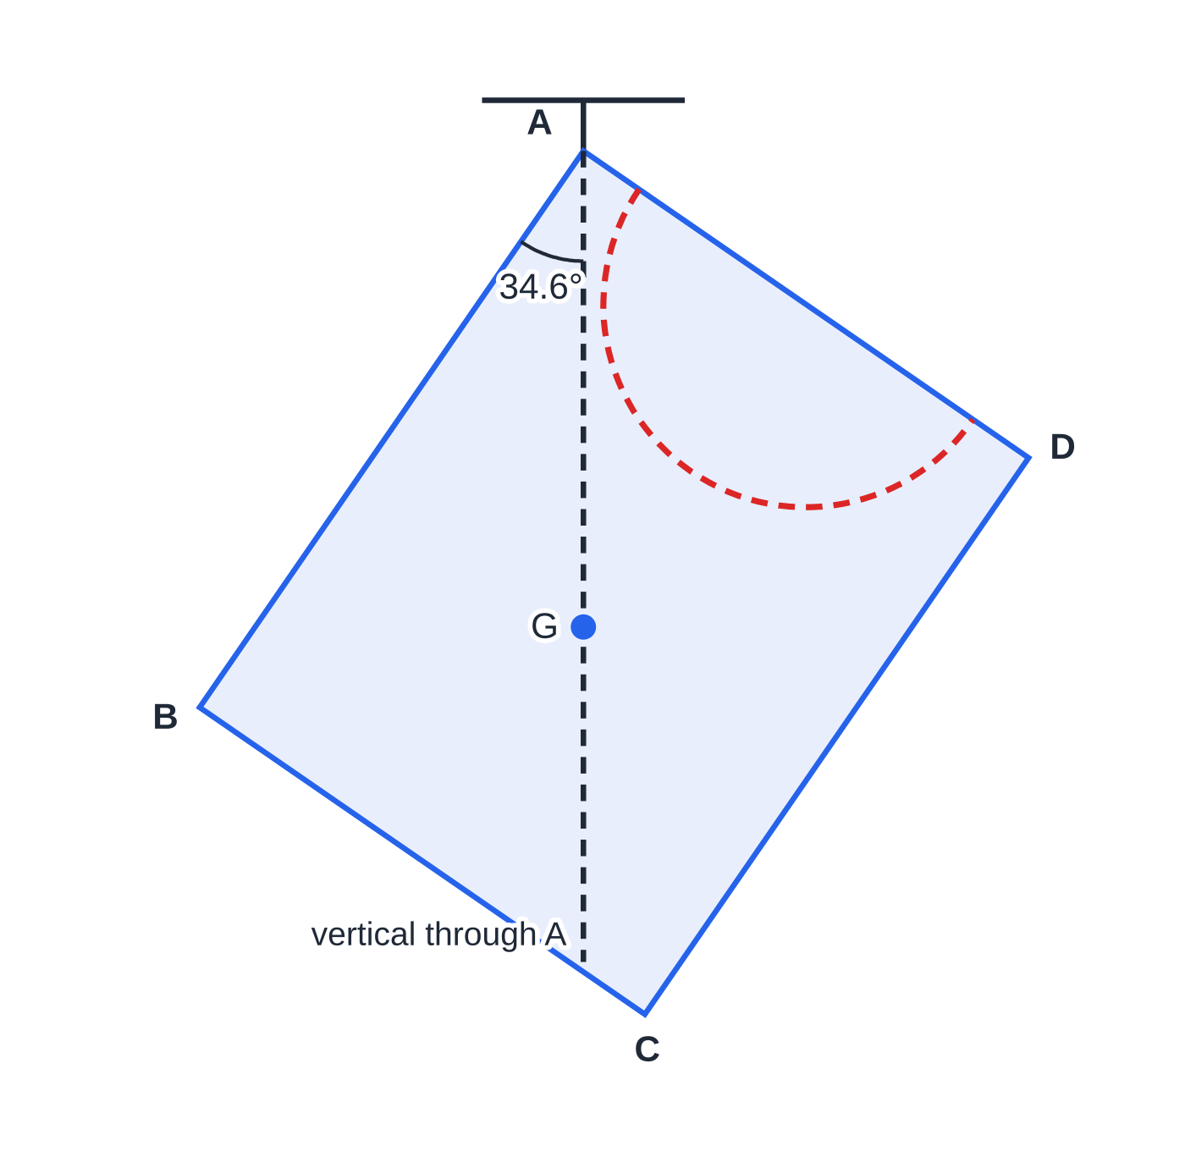
How does a lamina hang when it is suspended from a point?
Section 6 of 13
A lamina hanging freely from a point P has only two forces on it: its weight, acting at G, and the force at P. Two forces can only be in equilibrium if they are equal, opposite and act along the same line. The weight is vertical, so the line PG must be vertical: G is vertically below P. The same rule fixes how a lamina hangs from a string attached at P.
To find the angle that a line PQ of the lamina makes with the vertical, draw the line PG, which is vertical, and find the angle between PQ and PG. Usually this is one right-angled triangle built from the coordinates of G. If particles are attached to the lamina, use the centre of mass of the whole system, lamina plus particles.
The lamina of worked example 4 hanging from A. G is directly below A; the angle between AB and the vertical is the angle between AB and AG.
Notes:
How does a lamina hang when it is suspended from a point?. Full notes: https://examinerprep.com/notes/edexcel-ial-maths/centres-of-mass/

Slide 27
How does a lamina hang when it is suspended from a point? (continued)
Section 6 of 13 · Worked example 6 · Medium · Find
WORKED EXAMPLE · QUESTION
The lamina from worked example 4 is freely suspended from A and hangs in equilibrium. Find the angle between AB and the vertical.
SOLUTION
Step 1 G is 11.60 cm from AD (so 11.60 cm along AB from A) and 8 cm from AB.
Step 2 AG is vertical, so the required angle is angle GAB: tan θ=(8/11.60), giving θ=34.6°
Sketch first: AB goes down to one side of the vertical, and G must lie inside the angle between AB and AD.
Notes:
How does a lamina hang when it is suspended from a point?: Worked example 6. Full notes: https://examinerprep.com/notes/edexcel-ial-maths/centres-of-mass/

Slide 28
How does a lamina hang when it is suspended from a point? (continued)
Section 6 of 13
Common error
Writing the tangent upside down. The angle at A between AB and AG has opposite = distance of G from AB and adjacent = distance of G along AB. Mark both on a sketch before writing tan θ.
Notes:
How does a lamina hang when it is suspended from a point?. Full notes: https://examinerprep.com/notes/edexcel-ial-maths/centres-of-mass/

Slide 29
What happens when a lamina can turn about a fixed horizontal axis?
Section 7 of 13
Questions often say that a lamina is "free to rotate about a fixed smooth horizontal axis through P, perpendicular to the lamina". With no other forces, this behaves exactly like a lamina hanging from P: it rests with the centre of mass of the system vertically below P.
To make it rest in a chosen position, for example with a given edge horizontal, a particle is attached so that the combined centre of mass moves onto the vertical through P. There are two equivalent ways to write the equation. Either find the combined centre of mass and say it lies on the vertical through P, or take moments about the axis: the moment of the lamina's weight must balance the moment of the particle's weight. Both give the same equation.
The force from a smooth axis passes through the axis, so it has no moment about it. If only vertical forces act, the axis supplies a vertical force equal to the total weight.
Notes:
What happens when a lamina can turn about a fixed horizontal axis?. Full notes: https://examinerprep.com/notes/edexcel-ial-maths/centres-of-mass/

Slide 30
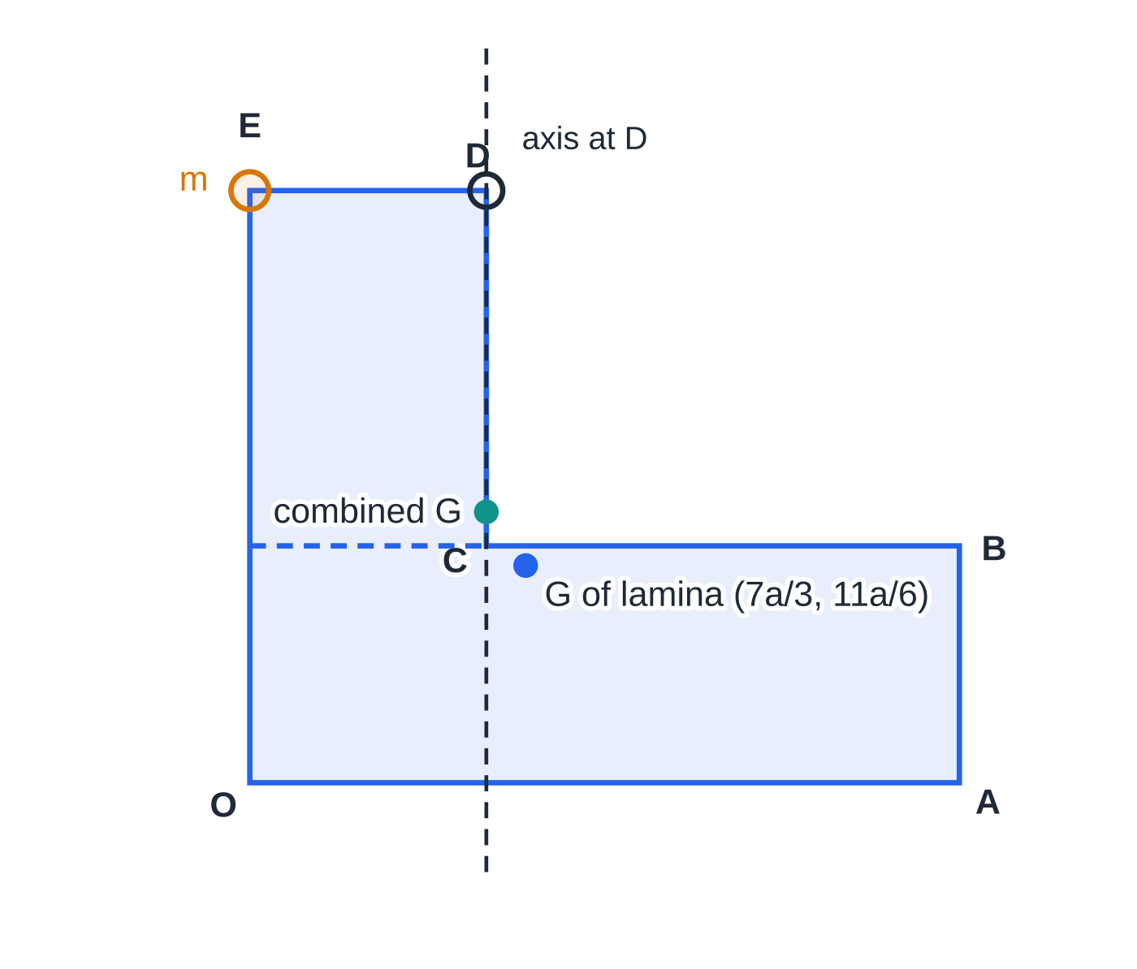
What happens when a lamina can turn about a fixed horizontal axis? (continued)
Section 7 of 13
Worked example 7(c) to scale (lengths in units of a). The particle at E moves the combined centre of mass onto the vertical through the axis at D, so DE rests horizontal.
Notes:
What happens when a lamina can turn about a fixed horizontal axis?. Full notes: https://examinerprep.com/notes/edexcel-ial-maths/centres-of-mass/

Slide 31
What happens when a lamina can turn about a fixed horizontal axis? (continued)
Section 7 of 13 · Worked example 7 · Hard · Show that, find
WORKED EXAMPLE · QUESTION
A uniform L-shaped lamina OABCDE, of mass M, has vertices O(0, 0), A(6a, 0), B(6a, 2a), C(2a, 2a), D(2a, 5a) and E(0, 5a). (a) Show that the centre of mass of the lamina is at (7a/3,11a/6). (b) The lamina is freely suspended from E and hangs in equilibrium. Find the angle between EO and the vertical. (c) The lamina is now free to rotate in a vertical plane about a fixed smooth horizontal axis through D, perpendicular to the lamina. A particle of mass m is attached at E, and the lamina rests in equilibrium with DE horizontal. Find m in terms of M.
SOLUTION
(a) Split into two rectangles, with F = (0, 2a).
Piece | Area | x | y
OABF, 6a×2a | 12a² | 3a | a
FCDE, 2a×3a | 6a² | a | 3.5a
Notes:
What happens when a lamina can turn about a fixed horizontal axis?: Worked example 7. Full notes: https://examinerprep.com/notes/edexcel-ial-maths/centres-of-mass/

Slide 32
What happens when a lamina can turn about a fixed horizontal axis? (continued)
Section 7 of 13 · Worked example 7 · Hard · Show that, find (continued)
Piece | Area | x | y
lamina | 18a² | x̄ | ȳ
18a²x̄=36a³+6a³=42a³, so x̄=7a/3. 18a²ȳ=12a³+21a³=33a³, so ȳ=11a/6, as required
(b) G is vertically below E. Relative to E, G is 7a/3 across and 5a-11a/6=19a/6 down (along EO). So tan θ=(7a/3)/(19a/6)=(14/19), giving θ=36.4°
(c) With DE horizontal the lamina is in the position shown, and the combined centre of mass must be vertically below D, at x=2a. Moments about the vertical through D: Mg(7a/3-2a)=mg(2a-0), so Ma/3=2ma and m=M/6
Check that the position really hangs: the combined centre of mass is at height (M×11a/6+M/6×5a)÷7M/6=16a/7, below D (at 5a). The axis then supplies a vertical force of 7Mg/6.
Notes:
What happens when a lamina can turn about a fixed horizontal axis?: Worked example 7. Full notes: https://examinerprep.com/notes/edexcel-ial-maths/centres-of-mass/

Slide 33
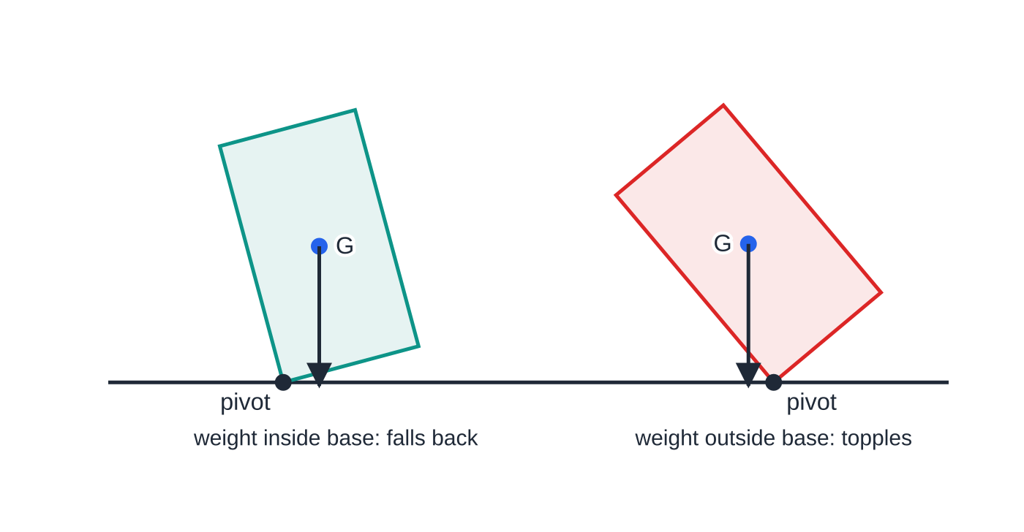
When does a lamina on an inclined plane topple?
Section 8 of 13
Picture a lamina standing in a vertical plane with one edge on a rough plane inclined at α. Its weight acts vertically downwards through G. While the vertical line through G passes inside the edge in contact, the weight has a moment that holds the lamina against the plane, and it stays upright (as long as it does not slide). Once the vertical through G passes outside the lowest point of contact, the weight has a moment that turns the lamina over that point.
The test for toppling. If the vertical through G falls inside the base, the weight turns the body back; if it falls outside the pivot, the weight turns it over.
Notes:
When does a lamina on an inclined plane topple?. Full notes: https://examinerprep.com/notes/edexcel-ial-maths/centres-of-mass/

Slide 34
When does a lamina on an inclined plane topple? (continued)
Section 8 of 13
So the lamina is about to topple about the lowest point of contact P when the vertical through G passes through P. If G is a distance h from the plane and a distance d up the slope from P (both measured in the lamina), the critical angle is given by
tan α=d/h.
The lamina might slide before it topples. From M1, a block on the point of sliding has F=μR, which on a plane gives tan α=μ. It slides when tan α>μ. The question "slide or topple?" is therefore a comparison of two critical angles: whichever is smaller is reached first as the plane is tilted.
Notes:
When does a lamina on an inclined plane topple?. Full notes: https://examinerprep.com/notes/edexcel-ial-maths/centres-of-mass/

Slide 35
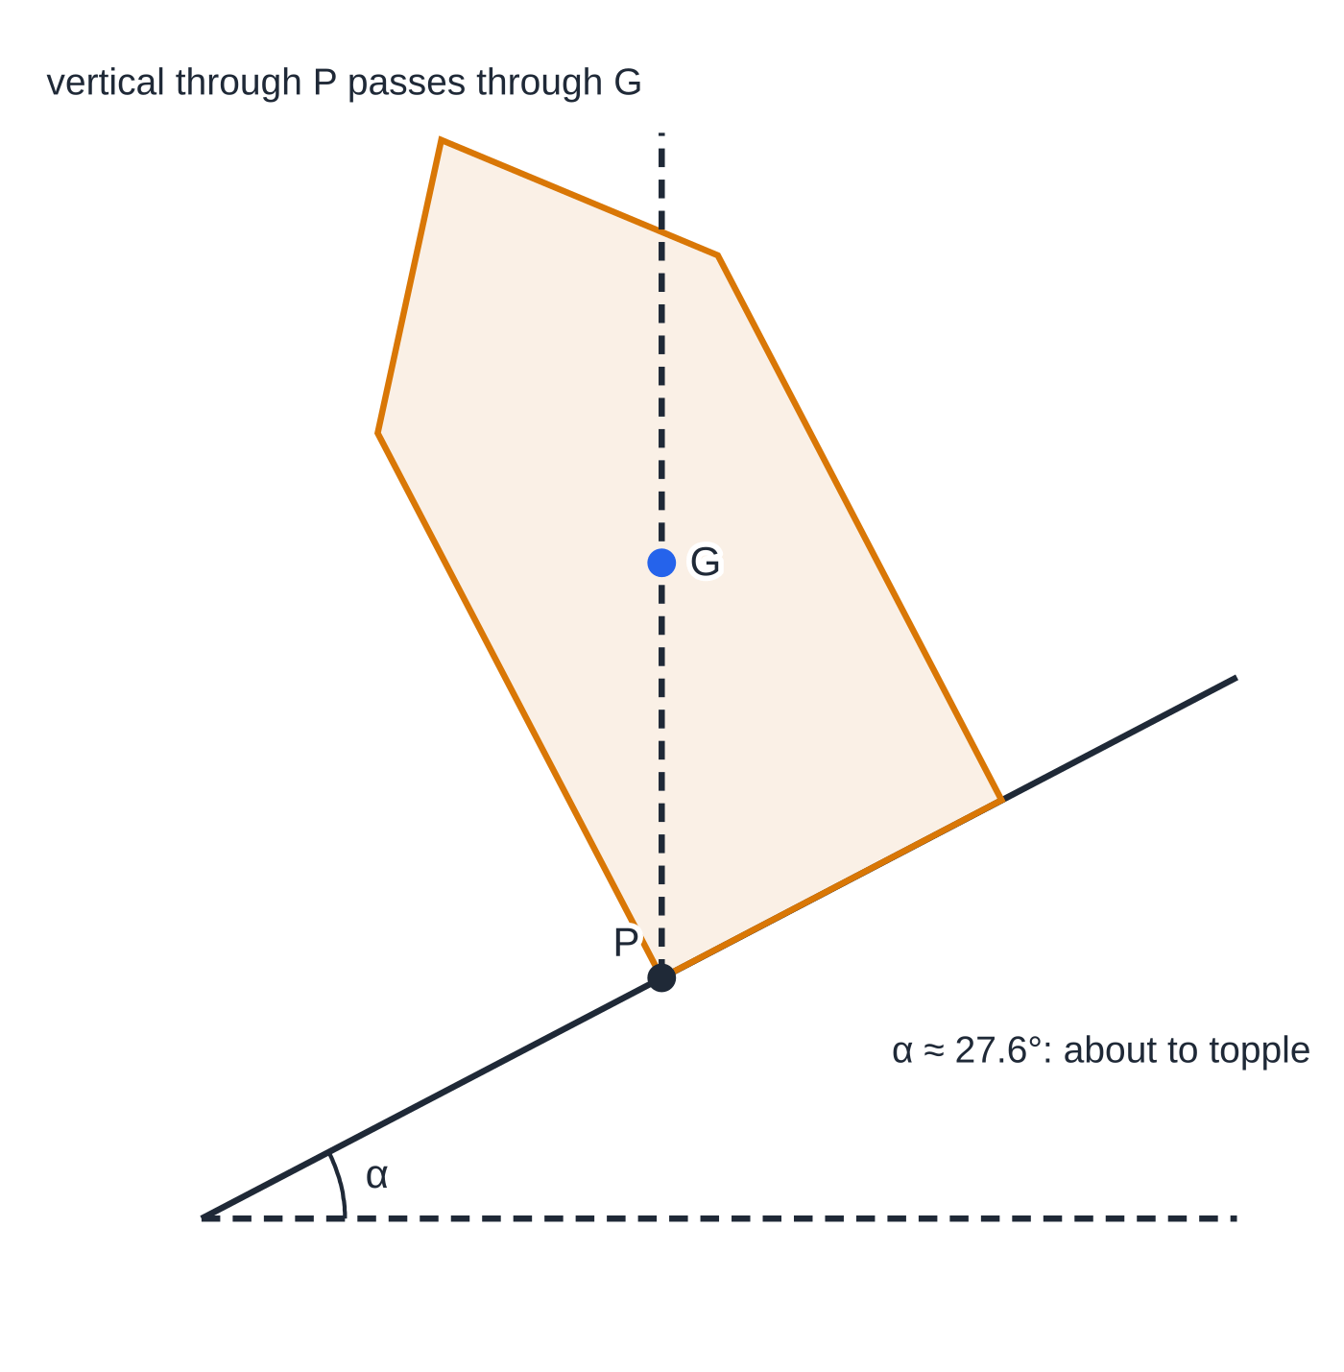
When does a lamina on an inclined plane topple? (continued)
Section 8 of 13 · Worked example 8 · Hard · Determine
WORKED EXAMPLE · QUESTION
A uniform lamina is a rectangle 10 cm wide and 16 cm tall, with an isosceles triangle of base 10 cm and height 6 cm fixed along its top edge (a "house" shape). It stands in a vertical plane with its 10 cm base on a rough plane, along a line of greatest slope. The coefficient of friction is 0.6. The angle of the plane is slowly increased from zero. (a) Find the distance of the centre of mass from the base. (b) Determine whether the lamina slides or topples first.
SOLUTION
(a) Symmetry puts G on the central vertical line. The centroid of the triangle is ⅓ of its height above its base, at 16+6/3=18 cm. Moments about the base:
Worked example 8 at the critical angle: G lies vertically above the lower corner P.
Notes:
When does a lamina on an inclined plane topple?: Worked example 8. Full notes: https://examinerprep.com/notes/edexcel-ial-maths/centres-of-mass/

Slide 36
When does a lamina on an inclined plane topple? (continued)
Section 8 of 13 · Worked example 8 · Hard · Determine (continued)
(160+30)ȳ=160×8+30×18=1280+540=1820, so ȳ=(1820/190)=(182/19)= 9.58 cm
(b) About to topple when G is vertically above the lower corner, which is 5 cm along the base from G's line: tan α=5/(182/19)=(95/182)=0.522, so α=27.6°.
Sliding needs tan α>0.6, that is α>31.0°. Since 0.522<0.6, the toppling angle is reached first: the lamina topples (at about 27.6°)
Notes:
When does a lamina on an inclined plane topple?: Worked example 8. Full notes: https://examinerprep.com/notes/edexcel-ial-maths/centres-of-mass/

Slide 37
Exam tips for M2.3
Section 9 of 13
Exam tip 1 — always draw the table
Pieces in rows, with area (or length, or mass) and the coordinates of each piece's centre of mass, then a final row for the whole. It organises the working and shows clear method even when a number goes wrong.
Exam tip 2 — say which way you measure
State the origin and axes ("distance from AD", "taking O as origin") before the calculation. A correct number measured from the wrong edge is still a wrong answer.
Exam tip 3 — symmetry first
Write "by symmetry, ȳ=8" as a line of working. It is quicker than a second moment equation, and it counts as working in its own right.
Notes:
Exam tips for M2.3. Full notes: https://examinerprep.com/notes/edexcel-ial-maths/centres-of-mass/

Slide 38
Exam tips for M2.3 (continued)
Section 9 of 13
Exam tip 4 — suspension questions need a sketch
Mark the point of suspension, G, and the line whose angle you want. Then the angle is in one right-angled triangle, and the sketch tells you which length is opposite and which is adjacent.
Exam tip 5 — topple versus slide is a comparison
Find both critical values (tan α=d/h for toppling, tan α=μ for sliding), compare them, and finish with a sentence saying which happens first.
Notes:
Exam tips for M2.3. Full notes: https://examinerprep.com/notes/edexcel-ial-maths/centres-of-mass/

Slide 39
Common misconceptions
Section 10 of 13
Misconception | Why it is wrong | Correct idea
A hole can be ignored if it is small. | Any removed area changes the moment and the total area. | Enter the removed piece with a negative area; subtract its moment and its area.
A triangular frame has the same centre of mass as a triangular lamina. | A frame's mass is in its sides, proportional to their lengths. | Frame: weight the midpoints by length. Lamina: mean of the vertices.
In the sector formula, α is the angle of the sector. | The formula is written for a sector of angle 2α. | Use half the angle at the centre, in radians.
The centre of mass must be inside the body. | It is a weighted mean position; it need not be on the material (an L-shape, a ring, an arc). | Calculate it; never assume it lies on the lamina.
A hanging lamina rests with an edge vertical. | Only the line from the point of suspension to G is vertical. | Find the angle between the given edge and the line PG.
Notes:
Common misconceptions. Full notes: https://examinerprep.com/notes/edexcel-ial-maths/centres-of-mass/

Slide 40
Common misconceptions (continued)
Section 10 of 13
Misconception | Why it is wrong | Correct idea
A body on a slope topples as soon as it starts to slide. | Sliding depends on μ; toppling depends on the position of G. | Compare tan α=μ with tan α=d/h; the smaller angle wins.
Notes:
Common misconceptions. Full notes: https://examinerprep.com/notes/edexcel-ial-maths/centres-of-mass/

Slide 41
How this topic connects
Section 11 of 13
M1 Moments
The formula x̄=Σmx/Σm is a moments equation, and a non-uniform rod with an unknown centre of mass is the one-dimensional version of this topic.
M2.6 Statics of rigid bodies
Ladders, hinged rods and laminas held by strings all need the position of G before you can take moments: the weight always acts there.
M1 Friction, P3/P4 Integration and IAL Physics
The sliding half of a topple-or-slide question is the M1 limiting-friction condition F=μR, which on a plane gives tan α=μ. The standard results in the formulae booklet come from integrating, and in Physics the same point is the centre of gravity, used for the stability and toppling of real objects.
Notes:
How this topic connects. Full notes: https://examinerprep.com/notes/edexcel-ial-maths/centres-of-mass/

Slide 42
Key formulae
Section 12 of 13
Formula | Use | In the formulae list?
x̄=Σmx/Σm, ȳ=Σmy/Σm | particles; pieces of a composite body | No — learn it
r̄=Σmr/Σm | particles given by position vectors | No — learn it
triangle: ⅔ along median from vertex; ((x₁+x₂+x₃)/3,(y₁+y₂+y₃)/3) | triangular laminas | Yes (the ⅔ result); the vertex mean follows from it
sector: 2rsin α/3α from centre | sectors; semicircle 4r/3π | Yes
arc: rsin α/α from centre | curved wires; semicircular arc 2r/π | Yes
suspended from P: PG vertical, tan θ= (distance of G from the line) ÷ (distance along the line) | angle of a line with the vertical | No — derive it
Notes:
Key formulae. Full notes: https://examinerprep.com/notes/edexcel-ial-maths/centres-of-mass/

Slide 43
Key formulae (continued)
Section 12 of 13
Formula | Use | In the formulae list?
about to topple: tan α=d/h | lamina on an inclined plane | No — derive it
about to slide: tan α=μ | comparing with toppling | No — derive it from F=μR
Notes:
Key formulae. Full notes: https://examinerprep.com/notes/edexcel-ial-maths/centres-of-mass/

Slide 44
Check your understanding
Section 13 of 13
1. Particles of mass 1 kg, 2 kg and 3 kg are at x=0, 3 and 6 on a light rod. Where is their centre of mass?
2. A uniform wire is bent into a semicircular arc of radius 10 cm. How far is its centre of mass from the centre of the circle?
3. Find the centre of mass of a uniform triangular lamina with vertices (0, 0), (6, 0) and (3, 9).
4. A uniform rectangular lamina PQRS has PQ = 10 cm and QR = 6 cm. It hangs freely from P. What angle does PQ make with the vertical?
5. A uniform lamina is a sector of radius 6 cm with angle 90° at the centre. Find the exact distance of its centre of mass from the centre.
6. Why does a disc with a hole cut off-centre have its centre of mass on the opposite side of the centre from the hole?
Notes:
Check your understanding: questions. Full notes: https://examinerprep.com/notes/edexcel-ial-maths/centres-of-mass/

Slide 45
Check your understanding · answers
Section 13 of 13
1. Σmx=0+6+18=24 and Σm=6, so x̄=4.
2. 2r/π=20/π≈6.37 cm, on the axis of symmetry — not on the wire itself.
3. The mean of the vertices: ((0+6+3)/3,(0+0+9)/3)=(3, 3).
4. G is 5 cm along PQ from P and 3 cm from PQ, so tan θ=(3/5) and θ≈31.0°.
5. 2α=π/2, so α=π/4. Distance =(2×6×sin(π/4))/(3×π/4)=6√2/(3π/4)=8√2/π≈3.60 cm, along the axis of symmetry.
6. The full disc balances about its centre. Removing mass from one side leaves more mass on the other side, so the weighted mean position moves away from the hole — in the table the hole has a negative area.
Notes:
Check your understanding: answers. Full notes: https://examinerprep.com/notes/edexcel-ial-maths/centres-of-mass/

Slide 46
Practice questions
2 original exam-style questions. Answers at the end of the deck.

Slide 47
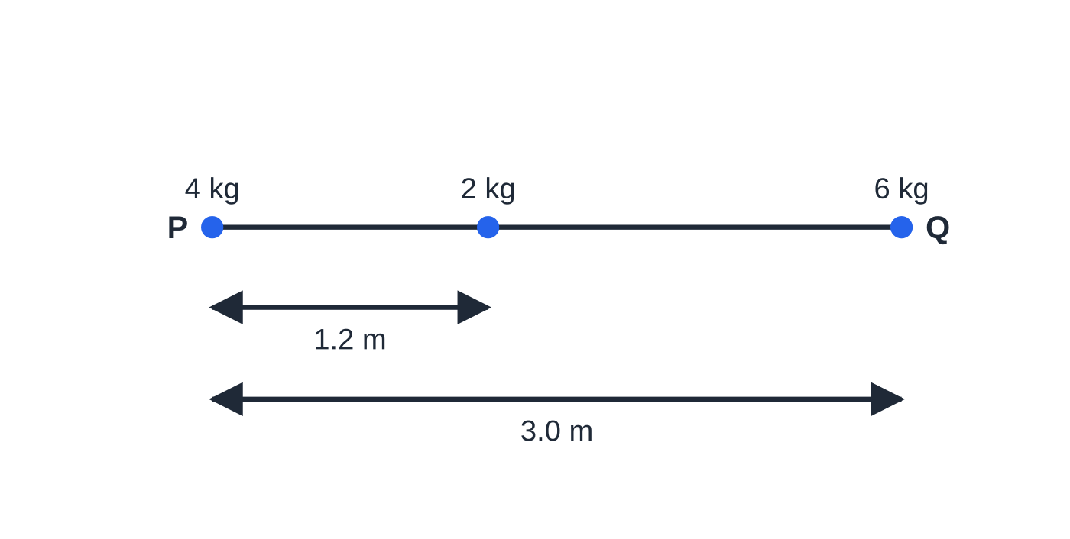
Question 1
5 marks
A light rod PQ has length 3.0 m. Particles of mass 4 kg, 2 kg and 6 kg are attached to the rod at P, at the point 1.2 m from P, and at Q respectively. The particles are modelled as point masses.
Figure: the light rod PQ with the three particles attached; not to scale.
(a) Find the distance of the centre of mass of the system from P. [2]
(b) The 2 kg particle is moved to a new position on the rod so that the centre of mass of the system is 1.6 m from P. Find the distance of the new position from P. [3]
Notes:
Online with the full mark scheme: https://examinerprep.com/ial-maths-m2-3-centres-of-mass-questions#IALM-M2-3-B-01

Slide 48
Question 2
7 marks
Three particles have masses 3 kg, 5 kg and 2 kg. Their position vectors are (2i + j) m, (−i + 4j) m and (6i − 3j) m respectively.
(a) Find the position vector of the centre of mass of the three particles. [3]
(b) A fourth particle, of mass m kg, is placed at the point with position vector (4i + kj) m. The centre of mass of the four particles is at the point with position vector (2.5i + 2.5j) m. Find the value of m and the value of k. [4]
Notes:
Online with the full mark scheme: https://examinerprep.com/ial-maths-m2-3-centres-of-mass-questions#IALM-M2-3-B-02

Slide 49
Answers

Slide 50
Question 1 · answer
Mark scheme
moments about P: 12x̄ = 4(0) + 2(1.2) + 6(3.0)
x̄ = 20.4 ÷ 12 = 1.7 m
new moment equation: 12 × 1.6 = 2d + 18
correct equation with 19.2
d = 0.6 m from P
Notes:
Full mark scheme: https://examinerprep.com/ial-maths-m2-3-centres-of-mass-questions#IALM-M2-3-B-01

Slide 51
Question 2 · answer
Mark scheme
Σmr = 3(2i + j) + 5(−i + 4j) + 2(6i − 3j)
= 13i + 17j
r̄ = (13i + 17j) ÷ 10 = (1.3i + 1.7j) m
i: 13 + 4m = 2.5(10 + m)
m = 8
j: 17 + 8k = 2.5 × 18
k = 3.5
Notes:
Full mark scheme: https://examinerprep.com/ial-maths-m2-3-centres-of-mass-questions#IALM-M2-3-B-02

Slide 52
Keep practising
Notes for this topic
Questions on this topic
Build a printable test
ExaminerPrep is an independent tutoring service. It has been developed independently from and is not endorsed by the International Baccalaureate Organization. "International Baccalaureate", "IB" and "IB Diploma Programme" are registered trademarks of the IBO, used here for descriptive purposes only.
Pearson Edexcel and Cambridge are trademarks of their owners; ExaminerPrep is not affiliated with any exam board.

