Slide 1
EP
EDEXCEL IAL MATHS
M2.5 Collisions and restitution
The full notes page in 11 sections · practice questions with answers · simulations
ExaminerPrep is an independent tutoring service. It has been developed independently from and is not endorsed by the International Baccalaureate Organization. "International Baccalaureate", "IB" and "IB Diploma Programme" are registered trademarks of the IBO, used here for descriptive purposes only.
Pearson Edexcel and Cambridge are trademarks of their owners; ExaminerPrep is not affiliated with any exam board.
Notes:
M2.5 Collisions and restitution. Notes for this topic: https://examinerprep.com/notes/edexcel-ial-maths/collisions-and-restitution/

Slide 2
What this page covers
Overview
Momentum as a vector and the impulse–momentum principle I=mv-mu with i and j components
Conservation of linear momentum, and the equal and opposite impulses in a collision
Newton's law of restitution for a direct impact between two particles, with 0≤e≤1
The kinetic energy lost in an impact
A particle striking a fixed smooth plane surface (a wall or the ground) at right angles
Successive impacts: up to three particles in a line, or two particles and a wall
Deciding whether any further collision happens
Notes:
What this page covers. Full notes: https://examinerprep.com/notes/edexcel-ial-maths/collisions-and-restitution/

Slide 3
In one minute
Key points
1. One number, the coefficient of restitution e, together with conservation of momentum, gives two equations for the two unknown velocities after any direct impact.
2. Impulse = change in momentum: I=mv-mu. It is a vector; work in i and j components. Unit N s.
3. In a collision the particles exert equal and opposite impulses on each other, so total momentum is conserved.
4. Newton's law of restitution: speed of separation = e × speed of approach, with 0≤e≤1.
5. e=1: perfectly elastic, no kinetic energy lost. e=0: the particles coalesce. Otherwise some kinetic energy is always lost.
6. Wall or ground (fixed, smooth, hit at right angles): rebound speed = e × impact speed.
7. Successive impacts: another collision happens only if a particle behind is moving faster (in the positive direction) than the one in front of it.
Notes:
In one minute. Full notes: https://examinerprep.com/notes/edexcel-ial-maths/collisions-and-restitution/

Slide 4
How do momentum and impulse work as vectors?
Section 1 of 11
M1 taught you that momentum is conserved. M2 adds two things: momentum in two dimensions, and the missing ingredient for collisions, which is how bouncy they are.
The momentum of a particle of mass m moving with velocity v is mv. It has the same direction as the velocity, and its unit is kg m s⁻¹, which is the same as N s. An impulse I acting on the particle changes its momentum. For a constant force F acting for time t, I=Ft; for a sudden blow you are usually given I directly.
I=mv-mu
Here u and v are the velocities just before and just after. This is not in the formulae booklet: learn it. Use it on one particle at a time. Because these are vectors, the equation holds component by component: the i parts balance and the j parts balance separately. Drawn head to tail, mu+I=mv forms a triangle, which is a useful check on directions.
Notes:
How do momentum and impulse work as vectors?. Full notes: https://examinerprep.com/notes/edexcel-ial-maths/collisions-and-restitution/

Slide 5
How do momentum and impulse work as vectors? (continued)
Section 1 of 11
In one dimension it becomes I=mv-mu with signs showing direction.
Notes:
How do momentum and impulse work as vectors?. Full notes: https://examinerprep.com/notes/edexcel-ial-maths/collisions-and-restitution/

Slide 6
How do momentum and impulse work as vectors? (continued)
Section 1 of 11 · Worked example 1 · Easy · Find
WORKED EXAMPLE · QUESTION
A particle of mass 0.4 kg is moving with velocity (5i-2j) m s⁻¹ on a smooth horizontal surface. It receives an impulse of (-3i+4j) N s. (a) Find the velocity of the particle immediately after the impulse. (b) Find its speed immediately after the impulse.
SOLUTION
(a) Momentum before: mu=0.4(5i-2j)=2i-0.8j. Since mv=mu+I: 0.4v=(2-3)i+(-0.8+4)j=-i+3.2j, so v=(-2.5i+8j) m s⁻¹
(b) |v|=√(2.5²+8²)=√70.25= 8.38 m s⁻¹
Notes:
How do momentum and impulse work as vectors?: Worked example 1. Full notes: https://examinerprep.com/notes/edexcel-ial-maths/collisions-and-restitution/

Slide 7
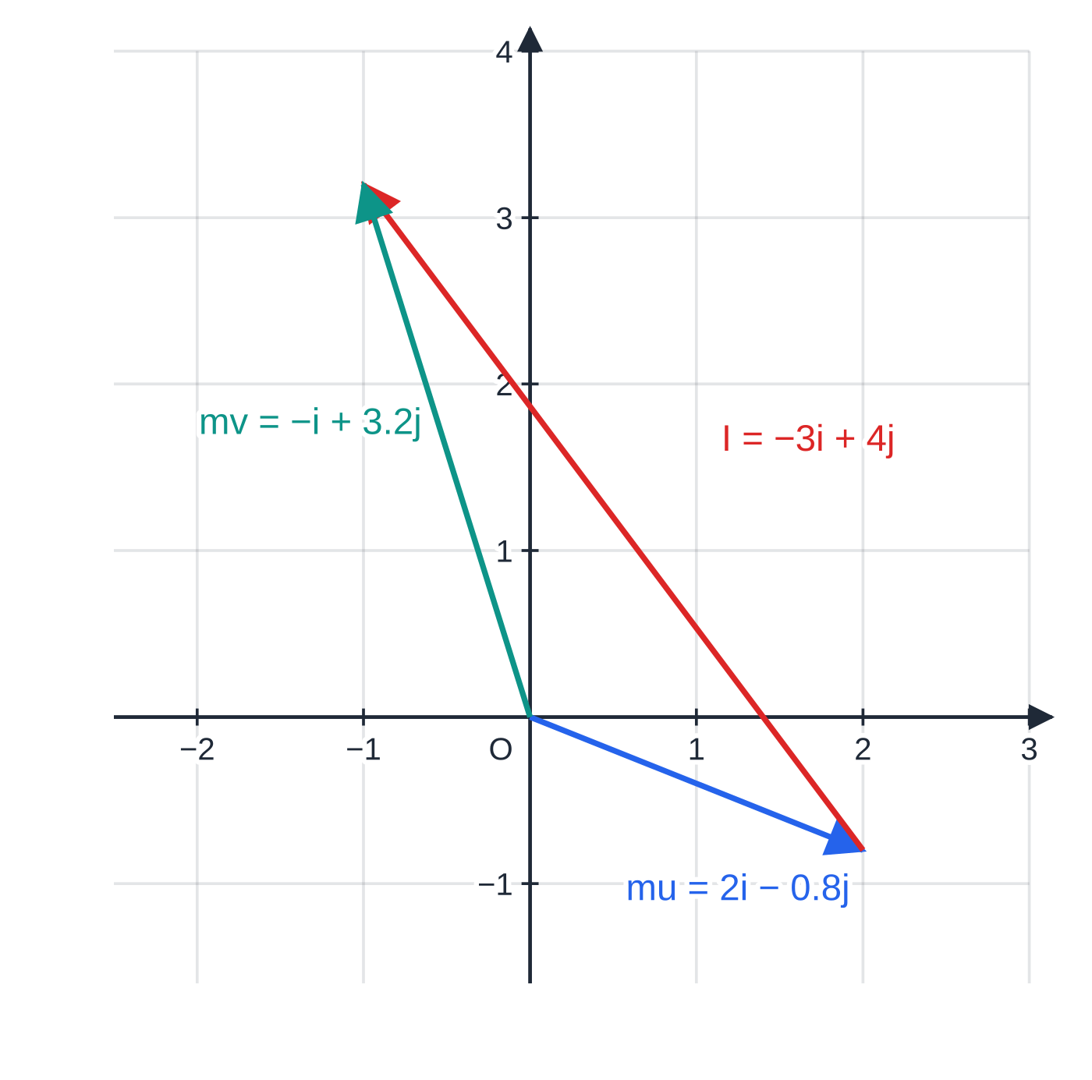
How do momentum and impulse work as vectors? (continued)
Section 1 of 11
Common error
Adding the impulse to the velocity: 5i-2j+(-3i+4j). The impulse changes momentum, so divide it by the mass first (or add it to mu).
Worked example 1 as a momentum triangle, to scale. The impulse, added head to tail to the momentum before, gives the momentum after.
Notes:
How do momentum and impulse work as vectors?. Full notes: https://examinerprep.com/notes/edexcel-ial-maths/collisions-and-restitution/

Slide 8
How do momentum and impulse work as vectors? (continued)
Section 1 of 11 · Worked example 2 · Medium · Find
WORKED EXAMPLE · QUESTION
A ball of mass 0.25 kg, modelled as a particle, is moving with velocity (6i+8j) m s⁻¹ when it is kicked. Immediately after the kick its velocity is (-9i+12j) m s⁻¹. Find (a) the impulse of the kick, (b) the magnitude of this impulse, (c) the angle through which the direction of motion of the ball is turned, (d) the kinetic energy gained by the ball.
SOLUTION
(a) I=m(v-u)=0.25(-15i+4j)= (-3.75i+j) N s
(b) |I|=√(3.75²+1²)= 3.88 N s
(c) The speeds are |u|=10 and |v|=15. By the scalar product, cos θ=(6(-9)+8(12))/(10×15)=(42/150)=0.28, so θ=73.7°. (Without the scalar product: the direction before is tan⁻¹(8/6)=53.1° above i; after, it is 180°-tan⁻¹(12/9)=126.9°; the difference is 73.7°.)
(d) Kinetic energy is a scalar, so use the speeds: ½(0.25)(15²-10²)=15.625 J ≈ 15.6 J
Notes:
How do momentum and impulse work as vectors?: Worked example 2. Full notes: https://examinerprep.com/notes/edexcel-ial-maths/collisions-and-restitution/

Slide 9
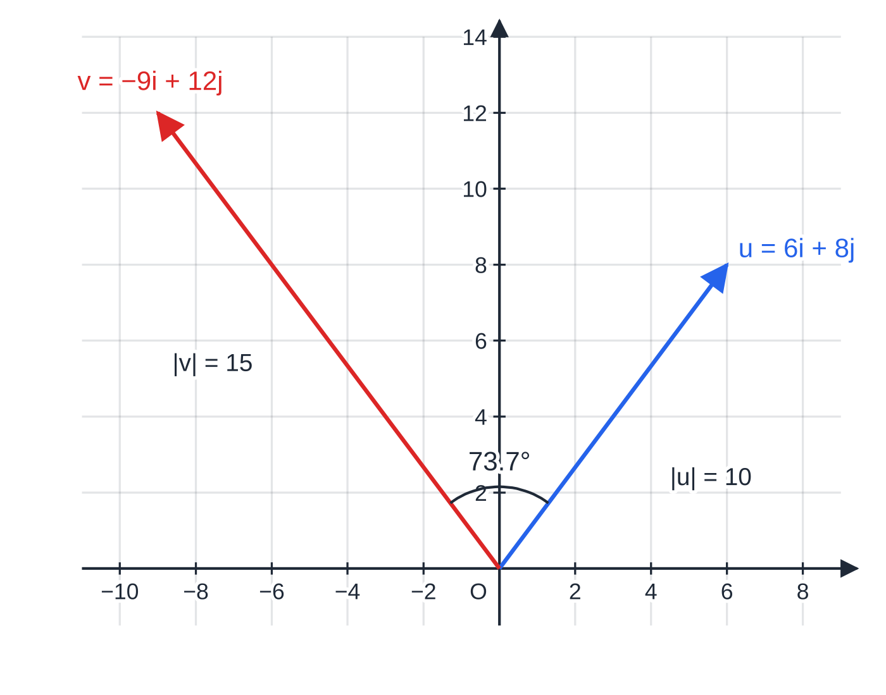
How do momentum and impulse work as vectors? (continued)
Section 1 of 11
Worked example 2: the velocities before and after the kick. The angle between them, 73.7°, is the angle through which the ball is turned.
Notes:
How do momentum and impulse work as vectors?. Full notes: https://examinerprep.com/notes/edexcel-ial-maths/collisions-and-restitution/

Slide 10
What is conserved when two particles collide?
Section 2 of 11
During the impact, A pushes on B and B pushes on A. By Newton's third law these forces are equal and opposite and act for the same time, so the impulses on A and B are equal and opposite. Adding the two impulse–momentum equations, the impulses cancel: total momentum before = total momentum after, provided no external impulse acts along the line of motion.
m₁u₁+m₂u₂=m₁v₁+m₂v₂
This is not in the formulae booklet: learn it. It is also true in vector form, m₁u₁+m₂u₂=m₁v₁+m₂v₂, for particles moving in a plane.
Choose a positive direction and draw a before-and-after diagram. Give every unknown velocity an arrow in the positive direction; a negative answer then simply means it moves the other way. Spheres are assumed smooth and of equal radius so that, in a direct impact, every force acts along the line of centres.
Notes:
What is conserved when two particles collide?. Full notes: https://examinerprep.com/notes/edexcel-ial-maths/collisions-and-restitution/

Slide 11
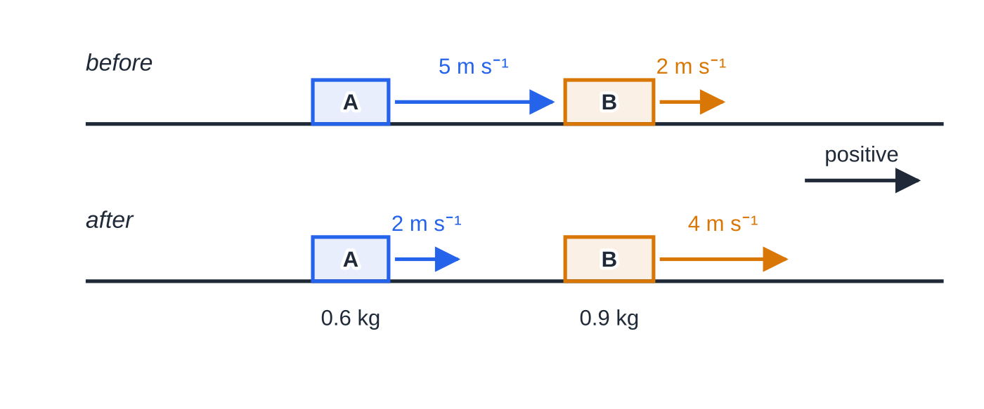
What is conserved when two particles collide? (continued)
Section 2 of 11
Worked example 3 before and after, arrows to scale. After the impact A is slower than B, so the blocks separate.
Notes:
What is conserved when two particles collide?. Full notes: https://examinerprep.com/notes/edexcel-ial-maths/collisions-and-restitution/

Slide 12
What is conserved when two particles collide? (continued)
Section 2 of 11 · Worked example 3 · Easy · Find
WORKED EXAMPLE · QUESTION
Two small blocks A and B, of masses 0.6 kg and 0.9 kg, slide in the same direction along a smooth straight groove. A moves at 5 m s⁻¹ and B at 2 m s⁻¹, so A catches up with B. Immediately after the collision, B moves at 4 m s⁻¹ in the same direction as before. (a) Find the velocity of A immediately after the collision. (b) Find the impulse exerted on B, and deduce the impulse exerted on A.
SOLUTION
(a) Positive in the direction of motion: 0.6(5)+0.9(2)=0.6v_A+0.9(4), so 4.8=0.6v_A+3.6 and v_A=2.0 m s⁻¹, in the original direction
(b) Impulse on B = change in B's momentum =0.9(4-2)= 1.8 N s in the direction of motion. On A: 0.6(2-5)=-1.8, so 1.8 N s opposite to the direction of motion
Sense check: after the impact A (2 m s⁻¹) is slower than B (4 m s⁻¹), so they separate. If your answer had A still faster than B, A would have to pass through B — impossible.
Notes:
What is conserved when two particles collide?: Worked example 3. Full notes: https://examinerprep.com/notes/edexcel-ial-maths/collisions-and-restitution/

Slide 13
What is Newton's law of restitution?
Section 3 of 11
Momentum gives one equation, but a collision has two unknown velocities. The second equation describes how much the particles bounce apart. The speed of approach is how fast the gap between them was closing before the impact; the speed of separation is how fast it opens afterwards. Experiments show that, for two given materials, separation ÷ approach is roughly constant. This constant is the coefficient of restitution e.
Newton's law of restitution: speed of separation = e × speed of approach. e=1 is perfectly elastic; e=0 is inelastic, and the particles coalesce. Real impacts lie in between, and e cannot exceed 1.
v₂-v₁=e(u₁-u₂), 0≤e≤1
Particle 1 is behind particle 2 (in the positive direction), u are velocities before and v velocities after, all signed. This is not in the formulae booklet: learn it.
Notes:
What is Newton's law of restitution?. Full notes: https://examinerprep.com/notes/edexcel-ial-maths/collisions-and-restitution/

Slide 14
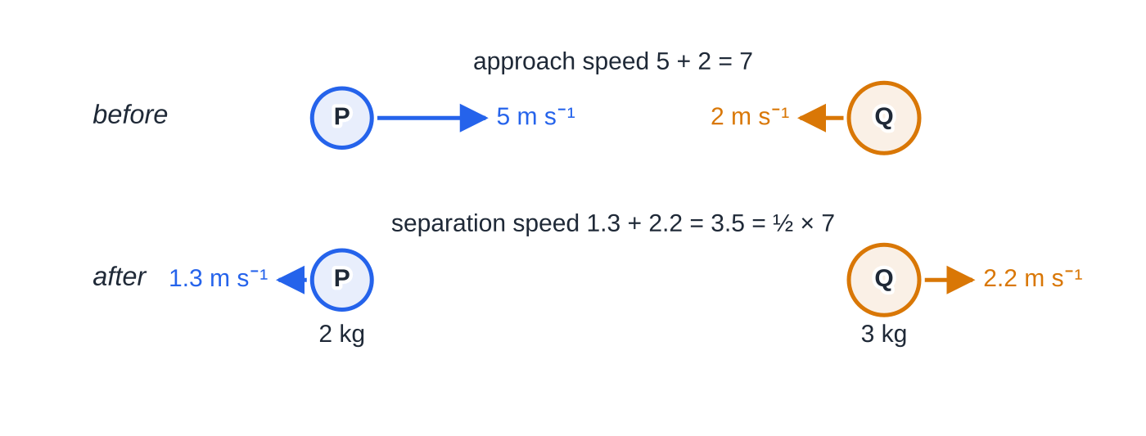
What is Newton's law of restitution? (continued)
Section 3 of 11
Both brackets must be positive: u₁-u₂>0 means they really do approach, and v₂-v₁≥0 means they separate.
Worked example 4, velocity arrows to scale. The gap closes at 5 + 2 = 7 m s⁻¹ and opens at 1.3 + 2.2 = 3.5 m s⁻¹ — exactly half, because e = ½.
Notes:
What is Newton's law of restitution?. Full notes: https://examinerprep.com/notes/edexcel-ial-maths/collisions-and-restitution/

Slide 15
What is Newton's law of restitution? (continued)
Section 3 of 11 · Worked example 4 · Medium · Find
WORKED EXAMPLE · QUESTION
Two smooth spheres P and Q, of equal radius and masses 2 kg and 3 kg, move towards each other along the same straight line on a smooth horizontal table. Just before they collide, P has speed 5 m s⁻¹ and Q has speed 2 m s⁻¹. The coefficient of restitution between them is ½. (a) Find the velocities of P and Q immediately after the collision. (b) Find the kinetic energy lost in the collision.
SOLUTION
(a) Take P's direction as positive, so u_P=5, u_Q=-2. Momentum: 2(5)+3(-2)=2v_P+3v_Q, so 2v_P+3v_Q=4 (1). Restitution, with approach speed 5-(-2)=7: v_Q-v_P=½×7=3.5 (2). Substitute v_Q=v_P+3.5 into (1): 5v_P+10.5=4, so v_P=-1.3 m s⁻¹, v_Q=2.2 m s⁻¹. P rebounds at 1.3 m s⁻¹ and Q rebounds at 2.2 m s⁻¹: both directions of motion are reversed.
(b) Before: ½(2)(5²)+½(3)(2²)=25+6=31 J. After: ½(2)(1.3²)+½(3)(2.2²)=1.69+7.26=8.95 J. Loss =31-8.95= 22.05 J
Notes:
What is Newton's law of restitution?: Worked example 4. Full notes: https://examinerprep.com/notes/edexcel-ial-maths/collisions-and-restitution/

Slide 16
What is Newton's law of restitution? (continued)
Section 3 of 11
Exam tip
Write the restitution equation the same way every time: "(velocity of the front particle after) − (velocity of the back particle after) = e × (velocity of the back particle before − velocity of the front particle before)". With signed velocities this never goes wrong, even when a particle reverses.
Notes:
What is Newton's law of restitution?. Full notes: https://examinerprep.com/notes/edexcel-ial-maths/collisions-and-restitution/

Slide 17
How much kinetic energy is lost in an impact?
Section 4 of 11
Momentum is always conserved in a collision; kinetic energy is not, unless e=1. The difference becomes heat, sound and permanent deformation. To find the loss, work out total kinetic energy before − total kinetic energy after. Kinetic energy is a scalar, so add ½ mv² for each particle; signs of velocities do not matter once squared.
Algebraically, for masses m₁ and m₂ with approach speed w, the loss is
½·m₁m₂/(m₁+m₂)·(1-e²) w² .
In worked example 4: ½×(6/5)×¾×49=22.05 J, as found. This shows why 0≤e≤1: if e were greater than 1 the "loss" would be negative and the collision would create kinetic energy from nowhere.
Notes:
How much kinetic energy is lost in an impact?. Full notes: https://examinerprep.com/notes/edexcel-ial-maths/collisions-and-restitution/

Slide 18
How much kinetic energy is lost in an impact? (continued)
Section 4 of 11 · Worked example 5 · Hard · Show that
WORKED EXAMPLE · QUESTION
A particle A of mass 2m moves with speed u on a smooth horizontal plane and collides directly with a particle B of mass m, which is at rest. The coefficient of restitution between A and B is e. (a) Show that the speed of B immediately after the collision is (2u(1+e))/3, and find the velocity of A. (b) Show that the kinetic energy lost is ⅓ mu²(1-e²). (c) Given that a quarter of the kinetic energy is lost, find e.
SOLUTION
(a) A's direction positive. Momentum: 2mu=2mv_A+mv_B, so 2u=2v_A+v_B. Restitution: v_B-v_A=eu. Eliminate v_B: 2u=3v_A+eu, so v_A=(u(2-e))/3 and v_B=(u(2-e))/3+eu=(2u(1+e))/3, as required. Since e≤1, 2-e>0: A always carries on in its original direction.
(b) KE before =½(2m)u²=mu². After: ½(2m)(u²(2-e)²)/9+½ m(4u²(1+e)²)/9=mu²/9[(4-4e+e²)+(2+4e+2e²)]=(mu²(6+3e²))/9. Loss =mu²-(mu²(2+e²))/3= ⅓ mu²(1-e²)
(c) The fraction lost is (1-e²)/3: (1-e²)/3=¼, so e²=¼ and e=½
Notes:
How much kinetic energy is lost in an impact?: Worked example 5. Full notes: https://examinerprep.com/notes/edexcel-ial-maths/collisions-and-restitution/

Slide 19
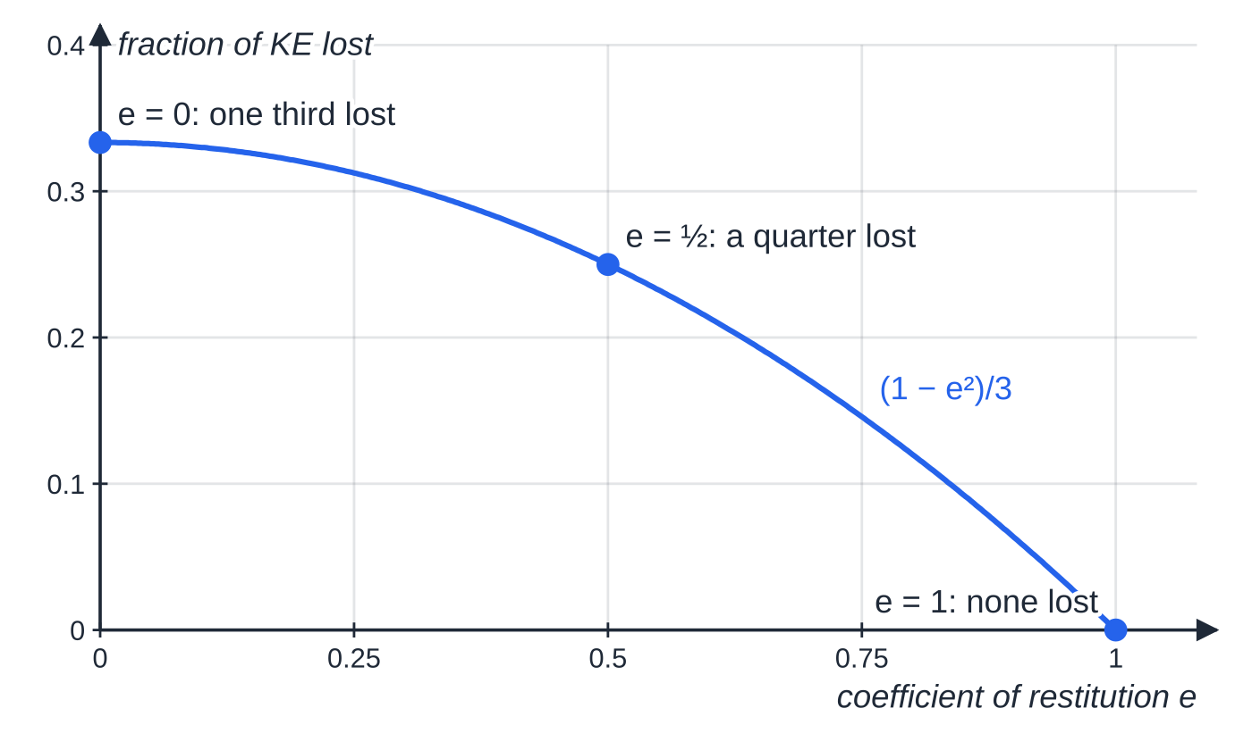
How much kinetic energy is lost in an impact? (continued)
Section 4 of 11
Worked example 5: the fraction of kinetic energy lost, (1 − e²)/3, against e. Even when the particles coalesce, only a third is lost — the rest is needed to keep the momentum going.
Notes:
How much kinetic energy is lost in an impact?. Full notes: https://examinerprep.com/notes/edexcel-ial-maths/collisions-and-restitution/

Slide 20
What happens when a particle hits a fixed smooth surface?
Section 5 of 11
A wall or the ground does not move, so its velocity is zero before and after. Restitution reduces to rebound speed = e × impact speed, with the direction reversed. Momentum of the particle is not conserved: the surface gives it an impulse. Find that impulse with I=mv-mu, remembering the change of sign.
In M2 the particle strikes the surface at right angles. The plane is smooth, so there is no sideways impulse. For a ball bouncing on the ground, use the constant-acceleration formulae between bounces and restitution at each bounce. Each rebound speed is e times the last, so each rebound height is e² times the last.
Notes:
What happens when a particle hits a fixed smooth surface?. Full notes: https://examinerprep.com/notes/edexcel-ial-maths/collisions-and-restitution/

Slide 21
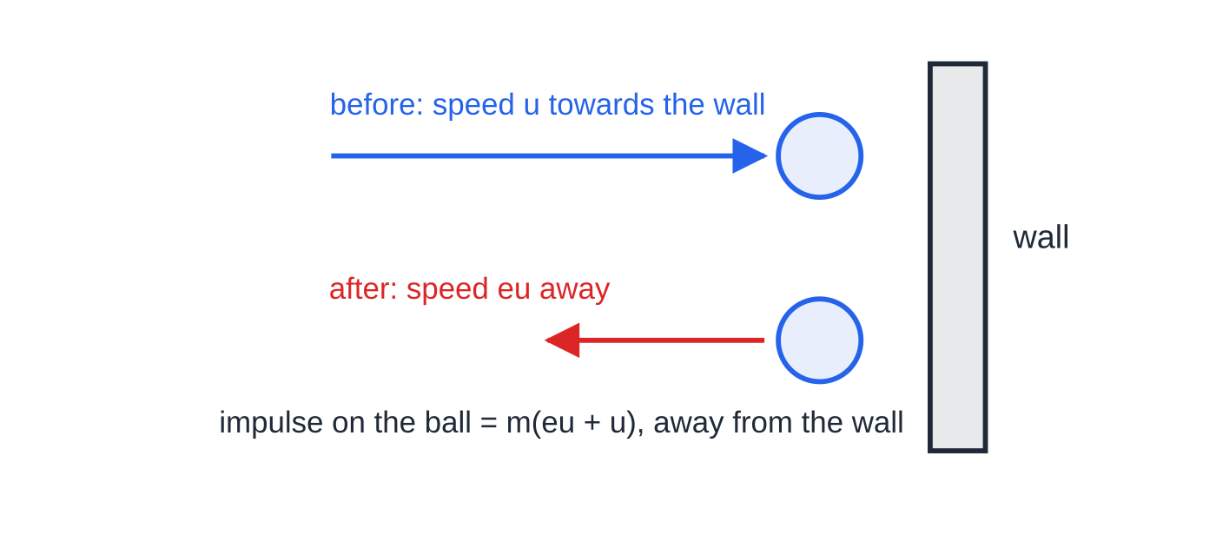
What happens when a particle hits a fixed smooth surface? (continued)
Section 5 of 11
A particle hitting a fixed smooth wall at right angles. It comes back at e times its impact speed, and the impulse on it is the full change of momentum, m(eu + u).
Notes:
What happens when a particle hits a fixed smooth surface?. Full notes: https://examinerprep.com/notes/edexcel-ial-maths/collisions-and-restitution/

Slide 22
What happens when a particle hits a fixed smooth surface? (continued)
Section 5 of 11 · Worked example 6 · Medium · Find
WORKED EXAMPLE · QUESTION
A small ball of mass 0.15 kg is released from rest at a height of 2.5 m above a horizontal floor. The coefficient of restitution between the ball and the floor is 0.6. The ball is modelled as a particle and air resistance is ignored. (a) Find the speed of the ball just before it hits the floor, and just after. (b) Find the magnitude of the impulse of the floor on the ball. (c) Find the height reached after the first bounce. (d) Find the time from release until the ball hits the floor for the second time.
SOLUTION
(a) v²=u²+2as with u=0, a=9.8, s=2.5: v=√(2×9.8×2.5)=√49= 7.0 m s⁻¹ before; 0.6×7.0=4.2 m s⁻¹ after
(b) Upwards positive: u=-7.0, v=+4.2. I=0.15(4.2-(-7.0))= 1.68 N s (upwards)
(c) Rising from 4.2 m s⁻¹ to rest: 0=4.2²-2(9.8)h, so h=0.90 m
(d) Fall: 7.0=9.8t₁, so t₁=0.714 s. Rebound flight: 0=4.2t-4.9t², so t=0.857 s. Total = 1.57 s (3 s.f.)
Notes:
What happens when a particle hits a fixed smooth surface?: Worked example 6. Full notes: https://examinerprep.com/notes/edexcel-ial-maths/collisions-and-restitution/

Slide 23
What happens when a particle hits a fixed smooth surface? (continued)
Section 5 of 11 · Worked example 6 · Medium · Find (continued)
Energy check: the kinetic energy lost at the bounce is ½(0.15)(7.0²-4.2²)=2.35 J, which equals the drop in maximum potential energy, 0.15×9.8×(2.5-0.9).
Notes:
What happens when a particle hits a fixed smooth surface?: Worked example 6. Full notes: https://examinerprep.com/notes/edexcel-ial-maths/collisions-and-restitution/

Slide 24
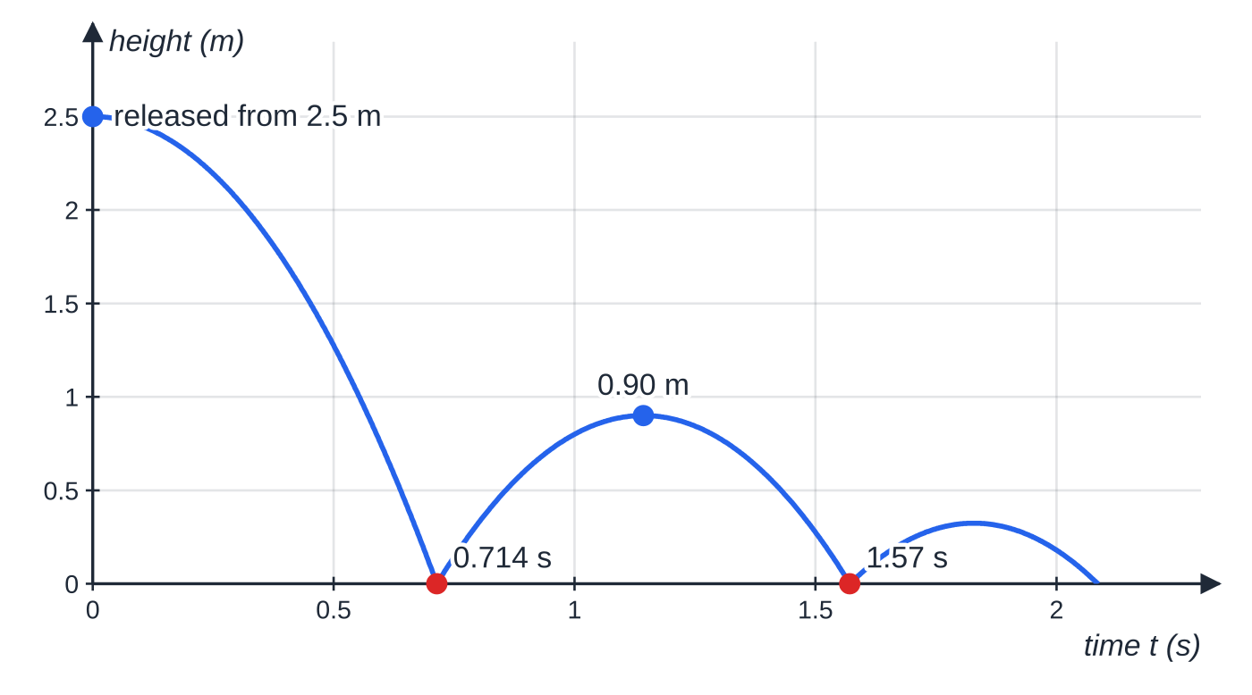
What happens when a particle hits a fixed smooth surface? (continued)
Section 5 of 11
Height against time for worked example 6. Each flight is a parabola; the rebound height falls from 2.5 m to 0.90 m, a factor of e² = 0.36.
Notes:
What happens when a particle hits a fixed smooth surface?. Full notes: https://examinerprep.com/notes/edexcel-ial-maths/collisions-and-restitution/

Slide 25
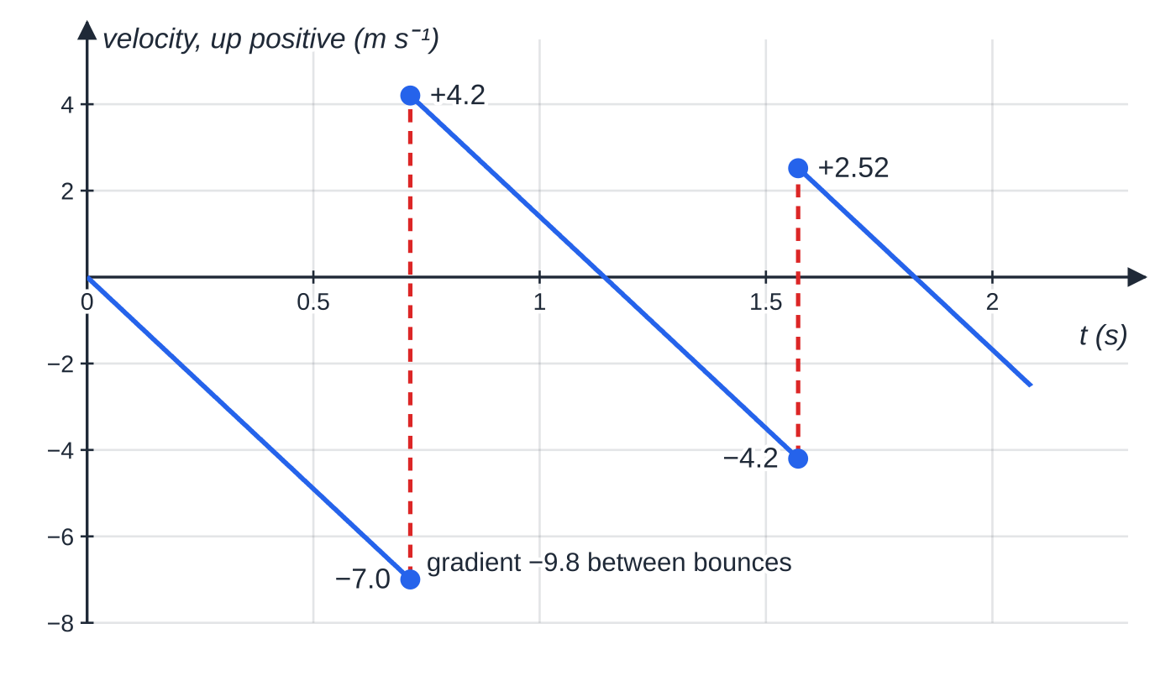
What happens when a particle hits a fixed smooth surface? (continued)
Section 5 of 11
Common error
Forgetting that the velocity changes sign at the bounce. The impulse is 0.15×(4.2+7.0), not 0.15×(7.0-4.2)=0.42 N s, which would be the answer if the ball were merely slowed down without changing direction.
Velocity–time graph of worked example 6, upwards positive. Between bounces every line has gradient −9.8; at each bounce the velocity jumps from −v to +0.6v.
Notes:
What happens when a particle hits a fixed smooth surface?. Full notes: https://examinerprep.com/notes/edexcel-ial-maths/collisions-and-restitution/

Slide 26
How do you decide whether there are further collisions?
Section 6 of 11
Treat the impacts one at a time, in the order they happen. Each impact involves only the two bodies touching; any other particle carries on unchanged. After each impact, write down every particle's velocity with its sign, in the order the particles sit on the line.
The test: two neighbouring particles collide again only if the one behind has a greater velocity (in the positive direction) than the one in front. If the back one is slower, or moving away, they never meet again. With a wall at the front, the wall reverses the front particle; then compare its new velocity with that of the particle following it. "Show that there will be no further collisions" and "find the range of values of e for which there is a further collision" are the same test, written as an inequality.
Notes:
How do you decide whether there are further collisions?. Full notes: https://examinerprep.com/notes/edexcel-ial-maths/collisions-and-restitution/

Slide 27
How do you decide whether there are further collisions? (continued)
Section 6 of 11 · Worked example 7 · Hard · Find, explain
WORKED EXAMPLE · QUESTION
Three particles A, B and C, of masses 2 kg, 1 kg and 3 kg, lie at rest in that order on a smooth horizontal surface, in a straight line. A is projected towards B with speed 6 m s⁻¹. The coefficient of restitution between any two of the particles is ½. (a) Find the velocities of A and B after A hits B. (b) Find the velocities of B and C after B hits C. (c) Explain why A and B collide again. (d) Find the velocities of A and B after their second collision. (e) Determine whether B and C collide again.
SOLUTION
(a) A–B: 2(6)=2v_A+v_B and v_B-v_A=½(6)=3, so 3v_A=9: v_A=3 m s⁻¹, v_B=6 m s⁻¹
(b) B–C, with C at rest: 1(6)=v_B+3v_C and v_C-v_B=½(6)=3, so 4v_B=-3: v_B=-0.75 m s⁻¹, v_C=2.25 m s⁻¹
(c) A moves at +3 m s⁻¹ towards B, and B now moves at −0.75 m s⁻¹ (back towards A): they are approaching, so A and B collide again
Notes:
How do you decide whether there are further collisions?: Worked example 7. Full notes: https://examinerprep.com/notes/edexcel-ial-maths/collisions-and-restitution/

Slide 28
How do you decide whether there are further collisions? (continued)
Section 6 of 11 · Worked example 7 · Hard · Find, explain (continued)
(d) Approach speed 3-(-0.75)=3.75. 2(3)+1(-0.75)=2v_A+v_B=5.25 and v_B-v_A=1.875, so v_A=1.125 m s⁻¹, v_B=3.0 m s⁻¹
(e) B (3.0 m s⁻¹) is behind C (2.25 m s⁻¹) and faster: B and C collide again
Carrying on: after that fourth impact B has (69/32)≈2.16 m s⁻¹ and C (81/32)≈2.53 m s⁻¹. Now A (1.125) < B < C, so all three separate and there are no more collisions.
Notes:
How do you decide whether there are further collisions?: Worked example 7. Full notes: https://examinerprep.com/notes/edexcel-ial-maths/collisions-and-restitution/

Slide 29
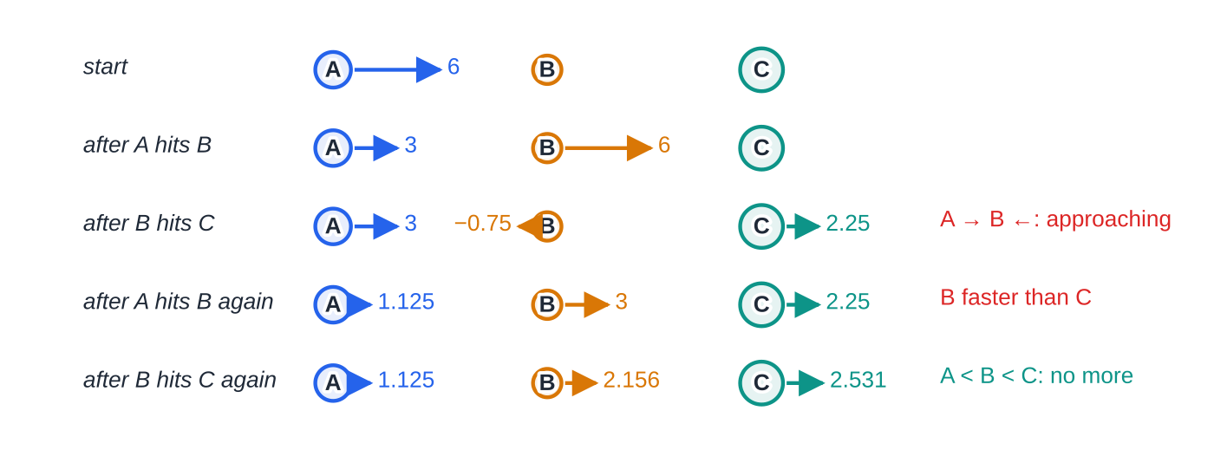
How do you decide whether there are further collisions? (continued)
Section 6 of 11
Worked example 7, stage by stage, arrows to scale (velocities in m s⁻¹, positive to the right). The red notes flag the pairs that must collide next; the last row has A < B < C, so the sequence ends.
Notes:
How do you decide whether there are further collisions?. Full notes: https://examinerprep.com/notes/edexcel-ial-maths/collisions-and-restitution/

Slide 30
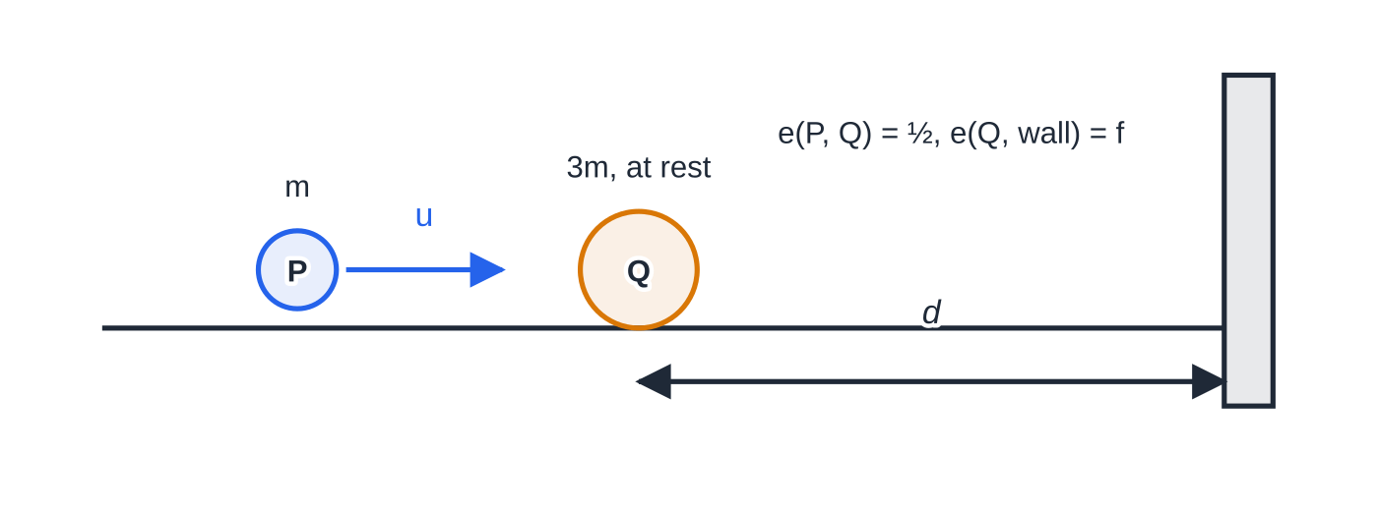
How do you decide whether there are further collisions? (continued)
Section 6 of 11
Worked example 8: P moves towards Q, which is at rest a distance d from a fixed smooth wall.
Notes:
How do you decide whether there are further collisions?. Full notes: https://examinerprep.com/notes/edexcel-ial-maths/collisions-and-restitution/

Slide 31
How do you decide whether there are further collisions? (continued)
Section 6 of 11 · Worked example 8 · Hard · Show that, find
WORKED EXAMPLE · QUESTION
A particle P of mass m and a particle Q of mass 3m lie on a smooth horizontal floor on a straight line perpendicular to a fixed smooth vertical wall. Q is at rest at distance d from the wall, and P moves towards Q, and the wall, with speed u. The coefficient of restitution between P and Q is ½, and between Q and the wall it is f. (a) Find the velocities of P and Q immediately after they collide. (b) Show that P and Q collide again if f>⅓. (c) Given f=⅔, find the distance from the wall of the second collision between P and Q, and the time between the two collisions.
SOLUTION
(a) Towards the wall positive: mu=mv_P+3mv_Q and v_Q-v_P=½ u. Then u=4v_P+(3/2) u, so v_P=-u/8 (P moves away from the wall at u/8), v_Q=3u/8 towards the wall
(b) Q rebounds from the wall with speed f×3u/8, moving away from the wall, the same way as P. Q catches P only if 3fu/8>u/8, that is f>⅓
Notes:
How do you decide whether there are further collisions?: Worked example 8. Full notes: https://examinerprep.com/notes/edexcel-ial-maths/collisions-and-restitution/

Slide 32
How do you decide whether there are further collisions? (continued)
Section 6 of 11 · Worked example 8 · Hard · Show that, find (continued)
(c) With f=⅔, Q comes back at ⅔×3u/8=u/4. Q's time to the wall: d÷3u/8=8d/3u; P is then d+u/8×8d/3u=4d/3 from the wall. Measuring t from Q leaving the wall: u/4t=4d/3+u/8t, so t=32d/3u and the distance is u/4×32d/3u= 8d/3 from the wall. Time between collisions =8d/3u+32d/3u= 40d/3u
Notes:
How do you decide whether there are further collisions?: Worked example 8. Full notes: https://examinerprep.com/notes/edexcel-ial-maths/collisions-and-restitution/

Slide 33
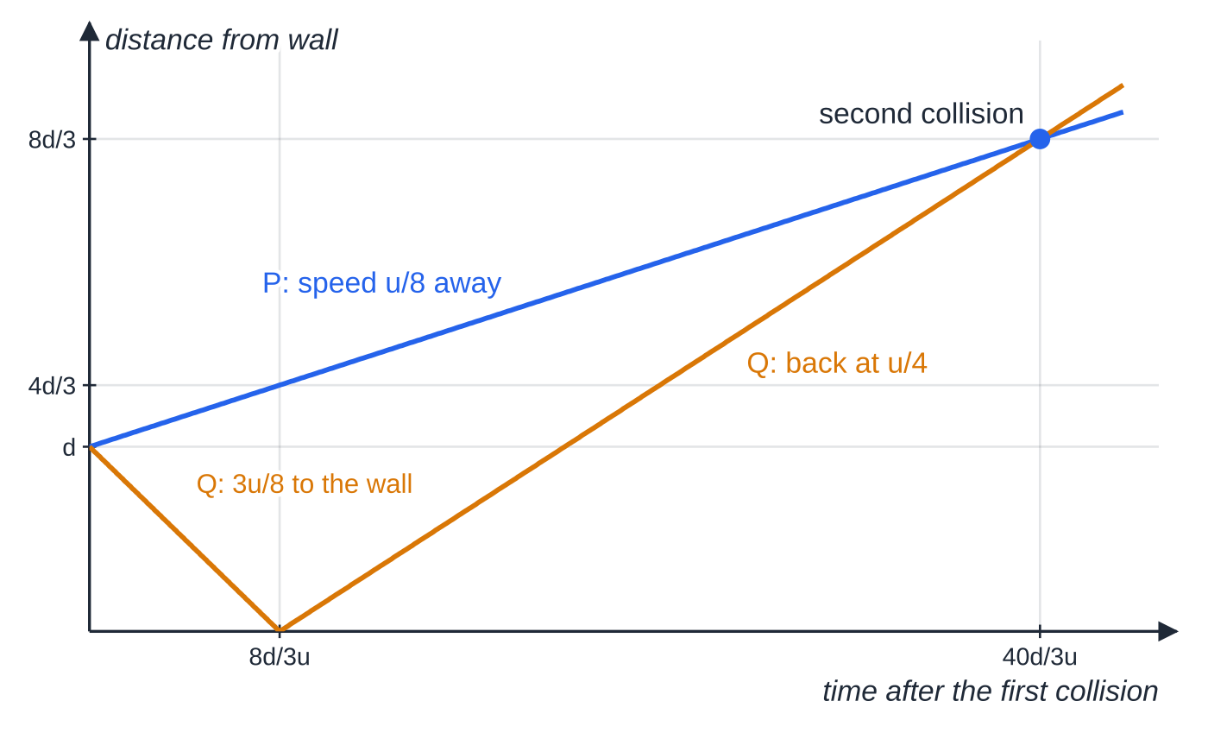
How do you decide whether there are further collisions? (continued)
Section 6 of 11
Exam tip
Before you start chasing distances and times, answer the yes/no question with velocities alone. Distances only matter when you are asked where or when the next impact happens; whether it happens depends only on which particle is faster.
Worked example 8 with f = ⅔: distance from the wall against time. Where the two lines cross, P and Q are at the same place — the second collision, 8d/3 from the wall.
Notes:
How do you decide whether there are further collisions?. Full notes: https://examinerprep.com/notes/edexcel-ial-maths/collisions-and-restitution/

Slide 34
Exam tips for M2.5
Section 7 of 11
Exam tip 1 — a diagram for every impact
Draw "before" and "after" for each collision, with masses, a positive direction and every velocity arrow pointing that way. Most sign errors disappear once the diagram is on the page.
Exam tip 2 — two equations, two unknowns
A direct impact always gives one momentum equation and one restitution equation. Label them (1) and (2), then solve simultaneously. If a question gives you one velocity after the impact, use momentum for the other and restitution to find e.
Exam tip 3 — "show that" with e unknown
When the answer contains e, keep it as a letter throughout and use 0≤e≤1 to decide directions: for example, u(1-3e)/4 is negative only when e>⅓.
Notes:
Exam tips for M2.5. Full notes: https://examinerprep.com/notes/edexcel-ial-maths/collisions-and-restitution/

Slide 35
Exam tips for M2.5 (continued)
Section 7 of 11
Exam tip 4 — kinetic energy lost
Work out the total kinetic energy before and after on separate lines and subtract. Squaring removes signs, so use speeds. A negative "loss" means an arithmetic slip, not an explosion.
Exam tip 5 — finish the story
In a successive-impacts question, end with a sentence that compares velocities: "A moves at 1.125 m s⁻¹ and B at 2.16 m s⁻¹ in the same direction, so A cannot catch B: no further collision." The comparison is the answer.
Notes:
Exam tips for M2.5. Full notes: https://examinerprep.com/notes/edexcel-ial-maths/collisions-and-restitution/

Slide 36
Common misconceptions
Section 8 of 11
Misconception | Why it is wrong | Correct idea
Kinetic energy is conserved in a collision. | Only when e=1. Otherwise some becomes heat, sound and deformation. | Momentum is conserved; kinetic energy decreases unless the impact is perfectly elastic.
Momentum is conserved when a ball bounces off a wall. | The wall exerts an external impulse on the ball. | Use restitution for the rebound speed and I=mv-mu for the impulse.
Restitution uses speeds, so signs do not matter. | A particle that reverses has a negative velocity; ignoring this changes the approach or separation speed. | Write v₂-v₁=e(u₁-u₂) with signed velocities.
A coefficient of 0 means the particles stop. | e=0 means the speed of separation is zero, not the speeds. | With e=0 the particles move off together with a common velocity.
An impulse can be added to a velocity. | Impulse changes momentum, which includes the mass. | v=u+I/m.
Notes:
Common misconceptions. Full notes: https://examinerprep.com/notes/edexcel-ial-maths/collisions-and-restitution/

Slide 37
Common misconceptions (continued)
Section 8 of 11
Misconception | Why it is wrong | Correct idea
If two particles are moving in the same direction they cannot collide again. | The one behind may be faster. | Compare velocities: a further collision happens if the back particle is faster than the front one.
Notes:
Common misconceptions. Full notes: https://examinerprep.com/notes/edexcel-ial-maths/collisions-and-restitution/

Slide 38
How this topic connects
Section 9 of 11
M1 Momentum and impulse
The one-dimensional conservation law, coalescing particles and jerks in strings come from M1; M2 adds restitution and vectors in i, j form.
M1 Kinematics and M2.4 Work, energy and power
Bouncing balls need the constant-acceleration formulae between impacts, and kinetic energy losses link straight to the work–energy principle.
Further Mechanics and IAL Physics
Oblique impacts with a plane and between spheres, where only the velocity component along the line of centres is affected, build directly on this page in IAL Further Mathematics. In IAL Physics Units 1 and 4, momentum conservation, impulse and elastic versus inelastic collisions are the same ideas in a physics setting.
Notes:
How this topic connects. Full notes: https://examinerprep.com/notes/edexcel-ial-maths/collisions-and-restitution/

Slide 39
Key formulae
Section 10 of 11
Formula | Use | In the formulae list?
momentum =mv | momentum of a particle (vector) | No — learn it
I=mv-mu | impulse on one particle, in i, j form or along a line | No — learn it
m₁u₁+m₂u₂=m₁v₁+m₂v₂ | conservation of momentum in a collision | No — learn it
v₂-v₁=e(u₁-u₂), 0≤e≤1 | Newton's law of restitution, direct impact | No — learn it
rebound speed = e × impact speed | particle hitting a fixed smooth surface at right angles | No — learn it
KE=½ mv² | kinetic energy lost = total before − total after | No — learn it
loss =½·m₁m₂/(m₁+m₂)(1-e²)w² | quick check on a kinetic energy loss (w = approach speed) | No — derive it
v²=u²+2as, v=u+at | motion between bounces | No — learn it
Notes:
Key formulae. Full notes: https://examinerprep.com/notes/edexcel-ial-maths/collisions-and-restitution/

Slide 40
Check your understanding
Section 11 of 11
1. Why can the coefficient of restitution not be greater than 1?
2. A particle of mass 0.2 kg hits a fixed smooth wall at right angles with speed 6 m s⁻¹, and e=0.5. Find its rebound speed and the impulse on it.
3. Two particles collide and move off together. What is the value of e?
4. A particle of mass 0.5 kg moving with velocity (2i+3j) m s⁻¹ receives an impulse of (i-4j) N s. Find its new speed.
5. Two particles of equal mass collide directly with e=1; one was at rest. What happens?
6. A ball dropped onto a floor rebounds to 64% of the height it fell from. Find e.
Notes:
Check your understanding: questions. Full notes: https://examinerprep.com/notes/edexcel-ial-maths/collisions-and-restitution/

Slide 41
Check your understanding · answers
Section 11 of 11
1. The kinetic energy lost is proportional to 1-e². If e>1 the loss would be negative, so the collision would create kinetic energy with no source of energy. Without an explosion this cannot happen.
2. Rebound speed =0.5×6=3 m s⁻¹. Impulse =0.2(3-(-6))=1.8 N s, directed away from the wall.
3. e=0: the speed of separation is zero because they share a common velocity.
4. v=u+I/m=(2+2)i+(3-8)j=4i-5j, so the speed is √41=6.40 m s⁻¹.
5. Momentum: u=v₁+v₂; restitution: v₂-v₁=u. So v₁=0 and v₂=u: the moving particle stops and the other takes its velocity.
6. Rebound height is e² times the drop height, so e²=0.64 and e=0.8.
Notes:
Check your understanding: answers. Full notes: https://examinerprep.com/notes/edexcel-ial-maths/collisions-and-restitution/

Slide 42
Practice questions
2 original exam-style questions. Answers at the end of the deck.

Slide 43
Question 1
5 marks
A small smooth sphere of mass 0.3 kg slides on a smooth horizontal floor with speed 4 m s⁻¹, moving at right angles towards a fixed smooth vertical wall. It rebounds from the wall along the same line with speed 2.8 m s⁻¹.
(a) Find the coefficient of restitution between the sphere and the wall. [1]
(b) Find the magnitude of the impulse exerted by the wall on the sphere. [2]
(c) Find the kinetic energy lost in the impact. [2]
Notes:
Online with the full mark scheme: https://examinerprep.com/ial-maths-m2-5-collisions-and-restitution-questions#IALM-M2-5-B-04

Slide 44
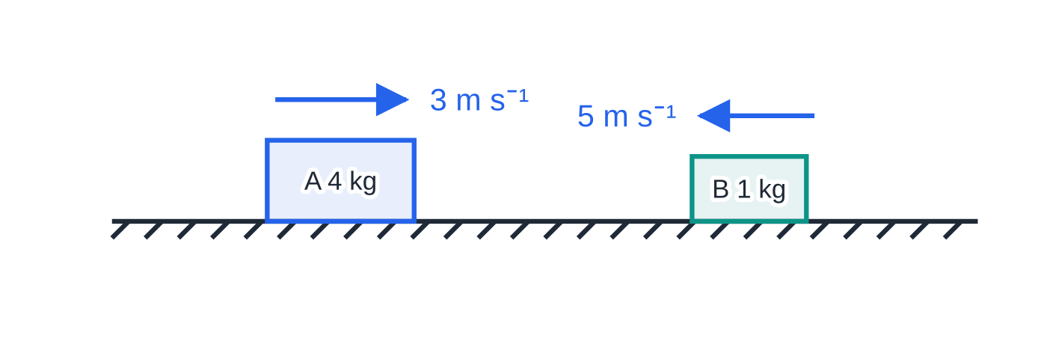
Question 2
8 marks
Two model railway trucks A and B, of masses 4 kg and 1 kg, run towards each other along a straight horizontal track. Just before they collide, A has speed 3 m s⁻¹ and B has speed 5 m s⁻¹. The coefficient of restitution between the trucks is 0.4. The trucks are modelled as particles and the track as smooth.
Figure: the trucks just before they collide; e = 0.4; not to scale.
(a) Find the velocities of A and B immediately after the collision, stating clearly the direction of motion of each truck. [5]
(b) Find the magnitude of the impulse exerted on B in the collision. [1]
(c) Find the kinetic energy lost in the collision. [2]
Notes:
Online with the full mark scheme: https://examinerprep.com/ial-maths-m2-5-collisions-and-restitution-questions#IALM-M2-5-B-05

Slide 45
Answers

Slide 46
Question 1 · answer
Mark scheme
e = 2.8 ÷ 4 = 0.7
I = 0.3(2.8 − (−4))
= 2.04 N s
½(0.3)(4²) − ½(0.3)(2.8²)
= 2.4 − 1.176 = 1.22 J (1.224)
Notes:
Full mark scheme: https://examinerprep.com/ial-maths-m2-5-collisions-and-restitution-questions#IALM-M2-5-B-04

Slide 47
Question 2 · answer
Mark scheme
(A's direction positive) 4(3) + 1(−5) = 4v_A + v_B
4v_A + v_B = 7
v_B − v_A = 0.4(3 + 5) = 3.2
solving: v_A = 0.76 m s⁻¹, in its original direction
v_B = 3.96 m s⁻¹, direction of motion reversed
1 × (3.96 + 5) = 8.96 N s ft
before ½ × 4 × 3² + ½ × 1 × 5² = 30.5 J; after ½ × 4 × 0.76² + ½ × 1 × 3.96² = 8.996 J
loss = 21.5 J (21.504)
Notes:
Full mark scheme: https://examinerprep.com/ial-maths-m2-5-collisions-and-restitution-questions#IALM-M2-5-B-05

Slide 48
Keep practising
Notes for this topic
Questions on this topic
Build a printable test
ExaminerPrep is an independent tutoring service. It has been developed independently from and is not endorsed by the International Baccalaureate Organization. "International Baccalaureate", "IB" and "IB Diploma Programme" are registered trademarks of the IBO, used here for descriptive purposes only.
Pearson Edexcel and Cambridge are trademarks of their owners; ExaminerPrep is not affiliated with any exam board.

