Slide 1
EP
EDEXCEL IAL MATHS
P3.4 Compound angles, double angles and R-form
The full notes page in 13 sections · practice questions with answers · simulations
ExaminerPrep is an independent tutoring service. It has been developed independently from and is not endorsed by the International Baccalaureate Organization. "International Baccalaureate", "IB" and "IB Diploma Programme" are registered trademarks of the IBO, used here for descriptive purposes only.
Pearson Edexcel and Cambridge are trademarks of their owners; ExaminerPrep is not affiliated with any exam board.
Notes:
P3.4 Compound angles, double angles and R-form. Notes for this topic: https://examinerprep.com/notes/edexcel-ial-maths/compound-angles-double-angles-and-r-form/

Slide 2
What this page covers
Overview
The compound angle formulae for sin(A ±B), cos(A ±B) and tan(A ±B), and a geometric proof
Exact values, and ratios of compound angles from given ratios and quadrants
The double-angle formulae for sin 2A, cos 2A (three forms) and tan 2A
Half-angle results such as cos² A = ½(1 + cos 2A)
Solving equations and proving identities with these formulae, in degrees or radians
Writing acos θ+ bsin θ as Rcos(θ±α) or Rsin(θ±α)
Solving acos θ+ bsin θ= c and finding greatest and least values, including in context
Notes:
What this page covers. Full notes: https://examinerprep.com/notes/edexcel-ial-maths/compound-angles-double-angles-and-r-form/

Slide 3
In one minute
Key points
1. The compound angle formulae sin(A ±B) = sin Acos B ±cos Asin B and cos(A ±B) = cos Acos B ∓sin Asin B give exact values, turn into the double-angle formulae when B = A, and, read backwards, turn acos θ+ bsin θ into a single wave.
2. tan(A ±B) = (tan A ±tan B)/(1 ∓tan Atan B). All three compound angle formulae are in the formulae booklet.
3. Double angles (not in the booklet): sin 2A = 2sin Acos A; cos 2A = cos² A - sin² A = 2cos² A - 1 = 1 - 2sin² A; tan 2A = 2tan A/(1 - tan² A).
4. For equations, expand, then collect into a single ratio (often tan θ) or a quadratic in one ratio; choose the form of cos 2A that matches the rest of the equation.
5. R-form: acos θ+ bsin θ= Rcos(θ- α) with R = √(a² + b²) and tan α= b/a. Expand the target form and compare coefficients to get the signs right.
Notes:
In one minute. Full notes: https://examinerprep.com/notes/edexcel-ial-maths/compound-angles-double-angles-and-r-form/

Slide 4
In one minute (continued)
Key points
6. Rsin(…) and Rcos(…) lie between -R and R; the maximum R occurs when the bracket is 90° (for sin) or 0° (for cos).
Notes:
In one minute. Full notes: https://examinerprep.com/notes/edexcel-ial-maths/compound-angles-double-angles-and-r-form/

Slide 5
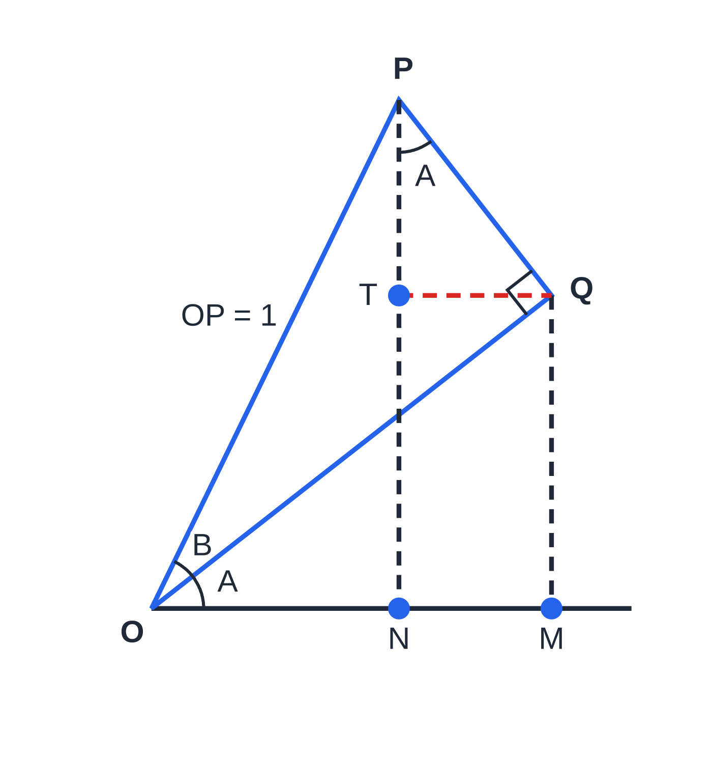
Where do the compound angle formulae come from?
Section 1 of 13
It is tempting to think that sin(A + B) = sin A + sin B, but a single test destroys the idea: with A = B = 90°, the left side is sin 180° = 0 while the right side is 2. The sine of a sum mixes sines and cosines, and a picture shows exactly how.
In the figure, the angle A + B is built from two right-angled triangles. OP has length 1, so the height of P is sin(A + B) and its horizontal distance from O is cos(A + B). In triangle OQP, OQ = cos B and QP = sin B. Then QM = OQsin A = sin Acos B. Because QT is parallel to OM and QP is perpendicular to OQ, the angle TPQ is also A, so PT = QPcos A = cos Asin B. Adding the two heights gives sin(A + B) = sin Acos B + cos Asin B. The horizontal distances give ON = OM - TQ, which is cos(A + B) = cos Acos B - sin Asin B.
A geometric proof, drawn to scale with A = 38° and B = 26°. The height of P is QM + PT = sin A cos B + cos A sin B; the horizontal distance ON is OM − TQ = cos A cos B − sin A sin B.
Notes:
Where do the compound angle formulae come from?. Full notes: https://examinerprep.com/notes/edexcel-ial-maths/compound-angles-double-angles-and-r-form/

Slide 6
Where do the compound angle formulae come from? (continued)
Section 1 of 13
Replacing B by -B, with cos(-B) = cos B and sin(-B) = -sin B, gives the "minus" versions, and dividing the sine formula by the cosine formula (then dividing top and bottom by cos Acos B) gives the tan formula.
Compound angle (addition) formulae.
sin(A ±B) = sin Acos B ±cos Asin B cos(A ±B) = cos Acos B ∓sin Asin B tan(A ±B) = (tan A ±tan B)/(1 ∓tan Atan B) Take the top signs together or the bottom signs together. tan(A ±B) is undefined where A ±B = 90°, 270°, …. The angles may be in degrees or radians; these are identities, true for every A and B. They are in the formulae booklet, but you need to use them quickly and in reverse.
Notes:
Where do the compound angle formulae come from?. Full notes: https://examinerprep.com/notes/edexcel-ial-maths/compound-angles-double-angles-and-r-form/

Slide 7
Where do the compound angle formulae come from? (continued)
Section 1 of 13 · Worked example 1 · Easy · Find
WORKED EXAMPLE · QUESTION
Without a calculator, find the exact values of (a) sin 105°; (b) tan 75°, giving your answer in the form p + q√3.
SOLUTION
(a) Split 105° into angles with known exact ratios: sin(60° + 45°) = sin 60°cos 45° + cos 60°sin 45° = √3/2·√2/2 + ½·√2/2 = (√6 + √2)/4.
(b) tan 75° = tan(45° + 30°) = (1 + 1/√3)/(1 - 1/√3) = (√3 + 1)/(√3 - 1) (multiplying top and bottom by √3). Rationalise: ((√3 + 1)²)/(3 - 1) = (4 + 2√3)/2 = 2 + √3. Check: 2 + √3 ≈3.7321, which matches tan 75° on a calculator.
Notes:
Where do the compound angle formulae come from?: Worked example 1. Full notes: https://examinerprep.com/notes/edexcel-ial-maths/compound-angles-double-angles-and-r-form/

Slide 8
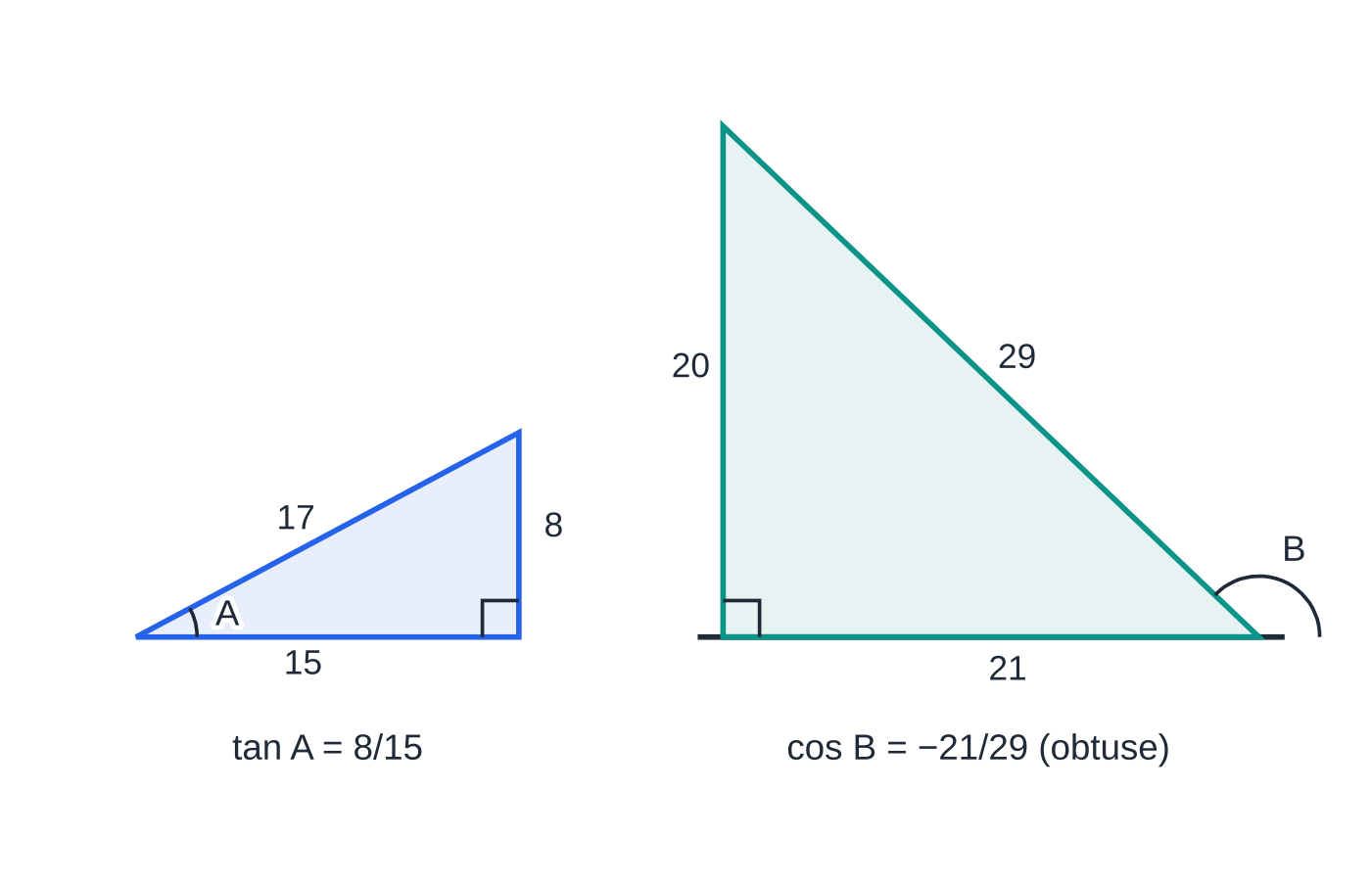
How do you find sin(A + B) from given ratios?
Section 2 of 13
A typical question gives one ratio of each angle and says which quadrant it lies in. To use the formulae you need both the sine and the cosine of each angle. Draw a right-angled triangle (or use sin² + cos² = 1) to find the size of the missing ratio, then use the quadrant to fix its sign. Acute angles have every ratio positive; obtuse angles (90° to 180°) have sin positive and cos and tan negative. Never find the angles on a calculator and round them: the question asks for exact values.
Completing the ratios in Worked example 2. Pythagoras gives the hypotenuse 17 for A and the third side 21 for B; because B is obtuse, its cosine is negative.
Notes:
How do you find sin(A + B) from given ratios?. Full notes: https://examinerprep.com/notes/edexcel-ial-maths/compound-angles-double-angles-and-r-form/

Slide 9
How do you find sin(A + B) from given ratios? (continued)
Section 2 of 13 · Worked example 2 · Medium · Find
WORKED EXAMPLE · QUESTION
The angle A is acute with tan A = (8/15). The angle B is obtuse with sin B = (20/29). Find the exact values of (a) sin(A + B); (b) cos(A - B); (c) tan(A + B).
SOLUTION
Complete the ratios. For A: hypotenuse √(8² + 15²) = 17, so sin A = (8/17), cos A = (15/17). For B: third side √(29² - 20²) = 21, and cos is negative for an obtuse angle, so cos B = -(21/29), tan B = -(20/21).
(a) sin(A + B) = (8/17)·(-21)/29 + (15/17)·(20/29) = (-168 + 300)/493 = (132/493).
(b) cos(A - B) has a plus sign in the middle: (15/17)·(-21)/29 + (8/17)·(20/29) = (-315 + 160)/493 = -(155/493).
(c) tan(A + B) = ((8/15) - (20/21))/(1 + (8/15)·(20/21)) = (-(44/105))/(475/315) = -(132/475). Check: cos(A + B) = (-315 - 160)/493 = -(475/493), and sin÷cos= -(132/475). Since sin(A + B) > 0 and cos(A + B) < 0, the angle A + B is obtuse.
Notes:
How do you find sin(A + B) from given ratios?: Worked example 2. Full notes: https://examinerprep.com/notes/edexcel-ial-maths/compound-angles-double-angles-and-r-form/

Slide 10
How do you find sin(A + B) from given ratios? (continued)
Section 2 of 13
Common error — the sign from Pythagoras
Writing cos B = +(21/29) because "21/29 came out of Pythagoras". A triangle only gives the size of the ratio; the sign comes from the quadrant. One wrong sign here spoils every later part.
Notes:
How do you find sin(A + B) from given ratios?. Full notes: https://examinerprep.com/notes/edexcel-ial-maths/compound-angles-double-angles-and-r-form/

Slide 11
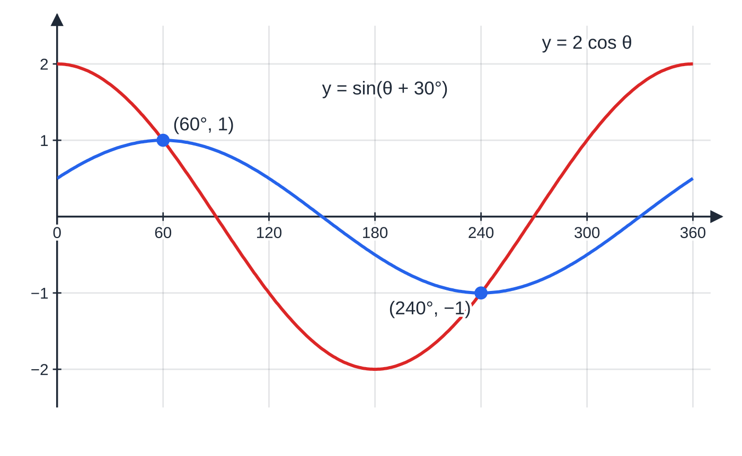
How do you solve equations involving compound angles?
Section 3 of 13
Expand every compound angle, using the exact values of the fixed angle (for example cos 30° = √3/2). Collect the sin θ terms on one side and the cos θ terms on the other, then divide by cos θ to reach tan θ= k. Dividing is allowed provided cos θ= 0 is not a solution, so check that by substituting. tan has period 180°, so in 0° ≤θ< 360° there are two solutions: the principal value and that value plus 180°.
The curves y = sin(θ + 30°) and y = 2 cos θ cross exactly twice in 0° ≤ θ < 360°: at 60° and at 240°. The solutions are 180° apart, as they must be for an equation that reduces to tan θ = √3.
Notes:
How do you solve equations involving compound angles?. Full notes: https://examinerprep.com/notes/edexcel-ial-maths/compound-angles-double-angles-and-r-form/

Slide 12
How do you solve equations involving compound angles? (continued)
Section 3 of 13 · Worked example 3 · Medium · Solve
WORKED EXAMPLE · QUESTION
Solve, for 0° ≤θ< 360°, the equation sin(θ+ 30°) = 2cos θ.
SOLUTION
Expand: sin θcos 30° + cos θsin 30° = √3/2sin θ+ ½cos θ. Multiply by 2 and collect: √3sin θ+ cos θ= 4cos θ⇒√3sin θ= 3cos θ. Divide by √3cos θ (cos θ= 0 would force sin θ= 0 too, which is impossible): tan θ= 3/√3 = √3. Principal value 60°, then add 180°: θ= 60° or 240°.
Notes:
How do you solve equations involving compound angles?: Worked example 3. Full notes: https://examinerprep.com/notes/edexcel-ial-maths/compound-angles-double-angles-and-r-form/

Slide 13
What are the double-angle formulae?
Section 4 of 13
Put B = A in the addition formulae. sin(A + A) = sin Acos A + cos Asin A = 2sin Acos A, and cos(A + A) = cos² A - sin² A. Replacing sin² A by 1 - cos² A, or cos² A by 1 - sin² A, gives two more versions of cos 2A. The formulae work for any angle and its double: sin 6x = 2sin 3xcos 3x, and cos x = 1 - 2sin²x/2.
Double-angle formulae.
sin 2A = 2sin Acos A cos 2A = cos² A - sin² A = 2cos² A - 1 = 1 - 2sin² A tan 2A = 2tan A/(1 - tan² A) Rearranged: cos² A = ½(1 + cos 2A) and sin² A = ½(1 - cos 2A). These are
not in the formulae booklet: learn them, or be ready to derive them in one line.
The rearranged forms are worth seeing as graphs. y = cos² x is a cosine wave of half the period, squeezed between 0 and 1 and centred on y = ½, which is exactly what ½(1 + cos 2x) describes.
Notes:
What are the double-angle formulae?. Full notes: https://examinerprep.com/notes/edexcel-ial-maths/compound-angles-double-angles-and-r-form/

Slide 14
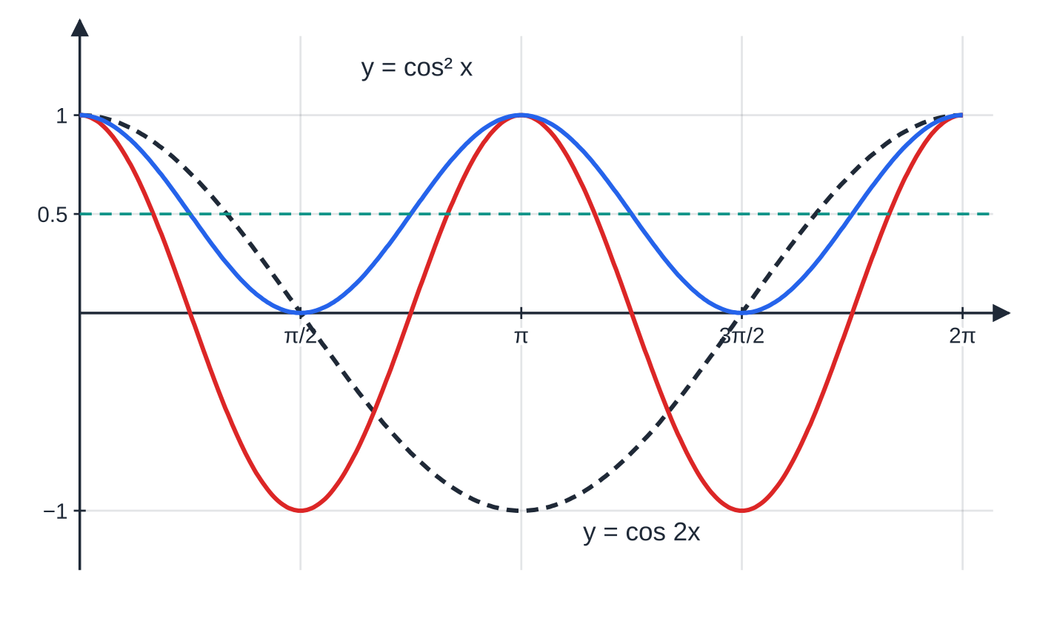
What are the double-angle formulae? (continued)
Section 4 of 13
y = cos² x (blue) lies between 0 and 1, is centred on y = 1/2 and repeats every π: it is ½(1 + cos 2x), half of cos 2x (red) lifted by 1/2. The dashed curve is y = cos x.
Notes:
What are the double-angle formulae?. Full notes: https://examinerprep.com/notes/edexcel-ial-maths/compound-angles-double-angles-and-r-form/

Slide 15
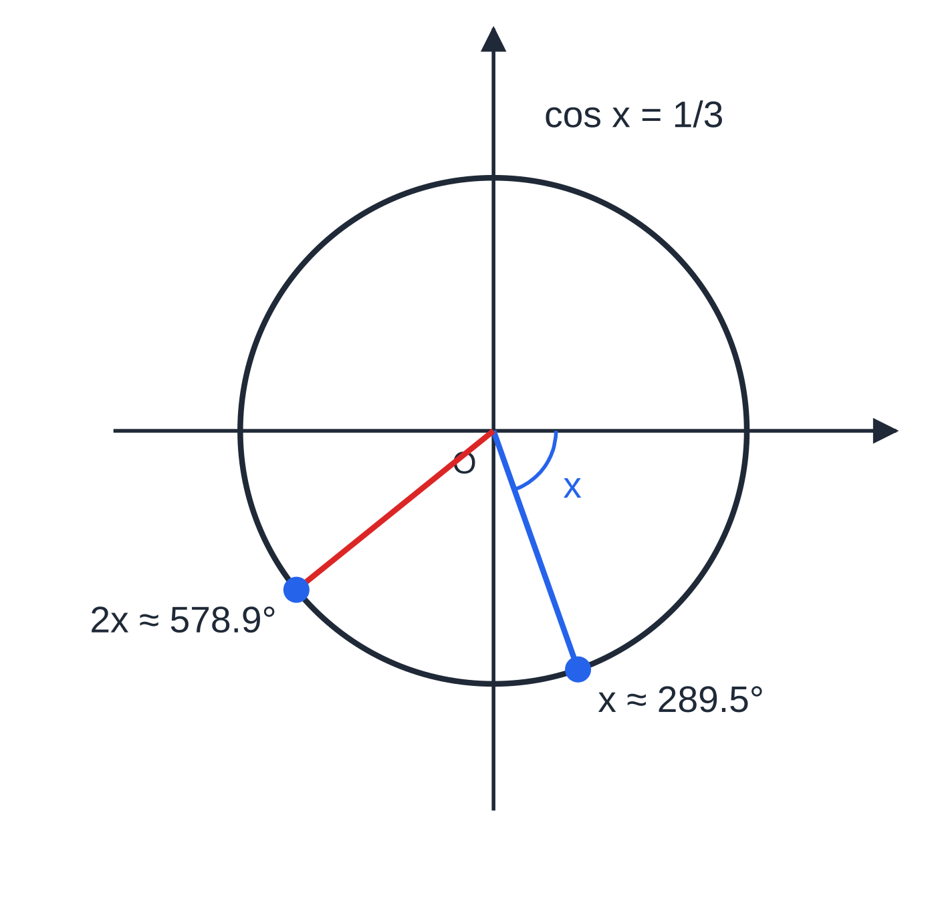
What are the double-angle formulae? (continued)
Section 4 of 13
Worked example 4 on the unit circle. With cos x = 1/3 and x in the fourth quadrant, 2x ≈ 578.9° (= 360° + 218.9°) ends in the third quadrant, where both sin 2x and cos 2x are negative.
Notes:
What are the double-angle formulae?. Full notes: https://examinerprep.com/notes/edexcel-ial-maths/compound-angles-double-angles-and-r-form/

Slide 16
What are the double-angle formulae? (continued)
Section 4 of 13 · Worked example 4 · Medium · Find
WORKED EXAMPLE · QUESTION
Given that cos x = ⅓ and 270° < x < 360°, find the exact values of (a) sin 2x; (b) cos 2x; (c) tan 2x.
SOLUTION
sin x is negative in the fourth quadrant: sin x = -√(1 - (1/9)) = -2√2/3.
(a) sin 2x = 2(-2√2/3)(⅓) = -4√2/9.
(b) The cos-only form needs no square roots: cos 2x = 2·(1/9) - 1 = -(7/9).
(c) tan 2x = (-4√2/9)/(-(7/9)) = 4√2/7. Check with the tan formula: tan x = -2√2, so (2(-2√2))/(1 - 8) = 4√2/7. There is no need to find 2x or its quadrant first: the formulae carry the signs.
Notes:
What are the double-angle formulae?: Worked example 4. Full notes: https://examinerprep.com/notes/edexcel-ial-maths/compound-angles-double-angles-and-r-form/

Slide 17
How do you solve equations containing sin 2θ or cos 2θ?
Section 5 of 13
The aim is always one trigonometric function of one angle. If the equation also contains sin θ or cos θ, replace the double angle using the formulae, and choose the form that matches:
cos 2θ with sin θ elsewhere: use cos 2θ= 1 - 2sin²θ. With cos θ: use 2cos²θ- 1. The result is a quadratic.
sin 2θ with sin θ or cos θ: write sin 2θ= 2sin θcos θ and factorise. Never divide by sin θ or cos θ, which loses the solutions where it is zero.
If every term already has the same double angle (for example 3sin 2θ= cos 2θ), keep it: solve for 2θ over the doubled interval, then halve.
Reject any root of the quadratic outside -1 ≤sin θ≤1, and say why.
Notes:
How do you solve equations containing sin 2θ or cos 2θ?. Full notes: https://examinerprep.com/notes/edexcel-ial-maths/compound-angles-double-angles-and-r-form/

Slide 18
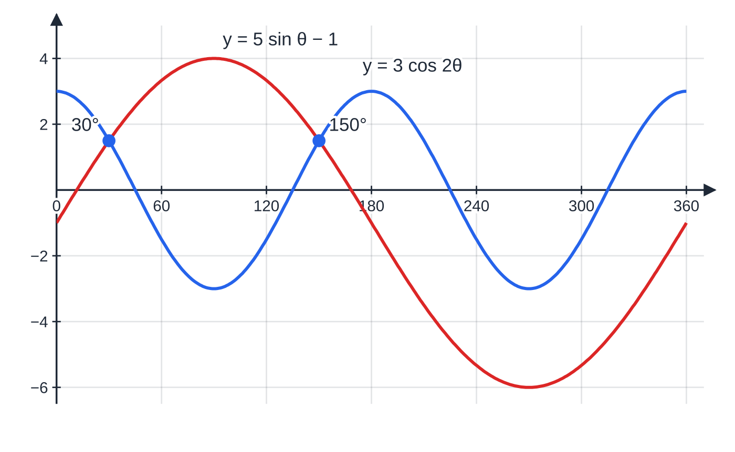
How do you solve equations containing sin 2θ or cos 2θ? (continued)
Section 5 of 13
The curves y = 3 cos 2θ and y = 5 sin θ − 1 meet only at θ = 30° and 150° in 0° ≤ θ < 360°. The other root of the quadratic, sin θ = −4/3, gives no points.
Notes:
How do you solve equations containing sin 2θ or cos 2θ?. Full notes: https://examinerprep.com/notes/edexcel-ial-maths/compound-angles-double-angles-and-r-form/

Slide 19
How do you solve equations containing sin 2θ or cos 2θ? (continued)
Section 5 of 13 · Worked example 5 · Medium · Solve
WORKED EXAMPLE · QUESTION
Solve, for 0° ≤θ< 360°, the equation 3cos 2θ= 5sin θ- 1.
SOLUTION
The other term is in sin θ, so use cos 2θ= 1 - 2sin²θ: 3 - 6sin²θ= 5sin θ- 1. Rearrange and factorise: 6sin²θ+ 5sin θ- 4 = 0 ⇒(2sin θ- 1)(3sin θ+ 4) = 0. So sin θ= ½, or sin θ= -(4/3), which has no solutions since -1 ≤sin θ≤1. Solving sin θ= ½: θ= 30° or 150°.
Notes:
How do you solve equations containing sin 2θ or cos 2θ?: Worked example 5. Full notes: https://examinerprep.com/notes/edexcel-ial-maths/compound-angles-double-angles-and-r-form/

Slide 20
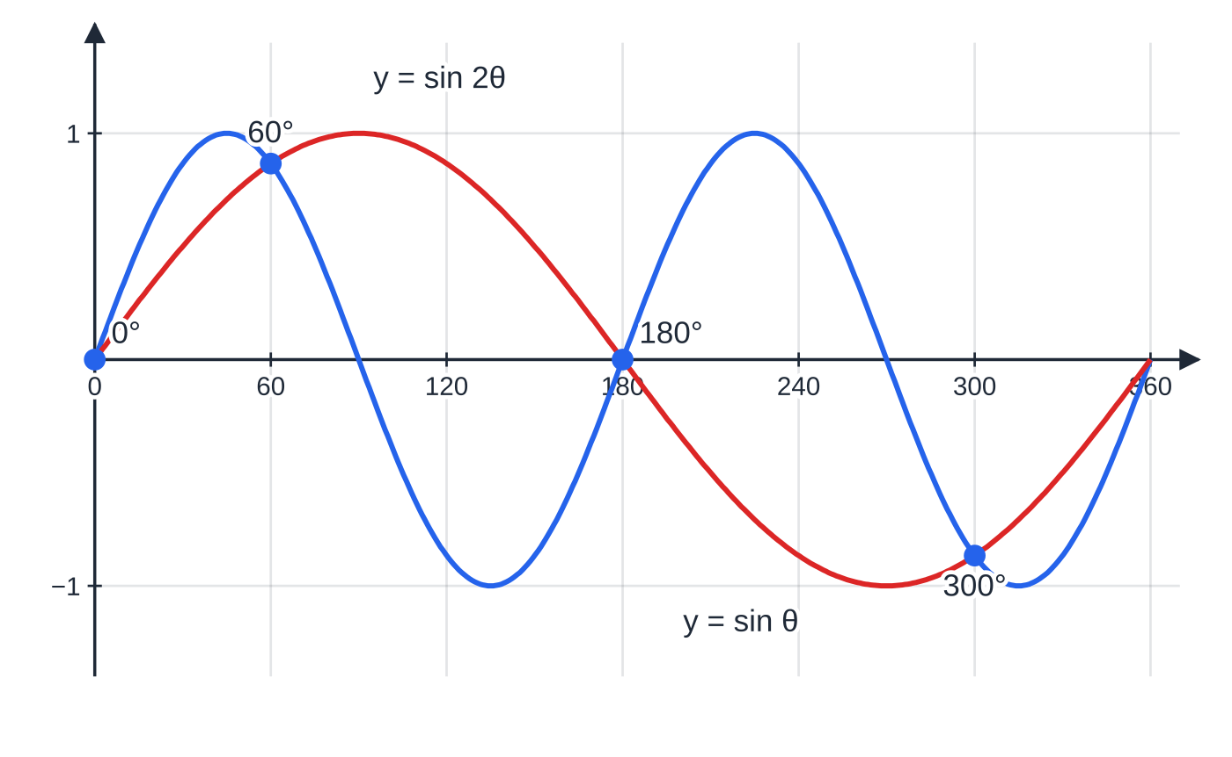
How do you solve equations containing sin 2θ or cos 2θ? (continued)
Section 5 of 13
Common error — dividing by sin θ
Solving sin 2θ= sin θ by dividing both sides by sin θ gives 2cos θ= 1, which finds 60° and 300° but loses 0° and 180°, where sin θ= 0. Write sin θ(2cos θ- 1) = 0 and solve both factors.
sin 2θ = sin θ has four solutions in 0° ≤ θ < 360°: 0°, 60°, 180° and 300°. Dividing by sin θ finds only 60° and 300°.
Notes:
How do you solve equations containing sin 2θ or cos 2θ?. Full notes: https://examinerprep.com/notes/edexcel-ial-maths/compound-angles-double-angles-and-r-form/

Slide 21
How do you prove identities and use half angles?
Section 6 of 13
Start from the more complicated side and work towards the other. Do not treat the identity as an equation: never do the same thing to both sides. A double angle on one side and single angles on the other tells you which formula to use, and you should choose the form of cos 2A that cancels something: 1 + cos 2A = 2cos² A and 1 - cos 2A = 2sin² A are the most useful. Finish with "= RHS" or "≡tan x as required".
Putting A = θ/2 in the cosine formulae gives cos θ= 2cos²θ/2 - 1 = 1 - 2sin²θ/2, and so the half-angle results below.
Half-angle results.
cos²θ/2 = ½(1 + cos θ) sin²θ/2 = ½(1 - cos θ) Take the square root and choose the sign from the quadrant of θ/2; for example cos 22.5° = √((1 + cos 45°)/2) = ½√(2 + √2) ≈0.9239. Not in the formulae booklet: derive them from cos 2A.
Notes:
How do you prove identities and use half angles?. Full notes: https://examinerprep.com/notes/edexcel-ial-maths/compound-angles-double-angles-and-r-form/

Slide 22
How do you prove identities and use half angles? (continued)
Section 6 of 13 · Worked example 6 · Medium · Prove, hence find
WORKED EXAMPLE · QUESTION
(a) Prove that sin 2x/(1 + cos 2x) ≡tan x, for cos x ≠0. (b) Hence find the exact value of tan 22.5°, in the form p + q√2. (c) Prove that cos⁴ x - sin⁴ x ≡cos 2x.
SOLUTION
(a) Use the form of cos 2x that cancels the 1: LHS = 2sin xcos x/(1 + (2cos² x - 1)) = 2sin xcos x/(2cos² x) = sin x/cos x = tan x as required.
(b) Put x = 22.5°, so 2x = 45°: tan 22.5° = (√2/2)/(1 + √2/2) = √2/(2 + √2) = (√2(2 - √2))/(4 - 2) = √2 - 1 (≈ 0.4142, matching the calculator). "Hence" means the identity in (a) must be used.
(c) Difference of two squares, then sin² + cos² = 1: (cos² x + sin² x)(cos² x - sin² x) = 1 ×(cos² x - sin² x) = cos 2x.
Notes:
How do you prove identities and use half angles?: Worked example 6. Full notes: https://examinerprep.com/notes/edexcel-ial-maths/compound-angles-double-angles-and-r-form/

Slide 23
How do you prove identities and use half angles? (continued)
Section 6 of 13
Exam tip — triple angles
Triple angles are built the same way: sin 3x = sin(2x + x) = sin 2xcos x + cos 2xsin x; then replace the double angles and use cos² x = 1 - sin² x. A "show that" of this type needs every line written out.
Notes:
How do you prove identities and use half angles?. Full notes: https://examinerprep.com/notes/edexcel-ial-maths/compound-angles-double-angles-and-r-form/

Slide 24
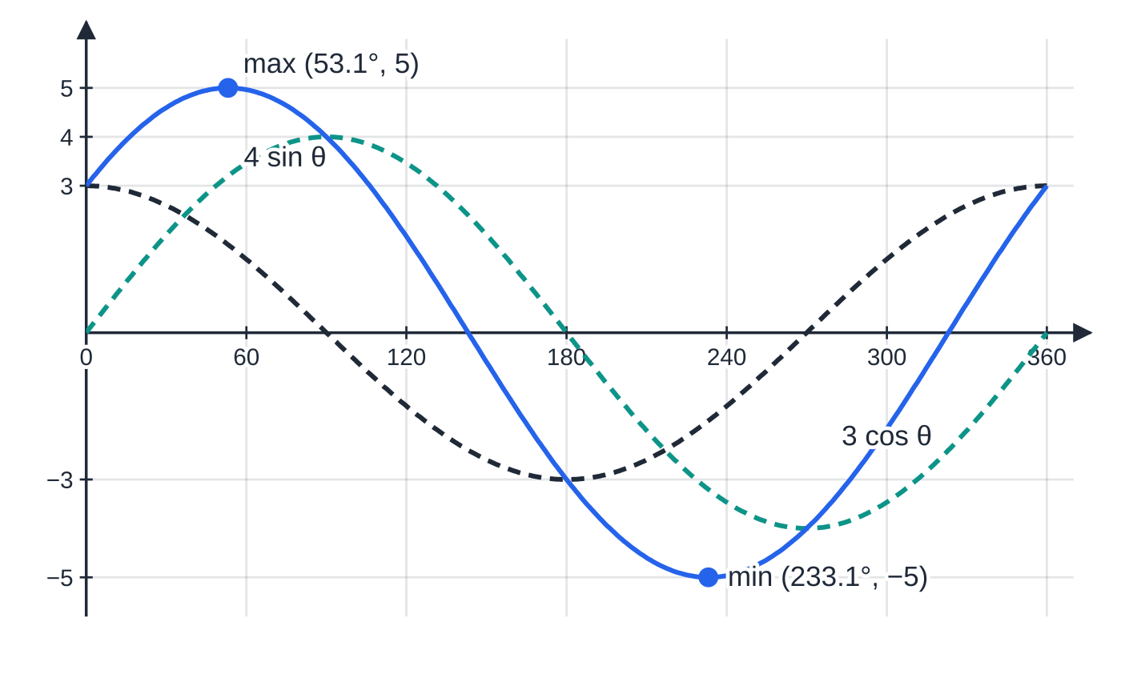
How do you write acos θ+ bsin θ as a single sine or cosine?
Section 7 of 13
Add a cosine wave and a sine wave of the same period and something remarkable happens: the result is a single wave of the same period, with a bigger amplitude R and a horizontal shift α. The figure shows 3cos θ+ 4sin θ, which is exactly 5cos(θ- 53.1°). Writing the sum this way is called the R-form (or harmonic form).
The method is always the same three lines:
expand the required form, for example Rcos(θ+ α) = Rcos θcos α- Rsin θsin α;
The sum of the dashed waves 3 cos θ and 4 sin θ is the solid wave 5 cos(θ − 53.1°): amplitude R = √(3² + 4²) = 5, shifted right by α = 53.1°, where tan α = 4/3.
Notes:
How do you write acos θ+ bsin θ as a single sine or cosine?. Full notes: https://examinerprep.com/notes/edexcel-ial-maths/compound-angles-double-angles-and-r-form/

Slide 25
How do you write acos θ+ bsin θ as a single sine or cosine? (continued)
Section 7 of 13
compare coefficients of cos θ and sin θ to get Rcos α= … and Rsin α= … (both positive when 0 < α< 90° and R > 0);
square and add for R = √(a² + b²); divide for tan α.
Use the form the question gives. As a guide, these choices keep α acute: acos+ bsin→Rcos(θ- α); acos- bsin→Rcos(θ+ α); bsin+ acos→Rsin(θ+ α); bsin- acos→Rsin(θ- α).
The R-form (harmonic form).
acos θ+ bsin θ= Rcos(θ- α), R = √(a² + b²) > 0, tan α= b/a The same R works for all four forms; only α and the signs change. Not in the formulae booklet: derive it each time by expanding with the compound angle formula.
To solve acos θ+ bsin θ= c, write it as Rcos(θ- α) = c, so cos(θ- α) = c/R.
Notes:
How do you write acos θ+ bsin θ as a single sine or cosine?. Full notes: https://examinerprep.com/notes/edexcel-ial-maths/compound-angles-double-angles-and-r-form/

Slide 26
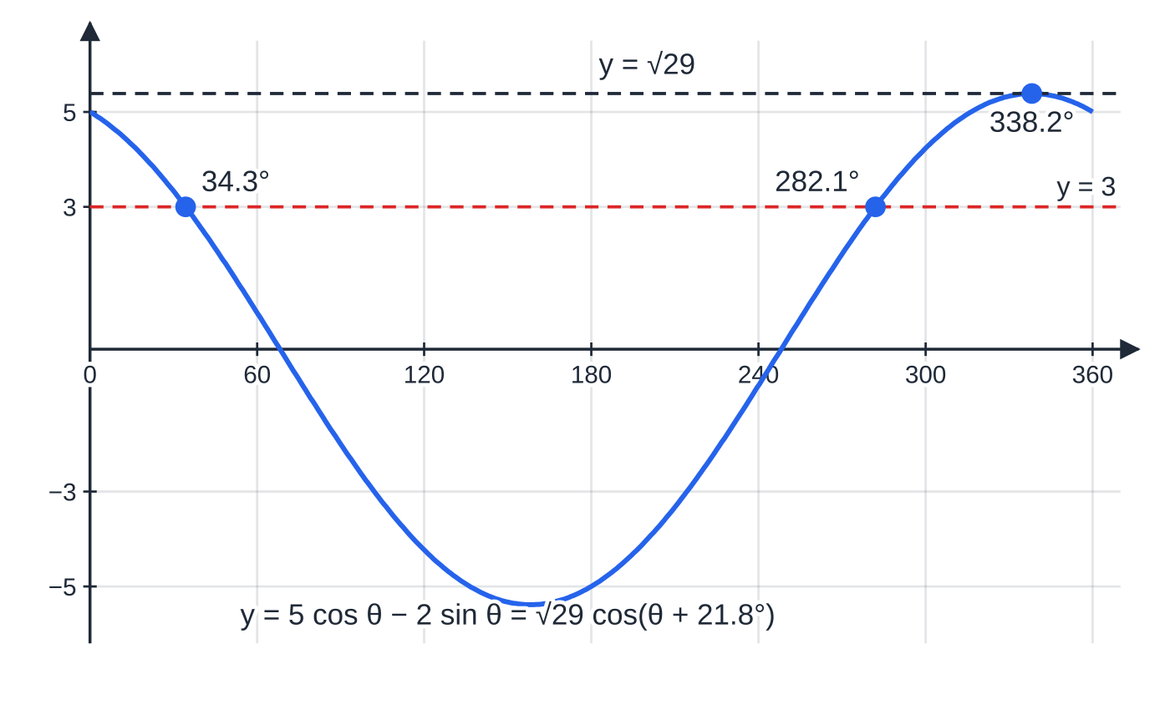
How do you write acos θ+ bsin θ as a single sine or cosine? (continued)
Section 7 of 13
Shift the interval by α before finding the values of the bracket, then add α back (with a "+" form, subtract it). There are no solutions if |c| > R.
Worked example 7: 5 cos θ − 2 sin θ is the cosine curve √29 cos(θ + 21.8°), shifted 21.8° to the left with amplitude √29 ≈ 5.39. The line y = 3 cuts it at θ = 34.3° and 282.1°; the maximum is at θ = 338.2°.
Notes:
How do you write acos θ+ bsin θ as a single sine or cosine?. Full notes: https://examinerprep.com/notes/edexcel-ial-maths/compound-angles-double-angles-and-r-form/

Slide 27
How do you write acos θ+ bsin θ as a single sine or cosine? (continued)
Section 7 of 13 · Worked example 7 · Medium · Express, hence solve
WORKED EXAMPLE · QUESTION
(a) Express 5cos θ- 2sin θ in the form Rcos(θ+ α), where R > 0 and 0 < α< 90°. Give the exact value of R and the value of α to 1 decimal place. (b) Hence solve, for 0 ≤θ< 360°, the equation 5cos θ- 2sin θ= 3, giving answers to 1 decimal place. (c) Write down the maximum value of 5cos θ- 2sin θ and the value of θ in this interval at which it occurs.
SOLUTION
(a) Rcos θcos α- Rsin θsin α, so Rcos α= 5 and Rsin α= 2. R = √(25 + 4) = √29; tan α= (2/5) ⇒ α= 21.8°.
(b) cos(θ+ 21.8°) = 3/√29, with 21.8° ≤θ+ 21.8° < 381.8°. The values of the bracket in this interval are 56.15° and 360° - 56.15° = 303.85°. Subtract the unrounded α: θ= 34.3° or 282.1°.
(c) The maximum of √29cos(…) is √29, when the bracket is 0° or 360°. Here θ+ 21.8° = 360°, so the maximum is √29 ≈5.39 at θ= 338.2°.
Notes:
How do you write acos θ+ bsin θ as a single sine or cosine?: Worked example 7. Full notes: https://examinerprep.com/notes/edexcel-ial-maths/compound-angles-double-angles-and-r-form/

Slide 28
How do you write acos θ+ bsin θ as a single sine or cosine? (continued)
Section 7 of 13
Common error — upside-down tan α
Writing tan α= (5/2) instead of (2/5). Divide Rsin α by Rcos α, in that order. A quick check: put θ= 0 into both forms; 5 = √29cos α only if cos α= 5/√29.
Notes:
How do you write acos θ+ bsin θ as a single sine or cosine?. Full notes: https://examinerprep.com/notes/edexcel-ial-maths/compound-angles-double-angles-and-r-form/

Slide 29
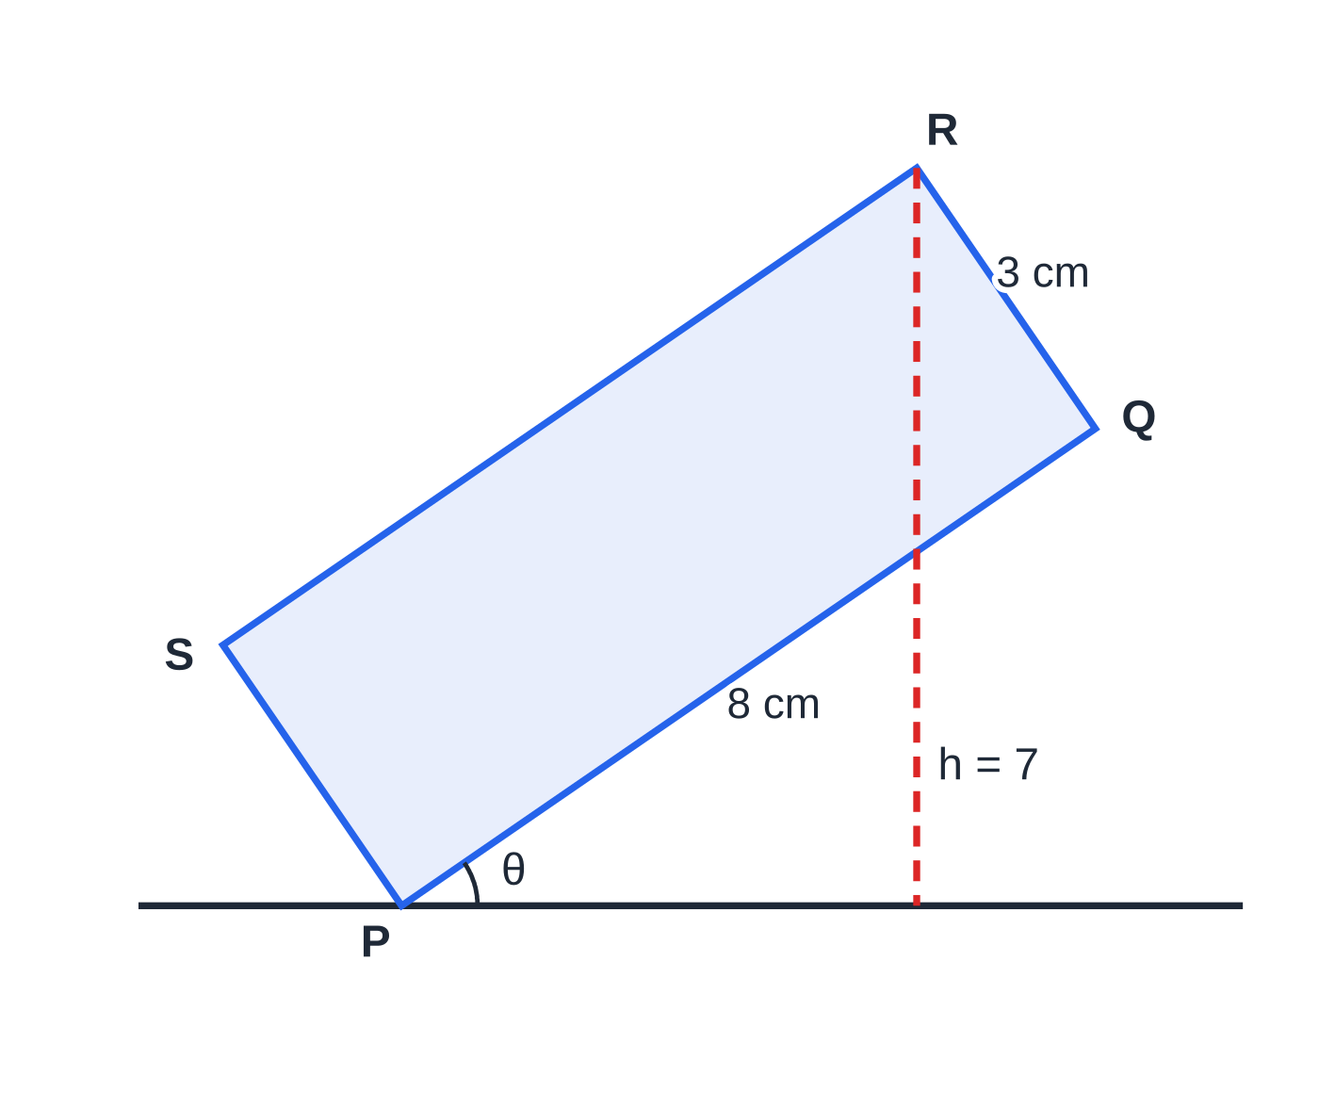
How does the R-form give maximum and minimum values?
Section 8 of 13
Since -1 ≤cos(…) ≤1, the expression Rcos(θ±α) lies between -R and R, and the same holds for Rsin(θ±α). The value of θ at the maximum comes from setting the bracket equal to 0° for cos (or 90° for sin); at the minimum, 180° for cos (or 270° for sin). Then solve for θ.
Linked expressions follow from this. For k + Rsin(…) the range is k - R to k + R. For a reciprocal such as m/(k + Rsin(…)) with k > R, the greatest value occurs when the denominator is least. For a squared term such as (Rsin(…))², the least value is 0, not -R². Contexts such as tides, temperatures and the heights of rotating objects use exactly this: the "greatest height" is k + R.
Worked example 8 drawn to scale at θ = 34.5°, when the corner R is 7 cm above the line. Q is 8 sin θ above P, and QR rises a further 3 cos θ.
Notes:
How does the R-form give maximum and minimum values?. Full notes: https://examinerprep.com/notes/edexcel-ial-maths/compound-angles-double-angles-and-r-form/

Slide 30
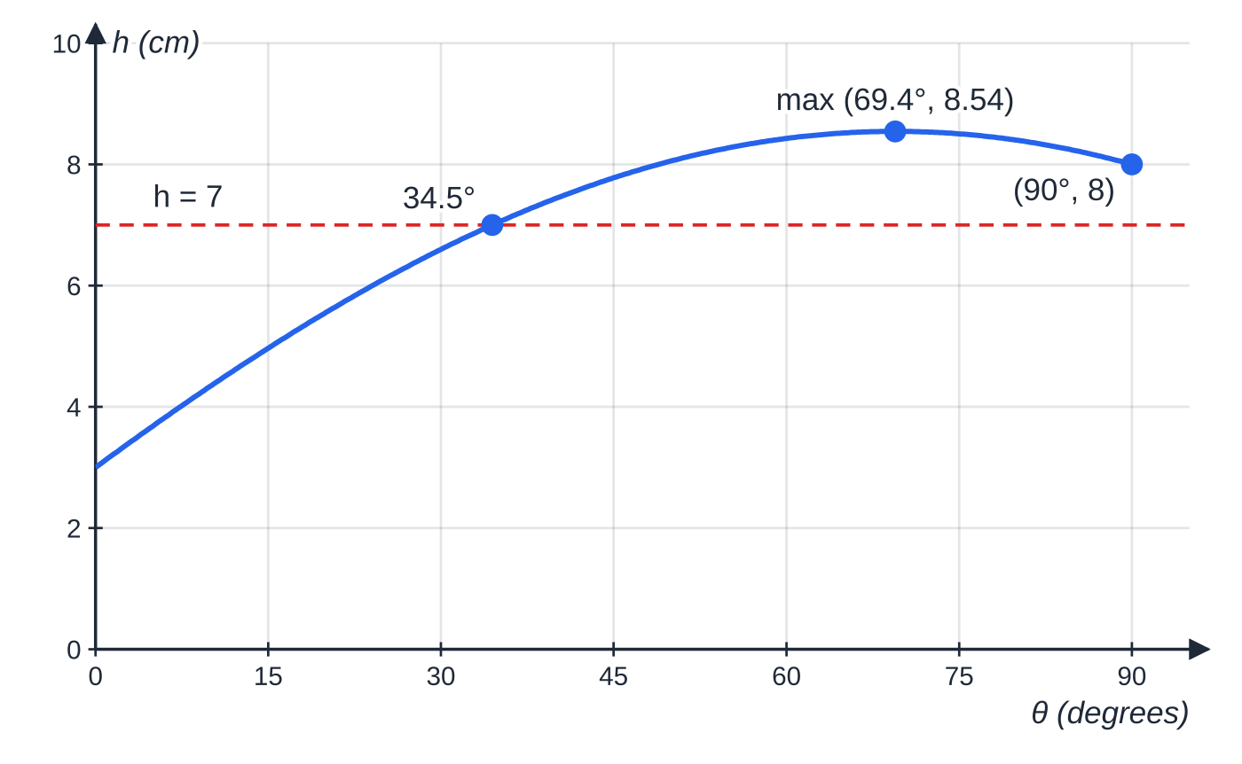
How does the R-form give maximum and minimum values? (continued)
Section 8 of 13
The height h = 8 sin θ + 3 cos θ = √73 sin(θ + 20.56°) for 0° < θ < 90°. It rises to 8.54 cm at θ = 69.4° and is still above 7 cm at θ = 90°, so h = 7 only once in this interval.
Notes:
How does the R-form give maximum and minimum values?. Full notes: https://examinerprep.com/notes/edexcel-ial-maths/compound-angles-double-angles-and-r-form/

Slide 31
How does the R-form give maximum and minimum values? (continued)
Section 8 of 13 · Worked example 8 · Hard · Show that, express, find
WORKED EXAMPLE · QUESTION
A rectangle PQRS has PQ = 8 cm and QR = 3 cm. It stands in a vertical plane with the corner P on a horizontal line and PQ at an angle θ to the line, where 0° < θ< 90°. The corner S is on the same side of PQ as R, above the line. (a) Show that the height of R above the line is h cm, where h = 8sin θ+ 3cos θ. (b) Express h in the form Rsin(θ+ α), where R > 0 and 0 < α< 90°. Give R exactly and α to 2 decimal places. (c) Find the greatest possible height of R above the line, and the value of θ at which it occurs. (d) Find the value of θ for which R is 7 cm above the line.
SOLUTION
(a) Q is 8sin θ above P. QR is perpendicular to PQ, so it makes angle θ with the vertical and rises 3cos θ. So h = 8sin θ+ 3cos θ as required.
(b) Rsin(θ+ α) = Rsin θcos α+ Rcos θsin α, so Rcos α= 8, Rsin α= 3. R = √73, α= 20.56° (tan α= (3/8)).
(c) Greatest when sin(θ+ α) = 1: h_(max) = √73 ≈ 8.54 cm when θ+ 20.56° = 90°, i.e. θ= 69.4°.
Notes:
How does the R-form give maximum and minimum values?: Worked example 8. Full notes: https://examinerprep.com/notes/edexcel-ial-maths/compound-angles-double-angles-and-r-form/

Slide 32
How does the R-form give maximum and minimum values? (continued)
Section 8 of 13 · Worked example 8 · Hard · Show that, express, find (continued)
(d) sin(θ+ α) = 7/√73 ⇒θ+ α= 55.01° or 124.99°, so θ= 34.46° or 104.43°. Only θ= 34.5° lies in 0° < θ< 90°. The second value solves the equation but not the problem: at θ= 104.4° the side PQ would lean back past the vertical.
Notes:
How does the R-form give maximum and minimum values?: Worked example 8. Full notes: https://examinerprep.com/notes/edexcel-ial-maths/compound-angles-double-angles-and-r-form/

Slide 33
Exam tips for P3.4
Section 9 of 13
Exam tip 1 — know which formulae are given
The compound angle formulae are in the booklet; the double-angle formulae and the R-form are not. Learn sin 2A, all three versions of cos 2A and tan 2A well enough to choose the right one without thinking.
Exam tip 2 — keep α unrounded
Store α in your calculator and subtract the stored value in the final step. Rounding α to 1 d.p. first and then subtracting can move the last digit of the answer.
Exam tip 3 — shift the interval before you solve
If 0 ≤θ< 360°, then θ+ α runs from α to 360° + α. Write that interval down and list every value of the bracket inside it before subtracting α. For 2θ the interval doubles.
Notes:
Exam tips for P3.4. Full notes: https://examinerprep.com/notes/edexcel-ial-maths/compound-angles-double-angles-and-r-form/

Slide 34
Exam tips for P3.4 (continued)
Section 9 of 13
Exam tip 4 — "hence" and "show that"
After "Express … in the form Rcos(θ+ α)", a "hence" part must use that form; solving another way is not what is asked. In a show-that, write every step down to the given result and finish with a statement.
Exam tip 5 — radians or degrees
Read the interval: 0 ≤x < 2π means radians, and α must then be in radians (usually to 3 decimal places). Set your calculator before the first inverse-trig step.
Notes:
Exam tips for P3.4. Full notes: https://examinerprep.com/notes/edexcel-ial-maths/compound-angles-double-angles-and-r-form/

Slide 35
Common misconceptions
Section 10 of 13
Misconception | Why it is wrong | Correct idea
sin(A + B) = sin A + sin B. | sin is not linear: A = B = 90° gives 0 on the left and 2 on the right. | sin(A + B) = sin Acos B + cos Asin B.
cos(A + B) = cos Acos B + sin Asin B. | That is cos(A - B); the signs are swapped for cos. | For cos, "plus" on the left gives "minus" on the right, and vice versa.
sin 2A = 2sin A. | At A = 90°, sin 180° = 0 but 2sin 90° = 2. | sin 2A = 2sin Acos A.
To solve sin 2θ= sin θ, divide by sin θ. | Dividing by an expression that can be zero loses solutions. | Factorise: sin θ(2cos θ- 1) = 0, and solve both factors.
In the R-form, R = a + b. | R comes from squaring and adding Rcos α and Rsin α. | R = √(a² + b²).
The maximum of 1/(10 + 6sin θ) is (1/16). | A fraction with a positive numerator is greatest when its denominator is least. | The denominator ranges from 4 to 16, so the maximum is ¼ and the minimum is (1/16).
Notes:
Common misconceptions. Full notes: https://examinerprep.com/notes/edexcel-ial-maths/compound-angles-double-angles-and-r-form/

Slide 36
How this topic connects
Section 11 of 13
P3.3 Reciprocal and inverse trigonometric functions
Exact values, CAST and solving sin θ= k come from earlier units; sec, cosec, cot and sec²θ= 1 + tan²θ from P3.3 are often mixed into the same identity or equation as the formulae here.
P3.6 Differentiation and P4 integration
The derivatives of sin x and cos x rest on the compound angle formulae: a first-principles argument expands sin(x + h). In P4, sin² x and cos² x are integrated by first writing them as ½(1 ∓cos 2x).
Mechanics and Physics
Resolving forces gives terms like Pcos θ+ Qsin θ, and the R-form finds the angle that makes such a force greatest or least; projectile ranges use 2sin θcos θ= sin 2θ. Adding two oscillations of the same frequency gives a single oscillation: the R-form is the algebra of superposition, with R the resultant amplitude and α the phase.
Notes:
How this topic connects. Full notes: https://examinerprep.com/notes/edexcel-ial-maths/compound-angles-double-angles-and-r-form/

Slide 37
Key formulae
Section 12 of 13
Formula | Use | In the formulae list?
sin(A ±B) = sin Acos B ±cos Asin B | expanding sines of sums and differences | Yes
cos(A ±B) = cos Acos B ∓sin Asin B | expanding cosines; the R-form | Yes
tan(A ±B) = (tan A ±tan B)/(1 ∓tan Atan B) | exact tangents; angles between lines | Yes
sin 2A = 2sin Acos A | double-angle equations and identities | No — derive it
cos 2A = cos² A - sin² A = 2cos² A - 1 = 1 - 2sin² A | quadratics in sin or cos; identities | No — derive it
tan 2A = 2tan A/(1 - tan² A) | double angles from a given tan | No — derive it
cos² A = ½(1 + cos 2A), sin² A = ½(1 - cos 2A) | half angles; removing squares | No — derive it
acos θ+ bsin θ= Rcos(θ- α), R = √(a² + b²), tan α= b/a | solving acos θ+ bsin θ= c; maxima and minima | No — derive it
sin² A + cos² A = 1 | missing ratios; simplifying | No — learn it
Notes:
Key formulae. Full notes: https://examinerprep.com/notes/edexcel-ial-maths/compound-angles-double-angles-and-r-form/

Slide 38
Check your understanding
Section 13 of 13
1. Find the exact value of cos 15°.
2. Simplify 2sin 3xcos 3x.
3. Write cos² x in terms of cos 2x.
4. Find the greatest and least values of 1/(20 + 12sin θ- 5cos θ).
5. Solve sin 2θ= sin θ for 0° ≤θ< 360°.
6. Express 3cos θ+ 4sin θ in the form Rcos(θ- α) and state its minimum value.
Notes:
Check your understanding: questions. Full notes: https://examinerprep.com/notes/edexcel-ial-maths/compound-angles-double-angles-and-r-form/

Slide 39
Check your understanding · answers
Section 13 of 13
1. cos(45° - 30°) = cos 45°cos 30° + sin 45°sin 30° = √2/2·√3/2 + √2/2·½ = (√6 + √2)/4.
2. It is sin 2A with A = 3x, so it equals sin 6x.
3. From cos 2x = 2cos² x - 1: cos² x = ½(1 + cos 2x).
4. 12sin θ- 5cos θ= 13sin(θ- α), with R = √(144 + 25) = 13. The denominator ranges from 20 - 13 = 7 to 20 + 13 = 33, so the greatest value is (1/7) and the least is (1/33).
5. 2sin θcos θ- sin θ= 0, so sin θ(2cos θ- 1) = 0. sin θ= 0 gives 0° and 180°; cos θ= ½ gives 60° and 300°. Four solutions: 0°, 60°, 180°, 300°.
6. Rcos α= 3, Rsin α= 4, so R = 5 and tan α= (4/3), α= 53.1°. The expression is 5cos(θ- 53.1°), with minimum -5 (when θ- 53.1° = 180°, i.e. θ= 233.1°).
Notes:
Check your understanding: answers. Full notes: https://examinerprep.com/notes/edexcel-ial-maths/compound-angles-double-angles-and-r-form/

Slide 40
Practice questions
2 original exam-style questions. Answers at the end of the deck.

Slide 41
Question 1
7 marks
Exact ratios of half angles can be found from the double-angle formula for cos 2A. Give exact answers with full working.
(a) Using the identity cos 2A ≡ 1 − 2 sin² A with a suitable value of A, show that sin 22.5° = ½√(2 − √2). [3]
(b) Given that cos θ = 7/25 and 270° < θ < 360°, find the exact values of sin(½θ) and cos(½θ). [4]
Notes:
Online with the full mark scheme: https://examinerprep.com/ial-maths-p3-4-compound-angles-double-angles-and-r-form-questions#IALM-P3-4-B-09

Slide 42
Question 2
5 marks
Do not use a calculator in this question. Show all your working.
(a) By writing 165° as 120° + 45°, show that cos 165° = −(√6 + √2)/4. [2]
(b) Find the exact value of tan 165°, giving your answer in the form a + b√3, where a and b are integers. [3]
Notes:
Online with the full mark scheme: https://examinerprep.com/ial-maths-p3-4-compound-angles-double-angles-and-r-form-questions#IALM-P3-4-B-01

Slide 43
Answers

Slide 44
Question 1 · answer
Mark scheme
cos 45° = 1 − 2 sin² 22.5°
sin² 22.5° = (1 − √2/2)/2 = (2 − √2)/4
sin 22.5° > 0, so sin 22.5° = ½√(2 − √2), as required
135° < ½θ < 180°, so sin(½θ) > 0 and cos(½θ) < 0
sin²(½θ) = (1 − 7/25)/2 = 9/25 or cos²(½θ) = (1 + 7/25)/2 = 16/25
sin(½θ) = 3/5
cos(½θ) = −4/5
Notes:
Full mark scheme: https://examinerprep.com/ial-maths-p3-4-compound-angles-double-angles-and-r-form-questions#IALM-P3-4-B-09

Slide 45
Question 2 · answer
Mark scheme
cos 120° cos 45° − sin 120° sin 45°
(−½)(√2/2) − (√3/2)(√2/2) = −(√2 + √6)/4, as required
(tan 120° + tan 45°)/(1 − tan 120° tan 45°) = (1 − √3)/(1 + √3)
multiplies numerator and denominator by (1 − √3)
(1 − √3)²/(1 − 3) = (4 − 2√3)/(−2) = −2 + √3
Notes:
Full mark scheme: https://examinerprep.com/ial-maths-p3-4-compound-angles-double-angles-and-r-form-questions#IALM-P3-4-B-01

Slide 46
Keep practising
Notes for this topic
Questions on this topic
Build a printable test
ExaminerPrep is an independent tutoring service. It has been developed independently from and is not endorsed by the International Baccalaureate Organization. "International Baccalaureate", "IB" and "IB Diploma Programme" are registered trademarks of the IBO, used here for descriptive purposes only.
Pearson Edexcel and Cambridge are trademarks of their owners; ExaminerPrep is not affiliated with any exam board.

