Slide 1
EP
EDEXCEL IAL MATHS
S2.3 Continuous uniform distribution and Normal approximations
The full notes page in 13 sections · practice questions with answers · simulations
ExaminerPrep is an independent tutoring service. It has been developed independently from and is not endorsed by the International Baccalaureate Organization. "International Baccalaureate", "IB" and "IB Diploma Programme" are registered trademarks of the IBO, used here for descriptive purposes only.
Pearson Edexcel and Cambridge are trademarks of their owners; ExaminerPrep is not affiliated with any exam board.
Notes:
S2.3 Continuous uniform distribution and Normal approximations. Notes for this topic: https://examinerprep.com/notes/edexcel-ial-maths/continuous-uniform-distribution-and-normal-approximations/

Slide 2
What this page covers
Overview
The continuous uniform (rectangular) distribution on [a,b]: its pdf and cdf
Deriving the mean (a+b)/2 and variance ((b-a)²)/12, and finding E(g(X)) for a uniform variable
Modelling with the uniform distribution, including rounding errors
The Normal approximation to the binomial, B(n,p)≈N(np,np(1-p)), and when it is valid
The Normal approximation to the Poisson, Po(λ)≈N(λ,λ), for large λ
Continuity corrections for any inequality or single value
Choosing the appropriate approximation, and using one in reverse with a percentage point
Notes:
What this page covers. Full notes: https://examinerprep.com/notes/edexcel-ial-maths/continuous-uniform-distribution-and-normal-approximations/

Slide 3
In one minute
Key points
1
For X~U[a,b] the pdf is a rectangle of height 1/(b-a), so every probability is the length of an interval divided by b-a.
4
B(n,p)≈N(np,np(1-p)) when n is large and p is close to ½; Po(λ)≈N(λ,λ) when λ is large (more than about 10).
2
E(X)=(a+b)/2, Var(X)=((b-a)²)/12, and F(x)=(x-a)/(b-a) on [a,b].
5
Continuity correction: each integer k becomes the interval k-0.5 to k+0.5, so P(X≤38)≈P(Y<38.5) and P(X≥36)≈P(Y>35.5).
3
A value rounded to the nearest k has a rounding error ~U[-k/2,k/2].
6
Choosing: n large, p small → Poisson; n large, p near ½ → Normal; Poisson with large λ → Normal.
Notes:
In one minute: the key points of this topic.

Slide 4
What is the continuous uniform distribution?
Section 1 of 13
Some quantities are equally likely to be anywhere in a fixed range and cannot fall outside it: the waiting time at a crossing whose signal cycles regularly, the point where a rod snaps, the error left after rounding a reading. The model for all of these is the simplest pdf there is — a flat line.
The continuous uniform (rectangular) distribution
on [a,b] has probability density function
f(x)=1/(b-a) for a≤x≤b, f(x)=0 otherwise.
We write X~U[a,b] (some books write U(a,b)).
The graph of f is a rectangle of width b-a and height 1/(b-a), so its total area is 1, as every pdf must have.
Probabilities are areas of thinner rectangles, so for a≤c<d≤b: P(c<X<d)=(d-c)/(b-a). No integration is needed.
Notes:
What is the continuous uniform distribution?. Full notes: https://examinerprep.com/notes/edexcel-ial-maths/continuous-uniform-distribution-and-normal-approximations/

Slide 5
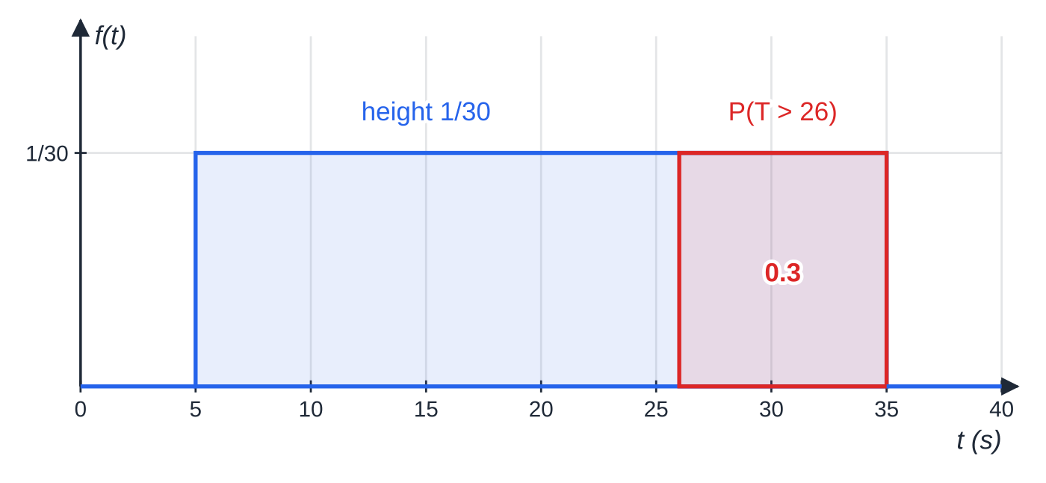
What is the continuous uniform distribution? (continued)
Section 1 of 13
For any continuous variable P(X=c)=0, so < and ≤ give the same probability. (This is not true for the binomial and Poisson distributions later on this page.)
The distribution is symmetrical about its midpoint, so the mean and the median are both (a+b)/2. It has no mode: every value in the range is equally likely.
The pdf of T~U[5,35] is a rectangle of height (1/30). The red part, from 26 to 35, has area 9×(1/30)=0.3=P(T>26).
Notes:
What is the continuous uniform distribution?. Full notes: https://examinerprep.com/notes/edexcel-ial-maths/continuous-uniform-distribution-and-normal-approximations/

Slide 6
What is the continuous uniform distribution? (continued)
Section 1 of 13 · Worked example 1 · Easy · Write down, find
WORKED EXAMPLE · QUESTION
After a pedestrian presses the button at a crossing, the time T seconds until the green signal appears is modelled by the continuous uniform distribution on [5,35]. (a) Write down the probability density function of T. (b) Find P(T>26). (c) Find E(T) and the standard deviation of T. (d) Find the probability that T is within one standard deviation of its mean.
SOLUTION
(a) Height = 1 ÷ width: f(t)=(1/30) for 5≤t≤35, 0 otherwise
(b) Length of interval × height: P(T>26)=(35-26)×(1/30)= 0.3
(c) Using the formulae (both in the booklet): E(T)=(5+35)/2= 20 s; Var(T)=30²/12=75⇒σ=√75= 8.66 s
(d) The interval 20±8.66 lies inside [5,35], so its probability is its length ÷ 30:
P(20-√75<T<20+√75)=2√75/30=1/√3=
Notes:
What is the continuous uniform distribution?: Worked example 1. Full notes: https://examinerprep.com/notes/edexcel-ial-maths/continuous-uniform-distribution-and-normal-approximations/

Slide 7
What is the continuous uniform distribution? (continued)
Section 1 of 13 · Worked example 1 · Easy · Write down, find (continued)
0.577
For any uniform distribution this probability is 1/√3≈0.577, whatever a and b are: the standard deviation is always width ÷√12.
Notes:
What is the continuous uniform distribution?: Worked example 1. Full notes: https://examinerprep.com/notes/edexcel-ial-maths/continuous-uniform-distribution-and-normal-approximations/

Slide 8
What is the continuous uniform distribution? (continued)
Section 1 of 13
Common error — a pdf without its range
Giving only "f(t)=(1/30)" for a pdf. A pdf is not complete without its range: write "for 5≤t≤35, and 0 otherwise".
Notes:
What is the continuous uniform distribution?. Full notes: https://examinerprep.com/notes/edexcel-ial-maths/continuous-uniform-distribution-and-normal-approximations/

Slide 9
Where do the mean and variance of U[a, b] come from?
Section 2 of 13
Mean and variance of X~U[a,b]
(in the formulae booklet, but the specification also expects you to derive them)
E(X)=(a+b)/2, Var(X)=((b-a)²)/12.
Both come from the general results for a continuous random variable in S2.2: E(X)=∫xf(x) dx and Var(X)=∫x²f(x) dx-[E(X)]². The only algebra you need is two factorisations.
Notes:
Where do the mean and variance of U[a, b] come from?. Full notes: https://examinerprep.com/notes/edexcel-ial-maths/continuous-uniform-distribution-and-normal-approximations/

Slide 10
Where do the mean and variance of U[a, b] come from? (continued)
Section 2 of 13 · Worked example 2 · Medium · Show that
WORKED EXAMPLE · QUESTION
The random variable X has the continuous uniform distribution on [a,b]. Show, by integration, that (a) E(X)=½(a+b) and (b) Var(X)=(1/12)(b-a)².
SOLUTION
(a) Integrate xf(x) over [a,b]:
E(X)=∫ₐᵇx/(b-a) dx=(b²-a²)/(2(b-a))=((b-a)(b+a))/(2(b-a))=
½(a+b)
(b) Find E(X²) in the same way, using b³-a³=(b-a)(b²+ab+a²):
E(X²)=∫ₐᵇx²/(b-a) dx=(b³-a³)/(3(b-a))=(a²+ab+b²)/3.
Notes:
Where do the mean and variance of U[a, b] come from?: Worked example 2. Full notes: https://examinerprep.com/notes/edexcel-ial-maths/continuous-uniform-distribution-and-normal-approximations/

Slide 11
Where do the mean and variance of U[a, b] come from? (continued)
Section 2 of 13 · Worked example 2 · Medium · Show that (continued)
Subtract the square of the mean over a common denominator of 12:
Var(X)=(a²+ab+b²)/3-((a+b)²)/4=(4a²+4ab+4b²-3a²-6ab-3b²)/12=(a²-2ab+b²)/12=
(1/12)(b-a)²
Part (a) can also be argued from symmetry: the pdf is symmetrical about x=(a+b)/2. But when the question says "by integration", the integral is what is required.
Notes:
Where do the mean and variance of U[a, b] come from?: Worked example 2. Full notes: https://examinerprep.com/notes/edexcel-ial-maths/continuous-uniform-distribution-and-normal-approximations/

Slide 12
Where do the mean and variance of U[a, b] come from? (continued)
Section 2 of 13
Exam tip — show every factorisation
In a "show that" derivation the answer is printed, so every factorisation must be visible: write b²-a²=(b-a)(b+a) and the expansion over 12 on separate lines, and end with the exact printed form.
Notes:
Where do the mean and variance of U[a, b] come from?. Full notes: https://examinerprep.com/notes/edexcel-ial-maths/continuous-uniform-distribution-and-normal-approximations/

Slide 13
How do you use the cumulative distribution function?
Section 3 of 13
The cdf is F(x)=P(X≤x). For U[a,b], integrate the constant pdf from a to x:
Cumulative distribution function of U[a,b]
(not in the formulae booklet — derive it from ∫ₐˣ f(t) dt)
F(x)={ 0, x<a; [2pt] (x-a)/(b-a), a≤x≤b; [4pt] 1, x>b }
All three pieces are part of the answer. The graph is a straight line from (a,0) to (b,1), flat at 0 before and at 1 after.
Quartiles and percentiles: solve F(x)=0.25, 0.5, 0.75,…. The rth percentile is a+r/100(b-a), a fraction of the way along the interval.
If a question gives the mean and variance, use them as two simultaneous equations: a+b=2E(X) and (b-a)²=12 Var(X). Take the positive square root, since b>a.
Notes:
How do you use the cumulative distribution function?. Full notes: https://examinerprep.com/notes/edexcel-ial-maths/continuous-uniform-distribution-and-normal-approximations/

Slide 14
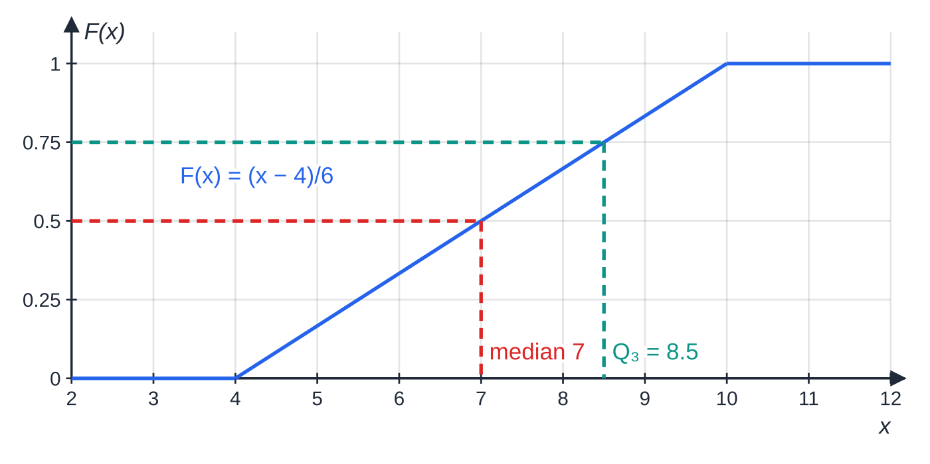
How do you use the cumulative distribution function? (continued)
Section 3 of 13
The cdf of X~U[4,10]: zero before 4, a straight line of gradient ⅙ up to (10,1), then constant at 1. Reading across from 0.5 and 0.75 gives the median 7 and the upper quartile 8.5.
Notes:
How do you use the cumulative distribution function?. Full notes: https://examinerprep.com/notes/edexcel-ial-maths/continuous-uniform-distribution-and-normal-approximations/

Slide 15
How do you use the cumulative distribution function? (continued)
Section 3 of 13 · Worked example 3 · Medium · Find, specify
WORKED EXAMPLE · QUESTION
The continuous random variable X is uniformly distributed on [a,b]. E(X)=7 and Var(X)=3. (a) Find the values of a and b. (b) Specify fully the cumulative distribution function of X. (c) Find the upper quartile of X. (d) Find P(|X-7|<2).
SOLUTION
(a) Two equations: (a+b)/2=7⇒a+b=14, and ((b-a)²)/12=3⇒b-a=6. So a=4, b=10
(b) All three pieces: F(x)=0 for x<4; (x-4)/6 for 4≤x≤10; 1 for x>10
(c) Solve F(q)=0.75: (q-4)/6=0.75⇒ q=8.5
(d) |X-7|<2 means 5<X<9, an interval of length 4: P(5<X<9)=F(9)-F(5)=(4/6)= ⅔
Notes:
How do you use the cumulative distribution function?: Worked example 3. Full notes: https://examinerprep.com/notes/edexcel-ial-maths/continuous-uniform-distribution-and-normal-approximations/

Slide 16
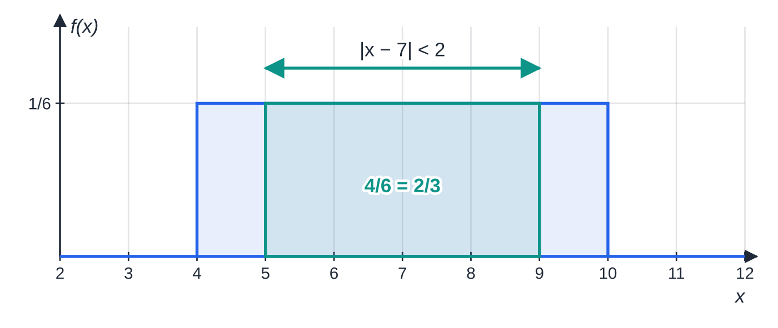
How do you use the cumulative distribution function? (continued)
Section 3 of 13
Part (d): the pdf of U[4,10]. The event |X-7|<2 is the strip from 5 to 9, which is (4/6) of the rectangle.
Notes:
How do you use the cumulative distribution function?. Full notes: https://examinerprep.com/notes/edexcel-ial-maths/continuous-uniform-distribution-and-normal-approximations/

Slide 17
How does the uniform distribution model rounding errors?
Section 4 of 13
When a measurement is rounded to the nearest k, the error (true value − recorded value) can be anything from -k/2 to k/2, with no reason to favour any part of that range. So the rounding error is modelled by U[-k/2,k/2]:
to the nearest whole number: U[-0.5,0.5]; to the nearest 0.1: U[-0.05,0.05]; to the nearest 5: U[-2.5,2.5];
the mean error is 0 and the variance is k²/12;
if a value is truncated (chopped down) rather than rounded, the error is U[0,k] instead, and its mean is k/2, not 0.
Other natural uniform models are the position of a random break along a rod, the time of an event during a fixed interval, and an angle chosen at random.
Notes:
How does the uniform distribution model rounding errors?. Full notes: https://examinerprep.com/notes/edexcel-ial-maths/continuous-uniform-distribution-and-normal-approximations/

Slide 18
How does the uniform distribution model rounding errors? (continued)
Section 4 of 13
Expected values of functions: E(g(X))
E(g(X))=∫g(x)f(x) dx. For linear functions use E(cX+d)=cE(X)+d and Var(cX+d)=c²Var(X). For E(X²) the quickest route is E(X²)=Var(X)+[E(X)]². Example: a disc has radius R cm with R~U[2,4]. Then E(R²)=(4/12)+3²=(28/3), so the expected area is E(πR²)=28π/3≈29.3 cm², a little more than π×3²=9π.
Notes:
How does the uniform distribution model rounding errors?. Full notes: https://examinerprep.com/notes/edexcel-ial-maths/continuous-uniform-distribution-and-normal-approximations/

Slide 19
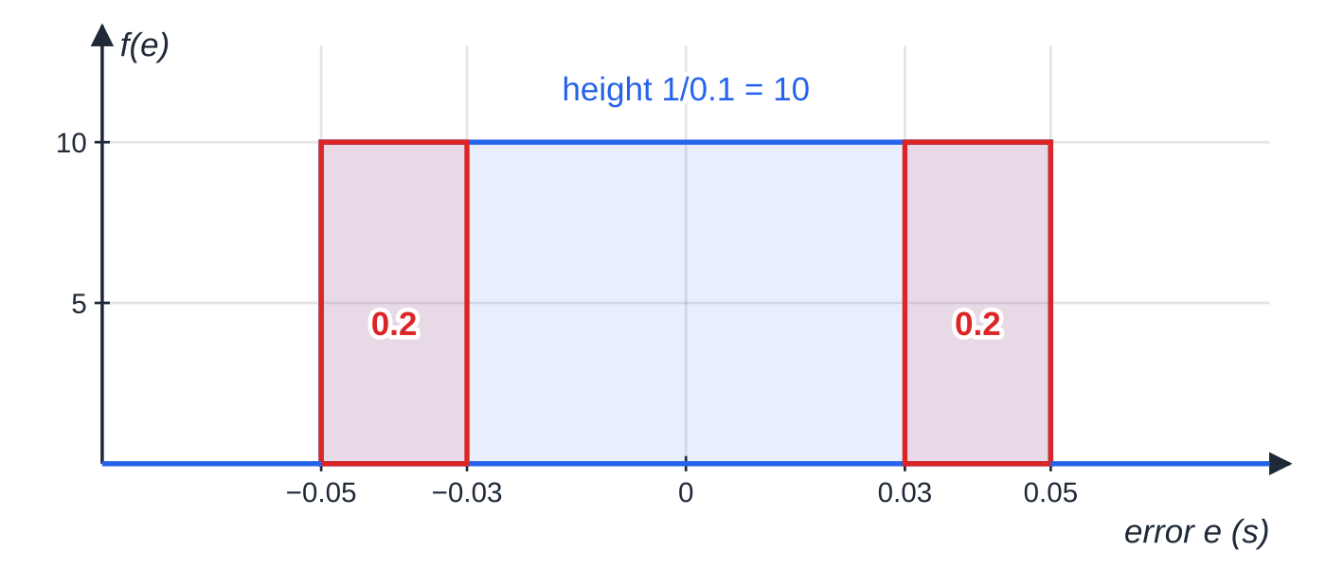
How does the uniform distribution model rounding errors? (continued)
Section 4 of 13 · Worked example 4 · Medium · Suggest, find
WORKED EXAMPLE · QUESTION
A stopwatch displays times to the nearest 0.1 second. The rounding error E seconds is the true time minus the displayed time. (a) Suggest a distribution for E. (b) Find P(|E|>0.03). (c) Find the standard deviation of E. (d) Find E(E²).
SOLUTION
(a) Rounding to the nearest 0.1 means an error of at most 0.05 either way: E~U[-0.05,0.05]
(b) |E|>0.03 is the two end pieces, −0.05 to −0.03 and 0.03 to 0.05:
The rounding error is equally likely to be anywhere between −0.05 and 0.05. The two red end strips are the event |E|>0.03.
Notes:
How does the uniform distribution model rounding errors?: Worked example 4. Full notes: https://examinerprep.com/notes/edexcel-ial-maths/continuous-uniform-distribution-and-normal-approximations/

Slide 20
How does the uniform distribution model rounding errors? (continued)
Section 4 of 13 · Worked example 4 · Medium · Suggest, find (continued)
P=(0.02+0.02)÷0.1= 0.4
(c) Variance = width²/12: Var(E)=0.1²/12=(1/1200)⇒σ=0.1/√12= 0.0289 s
(d) E(E)=0, so E(E²)=Var(E)+0²= (1/1200)≈0.000833 s²
Notes:
How does the uniform distribution model rounding errors?: Worked example 4. Full notes: https://examinerprep.com/notes/edexcel-ial-maths/continuous-uniform-distribution-and-normal-approximations/

Slide 21
How does the uniform distribution model rounding errors? (continued)
Section 4 of 13
Common error — an off-centre error interval
Writing U[0,0.1] for the error of a value rounded to the nearest 0.1. Rounding can push a value up or down, so the error interval is centred on zero. U[0,0.1] would describe a value that is always chopped down.
Notes:
How does the uniform distribution model rounding errors?. Full notes: https://examinerprep.com/notes/edexcel-ial-maths/continuous-uniform-distribution-and-normal-approximations/

Slide 22
When can a Normal distribution approximate a binomial distribution?
Section 5 of 13
The binomial tables stop at a limited set of values of n and p, and summing dozens of binomial terms by hand is impractical. When the binomial distribution is roughly bell-shaped, a Normal curve with the same mean and variance gives an accurate shortcut. That happens when n is large and p is close to ½. As a working guide, check that np and n(1-p) are both greater than 5.
If p is small (or close to 1), the binomial distribution is skewed and the Normal curve fits badly; with p small and n large, use the Poisson approximation from S2.1 instead.
Normal approximation to the binomial
Notes:
When can a Normal distribution approximate a binomial distribution?. Full notes: https://examinerprep.com/notes/edexcel-ial-maths/continuous-uniform-distribution-and-normal-approximations/

Slide 23
When can a Normal distribution approximate a binomial distribution? (continued)
Section 5 of 13
(not in the formulae booklet: the binomial mean np and variance np(1-p) are given; the approximation and its conditions are not)
X~B(n,p) ⇒ X≈Y, where Y~N(np, np(1-p)),
for n large and p close to ½ (both np and n(1-p) more than about 5). The second parameter is the variance; the standard deviation is √(np(1-p)).
Notes:
When can a Normal distribution approximate a binomial distribution?. Full notes: https://examinerprep.com/notes/edexcel-ial-maths/continuous-uniform-distribution-and-normal-approximations/

Slide 24
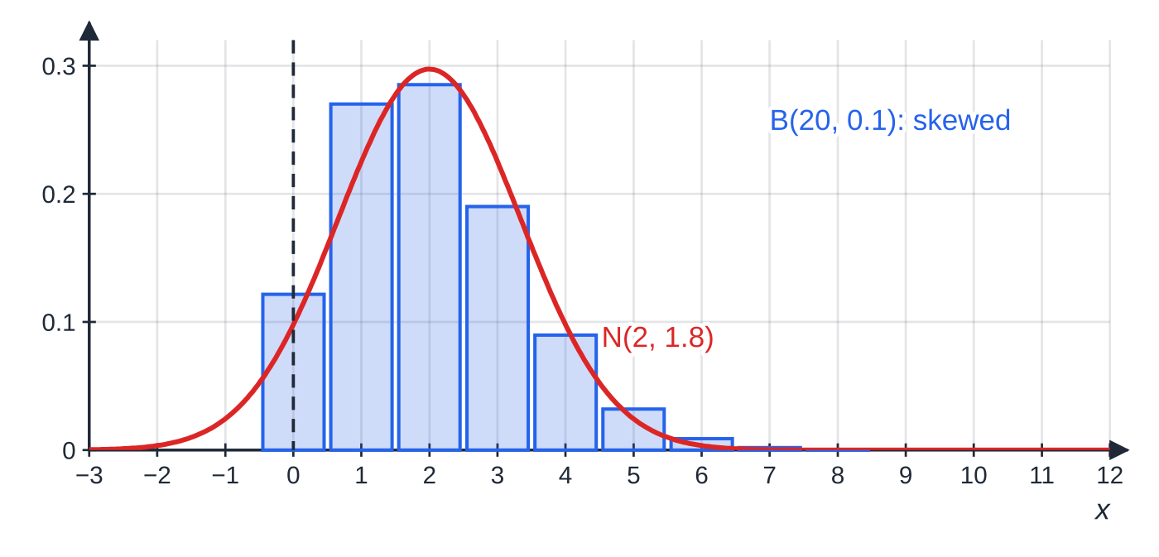
When can a Normal distribution approximate a binomial distribution? (continued)
Section 5 of 13
Same n=20, p=0.1: the binomial bars are skewed and the matching Normal curve misses them — it even gives probability to negative values, left of the black line.
Notes:
When can a Normal distribution approximate a binomial distribution?. Full notes: https://examinerprep.com/notes/edexcel-ial-maths/continuous-uniform-distribution-and-normal-approximations/

Slide 25
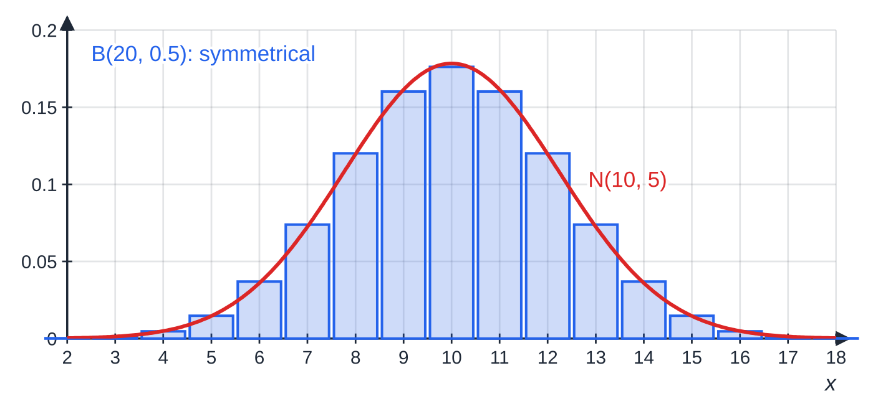
When can a Normal distribution approximate a binomial distribution? (continued)
Section 5 of 13
Same n=20, p=0.5: the bars are symmetrical and the curve with the same mean and variance follows them closely.
Notes:
When can a Normal distribution approximate a binomial distribution?. Full notes: https://examinerprep.com/notes/edexcel-ial-maths/continuous-uniform-distribution-and-normal-approximations/

Slide 26
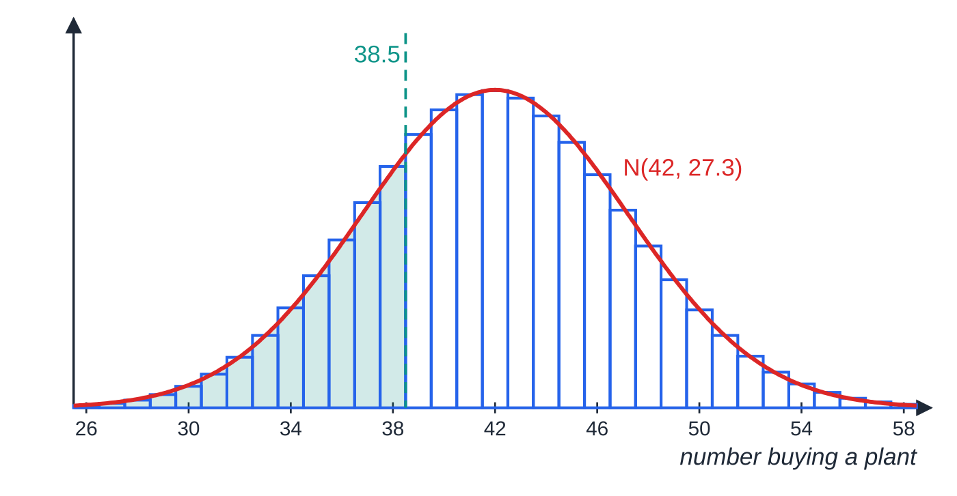
When can a Normal distribution approximate a binomial distribution? (continued)
Section 5 of 13 · Worked example 5 · Medium · Find
WORKED EXAMPLE · QUESTION
At a garden centre, 35% of customers buy a plant. On one morning 120 customers visit, independently of one another. Using a suitable approximation, find the probability that at most 38 of them buy a plant.
SOLUTION
Define the exact distribution and justify the approximation: X~B(120,0.35); n is large and np=42, n(1-p)=78 are both large, so use a Normal approximation.
Match the mean and variance: Y~N(42,27.3) (variance =120×0.35×0.65=27.3).
X~B(120,0.35) drawn as bars of width 1 with Y~N(42,27.3) over them. The bar for 38 runs from 37.5 to 38.5, so P(X≤38) is approximated by the area under the curve to the left of 38.5.
Notes:
When can a Normal distribution approximate a binomial distribution?: Worked example 5. Full notes: https://examinerprep.com/notes/edexcel-ial-maths/continuous-uniform-distribution-and-normal-approximations/

Slide 27
When can a Normal distribution approximate a binomial distribution? (continued)
Section 5 of 13 · Worked example 5 · Medium · Find (continued)
Continuity correction — "at most 38" includes the whole bar for 38: P(X≤38)≈P(Y<38.5).
Standardise, rounding z to 2 d.p. for the table:
P(Z<(38.5-42)/√27.3)=P(Z<-0.67)=1-Φ(0.67)=1-0.7486=
0.2514
The exact binomial probability is 0.2533, so the approximation is good to 2 significant figures. A calculator's Normal function (without rounding z) gives 0.2515; either is acceptable.
Notes:
When can a Normal distribution approximate a binomial distribution?: Worked example 5. Full notes: https://examinerprep.com/notes/edexcel-ial-maths/continuous-uniform-distribution-and-normal-approximations/

Slide 28
When can a Normal distribution approximate a binomial distribution? (continued)
Section 5 of 13
Exam tip — write the approximating distribution
Write it in full, "Y~N(42,27.3)", before any probability. It shows the method, and it reminds you that 27.3 is the variance: dividing by 27.3 instead of √27.3 is a costly slip.
Notes:
When can a Normal distribution approximate a binomial distribution?. Full notes: https://examinerprep.com/notes/edexcel-ial-maths/continuous-uniform-distribution-and-normal-approximations/

Slide 29
What is a continuity correction, and how do you apply it?
Section 6 of 13
A binomial or Poisson variable takes only whole-number values; a Normal variable is continuous. Think of each whole number k as a bar from k-0.5 to k+0.5. The continuity correction replaces "these whole numbers" by "the whole width of their bars". Decide which integers are included, then go half a unit beyond the outermost ones:
Discrete X | Integers included | Continuous Y
P(X≤38) | …, 37, 38 | P(Y<38.5)
P(X<38) | …, 36, 37 | P(Y<37.5)
P(X≥56) | 56, 57, … | P(Y>55.5)
P(X>56) | 57, 58, … | P(Y>56.5)
P(X=50) | 50 only | P(49.5<Y<50.5)
P(45≤X<53) | 45, 46, …, 52 | P(44.5<Y<52.5)
Notes:
What is a continuity correction, and how do you apply it?. Full notes: https://examinerprep.com/notes/edexcel-ial-maths/continuous-uniform-distribution-and-normal-approximations/

Slide 30
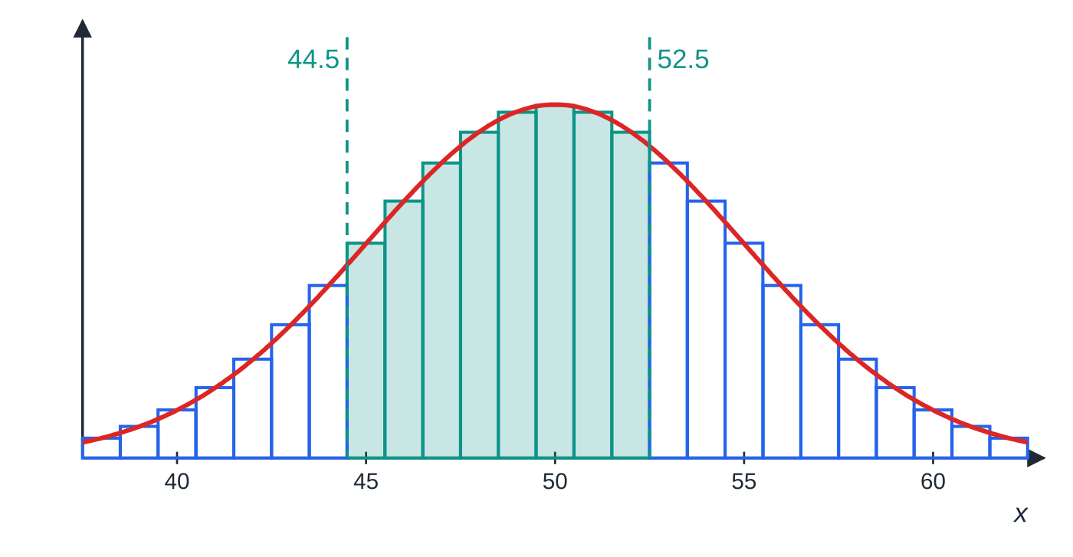
What is a continuity correction, and how do you apply it? (continued)
Section 6 of 13
For the continuous Y, < and ≤ are the same, so it does not matter which you write on the right-hand side. Without a continuity correction, P(X=50) would become P(Y=50)=0, which is plainly wrong. The correction is what makes the approximation work.
Close-up of B(100,0.5) with N(50,25). The shaded bars are 45, 46, …, 52: the left edge of the first is 44.5 and the right edge of the last is 52.5, so P(45≤X<53)≈P(44.5<Y<52.5).
Notes:
What is a continuity correction, and how do you apply it?. Full notes: https://examinerprep.com/notes/edexcel-ial-maths/continuous-uniform-distribution-and-normal-approximations/

Slide 31
What is a continuity correction, and how do you apply it? (continued)
Section 6 of 13 · Worked example 6 · Medium · Find
WORKED EXAMPLE · QUESTION
A quiz has 100 true-or-false questions. A contestant guesses every answer, so the number X of correct answers has distribution B(100,0.5). Use a Normal approximation to find (a) P(X=50), (b) P(X≥56), (c) P(45≤X<53).
SOLUTION
Parameters: np=50, np(1-p)=25⇒Y~N(50,5²).
(a) One integer is a bar of width 1: P(49.5<Y<50.5)=P(-0.1<Z<0.1)=2Φ(0.1)-1=2×0.5398-1= 0.0796
(b) 56 is included, so start at 55.5: P(Y>55.5)=P(Z>1.1)=1-0.8643= 0.1357
(c) Integers 45 to 52: P(44.5<Y<52.5)=P(-1.1<Z<0.5)=0.6915-(1-0.8643)= 0.5558
The exact binomial values are 0.0796, 0.1356 and 0.5557: with p=0.5 the approximation is excellent.
Notes:
What is a continuity correction, and how do you apply it?: Worked example 6. Full notes: https://examinerprep.com/notes/edexcel-ial-maths/continuous-uniform-distribution-and-normal-approximations/

Slide 32
What is a continuity correction, and how do you apply it? (continued)
Section 6 of 13
Common error — correcting the wrong way
P(X≥56)→P(Y>56.5) throws away the bar for 56. Always list the integers that are included and move half a unit outwards from them.
Notes:
What is a continuity correction, and how do you apply it?. Full notes: https://examinerprep.com/notes/edexcel-ial-maths/continuous-uniform-distribution-and-normal-approximations/

Slide 33
When can a Normal distribution approximate a Poisson distribution, and which approximation should you choose?
Section 7 of 13
The Poisson distribution has mean and variance both equal to λ. As λ grows, its slight right skew fades and it becomes bell-shaped. For large λ (as a guide, λ>10) use N(λ,λ), with a continuity correction as before, since a Poisson variable is also a whole-number count. If the rate is given per unit of time or space, scale λ first (2.5 per minute → 30 per 12 minutes), then approximate.
Normal approximation to the Poisson
(not in the formulae booklet — learn it; the Poisson mean and variance λ are given)
X~Po(λ) ⇒ X≈Y, where Y~N(λ,λ),
valid for large λ. The standard deviation is √λ.
Notes:
When can a Normal distribution approximate a Poisson distribution, and which approximation should you choose?. Full notes: https://examinerprep.com/notes/edexcel-ial-maths/continuous-uniform-distribution-and-normal-approximations/

Slide 34
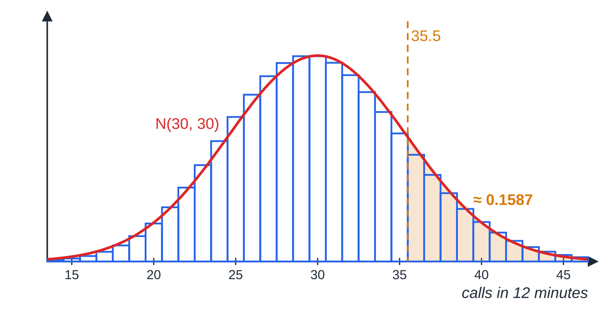
When can a Normal distribution approximate a Poisson distribution, and which approximation should you choose? (continued)
Section 7 of 13
Choosing the approximation
X~Po(30) with Y~N(30,30). The bars for 36 and above start at 35.5, so P(X>35)≈P(Y>35.5).
Notes:
When can a Normal distribution approximate a Poisson distribution, and which approximation should you choose?. Full notes: https://examinerprep.com/notes/edexcel-ial-maths/continuous-uniform-distribution-and-normal-approximations/

Slide 35
When can a Normal distribution approximate a Poisson distribution, and which approximation should you choose? (continued)
Section 7 of 13
Exact distribution | Conditions | Approximation
B(n,p) | n large, p small (np moderate, say up to about 10) | Po(np) — no continuity correction needed, both discrete (S2.1)
B(n,p) | n large, p close to ½ | N(np,np(1-p)) with continuity correction
Po(λ) | λ large (more than about 10) | N(λ,λ) with continuity correction
If p is close to 1, count failures instead: the number of failures is B(n,1-p) with a small probability. Use the exact tables whenever n, p or λ are in them: an approximation is only for when the exact route is impractical.
Notes:
When can a Normal distribution approximate a Poisson distribution, and which approximation should you choose?. Full notes: https://examinerprep.com/notes/edexcel-ial-maths/continuous-uniform-distribution-and-normal-approximations/

Slide 36
When can a Normal distribution approximate a Poisson distribution, and which approximation should you choose? (continued)
Section 7 of 13 · Worked example 7 · Medium · Find, name
WORKED EXAMPLE · QUESTION
Calls arrive at a help desk at random at a mean rate of 2.5 per minute. (a) Using a suitable approximation, find the probability that more than 35 calls arrive in a 12-minute period. (b) For each situation, name a suitable approximating distribution and use it where asked: (i) 0.75% of laptops sent for repair have a cracked hinge, and 400 laptops are sent; find the probability that at most 2 have a cracked hinge. (ii) 40% of 400 callers ask for a refund.
SOLUTION
(a) Scale the rate, then approximate: X~Po(2.5×12)=Po(30); λ is large, so Y~N(30,30). "More than 35" starts at 36, so the bar edge is 35.5:
P(X>35)≈P(Y>35.5)=P(Z>(35.5-30)/√30)=P(Z>1.00)=1-0.8413=
0.1587
Notes:
When can a Normal distribution approximate a Poisson distribution, and which approximation should you choose?: Worked example 7. Full notes: https://examinerprep.com/notes/edexcel-ial-maths/continuous-uniform-distribution-and-normal-approximations/

Slide 37
When can a Normal distribution approximate a Poisson distribution, and which approximation should you choose? (continued)
Section 7 of 13 · Worked example 7 · Medium · Find, name (continued)
(b)(i) n large, p small → Poisson with λ=np: B(400,0.0075)≈Po(3)⇒P(at most 2)≈ 0.4232 (Poisson table)
(b)(ii) n large, p=0.4 close to ½ → Normal: B(400,0.4)≈N(160,96)
Exact values for comparison: Po(30) gives 0.1574 in (a), and B(400,0.0075) gives 0.4223 in (b)(i).
Notes:
When can a Normal distribution approximate a Poisson distribution, and which approximation should you choose?: Worked example 7. Full notes: https://examinerprep.com/notes/edexcel-ial-maths/continuous-uniform-distribution-and-normal-approximations/

Slide 38
How does a full exam question fit together?
Section 8 of 13
The two halves of this topic often meet in one question: a uniform model gives a probability p, a count of successes over many repetitions is then binomial with that p, and the Normal approximation answers questions about the count — including a "find the largest value" part that runs the method backwards with a percentage point.
Notes:
How does a full exam question fit together?. Full notes: https://examinerprep.com/notes/edexcel-ial-maths/continuous-uniform-distribution-and-normal-approximations/

Slide 39
How does a full exam question fit together? (continued)
Section 8 of 13 · Worked example 8 · Hard · Find, give a reason
WORKED EXAMPLE · QUESTION
The delay D minutes of a regional train is modelled by the continuous uniform distribution on [-4,16]; a negative delay means the train is early. A journey is late if the delay is more than 10 minutes. Journeys are independent. (a) Find the probability that a journey is late. (b) Find E(D) and the standard deviation of D. (c) Over a season there are 150 journeys. Using a suitable approximation, find the probability that more than 50 of them are late. (d) The operator claims that, with probability at least 0.9, at least m of the 150 journeys will be late. Find the largest value of m for which the claim holds. (e) Give a reason why a Poisson approximation would not be suitable in part (c).
SOLUTION
(a) Length of interval ÷ width: P(D>10)=(16-10)/20= 0.3
(b) E(D)=(-4+16)/2= 6 minutes; Var(D)=20²/12=(100/3)⇒σ= 5.77 minutes
(c) The number late is binomial; approximate it. L~B(150,0.3); n large, np=45⇒Y~N(45,31.5).
Notes:
How does a full exam question fit together?: Worked example 8. Full notes: https://examinerprep.com/notes/edexcel-ial-maths/continuous-uniform-distribution-and-normal-approximations/

Slide 40
How does a full exam question fit together? (continued)
Section 8 of 13 · Worked example 8 · Hard · Find, give a reason (continued)
P(L>50)≈P(Y>50.5)=P(Z>(50.5-45)/√31.5)=P(Z>0.98)=1-0.8365=
0.1635
(d) With a continuity correction, P(L≥m)≈P(Y>m-0.5)≥0.9. The boundary is in the lower tail, so use z=-1.2816 (10% point):
(m-0.5-45)/√31.5≤-1.2816⇒m≤45.5-1.2816√31.5=45.5-7.193=38.31
so m=38. Check either side: m=38: P(Y>37.5)=Φ(1.34)=0.9099≥0.9 ✓; m=39: P(Y>38.5)=Φ(1.16)=0.8770<0.9 ✗.
(e) p=0.3 is not small (equivalently, the mean 45 and variance 31.5 are not approximately equal, as a Poisson model would need).
Notes:
How does a full exam question fit together?: Worked example 8. Full notes: https://examinerprep.com/notes/edexcel-ial-maths/continuous-uniform-distribution-and-normal-approximations/

Slide 41
How does a full exam question fit together? (continued)
Section 8 of 13 · Worked example 8 · Hard · Find, give a reason (continued)
The exact binomial answer to (c) is 0.1634, and the exact binomial distribution also gives m=38 in (d).
Notes:
How does a full exam question fit together?: Worked example 8. Full notes: https://examinerprep.com/notes/edexcel-ial-maths/continuous-uniform-distribution-and-normal-approximations/

Slide 42
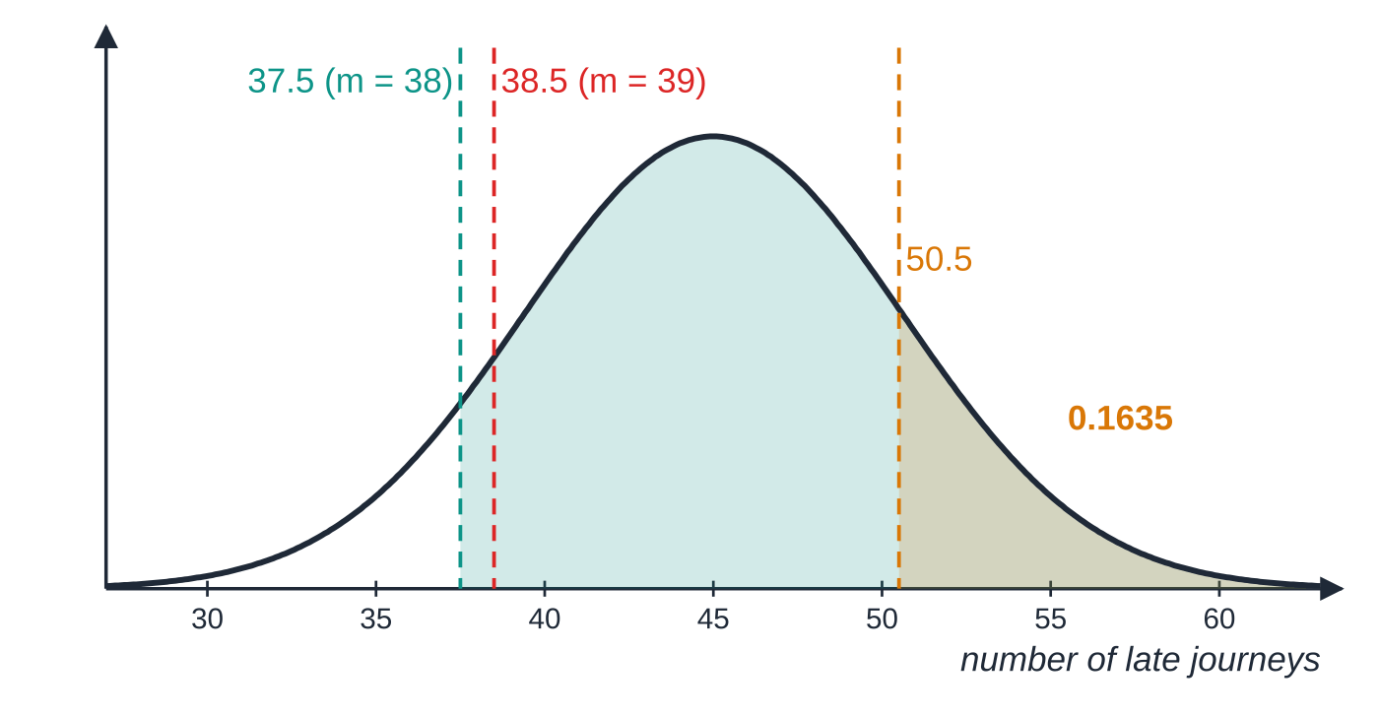
How does a full exam question fit together? (continued)
Section 8 of 13
Exam tip — round in the safe direction
In a "find the largest m" part, keep the inequality sign all the way through and round in the safe direction at the end: the bound 38.31 gives m=38, not 39. Testing the integers either side with the tables is a quick check.
Y~N(45,31.5) for the number of late journeys. The amber tail beyond 50.5 is about 0.1635. For part (d), the area to the right of 37.5 (m=38) is about 0.91, at least 0.9; for m=39 the boundary moves to 38.5 and the area drops to about 0.877.
Notes:
How does a full exam question fit together?. Full notes: https://examinerprep.com/notes/edexcel-ial-maths/continuous-uniform-distribution-and-normal-approximations/

Slide 43
Exam tips for S2.3
Section 9 of 13
Exam tip 1 — say which distribution, with parameters
Write the exact model first, then the approximation: "X~B(120,0.35), so X≈Y~N(42,27.3)". Parameters with no distribution, or a distribution with no parameters, leave out a step the method needs.
Exam tip 2 — list the integers before correcting
For each probability ask "which whole numbers are included?" and go half a unit outside them. "Fewer than 20" is 0 to 19, so the boundary is 19.5; "at least 20" starts at 20, so the boundary is 19.5 as well, but on the other side.
Exam tip 3 — standard deviation, not variance, in z
N(μ,σ²) is written with the variance. In z=(y-μ)/σ divide by its square root: √27.3, √30, √31.5.
Notes:
Exam tips for S2.3. Full notes: https://examinerprep.com/notes/edexcel-ial-maths/continuous-uniform-distribution-and-normal-approximations/

Slide 44
Exam tips for S2.3 (continued)
Section 9 of 13
Exam tip 4 — uniform probabilities are lengths
For U[a,b] there is nothing to integrate: P= (length of the interval inside [a,b]) ÷ (b-a). Clip the interval to [a,b] first — P(X>12) for U[4,10] is 0.
Exam tip 5 — justify the approximation in the question's terms
"n is large and p is close to 0.5" or "λ is large" is the reasoning required; a general remark such as "it is easier" is not. When choosing between Poisson and Normal for a binomial, the size of p decides.
Notes:
Exam tips for S2.3. Full notes: https://examinerprep.com/notes/edexcel-ial-maths/continuous-uniform-distribution-and-normal-approximations/

Slide 45
Common misconceptions
Section 10 of 13
Misconception | Why it is wrong | Correct idea
The variance of U[a,b] is (b-a)/12. | Variance has squared units; the width must be squared. | Var(X)=((b-a)²)/12; standard deviation =(b-a)/√12.
The rounding error for "nearest 0.1" is U[0,0.1]. | Rounding can move a value up or down. | The error is U[-0.05,0.05], mean 0.
A continuity correction is needed for the uniform distribution. | The uniform distribution is already continuous. | Correct only when a discrete count (binomial, Poisson) is replaced by a Normal variable.
P(X<20) and P(X≤20) have the same Normal approximation. | For a discrete X they include different integers. | P(X<20)≈P(Y<19.5); P(X≤20)≈P(Y<20.5).
Any binomial with large n can be approximated by a Normal distribution. | With small p the distribution is skewed even for large n. | Normal needs p near ½; for small p use Po(np).
Notes:
Common misconceptions. Full notes: https://examinerprep.com/notes/edexcel-ial-maths/continuous-uniform-distribution-and-normal-approximations/

Slide 46
Common misconceptions (continued)
Section 10 of 13
Misconception | Why it is wrong | Correct idea
Po(λ)≈N(λ,√λ). | The second parameter of N is the variance, and the Poisson variance is λ. | Po(λ)≈N(λ,λ); standardise with √λ.
Notes:
Common misconceptions. Full notes: https://examinerprep.com/notes/edexcel-ial-maths/continuous-uniform-distribution-and-normal-approximations/

Slide 47
How this topic connects
Section 11 of 13
S1.6 The Normal distribution
Every approximation on this page ends with standardising and the Φ(z) or percentage-point tables, exactly as in S1; only the continuity correction is new.
S2.1 and S2.2
The approximations replace the exact binomial and Poisson models from S2.1, and the uniform distribution is the simplest case of the general pdf, cdf, E(X) and Var(X) methods from S2.2.
S2.4 Hypothesis tests
Tests on a binomial proportion or a Poisson rate with large numbers use these same Normal approximations to find critical regions. In IAL Physics, a reading rounded to the smallest scale division has an error spread evenly over ± half a division, and large radioactive counts behave approximately Normally with standard deviation √(count).
Notes:
How this topic connects. Full notes: https://examinerprep.com/notes/edexcel-ial-maths/continuous-uniform-distribution-and-normal-approximations/

Slide 48
Key formulae
Section 12 of 13
Formula | Use | In the formulae list?
f(x)=1/(b-a), a≤x≤b | pdf of U[a,b] | Yes
E(X)=(a+b)/2, Var(X)=((b-a)²)/12 | mean and variance of U[a,b] (derivation also required) | Yes
F(x)=(x-a)/(b-a), a≤x≤b (0 below, 1 above) | cdf of U[a,b]; quartiles and percentiles | No – derive it
E(g(X))=∫g(x)f(x) dx; E(X²)=Var(X)+[E(X)]² | expected value of a function of X | Yes
rounding to nearest k: error ~U[-k/2,k/2] | modelling rounding errors | No – derive it
B(n,p)≈N(np,np(1-p)) | n large, p close to ½ | No – learn it
Po(λ)≈N(λ,λ) | λ large | No – learn it
P(X≤k)≈P(Y<k+0.5), P(X≥k)≈P(Y>k-0.5) | continuity correction | No – learn it
z=(y-μ)/σ | standardising before using Φ(z) | No – learn it
Notes:
Key formulae. Full notes: https://examinerprep.com/notes/edexcel-ial-maths/continuous-uniform-distribution-and-normal-approximations/

Slide 49
Check your understanding
Section 13 of 13
1. X~U[-2,6]. Find P(X<0) and Var(X).
2. X~B(80,0.45). Write P(X<30) in terms of the approximating Normal variable Y.
3. Which approximation would you use for B(500,0.004), and why?
4. Why is a Normal approximation unsuitable for B(30,0.05)?
5. X~Po(64). Use a Normal approximation to find P(X≥70).
6. A length is recorded to the nearest 5 mm. Find the standard deviation of the rounding error.
Notes:
Check your understanding: questions. Full notes: https://examinerprep.com/notes/edexcel-ial-maths/continuous-uniform-distribution-and-normal-approximations/

Slide 50
Check your understanding · answers
Section 13 of 13
1. P(X<0)=(2/8)=0.25. Var(X)=8²/12=(16/3).
2. "Fewer than 30" means 29 or fewer, so P(Y<29.5), with Y~N(36,19.8).
3. Po(2): n is large and p is small, and np=2.
4. np=1.5 is small: the distribution is strongly skewed, and a Normal curve would give noticeable probability to negative values. (A Poisson approximation Po(1.5) could be used, or the exact binomial.)
5. Y~N(64,64); P(Y>69.5)=P(Z>5.5/8)=P(Z>0.69)=1-0.7549=0.2451.
6. The error is U[-2.5,2.5], width 5, so σ=5/√12=1.44 mm (3 s.f.).
Notes:
Check your understanding: answers. Full notes: https://examinerprep.com/notes/edexcel-ial-maths/continuous-uniform-distribution-and-normal-approximations/

Slide 51
Practice questions
2 original exam-style questions. Answers at the end of the deck.

Slide 52
Question 1
9 marks
A computer program generates a random number R from the continuous uniform distribution on [−3, 5]. Successive numbers are independent.
(a) Specify fully the cumulative distribution function of R. [3]
(b) Find the 20th percentile of R. [1]
(c) Find E(4R − 3) and Var(4R − 3). [3]
(d) The program generates three numbers. Find the probability that all three are positive. [2]
Notes:
Online with the full mark scheme: https://examinerprep.com/ial-maths-s2-3-continuous-uniform-distribution-and-normal-approximations-questions#IALM-S2-3-B-06

Slide 53
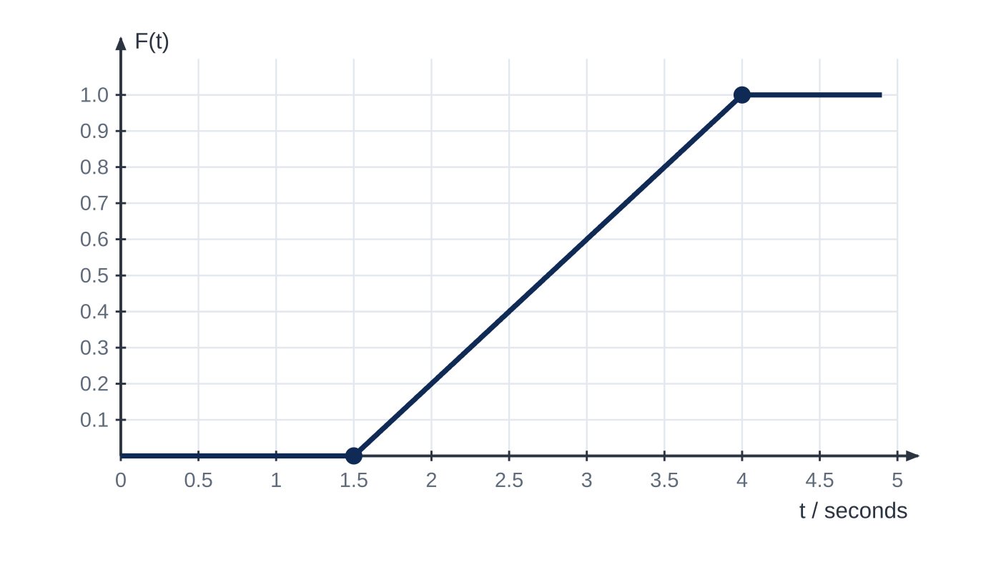
Question 2
6 marks
The time T seconds that a laser printer takes to warm up has the cumulative distribution function F(t) shown in Figure 1. The graph consists of straight-line sections.
(a) Explain how Figure 1 shows that T has a continuous uniform distribution, and state the interval on which it is defined. [2]
(b) Specify fully the probability density function of T. [1]
(c) Find P(2 < T < 3.2). [2]
(d) Find the value of t such that P(T > t) = 0.1. [1]
Notes:
Online with the full mark scheme: https://examinerprep.com/ial-maths-s2-3-continuous-uniform-distribution-and-normal-approximations-questions#IALM-S2-3-FB-02

Slide 54
Answers

Slide 55
Question 1 · answer
Mark scheme
F(r) = (r + 3)/8 for −3 ≤ r ≤ 5
F(r) = 0 for r < −3
F(r) = 1 for r > 5
(r + 3)/8 = 0.2 ⟹ r = −1.4
E(R) = 1, so E(4R − 3) = 1
Var(R) = 8²/12 = 16/3
Var(4R − 3) = 16 × 16/3 = 256/3 (≈ 85.3)
P(R > 0) = 5/8, cubed for three independent numbers
Notes:
Full mark scheme: https://examinerprep.com/ial-maths-s2-3-continuous-uniform-distribution-and-normal-approximations-questions#IALM-S2-3-B-06

Slide 56
Question 2 · answer
Mark scheme
F rises at a constant rate (a straight line) between its two corners, so the pdf, its gradient, is constant there
T ~ U[1.5, 4]
f(t) = 0.4 for 1.5 ≤ t ≤ 4, and f(t) = 0 otherwise
(3.2 − 2)/2.5 or F(3.2) − F(2) = 0.68 − 0.2
= 0.48
(t − 1.5)/2.5 = 0.9 ⟹ t = 3.75
Notes:
Full mark scheme: https://examinerprep.com/ial-maths-s2-3-continuous-uniform-distribution-and-normal-approximations-questions#IALM-S2-3-FB-02

Slide 57
Keep practising
Notes for this topic
Questions on this topic
Build a printable test
ExaminerPrep is an independent tutoring service. It has been developed independently from and is not endorsed by the International Baccalaureate Organization. "International Baccalaureate", "IB" and "IB Diploma Programme" are registered trademarks of the IBO, used here for descriptive purposes only.
Pearson Edexcel and Cambridge are trademarks of their owners; ExaminerPrep is not affiliated with any exam board.

