Slide 1
EP
EDEXCEL IAL MATHS
P2.2 Coordinate geometry of circles
The full notes page in 12 sections · practice questions with answers · simulations
ExaminerPrep is an independent tutoring service. It has been developed independently from and is not endorsed by the International Baccalaureate Organization. "International Baccalaureate", "IB" and "IB Diploma Programme" are registered trademarks of the IBO, used here for descriptive purposes only.
Pearson Edexcel and Cambridge are trademarks of their owners; ExaminerPrep is not affiliated with any exam board.
Notes:
P2.2 Coordinate geometry of circles. Notes for this topic: https://examinerprep.com/notes/edexcel-ial-maths/coordinate-geometry-of-circles/

Slide 2
What this page covers
Overview
The equation (x - a)² + (y - b)² = r² and where it comes from
The expanded form x² + y² + 2gx + 2fy + c = 0, and completing the square to find the centre and radius
Three circle properties: the angle in a semicircle, the perpendicular from the centre to a chord, and the tangent perpendicular to the radius
Equations of tangents and normals at a point on a circle
Where a line meets a circle, and using the discriminant to decide between two points, a tangent and no meeting
The circle through three given points
The length of a tangent from an outside point, and the equations of the tangents from it
Notes:
What this page covers. Full notes: https://examinerprep.com/notes/edexcel-ial-maths/coordinate-geometry-of-circles/

Slide 3
In one minute
Key points
1
A circle with centre (a, b) and radius r has equation (x - a)² + (y - b)² = r²; watch the signs, because centre (-2, 1) gives (x + 2)² + (y - 1)².
4
Tangent at P: find the gradient of the radius CP, then take the negative reciprocal.
2
Given the expanded form, complete the square in x and in y. The coefficients of x² and y² must be equal (divide through first if they are not 1).
5
Line meets circle: substitute to get a quadratic. b² - 4ac > 0 two points, = 0 tangent, < 0 no meeting.
3
Angle in a semicircle = 90°; the perpendicular from the centre bisects a chord; the tangent is perpendicular to the radius at the point of contact.
6
Three points: the perpendicular bisectors of two chords meet at the centre. Tangent length from P: PT² = PC² - r².
Notes:
In one minute: the key points of this topic.

Slide 4
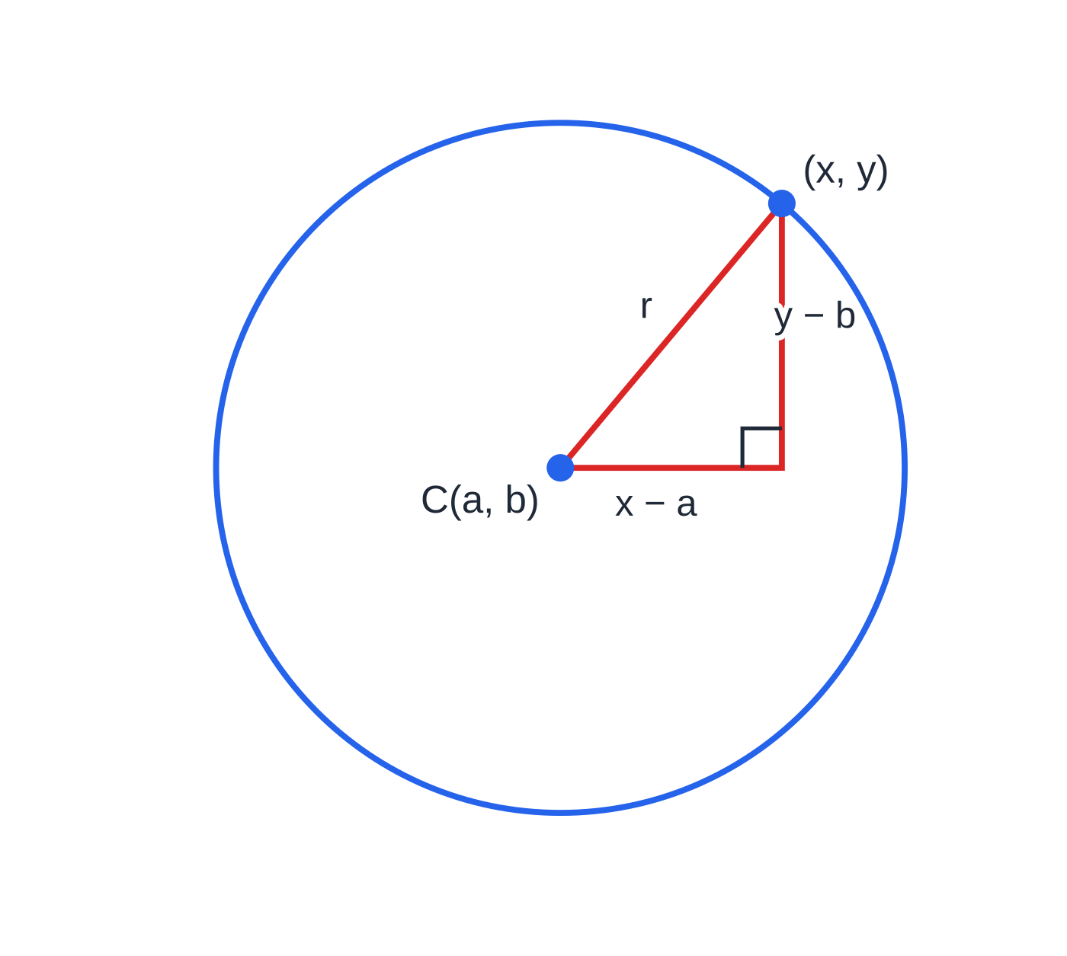
What is the equation of a circle?
Section 1 of 12
A circle is Pythagoras around a fixed point. Put that together with the straight-line toolkit from P1 (gradients, midpoints, perpendicular lines) and the discriminant of a quadratic, and every circle question becomes a short chain of familiar steps.
A circle is the set of all points at a fixed distance r (the radius) from a fixed point C(a, b) (the centre).
For a general point (x, y) on the circle, the horizontal and vertical distances from the centre are x - a and y - b. They are the two shorter sides of a right-angled triangle whose hypotenuse is the radius, so Pythagoras gives the equation directly.
Any point (x, y) on the circle makes a right-angled triangle with the centre: horizontal side x − a, vertical side y − b, hypotenuse r. Pythagoras gives (x − a)² + (y − b)² = r².
Notes:
What is the equation of a circle?. Full notes: https://examinerprep.com/notes/edexcel-ial-maths/coordinate-geometry-of-circles/

Slide 5
What is the equation of a circle? (continued)
Section 1 of 12
Equation of a circle
(x - a)² + (y - b)² = r²
Centre (a, b), radius r > 0. Centre at the origin: x² + y² = r².
In the formulae list? Not in the formulae booklet: learn it.
The signs inside the brackets are the opposite of the centre's coordinates: (x + 2)² means a = -2.
Inside, on or outside? Substitute a point into (x - a)² + (y - b)²: less than r² means inside, equal means on the circle, greater means outside.
Diameter given by its ends A and B: the centre is the midpoint of AB and the radius is half of AB.
Leave r² as a number on the right-hand side; there is no need to find r unless it is asked for.
Notes:
What is the equation of a circle?. Full notes: https://examinerprep.com/notes/edexcel-ial-maths/coordinate-geometry-of-circles/

Slide 6
What is the equation of a circle? (continued)
Section 1 of 12 · Worked example 1 · Medium · Find
WORKED EXAMPLE · QUESTION
The circle C has centre (-2, 1) and passes through the point P(4, 9).
(a) Find an equation for C. (b) Write it in the form x² + y² + px + qy + s = 0. (c) Determine whether the point Q(5, -5) lies inside or outside C. (d) A different circle has diameter AB, where A is (1, -3) and B is (7, 5). Find its equation.
SOLUTION
(a) The radius is the distance CP: r² = (4 - (-2))² + (9 - 1)² = 36 + 64 = 100, so (x + 2)² + (y - 1)² = 100.
(b) Expand and collect: x² + 4x + 4 + y² - 2y + 1 = 100, so x² + y² + 4x - 2y - 95 = 0.
(c) Compare CQ² with r²: (5 + 2)² + (-5 - 1)² = 49 + 36 = 85 < 100, so Q is inside C.
(d) Centre = midpoint of AB = ((1 + 7)/2, (-3 + 5)/2) = (4, 1). AB = √(6² + 8²) = 10, so r = 5: (x - 4)² + (y - 1)² = 25.
Notes:
What is the equation of a circle?: Worked example 1. Full notes: https://examinerprep.com/notes/edexcel-ial-maths/coordinate-geometry-of-circles/

Slide 7
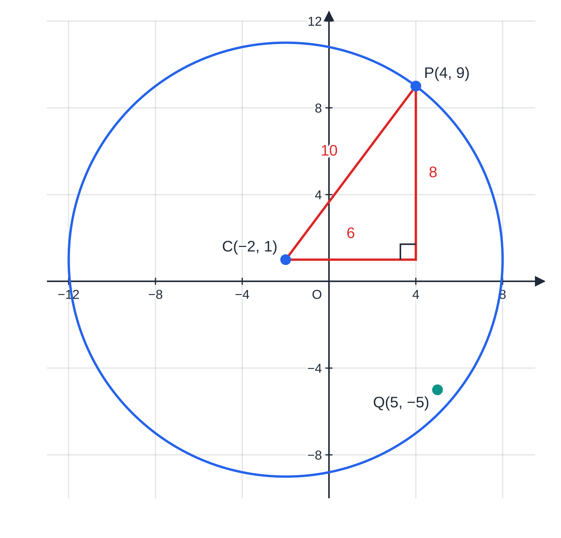
What is the equation of a circle? (continued)
Section 1 of 12
Worked example 1. The radius CP is the hypotenuse of a right-angled triangle with sides 6 and 8, so r² = 100. Q is closer to C than that (CQ² = 85), so it lies inside the circle.
Notes:
What is the equation of a circle?. Full notes: https://examinerprep.com/notes/edexcel-ial-maths/coordinate-geometry-of-circles/

Slide 8
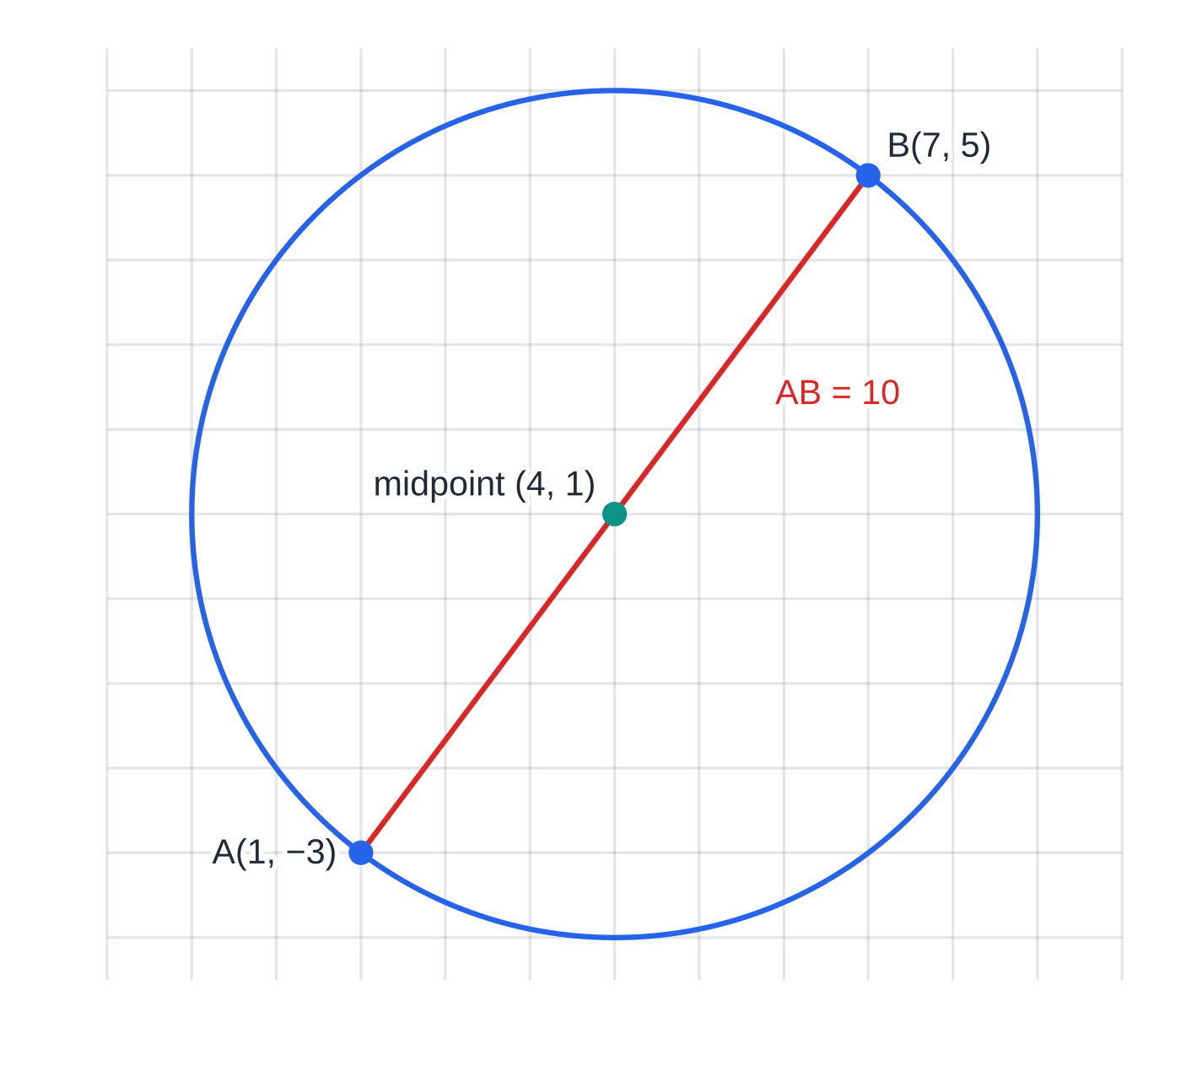
What is the equation of a circle? (continued)
Section 1 of 12
Common error
Writing the radius instead of its square on the right: (x + 2)² + (y - 1)² = 10. The right-hand side is r²; a circle of radius 10 needs 100.
Worked example 1(d). The centre of a circle on diameter AB is the midpoint (4, 1), and the radius is half of AB = 10, so r = 5 and r² = 25.
Notes:
What is the equation of a circle?. Full notes: https://examinerprep.com/notes/edexcel-ial-maths/coordinate-geometry-of-circles/

Slide 9
How do you find the centre and radius from the expanded form?
Section 2 of 12
Expanding (x - a)² + (y - b)² = r² always gives x² + y² + (terms in x and y) + constant = 0, with equal coefficients of x² and y² and no xy term.
To go back, complete the square separately in x and in y: x² - 6x = (x - 3)² - 9.
If the coefficients of x² and y² are both 2 (or 3, …), divide the whole equation by that number first.
The right-hand side after completing the square must be positive; if it is zero or negative, the equation is not a circle.
The general form
x² + y² + 2gx + 2fy + c = 0 ⇔ (x + g)² + (y + f)² = g² + f² - c
Centre (-g, -f), radius √(g² + f² - c), provided g² + f² - c > 0.
In the formulae list? Not in the formulae booklet: derive it by completing the square.
Notes:
How do you find the centre and radius from the expanded form?. Full notes: https://examinerprep.com/notes/edexcel-ial-maths/coordinate-geometry-of-circles/

Slide 10
How do you find the centre and radius from the expanded form? (continued)
Section 2 of 12 · Worked example 2 · Medium · Find
WORKED EXAMPLE · QUESTION
The circle C has equation 2x² + 2y² - 12x + 8y + 1 = 0.
(a) Find the coordinates of the centre of C and the exact radius. (b) Find the x-coordinates of the points where C meets the x-axis, giving your answers to 3 significant figures. (c) The equation x² + y² + 6x - 8y + k = 0 represents a circle. Find the set of possible values of the constant k.
SOLUTION
(a) Divide by 2, then complete the square in each variable: x² + y² - 6x + 4y + ½ = 0, so (x - 3)² - 9 + (y + 2)² - 4 + ½ = 0.
(x - 3)² + (y + 2)² = (25/2): centre (3, -2), radius √12.5 = 5√2/2 (≈ 3.54).
(b) On the x-axis, y = 0: (x - 3)² + 4 = 12.5, so (x - 3)² = 8.5 and x = 3 ±√8.5: x = 0.0845 and x = 5.92 (3 s.f.).
(c) Complete the square: (x + 3)² + (y - 4)² = 25 - k. A circle needs 25 - k > 0, so k < 25.
Notes:
How do you find the centre and radius from the expanded form?: Worked example 2. Full notes: https://examinerprep.com/notes/edexcel-ial-maths/coordinate-geometry-of-circles/

Slide 11
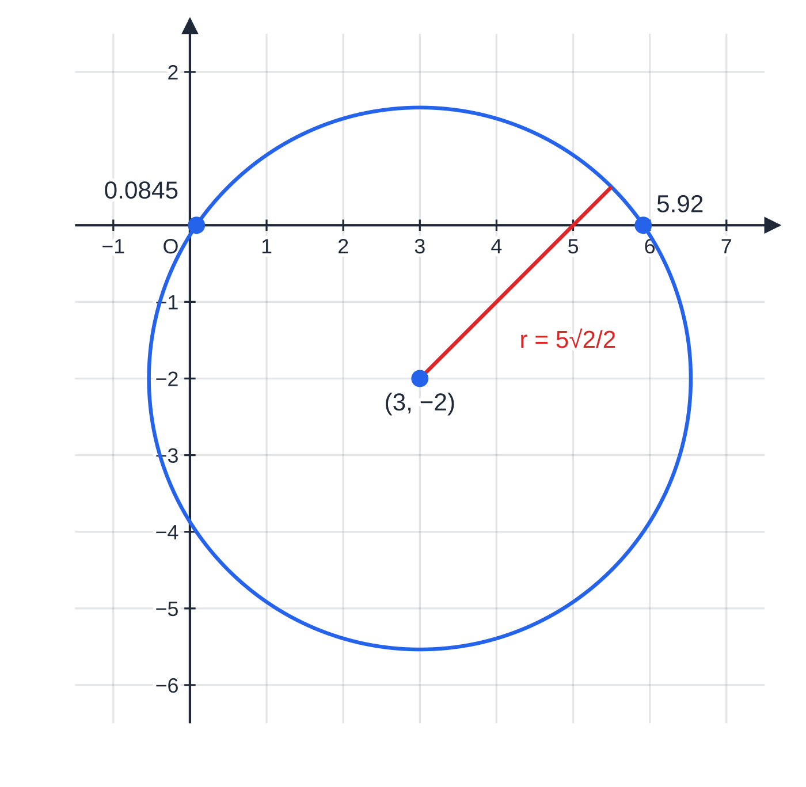
How do you find the centre and radius from the expanded form? (continued)
Section 2 of 12
Exam tip
Show the completed-square line, (x - 3)² + (y + 2)² = 12.5, before you state the centre and radius. Quoting (-g, -f) from memory leaves no method visible if a sign slips.
Worked example 2: dividing by 2 and completing both squares gives centre (3, −2) and radius √12.5 ≈ 3.54. The circle crosses the x-axis at x ≈ 0.0845 and x ≈ 5.92, symmetric about x = 3.
Notes:
How do you find the centre and radius from the expanded form?. Full notes: https://examinerprep.com/notes/edexcel-ial-maths/coordinate-geometry-of-circles/

Slide 12
Which circle properties do you need, and how are they used?
Section 3 of 12
Three geometric facts do most of the work. In coordinates each one becomes a statement about gradients or distances, which you already know how to calculate.
Property | In coordinates | Typical use
The angle in a semicircle is a right angle | if AD is a diameter and B is on the circle, gradient AB × gradient BD = -1 | showing a chord is a diameter; finding the centre as a midpoint
The perpendicular from the centre to a chord bisects the chord | the centre lies on the perpendicular bisector of every chord | finding the centre; distances from the centre to a chord
The tangent at a point is perpendicular to the radius there | gradient of tangent × gradient of radius = -1 | tangent equations; right-angled triangles for tangent lengths
The converse of the first fact is just as useful: if ∠ABD = 90°, then A, B and D lie on a circle with AD as a diameter.
Notes:
Which circle properties do you need, and how are they used?. Full notes: https://examinerprep.com/notes/edexcel-ial-maths/coordinate-geometry-of-circles/

Slide 13
Which circle properties do you need, and how are they used? (continued)
Section 3 of 12
The perpendicular from the centre C to a chord, half the chord and a radius form a right-angled triangle: (half-chord)² + (distance from C)² = r².
Notes:
Which circle properties do you need, and how are they used?. Full notes: https://examinerprep.com/notes/edexcel-ial-maths/coordinate-geometry-of-circles/

Slide 14
Which circle properties do you need, and how are they used? (continued)
Section 3 of 12 · Worked example 3 · Medium · Show that
WORKED EXAMPLE · QUESTION
The points A(-3, 1), B(6, 4) and D(7, 1) are given.
(a) Show that ∠ABD = 90°. (b) Hence find an equation of the circle through A, B and D. (c) M is the midpoint of BD and C is the centre of the circle. Verify that CM is perpendicular to BD, and find the exact length CM.
SOLUTION
(a) Gradient AB = (4 - 1)/(6 - (-3)) = ⅓; gradient BD = (1 - 4)/(7 - 6) = -3; product = -1, so ∠ABD = 90°.
(b) The angle in a semicircle is 90°, so AD is a diameter. Centre = midpoint of AD = (2, 1); radius = ½ ×10 = 5: (x - 2)² + (y - 1)² = 25.
(c) M = (6.5, 2.5). Gradient CM = (2.5 - 1)/(6.5 - 2) = ⅓, and ⅓ ×(-3) = -1, so CM ⊥BD. ✓
CM² = 4.5² + 1.5² = 22.5, so CM = 3√10/2 (≈ 4.74).
Notes:
Which circle properties do you need, and how are they used?: Worked example 3. Full notes: https://examinerprep.com/notes/edexcel-ial-maths/coordinate-geometry-of-circles/

Slide 15
Which circle properties do you need, and how are they used? (continued)
Section 3 of 12 · Worked example 3 · Medium · Show that (continued)
Check with Pythagoras: BM² = 0.5² + 1.5² = 2.5, and 22.5 + 2.5 = 25 = r². ✓
Notes:
Which circle properties do you need, and how are they used?: Worked example 3. Full notes: https://examinerprep.com/notes/edexcel-ial-maths/coordinate-geometry-of-circles/

Slide 16
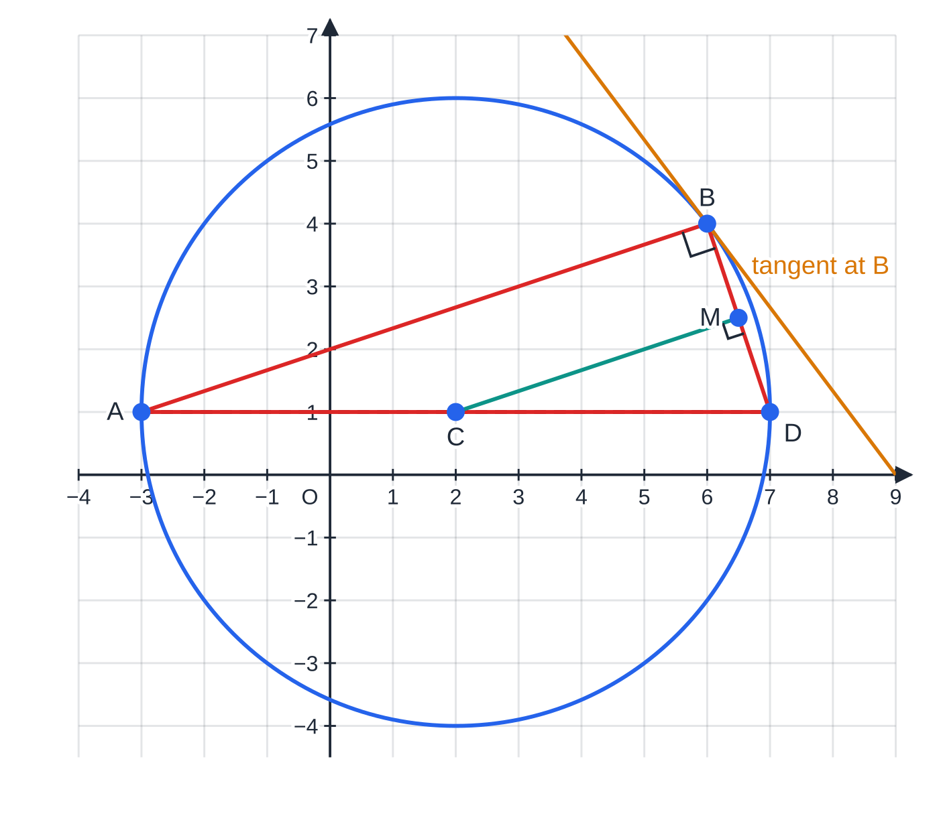
Which circle properties do you need, and how are they used? (continued)
Section 3 of 12
Common error
Assuming a chord is a diameter because it looks long. Only a right angle subtended at the circle (or the chord passing through the centre) proves it. Show the gradient product -1 first, then write "so AD is a diameter".
Worked example 3: all three properties in one circle. The right angle at B makes AD a diameter; the perpendicular from C to the chord BD lands at its midpoint M; and the tangent at B (amber, gradient −4/3) is perpendicular to the radius CB (gradient 3/4).
Notes:
Which circle properties do you need, and how are they used?. Full notes: https://examinerprep.com/notes/edexcel-ial-maths/coordinate-geometry-of-circles/

Slide 17
How do you find the equation of a tangent or normal?
Section 4 of 12
1. Check the point P really lies on the circle (substitute it).
2. Find the gradient of the radius CP: mᵣ = (y_P - b)/(x_P - a).
3. Tangent: gradient -1/mᵣ, through P: y - y_P = m(x - x_P).
The normal at P is the line through P perpendicular to the tangent. For a circle it is the line CP, so it always passes through the centre. If the radius is horizontal the tangent is vertical (x = constant), and vice versa, so no gradient calculation is needed.
Notes:
How do you find the equation of a tangent or normal?. Full notes: https://examinerprep.com/notes/edexcel-ial-maths/coordinate-geometry-of-circles/

Slide 18
How do you find the equation of a tangent or normal? (continued)
Section 4 of 12 · Worked example 4 · Medium · Find
WORKED EXAMPLE · QUESTION
The circle C has equation (x - 1)² + (y + 2)² = 20. The point P(3, 2) lies on C.
(a) Find an equation of the tangent to C at P, in the form ax + by + c = 0 where a, b and c are integers. (b) Find an equation of the normal to C at P. (c) The tangent meets the coordinate axes at R and S. Find the area of triangle ORS, where O is the origin.
SOLUTION
Check P is on C: (3 - 1)² + (2 + 2)² = 4 + 16 = 20. ✓
(a) Gradient of the radius from the centre (1, -2): mᵣ = (2 - (-2))/(3 - 1) = 2, so the tangent gradient is -½.
y - 2 = -½(x - 3), so 2y - 4 = -x + 3, giving x + 2y - 7 = 0.
(b) The normal is the line through P with gradient 2: y - 2 = 2(x - 3), so y = 2x - 4 (check: at x = 1, y = -2, the centre ✓).
Notes:
How do you find the equation of a tangent or normal?: Worked example 4. Full notes: https://examinerprep.com/notes/edexcel-ial-maths/coordinate-geometry-of-circles/

Slide 19
How do you find the equation of a tangent or normal? (continued)
Section 4 of 12 · Worked example 4 · Medium · Find (continued)
(c) Intercepts of x + 2y = 7: R(7, 0), S(0, 3.5). Area = ½ ×7 ×3.5 = (49/4) = 12.25.
Notes:
How do you find the equation of a tangent or normal?: Worked example 4. Full notes: https://examinerprep.com/notes/edexcel-ial-maths/coordinate-geometry-of-circles/

Slide 20
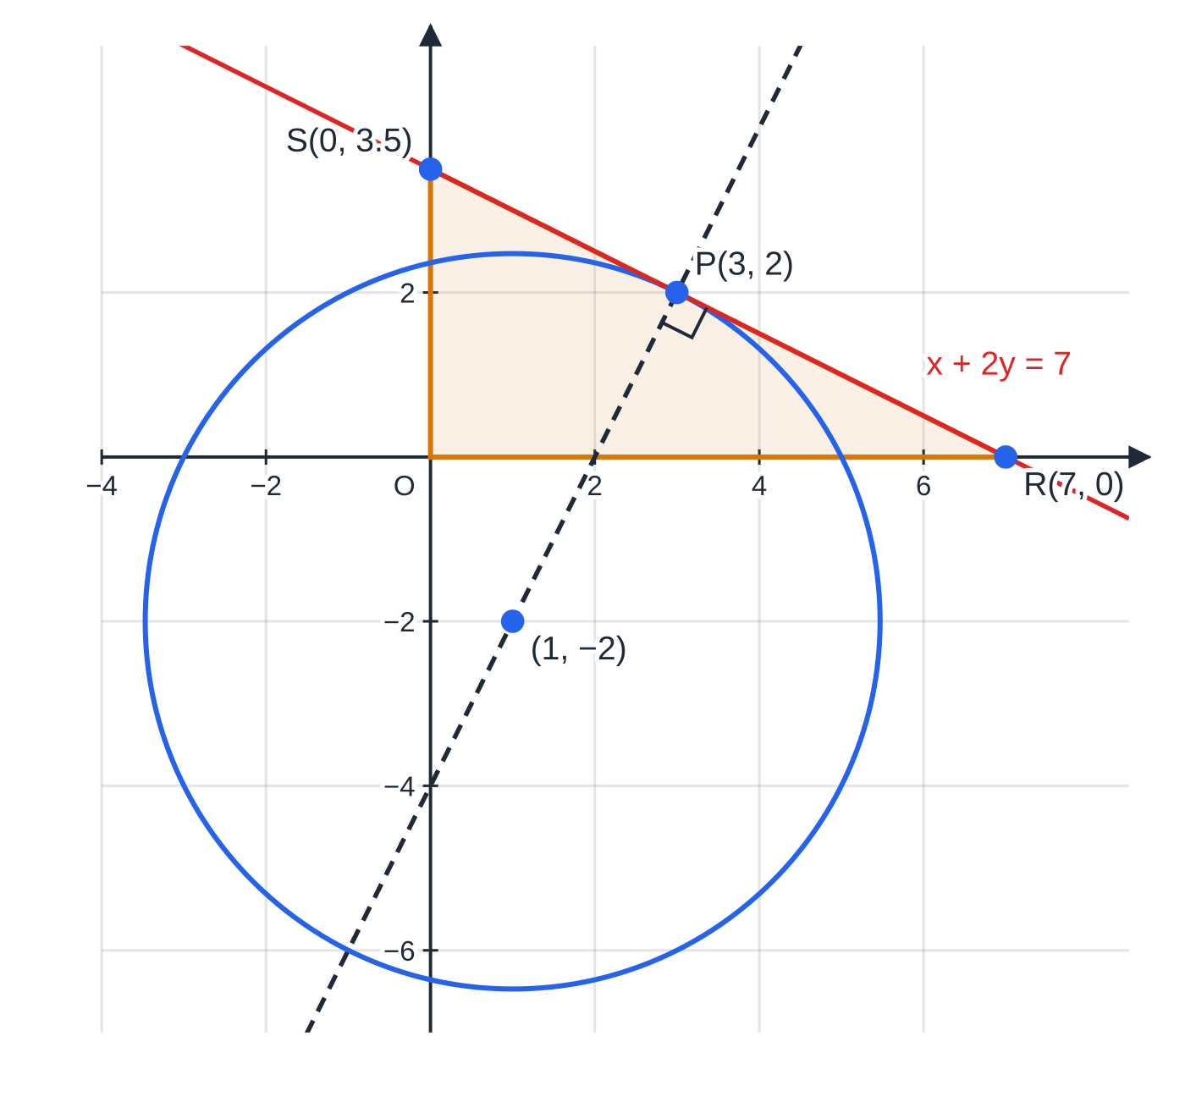
How do you find the equation of a tangent or normal? (continued)
Section 4 of 12
Exam tip
When the answer must be "in the form ax + by + c = 0 with integers", clear the fraction in the gradient before you rearrange (multiply by 2 here). Leaving y = -½ x + 3.5 does not meet the request.
Worked example 4. The radius CP has gradient 2; the tangent at P has gradient −½ and crosses the axes at R(7, 0) and S(0, 3.5), enclosing triangle ORS (shaded, area 12.25). The normal, dashed, runs through the centre.
Notes:
How do you find the equation of a tangent or normal?. Full notes: https://examinerprep.com/notes/edexcel-ial-maths/coordinate-geometry-of-circles/

Slide 21
Where does a line meet a circle, and when is it a tangent?
Section 5 of 12
Make y (or x) the subject of the line's equation and substitute into the circle. The result is a quadratic in one variable. Solve it for the coordinates of the intersection points, then use the line to find the other coordinate. Without solving, the discriminant of that quadratic tells you how many points there are.
Discriminant | Roots | Line and circle
b² - 4ac > 0 | two distinct real roots | line cuts the circle at two points (a chord)
b² - 4ac = 0 | one repeated root | line is a tangent
b² - 4ac < 0 | no real roots | line misses the circle
When the line contains an unknown constant (y = x + k, or y = mx + 3), the discriminant gives an equation or inequality for that constant.
Notes:
Where does a line meet a circle, and when is it a tangent?. Full notes: https://examinerprep.com/notes/edexcel-ial-maths/coordinate-geometry-of-circles/

Slide 22
Where does a line meet a circle, and when is it a tangent? (continued)
Section 5 of 12 · Worked example 5 · Hard · Show that
WORKED EXAMPLE · QUESTION
The circle C has equation x² + y² - 4x - 6y + 5 = 0. The line l has equation y = x + k, where k is a constant.
(a) Show that the x-coordinates of any points where l meets C satisfy 2x² + (2k - 10)x + k² - 6k + 5 = 0. (b) Find the values of k for which l is a tangent to C, and the point of contact in each case. (c) Find the set of values of k for which l meets C at two distinct points. (d) For k = 1, find the length of the chord cut off by C.
SOLUTION
Centre–radius form: (x - 2)² + (y - 3)² = 8, so centre (2, 3), radius √8.
(a) Substitute y = x + k: x² + (x + k)² - 4x - 6(x + k) + 5 = 0, so x² + x² + 2kx + k² - 4x - 6x - 6k + 5 = 0, giving 2x² + (2k - 10)x + k² - 6k + 5 = 0. ✓
(b) Tangent ⇔ discriminant = 0: (2k - 10)² - 8(k² - 6k + 5) = 4k² - 40k + 100 - 8k² + 48k - 40 = -4k² + 8k + 60.
-4(k² - 2k - 15) = -4(k - 5)(k + 3) = 0, so k = 5 or k = -3.
Notes:
Where does a line meet a circle, and when is it a tangent?: Worked example 5. Full notes: https://examinerprep.com/notes/edexcel-ial-maths/coordinate-geometry-of-circles/

Slide 23
Where does a line meet a circle, and when is it a tangent? (continued)
Section 5 of 12 · Worked example 5 · Hard · Show that (continued)
k = 5: 2x² = 0, contact at (0, 5). k = -3: 2x² - 16x + 32 = 0, so (x - 4)² = 0, contact at (4, 1).
(c) Two points ⇔ discriminant > 0: -4(k - 5)(k + 3) > 0 ⇔(k - 5)(k + 3) < 0, so -3 < k < 5.
(d) k = 1 gives 2x² - 8x = 0, so x = 0 or 4: the points (0, 1) and (4, 5). Chord length = √(4² + 4²) = 4√2, equal to the diameter 2√8, because y = x + 1 passes through the centre.
Notes:
Where does a line meet a circle, and when is it a tangent?: Worked example 5. Full notes: https://examinerprep.com/notes/edexcel-ial-maths/coordinate-geometry-of-circles/

Slide 24
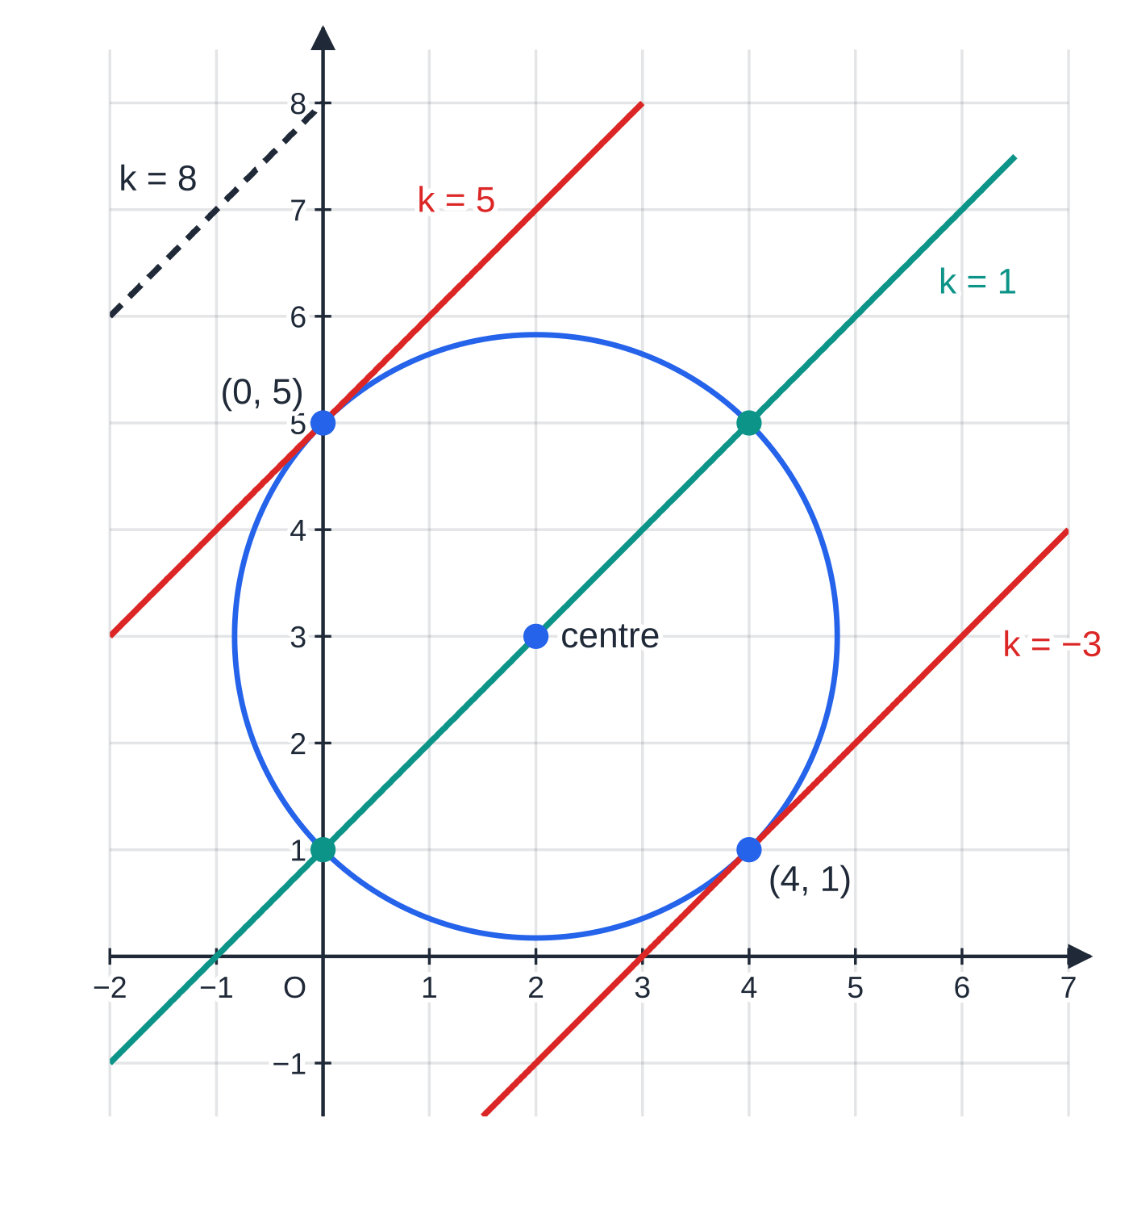
Where does a line meet a circle, and when is it a tangent? (continued)
Section 5 of 12
Common error
Squaring (x + k) as x² + k², which loses the 2kx term and spoils everything after it. Write the expansion out in full on its own line.
Worked example 5: parallel lines y = x + k and one circle. The discriminant is 64 for k = 1 (two points), 0 for k = 5 and k = −3 (tangents, red) and −132 for k = 8 (no meeting).
Notes:
Where does a line meet a circle, and when is it a tangent?. Full notes: https://examinerprep.com/notes/edexcel-ial-maths/coordinate-geometry-of-circles/

Slide 25
How do you find the circle through three points?
Section 6 of 12
Any three points not on one straight line lie on exactly one circle. Two methods find it.
Method 1, perpendicular bisectors: the centre is equidistant from all three points, so it lies on the perpendicular bisector of each chord. Find two of them and solve simultaneously; the radius is the distance from the centre to any of the points.
Method 2, simultaneous equations: substitute each point into x² + y² + 2gx + 2fy + c = 0 and solve the three linear equations for g, f and c.
Shortcut: if two of the chords are perpendicular (gradient product -1), the third side is a diameter and its midpoint is the centre.
Notes:
How do you find the circle through three points?. Full notes: https://examinerprep.com/notes/edexcel-ial-maths/coordinate-geometry-of-circles/

Slide 26
How do you find the circle through three points? (continued)
Section 6 of 12 · Worked example 6 · Medium · Find
WORKED EXAMPLE · QUESTION
The points A(-1, 4), B(6, 5) and C(7, -2) lie on a circle.
(a) Find the equation of the perpendicular bisector of AB. (b) The perpendicular bisector of BC has equation 7y = x + 4. Find the centre and radius of the circle. (c) Write down the equation of the circle.
SOLUTION
(a) Midpoint of AB = (2.5, 4.5); gradient AB = (5 - 4)/(6 - (-1)) = (1/7), so the perpendicular gradient is -7. y - 4.5 = -7(x - 2.5), giving y = -7x + 22.
(b) Solve with 7y = x + 4: 7(-7x + 22) = x + 4, so -49x + 154 = x + 4, giving x = 3, y = 1: centre (3, 1). Radius² = (-1 - 3)² + (4 - 1)² = 25: radius 5.
(c) (x - 3)² + (y - 1)² = 25
Check by method 2: the three points give -2g + 8f + c = -17, 12g + 10f + c = -61 and 14g - 4f + c = -53, with solution g = -3, f = -1, c = -15: centre (3, 1), r² = 9 + 1 + 15 = 25. ✓
Notes:
How do you find the circle through three points?: Worked example 6. Full notes: https://examinerprep.com/notes/edexcel-ial-maths/coordinate-geometry-of-circles/

Slide 27
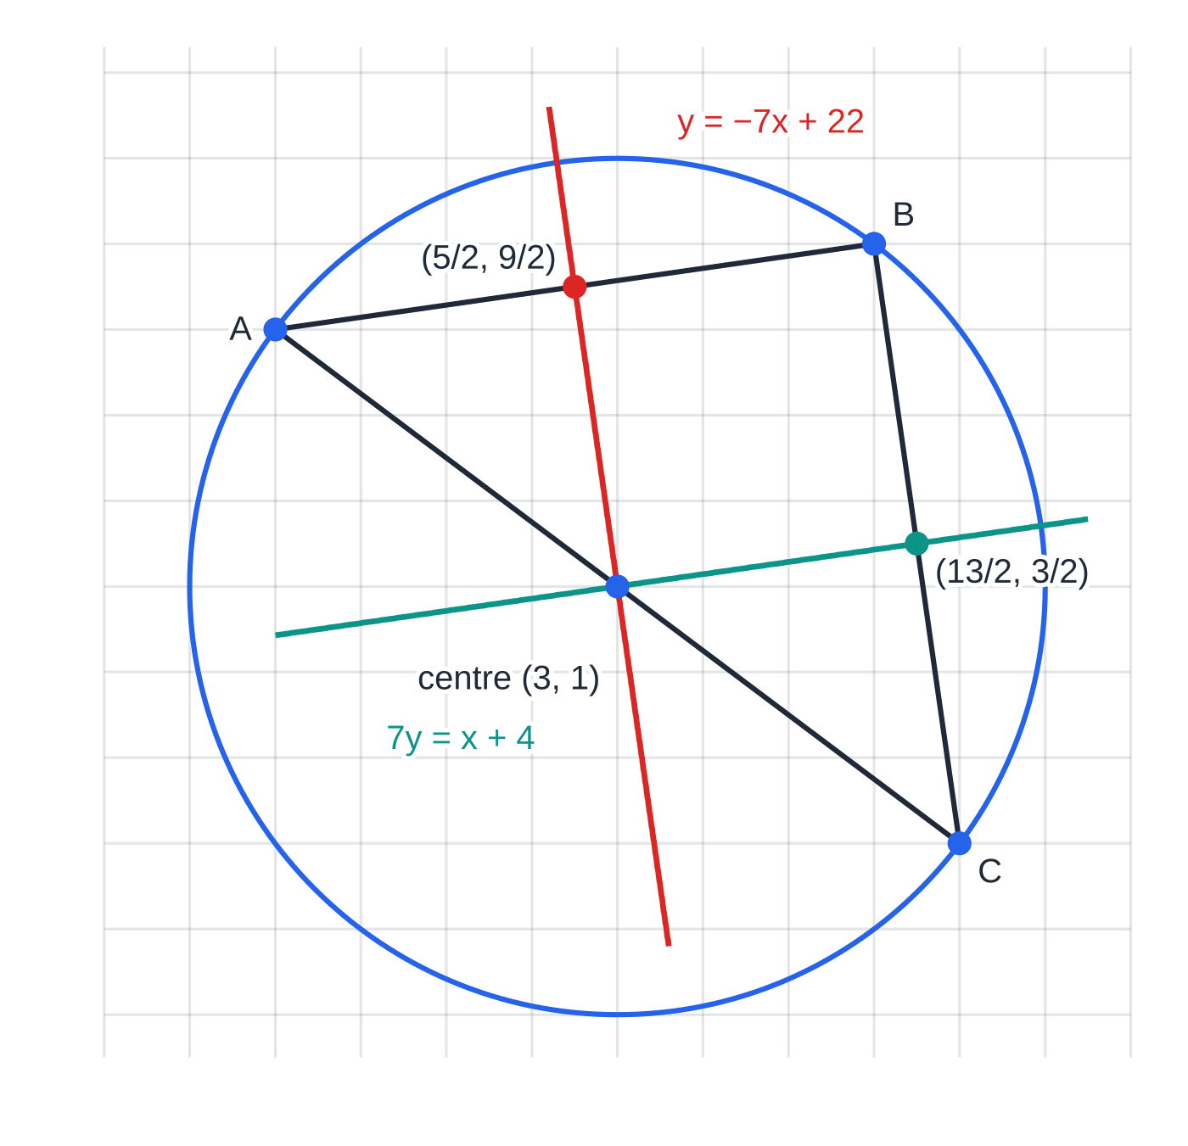
How do you find the circle through three points? (continued)
Section 6 of 12
Exam tip
Before you find any bisectors, check the gradients of the three sides: a product of -1 means a right angle, a diameter, and a much shorter route to the centre.
Worked example 6. The perpendicular bisectors of the chords AB and BC pass through their midpoints (5/2, 9/2) and (13/2, 3/2) and cross at the centre (3, 1).
Notes:
How do you find the circle through three points?. Full notes: https://examinerprep.com/notes/edexcel-ial-maths/coordinate-geometry-of-circles/

Slide 28
How long is a tangent from a point outside the circle?
Section 7 of 12
From a point P outside a circle there are two tangents, touching the circle at A and B. They have equal lengths: PA = PB.
The radius CA is perpendicular to the tangent, so triangle PAC has a right angle at A: PA² = PC² - r².
Shortcut: if the circle is x² + y² + 2gx + 2fy + c = 0, substituting P into the left-hand side gives PA² directly. A positive value confirms P is outside.
The quadrilateral PACB is a kite made of two congruent right-angled triangles: area = 2 ×½ ×r ×PA = r ×PA.
To find the equations of the tangents from P: take a line through P with gradient m, substitute into the circle and set the discriminant to zero.
Notes:
How long is a tangent from a point outside the circle?. Full notes: https://examinerprep.com/notes/edexcel-ial-maths/coordinate-geometry-of-circles/

Slide 29
How long is a tangent from a point outside the circle? (continued)
Section 7 of 12 · Worked example 7 · Hard · Hence
WORKED EXAMPLE · QUESTION
The circle C has equation x² + y² - 10x - 4y + 20 = 0. The point P has coordinates (1, -1).
(a) Find the centre and radius of C. (b) Show that P lies outside C, and find the length of a tangent from P to C. (c) A line through P has gradient m. Show that the x-coordinates of its points of intersection with C satisfy (1 + m²)x² - (2m² + 6m + 10)x + m² + 6m + 25 = 0. (d) Hence find the equations of the two tangents from P to C. (e) Find the area of the quadrilateral formed by P, the two points of contact and the centre, and the angle between the two tangents.
SOLUTION
(a) (x - 5)² - 25 + (y - 2)² - 4 + 20 = 0, so (x - 5)² + (y - 2)² = 9: centre (5, 2), radius 3.
(b) PC² = (1 - 5)² + (-1 - 2)² = 25 > 9, so P is outside. Tangent length = √(25 - 9) = 4. Shortcut check: 1² + (-1)² - 10(1) - 4(-1) + 20 = 16 = 4². ✓
(c) The line is y = m(x - 1) - 1, so y - 2 = mx - (m + 3). Substitute into the centre–radius form:
Notes:
How long is a tangent from a point outside the circle?: Worked example 7. Full notes: https://examinerprep.com/notes/edexcel-ial-maths/coordinate-geometry-of-circles/

Slide 30
How long is a tangent from a point outside the circle? (continued)
Section 7 of 12 · Worked example 7 · Hard · Hence (continued)
(x - 5)² + (mx - (m + 3))² = 9, so x² - 10x + 25 + m²x² - 2m(m + 3)x + m² + 6m + 9 - 9 = 0, giving (1 + m²)x² - (2m² + 6m + 10)x + m² + 6m + 25 = 0. ✓
(d) Tangent ⇔ discriminant = 0. Take out the factor 4 first: 4[(m² + 3m + 5)² - (1 + m²)(m² + 6m + 25)] = 0.
(m⁴ + 6m³ + 19m² + 30m + 25) - (m⁴ + 6m³ + 26m² + 6m + 25) = -7m² + 24m = 0, so m(24 - 7m) = 0, giving m = 0 or m = (24/7).
Tangents: y = -1 and 24x - 7y - 31 = 0 (from y + 1 = (24/7)(x - 1)). Points of contact: m = 0 gives x² - 10x + 25 = 0, so A(5, -1); m = (24/7) gives (25x - 53)² = 0, so B((53/25), (71/25)).
(e) A kite of two right-angled triangles with legs 3 and 4: area = 2 ×½ ×3 ×4 = 12. Half-angle at P: tan θ= ¾, so the angle between the tangents = 2 ×36.87° = 73.7°.
Notes:
How long is a tangent from a point outside the circle?: Worked example 7. Full notes: https://examinerprep.com/notes/edexcel-ial-maths/coordinate-geometry-of-circles/

Slide 31
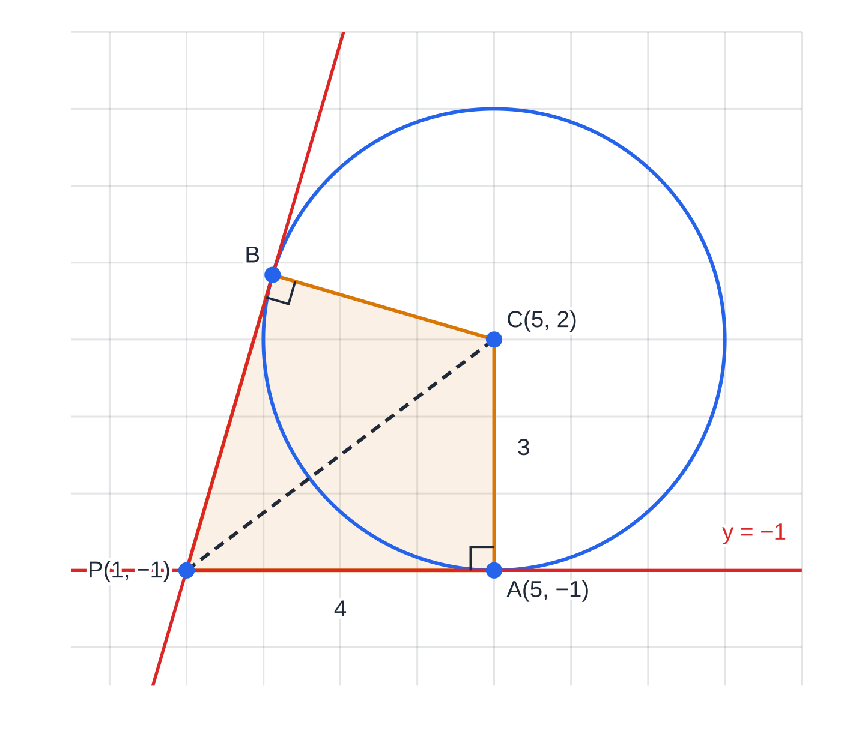
How long is a tangent from a point outside the circle? (continued)
Section 7 of 12
Common error
Forgetting that a vertical or horizontal tangent may be one of the answers. Here m = 0 is a genuine root: dividing the discriminant equation by m would lose the tangent y = -1. Factorise instead of dividing.
Worked example 7. The two tangents from P are equal in length (4), each meets a radius at a right angle, and the shaded kite PACB has area 3 × 4 = 12.
Notes:
How long is a tangent from a point outside the circle?. Full notes: https://examinerprep.com/notes/edexcel-ial-maths/coordinate-geometry-of-circles/

Slide 32
Exam tips for P2.2
Section 8 of 12
Exam tip 1 — sketch first
A quick sketch with the centre, the radius and any given points shows which properties are in play (a right angle, a chord, a tangent) and catches impossible answers, such as a "tangent" that clearly cuts the circle.
Exam tip 2 — exact means surds
"Exact radius" or "exact length" means √12.5 = 5√2/2 or 4√2, not 3.54 or 5.66. Simplify the surd; give a decimal only when the question asks for one.
Exam tip 3 — say which fact you use
Name the property in words: "tangent ⊥ radius", "angle in a semicircle = 90°", "the perpendicular bisector of a chord passes through the centre". It turns a gradient calculation into a complete argument.
Notes:
Exam tips for P2.2. Full notes: https://examinerprep.com/notes/edexcel-ial-maths/coordinate-geometry-of-circles/

Slide 33
Exam tips for P2.2 (continued)
Section 8 of 12
Exam tip 4 — discriminant, then inequality
For "find the set of values", write the discriminant inequality, find the critical values, then decide inside or outside from a sketch of the quadratic in k. Give the answer as an inequality such as -3 < k < 5.
Exam tip 5 — check points on the curve
After finding an intersection, a point of contact or a centre, substitute it back into the equations it should satisfy. One line of arithmetic catches most sign errors.
Notes:
Exam tips for P2.2. Full notes: https://examinerprep.com/notes/edexcel-ial-maths/coordinate-geometry-of-circles/

Slide 34
Common misconceptions
Section 9 of 12
Misconception | Why it is wrong | Correct idea
(x + 3)² + (y - 4)² = 16 has centre (3, -4). | The bracket is x - a, so x + 3 means a = -3. | Centre (-3, 4), radius 4.
The number on the right-hand side is the radius. | The equation comes from Pythagoras, so the right side is a squared distance. | Radius = √(right-hand side).
Every equation x² + y² + 2gx + 2fy + c = 0 is a circle. | After completing the square the right-hand side can be zero or negative. | A circle needs g² + f² - c > 0.
The tangent at P has the same gradient as the radius CP. | The tangent is perpendicular to the radius. | Tangent gradient = -1 ÷ (gradient of CP).
The length of the tangent from P is the distance PC to the centre. | PC is the hypotenuse of the right-angled triangle formed with the radius, so it is longer than the tangent. | PA² = PC² - r².
Notes:
Common misconceptions. Full notes: https://examinerprep.com/notes/edexcel-ial-maths/coordinate-geometry-of-circles/

Slide 35
Common misconceptions (continued)
Section 9 of 12
Misconception | Why it is wrong | Correct idea
The centre of a circle through three points is the average of the three points. | That is the centroid of the triangle, which is not in general equidistant from the vertices. | The centre is where the perpendicular bisectors of the chords meet.
Notes:
Common misconceptions. Full notes: https://examinerprep.com/notes/edexcel-ial-maths/coordinate-geometry-of-circles/

Slide 36
How this topic connects
Section 10 of 12
P1 straight lines and quadratics
Gradients, midpoints, the distance between two points and the rule m₁ m₂ = -1 are used in almost every circle question. Completing the square finds the centre; the discriminant decides how a line meets a circle; quadratic inequalities give the set of values of a constant.
P1 trigonometry
Arc length rθ and sector area ½ r²θ combine with circle equations when a question asks for the arc between two points or the area of a segment cut off by a chord.
P4 parametric equations and implicit differentiation
A circle can be written parametrically as x = a + rcos t, y = b + rsin t, and tangents can be found by implicit differentiation; the result always agrees with "tangent ⊥ radius".
Notes:
How this topic connects. Full notes: https://examinerprep.com/notes/edexcel-ial-maths/coordinate-geometry-of-circles/

Slide 37
Key formulae
Section 11 of 12
Formula | Use | In the formulae list?
(x - a)² + (y - b)² = r² | circle with centre (a, b) and radius r | No — learn it
x² + y² + 2gx + 2fy + c = 0: centre (-g, -f), r = √(g² + f² - c) | centre and radius from the expanded form | No — derive it
d = √((x₂ - x₁)² + (y₂ - y₁)²); midpoint ((x₁ + x₂)/2, (y₁ + y₂)/2) | radius, diameter, centre from a diameter | No — learn it
m₁ m₂ = -1 | tangent ⊥ radius; angle in a semicircle; perpendicular bisectors | No — learn it
b² - 4ac > 0, = 0, < 0 | line cuts, touches or misses a circle | No — learn it
PT² = PC² - r² | length of a tangent from an outside point P | No — derive it
Notes:
Key formulae. Full notes: https://examinerprep.com/notes/edexcel-ial-maths/coordinate-geometry-of-circles/

Slide 38
Check your understanding
Section 12 of 12
1. Find the centre and radius of the circle x² + y² - 8x + 2y - 8 = 0.
2. Explain why x² + y² + 4x - 6y + 20 = 0 is not the equation of a circle.
3. Does the point (6, 1) lie inside, on or outside the circle (x - 3)² + (y + 3)² = 25?
4. Find the equation of the tangent to x² + y² = 25 at the point (4, 3).
5. Find the length of a tangent from (7, 1) to the circle (x - 1)² + (y - 1)² = 11.
6. Find the set of values of c for which the line y = c meets the circle (x - 2)² + (y - 3)² = 8 at two distinct points.
Notes:
Check your understanding: questions. Full notes: https://examinerprep.com/notes/edexcel-ial-maths/coordinate-geometry-of-circles/

Slide 39
Check your understanding · answers
Section 12 of 12
1. (x - 4)² - 16 + (y + 1)² - 1 - 8 = 0, so (x - 4)² + (y + 1)² = 25. Centre (4, -1), radius 5.
2. Completing the square gives (x + 2)² + (y - 3)² = 4 + 9 - 20 = -7. A sum of squares cannot be negative, so no points satisfy it.
3. (6 - 3)² + (1 + 3)² = 9 + 16 = 25, equal to r², so the point lies on the circle.
4. The radius from (0, 0) has gradient ¾, so the tangent has gradient -(4/3): y - 3 = -(4/3)(x - 4). 4x + 3y = 25.
5. Distance to the centre squared: 6² + 0² = 36. Tangent length = √(36 - 11) = √25. The tangent length is 5.
6. Substitute y = c: (x - 2)² = 8 - (c - 3)². Two distinct points need 8 - (c - 3)² > 0, so |c - 3| < √8 = 2√2. 3 - 2√2 < c < 3 + 2√2.
Notes:
Check your understanding: answers. Full notes: https://examinerprep.com/notes/edexcel-ial-maths/coordinate-geometry-of-circles/

Slide 40
Practice questions
2 original exam-style questions. Answers at the end of the deck.

Slide 41
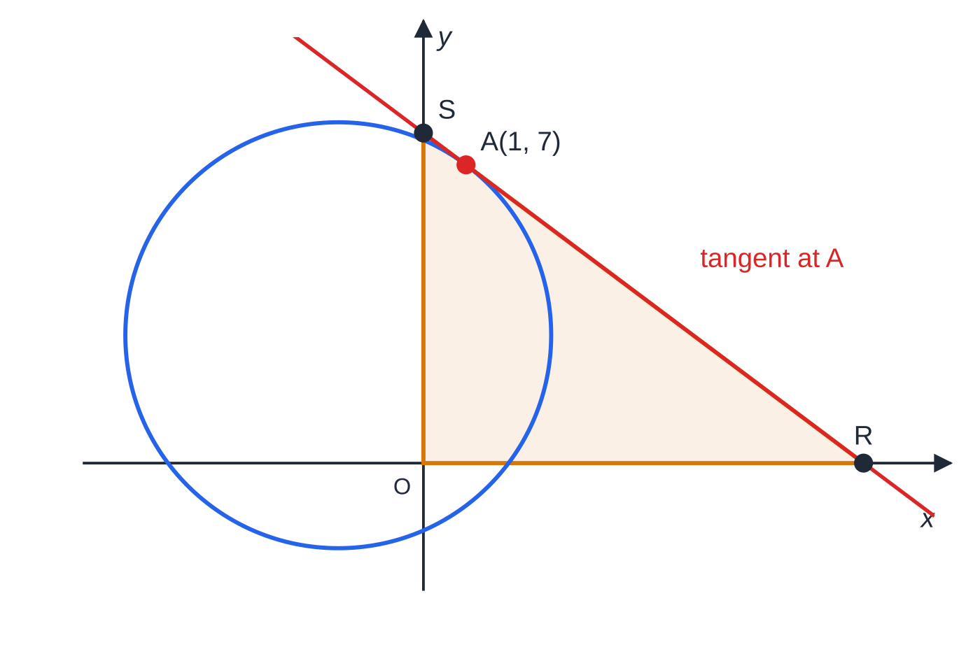
Question 1
8 marks
The point A(1, 7) lies on the circle C whose equation is x² + y² + 4x − 6y − 12 = 0. The tangent to C at A forms a triangle with the two coordinate axes.
Figure: the circle C, the tangent at A and the triangle ORS
(a) Find the centre and radius of C. [3]
(b) Find an equation of the tangent to C at A, giving your answer in the form ax + by + c = 0, where a, b and c are integers. [3]
(c) The tangent meets the x-axis at R and the y-axis at S. Find the exact area of triangle ORS, where O is the origin. [2]
Notes:
Online with the full mark scheme: https://examinerprep.com/ial-maths-p2-2-coordinate-geometry-of-circles-questions#IALM-P2-2-B-08

Slide 42
Question 2
8 marks
A circle lies in the first quadrant and touches both the x-axis and the y-axis. Its centre is (a, a), where a > 0. The circle passes through the point (2, 1).
(a) Explain why the equation of the circle is (x − a)² + (y − a)² = a². [1]
(b) Show that a² − 6a + 5 = 0. [3]
(c) Hence find the equations of the two possible circles. [2]
(d) Find the exact distance between the centres of the two circles. [2]
Notes:
Online with the full mark scheme: https://examinerprep.com/ial-maths-p2-2-coordinate-geometry-of-circles-questions#IALM-P2-2-B-10

Slide 43
Answers

Slide 44
Question 1 · answer
Mark scheme
(x + 2)² + (y − 3)² = 4 + 9 + 12
centre (−2, 3)
radius 5
gradient of radius = (7 − 3)/(1 + 2) = 4/3
tangent: y − 7 = −¾(x − 1)
3x + 4y − 31 = 0
R(31/3, 0) and S(0, 31/4)
area = ½ × 31/3 × 31/4 = 961/24
Notes:
Full mark scheme: https://examinerprep.com/ial-maths-p2-2-coordinate-geometry-of-circles-questions#IALM-P2-2-B-08

Slide 45
Question 2 · answer
Mark scheme
the circle touches the x-axis, so the radius equals the distance from the centre to the axis, which is a
(2 − a)² + (1 − a)² = a²
4 − 4a + a² + 1 − 2a + a² = a²
a² − 6a + 5 = 0 (given answer)
(a − 1)(a − 5) = 0, so a = 1 or 5
(x − 1)² + (y − 1)² = 1 and (x − 5)² + (y − 5)² = 25
√((5 − 1)² + (5 − 1)²) = √32
= 4√2
Notes:
Full mark scheme: https://examinerprep.com/ial-maths-p2-2-coordinate-geometry-of-circles-questions#IALM-P2-2-B-10

Slide 46
Keep practising
Notes for this topic
Questions on this topic
Build a printable test
ExaminerPrep is an independent tutoring service. It has been developed independently from and is not endorsed by the International Baccalaureate Organization. "International Baccalaureate", "IB" and "IB Diploma Programme" are registered trademarks of the IBO, used here for descriptive purposes only.
Pearson Edexcel and Cambridge are trademarks of their owners; ExaminerPrep is not affiliated with any exam board.

