Slide 1
EP
EDEXCEL IAL MATHS
S1.4 Correlation and regression
The full notes page in 14 sections · practice questions with answers · simulations
ExaminerPrep is an independent tutoring service. It has been developed independently from and is not endorsed by the International Baccalaureate Organization. "International Baccalaureate", "IB" and "IB Diploma Programme" are registered trademarks of the IBO, used here for descriptive purposes only.
Pearson Edexcel and Cambridge are trademarks of their owners; ExaminerPrep is not affiliated with any exam board.
Notes:
S1.4 Correlation and regression. Notes for this topic: https://examinerprep.com/notes/edexcel-ial-maths/correlation-and-regression/

Slide 2
What this page covers
Overview
Scatter diagrams and the language of correlation: positive, negative, strong, weak, none
Calculating Sₓₓ, S_yy and S_xy from raw data or from summary statistics
The product moment correlation coefficient r: calculating it, interpreting it in context, and its limitations
The least-squares regression line y=a+bx: what "least squares" means and how to find a and b
Explanatory and response variables, and interpreting a and b in context
Interpolation and extrapolation, and how reliable an estimate is
Coding: the effect on r, on the summary statistics and on the regression line
Notes:
What this page covers. Full notes: https://examinerprep.com/notes/edexcel-ial-maths/correlation-and-regression/

Slide 3
In one minute
Key points
1. Correlation and regression measure and use a straight-line relationship between two variables, and three summary numbers, Sₓₓ, S_yy and S_xy, carry the whole topic.
2. Sₓₓ=Σx²-(Σx)²/n, S_yy=Σy²-(Σy)²/n, S_xy=Σxy-(Σx)(Σy)/n.
3. r=S_xy/√(SₓₓS_yy), always between −1 and 1. It measures linear association only, and correlation does not prove cause.
4. Regression line of y on x: b=S_xy/Sₓₓ, a=ȳ-bx̄. It passes through (x̄,ȳ) and minimises the sum of the squared vertical distances.
5. b is the change in y for each extra unit of x; a is the value of y when x=0 (often outside the data, so treat it with care).
6. Interpolation is reliable when r is close to ±1; extrapolation is not. Coding u=(x-p)/q does not change r (for q>0).
Notes:
In one minute. Full notes: https://examinerprep.com/notes/edexcel-ial-maths/correlation-and-regression/

Slide 4
What does a scatter diagram show?
Section 1 of 14
Bivariate data. Pairs of values of two variables measured on each member of a sample, for example the height and the arm span of each student. A scatter diagram plots each pair as one point (x,y).
With positive correlation, as x increases y tends to increase: the points rise from left to right. With negative correlation they fall from left to right. With no correlation there is no straight-line pattern. The closer the points lie to a straight line, the stronger the (linear) correlation. In context, say what happens to one variable as the other increases: "days with more sunshine tend to generate more energy".
Notes:
What does a scatter diagram show?. Full notes: https://examinerprep.com/notes/edexcel-ial-maths/correlation-and-regression/

Slide 5
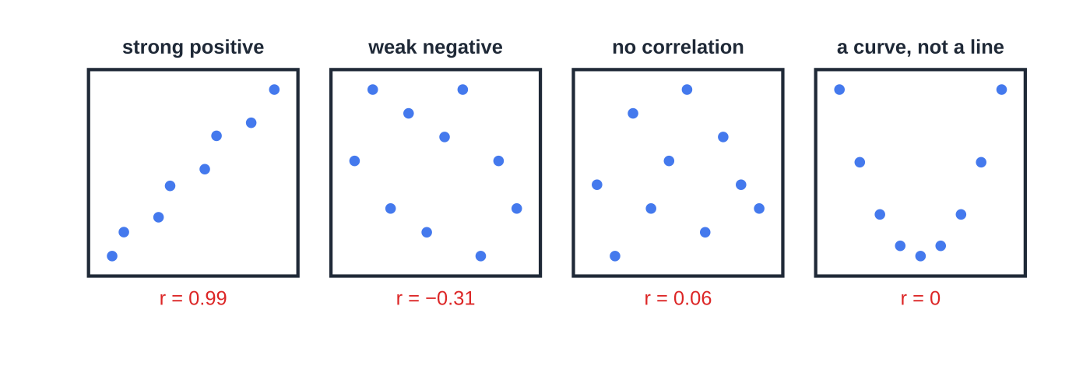
What does a scatter diagram show? (continued)
Section 1 of 14
Common error
Writing just "positive correlation" when asked to interpret a diagram in context. Name the variables: "as the hours of sunshine increase, the energy generated tends to increase".
Four sets of paired data with the product moment correlation coefficient of each, calculated from the plotted points. The U-shaped points follow a curve exactly, yet r=0: correlation only measures how close the points are to a straight line.
Notes:
What does a scatter diagram show?. Full notes: https://examinerprep.com/notes/edexcel-ial-maths/correlation-and-regression/

Slide 6
How do you calculate Sxx, Syy and Sxy?
Section 2 of 14
Summary statistics for paired data
(n = number of pairs): Sₓₓ=Σ(x-x̄)²=Σx²-(Σx)²/n, S_yy=Σ(y-ȳ)²=Σy²-(Σy)²/n S_xy=Σ(x-x̄)(y-ȳ)=Σxy-(Σx)(Σy)/n
Sₓₓ and S_yy are never negative. S_xy is positive for positive correlation and negative for negative correlation; it carries the sign of everything that follows. Why? For a point above-right of the mean point, both (x-x̄) and (y-ȳ) are positive, so its product is positive; points below-left also give positive products. A rising pattern therefore makes S_xy positive.
Notes:
How do you calculate Sxx, Syy and Sxy?. Full notes: https://examinerprep.com/notes/edexcel-ial-maths/correlation-and-regression/

Slide 7
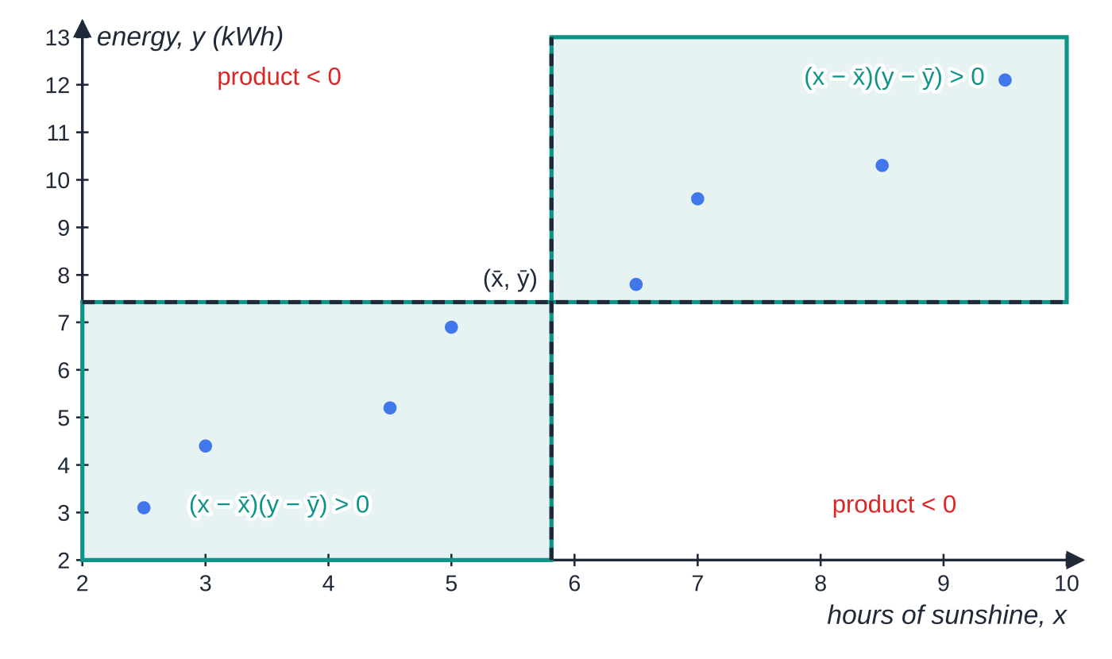
How do you calculate Sxx, Syy and Sxy? (continued)
Section 2 of 14
In most questions you are given Σx, Σy, Σx², Σy² and Σxy: substitute into the right-hand forms. From raw data, use your calculator's statistics mode, but still write the formula with the numbers in it, and keep full calculator values of Sₓₓ, S_yy and S_xy: rounding early can change the third significant figure of r.
The solar-panel data used in the next three sections: hours of sunshine on 8 days and the energy a domestic solar panel generated on each of those days.
The solar-panel data split by lines through the mean point. Every point lies in a shaded quadrant, where (x-x̄)(y-ȳ)>0, so S_xy is positive.
Notes:
How do you calculate Sxx, Syy and Sxy?. Full notes: https://examinerprep.com/notes/edexcel-ial-maths/correlation-and-regression/

Slide 8
How do you calculate Sxx, Syy and Sxy? (continued)
Section 2 of 14
hours of sunshine, x | 2.5 | 3.0 | 4.5 | 5.0 | 6.5 | 7.0 | 8.5 | 9.5
energy, y (kWh) | 3.1 | 4.4 | 5.2 | 6.9 | 7.8 | 9.6 | 10.3 | 12.1
Notes:
How do you calculate Sxx, Syy and Sxy?. Full notes: https://examinerprep.com/notes/edexcel-ial-maths/correlation-and-regression/

Slide 9
How do you calculate Sxx, Syy and Sxy? (continued)
Section 2 of 14 · Worked example 1 · Easy · Calculate
WORKED EXAMPLE · QUESTION
For the solar-panel data, Σx=46.5, Σy=59.4, Σx²=314.25, Σy²=509.12 and Σxy=399.25. Calculate Sₓₓ, S_yy and S_xy.
SOLUTION
Sₓₓ=314.25-46.5²/8=314.25-270.28125= 43.96875
S_yy=509.12-59.4²/8=509.12-441.045= 68.075
S_xy=399.25-(46.5×59.4)/8=399.25-345.2625= 53.9875, positive, matching the rising pattern of the points.
Notes:
How do you calculate Sxx, Syy and Sxy?: Worked example 1. Full notes: https://examinerprep.com/notes/edexcel-ial-maths/correlation-and-regression/

Slide 10
What does the product moment correlation coefficient measure?
Section 3 of 14
Product moment correlation coefficient.
A measure of the strength and direction of the linear relationship between two variables: r=S_xy/√(SₓₓS_yy), -1≤r≤1. r has no units, and swapping x and y gives the same value. A value outside -1≤r≤1 means an arithmetic error.
Value of r | Meaning
r=1 | perfect positive linear correlation: every point on a rising straight line
close to 1 (e.g. 0.9) | strong positive linear correlation
around 0.4 to 0.6 | moderate / weak positive linear correlation
close to 0 | little or no linear correlation (there may still be a curved relationship)
close to −1 | strong negative linear correlation
Notes:
What does the product moment correlation coefficient measure?. Full notes: https://examinerprep.com/notes/edexcel-ial-maths/correlation-and-regression/

Slide 11
What does the product moment correlation coefficient measure? (continued)
Section 3 of 14
Value of r | Meaning
r=-1 | perfect negative linear correlation: every point on a falling straight line
Notes:
What does the product moment correlation coefficient measure?. Full notes: https://examinerprep.com/notes/edexcel-ial-maths/correlation-and-regression/

Slide 12
What does the product moment correlation coefficient measure? (continued)
Section 3 of 14 · Worked example 2 · Easy · Calculate, interpret
WORKED EXAMPLE · QUESTION
Using the results of Worked example 1, calculate the product moment correlation coefficient between hours of sunshine and energy generated, and interpret it in context.
SOLUTION
r=53.9875/(√(43.96875×68.075))=0.98680…= 0.987
Strong positive linear correlation: days with more hours of sunshine tend to generate more energy.
Notes:
What does the product moment correlation coefficient measure?: Worked example 2. Full notes: https://examinerprep.com/notes/edexcel-ial-maths/correlation-and-regression/

Slide 13
What does the product moment correlation coefficient measure? (continued)
Section 3 of 14
Exam tip — three parts to an interpretation
An interpretation of r needs the direction (positive/negative), the strength (strong/weak) and the context (both variables named). "Strong" on its own, or a bare number, is not an interpretation.
Notes:
What does the product moment correlation coefficient measure?. Full notes: https://examinerprep.com/notes/edexcel-ial-maths/correlation-and-regression/

Slide 14
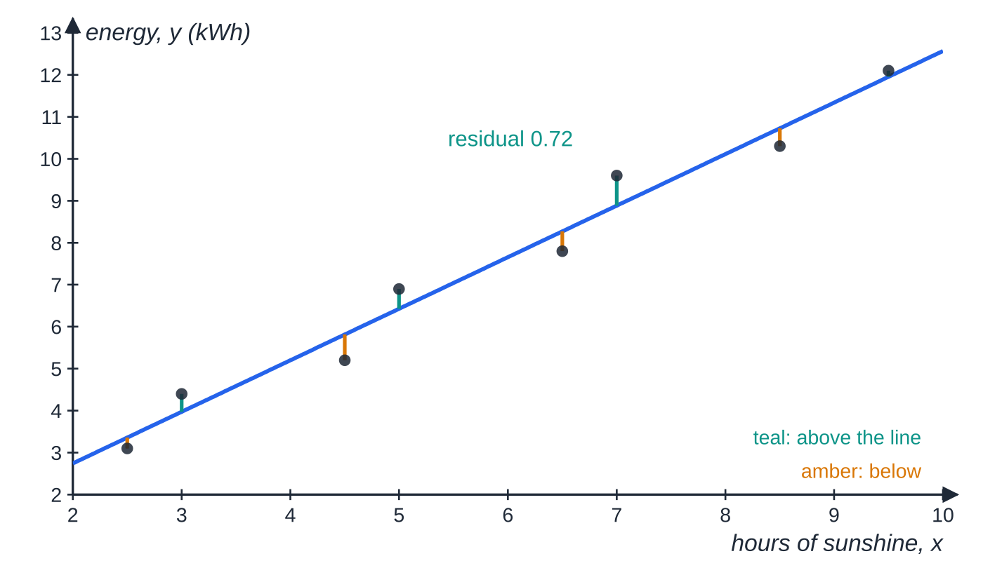
How do you find the least-squares regression line?
Section 4 of 14
For each point, the residual is its vertical distance from the line: observed y − value of y on the line. The least-squares regression line of y on x is the straight line that makes the sum of the squares of the residuals as small as possible. The distances are measured parallel to the y-axis because y is the variable being predicted.
Regression line of y on x.
Residuals for the solar-panel data. The largest is 0.72 kWh at x=7. No other straight line gives a smaller total of squared residuals than this one (1.79); the positive and negative residuals add up to exactly 0.
Notes:
How do you find the least-squares regression line?. Full notes: https://examinerprep.com/notes/edexcel-ial-maths/correlation-and-regression/

Slide 15
How do you find the least-squares regression line? (continued)
Section 4 of 14
y=a+bx, b=S_xy/Sₓₓ, a=ȳ-bx̄ Because a=ȳ-bx̄, the line always passes through the mean point (x̄,ȳ), a quick check on a sketch.
Notes:
How do you find the least-squares regression line?. Full notes: https://examinerprep.com/notes/edexcel-ial-maths/correlation-and-regression/

Slide 16
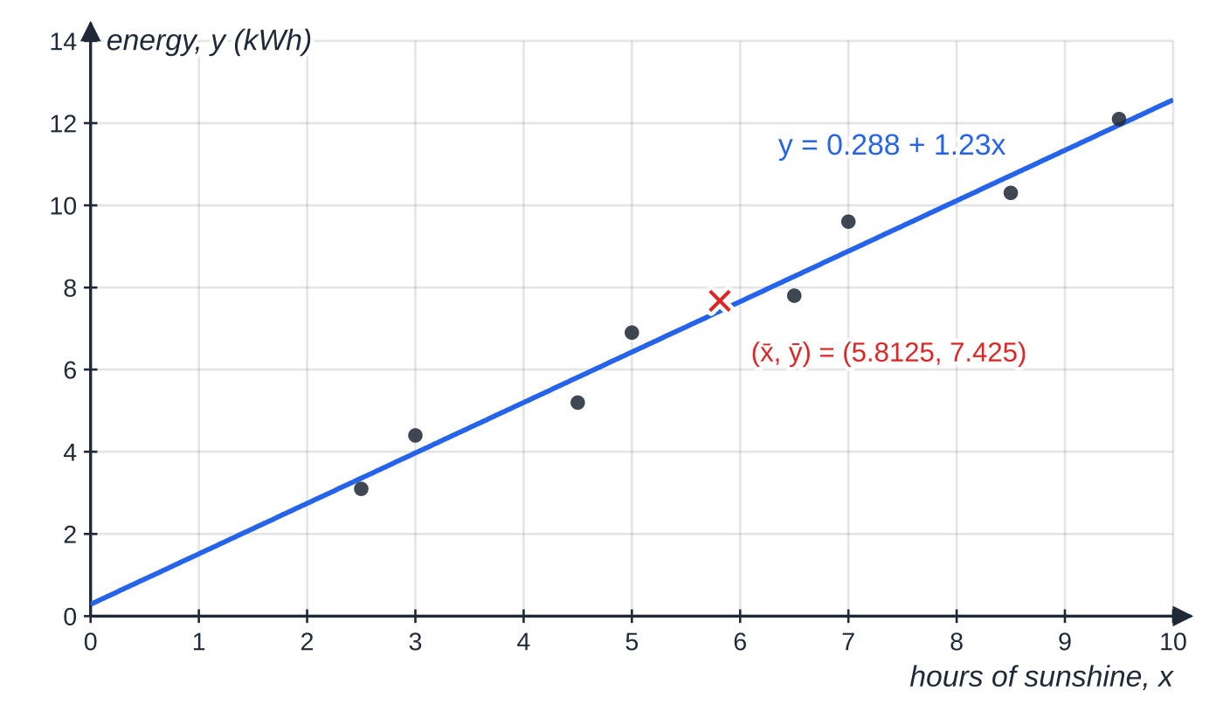
How do you find the least-squares regression line? (continued)
Section 4 of 14 · Worked example 3 · Medium · Find
WORKED EXAMPLE · QUESTION
Using the results of Worked example 1, find the equation of the regression line of y on x for the solar-panel data, giving a and b to 3 significant figures.
SOLUTION
Gradient: b=(53.9875/43.96875)=1.2279…
Means: x̄=(46.5/8)=5.8125, ȳ=(59.4/8)=7.425.
Intercept, using the unrounded b: a=7.425-1.2279…×5.8125=0.2881
y=0.288+1.23x
The solar-panel data with the regression line y=0.288+1.23x. The line passes through the mean point (5.8125, 7.425), marked with a cross.
Notes:
How do you find the least-squares regression line?: Worked example 3. Full notes: https://examinerprep.com/notes/edexcel-ial-maths/correlation-and-regression/

Slide 17
How do you find the least-squares regression line? (continued)
Section 4 of 14
Common error
Rounding b to 1.23 before finding a: 7.425-1.23×5.8125=0.276, not 0.288. Keep the full value of b in your calculator for the next step.
Notes:
How do you find the least-squares regression line?. Full notes: https://examinerprep.com/notes/edexcel-ial-maths/correlation-and-regression/

Slide 18
Which variable is which, and what do a and b mean?
Section 5 of 14
Explanatory (independent) variable: the variable that is set, controlled or changes on its own; it goes on the horizontal axis as x. Response (dependent) variable: the variable whose value depends on, or is predicted from, the explanatory variable; it goes on the vertical axis as y.
Ask which variable could affect the other: hours of sunshine can affect the energy generated, not the other way round. The regression line of y on x is used to estimate y for a given x; it is not the right line for estimating x from y.
Interpreting b: "for each extra (unit of x), (the response) increases/decreases by about b (units of y)".
Interpreting a: the value of y when x=0, meaningful only if x=0 makes sense and is not far outside the data.
The phone data: hours of screen-on time x since a full charge, and battery left y (%), for one phone on 8 occasions.
Notes:
Which variable is which, and what do a and b mean?. Full notes: https://examinerprep.com/notes/edexcel-ial-maths/correlation-and-regression/

Slide 19
Which variable is which, and what do a and b mean? (continued)
Section 5 of 14
x (hours) | 1 | 1.5 | 2.5 | 3 | 4 | 4.5 | 5.5 | 6
y (%) | 89 | 82 | 74 | 63 | 58 | 49 | 41 | 32
Notes:
Which variable is which, and what do a and b mean?. Full notes: https://examinerprep.com/notes/edexcel-ial-maths/correlation-and-regression/

Slide 20
Which variable is which, and what do a and b mean? (continued)
Section 5 of 14 · Worked example 4 · Medium · State, find, interpret
WORKED EXAMPLE · QUESTION
For the phone data, n=8, Σx=28, Σy=488, Σx²=121, Σy²=32 560 and Σxy=1456. (a) State, with a reason, which is the explanatory variable. (b) Find the regression line of y on x. (c) Interpret the gradient and the intercept in context.
SOLUTION
(a) Screen-on time: using the screen drains the battery, so the battery level depends on the time, not the reverse.
(b) Sₓₓ=121-28²/8=23, S_xy=1456-(28×488)/8=-252. b=(-252)/23=-10.957…, a=61-(-10.957…)(3.5)=99.35: y=99.3-11.0x.
(c) b: the battery level falls by about 11 percentage points for each hour of screen-on time. a: with no screen-on time the battery is at about 99%, close to the full charge it starts from.
Notes:
Which variable is which, and what do a and b mean?: Worked example 4. Full notes: https://examinerprep.com/notes/edexcel-ial-maths/correlation-and-regression/

Slide 21
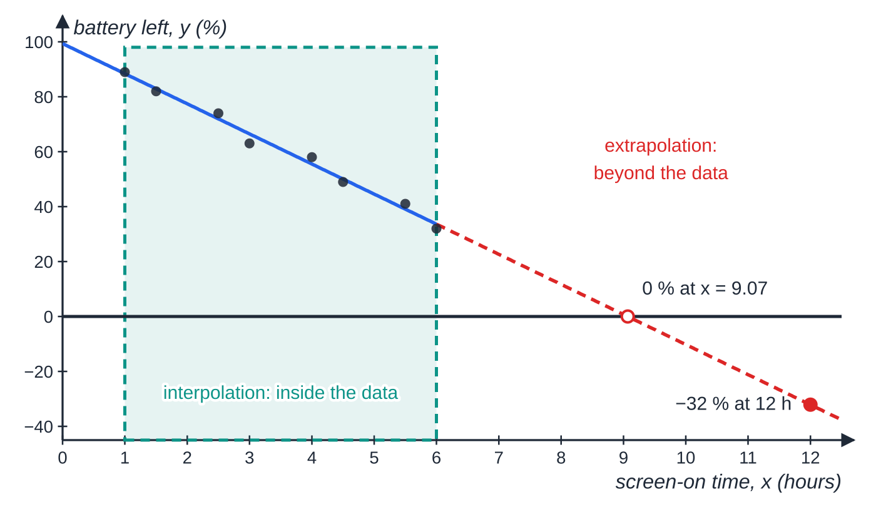
When can you trust an estimate from the line?
Section 6 of 14
Interpolation: estimating y for an x inside the range of the data. Extrapolation: estimating y for an x outside the range of the data.
An interpolated estimate is reliable when the correlation is strong (r close to ±1). An extrapolated estimate is unreliable: nothing in the data shows that the straight-line pattern carries on beyond it. A weak correlation makes every estimate unreliable, inside the range or not.
The phone data cover 1 to 6 hours (shaded). The line y=99.3-11.0x reaches 0% at x=9.07, and beyond that it predicts impossible negative values: a straight-line model cannot hold for ever.
Notes:
When can you trust an estimate from the line?. Full notes: https://examinerprep.com/notes/edexcel-ial-maths/correlation-and-regression/

Slide 22
When can you trust an estimate from the line? (continued)
Section 6 of 14 · Worked example 5 · Medium · Estimate, comment
WORKED EXAMPLE · QUESTION
Use the regression line from Worked example 4 to estimate the battery left after (a) 2 hours and (b) 10 hours of screen-on time. Comment on the reliability of each estimate.
SOLUTION
(a) y=99.348-10.957×2= 77.4%. Reliable: 2 hours is inside the data (interpolation), and r=-0.994 (using S_yy=2792 from the sums in Worked example 4) shows strong negative linear correlation.
(b) y=99.348-10.957×10= −10.2%. Unreliable: 10 hours is outside the data (extrapolation), and a negative battery level is impossible.
Notes:
When can you trust an estimate from the line?: Worked example 5. Full notes: https://examinerprep.com/notes/edexcel-ial-maths/correlation-and-regression/

Slide 23
When can you trust an estimate from the line? (continued)
Section 6 of 14
Common error
Rearranging y=a+bx to estimate x from a given y. The line of y on x minimises vertical distances only; to estimate x you would need the regression line of x on y, a different line unless r=±1.
Notes:
When can you trust an estimate from the line?. Full notes: https://examinerprep.com/notes/edexcel-ial-maths/correlation-and-regression/

Slide 24
How does coding affect correlation and regression?
Section 7 of 14
Data are often coded to make the numbers smaller: u=(x-p)/q and v=(y-s)/t. Adding or subtracting a constant shifts the points; dividing by a positive constant rescales an axis. Neither changes the shape of the scatter diagram, so r is unchanged. Dividing by a negative constant reflects the diagram: r changes sign but keeps its size. To turn a coded regression line into one for x and y, substitute the coding into it and rearrange.
Coding and the summary statistics
(q,t>0): Sᵤᵤ=Sₓₓ/q², Sᵥᵥ=S_yy/t², Sᵤᵥ=S_xy/qt, rᵤᵥ=r_xy The constants p and s that are subtracted have no effect on any of the S values.
Notes:
How does coding affect correlation and regression?. Full notes: https://examinerprep.com/notes/edexcel-ial-maths/correlation-and-regression/

Slide 25
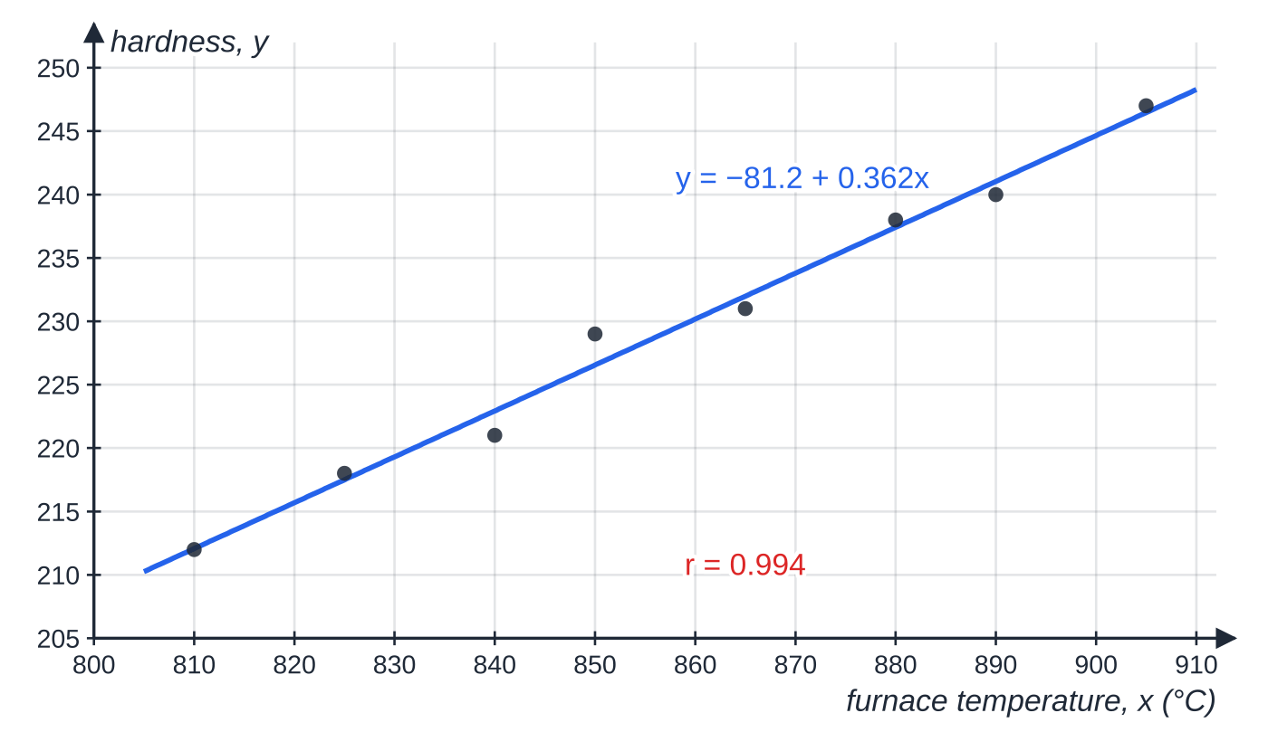
How does coding affect correlation and regression? (continued)
Section 7 of 14 · Worked example 6 · Hard · Find, hence, estimate
WORKED EXAMPLE · QUESTION
A batch of 8 steel bolts is heat-treated at different furnace temperatures x °C and the hardness y of each is measured. The data are coded using u=(x-800)/5 and v=y-200, giving Σu=93, Σv=236, Σu²=1383, Σv²=7964, Σuv=3290. (a) Find the product moment correlation coefficient between x and y. (b) Find the regression line of v on u. (c) Hence find the regression line of y on x. (d) Estimate the hardness of a bolt treated at 860 °C.
Hardness of the 8 bolts against furnace temperature, with the decoded line y=-81.2+0.362x.
Notes:
How does coding affect correlation and regression?: Worked example 6. Full notes: https://examinerprep.com/notes/edexcel-ial-maths/correlation-and-regression/

Slide 26
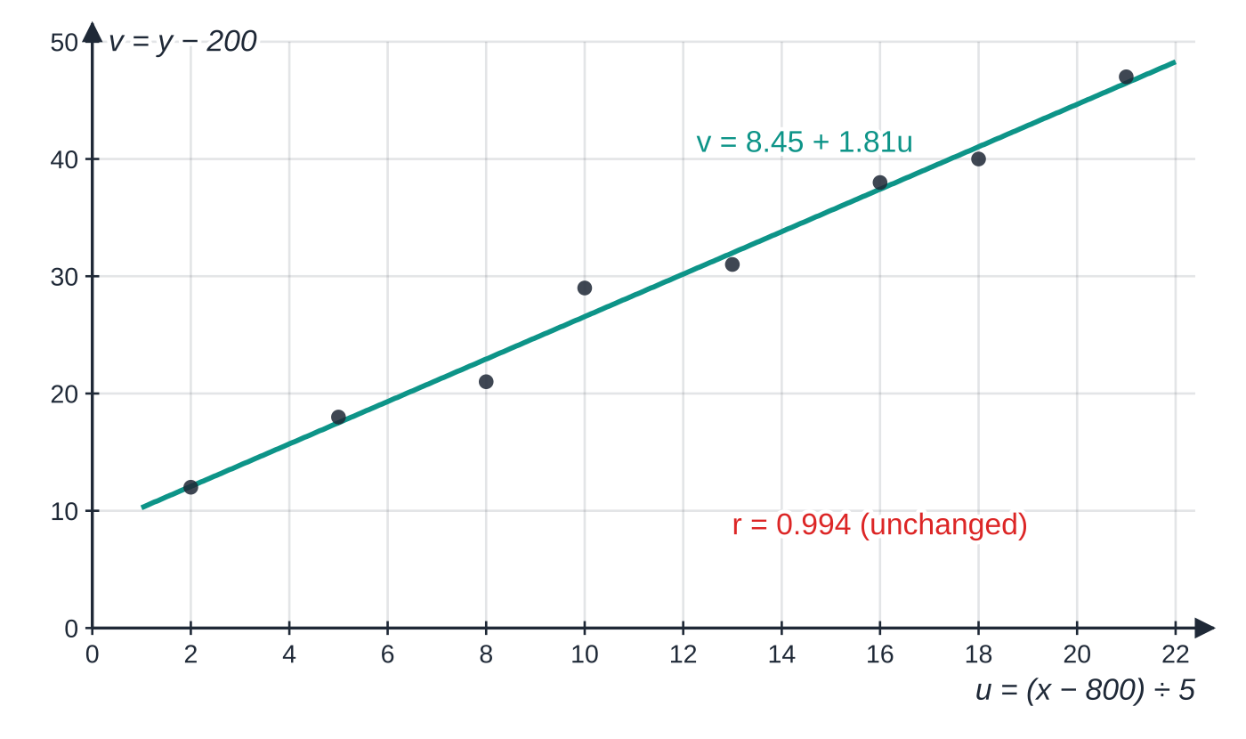
How does coding affect correlation and regression? (continued)
Section 7 of 14 · Worked example 6 · Hard · Find, hence, estimate (continued)
SOLUTION
(a) Sᵤᵤ=1383-93²/8=301.875, Sᵥᵥ=7964-236²/8=1002, Sᵤᵥ=3290-(93×236)/8=546.5. r=546.5/(√(301.875×1002))=0.994; coding does not change r, so r=0.994.
(b) Gradient =(546.5/301.875)=1.8104…; ū=11.625, v̄=29.5; intercept =29.5-1.8104…×11.625=8.4547: v=8.45+1.81u.
(c) Substitute: y-200=8.4547+1.8104×(x-800)/5, so y=208.45+0.36207x-289.66: y=-81.2+0.362x.
The same 8 bolts plotted with the coded variables. The pattern is identical, only the axis labels change, so r=0.994 for u and v as well as for x and y.
Notes:
How does coding affect correlation and regression?: Worked example 6. Full notes: https://examinerprep.com/notes/edexcel-ial-maths/correlation-and-regression/

Slide 27
How does coding affect correlation and regression? (continued)
Section 7 of 14 · Worked example 6 · Hard · Find, hence, estimate (continued)
(d) y=-81.202+0.36207×860= 230.
Check: Sₓₓ=5²×Sᵤᵤ=7546.875 and S_xy=5×Sᵤᵥ=2732.5, so b=2732.5÷7546.875=0.362. The intercept −81.2 would be the hardness at 0 °C, far outside the data, so it has no practical meaning.
Notes:
How does coding affect correlation and regression?: Worked example 6. Full notes: https://examinerprep.com/notes/edexcel-ial-maths/correlation-and-regression/

Slide 28
What are the limitations of the correlation coefficient?
Section 8 of 14
Linear only. r measures how close the points are to a straight line. A strong curved relationship can have r near 0, so always look at the scatter diagram.
Correlation is not causation. Both variables may depend on a third: ice-cream sales and sunburn cases rise together because both increase in hot, sunny weather.
Outliers. One unusual point, often a recording error, can change r a lot, in either direction.
Small samples. With only a few points, a large r can happen by chance (testing for this is beyond S1).
The range of the data. r describes the relationship only within the values measured.
Notes:
What are the limitations of the correlation coefficient?. Full notes: https://examinerprep.com/notes/edexcel-ial-maths/correlation-and-regression/

Slide 29
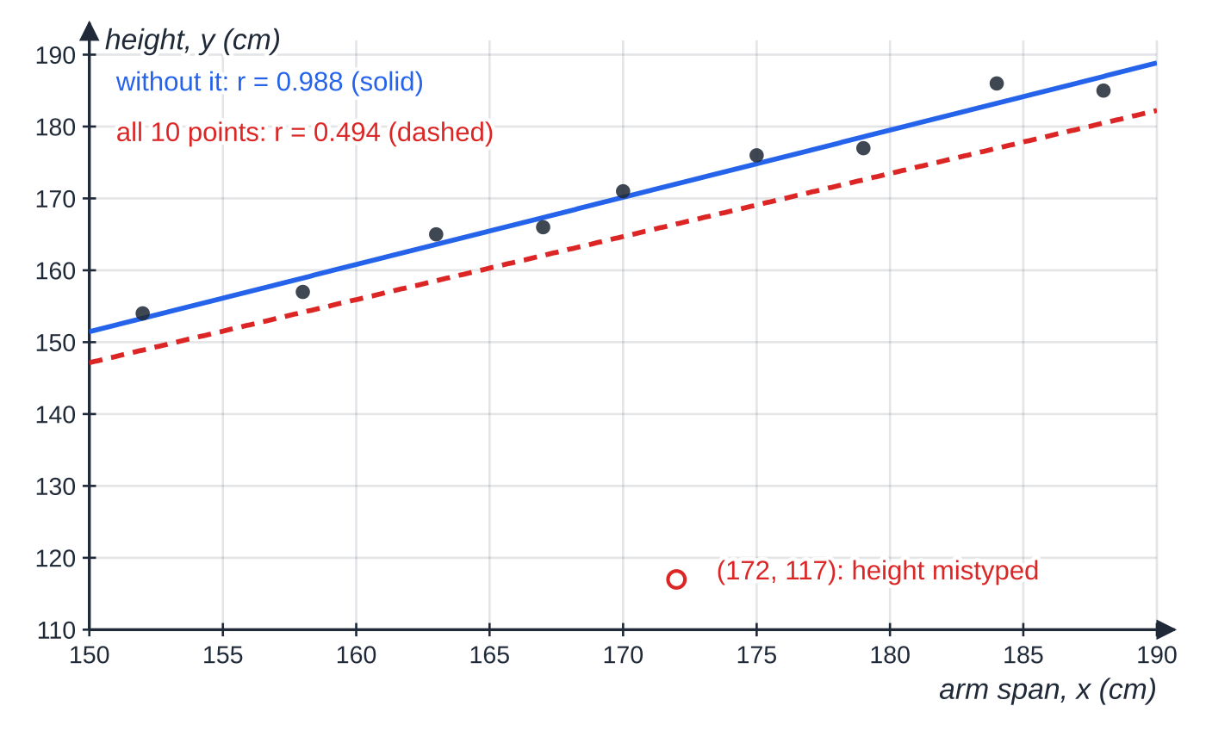
What are the limitations of the correlation coefficient? (continued)
Section 8 of 14 · Worked example 7 · Medium · Find, comment
WORKED EXAMPLE · QUESTION
The arm span x cm and height y cm of 10 students give Σx=1708, Σy=1654, Σx²=292 876, Σy²=277 202, Σxy=283 512, and r=0.494. One student's pair was recorded as (172, 117); it should be removed. (a) Find the new summary statistics for the remaining 9 students. (b) Find the new value of r and comment.
SOLUTION
One mistyped height (171 cm entered as 117 cm) drops r from 0.988 to 0.494 and drags the regression line down (dashed). Removing the error gives a much better model (solid).
Notes:
What are the limitations of the correlation coefficient?: Worked example 7. Full notes: https://examinerprep.com/notes/edexcel-ial-maths/correlation-and-regression/

Slide 30
What are the limitations of the correlation coefficient? (continued)
Section 8 of 14 · Worked example 7 · Medium · Find, comment (continued)
(a) Subtract the incorrect pair from every sum: Σx=1536, Σy=1537, Σx²=292 876-172²=263 292, Σy²=277 202-117²=263 513, Σxy=283 512-172×117=263 388.
(b) With n=9: Sₓₓ=263 292-1536²/9=1148, S_yy=263 513-1537²/9=1027.56, S_xy=263 388-(1536×1537)/9=1073.33. r=1073.33/(√(1148×1027.56))= 0.988. The correlation is now strong and positive: taller students tend to have longer arm spans; the single error had hidden this.
Notes:
What are the limitations of the correlation coefficient?: Worked example 7. Full notes: https://examinerprep.com/notes/edexcel-ial-maths/correlation-and-regression/

Slide 31
What are the limitations of the correlation coefficient? (continued)
Section 8 of 14
Common error
Removing a point by subtracting its values from Σx and Σy but leaving Σx², Σy², Σxy and n unchanged. Every sum loses that point's contribution, and n goes down by 1.
Notes:
What are the limitations of the correlation coefficient?. Full notes: https://examinerprep.com/notes/edexcel-ial-maths/correlation-and-regression/

Slide 32
How do the pieces fit together in a full question?
Section 9 of 14
A full question usually runs: summary statistics → r and its meaning → regression line → interpret the gradient → estimate and judge reliability → coding or a change of units. Keep full calculator values throughout.
Notes:
How do the pieces fit together in a full question?. Full notes: https://examinerprep.com/notes/edexcel-ial-maths/correlation-and-regression/

Slide 33
How do the pieces fit together in a full question? (continued)
Section 9 of 14 · Worked example 8 · Hard · Find, interpret, explain
WORKED EXAMPLE · QUESTION
The table gives the altitude x (hundreds of metres) and the mean July temperature y (°C) for 8 weather stations in one mountain region.
x | 2 | 5 | 7 | 9 | 12 | 14 | 16 | 19
y | 24.6 | 23.5 | 21.9 | 21.4 | 19.1 | 18.6 | 16.8 | 15.7
You may use Σx=84, Σy=161.6, Σx²=1116, Σy²=3334.48, Σxy=1569.3. (a) Find Sₓₓ, S_yy and S_xy. (b) Calculate r and interpret it in context. (c) Find the regression line of y on x. (d) Interpret the gradient in context. (e) Estimate the mean July temperature at a station 600 m above sea level, and comment on its reliability. (f) Explain why the line should not be used for a summit at 3500 m. (g) The altitudes are re-recorded in metres, w=100x. State the correlation coefficient between w and y, and the gradient of the regression line of y on w.
Notes:
How do the pieces fit together in a full question?: Worked example 8. Full notes: https://examinerprep.com/notes/edexcel-ial-maths/correlation-and-regression/

Slide 34
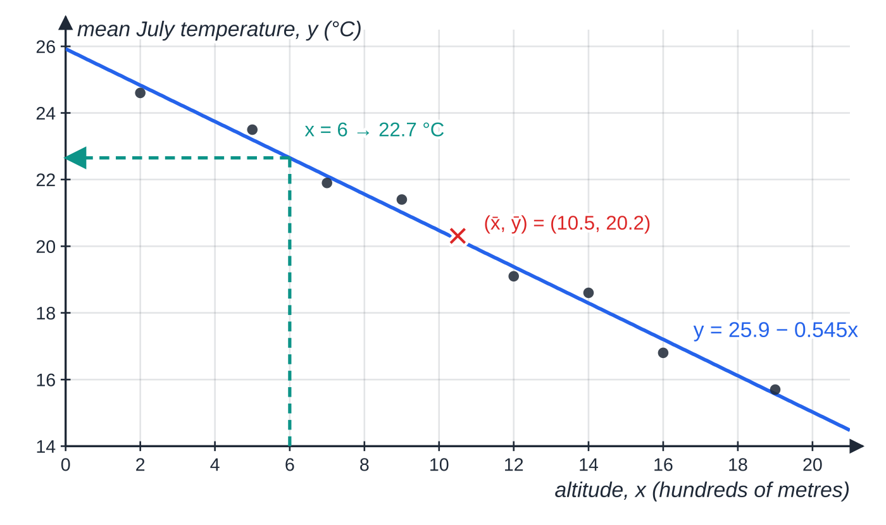
How do the pieces fit together in a full question? (continued)
Section 9 of 14 · Worked example 8 · Hard · Find, interpret, explain (continued)
SOLUTION
(a) Sₓₓ=1116-84²/8= 234; S_yy=3334.48-161.6²/8= 70.16; S_xy=1569.3-(84×161.6)/8= −127.5.
(b) r=(-127.5)/(√(234×70.16))= −0.995: strong negative linear correlation; higher stations tend to have lower mean July temperatures.
(c) b=(-127.5)/234=-0.54487…; x̄=10.5, ȳ=20.2; a=20.2-(-0.54487…)(10.5)=25.921: y=25.9-0.545x.
Mean July temperature against altitude for the 8 stations, with the regression line through the mean point (10.5, 20.2) and the estimate for an altitude of 600 m.
Notes:
How do the pieces fit together in a full question?: Worked example 8. Full notes: https://examinerprep.com/notes/edexcel-ial-maths/correlation-and-regression/

Slide 35
How do the pieces fit together in a full question? (continued)
Section 9 of 14 · Worked example 8 · Hard · Find, interpret, explain (continued)
(d) For each extra 100 m of altitude, the mean July temperature falls by about 0.545 °C.
(e) 600 m means x=6: y=25.921-0.54487×6= 22.7 °C; reliable, because x=6 is inside the data (interpolation) and the correlation is strong.
(f) 3500 m is x=35, far outside the range 2 to 19: extrapolation, so the linear pattern may not continue.
(g) Multiplying x by a positive constant does not change r; it divides the gradient by 100: r=-0.995, gradient −0.00545 °C per metre.
Notes:
How do the pieces fit together in a full question?: Worked example 8. Full notes: https://examinerprep.com/notes/edexcel-ial-maths/correlation-and-regression/

Slide 36
Exam tips for S1.4
Section 10 of 14
Exam tip 1 — write the formula with the numbers in
Show S_xy=1569.3-(84×161.6)/8 before the answer. If a calculator slip gives a wrong value, the method is still visible and later parts can follow through from it.
Exam tip 2 — keep unrounded values
Store Sₓₓ, S_yy, S_xy and b in your calculator memory. Give r, a and b to 3 significant figures at the end, unless the question asks otherwise.
Exam tip 3 — context in every interpretation
"For each extra hour of sunshine, about 1.23 kWh more energy is generated" is an interpretation; "b is the gradient" is not. Use the names and units of both variables.
Notes:
Exam tips for S1.4. Full notes: https://examinerprep.com/notes/edexcel-ial-maths/correlation-and-regression/

Slide 37
Exam tips for S1.4 (continued)
Section 10 of 14
Exam tip 4 — check sign and size
r, S_xy and b must all have the same sign as the trend in the scatter diagram, and -1≤r≤1. The line must pass through (x̄,ȳ).
Exam tip 5 — reliability needs two reasons
To judge an estimate, say whether it is interpolation or extrapolation and what the value of r shows about the strength of the correlation.
Notes:
Exam tips for S1.4. Full notes: https://examinerprep.com/notes/edexcel-ial-maths/correlation-and-regression/

Slide 38
Common misconceptions
Section 11 of 14
Misconception | Why it is wrong | Correct idea
r=0 means the variables are unrelated. | r only measures linear association; a curve can give r=0. | r=0 means no linear correlation; look at the scatter diagram.
A strong correlation proves that x causes y. | Both may depend on a third variable, or it may be coincidence. | Correlation describes association, not cause.
r=-0.9 is weaker than r=0.5. | The sign gives the direction, the size gives the strength. | −0.9 is a strong (negative) correlation.
Coding changes the correlation coefficient. | Shifting and positive rescaling do not change the shape of the scatter diagram. | r is unchanged by u=(x-p)/q with q>0.
The regression line of y on x can be rearranged to predict x. | It minimises vertical distances only. | Use it only to estimate y from x.
An estimate is reliable as long as r is close to 1. | The pattern is only known inside the data. | Extrapolated estimates are unreliable however strong r is.
Notes:
Common misconceptions. Full notes: https://examinerprep.com/notes/edexcel-ial-maths/correlation-and-regression/

Slide 39
How this topic connects
Section 12 of 14
S1.2 Measures of location and dispersion
Sₓₓ/n is the variance of x, so the coding rules here are the same ones used for means and standard deviations.
P1 Straight-line graphs
The regression line y=a+bx is a straight line: gradient and intercept are read and interpreted exactly as for y=mx+c.
P2/P3 Exponentials and logarithms
A curved relationship such as y=kxⁿ becomes linear when you plot log y against log x; correlation and regression then apply to the logged data.
Notes:
How this topic connects. Full notes: https://examinerprep.com/notes/edexcel-ial-maths/correlation-and-regression/

Slide 40
Key formulae
Section 13 of 14
Formula | Use | In the formulae list?
Sₓₓ=Σx²-(Σx)²/n | spread of x; also S_yy for y | Yes
S_xy=Σxy-(Σx)(Σy)/n | how x and y vary together | Yes
r=S_xy/√(SₓₓS_yy) | product moment correlation coefficient | Yes
b=S_xy/Sₓₓ, a=ȳ-bx̄ | regression line of y on x: y=a+bx | Yes
ȳ=a+bx̄ | the line passes through the mean point | No – derive it
Sᵤᵤ=Sₓₓ/q², Sᵤᵥ=S_xy/(qt), rᵤᵥ=r_xy | coding u=(x-p)/q, v=(y-s)/t | No – learn it
Notes:
Key formulae. Full notes: https://examinerprep.com/notes/edexcel-ial-maths/correlation-and-regression/

Slide 41
Check your understanding
Section 14 of 14
1. For a set of data, Sₓₓ=40, S_yy=90 and S_xy=-48. Find r.
2. The regression line of y on x is y=12.4+0.75x, and x̄=20. Find ȳ.
3. Two variables have r=0.03. Does this show they are not related?
4. Data are coded with u=(x-50)/10 and v=(y-3)/2. The coded data have r=0.62. Find r for x and y.
5. Phone sales in a country and the number of people over 80 have both risen steadily, with r=0.97. Does selling phones make people live longer?
Notes:
Check your understanding: questions. Full notes: https://examinerprep.com/notes/edexcel-ial-maths/correlation-and-regression/

Slide 42
Check your understanding · answers
Section 14 of 14
1. r=-48÷√(40×90)=-48÷60=-0.8: fairly strong negative linear correlation.
2. The line passes through (x̄,ȳ), so ȳ=12.4+0.75×20=27.4.
3. No. It shows there is almost no linear correlation. The variables could still have a strong curved relationship, which a scatter diagram would show.
4. 0.62. Subtracting constants and dividing by positive constants does not change the correlation coefficient.
5. No. Correlation does not imply causation: both quantities increase over time (time, wealth and population growth are third variables), so they are correlated without one causing the other.
Notes:
Check your understanding: answers. Full notes: https://examinerprep.com/notes/edexcel-ial-maths/correlation-and-regression/

Slide 43
Practice questions
2 original exam-style questions. Answers at the end of the deck.

Slide 44
Question 1
5 marks
An engineer records the wind speed x m s⁻¹ and the power output y kW of a wind turbine at 20 different times. The wind speeds recorded range from 4 m s⁻¹ to 12 m s⁻¹. The product moment correlation coefficient is 0.962 and the regression line of y on x is y = −62.4 + 31.5x.
(a) State, with a reason, which variable is the explanatory variable. [1]
(b) Interpret the value 31.5 in context. [1]
(c) Estimate the power output when the wind speed is 9 m s⁻¹, and comment on the reliability of your estimate. [2]
(d) Use the line to find the power output predicted for a wind speed of 1 m s⁻¹, and explain why this value should not be trusted. [1]
Notes:
Online with the full mark scheme: https://examinerprep.com/ial-maths-s1-4-correlation-and-regression-questions#IALM-S1-4-B-03

Slide 45
Question 2
7 marks
For 15 farms in one region, a researcher records the rainfall x mm during the growing season and the wheat yield y tonnes per hectare. The rainfall ranged from 38 mm to 91 mm. Sₓₓ = 1600, S_(yy) = 4.84, x̄ = 62.5, ȳ = 4.2, and the product moment correlation coefficient is exactly 0.6.
(a) Show that S_(xy) = 52.8. [2]
(b) Find the equation of the regression line of y on x. [3]
(c) Use your line to estimate the yield for a farm with 70 mm of rainfall, and comment on the reliability of the estimate. [2]
Notes:
Online with the full mark scheme: https://examinerprep.com/ial-maths-s1-4-correlation-and-regression-questions#IALM-S1-4-B-09

Slide 46
Answers

Slide 47
Question 1 · answer
Mark scheme
the wind speed, because the wind drives the turbine: the power output depends on the wind speed, not the reverse
for each increase of 1 m s⁻¹ in wind speed, the power output increases by about 31.5 kW
−62.4 + 31.5 × 9 = 221.1 kW
reliable: 9 is within the range of the data (interpolation) and r = 0.962 shows strong positive correlation
−30.9 kW, which is impossible (negative power); 1 m s⁻¹ is outside the data, so this is extrapolation
Notes:
Full mark scheme: https://examinerprep.com/ial-maths-s1-4-correlation-and-regression-questions#IALM-S1-4-B-03

Slide 48
Question 2 · answer
Mark scheme
0.6 = ^(Sxy)⁄_(√(1600 × 4.84))
√(1600 × 4.84) = 40 × 2.2 = 88, so S_(xy) = 0.6 × 88 = 52.8
b = ^(52.8)⁄₁₆₀₀ = 0.033
a = 4.2 − 0.033 × 62.5 = 2.1375
y = 2.14 + 0.033x
2.1375 + 0.033 × 70 = 4.45 tonnes per hectare
70 mm is inside the data (interpolation), but r = 0.6 is only moderate correlation, so the estimate is not very reliable
Notes:
Full mark scheme: https://examinerprep.com/ial-maths-s1-4-correlation-and-regression-questions#IALM-S1-4-B-09

Slide 49
Keep practising
Notes for this topic
Questions on this topic
Build a printable test
ExaminerPrep is an independent tutoring service. It has been developed independently from and is not endorsed by the International Baccalaureate Organization. "International Baccalaureate", "IB" and "IB Diploma Programme" are registered trademarks of the IBO, used here for descriptive purposes only.
Pearson Edexcel and Cambridge are trademarks of their owners; ExaminerPrep is not affiliated with any exam board.

