Slide 1
EP
EDEXCEL IAL MATHS
P2.8 Definite integration, areas and the trapezium rule
The full notes page in 11 sections · practice questions with answers · simulations
ExaminerPrep is an independent tutoring service. It has been developed independently from and is not endorsed by the International Baccalaureate Organization. "International Baccalaureate", "IB" and "IB Diploma Programme" are registered trademarks of the IBO, used here for descriptive purposes only.
Pearson Edexcel and Cambridge are trademarks of their owners; ExaminerPrep is not affiliated with any exam board.
Notes:
P2.8 Definite integration, areas and the trapezium rule. Notes for this topic: https://examinerprep.com/notes/edexcel-ial-maths/definite-integration-areas-and-the-trapezium-rule/

Slide 2
What this page covers
Overview
Evaluating definite integrals of sums of powers of x, including roots, fractions and unknown limits
Why there is no + c in a definite integral
The area between a curve and the x-axis
What happens when part of the region is below the axis
Areas of regions bounded by a curve and a straight line, or between two curves
The trapezium rule and the effect of using more strips
Whether the trapezium rule over- or underestimates, and percentage error
Notes:
What this page covers. Full notes: https://examinerprep.com/notes/edexcel-ial-maths/definite-integration-areas-and-the-trapezium-rule/

Slide 3
In one minute
Key points
1. A definite integral ∫ₐᵇ f(x) dx = F(b) - F(a), where F is any integral of f, is a number, and it equals the area under the curve between x = a and x = b as long as the curve stays above the x-axis there.
2. The constant c cancels, so leave it out of definite integrals.
3. Below the axis the integral is negative. If the curve crosses the axis, find where, integrate each part separately and add the sizes.
4. Between two graphs: area = ∫ₐᵇ (top - bottom) dx, with a and b where they meet. Composite regions: add or subtract simple pieces such as triangles.
5. Trapezium rule: ∫ₐᵇ y dx ≈½ h{y₀ + yₙ + 2(y₁ + y₂ + ⋯+ yₙ₋₁)}, h = (b-a)/n. Curve bending up: overestimate. Curve bending down: underestimate. More strips: smaller error.
Notes:
In one minute. Full notes: https://examinerprep.com/notes/edexcel-ial-maths/definite-integration-areas-and-the-trapezium-rule/

Slide 4
What does a definite integral calculate?
Section 1 of 11
In P1, integrating gave a family of curves: ∫2x dx = x² + c, one curve for each value of c. Put two numbers on the integral sign and the answer becomes a single number instead, and that number turns out to be an area.
Definite integral.
An integral with limits,
∫ₐᵇ f(x) dx = [F(x)]ₐᵇ = F(b) - F(a), where F′(x) = f(x).
Its value is a number. a is the lower limit and b the upper limit.
Integrate as in P1, write the result in square brackets with the limits attached, then substitute: upper value minus lower value.
The constant of integration cancels: (F(b) + c) - (F(a) + c) = F(b) - F(a). That is why there is no + c in a definite integral.
Notes:
What does a definite integral calculate?. Full notes: https://examinerprep.com/notes/edexcel-ial-maths/definite-integration-areas-and-the-trapezium-rule/

Slide 5
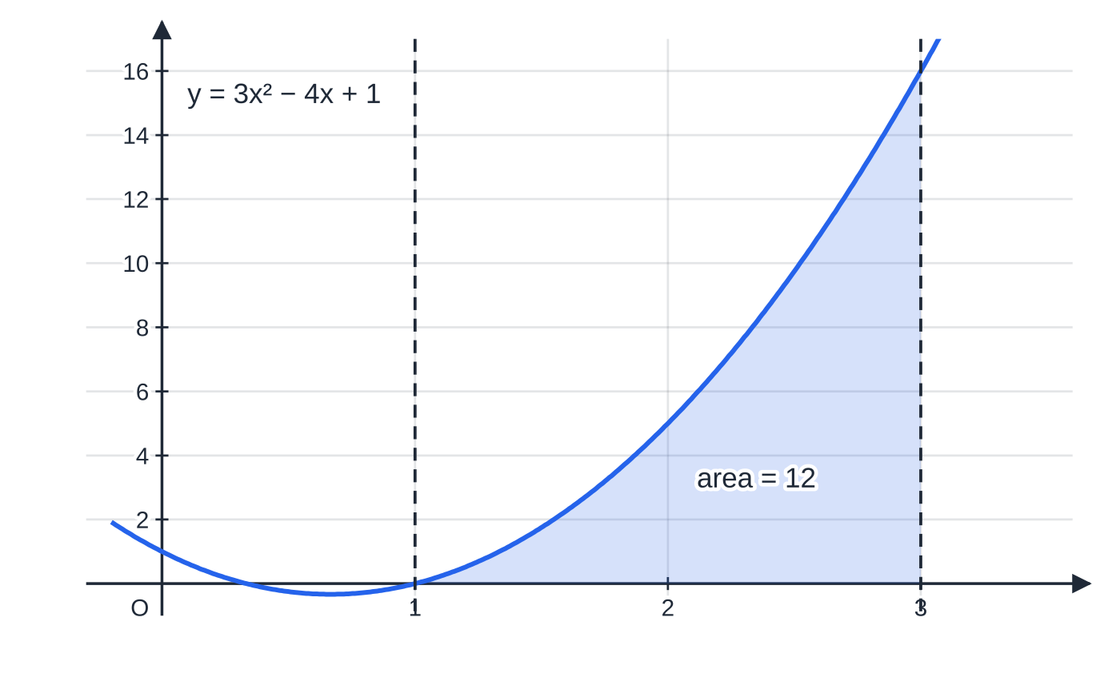
What does a definite integral calculate? (continued)
Section 1 of 11
For example, ∫₁³ (3x² - 4x + 1) dx = [x³ - 2x² + x]₁³ = (27 - 18 + 3) - (1 - 2 + 1) = 12 - 0 = 12.
Swapping the limits changes the sign: ∫₃¹ (3x² - 4x + 1) dx = -12.
∫₁³ (3x² − 4x + 1) dx = 12 is the shaded area under the curve between x = 1 and x = 3. The curve meets the axis at x = 1 and stays above it on the whole interval, so the integral and the area agree.
Notes:
What does a definite integral calculate?. Full notes: https://examinerprep.com/notes/edexcel-ial-maths/definite-integration-areas-and-the-trapezium-rule/

Slide 6
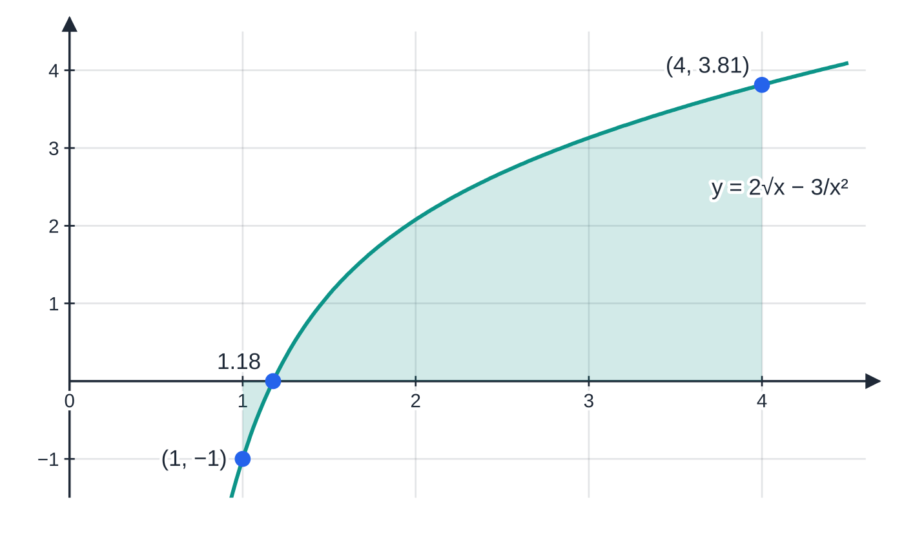
What does a definite integral calculate? (continued)
Section 1 of 11 · Worked example 1 · Medium · Find
WORKED EXAMPLE · QUESTION
Find the exact value of ∫₁⁴ (2√x - 3/x²) dx.
SOLUTION
Write each term as a power of x: 2x^(1/2) - 3x⁻².
Integrate (raise each power by one, divide by the new power):
[(4/3) x^(3/2) + 3x⁻¹]₁⁴ = [(4/3) x^(3/2) + 3/x]₁⁴
Substitute the limits, using 4^(3/2) = 8: ((32/3) + ¾) - ((4/3) + 3) = (28/3) - (9/4).
The integrand of Worked example 1. A thin sliver near x = 1 lies below the axis and counts negatively, so 85/12 is a signed total, not quite the shaded area. For a definite integral that is fine; for an area you would split at x ≈ 1.18.
Notes:
What does a definite integral calculate?: Worked example 1. Full notes: https://examinerprep.com/notes/edexcel-ial-maths/definite-integration-areas-and-the-trapezium-rule/

Slide 7
What does a definite integral calculate? (continued)
Section 1 of 11 · Worked example 1 · Medium · Find (continued)
Combine over a common denominator: (112/12) - (27/12). (85/12)
"Exact" means leave it as a fraction; the decimal 7.0833… would not be in the form asked.
Notes:
What does a definite integral calculate?: Worked example 1. Full notes: https://examinerprep.com/notes/edexcel-ial-maths/definite-integration-areas-and-the-trapezium-rule/

Slide 8
What does a definite integral calculate? (continued)
Section 1 of 11 · Worked example 2 · Medium · Find
WORKED EXAMPLE · QUESTION
Given that k > 1 and ∫₁ᵏ (4x - 1) dx = 14, find the value of k.
SOLUTION
Integrate and substitute the limits; the upper limit is k: [2x² - x]₁ᵏ = (2k² - k) - (2 - 1) = 2k² - k - 1.
Set equal to 14 and solve the quadratic: 2k² - k - 15 = 0 ⇒(k - 3)(2k + 5) = 0.
Use the condition k > 1: k = -(5/2) is rejected. k = 3
Notes:
What does a definite integral calculate?: Worked example 2. Full notes: https://examinerprep.com/notes/edexcel-ial-maths/definite-integration-areas-and-the-trapezium-rule/

Slide 9
What does a definite integral calculate? (continued)
Section 1 of 11
Common error
Losing a sign when subtracting the lower value. Put brackets round both F(b) and F(a) before subtracting: (…) - (…). The lower value often contains negatives, and every one of them changes sign.
Notes:
What does a definite integral calculate?. Full notes: https://examinerprep.com/notes/edexcel-ial-maths/definite-integration-areas-and-the-trapezium-rule/

Slide 10
How do I find the area under a curve?
Section 2 of 11
Why should an integral give an area? Think of the area under the curve from a up to a moving right-hand edge x, and call it A(x). Moving the edge a tiny step δx adds a thin strip of height about y, so δA ≈y δx, and dA/dx = y. The area function is therefore an integral of y, and the area between a and b is A(b) - A(a): exactly the definite integral.
Area under a curve
(not in the formulae booklet: learn it). For y = f(x) ≥0 when a ≤x ≤b, the region bounded by the curve, the x-axis and the lines x = a and x = b has
Area = ∫ₐᵇ y dx.
If the region is described as "bounded by the curve and the x-axis", the limits are where the curve meets the axis: solve f(x) = 0 first.
Notes:
How do I find the area under a curve?. Full notes: https://examinerprep.com/notes/edexcel-ial-maths/definite-integration-areas-and-the-trapezium-rule/

Slide 11
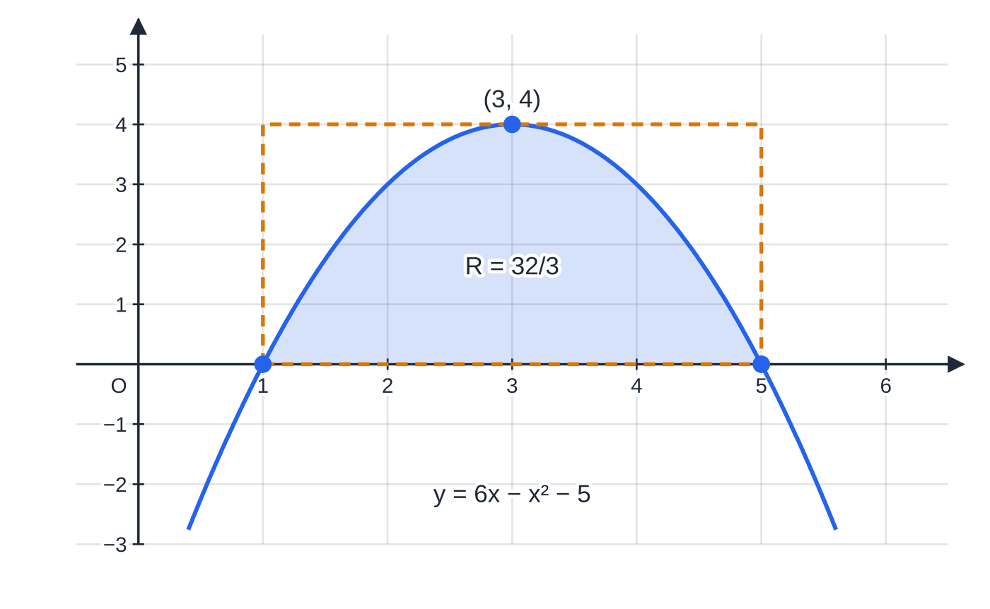
How do I find the area under a curve? (continued)
Section 2 of 11 · Worked example 3 · Medium · Find
WORKED EXAMPLE · QUESTION
The curve C has equation y = 6x - x² - 5. The region R is bounded by C and the x-axis. Find the exact area of R.
SOLUTION
Find the limits, where the curve meets the x-axis: 6x - x² - 5 = 0 ⇒x² - 6x + 5 = 0 ⇒(x - 1)(x - 5) = 0, so x = 1 and x = 5.
Integrate: ∫₁⁵ (6x - x² - 5) dx = [3x² - x³/3 - 5x]₁⁵.
Substitute the limits: (75 - (125/3) - 25) - (3 - ⅓ - 5) = (25/3) - (-(7/3)). (32/3)
The region R between y = 6x − x² − 5 and the x-axis. The curve meets the axis at x = 1 and x = 5, which become the limits; the area is 32/3 ≈ 10.67. The dashed rectangle under the maximum (3, 4) has area 16, so 32/3 is a sensible size.
Notes:
How do I find the area under a curve?: Worked example 3. Full notes: https://examinerprep.com/notes/edexcel-ial-maths/definite-integration-areas-and-the-trapezium-rule/

Slide 12
How do I find the area under a curve? (continued)
Section 2 of 11 · Worked example 3 · Medium · Find (continued)
The answer is positive, as it must be for a region above the axis: a quick check worth making every time.
Notes:
How do I find the area under a curve?: Worked example 3. Full notes: https://examinerprep.com/notes/edexcel-ial-maths/definite-integration-areas-and-the-trapezium-rule/

Slide 13
How do I find the area under a curve? (continued)
Section 2 of 11
Exam tip
Sketch the curve, even roughly, before integrating for an area. The sketch tells you the limits, whether the region is above or below the axis, and whether you need to add or subtract another shape.
Notes:
How do I find the area under a curve?. Full notes: https://examinerprep.com/notes/edexcel-ial-maths/definite-integration-areas-and-the-trapezium-rule/

Slide 14
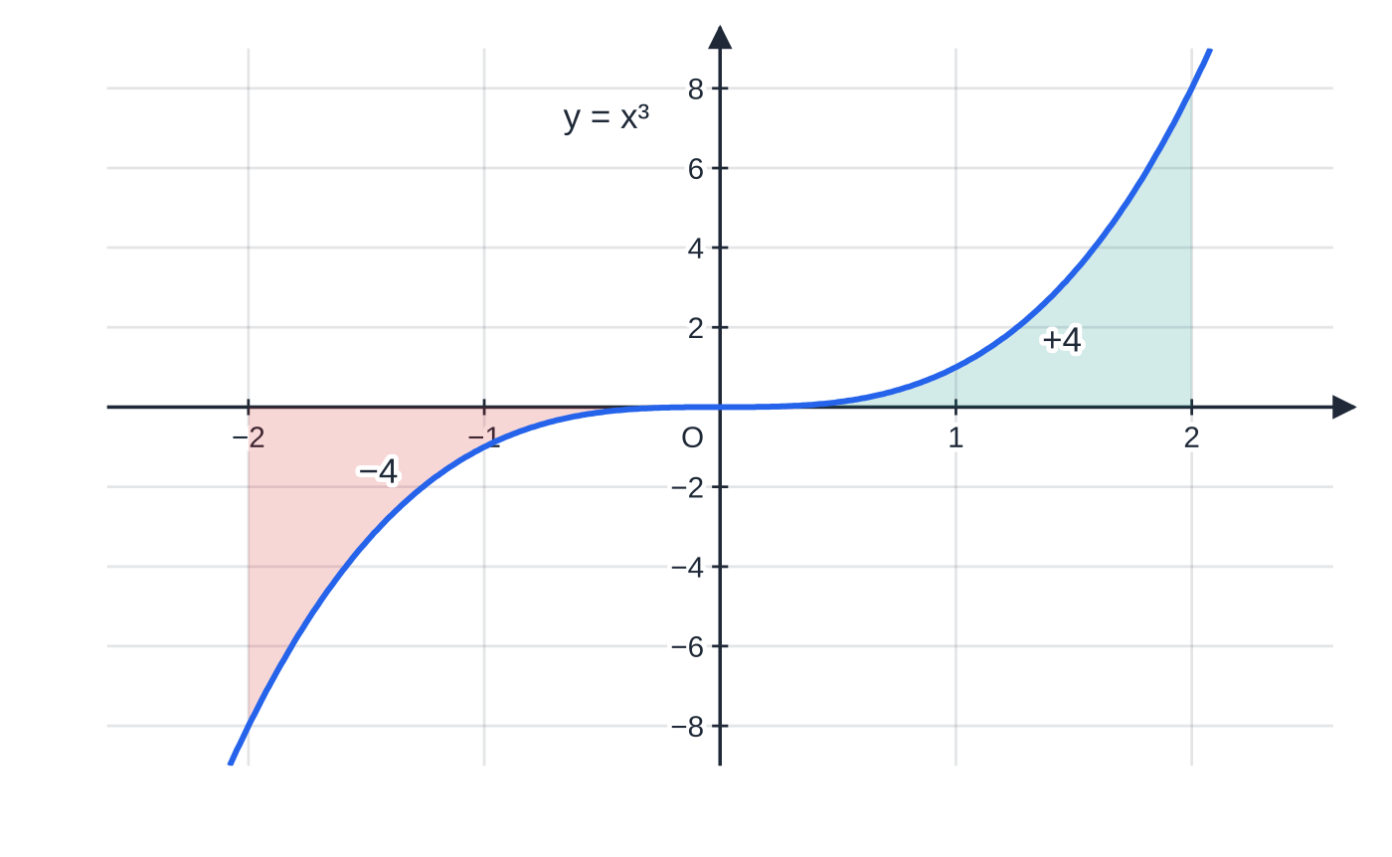
What happens when the region is below the x-axis?
Section 3 of 11
Where the curve is below the x-axis, y < 0, so each thin strip y δx is negative and the definite integral there is negative. The area is the size (modulus) of that integral.
If the curve crosses the axis between the limits, the positive and negative parts cancel. For example ∫₋₂² x³ dx = 0, although the region between y = x³ and the axis from x = -2 to 2 has area 8.
The method is therefore: find where the curve meets the axis, integrate each part separately, make each answer positive, then add.
∫₋₂² x³ dx = 0 because the region below the axis contributes −4 and the region above contributes +4. The total area is 4 + 4 = 8.
Notes:
What happens when the region is below the x-axis?. Full notes: https://examinerprep.com/notes/edexcel-ial-maths/definite-integration-areas-and-the-trapezium-rule/

Slide 15
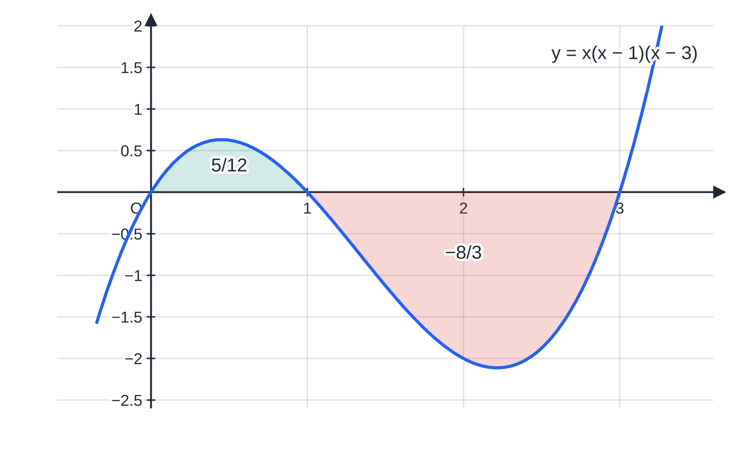
What happens when the region is below the x-axis? (continued)
Section 3 of 11 · Worked example 4 · Hard · Evaluate / Find
WORKED EXAMPLE · QUESTION
The curve y = x(x - 1)(x - 3) meets the x-axis at x = 0, 1 and 3. (a) Evaluate ∫₀³ x(x - 1)(x - 3) dx. (b) Find the total area of the regions bounded by the curve and the x-axis for 0 ≤x ≤3.
SOLUTION
Expand, then integrate: x(x - 1)(x - 3) = x³ - 4x² + 3x, so F(x) = x⁴/4 - (4/3) x³ + (3/2) x².
(a) One integral from 0 to 3: F(3) - F(0) = ((81/4) - 36 + (27/2)) - 0. -(9/4)
The teal region (0 ≤ x ≤ 1) gives a positive integral, 5/12; the red region (1 ≤ x ≤ 3) lies below the axis and gives −8/3. Integrating straight from 0 to 3 returns their sum, −9/4; the total area is 5/12 + 8/3 = 37/12.
Notes:
What happens when the region is below the x-axis?: Worked example 4. Full notes: https://examinerprep.com/notes/edexcel-ial-maths/definite-integration-areas-and-the-trapezium-rule/

Slide 16
What happens when the region is below the x-axis? (continued)
Section 3 of 11 · Worked example 4 · Hard · Evaluate / Find (continued)
(b) Split at x = 1, where the curve crosses the axis: ∫₀¹ = F(1) - F(0) = ¼ - (4/3) + (3/2) = (5/12); ∫₁³ = F(3) - F(1) = -(9/4) - (5/12) = -(8/3). Add the sizes: (5/12) + (8/3). Area = (37/12)
The answer to (a), -(9/4), is the signed total (5/12) - (8/3); it is not an area.
Notes:
What happens when the region is below the x-axis?: Worked example 4. Full notes: https://examinerprep.com/notes/edexcel-ial-maths/definite-integration-areas-and-the-trapezium-rule/

Slide 17
What happens when the region is below the x-axis? (continued)
Section 3 of 11
Common error
Giving a negative number as an area, or integrating straight across a root. An area is never negative, and an integral across a point where the curve crosses the axis gives the difference of the two areas, not their sum.
Notes:
What happens when the region is below the x-axis?. Full notes: https://examinerprep.com/notes/edexcel-ial-maths/definite-integration-areas-and-the-trapezium-rule/

Slide 18
How do I find areas bounded by curves and lines?
Section 4 of 11
Two approaches cover almost every region you will meet, and both integrate with respect to x.
Split into pieces. A region bounded by a curve, a straight line and the x-axis is often "area under the curve" plus (or minus) a triangle or trapezium. Use geometry for straight-edged pieces: it is quicker than integrating.
Top minus bottom. Between two graphs y = f(x) (upper) and y = g(x) (lower) meeting at x = a and x = b, the area is ∫ₐᵇ (f(x) - g(x)) dx. This works even if part of the region is below the x-axis, because f - g stays positive.
Find the x-coordinates where the graphs meet by solving f(x) = g(x); these are the limits.
Notes:
How do I find areas bounded by curves and lines?. Full notes: https://examinerprep.com/notes/edexcel-ial-maths/definite-integration-areas-and-the-trapezium-rule/

Slide 19
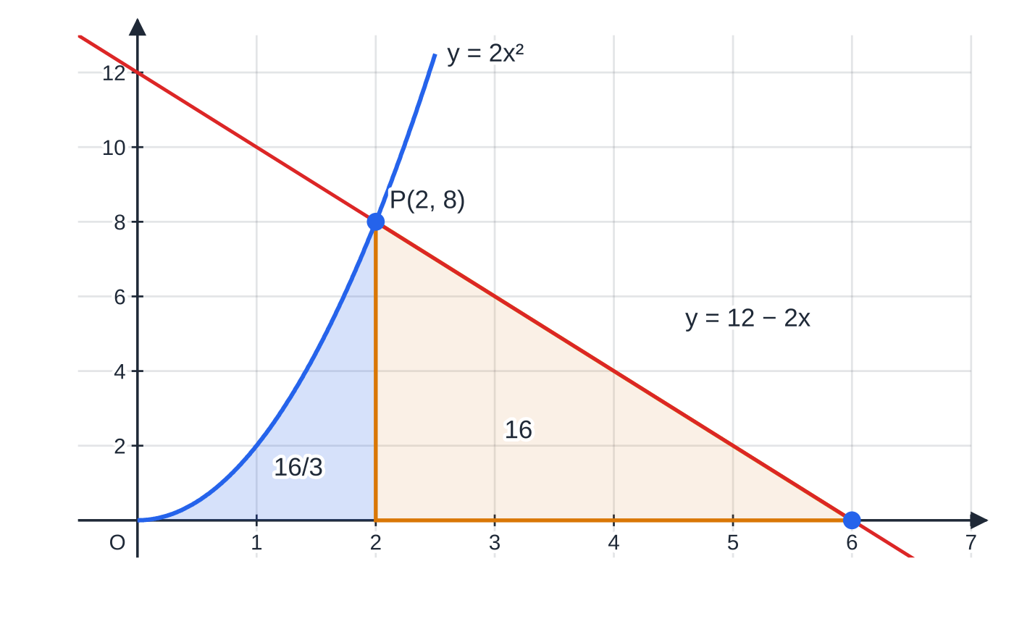
How do I find areas bounded by curves and lines? (continued)
Section 4 of 11 · Worked example 5 · Medium · Find
WORKED EXAMPLE · QUESTION
The curve y = 2x², x ≥0, and the line y = 12 - 2x meet at the point P. The region R is bounded by the curve, the line and the x-axis. (a) Find the coordinates of P. (b) Find the exact area of R.
SOLUTION
(a) Solve simultaneously: 2x² = 12 - 2x ⇒x² + x - 6 = 0 ⇒(x + 3)(x - 2) = 0; x ≥0, so x = 2. P(2, 8)
(b) Split at x = 2. Under the curve from 0 to 2: ∫₀² 2x² dx = [⅔ x³]₀² = (16/3). Under the line from 2 to where it meets the axis (12 - 2x = 0 ⇒x = 6) is a triangle: ½ ×(6 - 2) ×8 = 16. Add: (16/3) + 16. Area of R = (64/3)
The region R splits at P(2, 8): the area under the curve from x = 0 to 2 (16/3, by integration) and a right-angled triangle from x = 2 to 6 (16, by geometry). Integrating the line instead, ∫₂⁶ (12 − 2x) dx = 16, gives the same triangle area.
Notes:
How do I find areas bounded by curves and lines?: Worked example 5. Full notes: https://examinerprep.com/notes/edexcel-ial-maths/definite-integration-areas-and-the-trapezium-rule/

Slide 20
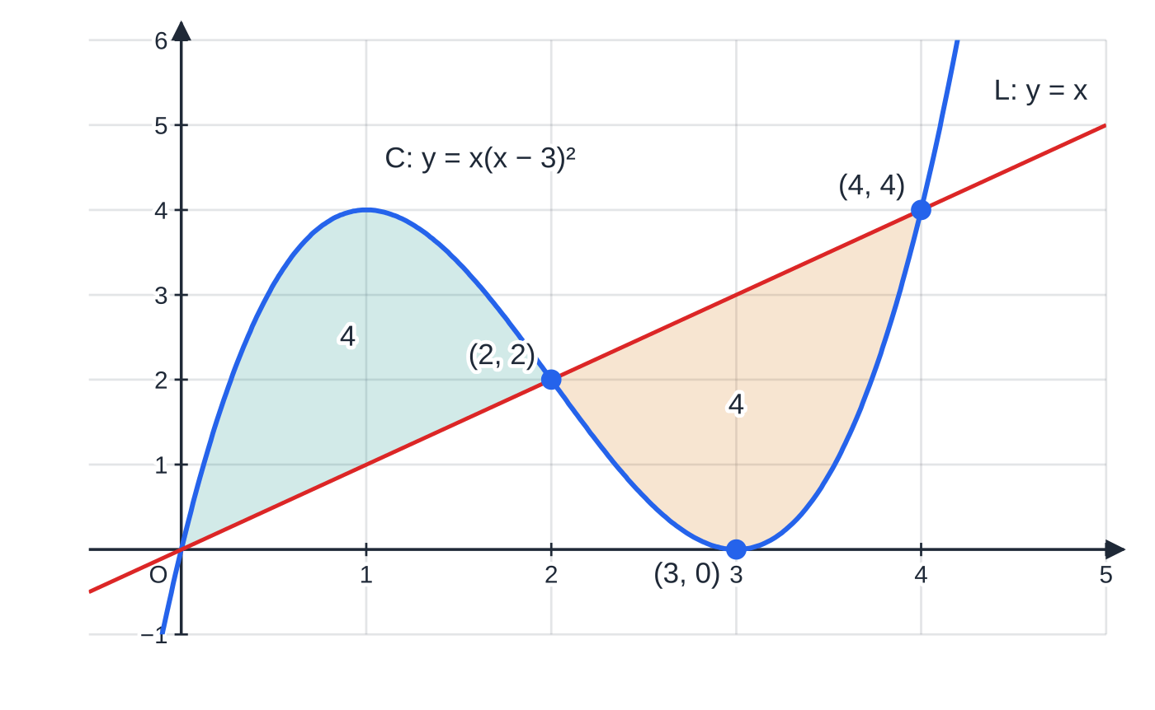
How do I find areas bounded by curves and lines? (continued)
Section 4 of 11 · Worked example 6 · Hard · Show that / Find
WORKED EXAMPLE · QUESTION
The curve C has equation y = x(x - 3)² and the line L has equation y = x. (a) Show that C and L meet where x = 0, x = 2 and x = 4. (b) Show that the two finite regions enclosed by C and L have equal area, and find that area.
SOLUTION
(a) Set the equations equal: x³ - 6x² + 9x = x ⇒x(x² - 6x + 8) = 0 ⇒x(x - 2)(x - 4) = 0, so x = 0, 2, 4 ✓
(b) Decide which graph is on top in each interval, using a test value. At x = 1: C gives 4, L gives 1, so C is above. At x = 3: C gives 0, L gives 3, so L is above.
C: y = x(x − 3)² and L: y = x meet at (0, 0), (2, 2) and (4, 4). On 0 ≤ x ≤ 2 the curve is on top; on 2 ≤ x ≤ 4 the line is on top. Each enclosed region has area 4. The lower region touches the x-axis at (3, 0), and top minus bottom handles that without any splitting at the axis.
Notes:
How do I find areas bounded by curves and lines?: Worked example 6. Full notes: https://examinerprep.com/notes/edexcel-ial-maths/definite-integration-areas-and-the-trapezium-rule/

Slide 21
How do I find areas bounded by curves and lines? (continued)
Section 4 of 11 · Worked example 6 · Hard · Show that / Find (continued)
Top minus bottom on [0, 2], with C - L = x³ - 6x² + 8x: ∫₀² (x³ - 6x² + 8x) dx = [x⁴/4 - 2x³ + 4x²]₀² = (4 - 16 + 16) - 0 = 4.
Top minus bottom on [2, 4] is L - C, the negative of the same expression: -[x⁴/4 - 2x³ + 4x²]₂⁴ = -((64 - 128 + 64) - 4) = 4. Both regions have area 4, so they are equal
∫₀⁴ (C - L) dx = 0: integrating across the crossing point at x = 2 cancels the two regions exactly, the same trap as for regions below the axis.
Notes:
How do I find areas bounded by curves and lines?: Worked example 6. Full notes: https://examinerprep.com/notes/edexcel-ial-maths/definite-integration-areas-and-the-trapezium-rule/

Slide 22
How do I find areas bounded by curves and lines? (continued)
Section 4 of 11
Exam tip
Write "area = ∫ₐᵇ (top - bottom) dx" with the actual expressions before simplifying. Subtracting the line from the curve first, then integrating once, is quicker and safer than finding two areas under graphs and subtracting.
Notes:
How do I find areas bounded by curves and lines?. Full notes: https://examinerprep.com/notes/edexcel-ial-maths/definite-integration-areas-and-the-trapezium-rule/

Slide 23
How does the trapezium rule estimate an area?
Section 5 of 11
Many functions cannot be integrated with the rules you know at this stage: 2ˣ, √(1 + x³), log₁₀ x. Data from an experiment has no formula at all. The trapezium rule replaces the curve by straight chords between equally spaced points and adds the areas of the trapezia underneath.
The trapezium rule
(in the formulae booklet: know how to use it):
∫ₐᵇ y dx ≈½ h{y₀ + yₙ + 2(y₁ + y₂ + ⋯+ yₙ₋₁)}
n = number of strips; h = (b - a)/n = width of each strip; yᵣ = f(a + rh) are the ordinates, and there are n + 1 of them.
In words: half the strip width × (first + last + twice everything in between). Each trapezium has area ½ h(yᵣ + yᵣ₊₁); each inner ordinate is a side of two trapezia, which is why it counts twice.
Notes:
How does the trapezium rule estimate an area?. Full notes: https://examinerprep.com/notes/edexcel-ial-maths/definite-integration-areas-and-the-trapezium-rule/

Slide 24
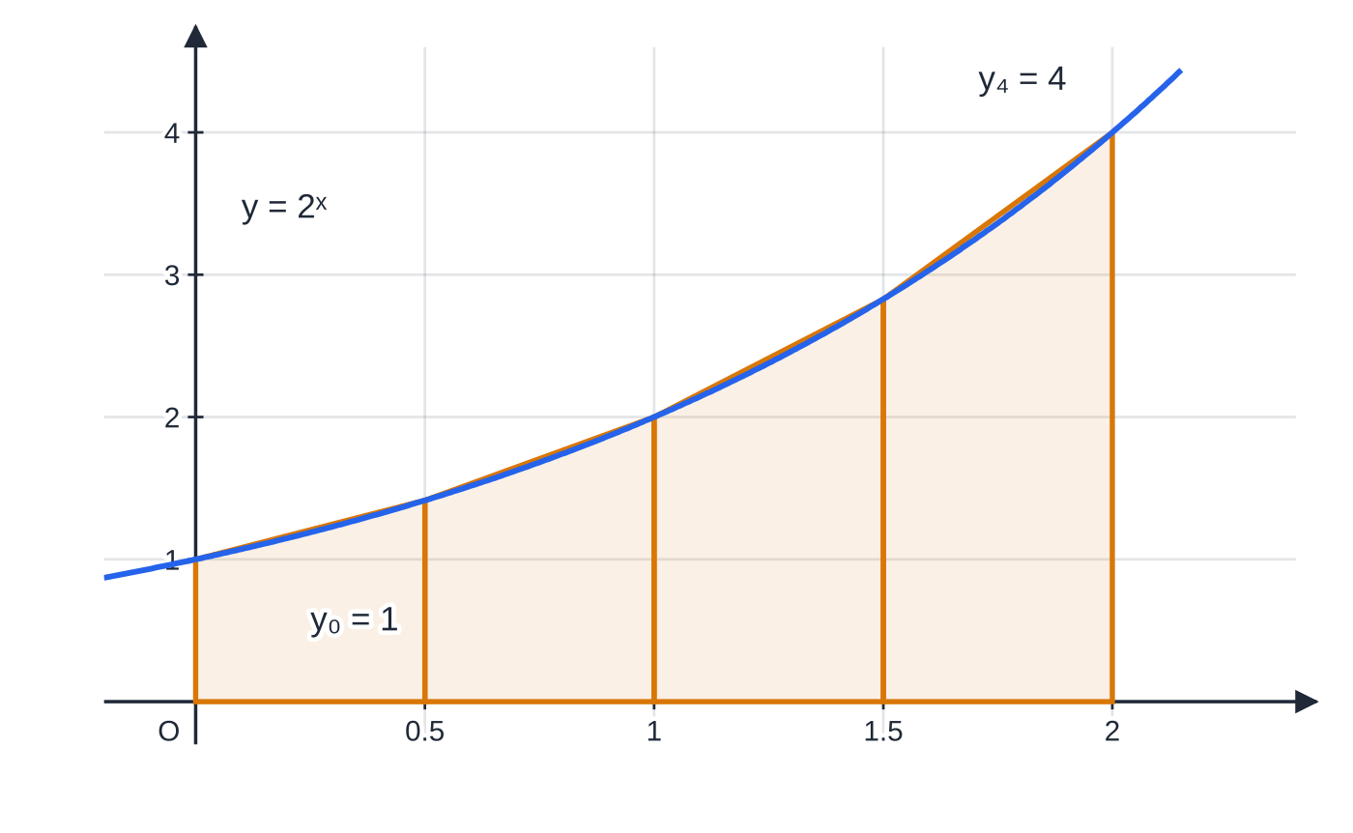
How does the trapezium rule estimate an area? (continued)
Section 5 of 11 · Worked example 7 · Easy · Estimate
WORKED EXAMPLE · QUESTION
Use the trapezium rule with 4 strips to estimate ∫₀² 2ˣ dx. Give the ordinates to 4 decimal places and your answer to 4 significant figures.
SOLUTION
Strip width and the x-values: h = (2 - 0)/4 = 0.5; x = 0, 0.5, 1, 1.5, 2.
Four trapezia of width h = 0.5 under y = 2ˣ. Their straight tops are chords of the curve; the total of their areas, 4.371, estimates the area under the curve.
Notes:
How does the trapezium rule estimate an area?: Worked example 7. Full notes: https://examinerprep.com/notes/edexcel-ial-maths/definite-integration-areas-and-the-trapezium-rule/

Slide 25
How does the trapezium rule estimate an area? (continued)
Section 5 of 11 · Worked example 7 · Easy · Estimate (continued)
x | 0 | 0.5 | 1 | 1.5 | 2
y = 2ˣ | 1 | 1.4142 | 2 | 2.8284 | 4
Apply the rule, end ordinates once and inner ordinates twice: ½ ×0.5 ×{(1 + 4) + 2(1.4142 + 2 + 2.8284)} = 0.25 ×{5 + 12.4852} = 0.25 ×17.4852. ≈4.371
Keep the ordinates to at least 4 decimal places in the working; rounding them to 2 d.p. can change the final figure.
Notes:
How does the trapezium rule estimate an area?: Worked example 7. Full notes: https://examinerprep.com/notes/edexcel-ial-maths/definite-integration-areas-and-the-trapezium-rule/

Slide 26
How does the trapezium rule estimate an area? (continued)
Section 5 of 11
Common error
Mixing up strips and ordinates. Four strips need five x-values; h = (b - a)/n uses the number of strips, not the number of ordinates.
Notes:
How does the trapezium rule estimate an area?. Full notes: https://examinerprep.com/notes/edexcel-ial-maths/definite-integration-areas-and-the-trapezium-rule/

Slide 27
Is the trapezium rule too big or too small, and by how much?
Section 6 of 11
If the curve bends upwards (convex, like y = x² or 2ˣ) across the interval, every chord lies above the curve, so the trapezium rule gives an overestimate.
If the curve bends downwards (concave, like y = √x), every chord lies below the curve: an underestimate.
If the curve changes from one to the other inside the interval, the errors partly cancel and you cannot say in general.
More strips (smaller h) make the chords hug the curve more closely, so the estimate improves. For 2ˣ on [0, 2], 2, 4 and 8 strips give 4.5, 4.371 and 4.339, closing in on the true value 4.328 (to 4 s.f.) from above.
Notes:
Is the trapezium rule too big or too small, and by how much?. Full notes: https://examinerprep.com/notes/edexcel-ial-maths/definite-integration-areas-and-the-trapezium-rule/

Slide 28
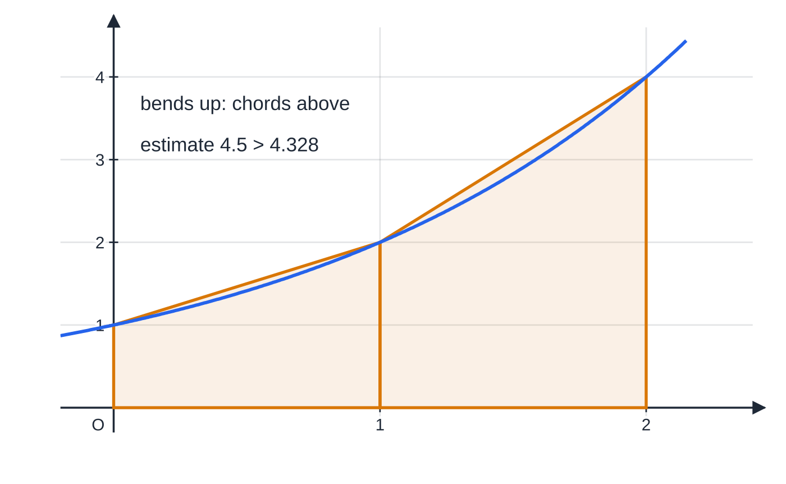
Is the trapezium rule too big or too small, and by how much? (continued)
Section 6 of 11
Two strips under y = 2ˣ. The curve bends upwards, so the straight tops sit above the curve and the rule overestimates (4.5 against 4.328).
Notes:
Is the trapezium rule too big or too small, and by how much?. Full notes: https://examinerprep.com/notes/edexcel-ial-maths/definite-integration-areas-and-the-trapezium-rule/

Slide 29
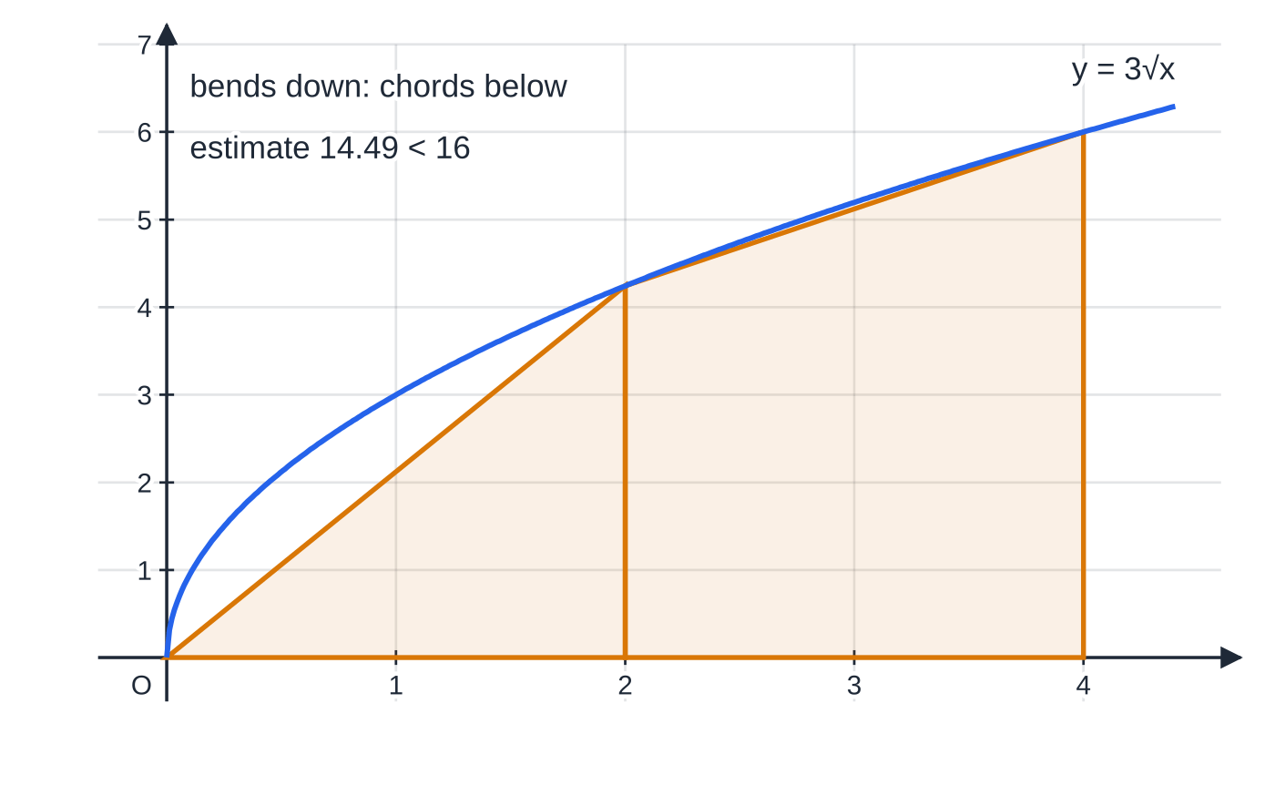
Is the trapezium rule too big or too small, and by how much? (continued)
Section 6 of 11
Percentage error
(not in the formulae booklet: learn it):
percentage error = (|estimate - exact value|)/(exact value) ×100%
You can only find it when the exact value is available, usually because the same integral can also be found by integration.
Two strips under y = 3√x on 0 ≤ x ≤ 4. The curve bends downwards, so the tops sit below the curve and the rule underestimates (14.49 against the exact 16).
Notes:
Is the trapezium rule too big or too small, and by how much?. Full notes: https://examinerprep.com/notes/edexcel-ial-maths/definite-integration-areas-and-the-trapezium-rule/

Slide 30
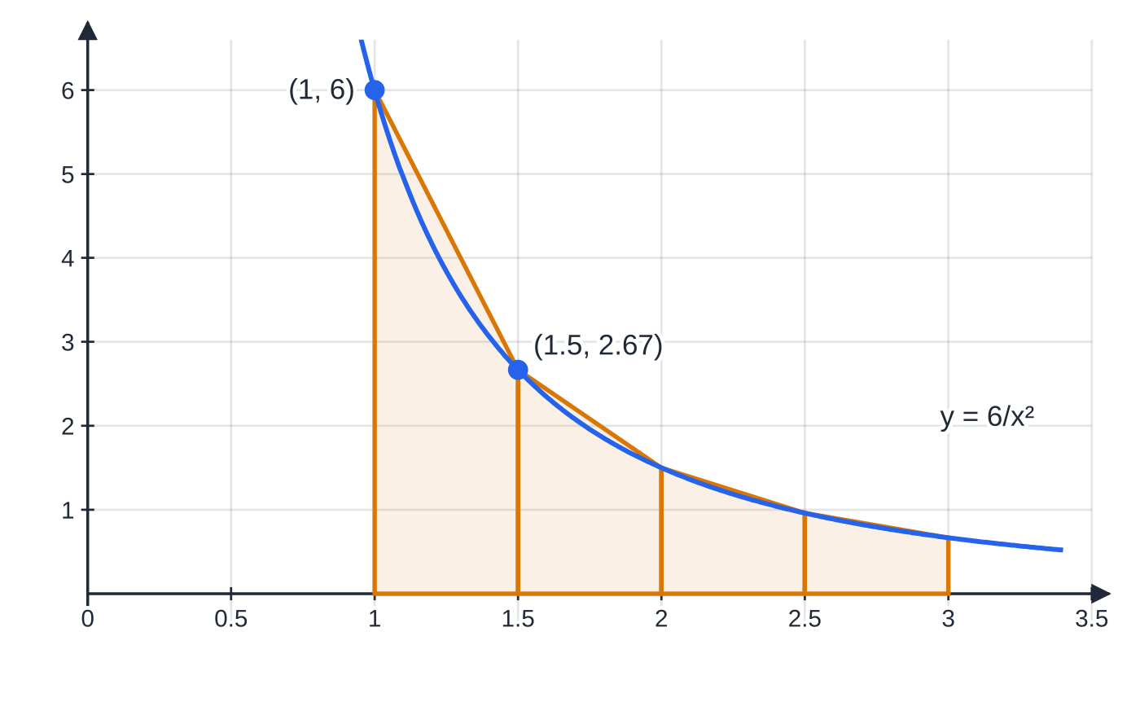
Is the trapezium rule too big or too small, and by how much? (continued)
Section 6 of 11 · Worked example 8 · Hard · Estimate / State / Find
WORKED EXAMPLE · QUESTION
(a) Use the trapezium rule with 4 strips to estimate ∫₁³ 6/x² dx. (b) State, with a reason, whether your answer is an overestimate or an underestimate. (c) Find the exact value of ∫₁³ 6/x² dx, and hence the percentage error in your estimate.
The four trapezia for y = 6/x² on 1 ≤ x ≤ 3, h = 0.5. Each straight top is a chord lying above the curve, so the total, 4.23, is more than the true area, 4. The gap is largest in the first strip, where the curve bends most sharply.
Notes:
Is the trapezium rule too big or too small, and by how much?: Worked example 8. Full notes: https://examinerprep.com/notes/edexcel-ial-maths/definite-integration-areas-and-the-trapezium-rule/

Slide 31
Is the trapezium rule too big or too small, and by how much? (continued)
Section 6 of 11 · Worked example 8 · Hard · Estimate / State / Find (continued)
Strips n | Width h | Estimate | Percentage error
2 | 1 | 4.833 | 20.8%
4 | 0.5 | 4.23 | 5.75%
8 | 0.25 | 4.059 | 1.49%
The same integral with 2, 4 and 8 strips: each halving of h cuts the error to about a quarter.
SOLUTION
(a) h = (3 - 1)/4 = 0.5.
x | 1 | 1.5 | 2 | 2.5 | 3
y = 6/x² | 6 | 2.6667 | 1.5 | 0.96 | 0.6667
0.25 ×{(6 + 0.6667) + 2(2.6667 + 1.5 + 0.96)} = 0.25 ×{6.6667 + 10.2534}. ≈4.23
Notes:
Is the trapezium rule too big or too small, and by how much?: Worked example 8. Full notes: https://examinerprep.com/notes/edexcel-ial-maths/definite-integration-areas-and-the-trapezium-rule/

Slide 32
Is the trapezium rule too big or too small, and by how much? (continued)
Section 6 of 11 · Worked example 8 · Hard · Estimate / State / Find (continued)
(b) y = 6x⁻² bends upwards on [1, 3] (it is decreasing ever more slowly), so each chord lies above the curve. Overestimate
(c) ∫₁³ 6x⁻² dx = [-6/x]₁³ = -2 - (-6) = 4. Percentage error = (4.23 - 4)/4 ×100%. 5.75%
The exact value is smaller than the estimate, consistent with part (b). Use the unrounded estimate (here it happens to be exactly 4.23).
Notes:
Is the trapezium rule too big or too small, and by how much?: Worked example 8. Full notes: https://examinerprep.com/notes/edexcel-ial-maths/definite-integration-areas-and-the-trapezium-rule/

Slide 33
Is the trapezium rule too big or too small, and by how much? (continued)
Section 6 of 11
Exam tip
"State, with a reason, whether … overestimate or underestimate" needs both parts: the shape (curve bends up or down, chords above or below the curve) and the conclusion. A sketch with one strip and its chord is a good reason.
Notes:
Is the trapezium rule too big or too small, and by how much?. Full notes: https://examinerprep.com/notes/edexcel-ial-maths/definite-integration-areas-and-the-trapezium-rule/

Slide 34
Exam tips for P2.8
Section 7 of 11
Exam tip 1 — show the substitution
Write out F(b) - F(a) with both brackets before simplifying. A calculator can evaluate a definite integral, but the working is where the method is shown, and "use algebraic integration" means a calculator value alone is not enough.
Exam tip 2 — limits from the question, not from habit
Limits come from the region: where the curve meets the axis, where the graphs meet, or the given lines x = a and x = b. Solve for them first and mark them on a sketch.
Exam tip 3 — areas are positive
If an integral for an area comes out negative, the region is below the axis (or you used bottom − top). State the area as a positive value, and split at every crossing point.
Notes:
Exam tips for P2.8. Full notes: https://examinerprep.com/notes/edexcel-ial-maths/definite-integration-areas-and-the-trapezium-rule/

Slide 35
Exam tips for P2.8 (continued)
Section 7 of 11
Exam tip 4 — trapezium rule layout
Give h, the table of ordinates and the bracket {y₀ + yₙ + 2(…)} as separate lines. Keep 4 or more decimal places in the table and round only the final answer, to the accuracy asked.
Exam tip 5 — "hence" with the trapezium rule
If ∫ₐᵇ f(x) dx ≈T, then ∫ₐᵇ (f(x) + k) dx ≈T + k(b - a) and ∫ₐᵇ mf(x) dx ≈mT. Use your earlier answer rather than starting a new table.
Notes:
Exam tips for P2.8. Full notes: https://examinerprep.com/notes/edexcel-ial-maths/definite-integration-areas-and-the-trapezium-rule/

Slide 36
Common misconceptions
Section 8 of 11
Misconception | Why it is wrong | Correct idea
A definite integral needs + c. | The constant appears in F(b) and F(a) and cancels. | Leave + c out of definite integrals.
A definite integral always equals an area. | Parts below the x-axis count as negative. | Split at the roots and add the sizes of the parts.
An integral of zero means there is no region. | Equal areas above and below the axis cancel. | Check where the curve crosses the axis between the limits.
Area between two graphs = area under the top one. | That includes the region under the lower graph too. | Integrate (top − bottom) between the meeting points.
With n strips there are n ordinates. | Each strip has two edges, shared with its neighbours. | n strips need n + 1 ordinates; h = (b-a)/n.
The trapezium rule always overestimates. | That depends on which way the curve bends. | Bends up: overestimate. Bends down: underestimate.
Notes:
Common misconceptions. Full notes: https://examinerprep.com/notes/edexcel-ial-maths/definite-integration-areas-and-the-trapezium-rule/

Slide 37
How this topic connects
Section 9 of 11
Integration (P1) and further integration (P3, P4)
Every definite integral starts with the indefinite integral from P1: rewriting roots and fractions as powers, then raising each power by one. Definite integrals of eˣ, 1/x and trigonometric functions come in P3; in P4 they give volumes of revolution and are combined with substitution and integration by parts. The trapezium rule returns for functions that still cannot be integrated exactly.
Variable acceleration (M2)
The area under a velocity–time graph is the displacement, ∫_(t₁)^(t₂) v dt. When the velocity changes sign, total distance needs the same splitting as for regions below the axis.
IAL Physics
Areas under graphs carry physical meaning: displacement from a velocity–time graph, work done from a force–extension graph, impulse from a force–time graph. When the graph comes from data, a trapezium estimate is the natural method.
Notes:
How this topic connects. Full notes: https://examinerprep.com/notes/edexcel-ial-maths/definite-integration-areas-and-the-trapezium-rule/

Slide 38
Key formulae
Section 10 of 11
Formula | Use | In the formulae list?
∫ₐᵇ f(x) dx = F(b) - F(a), F′ = f | evaluating a definite integral | No — learn it
∫xⁿ dx = xⁿ⁺¹/(n+1) + c, n ≠-1 | integrating each term before substituting limits | No — learn it
Area = ∫ₐᵇ y dx (curve above the axis) | area between a curve and the x-axis | No — learn it
Area = ∫ₐᵇ (yₜₒₚ - y_bottom) dx | area between two graphs meeting at x = a, b | No — derive it
∫ₐᵇ y dx ≈½ h{y₀ + yₙ + 2(y₁ + y₂ + ⋯+ yₙ₋₁)}, h = (b-a)/n | estimating a definite integral with n strips | Yes
percentage error = (|estimate - exact|)/exact ×100% | judging the accuracy of an estimate | No — learn it
Notes:
Key formulae. Full notes: https://examinerprep.com/notes/edexcel-ial-maths/definite-integration-areas-and-the-trapezium-rule/

Slide 39
Check your understanding
Section 11 of 11
1. Evaluate ∫₀² (x³ + 1) dx.
2. Find the exact value of ∫₁⁴ √x dx.
3. ∫₋₁¹ x³ dx = 0. Does that mean the curve y = x³ encloses no area with the x-axis between −1 and 1?
4. How many ordinates are needed to use the trapezium rule with 6 strips on 0 ≤x ≤3, and what is h?
5. The curve y = √(1 + x) bends downwards for x ≥0. Does the trapezium rule over- or underestimate ∫₀³ √(1 + x) dx?
6. Given that ∫₀² 2ˣ dx ≈4.371 (Worked example 7), estimate ∫₀² (2ˣ + 3) dx without a new table.
Notes:
Check your understanding: questions. Full notes: https://examinerprep.com/notes/edexcel-ial-maths/definite-integration-areas-and-the-trapezium-rule/

Slide 40
Check your understanding · answers
Section 11 of 11
1. [x⁴/4 + x]₀² = (4 + 2) - 0 = 6.
2. [⅔ x^(3/2)]₁⁴ = ⅔(8 - 1) = (14/3).
3. No. The part from −1 to 0 is below the axis and gives -¼; the part from 0 to 1 gives +¼. They cancel in the integral, but the total area is ½.
4. 7 ordinates (x = 0, 0.5, 1, …, 3), with h = (3/6) = 0.5.
5. Underestimate: the curve bends downwards, so every chord lies below it and each trapezium misses a sliver of area.
6. Adding 3 adds a rectangle of height 3 and width 2: 4.371 + 3 ×2 = 10.371 ≈10.37.
Notes:
Check your understanding: answers. Full notes: https://examinerprep.com/notes/edexcel-ial-maths/definite-integration-areas-and-the-trapezium-rule/

Slide 41
Practice questions
2 original exam-style questions. Answers at the end of the deck.

Slide 42
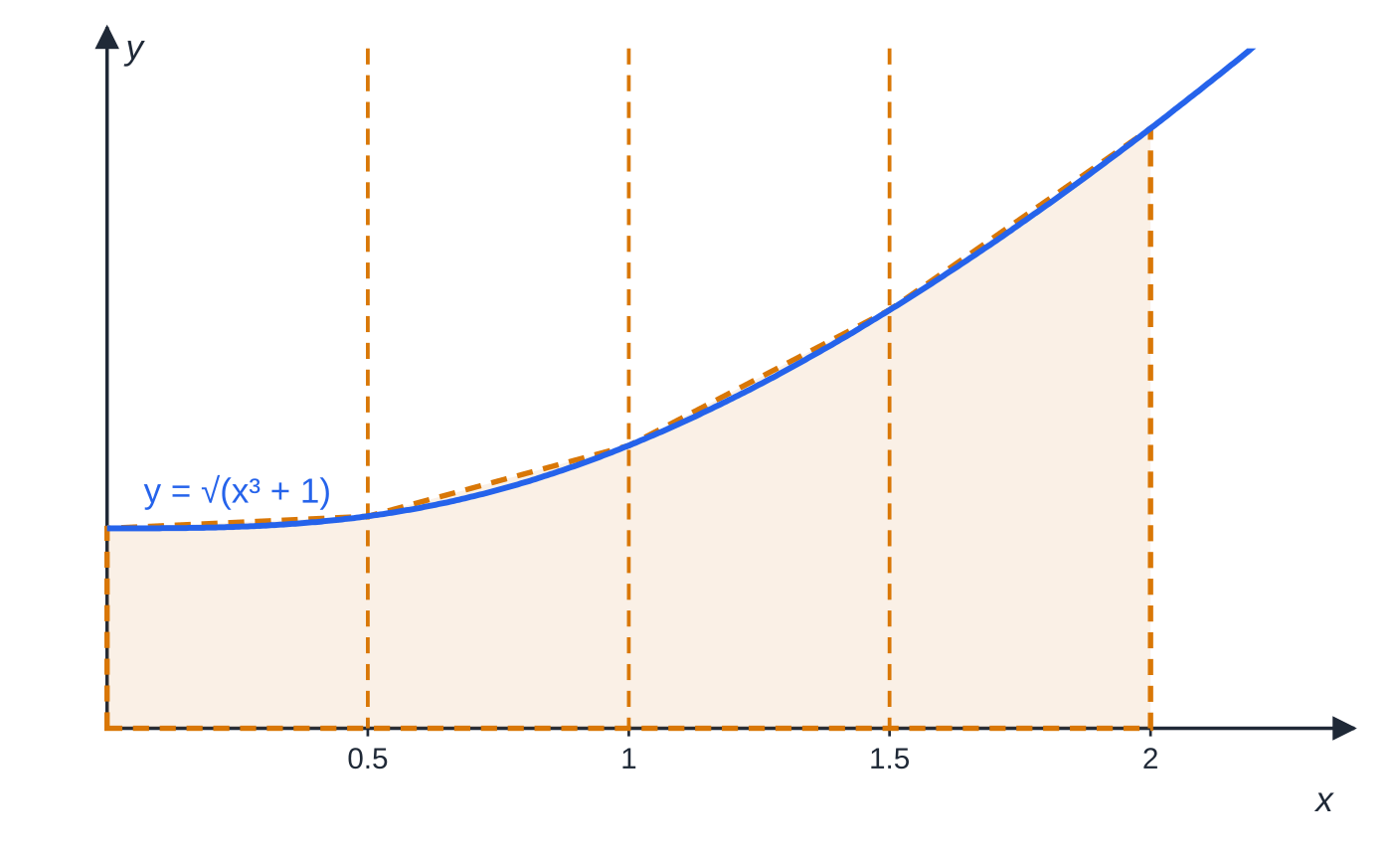
Question 1
6 marks
The table shows some values of y = √(x³ + 1), each given to 4 decimal places where appropriate.
Figure: the curve with the four trapezium strips
(a) Complete the table, giving the missing value of y to 4 decimal places. [1]
(b) Use the trapezium rule with all the values in the table to find an estimate for ∫₀² √(x³ + 1) dx, giving your answer to 3 significant figures. [4]
(c) State how the trapezium rule could be used to obtain a more accurate estimate for this integral. [1]
x | 0 | 0.5 | 1 | 1.5 | 2
y | 1 | 1.0607 |  | 2.0917 | 3
Notes:
Online with the full mark scheme: https://examinerprep.com/ial-maths-p2-8-definite-integration-areas-and-the-trapezium-rule-questions#IALM-P2-8-B-03

Slide 43
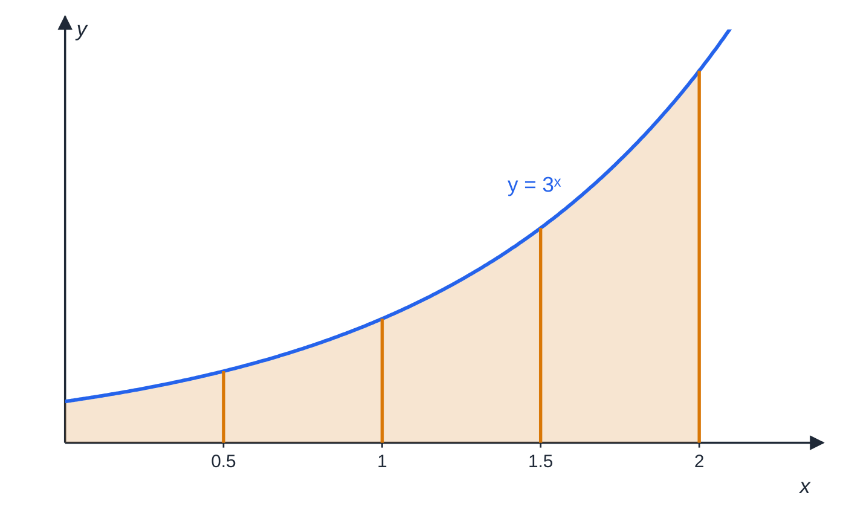
Question 2
8 marks
The integral I = ∫₀² 3ˣ dx is to be estimated numerically, because 3ˣ cannot be integrated with the methods of this unit. Values of 3ˣ that are not exact are rounded to 4 decimal places.
Figure: y = 3ˣ for 0 ≤ x ≤ 2 with the ordinates used in the trapezium rule
(a) Complete the table. [1]
(b) Use the trapezium rule with all the values in the completed table to find an estimate for ∫₀² 3ˣ dx, giving your answer to 3 significant figures. [3]
(c) State, with a reason, whether your answer to part (b) is an overestimate or an underestimate. [2]
(d) Using your answer to part (b), find an estimate for ∫₀² (3ˣ⁺¹ + 4x) dx. [2]
x | 0 | 0.5 | 1 | 1.5 | 2
3ˣ | 1 |  | 3 |  | 9
Notes:
Online with the full mark scheme: https://examinerprep.com/ial-maths-p2-8-definite-integration-areas-and-the-trapezium-rule-questions#IALM-P2-8-B-07

Slide 44
Answers

Slide 45
Question 1 · answer
Mark scheme
at x = 1: √2 = 1.4142
strip width h = 0.5
correct structure: ½h{(first + last) + 2(sum of the others)}
½ × 0.5 × {(1 + 3) + 2(1.0607 + 1.4142 + 2.0917)} = 0.25 × 13.1332 ft from their table value
3.28
use more strips (a smaller strip width h), e.g. 8 strips of width 0.25
Notes:
Full mark scheme: https://examinerprep.com/ial-maths-p2-8-definite-integration-areas-and-the-trapezium-rule-questions#IALM-P2-8-B-03

Slide 46
Question 2 · answer
Mark scheme
1.7321 at x = 0.5 and 5.1962 at x = 1.5, both correct
h = 0.5
½ × 0.5 × {(1 + 9) + 2(1.7321 + 3 + 5.1962)}
7.46
the curve y = 3ˣ bends upwards (convex) on 0 ≤ x ≤ 2, so each chord lies above the curve
so it is an overestimate (dependent on the reason)
3ˣ⁺¹ = 3 × 3ˣ, so the estimate is 3 × 7.46… + [2x²]₀² = 22.39… + 8
30.4 ft from their (b)
Notes:
Full mark scheme: https://examinerprep.com/ial-maths-p2-8-definite-integration-areas-and-the-trapezium-rule-questions#IALM-P2-8-B-07

Slide 47
Keep practising
Notes for this topic
Questions on this topic
Build a printable test
ExaminerPrep is an independent tutoring service. It has been developed independently from and is not endorsed by the International Baccalaureate Organization. "International Baccalaureate", "IB" and "IB Diploma Programme" are registered trademarks of the IBO, used here for descriptive purposes only.
Pearson Edexcel and Cambridge are trademarks of their owners; ExaminerPrep is not affiliated with any exam board.

