Slide 1
EP
EDEXCEL IAL MATHS
P4.7 Differential equations
The full notes page in 13 sections · practice questions with answers · simulations
ExaminerPrep is an independent tutoring service. It has been developed independently from and is not endorsed by the International Baccalaureate Organization. "International Baccalaureate", "IB" and "IB Diploma Programme" are registered trademarks of the IBO, used here for descriptive purposes only.
Pearson Edexcel and Cambridge are trademarks of their owners; ExaminerPrep is not affiliated with any exam board.
Notes:
P4.7 Differential equations. Notes for this topic: https://examinerprep.com/notes/edexcel-ial-maths/differential-equations/

Slide 2
What this page covers
Overview
What a differential equation is; general solutions (one arbitrary constant) and particular solutions
Solving dy/dx=f(x)g(y) by separating the variables, including equations that give ln|y|
Separated integrals that need partial fractions, a standard result from the formulae booklet, or integration by parts
Forming differential equations from statements about rates: proportional growth and decay
Newton's law of cooling and draining tanks
Limited (logistic) growth
Finding constants from data, interpreting solutions, long-term behaviour and the limits of a model
Notes:
What this page covers. Full notes: https://examinerprep.com/notes/edexcel-ial-maths/differential-equations/

Slide 3
In one minute
Key points
1. A differential equation links a function and its derivative; the general solution of a first-order equation contains one arbitrary constant, and a given condition such as y=2 when x=1 fixes it to give a particular solution.
2. Separate: dy/dx=f(x)g(y)⇒∫1/g(y) dy=∫f(x) dx. Add one constant, on the x side, as soon as you integrate.
3. Log constants: ln|y|=f(x)+c⇒y=Aeᶠ⁽ˣ⁾, with A=±eᶜ. Never y=eᶠ⁽ˣ⁾+c.
4. Forming: "rate of change of N" is dN/dt; "proportional to" brings in a constant k; a decreasing quantity gets a minus sign with k>0. Newton's law of cooling: dθ/dt=-k(θ-θₛ).
5. Interpret: use two pieces of data to find c and k; for the long term let t→∞ (e⁻ᵏᵗ→0); and say when the model stops being valid.
Notes:
In one minute. Full notes: https://examinerprep.com/notes/edexcel-ial-maths/differential-equations/

Slide 4
What is a differential equation, and what is a solution?
Section 1 of 13
First-order differential equation. An equation connecting x, y and the first derivative dy/dx. A solution is a relationship between x and y, with no derivative, that makes the equation true.
Solving means integrating once, so the general solution contains one arbitrary constant. Each value of the constant gives a different curve: a whole family. A boundary or initial condition ("y=2 when x=1", "initially the temperature is 85 °C") picks out one member, the particular solution.
The equation itself tells you the gradient at every point. Drawing a short segment with that gradient at many points gives a slope field, and every solution curve follows the segments. To verify a solution, differentiate it (implicitly if it is not in the form y=…) and show that the result matches the equation.
Notes:
What is a differential equation, and what is a solution?. Full notes: https://examinerprep.com/notes/edexcel-ial-maths/differential-equations/

Slide 5
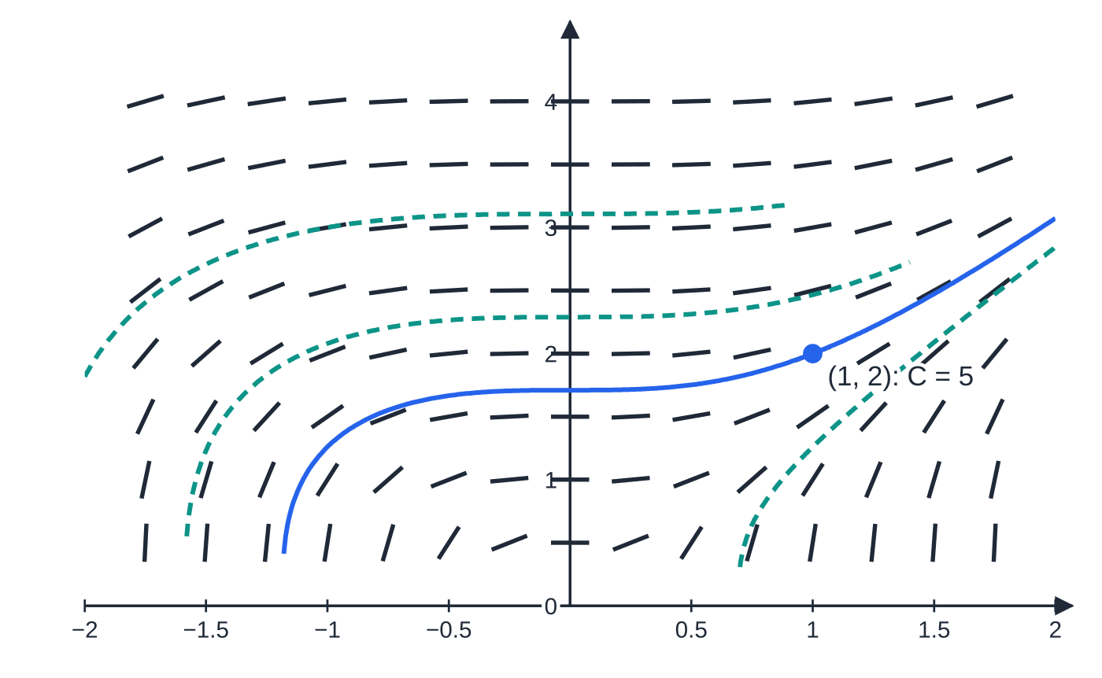
What is a differential equation, and what is a solution? (continued)
Section 1 of 13
The slope field of dy/dx=3x²/y², drawn from the gradient function, with solution curves y³=3x³+C for C=-1,12,30 (dashed) and the particular solution through (1,2), C=5 (solid).
Notes:
What is a differential equation, and what is a solution?. Full notes: https://examinerprep.com/notes/edexcel-ial-maths/differential-equations/

Slide 6
What is a differential equation, and what is a solution? (continued)
Section 1 of 13 · Worked example 1 · Easy · Show that / Find
WORKED EXAMPLE · QUESTION
(a) Show that y³=3x³+C, where C is a constant, satisfies the differential equation dy/dx=3x²/y². (b) Find the particular solution for which y=2 when x=1. (c) Use your answer to (b) to find y when x=2, giving your answer to 3 significant figures.
SOLUTION
(a) Differentiate implicitly: 3y²dy/dx=9x², so dy/dx=9x²/3y²=3x²/y² ✓.
(b) Substitute x=1, y=2: 8=3+C, so C=5 and y³=3x³+5.
(c) y³=24+5=29, so y=∛29=3.0723…= 3.07.
Notes:
What is a differential equation, and what is a solution?: Worked example 1. Full notes: https://examinerprep.com/notes/edexcel-ial-maths/differential-equations/

Slide 7
How do you solve an equation by separating the variables?
Section 2 of 13
An equation is separable if the right-hand side factorises into a function of x times a function of y. Then each variable can be moved to its own side and integrated on its own.
dy/dx=f(x) g(y) ⟹ ∫1/g(y) dy=∫f(x) dx
Divide by g(y), so every y is on the same side as dy and every x goes with dx. Integrate both sides and add one constant c (on the x side) straight away; then use the condition, then rearrange if asked. Not in the formulae booklet: learn the method.
Factorise first: dy/dx=xy+x=x(y+1) is separable. dy/dx=x+y is not, and cannot be solved this way.
Notes:
How do you solve an equation by separating the variables?. Full notes: https://examinerprep.com/notes/edexcel-ial-maths/differential-equations/

Slide 8
How do you solve an equation by separating the variables? (continued)
Section 2 of 13 · Worked example 2 · Medium · Find
WORKED EXAMPLE · QUESTION
Given that dy/dx=(2x+1)e⁻ʸ and that y=0 when x=0, (a) find y in terms of x; (b) find the exact value of y when x=2, and give it to 3 significant figures.
SOLUTION
(a) e⁻ʸ=1÷eʸ, so multiply both sides by eʸ: ∫eʸ dy=∫(2x+1) dx, giving eʸ=x²+x+c. Use x=0, y=0: e⁰=1=c. So eʸ=x²+x+1 and y=ln(x²+x+1).
(b) y=ln(4+2+1)= ln 7=1.9459…=1.95.
x²+x+1=(x+½)²+¾>0, so the logarithm is defined for every x.
Notes:
How do you solve an equation by separating the variables?: Worked example 2. Full notes: https://examinerprep.com/notes/edexcel-ial-maths/differential-equations/

Slide 9
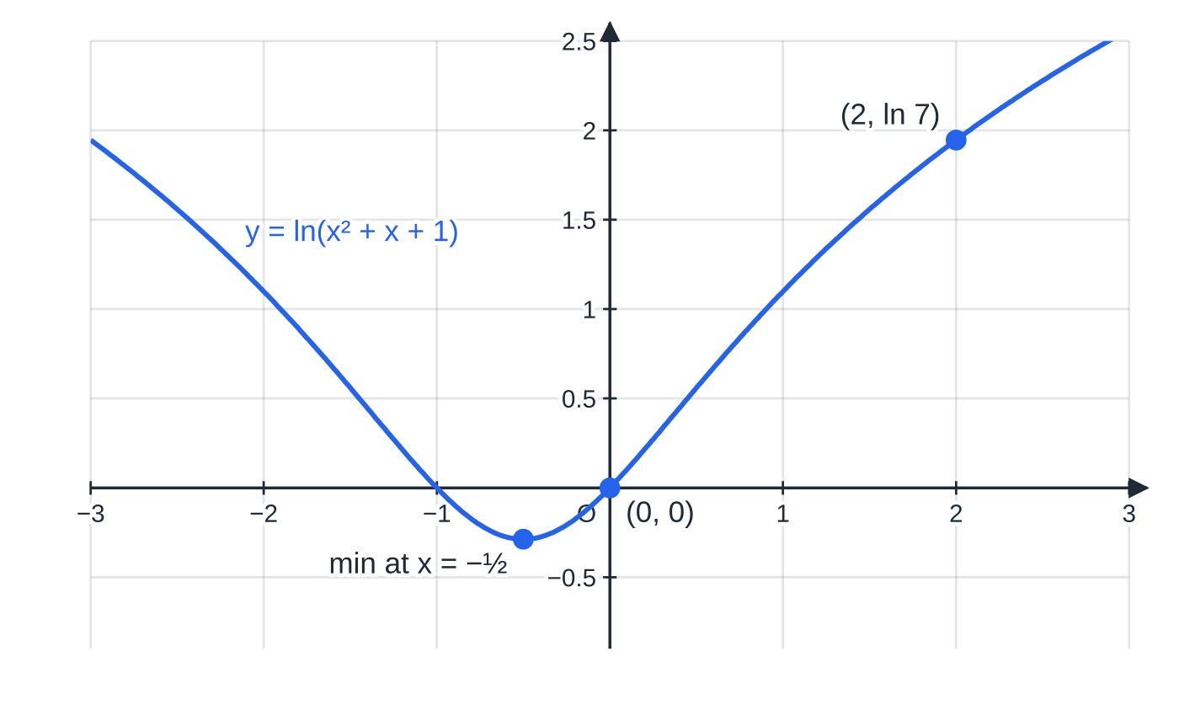
How do you solve an equation by separating the variables? (continued)
Section 2 of 13
Common error
Taking ln of each term separately: from eʸ=x²+x+1, writing y=ln x²+ln x+ln 1. The logarithm applies to the whole right-hand side: y=ln(x²+x+1).
Worked example 2: the particular solution passes through (0,0) and (2,ln 7). It is defined for every x, with its lowest point where x²+x+1 is least, at x=-½ (where dy/dx=(2x+1)e⁻ʸ=0).
Notes:
How do you solve an equation by separating the variables?. Full notes: https://examinerprep.com/notes/edexcel-ial-maths/differential-equations/

Slide 10
What happens to the constant when you get ln y?
Section 3 of 13
Whenever g(y)=y (or y+b), the y side integrates to ln|y|. Exponentiate the whole right-hand side: ln|y|=f(x)+c⇒|y|=eᶠ⁽ˣ⁾⁺ᶜ=eᶜ eᶠ⁽ˣ⁾. Replace ±eᶜ by a single constant A: y=Aeᶠ⁽ˣ⁾. Equivalently, write the constant as ln A from the start: ln y=f(x)+ln A. In context questions the quantity is usually positive (a mass, a population), so the modulus can be dropped; say so.
Notes:
What happens to the constant when you get ln y?. Full notes: https://examinerprep.com/notes/edexcel-ial-maths/differential-equations/

Slide 11
What happens to the constant when you get ln y? (continued)
Section 3 of 13 · Worked example 3 · Medium · Show that / Find
WORKED EXAMPLE · QUESTION
The variables x and y satisfy dy/dx=ysin x, with y>0, and y=3 when x=0. (a) Show that y=3e^(1-cos x). (b) Find the greatest value of y, giving the exact value and the value to 3 significant figures.
SOLUTION
(a) Separate: ∫1/y dy=∫sin x dx, so ln y=-cos x+c (y>0, so no modulus). Exponentiate the whole right-hand side: y=eᶜe^(-cos x)=Ae^(-cos x). Use x=0, y=3 (cos 0=1): 3=Ae⁻¹, so A=3e and y=3e×e^(-cos x)=3e^(1-cos x) ✓.
(b) The power 1-cos x is greatest when cos x=-1: y_(max)=3e²≈22.2 (at x=π,3π,…).
Notes:
What happens to the constant when you get ln y?: Worked example 3. Full notes: https://examinerprep.com/notes/edexcel-ial-maths/differential-equations/

Slide 12
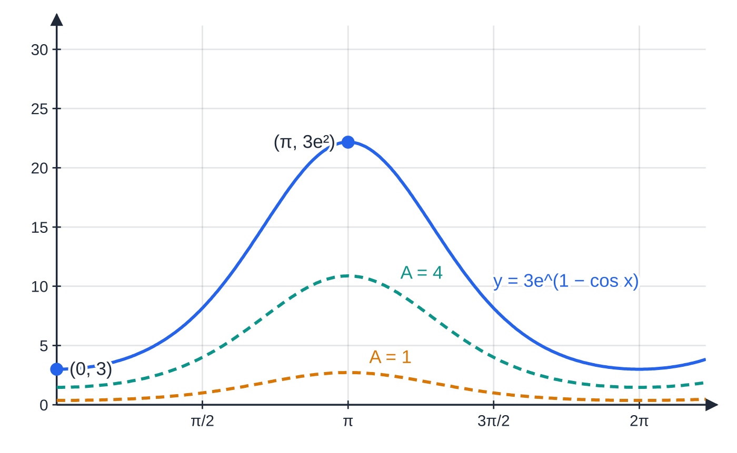
What happens to the constant when you get ln y? (continued)
Section 3 of 13
Common error
Writing ln y=-cos x+c as y=e^(-cos x)+c. The constant is part of the power, so it becomes a multiplier: y=Ae^(-cos x). Putting x=0 into the wrong form gives a different, incorrect curve.
Worked example 3: the particular solution y=3e^(1-cos x) (solid) and two other members of the family y=Ae^(-cos x) (dashed). The constant multiplies the whole curve; it does not shift it up or down.
Notes:
What happens to the constant when you get ln y?. Full notes: https://examinerprep.com/notes/edexcel-ial-maths/differential-equations/

Slide 13
When do you need partial fractions?
Section 4 of 13
After separating, either side may be a rational function such as 2/(x(x+2)) or 1/(P(6-P)). Split it into partial fractions (P4.1) so each piece integrates to a logarithm. Watch the sign: ∫1/(6-P) dP=-ln|6-P|, because the derivative of 6-P is -1. Collect the logarithms into one with the laws of logs, then exponentiate: ln y=ln x/(x+2)+c⇒y=Ax/(x+2). Other separated integrals may need a standard result from the formulae booklet (∫tan x dx=ln|sec x|) or integration by parts (∫xeˣ dx): see P4.5.
Notes:
When do you need partial fractions?. Full notes: https://examinerprep.com/notes/edexcel-ial-maths/differential-equations/

Slide 14
When do you need partial fractions? (continued)
Section 4 of 13 · Worked example 4 · Hard · Find
WORKED EXAMPLE · QUESTION
(a) Express 2/(x(x+2)) in partial fractions. (b) Given that dy/dx=2y/(x(x+2)) for x>0, y>0, and that y=6 when x=1, find y in terms of x. (c) Describe what happens to y as x becomes large.
SOLUTION
(a) 2≡P(x+2)+Qx; x=0 gives P=1, x=-2 gives Q=-1: 1/x-1/(x+2).
(b) Separate and use (a): ∫1/y dy=∫(1/x-1/(x+2))dx, so ln y=ln x-ln(x+2)+ln A. Combine: ln y=ln Ax/(x+2), so y=Ax/(x+2). With x=1, y=6: 6=A/3, A=18, so y=18x/(x+2).
(c) Divide top and bottom by x: y=18/(1+2/x)→18 as x→∞. y increases towards 18 but never reaches it.
Notes:
When do you need partial fractions?: Worked example 4. Full notes: https://examinerprep.com/notes/edexcel-ial-maths/differential-equations/

Slide 15
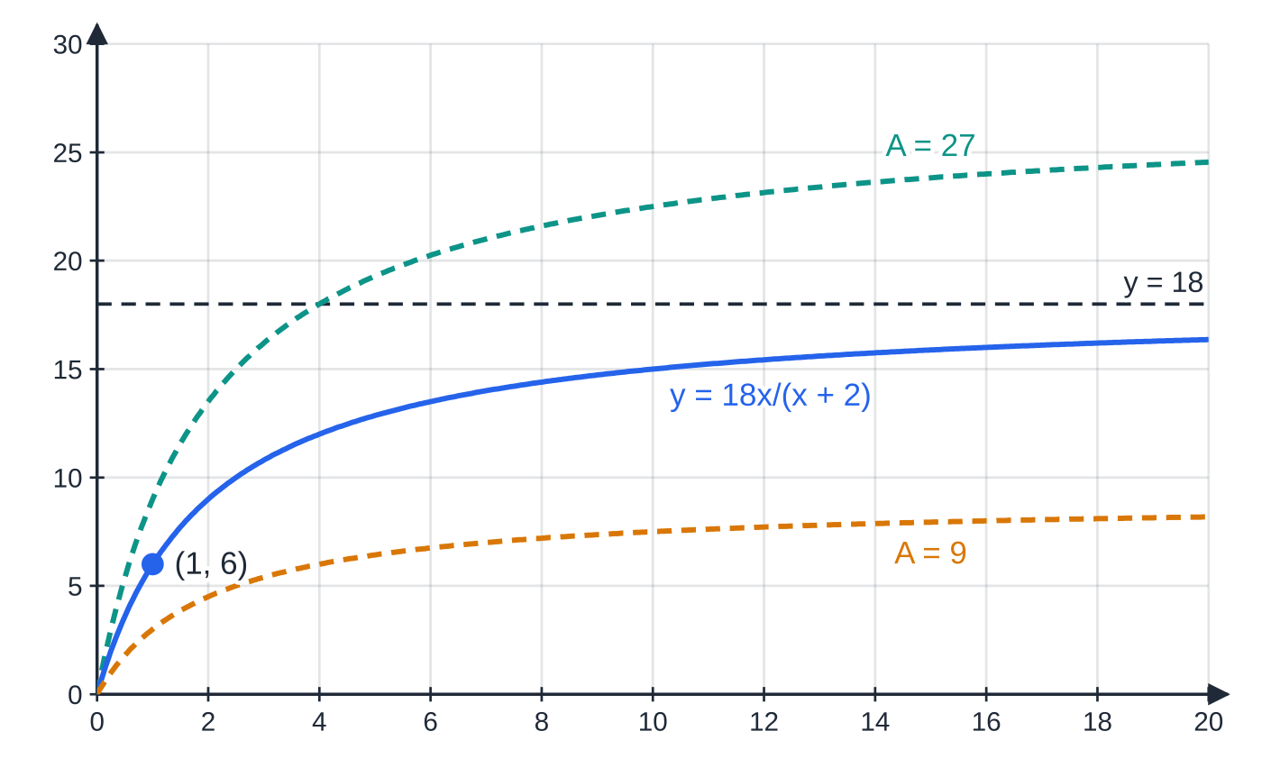
When do you need partial fractions? (continued)
Section 4 of 13
Exam tip
Writing the constant as ln A when every other term is a logarithm lets you combine everything into one log in a single line. Either form of the constant is correct; choose the one that makes the rearranging shortest.
Worked example 4: y=18x/(x+2) through (1,6), with the asymptote y=18. Each member y=Ax/(x+2) of the general solution levels off at its own value A.
Notes:
When do you need partial fractions?. Full notes: https://examinerprep.com/notes/edexcel-ial-maths/differential-equations/

Slide 16
How do you form a differential equation from a description?
Section 5 of 13
Identify the quantity and the time variable: "the rate of change of the mass m" is dm/dt. "Proportional to" gives a constant: proportional to m is km; inversely proportional to m is k/m; proportional to the square root of h is k√h. If the quantity decreases, write a minus sign and state k>0, so that dm/dt=-km is negative whenever m>0. "Proportional to the difference between θ and 20" gives k(θ-20); "to the product of P and 6-P" gives kP(6-P). When the rate is given for a different quantity (volume, when the question wants depth), connect them with the chain rule first (P4.4).
Description | Differential equation | Shape of the solution
N increases at a rate proportional to N | dN/dt=kN, k>0 | N=N₀eᵏᵗ: exponential growth
m decreases at a rate proportional to m | dm/dt=-km, k>0 | m=m₀e⁻ᵏᵗ: decay towards 0
temperature θ falls at a rate proportional to its excess over the surroundings at θₛ | dθ/dt=-k(θ-θₛ) | θ=θₛ+(θ₀-θₛ)e⁻ᵏᵗ: levels off at θₛ
Notes:
How do you form a differential equation from a description?. Full notes: https://examinerprep.com/notes/edexcel-ial-maths/differential-equations/

Slide 17
How do you form a differential equation from a description? (continued)
Section 5 of 13
Description | Differential equation | Shape of the solution
depth h falls at a rate proportional to √h | dh/dt=-k√h | √h falls linearly: the tank empties in a finite time
P grows at a rate proportional to P(L-P) | dP/dt=kP(L-P) | S-shaped curve levelling off at L
Notes:
How do you form a differential equation from a description?. Full notes: https://examinerprep.com/notes/edexcel-ial-maths/differential-equations/

Slide 18
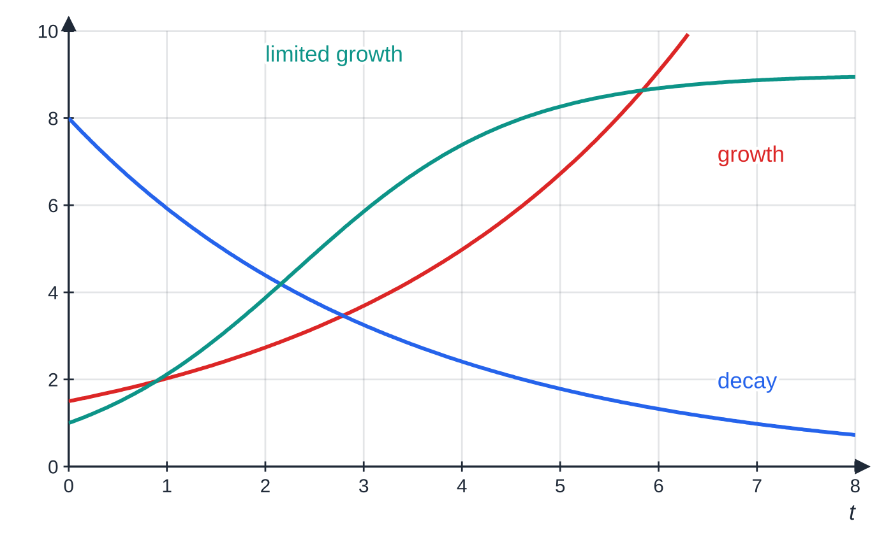
How do you form a differential equation from a description? (continued)
Section 5 of 13
Three shapes from the table: proportional growth (dN/dt=kN) runs away, proportional decay (dm/dt=-km) falls towards 0, and limited growth (dP/dt=kP(L-P)) is S-shaped, levelling off at its limit L.
Notes:
How do you form a differential equation from a description?. Full notes: https://examinerprep.com/notes/edexcel-ial-maths/differential-equations/

Slide 19
How do you form a differential equation from a description? (continued)
Section 5 of 13 · Worked example 5 · Medium · Show that / Find
WORKED EXAMPLE · QUESTION
A drug is injected into a patient's bloodstream. The mass of the drug, m mg, decreases at a rate proportional to the mass present. Initially there is 40 mg; 3 hours later there is 25 mg. (a) Write down a differential equation for m in terms of the time t hours. (b) Show that m=40e⁻ᵏᵗ, where k is a positive constant. (c) Show that k=⅓ln 1.6. (d) Find the time at which the mass has fallen to 5 mg. (e) Find the time taken for the mass to halve.
SOLUTION
(a) Decreasing, so a minus sign with k>0: dm/dt=-km.
(b) Separate (m>0): ∫1/m dm=∫-k dt, so ln m=-kt+c and m=Ae⁻ᵏᵗ. At t=0, m=40, so A=40: m=40e⁻ᵏᵗ ✓.
(c) Use t=3, m=25: e⁻³ᵏ=(25/40), so e³ᵏ=1.6 and k=⅓ln 1.6 ✓ (=0.1567…).
(d) 40e⁻ᵏᵗ=5⇒eᵏᵗ=8⇒t=ln 8/k=3ln 8/ln 1.6=13.273…= 13.3 hours.
(e) eᵏᵗ=2⇒t=3ln 2/ln 1.6= 4.42 hours, the same from any starting mass.
Notes:
How do you form a differential equation from a description?: Worked example 5. Full notes: https://examinerprep.com/notes/edexcel-ial-maths/differential-equations/

Slide 20
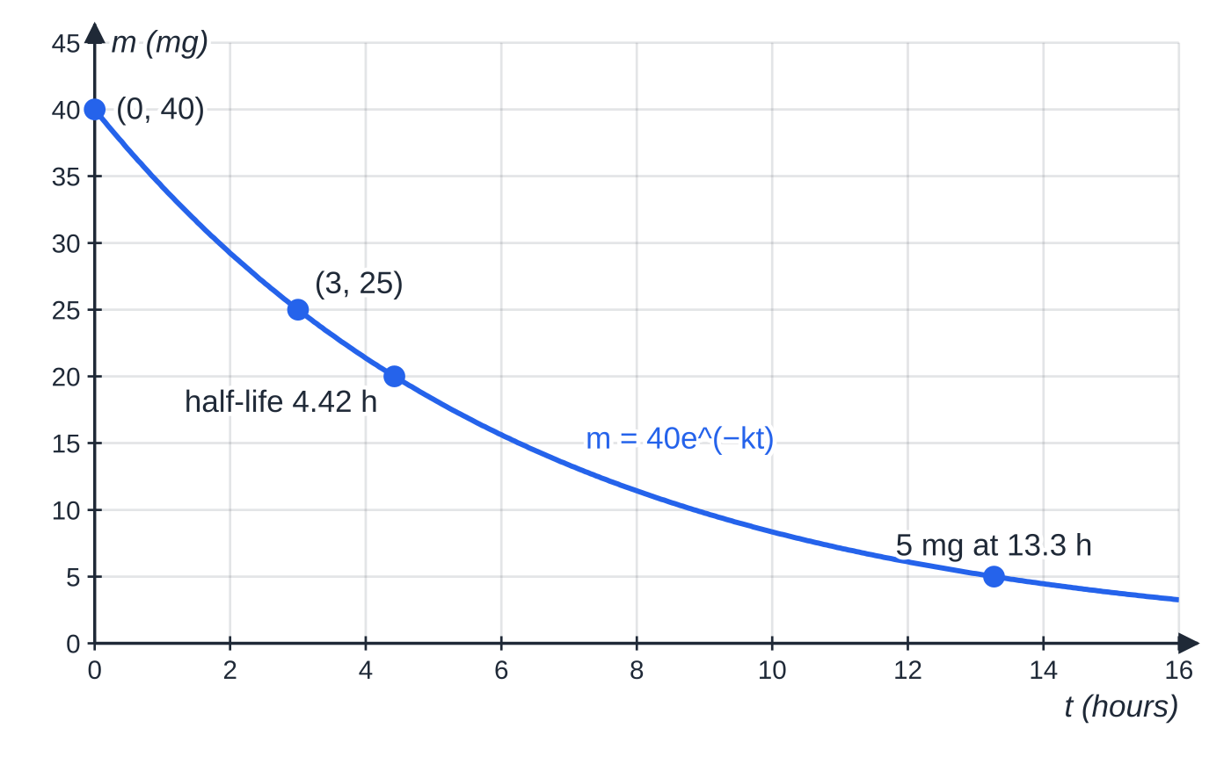
How do you form a differential equation from a description? (continued)
Section 5 of 13
Worked example 5: the solution through the two data points. The mass halves every 4.42 hours and reaches 5 mg after 13.3 hours, three half-lives (40 → 20 → 10 → 5).
Notes:
How do you form a differential equation from a description?. Full notes: https://examinerprep.com/notes/edexcel-ial-maths/differential-equations/

Slide 21
How do you model cooling?
Section 6 of 13
Newton's law of cooling. The rate at which a body's temperature changes is proportional to the difference between its temperature and the temperature of its surroundings. With surroundings at θₛ: dθ/dt=-k(θ-θₛ), k>0.
A hot body (θ>θₛ) cools; a cold body (θ<θₛ) warms up; the same equation covers both. Separate with θ-θₛ as one block: ∫1/(θ-θₛ) dθ=ln|θ-θₛ|. The temperature approaches θₛ but never reaches it in the model, so a "long-term" answer is θₛ.
Notes:
How do you model cooling?. Full notes: https://examinerprep.com/notes/edexcel-ial-maths/differential-equations/

Slide 22
How do you model cooling? (continued)
Section 6 of 13 · Worked example 6 · Medium · Show that / Find
WORKED EXAMPLE · QUESTION
A bowl of soup at 85 °C is placed in a room at a constant 20 °C. The temperature of the soup, θ °C, t minutes later satisfies dθ/dt=-k(θ-20), where k is a positive constant. After 10 minutes the temperature is 60 °C. (a) Show that θ=20+65e⁻ᵏᵗ. (b) Find the exact value of k. (c) Find the time at which the soup reaches 35 °C. (d) State what happens to θ in the long term.
SOLUTION
(a) Separate (θ>20 throughout): ∫1/(θ-20) dθ=∫-k dt, so ln(θ-20)=-kt+c and θ-20=Ae⁻ᵏᵗ. At t=0, A=85-20=65: θ=20+65e⁻ᵏᵗ ✓.
(b) t=10, θ=60: 65e⁻¹⁰ᵏ=40⇒e¹⁰ᵏ=(13/8)⇒ k=(1/10)ln(13/8) (=0.04855…).
(c) 65e⁻ᵏᵗ=15⇒eᵏᵗ=(13/3)⇒t=(10ln(13/3))/(ln(13/8))=30.20…= 30.2 minutes.
(d) e⁻ᵏᵗ→0 as t→∞, so θ→20: the soup cools towards room temperature but stays above it.
Notes:
How do you model cooling?: Worked example 6. Full notes: https://examinerprep.com/notes/edexcel-ial-maths/differential-equations/

Slide 23
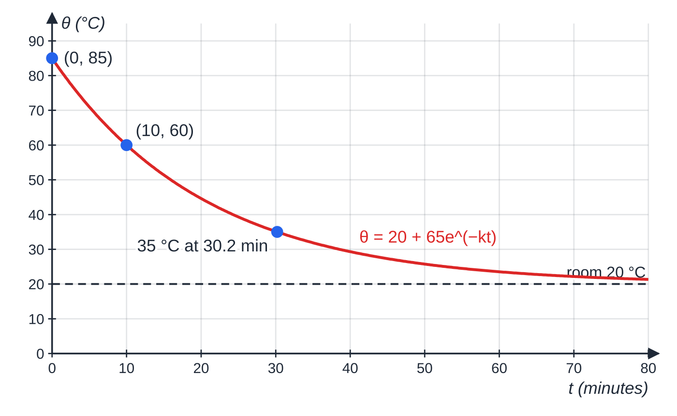
How do you model cooling? (continued)
Section 6 of 13
Common error
Using θ=85e⁻ᵏᵗ. That model cools towards 0 °C, not to room temperature. The exponential describes the excess temperature θ-20, which starts at 65, not 85.
Worked example 6: θ=20+65e⁻ᵏᵗ through (0,85) and (10,60), at 35 °C after 30.2 minutes and levelling off at the room temperature of 20 °C.
Notes:
How do you model cooling?. Full notes: https://examinerprep.com/notes/edexcel-ial-maths/differential-equations/

Slide 24
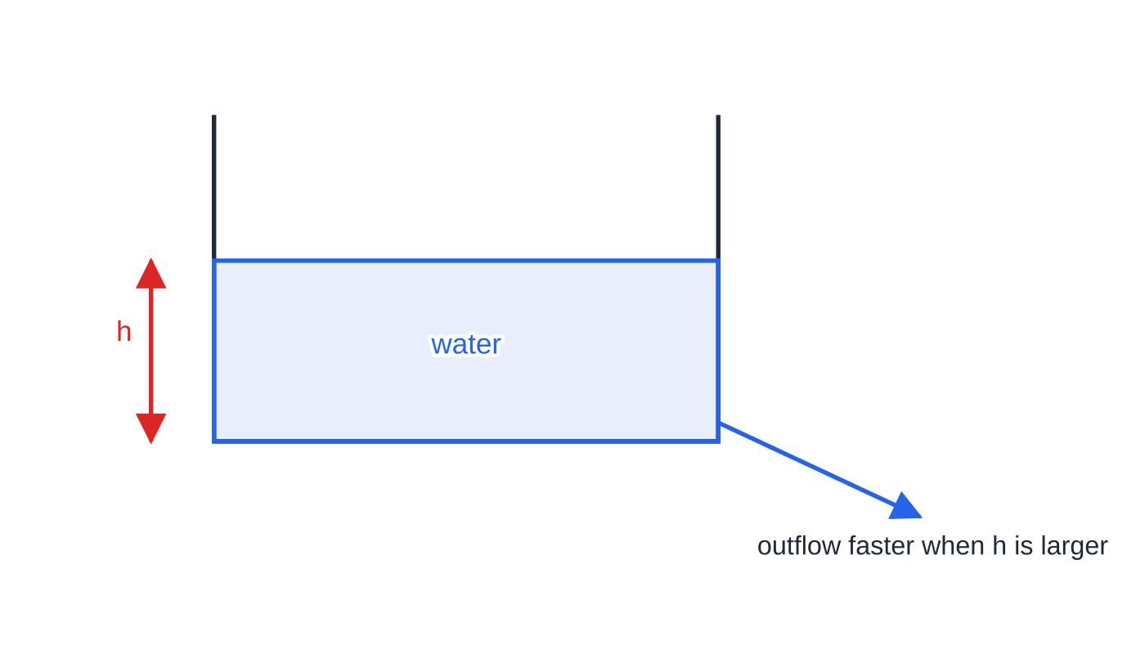
How do you model a draining tank?
Section 7 of 13
Water flowing out through a hole near the base leaves faster when the water is deeper. A common model: the depth falls at a rate proportional to √h, so dh/dt=-k√h. Separate with a power: ∫h^(-1/2) dh=2√h. The solution has √h falling linearly, so, unlike exponential decay, the tank empties in a finite time. The formula for h is a squared bracket, which would start rising again after the tank is empty, so state the interval of validity.
A tank draining through a small hole near its base. The outflow rate depends on the depth h, which gives dh/dt=-k√h.
Notes:
How do you model a draining tank?. Full notes: https://examinerprep.com/notes/edexcel-ial-maths/differential-equations/

Slide 25
How do you model a draining tank? (continued)
Section 7 of 13 · Worked example 7 · Medium · Find / State
WORKED EXAMPLE · QUESTION
Water leaks from a tank through a small hole in its base. The depth of water is h metres at time t minutes, and the depth decreases at a rate proportional to the square root of the depth. Initially the depth is 1.44 m; after 10 minutes it is 1.00 m. (a) Write down a differential equation for h. (b) Find the general solution. (c) Find the values of the constants, and hence express h in terms of t. (d) Find the time taken for the tank to empty. (e) State, with a reason, the interval of t for which your formula is valid.
SOLUTION
(a) dh/dt=-k√h, k>0.
(b) Separate: ∫h^(-1/2) dh=∫-k dt, so 2√h=-kt+c.
(c) t=0, h=1.44: c=2×1.2=2.4. t=10, h=1: 2=-10k+2.4, so k=0.04. Then √h=1.2-0.02t and h=(1.2-0.02t)².
(d) h=0: 1.2-0.02t=0⇒ t=60 minutes.
Notes:
How do you model a draining tank?: Worked example 7. Full notes: https://examinerprep.com/notes/edexcel-ial-maths/differential-equations/

Slide 26
How do you model a draining tank? (continued)
Section 7 of 13 · Worked example 7 · Medium · Find / State (continued)
(e) 0≤t≤60: after 60 minutes the tank is empty, but (1.2-0.02t)² would increase again.
Notes:
How do you model a draining tank?: Worked example 7. Full notes: https://examinerprep.com/notes/edexcel-ial-maths/differential-equations/

Slide 27
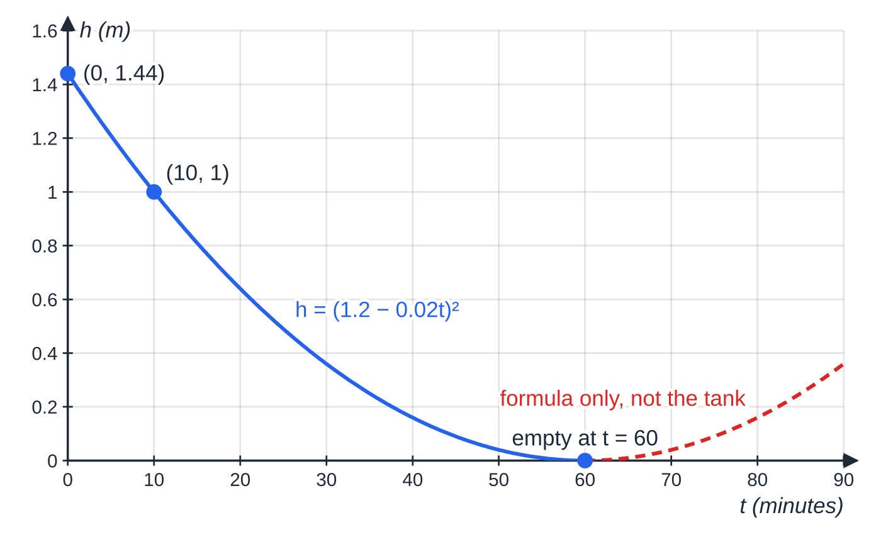
How do you model a draining tank? (continued)
Section 7 of 13
Exam tip
With two unknown constants (c and k), use the initial condition first: at t=0 the kt term vanishes and c comes out alone. Then the second data point gives k.
Worked example 7: h=(1.2-0.02t)² through (0,1.44) and (10,1), reaching zero at t=60. The dashed continuation is what the formula gives, not what the tank does.
Notes:
How do you model a draining tank?. Full notes: https://examinerprep.com/notes/edexcel-ial-maths/differential-equations/

Slide 28
How do you solve a limited-growth model?
Section 8 of 13
Unlimited growth dP/dt=kP is unrealistic for a population with limited food or space. Multiplying by (L-P) makes the growth rate fall to zero as P approaches the limit L. Separating gives ∫1/(P(L-P)) dP: split into partial fractions, integrate to logs (watch the minus sign on ln|L-P|), combine and exponentiate. Make P the subject by collecting the P terms on one side and factorising. The answer usually comes out in the form L/(1+Be⁻ᶜᵗ), which shows P→L at once.
Notes:
How do you solve a limited-growth model?. Full notes: https://examinerprep.com/notes/edexcel-ial-maths/differential-equations/

Slide 29
How do you solve a limited-growth model? (continued)
Section 8 of 13 · Worked example 8 · Hard · Show that / Find
WORKED EXAMPLE · QUESTION
The population of fish in a lake, P hundred, t years after the lake is stocked, is modelled by dP/dt=(P(6-P))/15, 0<P<6. Initially there are 100 fish. (a) Express 6/(P(6-P)) in partial fractions. (b) Show that ln(5P/(6-P))=0.4t. (c) Hence show that P=6/(1+5e^(-0.4t)). (d) Find the time taken for the population to reach 400 fish. (e) State the long-term size of the population according to the model.
SOLUTION
(a) 6≡a(6-P)+bP; P=0 gives a=1, P=6 gives b=1: 1/P+1/(6-P).
(b) Separate: 15/(P(6-P))=(5/2)×6/(P(6-P)), so ∫(5/2)(1/P+1/(6-P))dP=∫1 dt. The second term gives -ln(6-P): (5/2)[ln P-ln(6-P)]=t+c, so ln P/(6-P)=0.4t+c′. At t=0, P=1 (100 fish): c′=ln⅕. So ln P/(6-P)-ln⅕=0.4t, i.e. ln(5P/(6-P))=0.4t ✓.
(c) Remove the log: 5P=(6-P)e^(0.4t), so P(5+e^(0.4t))=6e^(0.4t) and P=6e^(0.4t)/(5+e^(0.4t))=6/(1+5e^(-0.4t)) ✓ (divide top and bottom by e^(0.4t)).
Notes:
How do you solve a limited-growth model?: Worked example 8. Full notes: https://examinerprep.com/notes/edexcel-ial-maths/differential-equations/

Slide 30
How do you solve a limited-growth model? (continued)
Section 8 of 13 · Worked example 8 · Hard · Show that / Find (continued)
(d) 400 fish means P=4: 1+5e^(-0.4t)=1.5⇒e^(-0.4t)=0.1⇒t=2.5ln 10= 5.76 years.
(e) e^(-0.4t)→0, so P→6: 600 fish.
Notes:
How do you solve a limited-growth model?: Worked example 8. Full notes: https://examinerprep.com/notes/edexcel-ial-maths/differential-equations/

Slide 31
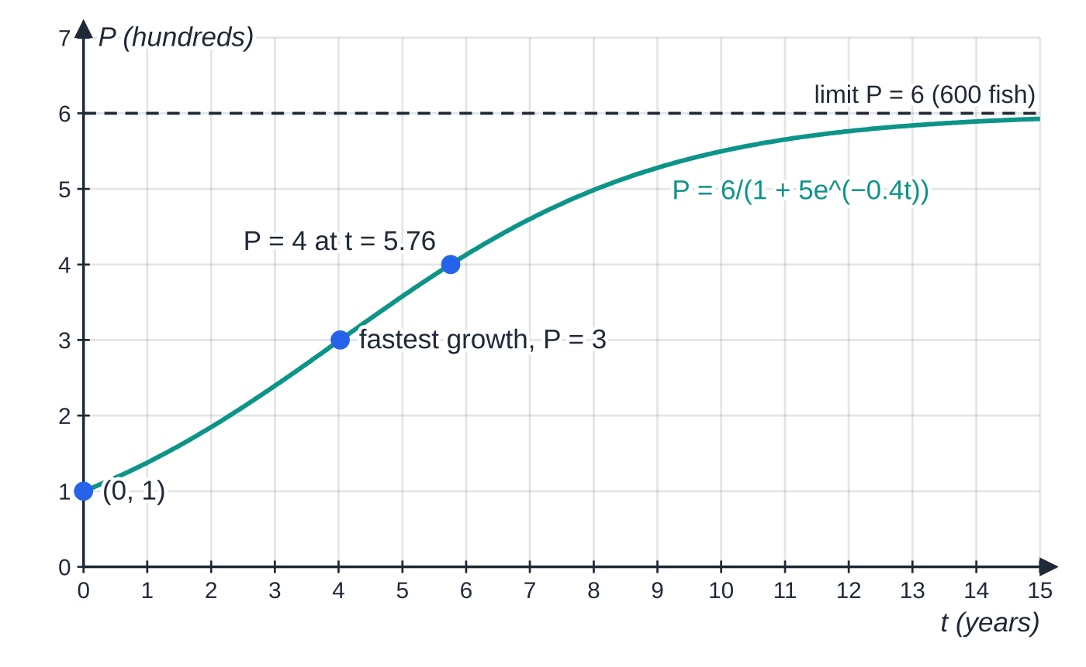
How do you solve a limited-growth model? (continued)
Section 8 of 13
Common error
Integrating 1/(6-P) as +ln(6-P). The derivative of 6-P is -1, so the integral is -ln(6-P). With the wrong sign the solution has no limiting value and part (e) cannot come out as 6.
Worked example 8: from 1 (100 fish) the population grows fastest when P=3, at t=2.5ln 5≈4.02, reaches 4 at t≈5.76 and levels off at 6 (600 fish).
Notes:
How do you solve a limited-growth model?. Full notes: https://examinerprep.com/notes/edexcel-ial-maths/differential-equations/

Slide 32
Exam tips for P4.7
Section 9 of 13
Exam tip 1 — separate fully before you integrate
Write a line of the form ∫(only y) dy=∫(only x) dx with both integral signs showing. Factorise the right-hand side first if needed: xy-2x=x(y-2).
Exam tip 2 — the constant goes in as soon as you integrate
Add +c on the line where the integral signs disappear. Adding it after rearranging (for example after exponentiating) puts it in the wrong place, and the particular solution that follows is wrong.
Exam tip 3 — keep constants exact
Leave k as ⅓ln 1.6 or (1/10)ln(13/8) and use the exact value (or the full calculator value) in later parts. Rounding k to 2 significant figures early can move a final answer by a whole unit in the third figure.
Notes:
Exam tips for P4.7. Full notes: https://examinerprep.com/notes/edexcel-ial-maths/differential-equations/

Slide 33
Exam tips for P4.7 (continued)
Section 9 of 13
Exam tip 4 — check the sign and the units
For a decreasing quantity the equation must make the derivative negative. After solving, check: does the formula give the initial value at t=0? Does it move in the right direction? State answers with units and in the words of the question ("600 fish", "30.2 minutes").
Exam tip 5 — "long term" and "comment on the model"
For long-term behaviour let t→∞ and say which term tends to zero. For a comment on the model, link it to the context: a population cannot be a fraction of a fish, a tank cannot have negative depth, room temperature might not stay constant.
Notes:
Exam tips for P4.7. Full notes: https://examinerprep.com/notes/edexcel-ial-maths/differential-equations/

Slide 34
Common misconceptions
Section 10 of 13
Misconception | Why it is wrong | Correct idea
ln y=2x+c gives y=e²ˣ+c. | e²ˣ⁺ᶜ=eᶜe²ˣ: the constant multiplies. | y=Ae²ˣ.
Each side needs its own constant. | Two constants combine into one, c₂-c₁. | One constant, on one side, is enough for a first-order equation.
∫1/(6-P) dP=ln(6-P). | The inner derivative of 6-P is -1. | -ln|6-P|+c.
"Decreases at a rate proportional to m" is dm/dt=km. | With k>0 this makes m increase. | dm/dt=-km, k>0.
Newton's law of cooling gives θ=θ₀e⁻ᵏᵗ. | That cools towards 0 °C. | θ-θₛ decays: θ=θₛ+(θ₀-θₛ)e⁻ᵏᵗ.
A solution formula holds for all t≥0. | The context can stop the model, e.g. an empty tank. | State the interval of validity (0≤t≤60 in worked example 7).
Notes:
Common misconceptions. Full notes: https://examinerprep.com/notes/edexcel-ial-maths/differential-equations/

Slide 35
How this topic connects
Section 11 of 13
P4.1, P4.4 and P4.5
The separated integrals use partial fractions (P4.1) and substitution or integration by parts (P4.5); connected rates of change (P4.4) turn a rate for volume into a rate for depth before you separate.
P3.5 Exponential and logarithmic functions
eˣ, ln x, ∫1/x dx=ln|x| and the exponential growth and decay models of P3 are exactly the solutions of dN/dt=±kN.
Mechanics and IAL Physics
Variable acceleration links displacement, velocity and acceleration by differentiation and integration with respect to time, the same "rate of change" language. Radioactive decay (dN/dt=-λN), capacitor discharge and half-life are proportional-decay differential equations with exponential solutions.
Notes:
How this topic connects. Full notes: https://examinerprep.com/notes/edexcel-ial-maths/differential-equations/

Slide 36
Key formulae
Section 12 of 13
Formula | Use | In the formulae list?
dy/dx=f(x)g(y)⇒∫1/g(y) dy=∫f(x) dx | separating the variables | No — learn it
∫1/x dx=ln|x|+c; ∫f′(x)/f(x) dx=ln|f(x)|+c | the y side of most model equations | No — learn it
ln|y|=f(x)+c⇒y=Aeᶠ⁽ˣ⁾ | removing the logarithm | No — derive it
dN/dt=kN⇒N=N₀eᵏᵗ | proportional growth (k>0) or decay (k<0) | No — derive it
dθ/dt=-k(θ-θₛ)⇒θ=θₛ+(θ₀-θₛ)e⁻ᵏᵗ | Newton's law of cooling | No — derive it
dh/dt=-k√h⇒2√h=-kt+c | draining tank | No — derive it
∫tan x dx=ln|sec x|+c; ∫udv/dx dx=uv-∫vdu/dx dx | harder separated integrals | Yes
Notes:
Key formulae. Full notes: https://examinerprep.com/notes/edexcel-ial-maths/differential-equations/

Slide 37
Check your understanding
Section 13 of 13
1. How many arbitrary constants does the general solution of a first-order differential equation contain, and how is it removed?
2. Solve dy/dx=2y, given that y=5 when x=0.
3. The volume V of a melting block of ice decreases at a rate proportional to V^(2/3). Write down a differential equation.
4. A model gives θ=15+50e^(-0.1t). What are the initial and long-term temperatures?
5. Is dy/dx=xy-3x separable?
Notes:
Check your understanding: questions. Full notes: https://examinerprep.com/notes/edexcel-ial-maths/differential-equations/

Slide 38
Check your understanding · answers
Section 13 of 13
1. One. A given pair of values (an initial or boundary condition) fixes it and gives the particular solution.
2. ∫1/y dy=∫2 dx, so ln|y|=2x+c and y=Ae²ˣ. With y=5 at x=0, A=5: y=5e²ˣ.
3. dV/dt=-kV^(2/3), where k is a positive constant (minus because V decreases).
4. At t=0, θ=15+50=65; as t→∞, e^(-0.1t)→0, so θ→15, the temperature of the surroundings.
5. Yes: xy-3x=x(y-3), so ∫1/(y-3) dy=∫x dx, giving y=3+Ae^(x²/2).
Notes:
Check your understanding: answers. Full notes: https://examinerprep.com/notes/edexcel-ial-maths/differential-equations/

Slide 39
Practice questions
2 original exam-style questions. Answers at the end of the deck.

Slide 40
Question 1
6 marks
The variables x and y, where y > 0, satisfy the differential equation dy/dx = 4x³ ÷ y.
(a) Find the general solution, giving your answer in the form y² = f(x). [3]
(b) Find the particular solution for which y = 3 when x = 1. [2]
(c) Hence find the value of y when x = 2, giving your answer to 3 significant figures. [1]
Notes:
Online with the full mark scheme: https://examinerprep.com/ial-maths-p4-7-differential-equations-questions#IALM-P4-7-B-01

Slide 41
Question 2
5 marks
A curve satisfies the differential equation dy/dx = 2xy.
(a) Show that y = Aeˣ², where A is a constant, satisfies the differential equation. [2]
(b) Given that the curve passes through (0, 5), find the value of A. [1]
(c) Find the positive value of x for which y = 20, giving your answer to 3 significant figures. [2]
Notes:
Online with the full mark scheme: https://examinerprep.com/ial-maths-p4-7-differential-equations-questions#IALM-P4-7-B-02

Slide 42
Answers

Slide 43
Question 1 · answer
Mark scheme
∫ y dy = ∫ 4x³ dx
½y² = x⁴ + c
y² = 2x⁴ + C
9 = 2 + C
y² = 2x⁴ + 7
y = √39 = 6.24 (6.2449…)
Notes:
Full mark scheme: https://examinerprep.com/ial-maths-p4-7-differential-equations-questions#IALM-P4-7-B-01

Slide 44
Question 2 · answer
Mark scheme
dy/dx = A × 2xeˣ² (chain rule)
= 2x(Aeˣ²) = 2xy as required
5 = Ae⁰, so A = 5
eˣ² = 4 ⇒ x² = ln 4
x = √(ln 4) = 1.18 (1.1774…)
Notes:
Full mark scheme: https://examinerprep.com/ial-maths-p4-7-differential-equations-questions#IALM-P4-7-B-02

Slide 45
Keep practising
Notes for this topic
Questions on this topic
Build a printable test
ExaminerPrep is an independent tutoring service. It has been developed independently from and is not endorsed by the International Baccalaureate Organization. "International Baccalaureate", "IB" and "IB Diploma Programme" are registered trademarks of the IBO, used here for descriptive purposes only.
Pearson Edexcel and Cambridge are trademarks of their owners; ExaminerPrep is not affiliated with any exam board.

