Slide 1
EP
EDEXCEL IAL MATHS
P3.6 Differentiation: chain, product and quotient rules
The full notes page in 13 sections · practice questions with answers · simulations
ExaminerPrep is an independent tutoring service. It has been developed independently from and is not endorsed by the International Baccalaureate Organization. "International Baccalaureate", "IB" and "IB Diploma Programme" are registered trademarks of the IBO, used here for descriptive purposes only.
Pearson Edexcel and Cambridge are trademarks of their owners; ExaminerPrep is not affiliated with any exam board.
Notes:
P3.6 Differentiation: chain, product and quotient rules. Notes for this topic: https://examinerprep.com/notes/edexcel-ial-maths/differentiation-chain-product-and-quotient-rules/

Slide 2
What this page covers
Overview
Differentiating eᵏˣ, ln kx, sin kx, cos kx and tan kx (angles in radians)
The chain rule for composite functions, including powers, exponentials and logarithms of functions
The product rule and the quotient rule
Derivatives of sec x, cosecx and cot x, and how to prove them
Using dy/dx = 1 ÷dx/dy when x is given as a function of y
Tangents, normals and stationary points of curves that need these rules
Notes:
What this page covers. Full notes: https://examinerprep.com/notes/edexcel-ial-maths/differentiation-chain-product-and-quotient-rules/

Slide 3
In one minute
Key points
1. Five standard derivatives and three combining rules (chain, product and quotient) let you differentiate almost any function built from powers, eˣ, ln x and trigonometric functions, and then find tangents, normals and stationary points exactly as before.
2. Standard results (radians): eᵏˣ →keᵏˣ; ln kx →1/x; sin kx →kcos kx; cos kx →-ksin kx; tan kx →ksec² kx.
3. Chain rule: dy/dx = dy/du×du/dx. Differentiate the outside, keep the inside, multiply by the derivative of the inside.
4. Product rule: (uv)′ = u′v + uv′. Quotient rule: (u/v)′ = (u′v - uv′)/v².
5. Reciprocal trig: sec x →sec xtan x; cosecx →-cosecxcot x; cot x →-cosec² x. If x = g(y), then dy/dx = 1 ÷dx/dy.
6. Factorise the derivative before solving dy/dx = 0, and say which factors can never be zero.
Notes:
In one minute. Full notes: https://examinerprep.com/notes/edexcel-ial-maths/differentiation-chain-product-and-quotient-rules/

Slide 4
What are the derivatives of eᵏˣ, ln kx and the trigonometric functions?
Section 1 of 13
In P1 and P2 you could only differentiate sums of powers of x. P3 removes that limit, starting with five new standard results. Each one has a reason you can picture.
eˣ is the one function that is its own derivative: the gradient of y = eˣ at any point equals the y-coordinate there. Stretching by a factor 1/k parallel to the x-axis multiplies every gradient by k, so eᵏˣ →keᵏˣ.
ln x has derivative 1/x for x > 0. Because ln kx = ln k + ln x, and ln k is a constant, ln kx also has derivative 1/x: the k disappears.
sin x →cos x and cos x →-sin x, only when x is in radians. In degrees an extra factor π/180 would appear in every answer.
tan x →sec² x, which follows from tan x = sin x/cos x and the quotient rule.
y | dy/dx | In the formulae list?
eᵏˣ | keᵏˣ | No — learn it
Notes:
What are the derivatives of eᵏˣ, ln kx and the trigonometric functions?. Full notes: https://examinerprep.com/notes/edexcel-ial-maths/differentiation-chain-product-and-quotient-rules/

Slide 5
What are the derivatives of eᵏˣ, ln kx and the trigonometric functions? (continued)
Section 1 of 13
y | dy/dx | In the formulae list?
ln kx (kx > 0) | 1/x | No — learn it
sin kx | kcos kx | No — learn it
cos kx | -ksin kx | No — learn it
tan kx | ksec² kx | Yes
The sign pattern for sin and cos is a cycle of four: differentiating goes sin→cos→-sin→-cos→sin. The figure shows why: where sin x has a maximum its gradient is zero, and that is exactly where cos x crosses the axis.
Notes:
What are the derivatives of eᵏˣ, ln kx and the trigonometric functions?. Full notes: https://examinerprep.com/notes/edexcel-ial-maths/differentiation-chain-product-and-quotient-rules/

Slide 6
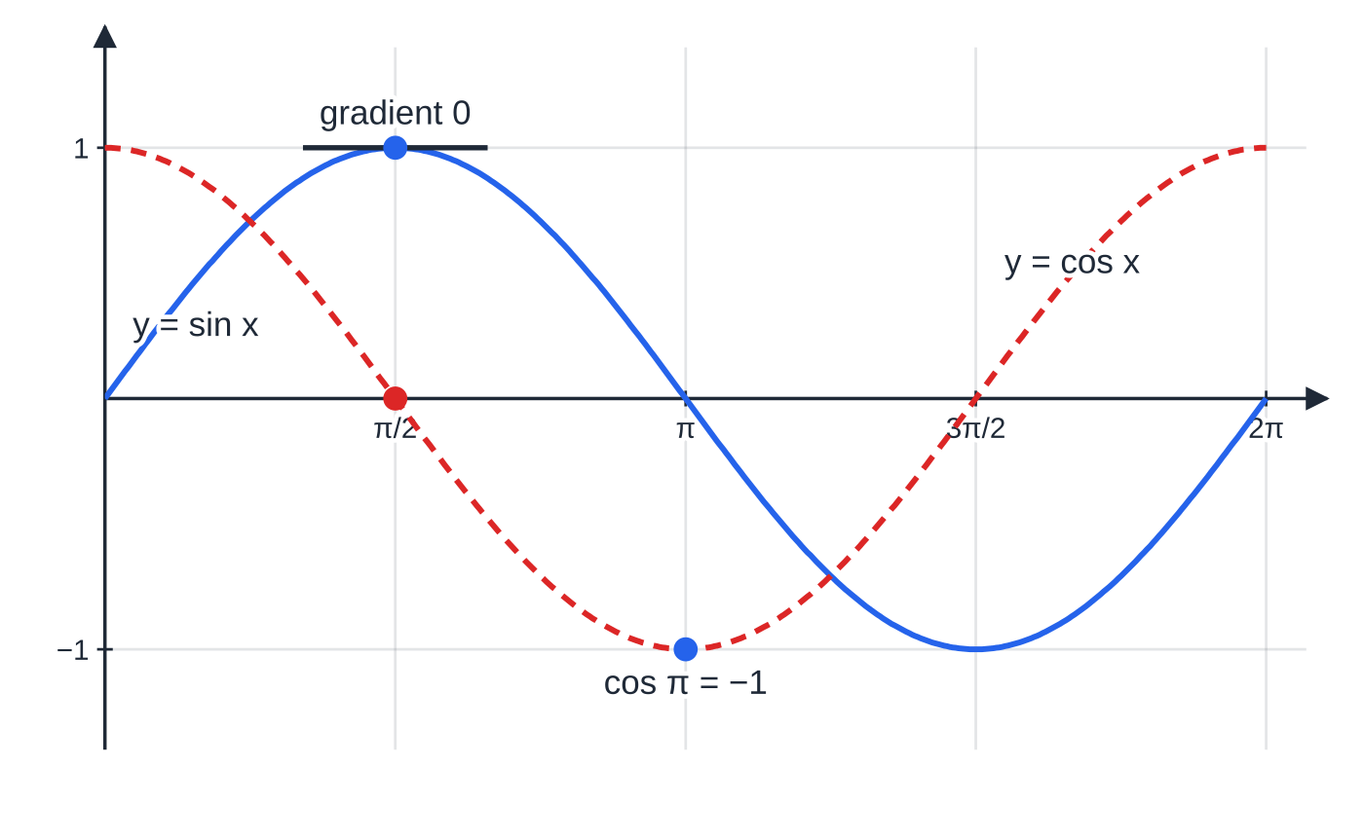
What are the derivatives of eᵏˣ, ln kx and the trigonometric functions? (continued)
Section 1 of 13
y = sin x (solid) and its derivative y = cos x (dashed). The horizontal tangent at the maximum of sin x sits above the zero of cos x, and sin x falls most steeply at x = π, where cos x = −1.
Notes:
What are the derivatives of eᵏˣ, ln kx and the trigonometric functions?. Full notes: https://examinerprep.com/notes/edexcel-ial-maths/differentiation-chain-product-and-quotient-rules/

Slide 7
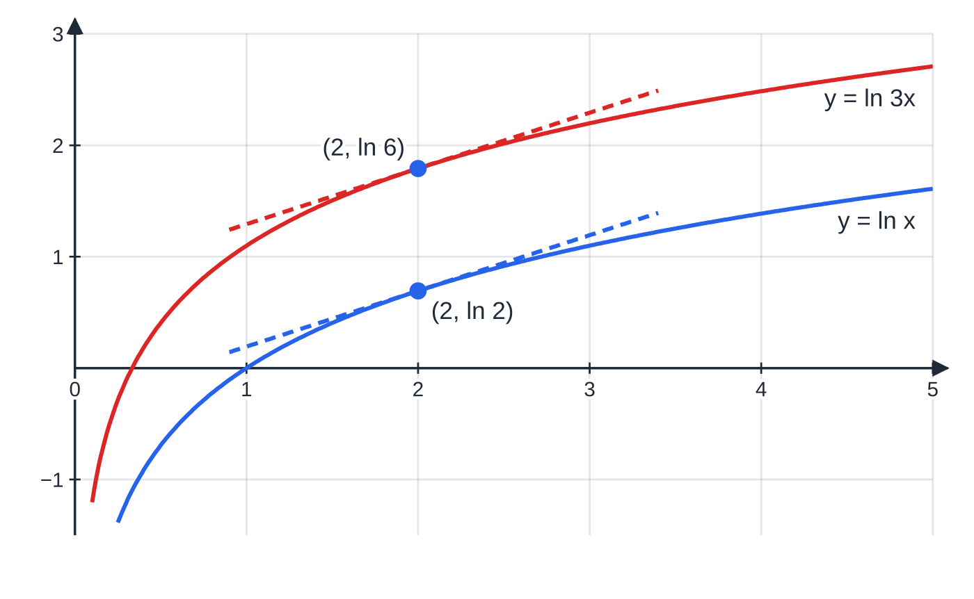
What are the derivatives of eᵏˣ, ln kx and the trigonometric functions? (continued)
Section 1 of 13
y = ln 3x is y = ln x moved up by ln 3 ≈ 1.099. A vertical shift does not change any gradient, so at x = 2 both tangents have gradient 1/2: the derivative of ln 3x is 1/x, not 3/x.
Notes:
What are the derivatives of eᵏˣ, ln kx and the trigonometric functions?. Full notes: https://examinerprep.com/notes/edexcel-ial-maths/differentiation-chain-product-and-quotient-rules/

Slide 8
What are the derivatives of eᵏˣ, ln kx and the trigonometric functions? (continued)
Section 1 of 13 · Worked example 1 · Easy · Differentiate, find
WORKED EXAMPLE · QUESTION
Differentiate with respect to x: (a) 5e⁻²ˣ (b) ln 7x (c) 4cos 3x (d) 2tan x/2. (e) Find the exact gradient of the curve y = 4cos 3x + 2tan x/2 at the point where x = π/2.
SOLUTION
(a)–(d) Use the table with k = -2, 7, 3 and ½: (a) -10e⁻²ˣ; (b) 1/x; (c) 4 ×(-3sin 3x) = -12sin 3x; (d) 2 ×½sec²x/2 = sec²x/2.
(e) Add (c) and (d), then substitute: dy/dx = -12sin 3π/2 + sec²π/4 = -12(-1) + 1/(cos²π/4) = 12 + 2 = 14. Here sec²π/4 = 1 ÷½ = 2; exact trigonometric values appear constantly in P3 calculus.
Notes:
What are the derivatives of eᵏˣ, ln kx and the trigonometric functions?: Worked example 1. Full notes: https://examinerprep.com/notes/edexcel-ial-maths/differentiation-chain-product-and-quotient-rules/

Slide 9
What are the derivatives of eᵏˣ, ln kx and the trigonometric functions? (continued)
Section 1 of 13
Common error — ln 7x is not 7/x
Writing d/dx(ln 7x) = 7/x by analogy with e⁷ˣ →7e⁷ˣ. The chain rule gives 7 ×1/7x = 1/x; the 7s cancel. Only a constant multiplying the logarithm, as in 7ln x, survives.
Notes:
What are the derivatives of eᵏˣ, ln kx and the trigonometric functions?. Full notes: https://examinerprep.com/notes/edexcel-ial-maths/differentiation-chain-product-and-quotient-rules/

Slide 10
How do you differentiate a function of a function?
Section 2 of 13
A composite function has an "inside" and an "outside". In (4x - 3)⁵ the inside is u = 4x - 3 and the outside is u⁵; in e^(sin x) the inside is sin x. The chain rule says that rates of change multiply: if y changes a times as fast as u, and u changes b times as fast as x, then y changes ab times as fast as x. In practice: differentiate the outside function, leaving the inside alone, then multiply by the derivative of the inside. The k in eᵏˣ, sin kx and so on is the chain rule with the simplest possible inside, u = kx.
The chain rule.
dy/dx = dy/du×du/dx equivalently d/dx[f(g(x))] = f′(g(x)) g′(x) Useful special cases: [f(x)]ⁿ →n[f(x)]ⁿ⁻¹f′(x); eᶠ⁽ˣ⁾ →f′(x)eᶠ⁽ˣ⁾; ln f(x) →f′(x)/f(x). Note that "sin³ x" means (sin x)³: the outside is the cube and the inside is sin x. Not in the formulae booklet: learn it.
Notes:
How do you differentiate a function of a function?. Full notes: https://examinerprep.com/notes/edexcel-ial-maths/differentiation-chain-product-and-quotient-rules/

Slide 11
How do you differentiate a function of a function? (continued)
Section 2 of 13 · Worked example 2 · Medium · Differentiate
WORKED EXAMPLE · QUESTION
Differentiate with respect to x: (a) (4x - 3)⁵ (b) 1/(√(2x² + 1)) (c) e^(x²-3x) (d) ln(cos x), 0 < x < π/2 (e) cos³ x
SOLUTION
(a) Outside u⁵, inside 4x - 3 with derivative 4: 5(4x - 3)⁴ ×4 = 20(4x - 3)⁴.
(b) Write as a power first, (2x² + 1)^(-½): -½(2x² + 1)^(-(3/2)) ×4x = -2x(2x² + 1)^(-(3/2)).
(c) The exponential stays as it is, times the derivative of the inside: (2x - 3)e^(x²-3x).
(d) Derivative of the inside over the inside: (-sin x)/cos x = -tan x. The condition 0 < x < π/2 makes cos x positive, so the logarithm is defined.
(e) Outside u³, inside cos x with derivative -sin x: 3cos² x ×(-sin x) = -3cos² xsin x.
Notes:
How do you differentiate a function of a function?: Worked example 2. Full notes: https://examinerprep.com/notes/edexcel-ial-maths/differentiation-chain-product-and-quotient-rules/

Slide 12
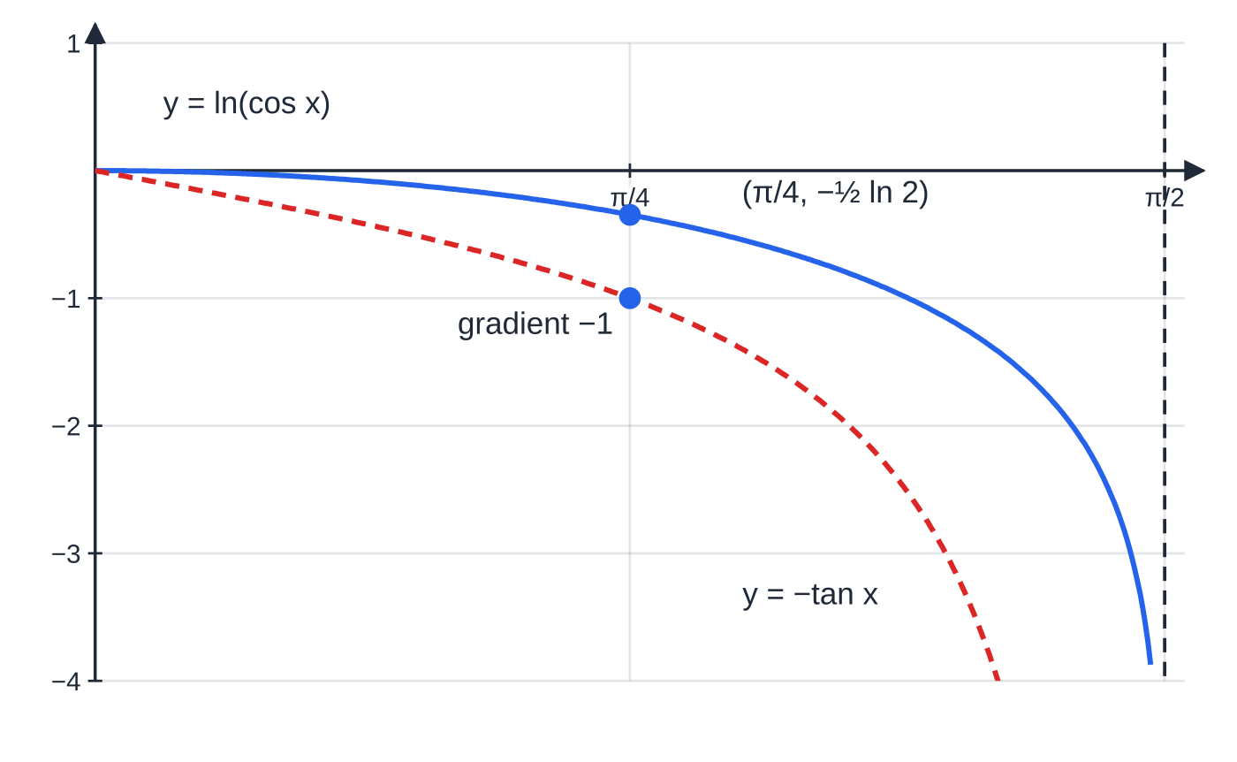
How do you differentiate a function of a function? (continued)
Section 2 of 13
Common error — forgetting the inside
d/dx(e^(x²)) is 2xe^(x²), not e^(x²), and certainly not x²e^(x²-1): the power rule does not apply to an exponential.
Worked example 2(d): y = ln(cos x) (solid) and its derivative −tan x (dashed). At x = π/4 the derivative is −1, and as x → π/2 the curve falls ever more steeply.
Notes:
How do you differentiate a function of a function?. Full notes: https://examinerprep.com/notes/edexcel-ial-maths/differentiation-chain-product-and-quotient-rules/

Slide 13
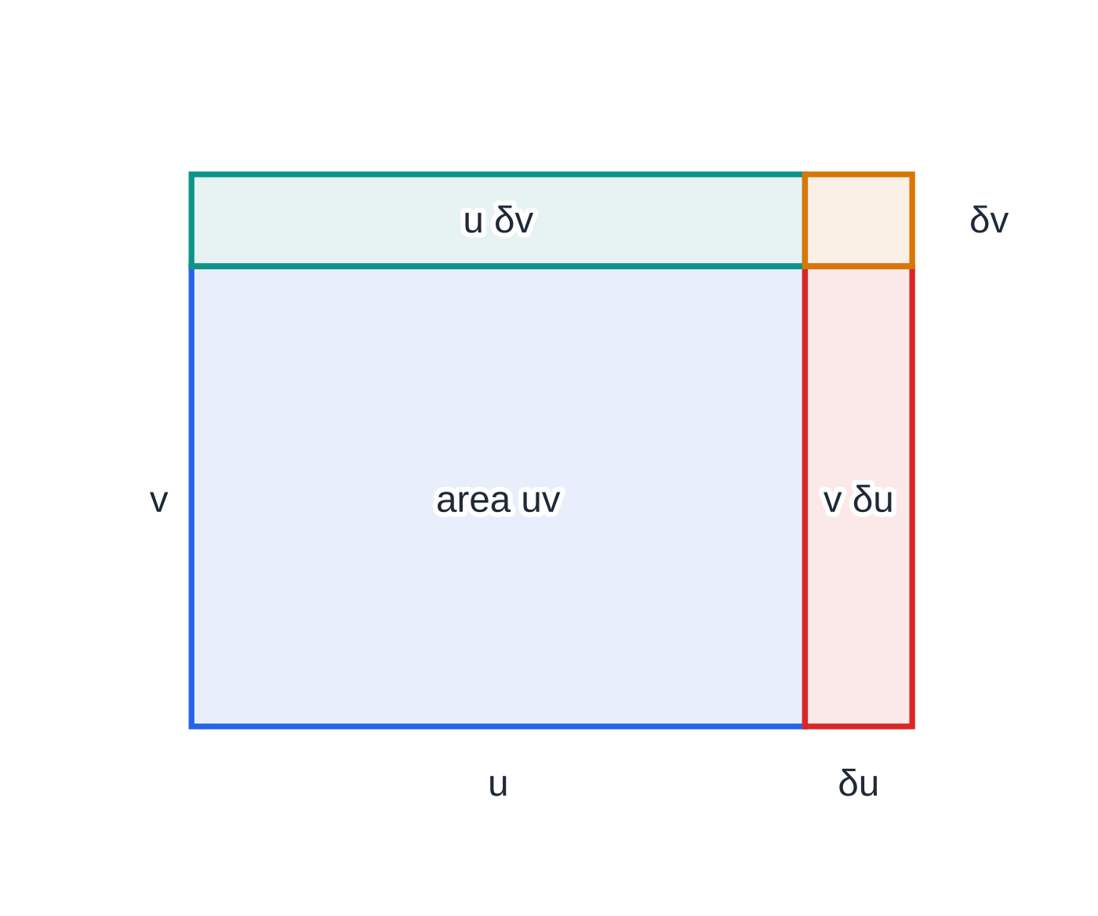
How do you differentiate a product?
Section 3 of 13
When y is a product of two functions of x, y = uv, its derivative is not u′v′. Think of uv as the area of a rectangle with sides u and v. When x changes a little, both sides grow, and the area gains two strips, one of area v δu and one of area u δv (the tiny corner is negligible). Dividing by δx gives the product rule: each factor's change contributes while the other is held fixed.
The product rule.
y = uv ⇒ dy/dx = vdu/dx + udv/dx It can also be written f(x)g(x) →f′(x)g(x) + f(x)g′(x); the order of the two terms does not matter. In the formulae booklet, but know it well enough not to look it up.
Why the product rule has two terms: when u and v both grow, the area uv gains a strip v δu and a strip u δv. The small corner δu δv becomes negligible, so δ(uv) ≈ v δu + u δv.
Notes:
How do you differentiate a product?. Full notes: https://examinerprep.com/notes/edexcel-ial-maths/differentiation-chain-product-and-quotient-rules/

Slide 14
How do you differentiate a product? (continued)
Section 3 of 13
Set the work out by writing u, v, u′ and v′ on one line, then assemble. It keeps the chain-rule parts (for example in v = e³ˣ) separate from the product rule. Products of an exponential with anything have a common factor e^(…): take it out, because you will need the factorised form to find stationary points, and e^(…) is never zero.
Notes:
How do you differentiate a product?. Full notes: https://examinerprep.com/notes/edexcel-ial-maths/differentiation-chain-product-and-quotient-rules/

Slide 15
How do you differentiate a product? (continued)
Section 3 of 13 · Worked example 3 · Medium · Show that, find, determine
WORKED EXAMPLE · QUESTION
The curve C has equation y = (x² - 3)eˣ. (a) Show that dy/dx = (x + 3)(x - 1)eˣ. (b) Find the exact coordinates of the stationary points of C. (c) Use d²y/dx² to determine the nature of each stationary point.
SOLUTION
(a) u = x² - 3, v = eˣ, u′ = 2x, v′ = eˣ. dy/dx = 2xeˣ + (x² - 3)eˣ = eˣ(x² + 2x - 3) = (x + 3)(x - 1)eˣ, as required.
(b) eˣ > 0 for all x, so dy/dx = 0 only when x = -3 or x = 1. At x = 1: y = (1 - 3)e = -2e. At x = -3: y = (9 - 3)e⁻³ = 6e⁻³. (1, -2e) and (-3, 6e⁻³).
(c) Differentiate eˣ(x² + 2x - 3) with the product rule again: d²y/dx² = eˣ(x² + 2x - 3) + eˣ(2x + 2) = eˣ(x² + 4x - 1). At x = 1: 4e > 0, so minimum. At x = -3: e⁻³(9 - 12 - 1) = -4e⁻³ < 0, so maximum.
Notes:
How do you differentiate a product?: Worked example 3. Full notes: https://examinerprep.com/notes/edexcel-ial-maths/differentiation-chain-product-and-quotient-rules/

Slide 16
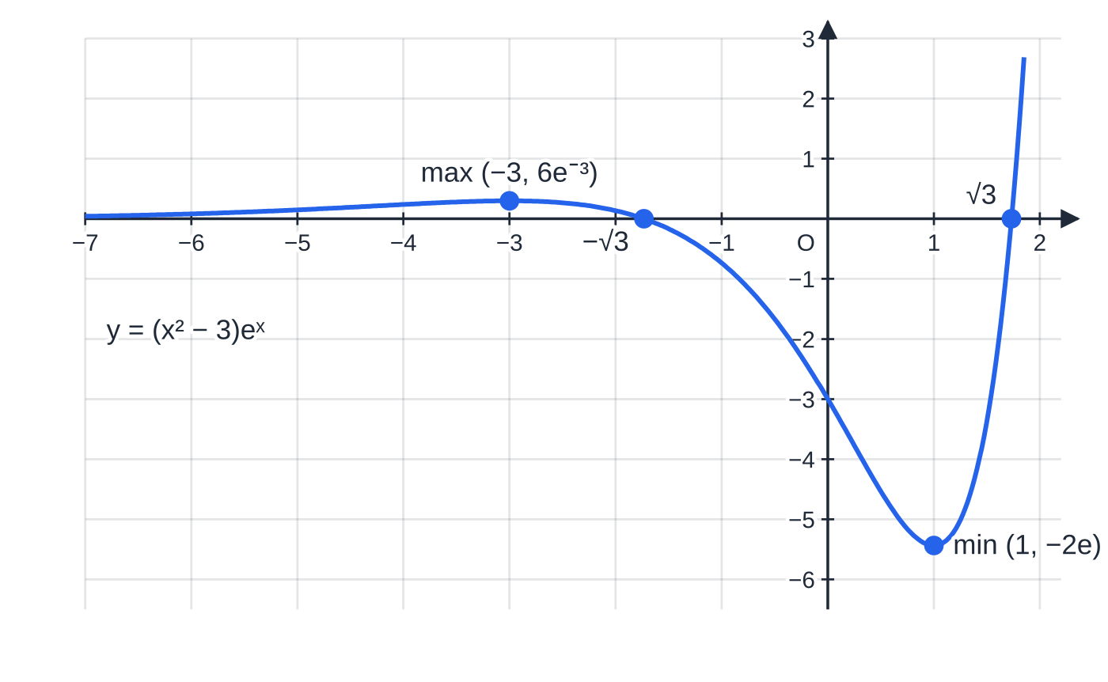
How do you differentiate a product? (continued)
Section 3 of 13
Exam tip — say why you cancel
Writing "eˣ > 0, so …" (or "eˣ ≠0") before you cancel it is part of a complete solution. Without it, a reader cannot tell whether you have lost a solution by dividing.
y = (x² − 3)eˣ (Worked example 3). The maximum at (−3, 6e⁻³) is only 0.299 above the x-axis, and to its left the curve approaches the axis because eˣ → 0 faster than x² grows.
Notes:
How do you differentiate a product?. Full notes: https://examinerprep.com/notes/edexcel-ial-maths/differentiation-chain-product-and-quotient-rules/

Slide 17
How do you differentiate a quotient?
Section 4 of 13
For y = u/v, use the quotient rule. The numerator is a difference, so the order matters: v times u′ comes first. You can always rewrite u/v as uv⁻¹ and use the product and chain rules instead; the result is the same, though usually less tidy. Simplify the numerator fully, and leave the denominator as v²: a fraction is zero only when its numerator is zero.
The quotient rule.
y = u/v ⇒ dy/dx = (vdu/dx - udv/dx)/v² Booklet form: f(x)/g(x) →(f′(x)g(x) - f(x)g′(x))/(g(x))². It is in the formulae booklet; watch the minus sign and the order. Example: tan x = sin x/cos x gives (cos xcos x - sin x(-sin x))/(cos² x) = 1/(cos² x) = sec² x.
Notes:
How do you differentiate a quotient?. Full notes: https://examinerprep.com/notes/edexcel-ial-maths/differentiation-chain-product-and-quotient-rules/

Slide 18
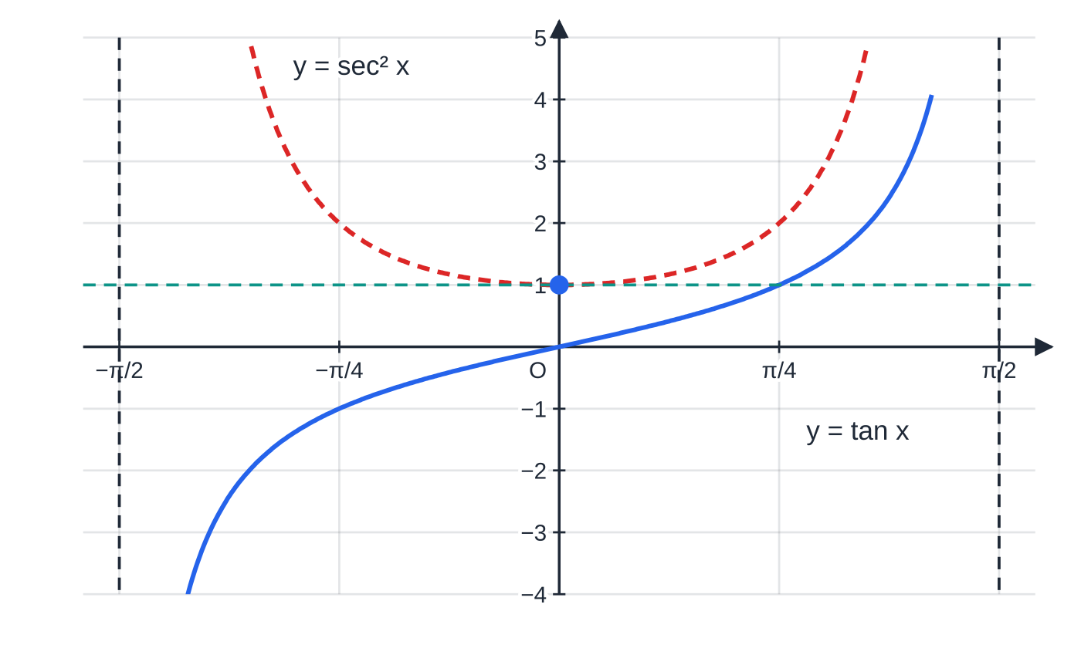
How do you differentiate a quotient? (continued)
Section 4 of 13
y = tan x (solid) and its derivative sec² x (dashed). Since sec² x ≥ 1, tan x is always increasing, and its gradient is least (exactly 1) at the origin.
Notes:
How do you differentiate a quotient?. Full notes: https://examinerprep.com/notes/edexcel-ial-maths/differentiation-chain-product-and-quotient-rules/

Slide 19
How do you differentiate a quotient? (continued)
Section 4 of 13 · Worked example 4 · Medium · Show that, find
WORKED EXAMPLE · QUESTION
The curve C has equation y = ln x/x, x > 0. (a) Show that dy/dx = (1 - ln x)/x². (b) Find the exact coordinates of the stationary point of C. (c) Find an equation of the tangent to C at the point where C crosses the x-axis.
SOLUTION
(a) u = ln x, v = x, u′ = 1/x, v′ = 1. dy/dx = (x ×1/x - ln x ×1)/x² = (1 - ln x)/x², as required.
(b) Numerator zero: ln x = 1 ⇒x = e, y = ln e/e = 1/e. (e, 1/e).
(c) C meets the x-axis where ln x = 0, at (1, 0); the gradient there is (1 - 0)/1 = 1. y - 0 = 1(x - 1) ⇒ y = x - 1.
Notes:
How do you differentiate a quotient?: Worked example 4. Full notes: https://examinerprep.com/notes/edexcel-ial-maths/differentiation-chain-product-and-quotient-rules/

Slide 20
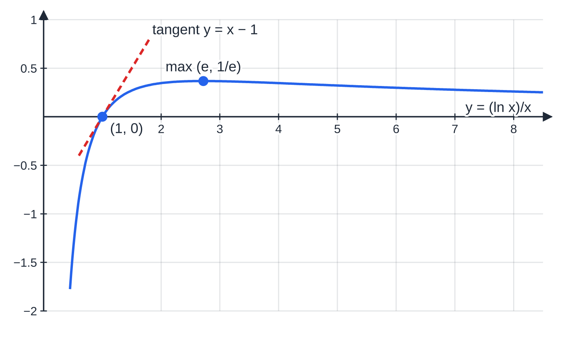
How do you differentiate a quotient? (continued)
Section 4 of 13
y = (ln x)/x (Worked example 4). The numerator of dy/dx, 1 − ln x, is positive for x < e and negative for x > e, so the curve rises to a maximum at x = e and then falls. The tangent at (1, 0) has gradient 1.
Notes:
How do you differentiate a quotient?. Full notes: https://examinerprep.com/notes/edexcel-ial-maths/differentiation-chain-product-and-quotient-rules/

Slide 21
How do you differentiate sec, cosec and cot?
Section 5 of 13
Write each one as a reciprocal or a quotient of sin and cos, then use the chain or quotient rule. You may be asked to prove these results, so learn the method as well as the answers. The three results share a pattern: the "co-" functions (cosec and cot) carry a minus sign, just as cos does. For a multiple angle the chain rule adds the factor k: d/dx(sec kx) = ksec kxtan kx.
Derivatives of the reciprocal trigonometric functions
(x in radians). sec x →sec xtan x cosecx →-cosecxcot x cot x →-cosec² x These results are in the formulae booklet; the proofs are not, so learn them.
Notes:
How do you differentiate sec, cosec and cot?. Full notes: https://examinerprep.com/notes/edexcel-ial-maths/differentiation-chain-product-and-quotient-rules/

Slide 22
How do you differentiate sec, cosec and cot? (continued)
Section 5 of 13 · Worked example 5 · Medium · Show that, differentiate
WORKED EXAMPLE · QUESTION
(a) Given that sec x = 1/cos x, show that d/dx(sec x) = sec xtan x. (b) Differentiate (i) cot 4x (ii) x²cosecx.
SOLUTION
(a) Write sec x = (cos x)⁻¹ and use the chain rule: -1 ×(cos x)⁻² ×(-sin x) = sin x/(cos² x) = 1/cos x×sin x/cos x = sec xtan x, as required.
(b)(i) cot u →-cosec² u, times du/dx = 4: -4cosec² 4x.
(b)(ii) Product rule with u = x², v = cosecx: 2xcosecx + x²(-cosecxcot x) = xcosecx(2 - xcot x).
The same method proves the cot result: cot x = cos x/sin x, so the quotient rule gives (-sin² x - cos² x)/(sin² x) = -1/(sin² x) = -cosec² x.
Notes:
How do you differentiate sec, cosec and cot?: Worked example 5. Full notes: https://examinerprep.com/notes/edexcel-ial-maths/differentiation-chain-product-and-quotient-rules/

Slide 23
How do you differentiate sec, cosec and cot? (continued)
Section 5 of 13
Common error — quoting instead of proving
In a "show that" proof, quoting the answer from the formulae booklet proves nothing. Rewrite in terms of sin and cos, differentiate with a stated rule, and simplify step by step to the given form.
Notes:
How do you differentiate sec, cosec and cot?. Full notes: https://examinerprep.com/notes/edexcel-ial-maths/differentiation-chain-product-and-quotient-rules/

Slide 24
How do you find dy/dx when x is given in terms of y?
Section 6 of 13
Some curves are easier to write with x as the subject: x = tan 2y, x = yeʸ, x = cos² y. Differentiate x with respect to y, then turn the result upside down. This works because dy/dx×dx/dy = dy/dy = 1 by the chain rule, provided dx/dy ≠0. The answer first comes out in terms of y; if the question asks for it in terms of x, use an identity to replace the y expression (for example sec² 2y = 1 + tan² 2y = 1 + x²). Where dx/dy = 0, the tangent is vertical and dy/dx is undefined.
Derivative of an inverse relationship.
dy/dx = 1/(dx/dy), valid wherever dx/dy ≠0 Not in the formulae booklet: learn it.
Notes:
How do you find dy/dx when x is given in terms of y?. Full notes: https://examinerprep.com/notes/edexcel-ial-maths/differentiation-chain-product-and-quotient-rules/

Slide 25
How do you find dy/dx when x is given in terms of y? (continued)
Section 6 of 13 · Worked example 6 · Medium · Show that, find
WORKED EXAMPLE · QUESTION
A curve has equation x = tan 2y, -π/4 < y < π/4. (a) Show that dy/dx = 1/(2(1 + x²)). (b) Find an equation of the tangent to the curve at the point where y = π/8.
SOLUTION
(a) dx/dy = 2sec² 2y = 2(1 + tan² 2y) = 2(1 + x²), so dy/dx = 1/(2(1 + x²)), as required.
(b) x = tan π/4 = 1, so the point is (1, π/8) and the gradient is 1/(2 ×2) = ¼. y - π/8 = ¼(x - 1) ⇒ y = ¼x + π/8 - ¼.
Since 1 + x² > 0, the gradient is never zero or undefined: the curve has no stationary points and no vertical tangents.
Notes:
How do you find dy/dx when x is given in terms of y?: Worked example 6. Full notes: https://examinerprep.com/notes/edexcel-ial-maths/differentiation-chain-product-and-quotient-rules/

Slide 26
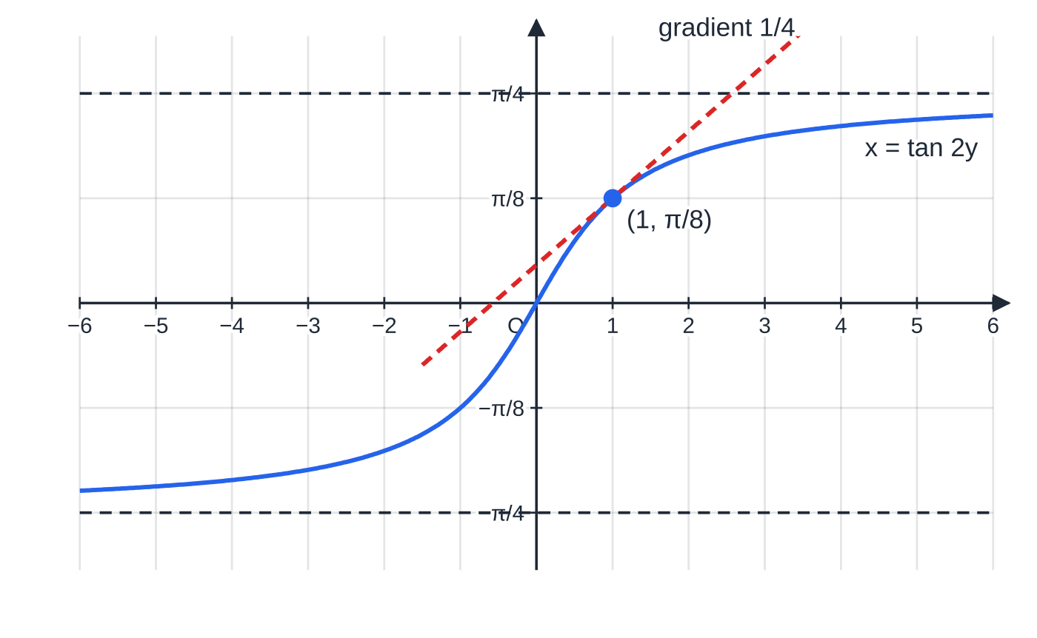
How do you find dy/dx when x is given in terms of y? (continued)
Section 6 of 13
The curve x = tan 2y, −π/4 < y < π/4, which is y = ½ arctan x. Its gradient 1/(2(1 + x²)) is ½ at the origin and falls towards 0 as the curve flattens towards y = ±π/4. The tangent at (1, π/8) has gradient 1/4.
Notes:
How do you find dy/dx when x is given in terms of y?. Full notes: https://examinerprep.com/notes/edexcel-ial-maths/differentiation-chain-product-and-quotient-rules/

Slide 27
How do you find tangents and normals with these rules?
Section 7 of 13
The method is the P1 method; only the differentiation is harder. Find the point by substituting into the curve, the gradient m by substituting into dy/dx, and use y - y₁ = m(x - x₁). For a normal, use -1/m. Questions are designed so that ln 1 = 0, e⁰ = 1, sin 0 = 0 and the exact trigonometric values appear, so evaluate them without a calculator. If an answer is asked for "in exact form", keep e, ln and π; do not round.
Notes:
How do you find tangents and normals with these rules?. Full notes: https://examinerprep.com/notes/edexcel-ial-maths/differentiation-chain-product-and-quotient-rules/

Slide 28
How do you find tangents and normals with these rules? (continued)
Section 7 of 13 · Worked example 7 · Hard · Show that, find
WORKED EXAMPLE · QUESTION
The curve C has equation y = (x + 1)ln(x - 1), x > 1. (a) Show that C passes through P(2, 0) and find dy/dx. (b) Find an equation of the tangent to C at P, and an equation of the normal to C at P in the form ax + by + c = 0, where a, b and c are integers. (c) The tangent and the normal meet the y-axis at A and B. Find the exact area of triangle APB.
SOLUTION
(a) x = 2: y = 3ln 1 = 0, so P lies on C. Product rule with u = x + 1, v = ln(x - 1); ln(x - 1) needs the chain rule, giving v′ = 1/(x - 1). dy/dx = ln(x - 1) + (x + 1)/(x - 1).
(b) Gradient at P = 0 + (3/1) = 3. Tangent: y - 0 = 3(x - 2) ⇒ y = 3x - 6. Normal gradient -⅓: y = -⅓(x - 2) ⇒3y = -x + 2 ⇒ x + 3y - 2 = 0.
(c) Put x = 0: A(0, -6) and B(0, ⅔), so AB = ⅔ + 6 = (20/3); the height from P to the y-axis is 2. Area = ½ ×(20/3) ×2 = (20/3).
Notes:
How do you find tangents and normals with these rules?: Worked example 7. Full notes: https://examinerprep.com/notes/edexcel-ial-maths/differentiation-chain-product-and-quotient-rules/

Slide 29
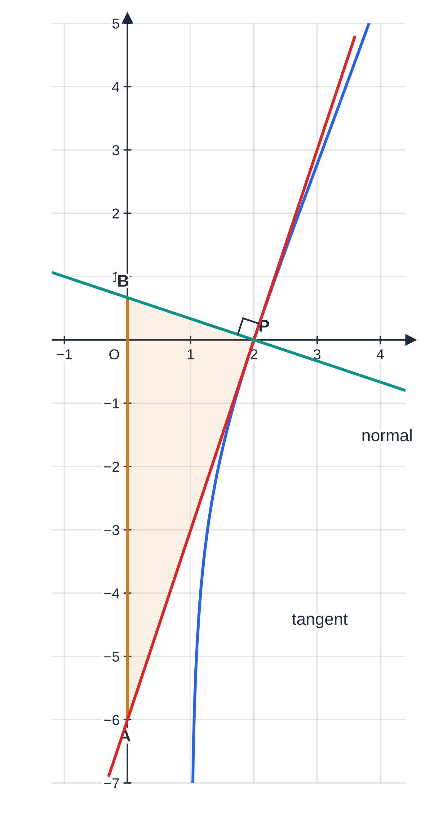
How do you find tangents and normals with these rules? (continued)
Section 7 of 13
The curve y = (x + 1) ln(x − 1), x > 1, with the tangent and normal at P(2, 0), drawn to equal scales so the right angle at P is true. They cut the y-axis at A(0, −6) and B(0, 2/3); triangle APB has area 20/3.
Notes:
How do you find tangents and normals with these rules?. Full notes: https://examinerprep.com/notes/edexcel-ial-maths/differentiation-chain-product-and-quotient-rules/

Slide 30
How do you find and classify stationary points of these curves?
Section 8 of 13
Solve dy/dx = 0. With exponentials, factor out e^(…), which is never zero. With quotients, set the numerator to zero. With trigonometric functions, use identities to get an equation in one trigonometric function, then solve in the given interval. Classify with the second derivative: d²y/dx² < 0 means a maximum, > 0 a minimum.
If d²y/dx² = 0 the test fails: it gives no information. Look at the sign of dy/dx just either side instead: + then - is a maximum, - then + a minimum, and the same sign on both sides is a stationary point of inflexion.
Notes:
How do you find and classify stationary points of these curves?. Full notes: https://examinerprep.com/notes/edexcel-ial-maths/differentiation-chain-product-and-quotient-rules/

Slide 31
How do you find and classify stationary points of these curves? (continued)
Section 8 of 13 · Worked example 8 · Hard · Show that, find, determine
WORKED EXAMPLE · QUESTION
The function f is defined by f(x) = 2sin x + sin 2x, 0 ≤x ≤2π. (a) Show that f′(x) = 2(2cos x - 1)(cos x + 1). (b) Find the exact coordinates of the stationary points of the curve y = f(x). (c) Determine the nature of each stationary point, justifying your answers. (d) Find an equation of the normal to the curve at the point where x = π/2.
SOLUTION
(a) Chain rule on sin 2x, then cos 2x = 2cos² x - 1: f′(x) = 2cos x + 2cos 2x = 2cos x + 4cos² x - 2 = 2(2cos² x + cos x - 1) = 2(2cos x - 1)(cos x + 1), as required.
(b) cos x = ½ gives x = π/3, 5π/3; cos x = -1 gives x = π. f(π/3) = 2·√3/2 + √3/2 = 3√3/2, f(π) = 0, f(5π/3) = -3√3/2. (π/3, 3√3/2), (π, 0), (5π/3, -3√3/2).
(c) f′′(x) = -2sin x - 4sin 2x. f′′(π/3) = -√3 - 2√3 = -3√3 < 0: maximum. f′′(5π/3) = √3 + 2√3 = 3√3 > 0:
Notes:
How do you find and classify stationary points of these curves?: Worked example 8. Full notes: https://examinerprep.com/notes/edexcel-ial-maths/differentiation-chain-product-and-quotient-rules/

Slide 32
How do you find and classify stationary points of these curves? (continued)
Section 8 of 13 · Worked example 8 · Hard · Show that, find, determine (continued)
minimum. f′′(π) = 0, so test the sign of f′: near x = π, 2cos x - 1 < 0 and cos x + 1 > 0 on both sides, so f′(x) < 0 on both sides: stationary point of inflexion. The factor cos x + 1 is zero at π but never negative, so it cannot change the sign of f′.
(d) f(π/2) = 2 + 0 = 2 and f′(π/2) = 0 + 2cos π= -2, so the normal gradient is ½. y - 2 = ½(x - π/2) ⇒ y = ½x + 2 - π/4.
Notes:
How do you find and classify stationary points of these curves?: Worked example 8. Full notes: https://examinerprep.com/notes/edexcel-ial-maths/differentiation-chain-product-and-quotient-rules/

Slide 33
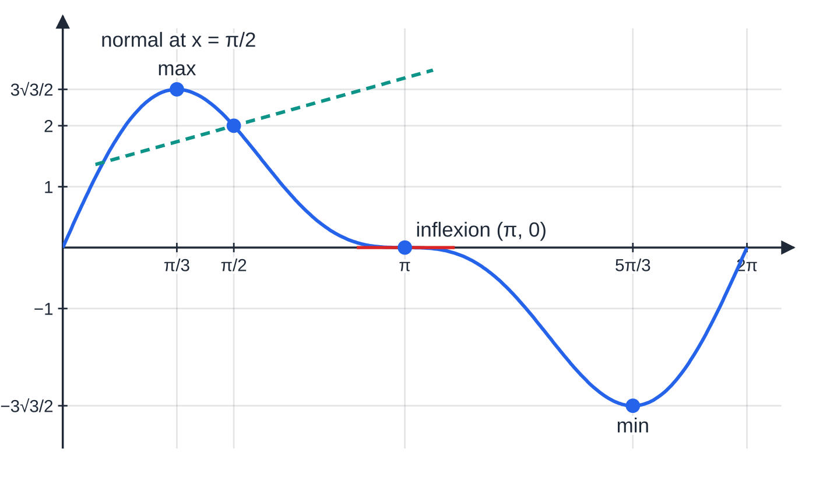
How do you find and classify stationary points of these curves? (continued)
Section 8 of 13
y = 2 sin x + sin 2x, 0 ≤ x ≤ 2π (Worked example 8). At x = π the tangent is horizontal but the curve keeps falling on both sides, so this stationary point is neither a maximum nor a minimum. The dashed line is the normal at x = π/2.
Notes:
How do you find and classify stationary points of these curves?. Full notes: https://examinerprep.com/notes/edexcel-ial-maths/differentiation-chain-product-and-quotient-rules/

Slide 34
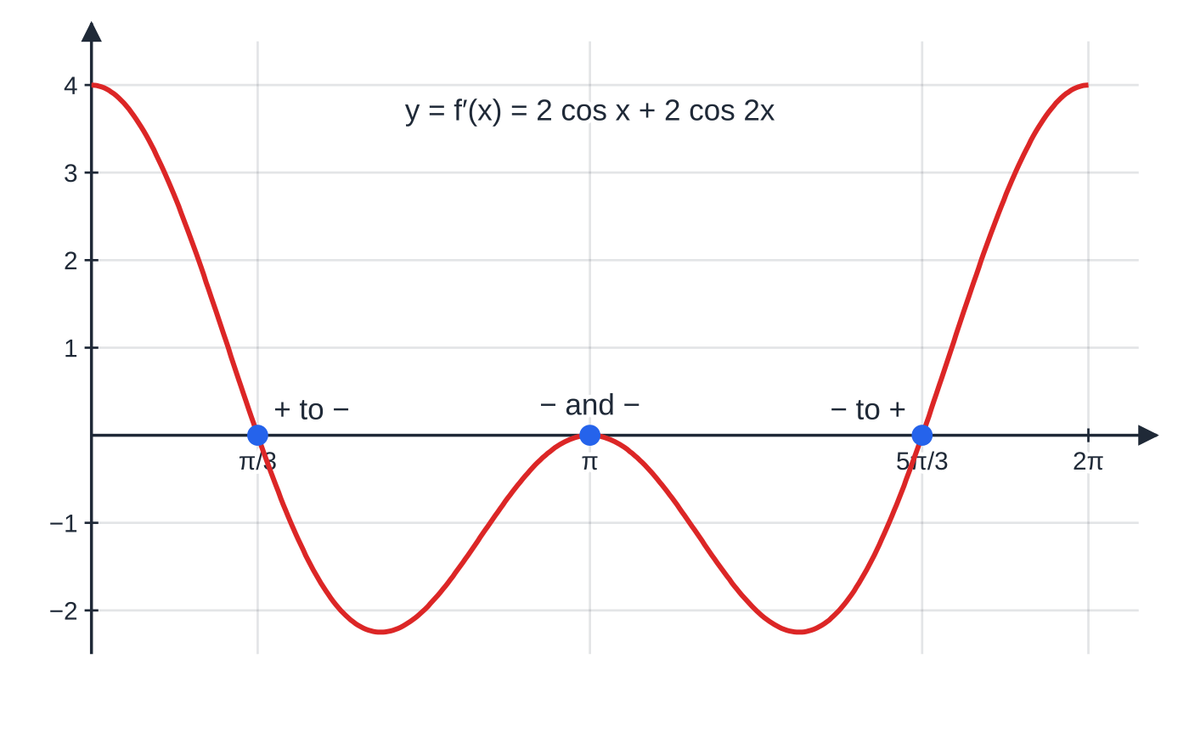
How do you find and classify stationary points of these curves? (continued)
Section 8 of 13
The derivative f′(x) for Worked example 8. It changes sign at π/3 (maximum) and 5π/3 (minimum), but only touches zero at π and stays negative on both sides, which is why (π, 0) is a stationary point of inflexion.
Notes:
How do you find and classify stationary points of these curves?. Full notes: https://examinerprep.com/notes/edexcel-ial-maths/differentiation-chain-product-and-quotient-rules/

Slide 35
Exam tips for P3.6
Section 9 of 13
Exam tip 1 — radians, always
Every derivative of a trigonometric function on this page assumes radians. If a question is set in degrees, convert to radians before differentiating, and set your calculator to radians when you evaluate a gradient.
Exam tip 2 — write u, v, u′, v′ first
For a product or quotient, list the four pieces on one line before assembling them. A correct structure such as vu′ - uv′ over v² shows your method clearly even if one of the pieces has a slip.
Exam tip 3 — factorise before you solve
Take out common factors such as eˣ, e⁻²ˣ, x² or sec x straight away. Then state which factors cannot be zero, and solve only what remains.
Notes:
Exam tips for P3.6. Full notes: https://examinerprep.com/notes/edexcel-ial-maths/differentiation-chain-product-and-quotient-rules/

Slide 36
Exam tips for P3.6 (continued)
Section 9 of 13
Exam tip 4 — a "show that" must reach the printed answer
When the result is given, every line between your first derivative and the target must be visible: the identity you used, the factor you took out, the sign you changed. Finish with the expression exactly as printed.
Exam tip 5 — read "in terms of x"
With dy/dx = 1 ÷dx/dy, your first answer is in terms of y. If the question asks for x, finish the job with an identity or the original equation.
Notes:
Exam tips for P3.6. Full notes: https://examinerprep.com/notes/edexcel-ial-maths/differentiation-chain-product-and-quotient-rules/

Slide 37
Common misconceptions
Section 10 of 13
Misconception | Why it is wrong | Correct idea
d/dx(ln 5x) = 5/x. | ln 5x = ln 5 + ln x, and ln 5 is a constant. | d/dx(ln 5x) = 1/x. Only 5ln x has derivative 5/x.
The derivative of uv is u′v′. | For x ×x = x² it would give 1 ×1 = 1 instead of 2x. | (uv)′ = u′v + uv′.
d/dx(cos x) = sin x. | cos x decreases on 0 < x < π, where sin x is positive. | d/dx(cos x) = -sin x; likewise cosec and cot have minus signs.
d/dx(sin² x) = 2sin x. | The inside function sin x has its own derivative, which the chain rule multiplies in. | 2sin xcos x (= sin 2x).
The quotient rule numerator can be written in either order. | It is a subtraction: swapping the terms changes the sign of the answer. | (vu′ - uv′)/v², with the bottom function times the derivative of the top first.
Notes:
Common misconceptions. Full notes: https://examinerprep.com/notes/edexcel-ial-maths/differentiation-chain-product-and-quotient-rules/

Slide 38
Common misconceptions (continued)
Section 10 of 13
Misconception | Why it is wrong | Correct idea
If d²y/dx² = 0 at a stationary point, it is a point of inflexion. | The test simply gives no information; y = x⁴ has d²y/dx² = 0 at its minimum. | Check the sign of dy/dx on each side.
Notes:
Common misconceptions. Full notes: https://examinerprep.com/notes/edexcel-ial-maths/differentiation-chain-product-and-quotient-rules/

Slide 39
How this topic connects
Section 11 of 13
P3.3, P3.4 and P3.5
The trigonometry topics supply the identities used to simplify derivatives (sec² = 1 + tan², cos 2x = 2cos² x - 1), and P3.5 uses d/dx(eᵏˣ) = keᵏˣ for rates of change in growth and decay models.
P3.7 Integration and P4
Integration reverses the results here, for example f′(x)/f(x) →ln|f(x)|. In P4, implicit and parametric differentiation are the chain rule applied in new settings, connected rates of change multiply derivatives exactly as the chain rule does, and integration by parts is the product rule in reverse.
Mechanics and Physics
Velocity and acceleration are derivatives with respect to time; with these rules a displacement such as s = 5e^(-0.2t)sin 3t can be differentiated as easily as a polynomial. In IAL Physics the same rules describe simple harmonic motion and exponential decay.
Notes:
How this topic connects. Full notes: https://examinerprep.com/notes/edexcel-ial-maths/differentiation-chain-product-and-quotient-rules/

Slide 40
Key formulae
Section 12 of 13
Formula | Use | In the formulae list?
d/dx(eᵏˣ) = keᵏˣ | exponentials | No — learn it
d/dx(ln kx) = 1/x | logarithms | No — learn it
d/dx(sin kx) = kcos kx; d/dx(cos kx) = -ksin kx | sine and cosine (radians) | No — learn it
d/dx(tan kx) = ksec² kx | tangent (radians) | Yes
sec x →sec xtan x; cosecx →-cosecxcot x; cot x →-cosec² x | reciprocal trigonometric functions | Yes
dy/dx = dy/du·du/dx | chain rule: composite functions | No — learn it
d/dx(uv) = u′v + uv′ | product rule | Yes
d/dx(u/v) = (u′v - uv′)/v² | quotient rule | Yes
Notes:
Key formulae. Full notes: https://examinerprep.com/notes/edexcel-ial-maths/differentiation-chain-product-and-quotient-rules/

Slide 41
Key formulae (continued)
Section 12 of 13
Formula | Use | In the formulae list?
d/dx[ln f(x)] = f′(x)/f(x); d/dx[eᶠ⁽ˣ⁾] = f′(x)eᶠ⁽ˣ⁾ | logarithm or exponential of a function | No — derive it from the chain rule
dy/dx = 1 ÷dx/dy | when x is given as a function of y | No — learn it
Notes:
Key formulae. Full notes: https://examinerprep.com/notes/edexcel-ial-maths/differentiation-chain-product-and-quotient-rules/

Slide 42
Check your understanding
Section 13 of 13
1. Why is d/dx(ln 4x) the same as d/dx(ln x)?
2. Differentiate sin² 3x.
3. Find the x-coordinate of the stationary point of y = xe⁻ˣ.
4. A curve has equation x = y² + 2y. Find the gradient at the point (3, 1).
5. Why must x be in radians for d/dx(sin x) = cos x?
6. Differentiate e²ˣ/(x² + 1) and find the x-coordinate of its stationary point.
Notes:
Check your understanding: questions. Full notes: https://examinerprep.com/notes/edexcel-ial-maths/differentiation-chain-product-and-quotient-rules/

Slide 43
Check your understanding · answers
Section 13 of 13
1. ln 4x = ln 4 + ln x. The constant ln 4 differentiates to 0, so both derivatives are 1/x. The graph of ln 4x is the graph of ln x shifted up by ln 4, which does not change gradients.
2. Outside (·)², inside sin 3x with derivative 3cos 3x: 2sin 3x ×3cos 3x = 6sin 3xcos 3x, which is 3sin 6x by the double-angle formula.
3. Product rule: dy/dx = e⁻ˣ - xe⁻ˣ = (1 - x)e⁻ˣ. Since e⁻ˣ > 0, the only stationary point is at x = 1.
4. dx/dy = 2y + 2 = 4 at y = 1, so dy/dx = ¼. (Check: 1 + 2 = 3, so (3, 1) is on the curve.)
5. The result depends on sin h/h →1 as h →0, which is true only when h is measured in radians. In degrees the derivative of sin x° is π/180cos x°.
6. Quotient rule: (2e²ˣ(x² + 1) - e²ˣ·2x)/((x² + 1)²) = (2e²ˣ(x² - x + 1))/((x² + 1)²). The discriminant of x² - x + 1 is 1 - 4 = -3 < 0, so it is never zero, and e²ˣ > 0: there is no stationary point. The curve is always increasing.
Notes:
Check your understanding: answers. Full notes: https://examinerprep.com/notes/edexcel-ial-maths/differentiation-chain-product-and-quotient-rules/

Slide 44
Practice questions
1 original exam-style questions. Answers at the end of the deck.

Slide 45
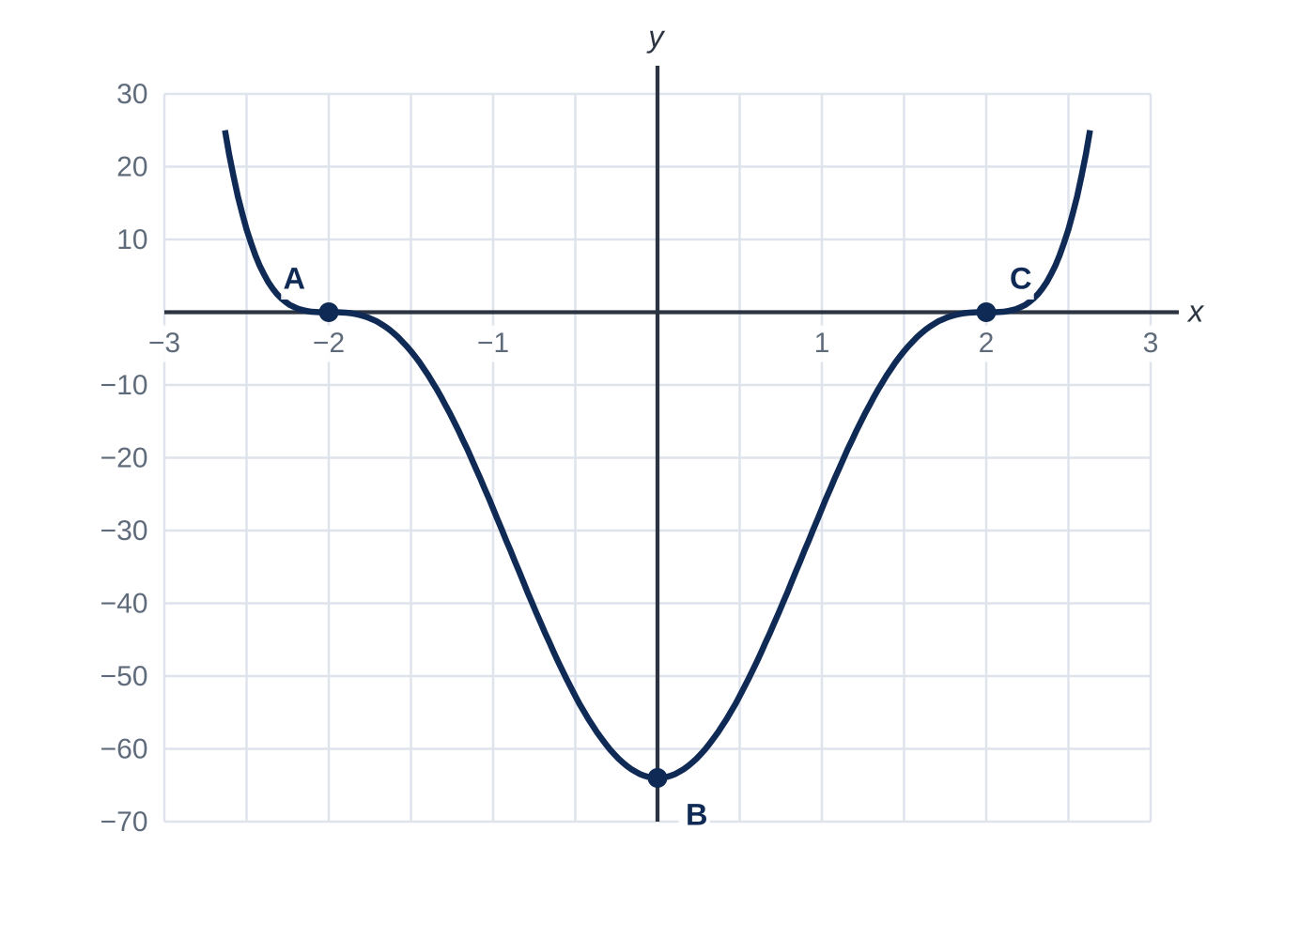
Question 1
7 marks
Figure 1 shows part of the curve with equation y = (x² − 4)³. The points A, B and C on the curve are its three stationary points.
(a) Use the chain rule to find dy/dx. [2]
(b) Find the coordinates of A, B and C. [3]
(c) By considering the sign of dy/dx on each side of x = 2, show that C is not a turning point. [2]
Notes:
Online with the full mark scheme: https://examinerprep.com/ial-maths-p3-6-differentiation-chain-product-and-quotient-rules-questions#IALM-P3-6-FB-03

Slide 46
Answers

Slide 47
Question 1 · answer
Mark scheme
3(x² − 4)² × 2x
dy/dx = 6x(x² − 4)²
6x(x² − 4)² = 0 ⇒ x = 0 or x = ±2
B(0, −64)
A(−2, 0) and C(2, 0)
(x² − 4)² ≥ 0, so near x = 2 the sign of dy/dx is the sign of 6x
dy/dx > 0 just to the left and just to the right of x = 2, so the gradient does not change sign: C is a stationary point of inflection, not a turning point
Notes:
Full mark scheme: https://examinerprep.com/ial-maths-p3-6-differentiation-chain-product-and-quotient-rules-questions#IALM-P3-6-FB-03

Slide 48
Keep practising
Notes for this topic
Questions on this topic
Build a printable test
ExaminerPrep is an independent tutoring service. It has been developed independently from and is not endorsed by the International Baccalaureate Organization. "International Baccalaureate", "IB" and "IB Diploma Programme" are registered trademarks of the IBO, used here for descriptive purposes only.
Pearson Edexcel and Cambridge are trademarks of their owners; ExaminerPrep is not affiliated with any exam board.

