Slide 1
EP
EDEXCEL IAL MATHS
P1.6 Differentiation
The full notes page in 13 sections · practice questions with answers · simulations
ExaminerPrep is an independent tutoring service. It has been developed independently from and is not endorsed by the International Baccalaureate Organization. "International Baccalaureate", "IB" and "IB Diploma Programme" are registered trademarks of the IBO, used here for descriptive purposes only.
Pearson Edexcel and Cambridge are trademarks of their owners; ExaminerPrep is not affiliated with any exam board.
Notes:
P1.6 Differentiation. Notes for this topic: https://examinerprep.com/notes/edexcel-ial-maths/differentiation/

Slide 2
What this page covers
Overview
The derivative as the gradient of the tangent, as the limit of chord gradients, and as a rate of change
Differentiation from first principles for simple polynomials
Differentiating xⁿ for any rational n, constant multiples and sums
Rewriting products, roots and simple fractions as sums of powers before differentiating
Second derivatives, d²y/dx² and f′′(x)
Equations of tangents and normals
Points where the gradient takes a given value
Notes:
What this page covers. Full notes: https://examinerprep.com/notes/edexcel-ial-maths/differentiation/

Slide 3
In one minute
Key points
1. The derivative dy/dx (or f′(x)) is the gradient of the tangent to the curve at a point: the limit of the gradients of chords as the second point slides towards the first.
2. First principles: f′(x)=lim_(h→0)(f(x+h)-f(x))/h.
3. Power rule: if y=axⁿ then dy/dx=anxⁿ⁻¹, for any rational n. Constants differentiate to 0; sums are differentiated term by term.
4. Prepare first: write roots as fractional powers, 1/xᵏ as x⁻ᵏ, expand brackets and split fractions.
5. The second derivative d²y/dx² is the rate of change of the gradient.
6. Tangent at (x₁, y₁): gradient m=dy/dx there. Normal: gradient -1/m. Then use y-y₁=m(x-x₁).
Notes:
In one minute. Full notes: https://examinerprep.com/notes/edexcel-ial-maths/differentiation/

Slide 4
What does a derivative measure?
Section 1 of 13
A straight line has one gradient everywhere. A curve does not: its steepness changes from point to point. So we need to say what "the gradient of a curve at a point" means.
The gradient of a curve at a point is the gradient of the tangent there: the straight line that just touches the curve at that point and has the same direction as the curve.
To find it, take a second point Q on the curve and work out the gradient of the chord PQ. As Q moves towards P, the chord turns towards the tangent, and its gradient approaches a limit. That limit is the gradient of the curve at P.
The function that gives the gradient at every x is the derivative (or gradient function). If y=f(x), the derivative is written dy/dx or f′(x).
Notes:
What does a derivative measure?. Full notes: https://examinerprep.com/notes/edexcel-ial-maths/differentiation/

Slide 5
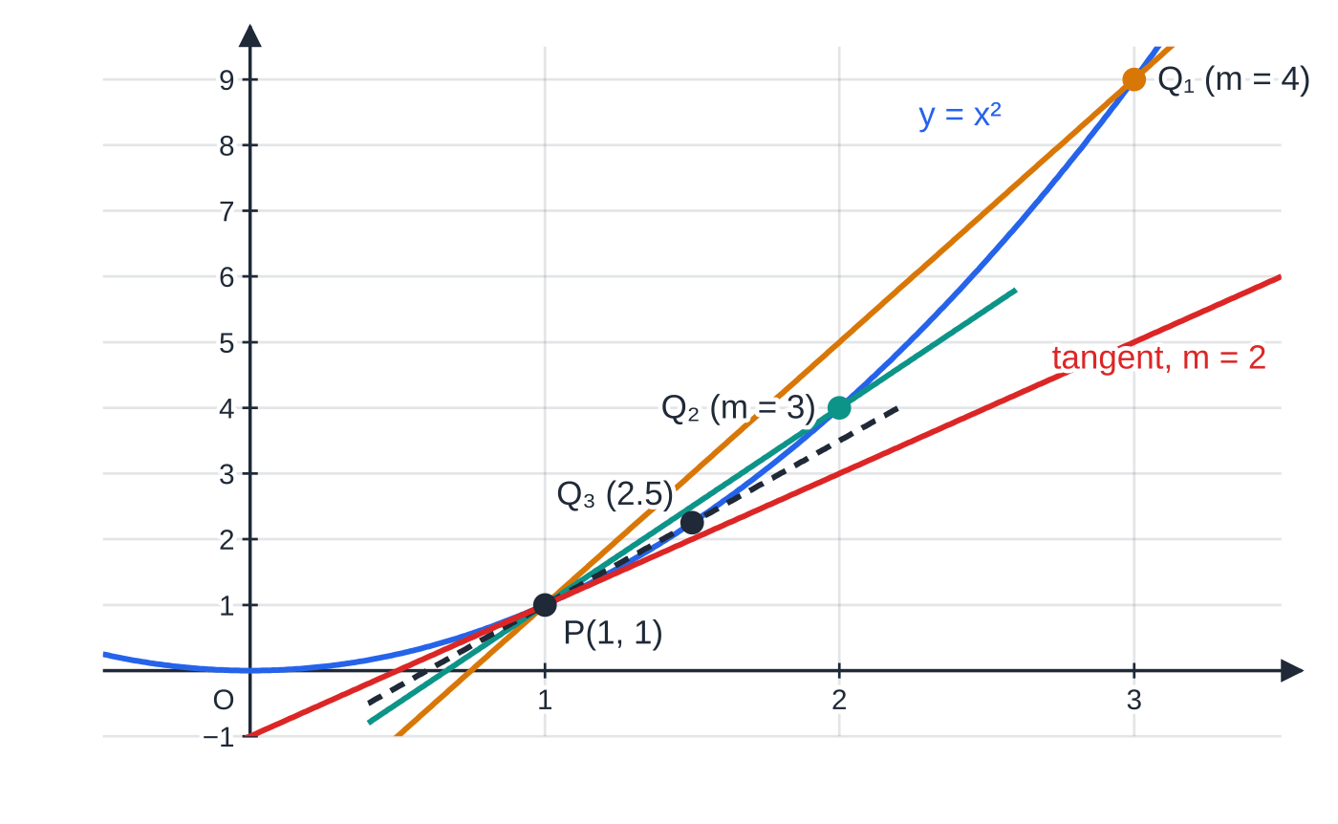
What does a derivative measure? (continued)
Section 1 of 13
Chords from P(1, 1) on y=x² to Q₁, Q₂, Q₃ at x=3, 2 and 1.5. Their gradients, 4, 3 and 2.5, approach 2, the gradient of the tangent at P.
Notes:
What does a derivative measure?. Full notes: https://examinerprep.com/notes/edexcel-ial-maths/differentiation/

Slide 6
What does a derivative measure? (continued)
Section 1 of 13
Q has x-coordinate 1+h | h | Gradient of PQ=((1+h)²-1)/h
Q₁ | 2 | 4
Q₂ | 1 | 3
Q₃ | 0.5 | 2.5
— | 0.1 | 2.10
— | 0.01 | 2.010
Algebraically, ((1+h)²-1)/h=(2h+h²)/h=2+h, which tends to 2 as h→0. The table is just this formula with numbers in. You cannot put h=0 straight into the chord gradient: it would be (0/0). You must simplify first, then let h tend to zero. That is the whole idea of the next section.
Notes:
What does a derivative measure?. Full notes: https://examinerprep.com/notes/edexcel-ial-maths/differentiation/

Slide 7
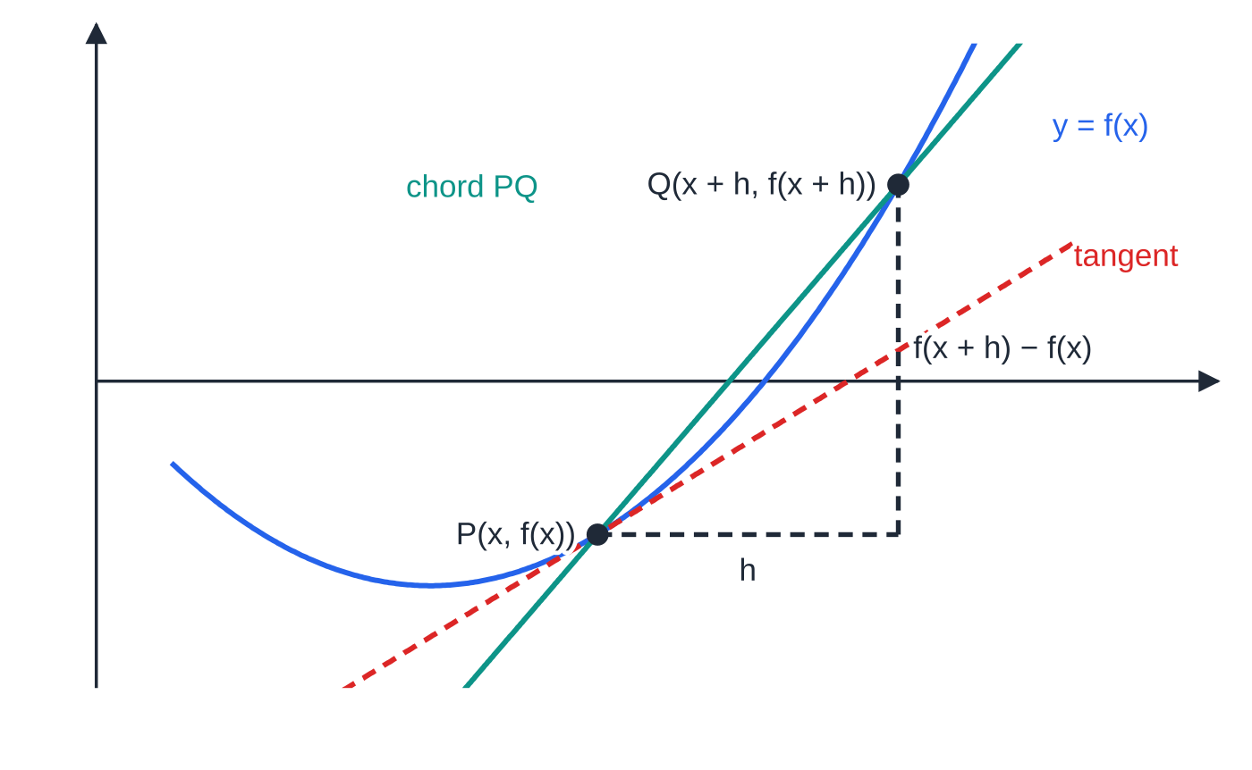
How do you differentiate from first principles?
Section 2 of 13
f′(x)=lim_(h→0)(f(x+h)-f(x))/h
Here f(x+h)-f(x) is the change in y between the two points, h is the change in x, and the fraction is the gradient of the chord. This definition is not in the formulae list: learn it, because you need to use it, not just quote it. Some books write δx for h, giving dy/dx=lim_(δx→0)δy/δx. Either notation is fine if you use it consistently.
The method for a polynomial always has the same four steps:
The chord from P to Q has run h and rise f(x+h)-f(x). As h→0, Q slides down the curve to P and the chord becomes the tangent.
Notes:
How do you differentiate from first principles?. Full notes: https://examinerprep.com/notes/edexcel-ial-maths/differentiation/

Slide 8
How do you differentiate from first principles? (continued)
Section 2 of 13
1. Substitute x+h into f and expand.
2. Subtract f(x): every term without an h cancels.
3. Divide by h: every remaining term had at least one factor of h.
4. Let h→0: terms still containing h vanish, and what is left is f′(x).
Notes:
How do you differentiate from first principles?. Full notes: https://examinerprep.com/notes/edexcel-ial-maths/differentiation/

Slide 9
How do you differentiate from first principles? (continued)
Section 2 of 13 · Worked example 1 · Medium · Prove
WORKED EXAMPLE · QUESTION
Given that f(x)=3x²-4x, prove from first principles that f′(x)=6x-4.
SOLUTION
Substitute and expand. f(x+h)=3(x+h)²-4(x+h)=3x²+6xh+3h²-4x-4h.
Subtract f(x). f(x+h)-f(x)=6xh+3h²-4h.
Divide by h (h≠0). (f(x+h)-f(x))/h=6x+3h-4.
Take the limit and conclude. f′(x)=lim_(h→0)(6x+3h-4)= 6x-4, as required
As a check, at x=2 the gradient is 6×2-4=8. The power rule in the next section gives the same answer in one line, but a "first principles" question asks for this method, not the rule.
Notes:
How do you differentiate from first principles?: Worked example 1. Full notes: https://examinerprep.com/notes/edexcel-ial-maths/differentiation/

Slide 10
How do you differentiate from first principles? (continued)
Section 2 of 13
Common error
Writing "=6x+3h-4=6x-4" with no limit. The two expressions are not equal; the second is the limit of the first. Write lim_(h→0) (or "as h→0") on the line where h disappears.
Notes:
How do you differentiate from first principles?. Full notes: https://examinerprep.com/notes/edexcel-ial-maths/differentiation/

Slide 11
How do you differentiate xⁿ when n is negative or a fraction?
Section 3 of 13
y=axⁿ ⟹ dy/dx=anxⁿ⁻¹
Here a is any constant and n is any rational number (positive, negative or a fraction): "multiply by the power, then reduce the power by one". The rule is not in the formulae list, so learn it. Also, the derivative of a constant is 0 (its graph is a horizontal line), and a sum or difference is differentiated term by term.
The rule only works on terms written as axⁿ. Use the laws of indices from P1.1 to rewrite first:
Term as given | Rewritten as axⁿ | Derivative
√x | x^½ | ½x^(-½)=1/2√x
5/x | 5x⁻¹ | -5x⁻²
3/x⁴ | 3x⁻⁴ | -12x⁻⁵
Notes:
How do you differentiate xⁿ when n is negative or a fraction?. Full notes: https://examinerprep.com/notes/edexcel-ial-maths/differentiation/

Slide 12
How do you differentiate xⁿ when n is negative or a fraction? (continued)
Section 3 of 13
Term as given | Rewritten as axⁿ | Derivative
2/√x | 2x^(-½) | -x^(-(3/2))
x√x | x^(3/2) | (3/2)x^½
∛(x²) | x^⅔ | ⅔x^(-⅓)
1/4x² | ¼x⁻² | -½x⁻³
Notes:
How do you differentiate xⁿ when n is negative or a fraction?. Full notes: https://examinerprep.com/notes/edexcel-ial-maths/differentiation/

Slide 13
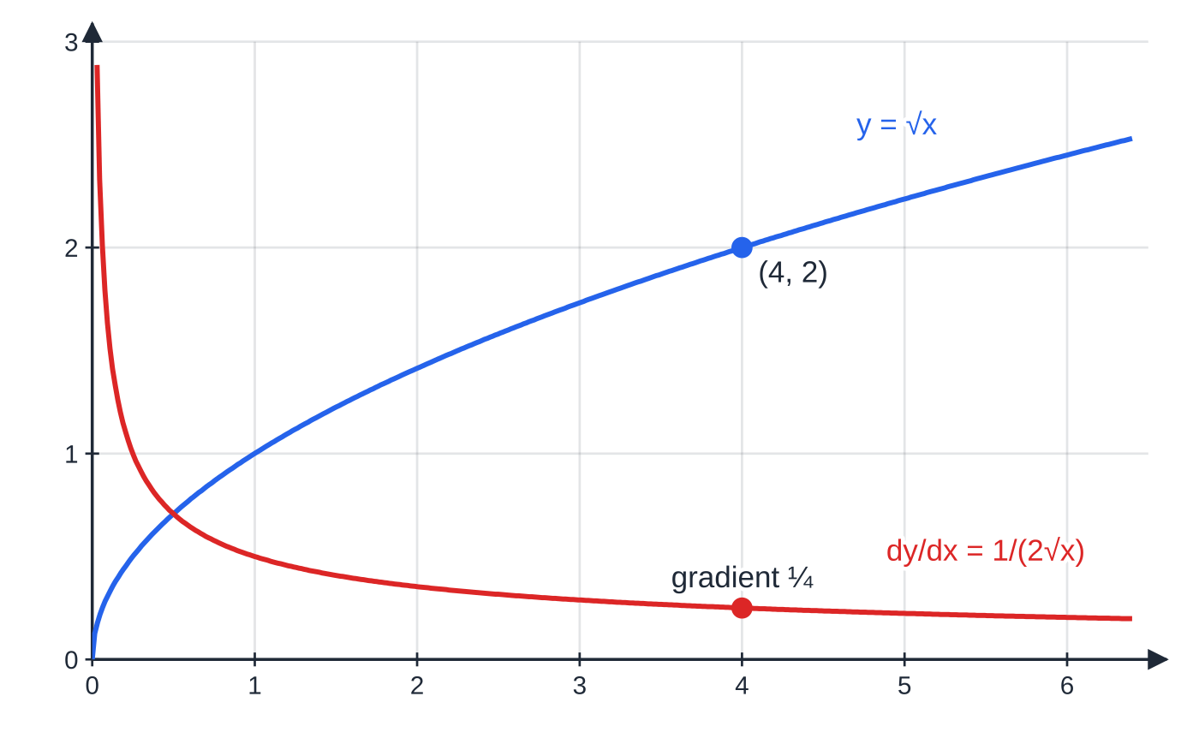
How do you differentiate xⁿ when n is negative or a fraction? (continued)
Section 3 of 13
y=√x and its gradient function 1/2√x. At x=4 the curve has gradient ¼; near x=0 the curve is almost vertical, so the gradient function grows without limit.
Notes:
How do you differentiate xⁿ when n is negative or a fraction?. Full notes: https://examinerprep.com/notes/edexcel-ial-maths/differentiation/

Slide 14
How do you differentiate xⁿ when n is negative or a fraction? (continued)
Section 3 of 13 · Worked example 2 · Medium · Find
WORKED EXAMPLE · QUESTION
Given that y=4x³-6√x+8/x²-7, x>0, (a) find dy/dx; (b) find the gradient of the curve at the point where x=4.
SOLUTION
(a) Rewrite every term as a power of x: y=4x³-6x^½+8x⁻²-7.
Differentiate term by term (the constant -7 gives 0): dy/dx=12x²-3x^(-½)-16x⁻³
(b) Substitute x=4, using 4^(-½)=½ and 4⁻³=(1/64): 12×16-3×½-16×(1/64)=192-1.5-0.25= 190.25 (=(761/4))
Notes:
How do you differentiate xⁿ when n is negative or a fraction?: Worked example 2. Full notes: https://examinerprep.com/notes/edexcel-ial-maths/differentiation/

Slide 15
How do you differentiate xⁿ when n is negative or a fraction? (continued)
Section 3 of 13
Common error
Reducing a negative power the wrong way. The power of 8x⁻² goes down by one, to -3, not up to -1. And -6x^½ becomes -6×½x^(-½)=-3x^(-½): the new power is ½-1=-½.
Notes:
How do you differentiate xⁿ when n is negative or a fraction?. Full notes: https://examinerprep.com/notes/edexcel-ial-maths/differentiation/

Slide 16
What must you do to products and fractions before differentiating?
Section 4 of 13
In P1 there is no product rule and no quotient rule (those come in P3). So a product or quotient must be turned into a sum of separate powers of x first.
Products: multiply out the brackets completely.
Fractions with a single term underneath (such as x², √x or 3x): divide every term on top by the denominator, then simplify each power with the index laws.
Never differentiate the top and bottom separately, and never differentiate the two brackets separately and multiply: the derivative of a product is not the product of the derivatives.
Notes:
What must you do to products and fractions before differentiating?. Full notes: https://examinerprep.com/notes/edexcel-ial-maths/differentiation/

Slide 17
What must you do to products and fractions before differentiating? (continued)
Section 4 of 13 · Worked example 3 · Medium · Find
WORKED EXAMPLE · QUESTION
Find dy/dx when (a) y=(2x-1)(x²+3); (b) y=(2x³+x-6)/√x, x>0, and evaluate it when x=4.
SOLUTION
(a) Expand, then differentiate: y=2x³-x²+6x-3, so dy/dx=6x²-2x+6
(b) Divide each term by x^½ (subtract ½ from each power): y=2x^(5/2)+x^½-6x^(-½).
Differentiate: dy/dx=5x^(3/2)+½x^(-½)+3x^(-(3/2)). Note that -6×(-½)=+3: the sign of the last term changes because the power is negative.
At x=4: 4^(3/2)=8, 4^(-½)=½, 4^(-(3/2))=⅛, so 5×8+½×½+3×⅛=40+0.25+0.375= 40.625 (=(325/8))
Notes:
What must you do to products and fractions before differentiating?: Worked example 3. Full notes: https://examinerprep.com/notes/edexcel-ial-maths/differentiation/

Slide 18
What must you do to products and fractions before differentiating? (continued)
Section 4 of 13
Exam tip
Many questions split this into two parts: "Write y in the form axᵖ+bx^q, where a, b, p and q are constants" and then "Hence find dy/dx". State the values of a, b, p and q clearly in the first part; the rewritten form is a step in its own right.
Notes:
What must you do to products and fractions before differentiating?. Full notes: https://examinerprep.com/notes/edexcel-ial-maths/differentiation/

Slide 19
What is the second derivative?
Section 5 of 13
The derivative dy/dx is itself a function of x, so it can be differentiated again. The result is the second derivative, written d²y/dx² or f′′(x).
It measures the rate of change of the gradient: positive where the gradient is increasing, negative where it is decreasing.
Same rules, applied twice. Simplify the first derivative before you differentiate again.
In the figures below, the gradient function f′(x) of a cubic is a parabola. Its own gradient, f′′(x)=6x-12, is zero at x=2, where the gradient of the cubic is least.
Notes:
What is the second derivative?. Full notes: https://examinerprep.com/notes/edexcel-ial-maths/differentiation/

Slide 20
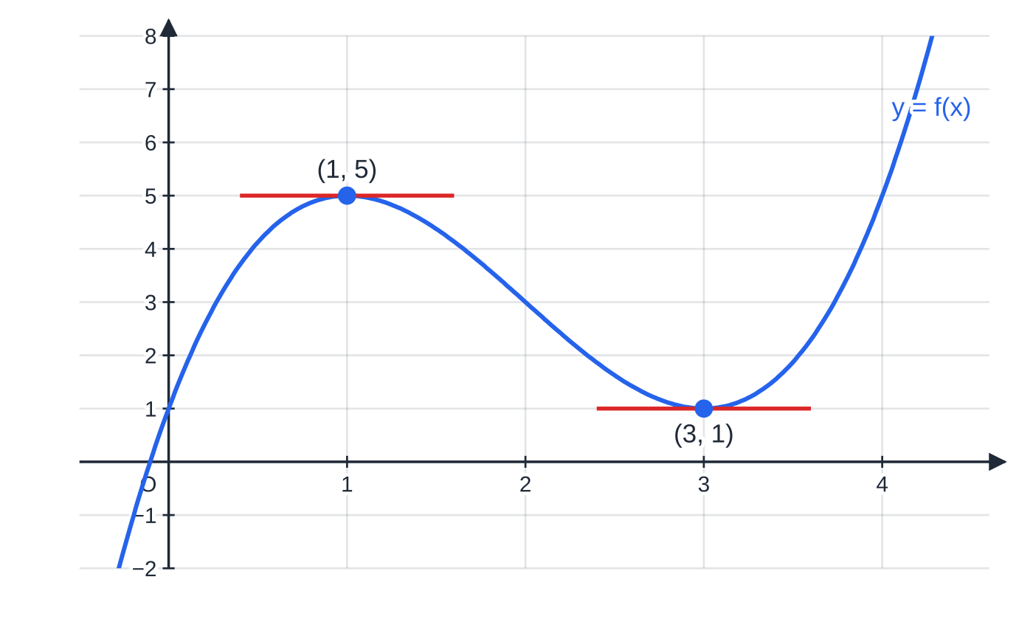
What is the second derivative? (continued)
Section 5 of 13
y=f(x)=x³-6x²+9x+1. The tangent is horizontal at (1, 5) and (3, 1).
Notes:
What is the second derivative?. Full notes: https://examinerprep.com/notes/edexcel-ial-maths/differentiation/

Slide 21
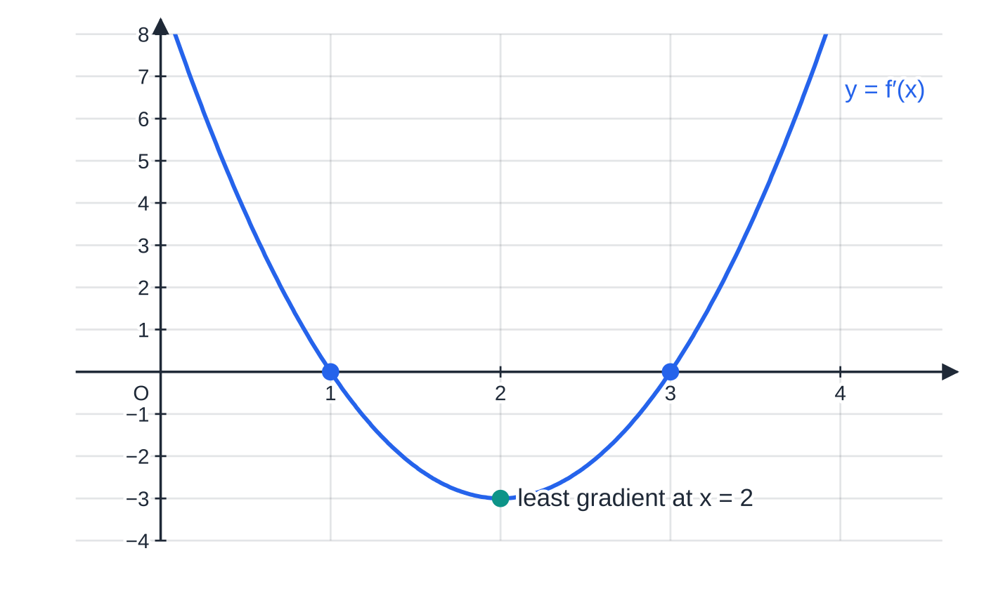
What is the second derivative? (continued)
Section 5 of 13
On the same x scale, its gradient function f′(x)=3x²-12x+9=3(x-1)(x-3). Where the tangent to f is horizontal, f′(x)=0; the gradient of f is least at x=2, where f′′(x)=0.
Notes:
What is the second derivative?. Full notes: https://examinerprep.com/notes/edexcel-ial-maths/differentiation/

Slide 22
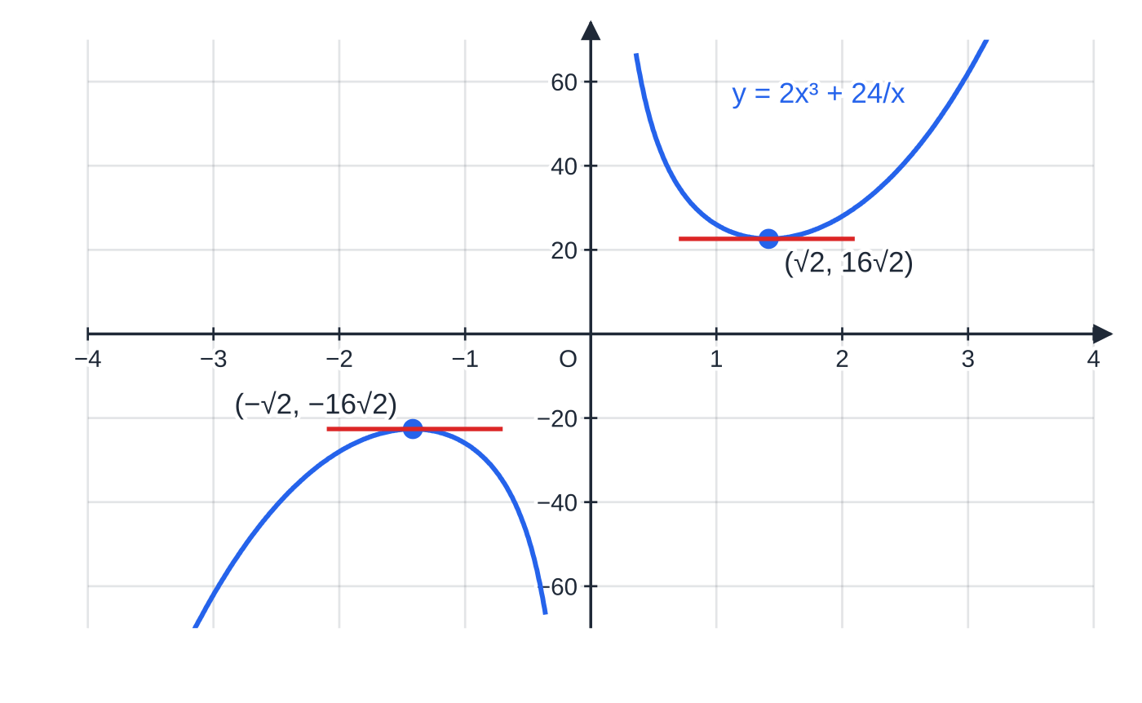
What is the second derivative? (continued)
Section 5 of 13 · Worked example 4 · Medium · Find
WORKED EXAMPLE · QUESTION
f(x)=2x³+24/x, x≠0. (a) Find f′(x) and f′′(x). (b) Find f′(2) and f′′(2). (c) Find the exact coordinates of the points on the curve y=f(x) where the gradient is zero.
SOLUTION
(a) Write 24/x as 24x⁻¹ and differentiate twice: f′(x)=6x²-24x⁻², f′′(x)=12x+48x⁻³
(b) Substitute x=2: f′(2)=24-6=18 and f′′(2)=24+6=30. f′(2)=18, f′′(2)=30
(c) Solve f′(x)=0, multiplying through by x²: 6x²=24/x²⇒x⁴=4⇒x²=2⇒x=±√2.
y=2x³+24/x has a horizontal tangent at exactly two points, (±√2, ±16√2), one on each branch.
Notes:
What is the second derivative?: Worked example 4. Full notes: https://examinerprep.com/notes/edexcel-ial-maths/differentiation/

Slide 23
What is the second derivative? (continued)
Section 5 of 13 · Worked example 4 · Medium · Find (continued)
Find y for each, using 1/√2=√2/2: f(√2)=2×2√2+24/√2=4√2+12√2=16√2. (√2, 16√2) and (-√2, -16√2)
x⁴=4 also gives x²=-2, which has no real solutions, so there are exactly two points. Deciding which is a maximum and which a minimum (using the sign of f′′) is a P2 skill.
Notes:
What is the second derivative?: Worked example 4. Full notes: https://examinerprep.com/notes/edexcel-ial-maths/differentiation/

Slide 24
How is a derivative a rate of change?
Section 6 of 13
dy/dx tells you how fast y changes as x changes. With other letters the meaning is the same: if A is an area and t is time, dA/dt is the rate of change of area with respect to time.
Units: (units of the top) per (unit of the bottom), for example m² per hour, cm³ s⁻¹, £ per item.
Sign: a positive derivative means the quantity is increasing; a negative one means it is decreasing.
The second derivative tells you whether the rate itself is going up or down: a growing quantity can be growing more slowly.
In mechanics the same idea gives velocity v=ds/dt and acceleration a=dv/dt.
Notes:
How is a derivative a rate of change?. Full notes: https://examinerprep.com/notes/edexcel-ial-maths/differentiation/

Slide 25
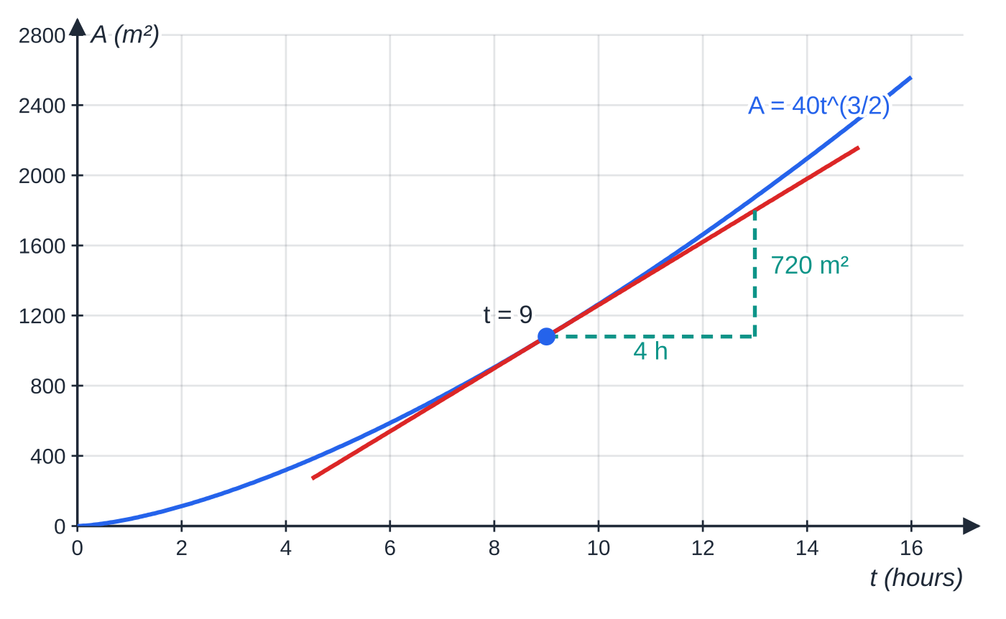
How is a derivative a rate of change? (continued)
Section 6 of 13 · Worked example 5 · Medium · Find, Explain
WORKED EXAMPLE · QUESTION
The area, A m², of an oil slick t hours after a leak starts is modelled by A=40t^(3/2), 0≤t≤16. (a) Find the rate at which the area is increasing when t=9. (b) Find the time at which the area is increasing at 120 m² per hour. (c) Find d²A/dt² and explain what its sign tells you.
SOLUTION
(a) Differentiate with respect to t: dA/dt=40×(3/2)t^½=60t^½. At t=9: 60×3= 180 m² per hour
(b) 60t^½=120⇒t^½=2⇒ t=4 hours
The area of the oil slick, A=40t^(3/2). The gradient of the tangent at t=9 is the rate at which the area is growing at that instant: 720 m² in 4 hours along the tangent, so 180 m² per hour.
Notes:
How is a derivative a rate of change?: Worked example 5. Full notes: https://examinerprep.com/notes/edexcel-ial-maths/differentiation/

Slide 26
How is a derivative a rate of change? (continued)
Section 6 of 13 · Worked example 5 · Medium · Find, Explain (continued)
(c) Differentiate again: d²A/dt²=30t^(-½)=30/√t
For t>0 this is positive, so the rate of increase of the area is itself increasing: the slick spreads faster and faster during the model's 16 hours (at t=9 the rate is rising by 10 m² per hour, every hour).
Notes:
How is a derivative a rate of change?: Worked example 5. Full notes: https://examinerprep.com/notes/edexcel-ial-maths/differentiation/

Slide 27
How is a derivative a rate of change? (continued)
Section 6 of 13
Exam tip
When a question says "find the rate of change", give units, and when it asks you to interpret a sign, write a sentence in context: "the volume of water is decreasing at 120 m³ per day", not just "it is negative".
Notes:
How is a derivative a rate of change?. Full notes: https://examinerprep.com/notes/edexcel-ial-maths/differentiation/

Slide 28
How do you find the equation of a tangent or a normal?
Section 7 of 13
The tangent at a point P on a curve is the straight line through P with the same gradient as the curve at P. The normal at P is the straight line through P perpendicular to the tangent.
Perpendicular gradients multiply to -1, so if the tangent has gradient m, the normal has gradient -1/m. The method:
1. Find the coordinates of P (if you are only given x, substitute into the equation of the curve to get y).
2. Differentiate, and substitute the x-coordinate of P to get the gradient m of the tangent.
3. For a normal, take -1/m.
4. Use y-y₁=m(x-x₁), then rearrange into the form asked for.
Special case: if the tangent is horizontal (m=0), the normal is the vertical line x=x₁.
Notes:
How do you find the equation of a tangent or a normal?. Full notes: https://examinerprep.com/notes/edexcel-ial-maths/differentiation/

Slide 29
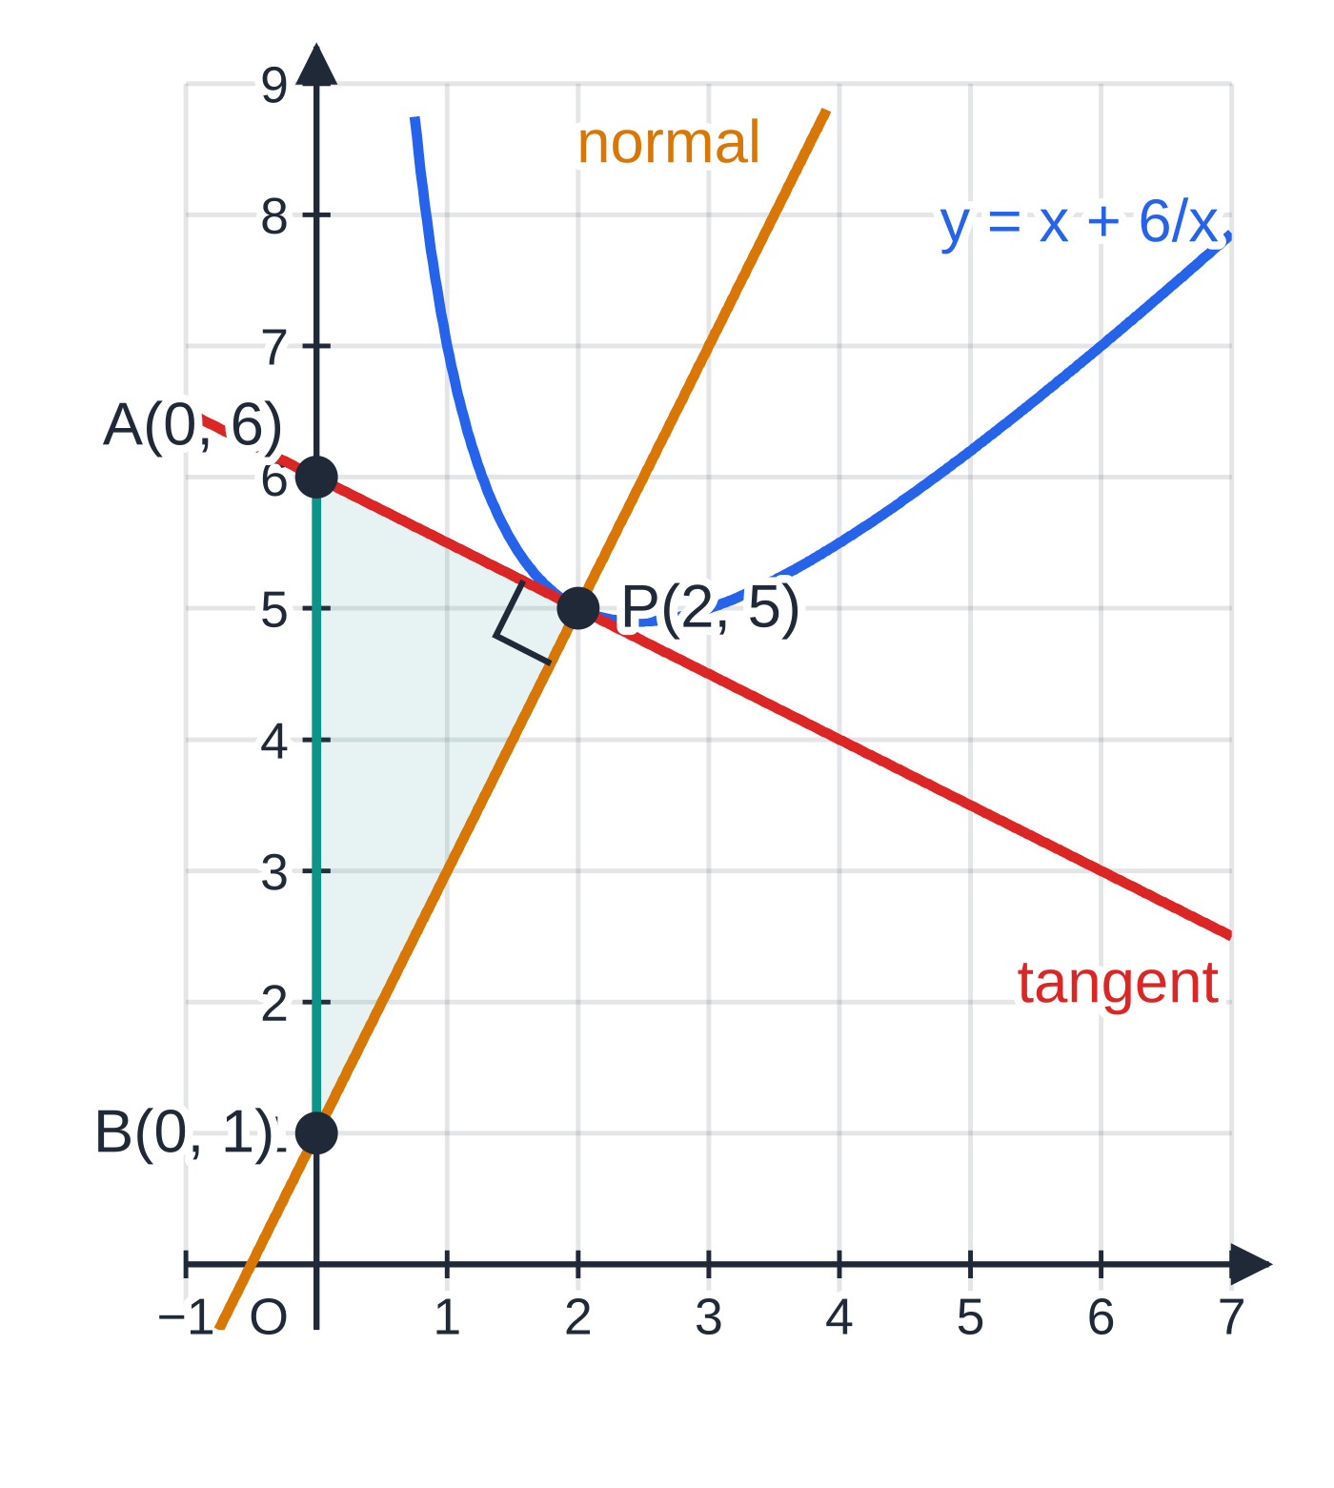
How do you find the equation of a tangent or a normal? (continued)
Section 7 of 13 · Worked example 6 · Medium · Find
WORKED EXAMPLE · QUESTION
The curve C has equation y=x+6/x, x>0. The point P on C has x-coordinate 2. (a) Find an equation of the tangent to C at P, in the form ax+by+c=0 where a, b and c are integers. (b) Find an equation of the normal to C at P. (c) The tangent and the normal meet the y-axis at A and B respectively. Find the area of triangle APB.
SOLUTION
(a) y=2+3=5, so P(2, 5). dy/dx=1-6x⁻²=1-(6/4)=-½ at x=2.
Tangent: y-5=-½(x-2), so 2y-10=-x+2, giving x+2y-12=0
(b) Normal gradient =-1÷(-½)=2: y-5=2(x-2), so y=2x+1
(c) Put x=0 in each line: A(0, 6) and B(0, 1), so AB=5; the height of the triangle from P to the y-axis is 2. Area =½×5×2= 5
The tangent and normal to y=x+6/x at P(2, 5), drawn to equal scales so the right angle at P is true. They cut the y-axis at A and B; triangle APB is shaded.
Notes:
How do you find the equation of a tangent or a normal?: Worked example 6. Full notes: https://examinerprep.com/notes/edexcel-ial-maths/differentiation/

Slide 30
How do you find the equation of a tangent or a normal? (continued)
Section 7 of 13 · Worked example 6 · Medium · Find (continued)
Using AB, which lies along the y-axis, as the base makes the height simply the x-coordinate of P.
Notes:
How do you find the equation of a tangent or a normal?: Worked example 6. Full notes: https://examinerprep.com/notes/edexcel-ial-maths/differentiation/

Slide 31
How do you find the equation of a tangent or a normal? (continued)
Section 7 of 13
Common error
Using the derivative itself as the gradient. dy/dx=1-6x⁻² is a function; the gradient of the tangent is the number you get after substituting x=2. An "equation of the tangent" containing x⁻² is not a straight line.
Notes:
How do you find the equation of a tangent or a normal?. Full notes: https://examinerprep.com/notes/edexcel-ial-maths/differentiation/

Slide 32
How do you find the points where the gradient has a given value?
Section 8 of 13
This is the previous section in reverse: you know the gradient and want the point. Set dy/dx equal to the given value and solve for x; then substitute each x into the equation of the curve to get y.
"The tangent is parallel to the line y=4x-1" means the gradient is 4. If the line is given as ax+by+c=0, rearrange it to read off its gradient -a/b.
"The normal is parallel to …" means -1÷dy/dx equals that gradient: find the tangent gradient first.
"The tangent is horizontal" or "parallel to the x-axis" means dy/dx=0.
The equation in x is often a quadratic, so expect two points, or none if the discriminant is negative.
Notes:
How do you find the points where the gradient has a given value?. Full notes: https://examinerprep.com/notes/edexcel-ial-maths/differentiation/

Slide 33
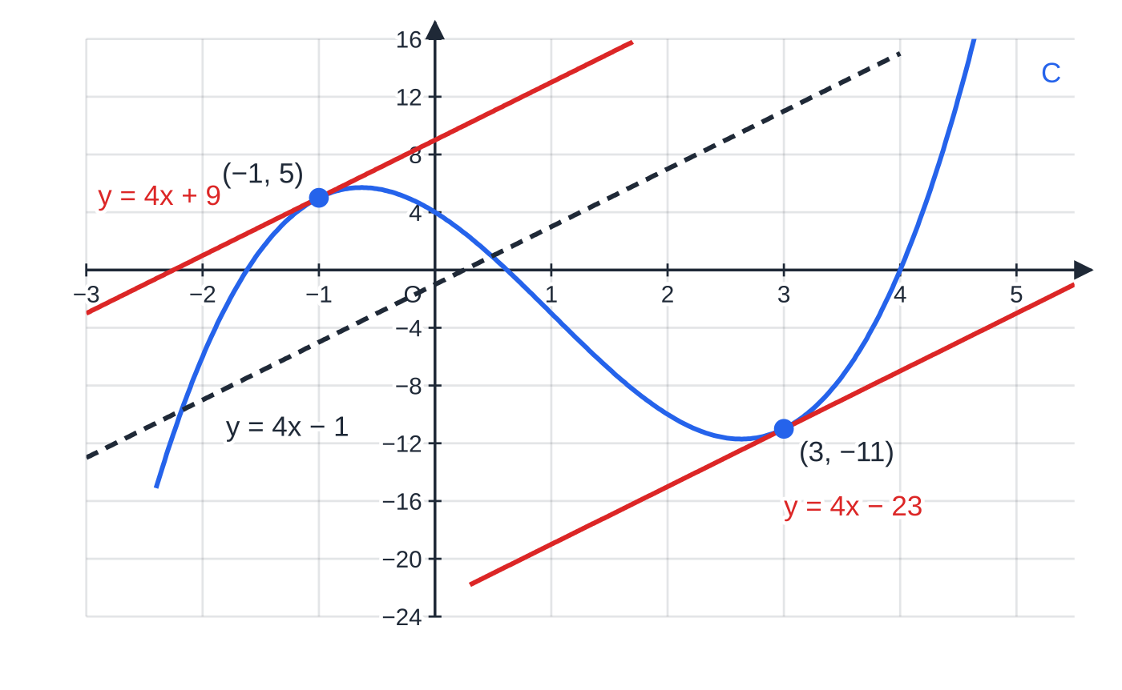
How do you find the points where the gradient has a given value? (continued)
Section 8 of 13 · Worked example 7 · Medium · Find
WORKED EXAMPLE · QUESTION
The curve C has equation y=x³-3x²-5x+4. Find the coordinates of the points on C at which the tangent is parallel to the line y=4x-1, and find the equation of each of these tangents.
SOLUTION
The gradient must equal 4: dy/dx=3x²-6x-5=4⇒3x²-6x-9=0⇒x²-2x-3=0.
Solve, then find y from the curve: (x-3)(x+1)=0, and y(3)=27-27-15+4=-11, y(-1)=-1-3+5+4=5. (3, -11) and (-1, 5)
On y=x³-3x²-5x+4 there are exactly two points where the gradient is 4. The tangents there are parallel to each other and to y=4x-1 (dashed).
Notes:
How do you find the points where the gradient has a given value?: Worked example 7. Full notes: https://examinerprep.com/notes/edexcel-ial-maths/differentiation/

Slide 34
How do you find the points where the gradient has a given value? (continued)
Section 8 of 13 · Worked example 7 · Medium · Find (continued)
Tangents with gradient 4: y+11=4(x-3)⇒y=4x-23 and y-5=4(x+1)⇒y=4x+9. y=4x-23 and y=4x+9
Notes:
How do you find the points where the gradient has a given value?: Worked example 7. Full notes: https://examinerprep.com/notes/edexcel-ial-maths/differentiation/

Slide 35
How do you find the points where the gradient has a given value? (continued)
Section 8 of 13
The last example puts the whole page together, at the length of a full P1 question.
Notes:
How do you find the points where the gradient has a given value?. Full notes: https://examinerprep.com/notes/edexcel-ial-maths/differentiation/

Slide 36
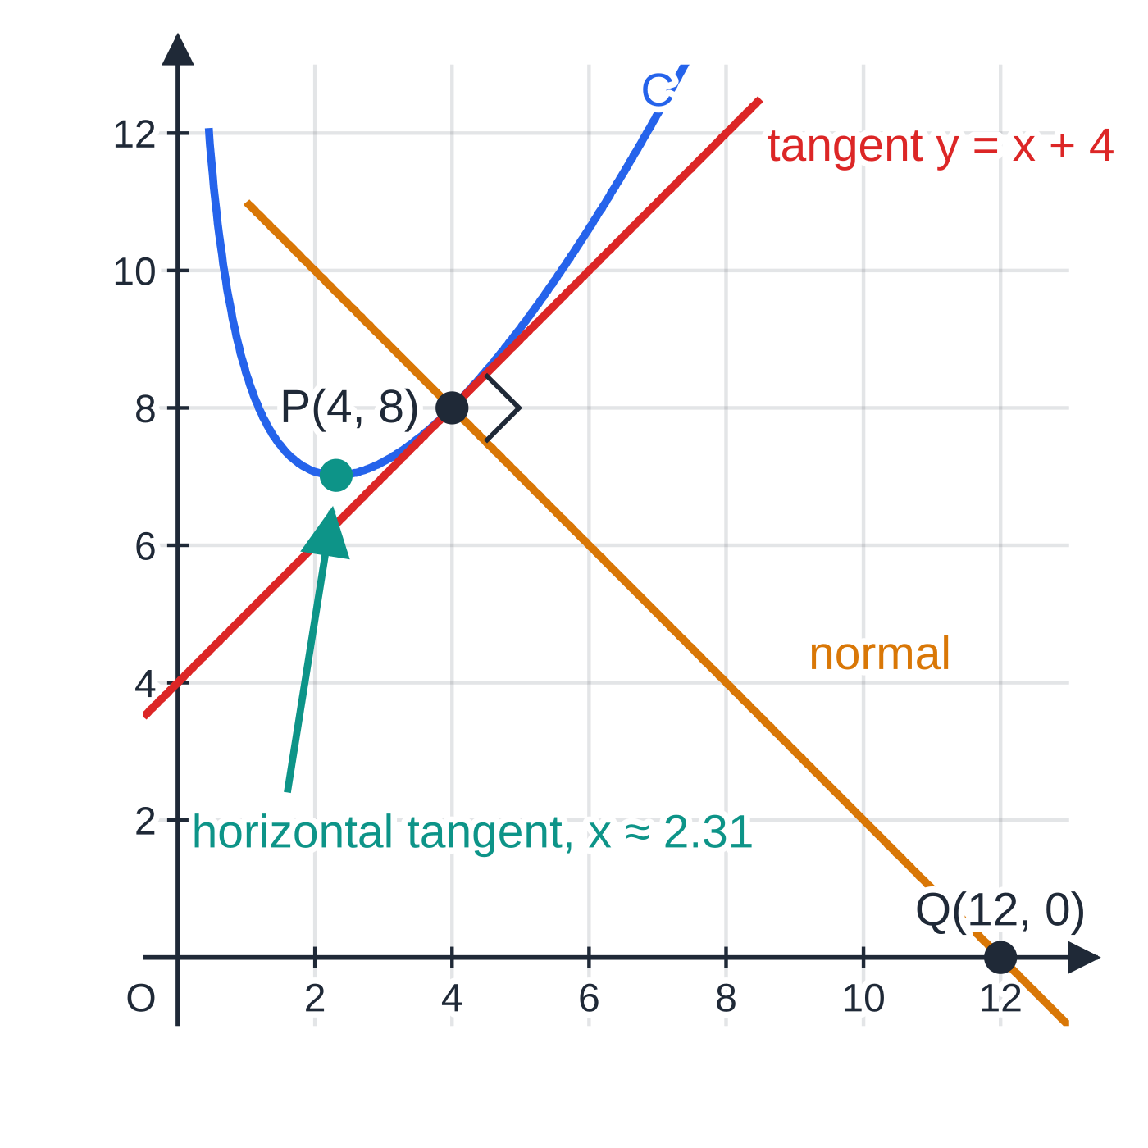
How do you find the points where the gradient has a given value? (continued)
Section 8 of 13 · Worked example 8 · Hard · Write, Hence, Show that, Find
WORKED EXAMPLE · QUESTION
The curve C has equation y=(x²+16)/2√x, x>0.
(a) Write y in the form axᵖ+bx^q, where a, b, p and q are constants.
(b) Hence find dy/dx.
(c) Show that the point P(4, 8) lies on C, and find an equation of the normal to C at P.
(d) The normal meets the x-axis at Q. Find the exact length of PQ.
(e) Find the exact x-coordinate of the point on C at which the tangent is parallel to the x-axis.
The curve in Worked example 8, drawn to equal scales: the tangent at P(4, 8) has gradient 1, so the normal there has gradient -1 and meets the x-axis at Q(12, 0). The tangent is horizontal at x=4√3/3≈2.31.
Notes:
How do you find the points where the gradient has a given value?: Worked example 8. Full notes: https://examinerprep.com/notes/edexcel-ial-maths/differentiation/

Slide 37
How do you find the points where the gradient has a given value? (continued)
Section 8 of 13 · Worked example 8 · Hard · Write, Hence, Show that, Find (continued)
SOLUTION
(a) Divide each term by 2x^½: y=x²/2x^½+16/2x^½= ½x^(3/2)+8x^(-½) (a=½, p=(3/2), b=8, q=-½)
(b) dy/dx=¾x^½-4x^(-(3/2))
(c) y=(16+16)÷(2×2)=8 ✓, so P lies on C. Gradient at x=4: ¾×2-4×⅛=1.5-0.5=1. Normal gradient =-1: y-8=-(x-4), so x+y-12=0
(d) Q has y=0, so Q(12, 0). PQ=√((12-4)²+(0-8)²)=√128= 8√2
(e) Tangent parallel to the x-axis means dy/dx=0; multiply by x^(3/2): ¾x^½=4x^(-(3/2))⇒¾x²=4⇒x²=(16/3)⇒x=4/√3= 4√3/3
x=-4√3/3 is rejected because x>0 (and √x would not be defined).
Notes:
How do you find the points where the gradient has a given value?: Worked example 8. Full notes: https://examinerprep.com/notes/edexcel-ial-maths/differentiation/

Slide 38
Exam tips for P1.6
Section 9 of 13
Exam tip 1 — rewrite before you differentiate
Your first line should show every term as axⁿ. It is a step worth showing on its own, and it is where the most costly slips (√x written as x² instead of x^½, or 1/x² as x² instead of x⁻²) become visible.
Exam tip 2 — first principles means first principles
If the question says "from first principles", show f(x+h) expanded, the subtraction, the division by h and the limit, and finish with a concluding statement. Quoting the power rule does not answer the question.
Exam tip 3 — the point comes from the curve, the gradient from the derivative
Substitute the x-coordinate into the equation of the curve for y₁, and into dy/dx for m. Mixing them up is the most common way to get a wrong tangent from correct calculus.
Notes:
Exam tips for P1.6. Full notes: https://examinerprep.com/notes/edexcel-ial-maths/differentiation/

Slide 39
Exam tips for P1.6 (continued)
Section 9 of 13
Exam tip 4 — give the form that is asked for
"ax+by+c=0 where a, b and c are integers" needs all terms on one side and no fractions. Multiply through by the denominator of the gradient at the end, and check your line passes through the point.
Exam tip 5 — use your calculator to check, not to replace working
Many scientific calculators can evaluate a derivative at a point. Use it to check a gradient you have found by hand; the algebra that produces dy/dx still has to be written out.
Notes:
Exam tips for P1.6. Full notes: https://examinerprep.com/notes/edexcel-ial-maths/differentiation/

Slide 40
Common misconceptions
Section 10 of 13
Misconception | Why it is wrong | Correct idea
The derivative of 1/x³ is 1/3x². | The power rule only applies to xⁿ; 1/x³ must first be written as x⁻³. | d/dx(x⁻³)=-3x⁻⁴=-3/x⁴.
To differentiate (x+2)(x-5), differentiate each bracket and multiply: 1×1=1. | The derivative of a product is not the product of the derivatives. | Expand to x²-3x-10, then differentiate: 2x-3.
The derivative of a constant such as 7 is 7. | The graph of y=7 is horizontal, so its gradient is 0 everywhere. | Constants differentiate to 0. A constant multiple stays: d/dx(7x)=7.
The gradient of the normal is 1/m (or -m). | Perpendicular gradients must multiply to -1; neither 1/m nor -m does in general. | Normal gradient =-1/m: take the reciprocal and change the sign.
In first principles you can put h=0 as soon as you have the fraction. | At h=0 the fraction is (0/0), which is undefined. | Cancel the factor h first; only then let h→0.
A negative derivative means the quantity is negative. | The derivative is a rate, not a value: a large positive quantity can be falling. | A negative rate of change means the quantity is decreasing.
Notes:
Common misconceptions. Full notes: https://examinerprep.com/notes/edexcel-ial-maths/differentiation/

Slide 41
How this topic connects
Section 11 of 13
P1.1 Indices, P1.2 Simultaneous equations and P1.4 Straight-line graphs
Rewriting roots and fractions uses the index laws from P1.1; tangents and normals use y-y₁=m(x-x₁) and m₁m₂=-1 from P1.4. A line that touches a curve can also be found with the discriminant method of P1.2.
P1.7 Integration and stationary points (P2); P3 and P4
Integration reverses the power rule. In P2, dy/dx=0 locates maxima and minima, the second derivative classifies them, and the sign of dy/dx tells you where a function is increasing. The chain, product and quotient rules in P3 remove the need to expand or divide first; P3 and P4 add exponentials, logarithms, trigonometric functions, and implicit and parametric differentiation.
Mechanics (M1, M2) and IAL Physics
Velocity is the rate of change of displacement and acceleration the rate of change of velocity; M2 differentiates expressions in t exactly as in the rates-of-change section. The gradient of any physics graph is the same idea as the tangent gradient here.
Notes:
How this topic connects. Full notes: https://examinerprep.com/notes/edexcel-ial-maths/differentiation/

Slide 42
Key formulae
Section 12 of 13
Formula | Use | In the formulae list?
f′(x)=lim_(h→0)(f(x+h)-f(x))/h | differentiation from first principles | No – learn it
y=axⁿ⇒dy/dx=anxⁿ⁻¹ | every derivative in P1, for rational n | No – learn it
d/dx(constant)=0; d/dx(f±g)=f′±g′ | constants and sums of terms | No – learn it
d²y/dx²=d/dx(dy/dx) | second derivative; rate of change of the gradient | No – learn it
y-y₁=m(x-x₁) | equation of a tangent or normal through (x₁, y₁) | No – learn it
mₙₒᵣₘₐₗ=-1/m_tangent | gradient of a normal | No – derive it from m₁m₂=-1
Notes:
Key formulae. Full notes: https://examinerprep.com/notes/edexcel-ial-maths/differentiation/

Slide 43
Check your understanding
Section 13 of 13
1. Differentiate y=5/2x³.
2. Find f′′(x) when f(x)=x⁴-8√x.
3. Find the gradient of the normal to y=x²-3x at the point where x=4.
4. Explain, using first principles, why the derivative of a constant function f(x)=c is zero.
5. Find the point on y=x²-6x+1 at which the gradient is 4.
6. Find the equation of the tangent to y=√x at the point where x=9.
Notes:
Check your understanding: questions. Full notes: https://examinerprep.com/notes/edexcel-ial-maths/differentiation/

Slide 44
Check your understanding · answers
Section 13 of 13
1. Write it as y=(5/2)x⁻³. Then dy/dx=(5/2)×(-3)x⁻⁴=-(15/2)x⁻⁴= -15/2x⁴.
2. f′(x)=4x³-4x^(-½), so f′′(x)=12x²+2x^(-(3/2)) (since -4×-½=+2).
3. dy/dx=2x-3=5 at x=4, so the normal has gradient -⅕.
4. f(x+h)-f(x)=c-c=0 for every h, so the chord gradient is 0/h=0 and its limit is 0. Geometrically, y=c is a horizontal line.
5. dy/dx=2x-6=4 gives x=5; then y=25-30+1=-4. The point is (5, -4).
6. y=3, so the point is (9, 3). dy/dx=½x^(-½)=½×⅓=⅙. Tangent: y-3=⅙(x-9), so y=⅙x+(3/2) (or x-6y+9=0).
Notes:
Check your understanding: answers. Full notes: https://examinerprep.com/notes/edexcel-ial-maths/differentiation/

Slide 45
Practice questions
2 original exam-style questions. Answers at the end of the deck.

Slide 46
Question 1
6 marks
A curve has equation y = 2x⁵ − 6x² + 4/x − 9, x ≠ 0.
(a) Find dy/dx. [3]
(b) Find d²y/dx². [2]
(c) Find the gradient of the curve at the point where x = −1. [1]
Notes:
Online with the full mark scheme: https://examinerprep.com/ial-maths-p1-6-differentiation-questions#IALM-P1-6-B-01

Slide 47
Question 2
6 marks
The function f is defined by f(x) = 9x^(4/3) − 16x^(−1/2), x > 0.
(a) Find f′(x). [3]
(b) Find the exact value of f′(8), giving your answer in the form a + b√2, where a and b are rational numbers. [3]
Notes:
Online with the full mark scheme: https://examinerprep.com/ial-maths-p1-6-differentiation-questions#IALM-P1-6-B-02

Slide 48
Answers

Slide 49
Question 1 · answer
Mark scheme
4/x written as 4x⁻¹
at least one power reduced by one and multiplied correctly
dy/dx = 10x⁴ − 12x − 4x⁻²
differentiates their dy/dx, at least two terms correct ft
d²y/dx² = 40x³ − 12 + 8x⁻³
10(−1)⁴ − 12(−1) − 4(−1)⁻² = 10 + 12 − 4 = 18
Notes:
Full mark scheme: https://examinerprep.com/ial-maths-p1-6-differentiation-questions#IALM-P1-6-B-01

Slide 50
Question 2 · answer
Mark scheme
one term of the form kxⁿ⁻¹
12x^(1/3)
+ 8x^(−3/2)
8^(1/3) = 2 and 8^(−3/2) = 1/(8√8) = 1/(16√2)
8 × 1/(16√2) = 1/(2√2) = √2/4, rationalising the denominator
f′(8) = 24 + ¼√2 (a = 24, b = ¼)
Notes:
Full mark scheme: https://examinerprep.com/ial-maths-p1-6-differentiation-questions#IALM-P1-6-B-02

Slide 51
Keep practising
Notes for this topic
Questions on this topic
Build a printable test
ExaminerPrep is an independent tutoring service. It has been developed independently from and is not endorsed by the International Baccalaureate Organization. "International Baccalaureate", "IB" and "IB Diploma Programme" are registered trademarks of the IBO, used here for descriptive purposes only.
Pearson Edexcel and Cambridge are trademarks of their owners; ExaminerPrep is not affiliated with any exam board.

