Slide 1
EP
EDEXCEL IAL MATHS
S1.5 Discrete random variables
The full notes page in 13 sections · practice questions with answers · simulations
ExaminerPrep is an independent tutoring service. It has been developed independently from and is not endorsed by the International Baccalaureate Organization. "International Baccalaureate", "IB" and "IB Diploma Programme" are registered trademarks of the IBO, used here for descriptive purposes only.
Pearson Edexcel and Cambridge are trademarks of their owners; ExaminerPrep is not affiliated with any exam board.
Notes:
S1.5 Discrete random variables. Notes for this topic: https://examinerprep.com/notes/edexcel-ial-maths/discrete-random-variables/

Slide 2
What this page covers
Overview
Discrete random variables and their probability distributions, given as a table, a formula p(x) or built from an experiment
Using ΣP(X=x)=1 to find an unknown constant
The cumulative distribution function F(x)=P(X≤x), and moving between F(x) and p(x)
E(X), E(X²), E(g(X)) and Var(X), with the standard deviation
E(aX+b)=aE(X)+b and Var(aX+b)=a²Var(X)
Finding unknown probabilities from conditions such as a given mean
The discrete uniform distribution: its mean and variance, and uniform distributions that do not start at 1
Notes:
What this page covers. Full notes: https://examinerprep.com/notes/edexcel-ial-maths/discrete-random-variables/

Slide 3
In one minute
Key points
1. A discrete random variable X takes separate values x with probabilities P(X=x); these probabilities are all between 0 and 1 and add to 1, and everything on this page is a sum built from that list.
2. The cumulative distribution function is F(x)=P(X≤x). For whole-number values, P(X=x)=F(x)-F(x-1).
3. Mean: E(X)=Σx P(X=x). More generally E(g(X))=Σg(x) P(X=x).
4. Variance: Var(X)=E(X²)-[E(X)]²; the standard deviation is its square root.
5. Linear change: E(aX+b)=aE(X)+b and Var(aX+b)=a²Var(X): adding a constant shifts the mean but not the spread.
6. Discrete uniform on 1,2,…,n: each value has probability 1/n, mean (n+1)/2, variance (n²-1)/12.
Notes:
In one minute. Full notes: https://examinerprep.com/notes/edexcel-ial-maths/discrete-random-variables/

Slide 4
What is a discrete random variable?
Section 1 of 13
Discrete random variable. A quantity whose value is decided by chance and which can take only separate (countable) values. Its probability distribution lists every possible value with its probability, and always satisfies 0≤P(X=x)≤1 for each x and ΣP(X=x)=1.
Capital letters name the variable (X, Y); lower-case letters name a value it can take (x, y). P(X=3) means "the probability that X takes the value 3". A distribution can be a table, a formula p(x)=P(X=x), or a vertical line diagram. Counts (heads, calls, a score on a dice) give discrete variables; measurements such as a time or a mass are continuous and are treated differently in S2.
To build a distribution from an experiment, list the equally likely outcomes (a sample-space grid or a tree), work out the value of X for each, and collect the probabilities.
Notes:
What is a discrete random variable?. Full notes: https://examinerprep.com/notes/edexcel-ial-maths/discrete-random-variables/

Slide 5
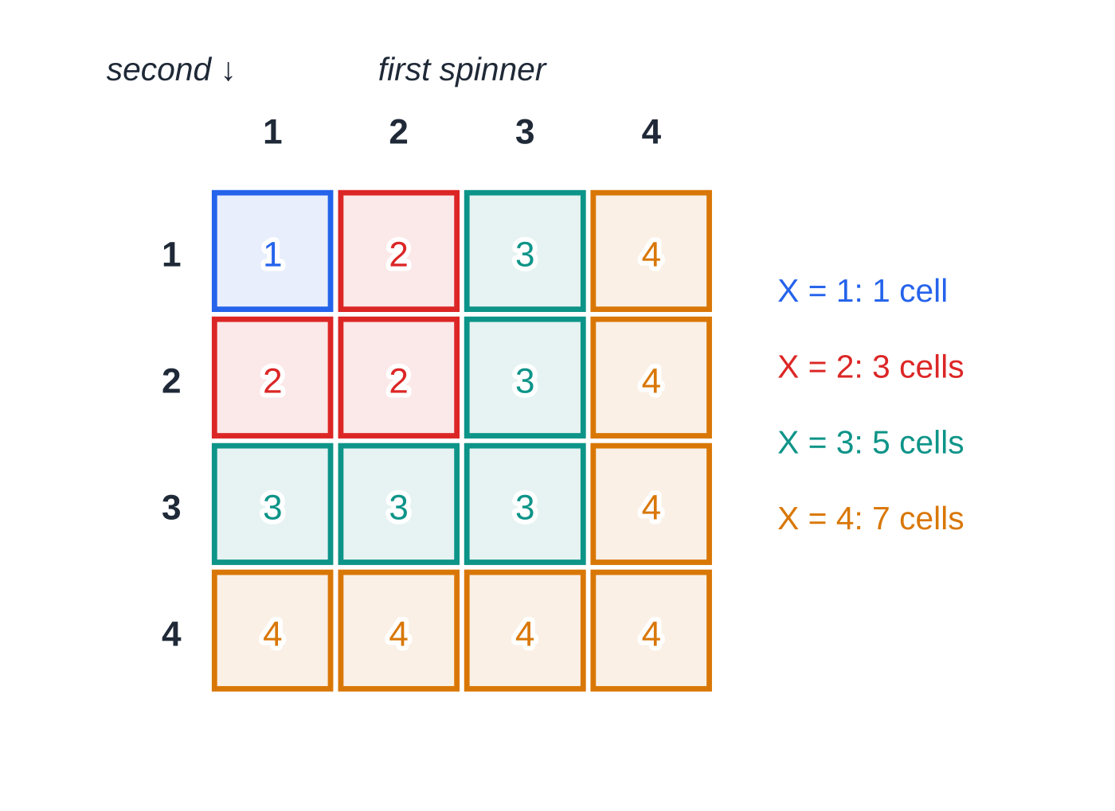
What is a discrete random variable? (continued)
Section 1 of 13 · Worked example 1 · Easy · Show that, find
WORKED EXAMPLE · QUESTION
Two fair spinners, each numbered 1, 2, 3, 4, are spun. The random variable X is the larger of the two scores (if the scores are equal, X is that score). (a) Show that P(X=3)=(5/16). (b) Find the probability distribution of X, and show that it can be written as P(X=x)=(2x-1)/16. (c) Find P(X≥3).
Two fair four-sided spinners give 16 equally likely outcomes. Colouring each cell by the larger score shows 1, 3, 5 and 7 cells for X=1,2,3,4.
Notes:
What is a discrete random variable?: Worked example 1. Full notes: https://examinerprep.com/notes/edexcel-ial-maths/discrete-random-variables/

Slide 6
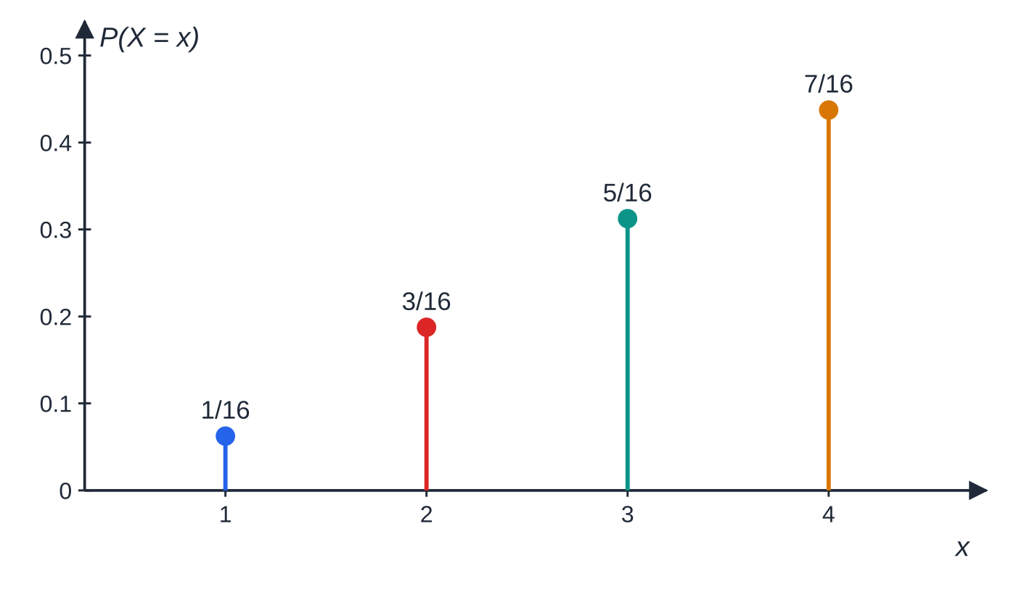
What is a discrete random variable? (continued)
Section 1 of 13 · Worked example 1 · Easy · Show that, find (continued)
SOLUTION
(a) (1, 3), (2, 3), (3, 3), (3, 2), (3, 1): 5 of the 16 equally likely outcomes, so P(X=3)=(5/16) as required.
(b) Counting cells for each value:
The distribution of X as a vertical line diagram: the heights rise by (2/16) each time and add to 1.
Notes:
What is a discrete random variable?: Worked example 1. Full notes: https://examinerprep.com/notes/edexcel-ial-maths/discrete-random-variables/

Slide 7
What is a discrete random variable? (continued)
Section 1 of 13 · Worked example 1 · Easy · Show that, find (continued)
x | 1 | 2 | 3 | 4
P(X=x) | (1/16) | (3/16) | (5/16) | (7/16)
1, 3, 5, 7 are 2x-1 for x=1,2,3,4, so P(X=x)=(2x-1)/16; check: (1+3+5+7)/16=1.
(c) P(X≥3)=(5/16)+(7/16)= ¾.
Notes:
What is a discrete random variable?: Worked example 1. Full notes: https://examinerprep.com/notes/edexcel-ial-maths/discrete-random-variables/

Slide 8
How do you work with a probability function p(x)?
Section 2 of 13
A probability function gives P(X=x) as a formula, often with an unknown constant k and sometimes in pieces for different ranges of x. Outside the listed values, p(x)=0. The method is always the same: write out every probability in terms of k first, then use Σp(x)=1 to find k.
The mode is the value with the largest probability, visible at a glance on a line diagram. Probabilities of events are sums: P(X is odd) adds the probabilities of the odd values. Conditional probability works as in S1.3: P(A|B)=P(A∩B)/P(B).
Notes:
How do you work with a probability function p(x)?. Full notes: https://examinerprep.com/notes/edexcel-ial-maths/discrete-random-variables/

Slide 9
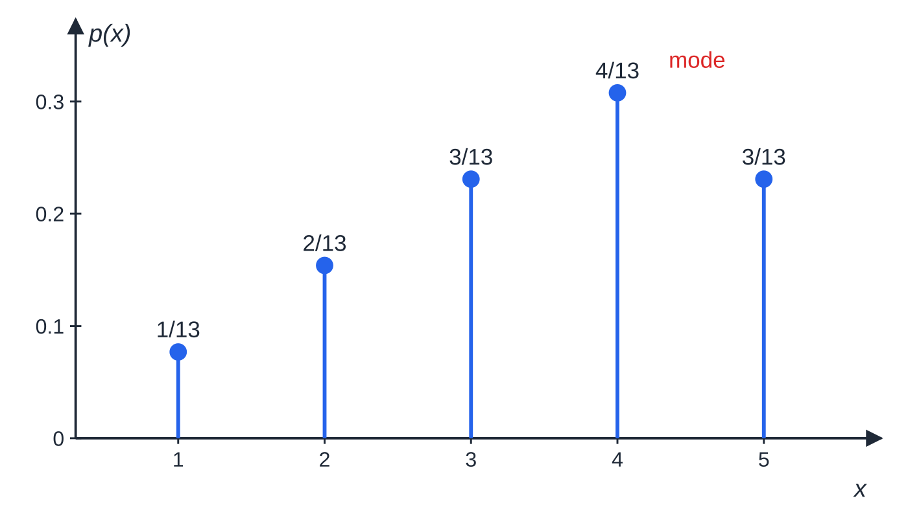
How do you work with a probability function p(x)? (continued)
Section 2 of 13 · Worked example 2 · Medium · Find
WORKED EXAMPLE · QUESTION
The discrete random variable X has probability function p(x)=kx for x=1,2,3 and p(x)=k(8-x) for x=4,5, where k is a constant; p(x)=0 otherwise. (a) Find the value of k. (b) Find P(X is odd). (c) Find P(X=4|X≥3).
SOLUTION
(a) k+2k+3k+4k+3k=13k=1⇒ k=(1/13).
(b) Odd values 1, 3, 5: (1+3+3)/13= (7/13).
(c) X=4 is inside X≥3, so the intersection is just X=4:
The distribution of Worked example 2. The heights rise in equal steps of (1/13) to the mode at x=4, then fall, and add to 1.
Notes:
How do you work with a probability function p(x)?: Worked example 2. Full notes: https://examinerprep.com/notes/edexcel-ial-maths/discrete-random-variables/

Slide 10
How do you work with a probability function p(x)? (continued)
Section 2 of 13 · Worked example 2 · Medium · Find (continued)
(P(X=4))/(P(X≥3))=(4/13)/((3+4+3)/13)=(4/10)= (2/5).
Notes:
How do you work with a probability function p(x)?: Worked example 2. Full notes: https://examinerprep.com/notes/edexcel-ial-maths/discrete-random-variables/

Slide 11
What does the cumulative distribution function F(x) tell you?
Section 3 of 13
Cumulative distribution function.
F(x₀)=P(X≤x₀)=Σ_(x≤x₀)p(x)
F is a running total of the probabilities. It never decreases and reaches 1 at the largest value of X. Plotted, it is a step graph: flat between values, jumping up at each value by exactly P(X=x). That picture gives every rule you need:
For whole-number values, P(X=x)=F(x)-F(x-1); the first probability is just F at the smallest value.
Ranges come straight from F: P(a<X≤b)=F(b)-F(a). Convert other inequalities first: P(X<4)=P(X≤3)=F(3) and P(X≥2)=1-F(1).
If F is given as a formula with a constant, use F(largest value)=1 to find it.
Notes:
What does the cumulative distribution function F(x) tell you?. Full notes: https://examinerprep.com/notes/edexcel-ial-maths/discrete-random-variables/

Slide 12
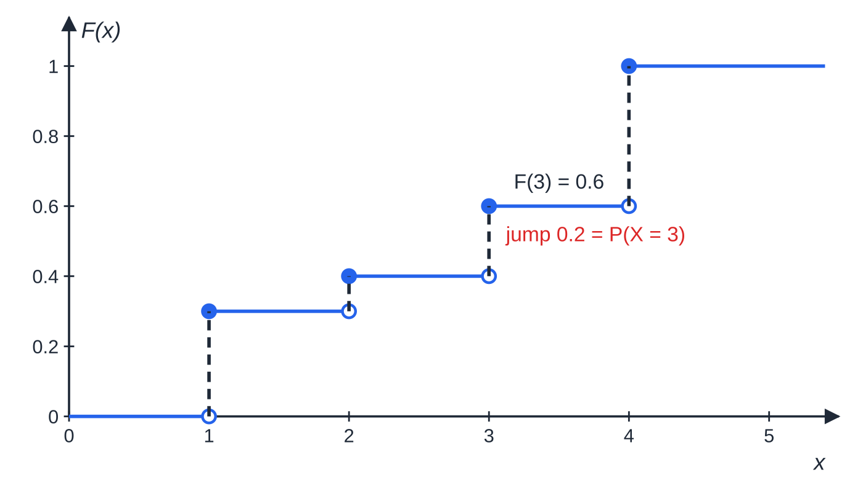
What does the cumulative distribution function F(x) tell you? (continued)
Section 3 of 13 · Worked example 3 · Medium · Find
WORKED EXAMPLE · QUESTION
The discrete random variable X takes the values 1, 2, 3, 4 and has cumulative distribution function F(x)=(2ˣ+k)/20 for x=1,2,3,4, where k is a constant. (a) Find k. (b) Find P(X=3). (c) Find the probability distribution of X. (d) Find P(1<X≤3).
SOLUTION
(a) F at the largest value is 1: F(4)=(16+k)/20=1⇒ k=4.
(b) P(X=3)=F(3)-F(2)=(12/20)-(8/20)= ⅕.
The step graph of F(x) in Worked example 3. Each filled dot is the value of F at a jump; the size of each jump is the probability of that value.
Notes:
What does the cumulative distribution function F(x) tell you?: Worked example 3. Full notes: https://examinerprep.com/notes/edexcel-ial-maths/discrete-random-variables/

Slide 13
What does the cumulative distribution function F(x) tell you? (continued)
Section 3 of 13 · Worked example 3 · Medium · Find (continued)
(c) F(1)=(6/20), F(2)=(8/20), F(3)=(12/20), F(4)=1; take differences:
x | 1 | 2 | 3 | 4
P(X=x) | 0.3 | 0.1 | 0.2 | 0.4
(d) P(1<X≤3)=F(3)-F(1)=(12/20)-(6/20)= 0.3 (check: 0.1+0.2).
Notes:
What does the cumulative distribution function F(x) tell you?: Worked example 3. Full notes: https://examinerprep.com/notes/edexcel-ial-maths/discrete-random-variables/

Slide 14
What does the cumulative distribution function F(x) tell you? (continued)
Section 3 of 13
Common error
Reading F(3) as P(X=3). F(3)=0.6 is the probability that X is at most 3; the probability that X is exactly 3 is the jump, F(3)-F(2)=0.2.
Notes:
What does the cumulative distribution function F(x) tell you?. Full notes: https://examinerprep.com/notes/edexcel-ial-maths/discrete-random-variables/

Slide 15
How do you find E(X), E(X²) and E(g(X))?
Section 4 of 13
Expectation of a discrete random variable.
E(X)=μ=Σx P(X=x), E(g(X))=Σg(x) P(X=x) summed over every value x that X can take; in particular E(X²)=Σx² P(X=x).
E(X) is a long-run average over many observations; it need not be a value X can actually take. Think of the probabilities as weights on a beam: E(X) is the balance point of the line diagram. Lay the work out in rows: x, P(X=x), xP(X=x), x²P(X=x), and add the last two rows. For any function g, apply g to each value, not to the mean: in general E(g(X))≠g(E(X)).
Notes:
How do you find E(X), E(X²) and E(g(X))?. Full notes: https://examinerprep.com/notes/edexcel-ial-maths/discrete-random-variables/

Slide 16
How do you find E(X), E(X²) and E(g(X))? (continued)
Section 4 of 13 · Worked example 4 · Medium · Find, compare
WORKED EXAMPLE · QUESTION
The random variable X has the probability distribution below. Find (a) E(X), (b) E(X²), (c) E(1/(X+2)), and compare (c) with 1/(E(X)+2).
x | −1 | 0 | 1 | 2 | 4
P(X=x) | 0.2 | 0.1 | 0.3 | 0.25 | 0.15
Notes:
How do you find E(X), E(X²) and E(g(X))?: Worked example 4. Full notes: https://examinerprep.com/notes/edexcel-ial-maths/discrete-random-variables/

Slide 17
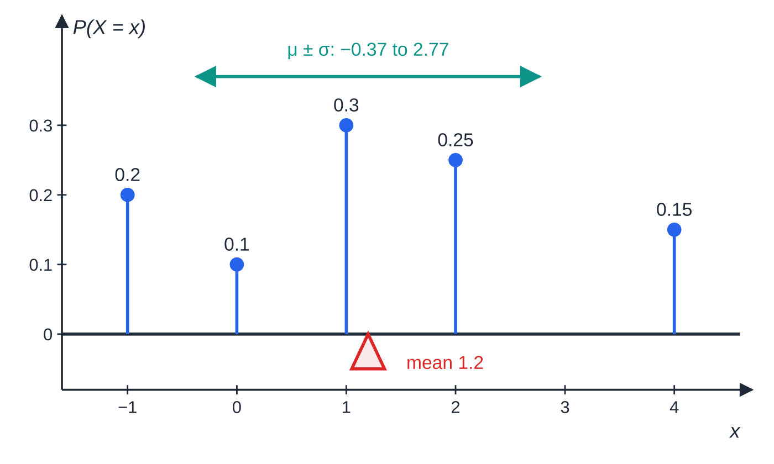
How do you find E(X), E(X²) and E(g(X))? (continued)
Section 4 of 13 · Worked example 4 · Medium · Find, compare (continued)
SOLUTION
(a) (-1)(0.2)+0(0.1)+1(0.3)+2(0.25)+4(0.15)=-0.2+0+0.3+0.5+0.6= 1.2
(b) 1(0.2)+0+1(0.3)+4(0.25)+16(0.15)=0.2+0.3+1+2.4= 3.9
(c) g(x)=1/(x+2) takes the values 1,½,⅓,¼,⅙: 0.2+0.05+0.1+0.0625+0.025= 0.4375. But 1/(1.2+2)=0.3125, which is not 0.4375: the function must be applied to each value before averaging.
The distribution of Worked examples 4 and 5. The mean 1.2 is the balance point; the arrow shows one standard deviation either side of it.
Notes:
How do you find E(X), E(X²) and E(g(X))?: Worked example 4. Full notes: https://examinerprep.com/notes/edexcel-ial-maths/discrete-random-variables/

Slide 18
How do you find the variance and standard deviation?
Section 5 of 13
Variance of a discrete random variable.
Var(X)=σ²=E(X²)-[E(X)]²=Σ(x-μ)² P(X=x), σ=√(Var(X)) The first form is almost always quicker.
Variance measures spread about the mean, in squared units; the standard deviation is back in the units of X. Find E(X²) and E(X) first, then subtract, keeping exact values until the last line. A variance can never be negative: a negative answer usually means you forgot to square the mean. With the standard deviation you can describe a range such as "within one standard deviation of the mean" and find its probability from the table.
Notes:
How do you find the variance and standard deviation?. Full notes: https://examinerprep.com/notes/edexcel-ial-maths/discrete-random-variables/

Slide 19
How do you find the variance and standard deviation? (continued)
Section 5 of 13 · Worked example 5 · Medium · Find
WORKED EXAMPLE · QUESTION
For the random variable X in Worked example 4, (a) find Var(X), (b) find the standard deviation of X, (c) find P(μ-σ<X<μ+σ).
SOLUTION
(a) Var(X)=3.9-1.2²=3.9-1.44= 2.46
(b) σ=√2.46=1.5684…= 1.57 (3 s.f.)
(c) μ±σ=1.2±1.5684…, from −0.37 to 2.77. The values inside are 0, 1, 2: 0.1+0.3+0.25= 0.65.
Check by the second form: Σ(x-1.2)²P(X=x)=0.968+0.144+0.012+0.16+1.176=2.46.
Notes:
How do you find the variance and standard deviation?: Worked example 5. Full notes: https://examinerprep.com/notes/edexcel-ial-maths/discrete-random-variables/

Slide 20
What happens to the mean and variance of aX + b?
Section 6 of 13
Linear functions of a random variable
(a, b constants): E(aX+b)=aE(X)+b, Var(aX+b)=a²Var(X) The standard deviation of aX+b is |a|σ.
Adding b moves every value by the same amount, so it changes the mean but not the spread. Multiplying by a stretches every gap by a, so the variance gains a factor a². The sign of a does not matter for the variance: Var(4-2X)=(-2)²Var(X)=4Var(X). The same rules work backwards (given E(Y) and Var(Y) for Y=aX+b, solve for the unknowns), and they match the coding rules for data in S1.2. A rearrangement that is often needed: E(X²)=Var(X)+[E(X)]².
Notes:
What happens to the mean and variance of aX + b?. Full notes: https://examinerprep.com/notes/edexcel-ial-maths/discrete-random-variables/

Slide 21
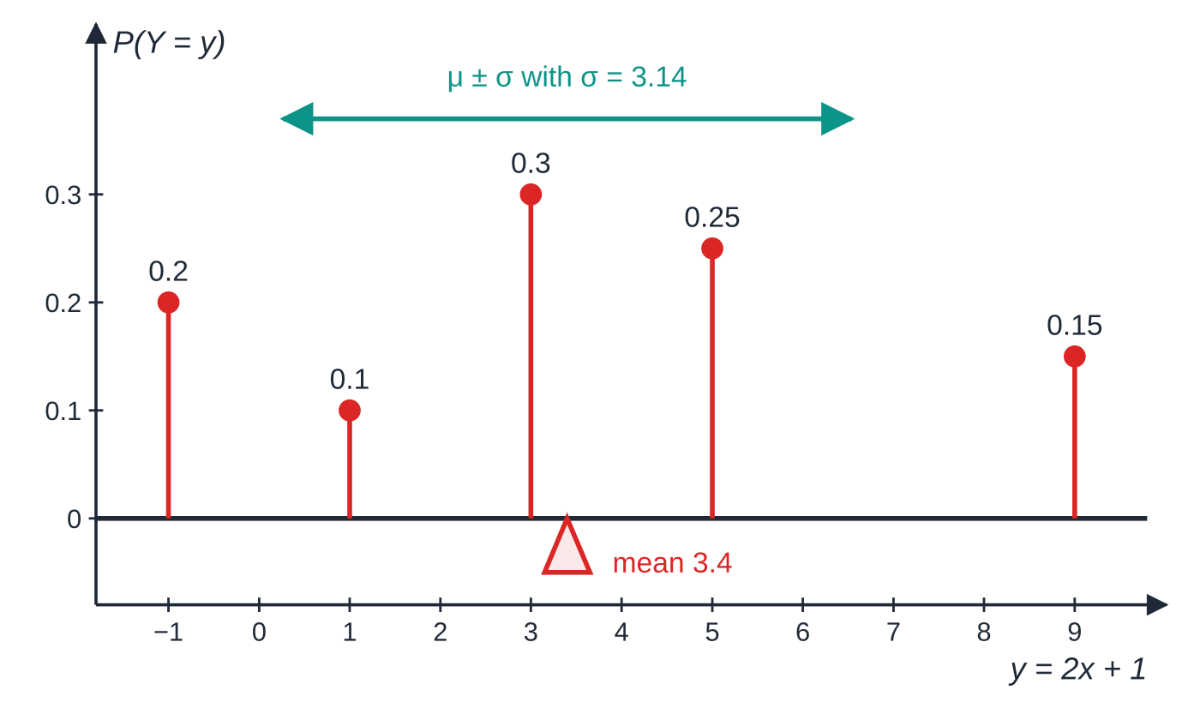
What happens to the mean and variance of aX + b? (continued)
Section 6 of 13
Doubling and then adding 1. The values of Y=2X+1 have the same probabilities as those of X; the mean goes from 1.2 to 2×1.2+1=3.4, and the standard deviation doubles from 1.57 to 3.14.
Notes:
What happens to the mean and variance of aX + b?. Full notes: https://examinerprep.com/notes/edexcel-ial-maths/discrete-random-variables/

Slide 22
What happens to the mean and variance of aX + b? (continued)
Section 6 of 13 · Worked example 6 · Medium · Find
WORKED EXAMPLE · QUESTION
In a game, the number of points X that a player scores has E(X)=4 and Var(X)=2.25. The prize, in pence, is Y=20X-30. (a) Find E(Y) and the standard deviation of Y. (b) Find E(X²). (c) A second scoring rule uses T=aX+b, where a>0 and b are constants, chosen so that E(T)=50 and Var(T)=9. Find a and b.
SOLUTION
(a) E(Y)=20×4-30= 50p; Var(Y)=20²×2.25=900, so s.d. = 30p.
(b) E(X²)=Var(X)+[E(X)]²=2.25+16= 18.25
(c) Variance first (it involves a only): a²×2.25=9⇒a²=4⇒a=2 (since a>0). Then 2×4+b=50⇒b=42. a=2, b=42.
Notes:
What happens to the mean and variance of aX + b?: Worked example 6. Full notes: https://examinerprep.com/notes/edexcel-ial-maths/discrete-random-variables/

Slide 23
How do you find unknown probabilities from given conditions?
Section 7 of 13
Each piece of information gives an equation. "Probabilities add to 1" is always one; a given E(X), a given value of F or a stated relationship (such as P(X=2)=2P(X=1)) give others. Two unknowns need two equations: solve them simultaneously, then check that every probability lies between 0 and 1. Once the table is complete, carry on as usual.
Notes:
How do you find unknown probabilities from given conditions?. Full notes: https://examinerprep.com/notes/edexcel-ial-maths/discrete-random-variables/

Slide 24
How do you find unknown probabilities from given conditions? (continued)
Section 7 of 13 · Worked example 7 · Hard · Find
WORKED EXAMPLE · QUESTION
The random variable X has the probability distribution below, where p and q are constants. Given that E(X)=3.25, (a) find p and q, (b) find Var(X), (c) find Var(4-2X), (d) find P(X≤3).
x | 1 | 2 | 3 | 4 | 5
P(X=x) | 0.1 | p | q | 0.3 | 0.2
Notes:
How do you find unknown probabilities from given conditions?: Worked example 7. Full notes: https://examinerprep.com/notes/edexcel-ial-maths/discrete-random-variables/

Slide 25
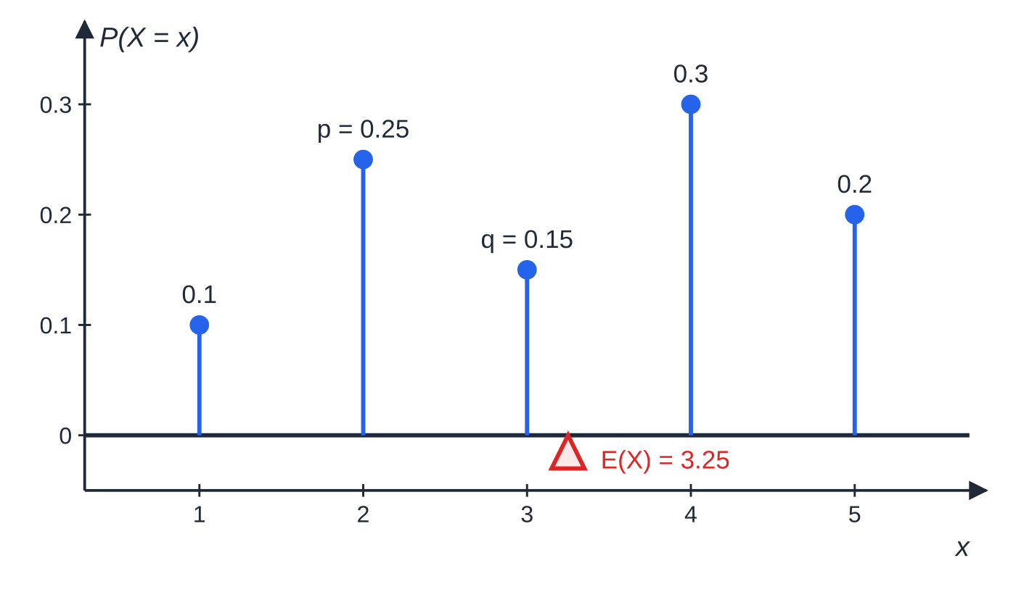
How do you find unknown probabilities from given conditions? (continued)
Section 7 of 13 · Worked example 7 · Hard · Find (continued)
SOLUTION
(a) Sum = 1: 0.1+p+q+0.3+0.2=1⇒p+q=0.4. Mean: 0.1+2p+3q+1.2+1.0=3.25⇒2p+3q=0.95. Subtract 2 × the first: q=0.95-0.8=0.15, so p=0.25, q=0.15.
(b) E(X²)=0.1+4(0.25)+9(0.15)+16(0.3)+25(0.2)=12.25; Var(X)=12.25-3.25²=12.25-10.5625= 1.6875.
(c) a=-2, so the factor is (-2)²=4: Var(4-2X)=4×1.6875= 6.75.
The completed distribution of Worked example 7, balancing at E(X)=3.25.
Notes:
How do you find unknown probabilities from given conditions?: Worked example 7. Full notes: https://examinerprep.com/notes/edexcel-ial-maths/discrete-random-variables/

Slide 26
How do you find unknown probabilities from given conditions? (continued)
Section 7 of 13 · Worked example 7 · Hard · Find (continued)
(d) P(X≤3)=0.1+0.25+0.15= 0.5.
Notes:
How do you find unknown probabilities from given conditions?: Worked example 7. Full notes: https://examinerprep.com/notes/edexcel-ial-maths/discrete-random-variables/

Slide 27
How do you find unknown probabilities from given conditions? (continued)
Section 7 of 13
Exam tip — label your equations
Write the two equations on separate lines with the conditions they come from ("sum = 1", "mean = 3.25"). If you get a negative probability or one bigger than 1, recheck the equations rather than carrying on.
Notes:
How do you find unknown probabilities from given conditions?. Full notes: https://examinerprep.com/notes/edexcel-ial-maths/discrete-random-variables/

Slide 28
What is the discrete uniform distribution?
Section 8 of 13
Discrete uniform distribution on 1,2,…,n.
Every one of the n values is equally likely: P(X=x)=1/n, x=1,2,…,n; E(X)=(n+1)/2; Var(X)=((n+1)(n-1))/12=(n²-1)/12 Examples: a fair dice, a fair spinner, a random whole number from a list.
Where the formulae come from. The mean uses the arithmetic series sum from P2: E(X)=1/n(1+2+⋯+n)=1/n×(n(n+1))/2=(n+1)/2. For the variance, Σr²=⅙n(n+1)(2n+1) gives E(X²)=((n+1)(2n+1))/6, so Var(X)=((n+1)(2n+1))/6-((n+1)²)/4=((n+1)(n-1))/12. For a fair six-sided dice (n=6): mean (7/2)=3.5 and variance (35/12).
The formulae are for values 1 to n. For other equally spaced values, write X as aU+b with U uniform on 1,…,n. A whole number chosen at random from 5, 6, …, 14 is X=U+4 with U uniform on 1,…,10, so E(X)=5.5+4=9.5 and Var(X)=(10²-1)/12=8.25, unchanged by the shift.
Notes:
What is the discrete uniform distribution?. Full notes: https://examinerprep.com/notes/edexcel-ial-maths/discrete-random-variables/

Slide 29
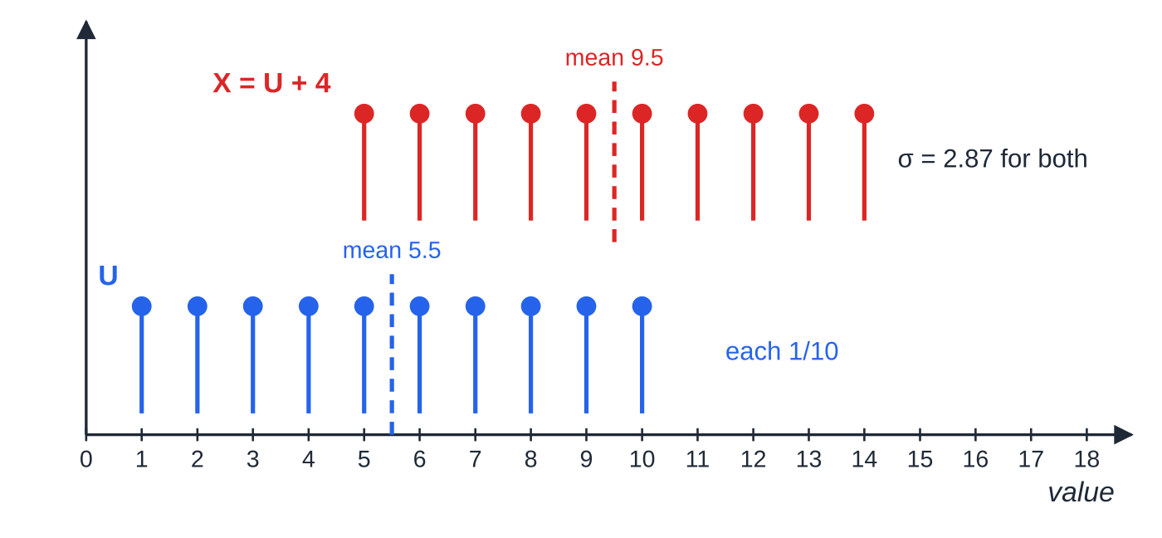
What is the discrete uniform distribution? (continued)
Section 8 of 13
A discrete uniform distribution has a flat line diagram. Shifting every value by 4 moves the mean from 5.5 to 9.5 but leaves the standard deviation at 2.87.
Notes:
What is the discrete uniform distribution?. Full notes: https://examinerprep.com/notes/edexcel-ial-maths/discrete-random-variables/

Slide 30
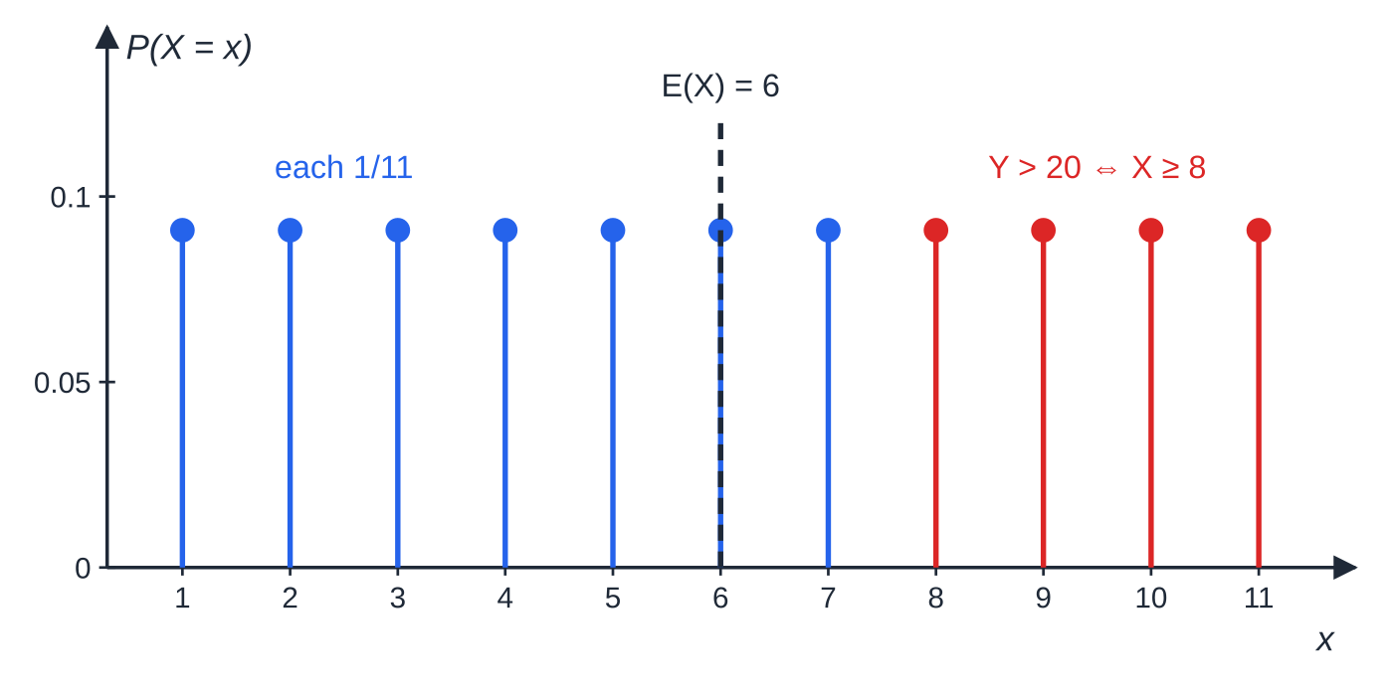
What is the discrete uniform distribution? (continued)
Section 8 of 13 · Worked example 8 · Hard · Find
WORKED EXAMPLE · QUESTION
A fair spinner has n equal sectors numbered 1,2,…,n. The score X on one spin has a discrete uniform distribution, and Var(X)=10. (a) Find the value of n. (b) Write down E(X) and find P(X>E(X)). (c) A player's points are Y=3X-2. Find E(Y) and Var(Y). (d) Find P(Y>20). (e) The spinner is spun twice. Find the probability that both scores are greater than E(X).
SOLUTION
(a) (n²-1)/12=10⇒n²=121⇒ n=11 (n>0).
(b) E(X)=(11+1)/2=6;
The uniform distribution on 1 to 11. The four red values are exactly the ones with Y=3X-2>20.
Notes:
What is the discrete uniform distribution?: Worked example 8. Full notes: https://examinerprep.com/notes/edexcel-ial-maths/discrete-random-variables/

Slide 31
What is the discrete uniform distribution? (continued)
Section 8 of 13 · Worked example 8 · Hard · Find (continued)
X>6 for 7, 8, 9, 10, 11, so P=(5/11).
(c) E(Y)=3×6-2= 16; Var(Y)=3²×10= 90.
(d) 3X-2>20⇒X>(22/3)=7.33…, so X≥8: values 8, 9, 10, 11, P=(4/11). X must be a whole number, so X>7.33… means X≥8, not X≥7.
(e) Independent spins: (5/11)²= (25/121).
Notes:
What is the discrete uniform distribution?: Worked example 8. Full notes: https://examinerprep.com/notes/edexcel-ial-maths/discrete-random-variables/

Slide 32
Exam tips for S1.5
Section 9 of 13
Exam tip 1 — check the total
After finding a constant or filling in a table, add the probabilities and confirm the total is exactly 1. It takes seconds and catches most slips before they spread into the mean and variance.
Exam tip 2 — show the sums
Write E(X) and E(X²) as sums of products, such as (-1)(0.2)+0(0.1)+⋯, before giving the total. The method is then visible even if a product is mistyped on the calculator.
Exam tip 3 — translate inequalities into values
For a whole-number variable, write "X<4" as "X≤3" and "X≥2" as "1-P(X≤1)" before using F. Listing the values included avoids the off-by-one slip.
Notes:
Exam tips for S1.5. Full notes: https://examinerprep.com/notes/edexcel-ial-maths/discrete-random-variables/

Slide 33
Exam tips for S1.5 (continued)
Section 9 of 13
Exam tip 4 — for aX + b, square a and drop b
Var(5-3X)=9Var(X), never -3Var(X)+5. A standard deviation scales by |a|.
Exam tip 5 — uniform: check where the values start
The results (n+1)/2 and (n²-1)/12 are for 1,2,…,n. For values such as 5 to 14 or 2, 4, …, 20, write the variable as aU+b first.
Notes:
Exam tips for S1.5. Full notes: https://examinerprep.com/notes/edexcel-ial-maths/discrete-random-variables/

Slide 34
Common misconceptions
Section 10 of 13
Misconception | Why it is wrong | Correct idea
E(X) must be one of the values X can take. | It is a long-run average, a balance point. | In Worked example 4, E(X)=1.2 although X only takes −1, 0, 1, 2, 4.
Var(X)=E(X²). | That ignores where the distribution is centred. | Var(X)=E(X²)-[E(X)]².
E(g(X))=g(E(X)), e.g. E(X²)=[E(X)]². | Averaging then applying g is not the same as applying g then averaging. | Apply g to every value: Σg(x)P(X=x). For x² the two agree only when the variance is 0.
Var(aX+b)=aVar(X)+b. | Adding a constant does not change the spread, and stretching by a multiplies squared distances by a². | Var(aX+b)=a²Var(X).
F(x) is the probability that X equals x. | F is cumulative: it includes all smaller values too. | P(X=x)=F(x)-F(x-1).
Notes:
Common misconceptions. Full notes: https://examinerprep.com/notes/edexcel-ial-maths/discrete-random-variables/

Slide 35
Common misconceptions (continued)
Section 10 of 13
Misconception | Why it is wrong | Correct idea
A random whole number from 5 to 14 has mean (14+1)/2=7.5. | The formula (n+1)/2 assumes the values start at 1. | Write X=U+4 with U uniform on 1,…,10: mean 9.5, variance 8.25.
Notes:
Common misconceptions. Full notes: https://examinerprep.com/notes/edexcel-ial-maths/discrete-random-variables/

Slide 36
How this topic connects
Section 11 of 13
S1.3 Probability and S1.2 Measures of location and dispersion
Building a distribution from an experiment uses sample spaces, trees, independence and conditional probability. E(X) and Var(X) are the mean and variance of a frequency distribution with probabilities in place of relative frequencies, and the rules for aX+b are the coding rules.
S2 The binomial and Poisson distributions
These are discrete distributions with formulae for p(x), for which E(X) and Var(X) reduce to np, np(1-p) and λ; continuous random variables replace sums with integrals.
P2 Series
The mean of the discrete uniform distribution uses the sum 1+2+⋯+n of an arithmetic series.
Notes:
How this topic connects. Full notes: https://examinerprep.com/notes/edexcel-ial-maths/discrete-random-variables/

Slide 37
Key formulae
Section 12 of 13
Formula | Use | In the formulae list?
ΣP(X=x)=1, 0≤P(X=x)≤1 | checking a distribution; finding an unknown constant | No – learn it
F(x₀)=P(X≤x₀)=Σ_(x≤x₀)P(X=x) | cumulative probabilities | No – learn it
P(X=x)=F(x)-F(x-1) | distribution from F, whole-number values | No – derive it
E(X)=Σx P(X=x) | mean | Yes
E(g(X))=Σg(x) P(X=x) | E(X²) and other expectations | Yes
Var(X)=E(X²)-[E(X)]²=Σ(x-μ)²P(X=x) | variance; σ=√(Var(X)) | Yes
E(aX+b)=aE(X)+b | mean of a linear function | No – learn it
Var(aX+b)=a²Var(X) | variance of a linear function | No – learn it
Notes:
Key formulae. Full notes: https://examinerprep.com/notes/edexcel-ial-maths/discrete-random-variables/

Slide 38
Key formulae (continued)
Section 12 of 13
Formula | Use | In the formulae list?
Uniform on 1,…,n: P(X=x)=1/n, E(X)=(n+1)/2, Var(X)=(n²-1)/12 | discrete uniform distribution | No – learn it
Notes:
Key formulae. Full notes: https://examinerprep.com/notes/edexcel-ial-maths/discrete-random-variables/

Slide 39
Check your understanding
Section 13 of 13
1. Can a discrete random variable have P(X=1)=0.6 and P(X=2)=0.6?
2. E(X)=3 and Var(X)=2. Find E(X²).
3. Var(X)=2. Find Var(5-3X).
4. For a whole-number random variable, F(3)=0.55 and F(4)=0.7. Find P(X=4).
5. Find the mean and variance of the score on one roll of a fair six-sided dice.
Notes:
Check your understanding: questions. Full notes: https://examinerprep.com/notes/edexcel-ial-maths/discrete-random-variables/

Slide 40
Check your understanding · answers
Section 13 of 13
1. No. The probabilities of all the values must add to 1, and these two alone add to 1.2.
2. E(X²)=Var(X)+[E(X)]²=2+9=11.
3. (-3)²×2=18. The 5 does not affect the spread, and the minus sign disappears when squared.
4. F(4)-F(3)=0.7-0.55=0.15.
5. Discrete uniform with n=6: mean (7/2)=3.5, variance (6²-1)/12=(35/12).
Notes:
Check your understanding: answers. Full notes: https://examinerprep.com/notes/edexcel-ial-maths/discrete-random-variables/

Slide 41
Practice questions
2 original exam-style questions. Answers at the end of the deck.

Slide 42
Question 1
9 marks
The 40 tickets in a raffle are numbered 21, 22, 23, …, 60. One ticket is drawn at random, and X is the number on it.
(a) Write down P(X = x) for x = 21, 22, …, 60. [1]
(b) By writing X = U + 20, where U has a discrete uniform distribution on 1, 2, …, 40, find E(X). [2]
(c) Find Var(X) and the standard deviation of X. [3]
(d) Find the probability that the number drawn is a multiple of 7. [1]
(e) Find the probability that X lies within one standard deviation of its mean. [2]
Notes:
Online with the full mark scheme: https://examinerprep.com/ial-maths-s1-5-discrete-random-variables-questions#IALM-S1-5-B-10

Slide 43
Question 2
5 marks
A restaurant takes table bookings for groups of 1, 2, 3 or 6 people. The size of a randomly chosen booking is modelled by the random variable X with probability function P(X = x) = k/x for x = 1, 2, 3, 6, where k is a constant.
(a) Show that k = 1/2. [2]
(b) Find P(X ≤ 3). [1]
(c) Find E(X). [2]
Notes:
Online with the full mark scheme: https://examinerprep.com/ial-maths-s1-5-discrete-random-variables-questions#IALM-S1-5-B-02

Slide 44
Answers

Slide 45
Question 1 · answer
Mark scheme
1/40
E(U) = (40 + 1)/2 = 20.5
E(X) = 20.5 + 20 = 40.5
Var(X) = Var(U) = (40² − 1)/12
= 133.25
standard deviation = 11.5 (3 s.f.)
21, 28, 35, 42, 49, 56: 6/40 = 3/20
40.5 ± 11.54…, from 28.96… to 52.04…, so X = 29, …, 52
Notes:
Full mark scheme: https://examinerprep.com/ial-maths-s1-5-discrete-random-variables-questions#IALM-S1-5-B-10

Slide 46
Question 2 · answer
Mark scheme
k + k/2 + k/3 + k/6 = 1
2k = 1, so k = 1/2, as required
1 − P(X = 6) = 1 − 1/12 = 11/12
Σ x × (k/x) = 4k, or 1(1/2) + 2(1/4) + 3(1/6) + 6(1/12)
2
Notes:
Full mark scheme: https://examinerprep.com/ial-maths-s1-5-discrete-random-variables-questions#IALM-S1-5-B-02

Slide 47
Keep practising
Notes for this topic
Questions on this topic
Build a printable test
ExaminerPrep is an independent tutoring service. It has been developed independently from and is not endorsed by the International Baccalaureate Organization. "International Baccalaureate", "IB" and "IB Diploma Programme" are registered trademarks of the IBO, used here for descriptive purposes only.
Pearson Edexcel and Cambridge are trademarks of their owners; ExaminerPrep is not affiliated with any exam board.

