Slide 1
EP
EDEXCEL IAL MATHS
M1.3 Dynamics: Newton's laws, connected particles and friction
The full notes page in 12 sections · practice questions with answers · simulations
ExaminerPrep is an independent tutoring service. It has been developed independently from and is not endorsed by the International Baccalaureate Organization. "International Baccalaureate", "IB" and "IB Diploma Programme" are registered trademarks of the IBO, used here for descriptive purposes only.
Pearson Edexcel and Cambridge are trademarks of their owners; ExaminerPrep is not affiliated with any exam board.
Notes:
M1.3 Dynamics: Newton's laws, connected particles and friction. Notes for this topic: https://examinerprep.com/notes/edexcel-ial-maths/dynamics-newtons-laws-connected-particles-and-friction/

Slide 2
What this page covers
Overview
Newton's three laws for a particle, with forces given as magnitudes or in the form ai + bj
Friction on a moving particle, F = μR, including when a pulling force acts at an angle
Motion up and down smooth and rough inclined planes
Lifts, and vehicles towing trailers or caravans (tension and thrust in a tow bar)
Two particles joined by a light inextensible string over a smooth pulley or peg, and the force the string exerts on the pulley
Forces that change from one constant value to another: a string breaking, a particle hitting the ground, a pulling force removed
Notes:
What this page covers. Full notes: https://examinerprep.com/notes/edexcel-ial-maths/dynamics-newtons-laws-connected-particles-and-friction/

Slide 3
In one minute
Key points
1. One method solves every dynamics question in M1: draw the forces on each particle, resolve along the direction of motion and write resultant force = mass × acceleration, F = ma (in vector form F = ma).
2. Weight = mg, with g = 9.8 m s⁻². Give final answers to 2 or 3 significant figures.
3. Friction on a moving particle is F = μR and acts against the motion. Find R first by resolving perpendicular to the motion.
4. On a slope at angle α: weight component mgsin α along the slope, and R = mgcos α if nothing else pushes into the slope.
5. Connected particles: a light inextensible string has the same tension throughout (over a smooth pulley too) and both particles have the same size of acceleration. Write one equation per particle.
6. When a force changes (string breaks, particle lands) start a new stage: new forces, new acceleration, and the speed at the change links the stages.
Notes:
In one minute. Full notes: https://examinerprep.com/notes/edexcel-ial-maths/dynamics-newtons-laws-connected-particles-and-friction/

Slide 4
How do Newton's laws turn forces into motion?
Section 1 of 12
Law | In words | How you use it in M1
First | a particle stays at rest or moves with constant velocity unless a resultant force acts on it | constant velocity ⇒ forces balance in every direction
Second | the resultant force on a particle equals its mass × its acceleration, in the direction of the resultant | F = ma along the direction of motion; 0 = m ×0 perpendicular to it
Third | if A exerts a force on B, then B exerts an equal and opposite force on A | the floor of a lift and the passenger push on each other equally; a tow bar pulls the car back as hard as it pulls the trailer forward
The forces you will meet. Weight mg, vertically down (mass in kg, weight in N). Normal reaction R, perpendicular to a surface, pushing away from it. Friction F, along a rough surface, opposing the motion. Tension T in a string, pulling away from the particle; a rod or tow bar can also push, a thrust. Resistance and driving force for vehicles, usually given as constants.
Notes:
How do Newton's laws turn forces into motion?. Full notes: https://examinerprep.com/notes/edexcel-ial-maths/dynamics-newtons-laws-connected-particles-and-friction/

Slide 5
How do Newton's laws turn forces into motion? (continued)
Section 1 of 12
Newton's second law and weight
F = ma W = mg
F = resultant force (N); m = mass (kg); a = acceleration (m s⁻²); g = 9.8 m s⁻². Not in the formulae list: learn both. “Resultant” means you add the forces along your chosen direction, with forces the other way counted negative, before you multiply out ma.
Notes:
How do Newton's laws turn forces into motion?. Full notes: https://examinerprep.com/notes/edexcel-ial-maths/dynamics-newtons-laws-connected-particles-and-friction/

Slide 6
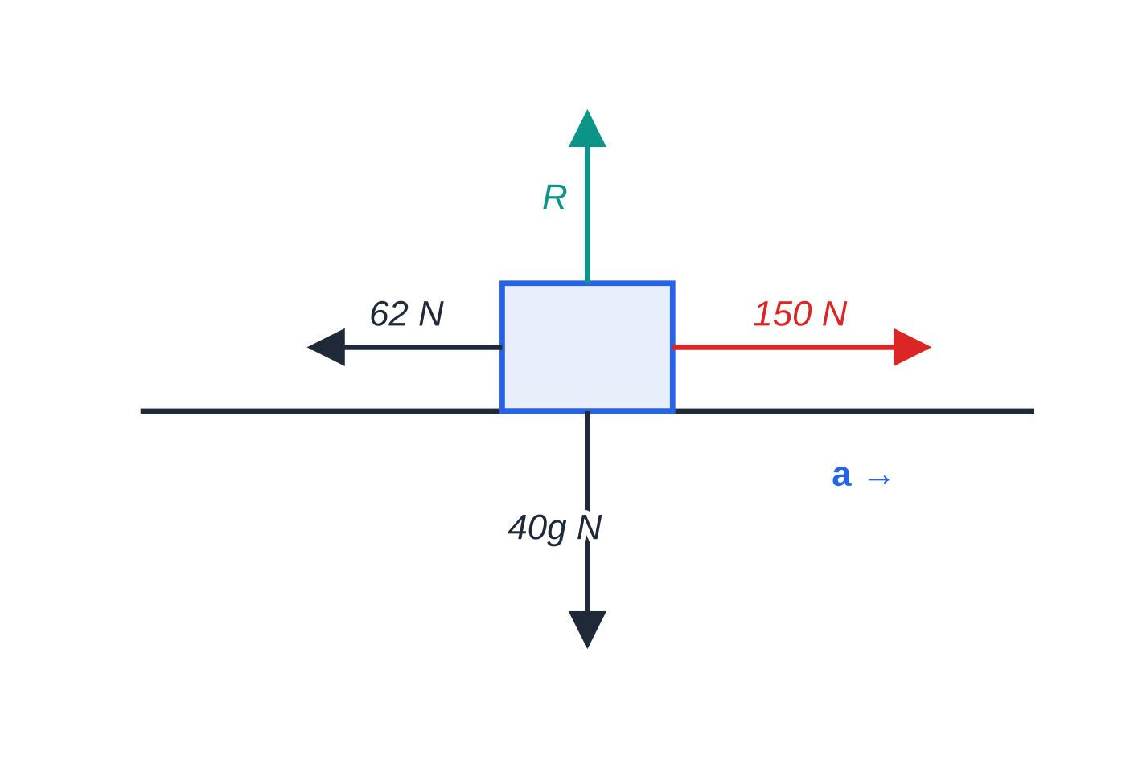
How do Newton's laws turn forces into motion? (continued)
Section 1 of 12 · Worked example 1 · Easy · Find
WORKED EXAMPLE · QUESTION
A crate of mass 40 kg is pushed from rest across a horizontal floor by a horizontal force of 150 N. The total resistance to motion is constant and equal to 62 N. The crate is modelled as a particle. Find (a) the acceleration of the crate, (b) the time it takes to reach a speed of 5.5 m s⁻¹, (c) the distance it has moved by then.
SOLUTION
(a) Resultant force in the direction of motion, then F = ma: 150 - 62 = 40a ⇒a = 88 ÷40 = 2.2 m s⁻²
Forces on the crate. Vertically R = 40g; horizontally the resultant is 150 - 62 = 88 N.
Notes:
How do Newton's laws turn forces into motion?: Worked example 1. Full notes: https://examinerprep.com/notes/edexcel-ial-maths/dynamics-newtons-laws-connected-particles-and-friction/

Slide 7
How do Newton's laws turn forces into motion? (continued)
Section 1 of 12 · Worked example 1 · Easy · Find (continued)
(b) Constant force, so constant acceleration: 5.5 = 0 + 2.2t ⇒ t = 2.5 s
(c) s = ½(u + v)t = ½ ×5.5 ×2.5 = 6.88 m (6.875 m)
Notes:
How do Newton's laws turn forces into motion?: Worked example 1. Full notes: https://examinerprep.com/notes/edexcel-ial-maths/dynamics-newtons-laws-connected-particles-and-friction/

Slide 8
How do Newton's laws turn forces into motion? (continued)
Section 1 of 12
Common error
Writing 150 = 40a. The 150 N is only one of the forces; F in F = ma is the resultant. Writing the subtraction out in full shows every force you have used.
Notes:
How do Newton's laws turn forces into motion?. Full notes: https://examinerprep.com/notes/edexcel-ial-maths/dynamics-newtons-laws-connected-particles-and-friction/

Slide 9
How do you use F = ma when the forces are vectors?
Section 2 of 12
Add the forces component by component, (ai + bj) + (ci + dj) = (a + c)i + (b + d)j; then F = ma gives the acceleration vector by dividing each component by the mass. Magnitude: |pi + qj| = √(p² + q²). Direction: tan θ= q/p, then check the quadrant on a sketch. “Parallel to ui + vj” means the components are in the ratio u: v. With constant a, v = u + at and r = ut + ½at² work just like the scalar forms.
Notes:
How do you use F = ma when the forces are vectors?. Full notes: https://examinerprep.com/notes/edexcel-ial-maths/dynamics-newtons-laws-connected-particles-and-friction/

Slide 10
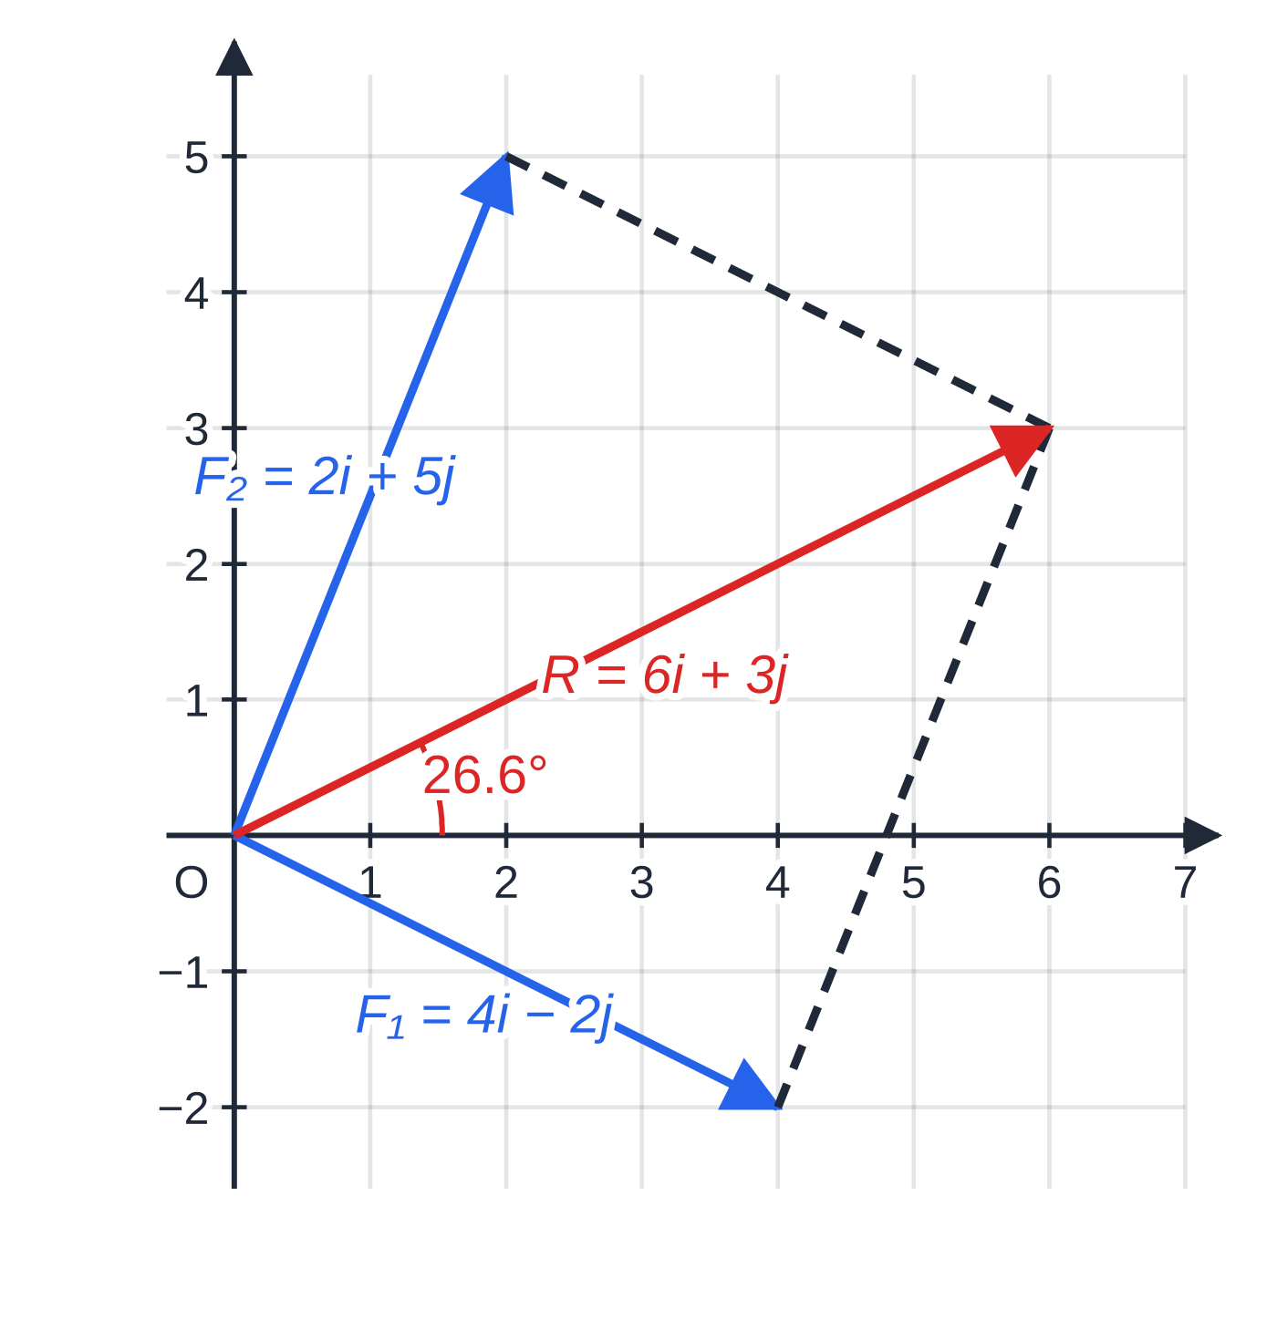
How do you use F = ma when the forces are vectors? (continued)
Section 2 of 12 · Worked example 2 · Medium · Find
WORKED EXAMPLE · QUESTION
Two forces F₁ = (4i - 2j) N and F₂ = (pi + 5j) N act on a particle of mass 2 kg. No other forces act. The acceleration of the particle is parallel to (2i + j). (a) Find the value of p. (b) Find the magnitude of the acceleration and the angle it makes with i. (c) The particle starts from rest. Find its velocity after 4 s.
SOLUTION
(a) R = (4 + p)i + 3j and (4 + p): 3 = 2: 1 ⇒4 + p = 6 ⇒ p = 2
(b) a = (6i + 3j) ÷2 = (3i + 1.5j) m s⁻². |a| = √(3² + 1.5²) = 3.35 m s⁻² (3.3541…); tan θ= 1.5 ÷3 ⇒ θ= 26.6° above i
(c) v = u + at = 4(3i + 1.5j) = (12i + 6j) m s⁻¹
The two forces and their resultant, to scale. The resultant is the diagonal of the parallelogram: 6i + 3j, at 26.6° to i, parallel to 2i + j.
Notes:
How do you use F = ma when the forces are vectors?: Worked example 2. Full notes: https://examinerprep.com/notes/edexcel-ial-maths/dynamics-newtons-laws-connected-particles-and-friction/

Slide 11
How do you use F = ma when the forces are vectors? (continued)
Section 2 of 12
Exam tip 1 — sketch every direction
tan⁻¹ of a ratio of components only gives an angle between −90° and 90°; a force such as -3i + 6j points up and to the left, at 116.6° to i, not −63.4°.
Notes:
How do you use F = ma when the forces are vectors?. Full notes: https://examinerprep.com/notes/edexcel-ial-maths/dynamics-newtons-laws-connected-particles-and-friction/

Slide 12
How does friction act on a moving particle?
Section 3 of 12
Friction on a sliding particle. F = μR, acting along the surface, opposite to the direction of motion. μ is the coefficient of friction between the two surfaces; it has no units. A smooth surface means μ= 0.
For a moving particle the friction always takes its full value μR (the inequality F ≤μR matters only for a particle at rest, on the statics page). The key point is that R is not always mg: find it by resolving perpendicular to the motion, where the acceleration is zero. A pull P at angle θ above the horizontal lifts the particle a little, so R = mg - Psin θ; a push at θ below the horizontal presses it down, so R = mg + Psin θ.
Notes:
How does friction act on a moving particle?. Full notes: https://examinerprep.com/notes/edexcel-ial-maths/dynamics-newtons-laws-connected-particles-and-friction/

Slide 13
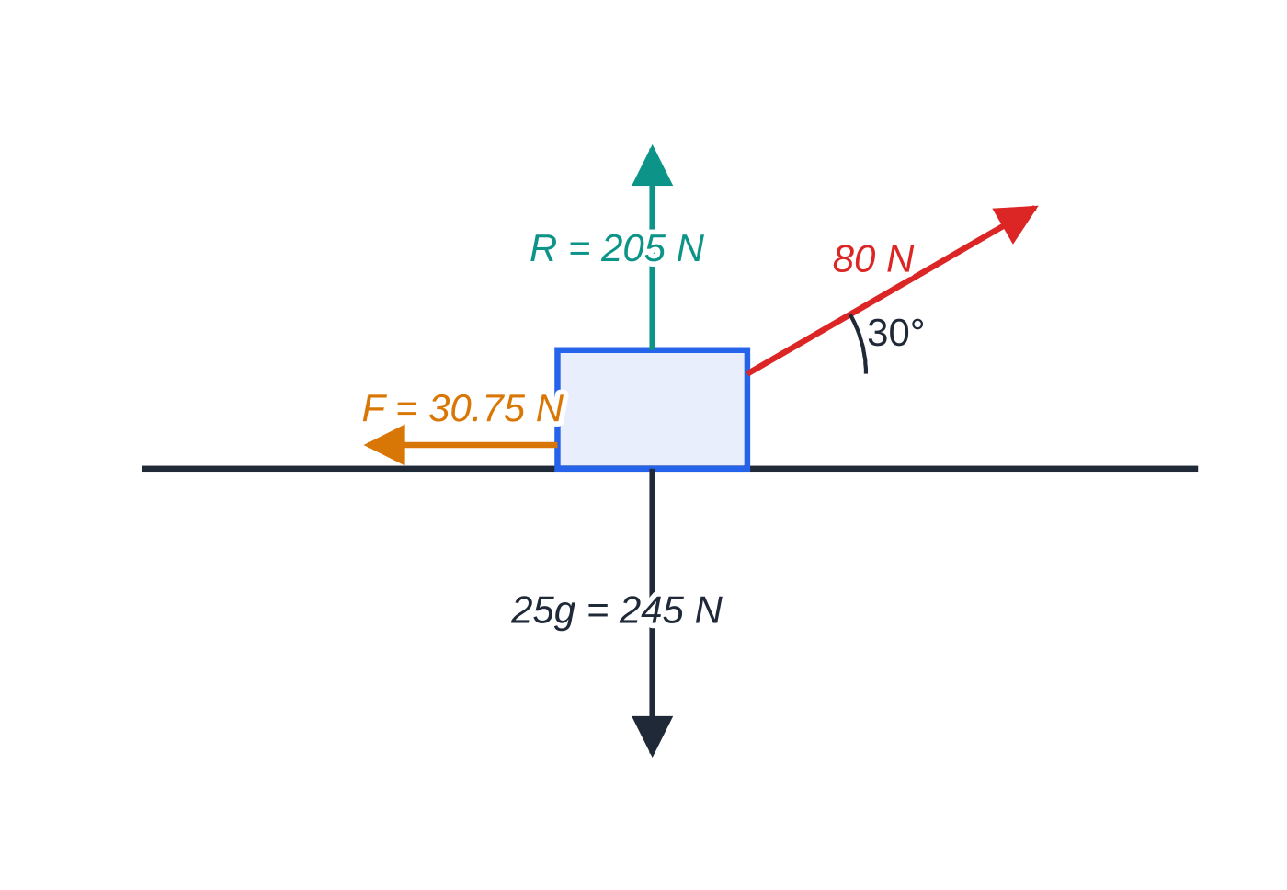
How does friction act on a moving particle? (continued)
Section 3 of 12 · Worked example 3 · Medium · Find
WORKED EXAMPLE · QUESTION
A sledge of mass 25 kg is pulled along rough horizontal snow by a rope inclined at 30° above the horizontal. The tension in the rope is 80 N and the coefficient of friction between the sledge and the snow is 0.15. The sledge is modelled as a particle. Find the acceleration of the sledge.
SOLUTION
Resolve vertically (no vertical acceleration): R + 80sin 30° = 25g ⇒R = 245 - 40 = 205 N.
Friction: F = μR = 0.15 ×205 = 30.75 N.
Forces on the sledge. The upward component of the pull, 40 N, reduces the normal reaction from 245 N to 205 N, and so reduces the friction.
Notes:
How does friction act on a moving particle?: Worked example 3. Full notes: https://examinerprep.com/notes/edexcel-ial-maths/dynamics-newtons-laws-connected-particles-and-friction/

Slide 14
How does friction act on a moving particle? (continued)
Section 3 of 12 · Worked example 3 · Medium · Find (continued)
Resolve horizontally: 80cos 30° - 30.75 = 25a ⇒a = 38.53 ÷25 = 1.54 m s⁻²
Notes:
How does friction act on a moving particle?: Worked example 3. Full notes: https://examinerprep.com/notes/edexcel-ial-maths/dynamics-newtons-laws-connected-particles-and-friction/

Slide 15
How does friction act on a moving particle? (continued)
Section 3 of 12
Common error
Using R = 25g = 245 N when the rope is at an angle. That gives F = 36.75 N and the wrong acceleration. Resolve perpendicular to the motion every time.
Notes:
How does friction act on a moving particle?. Full notes: https://examinerprep.com/notes/edexcel-ial-maths/dynamics-newtons-laws-connected-particles-and-friction/

Slide 16
How do you handle motion on an inclined plane?
Section 4 of 12
Resolve along the line of greatest slope and perpendicular to it. For a plane at angle α the weight has components mgsin α down the slope and mgcos α into the slope. Perpendicular: R = mgcos α (add or subtract the perpendicular component of any other applied force). Along the slope: F = ma, with friction μR opposing the motion: down the slope while the particle moves up, up the slope while it moves down. If tan α= ¾ you can use sin α= 0.6 and cos α= 0.8 exactly.
Notes:
How do you handle motion on an inclined plane?. Full notes: https://examinerprep.com/notes/edexcel-ial-maths/dynamics-newtons-laws-connected-particles-and-friction/

Slide 17
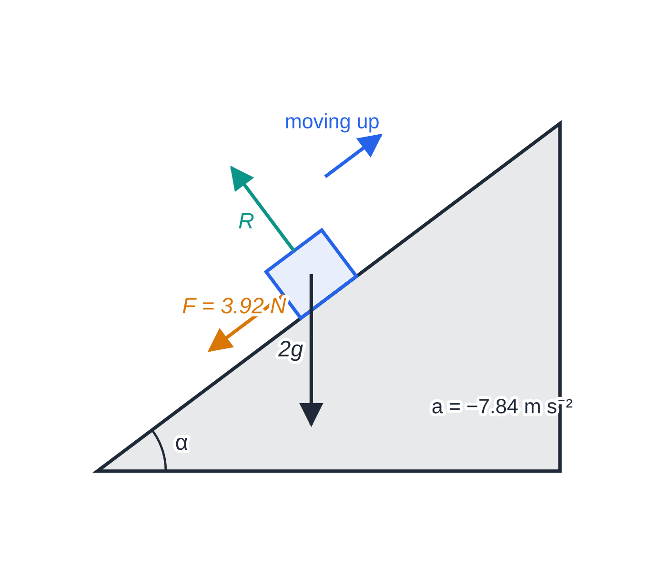
How do you handle motion on an inclined plane? (continued)
Section 4 of 12 · Worked example 4 · Hard · Find
WORKED EXAMPLE · QUESTION
A particle of mass 2 kg is projected with speed 8 m s⁻¹ up a line of greatest slope of a rough plane inclined at α to the horizontal, where tan α= ¾. The coefficient of friction is 0.25. (a) Find the distance the particle moves up the plane before coming to rest. (b) The particle then slides back down. Find its speed when it returns to its starting point.
Moving up the plane: the weight component (11.76 N) and the friction (3.92 N) both act down the slope.
Notes:
How do you handle motion on an inclined plane?: Worked example 4. Full notes: https://examinerprep.com/notes/edexcel-ial-maths/dynamics-newtons-laws-connected-particles-and-friction/

Slide 18
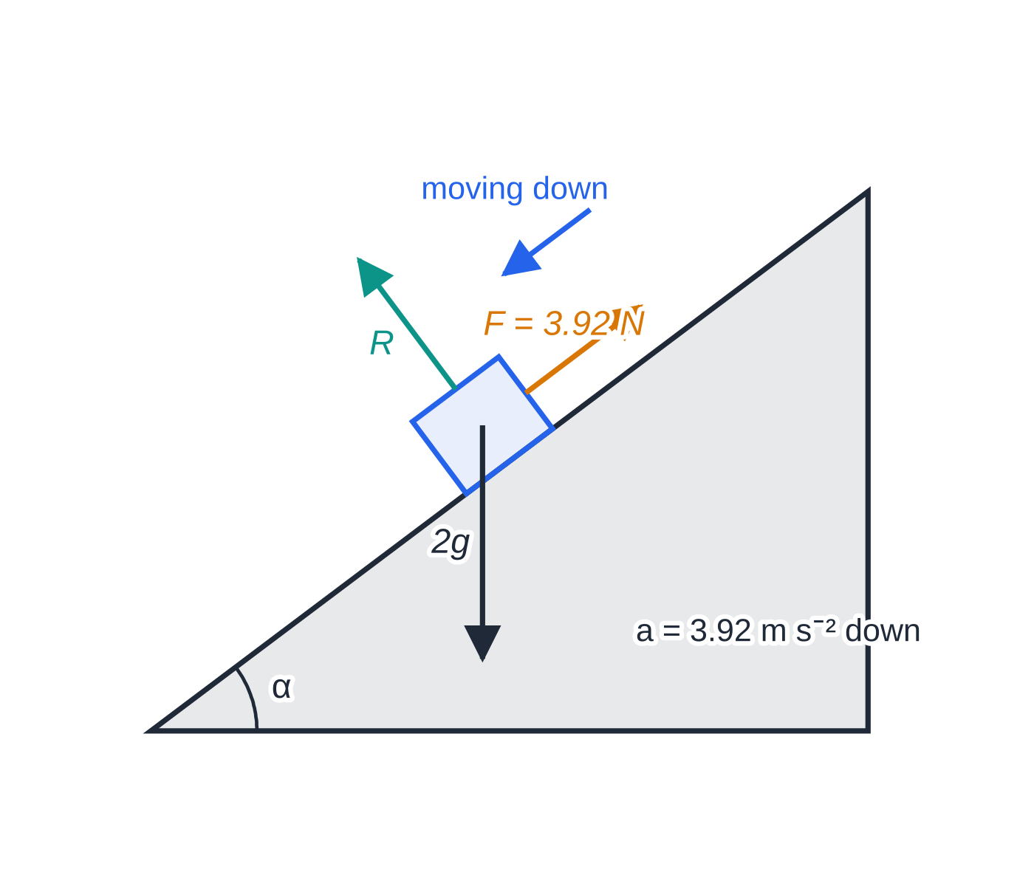
How do you handle motion on an inclined plane? (continued)
Section 4 of 12 · Worked example 4 · Hard · Find (continued)
SOLUTION
Perpendicular to the plane: R = 2gcos α= 2 ×9.8 ×0.8 = 15.68 N, so F = 0.25 ×15.68 = 3.92 N.
(a) Moving up, weight component and friction both act down the plane: -(2gsin α+ 3.92) = 2a ⇒a = -(11.76 + 3.92) ÷2 = -7.84 m s⁻². Then 0 = 8² - 2 ×7.84 ×s ⇒ s = 4.08 m (4.0816…)
(b) Moving down, friction now acts up the plane: 2gsin α- 3.92 = 2a ⇒a = (11.76 - 3.92) ÷2 = 3.92 m s⁻² down the plane. v² = 0 + 2 ×3.92 ×4.0816…= 32 ⇒ v = 5.66 m s⁻¹ (4√2)
The particle does slide back because the weight component, 11.76 N, is bigger than the greatest friction available, 3.92 N. Deciding this in general is a statics question (M1.5).
Moving down: the weight and normal reaction are unchanged, only the friction swaps direction, so the deceleration going up (7.84 m s⁻²) is bigger than the acceleration coming down (3.92 m s⁻²).
Notes:
How do you handle motion on an inclined plane?: Worked example 4. Full notes: https://examinerprep.com/notes/edexcel-ial-maths/dynamics-newtons-laws-connected-particles-and-friction/

Slide 19
How do you handle motion on an inclined plane? (continued)
Section 4 of 12
Common error
Keeping the friction in the same direction for the return journey. Friction opposes the current motion: when the velocity reverses, redraw the diagram and reverse the friction.
Notes:
How do you handle motion on an inclined plane?. Full notes: https://examinerprep.com/notes/edexcel-ial-maths/dynamics-newtons-laws-connected-particles-and-friction/

Slide 20
How do you model lifts and towed vehicles?
Section 5 of 12
Lifts. Choose upwards as positive and use the direction of the acceleration, not the velocity: a lift slowing down on its way up has a downward acceleration. For a load of mass m on the floor, R - mg = ma; the floor and the load push on each other with equal force (third law). For the cable, treat lift + contents as one particle: T - (M + m)g = (M + m)a.
Notes:
How do you model lifts and towed vehicles?. Full notes: https://examinerprep.com/notes/edexcel-ial-maths/dynamics-newtons-laws-connected-particles-and-friction/

Slide 21
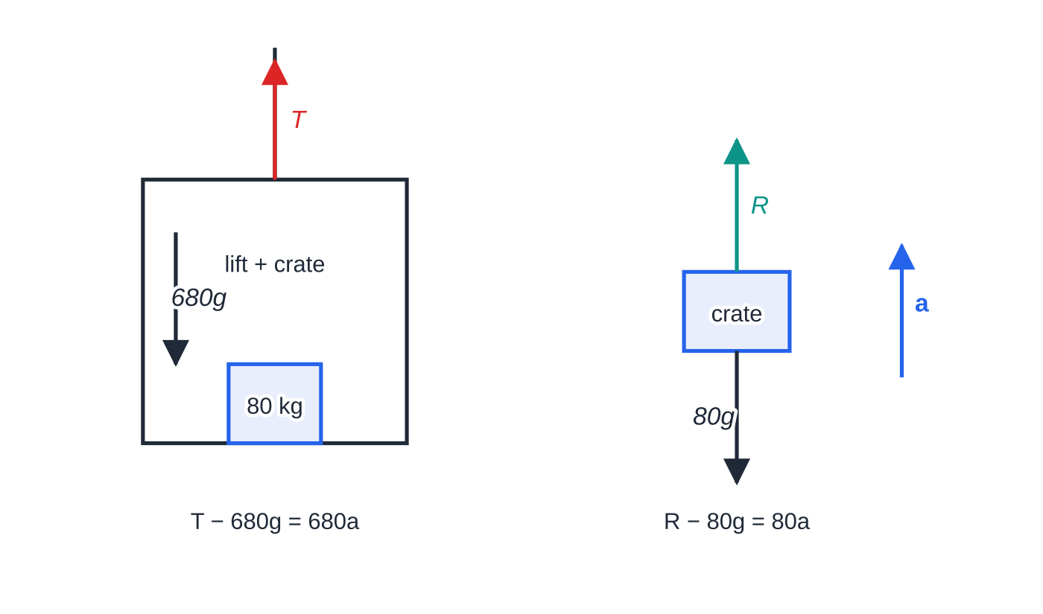
How do you model lifts and towed vehicles? (continued)
Section 5 of 12 · Worked example 5 · Medium · Find
WORKED EXAMPLE · QUESTION
A lift of mass 600 kg carries a crate of mass 80 kg on its floor. The lift is raised by a vertical cable. (a) The lift accelerates upwards at 0.5 m s⁻². Find the tension in the cable and the force of the floor on the crate. (b) Later the lift is moving upwards and slowing down at 1.2 m s⁻². Find the force of the floor on the crate.
SOLUTION
(a) Lift and crate together, upwards positive: T - 680g = 680 ×0.5 ⇒T = 680 ×10.3 = 7004 = 7000 N (3 s.f.). The crate alone:
Two force diagrams: lift and crate together (for the cable tension) and the crate alone (for the floor's force). Both have the same acceleration.
Notes:
How do you model lifts and towed vehicles?: Worked example 5. Full notes: https://examinerprep.com/notes/edexcel-ial-maths/dynamics-newtons-laws-connected-particles-and-friction/

Slide 22
How do you model lifts and towed vehicles? (continued)
Section 5 of 12 · Worked example 5 · Medium · Find (continued)
R - 80g = 80 ×0.5 ⇒ R = 824 N
(b) Slowing down while moving up means a = -1.2 m s⁻²: R - 80g = 80 ×(-1.2) ⇒R = 80 ×8.6 = 688 N
Check: the cable tension in this stage is 680 ×8.6 = 5848 N, less than the total weight 6664 N, as a downward acceleration needs.
Notes:
How do you model lifts and towed vehicles?: Worked example 5. Full notes: https://examinerprep.com/notes/edexcel-ial-maths/dynamics-newtons-laws-connected-particles-and-friction/

Slide 23
How do you model lifts and towed vehicles? (continued)
Section 5 of 12
Towed vehicles. The car and trailer move together, so they have the same acceleration; the tow bar is modelled as light, inextensible and parallel to the road. Take the whole system first (the tow-bar force is internal and cancels), then the trailer alone for the tension, and check with the car alone. When the car brakes, the trailer pushes on the car: the tow bar is in thrust (compression). A rope could not do this.
Notes:
How do you model lifts and towed vehicles?. Full notes: https://examinerprep.com/notes/edexcel-ial-maths/dynamics-newtons-laws-connected-particles-and-friction/

Slide 24
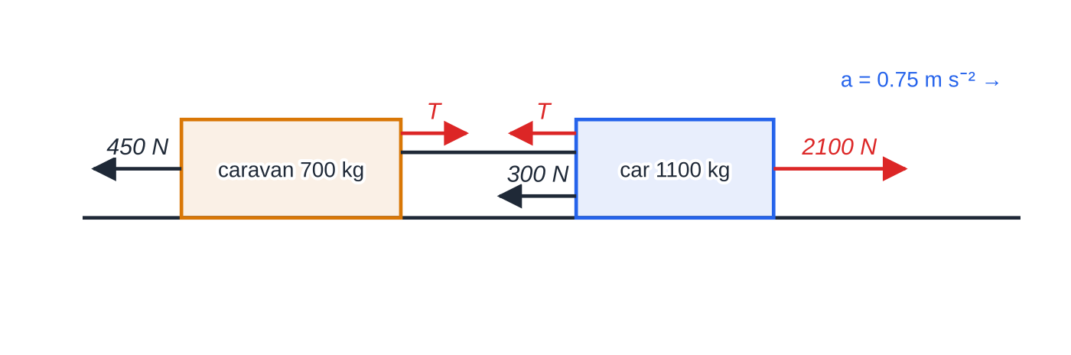
How do you model lifts and towed vehicles? (continued)
Section 5 of 12 · Worked example 6 · Medium · Find, state
WORKED EXAMPLE · QUESTION
A car of mass 1100 kg tows a caravan of mass 700 kg along a straight horizontal road by a light rigid tow bar. The resistances to motion are constant: 300 N on the car and 450 N on the caravan. (a) The engine produces a driving force of 2100 N. Find the acceleration and the tension in the tow bar. (b) The driver switches off the engine and brakes, and the car and caravan decelerate at 1.5 m s⁻². Find the force in the tow bar, stating whether it is a tension or a thrust, and the braking force on the car.
Horizontal forces while the engine drives. The tension T pulls the caravan forwards and the car backwards (third law).
Notes:
How do you model lifts and towed vehicles?: Worked example 6. Full notes: https://examinerprep.com/notes/edexcel-ial-maths/dynamics-newtons-laws-connected-particles-and-friction/

Slide 25
How do you model lifts and towed vehicles? (continued)
Section 5 of 12 · Worked example 6 · Medium · Find, state (continued)
SOLUTION
(a) Whole system: 2100 - 300 - 450 = 1800a ⇒ a = 0.75 m s⁻². Caravan alone: T - 450 = 700 ×0.75 ⇒ T = 975 N (check, car: 2100 - 300 - 975 = 825 = 1100 ×0.75 ✓).
(b) Caravan alone, with the tow-bar force S pushing backwards on it: S + 450 = 700 ×1.5 ⇒ S = 600 N, a thrust. Car alone, where the thrust pushes the car forwards: B + 300 - 600 = 1100 ×1.5 ⇒ B = 1950 N
Notes:
How do you model lifts and towed vehicles?: Worked example 6. Full notes: https://examinerprep.com/notes/edexcel-ial-maths/dynamics-newtons-laws-connected-particles-and-friction/

Slide 26
How do you model lifts and towed vehicles? (continued)
Section 5 of 12
Exam tip 2 — a negative tension is a thrust
If you assume a tension and your answer comes out negative, the tow bar is in thrust. Say so in words: “the force in the tow bar is a thrust of 600 N”.
Notes:
How do you model lifts and towed vehicles?. Full notes: https://examinerprep.com/notes/edexcel-ial-maths/dynamics-newtons-laws-connected-particles-and-friction/

Slide 27
How do you solve connected particles over a pulley?
Section 6 of 12
Light string: same tension along its whole length. Inextensible: both particles move with the same speed and the same size of acceleration. Smooth pulley or peg: the tension is the same on both sides.
Draw a separate force diagram for each particle and write F = ma for each in its own direction of motion. Adding the two equations removes T and gives a; substitute back for T.
You may not treat the two particles as one body unless they move along the same straight line: the string turns a corner at the pulley.
Force on the pulley: the two parts of the string each pull on it with tension T. Their resultant bisects the angle between the strings, with magnitude 2Tcos(θ/2), where θ is the angle between the two parts of the string.
Notes:
How do you solve connected particles over a pulley?. Full notes: https://examinerprep.com/notes/edexcel-ial-maths/dynamics-newtons-laws-connected-particles-and-friction/

Slide 28
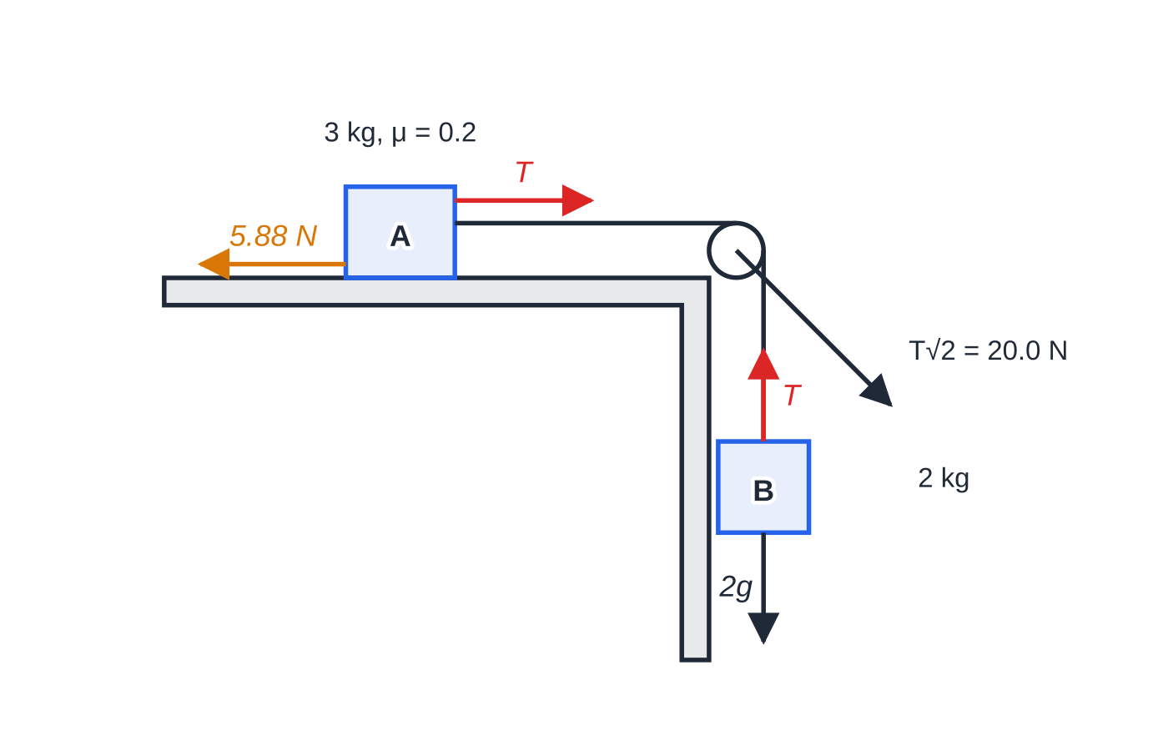
How do you solve connected particles over a pulley? (continued)
Section 6 of 12 · Worked example 7 · Medium · Find
WORKED EXAMPLE · QUESTION
A particle A of mass 3 kg lies on a rough horizontal table. The coefficient of friction between A and the table is 0.2. A is attached to a light inextensible string that passes over a small smooth pulley fixed at the edge of the table; the other end carries a particle B of mass 2 kg, which hangs freely. The string between A and the pulley is horizontal. The system is released from rest. Find (a) the acceleration of the particles, (b) the tension in the string, (c) the magnitude and direction of the force exerted by the string on the pulley.
The string pulls A towards the pulley and B upwards with the same 14.1 N. On the pulley, the horizontal and vertical parts of the string combine to give T√2 = 20.0 N at 45° below the horizontal.
Notes:
How do you solve connected particles over a pulley?: Worked example 7. Full notes: https://examinerprep.com/notes/edexcel-ial-maths/dynamics-newtons-laws-connected-particles-and-friction/

Slide 29
How do you solve connected particles over a pulley? (continued)
Section 6 of 12 · Worked example 7 · Medium · Find (continued)
SOLUTION
Friction on A (resolving vertically for A, R = 3g): F = 0.2 ×3g = 5.88 N.
One equation per particle: B (down): 2g - T = 2a; A (towards the pulley): T - 5.88 = 3a.
(a) Add: 2g - 5.88 = 5a ⇒a = 0.28g = 2.74 m s⁻² (2.744)
(b) T = 2(g - a) = 1.44g = 14.1 N (14.112)
(c) Two tensions at 90° to each other: √(T² + T²) = T√2 = 20.0 N, at 45° below the horizontal, towards the table side
Notes:
How do you solve connected particles over a pulley?: Worked example 7. Full notes: https://examinerprep.com/notes/edexcel-ial-maths/dynamics-newtons-laws-connected-particles-and-friction/

Slide 30
How do you solve connected particles over a pulley? (continued)
Section 6 of 12
Common error
Taking the tension as the weight of the hanging particle (here 19.6 N). That is true only if B is not accelerating. While B accelerates downwards, the tension must be less than its weight.
Notes:
How do you solve connected particles over a pulley?. Full notes: https://examinerprep.com/notes/edexcel-ial-maths/dynamics-newtons-laws-connected-particles-and-friction/

Slide 31
What happens when a force changes during the motion?
Section 7 of 12
In M1 a force does not vary smoothly; it switches from one constant value to another. Each stage has constant acceleration, so the suvat formulae apply within each stage, and the link between stages is the velocity at the instant of change.
Hanging particle hits the ground: it stops; the string goes slack, so T = 0 for the other particle, which carries on with its speed at that instant, acted on only by its weight, friction and the normal reaction.
String breaks: T = 0 from that instant for both particles. A pulling force removed: recompute R and the friction too.
A sketch of the velocity–time graph keeps the stages straight: straight segments, with a change of gradient at each change of force.
Notes:
What happens when a force changes during the motion?. Full notes: https://examinerprep.com/notes/edexcel-ial-maths/dynamics-newtons-laws-connected-particles-and-friction/

Slide 32
What happens when a force changes during the motion? (continued)
Section 7 of 12 · Worked example 8 · Hard · Find
WORKED EXAMPLE · QUESTION
A particle A of mass 2 kg rests on a rough plane inclined at 30° to the horizontal. The coefficient of friction between A and the plane is 0.25. A is attached to a light inextensible string that runs parallel to a line of greatest slope, over a small smooth pulley fixed at the top of the plane, to a particle B of mass 3 kg. B hangs freely 1.2 m above the ground. The system is released from rest with the string taut, and A does not reach the pulley. (a) Find the acceleration of the system and the tension in the string. (b) Find the magnitude of the force exerted by the string on the pulley. (c) Find the speed of B as it hits the ground. (d) B does not rebound. Find the further distance A moves up the plane before it first comes to rest.
Notes:
What happens when a force changes during the motion?: Worked example 8. Full notes: https://examinerprep.com/notes/edexcel-ial-maths/dynamics-newtons-laws-connected-particles-and-friction/

Slide 33
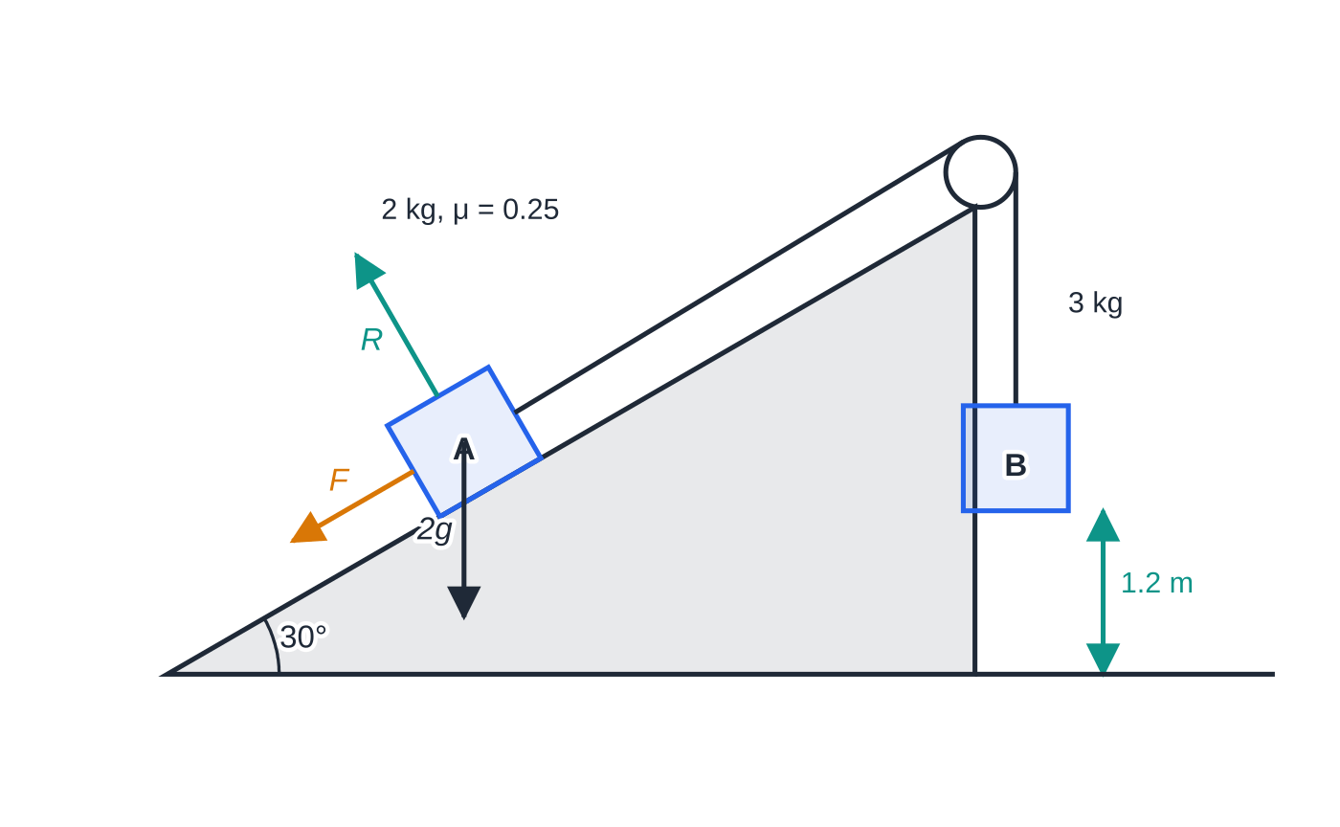
What happens when a force changes during the motion? (continued)
Section 7 of 12 · Worked example 8 · Hard · Find (continued)
The system while the string is taut. Friction on A acts down the plane because A moves up it; B starts 1.2 m above the ground.
Notes:
What happens when a force changes during the motion?: Worked example 8. Full notes: https://examinerprep.com/notes/edexcel-ial-maths/dynamics-newtons-laws-connected-particles-and-friction/

Slide 34
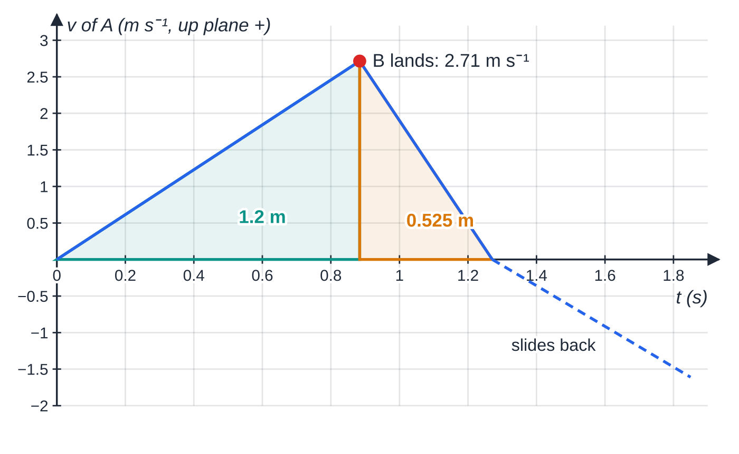
What happens when a force changes during the motion? (continued)
Section 7 of 12 · Worked example 8 · Hard · Find (continued)
SOLUTION
Normal reaction and friction on A: R = 2gcos 30° = 16.97 N, F = 0.25R = 4.244 N.
(a) B: 3g - T = 3a; A: T - 2gsin 30° - 4.2435 = 2a. Adding: 29.4 - 9.8 - 4.2435 = 5a ⇒ a = 3.07 m s⁻² (3.0713); T = 3(g - a) = 20.2 N
(b) The two parts of the string make 60° with each other (one along the plane at 30° above the horizontal, one vertical): 2Tcos 30° = T√3 = 35.0 N (34.96)
(c) B falls 1.2 m from rest with a = 3.0713…: v² = 2 ×3.0713 ×1.2 = 7.371 ⇒ v = 2.71 m s⁻¹
Velocity of A, up the plane positive. The shaded areas are the 1.2 m moved while the string is taut and the further 0.525 m after B lands. A then slides back (2.78 m s⁻² down the plane, friction now up the plane) until the string is taut again.
Notes:
What happens when a force changes during the motion?: Worked example 8. Full notes: https://examinerprep.com/notes/edexcel-ial-maths/dynamics-newtons-laws-connected-particles-and-friction/

Slide 35
What happens when a force changes during the motion? (continued)
Section 7 of 12 · Worked example 8 · Hard · Find (continued)
(d) The string is slack, so for A only its weight component and friction act along the plane, both down it: -(gsin 30° + 0.25gcos 30°) = a ⇒a = -7.022 m s⁻². Then 0 = 7.371 - 2 ×7.022 ×s ⇒ s = 0.525 m
Use the unrounded v² = 7.3711 here; rounding v to 2.71 first gives 0.523 m, which shows how early rounding drifts. The mass of A cancels in (d): once the string is slack, A's motion does not depend on B at all.
Notes:
What happens when a force changes during the motion?: Worked example 8. Full notes: https://examinerprep.com/notes/edexcel-ial-maths/dynamics-newtons-laws-connected-particles-and-friction/

Slide 36
What happens when a force changes during the motion? (continued)
Section 7 of 12
Exam tip 3 — label each stage
Write “string taut”, “string slack” before you start, and list u, v, a, s, t for each stage. The reasoning at the change of stage, such as stating that the tension becomes zero, is part of the answer, so write it down.
Notes:
What happens when a force changes during the motion?. Full notes: https://examinerprep.com/notes/edexcel-ial-maths/dynamics-newtons-laws-connected-particles-and-friction/

Slide 37
Exam tips for M1.3
Section 8 of 12
Exam tip 4 — one diagram per particle
Draw a separate force diagram for each particle, with every force labelled and the direction of the acceleration marked. A missing force, or one pointing the wrong way, spoils a whole equation and everything that follows from it.
Exam tip 5 — resolve in two directions, every time
Perpendicular to the motion gives R (acceleration zero); along the motion gives F = ma. Write each equation as “resolving parallel to the plane: …” so that each one stands on its own. Keep at least four significant figures in intermediate values and give final answers to 2 or 3, since g is only given to 2.
Notes:
Exam tips for M1.3. Full notes: https://examinerprep.com/notes/edexcel-ial-maths/dynamics-newtons-laws-connected-particles-and-friction/

Slide 38
Exam tips for M1.3 (continued)
Section 8 of 12
Exam tip 6 — “show that” answers
When a value is given (“show that the acceleration is 0.28g”), every step must appear, with the forces substituted before simplifying. Then use the given value in the following parts, even if your own answer differed.
Notes:
Exam tips for M1.3. Full notes: https://examinerprep.com/notes/edexcel-ial-maths/dynamics-newtons-laws-connected-particles-and-friction/

Slide 39
Common misconceptions
Section 9 of 12
Misconception | Why it is wrong | Correct idea
The normal reaction always equals mg. | Slopes and angled pulls change the perpendicular balance. | Resolve perpendicular to the motion: R = mgcos α on a slope, R = mg - Psin θ for an upward pull.
Friction acts in a fixed direction on a given slope. | Friction opposes the relative motion. | Down the plane while moving up; up the plane while moving down.
The tension equals the weight of the hanging particle. | That would make the resultant force on it zero. | While it accelerates down, T <mg; find T from mg - T = ma.
A lift going up always has R >mg. | The sign depends on the acceleration, not the velocity. | Slowing on the way up: acceleration downwards, so R <mg.
After a string breaks, the particle stops at once. | No force can change the velocity instantly. | It keeps its speed at that instant and starts a new stage with new forces.
Notes:
Common misconceptions. Full notes: https://examinerprep.com/notes/edexcel-ial-maths/dynamics-newtons-laws-connected-particles-and-friction/

Slide 40
Common misconceptions (continued)
Section 9 of 12
Misconception | Why it is wrong | Correct idea
The force on a pulley is 2T whatever the set-up. | The two tensions add as vectors. | 2T only when both strings are parallel; otherwise 2Tcos(θ/2).
Notes:
Common misconceptions. Full notes: https://examinerprep.com/notes/edexcel-ial-maths/dynamics-newtons-laws-connected-particles-and-friction/

Slide 41
How this topic connects
Section 10 of 12
M1.2 Kinematics and M1.1 Vectors
F = ma supplies the constant acceleration that the suvat formulae need, and the i, j methods carry straight over to forces.
M1.4 Momentum and M1.5 Statics
When a slack string becomes taut again, the sudden jerk is a momentum problem. A particle at rest on a rough surface, where friction can take any value up to μR, belongs to statics.
M2 and IAL Physics Unit 1
The same pulley and slope systems are solved with work and energy in M2. Free-body diagrams, lifts, towing and Newton's third law appear in Physics too, with g = 9.81 N kg⁻¹ instead of 9.8 m s⁻².
Notes:
How this topic connects. Full notes: https://examinerprep.com/notes/edexcel-ial-maths/dynamics-newtons-laws-connected-particles-and-friction/

Slide 42
Key formulae
Section 11 of 12
Formula | Use | In the formulae list?
F = ma · F = ma | Resultant force and acceleration, scalar or vector | No — learn it
W = mg | Weight, g = 9.8 m s⁻² | No — learn it
F = μR | Friction on a moving particle | No — learn it
R = mgcos α; mgsin α along the slope | Particle on a plane at angle α | No — derive it
2Tcos(θ/2) | Force of a string on a smooth pulley, θ = angle between the two parts of the string | No — derive it
v = u + at, s = ut + ½at², v² = u² + 2as, … | Each stage of constant acceleration | No — learn them
Notes:
Key formulae. Full notes: https://examinerprep.com/notes/edexcel-ial-maths/dynamics-newtons-laws-connected-particles-and-friction/

Slide 43
Check your understanding
Section 12 of 12
1. The only force on a particle of mass 3 kg is (6i - 9j) N. Find the magnitude of its acceleration.
2. A box slides across a rough horizontal floor with no other horizontal force acting. The coefficient of friction is 0.4. Find its deceleration.
3. A particle slides down a smooth plane inclined at 20° to the horizontal. Find its acceleration.
4. Particles of mass 4 kg and 6 kg hang at the ends of a light inextensible string over a smooth fixed pulley and are released from rest. Find the acceleration and the tension.
5. Why can the tension be taken as the same on both sides of a smooth pulley?
Notes:
Check your understanding: questions. Full notes: https://examinerprep.com/notes/edexcel-ial-maths/dynamics-newtons-laws-connected-particles-and-friction/

Slide 44
Check your understanding · answers
Section 12 of 12
1. a = (2i - 3j) m s⁻², so |a| = √13 = 3.61 m s⁻².
2. R = mg, so friction = 0.4mg and the deceleration is 0.4g = 3.92 m s⁻². The mass cancels.
3. a = gsin 20° = 3.35 m s⁻² down the plane.
4. 6g - T = 6a and T - 4g = 4a, so a = 2g/10 = 1.96 m s⁻² and T = 4(g + a) = 47.0 N.
5. The string is light (no mass, so no resultant force is needed to accelerate it) and the pulley is smooth (no friction between string and pulley), so nothing changes the tension as the string passes over.
Notes:
Check your understanding: answers. Full notes: https://examinerprep.com/notes/edexcel-ial-maths/dynamics-newtons-laws-connected-particles-and-friction/

Slide 45
Practice questions
2 original exam-style questions. Answers at the end of the deck.

Slide 46
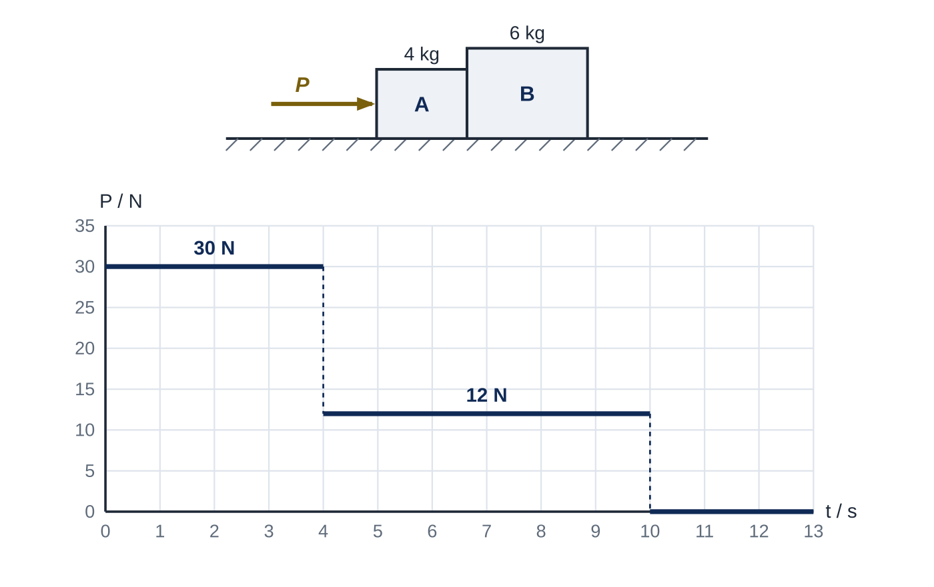
Question 1
9 marks
Two boxes A and B, of masses 4 kg and 6 kg, are at rest in contact on a rough horizontal floor. The coefficient of friction between each box and the floor is 0.1. A horizontal force of magnitude P newtons is applied to A, pushing it against B as shown in Figure 1, which also shows how P varies with the time t seconds. The boxes are modelled as particles moving along the same straight line. Take g = 9.8 m s⁻².
(a) Find the acceleration of the boxes for 0 < t < 4. [2]
(b) Find the magnitude of the force exerted by A on B for 0 < t < 4. [2]
(c) Find the speed of the boxes at t = 10. [3]
(d) For t > 10, explain why the force between the boxes is zero, and find the time taken for the boxes to come to rest after t = 10. [2]
Notes:
Online with the full mark scheme: https://examinerprep.com/ial-maths-m1-3-dynamics-newtons-laws-connected-particles-and-friction-questions#IALM-M1-3-FB-09

Slide 47
Question 2
6 marks
A small box slides in a straight line across a rough horizontal warehouse floor. It passes a point A with speed 6 m s⁻¹ and comes to rest 9 m beyond A. No force other than friction acts on the box horizontally. The box is modelled as a particle. Take g = 9.8 m s⁻².
(a) Find the deceleration of the box. [2]
(b) Find the coefficient of friction between the box and the floor. [3]
(c) A second box of twice the mass slides on the same floor with the same coefficient of friction. It passes A with speed 6 m s⁻¹. State how far beyond A it comes to rest, giving a reason. [1]
Notes:
Online with the full mark scheme: https://examinerprep.com/ial-maths-m1-3-dynamics-newtons-laws-connected-particles-and-friction-questions#IALM-M1-3-B-04

Slide 48
Answers

Slide 49
Question 1 · answer
Mark scheme
both boxes: 30 − 0.1 × 10g = 10a
a = 2.02 m s⁻²
B: C − 0.1 × 6g = 6 × 2.02
C = 18.0 N
at t = 4: v = 2.02 × 4 = 8.08 m s⁻¹
for 4 < t < 10: 12 − 9.8 = 10a, a = 0.22 m s⁻²
v = 8.08 + 0.22 × 6 = 9.40 m s⁻¹
each box on its own would decelerate at μg = 0.98 m s⁻², the same for both, so neither needs a push from the other
Notes:
Full mark scheme: https://examinerprep.com/ial-maths-m1-3-dynamics-newtons-laws-connected-particles-and-friction-questions#IALM-M1-3-FB-09

Slide 50
Question 2 · answer
Mark scheme
0 = 6² − 2 × a × 9
a = 2 m s⁻²
resolving vertically: R = mg
μmg = m × 2
μ = 2 ÷ 9.8 = 0.204
9 m, because the mass cancels: the deceleration μg does not depend on the mass
Notes:
Full mark scheme: https://examinerprep.com/ial-maths-m1-3-dynamics-newtons-laws-connected-particles-and-friction-questions#IALM-M1-3-B-04

Slide 51
Keep practising
Notes for this topic
Questions on this topic
Build a printable test
ExaminerPrep is an independent tutoring service. It has been developed independently from and is not endorsed by the International Baccalaureate Organization. "International Baccalaureate", "IB" and "IB Diploma Programme" are registered trademarks of the IBO, used here for descriptive purposes only.
Pearson Edexcel and Cambridge are trademarks of their owners; ExaminerPrep is not affiliated with any exam board.

