Slide 1
EP
EDEXCEL IAL MATHS
P3.5 Exponential and logarithmic functions
The full notes page in 13 sections · practice questions with answers · simulations
ExaminerPrep is an independent tutoring service. It has been developed independently from and is not endorsed by the International Baccalaureate Organization. "International Baccalaureate", "IB" and "IB Diploma Programme" are registered trademarks of the IBO, used here for descriptive purposes only.
Pearson Edexcel and Cambridge are trademarks of their owners; ExaminerPrep is not affiliated with any exam board.
Notes:
P3.5 Exponential and logarithmic functions. Notes for this topic: https://examinerprep.com/notes/edexcel-ial-maths/exponential-and-logarithmic-functions/

Slide 2
What this page covers
Overview
The number e, the graph of y = eˣ, and the gradient property of eᵏˣ
Sketching y = eᵃˣ⁺ᵇ + c: intercepts, asymptote and range
ln x as the inverse of eˣ, and graphs of y = ln(ax + b) + c
Exact solutions of eᵃˣ⁺ᵇ = p, ln(ax + b) = q and equations that reduce to them
Log graphs to estimate a and n in y = axⁿ, and k and b in y = kbˣ
Exponential growth and decay models: initial value, long-term behaviour and rates of change
d/dx(aˣ) = aˣln a, limitations of models and sensible refinements
Notes:
What this page covers. Full notes: https://examinerprep.com/notes/edexcel-ial-maths/exponential-and-logarithmic-functions/

Slide 3
In one minute
Key points
1. The number e ≈2.718 is the base for which the gradient of y = eˣ equals its height at every point, and its inverse, the natural logarithm ln x, lets you solve exponential equations exactly, straighten curved data and analyse growth and decay models.
2. d/dx(eᵏˣ) = keᵏˣ. The curve y = eᵃˣ⁺ᵇ + c has horizontal asymptote y = c, y-intercept eᵇ + c and range y > c.
3. ln x = logₑ x undoes eˣ: e^(ln x) = x for x > 0 and ln(eˣ) = x. Its graph is the reflection of y = eˣ in y = x.
4. To solve, isolate the exponential or the log, then take ln (or exponentiate): eᵃˣ⁺ᵇ = p ⇒x = (ln p - b)/a; ln(ax + b) = q ⇒x = (e^q - b)/a.
5. y = axⁿ ⇒log y = log a + nlog x: plot log y against log x. y = kbˣ ⇒log y = log k + xlog b: plot log y against x.
6. In a model y = A + Be⁻ᵏᵗ, put t = 0 for the initial value; as t →∞, e⁻ᵏᵗ →0 so y →A.
Notes:
In one minute. Full notes: https://examinerprep.com/notes/edexcel-ial-maths/exponential-and-logarithmic-functions/

Slide 4
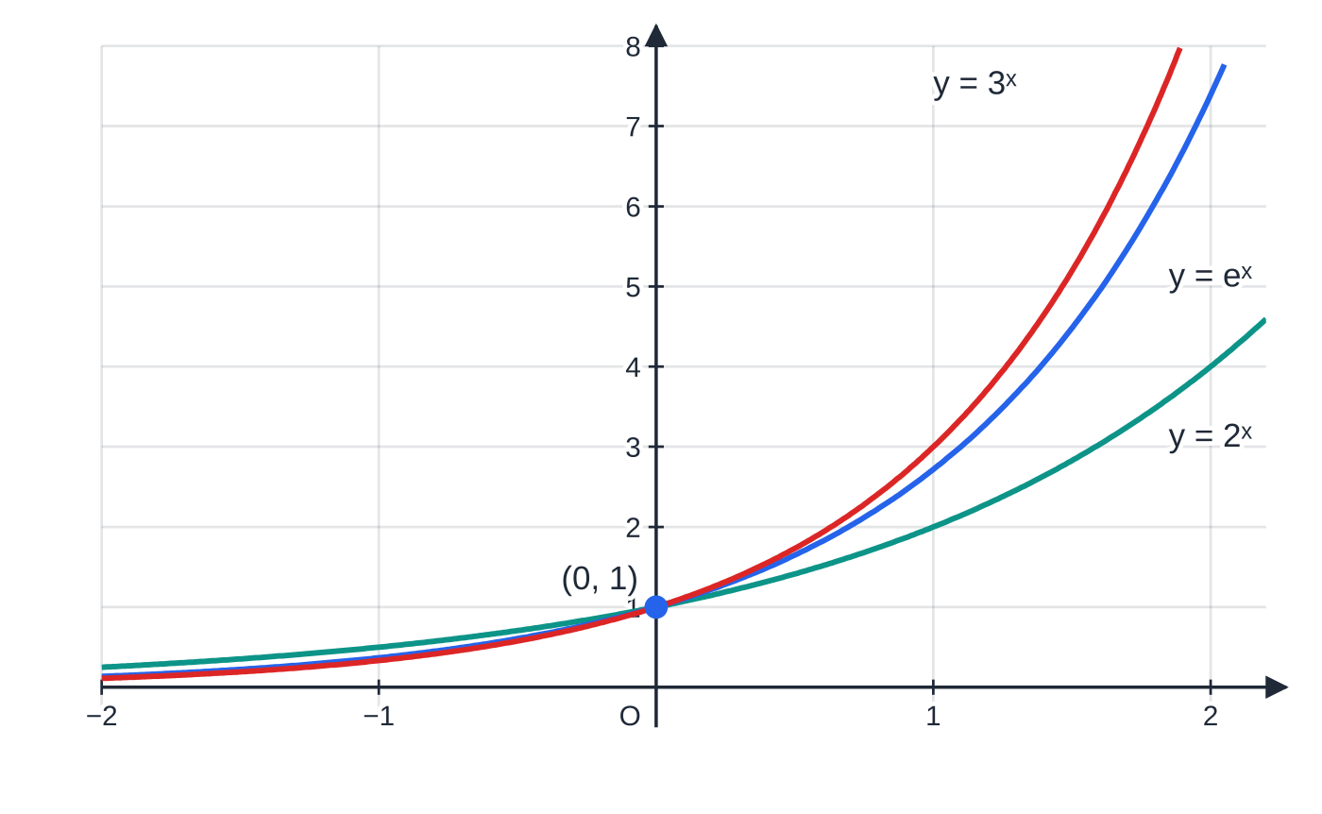
What is the number e, and what does y = eˣ look like?
Section 1 of 13
Every exponential curve y = aˣ with a > 1 passes through (0, 1), stays above the x-axis and gets steeper as x increases. A less obvious fact is that its gradient is always proportional to its height. For a = 2 the gradient is about 0.69 × height; for a = 3 it is about 1.10 × height. Somewhere between 2 and 3 there is a base for which the gradient equals the height. That base is e = 2.71828…, an irrational number like π.
So d/dx(eˣ) = eˣ, and more generally d/dx(eᵏˣ) = keᵏˣ.
y = 2ˣ, y = eˣ and y = 3ˣ all pass through (0, 1). At that point their gradients are about 0.69, exactly 1, and about 1.10: e is the base that gives gradient 1 there.
Notes:
What is the number e, and what does y = eˣ look like?. Full notes: https://examinerprep.com/notes/edexcel-ial-maths/exponential-and-logarithmic-functions/

Slide 5
What is the number e, and what does y = eˣ look like? (continued)
Section 1 of 13
This is why e is the natural base for growth and decay: a quantity whose rate of change is proportional to its size follows a curve Aeᵏᵗ. The curve y = e⁻ˣ is the reflection of y = eˣ in the y-axis; it also passes through (0, 1) but decreases towards the x-axis.
e also appears as a limit: (1 + 1/n)ⁿ gets closer to e as n grows. It is the value of £1 after a year at 100% interest compounded n times.
n | 1 | 2 | 12 | 365 | 1 000 000
(1 + 1/n)ⁿ | 2.00000 | 2.25000 | 2.61304 | 2.71457 | 2.71828
Notes:
What is the number e, and what does y = eˣ look like?. Full notes: https://examinerprep.com/notes/edexcel-ial-maths/exponential-and-logarithmic-functions/

Slide 6
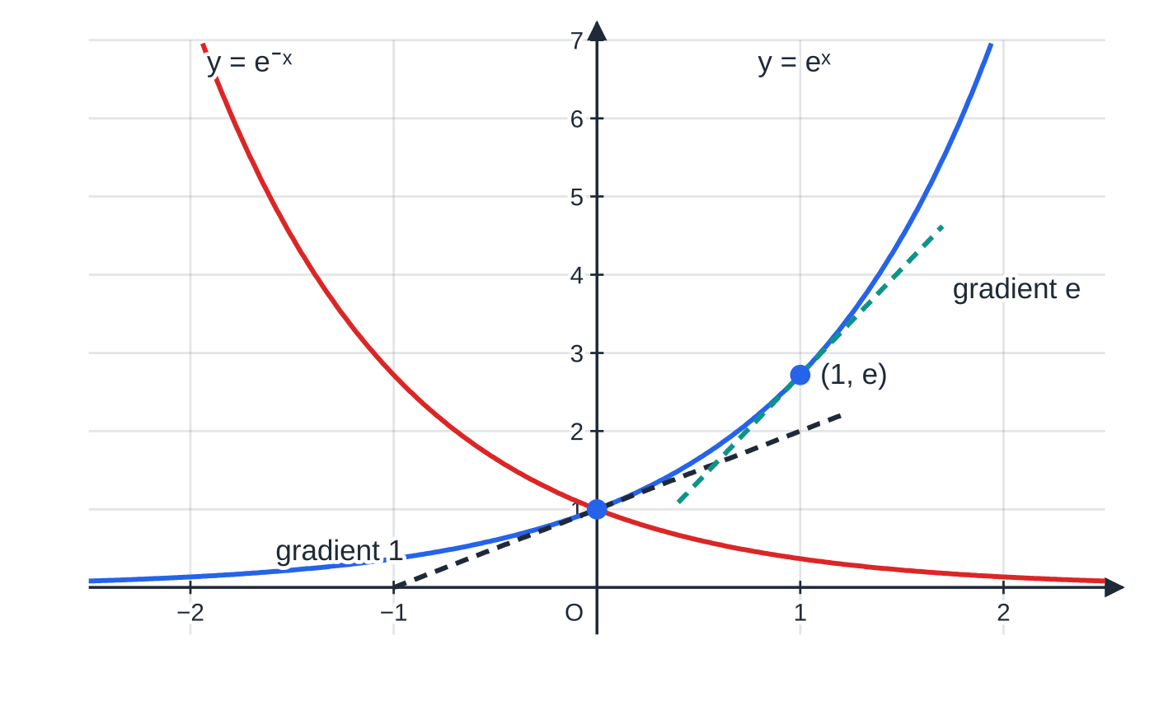
What is the number e, and what does y = eˣ look like? (continued)
Section 1 of 13
Key facts about eˣ. d/dx(eᵏˣ) = keᵏˣ and eˣ > 0 for every x. eˣ →∞ as x →∞; eˣ →0 as x →-∞, never reaching it; e⁰ = 1. The derivative of eᵏˣ is not in the formulae booklet. Harder derivatives such as xeˣ need the product and chain rules (P3.6).
y = eˣ and y = e⁻ˣ, both through (0, 1) with the x-axis as asymptote. The tangent to eˣ at (0, 1) has gradient 1 and at (1, e) has gradient e: the gradient always equals the y-value.
Notes:
What is the number e, and what does y = eˣ look like?. Full notes: https://examinerprep.com/notes/edexcel-ial-maths/exponential-and-logarithmic-functions/

Slide 7
How do you sketch y = eᵃˣ⁺ᵇ + c?
Section 2 of 13
Treat the curve as a transformation of y = eˣ (P3.2): a stretches it horizontally (and reflects it in the y-axis if a < 0), b shifts it sideways, and c shifts it up or down. Three questions then give the whole sketch.
Asymptote: it moves with the vertical shift, so it is the line y = c. Draw it dashed and label it.
Intercepts: put x = 0 for eᵇ + c. For the x-intercept put y = 0 and solve eᵃˣ⁺ᵇ = -c; it exists only if c < 0, because the curve must start below the axis to cross it.
Range: eᵃˣ⁺ᵇ > 0, so y > c. If the exponential is multiplied by a negative number, as in y = 5 - 2e⁻ˣ, the curve lies below its asymptote and the range is y < 5.
If a > 0 the curve rises to the right and approaches y = c on the left; if a < 0 it is the other way round.
Notes:
How do you sketch y = eᵃˣ⁺ᵇ + c?. Full notes: https://examinerprep.com/notes/edexcel-ial-maths/exponential-and-logarithmic-functions/

Slide 8
How do you sketch y = eᵃˣ⁺ᵇ + c? (continued)
Section 2 of 13 · Worked example 1 · Medium · Sketch
WORKED EXAMPLE · QUESTION
The curve C has equation y = e^(½x+1) - 2. Sketch C, giving the exact coordinates of the points where it meets the axes and the equation of its asymptote. State the range of values of y.
SOLUTION
y-intercept: x = 0 gives y = e - 2, so (0, e - 2) (≈ 0.718).
x-intercept: isolate the exponential, then take ln. e^(½x+1) = 2 ⇒½x + 1 = ln 2 ⇒x = 2ln 2 - 2, so (2ln 2 - 2, 0) (≈ −0.614).
As x →-∞, e^(½x+1) →0: asymptote y = -2, range y > -2. The sketch is an increasing curve, flattening onto y = -2 on the left.
Notes:
How do you sketch y = eᵃˣ⁺ᵇ + c?: Worked example 1. Full notes: https://examinerprep.com/notes/edexcel-ial-maths/exponential-and-logarithmic-functions/

Slide 9
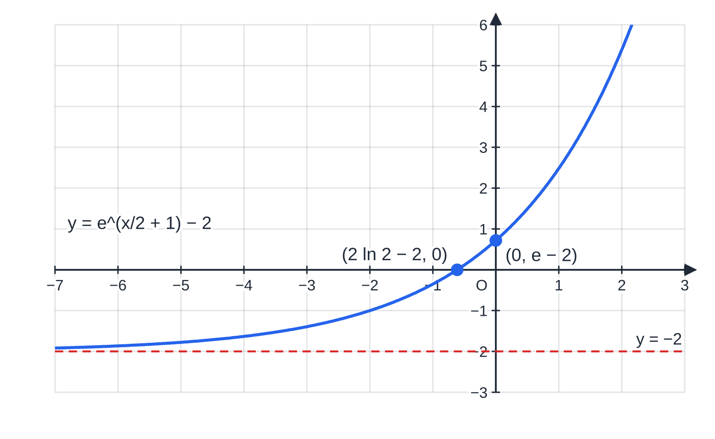
How do you sketch y = eᵃˣ⁺ᵇ + c? (continued)
Section 2 of 13
Common error — the asymptote out of habit
Drawing the curve crossing its asymptote, or putting the asymptote at y = 0 because that is where eˣ's is. The asymptote is at y = c; label it with its equation and leave a visible gap between the curve and the line.
The sketch for Worked example 1. The curve never reaches its asymptote y = −2; both intercepts are given exactly, with decimals only as a check.
Notes:
How do you sketch y = eᵃˣ⁺ᵇ + c?. Full notes: https://examinerprep.com/notes/edexcel-ial-maths/exponential-and-logarithmic-functions/

Slide 10
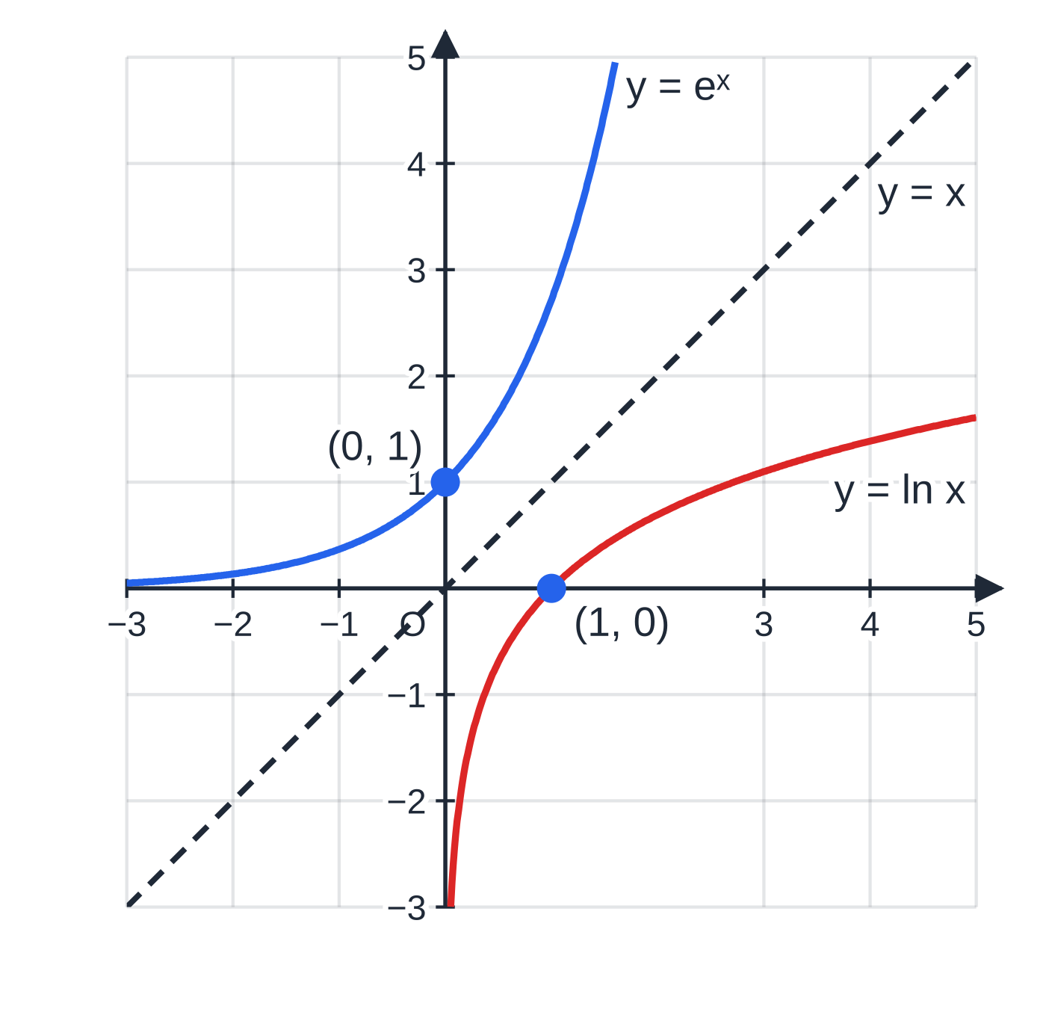
What is ln x, and how is its graph related to eˣ?
Section 3 of 13
The natural logarithm ln x is logₑ x: the power you raise e to in order to get x. So y = ln x ⇔x = eʸ. This makes ln and the exponential inverse functions, each undoing the other: ln(eˣ) = x for every real x, and e^(ln x) = x for x > 0. All the P2 laws of logarithms hold for ln: ln ab = ln a + ln b, ln a/b = ln a - ln b, ln aᵏ = kln a, ln 1 = 0 and ln e = 1.
Because they are inverses, the graph of y = ln x is the reflection of y = eˣ in the line y = x: every point (p, q) on one matches (q, p) on the other. So ln x is defined only for x > 0, passes through (1, 0), and has the y-axis as a vertical asymptote. It increases for ever, but very slowly.
For y = ln(ax + b) + c with a > 0, the same three questions as before give the sketch. You need ax + b > 0, so the domain is x > -b/a and the vertical asymptote is x = -b/a.
Equal scales: y = eˣ and y = ln x are reflections of each other in y = x. The horizontal asymptote of one (the x-axis) becomes the vertical asymptote of the other (the y-axis).
Notes:
What is ln x, and how is its graph related to eˣ?. Full notes: https://examinerprep.com/notes/edexcel-ial-maths/exponential-and-logarithmic-functions/

Slide 11
What is ln x, and how is its graph related to eˣ? (continued)
Section 3 of 13
The y-intercept (only if 0 is in the domain) is ln b + c. The x-intercept comes from ln(ax + b) = -c ⇒ax + b = e⁻ᶜ.
Notes:
What is ln x, and how is its graph related to eˣ?. Full notes: https://examinerprep.com/notes/edexcel-ial-maths/exponential-and-logarithmic-functions/

Slide 12
What is ln x, and how is its graph related to eˣ? (continued)
Section 3 of 13 · Worked example 2 · Medium · Sketch
WORKED EXAMPLE · QUESTION
Sketch the curve with equation y = ln(2x + 6) - 1, stating the equation of its asymptote and the exact coordinates of the points where it meets the coordinate axes.
SOLUTION
Domain: 2x + 6 > 0 ⇒x > -3, so the asymptote is x = -3.
y-intercept: x = 0 gives y = ln 6 - 1, so (0, ln 6 - 1) (≈ 0.792).
x-intercept: isolate the log, then exponentiate. ln(2x + 6) = 1 ⇒2x + 6 = e, so ((e - 6)/2, 0) (≈ −1.64).
Notes:
What is ln x, and how is its graph related to eˣ?: Worked example 2. Full notes: https://examinerprep.com/notes/edexcel-ial-maths/exponential-and-logarithmic-functions/

Slide 13
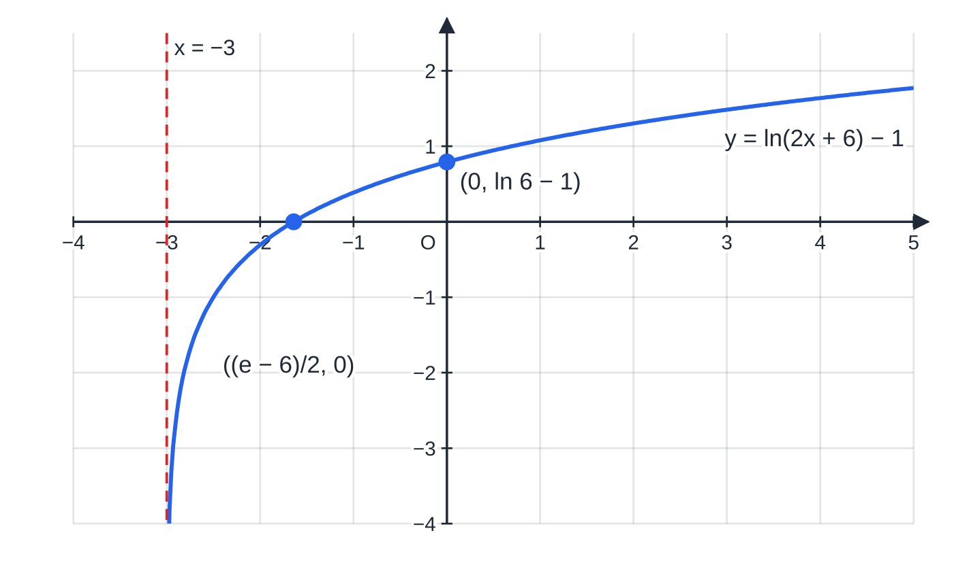
What is ln x, and how is its graph related to eˣ? (continued)
Section 3 of 13
The sketch for Worked example 2: the curve plunges down beside its asymptote x = −3 and rises slowly to the right.
Notes:
What is ln x, and how is its graph related to eˣ?. Full notes: https://examinerprep.com/notes/edexcel-ial-maths/exponential-and-logarithmic-functions/

Slide 14
How do you solve eᵃˣ⁺ᵇ = p and ln(ax + b) = q?
Section 4 of 13
The method has one golden rule: isolate first. Get the exponential (or the logarithm) on its own on one side, with a coefficient of 1. Then:
for an exponential equation, take ln of both sides: eᵃˣ⁺ᵇ = p ⇒ax + b = ln p. This needs p > 0; if p ≤0 there are no solutions, because e to any power is positive;
for a logarithmic equation, raise e to the power of both sides: ln(ax + b) = q ⇒ax + b = e^q. Any real q is allowed.
Exact answers keep ln and e: x = (ln 7 + 2)/3, not 1.315. If an equation contains both e²ˣ and eˣ (or eˣ and e⁻ˣ), it is a quadratic in disguise: let u = eˣ, so e²ˣ = u² and e⁻ˣ = 1/u, and reject any root u ≤0.
Notes:
How do you solve eᵃˣ⁺ᵇ = p and ln(ax + b) = q?. Full notes: https://examinerprep.com/notes/edexcel-ial-maths/exponential-and-logarithmic-functions/

Slide 15
How do you solve eᵃˣ⁺ᵇ = p and ln(ax + b) = q? (continued)
Section 4 of 13 · Worked example 3 · Easy · Find
WORKED EXAMPLE · QUESTION
Find the exact solution of each equation. (a) e³ˣ⁻² = 7 (b) ln(4x - 1) = 2 (c) 5 - 2e⁻ˣ = 1
SOLUTION
(a) Take ln: 3x - 2 = ln 7 ⇒ x = (2 + ln 7)/3 (≈ 1.315).
(b) Exponentiate: 4x - 1 = e² ⇒ x = (e² + 1)/4 (≈ 2.097; check 4x - 1 = e² > 0).
(c) Isolate first: 2e⁻ˣ = 4 ⇒e⁻ˣ = 2 ⇒-x = ln 2 ⇒ x = -ln 2 (or ln½).
Notes:
How do you solve eᵃˣ⁺ᵇ = p and ln(ax + b) = q?: Worked example 3. Full notes: https://examinerprep.com/notes/edexcel-ial-maths/exponential-and-logarithmic-functions/

Slide 16
How do you solve eᵃˣ⁺ᵇ = p and ln(ax + b) = q? (continued)
Section 4 of 13 · Worked example 4 · Medium · Solve
WORKED EXAMPLE · QUESTION
Solve, giving exact answers: (a) e²ˣ - 7eˣ + 12 = 0; (b) eˣ - 6e⁻ˣ = 1.
SOLUTION
(a) Let u = eˣ: u² - 7u + 12 = 0 ⇒(u - 3)(u - 4) = 0 ⇒eˣ = 3 or eˣ = 4. x = ln 3 or x = ln 4 (= 2ln 2).
(b) Multiply every term by eˣ, which is never zero: e²ˣ - 6 = eˣ ⇒u² - u - 6 = 0 ⇒(u - 3)(u + 2) = 0. eˣ = -2 has no solutions since eˣ > 0; eˣ = 3 gives x = ln 3 only.
Notes:
How do you solve eᵃˣ⁺ᵇ = p and ln(ax + b) = q?: Worked example 4. Full notes: https://examinerprep.com/notes/edexcel-ial-maths/exponential-and-logarithmic-functions/

Slide 17
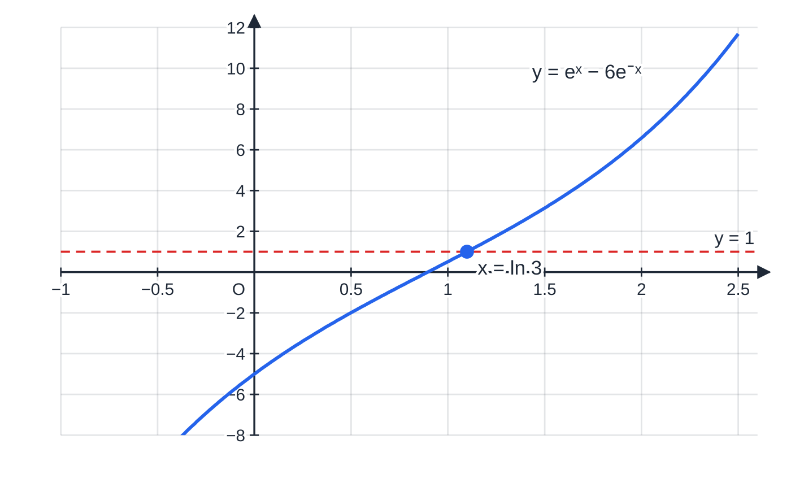
How do you solve eᵃˣ⁺ᵇ = p and ln(ax + b) = q? (continued)
Section 4 of 13
Common error — taking logs term by term
From e²ˣ - 7eˣ + 12 = 0, writing 2x - 7x + ln 12 = 0. ln(A + B) is not ln A + ln B. Take ln of both sides only when each side is a single product or power, here after factorising.
Worked example 4(b): y = eˣ − 6e⁻ˣ is increasing, so it meets y = 1 exactly once, at x = ln 3. The rejected root eˣ = −2 corresponds to no point at all.
Notes:
How do you solve eᵃˣ⁺ᵇ = p and ln(ax + b) = q?. Full notes: https://examinerprep.com/notes/edexcel-ial-maths/exponential-and-logarithmic-functions/

Slide 18
How can a log graph reveal y = axⁿ?
Section 5 of 13
Data from an experiment may follow a curve whose equation is unknown. A straight line is much easier to recognise and measure than a curve, so we change the variables until the graph is straight. If y = axⁿ, take logs (any base, usually 10 or e) of both sides and use the laws of logs:
log y = log a + nlog x
Compare with Y = c + mX: plotting log y against log x gives a straight line with gradient n and intercept log a on the vertical axis. So n is the gradient, and a = 10ⁱⁿᵗᵉʳᶜᵉᵖᵗ (base 10) or eⁱⁿᵗᵉʳᶜᵉᵖᵗ (base e). If the points do not lie close to a straight line, the relationship is not of the form axⁿ.
Notes:
How can a log graph reveal y = axⁿ?. Full notes: https://examinerprep.com/notes/edexcel-ial-maths/exponential-and-logarithmic-functions/

Slide 19
How can a log graph reveal y = axⁿ? (continued)
Section 5 of 13 · Worked example 5 · Medium · Find, estimate
WORKED EXAMPLE · QUESTION
Two variables are thought to satisfy y = axⁿ. Measurements give:
x | 2 | 4 | 8 | 12 | 18
y | 7.5 | 23.4 | 69.2 | 135 | 254
log₁₀x | 0.30 | 0.60 | 0.90 | 1.08 | 1.26
log₁₀y | 0.88 | 1.37 | 1.84 | 2.13 | 2.40
The graph of log₁₀y against log₁₀x is a straight line passing through (0.25, 0.80) and (1.25, 2.40). (a) Find the values of a and n. (b) Estimate y when x = 25.
SOLUTION
(a) log₁₀y = log₁₀a + nlog₁₀x: gradient n, intercept log₁₀a. n = (2.40 - 0.80)/(1.25 - 0.25) = 1.6. Intercept: 0.80 = c + 1.6 ×0.25 ⇒c = 0.40, so a = 10^(0.40) = 2.51 (3 s.f.).
Notes:
How can a log graph reveal y = axⁿ?: Worked example 5. Full notes: https://examinerprep.com/notes/edexcel-ial-maths/exponential-and-logarithmic-functions/

Slide 20
How can a log graph reveal y = axⁿ? (continued)
Section 5 of 13 · Worked example 5 · Medium · Find, estimate (continued)
(b) y = 10^(0.40) ×25^(1.6) ≈ 433. Keep a unrounded here. x = 25 is outside the measured range, so this is an extrapolation and less reliable.
Notes:
How can a log graph reveal y = axⁿ?: Worked example 5. Full notes: https://examinerprep.com/notes/edexcel-ial-maths/exponential-and-logarithmic-functions/

Slide 21
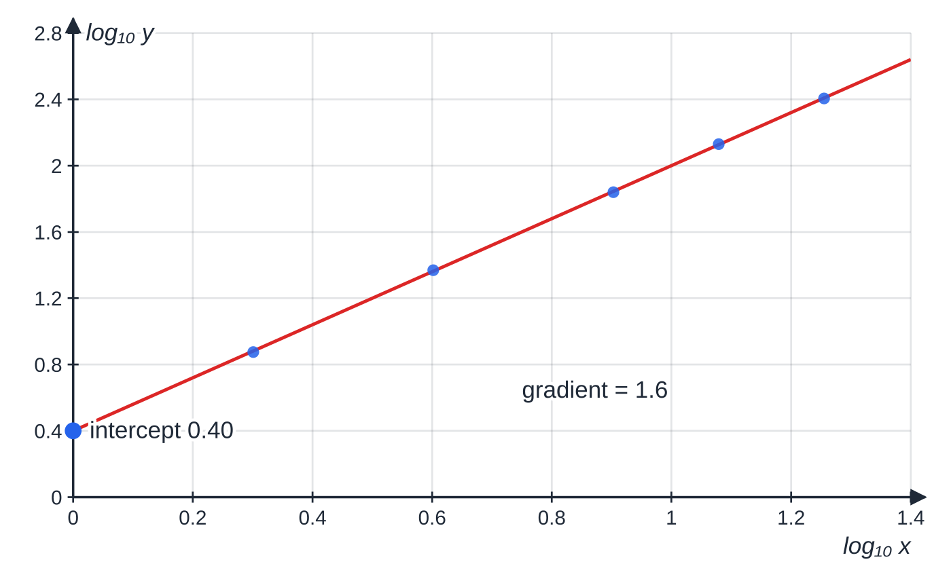
How can a log graph reveal y = axⁿ? (continued)
Section 5 of 13
log₁₀ y against log₁₀ x for the data in Worked example 5. The points lie close to a line of gradient 1.6, so n = 1.6; the intercept 0.40 is log₁₀ a.
Notes:
How can a log graph reveal y = axⁿ?. Full notes: https://examinerprep.com/notes/edexcel-ial-maths/exponential-and-logarithmic-functions/

Slide 22
How can a log graph reveal y = kbˣ?
Section 6 of 13
For an exponential relationship y = kbˣ the unknown is in the power, so taking logs gives
log y = log k + xlog b
Now plot log y against x itself, not log x. The line has gradient log b and intercept log k, so b = 10ᵍʳᵃᵈⁱᵉⁿᵗ (or eᵍʳᵃᵈⁱᵉⁿᵗ) and k = 10ⁱⁿᵗᵉʳᶜᵉᵖᵗ (or eⁱⁿᵗᵉʳᶜᵉᵖᵗ). The quickest way to tell the two models apart: axⁿ is straight on a log–log graph; kbˣ is straight when only the vertical axis is logged. The constant b is the growth factor per unit of x: b = 1.35 means a 35% increase for each unit increase in x, and 0 < b < 1 means decay.
Notes:
How can a log graph reveal y = kbˣ?. Full notes: https://examinerprep.com/notes/edexcel-ial-maths/exponential-and-logarithmic-functions/

Slide 23
How can a log graph reveal y = kbˣ? (continued)
Section 6 of 13 · Worked example 6 · Medium · Find, interpret
WORKED EXAMPLE · QUESTION
The number of bacteria, N, in a culture t hours after it is set up is recorded:
t | 0 | 2 | 4 | 6 | 8
N | 154 | 265 | 508 | 899 | 1671
ln N | 5.04 | 5.58 | 6.23 | 6.80 | 7.42
It is suggested that N = kbᵗ. A line of best fit on a graph of ln N against t passes through (1, 5.31) and (7, 7.11). (a) Find k and b, to 3 significant figures. (b) Interpret b. (c) Use the line to estimate N when t = 10.
SOLUTION
(a) ln N = ln k + tln b: gradient ln b, intercept ln k. Gradient = (7.11 - 5.31)/(7 - 1) = 0.30; intercept = 5.31 - 0.30 = 5.01. b = e^(0.30) = 1.35, k = e^(5.01) = 150.
(b) The number of bacteria is multiplied by about 1.35 each hour, an increase of about 35% per hour.
Notes:
How can a log graph reveal y = kbˣ?: Worked example 6. Full notes: https://examinerprep.com/notes/edexcel-ial-maths/exponential-and-logarithmic-functions/

Slide 24
How can a log graph reveal y = kbˣ? (continued)
Section 6 of 13 · Worked example 6 · Medium · Find, interpret (continued)
(c) ln N = 5.01 + 0.30 ×10 = 8.01 ⇒N = e^(8.01) ≈ 3010. k is the model's value of N at t = 0 (about 150; the recorded value was 154).
Notes:
How can a log graph reveal y = kbˣ?: Worked example 6. Full notes: https://examinerprep.com/notes/edexcel-ial-maths/exponential-and-logarithmic-functions/

Slide 25
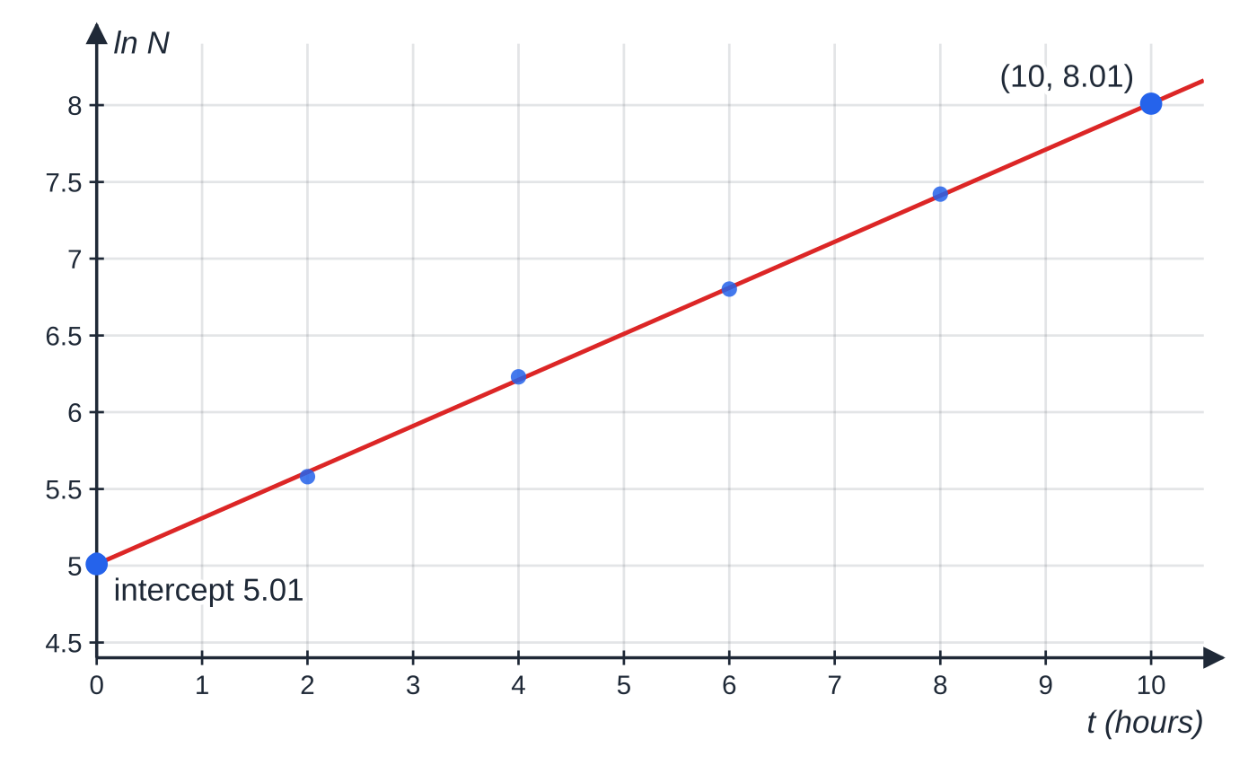
How can a log graph reveal y = kbˣ? (continued)
Section 6 of 13
ln N against t for Worked example 6. Only the vertical axis is logged, because the unknown t is in the power. The vertical axis starts at 4.4, so the intercept is read where the line meets t = 0.
Notes:
How can a log graph reveal y = kbˣ?. Full notes: https://examinerprep.com/notes/edexcel-ial-maths/exponential-and-logarithmic-functions/

Slide 26
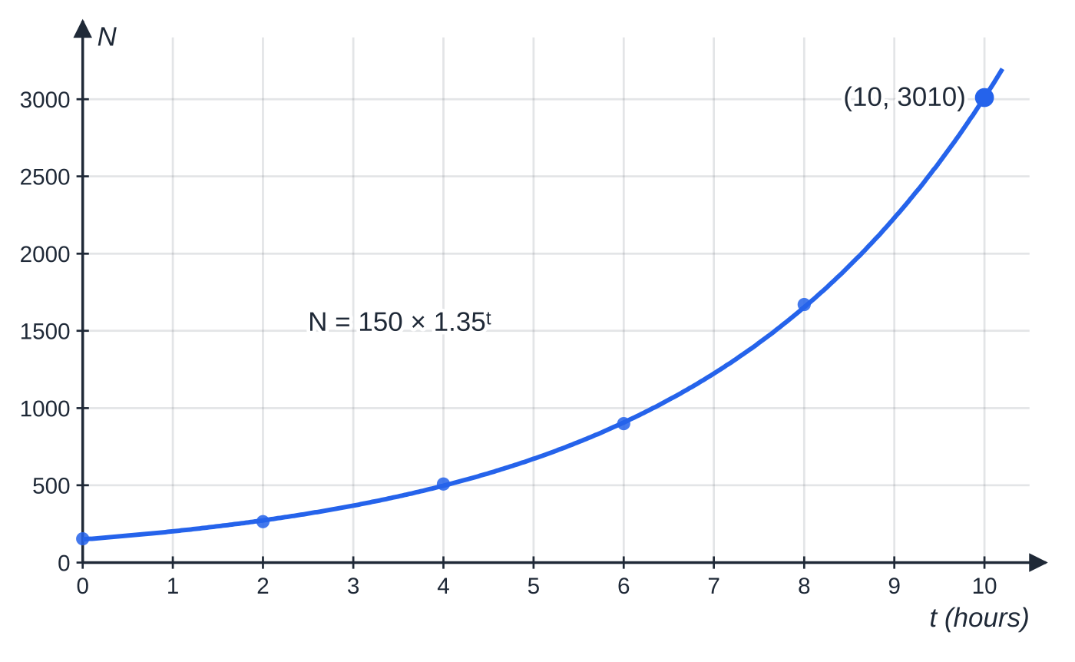
How can a log graph reveal y = kbˣ? (continued)
Section 6 of 13
Exam tip — which log?
Before reading off a gradient, check which logs are used. If the graph is of log₁₀y, undo with 10⁽⁾; if it is ln y, undo with e⁽⁾. Using e⁽⁾ on a base-10 intercept gives a wrong constant.
The same data on ordinary axes: a curve that bends upwards. Logging N straightened it, which is what made k and b easy to read off.
Notes:
How can a log graph reveal y = kbˣ?. Full notes: https://examinerprep.com/notes/edexcel-ial-maths/exponential-and-logarithmic-functions/

Slide 27
How do exponential growth and decay models behave?
Section 7 of 13
A model y = Aeᵏᵗ describes growth if k > 0 and decay if k < 0. Its rate of change is dy/dt = kAeᵏᵗ = ky, proportional to the current amount. Many real quantities settle towards a limit rather than to 0, giving y = L + Be⁻ᵏᵗ with k > 0; a hot drink cooling to room temperature L is the classic example.
Initial value: put t = 0, using e⁰ = 1. For L + Be⁻ᵏᵗ it is L + B.
Long-term behaviour: as t →∞, e⁻ᵏᵗ →0, so y →L. Say it in words, in context: "the temperature tends to 18 °C".
When does y reach a value? Set y equal to it, isolate the exponential and take ln.
Unknown constants: use the information given (often the value at t = 0 and at one other time) to set up equations; the one involving the exponential is solved with ln.
Notes:
How do exponential growth and decay models behave?. Full notes: https://examinerprep.com/notes/edexcel-ial-maths/exponential-and-logarithmic-functions/

Slide 28
How do exponential growth and decay models behave? (continued)
Section 7 of 13 · Worked example 7 · Medium · State, find
WORKED EXAMPLE · QUESTION
The temperature, T °C, of a cup of tea t minutes after it is made is modelled by T = 18 + 72e^(-0.04t), t ≥0. (a) State the initial temperature of the tea. (b) State the temperature the tea approaches in the long term, and what this represents. (c) Find the time taken for the tea to cool to 40 °C. (d) Find the rate at which the temperature is falling when t = 10.
SOLUTION
(a) t = 0: T = 18 + 72 = 90 °C.
(b) e^(-0.04t) →0, so T → 18 °C, the temperature of the room.
(c) 72e^(-0.04t) = 22 ⇒e^(-0.04t) = (11/36) ⇒-0.04t = ln(11/36) ⇒t = 25ln(36/11) = 29.6 minutes. ln(11/36) is negative, so dividing by −0.04 gives a positive time; at t = 30 the model gives 39.7 °C, just below 40, which agrees.
(d) dT/dt = 72 ×(-0.04)e^(-0.04t) = -2.88e^(-0.04t). At t = 10: -2.88e^(-0.4) = -1.93.
Notes:
How do exponential growth and decay models behave?: Worked example 7. Full notes: https://examinerprep.com/notes/edexcel-ial-maths/exponential-and-logarithmic-functions/

Slide 29
How do exponential growth and decay models behave? (continued)
Section 7 of 13 · Worked example 7 · Medium · State, find (continued)
The temperature is falling at 1.93 °C per minute.
Notes:
How do exponential growth and decay models behave?: Worked example 7. Full notes: https://examinerprep.com/notes/edexcel-ial-maths/exponential-and-logarithmic-functions/

Slide 30
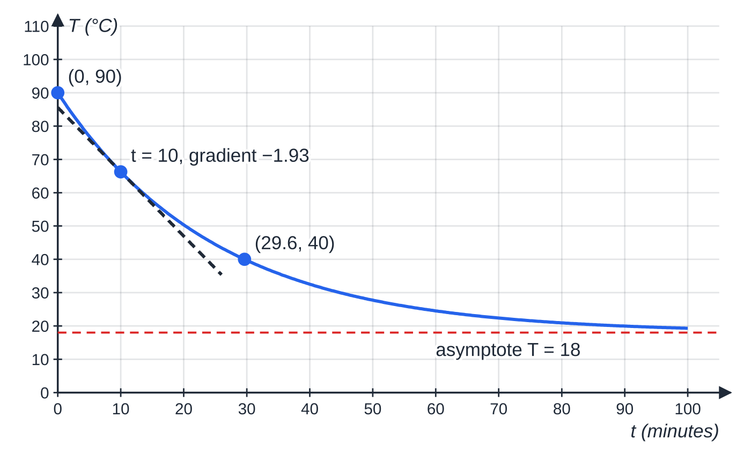
How do exponential growth and decay models behave? (continued)
Section 7 of 13
The cooling model of Worked example 7. The curve starts at 90 °C, falls fastest at the start, and flattens towards the asymptote T = 18. The dashed tangent at t = 10 shows the rate of cooling there.
Notes:
How do exponential growth and decay models behave?. Full notes: https://examinerprep.com/notes/edexcel-ial-maths/exponential-and-logarithmic-functions/

Slide 31
How do you differentiate aˣ, and where do models break down?
Section 8 of 13
Any exponential can be rewritten with base e. Since e^(ln a) = a, we have aˣ = (e^(ln a))ˣ = e^(xln a). Differentiating eᵏˣ with k = ln a gives the result below. For example, the gradient of y = 2ˣ at x = 3 is 8ln 2 ≈5.545.
Derivative of aˣ.
aˣ = e^(xln a) ⇒ d/dx(aˣ) = aˣln a a is a positive constant, and ln a is just a number, the "k" in eᵏˣ. The identity aˣ = e^(xln a) is in the formulae booklet; the derivative aˣln a is not, so derive it.
A model y = Abᵗ ("increases by 60% a month" means b = 1.6) can always be rewritten as Ae^((ln b)t), so everything in the previous section applies. Models are judged by their limitations:
Unlimited growth. Aeᵏᵗ with k > 0 grows without bound; real populations, users or sales are limited by space, food or the size of the market.
Notes:
How do you differentiate aˣ, and where do models break down?. Full notes: https://examinerprep.com/notes/edexcel-ial-maths/exponential-and-logarithmic-functions/

Slide 32
How do you differentiate aˣ, and where do models break down? (continued)
Section 8 of 13
Never reaching zero. A decay model predicts a positive amount for ever; a real quantity eventually becomes negligible, or has a floor such as a scrap value.
Continuous values. The model gives non-integer numbers of people or bacteria.
Constant conditions. The rate constant k is assumed fixed; a change in conditions breaks the model.
Refinements follow from the limitation: add a constant so the model levels off at a realistic limit (y = L - Be⁻ᵏᵗ for a quantity growing towards a maximum L; V = S + Be⁻ᵏᵗ for a value decaying to a floor S), or re-fit the constants to more recent data.
Notes:
How do you differentiate aˣ, and where do models break down?. Full notes: https://examinerprep.com/notes/edexcel-ial-maths/exponential-and-logarithmic-functions/

Slide 33
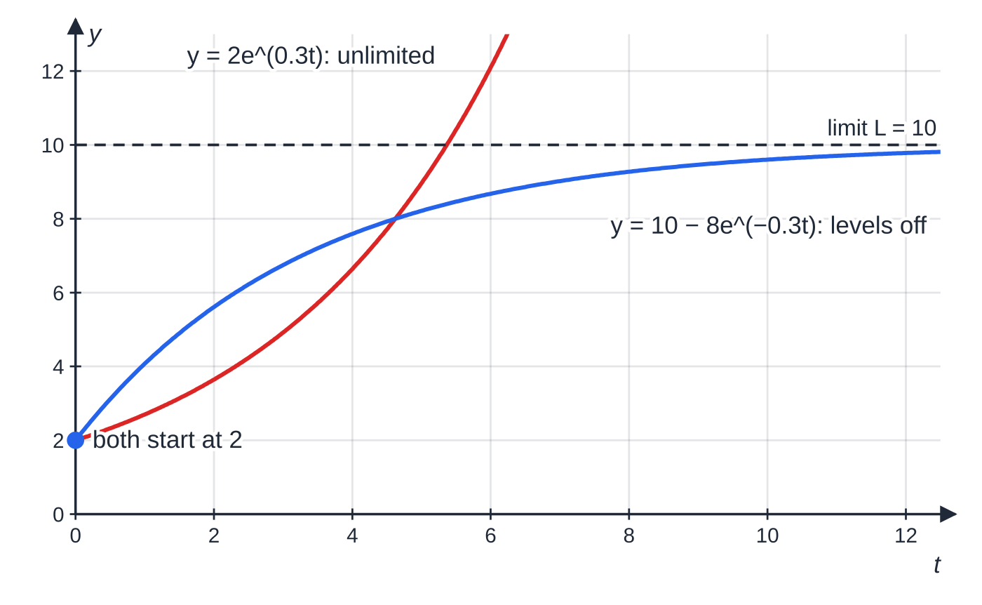
How do you differentiate aˣ, and where do models break down? (continued)
Section 8 of 13
Unlimited exponential growth (red) against a refined model that levels off at a maximum (blue). Both start at the same value, but only the refined model respects a finite limit.
Notes:
How do you differentiate aˣ, and where do models break down?. Full notes: https://examinerprep.com/notes/edexcel-ial-maths/exponential-and-logarithmic-functions/

Slide 34
How do you differentiate aˣ, and where do models break down? (continued)
Section 8 of 13 · Worked example 8 · Hard · Show that, find
WORKED EXAMPLE · QUESTION
After a new app is launched, the number of active users, N, is modelled by N = 500 ×1.6ᵗ, where t is the time in months after launch. (a) State the number of active users at launch. (b) Show that ln N = ln 500 + tln 1.6, and describe the graph of ln N against t. (c) Find the value of t at which the model first predicts 20 000 active users. (d) Using aˣ = e^(xln a), show that dN/dt = 500 ×1.6ᵗln 1.6, and find the rate of increase of users when t = 6. (e) Give one reason why this model is unlikely to be reliable for large t, and suggest how it could be refined.
SOLUTION
(a) 1.6⁰ = 1, so 500 users.
(b) ln N = ln(500 ×1.6ᵗ) = ln 500 + ln 1.6ᵗ = ln 500 + tln 1.6: a straight line with gradient ln 1.6 ≈0.470 and intercept ln 500 ≈6.21 on the ln N axis.
(c) 500 ×1.6ᵗ = 20 000 ⇒1.6ᵗ = 40 ⇒tln 1.6 = ln 40 ⇒t = ln 40/ln 1.6 = 7.85 months.
Notes:
How do you differentiate aˣ, and where do models break down?: Worked example 8. Full notes: https://examinerprep.com/notes/edexcel-ial-maths/exponential-and-logarithmic-functions/

Slide 35
How do you differentiate aˣ, and where do models break down? (continued)
Section 8 of 13 · Worked example 8 · Hard · Show that, find (continued)
(d) N = 500e^(tln 1.6) ⇒dN/dt = 500ln 1.6 ×e^(tln 1.6) = 500 ×1.6ᵗln 1.6, as required. At t = 6: 500 ×16.78 ×0.4700 ≈ 3940 users per month (keep 1.6⁶ = 16.78… unrounded until the end).
(e) The model grows without limit: by t = 12 it predicts about 141 000 users, and the number of possible users is finite. A refinement is a model that levels off at a maximum, for example N = M - Be⁻ᵏᵗ.
Notes:
How do you differentiate aˣ, and where do models break down?: Worked example 8. Full notes: https://examinerprep.com/notes/edexcel-ial-maths/exponential-and-logarithmic-functions/

Slide 36
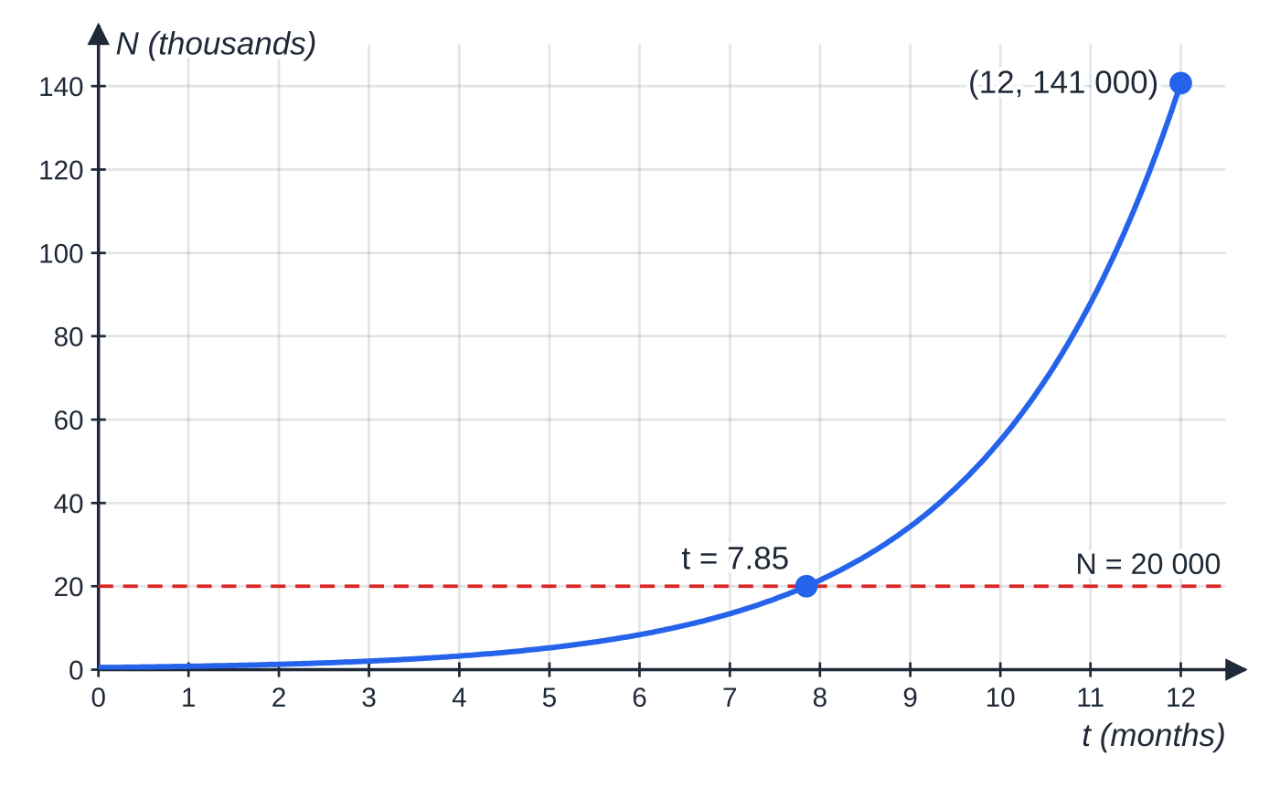
How do you differentiate aˣ, and where do models break down? (continued)
Section 8 of 13
The app model N = 500 × 1.6ᵗ (in thousands). It reaches 20 000 users at t ≈ 7.85 months and then shoots up without limit, which is the model's main weakness.
Notes:
How do you differentiate aˣ, and where do models break down?. Full notes: https://examinerprep.com/notes/edexcel-ial-maths/exponential-and-logarithmic-functions/

Slide 37
Exam tips for P3.5
Section 9 of 13
Exam tip 1 — isolate before you log
Your first line should leave one exponential (or one log) alone on one side, with coefficient 1. Only then take ln (or exponentiate). This is the key method step in almost every equation in this topic.
Exam tip 2 — "exact" means keep ln and e
If the question asks for an exact answer or a form such as a + ln b, leave ln 7, e² and so on in the answer and simplify with the log laws (ln 4 = 2ln 2). A decimal alone is not an exact answer.
Exam tip 3 — sketches need three labels
Every exponential or log sketch should show the intercept(s) with coordinates, the asymptote as a dashed line with its equation, and the correct shape on each side. Check that the curve approaches the asymptote at the correct end.
Notes:
Exam tips for P3.5. Full notes: https://examinerprep.com/notes/edexcel-ial-maths/exponential-and-logarithmic-functions/

Slide 38
Exam tips for P3.5 (continued)
Section 9 of 13
Exam tip 4 — log graphs: match the model to the axes
Write the linear form first (log y = log a + nlog x, or log y = log k + xlog b), then say which quantity the gradient and the intercept represent. Undo the correct log at the end.
Exam tip 5 — models: answer in context
For "interpret", "state the long-term value" or "give a limitation", write a sentence about the real situation: "the temperature of the tea tends to 18 °C, the temperature of the room", not "T →18".
Notes:
Exam tips for P3.5. Full notes: https://examinerprep.com/notes/edexcel-ial-maths/exponential-and-logarithmic-functions/

Slide 39
Common misconceptions
Section 10 of 13
Misconception | Why it is wrong | Correct idea
ln(x + 3) = ln x + ln 3. | The log of a sum has no simple rule; the law is for a product: ln(3x) = ln 3 + ln x. | Leave ln(x + 3) as it is, or exponentiate the whole equation.
eˣ = -4 gives x = ln(-4). | eˣ is positive for every real x, and ln is only defined for positive numbers. | eˣ = negative or zero has no solutions; reject such roots.
The asymptote of y = eˣ + c is the x-axis. | The whole curve has been shifted by c, asymptote included. | The asymptote is y = c; the range is y > c.
d/dx(e³ˣ) = e³ˣ, or 3xe³ˣ⁻¹. | The power rule does not apply when x is in the exponent, and the 3 scales the gradient. | d/dx(eᵏˣ) = keᵏˣ, so 3e³ˣ.
For y = kbˣ you plot log y against log x. | log y = log k + xlog b is linear in x, not in log x. | log–log for axⁿ; log y against x for kbˣ.
Notes:
Common misconceptions. Full notes: https://examinerprep.com/notes/edexcel-ial-maths/exponential-and-logarithmic-functions/

Slide 40
Common misconceptions (continued)
Section 10 of 13
Misconception | Why it is wrong | Correct idea
A decay model Ae⁻ᵏᵗ eventually reaches zero. | e⁻ᵏᵗ > 0 for every t; it only tends to zero. | The model approaches its asymptote but never reaches it, which is often itself a limitation of the model.
Notes:
Common misconceptions. Full notes: https://examinerprep.com/notes/edexcel-ial-maths/exponential-and-logarithmic-functions/

Slide 41
How this topic connects
Section 11 of 13
P2 exponentials and P3.1 functions
The laws of logarithms, solving aˣ = b and change of base all carry over to ln, which is simply logₑ. ln x and eˣ are the standard example of a function and its inverse, with domain and range swapped.
P3.6 Differentiation and P3.7 Integration
The chain, product and quotient rules differentiate expressions such as x²e³ˣ and ln(x² + 1), and d/dx(ln x) = 1/x follows from the inverse relationship. In P3.7, ∫eᵏˣ dx = 1/k eᵏˣ and ∫1/x dx = ln|x|; in P4, solving dy/dt = ky produces exactly the models on this page.
Statistics and Physics
The Poisson distribution uses e^(-λ). In IAL Physics, radioactive decay, capacitor discharge and log graphs of experimental data (log–log for power laws) use the same algebra as the log-graph and model sections here.
Notes:
How this topic connects. Full notes: https://examinerprep.com/notes/edexcel-ial-maths/exponential-and-logarithmic-functions/

Slide 42
Key formulae
Section 12 of 13
Formula | Use | In the formulae list?
e^(ln x) = x (x > 0); ln(eˣ) = x | undoing e and ln; ln and eˣ are inverses | No — learn it
eᵃˣ⁺ᵇ = p ⇒x = (ln p - b)/a, p > 0 | solving exponential equations | No — derive it
ln(ax + b) = q ⇒x = (e^q - b)/a | solving logarithmic equations | No — derive it
y = eᵃˣ⁺ᵇ + c: asymptote y = c, y-intercept eᵇ + c | sketching exponential graphs | No — derive it
y = axⁿ ⇒log y = log a + nlog x | log–log graph: gradient n, intercept log a | No — derive it
y = kbˣ ⇒log y = log k + xlog b | log y against x: gradient log b, intercept log k | No — derive it
d/dx(eᵏˣ) = keᵏˣ | rates of change in exponential models | No — learn it
aˣ = e^(xln a) | rewriting any exponential with base e | Yes
Notes:
Key formulae. Full notes: https://examinerprep.com/notes/edexcel-ial-maths/exponential-and-logarithmic-functions/

Slide 43
Key formulae (continued)
Section 12 of 13
Formula | Use | In the formulae list?
d/dx(aˣ) = aˣln a | rates of change for models Abᵗ | No — derive it from aˣ = e^(xln a)
ln ab = ln a + ln b; ln a/b = ln a - ln b; ln aᵏ = kln a | simplifying exact answers; linearising models | No — learn it
Notes:
Key formulae. Full notes: https://examinerprep.com/notes/edexcel-ial-maths/exponential-and-logarithmic-functions/

Slide 44
Check your understanding
Section 13 of 13
1. Solve e²ˣ⁺¹ = 5, giving an exact answer.
2. Solve ln(3x - 2) = -1, giving an exact answer.
3. State the asymptote and range of y = 4 - 3e⁻²ˣ.
4. A graph of ln y against ln x is a straight line. What form of relationship does this suggest, and what do the gradient and intercept give?
5. Find the gradient of y = 3ˣ at x = 2, exactly.
6. A car's value is modelled by V = 2000 + 18 000e^(-0.25t) (£, t in years). State its value when new and the value it approaches in the long term.
Notes:
Check your understanding: questions. Full notes: https://examinerprep.com/notes/edexcel-ial-maths/exponential-and-logarithmic-functions/

Slide 45
Check your understanding · answers
Section 13 of 13
1. 2x + 1 = ln 5, so x = (ln 5 - 1)/2.
2. 3x - 2 = e⁻¹, so x = (e⁻¹ + 2)/3 = (2e + 1)/3e. A negative right-hand side is fine for a log equation.
3. As x →∞, e⁻²ˣ →0, so the asymptote is y = 4. Since 3e⁻²ˣ > 0, y < 4: the curve lies below its asymptote.
4. y = axⁿ: ln y = ln a + nln x, so the gradient is n and the intercept is ln a, giving a = eⁱⁿᵗᵉʳᶜᵉᵖᵗ.
5. dy/dx = 3ˣln 3, so at x = 2 the gradient is 9ln 3 (≈ 9.89).
6. At t = 0: V = 2000 + 18 000 = £20 000. As t →∞, e^(-0.25t) →0, so V →£2000: the model has a floor, like a scrap value, rather than decaying to zero.
Notes:
Check your understanding: answers. Full notes: https://examinerprep.com/notes/edexcel-ial-maths/exponential-and-logarithmic-functions/

Slide 46
Practice questions
2 original exam-style questions. Answers at the end of the deck.

Slide 47
Question 1
5 marks
The curve C has equation y = 3e²ˣ − 5.
(a) Find the coordinates of the point where C crosses the y-axis. [1]
(b) Find the exact coordinates of the point where C crosses the x-axis. [2]
(c) State the equation of the asymptote to C and the range of values of y. [2]
Notes:
Online with the full mark scheme: https://examinerprep.com/ial-maths-p3-5-exponential-and-logarithmic-functions-questions#IALM-P3-5-B-01

Slide 48
Question 2
6 marks
Find the exact solution of each of the following equations.
(a) e⁴ˣ⁻³ = 9 [2]
(b) ln(5x + 2) = 3 [2]
(c) 3 + 4 ln(2x) = 11 [2]
Notes:
Online with the full mark scheme: https://examinerprep.com/ial-maths-p3-5-exponential-and-logarithmic-functions-questions#IALM-P3-5-B-02

Slide 49
Answers

Slide 50
Question 1 · answer
Mark scheme
(0, −2), since 3e⁰ − 5 = −2
e²ˣ = 5/3 and takes ln: 2x = ln(5/3)
(½ ln(5/3), 0)
asymptote y = −5
range y > −5
Notes:
Full mark scheme: https://examinerprep.com/ial-maths-p3-5-exponential-and-logarithmic-functions-questions#IALM-P3-5-B-01

Slide 51
Question 2 · answer
Mark scheme
4x − 3 = ln 9
x = (3 + ln 9)/4 or (3 + 2 ln 3)/4
5x + 2 = e³
x = (e³ − 2)/5
ln(2x) = 2 ⇒ 2x = e², isolating the log before exponentiating
x = e²/2
Notes:
Full mark scheme: https://examinerprep.com/ial-maths-p3-5-exponential-and-logarithmic-functions-questions#IALM-P3-5-B-02

Slide 52
Keep practising
Notes for this topic
Questions on this topic
Build a printable test
ExaminerPrep is an independent tutoring service. It has been developed independently from and is not endorsed by the International Baccalaureate Organization. "International Baccalaureate", "IB" and "IB Diploma Programme" are registered trademarks of the IBO, used here for descriptive purposes only.
Pearson Edexcel and Cambridge are trademarks of their owners; ExaminerPrep is not affiliated with any exam board.

