Slide 1
EP
EDEXCEL IAL MATHS
P2.5 Exponentials and logarithms
The full notes page in 12 sections · practice questions with answers · simulations
ExaminerPrep is an independent tutoring service. It has been developed independently from and is not endorsed by the International Baccalaureate Organization. "International Baccalaureate", "IB" and "IB Diploma Programme" are registered trademarks of the IBO, used here for descriptive purposes only.
Pearson Edexcel and Cambridge are trademarks of their owners; ExaminerPrep is not affiliated with any exam board.
Notes:
P2.5 Exponentials and logarithms. Notes for this topic: https://examinerprep.com/notes/edexcel-ial-maths/exponentials-and-logarithms/

Slide 2
What this page covers
Overview
The function y = aˣ for a > 0, a ≠1: its graph, intercept, asymptote and translations
The meaning of logₐ x, including logₐ a = 1 and logₐ 1 = 0
Why y = logₐ x is the reflection of y = aˣ in the line y = x
The laws of logarithms for products, quotients, powers and reciprocals
Solving aˣ = b, including equations with the unknown in two different powers
Equations that become quadratics in aˣ
Changing the base of a logarithm, and proving the change of base formula
Solving logarithmic equations and checking that every log is defined
Notes:
What this page covers. Full notes: https://examinerprep.com/notes/edexcel-ial-maths/exponentials-and-logarithms/

Slide 3
In one minute
Key points
1. A logarithm answers the question "what power?": logₐ b = x means exactly the same as aˣ = b, and every exponential or logarithmic equation on this page is solved by moving between those two forms.
2. y = aˣ (a > 0, a ≠1) passes through (0, 1), is always positive and has the x-axis as an asymptote. It increases if a > 1 and decreases if 0 < a < 1.
3. logₐ a = 1, logₐ 1 = 0, and you can only take the log of a positive number.
4. Laws: log xy = log x + log y; log x/y = log x - log y; log xᵏ = klog x; log 1/x = -log x. All logs in one law must have the same base.
5. To solve aˣ = b, take logs of both sides: x = log b/log a. If a²ˣ and aˣ both appear, let u = aˣ, solve a quadratic and reject u ≤0.
6. Change of base: logₐ x = (log_b x)/(log_b a). For log equations, combine into one log, remove the logs, and check every root keeps each original argument positive.
Notes:
In one minute. Full notes: https://examinerprep.com/notes/edexcel-ial-maths/exponentials-and-logarithms/

Slide 4
What does the graph of y = aˣ look like?
Section 1 of 12
In P1 the variable was the base, as in x² or x³. Now the base is fixed and the variable is the power. That small change produces a completely different kind of curve: one that grows by the same factor every time x goes up by 1.
Exponential function. A function of the form y = aˣ, where the base a is a positive constant other than 1 and the variable x is the power.
Why must a be positive and not 1? If a = 1 the graph is just the line y = 1, which is not interesting. If a were negative, numbers like (-2)^(1/2) would not be real, so the curve would have gaps everywhere. With a > 0, the power aˣ is defined for every real x.
Four features follow from the index laws:
Intercept. a⁰ = 1 for every base, so every curve y = aˣ passes through (0, 1). At x = 1 the height is a itself.
Notes:
What does the graph of y = aˣ look like?. Full notes: https://examinerprep.com/notes/edexcel-ial-maths/exponentials-and-logarithms/

Slide 5
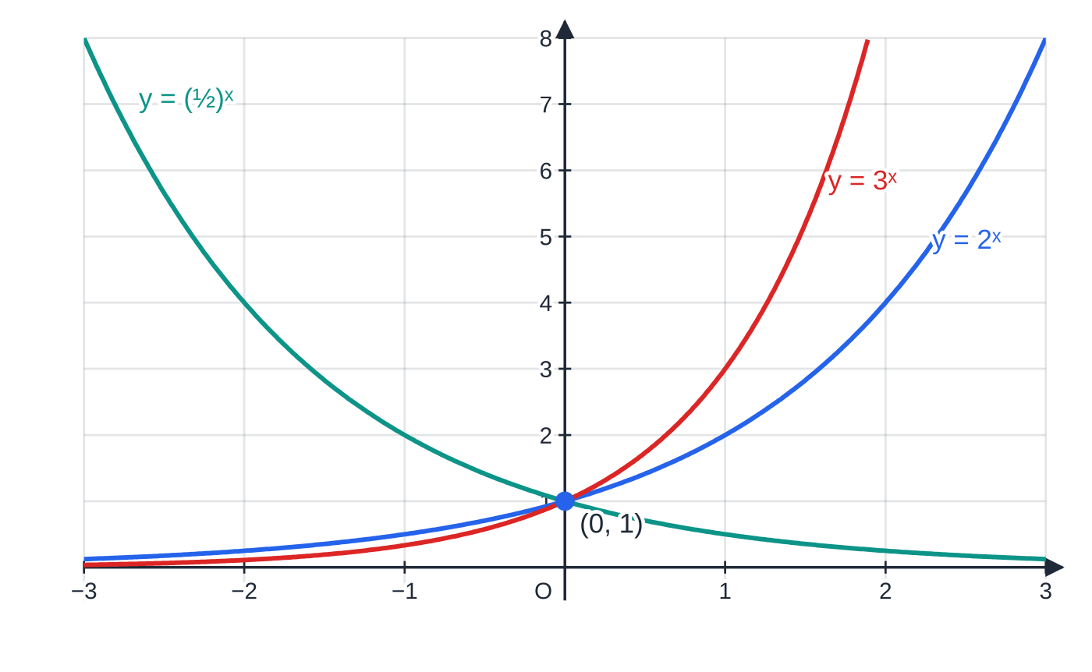
What does the graph of y = aˣ look like? (continued)
Section 1 of 12
Always positive. aˣ > 0 for every real x. The curve never meets the x-axis, which is a horizontal asymptote.
Growth or decay. If a > 1 the curve increases, more and more steeply (exponential growth). If 0 < a < 1 it decreases towards the x-axis (exponential decay).
Reflection. (½)ˣ = 2⁻ˣ, so y = (½)ˣ is the reflection of y = 2ˣ in the y-axis.
y = 2ˣ, y = 3ˣ and y = (½)ˣ. All three pass through (0, 1) and stay above the x-axis. The larger the base, the steeper the curve for x > 0 and the flatter for x < 0; (½)ˣ is the mirror image of 2ˣ in the y-axis.
Notes:
What does the graph of y = aˣ look like?. Full notes: https://examinerprep.com/notes/edexcel-ial-maths/exponentials-and-logarithms/

Slide 6
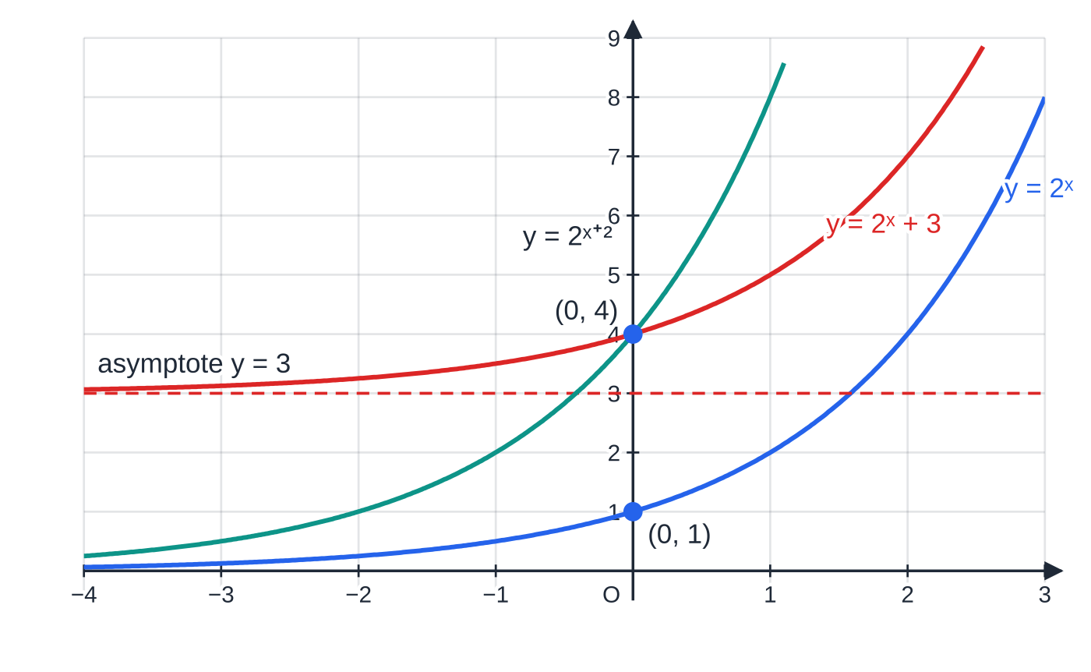
What does the graph of y = aˣ look like? (continued)
Section 1 of 12
The P1 transformations still apply. y = aˣ + k moves the curve and its asymptote up by k, so the asymptote becomes y = k. y = aˣ⁺ᶜ moves the curve c to the left; the asymptote stays on the x-axis but the y-intercept becomes aᶜ.
Translations of y = 2ˣ. Adding 3 lifts the curve and its asymptote to y = 3. Replacing x by x + 2 moves the curve 2 left, so it now crosses the y-axis at 2² = 4, but the asymptote stays y = 0.
Notes:
What does the graph of y = aˣ look like?. Full notes: https://examinerprep.com/notes/edexcel-ial-maths/exponentials-and-logarithms/

Slide 7
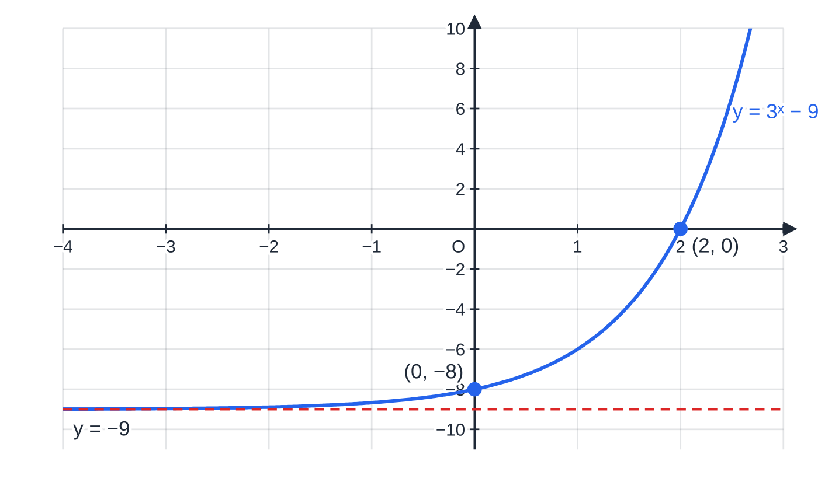
What does the graph of y = aˣ look like? (continued)
Section 1 of 12 · Worked example 1 · Easy · Sketch
WORKED EXAMPLE · QUESTION
The curve C has equation y = 3ˣ - 9. (a) Find the coordinates of the points where C meets the coordinate axes. (b) Write down the equation of the asymptote to C. (c) Sketch C. (d) Find the value of x for which y = 72.
SOLUTION
(a) On the y-axis, x = 0: y = 3⁰ - 9 = 1 - 9 = -8, giving (0, -8). On the x-axis, y = 0: 3ˣ = 9 = 3², so x = 2, giving (2, 0). (0, -8) and (2, 0)
(b) As x →-∞, 3ˣ →0, so y →-9. y = -9
C: y = 3ˣ − 9. A sketch must show the two intercepts (2, 0) and (0, −8) and the asymptote y = −9, with the curve staying strictly above the asymptote.
Notes:
What does the graph of y = aˣ look like?: Worked example 1. Full notes: https://examinerprep.com/notes/edexcel-ial-maths/exponentials-and-logarithms/

Slide 8
What does the graph of y = aˣ look like? (continued)
Section 1 of 12 · Worked example 1 · Easy · Sketch (continued)
(c) The curve y = 3ˣ moved down 9: increasing, through both intercepts, approaching y = -9 on the left (see the figure).
(d) 3ˣ - 9 = 72 ⇒3ˣ = 81 = 3⁴. x = 4
Notes:
What does the graph of y = aˣ look like?: Worked example 1. Full notes: https://examinerprep.com/notes/edexcel-ial-maths/exponentials-and-logarithms/

Slide 9
What does the graph of y = aˣ look like? (continued)
Section 1 of 12
Common error
Drawing the asymptote of y = 3ˣ - 9 on the x-axis, or letting the curve cross y = -9. The translation moves the asymptote too, and the curve stays strictly above it.
Notes:
What does the graph of y = aˣ look like?. Full notes: https://examinerprep.com/notes/edexcel-ial-maths/exponentials-and-logarithms/

Slide 10
What is a logarithm?
Section 2 of 12
Suppose 2ˣ = 8. You can see that x = 3. But for 2ˣ = 7 there is no whole-number answer, and we need a name for "the power of 2 that gives 7". That name is the logarithm.
Logarithm.
The logarithm to base a of a positive number b is the power to which a must be raised to give b:
logₐ b = x ⇔aˣ = b.
Moving between the two forms is the key skill of the whole topic. For example 10³ = 1000 ⇔log₁₀ 1000 = 3, and 2⁻³ = ⅛ ⇔log₂ ⅛ = -3. Notice that a logarithm can be negative or a fraction; only the number you take the log of has to be positive.
Two special values: logₐ a = 1 because a¹ = a, and logₐ 1 = 0 because a⁰ = 1.
Since aˣ is always positive, logₐ b exists only for b > 0. There is no log of 0 or of a negative number.
Notes:
What is a logarithm?. Full notes: https://examinerprep.com/notes/edexcel-ial-maths/exponentials-and-logarithms/

Slide 11
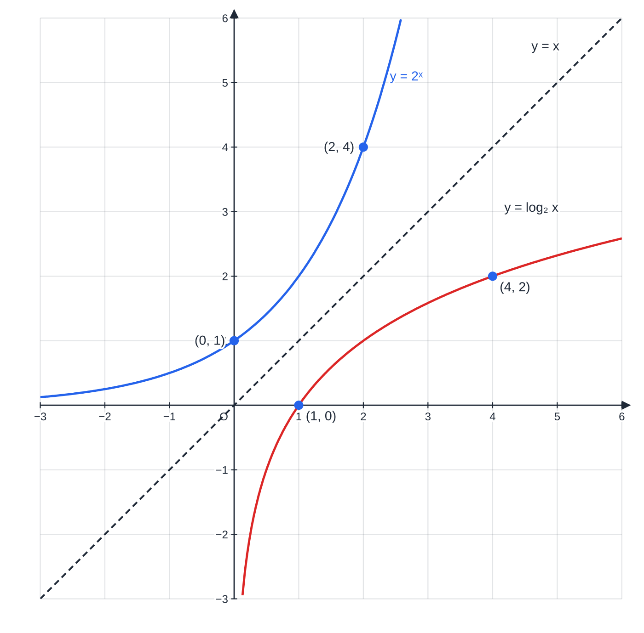
What is a logarithm? (continued)
Section 2 of 12
y = logₐ x undoes y = aˣ: it is the inverse function. So logₐ aˣ = x and a^(logₐx) = x.
Because the two functions are inverses, their graphs are reflections of each other in the line y = x. Every point (p, q) on y = 2ˣ becomes the point (q, p) on y = log₂ x. The intercept (0, 1) becomes (1, 0), and the horizontal asymptote y = 0 becomes the vertical asymptote x = 0.
Every log curve with base greater than 1 has the same shape: through (1, 0), increasing, slowly. A larger base gives a flatter curve, because a larger base needs a smaller power to reach the same number.
y = 2ˣ and y = log₂ x on equal scales are mirror images in y = x: 2² = 4 gives (2, 4), and log₂ 4 = 2 gives (4, 2). The log curve passes through (1, 0) and has the y-axis as an asymptote, so it only exists for x > 0.
Notes:
What is a logarithm?. Full notes: https://examinerprep.com/notes/edexcel-ial-maths/exponentials-and-logarithms/

Slide 12
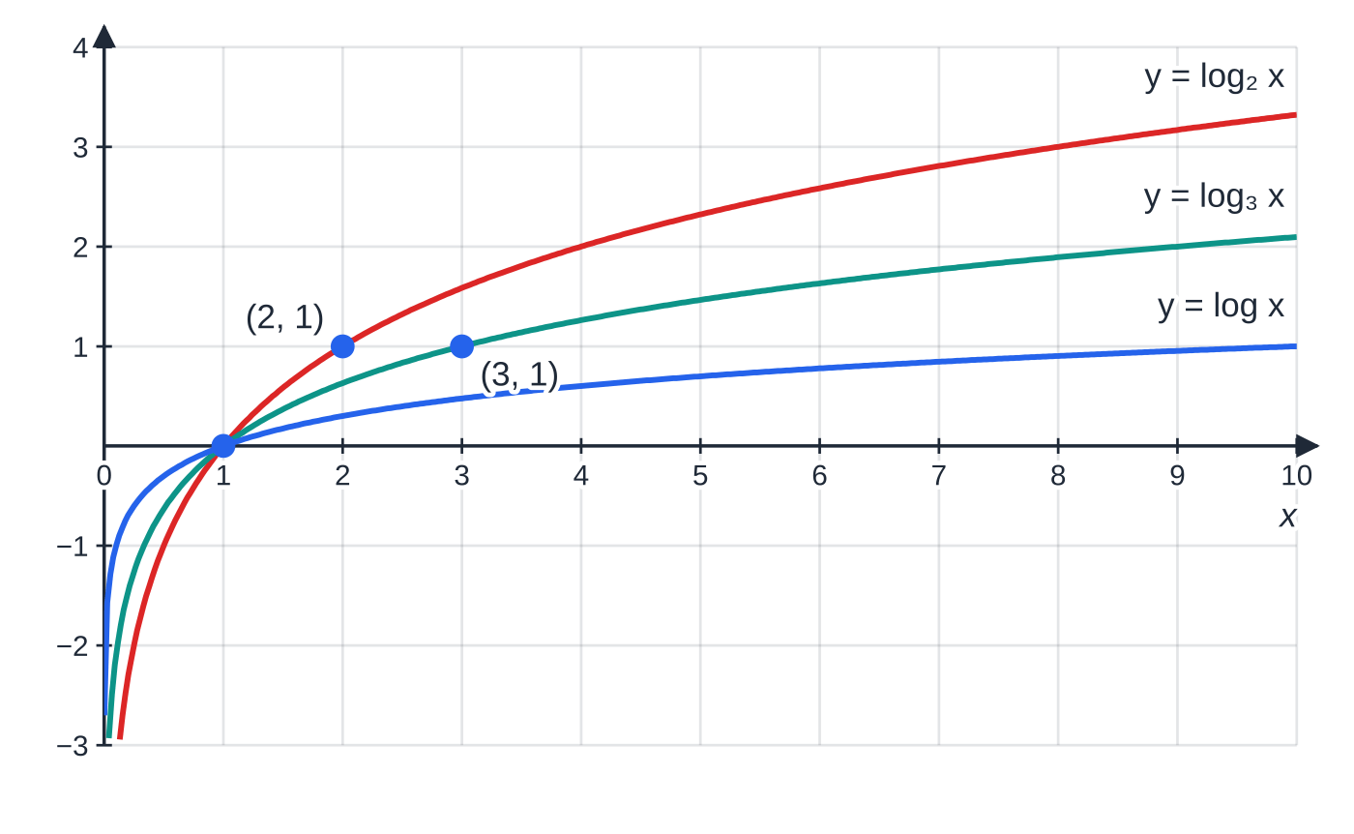
What is a logarithm? (continued)
Section 2 of 12
Logs to three bases. All pass through (1, 0) because a⁰ = 1, and each reaches height 1 at x = a, because log_a a = 1. All are negative for 0 < x < 1.
Notes:
What is a logarithm?. Full notes: https://examinerprep.com/notes/edexcel-ial-maths/exponentials-and-logarithms/

Slide 13
What is a logarithm? (continued)
Section 2 of 12 · Worked example 2 · Easy · Find
WORKED EXAMPLE · QUESTION
(a) Without a calculator, find the value of: (i) log₂ 64 (ii) log₃ (1/27) (iii) log₂₅ 5 (iv) log₄ 8 (v) log₇ 1. (b) Solve (i) logₓ 49 = 2, where x > 0, and (ii) log₅ y = -2.
SOLUTION
(a) Ask "what power?" each time. (i) 2⁶ = 64, so 6. (ii) 3⁻³ = (1/27), so -3. (iii) 25^(1/2) = 5, so ½. (iv) 4ˣ = 8 ⇒2²ˣ = 2³ ⇒x = (3/2). (v) 7⁰ = 1, so 0. 6, -3, ½, (3/2), 0
(b) Rewrite in index form. (i) x² = 49, and a base must be positive, so x = 7. (ii) y = 5⁻² = (1/25). x = 7, y = (1/25)
Notes:
What is a logarithm?: Worked example 2. Full notes: https://examinerprep.com/notes/edexcel-ial-maths/exponentials-and-logarithms/

Slide 14
What is a logarithm? (continued)
Section 2 of 12
Exam tip
When two numbers are powers of the same thing (4 and 8, 9 and 27, 25 and 125) write both as powers of that common base. log₄ 8 becomes 2²ˣ = 2³, and the answer is exact without a calculator.
Notes:
What is a logarithm?. Full notes: https://examinerprep.com/notes/edexcel-ial-maths/exponentials-and-logarithms/

Slide 15
What are the laws of logarithms?
Section 3 of 12
Each law of logarithms is an index law read backwards. Suppose logₐ x = m and logₐ y = n, so x = aᵐ and y = aⁿ. Then xy = aᵐ aⁿ = aᵐ⁺ⁿ, so logₐ xy = m + n = logₐ x + logₐ y. Multiplying numbers adds their powers, so the log of a product is the sum of the logs. The other laws come the same way from aᵐ ÷aⁿ = aᵐ⁻ⁿ and (aᵐ)ᵏ = aᵐᵏ.
The laws of logarithms
(any base a; x, y > 0):
logₐ xy = logₐ x + logₐ y logₐ x/y = logₐ x - logₐ y
logₐ xᵏ = klogₐ x logₐ 1/x = -logₐ x logₐ a = 1 logₐ 1 = 0
These are not in the formulae booklet: learn them.
The reciprocal law is just the power law with k = -1. Roots are powers too: logₐ √x = ½ logₐ x. There is no law for log(x + y), and log x ÷log y is not log x/y.
Notes:
What are the laws of logarithms?. Full notes: https://examinerprep.com/notes/edexcel-ial-maths/exponentials-and-logarithms/

Slide 16
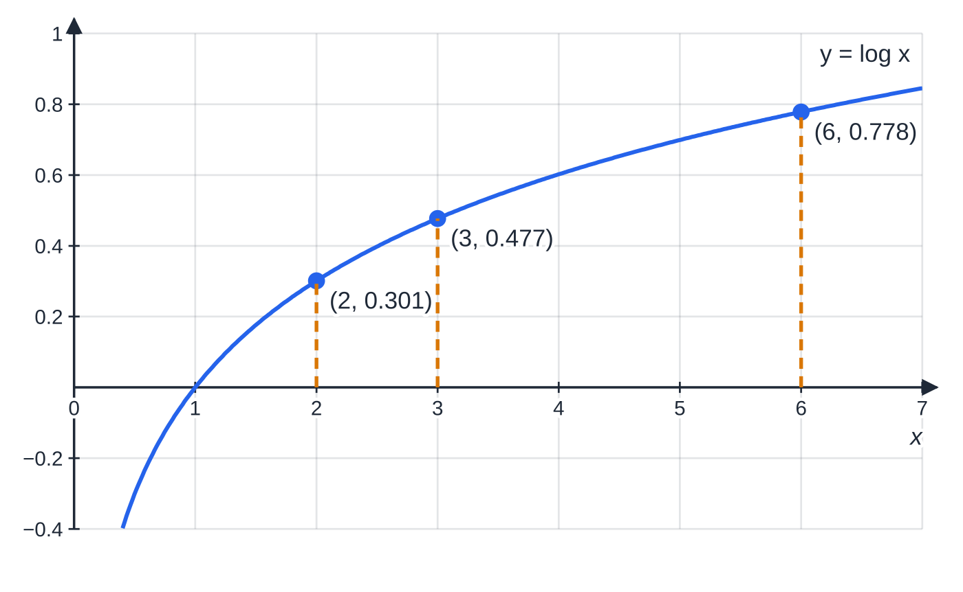
What are the laws of logarithms? (continued)
Section 3 of 12
The product law on the graph of y = log x: the height at 6 equals the height at 2 plus the height at 3, since 0.301 + 0.477 = 0.778. Heights add when the inputs multiply.
Notes:
What are the laws of logarithms?. Full notes: https://examinerprep.com/notes/edexcel-ial-maths/exponentials-and-logarithms/

Slide 17
What are the laws of logarithms? (continued)
Section 3 of 12 · Worked example 3 · Medium · Show that / Express
WORKED EXAMPLE · QUESTION
(a) Show that 2log₃ 6 - log₃ 4 = 2. (b) Given that logₐ 2 = p and logₐ 3 = q, express in terms of p and q: (i) logₐ 18 (ii) logₐ(8/9a) (iii) logₐ(⅙).
SOLUTION
(a) Power law first, then the quotient law: 2log₃ 6 - log₃ 4 = log₃ 36 - log₃ 4 = log₃ (36/4) = log₃ 9 = 2, since 3² = 9. = 2 as required
(b)(i) 18 = 2 ×3², so logₐ 18 = logₐ 2 + 2logₐ 3. p + 2q
(b)(ii) Split the quotient and the product, and use logₐ a = 1: logₐ 2³ - logₐ 3² - logₐ a. 3p - 2q - 1
(b)(iii) Reciprocal law: -logₐ 6 = -(logₐ 2 + logₐ 3). -p - q
Notes:
What are the laws of logarithms?: Worked example 3. Full notes: https://examinerprep.com/notes/edexcel-ial-maths/exponentials-and-logarithms/

Slide 18
What are the laws of logarithms? (continued)
Section 3 of 12
Common error
Writing 2log₃ 6 as log₃ 12. The coefficient 2 becomes a power: 2log₃ 6 = log₃ 6² = log₃ 36. Apply the power law before combining sums and differences.
Notes:
What are the laws of logarithms?. Full notes: https://examinerprep.com/notes/edexcel-ial-maths/exponentials-and-logarithms/

Slide 19
How do I solve aˣ = b?
Section 4 of 12
If both sides are obviously powers of the same base, match the powers, as in 3ˣ = 81 = 3⁴. Otherwise, take logs of both sides (any base will do; log₁₀ is the calculator key) and use the power law to bring the unknown down from the power:
aˣ = b ⇒ xlog a = log b ⇒ x = log b/log a, which is logₐ b.
This result is not in the formulae booklet; derive it by taking logs each time. A solution exists only if b > 0, because aˣ is never zero or negative. Graphically, the solution of aˣ = b is the x-coordinate where the curve y = aˣ meets the horizontal line y = b; since an exponential curve is always increasing (or always decreasing), there is exactly one such point.
Notes:
How do I solve aˣ = b?. Full notes: https://examinerprep.com/notes/edexcel-ial-maths/exponentials-and-logarithms/

Slide 20
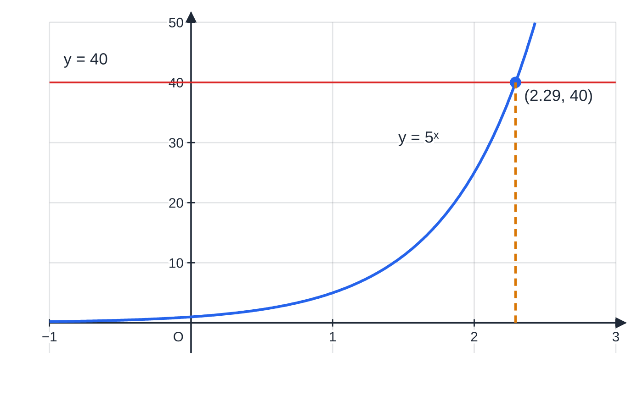
How do I solve aˣ = b? (continued)
Section 4 of 12
When the unknown is in two powers with different bases, take logs, expand the brackets, collect the x terms on one side and factorise. Keep the exact form (such as log 40/log 5) until the last line and round only the final answer.
5ˣ = 40 has exactly one solution, where the increasing curve meets y = 40: x = log 40 ÷ log 5 = 2.29 (3 s.f.). Between x = 2 (height 25) and x = 3 (height 125), as expected.
Notes:
How do I solve aˣ = b?. Full notes: https://examinerprep.com/notes/edexcel-ial-maths/exponentials-and-logarithms/

Slide 21
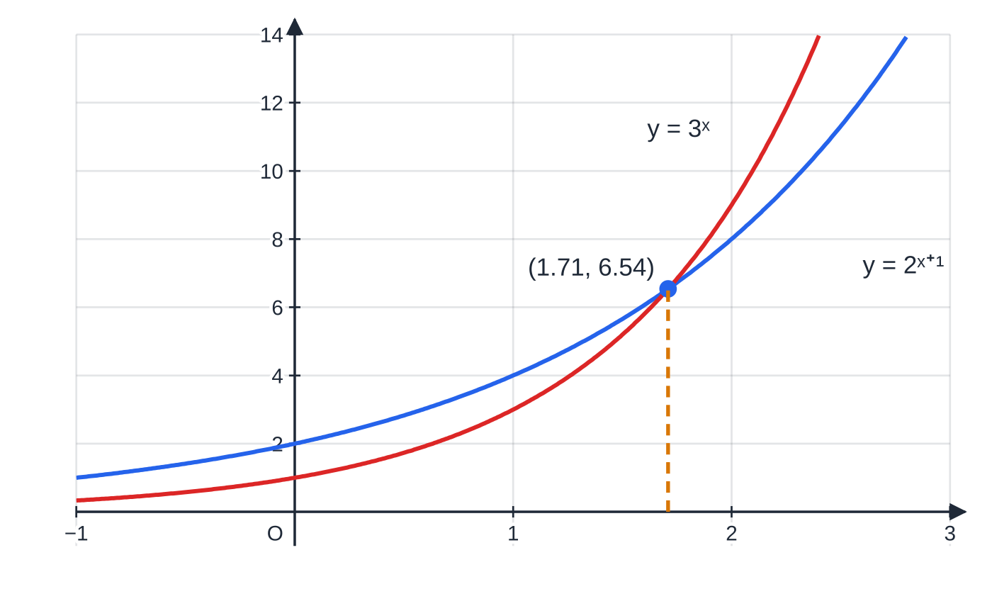
How do I solve aˣ = b? (continued)
Section 4 of 12 · Worked example 4 · Medium · Solve
WORKED EXAMPLE · QUESTION
Solve, giving each answer to 3 significant figures: (a) 5ˣ = 40 (b) 2ˣ⁺¹ = 3ˣ.
SOLUTION
(a) Take logs of both sides: xlog 5 = log 40, so x = log 40/log 5 = 2.2920… x = 2.29
(b) Take logs and use the power law on each side: (x+1)log 2 = xlog 3. Expand and collect the x terms: xlog 2 + log 2 = xlog 3 ⇒log 2 = x(log 3 - log 2). Divide, and simplify with the quotient law:
The solution of 2ˣ⁺¹ = 3ˣ is the x-coordinate where the two curves cross: x = 1.7095…, y = 6.54. Left of the crossing 2ˣ⁺¹ is larger; to the right 3ˣ grows faster. One crossing, so one solution.
Notes:
How do I solve aˣ = b?: Worked example 4. Full notes: https://examinerprep.com/notes/edexcel-ial-maths/exponentials-and-logarithms/

Slide 22
How do I solve aˣ = b? (continued)
Section 4 of 12 · Worked example 4 · Medium · Solve (continued)
x = log 2/(log 3 - log 2) = log 2/log 1.5 = 1.7095…
x = 1.71
Check: 2^(2.7095) ≈3^(1.7095) ≈6.54, the crossing point in the figure.
Notes:
How do I solve aˣ = b?: Worked example 4. Full notes: https://examinerprep.com/notes/edexcel-ial-maths/exponentials-and-logarithms/

Slide 23
How do I solve aˣ = b? (continued)
Section 4 of 12
Common error
Writing log(2ˣ⁺¹) as x + 1log 2 without the bracket, or as xlog 2 + 1. The whole power multiplies the log: (x+1)log 2.
Notes:
How do I solve aˣ = b?. Full notes: https://examinerprep.com/notes/edexcel-ial-maths/exponentials-and-logarithms/

Slide 24
How do I solve a quadratic in aˣ?
Section 5 of 12
Look for a²ˣ together with aˣ. Because a²ˣ = (aˣ)², the substitution u = aˣ turns the equation into an ordinary quadratic in u. Before substituting, rewrite every term using the index laws:
4ˣ = (2²)ˣ = (2ˣ)², so 4ˣ = u² when u = 2ˣ.
2ˣ⁺³ = 2³ ×2ˣ = 8u.
3²ˣ⁺¹ = 3 ×(3ˣ)² = 3u² when u = 3ˣ.
Solve for u, then solve aˣ = u for each value. Reject any u ≤0: aˣ is never zero or negative, so such a value gives no x at all.
Notes:
How do I solve a quadratic in aˣ?. Full notes: https://examinerprep.com/notes/edexcel-ial-maths/exponentials-and-logarithms/

Slide 25
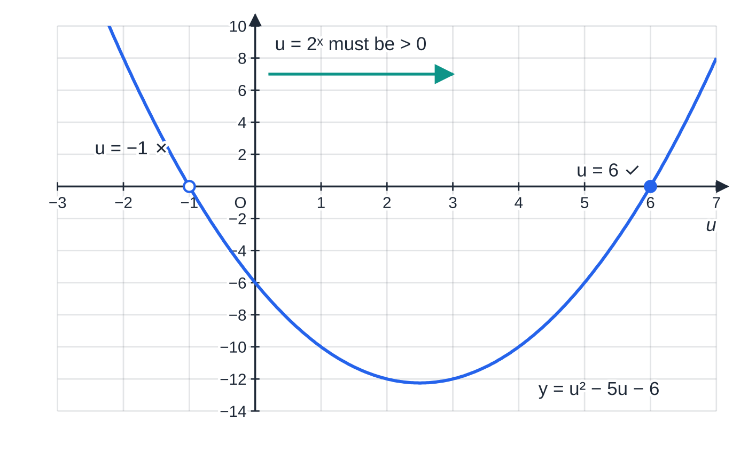
How do I solve a quadratic in aˣ? (continued)
Section 5 of 12 · Worked example 5 · Medium · Solve
WORKED EXAMPLE · QUESTION
(a) Solve 4ˣ - 5 ×2ˣ - 6 = 0, giving your answer to 3 significant figures. (b) Solve 3²ˣ⁺¹ - 10 ×3ˣ + 3 = 0.
The quadratic in u from part (a). Only roots to the right of u = 0 can be values of 2ˣ, so u = −1 is rejected and u = 6 is kept.
Notes:
How do I solve a quadratic in aˣ?: Worked example 5. Full notes: https://examinerprep.com/notes/edexcel-ial-maths/exponentials-and-logarithms/

Slide 26
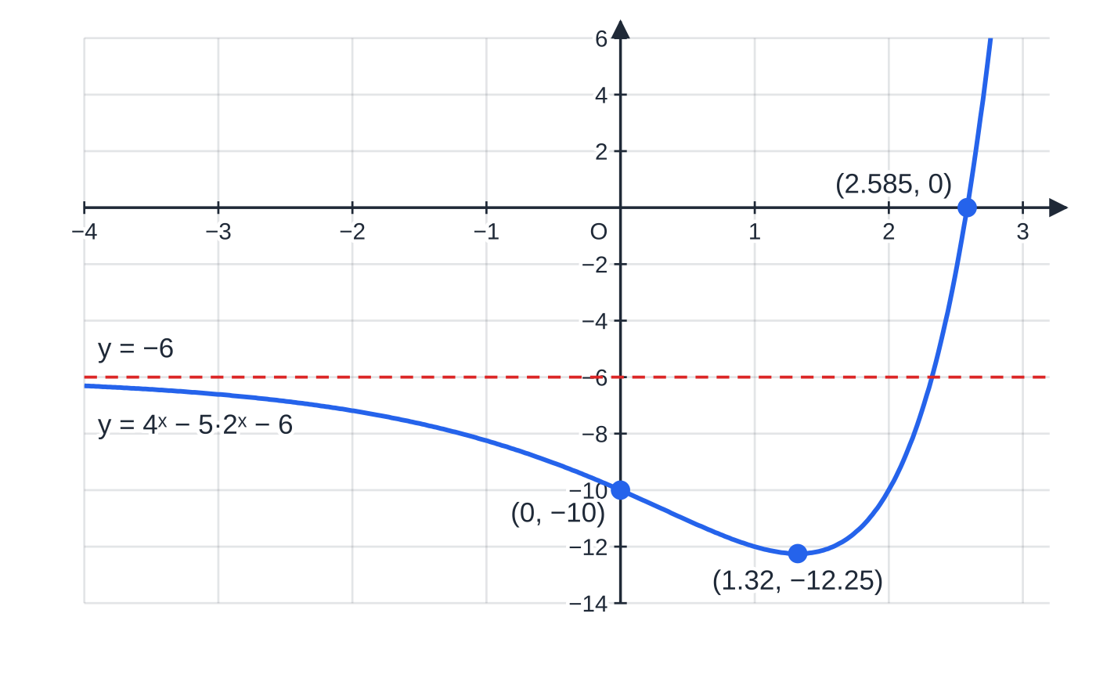
How do I solve a quadratic in aˣ? (continued)
Section 5 of 12 · Worked example 5 · Medium · Solve (continued)
SOLUTION
(a) Let u = 2ˣ, so 4ˣ = u²: u² - 5u - 6 = 0 ⇒(u - 6)(u + 1) = 0 ⇒u = 6 or u = -1. Now 2ˣ = -1 has no solution, since 2ˣ > 0 for all x. So 2ˣ = 6 ⇒x = log 6/log 2 = 2.5850… x = 2.58
(b) 3²ˣ⁺¹ = 3 ×3²ˣ = 3u² with u = 3ˣ: 3u² - 10u + 3 = 0 ⇒(3u - 1)(u - 3) = 0 ⇒u = ⅓ or u = 3. Both values are positive, so both give a solution: 3ˣ = 3⁻¹ ⇒x = -1, and 3ˣ = 3¹ ⇒x = 1. x = -1 or x = 1
The same equation in x. The curve crosses the x-axis once, at x = 2.585; the rejected root u = −1 has no point on the graph. It starts near the asymptote y = −6, passes through (0, −10) and dips to −12.25 before rising.
Notes:
How do I solve a quadratic in aˣ?: Worked example 5. Full notes: https://examinerprep.com/notes/edexcel-ial-maths/exponentials-and-logarithms/

Slide 27
How do I solve a quadratic in aˣ? (continued)
Section 5 of 12
Exam tip
When you reject a value of u, write the reason: "2ˣ > 0 for all x, so 2ˣ = -1 has no solution". A value crossed out with no reason looks like a lost root.
Notes:
How do I solve a quadratic in aˣ?. Full notes: https://examinerprep.com/notes/edexcel-ial-maths/exponentials-and-logarithms/

Slide 28
How do I change the base of a logarithm?
Section 6 of 12
A calculator works in base 10 (and base e, met in P3). To evaluate a log in any other base, or to combine logs with different bases in one equation, rewrite them in a common base.
Change of base
(in the formulae booklet; know how to use it and how to prove it):
logₐ x = (log_b x)/(log_b a)
with a, b > 0 and ≠1, and x > 0. The base b is any base you choose, usually 10 or the base of the other logs in the equation.
Proof. Let y = logₐ x, so aʸ = x. Take log_b of both sides: log_b aʸ = log_b x, so ylog_b a = log_b x, giving y = (log_b x)/(log_b a).
Two special cases appear often. Putting x = b gives logₐ b = 1/(log_b a).
Notes:
How do I change the base of a logarithm?. Full notes: https://examinerprep.com/notes/edexcel-ial-maths/exponentials-and-logarithms/

Slide 29
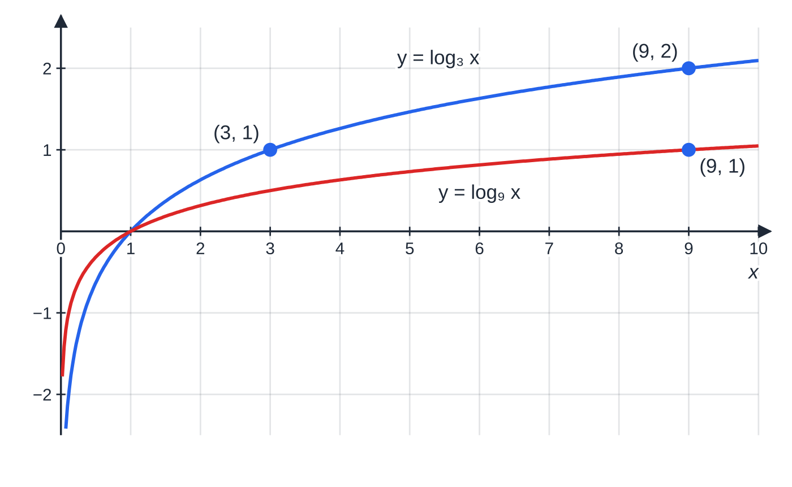
How do I change the base of a logarithm? (continued)
Section 6 of 12
Putting a = b² gives log_(b²) x = ½log_b x; for example log₉ x = ½log₃ x.
log₉ x = ½ log₃ x: at every x the red curve is exactly half the height of the blue one. At x = 9, log₃ 9 = 2 and log₉ 9 = 1.
Notes:
How do I change the base of a logarithm?. Full notes: https://examinerprep.com/notes/edexcel-ial-maths/exponentials-and-logarithms/

Slide 30
How do I change the base of a logarithm? (continued)
Section 6 of 12 · Worked example 6 · Medium · Find / Solve
WORKED EXAMPLE · QUESTION
(a) Find log₅ 12, giving your answer to 3 significant figures. (b) Solve log₃ x = 4logₓ 3, where x > 0 and x ≠1.
SOLUTION
(a) Change to base 10: log₅ 12 = log 12/log 5 = 1.5440… (check: 5^(1.544) ≈12). 1.54
(b) Write logₓ 3 in base 3 and let L = log₃ x: logₓ 3 = (log₃ 3)/(log₃ x) = 1/L, so L = 4/L. Multiply by L (non-zero, since x ≠1): L² = 4, so L = 2 or L = -2. Undo the log: x = 3² = 9 or x = 3⁻² = (1/9). x = 9 or x = (1/9)
Notes:
How do I change the base of a logarithm?: Worked example 6. Full notes: https://examinerprep.com/notes/edexcel-ial-maths/exponentials-and-logarithms/

Slide 31
How do I change the base of a logarithm? (continued)
Section 6 of 12
Common error
Using only L = 2 from L² = 4. A logarithm can be negative (log₃ (1/9) = -2), so both square roots give valid values of x. It is x, not L, that must be positive.
Notes:
How do I change the base of a logarithm?. Full notes: https://examinerprep.com/notes/edexcel-ial-maths/exponentials-and-logarithms/

Slide 32
How do I solve a logarithmic equation?
Section 7 of 12
A logarithmic equation has the unknown inside one or more logs. The method has four steps, and the last one is the step most often forgotten.
1. Make every log the same base (change of base if needed).
2. Use the laws to collect the logs into a single log on one side, or one log on each side.
3. Remove the logs: logₐ P = k ⇒P = aᵏ, and logₐ P = logₐ Q ⇒P = Q. A plain number k can be rewritten as logₐ aᵏ if that helps.
4. Solve the resulting equation, then check every root in the original equation: each log must have a positive argument.
Why the check? Combining logs can enlarge the set of allowed values. log₃ (x-1)² is defined for every x ≠1, but the original 2log₃(x-1) needs x > 1. The algebra therefore can produce a root that the original equation never allowed.
Notes:
How do I solve a logarithmic equation?. Full notes: https://examinerprep.com/notes/edexcel-ial-maths/exponentials-and-logarithms/

Slide 33
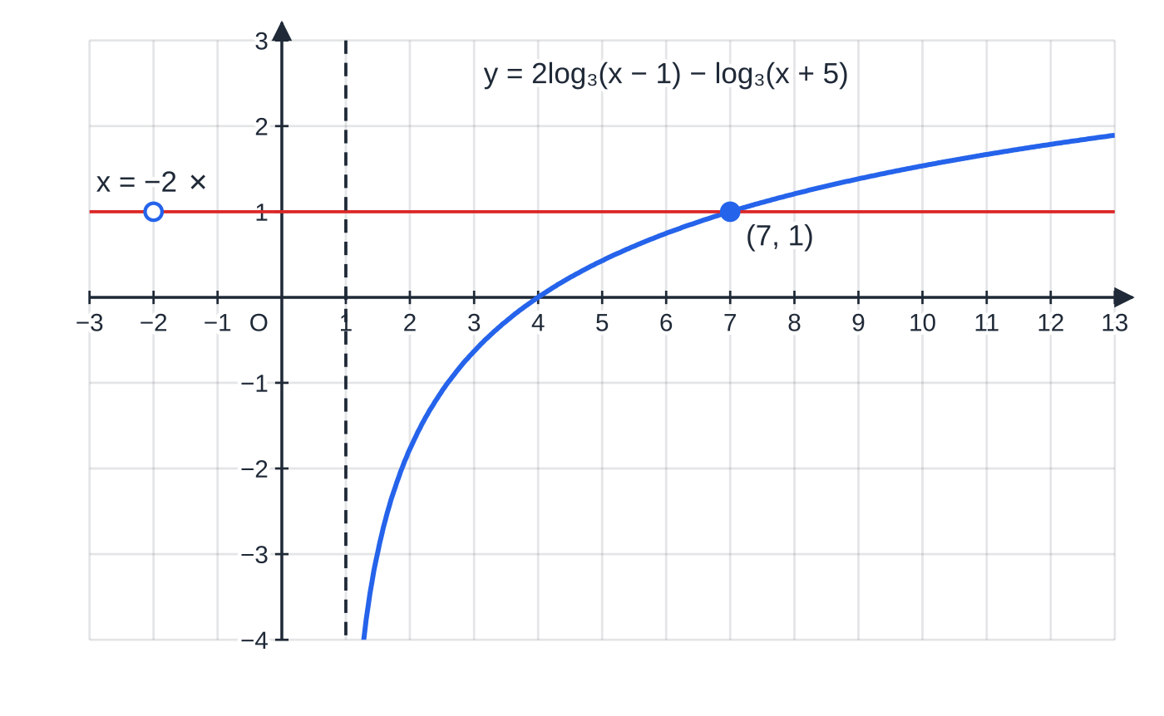
How do I solve a logarithmic equation? (continued)
Section 7 of 12 · Worked example 7 · Medium · Solve
WORKED EXAMPLE · QUESTION
Solve 2log₃(x - 1) - log₃(x + 5) = 1, where x > 1.
SOLUTION
Power law, then quotient law: log₃ (x-1)² - log₃(x+5) = 1 ⇒log₃ ((x-1)²)/(x+5) = 1.
Remove the log (log₃ P = 1 ⇒P = 3¹): (x-1)² = 3(x+5) ⇒x² - 2x + 1 = 3x + 15 ⇒x² - 5x - 14 = 0.
Solve and check: (x-7)(x+2) = 0, so x = 7 or x = -2. But x = -2 makes x - 1 negative, so log₃(x-1) is undefined. x = 7 only
Check: 2log₃ 6 - log₃ 12 = log₃ (36/12) = log₃ 3 = 1 ✓
The left-hand side as a function of x exists only for x > 1 (dashed line) and meets y = 1 once, at (7, 1). The algebra's second root, x = −2, lies outside the domain, so there is no point of the curve there.
Notes:
How do I solve a logarithmic equation?: Worked example 7. Full notes: https://examinerprep.com/notes/edexcel-ial-maths/exponentials-and-logarithms/

Slide 34
How do I solve a logarithmic equation? (continued)
Section 7 of 12 · Worked example 8 · Hard · Show that / Hence / Solve
WORKED EXAMPLE · QUESTION
(a) Show that log₉ x = ½log₃ x for x > 0. (b) Hence solve log₃ x + log₉ x = 6. (c) Solve 9ˣ - 4 ×3ˣ⁺¹ + 27 = 0. (d) Solve 3ˣ = 2 ×5ˣ⁻¹, giving your answer to 3 significant figures.
SOLUTION
(a) Change of base to base 3: log₉ x = (log₃ x)/(log₃ 9) = (log₃ x)/2 = ½log₃ x ✓
(b) Using (a), let L = log₃ x: L + ½ L = 6 ⇒(3/2) L = 6 ⇒L = 4, so x = 3⁴ = 81. x = 81
(c) 9ˣ = (3ˣ)² and 3ˣ⁺¹ = 3 ×3ˣ; let u = 3ˣ: u² - 12u + 27 = 0 ⇒(u-3)(u-9) = 0 ⇒u = 3 or 9. So 3ˣ = 3 ⇒x = 1, and 3ˣ = 9 ⇒x = 2. x = 1 or x = 2
(d) Take logs, expand, collect: xlog 3 = log 2 + (x-1)log 5 ⇒x(log 3 - log 5) = log 2 - log 5, so
x = (log 2 - log 5)/(log 3 - log 5) = log 0.4/log 0.6 = 1.7937…
Notes:
How do I solve a logarithmic equation?: Worked example 8. Full notes: https://examinerprep.com/notes/edexcel-ial-maths/exponentials-and-logarithms/

Slide 35
How do I solve a logarithmic equation? (continued)
Section 7 of 12 · Worked example 8 · Hard · Show that / Hence / Solve (continued)
Both brackets are negative, so x is positive; dividing by log 3 - log 5 needs no sign change in an equation. x = 1.79
Notes:
How do I solve a logarithmic equation?: Worked example 8. Full notes: https://examinerprep.com/notes/edexcel-ial-maths/exponentials-and-logarithms/

Slide 36
Exam tips for P2.5
Section 8 of 12
Exam tip 1 — exact first, decimal last
Write the exact answer, such as log 40/log 5 or log₅ 40, before the decimal. If the question asks for an exact answer, stop there; otherwise round only the final value to the accuracy asked for (3 significant figures if none is given).
Exam tip 2 — check the domain of every log
After solving a log equation, substitute each root into each original log. A root that makes any argument zero or negative is rejected, and you should say so in words.
Exam tip 3 — spot the hidden quadratic
Three terms, one of them with a doubled power (a²ˣ, 4ˣ, 9ˣ, 25ˣ), means substitute u = aˣ. Rewrite aˣ⁺ᵏ as aᵏ ×aˣ first.
Notes:
Exam tips for P2.5. Full notes: https://examinerprep.com/notes/edexcel-ial-maths/exponentials-and-logarithms/

Slide 37
Exam tips for P2.5 (continued)
Section 8 of 12
Exam tip 4 — one base before you combine
The laws of logs only combine logs with the same base. If you see log₂ x and log₄ x in one equation, change base first; then collect into a single log.
Exam tip 5 — "show that" and "hence"
In a "show that" part, every law you use should appear as a separate line ending at the printed result. In a "hence" part, start by quoting the result you have just shown: that is the method the question is asking for.
Notes:
Exam tips for P2.5. Full notes: https://examinerprep.com/notes/edexcel-ial-maths/exponentials-and-logarithms/

Slide 38
Common misconceptions
Section 9 of 12
Misconception | Why it is wrong | Correct idea
log(x + y) = log x + log y | The sum law is for a product inside the log. | log xy = log x + log y; log(x + y) cannot be split.
log 8/log 2 = log 4 | Dividing two logs is not the quotient law. | log 8/log 2 = log₂ 8 = 3 (change of base); log 8 - log 2 = log 4.
(log x)² = 2log x | The power law needs the power inside the log. | log x² = 2log x; (log x)² is a square, used when substituting L = log x.
4ˣ = 2 ×2ˣ and 2ˣ⁺¹ = 2ˣ + 1 | Index laws multiply powers; they do not add numbers. | 4ˣ = (2ˣ)²; 2ˣ⁺¹ = 2 ×2ˣ.
logₐ 1 = 1 | a¹ = a, not 1. | logₐ 1 = 0 and logₐ a = 1.
A negative answer to a log equation is always rejected. | The arguments of the logs must be positive, not x itself. | Reject a root only if it makes some argument ≤0; e.g. log₂(x + 5) = 1 has x = -3.
Notes:
Common misconceptions. Full notes: https://examinerprep.com/notes/edexcel-ial-maths/exponentials-and-logarithms/

Slide 39
How this topic connects
Section 10 of 12
P1 Pure Mathematics 1
The laws of indices are the laws of logarithms written the other way round. Translations and reflections of graphs give the sketches of aˣ + k and a⁻ˣ, and factorising quadratics finishes every hidden-quadratic question.
P2 sequences and series
Finding the least n for which a geometric term or sum passes a value means solving rⁿ = k with a logarithm, with care over the inequality sign when log r < 0.
P3 Pure Mathematics 3
The base e, ln x as the inverse of eˣ, exponential growth and decay models, and turning y = axⁿ or y = kbˣ into straight lines by taking logs all build on this page. In IAL Physics, radioactive decay, capacitor discharge and half-life use the same exponential functions.
Notes:
How this topic connects. Full notes: https://examinerprep.com/notes/edexcel-ial-maths/exponentials-and-logarithms/

Slide 40
Key formulae
Section 11 of 12
Formula | Use | In the formulae list?
logₐ b = x ⇔aˣ = b | definition: switch between log form and index form | No — must be known
logₐ a = 1, logₐ 1 = 0 | special values | No — must be known
logₐ xy = logₐ x + logₐ y | product law | No — must be known
logₐ x/y = logₐ x - logₐ y | quotient law | No — must be known
logₐ xᵏ = klogₐ x, logₐ 1/x = -logₐ x | power and reciprocal laws | No — must be known
aˣ = b ⇒x = log b/log a | solving an exponential equation | No — derive it
logₐ x = (log_b x)/(log_b a) | change of base; evaluating logs on a calculator | Yes
Notes:
Key formulae. Full notes: https://examinerprep.com/notes/edexcel-ial-maths/exponentials-and-logarithms/

Slide 41
Check your understanding
Section 12 of 12
1. Write down log₂ 32 and log₂ (1/32).
2. Show that 3log 2 + log 125 = 3, where log means log₁₀.
3. Solve 3ˣ = 200, giving x to 3 significant figures.
4. Solve 2²ˣ - 3 ×2ˣ + 2 = 0.
5. Solve log₂(x + 3) = 3. Is the answer allowed?
6. Find the least integer n for which 0.8ⁿ < 0.1.
Notes:
Check your understanding: questions. Full notes: https://examinerprep.com/notes/edexcel-ial-maths/exponentials-and-logarithms/

Slide 42
Check your understanding · answers
Section 12 of 12
1. 2⁵ = 32, so log₂ 32 = 5; by the reciprocal law log₂ (1/32) = -5.
2. 3log 2 + log 125 = log 8 + log 125 = log 1000 = 3, because 10³ = 1000.
3. x = log 200/log 3 = 4.8227…= 4.82.
4. With u = 2ˣ: u² - 3u + 2 = (u-1)(u-2) = 0, so 2ˣ = 1 or 2, giving x = 0 or x = 1.
5. x + 3 = 2³ = 8, so x = 5. The argument x + 3 = 8 is positive, so yes.
6. Take logs: nlog 0.8 < log 0.1. Since log 0.8 < 0, dividing reverses the inequality: n > log 0.1/log 0.8 = 10.318…, so the least integer is n = 11. (Check: 0.8¹⁰ = 0.107, 0.8¹¹ = 0.0859.)
Notes:
Check your understanding: answers. Full notes: https://examinerprep.com/notes/edexcel-ial-maths/exponentials-and-logarithms/

Slide 43
Practice questions
2 original exam-style questions. Answers at the end of the deck.

Slide 44
Question 1
6 marks
The curve C has equation y = (½)ˣ + 3, for all real values of x.
(a) Write down the coordinates of the point where C crosses the y-axis. [1]
(b) Write down the equation of the asymptote to C. [1]
(c) Explain why C does not meet the x-axis. [1]
(d) State whether y increases or decreases as x increases, giving a reason. [1]
(e) Find the value of x for which y = 11. [2]
Notes:
Online with the full mark scheme: https://examinerprep.com/ial-maths-p2-5-exponentials-and-logarithms-questions#IALM-P2-5-B-01

Slide 45
Question 2
7 marks
This question is about the meaning of a logarithm. Do not use a calculator.
(a) Write 5⁴ = 625 in logarithmic form. [1]
(b) Write log₂ 0.5 = −1 in index form. [1]
(c) Find the value of (i) log₂ 32 (ii) log₉ 3 (iii) log₈(¹⁄₆₄). [3]
(d) Find the exact value of log₁₆ 8. [2]
Notes:
Online with the full mark scheme: https://examinerprep.com/ial-maths-p2-5-exponentials-and-logarithms-questions#IALM-P2-5-B-02

Slide 46
Answers

Slide 47
Question 1 · answer
Mark scheme
(½)⁰ + 3 = 4, so (0, 4)
y = 3
(½)ˣ > 0 for every x, so y > 3 and y is never zero
decreases: the base ½ lies between 0 and 1 (equivalently (½)ˣ = 2⁻ˣ)
(½)ˣ = 8, i.e. 2⁻ˣ = 2³
x = −3
Notes:
Full mark scheme: https://examinerprep.com/ial-maths-p2-5-exponentials-and-logarithms-questions#IALM-P2-5-B-01

Slide 48
Question 2 · answer
Mark scheme
log₅ 625 = 4
2⁻¹ = 0.5
(i) 5
(ii) ½, since 9^½ = 3
(iii) −2, since 8⁻² = 1⁄64
16ʸ = 8 ⇒ 2⁴ʸ = 2³
y = ¾
Notes:
Full mark scheme: https://examinerprep.com/ial-maths-p2-5-exponentials-and-logarithms-questions#IALM-P2-5-B-02

Slide 49
Keep practising
Notes for this topic
Questions on this topic
Build a printable test
ExaminerPrep is an independent tutoring service. It has been developed independently from and is not endorsed by the International Baccalaureate Organization. "International Baccalaureate", "IB" and "IB Diploma Programme" are registered trademarks of the IBO, used here for descriptive purposes only.
Pearson Edexcel and Cambridge are trademarks of their owners; ExaminerPrep is not affiliated with any exam board.

