Slide 1
EP
EDEXCEL IAL MATHS
P4.4 Implicit differentiation and rates of change
The full notes page in 13 sections · practice questions with answers · simulations
ExaminerPrep is an independent tutoring service. It has been developed independently from and is not endorsed by the International Baccalaureate Organization. "International Baccalaureate", "IB" and "IB Diploma Programme" are registered trademarks of the IBO, used here for descriptive purposes only.
Pearson Edexcel and Cambridge are trademarks of their owners; ExaminerPrep is not affiliated with any exam board.
Notes:
P4.4 Implicit differentiation and rates of change. Notes for this topic: https://examinerprep.com/notes/edexcel-ial-maths/implicit-differentiation-and-rates-of-change/

Slide 2
What this page covers
Overview
Differentiating equations in x and y implicitly, including products such as x²y³ and terms such as eʸ, ln y and sin y
Tangents and normals to implicitly defined curves, including where a tangent meets the curve again
Stationary points (horizontal tangents) and vertical tangents on implicit curves
Differentiating aˣ by taking logarithms
Forming simple differential equations from a description in words
Connected rates of change, such as dV/dt=dV/dr×dr/dt
Combining all of these in a longer multi-part question
Notes:
What this page covers. Full notes: https://examinerprep.com/notes/edexcel-ial-maths/implicit-differentiation-and-rates-of-change/

Slide 3
In one minute
Key points
1. Implicit differentiation is the chain rule applied to every term containing y: you differentiate both sides of an equation such as x²+xy+y²=12 with respect to x, treating y as a function of x, and then rearrange for dy/dx.
2. Chain rule on y terms: d/dx[g(y)]=g′(y)dy/dx, so y³→3y²dy/dx and e²ʸ→2e²ʸdy/dx. Product rule on mixed terms: d/dx(xy)=y+xdy/dx. A constant differentiates to 0.
3. The gradient usually contains both x and y, so substitute both coordinates of the point.
4. Horizontal tangent: numerator of dy/dx is zero. Vertical tangent: denominator is zero. Either way, solve together with the curve's equation.
5. d/dx(aˣ)=aˣln a, from ln y = xln a.
6. "Rate of change" means d/dt. Link rates with the chain rule, e.g. dV/dt=dV/dh×dh/dt. "Proportional to" becomes "=k×", with a minus sign for a decrease.
Notes:
In one minute. Full notes: https://examinerprep.com/notes/edexcel-ial-maths/implicit-differentiation-and-rates-of-change/

Slide 4
What does it mean for a curve to be defined implicitly?
Section 1 of 13
An explicit equation gives y directly in terms of x: y=x³-4x or y=e²ˣsin x. You differentiate these with the P3 rules. An implicit equation mixes x and y without y being the subject: x²+y²=25, x²y+y³=10, xeʸ=2x+y.
Rearranging is often impossible (try making y the subject of xeʸ=2x+y), or it gives two branches, such as y=±√(25-x²). Implicit differentiation avoids rearranging altogether. The idea is that near any point where the curve is not vertical, the curve is the graph of some function y(x), even if you cannot write that function down. So you can differentiate both sides of the equation with respect to x, and the two sides stay equal.
Implicit differentiation. Differentiate every term of an equation in x and y with respect to x, treating y as an unknown function of x; then rearrange the result to make dy/dx the subject.
The gradient you get is a formula in both x and y. That is not a flaw; it is necessary.
Notes:
What does it mean for a curve to be defined implicitly?. Full notes: https://examinerprep.com/notes/edexcel-ial-maths/implicit-differentiation-and-rates-of-change/

Slide 5
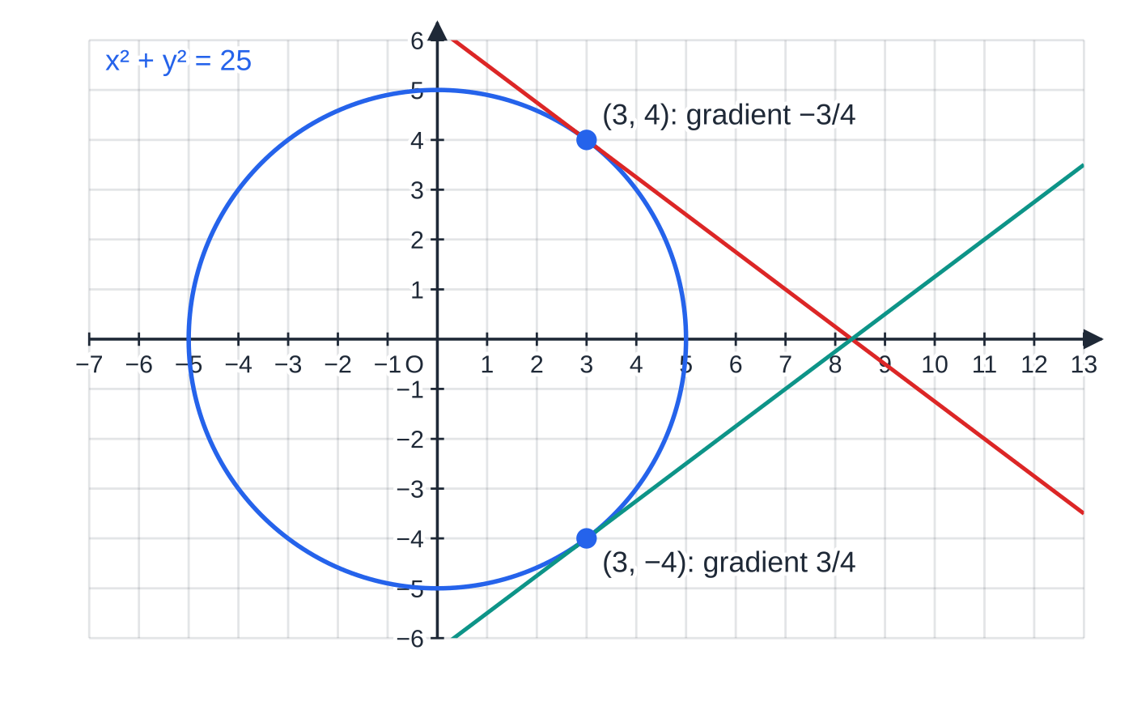
What does it mean for a curve to be defined implicitly? (continued)
Section 1 of 13
On the circle x²+y²=25 the points (3,4) and (3,-4) share an x-coordinate but have different gradients, so no formula in x alone could describe both. Differentiating gives 2x+2ydy/dx=0, so dy/dx=-x/y: that is -¾ at (3,4) and +¾ at (3,-4).
Two points on the circle with the same x-coordinate have different tangent gradients, so the derivative must depend on y as well: dy/dx=-x/y.
Notes:
What does it mean for a curve to be defined implicitly?. Full notes: https://examinerprep.com/notes/edexcel-ial-maths/implicit-differentiation-and-rates-of-change/

Slide 6
How do you differentiate a term containing y?
Section 2 of 13
Differentiate it as if the letter were x, then multiply by dy/dx. This is the chain rule with y as the inner function. Terms in x only are differentiated normally, and constants give 0.
d/dx[g(y)]=g′(y) dy/dx e.g. d/dx(yⁿ)=nyⁿ⁻¹dy/dx
This is not in the formulae booklet: learn it (the chain rule is not given).
Mixed terms such as xy or x²y³ are products of a function of x and a function of y, so they need the product rule (which is in the booklet) with the chain rule on the y part.
Term | Rule used | Derivative with respect to x
y³ | chain | 3y²dy/dx
1/y=y⁻¹ | chain | -y⁻²dy/dx
e²ʸ | chain | 2e²ʸdy/dx
Notes:
How do you differentiate a term containing y?. Full notes: https://examinerprep.com/notes/edexcel-ial-maths/implicit-differentiation-and-rates-of-change/

Slide 7
How do you differentiate a term containing y? (continued)
Section 2 of 13
Term | Rule used | Derivative with respect to x
ln y | chain | 1/ydy/dx
sin y | chain | cos ydy/dx
xy | product | y+xdy/dx
x²y³ | product + chain | 2xy³+3x²y²dy/dx
The method is always the same four steps: (1) differentiate every term on both sides; (2) collect the terms containing dy/dx on one side and everything else on the other; (3) factorise out dy/dx; (4) divide.
Notes:
How do you differentiate a term containing y?. Full notes: https://examinerprep.com/notes/edexcel-ial-maths/implicit-differentiation-and-rates-of-change/

Slide 8
How do you differentiate a term containing y? (continued)
Section 2 of 13 · Worked example 1 · Medium · Find
WORKED EXAMPLE · QUESTION
The circle C has equation x²+y²-6x+4y-12=0. (a) Find dy/dx in terms of x and y. (b) Find an equation of the tangent to C at P(7,1), in the form ax+by+c=0 where a, b and c are integers.
SOLUTION
(a) Differentiate term by term: 2x+2ydy/dx-6+4dy/dx=0. Collect and factorise: (2y+4)dy/dx=6-2x, so dy/dx=(3-x)/(y+2).
(b) Check P is on C: 49+1-42+4-12=0 ✓. Gradient at P: (3-7)/(1+2)=-(4/3). Tangent: y-1=-(4/3)(x-7), so 3y-3=-4x+28, giving 4x+3y-31=0.
Check by geometry: completing the square gives centre (3,-2) and radius 5. The radius to P has gradient ¾, and ¾×(-(4/3))=-1, so the tangent is perpendicular to the radius, as it must be.
Notes:
How do you differentiate a term containing y?: Worked example 1. Full notes: https://examinerprep.com/notes/edexcel-ial-maths/implicit-differentiation-and-rates-of-change/

Slide 9
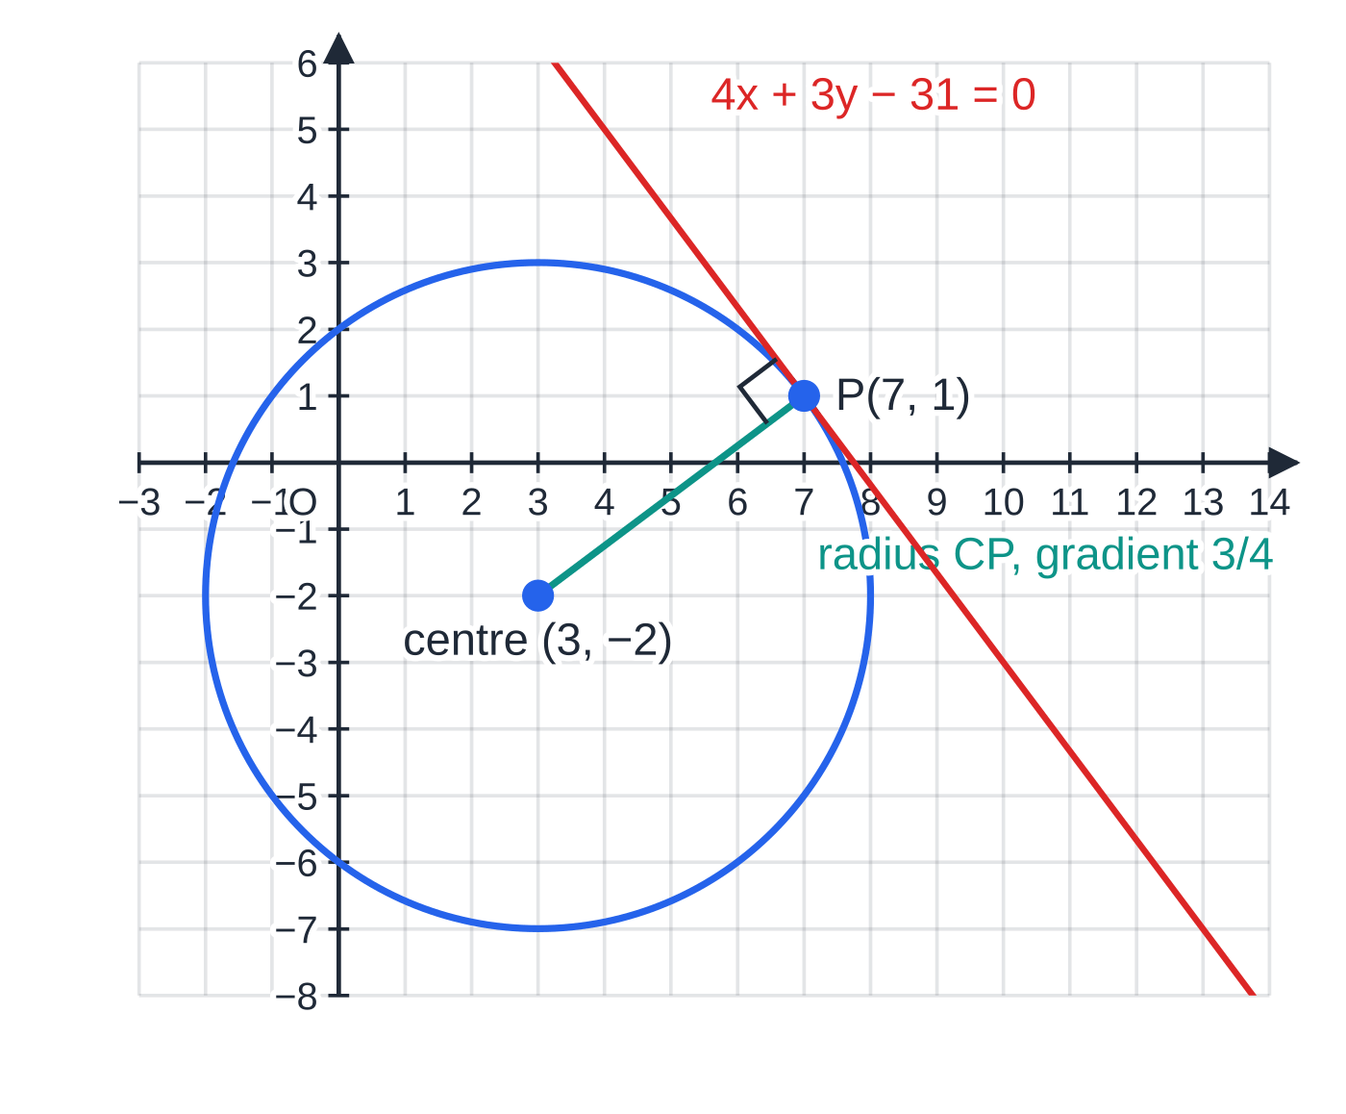
How do you differentiate a term containing y? (continued)
Section 2 of 13
Worked example 1: implicit differentiation gives the tangent gradient -(4/3) at P; the radius CP has gradient ¾, and the two are perpendicular. Equal scales, so the right angle is true.
Notes:
How do you differentiate a term containing y?. Full notes: https://examinerprep.com/notes/edexcel-ial-maths/implicit-differentiation-and-rates-of-change/

Slide 10
How do you differentiate a term containing y? (continued)
Section 2 of 13 · Worked example 2 · Medium · Find
WORKED EXAMPLE · QUESTION
(a) The curve C₁ has equation x³-2xy+y²=5. Find the gradient of C₁ at the point (2,3). (b) The curve C₂ has equation xeʸ=2x+y. Find dy/dx in terms of x and y, and its value at the origin.
SOLUTION
(a) Product rule on 2xy (in a bracket because of the minus sign), chain rule on y²: 3x²-(2y+2xdy/dx)+2ydy/dx=0. Collect: (2y-2x)dy/dx=2y-3x², so dy/dx=(2y-3x²)/(2y-2x). The point is on C₁ since 8-12+9=5. At (2,3): (6-12)/(6-4)= -3.
(b) Product rule on xeʸ; the right-hand side gives 2+dy/dx: eʸ+xeʸdy/dx=2+dy/dx. So (xeʸ-1)dy/dx=2-eʸ and dy/dx=(2-eʸ)/(xeʸ-1). At (0,0): (2-1)/(0-1)= -1.
Notes:
How do you differentiate a term containing y?: Worked example 2. Full notes: https://examinerprep.com/notes/edexcel-ial-maths/implicit-differentiation-and-rates-of-change/

Slide 11
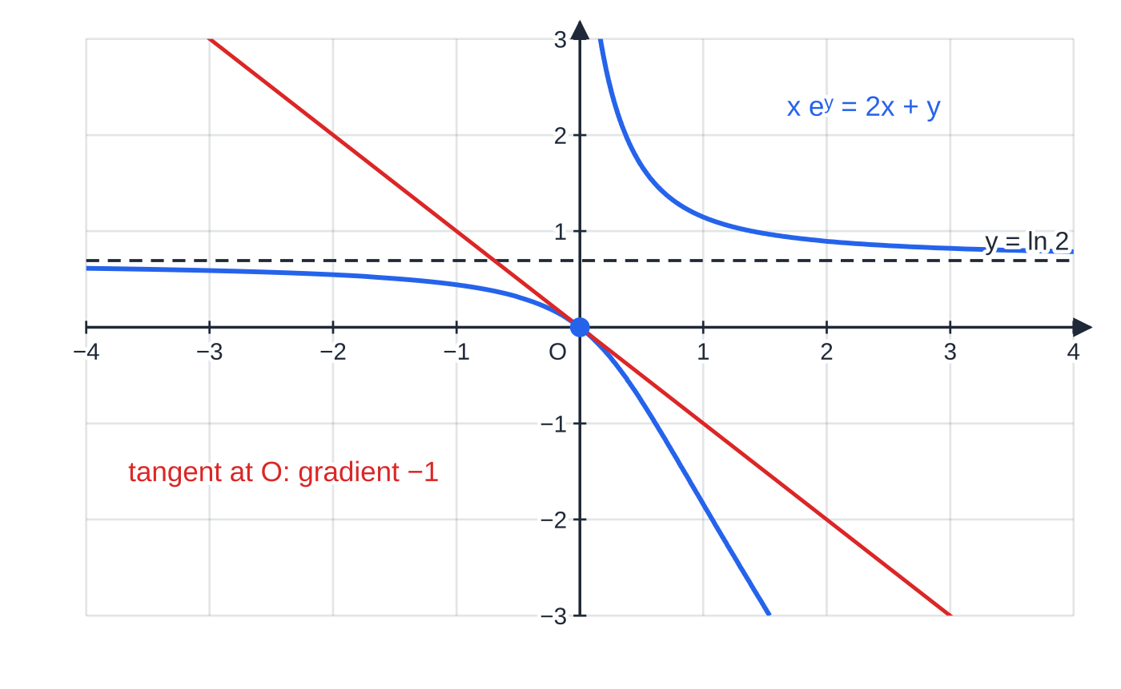
How do you differentiate a term containing y? (continued)
Section 2 of 13
Common error
Differentiating 2xy as 2y (treating y as a constant) or as 2dy/dx (forgetting the y term). It is a product: 2y+2xdy/dx. Watch the sign too: -2xy gives -2y-2xdy/dx, so put the derivative in a bracket first.
Worked example 2(b): the curve xeʸ=2x+y cannot be rearranged for y, yet implicit differentiation gives its gradient at the origin as -1. The curve never reaches the line y=ln 2, where eʸ-2=0.
Notes:
How do you differentiate a term containing y?. Full notes: https://examinerprep.com/notes/edexcel-ial-maths/implicit-differentiation-and-rates-of-change/

Slide 12
How do you find a tangent or normal to an implicit curve?
Section 3 of 13
The method is the one from P1: find the gradient m at the point, use -1/m for the normal, then y-y₁=m(x-x₁). The only change is that dy/dx depends on x and y, so you need both coordinates of the point. If you are given only x, substitute it into the curve's equation and solve for y first; there may be more than one point.
To find where a line meets the curve again, substitute the line into the curve's equation. A tangent gives a repeated root at the point of contact, because the line touches the curve there. Knowing this root twice over makes the resulting cubic easy to factorise, and it is also a strong check that your tangent is right.
Notes:
How do you find a tangent or normal to an implicit curve?. Full notes: https://examinerprep.com/notes/edexcel-ial-maths/implicit-differentiation-and-rates-of-change/

Slide 13
How do you find a tangent or normal to an implicit curve? (continued)
Section 3 of 13 · Worked example 3 · Hard · Find
WORKED EXAMPLE · QUESTION
The curve C has equation x²y+y³=10. The point P(3,1) lies on C. (a) Find dy/dx in terms of x and y. (b) Find an equation of the tangent to C at P. (c) The tangent at P meets C again at Q. Find the coordinates of Q. (d) Find an equation of the normal to C at P.
SOLUTION
(a) Product rule on x²y, chain rule on y³: 2xy+x²dy/dx+3y²dy/dx=0, so dy/dx=(-2xy)/(x²+3y²).
(b) At P(3,1): dy/dx=(-6)/(9+3)=-½. Then y-1=-½(x-3), so x+2y-5=0.
(c) Substitute x=5-2y into C: (5-2y)²y+y³=10, which expands to 5y³-20y²+25y-10=0, i.e. y³-4y²+5y-2=0. The tangent touches at P, so y=1 is a repeated root: (y-1)²(y-2)=0. Hence y=2 and x=5-4=1: Q(1,2). Check: 1×2+8=10 ✓.
(d) Normal gradient =-1÷(-½)=2. So y-1=2(x-3), i.e. y=2x-5.
Notes:
How do you find a tangent or normal to an implicit curve?: Worked example 3. Full notes: https://examinerprep.com/notes/edexcel-ial-maths/implicit-differentiation-and-rates-of-change/

Slide 14
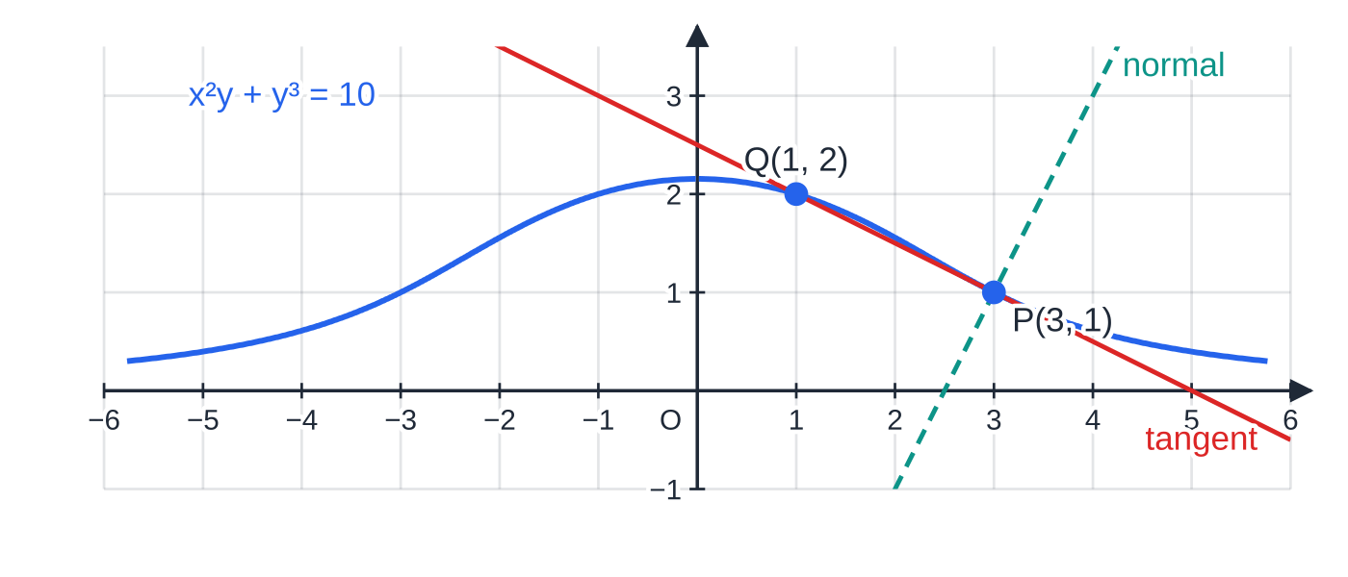
How do you find a tangent or normal to an implicit curve? (continued)
Section 3 of 13
Worked example 3: the curve lies entirely above the x-axis. The tangent at P touches the curve there and crosses it at Q(1,2); the dashed normal at P is perpendicular to the tangent.
Notes:
How do you find a tangent or normal to an implicit curve?. Full notes: https://examinerprep.com/notes/edexcel-ial-maths/implicit-differentiation-and-rates-of-change/

Slide 15
How do you find stationary points and vertical tangents?
Section 4 of 13
A stationary point has dy/dx=0: the tangent is horizontal. For a fraction this means the numerator is zero (with the denominator not zero). Setting the numerator to zero gives a relationship between x and y, such as y=-2x, not the points themselves. Geometrically it is a whole line of possible points; the actual stationary points are where that line meets the curve, so you substitute it into the curve's equation.
A vertical tangent has dx/dy=0. Since dx/dy=1/dy/dx (P3), this happens where the denominator of dy/dx is zero. Same method: denominator =0, then substitute into the curve. In words, "parallel to the x-axis" means horizontal and "parallel to the y-axis" means vertical. To decide which stationary point is a maximum and which a minimum, the shape of the curve is usually enough: a closed curve has its highest point at the stationary point with the larger y.
Notes:
How do you find stationary points and vertical tangents?. Full notes: https://examinerprep.com/notes/edexcel-ial-maths/implicit-differentiation-and-rates-of-change/

Slide 16
How do you find stationary points and vertical tangents? (continued)
Section 4 of 13 · Worked example 4 · Hard · Show that / Find
WORKED EXAMPLE · QUESTION
The curve C has equation x²+xy+y²=12. (a) Show that dy/dx=-(2x+y)/(x+2y). (b) Find the coordinates of the points on C at which the tangent is parallel to the x-axis. (c) Find the coordinates of the points on C at which the tangent is parallel to the y-axis.
SOLUTION
(a) Product rule on xy: 2x+y+xdy/dx+2ydy/dx=0, so (x+2y)dy/dx=-(2x+y) and dy/dx=-(2x+y)/(x+2y) as required.
(b) Numerator zero: 2x+y=0, so y=-2x. Substitute: x²-2x²+4x²=12, so 3x²=12 and x=±2. The points are (2,-4) and (-2,4). Check the denominator: at (2,-4), x+2y=-6≠0.
(c) Denominator zero: x=-2y. Substitute: 4y²-2y²+y²=12, so y=±2. The points are (-4,2) and (4,-2).
The curve is a closed oval, so (-2,4) is its highest point and (2,-4) its lowest.
Notes:
How do you find stationary points and vertical tangents?: Worked example 4. Full notes: https://examinerprep.com/notes/edexcel-ial-maths/implicit-differentiation-and-rates-of-change/

Slide 17
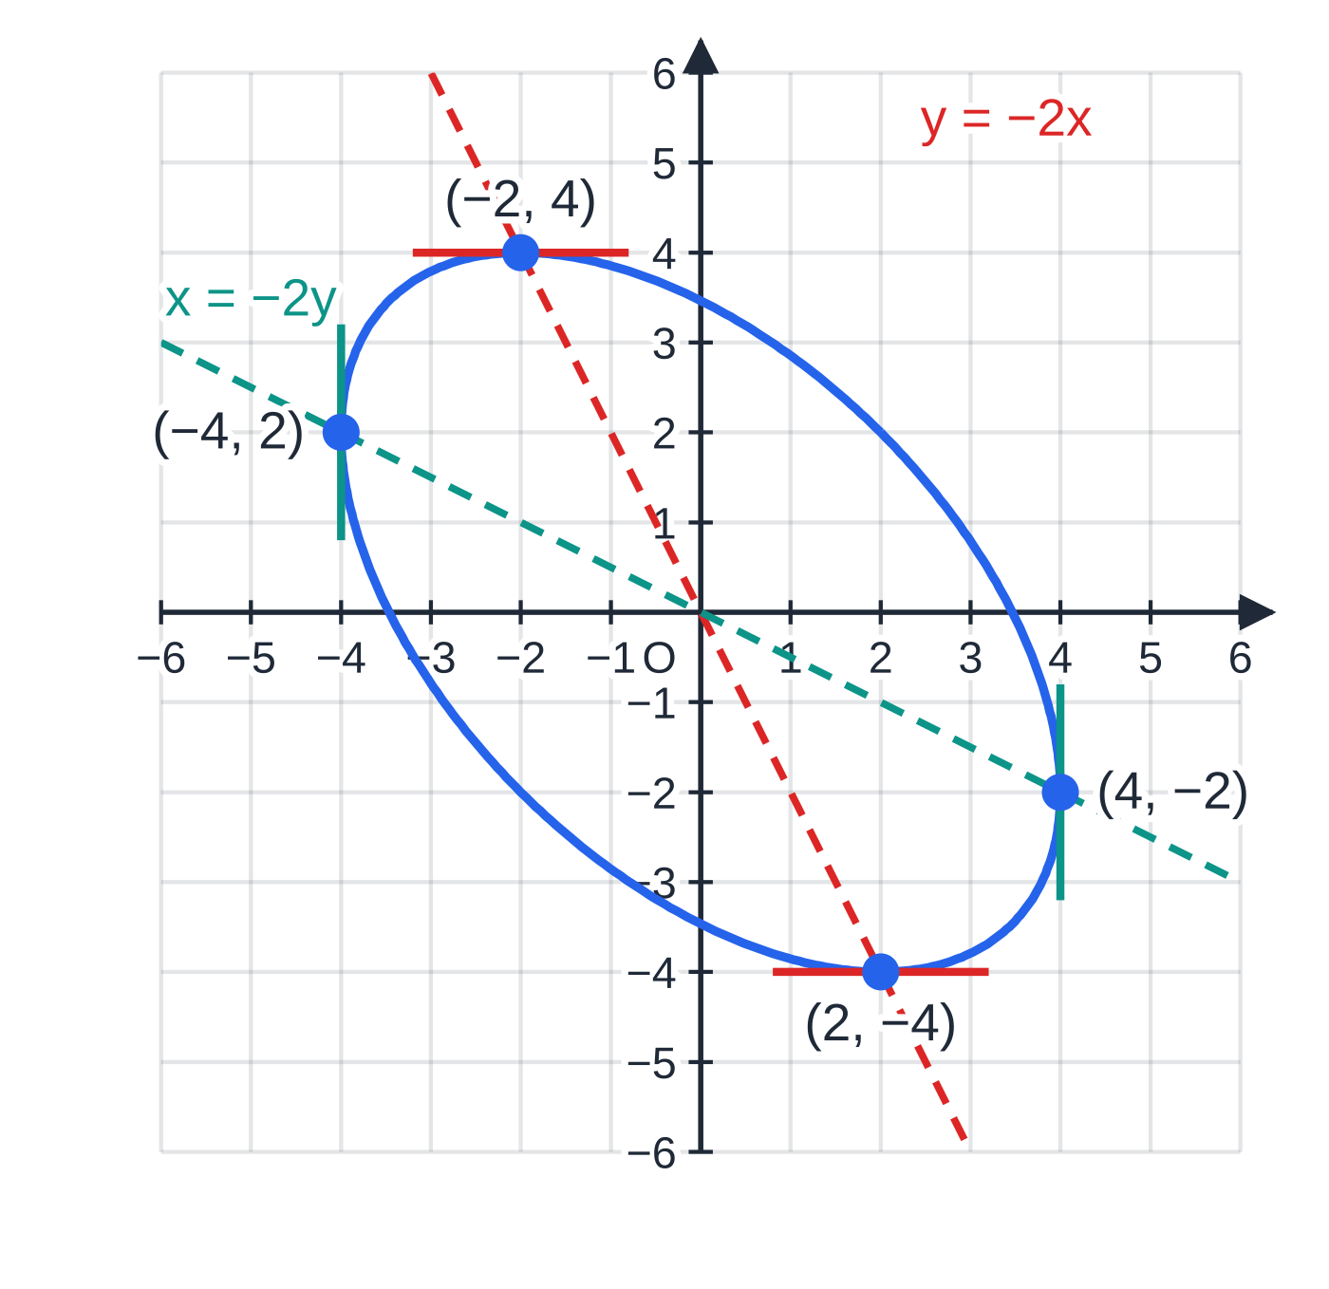
How do you find stationary points and vertical tangents? (continued)
Section 4 of 13
Common error
Stopping at "y=-2x" or solving 2x+y=0 on its own. That line is where stationary points could be; the points themselves are where it meets the curve, so you must substitute back into the curve's equation.
Worked example 4: horizontal tangents lie on y=-2x (numerator zero) and vertical tangents on x=-2y (denominator zero). Each line meets the oval x²+xy+y²=12 twice.
Notes:
How do you find stationary points and vertical tangents?. Full notes: https://examinerprep.com/notes/edexcel-ial-maths/implicit-differentiation-and-rates-of-change/

Slide 18
How do you differentiate a to the power x?
Section 5 of 13
The power rule does not apply to 3ˣ: it needs a constant power and a variable base, and here the base is constant while the power varies. Instead take natural logarithms, which turns the power into a product, and then differentiate implicitly.
y=aˣ (a>0) ⟹ dy/dx=aˣln a
Proof: ln y=xln a; differentiate implicitly: 1/ydy/dx=ln a; so dy/dx=yln a=aˣln a. With a multiple in the power, d/dx(aᵏˣ)=kln a·aᵏˣ. Not in the formulae booklet: derive it. The booklet gives aˣ=e^(xln a), which you can also differentiate with the chain rule.
When a=e, ln e=1 and the rule gives back d/dx(eˣ)=eˣ. For 0<a<1, ln a<0 and the gradient is negative everywhere. Notice that the gradient aˣln a is a constant multiple of the height aˣ: every exponential curve grows at a rate proportional to its own value, which is exactly why exponentials model growth.
Notes:
How do you differentiate a to the power x?. Full notes: https://examinerprep.com/notes/edexcel-ial-maths/implicit-differentiation-and-rates-of-change/

Slide 19
How do you differentiate a to the power x? (continued)
Section 5 of 13 · Worked example 5 · Medium · Show that / Find
WORKED EXAMPLE · QUESTION
(a) By taking natural logarithms, show that if y=aˣ, where a is a positive constant, then dy/dx=aˣln a. (b) The tangent to y=3ˣ at the point (2,9) meets the x-axis at A. Find the exact x-coordinate of A. (c) Differentiate y=4³ˣ.
SOLUTION
(a) ln y=xln a, so 1/ydy/dx=ln a, and dy/dx=yln a=aˣln a as required.
(b) Gradient at x=2: 3²ln 3=9ln 3 (≈9.89). Tangent: y-9=9ln 3 (x-2). Put y=0: -9=9ln 3 (x-2), so x=2-1/ln 3 (≈1.09).
(c) ln y=3xln 4, so 1/ydy/dx=3ln 4 and dy/dx=3ln 4·4³ˣ (=6ln 2·4³ˣ).
Notes:
How do you differentiate a to the power x?: Worked example 5. Full notes: https://examinerprep.com/notes/edexcel-ial-maths/implicit-differentiation-and-rates-of-change/

Slide 20
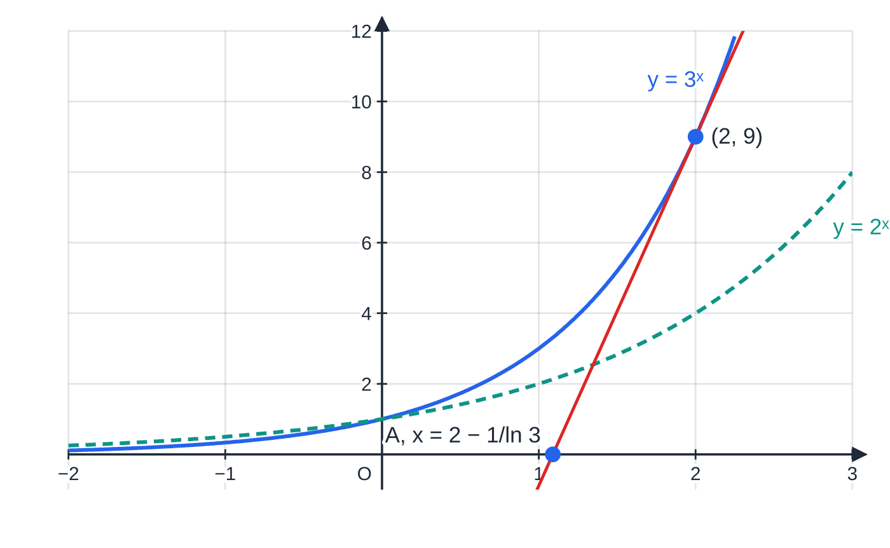
How do you differentiate a to the power x? (continued)
Section 5 of 13
Worked example 5: the gradient of y=3ˣ is 3ˣln 3, proportional to the height of the curve; at (2,9) it is 9ln 3. The flatter dashed curve y=2ˣ has gradient 2ˣln 2.
Notes:
How do you differentiate a to the power x?. Full notes: https://examinerprep.com/notes/edexcel-ial-maths/implicit-differentiation-and-rates-of-change/

Slide 21
How do you turn a description into a differential equation?
Section 6 of 13
A differential equation is an equation containing a derivative. In context, "the rate of change of N" (with time) is dN/dt. The translation from words follows a few fixed rules:
"A is proportional to B" becomes A=kB, where k is a constant of proportionality; "inversely proportional to B" gives A=k/B.
Take k>0 and put the sign in yourself: a quantity that decreases gets a minus sign, dm/dt=-km.
If a rate is given at one moment ("when θ=78 it is falling at 2.4 degrees per minute"), substitute it to find k. "Falling at 2.4" means the derivative is -2.4.
Several effects at once add up: "water flows in at 20 cm³ s⁻¹ and leaks out at a rate proportional to the depth" gives dV/dt=20-kh.
Notes:
How do you turn a description into a differential equation?. Full notes: https://examinerprep.com/notes/edexcel-ial-maths/implicit-differentiation-and-rates-of-change/

Slide 22
How do you turn a description into a differential equation? (continued)
Section 6 of 13 · Worked example 6 · Medium · Write down / Find
WORKED EXAMPLE · QUESTION
Write a differential equation for each situation, stating the meaning of any constant. (a) The number of fish, N, in a lake t years after stocking increases at a rate proportional to N. (b) The depth, h m, of water in a draining tank decreases at a rate proportional to the square root of h. (c) A drink at temperature θ °C stands in a room at 18 °C. Its temperature falls at a rate proportional to the difference between its temperature and the room temperature. When θ=78 it is cooling at 2.4 °C per minute. Find the constant, and the rate of cooling when θ=48.
SOLUTION
(a) dN/dt=kN, where k>0 is a constant.
(b) Decreasing, so a minus sign: dh/dt=-k√h, k>0.
(c) The difference is θ-18 and the temperature is falling: dθ/dt=-k(θ-18). Substitute: -2.4=-k(78-18), so k=0.04. At θ=48: dθ/dt=-0.04×30=-1.2, so the drink is cooling at 1.2 °C per minute.
Notes:
How do you turn a description into a differential equation?: Worked example 6. Full notes: https://examinerprep.com/notes/edexcel-ial-maths/implicit-differentiation-and-rates-of-change/

Slide 23
How do you turn a description into a differential equation? (continued)
Section 6 of 13 · Worked example 6 · Medium · Write down / Find (continued)
Here t is in minutes, so k has units per minute. Solving these equations, to get N, h or θ as functions of t, is done on the P4 differential equations page.
Notes:
How do you turn a description into a differential equation?: Worked example 6. Full notes: https://examinerprep.com/notes/edexcel-ial-maths/implicit-differentiation-and-rates-of-change/

Slide 24
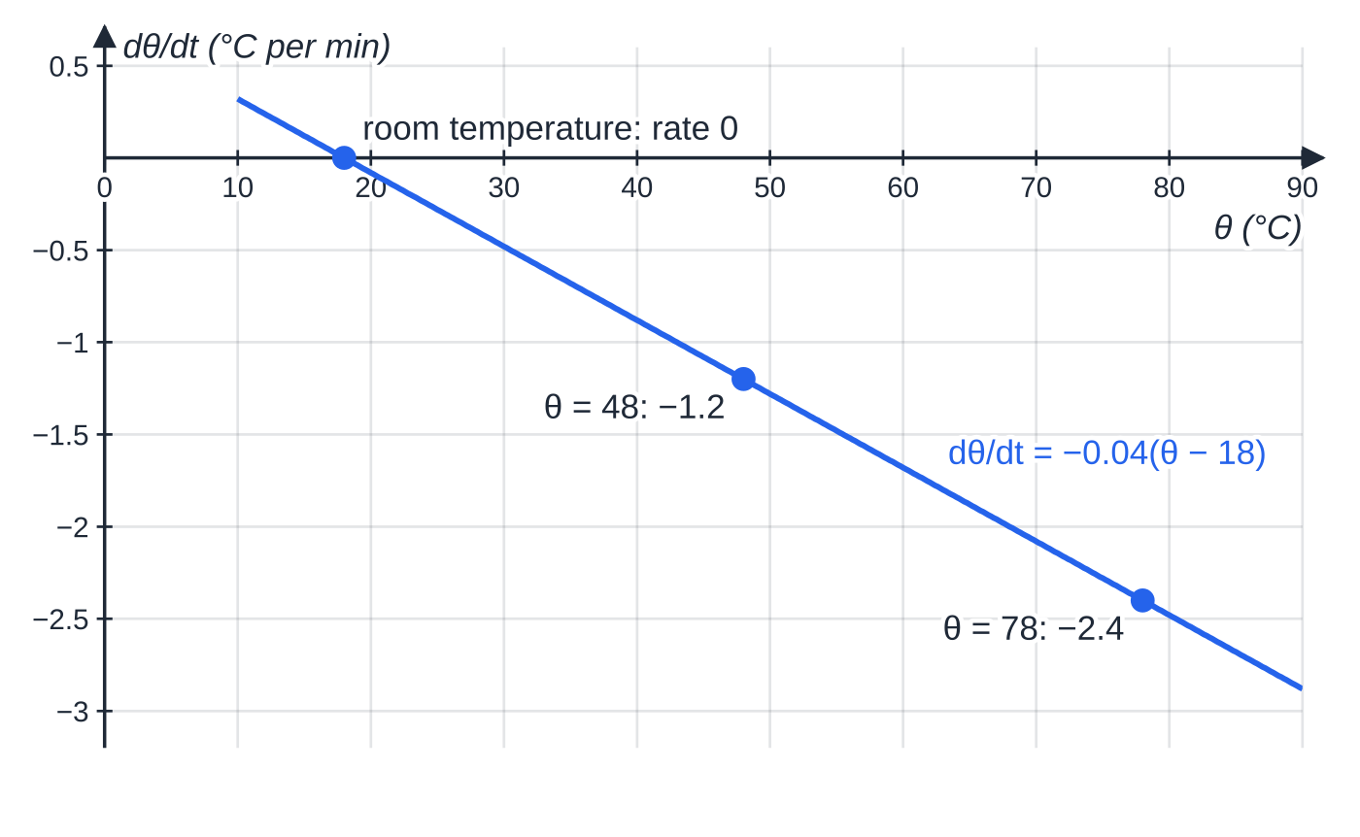
How do you turn a description into a differential equation? (continued)
Section 6 of 13
Exam tip
Always define your variables and say "k is a positive constant". If the question uses a different letter or tells you the sign, use exactly that form; a "show that" with a given equation tells you which way round the constant goes.
Worked example 6(c): the rate of cooling is a straight-line function of θ. The hotter the drink, the faster it cools; at room temperature the rate is zero.
Notes:
How do you turn a description into a differential equation?. Full notes: https://examinerprep.com/notes/edexcel-ial-maths/implicit-differentiation-and-rates-of-change/

Slide 25
How does the chain rule connect two rates of change?
Section 7 of 13
Often you know one rate (how fast air is pumped in, dV/dt) and want another (how fast the radius grows, dr/dt). A geometric formula links the quantities, V=(4/3)πr³, so you can find dV/dr. The chain rule joins them:
dV/dt=dV/dr×dr/dt
Write it so that the "dr" would cancel, as a check that the chain is the right way up. To go via a third quantity use a longer chain, e.g. dS/dt=dS/dr×dr/dt, with dr/dt from the first step.
Method: (1) write the formula linking the two quantities; (2) differentiate it; (3) write the chain rule and substitute the known rate and the value at that instant; (4) solve, with units. Substitute the particular value last: if you put r=10 into V before differentiating, V becomes a constant and its derivative is 0.
Notes:
How does the chain rule connect two rates of change?. Full notes: https://examinerprep.com/notes/edexcel-ial-maths/implicit-differentiation-and-rates-of-change/

Slide 26
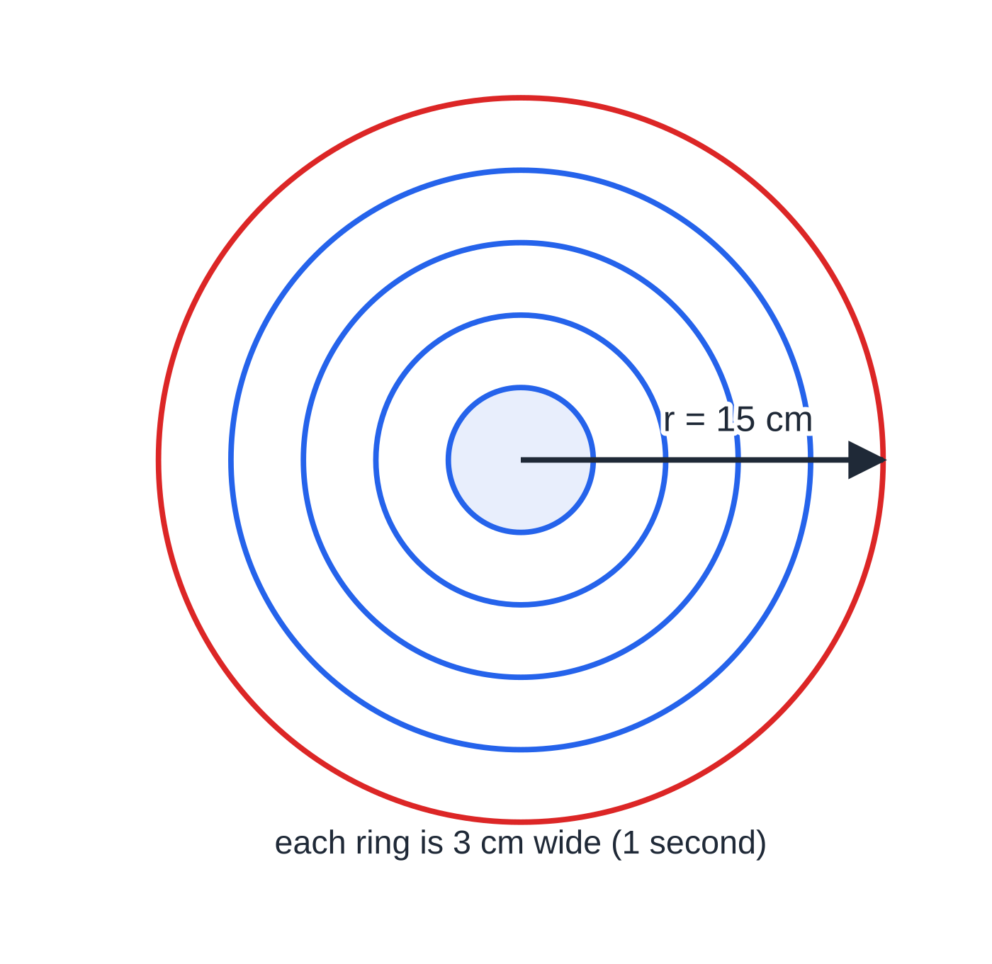
How does the chain rule connect two rates of change? (continued)
Section 7 of 13
A first example: a stone dropped in a pond makes a circular ripple whose radius grows at a steady 3 cm s⁻¹. The area is A=πr², so dA/dt=2πr×3=6πr. When r=15 cm the area is growing at 90π≈283 cm² s⁻¹. The radius grows at a constant rate, but the area grows faster and faster.
Ripples at one-second intervals, drawn to scale. Each ring is 3 cm wide, yet the outer rings hold far more area: the ring added in the fifth second is nine times the first circle. That is dA/dt=6πr growing with r.
Notes:
How does the chain rule connect two rates of change?. Full notes: https://examinerprep.com/notes/edexcel-ial-maths/implicit-differentiation-and-rates-of-change/

Slide 27
How does the chain rule connect two rates of change? (continued)
Section 7 of 13 · Worked example 7 · Medium · Find
WORKED EXAMPLE · QUESTION
A spherical balloon is inflated so that its volume increases at a constant rate of 50 cm³ s⁻¹. [The volume of a sphere of radius r is (4/3)πr³ and its surface area is 4πr².] When the radius is 10 cm, find (a) the rate at which the radius is increasing, (b) the rate at which the surface area is increasing.
SOLUTION
(a) V=(4/3)πr³, so dV/dr=4πr²=400π when r=10. Chain rule: dV/dt=dV/dr×dr/dt, so 50=400π×dr/dt and dr/dt=1/8π≈0.0398 cm s⁻¹.
(b) S=4πr², so dS/dr=8πr=80π. Then dS/dt=80π×1/8π= 10 cm² s⁻¹.
Keep dr/dt exact for part (b): the π cancels and the answer is exact.
Notes:
How does the chain rule connect two rates of change?: Worked example 7. Full notes: https://examinerprep.com/notes/edexcel-ial-maths/implicit-differentiation-and-rates-of-change/

Slide 28
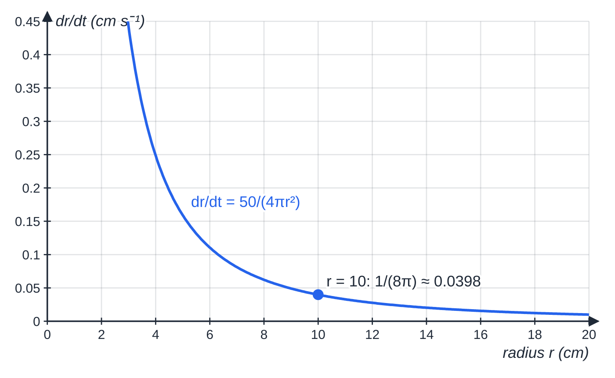
How does the chain rule connect two rates of change? (continued)
Section 7 of 13
Common error
Writing the chain upside down, e.g. dr/dt=dV/dt×dV/dr. That would give 50×400π, a radius growing at over 60 000 cm per second. Check that the fractions "cancel" to the rate you want, and that the size of the answer is sensible.
Worked example 7 for every radius: with air entering at a constant 50 cm³ s⁻¹, the radius grows more and more slowly, because each extra centimetre of radius needs a larger shell of air (dV/dr=4πr²).
Notes:
How does the chain rule connect two rates of change?. Full notes: https://examinerprep.com/notes/edexcel-ial-maths/implicit-differentiation-and-rates-of-change/

Slide 29
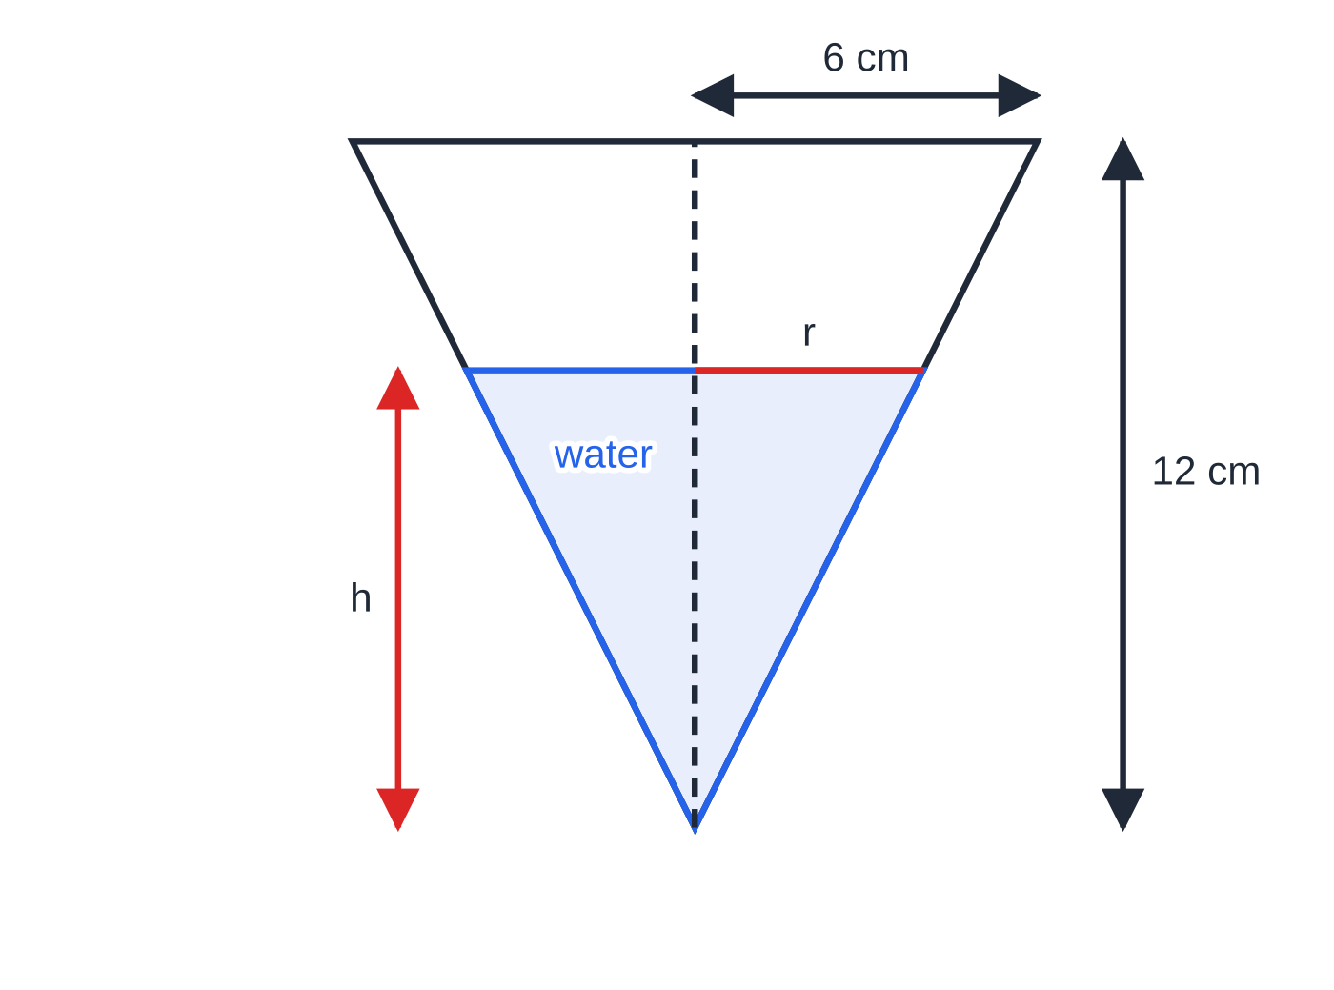
How do the pieces fit in a longer question?
Section 8 of 13
Longer questions combine a geometric formula (often with similar triangles), a connected-rates calculation and a differential equation formed from a description. The next example does all three. The key geometric step is that in a cone held vertex down, the water always forms a smaller cone of the same shape, so its radius is a fixed fraction of its depth and the volume can be written in terms of the depth alone.
A hollow cone with its vertex down, drawn to scale. The water surface is a circle of radius r at depth h; similar triangles fix r=h/2 at every depth.
Notes:
How do the pieces fit in a longer question?. Full notes: https://examinerprep.com/notes/edexcel-ial-maths/implicit-differentiation-and-rates-of-change/

Slide 30
How do the pieces fit in a longer question? (continued)
Section 8 of 13 · Worked example 8 · Hard · Show that / Find
WORKED EXAMPLE · QUESTION
A container is a hollow right circular cone of height 12 cm and top radius 6 cm, held with its axis vertical and its vertex at the bottom. Water is poured in at a constant rate of 20 cm³ s⁻¹. When the depth of water is h cm the volume of water is V cm³. [The volume of a cone is ⅓πr²h.] (a) Show that V=πh³/12. (b) Assuming no water is lost, find the rate at which the depth is increasing when h=8. In a refined model, water also leaks from a small hole at the vertex at a rate of kh cm³ s⁻¹, where k is a positive constant. (c) Show that dh/dt=(4(20-kh))/πh². (d) In this model the depth stays constant when h=10. Find k. (e) Find the rate at which the depth is increasing when h=8 in the refined model, and compare it with (b).
SOLUTION
(a) Similar triangles: r/h=(6/12), so r=h/2. Then V=⅓π(h/2)²h=πh³/12 as required.
(b) dV/dh=πh²/4=16π at h=8. So dh/dt=dV/dt÷dV/dh=20/16π= 5/4π≈0.398 cm s⁻¹.
(c) Net rate in = rate in − rate out: dV/dt=20-kh. Also dV/dt=πh²/4dh/dt.
Notes:
How do the pieces fit in a longer question?: Worked example 8. Full notes: https://examinerprep.com/notes/edexcel-ial-maths/implicit-differentiation-and-rates-of-change/

Slide 31
How do the pieces fit in a longer question? (continued)
Section 8 of 13 · Worked example 8 · Hard · Show that / Find (continued)
Equate: πh²/4dh/dt=20-kh, so dh/dt=(4(20-kh))/πh² as required.
(d) Depth constant means dh/dt=0: 20-10k=0, so k=2.
(e) With k=2, h=8: dh/dt=(4(20-16))/64π= 1/4π≈0.0796 cm s⁻¹. This is one fifth of the answer to (b): the leak removes 16 of the 20 cm³ entering each second at this depth, so the water rises much more slowly. In this model the depth approaches 10 cm and the cone (12 cm tall) never overflows.
Notes:
How do the pieces fit in a longer question?: Worked example 8. Full notes: https://examinerprep.com/notes/edexcel-ial-maths/implicit-differentiation-and-rates-of-change/

Slide 32
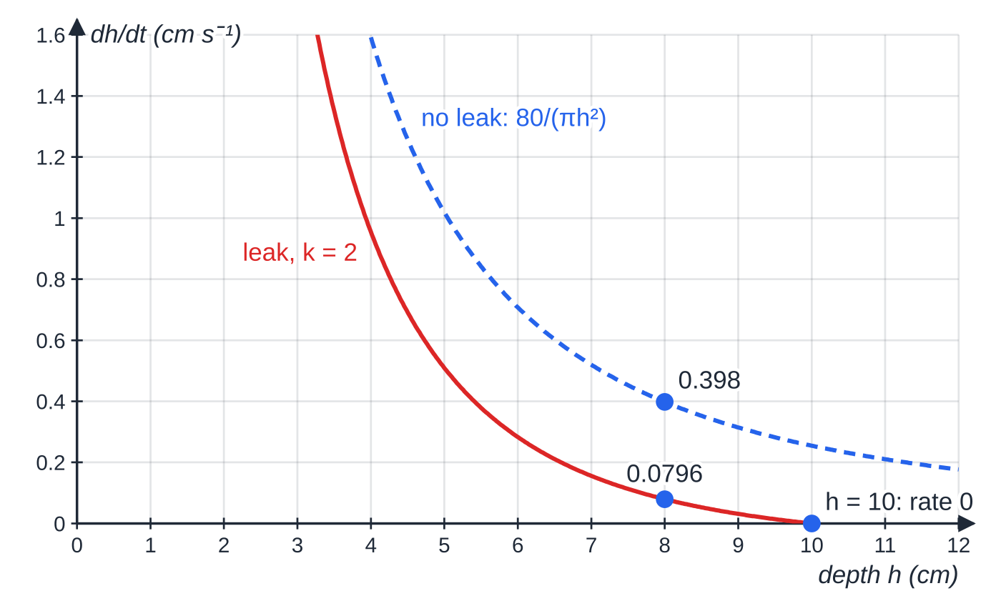
How do the pieces fit in a longer question? (continued)
Section 8 of 13
Worked example 8: the rate of rise against depth in both models. With the leak, the rate falls to zero at h=10, so the depth levels off below the 12 cm rim.
Notes:
How do the pieces fit in a longer question?. Full notes: https://examinerprep.com/notes/edexcel-ial-maths/implicit-differentiation-and-rates-of-change/

Slide 33
Exam tips for P4.4
Section 9 of 13
Exam tip 1 — show the differentiated line in full
Write the whole equation after differentiating, before rearranging. That line, with dy/dx attached to every y term and the product rule applied to every mixed term, is where the method is shown; the rearrangement is a short step after it.
Exam tip 2 — a constant on the right gives 0
Differentiate both sides. A number such as the 12 in x²+xy+y²=12 becomes 0; a term such as 2x+y on the right becomes 2+dy/dx. Then collect.
Exam tip 3 — stationary points: relationship first, then substitute
Set the numerator to zero to get a link like y=-2x, substitute it into the curve, and give both coordinates of every point. Check that the denominator is non-zero at your points.
Notes:
Exam tips for P4.4. Full notes: https://examinerprep.com/notes/edexcel-ial-maths/implicit-differentiation-and-rates-of-change/

Slide 34
Exam tips for P4.4 (continued)
Section 9 of 13
Exam tip 4 — connected rates: write the chain before the numbers
Start with a line such as dh/dt=dh/dV×dV/dt, then substitute. Give units (cm s⁻¹, cm² s⁻¹) and 3 significant figures unless an exact answer is asked for.
Exam tip 5 — forming equations: signs and constants
"Decreases at a rate proportional to …" needs a minus sign with k>0. When a rate is quoted at one instant, substitute the values at that instant to find k, and check the sign of your k makes sense.
Notes:
Exam tips for P4.4. Full notes: https://examinerprep.com/notes/edexcel-ial-maths/implicit-differentiation-and-rates-of-change/

Slide 35
Common misconceptions
Section 10 of 13
Misconception | Why it is wrong | Correct idea
d/dx(y²)=2y. | y depends on x; differentiating with respect to x needs the chain rule. | d/dx(y²)=2ydy/dx.
d/dx(xy)=dy/dx. | xy is a product of two functions of x. | Product rule: y+xdy/dx.
The gradient at a point only needs its x-coordinate. | Implicit derivatives usually contain y as well, and one x can give several points. | Substitute both coordinates; find y from the curve first if needed.
Setting the numerator of dy/dx to zero gives the stationary points. | It gives a relationship between x and y, a whole line of possible points. | Solve it together with the curve's equation.
d/dx(2ˣ)=x·2ˣ⁻¹. | The power rule needs a constant power; here the power is the variable. | d/dx(2ˣ)=2ˣln 2.
In connected rates, substitute the given radius into the formula before differentiating. | The formula then becomes a constant, whose derivative is 0. | Differentiate the general formula, then substitute the value at that instant.
Notes:
Common misconceptions. Full notes: https://examinerprep.com/notes/edexcel-ial-maths/implicit-differentiation-and-rates-of-change/

Slide 36
How this topic connects
Section 11 of 13
P3 differentiation
Every step here is the chain and product rules from P3; dy/dx=1/dx/dy explains why a zero denominator means a vertical tangent, and aˣ=e^(xln a) gives a second route to the derivative of aˣ.
P1 and P2 coordinate geometry
Tangents and normals use y-y₁=m(x-x₁) and perpendicular gradients from P1; circles from P2 give a geometric check (tangent perpendicular to radius).
Other P4 pages
P4.2 Parametric equations give dy/dx by a different route; P4.7 Differential equations solves the equations formed in this page, and P4.6 Volumes of revolution builds on the volume formulae used for rates. In Mechanics, rates of change in time are velocity and acceleration, and dN/dt=-λN (radioactive decay) and Newton's law of cooling are the physics versions of forming differential equations.
Notes:
How this topic connects. Full notes: https://examinerprep.com/notes/edexcel-ial-maths/implicit-differentiation-and-rates-of-change/

Slide 37
Key formulae
Section 12 of 13
Formula | Use | In the formulae list?
d/dx[g(y)]=g′(y)dy/dx, e.g. d/dx(yⁿ)=nyⁿ⁻¹dy/dx | differentiating any term in y implicitly | No — learn it
d/dx(uv)=udv/dx+vdu/dx | mixed terms such as xy, x²y³, xeʸ | Yes
dy/dx=0 (numerator =0); dx/dy=0 (denominator =0) | horizontal and vertical tangents on an implicit curve | No — learn it
aˣ=e^(xln a) | rewriting an exponential with base a | Yes
d/dx(aˣ)=aˣln a | gradient of y=aˣ | No — derive it
dA/dt=dA/dr×dr/dt | connected rates of change | No — learn it
"A decreases at a rate proportional to B": dA/dt=-kB, k>0 | forming a differential equation | No — learn it
Surface area of a sphere 4πr² | rates involving spheres | Yes
Notes:
Key formulae. Full notes: https://examinerprep.com/notes/edexcel-ial-maths/implicit-differentiation-and-rates-of-change/

Slide 38
Key formulae (continued)
Section 12 of 13
Formula | Use | In the formulae list?
Area of a circle πr²; volume of a sphere (4/3)πr³; volume of a cone ⅓πr²h | linking quantities in rates questions | No — learn it
Notes:
Key formulae. Full notes: https://examinerprep.com/notes/edexcel-ial-maths/implicit-differentiation-and-rates-of-change/

Slide 39
Check your understanding
Section 13 of 13
1. Find dy/dx for the curve y²=4x.
2. Find the gradient of the curve xy=6 at the point (2,3).
3. What is the gradient of y=2ˣ where it crosses the y-axis?
4. The radius of a circle increases at ½ cm s⁻¹. How fast is the area increasing when the radius is 5 cm?
5. Write a differential equation for: "the mass m of a melting block of ice decreases at a rate inversely proportional to m".
6. In worked example 4, show that the point (-2,4) is on the curve and confirm the tangent there is horizontal.
Notes:
Check your understanding: questions. Full notes: https://examinerprep.com/notes/edexcel-ial-maths/implicit-differentiation-and-rates-of-change/

Slide 40
Check your understanding · answers
Section 13 of 13
1. 2ydy/dx=4, so dy/dx=2/y. For example, at (1,2) the gradient is 1 and at (1,-2) it is -1.
2. y+xdy/dx=0, so dy/dx=-y/x=-(3/2).
3. dy/dx=2ˣln 2, which is ln 2≈0.693 at x=0.
4. dA/dt=2πr×dr/dt=2π×5×½=5π≈15.7 cm² s⁻¹.
5. dm/dt=-k/m, where k is a positive constant. "Inversely proportional" puts m in the denominator; "decreases" gives the minus sign.
6. 4+(-2)(4)+16=12 ✓. The numerator 2x+y=-4+4=0 and the denominator x+2y=-2+8=6≠0, so dy/dx=0: the tangent is horizontal.
Notes:
Check your understanding: answers. Full notes: https://examinerprep.com/notes/edexcel-ial-maths/implicit-differentiation-and-rates-of-change/

Slide 41
Practice questions
1 original exam-style questions. Answers at the end of the deck.

Slide 42
Question 1
7 marks
The circle C has equation x² + y² + 4x − 10y + 4 = 0. The point A(1, 9) lies on C.
(a) Use implicit differentiation to find dy/dx in terms of x and y. [3]
(b) Find an equation of the tangent to C at A, in the form ax + by + c = 0, where a, b and c are integers. [2]
(c) The tangent meets the x-axis at B and the y-axis at D. Find the exact area of triangle OBD, where O is the origin. [2]
Notes:
Online with the full mark scheme: https://examinerprep.com/ial-maths-p4-4-implicit-differentiation-and-rates-of-change-questions#IALM-P4-4-B-05

Slide 43
Answers

Slide 44
Question 1 · answer
Mark scheme
2x + 2ydy/dx + 4 − 10dy/dx = 0
collects: (2y − 10)dy/dx = −2x − 4
dy/dx = −(x + 2)/(y − 5)
gradient −3/4 and y − 9 = −¾(x − 1)
3x + 4y − 39 = 0
B(13, 0) and D(0, 39/4) from their tangent
area = ½ × 13 × 39/4 = 507/8
Notes:
Full mark scheme: https://examinerprep.com/ial-maths-p4-4-implicit-differentiation-and-rates-of-change-questions#IALM-P4-4-B-05

Slide 45
Keep practising
Notes for this topic
Questions on this topic
Build a printable test
ExaminerPrep is an independent tutoring service. It has been developed independently from and is not endorsed by the International Baccalaureate Organization. "International Baccalaureate", "IB" and "IB Diploma Programme" are registered trademarks of the IBO, used here for descriptive purposes only.
Pearson Edexcel and Cambridge are trademarks of their owners; ExaminerPrep is not affiliated with any exam board.

