Slide 1
EP
EDEXCEL IAL MATHS
P1.1 Indices, surds and quadratics
The full notes page in 13 sections · practice questions with answers · simulations
ExaminerPrep is an independent tutoring service. It has been developed independently from and is not endorsed by the International Baccalaureate Organization. "International Baccalaureate", "IB" and "IB Diploma Programme" are registered trademarks of the IBO, used here for descriptive purposes only.
Pearson Edexcel and Cambridge are trademarks of their owners; ExaminerPrep is not affiliated with any exam board.
Notes:
P1.1 Indices, surds and quadratics. Notes for this topic: https://examinerprep.com/notes/edexcel-ial-maths/indices-surds-and-quadratics/

Slide 2
What this page covers
Overview
The laws of indices for all rational exponents, including a⁰, negative powers and a^(m/n) as a root
Simplifying surds and multiplying out brackets containing surds
Rationalising denominators of the form √b and a±√b
Quadratic functions and their graphs: shape, intercepts, line of symmetry and vertex
Completing the square, and reading off the vertex and the minimum or maximum value
Solving quadratic equations by factorising, by completing the square and by the formula
The discriminant b²-4ac and the nature of the roots, including finding an unknown constant for equal roots
Disguised quadratics in √x, x^(1/3), 2ˣ or x²
Notes:
What this page covers. Full notes: https://examinerprep.com/notes/edexcel-ial-maths/indices-surds-and-quadratics/

Slide 3
In one minute
Key points
1. This page is the algebra every later pure topic leans on: powers written as xⁿ, exact surd answers, and quadratics that you solve, sketch or test with the discriminant.
2. aᵐ×aⁿ=aᵐ⁺ⁿ, aᵐ÷aⁿ=aᵐ⁻ⁿ, (aᵐ)ⁿ=aᵐⁿ, a⁰=1, a⁻ⁿ=1/aⁿ, a^(m/n)=(ⁿ√a)ᵐ.
3. √(ab)=√a√b: pull out the largest square factor, so √72=6√2. But √(a+b) is not √a+√b.
4. To rationalise 1/(a+√b), multiply top and bottom by a-√b; the denominator becomes a²-b.
5. a(x+p)²+q has vertex (-p, q) and line of symmetry x=-p; a minimum if a>0, a maximum if a<0.
6. b²-4ac>0: two distinct real roots; =0: one repeated root (the curve touches the x-axis); <0: no real roots.
7. If an equation contains a power and its square (√x and x, 2ˣ and 4ˣ), substitute u and solve a quadratic in u.
Notes:
In one minute. Full notes: https://examinerprep.com/notes/edexcel-ial-maths/indices-surds-and-quadratics/

Slide 4
How do the laws of indices work for negative and fractional powers?
Section 1 of 13
The three basic laws come from counting factors: a³×a² has 3+2 factors of a. Insisting that the same laws hold for every rational power forces the meaning of zero, negative and fractional powers.
Zero: a³÷a³=a⁰ and also =1, so a⁰=1 (for a≠0).
Negative: a⁰÷aⁿ=a⁻ⁿ, so a⁻ⁿ=1/aⁿ. A negative power means "reciprocal", not "negative number": 2⁻³=⅛.
Unit fractions: (a^(1/n))ⁿ=a¹, so a^(1/n) is the nth root of a: 8^(1/3)=2, x^(1/2)=√x.
General fractions: a^(m/n)=(ⁿ√a)ᵐ=ⁿ√(aᵐ). Take the root first and the numbers stay small: 27^(2/3)=3²=9.
The laws only combine powers of the same base. To compare 4ˣ with 8ʸ, first write both as powers of 2.
aᵐ aⁿ=aᵐ⁺ⁿ aᵐ÷aⁿ=aᵐ⁻ⁿ (aᵐ)ⁿ=aᵐⁿ
Notes:
How do the laws of indices work for negative and fractional powers?. Full notes: https://examinerprep.com/notes/edexcel-ial-maths/indices-surds-and-quadratics/

Slide 5
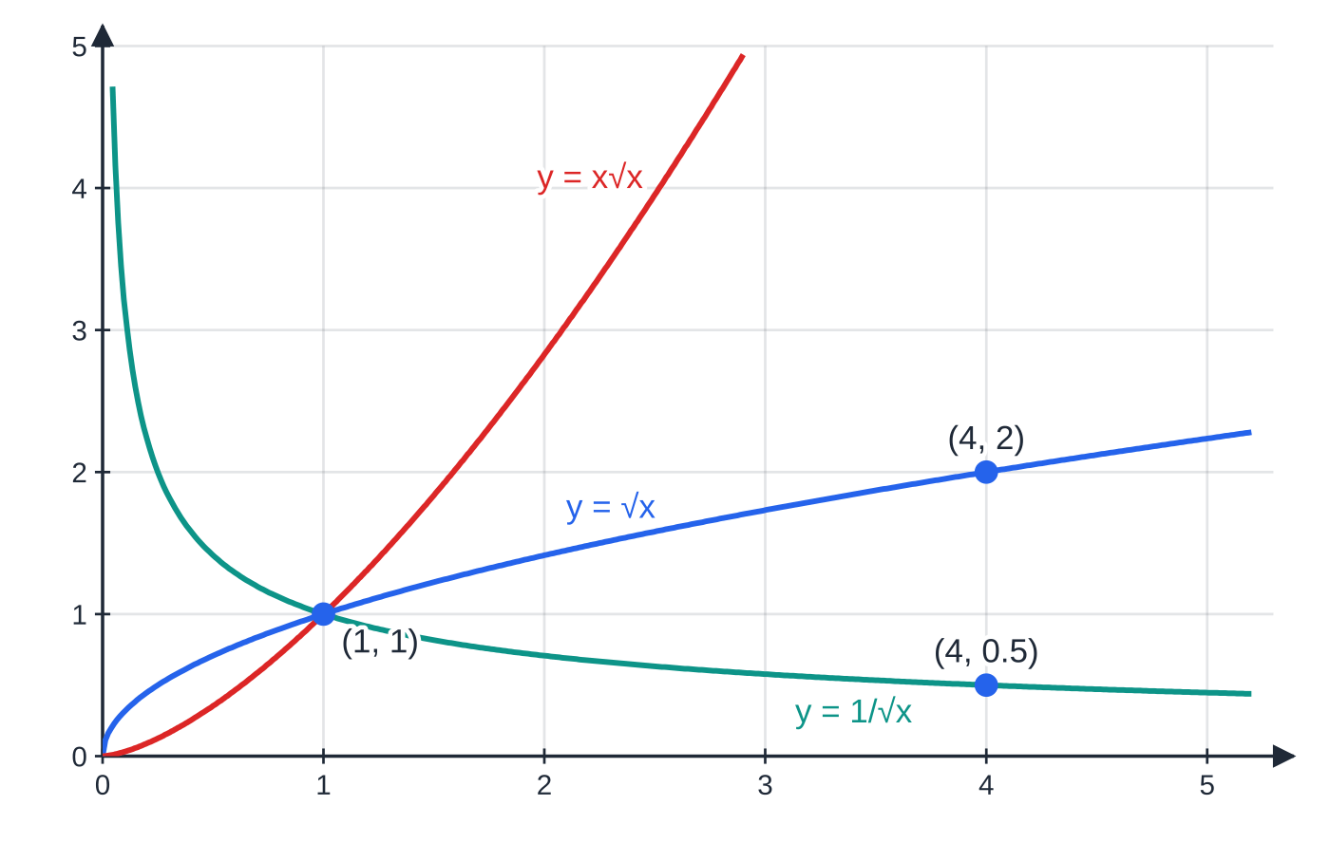
How do the laws of indices work for negative and fractional powers? (continued)
Section 1 of 13
a⁰=1 a⁻ⁿ=1/aⁿ a^(m/n)=(ⁿ√a)ᵐ
These are not in the formulae booklet: learn them. Also (ab)ⁿ=aⁿbⁿ and (a/b)⁻ⁿ=(b/a)ⁿ. Take a>0 whenever the power is a fraction.
Three rational powers of x: x^(1/2)=√x, x^(3/2)=x√x and x^(-1/2)=1/√x. Every power of x passes through (1, 1). At x = 4 the values are 2, 8 (off the top) and 0.5: the negative power is the reciprocal of the positive one.
Notes:
How do the laws of indices work for negative and fractional powers?. Full notes: https://examinerprep.com/notes/edexcel-ial-maths/indices-surds-and-quadratics/

Slide 6
How do the laws of indices work for negative and fractional powers? (continued)
Section 1 of 13 · Worked example 1 · Easy · Find, simplify
WORKED EXAMPLE · QUESTION
(a) Find the exact value of (16/81)^(-3/4). (b) Simplify fully ((9x⁴)^(3/2))/(3x)², where x>0.
SOLUTION
(a) The negative power turns the fraction upside down: (16/81)^(-3/4)=(81/16)^(3/4). Fourth root first, then cube: (81/16)^(1/4)=(3/2), and (3/2)³= (27/8)
(b) Apply the power to each factor of the numerator: (9x⁴)^(3/2)=9^(3/2)x^(4×3/2)=27x⁶, and (3x)²=9x². So 27x⁶/9x²= 3x⁴
A common slip in (b) is 9^(3/2)=9×(3/2). The power applies to the 9 as well: √9=3, then 3³=27.
Notes:
How do the laws of indices work for negative and fractional powers?: Worked example 1. Full notes: https://examinerprep.com/notes/edexcel-ial-maths/indices-surds-and-quadratics/

Slide 7
How do the laws of indices work for negative and fractional powers? (continued)
Section 1 of 13 · Worked example 2 · Medium · Write, solve
WORKED EXAMPLE · QUESTION
(a) Write (5x²-3√x)/2x√x in the form Axᵖ+Bx^q, where A, B, p and q are constants. (b) Solve 4ˣ×2ˣ⁺¹=32.
SOLUTION
(a) Write every root as a power: x√x=x^(3/2) and √x=x^(1/2). Then divide each term separately, subtracting the powers: 5x²/(2x^(3/2))-(3x^(1/2))/(2x^(3/2))= (5/2) x^(1/2)-(3/2) x⁻¹
(b) Write everything as a power of 2: 2²ˣ×2ˣ⁺¹=2⁵, so 2³ˣ⁺¹=2⁵. Equal bases, so equal powers: 3x+1=5 and x=(4/3)
This "same base" method only works when every term can be written as a power of one number. Equations such as 3ˣ=7 need logarithms (P2).
Notes:
How do the laws of indices work for negative and fractional powers?: Worked example 2. Full notes: https://examinerprep.com/notes/edexcel-ial-maths/indices-surds-and-quadratics/

Slide 8
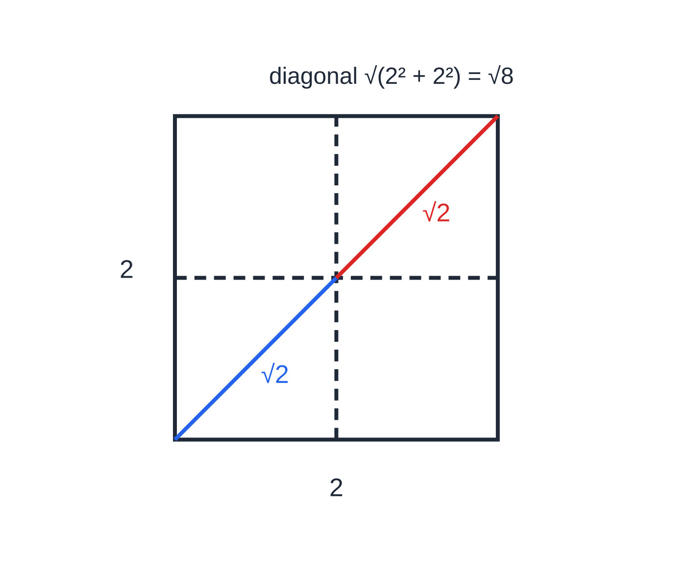
What is a surd, and how do you simplify one?
Section 2 of 13
A surd is an irrational root such as √2, √12 or ∛5. Leaving an answer as a surd keeps it exact; a decimal is only an approximation.
The key rules are √(ab)=√a×√b and √(a/b)=√a/√b, together with √a×√a=a. To simplify, split off the largest square factor: √75=√(25×3)=5√3. "Simplest form" means the number left under the root has no square factor other than 1.
Like surds collect like algebra: 5√3+4√3=9√3. Unlike surds such as √2+√3 cannot be combined. Brackets expand exactly like algebra, using √a×√a=a to tidy up.
Why √8 = 2√2. The diagonal of a 2 × 2 square is √8 by Pythagoras, and it is made of two unit-square diagonals, each √2 long.
Notes:
What is a surd, and how do you simplify one?. Full notes: https://examinerprep.com/notes/edexcel-ial-maths/indices-surds-and-quadratics/

Slide 9
What is a surd, and how do you simplify one? (continued)
Section 2 of 13 · Worked example 3 · Easy · Simplify, expand
WORKED EXAMPLE · QUESTION
(a) Simplify √75+√48-√12, giving your answer in the form k√3. (b) Expand and simplify (4-√3)(2+3√3).
SOLUTION
(a) Largest square factor of each number: √75=5√3, √48=4√3, √12=2√3. So 5√3+4√3-2√3= 7√3
(b) Four products, as with any two brackets: 8+12√3-2√3-3×3=8+10√3-9= -1+10√3
The last product is (-√3)(3√3)=-3×(√3)²=-9. Forgetting that √3×√3 is a whole number is the usual source of error.
Notes:
What is a surd, and how do you simplify one?: Worked example 3. Full notes: https://examinerprep.com/notes/edexcel-ial-maths/indices-surds-and-quadratics/

Slide 10
How do you rationalise a denominator?
Section 3 of 13
Rationalising means rewriting a fraction so that its denominator has no surd. The value does not change: you multiply by a form of 1.
Denominator √b: multiply top and bottom by √b, because √b×√b=b. So 6/√3=6√3/3=2√3.
Denominator a+√b: multiply top and bottom by the conjugate a-√b. The difference of two squares removes the surd: (a+√b)(a-√b)=a²-b.
The same works for √a±√b: (√a+√b)(√a-√b)=a-b.
Notes:
How do you rationalise a denominator?. Full notes: https://examinerprep.com/notes/edexcel-ial-maths/indices-surds-and-quadratics/

Slide 11
How do you rationalise a denominator? (continued)
Section 3 of 13 · Worked example 4 · Medium · Write
WORKED EXAMPLE · QUESTION
Write (7+√5)/(3-√5) in the form p+q√5, where p and q are rational numbers.
SOLUTION
Step 1 Multiply top and bottom by the conjugate 3+√5: ((7+√5)(3+√5))/((3-√5)(3+√5)).
Step 2 Denominator by difference of two squares: 3²-(√5)²=9-5=4. Numerator: 21+7√5+3√5+5=26+10√5.
Step 3 Divide each term by 4: (26+10√5)/4= (13/2)+(5/2)√5
Check with a calculator: both the original and the answer are about 12.090. A numerical check catches sign slips in the conjugate.
Notes:
How do you rationalise a denominator?: Worked example 4. Full notes: https://examinerprep.com/notes/edexcel-ial-maths/indices-surds-and-quadratics/

Slide 12
How do you rationalise a denominator? (continued)
Section 3 of 13
Using your calculator
Type the original expression and your simplified answer separately; they must give the same decimal.
Many scientific calculators display surds exactly: use this to check, but write every line of working yourself.
For powers like 27^(2/3), enter the index in brackets: 27^(2÷3).
Common error
Multiplying only the denominator by the conjugate. Top and bottom must both be multiplied, or the value of the fraction changes. A second trap: (3-√5)(3+√5) is 9-5=4, not 9+5.
Notes:
How do you rationalise a denominator?. Full notes: https://examinerprep.com/notes/edexcel-ial-maths/indices-surds-and-quadratics/

Slide 13
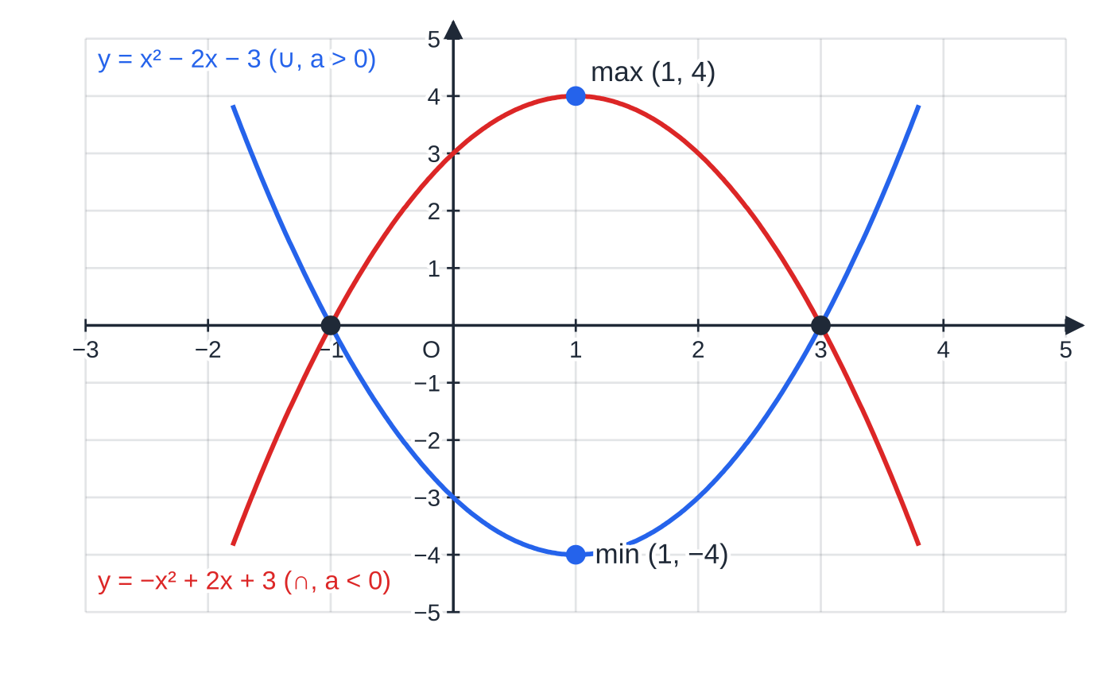
What does the graph of a quadratic tell you?
Section 4 of 13
The graph of y=ax²+bx+c (a≠0) is a parabola: ∪-shaped if a>0, ∩-shaped if a<0.
It crosses the y-axis at (0, c), and it meets the x-axis where ax²+bx+c=0, so the roots of the equation are the x-intercepts of the graph. It is symmetrical about a vertical line through its vertex (turning point). When there are two roots, the line of symmetry is halfway between them.
A sketch shows the correct shape, with every point where the curve meets the axes labelled, and the vertex when it is asked for. It does not need to be to scale.
The sign of a decides the shape. Both curves cross the x-axis at −1 and 3 and are symmetrical about x = 1, but one has a minimum and the other a maximum.
Notes:
What does the graph of a quadratic tell you?. Full notes: https://examinerprep.com/notes/edexcel-ial-maths/indices-surds-and-quadratics/

Slide 14
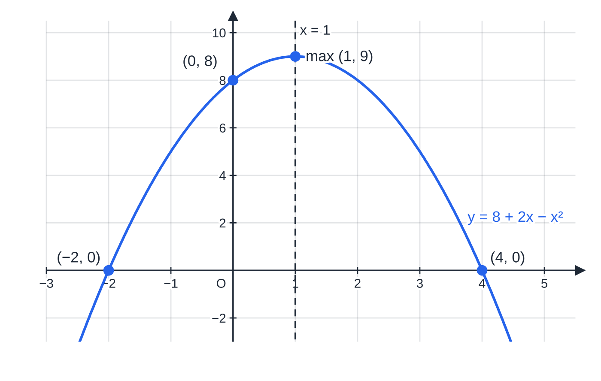
What does the graph of a quadratic tell you? (continued)
Section 4 of 13
Exam tip
For a ∩-shaped curve, factorise with the negative sign handled first: 8+2x-x²=-(x²-2x-8)=-(x-4)(x+2), which is the same as (4-x)(2+x). Check the y-intercept from your factors: 4×2=8.
A ∩-shaped parabola: y = 8 + 2x − x² = (4 − x)(2 + x). The roots −2 and 4 are symmetrical about x = 1, so the maximum point is at x = 1, y = 8 + 2 − 1 = 9.
Notes:
What does the graph of a quadratic tell you?. Full notes: https://examinerprep.com/notes/edexcel-ial-maths/indices-surds-and-quadratics/

Slide 15
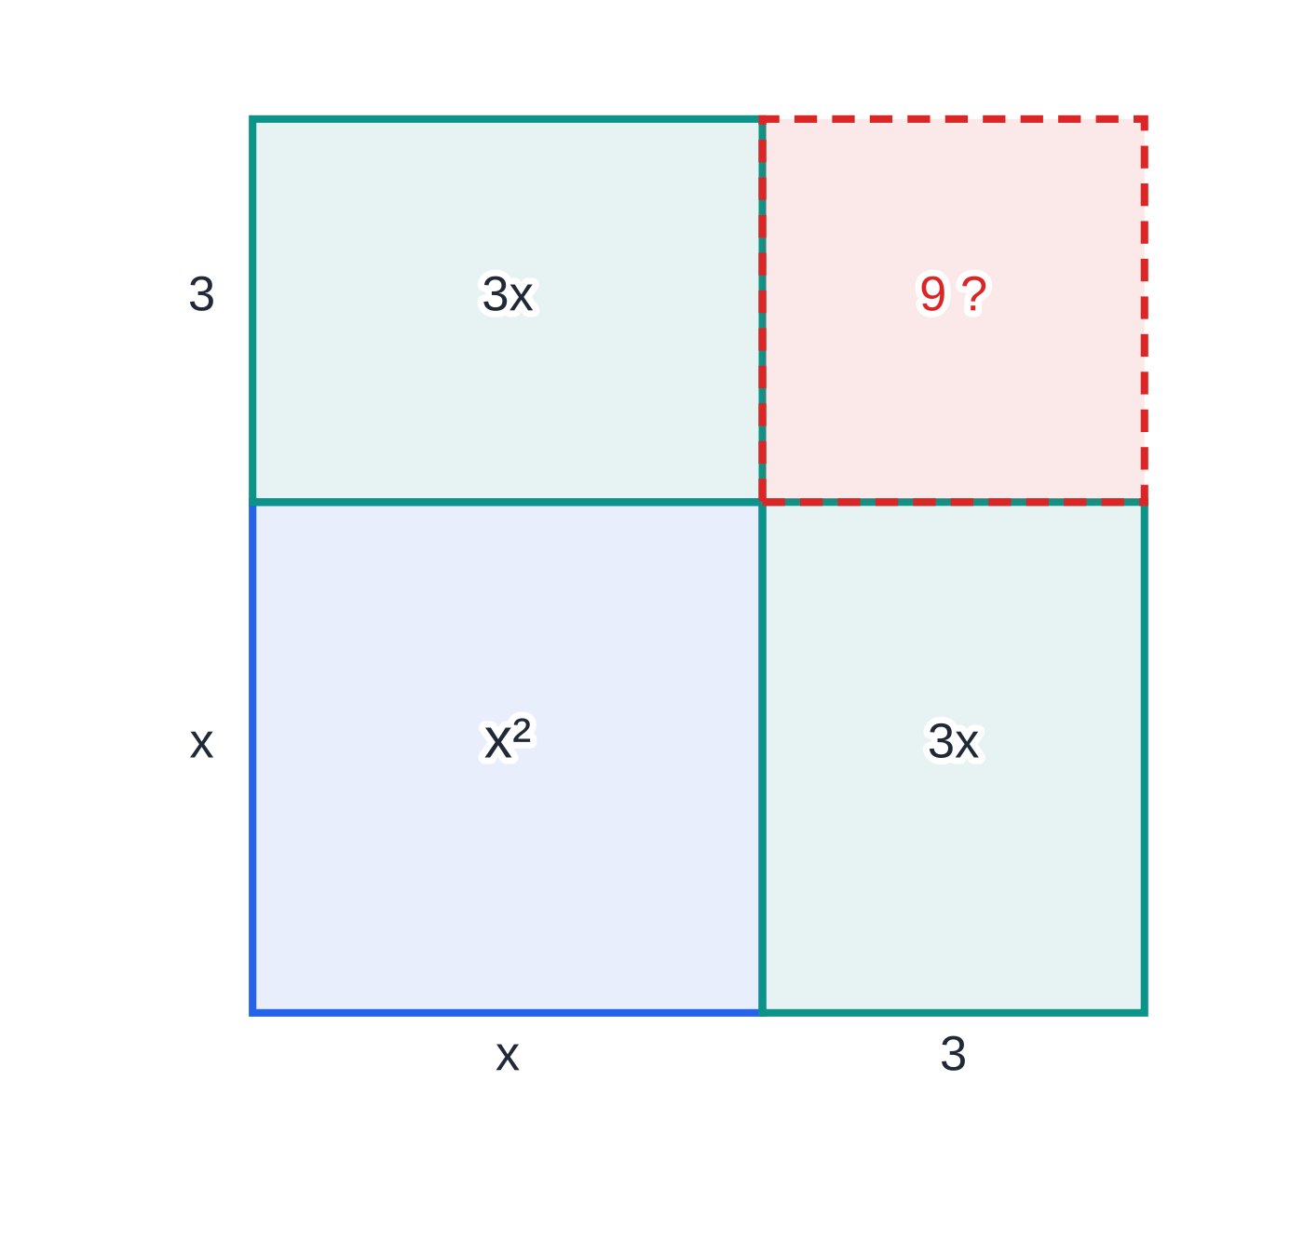
How does completing the square find the vertex?
Section 5 of 13
Completing the square rewrites x²+bx+c as (x+b/2)²-(b/2)²+c: halve the coefficient of x, then subtract the square you have added. The picture shows why: x²+6x is a square with two strips of 3x, and it needs an extra 3²=9 to make the full square (x+3)².
If a≠1, take a out as a factor of the x² and x terms first, complete the square inside the bracket, then multiply back out. In the form a(x+p)²+q, the squared term is never negative, so for a>0 the least value is q, when x=-p. The vertex is (-p, q) and the line of symmetry is x=-p. For a<0 the same point is a maximum, with greatest value q.
ax²+bx+c=a(x+b/2a)²+c-b²/4a
Completing the square as an area: x² + 6x fills all of the (x + 3) by (x + 3) square except the 3 × 3 corner, so x² + 6x = (x + 3)² − 9.
Notes:
How does completing the square find the vertex?. Full notes: https://examinerprep.com/notes/edexcel-ial-maths/indices-surds-and-quadratics/

Slide 16
How does completing the square find the vertex? (continued)
Section 5 of 13
So the vertex is at x=-b/2a, which is also the line of symmetry. This is not in the formulae booklet: learn the method, not the formula. Rearranging this form for ax²+bx+c=0 is how the quadratic formula is derived.
Notes:
How does completing the square find the vertex?. Full notes: https://examinerprep.com/notes/edexcel-ial-maths/indices-surds-and-quadratics/

Slide 17
How does completing the square find the vertex? (continued)
Section 5 of 13 · Worked example 5 · Medium · Write, state, solve
WORKED EXAMPLE · QUESTION
f(x)=2x²-12x+7. (a) Write f(x) in the form a(x+p)²+q. (b) State the coordinates of the vertex of y=f(x) and the equation of its line of symmetry. (c) Solve f(x)=0, giving your answers in simplest surd form.
SOLUTION
(a) Take out the factor 2 from the first two terms: 2(x²-6x)+7. Complete the square inside the bracket: 2[(x-3)²-9]+7=2(x-3)²-18+7= 2(x-3)²-11
(b) Minimum point (3, -11); line of symmetry x=3
(c) 2(x-3)²=11, so (x-3)²=(11/2) and x-3=±√(11/2). Since √(11/2)=√11/√2=√22/2, x=3±√22/2
As decimals the roots are 0.655 and 5.35: symmetrical about x=3, as they must be.
Notes:
How does completing the square find the vertex?: Worked example 5. Full notes: https://examinerprep.com/notes/edexcel-ial-maths/indices-surds-and-quadratics/

Slide 18
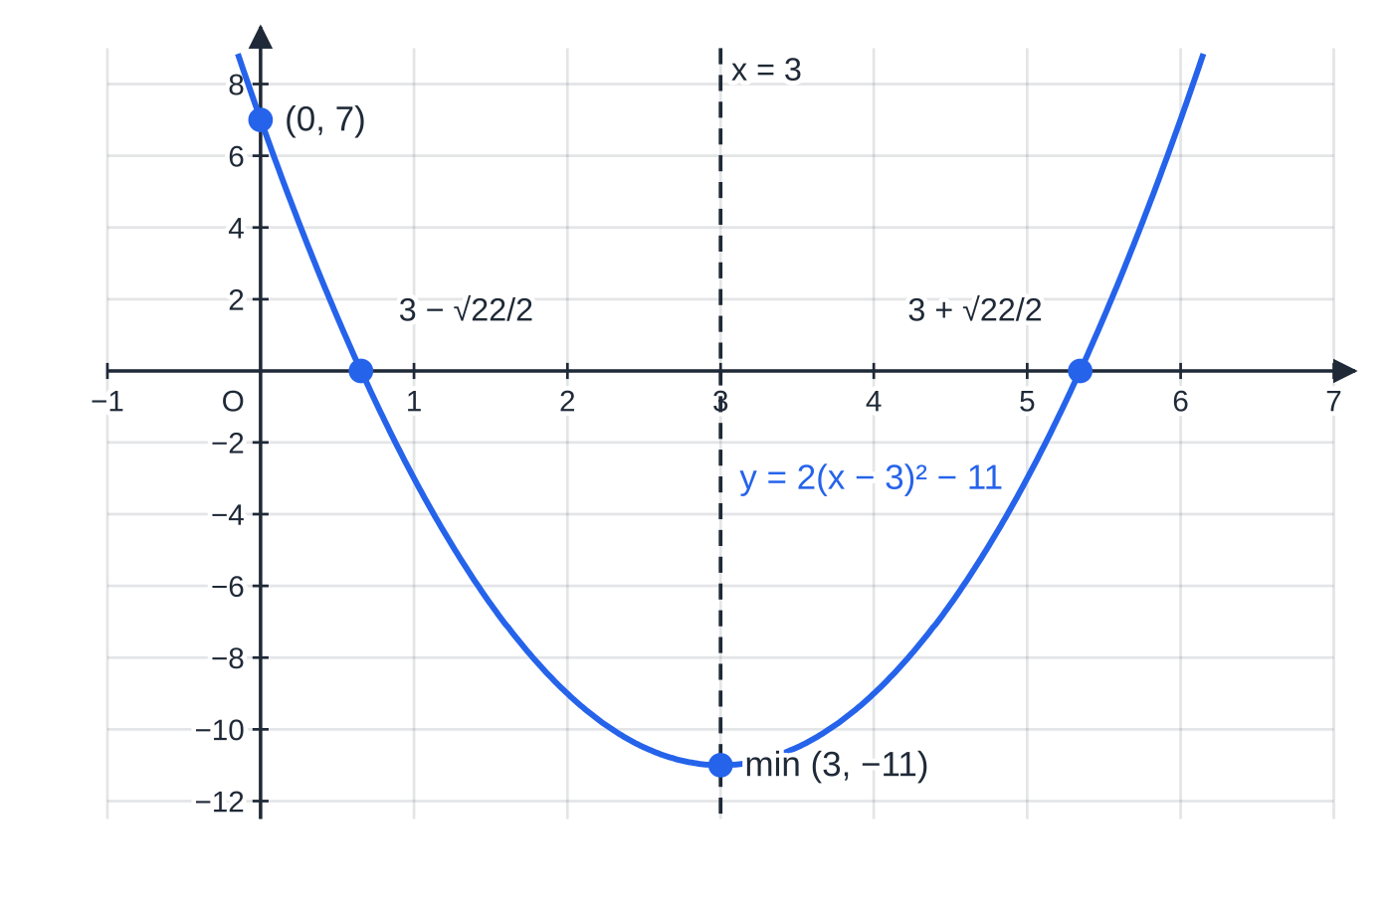
How does completing the square find the vertex? (continued)
Section 5 of 13
The graph of worked example 5. The completed square form shows the minimum (3, −11) and the line of symmetry x = 3 directly; the roots 3 ± √22/2 lie the same distance either side of it.
Notes:
How does completing the square find the vertex?. Full notes: https://examinerprep.com/notes/edexcel-ial-maths/indices-surds-and-quadratics/

Slide 19
Which method should you use to solve a quadratic equation?
Section 6 of 13
Method | Use it when | Watch out for
Factorising | the roots are rational — try it first when the numbers are small | rearrange to "= 0" first; never divide both sides by x (you lose the root x=0)
Completing the square | the question asks for it, or you also need the vertex; a=1 and b even makes it quick | both square roots, ±
Quadratic formula | it will not factorise, or a decimal answer is wanted | bracket a negative b when squaring; divide the whole numerator by 2a
ax²+bx+c=0 ⇒ x=(-b±√(b²-4ac))/2a
The quadratic formula is not in the formulae booklet: learn it by heart. The expression under the root, b²-4ac, is the discriminant (next section).
Notes:
Which method should you use to solve a quadratic equation?. Full notes: https://examinerprep.com/notes/edexcel-ial-maths/indices-surds-and-quadratics/

Slide 20
Which method should you use to solve a quadratic equation? (continued)
Section 6 of 13 · Worked example 6 · Medium · Solve
WORKED EXAMPLE · QUESTION
(a) Solve 6x²+x-15=0. (b) By completing the square, solve x²-6x+4=0, giving exact answers. (c) Solve 3x²+4x-2=0, giving your answers in the form (p±√q)/3 and also to 3 significant figures.
SOLUTION
(a) ac=-90; the factor pair 10 and −9 sums to 1. 6x²+10x-9x-15=2x(3x+5)-3(3x+5)=(2x-3)(3x+5), so x=(3/2) or x=-(5/3)
(b) (x-3)²-9+4=0, so (x-3)²=5 and x=3±√5
(c) Formula with a=3, b=4, c=-2: x=(-4±√(16+24))/6=(-4±2√10)/6= (-2±√10)/3; x=0.387 or x=-1.72 (3 s.f.)
In (c), -4ac=-4×3×(-2)=+24. Simplify √40=2√10, then cancel the common factor 2 from every term.
Notes:
Which method should you use to solve a quadratic equation?: Worked example 6. Full notes: https://examinerprep.com/notes/edexcel-ial-maths/indices-surds-and-quadratics/

Slide 21
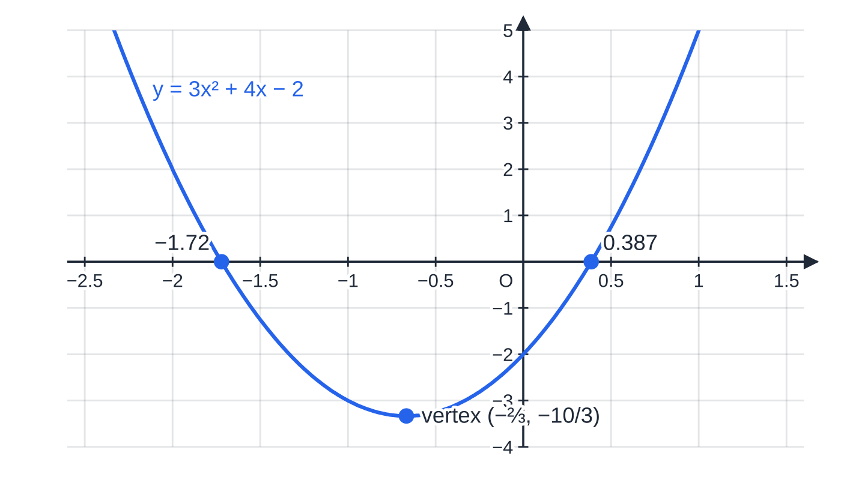
Which method should you use to solve a quadratic equation? (continued)
Section 6 of 13
Worked example 6(c): y = 3x² + 4x − 2 crosses the x-axis at (−2 ± √10)/3, that is 0.387 and −1.72, symmetrical about the vertex line x = −⅔.
Notes:
Which method should you use to solve a quadratic equation?. Full notes: https://examinerprep.com/notes/edexcel-ial-maths/indices-surds-and-quadratics/

Slide 22
How does the discriminant decide the number of real roots?
Section 7 of 13
In the formula, ±√(b²-4ac) gives two different values only if b²-4ac is positive. This quantity is the discriminant.
b²-4ac>0: two distinct real roots — the graph crosses the x-axis twice.
b²-4ac=0: one repeated (equal) root, x=-b/2a — the vertex sits on the x-axis.
b²-4ac<0: no real roots — the graph never meets the x-axis.
"Real roots" (with no "distinct") means b²-4ac≥0. The discriminant is not in the formulae booklet: learn it. Write the equation as ax²+bx+c=0 before reading off a, b and c, including their signs.
Notes:
How does the discriminant decide the number of real roots?. Full notes: https://examinerprep.com/notes/edexcel-ial-maths/indices-surds-and-quadratics/

Slide 23
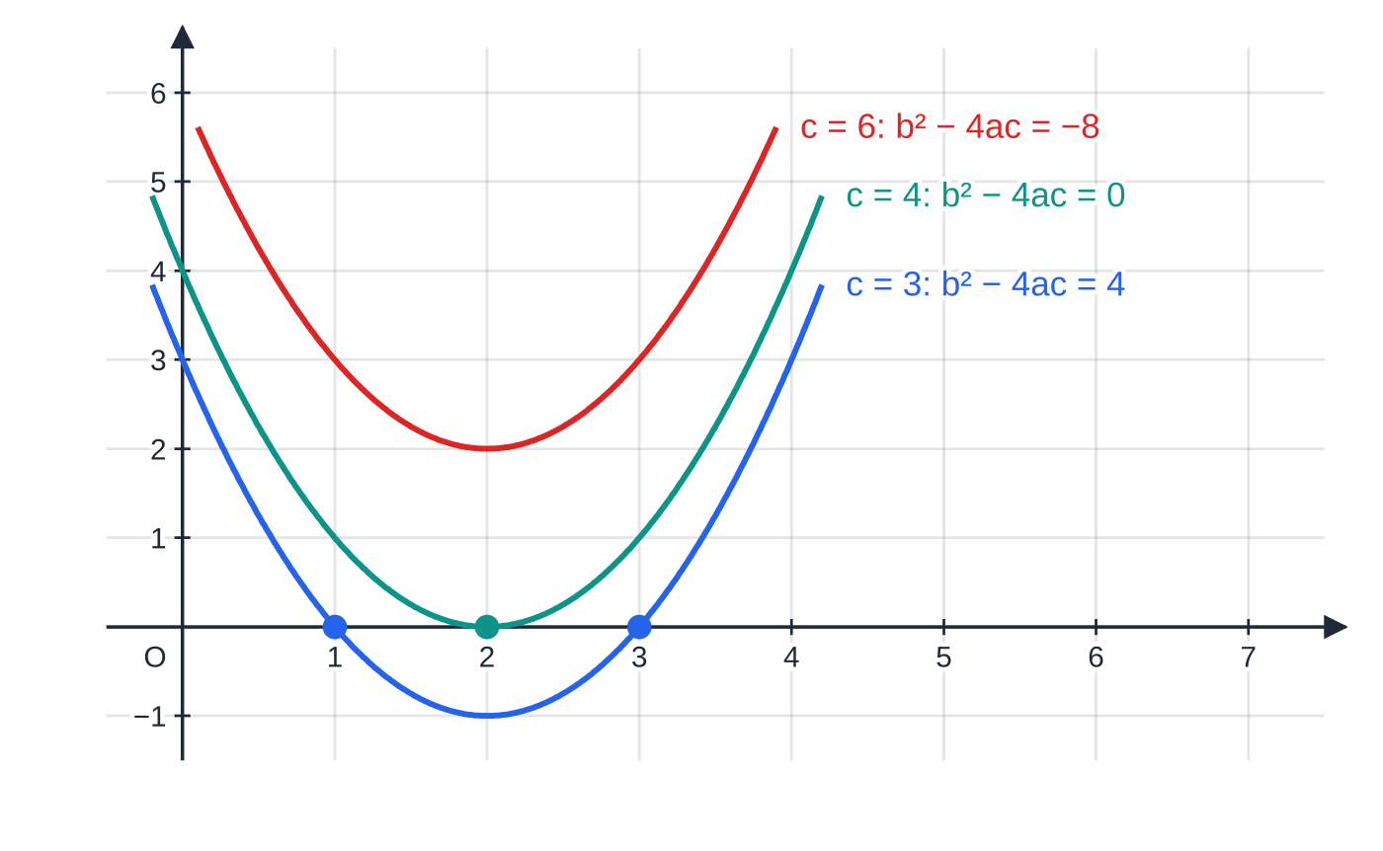
How does the discriminant decide the number of real roots? (continued)
Section 7 of 13
The same ∪ shape lifted up the page. Raising c from 3 to 4 to 6 changes the discriminant 16 − 4c from 4 to 0 to −8: two roots, a repeated root, then none.
Notes:
How does the discriminant decide the number of real roots?. Full notes: https://examinerprep.com/notes/edexcel-ial-maths/indices-surds-and-quadratics/

Slide 24
How does the discriminant decide the number of real roots? (continued)
Section 7 of 13 · Worked example 7 · Medium · Find, state
WORKED EXAMPLE · QUESTION
The equation x²+kx+(k+3)=0, where k is a constant, has equal roots. (a) Find the possible values of k. (b) For each value, find the repeated root. (c) State the set of values of k for which the equation has no real roots.
SOLUTION
(a) a=1, b=k, c=k+3. Equal roots: k²-4(k+3)=0, so k²-4k-12=0, (k-6)(k+2)=0 and k=6 or k=-2
(b) k=6: x²+6x+9=(x+3)², so x=-3. k=-2: x²-2x+1=(x-1)², so x=1
(c) The discriminant k²-4k-12 is a ∪-shaped quadratic in k with roots −2 and 6, so it is negative between them: -2<k<6
Part (c) uses a quadratic inequality; the full method is on the P1 equations and inequalities page.
Notes:
How does the discriminant decide the number of real roots?: Worked example 7. Full notes: https://examinerprep.com/notes/edexcel-ial-maths/indices-surds-and-quadratics/

Slide 25
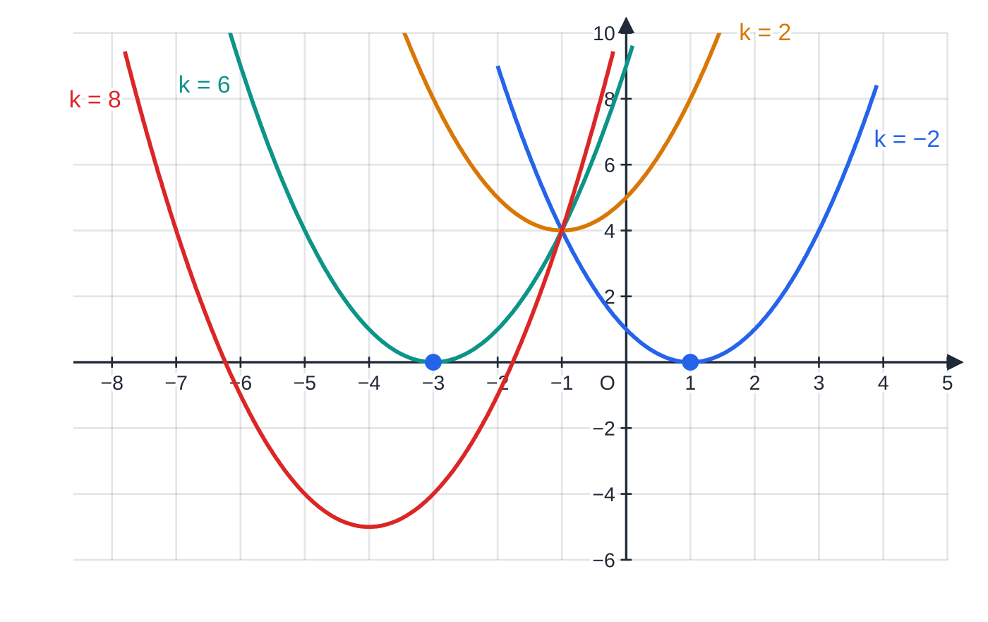
How does the discriminant decide the number of real roots? (continued)
Section 7 of 13
The curves y = x² + kx + k + 3 from worked example 7. For k = −2 and k = 6 the curve just touches the x-axis (at x = 1 and x = −3); k = 2, between them, misses it, and k = 8, outside, crosses it twice.
Notes:
How does the discriminant decide the number of real roots?. Full notes: https://examinerprep.com/notes/edexcel-ial-maths/indices-surds-and-quadratics/

Slide 26
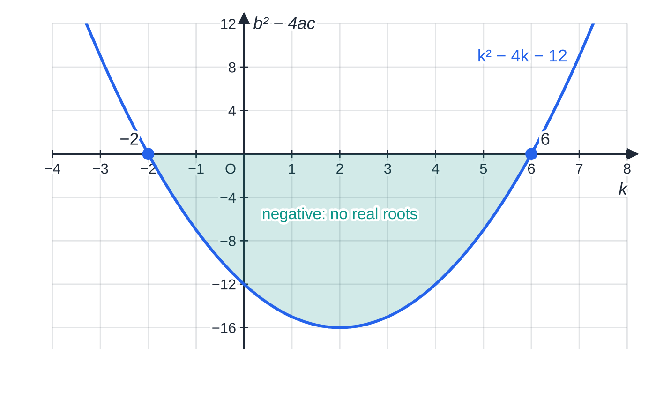
How does the discriminant decide the number of real roots? (continued)
Section 7 of 13
Worked example 7(c): the discriminant k² − 4k − 12 as a function of k. It is negative (shaded) exactly when −2 < k < 6, so those values give no real roots.
Notes:
How does the discriminant decide the number of real roots?. Full notes: https://examinerprep.com/notes/edexcel-ial-maths/indices-surds-and-quadratics/

Slide 27
How do you spot and solve a disguised quadratic?
Section 8 of 13
A disguised quadratic has the shape a(something)²+b(something)+c=0. Common "somethings" are √x (because x=(√x)²), x^(1/3), x², and 2ˣ (because 4ˣ=(2ˣ)²).
Method: let u = the something, rewrite, solve for u, then convert back to x. Reject impossible values: √x and 2ˣ are never negative, and x²=-4 has no real solution. Say why you reject a value. Watch powers like 2²ˣ⁺¹=2×2²ˣ=2u²: split the index with the laws of indices first.
Notes:
How do you spot and solve a disguised quadratic?. Full notes: https://examinerprep.com/notes/edexcel-ial-maths/indices-surds-and-quadratics/

Slide 28
How do you spot and solve a disguised quadratic? (continued)
Section 8 of 13 · Worked example 8 · Hard · Solve
WORKED EXAMPLE · QUESTION
Solve (a) 2x-7√x+3=0, (b) 2²ˣ⁺¹-17×2ˣ+8=0, (c) x⁴-5x²-36=0, for real values of x.
SOLUTION
(a) Let u=√x, so x=u²: 2u²-7u+3=0, (2u-1)(u-3)=0, u=½ or 3. Then √x=½ or √x=3, so x=¼ or x=9
(b) 2²ˣ⁺¹=2×(2ˣ)², so with u=2ˣ: 2u²-17u+8=0, (2u-1)(u-8)=0, u=½ or 8. Then 2ˣ=2⁻¹ or 2ˣ=2³, so x=-1 or x=3
(c) Let u=x²: u²-5u-36=0, (u-9)(u+4)=0, u=9 or u=-4. x²=9 gives x=±3; x²=-4 has no real solutions, so it is rejected.
In (a) both values of u are positive, so both are valid. Had a negative u appeared, it would be rejected because √x≥0. Substituting x=¼: 2×¼-7×½+3=0.
Notes:
How do you spot and solve a disguised quadratic?: Worked example 8. Full notes: https://examinerprep.com/notes/edexcel-ial-maths/indices-surds-and-quadratics/

Slide 29
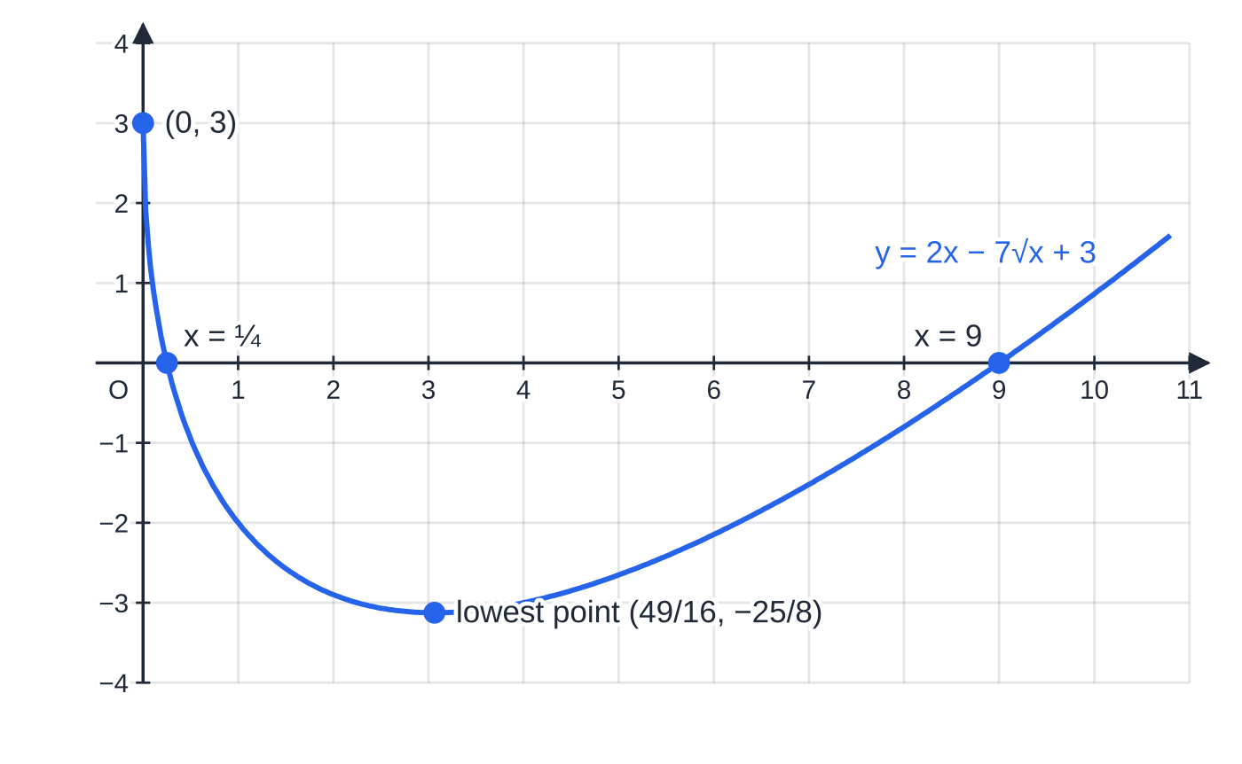
How do you spot and solve a disguised quadratic? (continued)
Section 8 of 13
The graph of y = 2x − 7√x + 3 (worked example 8(a)). It is not a parabola in x, but it meets the x-axis exactly at x = ¼ and x = 9. Its lowest point is where u = √x = 7/4, the vertex of the quadratic in u: x = 49/16, y = −25/8.
Notes:
How do you spot and solve a disguised quadratic?. Full notes: https://examinerprep.com/notes/edexcel-ial-maths/indices-surds-and-quadratics/

Slide 30
Exam tips for P1.1
Section 9 of 13
Exam tip 1 — "exact" means surds and fractions
When a question says "exact", "in simplest surd form" or "in the form p+q√3", a decimal answer does not count, however accurate. Keep √ and fractions to the end, and simplify the surd fully.
Exam tip 2 — write the index form before you differentiate or integrate
Rewrite roots and reciprocals as powers, one term at a time: 3/√x=3x^(-1/2) and 1/2x³=½ x⁻³. The coefficient stays outside the power.
Exam tip 3 — "show that" with a discriminant
Write the equation in the form ax²+bx+c=0, state a, b and c (with signs and brackets), write b²-4ac=0 (or >0, <0) explicitly, then expand line by line to the given result. The final line is given, so the working is the whole answer.
Notes:
Exam tips for P1.1. Full notes: https://examinerprep.com/notes/edexcel-ial-maths/indices-surds-and-quadratics/

Slide 31
Exam tips for P1.1 (continued)
Section 9 of 13
Exam tip 4 — completing the square when a ≠ 1
Factor out a from the x² and x terms only, complete the square inside, then multiply the subtracted square by a as you remove the outer bracket. Expand your answer mentally to check it.
Exam tip 5 — disguised quadratics: finish the job
Solving for u is only half the question. Convert every value back to x, reject any that are impossible with a reason, and give all the solutions that remain.
Notes:
Exam tips for P1.1. Full notes: https://examinerprep.com/notes/edexcel-ial-maths/indices-surds-and-quadratics/

Slide 32
Common misconceptions
Section 10 of 13
Misconception | Why it is wrong | Correct idea
A negative power gives a negative number: 4^(-1/2)=-2. | The minus sign in the index means "reciprocal". | 4^(-1/2)=1/√4=½.
√(a+b)=√a+√b. | Roots split over multiplication, not addition: √(9+16)=5, but √9+√16=7. | √(ab)=√a√b only.
3x⁻²=1/3x². | The power belongs to x only, not to the 3. | 3x⁻²=3/x²; but (3x)⁻²=1/9x².
(x+4)²-7 has its vertex at (4, -7). | The bracket is zero when x=-4. | a(x+p)²+q has vertex (-p, q): here (-4, -7).
b²-4ac=0 means there are no roots. | The ± part of the formula vanishes, leaving one value. | Zero discriminant: one repeated root, where the graph touches the axis.
Dividing x²=5x by x gives the only answer x=5. | Dividing by x assumes x≠0 and loses a root. | x²-5x=0, x(x-5)=0, x=0 or 5.
Notes:
Common misconceptions. Full notes: https://examinerprep.com/notes/edexcel-ial-maths/indices-surds-and-quadratics/

Slide 33
How this topic connects
Section 11 of 13
P1 Differentiation and integration
Every term must be a power of x before you differentiate or integrate, so index form (worked example 2) comes first. Stationary points of a quadratic agree with the vertex from completing the square.
P1 Equations, inequalities and curve sketching
The discriminant decides whether a line meets a curve, and the roots found here become the critical values of quadratic inequalities and the intercepts on sketches and transformed graphs.
P2, P3, M1 and IAL Physics
Equations like 2²ˣ-5×2ˣ+6=0 return in P2 with answers that need logarithms; in P3 the completed square gives the range of a quadratic function and the domain needed for an inverse. In kinematics, s=ut+½ at² is a quadratic in t: two positive roots mean a projectile passes the same height twice, and a negative discriminant means it never reaches that height.
Notes:
How this topic connects. Full notes: https://examinerprep.com/notes/edexcel-ial-maths/indices-surds-and-quadratics/

Slide 34
Key formulae
Section 12 of 13
Formula | Use | In the formulae list?
aᵐaⁿ=aᵐ⁺ⁿ, aᵐ÷aⁿ=aᵐ⁻ⁿ, (aᵐ)ⁿ=aᵐⁿ | simplifying powers of the same base | No — learn it
a⁰=1, a⁻ⁿ=1/aⁿ, a^(m/n)=(ⁿ√a)ᵐ | zero, negative and fractional powers | No — learn it
√(ab)=√a√b, √(a/b)=√a/√b | simplifying surds | No — learn it
(a+√b)(a-√b)=a²-b | rationalising with the conjugate | No — derive it (difference of two squares)
ax²+bx+c=a(x+b/2a)²+c-b²/4a | vertex, line of symmetry, maximum or minimum value | No — derive it by completing the square
x=(-b±√(b²-4ac))/2a | roots of any quadratic equation | No — learn it
b²-4ac (>0, =0, <0) | number of real roots; finding an unknown constant | No — learn it
Notes:
Key formulae. Full notes: https://examinerprep.com/notes/edexcel-ial-maths/indices-surds-and-quadratics/

Slide 35
Check your understanding
Section 13 of 13
1. Find the exact value of 32^(-3/5).
2. Simplify √200-√18.
3. Rationalise the denominator of 1/(√7-2).
4. Find the coordinates of the vertex of y=x²+10x+19.
5. The equation px²-4x+1=0, where p≠0, has equal roots. Find p.
6. Solve x^(2/3)-5x^(1/3)+4=0.
Notes:
Check your understanding: questions. Full notes: https://examinerprep.com/notes/edexcel-ial-maths/indices-surds-and-quadratics/

Slide 36
Check your understanding · answers
Section 13 of 13
1. 32^(1/5)=2, so 32^(3/5)=2³=8 and 32^(-3/5)=⅛.
2. √200=√(100×2)=10√2 and √18=√(9×2)=3√2, so the answer is 7√2.
3. Multiply top and bottom by √7+2: the denominator becomes 7-4=3, so the answer is (√7+2)/3.
4. x²+10x+19=(x+5)²-25+19=(x+5)²-6, so the vertex (a minimum) is (-5, -6).
5. b²-4ac=16-4p=0, so p=4. Then 4x²-4x+1=(2x-1)², with repeated root x=½.
6. Let u=x^(1/3): u²-5u+4=0, (u-1)(u-4)=0, so u=1 or 4. Cubing, x=1 or x=64. (Cube roots can be negative, so no value of u needs to be rejected here.)
Notes:
Check your understanding: answers. Full notes: https://examinerprep.com/notes/edexcel-ial-maths/indices-surds-and-quadratics/

Slide 37
Practice questions
2 original exam-style questions. Answers at the end of the deck.

Slide 38
Question 1
5 marks
Give exact answers to this question.
(a) Find the value of 125^(2/3). [2]
(b) Find the value of (⁴⁄₉)^(−3/2). [2]
(c) Simplify (x⁻³)^(−2/3), where x > 0. [1]
Notes:
Online with the full mark scheme: https://examinerprep.com/ial-maths-p1-1-indices-surds-and-quadratics-questions#IALM-P1-1-B-01

Slide 39
Question 2
6 marks
In this question, show all your working and give each answer in its simplest form.
(a) Simplify √98 − √32 + √8, giving your answer in the form k√2, where k is an integer. [2]
(b) Expand and simplify (3 + 2√5)(3 − √5). [2]
(c) Show that (√6 + √2)² = 8 + 4√3. [2]
Notes:
Online with the full mark scheme: https://examinerprep.com/ial-maths-p1-1-indices-surds-and-quadratics-questions#IALM-P1-1-B-02

Slide 40
Answers

Slide 41
Question 1 · answer
Mark scheme
125^(1/3) = 5
5² = 25
reciprocal and root used, e.g. (⁹⁄₄)^(3/2) or (²⁄₃)⁻³ or (³⁄₂)³
= ²⁷⁄₈
x²
Notes:
Full mark scheme: https://examinerprep.com/ial-maths-p1-1-indices-surds-and-quadratics-questions#IALM-P1-1-B-01

Slide 42
Question 2 · answer
Mark scheme
at least two of √98 = 7√2, √32 = 4√2, √8 = 2√2
5√2
9 − 3√5 + 6√5 − 2 × 5 (four terms, at least three correct)
−1 + 3√5
6 + 2√12 + 2 (or 6 + √12 + √12 + 2)
√12 = 2√3, so 8 + 4√3 with no errors seen
Notes:
Full mark scheme: https://examinerprep.com/ial-maths-p1-1-indices-surds-and-quadratics-questions#IALM-P1-1-B-02

Slide 43
Keep practising
Notes for this topic
Questions on this topic
Build a printable test
ExaminerPrep is an independent tutoring service. It has been developed independently from and is not endorsed by the International Baccalaureate Organization. "International Baccalaureate", "IB" and "IB Diploma Programme" are registered trademarks of the IBO, used here for descriptive purposes only.
Pearson Edexcel and Cambridge are trademarks of their owners; ExaminerPrep is not affiliated with any exam board.

