Slide 1
EP
EDEXCEL IAL MATHS
P4.5 Integration by substitution, by parts and with partial fractions
The full notes page in 12 sections · practice questions with answers · simulations
ExaminerPrep is an independent tutoring service. It has been developed independently from and is not endorsed by the International Baccalaureate Organization. "International Baccalaureate", "IB" and "IB Diploma Programme" are registered trademarks of the IBO, used here for descriptive purposes only.
Pearson Edexcel and Cambridge are trademarks of their owners; ExaminerPrep is not affiliated with any exam board.
Notes:
P4.5 Integration by substitution, by parts and with partial fractions. Notes for this topic: https://examinerprep.com/notes/edexcel-ial-maths/integration-by-substitution-by-parts-and-with-partial-fractions/

Slide 2
What this page covers
Overview
Integration by substitution, including substitutions that are given to you in harder cases
Changing the limits of a definite integral when you substitute
Integration by parts, including ∫ln x dx and products with ln x
Using integration by parts twice, keeping control of the signs
Integrating rational functions by first writing them in partial fractions, including repeated factors and improper fractions
Recognising which method an integral needs
Chaining two methods in one longer question
Notes:
What this page covers. Full notes: https://examinerprep.com/notes/edexcel-ial-maths/integration-by-substitution-by-parts-and-with-partial-fractions/

Slide 3
In one minute
Key points
1. When no standard result fits, there are three tools: substitution rewrites the integral in a simpler variable, integration by parts trades a product for an easier integral, and partial fractions turn a rational function into terms that integrate to logarithms.
2. Substitution: choose u=g(x), replace dx using du/dx, and rewrite everything in u before integrating. Return to x, or, for a definite integral, change the limits to u-values and never go back.
3. By parts: ∫udv/dx dx=uv-∫vdu/dx dx. Let u be the factor that gets simpler when differentiated, but if there is a ln x, let u=ln x.
4. ln x on its own: write it as 1×ln x, so ∫ln x dx=xln x-x+c.
5. With x² times eˣ, sin x or cos x, the first use of parts leaves a power of x; use parts again.
6. Partial fractions: each linear term gives k/aln|ax+b|; a squared factor gives -k/(a(ax+b)). Divide first if the fraction is improper.
Notes:
In one minute. Full notes: https://examinerprep.com/notes/edexcel-ial-maths/integration-by-substitution-by-parts-and-with-partial-fractions/

Slide 4
How does integration by substitution work?
Section 1 of 12
Substitution is the chain rule run backwards. If an integral contains a function g(x) and also (a multiple of) its derivative, writing u=g(x) collapses it to an integral in u that you already know. Even when the derivative is not obviously there, a well-chosen u can turn an awkward expression, such as a power of x-3 multiplied by x, into a sum of simple powers.
Integration by substitution.
∫f(g(x)) g′(x) dx=∫f(u) du, u=g(x)
From u=g(x): du/dx=g′(x), so dx=du/g′(x); every dx must be replaced. Any x left over is rewritten using the substitution, e.g. u=x-3 gives x=u+3. Not in the formulae booklet: learn the method.
The method has three steps. (1) Choose u (or use the one given) and differentiate to link du and dx. (2) Replace every part of the integrand and the dx; if any x remains, the substitution is not finished.
Notes:
How does integration by substitution work?. Full notes: https://examinerprep.com/notes/edexcel-ial-maths/integration-by-substitution-by-parts-and-with-partial-fractions/

Slide 5
How does integration by substitution work? (continued)
Section 1 of 12
(3) Integrate with respect to u, then substitute back to give the answer in x.
Notes:
How does integration by substitution work?. Full notes: https://examinerprep.com/notes/edexcel-ial-maths/integration-by-substitution-by-parts-and-with-partial-fractions/

Slide 6
How does integration by substitution work? (continued)
Section 1 of 12 · Worked example 1 · Medium · Find
WORKED EXAMPLE · QUESTION
(a) Use the substitution u=x-3 to find ∫x(x-3)⁵ dx, giving your answer in the form k(x-3)⁶(px+q)+c. (b) Use the substitution u=eˣ+1 to find ∫e²ˣ/(eˣ+1) dx.
SOLUTION
(a) du/dx=1, so dx=du, and x=u+3. Then ∫(u+3)u⁵ du=∫(u⁶+3u⁵) du=u⁷/7+u⁶/2+c. Back to x and factorise out (1/14)(x-3)⁶: (1/14)(x-3)⁶[2(x-3)+7]= (1/14)(x-3)⁶(2x+1)+c.
(b) du/dx=eˣ, so eˣ dx=du. The numerator e²ˣ=eˣ×eˣ supplies du with one eˣ=u-1 left over. So the integral is ∫(u-1)/u du=∫(1-1/u)du=u-ln u+c. Back to x: eˣ+1-ln(eˣ+1)+c, which is eˣ-ln(eˣ+1)+c.
In (b) the "+1" has been absorbed into the arbitrary constant, and ln u needs no modulus because u=eˣ+1>0. Check by differentiating: eˣ-eˣ/(eˣ+1)=e²ˣ/(eˣ+1) ✓.
Notes:
How does integration by substitution work?: Worked example 1. Full notes: https://examinerprep.com/notes/edexcel-ial-maths/integration-by-substitution-by-parts-and-with-partial-fractions/

Slide 7
How does integration by substitution work? (continued)
Section 1 of 12
Common error
Replacing (x-3) by u but leaving dx (or a stray x) in the integral, then integrating "with respect to u" anyway. An integral containing both letters cannot be integrated as it stands. Convert everything first.
Notes:
How does integration by substitution work?. Full notes: https://examinerprep.com/notes/edexcel-ial-maths/integration-by-substitution-by-parts-and-with-partial-fractions/

Slide 8
What happens to the limits when you substitute?
Section 2 of 12
The limits of a definite integral are values of the variable you integrate with respect to. When the variable changes from x to u, the limits must change too: put each x-limit into u=g(x). Then evaluate in u; there is no need to go back to x. Geometrically, the substitution changes the shape of the region but not its area, as the two figures below show.
Notes:
What happens to the limits when you substitute?. Full notes: https://examinerprep.com/notes/edexcel-ial-maths/integration-by-substitution-by-parts-and-with-partial-fractions/

Slide 9
What happens to the limits when you substitute? (continued)
Section 2 of 12 · Worked example 2 · Medium · Show that
WORKED EXAMPLE · QUESTION
Use the substitution u=2x-1 to show that ∫₁⁵x/(√(2x-1)) dx=(16/3).
SOLUTION
du/dx=2, so dx=½ du, and x=(u+1)/2. New limits: x=1⇒u=1; x=5⇒u=9.
Rewrite entirely in u: ∫₁⁹((u+1)/2)/√u×½ du=¼∫₁⁹(u^(1/2)+u^(-1/2))du.
Integrate and use the u-limits: ¼[⅔u^(3/2)+2u^(1/2)]₁⁹=¼[(18+6)-(⅔+2)]=¼×(64/3)= (16/3) as required.
Notes:
What happens to the limits when you substitute?: Worked example 2. Full notes: https://examinerprep.com/notes/edexcel-ial-maths/integration-by-substitution-by-parts-and-with-partial-fractions/

Slide 10
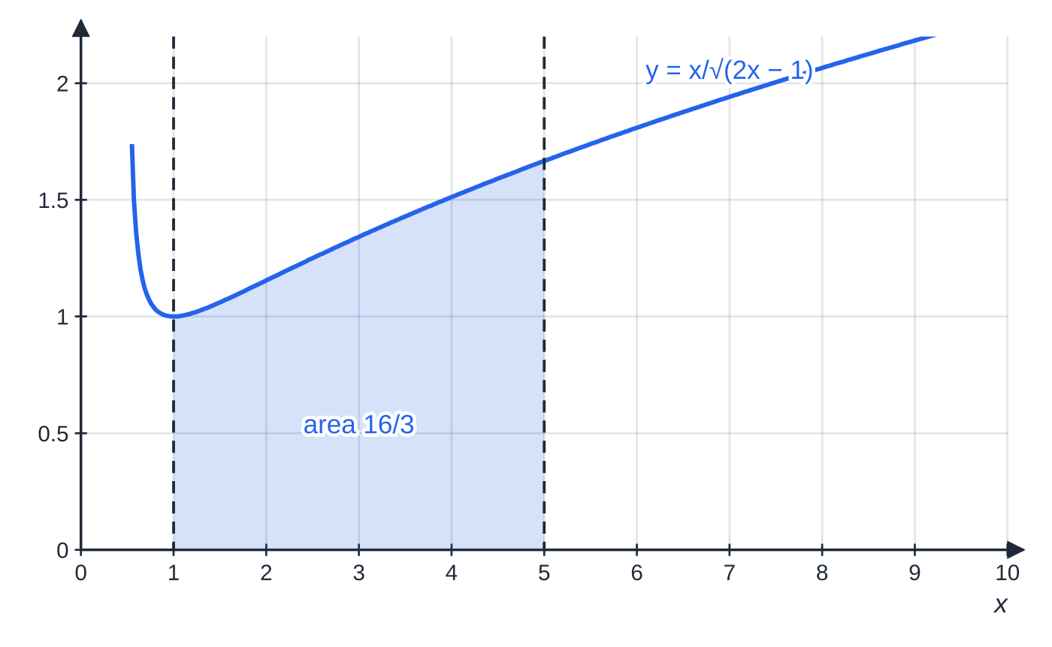
What happens to the limits when you substitute? (continued)
Section 2 of 12
Worked example 2 in x: the region under y=x/(√(2x-1)) from x=1 to x=5 has area (16/3).
Notes:
What happens to the limits when you substitute?. Full notes: https://examinerprep.com/notes/edexcel-ial-maths/integration-by-substitution-by-parts-and-with-partial-fractions/

Slide 11
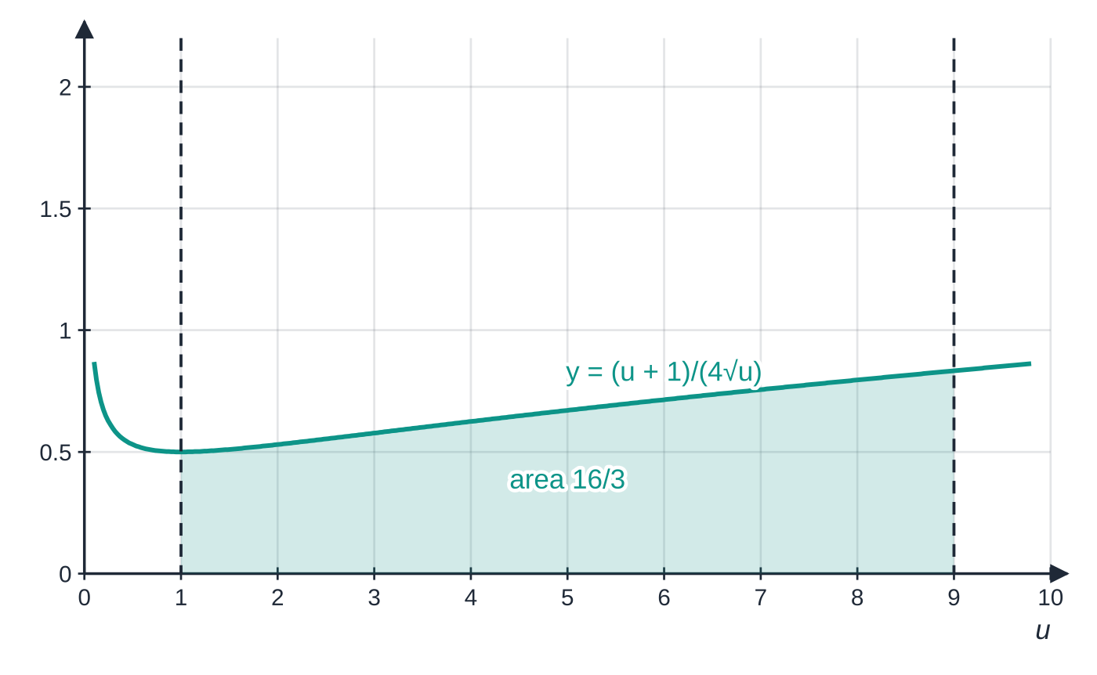
What happens to the limits when you substitute? (continued)
Section 2 of 12
Exam tip
In harder cases the substitution is given, often in a form such as u²=2x-1 or x=sin θ. Differentiate it as it stands (2u du=2 dx is quicker than making u the subject), and in a "show that" write every line: the new limits, the integral in u, and the evaluation.
The same integral in u: the interval is twice as long (1 to 9) but the curve is half as high, because of the factor ½ from dx=½ du. The area is still (16/3).
Notes:
What happens to the limits when you substitute?. Full notes: https://examinerprep.com/notes/edexcel-ial-maths/integration-by-substitution-by-parts-and-with-partial-fractions/

Slide 12
How does integration by parts work?
Section 3 of 12
Integrating the product rule, d/dx(uv)=udv/dx+vdu/dx, and rearranging gives a formula for integrating a product.
Integration by parts.
∫udv/dx dx=uv-∫vdu/dx dx
u is the factor you differentiate; dv/dx is the factor you integrate. Choose so that the new integral, ∫vdu/dx dx, is easier than the one you started with. In the formulae booklet (P4), but choosing u well is up to you.
Three rules cover almost every case. A power of x times eˣ, sin or cos: u= the power of x, because differentiating lowers the power while eˣ, sin and cos are easy to integrate. Anything times ln x: u=ln x, because you cannot easily integrate ln x but its derivative is 1/x. And ln x on its own: write it as 1×ln x, with u=ln x and dv/dx=1.
Notes:
How does integration by parts work?. Full notes: https://examinerprep.com/notes/edexcel-ial-maths/integration-by-substitution-by-parts-and-with-partial-fractions/

Slide 13
How does integration by parts work? (continued)
Section 3 of 12 · Worked example 3 · Easy · Find
WORKED EXAMPLE · QUESTION
Find ∫xcos 2x dx. Hence find the area between y=xcos 2x and the x-axis from x=0 to x=π/4.
SOLUTION
Choose u=x (differentiates to 1) and dv/dx=cos 2x: du/dx=1, v=½sin 2x. Then ∫xcos 2x dx=½xsin 2x-∫½sin 2x dx= ½xsin 2x+¼cos 2x+c.
Area: [½xsin 2x+¼cos 2x]₀^(π/4)=(π/8+0)-(0+¼)= π/8-¼≈0.143.
Choosing u=cos 2x instead would make v=½x²: the new integral, of ½x²×(-2sin 2x), is harder than the original.
Notes:
How does integration by parts work?: Worked example 3. Full notes: https://examinerprep.com/notes/edexcel-ial-maths/integration-by-substitution-by-parts-and-with-partial-fractions/

Slide 14
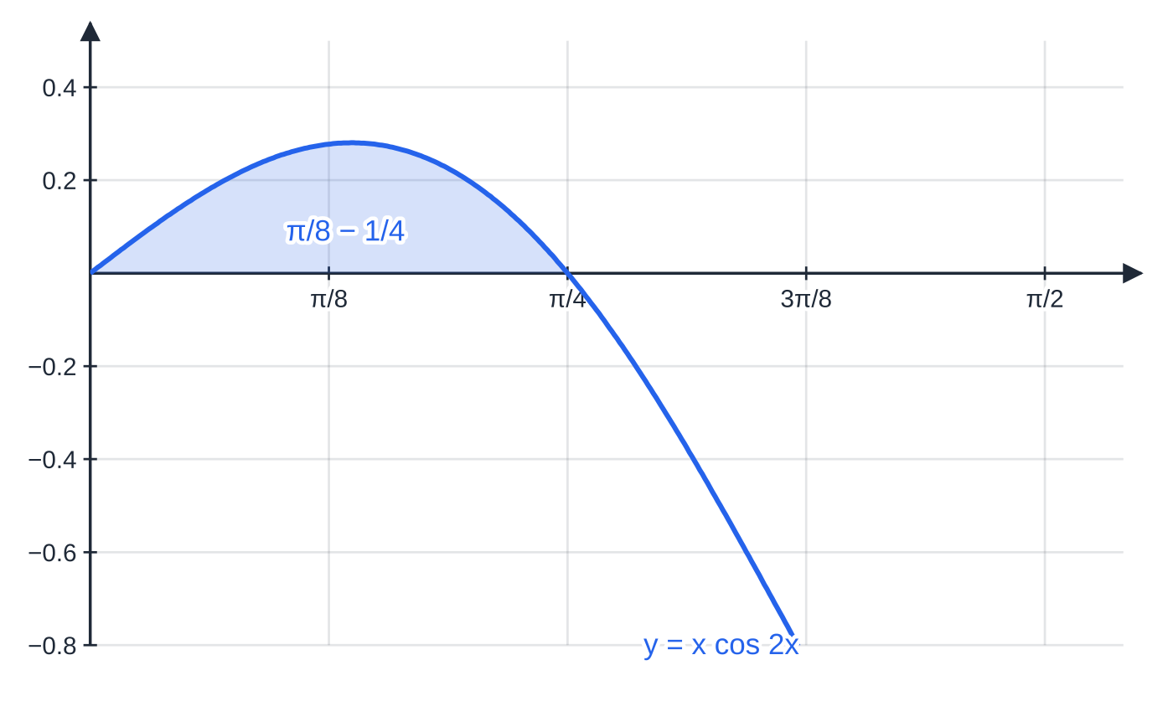
How does integration by parts work? (continued)
Section 3 of 12
Worked example 3: the shaded area under y=xcos 2x up to its first root x=π/4 is π/8-¼≈0.143.
Notes:
How does integration by parts work?. Full notes: https://examinerprep.com/notes/edexcel-ial-maths/integration-by-substitution-by-parts-and-with-partial-fractions/

Slide 15
How does integration by parts work? (continued)
Section 3 of 12 · Worked example 4 · Medium · Find / Show that
WORKED EXAMPLE · QUESTION
(a) Find ∫ln x dx. (b) Hence show that ∫₁ᵉln x dx=1. (c) Find the exact value of ∫₁ᵉ xln x dx.
SOLUTION
(a) Write ln x=1×ln x; u=ln x, dv/dx=1, so du/dx=1/x, v=x. Then ∫ln x dx=xln x-∫x×1/x dx= xln x-x+c.
(b) With ln e=1 and ln 1=0: [xln x-x]₁ᵉ=(e-e)-(0-1)=1 as required.
(c) u=ln x again, now with dv/dx=x, so v=½x²: ∫xln x dx=½x²ln x-∫½x²×1/x dx=½x²ln x-¼x²+c. Evaluate: (½e²-¼e²)-(0-¼)= (e²+1)/4.
Notes:
How does integration by parts work?: Worked example 4. Full notes: https://examinerprep.com/notes/edexcel-ial-maths/integration-by-substitution-by-parts-and-with-partial-fractions/

Slide 16
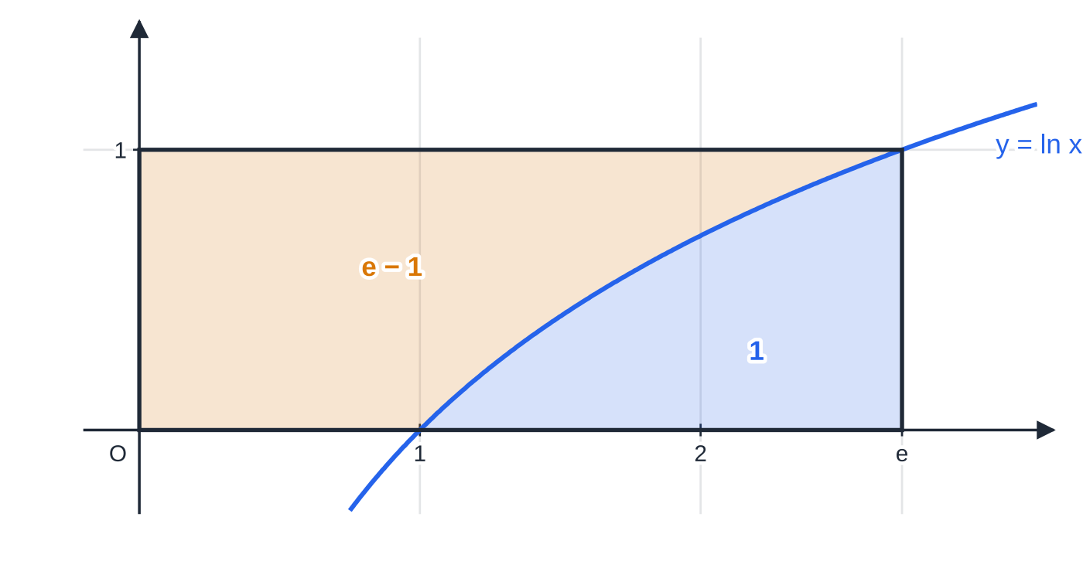
How does integration by parts work? (continued)
Section 3 of 12
Common error
Choosing u=x in ∫xln x dx. Then dv/dx=ln x, and you need ∫ln x dx before you can even start. When ln x is present, it is almost always u.
Why ∫₁ᵉln x dx=1: the blue area under y=ln x and the amber area between the curve and the y-axis (∫₀¹eʸ dy=e-1) fill the rectangle of area e×1. That rectangle is the [uv] term of the parts formula, so the blue area is e-(e-1)=1.
Notes:
How does integration by parts work?. Full notes: https://examinerprep.com/notes/edexcel-ial-maths/integration-by-substitution-by-parts-and-with-partial-fractions/

Slide 17
When do you use integration by parts twice?
Section 4 of 12
Each use of parts with u=xⁿ lowers the power by one. With x² the first application leaves an integral containing x, so parts is needed a second time. Keep careful track of signs: the second application sits inside a minus sign from the first.
Notes:
When do you use integration by parts twice?. Full notes: https://examinerprep.com/notes/edexcel-ial-maths/integration-by-substitution-by-parts-and-with-partial-fractions/

Slide 18
When do you use integration by parts twice? (continued)
Section 4 of 12 · Worked example 5 · Hard · Find
WORKED EXAMPLE · QUESTION
Find the exact value of ∫₀^(π/2)x²sin x dx.
SOLUTION
First application, u=x², dv/dx=sin x, v=-cos x: ∫x²sin x dx=-x²cos x+∫2xcos x dx.
Second application, u=2x, dv/dx=cos x, v=sin x: ∫2xcos x dx=2xsin x-∫2sin x dx=2xsin x+2cos x.
Combine: ∫x²sin x dx=-x²cos x+2xsin x+2cos x+c.
Limits, with cos π/2=0, sin π/2=1, cos 0=1: (0+π+0)-(0+0+2)= π-2.
Notes:
When do you use integration by parts twice?: Worked example 5. Full notes: https://examinerprep.com/notes/edexcel-ial-maths/integration-by-substitution-by-parts-and-with-partial-fractions/

Slide 19
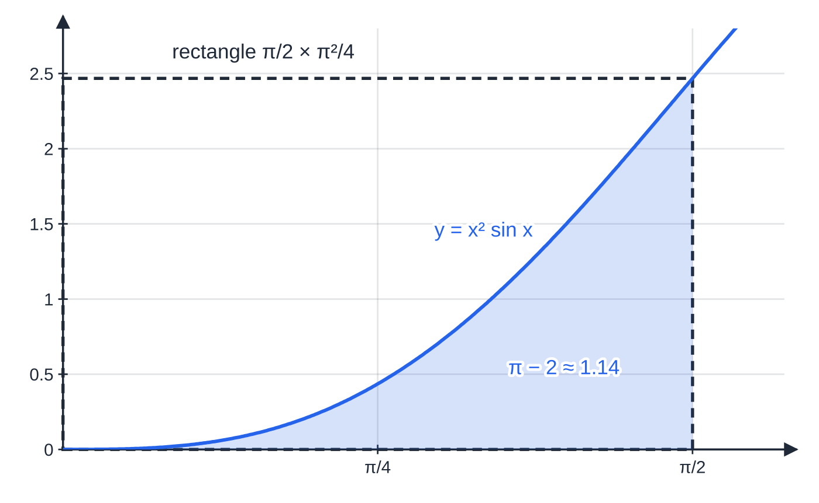
When do you use integration by parts twice? (continued)
Section 4 of 12
Exam tip
Write the second application in brackets: -x²cos x+[2xsin x-∫2sin x dx]. Most sign slips in repeated parts happen when the brackets are dropped. Then differentiate your final answer as a check; it takes a minute and catches them.
Worked example 5: the area is π-2≈1.14. A quick check: the region lies inside the rectangle of width π/2 and height π²/4≈2.47, and fills a little under a third of it.
Notes:
When do you use integration by parts twice?. Full notes: https://examinerprep.com/notes/edexcel-ial-maths/integration-by-substitution-by-parts-and-with-partial-fractions/

Slide 20
How do partial fractions help you integrate?
Section 5 of 12
A rational function such as (5x+4)/((x-1)(x+2)) has no standard integral, but its partial fractions do. Split it first (the algebra is on the P4 partial fractions page), then integrate each term.
Partial fraction | Integral | Why
k/(ax+b) | k/aln|ax+b|+c | f′/f form; divide by a, the derivative of the inside
k/((ax+b)²) | -k/(a(ax+b))+c | a power (-2) of a linear function, not a logarithm
a constant (polynomial) part, A | Ax+c | appears when the fraction is improper and you divide first
With distinct linear factors each term gives a logarithm; combine them with the laws of logarithms when an exact answer "in the form ln k" is asked for. A repeated factor (x+b)² needs both A/(x+b) and B/((x+b)²), and the second integrates to a fraction, not a log. An improper fraction (degree of numerator ≥ degree of denominator) must be divided first: for example (x²+x+1)/(x(x+1))=1+1/x-1/(x+1), so its integral is x+ln|x|-ln|x+1|+c.
Notes:
How do partial fractions help you integrate?. Full notes: https://examinerprep.com/notes/edexcel-ial-maths/integration-by-substitution-by-parts-and-with-partial-fractions/

Slide 21
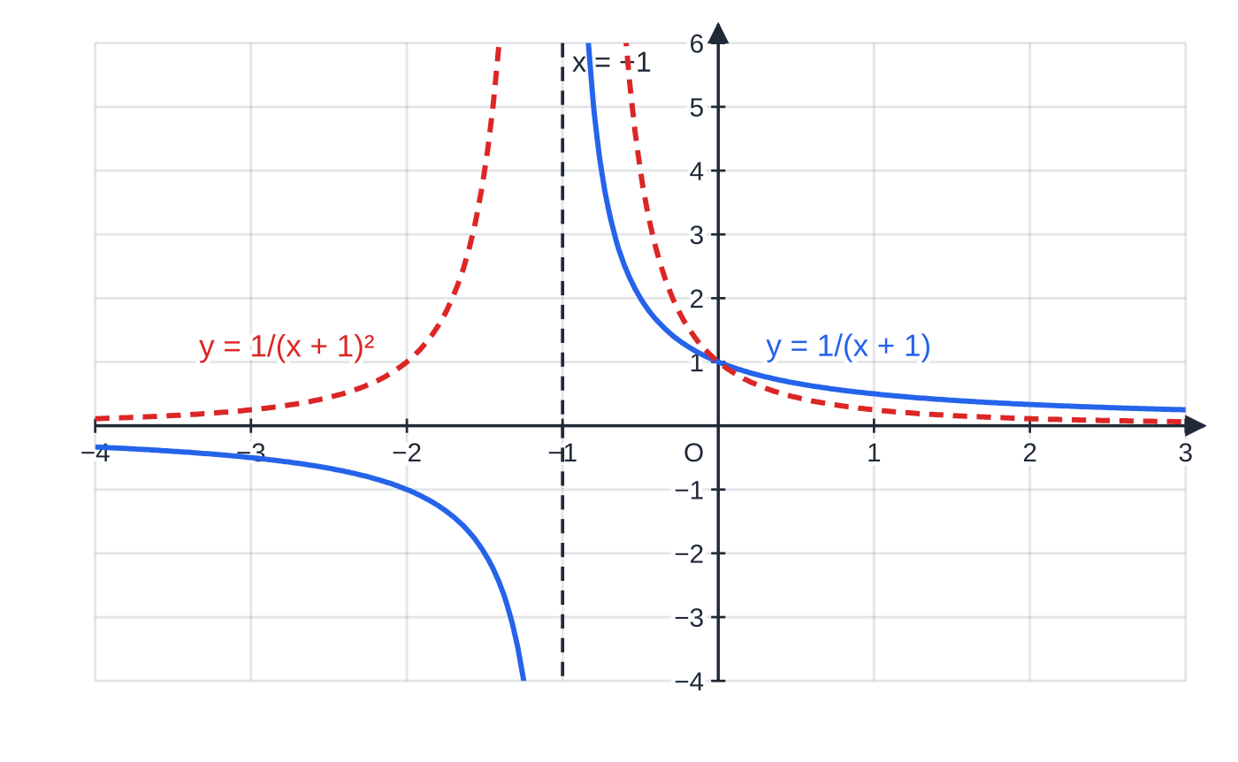
How do partial fractions help you integrate? (continued)
Section 5 of 12
A single factor and a squared factor behave differently. 1/(x+1) changes sign across the asymptote and integrates to ln|x+1|; 1/((x+1)²) is positive on both sides and integrates to -1/(x+1).
Notes:
How do partial fractions help you integrate?. Full notes: https://examinerprep.com/notes/edexcel-ial-maths/integration-by-substitution-by-parts-and-with-partial-fractions/

Slide 22
How do partial fractions help you integrate? (continued)
Section 5 of 12 · Worked example 6 · Medium · Show that
WORKED EXAMPLE · QUESTION
Show that ∫₂⁴(5x+4)/((x-1)(x+2)) dx=ln k, stating the exact value of k.
SOLUTION
Partial fractions: (5x+4)/((x-1)(x+2))≡A/(x-1)+B/(x+2), so 5x+4≡A(x+2)+B(x-1). x=1: 9=3A⇒A=3. x=-2: -6=-3B⇒B=2.
Integrate: ∫₂⁴(3/(x-1)+2/(x+2))dx=[3ln|x-1|+2ln|x+2|]₂⁴.
Evaluate: (3ln 3+2ln 6)-(3ln 1+2ln 4)=3ln 3+2ln(3/2). Combine: ln 27+ln(9/4)=ln(243/4), so k=(243/4).
Notes:
How do partial fractions help you integrate?: Worked example 6. Full notes: https://examinerprep.com/notes/edexcel-ial-maths/integration-by-substitution-by-parts-and-with-partial-fractions/

Slide 23
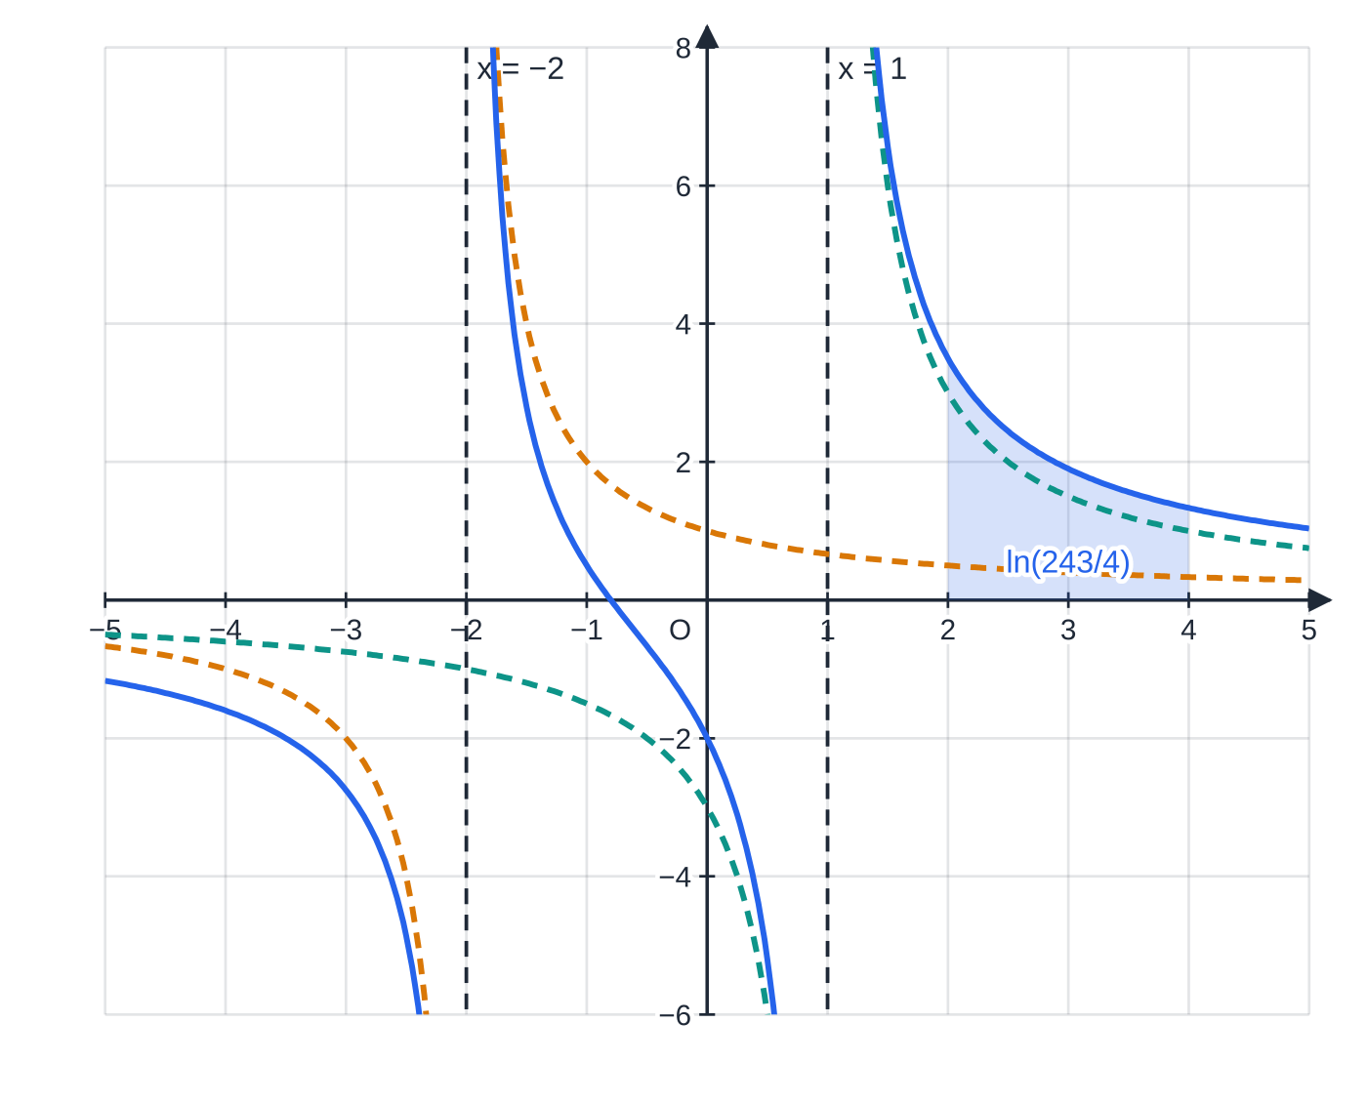
How do partial fractions help you integrate? (continued)
Section 5 of 12
Worked example 6: the blue curve is the sum of the dashed curves 3/(x-1) and 2/(x+2); its asymptotes come from the factors of the denominator. The shaded area is ln(243/4)≈4.11, and the interval avoids both asymptotes, as it must.
Notes:
How do partial fractions help you integrate?. Full notes: https://examinerprep.com/notes/edexcel-ial-maths/integration-by-substitution-by-parts-and-with-partial-fractions/

Slide 24
How do partial fractions help you integrate? (continued)
Section 5 of 12 · Worked example 7 · Hard · Find
WORKED EXAMPLE · QUESTION
Given that (x+5)/((x+1)²(x+3))≡A/(x+1)+B/((x+1)²)+C/(x+3), find A, B and C, and hence find the exact value of ∫₀¹(x+5)/((x+1)²(x+3)) dx.
SOLUTION
x+5≡A(x+1)(x+3)+B(x+3)+C(x+1)². x=-1: 4=2B⇒B=2. x=-3: 2=4C⇒C=½. Compare x²: 0=A+C⇒A=-½.
Integrate term by term; the middle term is a power, not a log: [-½ln(x+1)-2/(x+1)+½ln(x+3)]₀¹.
Evaluate: (-½ln 2-1+½ln 4)-(0-2+½ln 3)=1+½ln 2-½ln 3= 1+½ln⅔ (≈0.797).
½ln 4=ln 2, which is how -½ln 2+½ln 4 becomes +½ln 2. Equivalent exact forms, such as 1-½ln 1.5, are equally correct.
Notes:
How do partial fractions help you integrate?: Worked example 7. Full notes: https://examinerprep.com/notes/edexcel-ial-maths/integration-by-substitution-by-parts-and-with-partial-fractions/

Slide 25
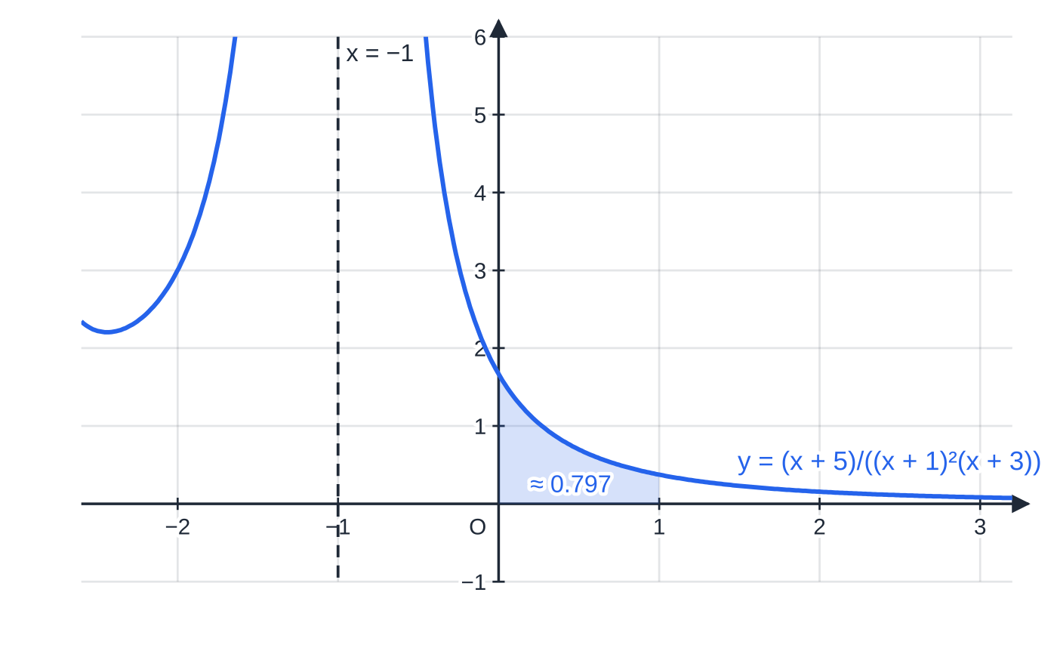
How do partial fractions help you integrate? (continued)
Section 5 of 12
Common error
Integrating 2/((x+1)²) as 2ln(x+1)². The derivative of (x+1)² is not on the top, so this is not an f′/f integral. Write it as 2(x+1)⁻² and use the power rule: -2(x+1)⁻¹.
Worked example 7: near the squared factor the curve goes to +∞ on both sides of x=-1, unlike a single factor. The shaded area from x=0 to x=1 is 1+½ln⅔≈0.797.
Notes:
How do partial fractions help you integrate?. Full notes: https://examinerprep.com/notes/edexcel-ial-maths/integration-by-substitution-by-parts-and-with-partial-fractions/

Slide 26
How do you choose the method?
Section 6 of 12
Before anything else, look for a standard integral or a "recognition" integral (f′/f, or a function times its inside's derivative), which can be written down in one line. Then ask what kind of integrand you have.
Integrand | What to notice | Method | Result
xe^(x²) | x is (half) the derivative of x² | recognition (or u=x²) | ½e^(x²)+c
sin xcos⁴x | sin x is (minus) the derivative of cos x | recognition (or u=cos x) | -⅕cos⁵x+c
(2x+3)/(x²+3x) | numerator is the derivative of the denominator | f′/f | ln|x²+3x|+c
3/(x²+3x) | constant over a quadratic that factorises | partial fractions | ln|x|-ln|x+3|+c
xeˣ | product of unrelated functions | parts, u=x | (x-1)eˣ+c
x²ln x | product including ln x | parts, u=ln x | ⅓x³ln x-(1/9)x³+c
x/(√(x+1)) | a root of a linear expression | substitution u=x+1 (or u²=x+1) | ⅔(x+1)^(3/2)-2(x+1)^(1/2)+c
Notes:
How do you choose the method?. Full notes: https://examinerprep.com/notes/edexcel-ial-maths/integration-by-substitution-by-parts-and-with-partial-fractions/

Slide 27
How do you choose the method? (continued)
Section 6 of 12
Exam tip
When the question names a method ("use integration by parts", "use the substitution …"), use it: a different method does not answer the question that was set. When it does not, any valid method is fine; pick the one with the fewest steps.
Notes:
How do you choose the method?. Full notes: https://examinerprep.com/notes/edexcel-ial-maths/integration-by-substitution-by-parts-and-with-partial-fractions/

Slide 28
How do longer integration questions fit together?
Section 7 of 12
Longer questions often chain two techniques: a substitution turns the integrand into a rational function of u, which then needs partial fractions. Keep each stage on its own lines (limits, the u-integral, the partial fractions, the evaluation) so that each can be followed.
Notes:
How do longer integration questions fit together?. Full notes: https://examinerprep.com/notes/edexcel-ial-maths/integration-by-substitution-by-parts-and-with-partial-fractions/

Slide 29
How do longer integration questions fit together? (continued)
Section 7 of 12 · Worked example 8 · Hard · Show that
WORKED EXAMPLE · QUESTION
I=∫₀^(ln 2)6eˣ/((eˣ+1)(eˣ+4)) dx. (a) Use the substitution u=eˣ to show that I=∫₁²6/((u+1)(u+4)) du. (b) Express 6/((u+1)(u+4)) in partial fractions. (c) Hence show that I=ln(25/16).
SOLUTION
(a) du/dx=eˣ, so eˣ dx=du. Limits: x=0⇒u=1; x=ln 2⇒u=2. So I=∫₁²6/((u+1)(u+4)) du as required.
(b) 6≡A(u+4)+B(u+1). u=-1: 6=3A⇒A=2. u=-4: 6=-3B⇒B=-2. So 2/(u+1)-2/(u+4).
(c) [2ln(u+1)-2ln(u+4)]₁²=(2ln 3-2ln 6)-(2ln 2-2ln 5)=2ln(3×5)/(6×2)=2ln(5/4)= ln(25/16) (≈0.446).
Notes:
How do longer integration questions fit together?: Worked example 8. Full notes: https://examinerprep.com/notes/edexcel-ial-maths/integration-by-substitution-by-parts-and-with-partial-fractions/

Slide 30
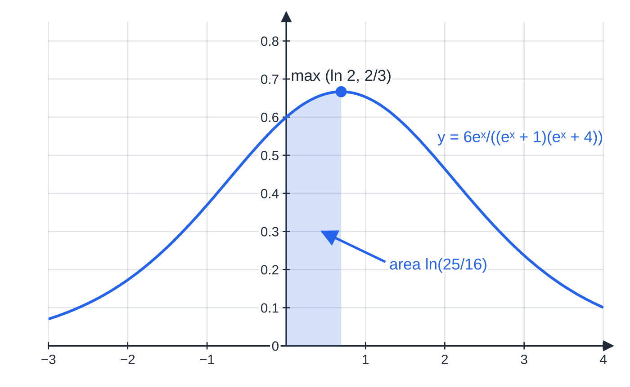
How do longer integration questions fit together? (continued)
Section 7 of 12
Common error
Changing the variable but keeping the x-limits 0 and ln 2 in the u-integral. The limits must be u-values; with 0 and ln 2 the value obtained is wrong, and nothing in the later working will reveal it.
Worked example 8: the shaded area from x=0 to x=ln 2 is ln(25/16)≈0.446. The upper limit, ln 2, is also where the curve reaches its maximum value of ⅔ (at u=2).
Notes:
How do longer integration questions fit together?. Full notes: https://examinerprep.com/notes/edexcel-ial-maths/integration-by-substitution-by-parts-and-with-partial-fractions/

Slide 31
Exam tips for P4.5
Section 8 of 12
Exam tip 1 — differentiate to check
Every indefinite integral on this page can be checked by differentiating your answer. For a "find" question with no limits this is the fastest way to catch a sign or a missing factor.
Exam tip 2 — "show that" means show everything
In "show that … =ln k" or "show that I=∫…du", the answer is given, so the working is what counts: the differential link, the new limits, each log term with its limits substituted, and the laws of logarithms used to combine them.
Exam tip 3 — exact means exact
Keep ln 3, π, e² and fractions as they are. "In the form ln k" needs a single logarithm; "a+ln b" needs the rational part separated. Give a decimal only if one is asked for, and then as well as the exact value.
Notes:
Exam tips for P4.5. Full notes: https://examinerprep.com/notes/edexcel-ial-maths/integration-by-substitution-by-parts-and-with-partial-fractions/

Slide 32
Exam tips for P4.5 (continued)
Section 8 of 12
Exam tip 4 — choose u by what it becomes
In integration by parts, u should get simpler when differentiated and dv/dx must be something you can integrate. If the new integral looks harder than the old one, swap the choice at once.
Exam tip 5 — read the denominator
Linear factors give logarithms; a squared factor gives a fraction; numerator degree ≥ denominator degree means divide first. Decide which case you are in before you write the partial fractions.
Notes:
Exam tips for P4.5. Full notes: https://examinerprep.com/notes/edexcel-ial-maths/integration-by-substitution-by-parts-and-with-partial-fractions/

Slide 33
Common misconceptions
Section 9 of 12
Misconception | Why it is wrong | Correct idea
After substituting u=g(x), dx can simply be replaced by du. | du=g′(x) dx; the factor g′(x) matters unless it equals 1. | Find du/dx and replace dx properly.
The limits stay the same when you substitute. | Limits are values of the variable of integration. | Convert each limit with u=g(x), or substitute back to x before using the old limits.
∫u dv=uv+∫v du. | The product rule puts both terms on the same side; rearranging gives a minus. | uv-∫vdu/dx dx.
∫ln x dx=1/x. | That is the derivative of ln x, not its integral. | Parts with 1×ln x: xln x-x+c.
∫1/(2x+1) dx=ln|2x+1|+c. | Differentiating ln|2x+1| gives 2/(2x+1). | Divide by the coefficient of x: ½ln|2x+1|+c.
Notes:
Common misconceptions. Full notes: https://examinerprep.com/notes/edexcel-ial-maths/integration-by-substitution-by-parts-and-with-partial-fractions/

Slide 34
Common misconceptions (continued)
Section 9 of 12
Misconception | Why it is wrong | Correct idea
Every partial fraction integrates to a logarithm. | A term over (x+b)² is a power of a linear function. | ∫k(x+b)⁻² dx=-k/(x+b)+c.
Notes:
Common misconceptions. Full notes: https://examinerprep.com/notes/edexcel-ial-maths/integration-by-substitution-by-parts-and-with-partial-fractions/

Slide 35
How this topic connects
Section 10 of 12
P3.7 Integration of standard functions and P3.6 differentiation
Every technique here ends in a standard result from P3: eˣ, 1/x, sin, cos, f(ax+b) and f′/f. Substitution is the chain rule reversed; parts is the product rule reversed.
P4.1 Partial fractions, P4.6 Volumes of revolution, P4.7 Differential equations
The algebra of splitting fractions comes first; areas, volumes of revolution and separable differential equations then need exactly these integrals, often as the second half of a longer question. Partial fractions are also used to expand rational functions as binomial series.
Mechanics and physics
Work done by a variable force, and displacement from a variable acceleration, lead to integrals such as ∫te⁻ᵏᵗ dt, which need integration by parts; exponential decay and capacitor discharge give similar integrals.
Notes:
How this topic connects. Full notes: https://examinerprep.com/notes/edexcel-ial-maths/integration-by-substitution-by-parts-and-with-partial-fractions/

Slide 36
Key formulae
Section 11 of 12
Formula | Use | In the formulae list?
∫f(g(x)) g′(x) dx=∫f(u) du, u=g(x) | integration by substitution | No — learn it
∫ₐᵇ…dx=∫_(g(a))ᵍ⁽ᵇ⁾…du | changing the limits for u=g(x) | No — learn it
∫udv/dx dx=uv-∫vdu/dx dx | integration by parts | Yes
∫ln x dx=xln x-x+c | integrating ln x (parts with 1×ln x) | No — derive it
∫k/(ax+b) dx=k/aln|ax+b|+c | integrating a linear partial fraction | No — learn it
∫k/((ax+b)²) dx=-k/(a(ax+b))+c | integrating a repeated-factor partial fraction | No — derive it
∫f′(x)/f(x) dx=ln|f(x)|+c | recognising a log integral before choosing a method | No — learn it
Notes:
Key formulae. Full notes: https://examinerprep.com/notes/edexcel-ial-maths/integration-by-substitution-by-parts-and-with-partial-fractions/

Slide 37
Check your understanding
Section 12 of 12
1. Find ∫xe⁻ˣ dx.
2. Use the substitution u=1+x² to find ∫₀¹x/((1+x²)²) dx.
3. Which method would you use for ∫1/(x²-1) dx, and what is the result?
4. In ∫xln x dx, why is u=ln x the right choice rather than u=x?
5. Find the exact value of ∫₁²ln x dx.
6. Find ∫(x²+x+1)/(x(x+1)) dx.
Notes:
Check your understanding: questions. Full notes: https://examinerprep.com/notes/edexcel-ial-maths/integration-by-substitution-by-parts-and-with-partial-fractions/

Slide 38
Check your understanding · answers
Section 12 of 12
1. Parts with u=x, v=-e⁻ˣ: -xe⁻ˣ+∫e⁻ˣ dx=-xe⁻ˣ-e⁻ˣ+c=-(x+1)e⁻ˣ+c.
2. du=2x dx; limits 1 and 2. ∫₁²1/2u² du=½[-1/u]₁²=½(-½+1)=¼.
3. Partial fractions: 1/(x²-1)=(1/2)/(x-1)-(1/2)/(x+1), so the integral is ½ln|x-1|-½ln|x+1|+c=½ln|(x-1)/(x+1)|+c.
4. With u=x you would need v=∫ln x dx, itself a parts integral. With u=ln x, du/dx=1/x cancels against v=½x², leaving the easy ∫½x dx.
5. [xln x-x]₁²=(2ln 2-2)-(0-1)=2ln 2-1.
6. The fraction is improper, so divide first: (x²+x+1)/(x(x+1))=1+1/(x(x+1))=1+1/x-1/(x+1). The integral is x+ln|x|-ln|x+1|+c.
Notes:
Check your understanding: answers. Full notes: https://examinerprep.com/notes/edexcel-ial-maths/integration-by-substitution-by-parts-and-with-partial-fractions/

Slide 39
Practice questions
2 original exam-style questions. Answers at the end of the deck.

Slide 40
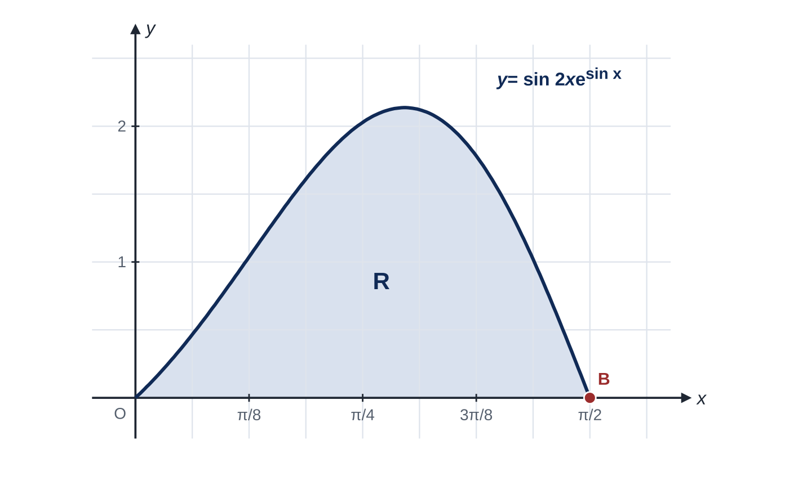
Question 1
8 marks
Figure 1 shows the curve with equation y = sin 2x eˢⁱⁿˣ, 0 ≤ x ≤ π/2. The curve meets the x-axis at the origin and at B(π/2, 0). The shaded region R is bounded by the curve and the x-axis.
(a) Use the substitution u = sin x to show that the area of R is given by ∫₀¹ 2ueᵘ du. [4]
(b) Hence, using integration by parts, show that the area of R is 2. [4]
Notes:
Online with the full mark scheme: https://examinerprep.com/ial-maths-p4-5-integration-by-substitution-by-parts-and-with-partial-fractions-questions#IALM-P4-5-FB-06

Slide 41
Question 2
5 marks
Integration by parts is used to find integrals of the product of a power of x and an exponential function.
(a) Find ∫xe³ˣ dx. [3]
(b) Hence find the exact value of ∫₀¹ xe³ˣ dx, giving your answer in the form (ae³ + b)/9, where a and b are integers. [2]
Notes:
Online with the full mark scheme: https://examinerprep.com/ial-maths-p4-5-integration-by-substitution-by-parts-and-with-partial-fractions-questions#IALM-P4-5-B-02

Slide 42
Answers

Slide 43
Question 1 · answer
Mark scheme
du/dx = cos x, so dx = du/cos x
sin 2x = 2 sin x cos x
2 sin x cos x eˢⁱⁿˣ × du/cos x = 2ueᵘ du
limits: x = 0 gives u = 0 and x = π/2 gives u = 1
differentiates 2u and integrates eᵘ
2ueᵘ − ∫2eᵘ du = 2ueᵘ − 2eᵘ
(2e − 2e) − (0 − 2)
= 2
Notes:
Full mark scheme: https://examinerprep.com/ial-maths-p4-5-integration-by-substitution-by-parts-and-with-partial-fractions-questions#IALM-P4-5-FB-06

Slide 44
Question 2 · answer
Mark scheme
parts with u = x, dv/dx = e³ˣ, giving ⅓xe³ˣ − ∫⅓e³ˣ dx
second term −(1/9)e³ˣ
⅓xe³ˣ − (1/9)e³ˣ + c, all correct with + c
substitutes both limits into their answer: (⅓e³ − (1/9)e³) − (0 − 1/9)
(2e³ + 1)/9
Notes:
Full mark scheme: https://examinerprep.com/ial-maths-p4-5-integration-by-substitution-by-parts-and-with-partial-fractions-questions#IALM-P4-5-B-02

Slide 45
Keep practising
Notes for this topic
Questions on this topic
Build a printable test
ExaminerPrep is an independent tutoring service. It has been developed independently from and is not endorsed by the International Baccalaureate Organization. "International Baccalaureate", "IB" and "IB Diploma Programme" are registered trademarks of the IBO, used here for descriptive purposes only.
Pearson Edexcel and Cambridge are trademarks of their owners; ExaminerPrep is not affiliated with any exam board.

