Slide 1
EP
EDEXCEL IAL MATHS
P3.7 Integration of standard functions
The full notes page in 11 sections · practice questions with answers · simulations
ExaminerPrep is an independent tutoring service. It has been developed independently from and is not endorsed by the International Baccalaureate Organization. "International Baccalaureate", "IB" and "IB Diploma Programme" are registered trademarks of the IBO, used here for descriptive purposes only.
Pearson Edexcel and Cambridge are trademarks of their owners; ExaminerPrep is not affiliated with any exam board.
Notes:
P3.7 Integration of standard functions. Notes for this topic: https://examinerprep.com/notes/edexcel-ial-maths/integration-of-standard-functions/

Slide 2
What this page covers
Overview
Integrating eˣ, 1/x, sin x, cos x and sec² x, and sums and multiples of them
Why the integral of 1/x is ln|x|, with a modulus sign
Integrating functions of ax+b: (ax+b)ⁿ, 1/(ax+b), eᵃˣ⁺ᵇ, sin(ax+b) and cos(ax+b)
Integrating by recognition: f′(x)/f(x) gives ln|f(x)|, including ∫tan x dx
Integrating by recognition: f′(x)[f(x)]ⁿ gives a power of f(x)
Using identities to integrate sin² x, cos² x and tan² x
Exact definite integrals and areas, including regions below the x-axis and between two curves
Notes:
What this page covers. Full notes: https://examinerprep.com/notes/edexcel-ial-maths/integration-of-standard-functions/

Slide 3
In one minute
Key points
1. Every standard integral in P3 is a P3 derivative read backwards, so ∫eˣ dx = eˣ + c, ∫1/x dx = ln|x| + c, ∫sin x dx = -cos x + c and ∫cos x dx = sin x + c, and you can check any answer by differentiating it.
2. Linear inside? Divide by a: ∫f(ax+b) dx = 1/aF(ax+b) + c. This only works when the inside is linear.
3. Top is (a multiple of) the derivative of the bottom? ∫f′(x)/f(x) dx = ln|f(x)| + c; adjust any constant factor.
4. A power of a function times the derivative of its inside? ∫f′(x)[f(x)]ⁿ dx = [f(x)]ⁿ⁺¹/(n+1) + c.
5. Squares of trigonometric functions must be rewritten first: sin² x = ½(1-cos 2x), cos² x = ½(1+cos 2x), tan² x = sec² x - 1.
6. A region below the x-axis gives a negative integral, so for an area you split at the roots and add the sizes.
Notes:
In one minute. Full notes: https://examinerprep.com/notes/edexcel-ial-maths/integration-of-standard-functions/

Slide 4
Which functions can you integrate on sight?
Section 1 of 11
Integration is the reverse of differentiation. In P3 you met the derivatives of eˣ, ln x, sin x, cos x and tan x. Read each of those results from right to left and you have a standard integral. That is the whole idea of this page: before you integrate anything, ask which derivative it came from.
Standard integrals
(x in radians, c the constant of integration)
∫eˣ dx = eˣ + c ∫1/x dx = ln|x| + c
∫sin x dx = -cos x + c ∫cos x dx = sin x + c ∫sec² x dx = tan x + c
The results for eˣ, 1/x, sin x and cos x are not in the formulae list, so learn them. The integral of sec² kx is in the formulae list.
The result for 1/x fills the one gap in the P1 power rule. The rule ∫xⁿ dx = xⁿ⁺¹/(n+1) + c breaks down when n = -1, because you would divide by zero.
Notes:
Which functions can you integrate on sight?. Full notes: https://examinerprep.com/notes/edexcel-ial-maths/integration-of-standard-functions/

Slide 5
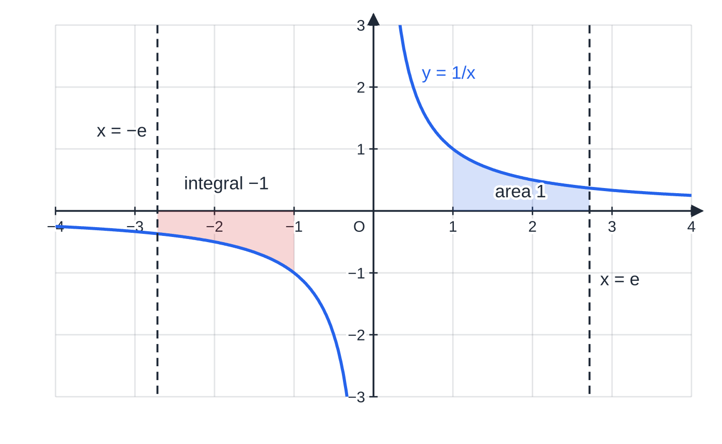
Which functions can you integrate on sight? (continued)
Section 1 of 11
The function x⁻¹ is the only power that does not integrate to a power; it integrates to a logarithm instead.
Why is there a modulus in ln|x|?
The function ln x only exists for x > 0, but y = 1/x has a second branch for x < 0. On that branch, differentiate ln(-x) with the chain rule: d/dxln(-x) = (-1)/(-x) = 1/x. So ln(-x) is also an antiderivative of 1/x, valid for negative x. Writing ln|x| covers both branches in one expression.
Each trigonometric result needs radians.
Both branches of y = 1/x. From x = 1 to x = e the area is ln e − ln 1 = 1. From x = −e to x = −1 the region lies below the axis and the integral is ln|−1| − ln|−e| = −1. Both limits must lie on the same branch: you can never integrate 1/x across x = 0.
Notes:
Which functions can you integrate on sight?. Full notes: https://examinerprep.com/notes/edexcel-ial-maths/integration-of-standard-functions/

Slide 6
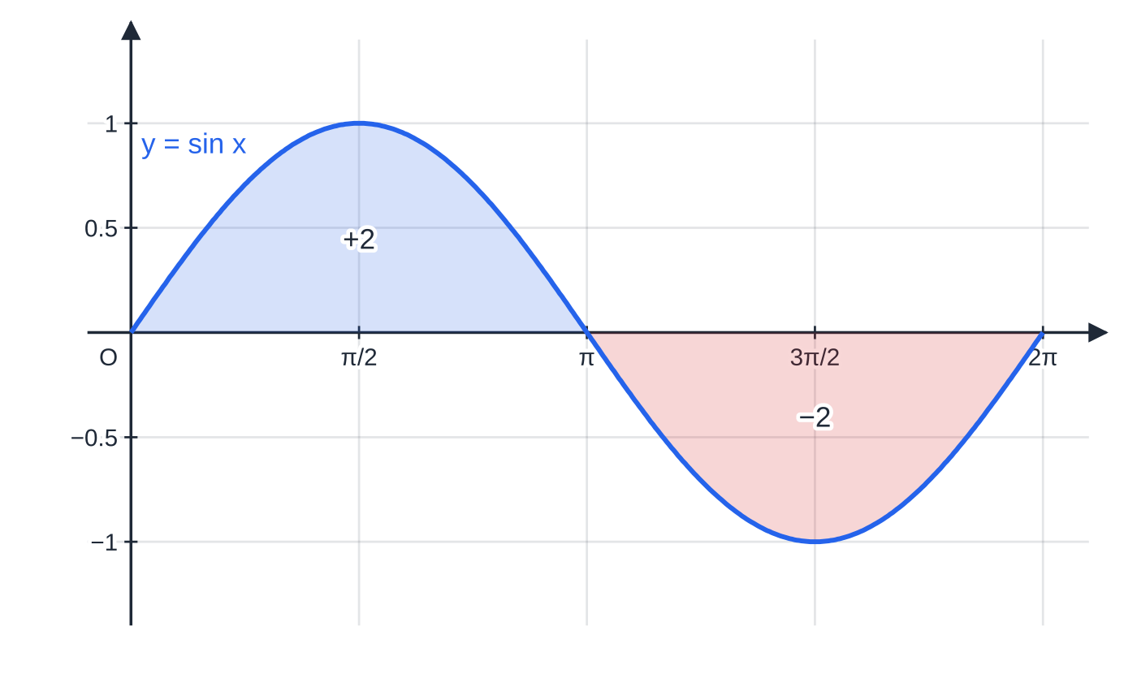
Which functions can you integrate on sight? (continued)
Section 1 of 11
If x were measured in degrees, the derivative of sin x would carry a factor π/180, and so would every integral. Keep your calculator in radian mode for the whole topic.
Using ∫sin x dx = −cos x: from 0 to π the integral is −cos π + cos 0 = 2; from π to 2π it is −2. The two regions have the same size, so ∫ from 0 to 2π of sin x dx = 0, even though the total area is 4.
Notes:
Which functions can you integrate on sight?. Full notes: https://examinerprep.com/notes/edexcel-ial-maths/integration-of-standard-functions/

Slide 7
Which functions can you integrate on sight? (continued)
Section 1 of 11 · Worked example 1 · Easy · Find, evaluate
WORKED EXAMPLE · QUESTION
(a) Find ∫(4eˣ - 3/x + 5sin x - 2cos x)dx, x > 0. (b) Evaluate ∫₀^(π/2) (5sin x - 2cos x) dx.
SOLUTION
(a) Integrate term by term, watching the signs on the trigonometric terms: 4eˣ stays 4eˣ; -3/x gives -3ln x; 5sin x gives -5cos x; -2cos x gives -2sin x. Because x > 0, ln|x| can be written ln x. 4eˣ - 3ln x - 5cos x - 2sin x + c
(b) Use the antiderivative -5cos x - 2sin x and substitute the limits: (-5×0 - 2×1) - (-5×1 - 2×0) = -2 + 5. 3
Notes:
Which functions can you integrate on sight?: Worked example 1. Full notes: https://examinerprep.com/notes/edexcel-ial-maths/integration-of-standard-functions/

Slide 8
Which functions can you integrate on sight? (continued)
Section 1 of 11
Common error
Getting the sign of ∫sin x dx wrong. Differentiating cos x gives -sin x, so going back, ∫sin x dx = -cos x + c. Check by differentiating: d/dx(-cos x) = sin x.
Notes:
Which functions can you integrate on sight?. Full notes: https://examinerprep.com/notes/edexcel-ial-maths/integration-of-standard-functions/

Slide 9
How do you integrate a function of ax + b?
Section 2 of 11
By the chain rule, d/dx[F(ax+b)] = a F′(ax+b). The derivative picks up an extra factor a, the coefficient of x. Reversing this, you integrate as if the bracket were a single x, then divide by a to cancel the factor the chain rule would put back.
Integrating a function of a linear expression
∫f(ax+b) dx = 1/aF(ax+b) + c, where F′ = f
(ax+b)ⁿ →((ax+b)ⁿ⁺¹)/(a(n+1)), n ≠-1; 1/(ax+b) →1/aln|ax+b|
eᵃˣ⁺ᵇ →1/aeᵃˣ⁺ᵇ; sin(ax+b) →-1/acos(ax+b); cos(ax+b) →1/asin(ax+b)
This is not in the formulae list: derive it from the chain rule and differentiate your answer to check the factor.
There is a neat picture behind the factor 1/a. The graph of y = cos 2x is the graph of y = cos x squashed horizontally by a factor of 2.
Notes:
How do you integrate a function of ax + b?. Full notes: https://examinerprep.com/notes/edexcel-ial-maths/integration-of-standard-functions/

Slide 10
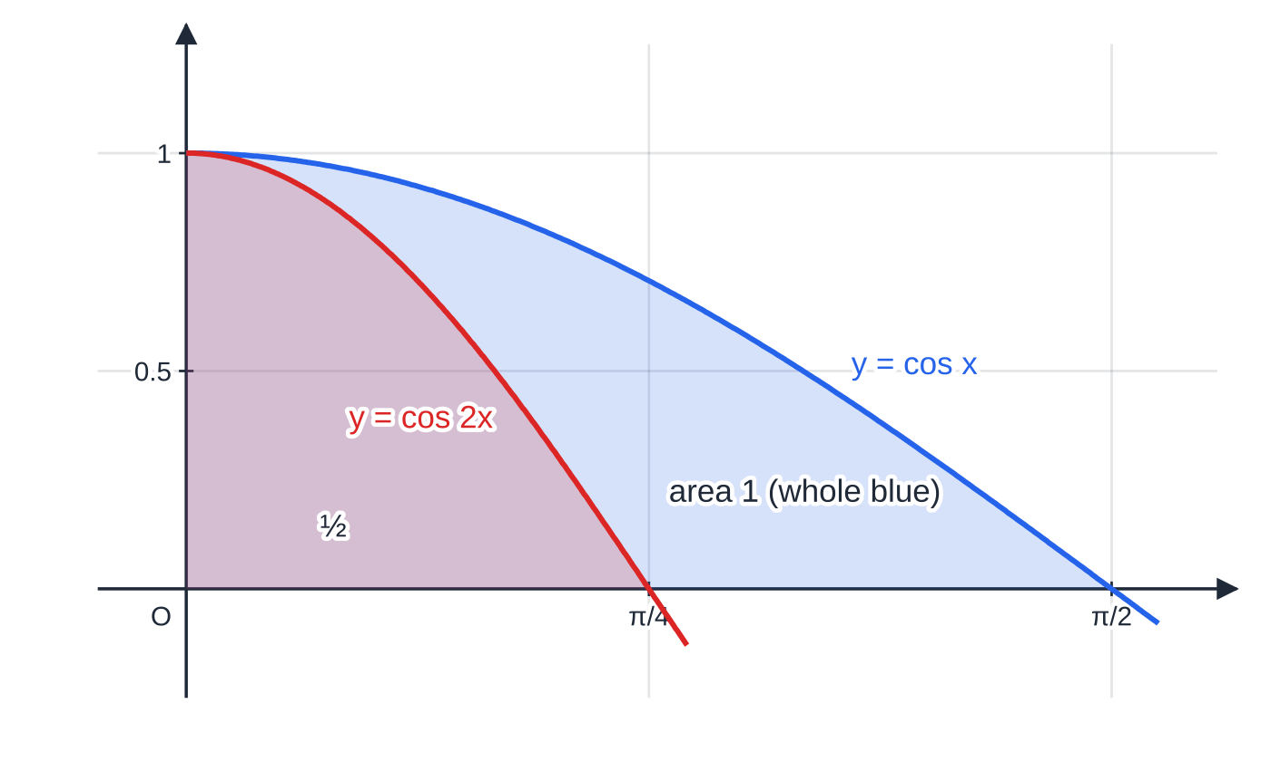
How do you integrate a function of ax + b? (continued)
Section 2 of 11
Every vertical strip becomes half as wide but keeps its height, so every area is halved. That is exactly the ½ in ∫cos 2x dx = ½sin 2x + c.
The rule only works when the inside is linear. For ∫(x²+1)³ dx the derivative of the inside is 2x, which is not a constant, so you cannot simply divide by it. Either expand the bracket or, if a factor of x is present outside, use the pattern in the section on f′(x)[f(x)]ⁿ.
Squashing y = cos x horizontally by a factor 2 gives y = cos 2x. The area under cos x from 0 to π/2 is 1; the area under cos 2x from 0 to π/4 is ½. Halving the width halves the area, which is why you divide by a = 2.
Notes:
How do you integrate a function of ax + b?. Full notes: https://examinerprep.com/notes/edexcel-ial-maths/integration-of-standard-functions/

Slide 11
How do you integrate a function of ax + b? (continued)
Section 2 of 11 · Worked example 2 · Easy · Find
WORKED EXAMPLE · QUESTION
Find (a) ∫(3x-2)⁴ dx (b) ∫8/(2x+5) dx (c) ∫e¹⁻⁴ˣ dx (d) ∫sin(2x + π/6)dx.
SOLUTION
(a) Raise the power to 5, divide by the new power and by a = 3: ((3x-2)⁵)/(5×3). (1/15)(3x-2)⁵ + c
(b) 8 ×½ln|2x+5|. 4ln|2x+5| + c
(c) Here a = -4, so divide by -4. -¼ e¹⁻⁴ˣ + c
(d) ∫sin u du = -cos u, then divide by 2. -½cos(2x + π/6) + c
Notes:
How do you integrate a function of ax + b?: Worked example 2. Full notes: https://examinerprep.com/notes/edexcel-ial-maths/integration-of-standard-functions/

Slide 12
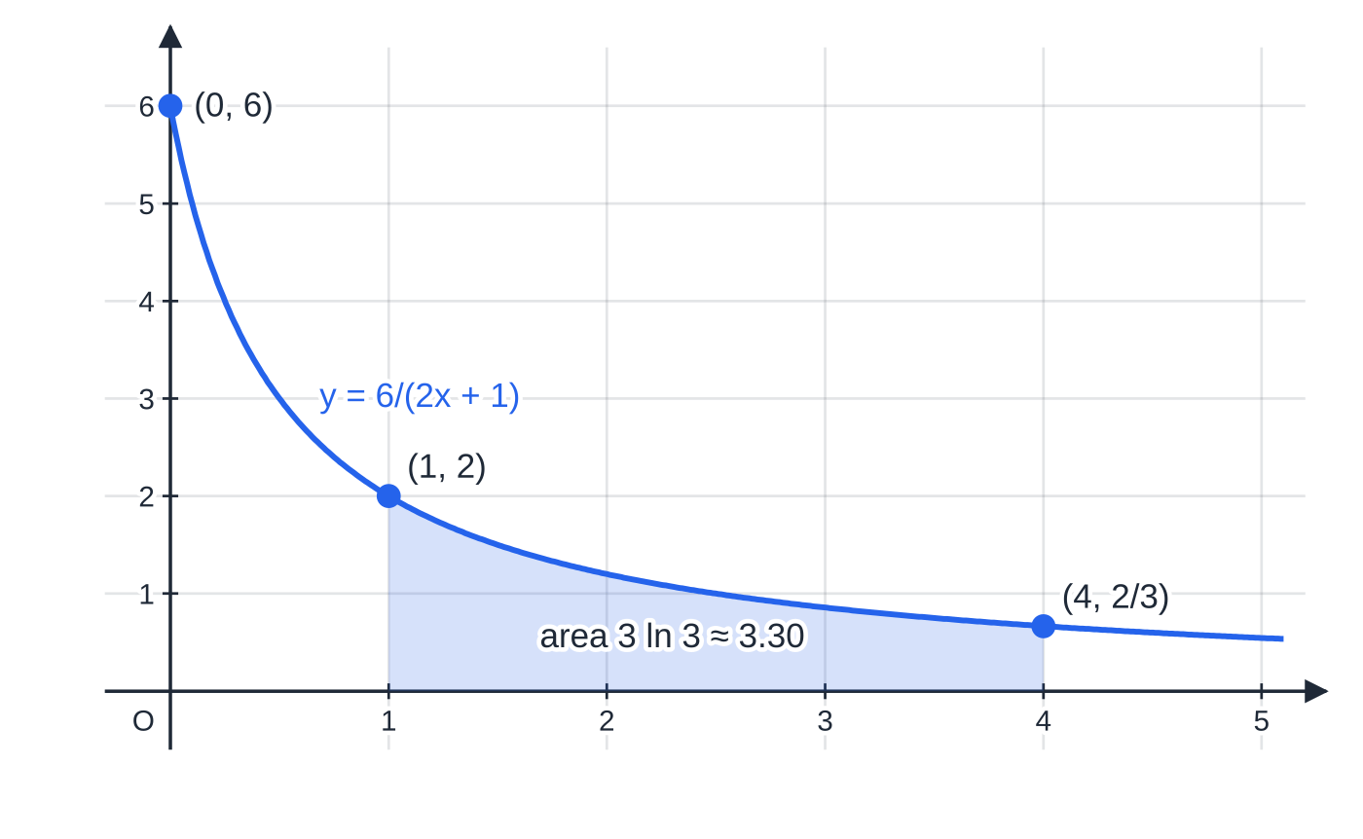
How do you integrate a function of ax + b? (continued)
Section 2 of 11 · Worked example 3 · Medium · Find the exact value
WORKED EXAMPLE · QUESTION
Find the exact value of (a) ∫₁⁴ 6/(2x+1) dx (b) ∫₀^(ln 2) e³ˣ dx.
SOLUTION
(a) Integrate, dividing by 2: [3ln|2x+1|]₁⁴ = 3ln 9 - 3ln 3. Combine with the laws of logarithms: 3ln(9/3) = 3ln 3 (≈ 3.30). 3ln 3
(b) [⅓ e³ˣ]₀^(ln 2). Use e^(3ln 2) = e^(ln 8) = 8: ⅓(8 - 1). (7/3)
The region under y = 6/(2x + 1) from x = 1 to x = 4. The curve stays positive on this interval, so the definite integral in part (a) is the area, 3 ln 3 ≈ 3.30.
Notes:
How do you integrate a function of ax + b?: Worked example 3. Full notes: https://examinerprep.com/notes/edexcel-ial-maths/integration-of-standard-functions/

Slide 13
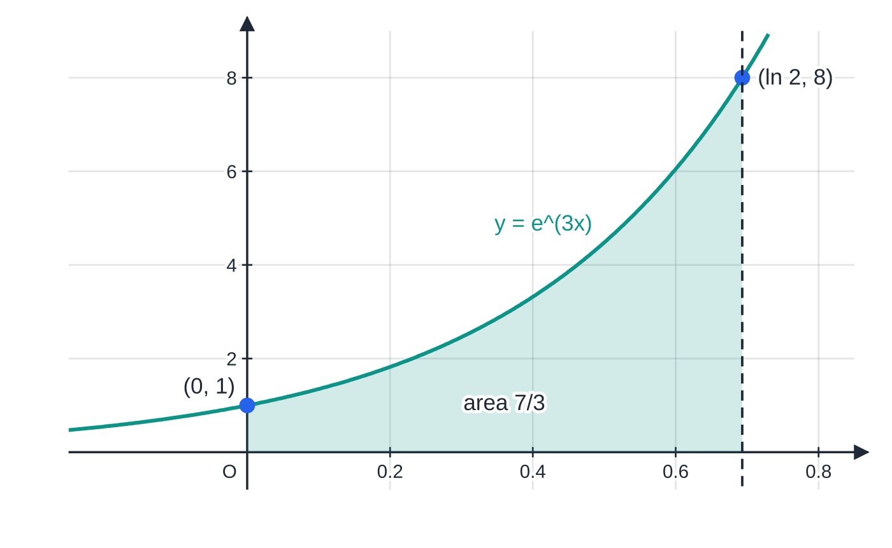
How do you integrate a function of ax + b? (continued)
Section 2 of 11
Exam tip 1 — exact means exact
"Exact value" means leave ln, e and π in your answer and simplify with the laws of logarithms: 3ln 9 - 3ln 3 = 3ln 3. A calculator decimal is not an exact answer; use it only as a check.
Worked example 3(b): the curve y = e^(3x) rises from 1 at x = 0 to 8 at x = ln 2, and the shaded area is (8 − 1)/3 = 7/3.
Notes:
How do you integrate a function of ax + b?. Full notes: https://examinerprep.com/notes/edexcel-ial-maths/integration-of-standard-functions/

Slide 14
When does an integral give a logarithm?
Section 3 of 11
By the chain rule, d/dxln|f(x)| = f′(x)/f(x). So whenever the numerator of a fraction is the derivative of its denominator, or a constant multiple of it, the integral is a logarithm. This is the most useful recognition pattern on the paper, and the test is quick: differentiate the bottom and compare it with the top.
Recognising f′(x)/f(x)
∫f′(x)/f(x) dx = ln|f(x)| + c and ∫k f′(x)/f(x) dx = kln|f(x)| + c
Not in the formulae list for the general pattern, so learn it. The results ∫tan kx dx = 1/kln|sec kx| + c and ∫cot x dx = ln|sin x| + c are in the formulae list.
The most famous case is tan x. Write it as sin x/cos x. The derivative of cos x is -sin x, so the numerator is -1 times the derivative of the denominator:
Notes:
When does an integral give a logarithm?. Full notes: https://examinerprep.com/notes/edexcel-ial-maths/integration-of-standard-functions/

Slide 15
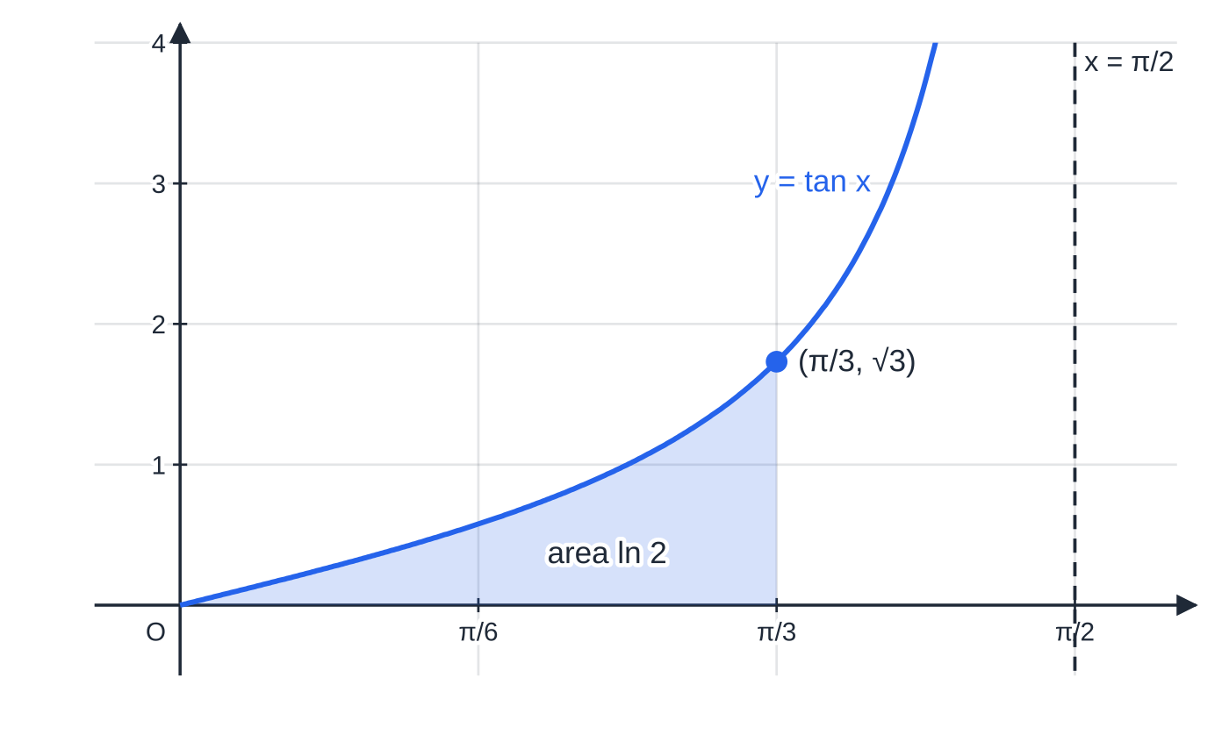
When does an integral give a logarithm? (continued)
Section 3 of 11
∫tan x dx = -∫(-sin x)/cos x dx = -ln|cos x| + c = ln|sec x| + c.
The last step uses -ln|cos x| = ln|cos x|⁻¹ = ln|sec x|. Similarly ∫cot x dx = ∫cos x/sin x dx = ln|sin x| + c.
The numerator must be a constant multiple of the derivative of the denominator. ∫x/(x²+1) dx = ½ln(x²+1) + c works, because x is half of 2x. But ∫1/(x²+1) dx does not fit the pattern at all: the top would need to contain x.
The area under y = tan x from 0 to π/3 is [ln|sec x|] = ln 2 − ln 1 = ln 2 ≈ 0.693, because sec(π/3) = 2. The curve has an asymptote at x = π/2, so the limits must stay on one side of it.
Notes:
When does an integral give a logarithm?. Full notes: https://examinerprep.com/notes/edexcel-ial-maths/integration-of-standard-functions/

Slide 16
When does an integral give a logarithm? (continued)
Section 3 of 11 · Worked example 4 · Medium · Find, show that
WORKED EXAMPLE · QUESTION
(a) Find ∫(4x-2)/(x²-x+3) dx. (b) Show that ∫₀^(π/2) cos x/(3+sin x) dx = ln(4/3).
SOLUTION
(a) Differentiate the denominator: d/dx(x²-x+3) = 2x-1, and 4x-2 = 2(2x-1). The integrand is twice f′/f, so it integrates to twice a logarithm. No modulus is needed: x²-x+3 has discriminant 1 - 12 < 0, so it is always positive. 2ln(x²-x+3) + c
(b) The numerator cos x is the derivative of 3 + sin x, which is always positive. So [ln(3+sin x)]₀^(π/2) = ln 4 - ln 3. ln(4/3) as required.
Notes:
When does an integral give a logarithm?: Worked example 4. Full notes: https://examinerprep.com/notes/edexcel-ial-maths/integration-of-standard-functions/

Slide 17
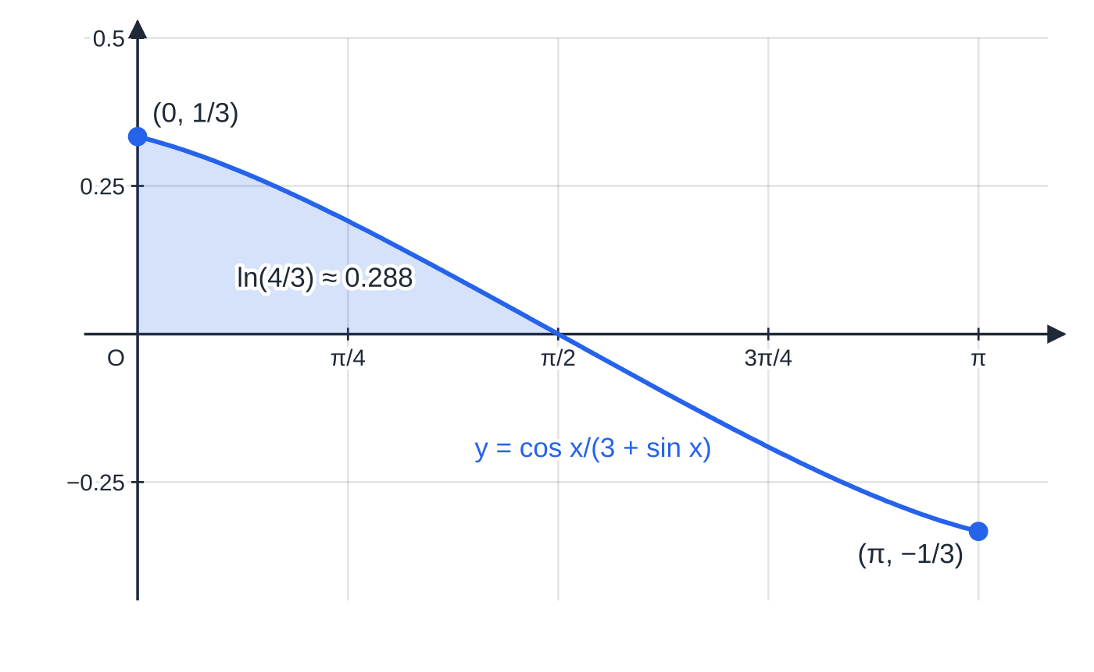
When does an integral give a logarithm? (continued)
Section 3 of 11
Common error
Writing ∫1/(x²+1) dx = ln(x²+1). Differentiate it: you get 2x/(x²+1), not the integrand. The f′/f pattern needs the derivative of the denominator on top.
Worked example 4(b): the shaded region from 0 to π/2 has area ln(4/3) ≈ 0.288. Beyond π/2 the curve is below the axis, so an integral that ran past π/2 would include a negative contribution.
Notes:
When does an integral give a logarithm?. Full notes: https://examinerprep.com/notes/edexcel-ial-maths/integration-of-standard-functions/

Slide 18
How do you spot f′(x)[f(x)]ⁿ?
Section 4 of 11
The chain rule gives d/dx[f(x)]ⁿ⁺¹/(n+1) = f′(x)[f(x)]ⁿ. So a power of a function, multiplied by the derivative of that function, integrates by raising the power, exactly as if f(x) were a single variable.
Recognising f′(x)[f(x)]ⁿ
∫f′(x)[f(x)]ⁿ dx = [f(x)]ⁿ⁺¹/(n+1) + c, n ≠-1
Look for a bracket (or a function such as cos x or eˣ + 1) raised to a power, multiplied by a constant multiple of its derivative.
Guess [f(x)]ⁿ⁺¹, differentiate it, compare with the integrand, then fix the constant.
n = -1 is the f′/f case of the previous section.
Not in the formulae list: derive it from the chain rule.
The method "guess, differentiate, adjust" is more reliable than trying to remember a formula. You only ever have to fix a constant factor.
Notes:
How do you spot f′(x)[f(x)]ⁿ?. Full notes: https://examinerprep.com/notes/edexcel-ial-maths/integration-of-standard-functions/

Slide 19
How do you spot f′(x)[f(x)]ⁿ? (continued)
Section 4 of 11
If the factor you need is a function of x, the pattern does not apply and you need a different method (substitution, in P4).
Notes:
How do you spot f′(x)[f(x)]ⁿ?. Full notes: https://examinerprep.com/notes/edexcel-ial-maths/integration-of-standard-functions/

Slide 20
How do you spot f′(x)[f(x)]ⁿ? (continued)
Section 4 of 11 · Worked example 5 · Medium · Find, evaluate
WORKED EXAMPLE · QUESTION
(a) Find ∫x²(x³+2)⁴ dx. (b) Evaluate ∫₀^(π/2) sin xcos³ x dx.
SOLUTION
(a) Guess (x³+2)⁵ and differentiate: d/dx(x³+2)⁵ = 5(x³+2)⁴ ×3x² = 15x²(x³+2)⁴. That is 15 times too big, so divide by 15. (1/15)(x³+2)⁵ + c
(b) cos³ x = (cos x)³, and its inside, cos x, has derivative -sin x. Guess cos⁴ x: d/dxcos⁴ x = -4sin xcos³ x, so ∫sin xcos³ x dx = -¼cos⁴ x + c. With limits: [-¼cos⁴ x]₀^(π/2) = 0 - (-¼). ¼
Notes:
How do you spot f′(x)[f(x)]ⁿ?: Worked example 5. Full notes: https://examinerprep.com/notes/edexcel-ial-maths/integration-of-standard-functions/

Slide 21
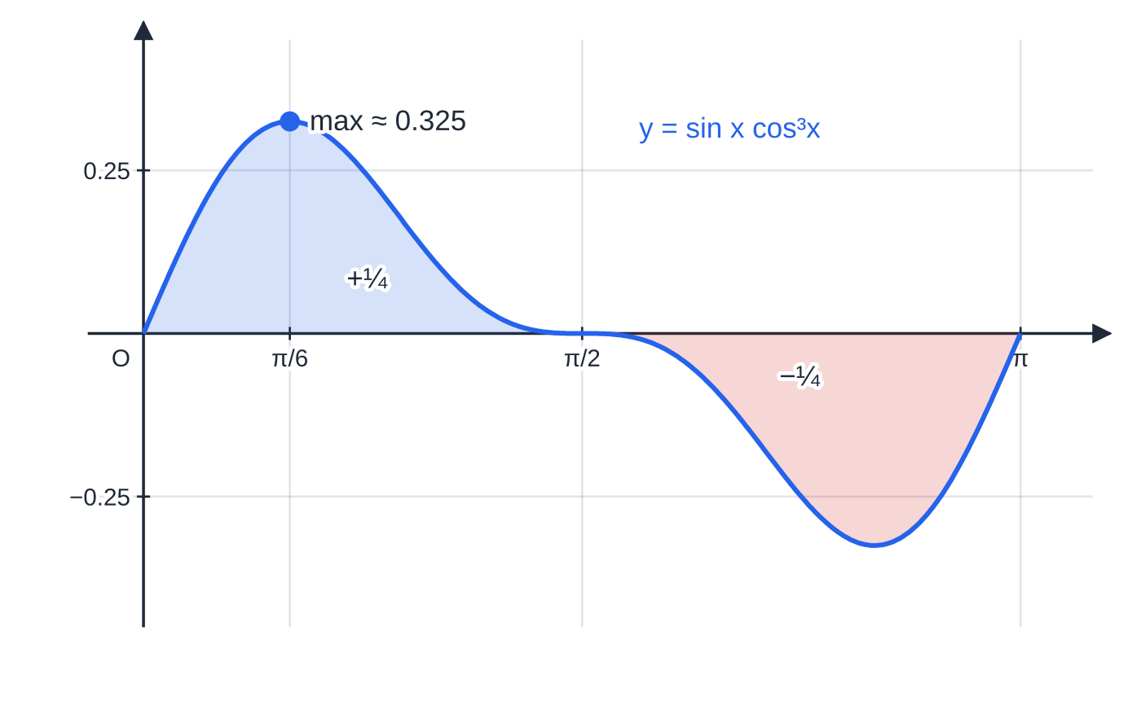
How do you spot f′(x)[f(x)]ⁿ? (continued)
Section 4 of 11
Exam tip 2 — "by differentiating … or otherwise"
Questions often say "by differentiating (x³+2)⁵, or otherwise". That is a hint to use this pattern: write down the derivative, then divide by the constant that appeared.
Worked example 5(b): the area from 0 to π/2 is ¼. The part from π/2 to π is the same shape below the axis, so the integral from 0 to π is 0, even though the total area is ½.
Notes:
How do you spot f′(x)[f(x)]ⁿ?. Full notes: https://examinerprep.com/notes/edexcel-ial-maths/integration-of-standard-functions/

Slide 22
How do identities help with sin²x, cos²x and tan²x?
Section 5 of 11
There is no standard integral for sin² x, cos² x or tan² x. The trick is to rearrange an identity so that the square disappears, and then use the earlier sections. The double-angle formula cos 2x = 1 - 2sin² x = 2cos² x - 1 gives the first two, and 1 + tan² x = sec² x gives the third.
Identities that remove the square
sin² x = ½(1-cos 2x) cos² x = ½(1+cos 2x) tan² x = sec² x - 1
So ∫sin² x dx = x/2 - sin 2x/4 + c, ∫cos² x dx = x/2 + sin 2x/4 + c and ∫tan² x dx = tan x - x + c. The double-angle formulae and sec² x = 1 + tan² x are not in the formulae list, so learn them.
The graphs show why these identities are natural. The curve y = cos² x never goes below zero; it oscillates between 0 and 1 about the mean level ½, with period π. That is exactly a cosine wave ½cos 2x lifted up by ½.
Notes:
How do identities help with sin²x, cos²x and tan²x?. Full notes: https://examinerprep.com/notes/edexcel-ial-maths/integration-of-standard-functions/

Slide 23
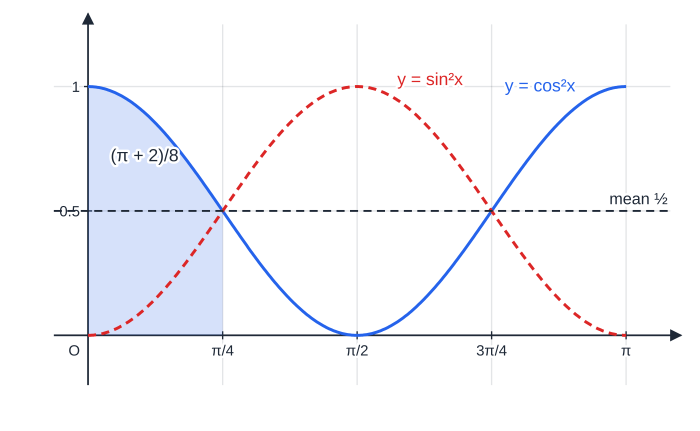
How do identities help with sin²x, cos²x and tan²x? (continued)
Section 5 of 11
cos²x and ½ + ½cos 2x are the same curve: a wave of period π about the level ½. sin²x is the same wave shifted by π/2. The shaded area from 0 to π/4 is (π + 2)/8 ≈ 0.643 (worked example 6a).
Notes:
How do identities help with sin²x, cos²x and tan²x?. Full notes: https://examinerprep.com/notes/edexcel-ial-maths/integration-of-standard-functions/

Slide 24
How do identities help with sin²x, cos²x and tan²x? (continued)
Section 5 of 11 · Worked example 6 · Medium · Show that, find
WORKED EXAMPLE · QUESTION
(a) Show that ∫₀^(π/4) cos² x dx = (π+2)/8. (b) Find ∫tan² 3x dx.
SOLUTION
(a) Use the identity: ∫₀^(π/4) ½(1+cos 2x) dx. Integrate, dividing the cos 2x term by 2: [x/2 + sin 2x/4]₀^(π/4). With sin π/2 = 1: (π/8 + ¼) - 0. (π+2)/8 as required.
(b) tan² 3x = sec² 3x - 1, and ∫sec² kx dx = 1/ktan kx. ⅓tan 3x - x + c
Notes:
How do identities help with sin²x, cos²x and tan²x?: Worked example 6. Full notes: https://examinerprep.com/notes/edexcel-ial-maths/integration-of-standard-functions/

Slide 25
How do identities help with sin²x, cos²x and tan²x? (continued)
Section 5 of 11
A useful sanity check: over a full period the average of sin² x is ½, so ∫₀^π sin² x dx = π/2. The formula agrees: [x/2 - sin 2x/4]₀^π = π/2.
Common error
Writing ∫sin² x dx = (sin³ x)/3. That treats sin x as if it were x. Differentiating (sin³ x)/3 gives sin² xcos x, not sin² x. Use the identity.
Notes:
How do identities help with sin²x, cos²x and tan²x?. Full notes: https://examinerprep.com/notes/edexcel-ial-maths/integration-of-standard-functions/

Slide 26
How do you find areas with these functions?
Section 6 of 11
The rules for definite integrals are the same as in P2; only the functions are new.
∫ₐᵇ f(x) dx = F(b) - F(a). The constant cancels, so leave it out.
A region below the x-axis gives a negative integral. Find where the curve crosses the axis, integrate each part separately and add the sizes.
The area between two curves is ∫(upper - lower) dx between their intersections; it does not matter whether the region is above or below the axis.
For trigonometric functions use radians and exact values such as cos π/3 = ½.
Notes:
How do you find areas with these functions?. Full notes: https://examinerprep.com/notes/edexcel-ial-maths/integration-of-standard-functions/

Slide 27
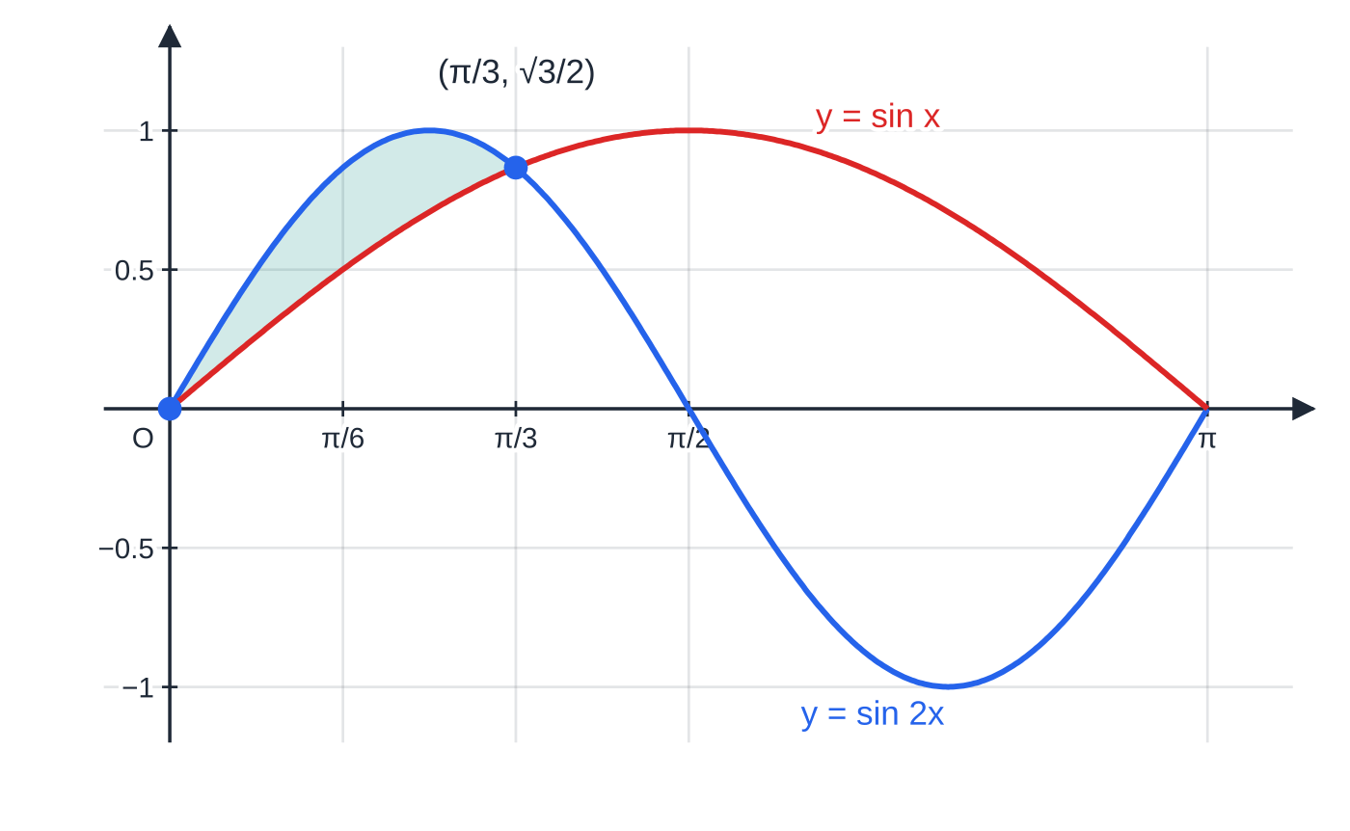
How do you find areas with these functions? (continued)
Section 6 of 11 · Worked example 7 · Hard · Show that, find
WORKED EXAMPLE · QUESTION
The curves y = sin 2x and y = sin x meet at the origin. (a) Show that, for 0 < x < π, the curves meet only where x = π/3. (b) Find the exact area of the finite region enclosed by the two curves for 0 ≤x ≤π/3.
SOLUTION
(a) Use sin 2x = 2sin xcos x: 2sin xcos x = sin x ⇒sin x(2cos x - 1) = 0. Since sin x ≠0 for 0 < x < π, cos x = ½, and x = π/3 is the only solution in (0, π). x = π/3 only
(b) sin 2x is the upper curve on (0, π/3) (at x = π/6: √3/2 > ½).
y = sin 2x and y = sin x meet at O and at (π/3, √3/2). Between them sin 2x is the upper curve, and the enclosed region has area ¼.
Notes:
How do you find areas with these functions?: Worked example 7. Full notes: https://examinerprep.com/notes/edexcel-ial-maths/integration-of-standard-functions/

Slide 28
How do you find areas with these functions? (continued)
Section 6 of 11 · Worked example 7 · Hard · Show that, find (continued)
Area = ∫₀^(π/3)(sin 2x - sin x) dx = [-½cos 2x + cos x]₀^(π/3). With cos 2π/3 = -½ and cos π/3 = ½: (¼ + ½) - (-½ + 1) = ¾ - ½. ¼
Notes:
How do you find areas with these functions?: Worked example 7. Full notes: https://examinerprep.com/notes/edexcel-ial-maths/integration-of-standard-functions/

Slide 29
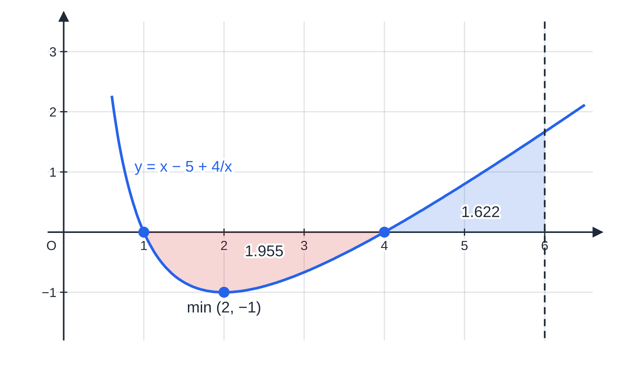
How do you find areas with these functions? (continued)
Section 6 of 11 · Worked example 8 · Hard · Find, show that
WORKED EXAMPLE · QUESTION
The curve C has equation y = x - 5 + 4/x, x > 0. (a) Find the x-coordinates of the points where C crosses the x-axis. (b) Show that the area of the finite region bounded by C and the x-axis is (15/2) - 8ln 2. (c) Find, in the form p + qln 2 + rln 3, the total area of the regions between C, the x-axis and the lines x = 1 and x = 6.
SOLUTION
(a) Multiply by x (allowed, since x > 0): x² - 5x + 4 = 0 ⇒(x-1)(x-4) = 0. x = 1 and x = 4
(b) ∫₁⁴(x - 5 + 4/x)dx = [x²/2 - 5x + 4ln x]₁⁴.
C crosses the x-axis at x = 1 and x = 4 and has its minimum at (2, −1). The red region (below the axis) has area 1.955 and the blue region (from 4 to 6) has area 1.622; the total area is their sum, 3.58.
Notes:
How do you find areas with these functions?: Worked example 8. Full notes: https://examinerprep.com/notes/edexcel-ial-maths/integration-of-standard-functions/

Slide 30
How do you find areas with these functions? (continued)
Section 6 of 11 · Worked example 8 · Hard · Find, show that (continued)
With ln 4 = 2ln 2: (8 - 20 + 8ln 2) - (½ - 5) = -(15/2) + 8ln 2, which is negative because the region is below the axis. The area is its size. (15/2) - 8ln 2 (≈ 1.955)
(c) Between 4 and 6 the curve is above the axis: [x²/2 - 5x + 4ln x]₄⁶ = (18 - 30 + 4ln 6) - (8 - 20 + 4ln 4) = 4ln(6/4) = 4ln 3 - 4ln 2 (≈ 1.622). Add the two sizes: (15/2) - 8ln 2 + 4ln 3 - 4ln 2. (15/2) - 12ln 2 + 4ln 3 (≈ 3.58)
Integrating straight from 1 to 6 gives 4ln 6 - (15/2) ≈-0.333: the parts below and above the axis have partly cancelled. That is not an area.
Notes:
How do you find areas with these functions?: Worked example 8. Full notes: https://examinerprep.com/notes/edexcel-ial-maths/integration-of-standard-functions/

Slide 31
How do you find areas with these functions? (continued)
Section 6 of 11
Using your calculator
Many scientific calculators can evaluate a definite integral numerically. Use it to check an exact answer: 3ln 3 ≈3.30 should match ∫₁⁴ 6/(2x+1) dx.
Set radian mode before any trigonometric integral; in degree mode the check will disagree.
A numerical value never replaces the working when a question asks for an exact answer or says "show that".
Common error
Integrating straight across a root. If the curve crosses the axis between the limits, a single definite integral gives the area above minus the area below. Sketch or test the sign first, then split the integral at each root.
Notes:
How do you find areas with these functions?. Full notes: https://examinerprep.com/notes/edexcel-ial-maths/integration-of-standard-functions/

Slide 32
Exam tips for P3.7
Section 7 of 11
Exam tip 3 — differentiate to check
Every result on this page can be checked in a few seconds by differentiating your answer. The factor 1/a, the sign of a cosine and the constant in an f′fⁿ integral are the usual slips, and differentiation catches all three.
Exam tip 4 — name the pattern
Before integrating, ask in order: is it a standard function? A function of ax+b? Is the top the derivative of the bottom? Is a power multiplied by the derivative of its inside? Is it a trigonometric square that needs an identity? Write the rewritten form down before you integrate.
Notes:
Exam tips for P3.7. Full notes: https://examinerprep.com/notes/edexcel-ial-maths/integration-of-standard-functions/

Slide 33
Exam tips for P3.7 (continued)
Section 7 of 11
Exam tip 5 — radians and exact values
Calculus with trigonometric functions only works in radians. Keep π in limits, use exact values such as sin π/3 = √3/2, and combine logarithms with the laws of logs for exact answers.
Exam tip 6 — modulus signs
Write ln|f(x)| unless you know f(x) > 0 on the interval. With limits, both must lie where the denominator has the same sign: ∫1/(2x-1) dx cannot be evaluated across x = ½.
Exam tip 7 — areas need a sign check
For an area, find the roots in the interval first. A negative definite integral is a perfectly good integral but never a final area: report its size, and add separate pieces.
Notes:
Exam tips for P3.7. Full notes: https://examinerprep.com/notes/edexcel-ial-maths/integration-of-standard-functions/

Slide 34
Common misconceptions
Section 8 of 11
Misconception | Why it is wrong | Correct idea
∫sin x dx = cos x + c. | d/dx(cos x) = -sin x, so the sign is wrong. | ∫sin x dx = -cos x + c.
∫e³ˣ dx = 3e³ˣ + c. | That is the derivative: it multiplies by a. | Integrating divides by a: ⅓ e³ˣ + c.
∫1/(5x+2) dx = ln|5x+2| + c. | Differentiating gives 5/(5x+2). | ⅕ln|5x+2| + c.
Any fraction integrates to a logarithm. | Only if the top is a multiple of the derivative of the bottom. | Differentiate the denominator and compare before writing ln.
∫cos² x dx = (cos³ x)/3 + c. | cos x is not the variable; the chain rule factor is missing. | Use cos² x = ½(1+cos 2x) first.
A definite integral always gives the area. | Parts below the axis count as negative. | Split at the roots and add the sizes.
Notes:
Common misconceptions. Full notes: https://examinerprep.com/notes/edexcel-ial-maths/integration-of-standard-functions/

Slide 35
How this topic connects
Section 9 of 11
P3 Differentiation
Every result here is a P3 derivative reversed: the derivatives of eˣ, ln x, sin x and cos x, the chain rule (for f(ax+b), f′/f and f′fⁿ), and the double-angle and Pythagorean identities from P3 trigonometry.
P1 and P2 Integration
The power rule and the constant of integration come from P1; definite integrals, areas and the trapezium rule from P2. This page widens the set of functions you can apply them to.
P4.6 Integration and beyond
Integration by substitution generalises the f′/f and f′fⁿ patterns; integration by parts, partial fractions (P4.1, which often end in ln terms), volumes of revolution and separable differential equations all rely on these standard results. In mechanics, a velocity such as v = 4e^(-0.5t) or 3sin 2t is integrated to give displacement, and in IAL Physics exponential decay and simple harmonic motion lead to the same integrals.
Notes:
How this topic connects. Full notes: https://examinerprep.com/notes/edexcel-ial-maths/integration-of-standard-functions/

Slide 36
Key formulae
Section 10 of 11
Formula | Use | In the formulae list?
∫eˣ dx = eˣ + c; ∫1/x dx = ln|x| + c | exponential and reciprocal | No — learn it
∫sin x dx = -cos x + c; ∫cos x dx = sin x + c | sine and cosine (x in radians) | No — learn it
∫sec² kx dx = 1/ktan kx + c | secant squared | Yes
∫tan kx dx = 1/kln|sec kx| + c; ∫cot x dx = ln|sin x| + c | tangent and cotangent | Yes
∫f(ax+b) dx = 1/a F(ax+b) + c | linear inside function, e.g. (ax+b)ⁿ, 1/(ax+b), eᵃˣ⁺ᵇ | No — derive it (reverse chain rule)
∫f′(x)/f(x) dx = ln|f(x)| + c | numerator is the derivative of the denominator | No — learn it
∫f′(x)[f(x)]ⁿ dx = [f(x)]ⁿ⁺¹/(n+1) + c | power of a function times its derivative | No — derive it (reverse chain rule)
Notes:
Key formulae. Full notes: https://examinerprep.com/notes/edexcel-ial-maths/integration-of-standard-functions/

Slide 37
Key formulae (continued)
Section 10 of 11
Formula | Use | In the formulae list?
sin² x = ½(1-cos 2x); cos² x = ½(1+cos 2x) | integrating sin² x and cos² x | No — learn it (from cos 2x)
tan² x = sec² x - 1 | integrating tan² x | No — learn it
∫ₐᵇ f(x) dx = F(b) - F(a) | definite integrals and areas | No — learn it
Notes:
Key formulae. Full notes: https://examinerprep.com/notes/edexcel-ial-maths/integration-of-standard-functions/

Slide 38
Check your understanding
Section 11 of 11
1. Find ∫e^(-x/2) dx.
2. Find the exact value of ∫₂⁶ 1/x dx.
3. Find ∫3x²/(x³+1) dx.
4. Explain why ∫sin² x dx is not (sin³ x)/3 + c, and find it.
5. Find ∫cos xsin⁴ x dx.
6. Find the exact area under y = tan x between x = 0 and x = π/3.
Notes:
Check your understanding: questions. Full notes: https://examinerprep.com/notes/edexcel-ial-maths/integration-of-standard-functions/

Slide 39
Check your understanding · answers
Section 11 of 11
1. Here a = -½, so divide by -½, i.e. multiply by -2: -2e^(-x/2) + c.
2. ln 6 - ln 2 = ln(6/2) = ln 3.
3. The numerator is the derivative of the denominator, so the integral is ln|x³+1| + c.
4. Differentiating (sin³ x)/3 gives sin² xcos x, not sin² x. Use sin² x = ½(1-cos 2x): ∫sin² x dx = x/2 - sin 2x/4 + c.
5. cos x is the derivative of sin x, so this is f′f⁴: (sin⁵ x)/5 + c.
6. tan x > 0 on this interval, so the area is [ln|sec x|]₀^(π/3) = ln 2 - ln 1 = ln 2 (≈ 0.693), because sec π/3 = 1/(cos(π/3)) = 2.
Notes:
Check your understanding: answers. Full notes: https://examinerprep.com/notes/edexcel-ial-maths/integration-of-standard-functions/

Slide 40
Practice questions
2 original exam-style questions. Answers at the end of the deck.

Slide 41
Question 1
6 marks
This question is about integrals of exponential functions.
(a) Find the exact value of ∫₀ˡⁿ³ e²ˣ dx. [3]
(b) Expand (eˣ + e⁻ˣ)² and hence find ∫(eˣ + e⁻ˣ)² dx. [3]
Notes:
Online with the full mark scheme: https://examinerprep.com/ial-maths-p3-7-integration-of-standard-functions-questions#IALM-P3-7-B-03

Slide 42
Question 2
7 marks
Squared trigonometric functions can be integrated after rewriting them with an identity.
(a) Using the identity cos 2A ≡ 1 − 2 sin²A, show that sin²3x ≡ ½(1 − cos 6x). [1]
(b) Hence find ∫sin²3x dx. [3]
(c) Find the exact value of ∫₀^(π/4) tan²x dx. [3]
Notes:
Online with the full mark scheme: https://examinerprep.com/ial-maths-p3-7-integration-of-standard-functions-questions#IALM-P3-7-B-05

Slide 43
Answers

Slide 44
Question 1 · answer
Mark scheme
[½e²ˣ]
uses e²ˡⁿ³ = 9: ½(9 − 1)
4
e²ˣ + 2 + e⁻²ˣ
integrates an exponential term with factor ½ or −½
½e²ˣ + 2x − ½e⁻²ˣ + c
Notes:
Full mark scheme: https://examinerprep.com/ial-maths-p3-7-integration-of-standard-functions-questions#IALM-P3-7-B-03

Slide 45
Question 2 · answer
Mark scheme
with A = 3x: cos 6x = 1 − 2 sin²3x, rearranged to sin²3x = ½(1 − cos 6x)
½x
k sin 6x
½x − (1/12) sin 6x + c
uses tan²x = sec²x − 1
[tan x − x]
1 − π/4
Notes:
Full mark scheme: https://examinerprep.com/ial-maths-p3-7-integration-of-standard-functions-questions#IALM-P3-7-B-05

Slide 46
Keep practising
Notes for this topic
Questions on this topic
Build a printable test
ExaminerPrep is an independent tutoring service. It has been developed independently from and is not endorsed by the International Baccalaureate Organization. "International Baccalaureate", "IB" and "IB Diploma Programme" are registered trademarks of the IBO, used here for descriptive purposes only.
Pearson Edexcel and Cambridge are trademarks of their owners; ExaminerPrep is not affiliated with any exam board.

