Slide 1
EP
EDEXCEL IAL MATHS
P1.7 Integration
The full notes page in 11 sections · practice questions with answers · simulations
ExaminerPrep is an independent tutoring service. It has been developed independently from and is not endorsed by the International Baccalaureate Organization. "International Baccalaureate", "IB" and "IB Diploma Programme" are registered trademarks of the IBO, used here for descriptive purposes only.
Pearson Edexcel and Cambridge are trademarks of their owners; ExaminerPrep is not affiliated with any exam board.
Notes:
P1.7 Integration. Notes for this topic: https://examinerprep.com/notes/edexcel-ial-maths/integration/

Slide 2
What this page covers
Overview
Integration as the reverse process of differentiation
Why every indefinite integral needs a constant of integration, and what the family of curves looks like
Integrating xⁿ for any rational n ≠-1, including a constant
Constant multiples, sums and differences, and why products must be expanded first
Rewriting roots and fractions as powers of x before integrating
Finding the equation y = f(x) of a curve from f′(x) and one point on the curve
Longer questions that combine integration with tangents and points of zero gradient
Notes:
What this page covers. Full notes: https://examinerprep.com/notes/edexcel-ial-maths/integration/

Slide 3
In one minute
Key points
1
Integration undoes differentiation: if dy/dx = f′(x), then y = ∫f′(x) dx, and the answer always carries a constant of integration + c.
4
Powers first: expand brackets and split fractions; write √x = x^½ and 1/x² = x⁻². Never integrate a product or a quotient piece by piece.
2
Power rule: raise the power by one, then divide by the new power. ∫xⁿ dx = xⁿ⁺¹/(n+1) + c for n ≠-1.
5
A point fixes c: integrate, substitute the coordinates of a known point, solve for c, and write the equation in full.
3
Constants vanish when you differentiate, so an indefinite integral is a whole family of curves, one for each value of c.
6
Definite integrals and areas are in P2; ∫x⁻¹ dx, exponentials and trigonometric functions are in P3.
Notes:
In one minute: the key points of this topic.

Slide 4
What does integration undo?
Section 1 of 11
In P1.6 you learned to start with a curve and find its gradient function. Integration runs the same machine backwards: you are given the gradient function and asked which curve it came from. That is useful whenever a rate of change is easier to know than the quantity itself, which is why integration appears later in kinematics, areas, volumes and differential equations.
Integration
is the reverse process of differentiation. If F′(x) = f(x), then F is an integral (an antiderivative) of f, and we write
∫f(x) dx = F(x) + c.
The ∫ sign and the dx belong together: dx says that x is the variable you are integrating with respect to. An integral with no limits, such as ∫3x² dx = x³ + c, is an
indefinite integral.
Notes:
What does integration undo?. Full notes: https://examinerprep.com/notes/edexcel-ial-maths/integration/

Slide 5
What does integration undo? (continued)
Section 1 of 11
Why the + c? Differentiate x³ + 7 and you get 3x². Differentiate x³ - 2 and you also get 3x². Any constant disappears when you differentiate, because a constant has zero gradient. So when you reverse the process, there is no way to know which constant was there. You record that uncertainty by writing + c, the constant of integration.
Geometrically, adding a constant moves a graph up or down without changing its shape. Every member of the family has exactly the same gradient at each value of x, so the gradient function cannot tell them apart. The figure shows four members of the family ∫(2x - 2) dx = x² - 2x + c.
Notes:
What does integration undo?. Full notes: https://examinerprep.com/notes/edexcel-ial-maths/integration/

Slide 6
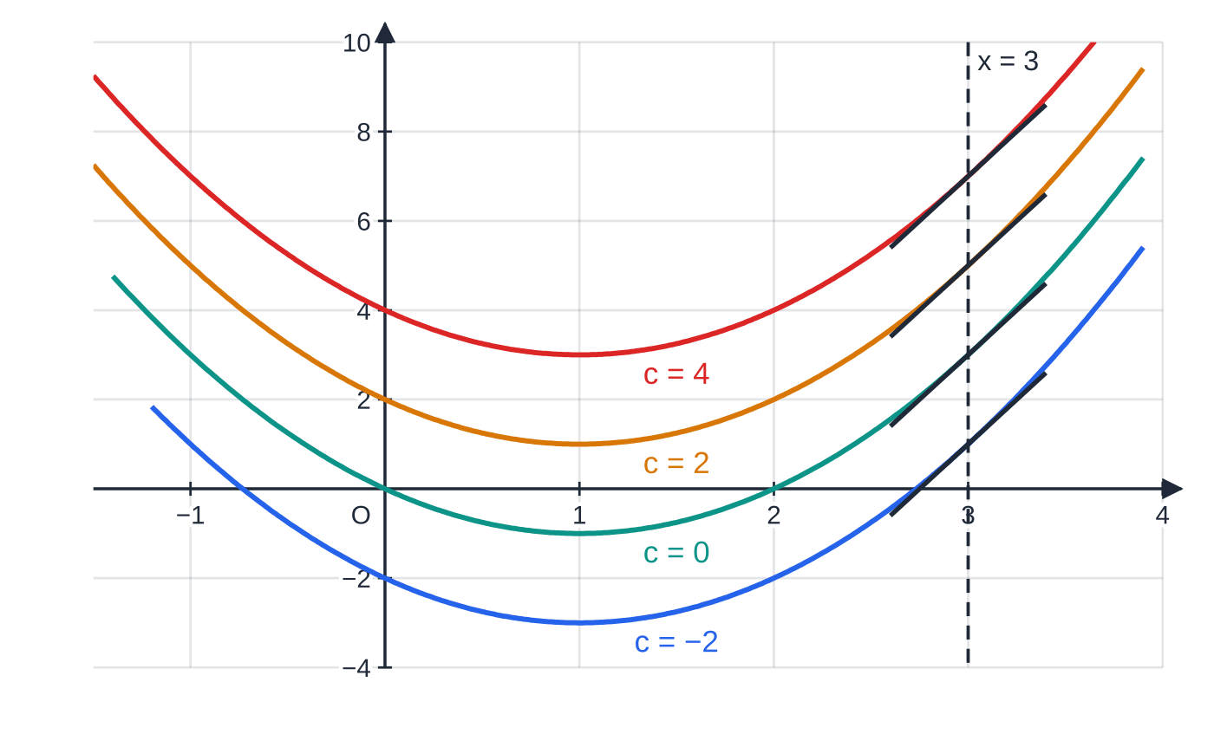
What does integration undo? (continued)
Section 1 of 11
Common error
Leaving out + c. Without it you have found only one curve of the family, and the next part of the question, which usually asks for the curve through a given point, becomes impossible.
Four members of y = x² − 2x + c. Every one has gradient function 2x − 2, so at x = 3 all four tangents (black) have gradient 4 and are parallel. The curves are vertical translations of one another.
Notes:
What does integration undo?. Full notes: https://examinerprep.com/notes/edexcel-ial-maths/integration/

Slide 7
How do you integrate a power of x?
Section 2 of 11
Start from what you know about differentiation. Differentiating xⁿ⁺¹ gives (n+1)xⁿ. That is almost xⁿ; it is just n+1 times too big. So differentiate xⁿ⁺¹/(n+1) instead and you get exactly xⁿ. Reversing this gives the rule.
Integrating a power of x
∫xⁿ dx = xⁿ⁺¹/(n+1) + c, n ≠-1
n can be any rational number (positive, negative or a fraction) except -1; c is the constant of integration.
For a constant: ∫a dx = ax + c. This is the case n = 0, since a = ax⁰.
In the formulae list? No — learn it: you will use it in almost every question.
In words: add one to the power, then divide by the new power. The order matters, because the division uses the new power, not the old one. For n = -1 the new power would be 0 and you would divide by zero, so the rule breaks down; ∫x⁻¹ dx needs the natural logarithm, which is in P3.
Notes:
How do you integrate a power of x?. Full notes: https://examinerprep.com/notes/edexcel-ial-maths/integration/

Slide 8
How do you integrate a power of x? (continued)
Section 2 of 11
Integrand | As a power | New power | Integral
x³ | x³ | 4 | ¼ x⁴ + c
√x | x^½ | (3/2) | x^(3/2) ÷(3/2) = ⅔ x^(3/2) + c
1/x² | x⁻² | -1 | x⁻¹ ÷(-1) = -1/x + c
1/√x | x^(-½) | ½ | x^½ ÷½ = 2√x + c
7 | 7x⁰ | 1 | 7x + c
Notice how negative powers behave. For x⁻², "add one" means -2 + 1 = -1, so the power moves towards zero, and the division by -1 changes the sign. Students often write x⁻³ here because they subtract out of habit from differentiation. A quick derivative check catches it.
Notes:
How do you integrate a power of x?. Full notes: https://examinerprep.com/notes/edexcel-ial-maths/integration/

Slide 9
How do you integrate a power of x? (continued)
Section 2 of 11 · Worked example 1 · Easy · Find
WORKED EXAMPLE · QUESTION
Find ∫(8x³ - 6x² + 5) dx.
SOLUTION
Integrate term by term, raising each power by one and dividing by the new power:
8 ×x⁴/4 - 6 ×x³/3 + 5x
Simplify and add the constant: 2x⁴ - 2x³ + 5x + c
Check by differentiating: 8x³ - 6x² + 5. ✓
Notes:
How do you integrate a power of x?: Worked example 1. Full notes: https://examinerprep.com/notes/edexcel-ial-maths/integration/

Slide 10
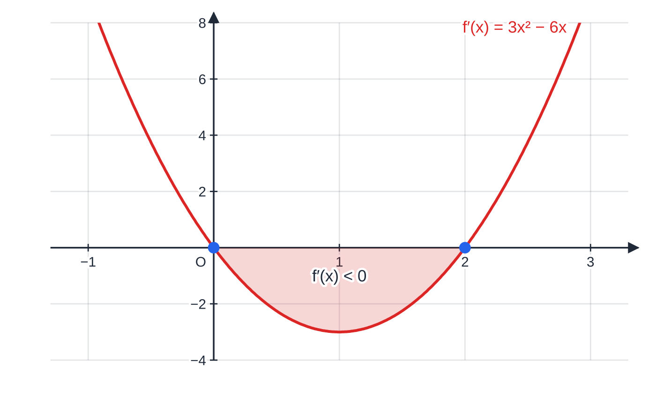
How do you integrate a power of x? (continued)
Section 2 of 11
It helps to see a gradient function and one of its integrals side by side. The first graph below is f′(x) = 3x² - 6x. Integrating gives f(x) = x³ - 3x² + c; the second graph shows the member with c = 4. Read them together: where f′(x) is positive the curve rises, where f′(x) is negative it falls, and where f′(x) = 0 the curve has a stationary point.
The gradient function f′(x) = 3x² − 6x is zero at x = 0 and x = 2 and negative between them (shaded).
Notes:
How do you integrate a power of x?. Full notes: https://examinerprep.com/notes/edexcel-ial-maths/integration/

Slide 11
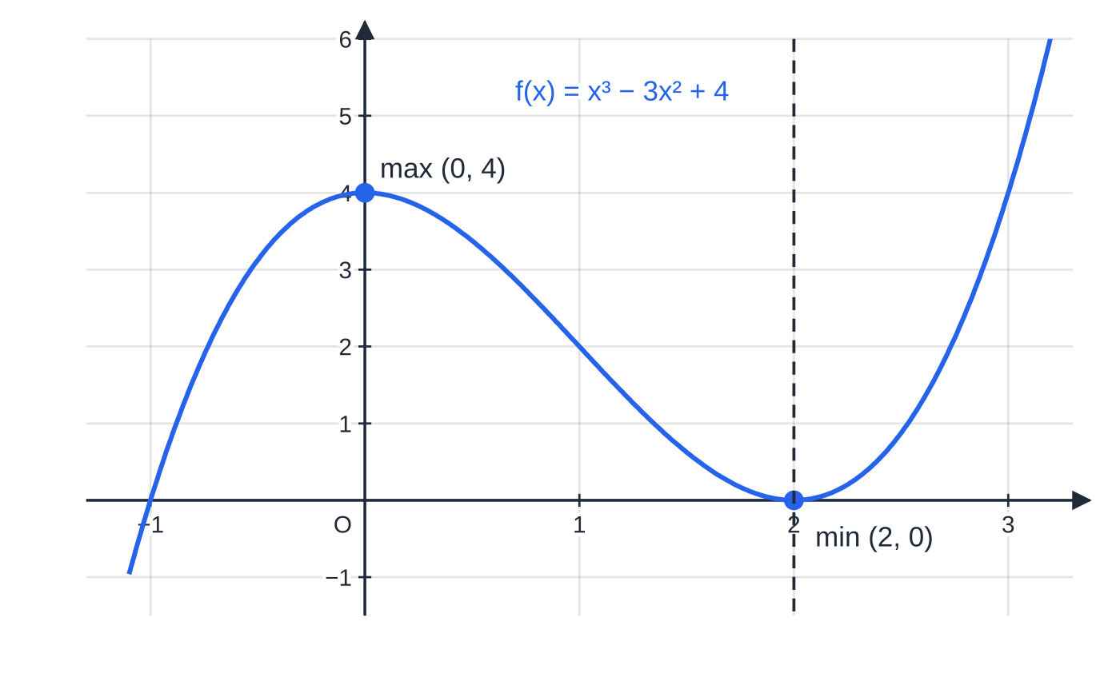
How do you integrate a power of x? (continued)
Section 2 of 11
Exam tip
Differentiate your answer in your head before moving on. It takes seconds and catches the two classic slips: multiplying by the new power instead of dividing, and lowering the power instead of raising it.
One integral of that gradient function, f(x) = x³ − 3x² + 4, on the same x-scale. The stationary points sit exactly where f′(x) = 0, and the curve falls on 0 < x < 2, where f′(x) is negative.
Notes:
How do you integrate a power of x?. Full notes: https://examinerprep.com/notes/edexcel-ial-maths/integration/

Slide 12
How do you integrate sums, multiples and brackets?
Section 3 of 11
Differentiation is linear: a constant multiple stays in front, and a sum is differentiated term by term. Integration inherits exactly the same two properties, because it is the reverse process.
Constant multiples come outside: ∫k f(x) dx = k∫f(x) dx.
Sums and differences are integrated term by term: ∫(f(x) ±g(x)) dx = ∫f(x) dx ±∫g(x) dx. One + c at the end covers all the terms, because several unknown constants added together are still just one unknown constant.
Products are different. There is no rule that ∫fg dx = ∫f dx ×∫g dx. Multiply out the brackets first, so that you have a sum of powers.
Notes:
How do you integrate sums, multiples and brackets?. Full notes: https://examinerprep.com/notes/edexcel-ial-maths/integration/

Slide 13
How do you integrate sums, multiples and brackets? (continued)
Section 3 of 11 · Worked example 2 · Medium · Find
WORKED EXAMPLE · QUESTION
Find ∫(x - 3)(2x + 1) dx, giving each coefficient as an exact fraction or integer.
SOLUTION
Step 1. Multiply out the brackets: (x-3)(2x+1) = 2x² + x - 6x - 3 = 2x² - 5x - 3.
Step 2. Integrate term by term: 2 ×x³/3 - 5 ×x²/2 - 3x + c.
Step 3. Simplify: ⅔ x³ - (5/2) x² - 3x + c
Integrating each bracket separately and multiplying, (½ x² - 3x)(x² + x), gives a quartic, and differentiating it does not give back the integrand.
Notes:
How do you integrate sums, multiples and brackets?: Worked example 2. Full notes: https://examinerprep.com/notes/edexcel-ial-maths/integration/

Slide 14
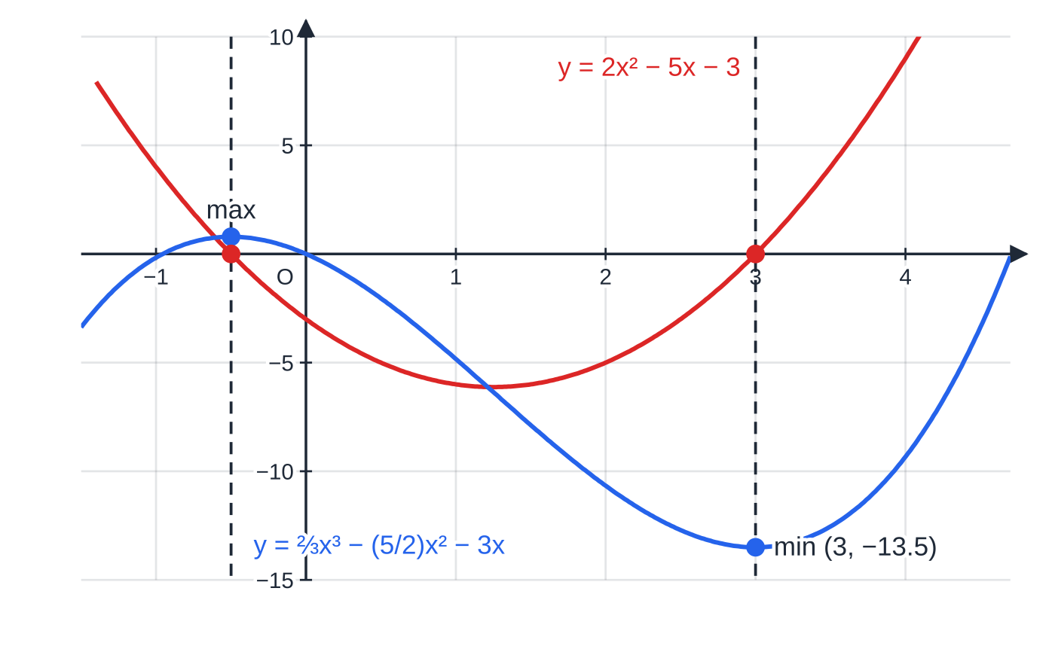
How do you integrate sums, multiples and brackets? (continued)
Section 3 of 11
The graph below shows the integrand from Worked example 2 and the integral with c = 0. The integrand is the gradient of the integral, so the integral has its turning points exactly where the integrand crosses the x-axis, at x = -½ and x = 3.
A constant on its own is a common source of slips. When you differentiate, a constant disappears; when you integrate, it does the opposite and gains an x. The gradient function y = 5 is a horizontal line, and the curves with that gradient everywhere are the straight lines y = 5x + c.
Red: the integrand 2x² − 5x − 3 = (x − 3)(2x + 1). Blue: its integral with c = 0. The blue curve turns where the red one crosses zero (x = −½ and x = 3) and falls where the red one is negative.
Notes:
How do you integrate sums, multiples and brackets?. Full notes: https://examinerprep.com/notes/edexcel-ial-maths/integration/

Slide 15
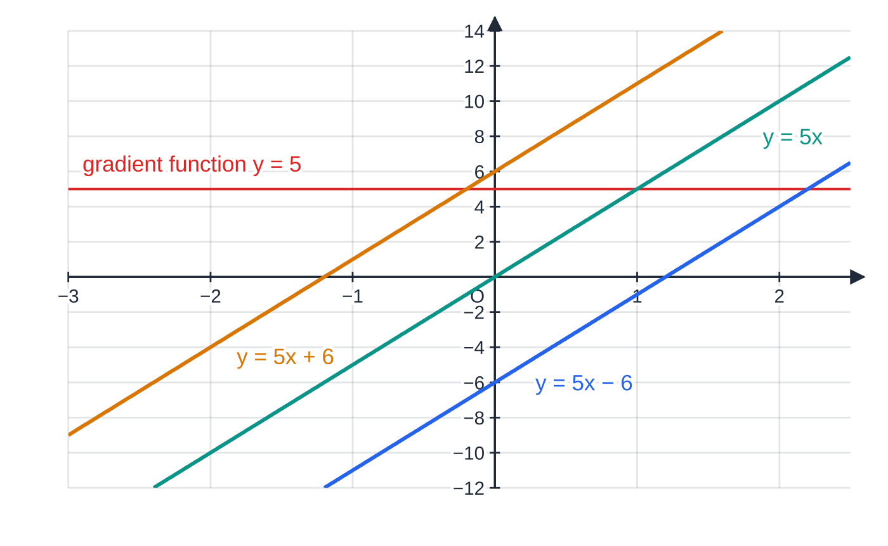
How do you integrate sums, multiples and brackets? (continued)
Section 3 of 11
Common error
Treating a constant as if it vanishes when integrating, as it does when differentiating. ∫5 dx = 5x + c, not 0 and not 5.
∫5 dx = 5x + c: every line of gradient 5 has the constant gradient function y = 5. The integral of a constant is a straight line, not zero.
Notes:
How do you integrate sums, multiples and brackets?. Full notes: https://examinerprep.com/notes/edexcel-ial-maths/integration/

Slide 16
How do you integrate roots and fractions?
Section 4 of 11
The power rule only accepts terms of the form axⁿ. So every root and every fraction must be rewritten using the laws of indices from P1.1 before any integrating happens. This rewriting line is where most of the real work in this topic lies.
√x = x^½, ∛x = x^⅓, x√x = x^(3/2).
1/xⁿ = x⁻ⁿ, 1/√x = x^(-½), 4/x³ = 4x⁻³ (the 4 stays in front: it is not part of the denominator's power).
A fraction with a sum on top and a single term underneath splits: (x² - 5)/2√x = x²/2x^½ - 5/2x^½.
Dividing by a fractional power is multiplying by its reciprocal: x^(3/2) ÷(3/2) = ⅔ x^(3/2). Dividing by ½ doubles.
A fraction with a single term on top and a sum underneath, such as 1/(x+1), cannot be split this way. Such integrals are not part of P1.
Notes:
How do you integrate roots and fractions?. Full notes: https://examinerprep.com/notes/edexcel-ial-maths/integration/

Slide 17
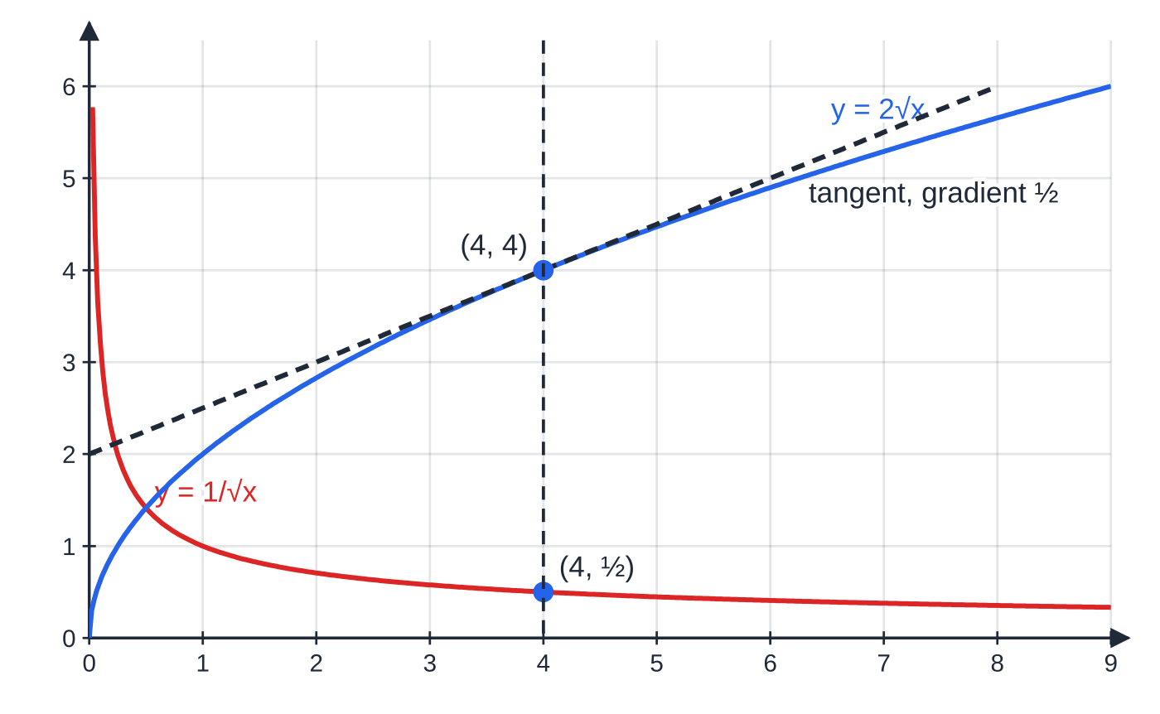
How do you integrate roots and fractions? (continued)
Section 4 of 11
The gradient function 1/√x and its integral 2√x (with c = 0), for x > 0. At x = 4 the curve y = 2√x is at height 4 and its tangent has gradient ½, exactly the height of the gradient curve at x = 4. The gradient function is undefined at x = 0, where y = 2√x has a vertical tangent.
Notes:
How do you integrate roots and fractions?. Full notes: https://examinerprep.com/notes/edexcel-ial-maths/integration/

Slide 18
How do you integrate roots and fractions? (continued)
Section 4 of 11 · Worked example 3 · Medium · Find
WORKED EXAMPLE · QUESTION
Find ∫(6√x + 4/x³)dx, x > 0, simplifying your answer.
SOLUTION
Step 1. Write each term as a power of x: 6x^½ + 4x⁻³.
Step 2. Raise each power by one and divide by the new power: 6 ×x^(3/2) ÷(3/2) + 4 ×x⁻² ÷(-2).
Step 3. Simplify (6 ÷(3/2) = 4 and 4 ÷(-2) = -2): 4x^(3/2) - 2x⁻² + c, which can also be written 4x√x - 2/x² + c.
Notes:
How do you integrate roots and fractions?: Worked example 3. Full notes: https://examinerprep.com/notes/edexcel-ial-maths/integration/

Slide 19
How do you integrate roots and fractions? (continued)
Section 4 of 11 · Worked example 4 · Medium · Hence
WORKED EXAMPLE · QUESTION
(a) Write (x² - 5)/2√x in the form Axᵖ + Bx^q, where A, B, p and q are constants. (b) Hence find ∫(x² - 5)/2√x dx.
SOLUTION
(a) Split the fraction and use the index laws, x² ÷x^½ = x^(3/2):
x²/2x^½ - 5/2x^½ = ½ x^(3/2) - (5/2) x^(-½), so A = ½, p = (3/2), B = -(5/2), q = -½.
(b) Integrate each term: ½ ×x^(5/2) ÷(5/2) - (5/2) ×x^½ ÷½.
Simplify: ⅕ x^(5/2) - 5x^½ + c
"Hence" means use part (a): you are expected to integrate the rewritten form, not the original fraction.
Notes:
How do you integrate roots and fractions?: Worked example 4. Full notes: https://examinerprep.com/notes/edexcel-ial-maths/integration/

Slide 20
How do you integrate roots and fractions? (continued)
Section 4 of 11
Common error
Integrating the top and the bottom of a fraction separately. (x² - 5)/2√x does not integrate to (x³/3 - 5x) ÷((4/3) x^(3/2)). Split the fraction into separate powers of x first.
Notes:
How do you integrate roots and fractions?. Full notes: https://examinerprep.com/notes/edexcel-ial-maths/integration/

Slide 21
How do you find a curve from its gradient function?
Section 5 of 11
Integrating f′(x) gives the whole family f(x) + c. To pick out one particular curve you need one more piece of information, and in P1 that is almost always a point the curve passes through. Substituting its coordinates turns the equation into a single equation in c.
Method: the curve through a point
1. Integrate f′(x), including + c.
2. Substitute the coordinates (x₁, y₁) of the given point and solve for c.
3. Write the final answer in full, y = … or f(x) = …, with the value of c in place.
Notes:
How do you find a curve from its gradient function?. Full notes: https://examinerprep.com/notes/edexcel-ial-maths/integration/

Slide 22
How do you find a curve from its gradient function? (continued)
Section 5 of 11 · Worked example 5 · Medium · Find
WORKED EXAMPLE · QUESTION
A curve has equation y = f(x), where f′(x) = 6x² - 2x - 3. The curve passes through the point (2, 7). Find f(x).
SOLUTION
Step 1. Integrate: f(x) = 2x³ - x² - 3x + c.
Step 2. Use the point: when x = 2, y = 7, so 7 = 2(8) - 4 - 6 + c = 6 + c, giving c = 1.
Step 3. State the function: f(x) = 2x³ - x² - 3x + 1
Notes:
How do you find a curve from its gradient function?: Worked example 5. Full notes: https://examinerprep.com/notes/edexcel-ial-maths/integration/

Slide 23
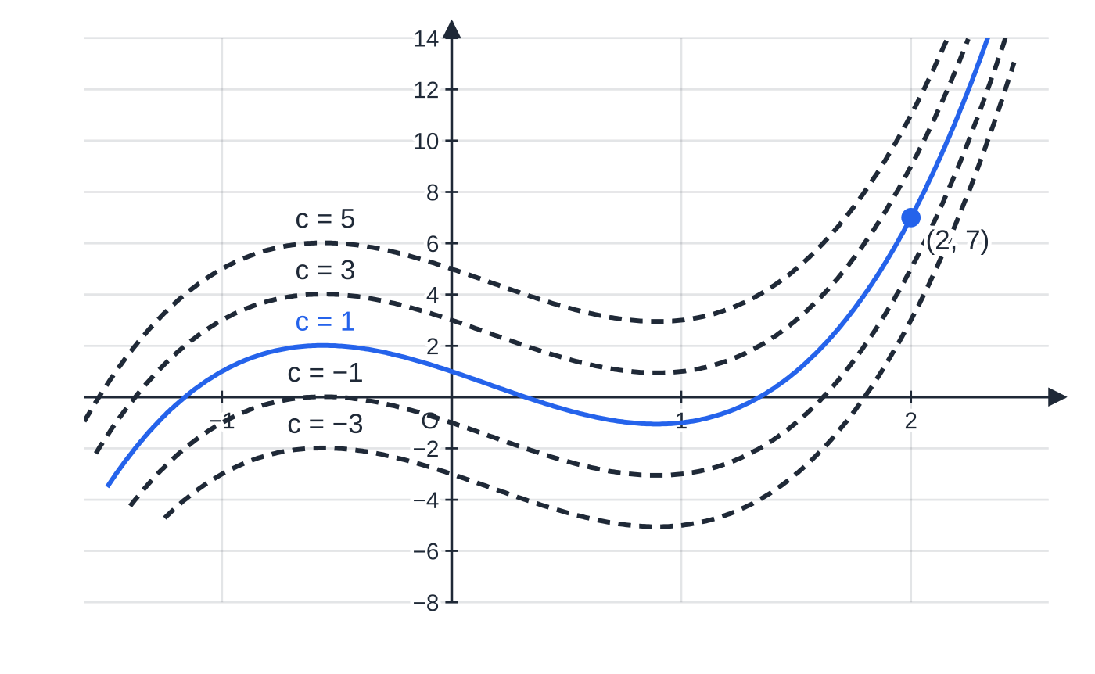
How do you find a curve from its gradient function? (continued)
Section 5 of 11
Look at how the point does its job. All five curves have the same shape and the same turning points' x-coordinates; they differ only in height. The point (2, 7) fixes the height, and with it the curve.
Exam tip
The constant is not always the y-intercept. It equals f(0) only when every other term is zero at x = 0; with terms such as 12/x the curve may not even meet the y-axis. Always find c by substituting the point you are given.
Five members of the family y = 2x³ − x² − 3x + c (c = −3, −1, 1, 3, 5). Each has gradient function 6x² − 2x − 3, but only c = 1 (blue) passes through (2, 7).
Notes:
How do you find a curve from its gradient function?. Full notes: https://examinerprep.com/notes/edexcel-ial-maths/integration/

Slide 24
How do longer integration questions fit together?
Section 6 of 11
Exam-length questions join this topic to differentiation. A typical structure is: find the curve by integrating, then use the gradient function again for a tangent, a normal or a point where the gradient is zero. Two habits keep these questions clean.
Keep f′(x). It is given in the question, so you do not need to differentiate your answer to find a gradient. Use the given expression directly.
Keep exact values (fractions, surds) until the last line. The form usually asked for, such as ax + by + d = 0 with integers, needs them.
Notes:
How do longer integration questions fit together?. Full notes: https://examinerprep.com/notes/edexcel-ial-maths/integration/

Slide 25
How do longer integration questions fit together? (continued)
Section 6 of 11 · Worked example 6 · Hard · Find
WORKED EXAMPLE · QUESTION
The curve C has equation y = f(x), x > 0, and dy/dx = 3√x - 12/x². The point P(4, 9) lies on C.
(a) Find the equation of C. (b) Find the equation of the tangent to C at P, giving your answer in the form ax + by + d = 0, where a, b and d are integers.
SOLUTION
(a) Powers first: dy/dx = 3x^½ - 12x⁻².
Integrate: y = 3 ×x^(3/2) ÷(3/2) - 12 ×x⁻¹ ÷(-1) + c = 2x^(3/2) + 12/x + c.
Use P(4, 9), with 4^(3/2) = 8: 9 = 16 + 3 + c, so c = -10. y = 2x^(3/2) + 12/x - 10
(b) Gradient at P from the given dy/dx: 3√4 - (12/16) = 6 - ¾ = (21/4).
Tangent through (4, 9): y - 9 = (21/4)(x - 4), so 4y - 36 = 21x - 84, giving 21x - 4y - 48 = 0.
Notes:
How do longer integration questions fit together?: Worked example 6. Full notes: https://examinerprep.com/notes/edexcel-ial-maths/integration/

Slide 26
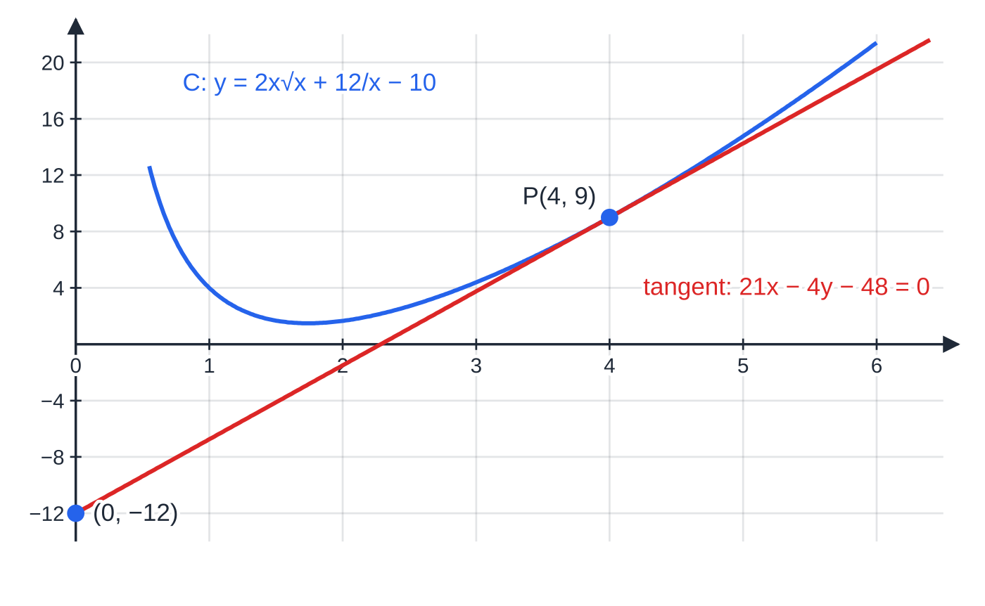
How do longer integration questions fit together? (continued)
Section 6 of 11
The curve C and its tangent at P(4, 9), gradient 21/4. The tangent meets the y-axis at (0, −12). This is not the constant of integration, which is −10.
Notes:
How do longer integration questions fit together?. Full notes: https://examinerprep.com/notes/edexcel-ial-maths/integration/

Slide 27
How do longer integration questions fit together? (continued)
Section 6 of 11 · Worked example 7 · Hard · Find
WORKED EXAMPLE · QUESTION
The curve y = f(x) has f′(x) = 3x² + kx - 9, where k is a constant. The gradient of the curve is zero where x = 3, and the curve passes through the point (2, -18).
(a) Find the value of k. (b) Find f(x). (c) Find the coordinates of the other point on the curve where the gradient is zero.
SOLUTION
(a) Zero gradient at x = 3 means f′(3) = 0: 27 + 3k - 9 = 0, so k = -6.
(b) Integrate f′(x) = 3x² - 6x - 9: f(x) = x³ - 3x² - 9x + c.
Use (2, -18): -18 = 8 - 12 - 18 + c = -22 + c, so c = 4. f(x) = x³ - 3x² - 9x + 4
(c) Solve f′(x) = 0: 3(x² - 2x - 3) = 3(x - 3)(x + 1) = 0, so the other value is x = -1. Then f(-1) = -1 - 3 + 9 + 4 = 9, giving (-1, 9).
Notes:
How do longer integration questions fit together?: Worked example 7. Full notes: https://examinerprep.com/notes/edexcel-ial-maths/integration/

Slide 28
How do longer integration questions fit together? (continued)
Section 6 of 11 · Worked example 7 · Hard · Find (continued)
These are the curve's stationary points. Deciding whether each is a maximum or a minimum is covered in P2.
Notes:
How do longer integration questions fit together?: Worked example 7. Full notes: https://examinerprep.com/notes/edexcel-ial-maths/integration/

Slide 29
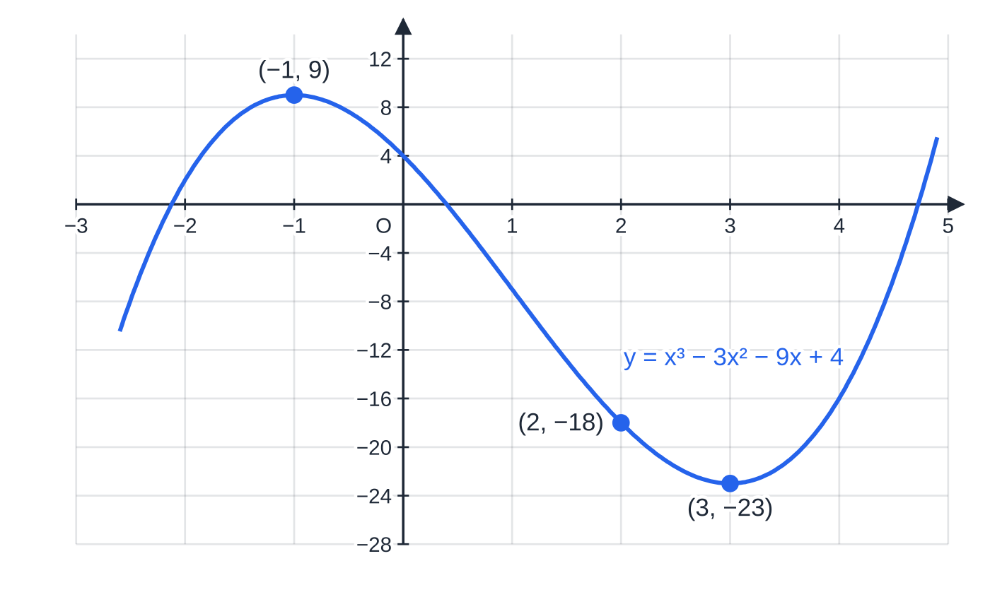
How do longer integration questions fit together? (continued)
Section 6 of 11
Common error
Using the given point in f′(x) instead of f(x). The coordinates (2, -18) lie on the curve, so they satisfy y = f(x); f′(2) is a gradient and has nothing to do with -18.
f(x) = x³ − 3x² − 9x + 4. The given point (2, −18) fixes c; the stationary points are the maximum (−1, 9) and the minimum (3, −23), where f′(x) = 3(x − 3)(x + 1) = 0.
Notes:
How do longer integration questions fit together?. Full notes: https://examinerprep.com/notes/edexcel-ial-maths/integration/

Slide 30
Exam tips for P1.7
Section 7 of 11
Exam tip 1 — every term a power of x
Before you integrate anything, rewrite the whole integrand as a sum of terms axⁿ. Write this line down: it shows your method, and most errors in this topic come from skipping it.
Exam tip 2 — fractional powers
When the new power is a fraction, write the division out: x^(-½) becomes x^½ ÷½ = 2x^½. Dividing by ½ doubles; dividing by (3/2) multiplies by ⅔.
Exam tip 3 — + c, then find c
Every indefinite integral ends with + c. If the question gives a point, finding c is expected, and the final answer is the equation with the number in place, not just "c = 1".
Notes:
Exam tips for P1.7. Full notes: https://examinerprep.com/notes/edexcel-ial-maths/integration/

Slide 31
Exam tips for P1.7 (continued)
Section 7 of 11
Exam tip 4 — answer in the form asked
"Simplify" means combine coefficients (6 ÷(3/2) = 4). "In the form Axᵖ + Bx^q" means state the constants clearly. "ax + by + d = 0 with integers" means clear every fraction.
Exam tip 5 — "hence" and "show that"
"Hence" tells you to use the result you have just found, usually a rewritten integrand. "Show that" gives you the target: every step must be visible, and the final line should match it exactly.
Notes:
Exam tips for P1.7. Full notes: https://examinerprep.com/notes/edexcel-ial-maths/integration/

Slide 32
Common misconceptions
Section 8 of 11
Misconception | Why it is wrong | Correct idea
The constant of integration is optional. | Infinitely many functions have the same derivative. | Always write + c on an indefinite integral.
∫x³ dx = 3x². | That is differentiation: the power went down. | Raise the power and divide: x⁴/4 + c.
A product can be integrated bracket by bracket. | Differentiating the product of the integrals does not give back the product. | Expand first, then integrate term by term.
∫1/x² dx = 1/(x³/3). | The denominator has been integrated as if it were on its own. | Rewrite as x⁻²: the integral is -x⁻¹ + c.
The power rule works for x⁻¹ too. | The new power would be 0, and dividing by 0 is undefined. | ∫x⁻¹ dx involves the natural logarithm (P3).
The constant c is the y-intercept. | Only true when every other term is zero at x = 0. | Find c by substituting the given point.
Notes:
Common misconceptions. Full notes: https://examinerprep.com/notes/edexcel-ial-maths/integration/

Slide 33
How this topic connects
Section 9 of 11
P1.6 Differentiation and P2 stationary points
Integration reverses differentiation, and longer questions use both: integrate to find the curve, then use the gradient function for tangents, normals and points of zero gradient. Stationary points and their nature follow in P2.
P2 Definite integrals and areas
Putting limits on the integral removes the constant and gives the area between a curve and the x-axis; the trapezium rule estimates it when the function cannot be integrated exactly.
P3 and P4 further integration; M2 variable acceleration
∫x⁻¹ dx, exponentials and trigonometric functions come in P3; substitution, integration by parts, volumes of revolution and differential equations in P4. In M2, velocity is the integral of acceleration and displacement the integral of velocity, each with a constant fixed by a known starting value: exactly the "curve through a point" method of this page.
Notes:
How this topic connects. Full notes: https://examinerprep.com/notes/edexcel-ial-maths/integration/

Slide 34
Key formulae
Section 10 of 11
Formula | Use | In the formulae list?
∫xⁿ dx = xⁿ⁺¹/(n+1) + c, n ≠-1 | integrating any power of x except x⁻¹ | No — learn it
∫a dx = ax + c | integrating a constant | No — derive it (the case n = 0)
∫k f(x) dx = k∫f(x) dx; ∫(f ±g) dx = ∫f dx ±∫g dx | constant multiples, sums and differences | No — learn it
√x = x^½, 1/xⁿ = x⁻ⁿ, 1/√x = x^(-½) | rewriting before integrating | No — learn it (laws of indices)
y = ∫f′(x) dx, then substitute (x₁, y₁) | equation of a curve from its gradient and a point | No — derive it
Notes:
Key formulae. Full notes: https://examinerprep.com/notes/edexcel-ial-maths/integration/

Slide 35
Check your understanding
Section 11 of 11
1. Find ∫(5x⁴ + 2) dx.
2. Find ∫3/√x dx, x > 0.
3. Explain why the rule ∫xⁿ dx = xⁿ⁺¹/(n+1) + c cannot be used for 1/x.
4. A curve has gradient function 2x + 4 and passes through (1, 0). Find its equation.
5. Find ∫(x² + 1)/x² dx, x ≠0.
6. The curve y = f(x), x > 0, has f′(x) = 4x - 3/x² and passes through (1, 2). Find f(x).
Notes:
Check your understanding: questions. Full notes: https://examinerprep.com/notes/edexcel-ial-maths/integration/

Slide 36
Check your understanding · answers
Section 11 of 11
1. Raise each power and divide: 5 ×x⁵/5 + 2x. x⁵ + 2x + c. Differentiate to check: 5x⁴ + 2.
2. 3x^(-½) →3 ×x^½ ÷½. 6√x + c.
3. 1/x = x⁻¹, so n + 1 = 0 and the rule would divide by zero. This integral needs the natural logarithm (P3).
4. y = x² + 4x + c; 0 = 1 + 4 + c, so c = -5. y = x² + 4x - 5.
5. Split first: 1 + x⁻². Then integrate: x + x⁻¹ ÷(-1). x - 1/x + c.
6. f′(x) = 4x - 3x⁻², so f(x) = 2x² - 3x⁻¹ ÷(-1) + c = 2x² + 3/x + c. At (1, 2): 2 = 2 + 3 + c, so c = -3. f(x) = 2x² + 3/x - 3.
Notes:
Check your understanding: answers. Full notes: https://examinerprep.com/notes/edexcel-ial-maths/integration/

Slide 37
Practice questions
2 original exam-style questions. Answers at the end of the deck.

Slide 38
Question 1
5 marks
A curve has equation y = f(x). Given that f′(x) = 4x³ − 9x² + 2 and that the curve passes through the point (2, −3),
(a) find an expression for f(x), including a constant of integration c. [3]
(b) find f(x). [2]
Notes:
Online with the full mark scheme: https://examinerprep.com/ial-maths-p1-7-integration-questions#IALM-P1-7-B-02

Slide 39
Question 2
8 marks
The gradient of a curve is given by dy/dx = 4x³ + kx, where k is a constant. The curve passes through the points (1, 3) and (2, 6).
(a) Find y in terms of x, k and a constant of integration c. [2]
(b) Find the value of k and the value of c. [4]
(c) The gradient of the curve is zero at three points, one of which has x = 0. Find the exact x-coordinates of the other two points and show that they have the same y-coordinate. [2]
Notes:
Online with the full mark scheme: https://examinerprep.com/ial-maths-p1-7-integration-questions#IALM-P1-7-B-09

Slide 40
Answers

Slide 41
Question 1 · answer
Mark scheme
raises the power of at least one term by one
two terms of x⁴ − 3x³ + 2x correct
f(x) = x⁴ − 3x³ + 2x + c, all correct
substitutes x = 2, y = −3: 16 − 24 + 4 + c = −3
f(x) = x⁴ − 3x³ + 2x + 1
Notes:
Full mark scheme: https://examinerprep.com/ial-maths-p1-7-integration-questions#IALM-P1-7-B-02

Slide 42
Question 2 · answer
Mark scheme
raises the power of at least one term by one
y = x⁴ + ½kx² + c
(1, 3): 1 + ½k + c = 3
(2, 6): 16 + 2k + c = 6
subtracts: 15 + 1.5k = 3, so k = −8
c = 6
4x³ − 8x = 4x(x² − 2) = 0, so x = ±√2
y = 4 − 8 + 6 = 2 for both, since y depends only on x² = 2
Notes:
Full mark scheme: https://examinerprep.com/ial-maths-p1-7-integration-questions#IALM-P1-7-B-09

Slide 43
Keep practising
Notes for this topic
Questions on this topic
Build a printable test
ExaminerPrep is an independent tutoring service. It has been developed independently from and is not endorsed by the International Baccalaureate Organization. "International Baccalaureate", "IB" and "IB Diploma Programme" are registered trademarks of the IBO, used here for descriptive purposes only.
Pearson Edexcel and Cambridge are trademarks of their owners; ExaminerPrep is not affiliated with any exam board.

