Slide 1
EP
EDEXCEL IAL MATHS
M1.2 Kinematics in a straight line
The full notes page in 12 sections · practice questions with answers · simulations
ExaminerPrep is an independent tutoring service. It has been developed independently from and is not endorsed by the International Baccalaureate Organization. "International Baccalaureate", "IB" and "IB Diploma Programme" are registered trademarks of the IBO, used here for descriptive purposes only.
Pearson Edexcel and Cambridge are trademarks of their owners; ExaminerPrep is not affiliated with any exam board.
Notes:
M1.2 Kinematics in a straight line. Notes for this topic: https://examinerprep.com/notes/edexcel-ial-maths/kinematics-in-a-straight-line/

Slide 2
What this page covers
Overview
Displacement, distance, velocity, speed and acceleration in one dimension, with a sign convention
The five constant-acceleration formulae, including s = vt - ½at², and how to choose between them
Vertical motion under gravity with g = 9.8 m s⁻²
Journeys made of several stages, each with its own constant acceleration
Displacement–time, velocity–time, speed–time and acceleration–time graphs: gradients and areas
Trapezium journeys, unknown times found from areas, and two-vehicle (overtaking and meeting) problems
Notes:
What this page covers. Full notes: https://examinerprep.com/notes/edexcel-ial-maths/kinematics-in-a-straight-line/

Slide 3
In one minute
Key points
1. Straight-line kinematics models a moving body as a particle with constant acceleration and gives two tools for it, the five suvat formulae and the velocity–time graph; the hardest questions need both.
2. Choose a positive direction and give every displacement, velocity and acceleration a sign.
3. With constant acceleration, list s, u, v, a, t, mark the three you know, and pick the formula without the one you neither know nor want.
4. Under gravity the acceleration is 9.8 m s⁻² downwards all the way: on the way up, at the top and on the way down.
5. Multi-stage journeys: the final velocity of one stage is the initial velocity of the next.
6. Gradient of s–t = velocity; gradient of v–t = acceleration; area under v–t = displacement; area under a–t = change in velocity. Two objects meet when their displacements from the same origin are equal, not when their velocities are.
Notes:
In one minute. Full notes: https://examinerprep.com/notes/edexcel-ial-maths/kinematics-in-a-straight-line/

Slide 4
What do the words for straight-line motion mean?
Section 1 of 12
In M1 the moving body is modelled as a particle: its size is ignored, so it has a single position on a line. Positions are measured from a fixed origin O, and one direction along the line is chosen as positive.
Quantity | Meaning | Scalar or vector | Unit
Displacement s | position relative to the start (or to O), with a sign | vector | m
Distance | total length of path travelled; never decreases | scalar | m
Velocity v | rate of change of displacement, with a sign | vector | m s⁻¹
Speed | magnitude of the velocity | scalar | m s⁻¹
Acceleration a | rate of change of velocity, with a sign | vector | m s⁻²
Notes:
What do the words for straight-line motion mean?. Full notes: https://examinerprep.com/notes/edexcel-ial-maths/kinematics-in-a-straight-line/

Slide 5
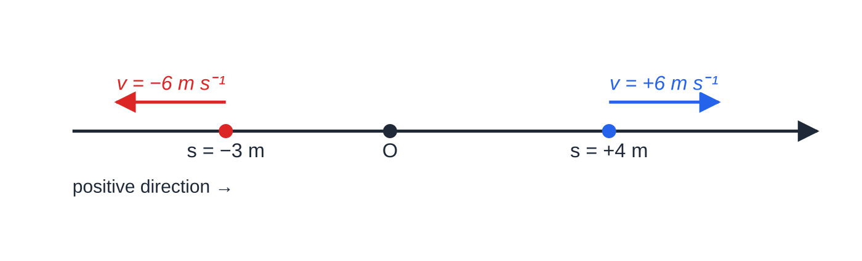
What do the words for straight-line motion mean? (continued)
Section 1 of 12
A deceleration (or retardation) of 2 m s⁻² means an acceleration of 2 m s⁻² against the motion: write a = -2 if the motion is in the positive direction.
Average velocity = total displacement ÷ total time; average speed = total distance ÷ total time. A round trip has zero average velocity but a non-zero average speed.
“At rest” and “instantaneously at rest” both mean v = 0. A particle can be instantaneously at rest while it still has an acceleration, at the top of a throw for example.
In one dimension a vector is a number with a sign: +6 m s⁻¹ and −6 m s⁻¹ are the same speed in opposite directions, and a point on the negative side of O has a negative displacement.
Notes:
What do the words for straight-line motion mean?. Full notes: https://examinerprep.com/notes/edexcel-ial-maths/kinematics-in-a-straight-line/

Slide 6
What do the words for straight-line motion mean? (continued)
Section 1 of 12
Common error
Mixing directions inside one equation: taking up as positive for the velocity but substituting g = +9.8 for the acceleration. Fix the positive direction once, write it down (for example “↑ +”), and give every vector quantity the matching sign.
Notes:
What do the words for straight-line motion mean?. Full notes: https://examinerprep.com/notes/edexcel-ial-maths/kinematics-in-a-straight-line/

Slide 7
How do you choose and use the constant-acceleration formulae?
Section 2 of 12
The constant-acceleration (suvat) formulae
v = u + at s = (u + v)/2t v² = u² + 2as s = ut + ½at² s = vt - ½at²
s = displacement (m); u = initial velocity (m s⁻¹); v = final velocity (m s⁻¹); a = acceleration (m s⁻²); t = time (s). Not in the formulae list: all five must be known. Valid only while the acceleration is constant; if it changes, split the motion into stages.
Each formula leaves out exactly one of the five quantities. Write down s, u, v, a, t, fill in the three you know and the one you want, and use the formula that leaves out the fifth.
Formula | Leaves out | Typical use
v = u + at | s | time to reach a speed
s = ½(u + v)t | a | distance when both speeds and the time are known
Notes:
How do you choose and use the constant-acceleration formulae?. Full notes: https://examinerprep.com/notes/edexcel-ial-maths/kinematics-in-a-straight-line/

Slide 8
How do you choose and use the constant-acceleration formulae? (continued)
Section 2 of 12
Formula | Leaves out | Typical use
v² = u² + 2as | t | braking distance; greatest height
s = ut + ½at² | v | where the particle is at time t; times from a quadratic
s = vt - ½at² | u | the end speed is known but the start speed is not
Where they come from. Constant acceleration means the velocity–time graph is a straight line with gradient a: (v - u)/t = a, which is v = u + at. The area under it is a trapezium: s = ½(u + v)t. Substituting v = u + at into the area gives s = ut + ½at²; substituting u = v - at gives s = vt - ½at²; eliminating t gives v² = u² + 2as.
Notes:
How do you choose and use the constant-acceleration formulae?. Full notes: https://examinerprep.com/notes/edexcel-ial-maths/kinematics-in-a-straight-line/

Slide 9
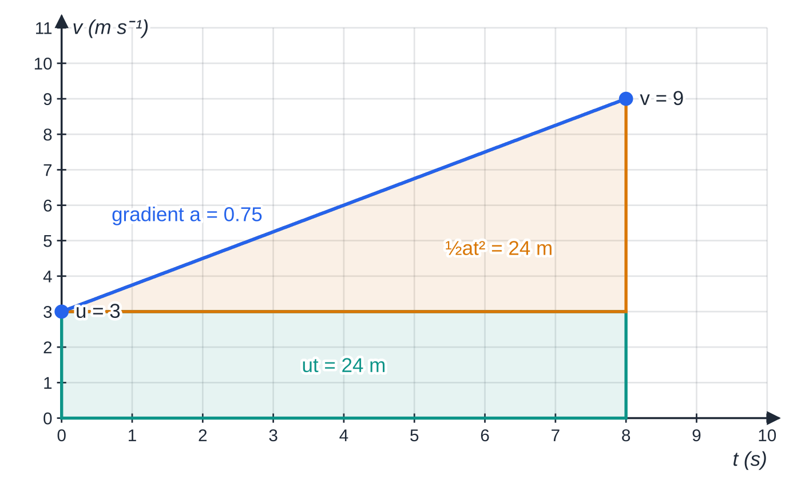
How do you choose and use the constant-acceleration formulae? (continued)
Section 2 of 12
The cyclist of worked example 1. The area under the velocity–time line splits into a rectangle (ut) and a triangle (½at², since v - u = at): together 48 m.
Notes:
How do you choose and use the constant-acceleration formulae?. Full notes: https://examinerprep.com/notes/edexcel-ial-maths/kinematics-in-a-straight-line/

Slide 10
How do you choose and use the constant-acceleration formulae? (continued)
Section 2 of 12 · Worked example 1 · Easy · Find
WORKED EXAMPLE · QUESTION
A cyclist moving along a straight road at 3 m s⁻¹ accelerates uniformly at 0.75 m s⁻² for 8 s. (a) Find her speed at the end of the 8 s. (b) Find the distance she travels in the 8 s. (c) Find the time she takes to travel the first 20 m.
SOLUTION
(a) u = 3, a = 0.75, t = 8, want v: v = 3 + 0.75 ×8 = 9 m s⁻¹
(b) s = ½(3 + 9) ×8 = 48 m
(c) s = 20, u = 3, a = 0.75, want t: the formula without v. 20 = 3t + 0.375t² ⇒0.375t² + 3t - 20 = 0, so t = (-3 + √(9 + 30))/0.75 = 4.33 s (3 s.f.). The other root is negative and is rejected: the motion starts at t = 0.
Notes:
How do you choose and use the constant-acceleration formulae?: Worked example 1. Full notes: https://examinerprep.com/notes/edexcel-ial-maths/kinematics-in-a-straight-line/

Slide 11
How do you choose and use the constant-acceleration formulae? (continued)
Section 2 of 12
When a quadratic gives two positive roots. If u and a have opposite signs, both roots of s = ut + ½at² can be positive: the particle passes the point, stops, comes back and passes it again. Both times are valid if the acceleration really stays the same for that long; read the question to decide.
Notes:
How do you choose and use the constant-acceleration formulae?. Full notes: https://examinerprep.com/notes/edexcel-ial-maths/kinematics-in-a-straight-line/

Slide 12
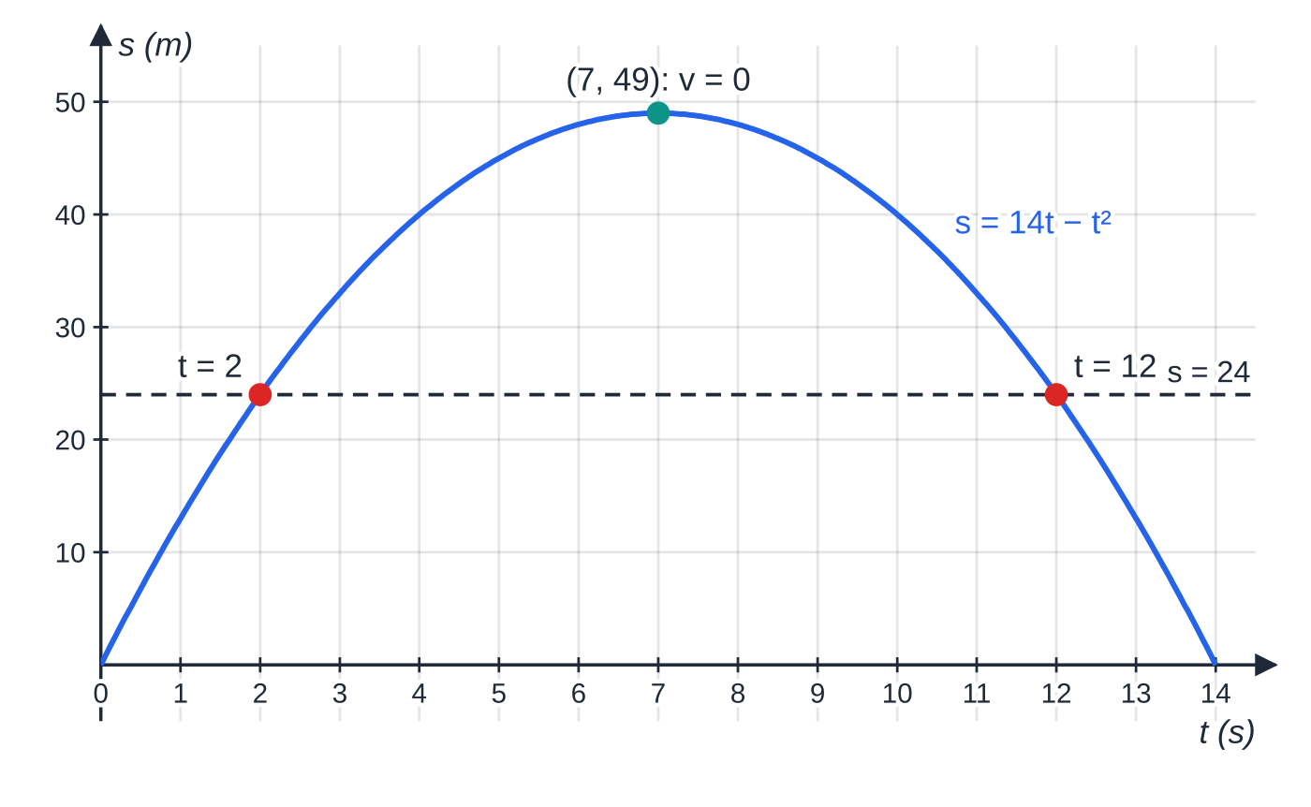
How do you choose and use the constant-acceleration formulae? (continued)
Section 2 of 12 · Worked example 2 · Medium · Find, interpret
WORKED EXAMPLE · QUESTION
A particle P moves along a straight line with constant acceleration. It passes a point A and, 5 s later, passes a point B, where AB = 45 m. At B its speed is 4 m s⁻¹, in the direction from A to B. (a) Find the acceleration of P. (b) Find the speed of P at A. (c) The acceleration stays the same after P passes B. Find the times after passing A at which P is 24 m from A, and interpret them.
Worked example 2 after A. The displacement–time graph is a parabola; the line s = 24 m cuts it twice.
Notes:
How do you choose and use the constant-acceleration formulae?: Worked example 2. Full notes: https://examinerprep.com/notes/edexcel-ial-maths/kinematics-in-a-straight-line/

Slide 13
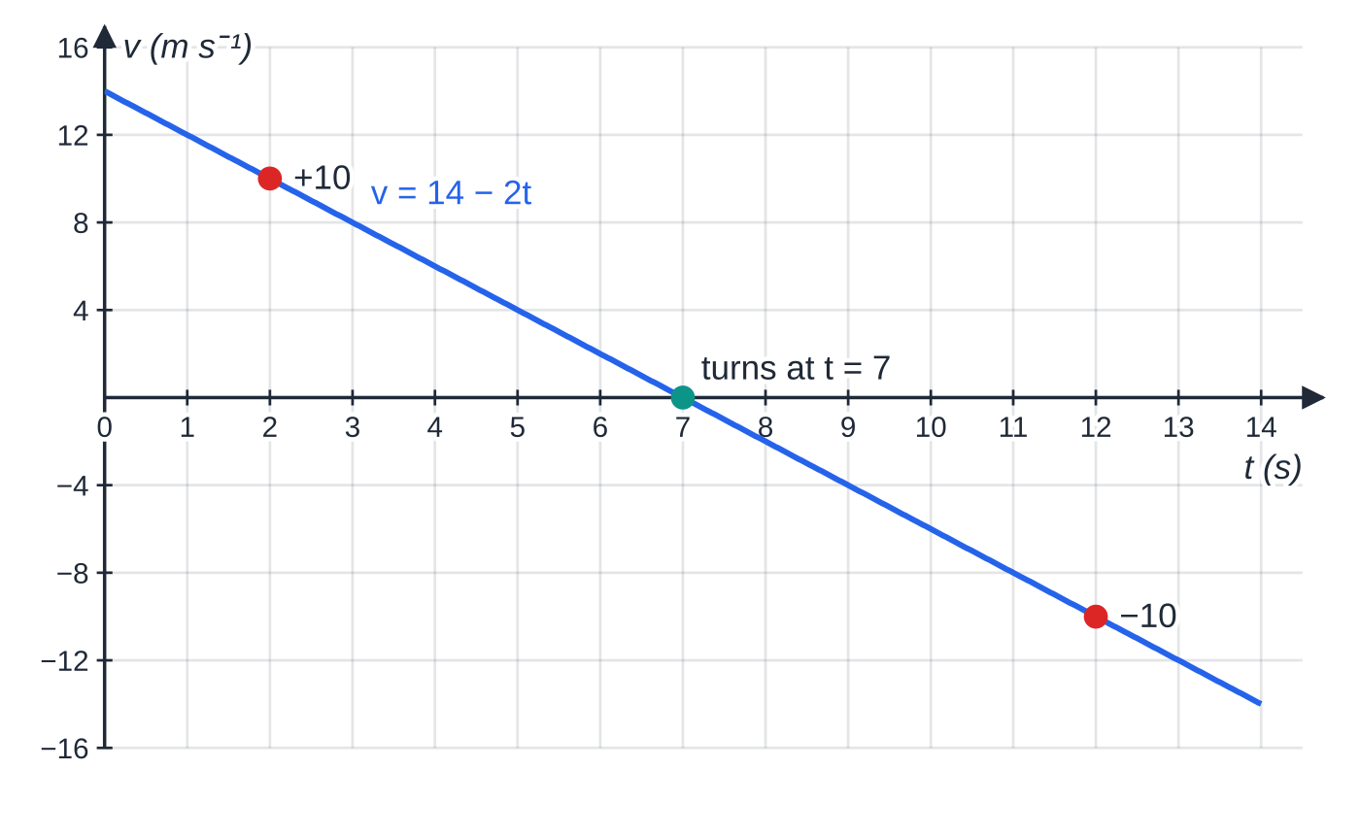
How do you choose and use the constant-acceleration formulae? (continued)
Section 2 of 12 · Worked example 2 · Medium · Find, interpret (continued)
SOLUTION
(a) s = 45, v = 4, t = 5, want a; u is unknown, so use the formula without u: 45 = 4 ×5 - ½a ×25 ⇒12.5a = -25 ⇒ a = -2 m s⁻² (a deceleration of 2 m s⁻²)
(b) 4 = u - 2 ×5 ⇒ u = 14 m s⁻¹. Check with the formula without a: ½(14 + 4) ×5 = 45 ✓.
(c) From A, u = 14, a = -2, s = 24: 24 = 14t - t² ⇒t² - 14t + 24 = 0 ⇒(t - 2)(t - 12) = 0. t = 2 s and t = 12 s. At t = 2, v = 14 - 4 = +10: moving away from A. At t = 12, v = 14 - 24 = -10: P has stopped (at t = 7, 49 m from A) and is on its way back.
The velocity–time graph shows why: the velocity changes sign at t = 7 s, so the particle passes the 24 m point once going out and once coming back.
Notes:
How do you choose and use the constant-acceleration formulae?: Worked example 2. Full notes: https://examinerprep.com/notes/edexcel-ial-maths/kinematics-in-a-straight-line/

Slide 14
How do you choose and use the constant-acceleration formulae? (continued)
Section 2 of 12
Exam tip 1 — write s u v a t
Write the five letters in a column at the start of every part and fill in what you know, with signs. It takes ten seconds, shows your method, and makes the choice of formula automatic.
Notes:
How do you choose and use the constant-acceleration formulae?. Full notes: https://examinerprep.com/notes/edexcel-ial-maths/kinematics-in-a-straight-line/

Slide 15
How do you model vertical motion under gravity?
Section 3 of 12
A body moving freely up or down near the Earth's surface is modelled as a particle with no air resistance, so its acceleration is constant: g = 9.8 m s⁻² vertically downwards. This is true on the way up, at the highest point and on the way down. At the top, v = 0 but a = -9.8 (up positive).
Take up as positive for anything thrown upwards: then a = -9.8, and a point below the start has a negative displacement. For something only falling, down positive (a = +9.8) is fine.
For a particle projected upwards at u: time to the top = u/g; greatest height above the start = u²/2g (from v² = u² + 2as with v = 0).
Symmetry: it returns to its starting level after 2u/g, with the same speed u it was projected with.
Using g = 9.8, give answers to 2 or 3 significant figures.
Notes:
How do you model vertical motion under gravity?. Full notes: https://examinerprep.com/notes/edexcel-ial-maths/kinematics-in-a-straight-line/

Slide 16
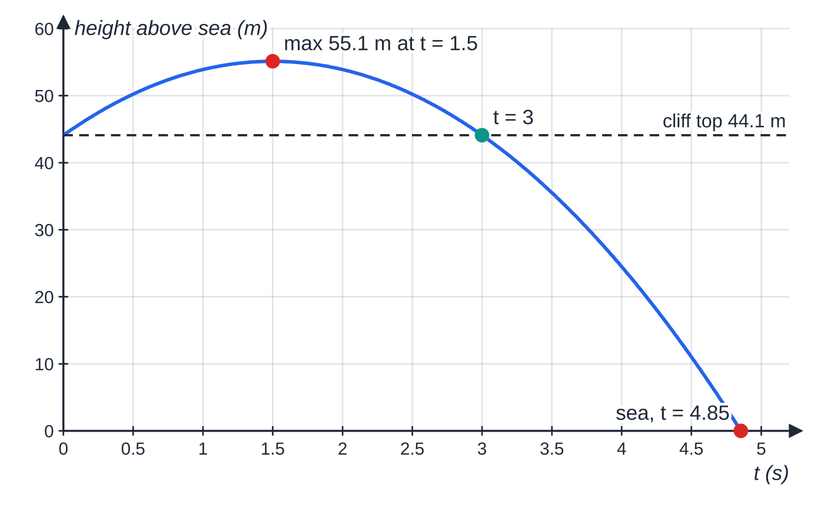
How do you model vertical motion under gravity? (continued)
Section 3 of 12 · Worked example 3 · Medium · Find
WORKED EXAMPLE · QUESTION
A stone is thrown vertically upwards at 14.7 m s⁻¹ from a point on a cliff 44.1 m above the sea. It falls past the cliff into the sea. The stone is modelled as a particle moving freely under gravity. (a) Find the greatest height of the stone above the sea. (b) Find the time from throwing until the stone reaches the sea. (c) Find its speed as it reaches the sea. (d) Find the length of time for which the stone is above the point of projection.
Height of the stone above the sea. It rises 11.0 m above the cliff top, is back at the point of projection after 3 s and reaches the sea after 4.85 s.
Notes:
How do you model vertical motion under gravity?: Worked example 3. Full notes: https://examinerprep.com/notes/edexcel-ial-maths/kinematics-in-a-straight-line/

Slide 17
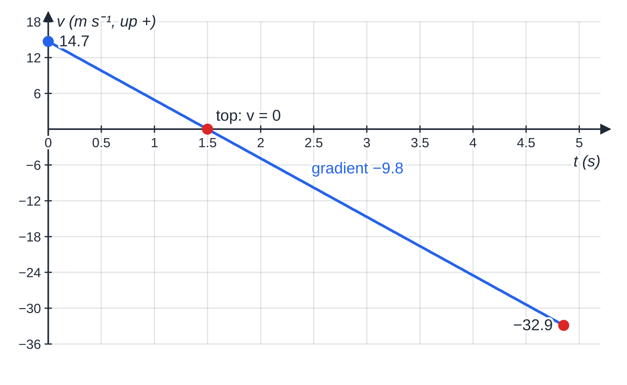
How do you model vertical motion under gravity? (continued)
Section 3 of 12 · Worked example 3 · Medium · Find (continued)
SOLUTION
(a) Up positive. At the top v = 0; u = 14.7, a = -9.8: 0 = 14.7² - 2 ×9.8 ×s ⇒s = 11.025 m. Height above the sea = 44.1 + 11.025 = 55.1 m
(b) The sea is 44.1 m below the start: s = -44.1. -44.1 = 14.7t - 4.9t² ⇒t² - 3t - 9 = 0 ⇒t = (3 + √45)/2 = 4.85 s
(c) Using v² = u² + 2as, which avoids the rounded time: v² = 14.7² + 2 ×(-9.8) ×(-44.1), so the speed is 32.9 m s⁻¹
The velocity–time graph has gradient −9.8 throughout; the velocity is zero exactly where the height is greatest, at t = 1.5 s.
Notes:
How do you model vertical motion under gravity?: Worked example 3. Full notes: https://examinerprep.com/notes/edexcel-ial-maths/kinematics-in-a-straight-line/

Slide 18
How do you model vertical motion under gravity? (continued)
Section 3 of 12 · Worked example 3 · Medium · Find (continued)
(d) Back at the point of projection (s = 0) when 14.7t - 4.9t² = 0: t = 14.7 ÷4.9 = 3 s (= 2u/g)
Notes:
How do you model vertical motion under gravity?: Worked example 3. Full notes: https://examinerprep.com/notes/edexcel-ial-maths/kinematics-in-a-straight-line/

Slide 19
How do you model vertical motion under gravity? (continued)
Section 3 of 12
Common error
Using s = +44.1 for a point below the start. With up positive, the sea is at s = -44.1; using +44.1 gives an equation with no real solution or a nonsense time.
Notes:
How do you model vertical motion under gravity?. Full notes: https://examinerprep.com/notes/edexcel-ial-maths/kinematics-in-a-straight-line/

Slide 20
How do you handle a journey made of stages?
Section 4 of 12
Split the motion wherever the acceleration changes: an engine cuts out, brakes are applied, a string breaks, the particle hits the ground. Work through the stages in order. The final velocity of one stage is the initial velocity of the next, and the displacements add. Keep the same positive direction and origin for every stage. A sketch of the velocity–time graph is the best plan: one straight segment per stage.
Notes:
How do you handle a journey made of stages?. Full notes: https://examinerprep.com/notes/edexcel-ial-maths/kinematics-in-a-straight-line/

Slide 21
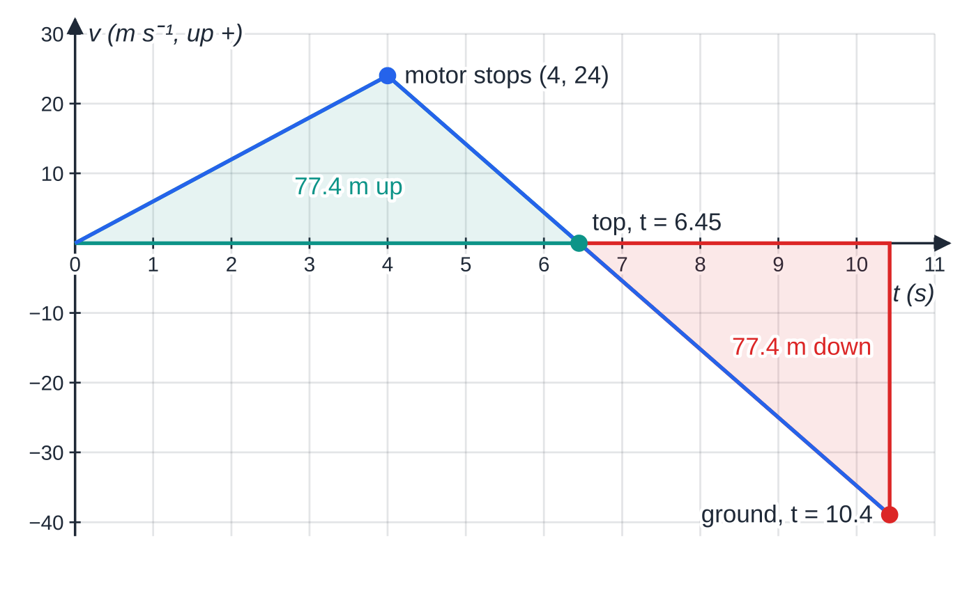
How do you handle a journey made of stages? (continued)
Section 4 of 12 · Worked example 4 · Hard · Find
WORKED EXAMPLE · QUESTION
A model rocket is launched vertically upwards from rest at ground level. While its motor burns, it moves with constant acceleration 6 m s⁻² upwards. The motor stops after 4 s, and the rocket then moves freely under gravity until it hits the ground. (a) Find the speed and height of the rocket when the motor stops. (b) Find the greatest height reached. (c) Find the total time from launch until the rocket hits the ground.
The two-stage velocity–time graph of the rocket. The area above the axis (the rise, 77.4 m) equals the area below it (the fall back to the launch point), so the total displacement is zero.
Notes:
How do you handle a journey made of stages?: Worked example 4. Full notes: https://examinerprep.com/notes/edexcel-ial-maths/kinematics-in-a-straight-line/

Slide 22
How do you handle a journey made of stages? (continued)
Section 4 of 12 · Worked example 4 · Hard · Find (continued)
SOLUTION
(a) Stage 1: u = 0, a = 6, t = 4. v = 6 ×4 = 24 m s⁻¹; s = ½ ×6 ×4² = 48 m. 24 m s⁻¹ at 48 m
(b) Stage 2 starts with u = 24 (up positive), a = -9.8; at the top v = 0: 0 = 24² - 19.6s ⇒s = 29.39 m. Greatest height = 48 + 29.39 = 77.4 m
(c) Stage 2 from the motor stopping to the ground: s = -48. -48 = 24t - 4.9t² ⇒4.9t² - 24t - 48 = 0 ⇒t = 6.423 s (positive root). Total time = 4 + 6.423 = 10.4 s
Check by another route: 2.449 s up to the top, then 3.974 s falling 77.39 m from rest: 4 + 2.449 + 3.974 = 10.42 s ✓. Stage 2 is one constant-acceleration stage from the motor stopping all the way to the ground; there is no need to split it at the top.
Notes:
How do you handle a journey made of stages?: Worked example 4. Full notes: https://examinerprep.com/notes/edexcel-ial-maths/kinematics-in-a-straight-line/

Slide 23
How do you handle a journey made of stages? (continued)
Section 4 of 12
Exam tip 2 — label stages, round once
When a question asks for a total time or distance, label each stage's answer (“stage 1: 4 s”, “stage 2: 6.42 s”) before adding. Keep unrounded values from one stage to the next and round only the final answer.
Notes:
How do you handle a journey made of stages?. Full notes: https://examinerprep.com/notes/edexcel-ial-maths/kinematics-in-a-straight-line/

Slide 24
What do the gradients and areas of motion graphs tell you?
Section 5 of 12
Graph | Gradient gives | Area under it gives
displacement–time (s–t) | velocity | —
velocity–time (v–t) | acceleration | displacement (area below the t-axis counts as negative)
speed–time | magnitude of the acceleration | distance travelled (always positive)
acceleration–time (a–t) | — | change in velocity
On an s–t graph a straight line means constant velocity, a horizontal line means at rest, and a curve means the velocity is changing. A maximum or minimum of s is where v = 0.
On a v–t graph a straight segment means constant acceleration. Where the graph crosses the t-axis, the particle changes direction.
Displacement = area above the axis − area below; distance = area above + area below. A speed–time graph is the v–t graph with the parts below the axis reflected above it.
Notes:
What do the gradients and areas of motion graphs tell you?. Full notes: https://examinerprep.com/notes/edexcel-ial-maths/kinematics-in-a-straight-line/

Slide 25
What do the gradients and areas of motion graphs tell you? (continued)
Section 5 of 12
For constant-acceleration stages the a–t graph is a set of horizontal segments; each rectangle's area is the change in velocity in that stage.
Notes:
What do the gradients and areas of motion graphs tell you?. Full notes: https://examinerprep.com/notes/edexcel-ial-maths/kinematics-in-a-straight-line/

Slide 26
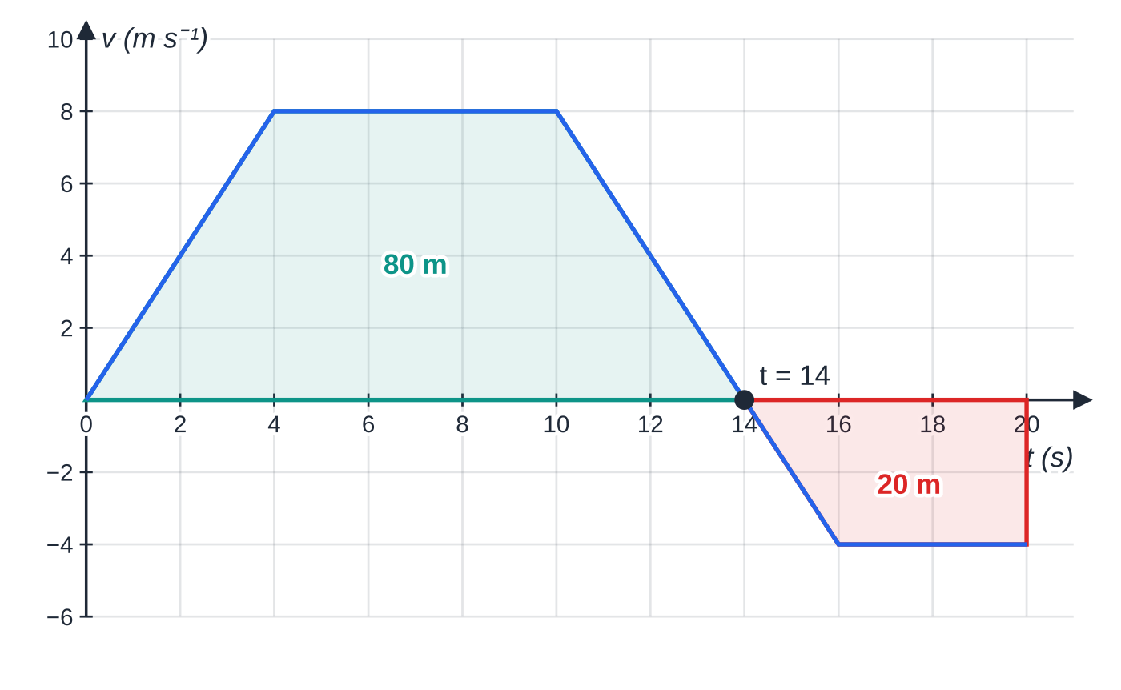
What do the gradients and areas of motion graphs tell you? (continued)
Section 5 of 12 · Worked example 5 · Medium · Find
WORKED EXAMPLE · QUESTION
A particle moves along a straight line, starting from rest at O. Its velocity–time graph consists of straight segments joining (0, 0), (4, 8), (10, 8), (16, −4) and (20, −4), with t in seconds and v in m s⁻¹. (a) Find the acceleration in each of the four stages. (b) Find the time at which the particle is instantaneously at rest. (c) Find the displacement from O at t = 20. (d) Find the total distance travelled in the 20 s.
Worked example 5: the 80 m above the axis and 20 m below give a displacement of 60 m but a distance of 100 m.
Notes:
What do the gradients and areas of motion graphs tell you?: Worked example 5. Full notes: https://examinerprep.com/notes/edexcel-ial-maths/kinematics-in-a-straight-line/

Slide 27
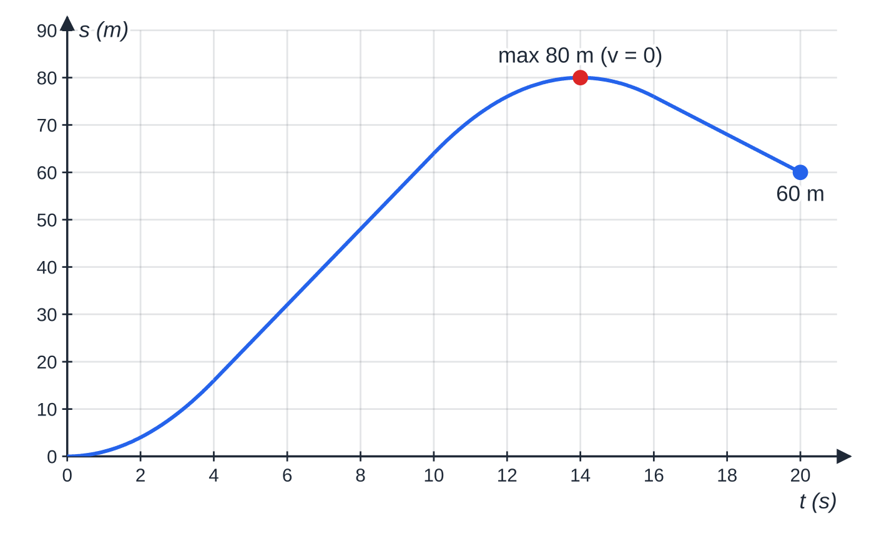
What do the gradients and areas of motion graphs tell you? (continued)
Section 5 of 12 · Worked example 5 · Medium · Find (continued)
The same motion as a displacement–time graph: steepest where v is largest, flat at the maximum (80 m at t = 14, where v = 0), then falling back to 60 m.
Notes:
What do the gradients and areas of motion graphs tell you?: Worked example 5. Full notes: https://examinerprep.com/notes/edexcel-ial-maths/kinematics-in-a-straight-line/

Slide 28
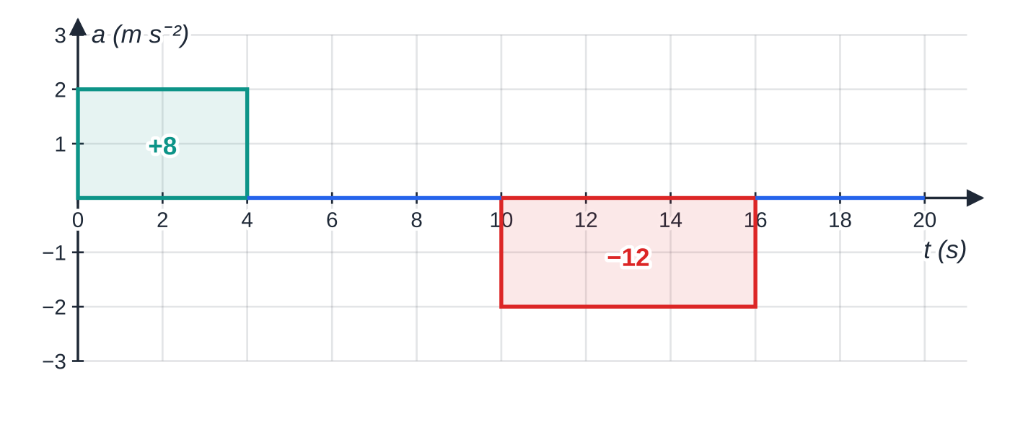
What do the gradients and areas of motion graphs tell you? (continued)
Section 5 of 12 · Worked example 5 · Medium · Find (continued)
SOLUTION
(a) Gradients: 8 ÷4 = 2 m s⁻²; 0; (-4 - 8) ÷6 = -2 m s⁻²; 0. 2, 0, −2, 0 m s⁻²
(b) The third segment crosses v = 0: from 8 at t = 10, losing 2 m s⁻¹ each second, t = 10 + 8 ÷2 = 14 s
(c) Above: ½ ×4 ×8 + 6 ×8 + ½ ×4 ×8 = 16 + 48 + 16 = 80 m. Below: ½ ×2 ×4 + 4 ×4 = 4 + 16 = 20 m. Displacement = 80 - 20 = 60 m
(d) Distance counts both areas as positive: 80 + 20 = 100 m
The acceleration–time graph: the areas +8 and −12 are the changes in velocity (0 → 8 and 8 → −4).
Notes:
What do the gradients and areas of motion graphs tell you?: Worked example 5. Full notes: https://examinerprep.com/notes/edexcel-ial-maths/kinematics-in-a-straight-line/

Slide 29
What do the gradients and areas of motion graphs tell you? (continued)
Section 5 of 12
Common error
Reading the height of a velocity–time graph as a distance, or taking the area of a speed–time graph as a displacement. Height = velocity; area = displacement for v–t, distance for speed–time.
Notes:
What do the gradients and areas of motion graphs tell you?. Full notes: https://examinerprep.com/notes/edexcel-ial-maths/kinematics-in-a-straight-line/

Slide 30
How do you find an unknown time from a velocity–time graph?
Section 6 of 12
Many journeys are “accelerate – steady speed – decelerate”: a trapezium on the v–t graph. Label every time and speed on a sketch, using letters (T, V) for the unknowns. Then write gradient equations for the accelerations (time = change in speed ÷ acceleration) and an area equation for the distance. Area of a trapezium = ½ × (sum of parallel sides) × height; for the whole journey, ½ × (time at steady speed + total time) × top speed. If the unknown appears in a product, the area equation may be a quadratic: check which root fits the times on your sketch.
Notes:
How do you find an unknown time from a velocity–time graph?. Full notes: https://examinerprep.com/notes/edexcel-ial-maths/kinematics-in-a-straight-line/

Slide 31
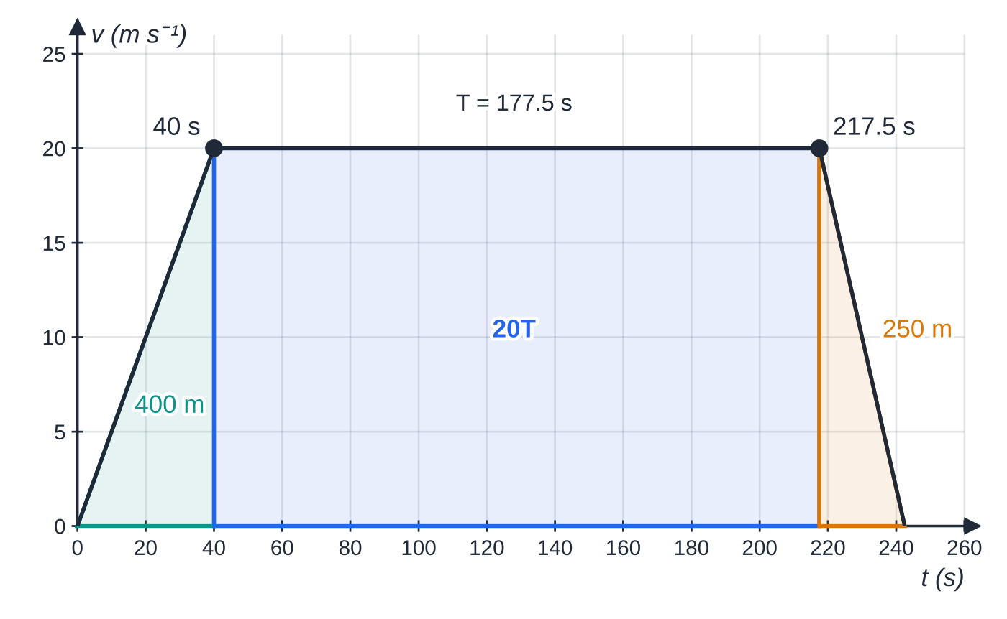
How do you find an unknown time from a velocity–time graph? (continued)
Section 6 of 12 · Worked example 6 · Medium · Sketch, find
WORKED EXAMPLE · QUESTION
A train starts from rest at station P and accelerates uniformly at 0.5 m s⁻² until its speed is 20 m s⁻¹. It then travels at 20 m s⁻¹ for T seconds, and then decelerates uniformly at 0.8 m s⁻², coming to rest at station Q. The distance PQ is 4.2 km. (a) Sketch the velocity–time graph. (b) Find T. (c) Find the average speed for the whole journey. (d) Find the time after leaving P at which the train has travelled 1 km.
Worked example 6: the train's journey. The three pieces of the area (400 m, 20T and 250 m) add to the 4200 m between the stations.
Notes:
How do you find an unknown time from a velocity–time graph?: Worked example 6. Full notes: https://examinerprep.com/notes/edexcel-ial-maths/kinematics-in-a-straight-line/

Slide 32
How do you find an unknown time from a velocity–time graph? (continued)
Section 6 of 12 · Worked example 6 · Medium · Sketch, find (continued)
SOLUTION
(a) A trapezium: up from (0, 0) to 20 m s⁻¹, horizontal for T s, down to zero; the deceleration line is steeper than the acceleration line (see the figure).
(b) Accelerating: 20 ÷0.5 = 40 s; decelerating: 20 ÷0.8 = 25 s. Area: ½ ×40 ×20 + 20T + ½ ×25 ×20 = 4200 ⇒650 + 20T = 4200 ⇒ T = 177.5 s
(c) Total time = 40 + 177.5 + 25 = 242.5 s; average speed = 4200 ÷242.5 = 17.3 m s⁻¹
(d) 400 m are covered in the first 40 s, so 1 km is reached at steady speed: 400 + 20(t - 40) = 1000 ⇒ t = 70 s
Notes:
How do you find an unknown time from a velocity–time graph?: Worked example 6. Full notes: https://examinerprep.com/notes/edexcel-ial-maths/kinematics-in-a-straight-line/

Slide 33
How do you find an unknown time from a velocity–time graph? (continued)
Section 6 of 12
Exam tip 3 — the sketch is the key
A sketch asked for in part (a) usually unlocks the rest. Draw it with a ruler, label the axes (t and v), and mark the speeds and every time, known or unknown, on the axes.
Notes:
How do you find an unknown time from a velocity–time graph?. Full notes: https://examinerprep.com/notes/edexcel-ial-maths/kinematics-in-a-straight-line/

Slide 34
How do you solve problems with two moving objects?
Section 7 of 12
Measure both displacements from the same origin and the same starting time. If one object starts later, its time is (t − delay).
They are level (one overtakes the other, or they meet) when their displacements are equal. Coming towards each other from D apart, they meet when the distances they have each travelled add up to D.
The gap between them is greatest (or least) when their velocities are equal, where the v–t lines cross.
If one object changes stage, check which stage it is in at the meeting time: a root that lies outside the stage you used is not valid. On a v–t graph the meeting time is when the areas under the two graphs are equal.
Notes:
How do you solve problems with two moving objects?. Full notes: https://examinerprep.com/notes/edexcel-ial-maths/kinematics-in-a-straight-line/

Slide 35
How do you solve problems with two moving objects? (continued)
Section 7 of 12 · Worked example 7 · Hard · Show that, find
WORKED EXAMPLE · QUESTION
A car is at rest at traffic lights. At t = 0, a lorry passes the car moving at a constant 15 m s⁻¹, and at the same instant the car moves off in the same direction with constant acceleration 2.5 m s⁻² until it reaches 25 m s⁻¹. It then continues at 25 m s⁻¹. (a) Show that the car has not caught up with the lorry when it reaches its top speed. (b) Find the time at which the car overtakes the lorry, and the distance from the traffic lights at that moment. (c) Find the greatest distance between the lorry and the car before the car overtakes.
Notes:
How do you solve problems with two moving objects?: Worked example 7. Full notes: https://examinerprep.com/notes/edexcel-ial-maths/kinematics-in-a-straight-line/

Slide 36
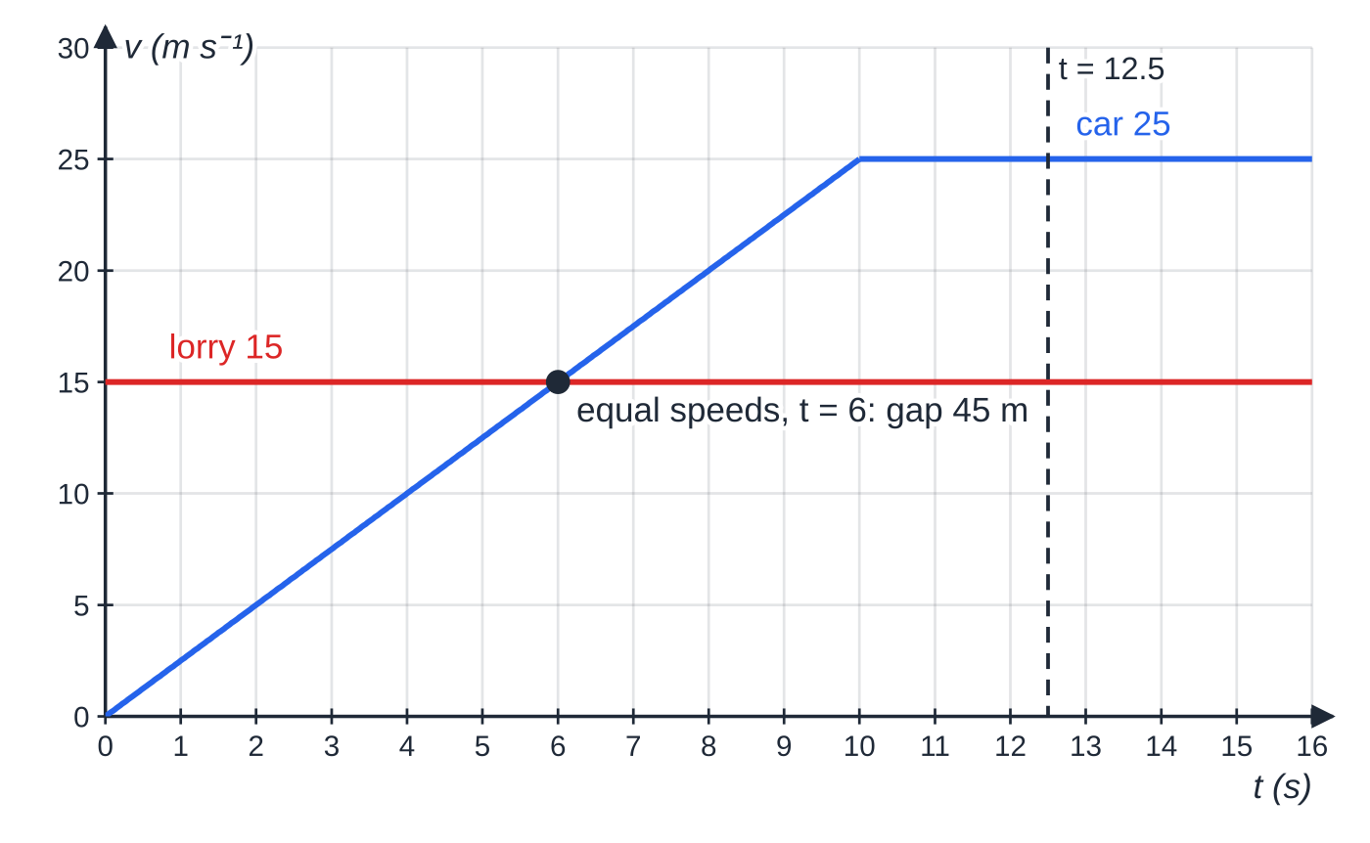
How do you solve problems with two moving objects? (continued)
Section 7 of 12 · Worked example 7 · Hard · Show that, find (continued)
The velocity–time lines cross at t = 6 s: that is when the gap is largest (45 m), not when the vehicles meet. The areas under the two graphs are equal (187.5 m) at t = 12.5 s.
Notes:
How do you solve problems with two moving objects?: Worked example 7. Full notes: https://examinerprep.com/notes/edexcel-ial-maths/kinematics-in-a-straight-line/

Slide 37
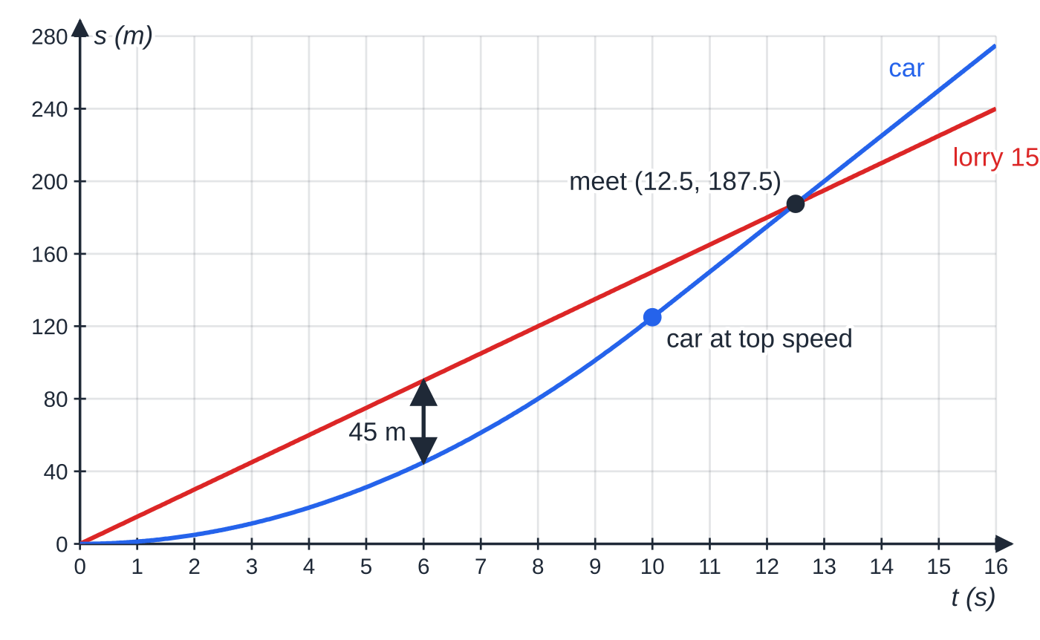
How do you solve problems with two moving objects? (continued)
Section 7 of 12 · Worked example 7 · Hard · Show that, find (continued)
SOLUTION
(a) The car reaches 25 m s⁻¹ after 25 ÷2.5 = 10 s, having travelled ½ ×2.5 ×10² = 125 m. The lorry after 10 s: 15 ×10 = 150 m >125 m, so the lorry is still ahead.
(b) For t ≥10, car: 125 + 25(t - 10); lorry: 15t. 125 + 25t - 250 = 15t ⇒10t = 125 ⇒ t = 12.5 s, at 187.5 m from the lights
(c) The gap grows while the lorry is faster and shrinks once the car is faster, so it is greatest when the speeds are equal: 2.5t = 15 ⇒t = 6. Gap = 15 ×6 - ½ ×2.5 ×6² = 90 - 45 = 45 m
The displacement–time graphs cross at t = 12.5 s, 187.5 m from the lights; the vertical gap is greatest at t = 6.
Notes:
How do you solve problems with two moving objects?: Worked example 7. Full notes: https://examinerprep.com/notes/edexcel-ial-maths/kinematics-in-a-straight-line/

Slide 38
How do you solve problems with two moving objects? (continued)
Section 7 of 12 · Worked example 7 · Hard · Show that, find (continued)
Solving ½ ×2.5t² = 15t gives t = 12 s, but that assumes the car is still accelerating after 10 s, which it is not. Part (a) is there to stop you using that root.
Notes:
How do you solve problems with two moving objects?: Worked example 7. Full notes: https://examinerprep.com/notes/edexcel-ial-maths/kinematics-in-a-straight-line/

Slide 39
How do you solve problems with two moving objects? (continued)
Section 7 of 12
Common error
Setting the two velocities equal to find when one vehicle catches the other. Equal velocities give the moment the gap stops growing; catching up needs equal displacements.
Notes:
How do you solve problems with two moving objects?. Full notes: https://examinerprep.com/notes/edexcel-ial-maths/kinematics-in-a-straight-line/

Slide 40
Exam tips for M1.2
Section 8 of 12
Exam tip 4 — state the direction
Begin each kinematics answer with your positive direction (↑ + or → +). A negative answer then has a clear meaning: say it in words (“3.2 m s⁻¹ downwards”) when the question asks for a velocity.
Exam tip 5 — check with a second formula
Find a quantity with one formula and check it with another that uses different given data. Agreement is quick evidence that the signs are right. Carry exact values such as (3 + √45)/2 into later parts, and with g = 9.8 give final answers to 2 or 3 significant figures.
Notes:
Exam tips for M1.2. Full notes: https://examinerprep.com/notes/edexcel-ial-maths/kinematics-in-a-straight-line/

Slide 41
Exam tips for M1.2 (continued)
Section 8 of 12
Exam tip 6 — test every root
When a quadratic gives two times, substitute each back into the story: is it negative, before the object started, or after the stage in which the formula applies? Say why a root is rejected. For graph questions, shade the area you are using and write its value inside it.
Notes:
Exam tips for M1.2. Full notes: https://examinerprep.com/notes/edexcel-ial-maths/kinematics-in-a-straight-line/

Slide 42
Common misconceptions
Section 9 of 12
Misconception | Why it is wrong | Correct idea
At the highest point the acceleration is zero. | Gravity still acts; only the velocity is zero there. | a = 9.8 m s⁻² downwards throughout free motion.
Distance and displacement are the same thing. | Displacement can decrease or be negative when the particle turns back. | Distance = total path length; displacement = signed change in position.
The area under any velocity–time graph is the distance travelled. | Area below the axis is negative displacement. | Distance = area above + area below; displacement = area above − area below.
Deceleration means a negative velocity. | A particle moving forwards can be slowing down. | Deceleration means the acceleration is opposite to the velocity.
The suvat formulae work for the whole of any journey. | They assume a single constant acceleration. | Split the journey at each change of acceleration.
Notes:
Common misconceptions. Full notes: https://examinerprep.com/notes/edexcel-ial-maths/kinematics-in-a-straight-line/

Slide 43
Common misconceptions (continued)
Section 9 of 12
Misconception | Why it is wrong | Correct idea
Two vehicles meet where their velocity–time graphs cross. | Crossing lines mean equal velocities, not equal positions. | They meet when the areas (displacements) are equal.
Notes:
Common misconceptions. Full notes: https://examinerprep.com/notes/edexcel-ial-maths/kinematics-in-a-straight-line/

Slide 44
How this topic connects
Section 10 of 12
P1 Pure Mathematics 1
Finding times from s = ut + ½at² is solving a quadratic; reading gradients and areas uses straight-line graphs and the area of a trapezium.
M1.3 Dynamics
A constant resultant force gives a constant acceleration (F = ma), which is what makes the suvat formulae usable for connected particles, slopes and particles that slide and then collide.
M1.1 Vectors, M2 and IAL Physics
Motion in a plane at constant velocity is written as r = r₀ + vt; M2 uses calculus when the acceleration varies and treats projectiles as two straight-line motions at once. IAL Physics Unit 1 uses the same equations, usually with g = 9.81 m s⁻².
Notes:
How this topic connects. Full notes: https://examinerprep.com/notes/edexcel-ial-maths/kinematics-in-a-straight-line/

Slide 45
Key formulae
Section 11 of 12
Formula | Use | In the formulae list?
v = u + at | Constant acceleration, no s | No — must be known
s = ½(u + v)t | Constant acceleration, no a | No — must be known
v² = u² + 2as | Constant acceleration, no t | No — must be known
s = ut + ½at² | Constant acceleration, no v | No — must be known
s = vt - ½at² | Constant acceleration, no u | No — must be known
Notes:
Key formulae. Full notes: https://examinerprep.com/notes/edexcel-ial-maths/kinematics-in-a-straight-line/

Slide 46
Key formulae (continued)
Section 11 of 12
Formula | Use | In the formulae list?
gradient of s–t = v; gradient of v–t = a; area under v–t = s; area under a–t = change in v | Reading motion graphs | No — must be known
t = u/g, H = u²/2g, total time 2u/g | Projection vertically upwards from ground level | No — derive it
Notes:
Key formulae. Full notes: https://examinerprep.com/notes/edexcel-ial-maths/kinematics-in-a-straight-line/

Slide 47
Check your understanding
Section 12 of 12
1. A small stone is dropped from rest and falls 2.5 m to the floor. Find its speed as it reaches the floor.
2. A car decelerates uniformly at 1.5 m s⁻² and comes to rest after 12 s. Find the distance it travels in those 12 s, without first finding its initial speed.
3. A velocity–time graph is a straight line from (0, 10) to (5, 0). State the acceleration and the displacement over the 5 s.
4. A ball is projected vertically upwards from ground level at 9.8 m s⁻¹. Find how long it is in the air, and explain why its mass is not needed.
5. A particle has velocity v = 6 - 2t m s⁻¹ for 0 ≤t ≤5. Find its displacement and the distance it travels in the 5 s.
Notes:
Check your understanding: questions. Full notes: https://examinerprep.com/notes/edexcel-ial-maths/kinematics-in-a-straight-line/

Slide 48
Check your understanding · answers
Section 12 of 12
1. Down positive: v² = 0 + 2 ×9.8 ×2.5 = 49, so v = 7 m s⁻¹ (exactly, with g = 9.8).
2. s = vt - ½at² with v = 0, a = -1.5, t = 12: s = 0 + ½ ×1.5 ×144 = 108 m.
3. Gradient = (0 - 10) ÷5 = −2 m s⁻² (a deceleration of 2 m s⁻²). Area = ½ ×5 ×10 = 25 m.
4. 0 = 9.8t - 4.9t² ⇒t = 2 s. Without air resistance every body falls with the same acceleration g, so the mass does not appear in the model.
5. It stops at t = 3 after 9 m; from t = 3 to 5 it moves back ½ ×2 ×4 = 4 m. Displacement = 9 - 4 = 5 m (also 6 ×5 - 25); distance = 9 + 4 = 13 m.
Notes:
Check your understanding: answers. Full notes: https://examinerprep.com/notes/edexcel-ial-maths/kinematics-in-a-straight-line/

Slide 49
Practice questions
2 original exam-style questions. Answers at the end of the deck.

Slide 50
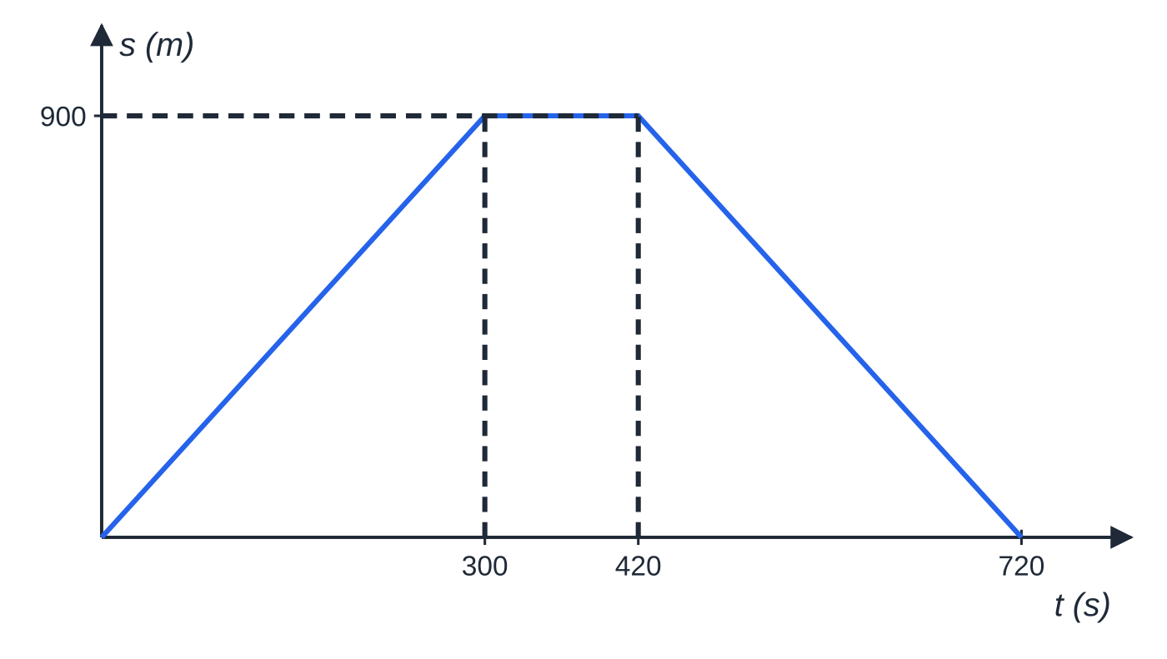
Question 1
6 marks
A jogger runs along a straight path that starts at her front gate H. Her displacement–time graph consists of three straight line segments joining the points (0, 0), (300, 900), (420, 900) and (720, 0), where t is the time in seconds and s is her displacement from H in metres.
Figure: displacement–time graph of the jogger, drawn from the points given.
(a) Find her velocity during the first 300 s. [1]
(b) Describe her motion for 300 ≤ t ≤ 420. [1]
(c) Find her velocity for 420 ≤ t ≤ 720. [2]
(d) Find her average speed for the whole 720 s, and state her average velocity for the whole 720 s, giving a reason. [2]
Notes:
Online with the full mark scheme: https://examinerprep.com/ial-maths-m1-2-kinematics-in-a-straight-line-questions#IALM-M1-2-B-03

Slide 51
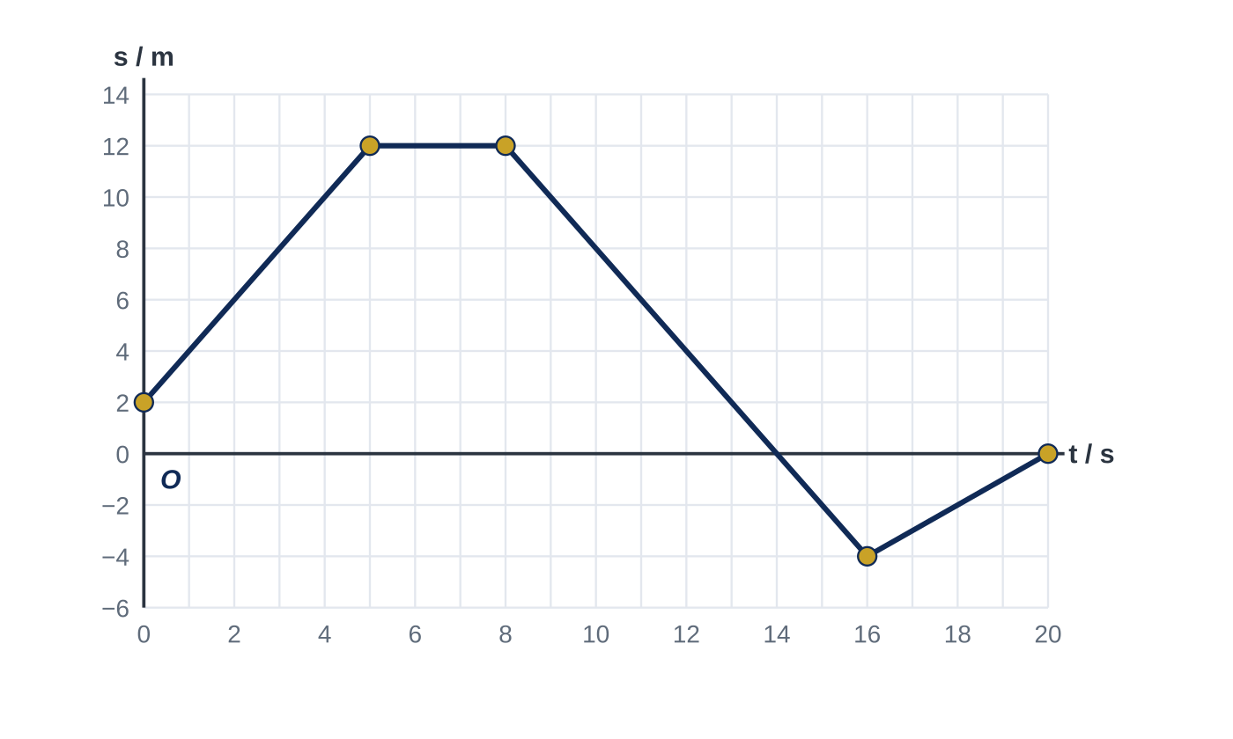
Question 2
6 marks
A robot cleaner moves along a straight corridor. Figure 1 shows the graph of its displacement s metres from a fixed point O in the corridor against time t seconds, for 0 ≤ t ≤ 20. The graph consists of four straight line segments. The robot is modelled as a particle.
(a) Find the velocity of the robot for 0 < t < 5. [1]
(b) Find the velocity of the robot for 8 < t < 16. [2]
(c) Find the time, for 0 < t < 20, at which the robot passes through O. [1]
(d) Find the total distance travelled by the robot for 0 ≤ t ≤ 20, and its average speed over this time. [2]
Notes:
Online with the full mark scheme: https://examinerprep.com/ial-maths-m1-2-kinematics-in-a-straight-line-questions#IALM-M1-2-FB-02

Slide 52
Answers

Slide 53
Question 1 · answer
Mark scheme
gradient = 900 ÷ 300 = 3 m s⁻¹ (away from H)
she is at rest (stationary), 900 m from H
gradient = (0 − 900) ÷ (720 − 420)
= −3 m s⁻¹, i.e. 3 m s⁻¹ back towards H
average speed = (900 + 900) ÷ 720 = 2.5 m s⁻¹
average velocity = 0, because her final displacement from H is zero
Notes:
Full mark scheme: https://examinerprep.com/ial-maths-m1-2-kinematics-in-a-straight-line-questions#IALM-M1-2-B-03

Slide 54
Question 2 · answer
Mark scheme
gradient = (12 − 2) ÷ 5 = 2 m s⁻¹
gradient = (−4 − 12) ÷ (16 − 8)
= −2 m s⁻¹, i.e. 2 m s⁻¹ in the negative direction
12 − 2(t − 8) = 0 ⇒ t = 14 (allow read from the graph)
distance = 10 + 0 + 16 + 4 = 30 m
average speed = 30 ÷ 20 = 1.5 m s⁻¹ (ft)
Notes:
Full mark scheme: https://examinerprep.com/ial-maths-m1-2-kinematics-in-a-straight-line-questions#IALM-M1-2-FB-02

Slide 55
Keep practising
Notes for this topic
Questions on this topic
Build a printable test
ExaminerPrep is an independent tutoring service. It has been developed independently from and is not endorsed by the International Baccalaureate Organization. "International Baccalaureate", "IB" and "IB Diploma Programme" are registered trademarks of the IBO, used here for descriptive purposes only.
Pearson Edexcel and Cambridge are trademarks of their owners; ExaminerPrep is not affiliated with any exam board.

