Slide 1
EP
EDEXCEL IAL MATHS
D1.5 Linear programming
The full notes page in 12 sections · practice questions with answers · simulations
ExaminerPrep is an independent tutoring service. It has been developed independently from and is not endorsed by the International Baccalaureate Organization. "International Baccalaureate", "IB" and "IB Diploma Programme" are registered trademarks of the IBO, used here for descriptive purposes only.
Pearson Edexcel and Cambridge are trademarks of their owners; ExaminerPrep is not affiliated with any exam board.
Notes:
D1.5 Linear programming. Notes for this topic: https://examinerprep.com/notes/edexcel-ial-maths/linear-programming/

Slide 2
What this page covers
Overview
Decision variables, constraints (including non-negativity) and the objective function
Formulating a problem from context, including “at least”, “at most”, ratio and percentage conditions
Drawing constraint lines and identifying the feasible region
The objective line (ruler) method for maximising and minimising
The vertex method: testing every corner of the feasible region
Unbounded regions and problems with more than one optimal solution
Integer solutions when the optimal vertex does not have integer coordinates
Notes:
What this page covers. Full notes: https://examinerprep.com/notes/edexcel-ial-maths/linear-programming/

Slide 3
In one minute
Key points
1. Linear programming finds the values of two decision variables that make a linear objective as large or as small as possible, subject to linear inequality constraints, by drawing the feasible region and finding its best corner.
2. Decision variables: say exactly what x and y count, with the time period (“the number of vases made each week”).
3. Constraints: one linear inequality per restriction, plus x ≥0, y ≥0. Simplify by dividing through by common factors.
4. Feasible region: draw each boundary line from two points, decide the side with a test point, and label the region R that satisfies every constraint.
5. Optimum: slide an objective line parallel to itself (the last point of R it touches), or evaluate the objective at every vertex.
Notes:
In one minute. Full notes: https://examinerprep.com/notes/edexcel-ial-maths/linear-programming/

Slide 4
In one minute (continued)
Key points
6. Integers: if the best vertex is not a whole-number point, test the integer points near it against every constraint and pick the best one.
Notes:
In one minute. Full notes: https://examinerprep.com/notes/edexcel-ial-maths/linear-programming/

Slide 5
What is a linear programming problem?
Section 1 of 12
A business has limited clay, limited machine hours or a limited budget, and wants the plan that makes the most profit or costs the least. When every restriction and the goal can be written as linear expressions in two unknowns, the problem can be solved on a graph. That is linear programming.
Linear programming problem. Finding the values of the decision variables that make a linear objective function as large or as small as possible, subject to linear constraints.
Decision variables (x, y): the quantities you choose, such as how many of each product, how many hours or how many vehicles.
Constraints: linear inequalities such as 3x + 2y ≤60 that come from limited resources, minimum requirements or ratios.
Non-negativity constraints: x ≥0 and y ≥0. You cannot make a negative number of anything, so always include them.
Notes:
What is a linear programming problem?. Full notes: https://examinerprep.com/notes/edexcel-ial-maths/linear-programming/

Slide 6
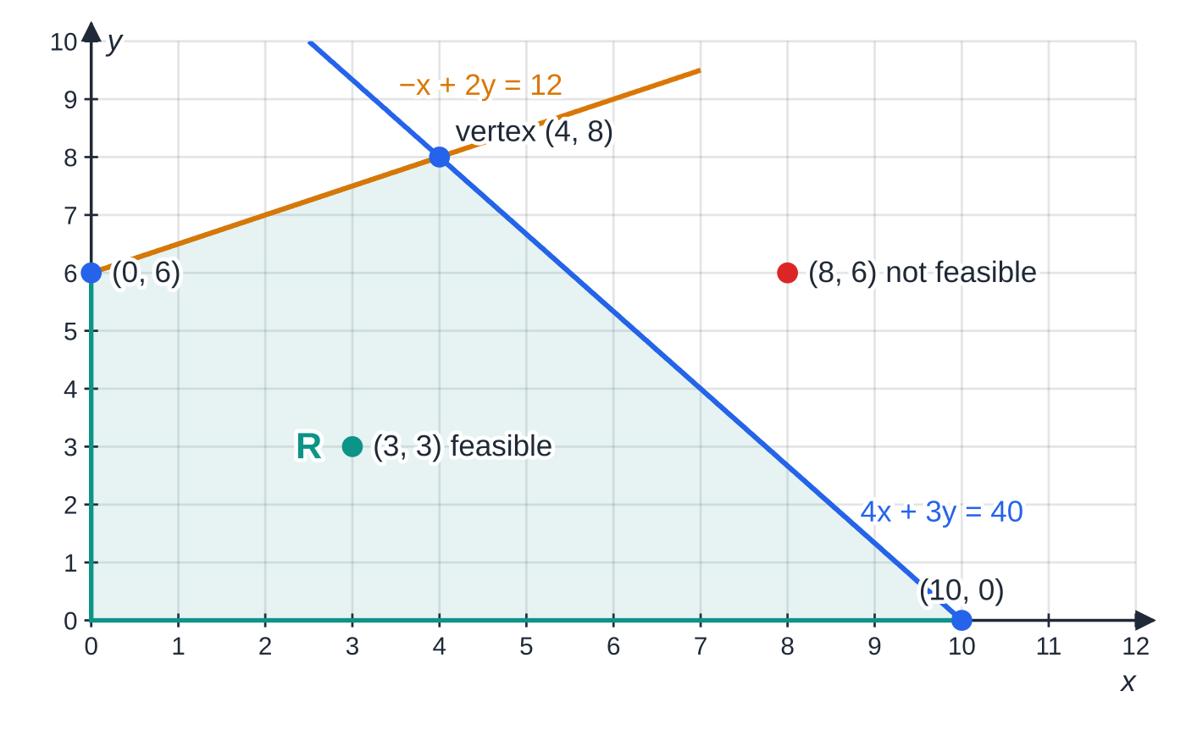
What is a linear programming problem? (continued)
Section 1 of 12
Objective function: the quantity to optimise, for example profit P = 15x + 12y (maximise) or cost C = 400x + 250y (minimise).
A feasible solution satisfies every constraint; the feasible region is the set of all feasible solutions; an optimal solution is a feasible solution with the best value of the objective. Because every boundary is a straight line, the feasible region is a convex polygon (or an unbounded convex region), and its corners are called vertices.
A feasible region R bounded by x ≥0, y ≥0, 4x + 3y ≤40 and -x + 2y ≤12. The point (3, 3) satisfies every constraint; (8, 6) breaks 4x + 3y ≤40. The optimum of a linear objective will be at one of the four vertices.
Notes:
What is a linear programming problem?. Full notes: https://examinerprep.com/notes/edexcel-ial-maths/linear-programming/

Slide 7
What is a linear programming problem? (continued)
Section 1 of 12
The standard layout of a formulation
Maximise (or minimise) P = ax + by subject to constraints, x ≥0, y ≥0
a, b = profit (or cost) per unit of each variable; each constraint is “(amount used per unit) × variable … ≤ (amount available)”. Not in the formulae list: learn the layout.
Notes:
What is a linear programming problem?. Full notes: https://examinerprep.com/notes/edexcel-ial-maths/linear-programming/

Slide 8
How do you formulate a problem from a description?
Section 2 of 12
Formulating is where most of the thinking happens. Work through the text in a fixed order:
1. Define the variables in words, with units and the time period.
2. Go through the text sentence by sentence; every limit, requirement or comparison becomes one inequality.
3. Write the objective and say whether it is maximised or minimised.
4. Add x ≥0, y ≥0 and simplify each constraint (divide by common factors, clear fractions).
The table translates the phrases that come up most often. Ratio and percentage conditions are the ones to slow down on: write them first exactly as the words say, then rearrange.
Words | Inequality
at least 20 tablets | y ≥20
no more than 16 deluxe benches | y ≤16
Notes:
How do you formulate a problem from a description?. Full notes: https://examinerprep.com/notes/edexcel-ial-maths/linear-programming/

Slide 9
How do you formulate a problem from a description? (continued)
Section 2 of 12
Words | Inequality
at least 60 devices in total | x + y ≥60
the number of standard benches is at most three times the number of deluxe benches | x ≤3y
at least a quarter of the devices are laptops | x ≥¼(x + y), i.e. y ≤3x
at least 2 rolls for every 3 loaves | y/x ≥⅔, i.e. 3y ≥2x
Notes:
How do you formulate a problem from a description?. Full notes: https://examinerprep.com/notes/edexcel-ial-maths/linear-programming/

Slide 10
How do you formulate a problem from a description? (continued)
Section 2 of 12 · Worked example 1 · Medium · Formulate
WORKED EXAMPLE · QUESTION
A pottery makes vases and bowls. Each vase uses 3 kg of clay and 1 hour of glazing; each bowl uses 2 kg of clay and 2 hours of glazing. Each week 60 kg of clay and 32 hours of glazing time are available. At least 3 bowls must be made each week. The profit is £15 on a vase and £12 on a bowl. Formulate this as a linear programming problem, stating your decision variables clearly.
SOLUTION
Variables. Let x = the number of vases and y = the number of bowls made each week.
Constraints, one sentence at a time: clay 3x + 2y ≤60; glazing x + 2y ≤32; bowls y ≥3; x ≥0.
Objective. Maximise P = 15x + 12y subject to 3x + 2y ≤60, x + 2y ≤32, y ≥3, x ≥0.
y ≥0 is already implied by y ≥3, so it does not need to be written separately (writing it is not wrong).
Notes:
How do you formulate a problem from a description?: Worked example 1. Full notes: https://examinerprep.com/notes/edexcel-ial-maths/linear-programming/

Slide 11
How do you formulate a problem from a description? (continued)
Section 2 of 12 · Worked example 2 · Medium · Formulate
WORKED EXAMPLE · QUESTION
A school buys laptops at £400 each and tablets at £250 each. It needs at least 60 devices, at least 20 of which are tablets, and at least a quarter of all the devices must be laptops. The school wants to keep the cost as low as possible. Formulate this as a linear programming problem, simplifying each constraint.
SOLUTION
Variables. x = number of laptops, y = number of tablets bought.
Constraints. x + y ≥60; y ≥20; x ≥¼(x + y) ⇒4x ≥x + y ⇒y ≤3x; x ≥0.
Minimise C = 400x + 250y subject to x + y ≥60, y ≥20, y ≤3x, x ≥0.
Notes:
How do you formulate a problem from a description?: Worked example 2. Full notes: https://examinerprep.com/notes/edexcel-ial-maths/linear-programming/

Slide 12
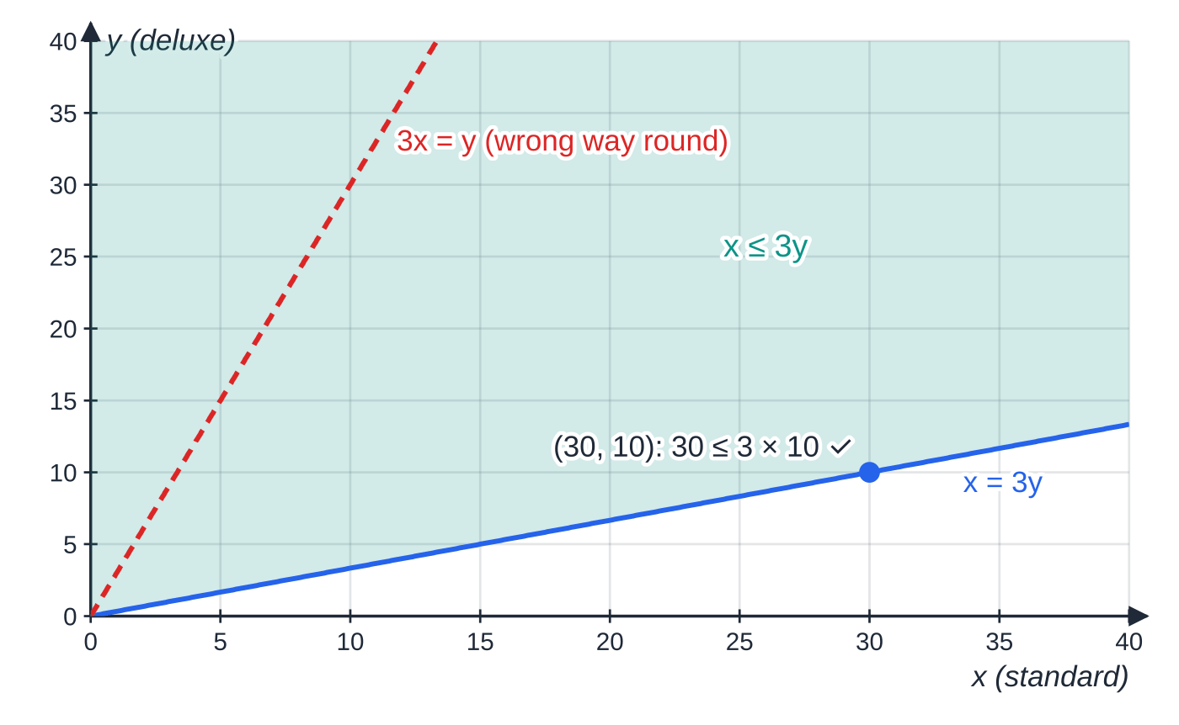
How do you formulate a problem from a description? (continued)
Section 2 of 12
Common error
Reversing a ratio. “At most three times as many standard as deluxe” means x ≤3y, not 3x ≤y. Test it with numbers: 30 standard and 10 deluxe should be allowed, and 30 ≤3 ×10 ✓.
The ratio constraint x ≤3y is the region above the line x = 3y (through O and (30, 10)). The dashed line 3x = y is what you get by reversing the ratio; it would forbid sensible plans such as 30 standard and 10 deluxe.
Notes:
How do you formulate a problem from a description?. Full notes: https://examinerprep.com/notes/edexcel-ial-maths/linear-programming/

Slide 13
How do you draw the feasible region?
Section 3 of 12
For each constraint draw the boundary line (replace the inequality sign by =), using two easy points, usually the intercepts.
Decide which side is allowed with a test point not on the line. O is easiest unless the line passes through it; then try (1, 0) or (0, 1).
Lines of the form y = mx, from ratio constraints, pass through the origin: plot a second point such as (10, 10m).
The feasible region R is where every constraint holds. Either shade the parts you do not want, leaving R clear, or shade R itself. Say which you have done, and label R.
Find each vertex by solving the equations of the two lines that cross there; do not rely on reading a graph if exact values are needed.
Notes:
How do you draw the feasible region?. Full notes: https://examinerprep.com/notes/edexcel-ial-maths/linear-programming/

Slide 14
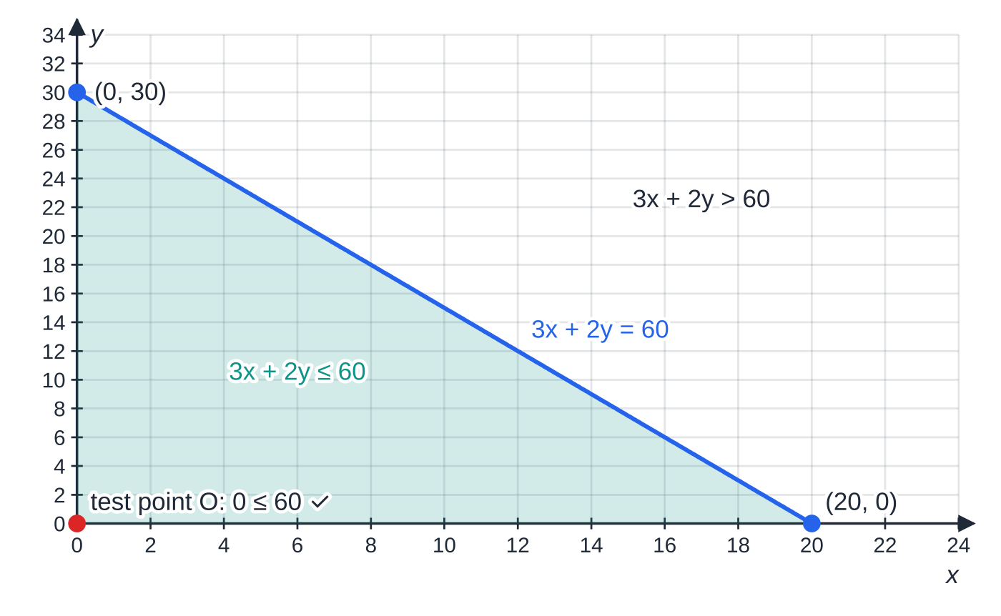
How do you draw the feasible region? (continued)
Section 3 of 12
The boundary 3x + 2y = 60 drawn through its intercepts (20, 0) and (0, 30). The test point O gives 0 ≤60, which is true, so the side containing O is allowed.
Notes:
How do you draw the feasible region?. Full notes: https://examinerprep.com/notes/edexcel-ial-maths/linear-programming/

Slide 15
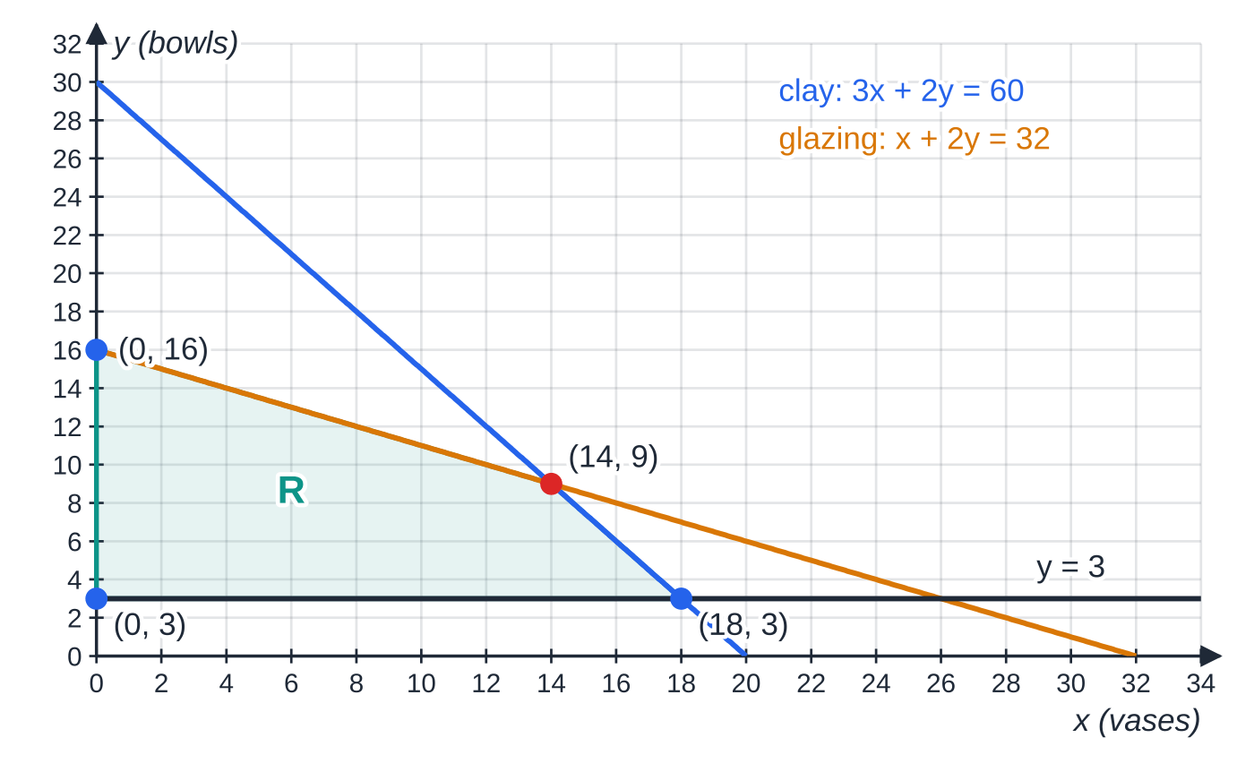
How do you draw the feasible region? (continued)
Section 3 of 12 · Worked example 3 · Medium · Draw, find
WORKED EXAMPLE · QUESTION
Continue worked example 1. Draw the feasible region R and find the coordinates of its vertices.
SOLUTION
Boundary lines from their intercepts: 3x + 2y = 60 through (20, 0) and (0, 30); x + 2y = 32 through (32, 0) and (0, 16); y = 3.
Sides. O satisfies the two ≤ constraints; R is above y = 3 and to the right of the y-axis.
The feasible region R for the pottery problem. The clay line and the glazing line cross at (14, 9); R lies above y = 3 and below both lines.
Notes:
How do you draw the feasible region?: Worked example 3. Full notes: https://examinerprep.com/notes/edexcel-ial-maths/linear-programming/

Slide 16
How do you draw the feasible region? (continued)
Section 3 of 12 · Worked example 3 · Medium · Draw, find (continued)
The vertex where clay and glazing both run out: (3x + 2y) - (x + 2y) = 60 - 32 ⇒2x = 28 ⇒x = 14, y = 9.
The other vertices: 3x + 2(3) = 60 ⇒(18, 3); and (0, 16), (0, 3). Vertices (0, 3), (18, 3), (14, 9), (0, 16).
Notes:
How do you draw the feasible region?: Worked example 3. Full notes: https://examinerprep.com/notes/edexcel-ial-maths/linear-programming/

Slide 17
How does the objective line (ruler) method work?
Section 4 of 12
For a fixed value of P, the equation ax + by = P is a straight line. Changing P moves the line but does not change its gradient, -a/b. So the objective lines form a family of parallel lines, and larger values of P (with a, b >0) lie further from O.
Draw one objective line accurately (pick a convenient value of P, such as a multiple of a and b) and place a ruler along it.
To maximise, slide the ruler parallel to itself away from O; the last point of R it touches is optimal.
To minimise, slide it towards O; the last point of R it touches is optimal.
The optimal point is at a vertex. Find it exactly by solving the two boundary equations that meet there.
If the objective line is parallel to an edge of R that it finishes on, every point on that edge is optimal.
Notes:
How does the objective line (ruler) method work?. Full notes: https://examinerprep.com/notes/edexcel-ial-maths/linear-programming/

Slide 18
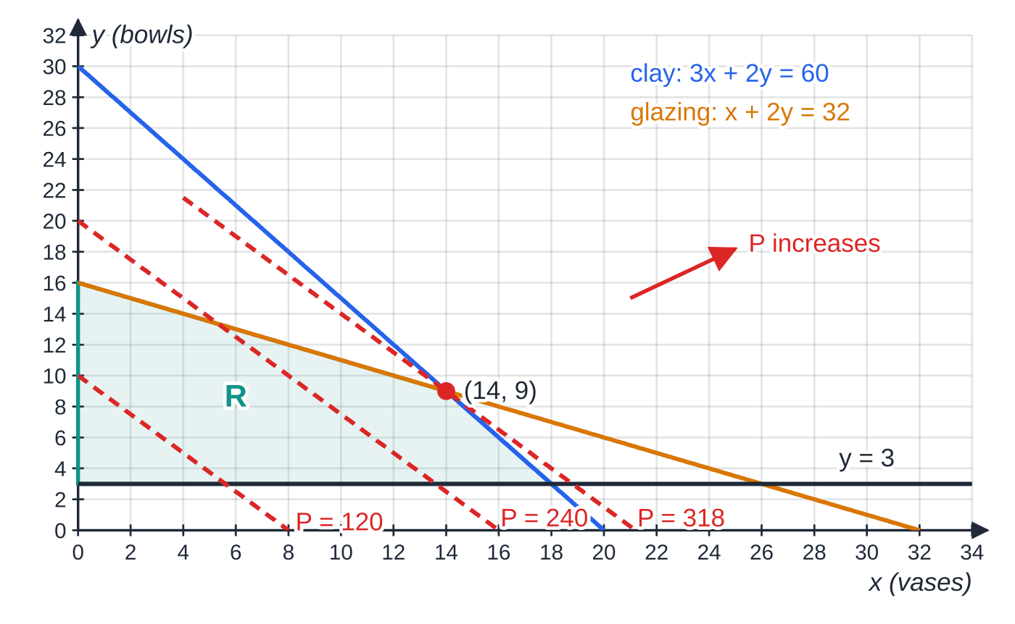
How does the objective line (ruler) method work? (continued)
Section 4 of 12
Which vertex is optimal?
For P = ax + by, the vertex is optimal when the gradient of the objective line, -a/b, lies between the gradients of the two edges that meet at that vertex. Not in the formulae list: derive it from the gradient of ax + by = c.
Objective lines 15x + 12y = 120, 240 and 318. They are parallel; moving away from O, the last point of R touched is the vertex (14, 9).
Notes:
How does the objective line (ruler) method work?. Full notes: https://examinerprep.com/notes/edexcel-ial-maths/linear-programming/

Slide 19
How does the objective line (ruler) method work? (continued)
Section 4 of 12 · Worked example 4 · Medium · Find, state
WORKED EXAMPLE · QUESTION
Continue worked example 3. Use the objective line method to find the number of vases and bowls the pottery should make to maximise its weekly profit, and state the maximum profit.
SOLUTION
Gradient of the objective line: 15x + 12y = c has gradient -(15/12) = -(5/4).
Compare with the edges: clay -(3/2), glazing -½. Since -(3/2) <-(5/4) <-½, the last point touched is where clay and glazing meet.
14 vases and 9 bowls per week; P = 15(14) + 12(9) = 318, a profit of £318.
At this point all the clay (3 ×14 + 2 ×9 = 60 kg) and all the glazing time (14 + 2 ×9 = 32 h) are used.
Notes:
How does the objective line (ruler) method work?: Worked example 4. Full notes: https://examinerprep.com/notes/edexcel-ial-maths/linear-programming/

Slide 20
How does the objective line (ruler) method work? (continued)
Section 4 of 12
Exam tip 1 — make the method visible
Draw the objective line clearly and label it, for example “15x + 12y = 120”, so that the method can be seen on your graph. An optimal point with no visible objective line or vertex testing is just a claim.
Notes:
How does the objective line (ruler) method work?. Full notes: https://examinerprep.com/notes/edexcel-ial-maths/linear-programming/

Slide 21
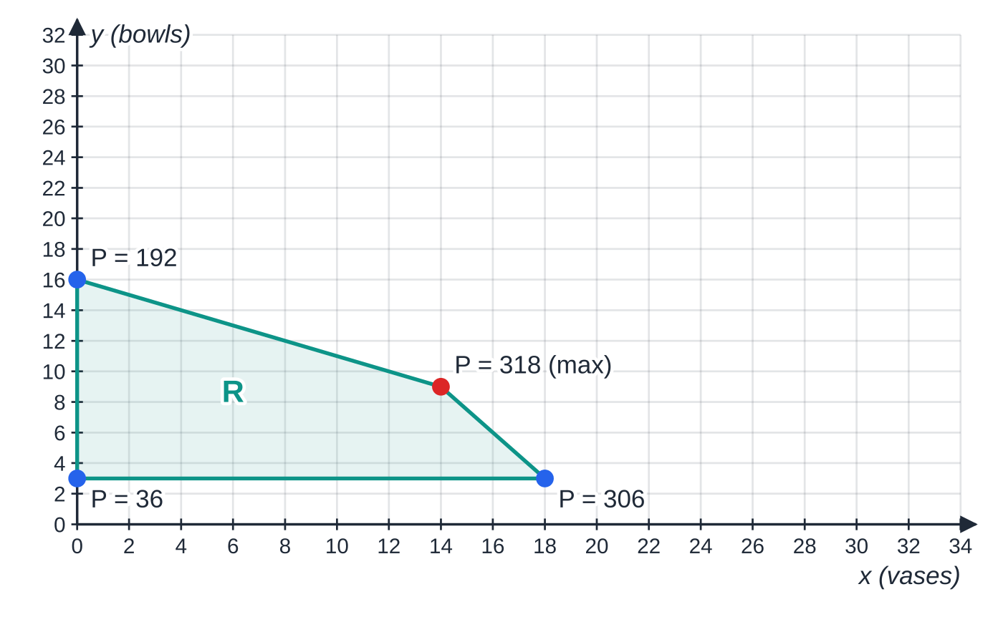
How does the vertex method work, and how do you minimise?
Section 5 of 12
The vertex method avoids drawing an objective line: find the exact coordinates of every vertex of R, evaluate the objective at each, and choose the largest (maximising) or smallest (minimising). It works because a linear objective on a convex region always takes its best value at a vertex. Set the work out as a table (vertex, value of the objective), then state the answer in context.
Minimising problems often have an unbounded region, because constraints like x + y ≥60 do not cap anything. A minimum can still exist, but there is no maximum.
The vertex method for the pottery: P = 15x + 12y at each corner of R. The largest value, 318, is at (14, 9), agreeing with the objective line method.
Notes:
How does the vertex method work, and how do you minimise?. Full notes: https://examinerprep.com/notes/edexcel-ial-maths/linear-programming/

Slide 22
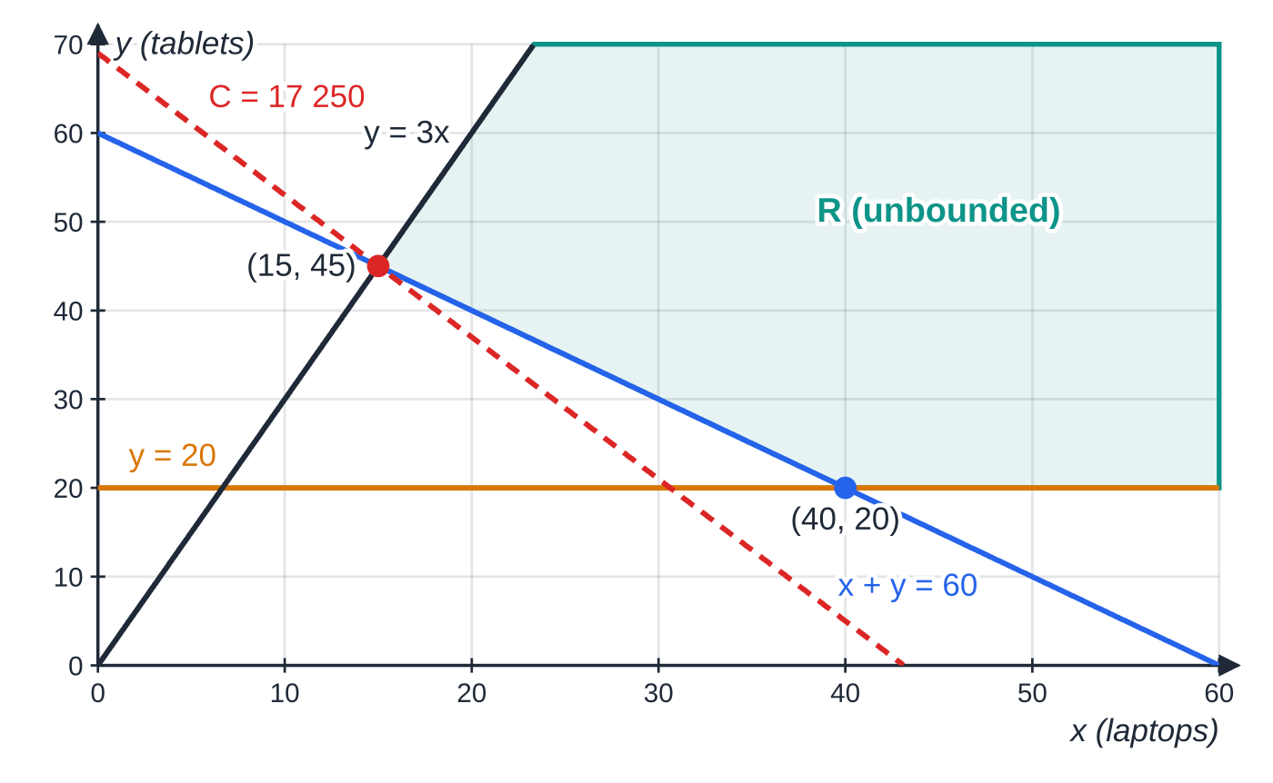
How does the vertex method work, and how do you minimise? (continued)
Section 5 of 12
Checking only the listed vertices is enough, because the objective increases as you move away into R.
An unbounded region for the devices problem. Sliding the cost line towards O, the last point of R touched is (15, 45); the other vertex, (40, 20), costs more.
Notes:
How does the vertex method work, and how do you minimise?. Full notes: https://examinerprep.com/notes/edexcel-ial-maths/linear-programming/

Slide 23
How does the vertex method work, and how do you minimise? (continued)
Section 5 of 12 · Worked example 5 · Medium · Find, hence
WORKED EXAMPLE · QUESTION
Continue worked example 2. Find the vertices of the feasible region and hence the number of laptops and tablets that minimises the cost. State the minimum cost.
SOLUTION
Vertices. x + y = 60 and y = 3x: 4x = 60 ⇒(15, 45). x + y = 60 and y = 20 ⇒(40, 20).
Vertex | C = 400x + 250y
(15, 45) | 6000 + 11 250 = 17 250
(40, 20) | 16 000 + 5000 = 21 000
15 laptops and 45 tablets, minimum cost £17 250.
The region is unbounded, but moving further into it only raises the cost (for example (100, 20) costs £45 000), so the minimum is at a vertex.
Notes:
How does the vertex method work, and how do you minimise?: Worked example 5. Full notes: https://examinerprep.com/notes/edexcel-ial-maths/linear-programming/

Slide 24
How does the vertex method work, and how do you minimise? (continued)
Section 5 of 12
Common error
For a minimising problem, sliding the objective line away from O, or quoting a “maximum” for an unbounded region. Ask which way the objective gets better, then slide that way.
Notes:
How does the vertex method work, and how do you minimise?. Full notes: https://examinerprep.com/notes/edexcel-ial-maths/linear-programming/

Slide 25
What if the answer must be a whole number?
Section 6 of 12
When the variables count objects (vases, buses, batches) the solution must be an integer point of R. If the optimal vertex is not an integer point, the best integer solution is usually near it, but not always the point you get by rounding.
List the integer points close to the vertex, check each one against every constraint and evaluate the objective at the feasible ones.
Alternatively, slide the objective line back from the vertex until it meets the first integer point in R.
Rounding both coordinates down keeps you feasible for ≤ constraints but is often not optimal; rounding up can break a constraint.
Notes:
What if the answer must be a whole number?. Full notes: https://examinerprep.com/notes/edexcel-ial-maths/linear-programming/

Slide 26
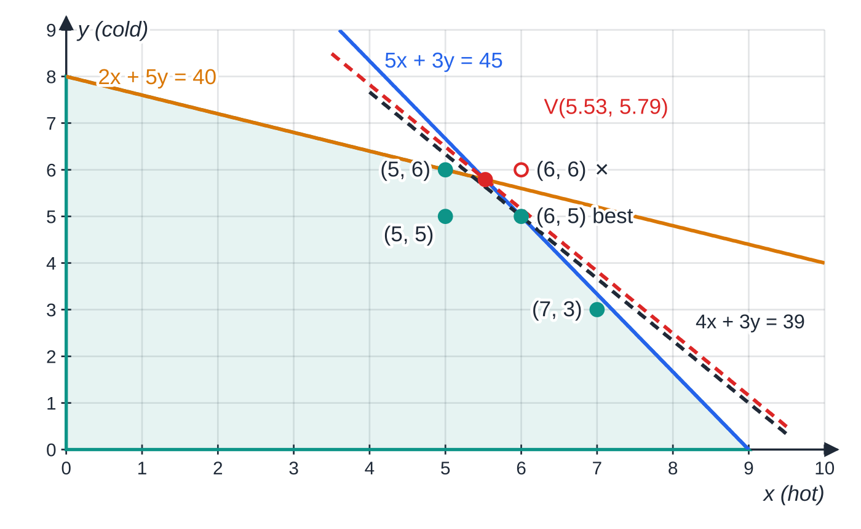
What if the answer must be a whole number? (continued)
Section 6 of 12 · Worked example 6 · Hard · Find
WORKED EXAMPLE · QUESTION
A caterer prepares x batches of hot meals and y batches of cold meals each day, where 5x + 3y ≤45 (kitchen hours), 2x + 5y ≤40 (fridge space) and x, y ≥0. The profit is £40 per batch of hot meals and £30 per batch of cold meals. Only whole batches can be made. Find the number of batches of each type that maximises the profit.
SOLUTION
Optimal vertex. The objective gradient -(4/3) lies between -(5/3) and -(2/5), so the optimum is where the two constraints meet:
The optimal vertex V((105/19), (110/19)) ≈(5.53, 5.79) is not an integer point. Of the nearby integer points, (6, 5) lies in R and gives the largest profit; the black dashed line 4x + 3y = 39 through it lies just behind the red objective line through V.
Notes:
What if the answer must be a whole number?: Worked example 6. Full notes: https://examinerprep.com/notes/edexcel-ial-maths/linear-programming/

Slide 27
What if the answer must be a whole number? (continued)
Section 6 of 12 · Worked example 6 · Hard · Find (continued)
25x + 15y = 225 and 6x + 15y = 120 ⇒19x = 105 ⇒V((105/19), (110/19)) ≈(5.53, 5.79), P ≈394.7.
Test integer points near V against both constraints:
Point | 5x + 3y ≤45? | 2x + 5y ≤40? | P = 40x + 30y
(5, 5) | 40 ✓ | 35 ✓ | 350
(5, 6) | 43 ✓ | 40 ✓ | 380
(6, 5) | 45 ✓ | 37 ✓ | 390
(6, 6) | 48 ✗ | 42 ✗ | not feasible
(7, 3) | 44 ✓ | 29 ✓ | 370
6 batches of hot and 5 batches of cold meals, profit £390.
Why nothing beats 390: P = 10(4x + 3y) and the largest value of 4x + 3y in R is (750/19) ≈39.5.
Notes:
What if the answer must be a whole number?: Worked example 6. Full notes: https://examinerprep.com/notes/edexcel-ial-maths/linear-programming/

Slide 28
What if the answer must be a whole number? (continued)
Section 6 of 12 · Worked example 6 · Hard · Find (continued)
For integers 4x + 3y is a whole number, so it is at most 39, giving P ≤390. Rounding V down to (5, 5) gives only £350.
Notes:
What if the answer must be a whole number?: Worked example 6. Full notes: https://examinerprep.com/notes/edexcel-ial-maths/linear-programming/

Slide 29
How do the pieces fit together in a full question?
Section 7 of 12
A long question usually runs: formulate → draw and label R → find the optimum with an objective line or the vertices → interpret. It sometimes asks how far a profit could change before the optimal plan changes; that is the gradient comparison from the ruler-method section, run backwards.
Notes:
How do the pieces fit together in a full question?. Full notes: https://examinerprep.com/notes/edexcel-ial-maths/linear-programming/

Slide 30
How do the pieces fit together in a full question? (continued)
Section 7 of 12 · Worked example 7 · Hard · Formulate, draw, find
WORKED EXAMPLE · QUESTION
A workshop makes standard and deluxe garden benches. A standard bench needs 2 hours of cutting and 4 hours of finishing; a deluxe bench needs 3 hours of cutting and 3 hours of finishing. Each week there are 60 hours of cutting and 90 hours of finishing available. Only 16 sets of deluxe fittings arrive each week, and the number of standard benches made must not be more than three times the number of deluxe benches. The profit is £30 on a standard bench and £40 on a deluxe bench.
(a) Formulate this as a linear programming problem. (b) Draw the constraints and label the feasible region R. (c) Use the objective line method to find the optimal number of each bench, and the maximum weekly profit. (d) The profit on a deluxe bench changes to £k, the profit on a standard bench staying at £30. Find the range of values of k for which your answer to (c) remains optimal.
Notes:
How do the pieces fit together in a full question?: Worked example 7. Full notes: https://examinerprep.com/notes/edexcel-ial-maths/linear-programming/

Slide 31
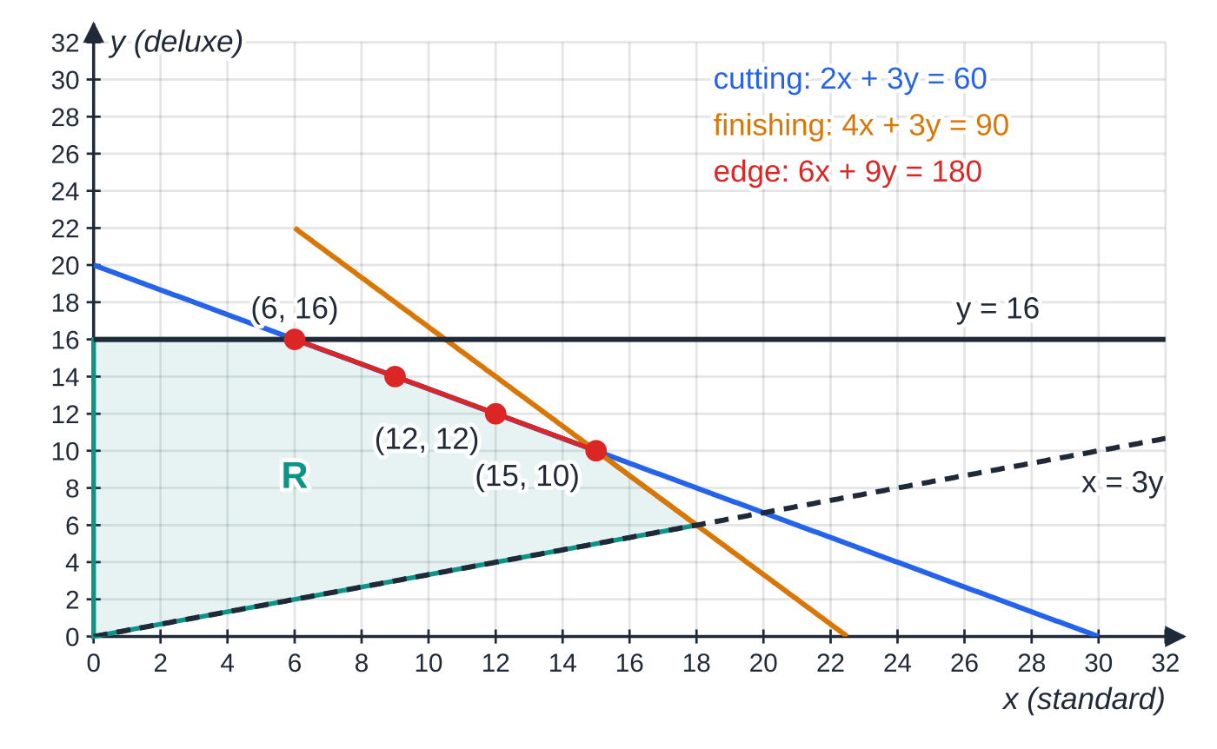
How do the pieces fit together in a full question? (continued)
Section 7 of 12 · Worked example 7 · Hard · Formulate, draw, find (continued)
SOLUTION
(a) x = number of standard and y = number of deluxe benches made each week. Maximise P = 30x + 40y subject to 2x + 3y ≤60, 4x + 3y ≤90, y ≤16, x ≤3y, x, y ≥0.
(b) Lines through (30, 0) and (0, 20); (22.5, 0) and (0, 30); y = 16; x = 3y through O and (18, 6). R has vertices (0, 0), (18, 6), (15, 10), (6, 16), (0, 16).
If the objective is parallel to an edge, the whole edge is optimal. With P = 6x + 9y = 3(2x + 3y), every point from (6, 16) to (15, 10) gives P = 180, including the integer points (9, 14) and (12, 12).
Notes:
How do the pieces fit together in a full question?: Worked example 7. Full notes: https://examinerprep.com/notes/edexcel-ial-maths/linear-programming/

Slide 32
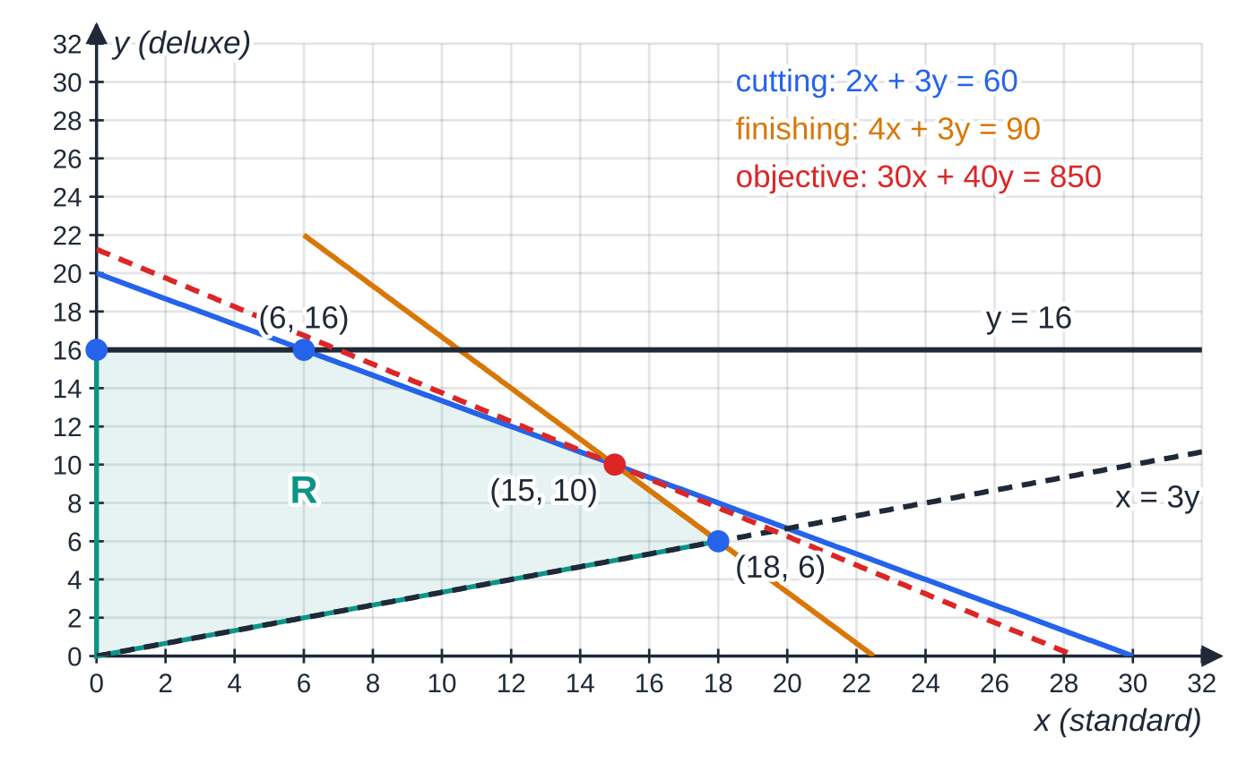
How do the pieces fit together in a full question? (continued)
Section 7 of 12 · Worked example 7 · Hard · Formulate, draw, find (continued)
(c) Objective gradient -(30/40) = -¾, between -(4/3) (finishing) and -⅔ (cutting). (4x + 3y) - (2x + 3y) = 90 - 60 ⇒2x = 30 ⇒x = 15, y = 10. 15 standard and 10 deluxe benches, P = 450 + 400 = 850, i.e. £850.
Check by the vertex method: P = 0, 780, 850, 820, 640 at the five vertices, and 850 is the largest ✓.
(d) (15, 10) stays optimal while the gradient -30/k lies between -(4/3) and -⅔: ⅔ ≤30/k ≤(4/3) ⇒ 22.5 ≤k ≤45.
Worked example 7. The objective line 30x + 40y = 850 touches R only at (15, 10), where the cutting and finishing lines meet.
Notes:
How do the pieces fit together in a full question?: Worked example 7. Full notes: https://examinerprep.com/notes/edexcel-ial-maths/linear-programming/

Slide 33
How do the pieces fit together in a full question? (continued)
Section 7 of 12 · Worked example 7 · Hard · Formulate, draw, find (continued)
At k = 45 or k = 22.5 the objective line lies along an edge, so (15, 10) is still optimal but no longer the only optimum.
Notes:
How do the pieces fit together in a full question?: Worked example 7. Full notes: https://examinerprep.com/notes/edexcel-ial-maths/linear-programming/

Slide 34
Exam tips for D1.5
Section 8 of 12
Exam tip 2 — define the variables in full
“Let x = vases” is too vague. Write “let x be the number of vases made each week”. The definition decides whether the constraints and the objective make sense.
Exam tip 3 — simplify before you draw
Divide each constraint by any common factor: 400x + 250y ≤20 000 becomes 8x + 5y ≤400. Smaller numbers make intercepts, sketches and simultaneous equations quicker and safer.
Exam tip 4 — draw accurately and label everything
Use a ruler, extend lines across the whole grid, label each line with its equation and label the feasible region R. A small error in a line can move the optimal vertex.
Notes:
Exam tips for D1.5. Full notes: https://examinerprep.com/notes/edexcel-ial-maths/linear-programming/

Slide 35
Exam tips for D1.5 (continued)
Section 8 of 12
Exam tip 5 — find vertices by algebra and answer in context
Read the graph to see which two lines meet at the optimum, then solve their equations simultaneously: exact coordinates such as ((105/19), (110/19)) cannot be read from a grid. Finish with a sentence in context, and if whole numbers are needed give the integer solution, not the vertex.
Notes:
Exam tips for D1.5. Full notes: https://examinerprep.com/notes/edexcel-ial-maths/linear-programming/

Slide 36
Common misconceptions
Section 9 of 12
Misconception | Why it is wrong | Correct idea
The non-negativity constraints are obvious, so leave them out. | They are part of the model, and they bound the region. | Always state x ≥0, y ≥0 (unless implied by a stronger constraint such as y ≥3).
“x is at most three times y” means 3x ≤y. | The multiplier belongs with the smaller quantity. | x ≤3y; test with numbers, e.g. x = 30, y = 10 should satisfy it.
The optimal point can be inside R. | A linear objective always improves by moving towards an edge. | The optimum is at a vertex (or along a whole edge).
Round the optimal vertex to the nearest integers. | Rounding can leave R or miss a better point. | Test nearby integer points against every constraint and compare objective values.
For a minimum, slide the objective line away from O. | Moving away from O increases ax + by when a, b >0. | Minimise: slide towards O; maximise: slide away from O.
An unbounded region has no optimal solution. | It has no maximum for a positive objective, but it can have a minimum. | Check which way the objective improves before deciding.
Notes:
Common misconceptions. Full notes: https://examinerprep.com/notes/edexcel-ial-maths/linear-programming/

Slide 37
How this topic connects
Section 10 of 12
P1 Straight-line graphs and inequalities
Every constraint boundary is a straight line; intercepts, gradients (-a ÷b) and simultaneous equations are the tools for drawing R and finding its vertices. Shading the region that satisfies a linear inequality is the same skill as in P1.
D1.4 Critical path analysis and other D1 topics
Like critical path analysis and minimum spanning trees, linear programming is about finding the best plan under restrictions; here the restrictions are inequalities and the plan is a point on a graph.
Beyond this unit
Real problems with many variables are solved with the simplex algorithm and computer solvers; the two-variable graphical method shows why the optimum always lies at a corner.
Notes:
How this topic connects. Full notes: https://examinerprep.com/notes/edexcel-ial-maths/linear-programming/

Slide 38
Key formulae
Section 11 of 12
Formula | Use | In the formulae list?
maximise/minimise P = ax + by, subject to constraints, x ≥0, y ≥0 | Layout of a formulation | No — learn it
gradient of ax + by = c is -a/b | Objective lines and boundary lines | No — derive it
intercepts of ax + by = c: (c/a, 0) and (0, c/b) | Drawing a constraint line | No — derive it
“at least p% are x”: x ≥p/100(x + y) | Percentage constraints | No — learn it
“at least m of y for every n of x”: ny ≥mx | Ratio constraints | No — learn it
vertex stays optimal while -a/b lies between the gradients of the two edges meeting there | Sensitivity of the optimum to the objective | No — derive it
Notes:
Key formulae. Full notes: https://examinerprep.com/notes/edexcel-ial-maths/linear-programming/

Slide 39
Check your understanding
Section 12 of 12
1. x red tiles and y blue tiles are used. The number of red tiles must be at most twice the number of blue tiles. Write this as an inequality.
2. Why is the optimal value of a linear objective always found at a vertex of the feasible region?
3. In worked example 7 the profit becomes P = 6x + 9y. What happens to the optimal solution?
4. A feasible region has vertices (0, 0), (10, 0), (4, 8) and (0, 6), as in the first figure. Find the maximum of P = 3x + y.
5. The feasible region for a problem is unbounded. Can you always find a minimum? A maximum?
6. In worked example 1, the profit on a bowl rises to £20 while a vase stays at £15. Does (14, 9) remain optimal?
Notes:
Check your understanding: questions. Full notes: https://examinerprep.com/notes/edexcel-ial-maths/linear-programming/

Slide 40
Check your understanding · answers
Section 12 of 12
1. x ≤2y. Check: 20 red and 10 blue is allowed, 20 ≤20 ✓.
2. The objective lines are parallel. Sliding one across R in the improving direction, the last contact with a convex polygon is at a corner, or along a whole edge if the line is parallel to that edge, which still includes the corners at each end.
3. 6x + 9y = 3(2x + 3y) is parallel to the cutting line, so every point on the edge from (6, 16) to (15, 10) gives the maximum P = 180. The integer points on that edge are (6, 16), (9, 14), (12, 12) and (15, 10).
4. P = 0, 30, 20, 6 at the four vertices, so the maximum is 30 at (10, 0).
5. For an objective with positive coefficients and the region away from O, there is no maximum (it increases without limit), but a minimum exists at a vertex. Check the direction in which the objective improves.
6. The objective gradient is now -(15/20) = -¾, which is still between -(3/2) (clay) and -½ (glazing), so yes: (14, 9) remains optimal, with P = 15(14) + 20(9) = 390, i.e. £390.
Notes:
Check your understanding: answers. Full notes: https://examinerprep.com/notes/edexcel-ial-maths/linear-programming/

Slide 41
Practice questions
2 original exam-style questions. Answers at the end of the deck.

Slide 42
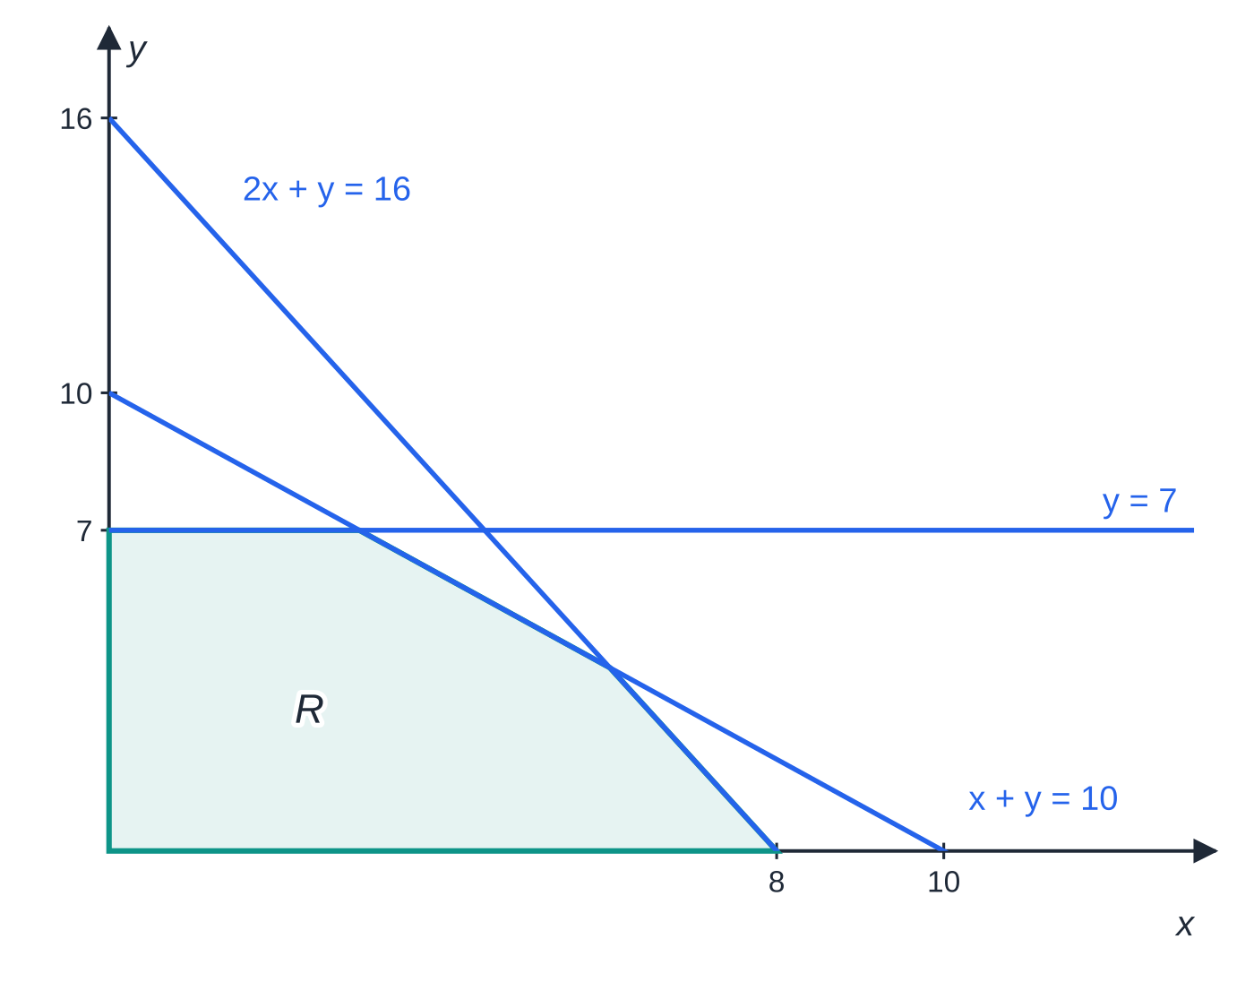
Question 1
5 marks
The feasible region R of a linear programming problem is defined by
x + y ≤ 10, 2x + y ≤ 16, y ≤ 7, x ≥ 0, y ≥ 0.
Figure: the region R (shaded); not to scale
(a) Find the coordinates of the vertex of R where x + y = 10 meets 2x + y = 16, and of the vertex where y = 7 meets x + y = 10. [2]
(b) Use the vertex method to find the maximum value of P = 5x + 4y on R, and the point at which it occurs. [3]
Notes:
Online with the full mark scheme: https://examinerprep.com/ial-maths-d1-5-linear-programming-questions#IALM-D1-5-B-02

Slide 43
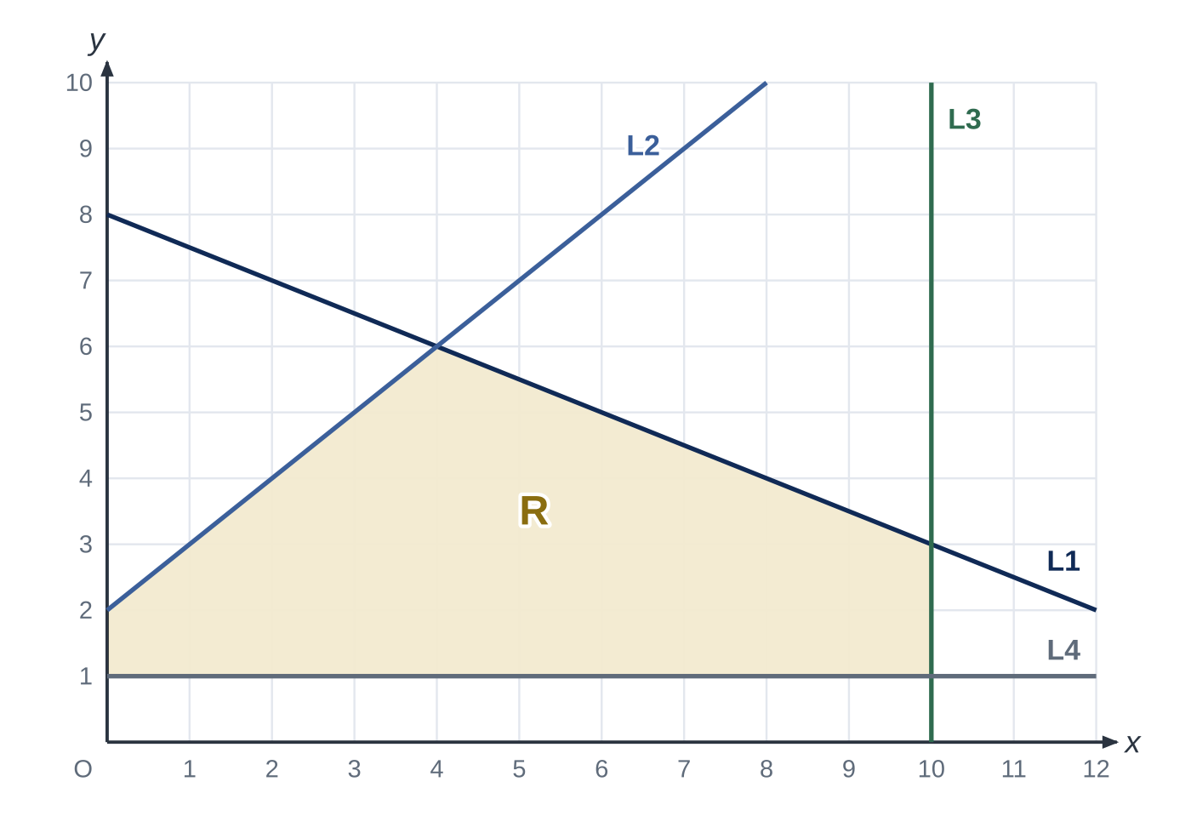
Question 2
6 marks
Figure 1 shows four straight lines L1, L2, L3 and L4 and the shaded region R, which is the feasible region of a linear programming problem. The y-axis also forms part of the boundary of R.
(a) Find the equations of L1 and L2. [2]
(b) Write down the four inequalities, other than x ≥ 0, that define R. [2]
(c) Use the vertex method to find the maximum value of P = 3x + 4y on R, and the point at which it occurs. [2]
Notes:
Online with the full mark scheme: https://examinerprep.com/ial-maths-d1-5-linear-programming-questions#IALM-D1-5-FB-01

Slide 44
Answers

Slide 45
Question 1 · answer
Mark scheme
subtracting: x = 6, y = 4, so (6, 4)
y = 7 gives x = 3, so (3, 7)
vertices (0, 0), (8, 0), (6, 4), (3, 7), (0, 7)
P = 0, 40, 46, 43, 28 respectively
maximum P = 46 at (6, 4)
Notes:
Full mark scheme: https://examinerprep.com/ial-maths-d1-5-linear-programming-questions#IALM-D1-5-B-02

Slide 46
Question 2 · answer
Mark scheme
L1 passes through (0, 8) with gradient −½: x + 2y = 16
L2 passes through (0, 2) with gradient 1: y = x + 2
x + 2y ≤ 16 and y ≤ x + 2
x ≤ 10 and y ≥ 1
vertices (0, 1), (10, 1), (10, 3), (4, 6), (0, 2) give P = 4, 34, 42, 36, 8
maximum P = 42 at (10, 3)
Notes:
Full mark scheme: https://examinerprep.com/ial-maths-d1-5-linear-programming-questions#IALM-D1-5-FB-01

Slide 47
Keep practising
Notes for this topic
Questions on this topic
Build a printable test
ExaminerPrep is an independent tutoring service. It has been developed independently from and is not endorsed by the International Baccalaureate Organization. "International Baccalaureate", "IB" and "IB Diploma Programme" are registered trademarks of the IBO, used here for descriptive purposes only.
Pearson Edexcel and Cambridge are trademarks of their owners; ExaminerPrep is not affiliated with any exam board.

