Slide 1
EP
EDEXCEL IAL MATHS
S1.2 Measures of location and dispersion
The full notes page in 13 sections · practice questions with answers · simulations
ExaminerPrep is an independent tutoring service. It has been developed independently from and is not endorsed by the International Baccalaureate Organization. "International Baccalaureate", "IB" and "IB Diploma Programme" are registered trademarks of the IBO, used here for descriptive purposes only.
Pearson Edexcel and Cambridge are trademarks of their owners; ExaminerPrep is not affiliated with any exam board.
Notes:
S1.2 Measures of location and dispersion. Notes for this topic: https://examinerprep.com/notes/edexcel-ial-maths/measures-of-location-and-dispersion/

Slide 2
What this page covers
Overview
Mean, median and mode for raw lists, discrete frequency tables and grouped data
Quartiles and percentiles of a list, the range and the interquartile range
Variance and standard deviation, including from Σx, Σx² and Σfx, Σfx²
Estimating the mean and standard deviation of grouped data from midpoints
Interpolation for the median, quartiles and percentiles of grouped data, with class boundaries
Coding: how adding, subtracting, multiplying and dividing change the mean and standard deviation
Comparing data sets; combining groups; adding, removing or correcting a value
Notes:
What this page covers. Full notes: https://examinerprep.com/notes/edexcel-ial-maths/measures-of-location-and-dispersion/

Slide 3
In one minute
Key points
1. A data set is summarised by a measure of location (mean, median or mode) and a measure of spread (range, IQR or standard deviation), and two data sets are compared using one of each, in context.
2. Mean x̄=Σx÷n (or Σfx÷Σf); median = middle value; mode = most common value (modal class for grouped data).
3. Lists: for the median and quartiles find n/2, n/4, 3n/4. Not a whole number → round up; a whole number k → average the kth and (k+1)th values.
4. Grouped data: interpolate. Median = lower boundary + (n/2-cf before)/(class frequency) × class width.
5. Variance σ²=Σx²/n-x̄² ("mean of the squares minus square of the mean"); σ=√(variance).
6. Coding y=(x-a)/b: ȳ=(x̄-a)/b and σ_y=σₓ/b. Shifting does not change the spread.
Notes:
In one minute. Full notes: https://examinerprep.com/notes/edexcel-ial-maths/measures-of-location-and-dispersion/

Slide 4
What do the mean, median and mode measure?
Section 1 of 13
Measure of location.
A single value that represents the centre, or a typical value, of a set of data. x̄=Σx/n x̄=Σfx/Σf where f is the frequency of the value x (for grouped data, x is the class midpoint) and Σf=n.
The median is the middle value when the data are in order; for n values it is the (n+1)/2th value, which is the same as the rule "n/2: round up, or average the two values either side if n/2 is a whole number". The mode is the value with the highest frequency; a data set can have no mode or several. For grouped data quote the modal class (highest frequency density if the widths differ).
The three behave differently. The mean uses every value, so one extreme value can drag it a long way. The median and mode do not care how extreme the largest or smallest values are. That difference decides which average to use.
Notes:
What do the mean, median and mode measure?. Full notes: https://examinerprep.com/notes/edexcel-ial-maths/measures-of-location-and-dispersion/

Slide 5
What do the mean, median and mode measure? (continued)
Section 1 of 13 · Worked example 1 · Easy · Find
WORKED EXAMPLE · QUESTION
A courier records the number of parcels, x, delivered to one office on each of 40 days.
Parcels, x | 0 | 1 | 2 | 3 | 4 | 5
Frequency, f | 6 | 11 | 9 | 7 | 4 | 3
Find (a) the mode, (b) the median, (c) the mean number of parcels per day.
Notes:
What do the mean, median and mode measure?: Worked example 1. Full notes: https://examinerprep.com/notes/edexcel-ial-maths/measures-of-location-and-dispersion/

Slide 6
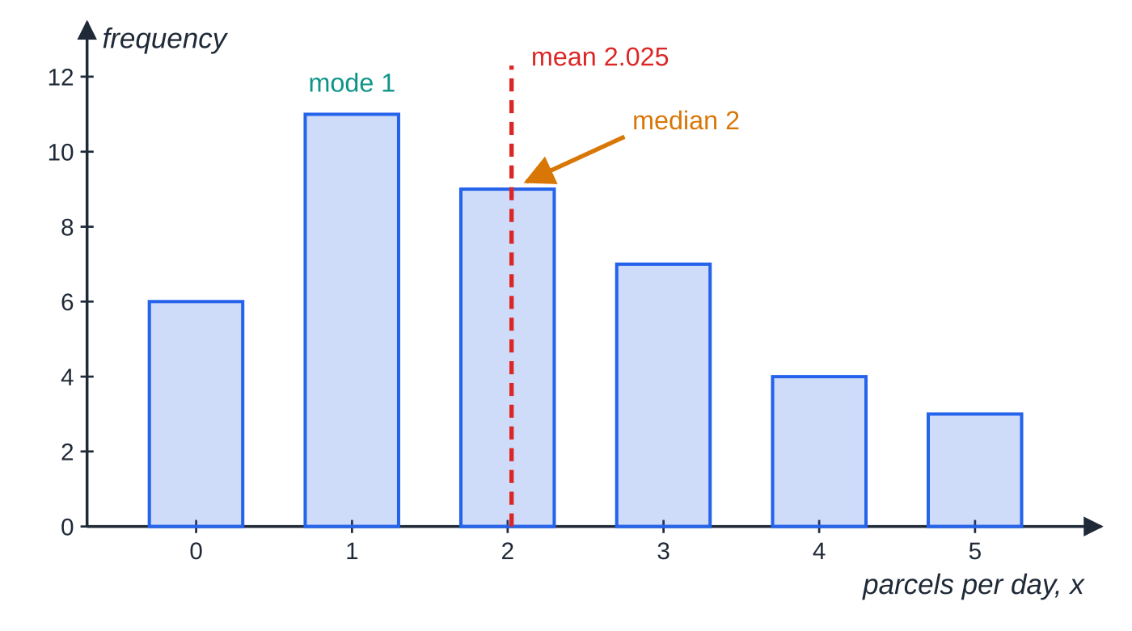
What do the mean, median and mode measure? (continued)
Section 1 of 13 · Worked example 1 · Easy · Find (continued)
SOLUTION
(a) The highest frequency is 11, so mode = 1.
(b) n/2=20 is a whole number, so average the 20th and 21st values. Cumulative frequencies are 6, 17, 26, …, so the 18th to 26th values are all 2: median = 2.
(c) Σfx=0×6+1×11+2×9+3×7+4×4+5×3=81, so x̄=(81/40)= 2.025 parcels per day. The mean need not be a possible data value.
Parcels delivered on 40 days. The tallest bar gives the mode 1; the 20th and 21st values are both 2, so the median is 2; the mean is 81 ÷ 40 = 2.025.
Notes:
What do the mean, median and mode measure?: Worked example 1. Full notes: https://examinerprep.com/notes/edexcel-ial-maths/measures-of-location-and-dispersion/

Slide 7
How do you find quartiles and percentiles of a list?
Section 2 of 13
Quartiles Q₁, Q₂, Q₃ are the values a quarter, a half and three quarters of the way through the ordered data. Positions in a list of n ordered values: Q₁: n/4, Q₂: n/2, Q₃: 3n/4, rth percentile: rn/100. Not a whole number → round up and take that value; a whole number k → the mean of the kth and (k+1)th values.
Three measures of spread come from these positions. The range (largest − smallest) is quick but decided entirely by the two most extreme values. The interquartile range IQR=Q₃-Q₁ is the spread of the middle half. An interpercentile range, such as P₉₀-P₁₀, is the spread of the middle 80%. Always put the data in order first; with a frequency table, use cumulative frequencies to find a position.
Notes:
How do you find quartiles and percentiles of a list?. Full notes: https://examinerprep.com/notes/edexcel-ial-maths/measures-of-location-and-dispersion/

Slide 8
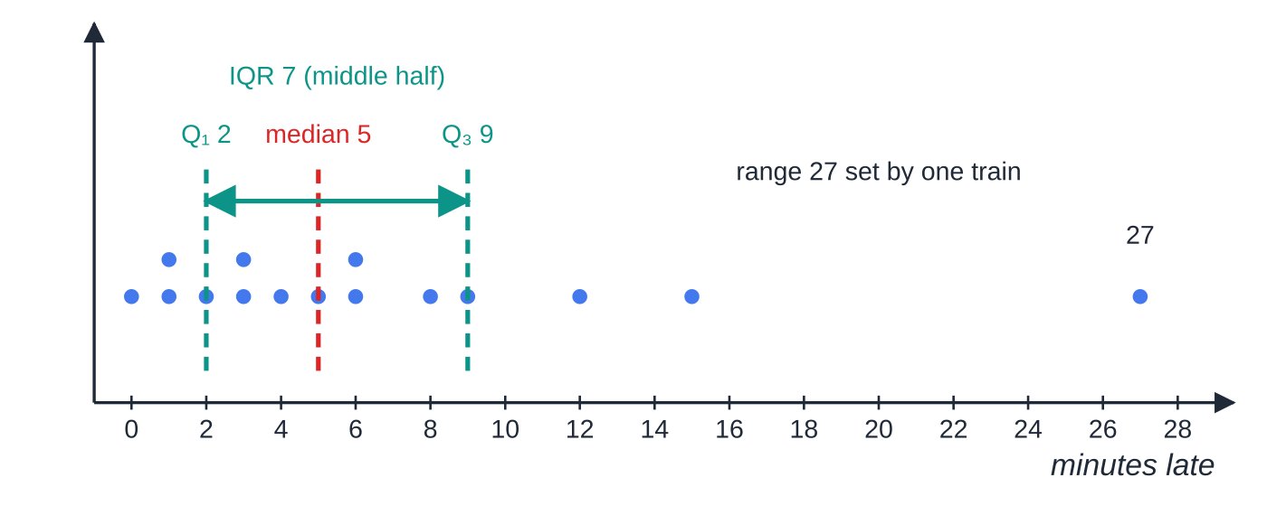
How do you find quartiles and percentiles of a list? (continued)
Section 2 of 13 · Worked example 2 · Medium · Find
WORKED EXAMPLE · QUESTION
The numbers of minutes that 15 trains arrived late were 0, 1, 1, 2, 3, 3, 4, 5, 6, 6, 8, 9, 12, 15, 27. (a) Find the median and the interquartile range. (b) Find the 10th and 90th percentiles. (c) A 16th train arrives 20 minutes late. Find the new median.
SOLUTION
(a) n=15. Median: 15/2=7.5→ 8th value; Q₁: 15/4=3.75→ 4th; Q₃: 45/4=11.25→ 12th. Median = 5, Q₁=2, Q₃=9, so median 5 min, IQR 7 min.
(b) 10×15/100=1.5→ 2nd value;
The 15 late trains as a dot plot. The IQR (7) describes the typical spread; the range (27) is set by a single very late train.
Notes:
How do you find quartiles and percentiles of a list?: Worked example 2. Full notes: https://examinerprep.com/notes/edexcel-ial-maths/measures-of-location-and-dispersion/

Slide 9
How do you find quartiles and percentiles of a list? (continued)
Section 2 of 13 · Worked example 2 · Medium · Find (continued)
90×15/100=13.5→ 14th value: P₁₀=1, P₉₀=15.
(c) n=16, 16/2=8 is a whole number, so average the 8th and 9th values of the new list: (5+6)/2= 5.5 min.
Notes:
How do you find quartiles and percentiles of a list?: Worked example 2. Full notes: https://examinerprep.com/notes/edexcel-ial-maths/measures-of-location-and-dispersion/

Slide 10
How do you find quartiles and percentiles of a list? (continued)
Section 2 of 13
Common error
Taking the 4th value as Q₁ for 16 values. 16/4=4 is a whole number, so Q₁ is the mean of the 4th and 5th values; in part (c) that is (2+3)÷2=2.5.
Notes:
How do you find quartiles and percentiles of a list?. Full notes: https://examinerprep.com/notes/edexcel-ial-maths/measures-of-location-and-dispersion/

Slide 11
How do you calculate the variance and standard deviation?
Section 3 of 13
Standard deviation.
A measure of the typical distance of the values from their mean, in the same units as the data. With divisor n: σ²=(Σ(x-x̄)²)/n=Σx²/n-x̄²=Sₓₓ/n, σ=√(σ²) For frequency tables σ²=Σfx²/Σf-x̄², and Sₓₓ=Σx²-(Σx)²/n.
The first form explains the idea: measure each value's deviation from the mean, square it so that negatives do not cancel, and average. The second form is the one you calculate with. Variance is in squared units (years², cm²); the standard deviation is back in the units of the data.
Notes:
How do you calculate the variance and standard deviation?. Full notes: https://examinerprep.com/notes/edexcel-ial-maths/measures-of-location-and-dispersion/

Slide 12
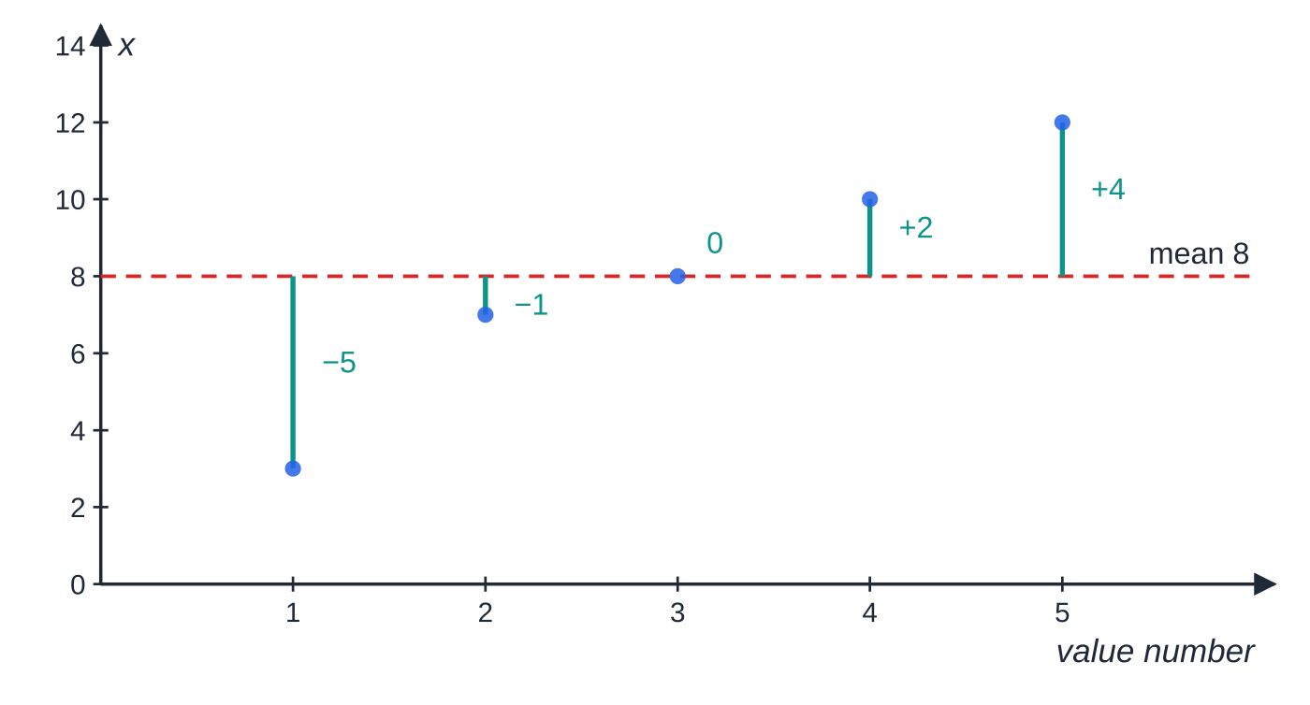
How do you calculate the variance and standard deviation? (continued)
Section 3 of 13
Deviations from the mean for 3, 7, 8, 10, 12. Their squares 25, 1, 0, 4, 16 add to 46; 46÷5=9.2 is the variance, so σ=3.03.
Notes:
How do you calculate the variance and standard deviation?. Full notes: https://examinerprep.com/notes/edexcel-ial-maths/measures-of-location-and-dispersion/

Slide 13
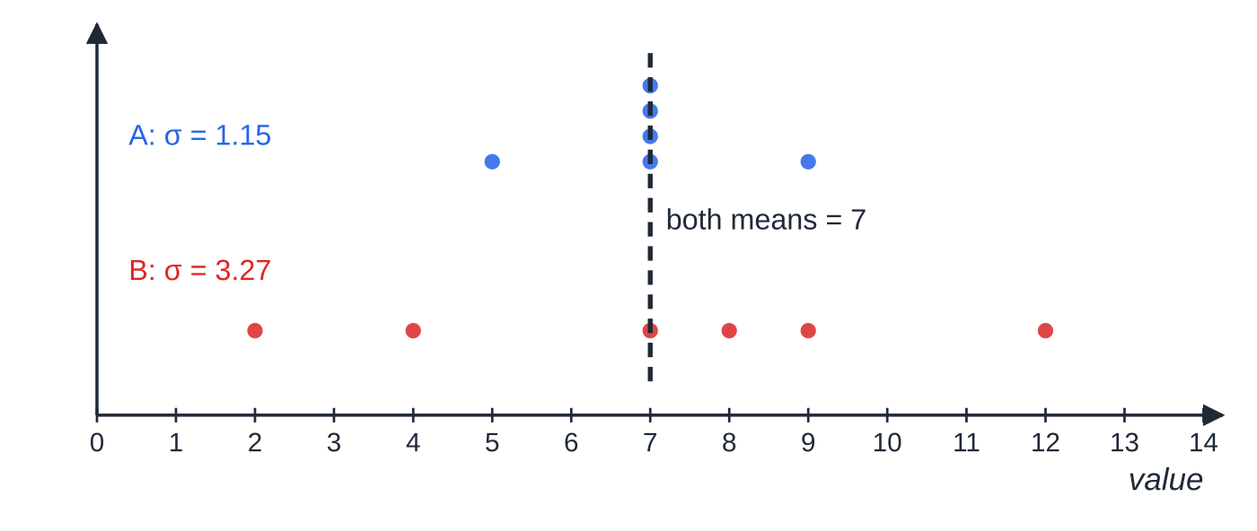
How do you calculate the variance and standard deviation? (continued)
Section 3 of 13
The order matters: Σx²÷n first, then subtract x̄².
A variance can never be negative. A negative answer means a slip, usually (Σx)² in place of Σx².
Keep x̄ at full accuracy before squaring it; rounding first can change the third significant figure of σ.
Adding a value equal to the mean leaves the mean unchanged and makes the standard deviation smaller (the same total spread shared among more values).
Set A (5, 7, 7, 7, 7, 9) and set B (2, 4, 7, 8, 9, 12) both have mean 7, but B is much more spread out: its standard deviation is nearly three times as large.
Notes:
How do you calculate the variance and standard deviation?. Full notes: https://examinerprep.com/notes/edexcel-ial-maths/measures-of-location-and-dispersion/

Slide 14
How do you calculate the variance and standard deviation? (continued)
Section 3 of 13
Using your calculator
In statistics mode, enter the data (with a frequency column if needed) and read off x̄, σₓ, Σx and Σx². Use σₓ (divisor n), not sₓ.
Still write the sums down: if a later part adds or corrects a value, you need them.
Notes:
How do you calculate the variance and standard deviation?. Full notes: https://examinerprep.com/notes/edexcel-ial-maths/measures-of-location-and-dispersion/

Slide 15
How do you calculate the variance and standard deviation? (continued)
Section 3 of 13 · Worked example 3 · Medium · Find
WORKED EXAMPLE · QUESTION
The ages, x years, of the 25 members of a choir give Σx=1150 and Σx²=54 610. (a) Find the mean and the standard deviation of the ages. (b) A new member aged 46 joins. Find the new mean and standard deviation.
SOLUTION
(a) x̄=(1150/25)=46 years. σ²=54 610/25-46²=2184.4-2116=68.4, so mean 46 years, σ=8.27 years (3 s.f.).
(b) Update the sums: Σx=1196, Σx²=54 610+46²=56 726, n=26. x̄=(1196/26)=46; σ²=56 726/26-46²=65.8, so mean 46 years, σ=8.11 years.
Check by Sₓₓ: 54 610-1150²/25=1710 and 1710÷25=68.4. The new value adds 0 to Sₓₓ but 1 to n.
Notes:
How do you calculate the variance and standard deviation?: Worked example 3. Full notes: https://examinerprep.com/notes/edexcel-ial-maths/measures-of-location-and-dispersion/

Slide 16
How do you estimate the mean and standard deviation of grouped data?
Section 4 of 13
In grouped data the individual values are lost, so assume every value in a class sits at the class midpoint, then use Σfx÷Σf and Σfx²÷Σf-x̄². The answers are estimates; say so. The midpoint is halfway between the class boundaries: for 0≤t<10 it is 5; for ages "20–29" in whole years the boundaries are 20 and 30, midpoint 25; for lengths "20–29" to the nearest mm the boundaries are 19.5 and 29.5, midpoint 24.5.
Notes:
How do you estimate the mean and standard deviation of grouped data?. Full notes: https://examinerprep.com/notes/edexcel-ial-maths/measures-of-location-and-dispersion/

Slide 17
How do you estimate the mean and standard deviation of grouped data? (continued)
Section 4 of 13 · Worked example 4 · Medium · Estimate
WORKED EXAMPLE · QUESTION
The journey times, t minutes, of 70 commuters are summarised below. Estimate the mean and the standard deviation of the journey times.
Time, t (min) | Frequency | Midpoint | Cumulative frequency
0≤t<10 | 8 | 5 | 8
10≤t<15 | 14 | 12.5 | 22
15≤t<20 | 21 | 17.5 | 43
20≤t<30 | 17 | 25 | 60
30≤t<50 | 10 | 40 | 70
Notes:
How do you estimate the mean and standard deviation of grouped data?: Worked example 4. Full notes: https://examinerprep.com/notes/edexcel-ial-maths/measures-of-location-and-dispersion/

Slide 18
How do you estimate the mean and standard deviation of grouped data? (continued)
Section 4 of 13 · Worked example 4 · Medium · Estimate (continued)
SOLUTION
Σfx=40+175+367.5+425+400=1407.5, so x̄=(1407.5/70)=20.107…
Σfx²=8×5²+14×12.5²+21×17.5²+17×25²+10×40²=35 443.75
σ²=35 443.75/70-20.107…²=102.04, so mean ≈ 20.1 min, σ ≈ 10.1 min.
Notes:
How do you estimate the mean and standard deviation of grouped data?: Worked example 4. Full notes: https://examinerprep.com/notes/edexcel-ial-maths/measures-of-location-and-dispersion/

Slide 19
How do you estimate the mean and standard deviation of grouped data? (continued)
Section 4 of 13
Exam tip — add columns
Add a midpoint column and an fx column to the table, and write the totals Σfx and Σfx² in your answer. If the final value slips, those totals still show your method.
Notes:
How do you estimate the mean and standard deviation of grouped data?. Full notes: https://examinerprep.com/notes/edexcel-ial-maths/measures-of-location-and-dispersion/

Slide 20
How do you interpolate for the median, quartiles and percentiles?
Section 5 of 13
Linear interpolation in a grouped frequency table.
value=L+(p-C)/f_c×w p = position (n/2 for the median, n/4 and 3n/4 for the quartiles, rn/100 for the rth percentile); L = lower class boundary of the class containing position p; C = cumulative frequency up to L; f_c = frequency of that class; w = class width.
Interpolation assumes the values are spread evenly through the class, which is why the answer is an estimate. This page uses n/2, not (n+1)/2, for grouped data. The formula is not something to memorise blindly: it simply says "go (p-C)/f_c of the way through the class".
Notes:
How do you interpolate for the median, quartiles and percentiles?. Full notes: https://examinerprep.com/notes/edexcel-ial-maths/measures-of-location-and-dispersion/

Slide 21
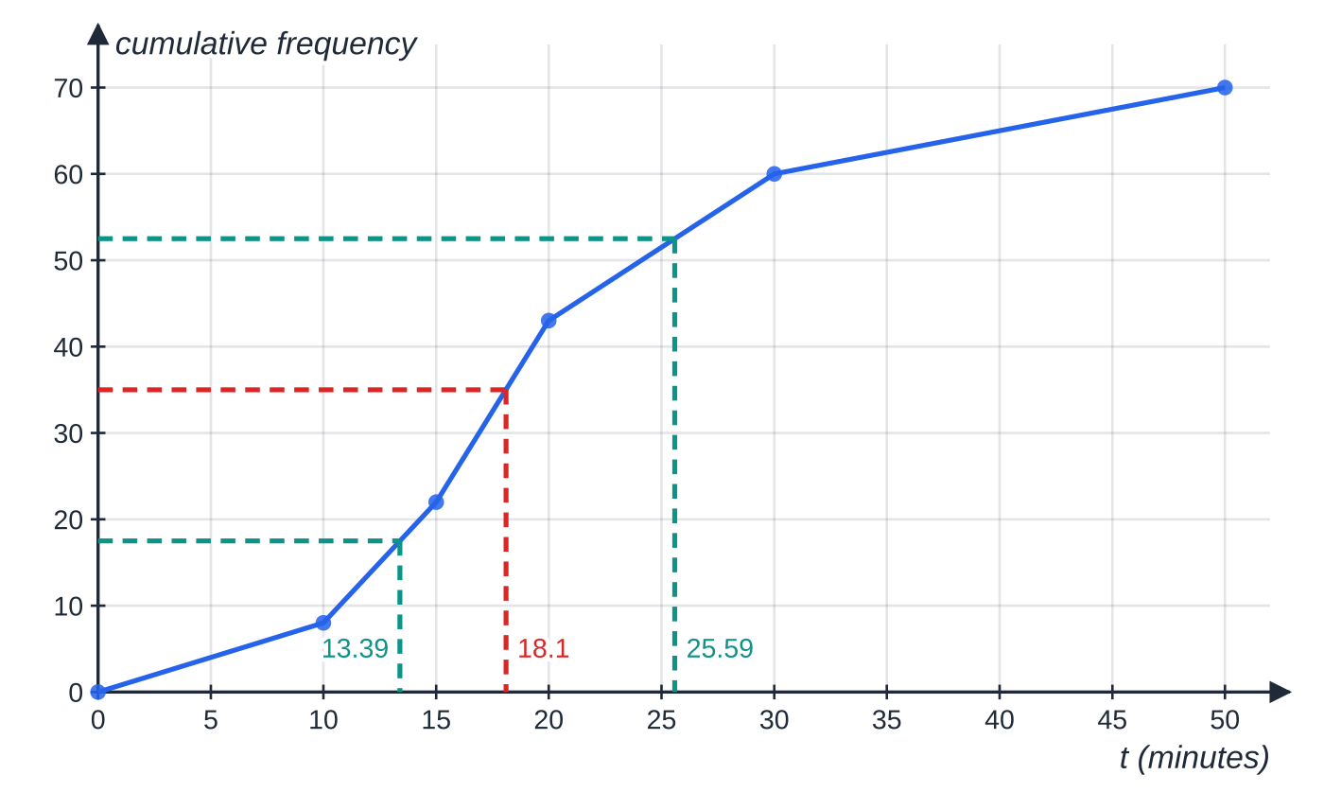
How do you interpolate for the median, quartiles and percentiles? (continued)
Section 5 of 13
The cumulative frequency polygon of the journey times. Joining the points with straight lines is exactly linear interpolation, so reading across from 17.5, 35 and 52.5 gives the same quartiles as the formula.
Notes:
How do you interpolate for the median, quartiles and percentiles?. Full notes: https://examinerprep.com/notes/edexcel-ial-maths/measures-of-location-and-dispersion/

Slide 22
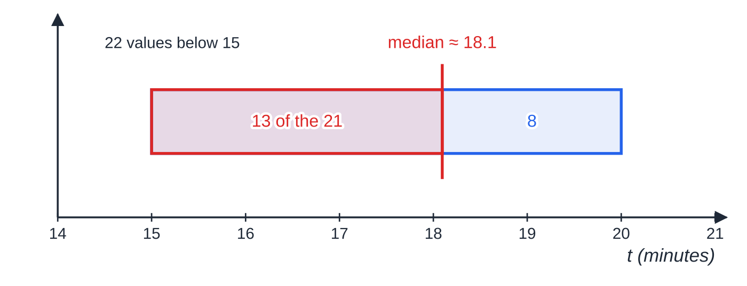
How do you interpolate for the median, quartiles and percentiles? (continued)
Section 5 of 13
Inside the median class 15≤t<20: 22 values are below 15 and the median is the 35th, so we need 13 of the 21 values in this class, (13/21) of the way through its width of 5.
Notes:
How do you interpolate for the median, quartiles and percentiles?. Full notes: https://examinerprep.com/notes/edexcel-ial-maths/measures-of-location-and-dispersion/

Slide 23
How do you interpolate for the median, quartiles and percentiles? (continued)
Section 5 of 13 · Worked example 5 · Medium · Estimate
WORKED EXAMPLE · QUESTION
Use the journey-time table in Worked example 4. (a) Estimate the median and the interquartile range. (b) Estimate the 10th to 90th interpercentile range.
SOLUTION
(a) Median position 70/2=35, in 15≤t<20 (cumulative frequencies 22, 43): Q₂=15+(35-22)/21×5=18.1 min.
Q₁: position 17.5, in 10≤t<15: Q₁=10+(17.5-8)/14×5=13.39. Q₃: position 52.5, in 20≤t<30: Q₃=20+(52.5-43)/17×10=25.59. Median 18.1 min, IQR = 25.59 − 13.39 = 12.2 min.
(b) P₁₀: position 7, in 0≤t<10: 0+(7/8)×10=8.75. P₉₀: position 63, in 30≤t<50: 30+(63-60)/10×20=36. Range 36 − 8.75 = 27.25 min.
Notes:
How do you interpolate for the median, quartiles and percentiles?: Worked example 5. Full notes: https://examinerprep.com/notes/edexcel-ial-maths/measures-of-location-and-dispersion/

Slide 24
How do you interpolate for the median, quartiles and percentiles? (continued)
Section 5 of 13
Common error
Using the stated class limits instead of the boundaries. Lengths recorded to the nearest cm as "30–34" and "35–39" have boundaries 29.5, 34.5, 39.5, so L=34.5 and w=5 for the class 35–39, not L=35 and w=4.
Notes:
How do you interpolate for the median, quartiles and percentiles?. Full notes: https://examinerprep.com/notes/edexcel-ial-maths/measures-of-location-and-dispersion/

Slide 25
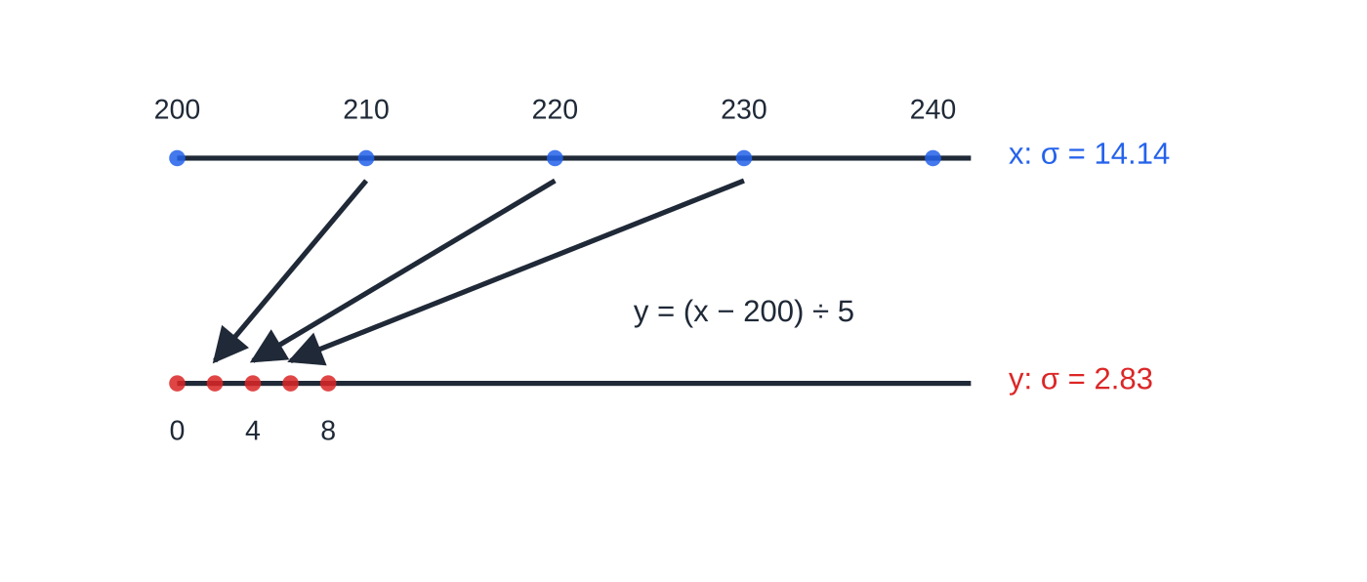
How does coding change the mean and standard deviation?
Section 6 of 13
Coding y=(x-a)/b.
ȳ=(x̄-a)/b, σ_y=σₓ/b, σ_y²=σₓ²/b² Reverse it to decode: x̄=bȳ+a and σₓ=bσ_y (for b>0).
Adding or subtracting moves every value by the same amount: the centre moves, the spread does not. Multiplying or dividing scales every distance, so it changes both. The same rules hold for the median and quartiles (the IQR divides by b; subtracting a does not change it).
Coding 200, 210, 220, 230, 240 with y=(x-200)÷5. Subtracting 200 slides the data to start at 0; dividing by 5 squeezes every gap by a factor of 5. So ȳ=(220-200)÷5=4 and the standard deviation drops from 14.14 to 2.83.
Notes:
How does coding change the mean and standard deviation?. Full notes: https://examinerprep.com/notes/edexcel-ial-maths/measures-of-location-and-dispersion/

Slide 26
How does coding change the mean and standard deviation? (continued)
Section 6 of 13 · Worked example 6 · Medium · Find, hence
WORKED EXAMPLE · QUESTION
The daily output, x kg, of a machine is recorded on 20 days. The data are coded using y=(x-200)/5, giving Σy=34 and Σy²=182. (a) Find the mean and standard deviation of y. (b) Hence find the mean and standard deviation of x. (c) Find Σx and Σx².
SOLUTION
(a) ȳ=(34/20)=1.7; σ_y²=(182/20)-1.7²=9.1-2.89=6.21; σ_y=2.4920…
(b) Decode with x=5y+200: x̄=5×1.7+200= 208.5 kg; σₓ=5×2.4920…= 12.5 kg.
(c) Σx=20×208.5= 4170. σₓ²=25×6.21=155.25, so Σx²=20×(155.25+208.5²)= 872 550.
Notes:
How does coding change the mean and standard deviation?: Worked example 6. Full notes: https://examinerprep.com/notes/edexcel-ial-maths/measures-of-location-and-dispersion/

Slide 27
How does coding change the mean and standard deviation? (continued)
Section 6 of 13
Common error
Adding 200 back on to the standard deviation, or multiplying the variance by 5 instead of 25. Only the scaling factor affects spread: σₓ=5σ_y, σₓ²=25σ_y².
Notes:
How does coding change the mean and standard deviation?. Full notes: https://examinerprep.com/notes/edexcel-ial-maths/measures-of-location-and-dispersion/

Slide 28
How do you compare and combine data sets?
Section 7 of 13
A comparison needs one measure of location and one measure of spread, each in context: "the median time for group A is higher, so group A were generally slower". Use median and IQR when the data contain extreme values or are not symmetrical; use mean and standard deviation when the data are roughly symmetrical with no extreme values, because they use every value.
Combining two groups: never average the two means. Recover each group's Σx=nx̄ and Σx²=n(σ²+x̄²), add, then use the formulae on the totals. For example, 30 values with mean 62 and s.d. 5, and 20 values with mean 70 and s.d. 4: Σx=1860+1400=3260, Σx²=116 070+98 320=214 390, so the combined mean is 3260÷50=65.2 and the combined s.d. is √(214 390÷50-65.2²)=√36.76=6.06.
Correcting a value: if a value p was recorded as q, replace it in both sums: Σx-q+p and Σx²-q²+p².
Notes:
How do you compare and combine data sets?. Full notes: https://examinerprep.com/notes/edexcel-ial-maths/measures-of-location-and-dispersion/

Slide 29
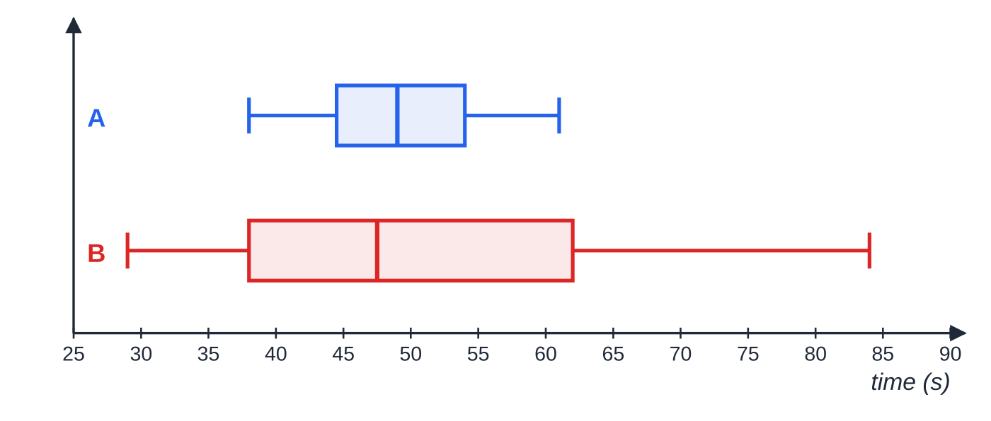
How do you compare and combine data sets? (continued)
Section 7 of 13 · Worked example 7 · Medium · Find, compare
WORKED EXAMPLE · QUESTION
Two groups of 12 people each completed a puzzle. Their times, in seconds, were
A: 38, 41, 44, 45, 47, 48, 50, 52, 53, 55, 58, 61
B: 29, 33, 36, 40, 42, 46, 49, 55, 60, 64, 70, 84
(a) For group A, find the median and the interquartile range. (b) For group B the median is 47.5 s and the interquartile range is 24 s. Compare the two groups. (c) Find the mean time of all 24 people.
Box plots of the two groups on one scale. The medians are close (49 s and 47.5 s), but B's box is about two and a half times as wide: its times are much less consistent.
Notes:
How do you compare and combine data sets?: Worked example 7. Full notes: https://examinerprep.com/notes/edexcel-ial-maths/measures-of-location-and-dispersion/

Slide 30
How do you compare and combine data sets? (continued)
Section 7 of 13 · Worked example 7 · Medium · Find, compare (continued)
SOLUTION
(a) n=12: 12/2 = 6, 12/4 = 3 and 36/4 = 9 are whole numbers, so average pairs. Median =(48+50)/2=49; Q₁=(44+45)/2=44.5; Q₃=(53+55)/2=54. Median 49 s, IQR 9.5 s.
(b) The medians are similar (49 s and 47.5 s), so a typical person in each group took about the same time. Group B's IQR (24 s) is much larger than group A's (9.5 s), so group B's times were much more varied.
(c) Add the totals, not the means: Σx=592+608=1200, so mean =(1200/24)= 50 s.
Notes:
How do you compare and combine data sets?: Worked example 7. Full notes: https://examinerprep.com/notes/edexcel-ial-maths/measures-of-location-and-dispersion/

Slide 31
How do you compare and combine data sets? (continued)
Section 7 of 13
Group B contains one very slow time (84 s). The median and IQR are not affected by how extreme it is, which is why they are the better pair to compare here.
Notes:
How do you compare and combine data sets?. Full notes: https://examinerprep.com/notes/edexcel-ial-maths/measures-of-location-and-dispersion/

Slide 32
How do the pieces fit together in a full question?
Section 8 of 13
Longer questions combine a grouped table, coding for the mean and standard deviation, interpolation for the median and quartiles, and an interpretation. Keep full accuracy in the middle of the working and round only the final answers.
Notes:
How do the pieces fit together in a full question?. Full notes: https://examinerprep.com/notes/edexcel-ial-maths/measures-of-location-and-dispersion/

Slide 33
How do the pieces fit together in a full question? (continued)
Section 8 of 13 · Worked example 8 · Hard · Estimate
WORKED EXAMPLE · QUESTION
The masses, m grams, of 80 apples from an orchard are summarised in the table.
Mass, m (g) | 100≤m<120 | 120≤m<130 | 130≤m<140 | 140≤m<150 | 150≤m<170 | 170≤m<200
Frequency | 7 | 15 | 24 | 19 | 11 | 4
The midpoints of the classes are coded using y=(m-135)/5. (a) Use the coding to estimate the mean and the standard deviation of the masses. (b) Use interpolation to estimate the median mass. (c) Estimate the interquartile range. (d) Estimate the number of apples whose masses lie within one standard deviation of the mean.
Notes:
How do the pieces fit together in a full question?: Worked example 8. Full notes: https://examinerprep.com/notes/edexcel-ial-maths/measures-of-location-and-dispersion/

Slide 34
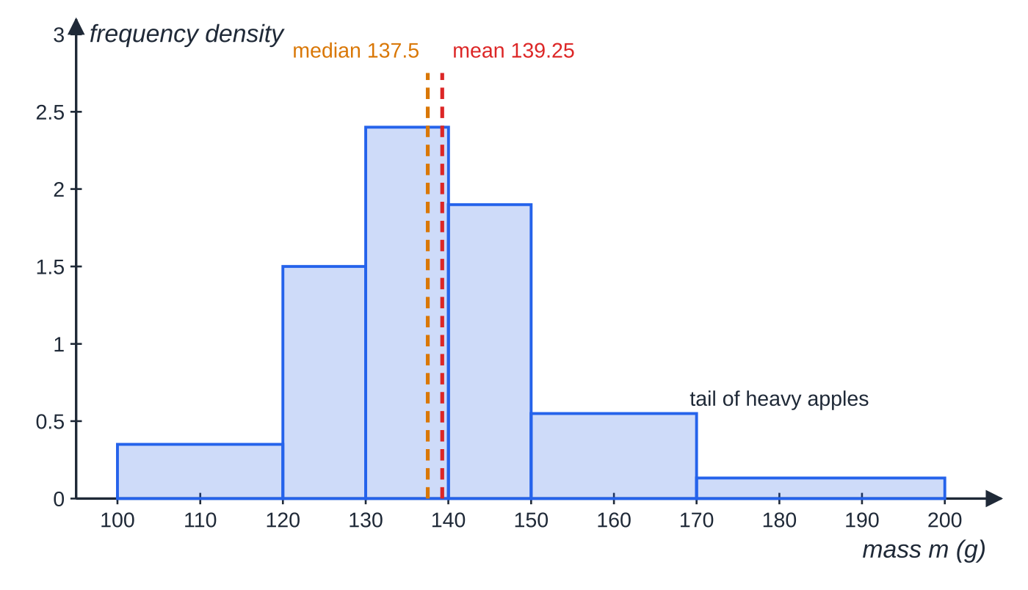
How do the pieces fit together in a full question? (continued)
Section 8 of 13 · Worked example 8 · Hard · Estimate (continued)
Histogram of the 80 apple masses (heights are frequency densities). The estimated mean, 139.25 g, is a little above the estimated median, 137.5 g, because of the long tail of heavy apples.
Notes:
How do the pieces fit together in a full question?: Worked example 8. Full notes: https://examinerprep.com/notes/edexcel-ial-maths/measures-of-location-and-dispersion/

Slide 35
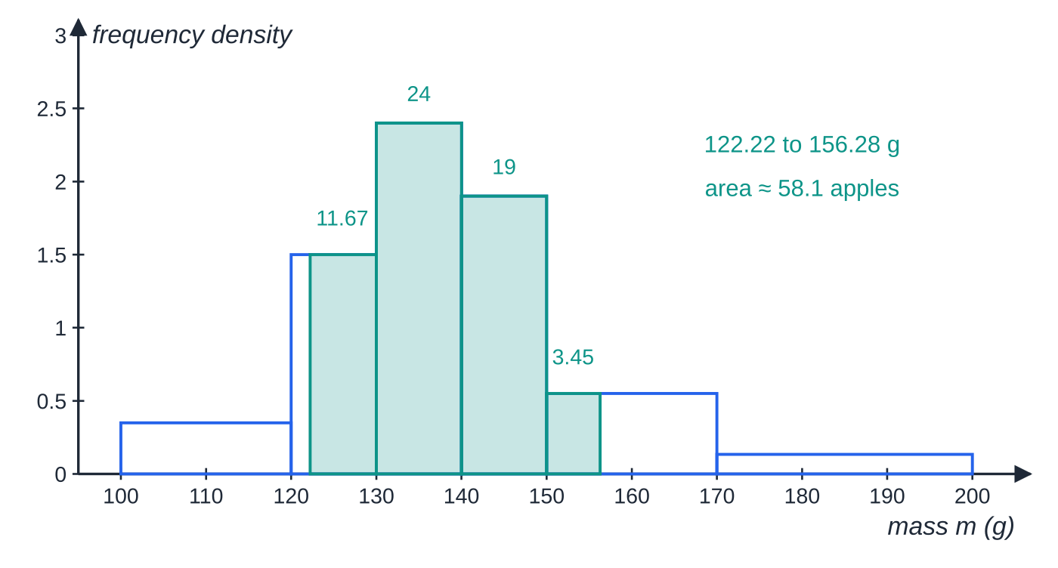
How do the pieces fit together in a full question? (continued)
Section 8 of 13 · Worked example 8 · Hard · Estimate (continued)
SOLUTION
(a) Midpoints 110, 125, 135, 145, 160, 185 give y=-5,-2,0,2,5,10. Σfy=-35-30+0+38+55+40=68; Σfy²=175+60+0+76+275+400=986. ȳ=(68/80)=0.85; σ_y²=(986/80)-0.85²=12.325-0.7225=11.6025, σ_y=3.4062… Mean =135+5×0.85= 139.25 g (139 g to 3 s.f.); s.d. =5×3.4062…= 17.0 g.
(b) Position 40; cumulative frequencies 7, 22, 46, so the median is in 130≤m<140: Q₂=130+(40-22)/24×10= 137.5 g.
(c) Q₁: position 20, in 120≤m<130:
Part (d): the shaded region runs from one standard deviation below the mean to one above. Its area, 11.67 + 24 + 19 + 3.45, estimates 58 apples.
Notes:
How do the pieces fit together in a full question?: Worked example 8. Full notes: https://examinerprep.com/notes/edexcel-ial-maths/measures-of-location-and-dispersion/

Slide 36
How do the pieces fit together in a full question? (continued)
Section 8 of 13 · Worked example 8 · Hard · Estimate (continued)
120+(20-7)/15×10=128.67. Q₃: position 60, in 140≤m<150: 140+(60-46)/19×10=147.37. IQR = 18.7 g.
(d) Mean ± s.d. =139.25±17.03, from 122.22 g to 156.28 g. Interpolate at both ends: (130-122.22)/10×15+24+19+(156.28-150)/20×11=11.67+43+3.45=58.1, so about 58 apples. That is about 73% of 80; for a roughly symmetrical, single-peaked distribution about two thirds usually lie within one standard deviation, so this is reasonable.
Notes:
How do the pieces fit together in a full question?: Worked example 8. Full notes: https://examinerprep.com/notes/edexcel-ial-maths/measures-of-location-and-dispersion/

Slide 37
Exam tips for S1.2
Section 9 of 13
Exam tip 1 — write the sums down
Before any variance, write Σx (or Σfx) and Σx² (or Σfx²) as numbers. They are the method, and you need them again if a later part adds, removes or corrects a value.
Exam tip 2 — check the position rule twice
For a list, decide first whether n/4, n/2, 3n/4 are whole numbers: round up if not, average two values if so. For grouped data, use n/2, n/4, 3n/4 directly in the interpolation, with class boundaries.
Exam tip 3 — decode carefully
Write the coding the other way round before using it: y=(x-200)/5 becomes x=5y+200. The mean follows the whole rule; the standard deviation only feels the ×5.
Notes:
Exam tips for S1.2. Full notes: https://examinerprep.com/notes/edexcel-ial-maths/measures-of-location-and-dispersion/

Slide 38
Exam tips for S1.2 (continued)
Section 9 of 13
Exam tip 4 — compare in context, with two measures
"Group B has a higher IQR" is not enough on its own. Say which measure, which group, and what it means: "the IQR for B is larger, so B's times are less consistent", paired with a comparison of medians or means.
Exam tip 5 — round only at the end
Keep x̄ at full accuracy when you square it, give final answers to 3 significant figures unless told otherwise, and describe results from grouped data as estimates.
Notes:
Exam tips for S1.2. Full notes: https://examinerprep.com/notes/edexcel-ial-maths/measures-of-location-and-dispersion/

Slide 39
Common misconceptions
Section 10 of 13
Misconception | Why it is wrong | Correct idea
Variance = (Σx)²÷n-x̄². | (Σx)² is the square of the total, not the total of the squares. | σ²=Σx²÷n-x̄².
The mean of two combined groups is the mean of their means. | That only works when the groups are the same size. | Add the totals nx̄ and divide by the combined n.
Adding 10 to every value adds 10 to the standard deviation. | Every value moves by the same amount, so distances from the mean are unchanged. | The mean goes up by 10; the s.d. is unchanged.
The median of grouped data is the midpoint of the median class. | The median need not be in the middle of its class. | Interpolate: L+(p-C)/f_c×w.
The modal class has the highest frequency, whatever the widths. | A wide class can collect many values without being dense. | With unequal widths, compare frequency densities.
Notes:
Common misconceptions. Full notes: https://examinerprep.com/notes/edexcel-ial-maths/measures-of-location-and-dispersion/

Slide 40
Common misconceptions (continued)
Section 10 of 13
Misconception | Why it is wrong | Correct idea
The range is the best measure of spread because it is easy. | It depends only on the two most extreme values. | Use the IQR (resistant) or the standard deviation (uses all values).
Notes:
Common misconceptions. Full notes: https://examinerprep.com/notes/edexcel-ial-maths/measures-of-location-and-dispersion/

Slide 41
How this topic connects
Section 11 of 13
S1.1 Representing data
Quartiles and the IQR build box plots and the outlier rule; comparing mean, median and mode, or the quartiles, describes skewness.
S1.4 Correlation and regression
Sₓₓ=Σx²-(Σx)²/n is the same quantity used for the correlation coefficient and the regression line, and coding appears there too.
S1.5 Discrete random variables and S1.6 The Normal distribution
Var(X)=E(X²)-[E(X)]² is the probability version of "mean of squares minus square of mean"; E(aX+b) and Var(aX+b) follow the coding rules.
Notes:
How this topic connects. Full notes: https://examinerprep.com/notes/edexcel-ial-maths/measures-of-location-and-dispersion/

Slide 42
Key formulae
Section 12 of 13
Formula | Use | In the formulae list?
x̄=Σx÷n; x̄=Σfx÷Σf | mean of raw data; of a frequency table (midpoints for grouped data) | No – learn it
Q₁, Q₂, Q₃ at n/4, n/2, 3n/4 | quartile positions (round up, or average two values if whole) | No – learn it
L+(p-C)/f_c×w | interpolation for grouped data | No – derive it
σ²=Σx²÷n-x̄²; σ²=Σfx²÷Σf-x̄² | variance of data (divisor n); σ=√(σ²) | No – learn it
Sₓₓ=Σx²-(Σx)²÷n | variance =Sₓₓ÷n | Yes
y=(x-a)÷b: ȳ=(x̄-a)÷b, σ_y=σₓ÷b | coding and decoding | No – learn it
IQR=Q₃-Q₁; range = max − min | measures of spread | No – learn it
Notes:
Key formulae. Full notes: https://examinerprep.com/notes/edexcel-ial-maths/measures-of-location-and-dispersion/

Slide 43
Check your understanding
Section 13 of 13
1. Find the mean and standard deviation of 3, 7, 8, 10, 12.
2. Eight values have Σx=96 and Σx²=1240. Find the mean and standard deviation.
3. Data coded with y=(x-50)÷2 have ȳ=3 and σ_y=1.5. Find x̄ and σₓ.
4. Why is the median usually preferred to the mean for the incomes of people in a town?
5. Lengths are recorded to the nearest cm in classes 10–14, 15–19, 20–24. What are the boundaries and width of the class 15–19?
Notes:
Check your understanding: questions. Full notes: https://examinerprep.com/notes/edexcel-ial-maths/measures-of-location-and-dispersion/

Slide 44
Check your understanding · answers
Section 13 of 13
1. Σx=40, so x̄=8. Σx²=366, so σ²=73.2-64=9.2 and σ=3.03.
2. x̄=12; σ²=155-144=11; σ=3.32.
3. x=2y+50, so x̄=2×3+50=56 and σₓ=2×1.5=3.
4. A few very high incomes pull the mean upwards, so it is not typical of most people. The median is not affected by how extreme those values are.
5. 14.5 and 19.5; width 5. Its midpoint is 17.
Notes:
Check your understanding: answers. Full notes: https://examinerprep.com/notes/edexcel-ial-maths/measures-of-location-and-dispersion/

Slide 45
Practice questions
2 original exam-style questions. Answers at the end of the deck.

Slide 46
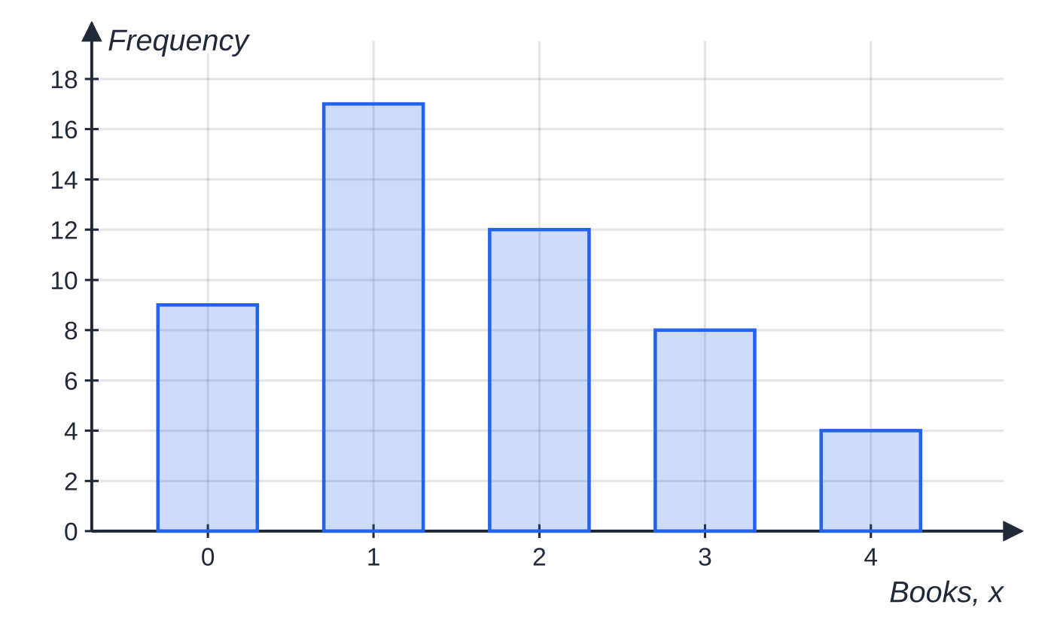
Question 1
5 marks
The number of books, x, borrowed in one month by each of 50 members of a library is shown in the table.
Figure: bar chart of the numbers of books borrowed
(a) Write down the mode. [1]
(b) Find the median. [2]
(c) Find the mean number of books borrowed. [2]
Books, x | 0 | 1 | 2 | 3 | 4
Frequency | 9 | 17 | 12 | 8 | 4
Notes:
Online with the full mark scheme: https://examinerprep.com/ial-maths-s1-2-measures-of-location-and-dispersion-questions#IALM-S1-2-B-01

Slide 47
Question 2
6 marks
The heights, in mm, of 11 seedlings grown in a tray are
23 31 18 27 35 29 22 40 26 33 24
(a) Find the median and the lower and upper quartiles of the heights. [3]
(b) Find the interquartile range and the range. [1]
(c) The height recorded as 40 mm should have been 14 mm. Find the correct median. [2]
Notes:
Online with the full mark scheme: https://examinerprep.com/ial-maths-s1-2-measures-of-location-and-dispersion-questions#IALM-S1-2-B-02

Slide 48
Answers

Slide 49
Question 1 · answer
Mark scheme
mode = 1 book
50/2 = 25, so the median is the mean of the 25th and 26th values; cumulative frequencies 9, 26, …
both are 1, so median = 1 book
Σfx = 0 + 17 + 24 + 24 + 16 = 81
mean = 81 ÷ 50 = 1.62 books
Notes:
Full mark scheme: https://examinerprep.com/ial-maths-s1-2-measures-of-location-and-dispersion-questions#IALM-S1-2-B-01

Slide 50
Question 2 · answer
Mark scheme
ordered: 18, 22, 23, 24, 26, 27, 29, 31, 33, 35, 40
median = 6th value = 27 mm
Q₁ = 3rd value = 23 mm, Q₃ = 9th value = 33 mm
IQR = 33 − 23 = 10 mm and range = 40 − 18 = 22 mm, ft their quartiles
new order 14, 18, 22, 23, 24, 26, 27, …; the median is still the 6th value
median = 26 mm
Notes:
Full mark scheme: https://examinerprep.com/ial-maths-s1-2-measures-of-location-and-dispersion-questions#IALM-S1-2-B-02

Slide 51
Keep practising
Notes for this topic
Questions on this topic
Build a printable test
ExaminerPrep is an independent tutoring service. It has been developed independently from and is not endorsed by the International Baccalaureate Organization. "International Baccalaureate", "IB" and "IB Diploma Programme" are registered trademarks of the IBO, used here for descriptive purposes only.
Pearson Edexcel and Cambridge are trademarks of their owners; ExaminerPrep is not affiliated with any exam board.

