Slide 1
EP
EDEXCEL IAL MATHS
M1.1 Modelling and vectors in mechanics
The full notes page in 11 sections · practice questions with answers · simulations
ExaminerPrep is an independent tutoring service. It has been developed independently from and is not endorsed by the International Baccalaureate Organization. "International Baccalaureate", "IB" and "IB Diploma Programme" are registered trademarks of the IBO, used here for descriptive purposes only.
Pearson Edexcel and Cambridge are trademarks of their owners; ExaminerPrep is not affiliated with any exam board.
Notes:
M1.1 Modelling and vectors in mechanics. Notes for this topic: https://examinerprep.com/notes/edexcel-ial-maths/modelling-and-vectors-in-mechanics/

Slide 2
What this page covers
Overview
Modelling vocabulary (particle, lamina, rigid body, rod, light, inextensible, smooth, rough, light smooth pulley, bead, wire, peg) and what each assumption ignores
Magnitude and direction of a vector, the angle with i, bearings and unit vectors
Resultants, resolving, vector diagrams and parallel vectors
Position, displacement and velocity: r = r₀ + vt for constant velocity
Constant acceleration in vector form, and F = ma with forces written as vectors
When one object is due north or due east of another, whether two objects collide, and their least distance apart (without calculus)
Notes:
What this page covers. Full notes: https://examinerprep.com/notes/edexcel-ial-maths/modelling-and-vectors-in-mechanics/

Slide 3
In one minute
Key points
1. A mechanical model simplifies a real situation with stated assumptions, and vectors in i, j form keep track of size and direction at once, so a ship, a puck or a drone becomes a point moving according to r = r₀ + vt.
2. Each modelling word is a promise: particle (ignore size and rotation), light (ignore mass), inextensible (no stretching), smooth (no friction).
3. For v = ai + bj: |v| = √(a² + b²); direction from tan θ= b/a, with a sketch to fix the quadrant. With i east and j north, a bearing is measured clockwise from j.
4. Add vectors by adding components. Two vectors are parallel when one is a multiple of the other.
5. Constant velocity: r = r₀ + vt. Constant acceleration: v = u + at, r = r₀ + ut + ½at². Resultant force: F = ma.
6. Due north of a point: equal i-components. Due east: equal j-components. Collide: both components equal at the same time.
Notes:
In one minute. Full notes: https://examinerprep.com/notes/edexcel-ial-maths/modelling-and-vectors-in-mechanics/

Slide 4
What is a mathematical model in mechanics?
Section 1 of 11
Mathematical model. A simplified description of a real situation, built on stated assumptions, that can be solved with mathematics.
Real objects are complicated: a sledge has a shape, a rope stretches a little, snow has some friction. Mechanics makes progress by deciding which effects are small enough to ignore. The modelling cycle is: simplify (state assumptions) → solve → compare with reality → refine the assumptions if the answer is not good enough.
Every assumption removes an effect. Questions often ask you to state an assumption, explain what it means in the situation, or say how the answer would change if it were dropped. Learn the vocabulary as pairs: what the word means, and what it lets you ignore.
Notes:
What is a mathematical model in mechanics?. Full notes: https://examinerprep.com/notes/edexcel-ial-maths/modelling-and-vectors-in-mechanics/

Slide 5
What is a mathematical model in mechanics? (continued)
Section 1 of 11
Term | What it means in the model | What it ignores
Particle | the whole mass is at a single point | size, shape, rotation; air resistance is usually ignored too
Rigid body | an object whose shape never changes | bending, stretching, squashing
Rod | a rigid body with length only (one dimension) | its thickness and width
Lamina | a flat object with area but negligible thickness | its thickness
Uniform | mass spread evenly, so the centre of mass is at the geometric centre | variations in density
Light (string, rod, pulley) | its mass is negligible | its weight; so the tension is the same along a light string
Notes:
What is a mathematical model in mechanics?. Full notes: https://examinerprep.com/notes/edexcel-ial-maths/modelling-and-vectors-in-mechanics/

Slide 6
What is a mathematical model in mechanics? (continued)
Section 1 of 11
Term | What it means in the model | What it ignores
Inextensible string | it does not stretch | stretching; so particles joined by a taut string have the same speed and the same size of acceleration
Smooth surface | no friction acts | friction; the only contact force is perpendicular to the surface
Rough surface | friction can act along the surface | — (this is a refinement, not a simplification)
Light smooth pulley | a weightless pulley with no friction at its axle | the pulley's mass and friction, so the tension is the same on both sides
Bead | a particle with a hole, threaded on a wire or string | its size; it can only move along the wire
Wire | a rigid, thin path that a bead is constrained to follow | its thickness
Notes:
What is a mathematical model in mechanics?. Full notes: https://examinerprep.com/notes/edexcel-ial-maths/modelling-and-vectors-in-mechanics/

Slide 7
What is a mathematical model in mechanics? (continued)
Section 1 of 11
Term | What it means in the model | What it ignores
Peg | a support of negligible size; if smooth, it pushes at right angles to the object resting on it | its size (and friction, if smooth)
Air resistance negligible; g constant | the only force from the air is ignored; g = 9.8 m s⁻² everywhere | drag, wind, variation of g with height
Notes:
What is a mathematical model in mechanics?. Full notes: https://examinerprep.com/notes/edexcel-ial-maths/modelling-and-vectors-in-mechanics/

Slide 8
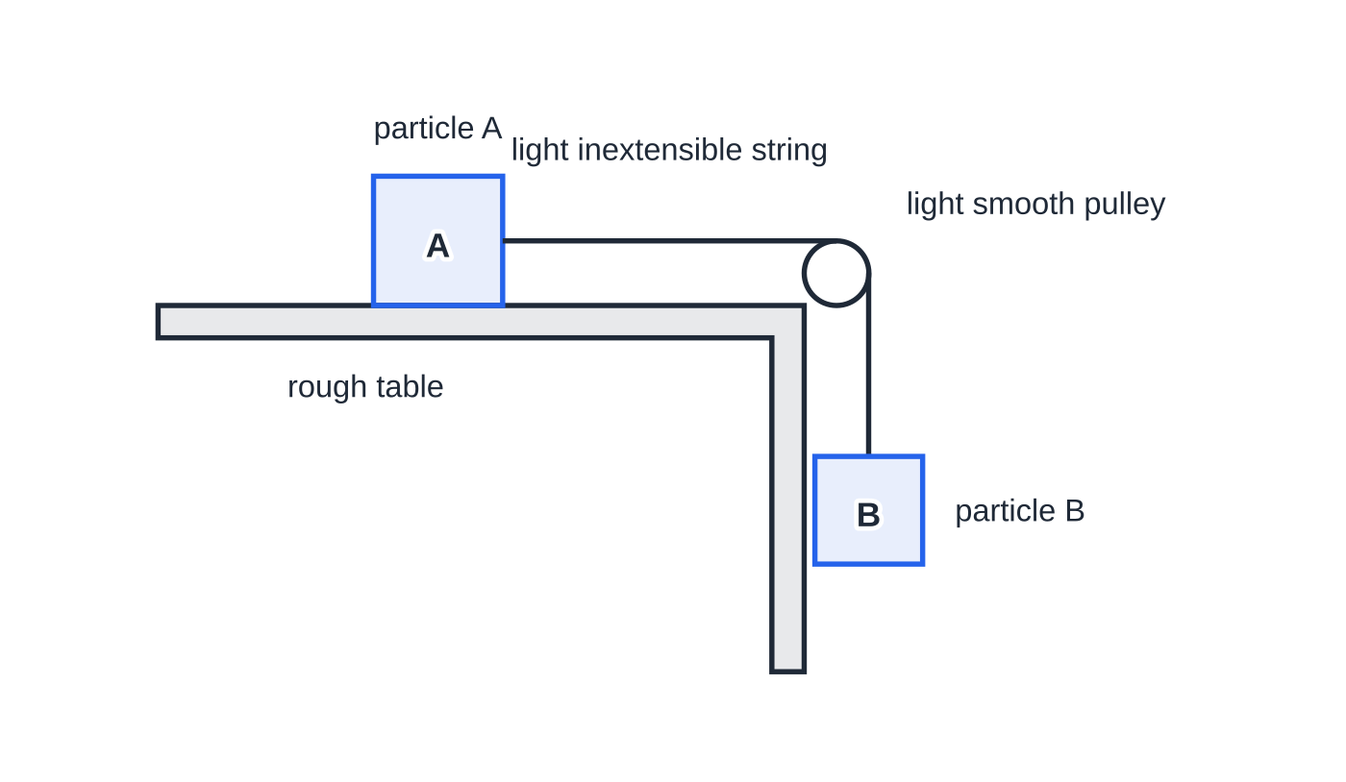
What is a mathematical model in mechanics? (continued)
Section 1 of 11
Modelling words on one set-up: particle A on a rough table, joined by a light inextensible string over a light smooth pulley to particle B. Because the string is light and the pulley smooth, the tension is the same on both sides; because it is inextensible, A and B move with the same speed.
Notes:
What is a mathematical model in mechanics?. Full notes: https://examinerprep.com/notes/edexcel-ial-maths/modelling-and-vectors-in-mechanics/

Slide 9
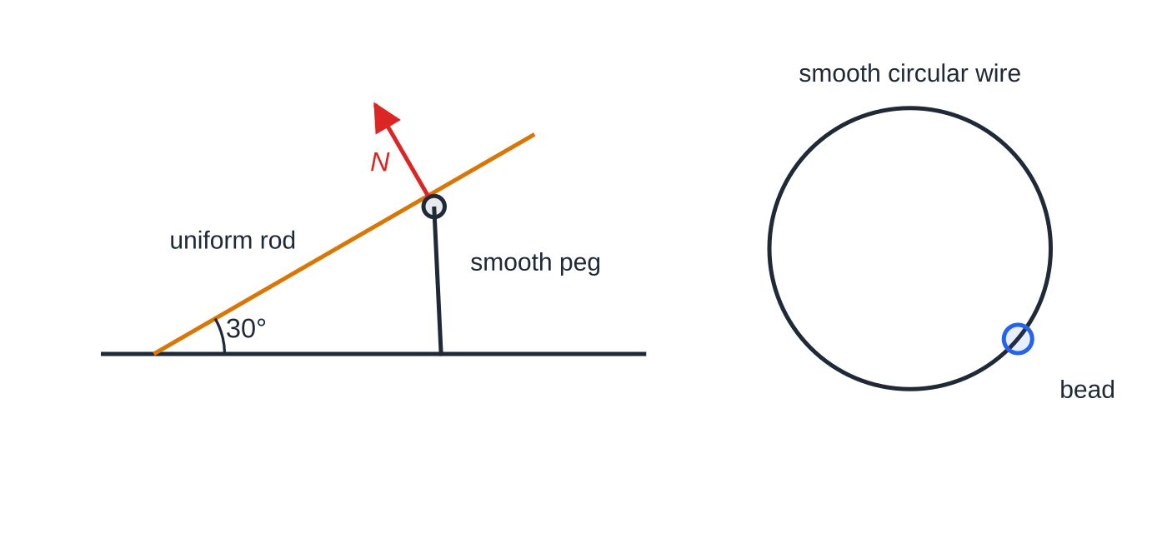
What is a mathematical model in mechanics? (continued)
Section 1 of 11
Left: a uniform rod resting on a smooth peg; the peg's force N is perpendicular to the rod. Right: a bead threaded on a smooth circular wire can only move along the wire.
Notes:
What is a mathematical model in mechanics?. Full notes: https://examinerprep.com/notes/edexcel-ial-maths/modelling-and-vectors-in-mechanics/

Slide 10
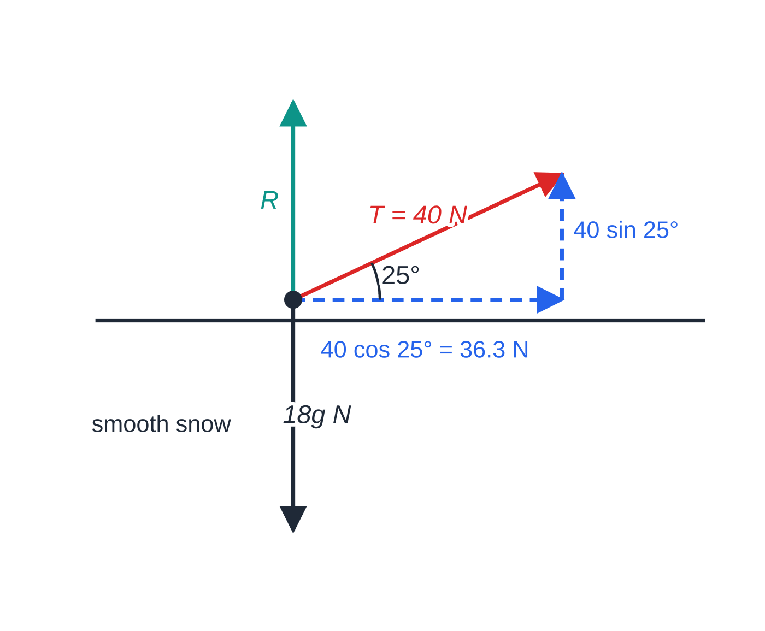
What is a mathematical model in mechanics? (continued)
Section 1 of 11 · Worked example 1 · Medium · Explain, find
WORKED EXAMPLE · QUESTION
A child of mass 15 kg sits on a sledge of mass 3 kg. A parent pulls the sledge across horizontal snow with a rope inclined at 25° above the horizontal. The tension in the rope is 40 N. The child and sledge are modelled as a single particle, the rope as light and inextensible, and the snow as smooth. (a) Explain what is meant by modelling the child and sledge as a particle. (b) Explain what is meant by the rope being light. (c) Find the horizontal component of the tension and hence the acceleration of the sledge in this model. (d) State how the answer to (c) would change if the snow were modelled as rough.
Forces on the sledge (not to scale). Only the horizontal component of the tension changes the horizontal motion.
Notes:
What is a mathematical model in mechanics?: Worked example 1. Full notes: https://examinerprep.com/notes/edexcel-ial-maths/modelling-and-vectors-in-mechanics/

Slide 11
What is a mathematical model in mechanics? (continued)
Section 1 of 11 · Worked example 1 · Medium · Explain, find (continued)
SOLUTION
(a) The mass is concentrated at one point: the size of the sledge and any rotation are ignored.
(b) The mass of the rope is ignored, so the tension is the same all along it.
(c) 40cos 25° = 36.25… N. The snow is smooth, so this is the only horizontal force: a = 36.25 ÷18 = 2.01 m s⁻². 36.3 N; 2.01 m s⁻²
(d) Friction would oppose the motion, so the resultant force and the acceleration would be smaller.
The vertical component, 40sin 25° = 16.9 N, does not change the horizontal motion; it only reduces the push of the snow on the sledge.
Notes:
What is a mathematical model in mechanics?: Worked example 1. Full notes: https://examinerprep.com/notes/edexcel-ial-maths/modelling-and-vectors-in-mechanics/

Slide 12
What is a mathematical model in mechanics? (continued)
Section 1 of 11
Common error
Mixing up light and inextensible. A light string has the same tension throughout; an inextensible string makes the connected particles move with the same speed and the same size of acceleration. Explain the one the question names.
Notes:
What is a mathematical model in mechanics?. Full notes: https://examinerprep.com/notes/edexcel-ial-maths/modelling-and-vectors-in-mechanics/

Slide 13
How do you find the magnitude and direction of a vector?
Section 2 of 11
Vector. A quantity with both magnitude and direction, such as displacement, velocity, acceleration or force. A scalar has magnitude only: distance, speed, time, mass. Speed is the magnitude of velocity.
i and j are unit vectors (magnitude 1) at right angles; in bearing problems i points east and j points north. The vector ai + bj can also be written as the column vector (a, b). Because the components are at right angles, Pythagoras gives the magnitude and right-angled trigonometry gives the direction.
Magnitude, direction and unit vector
|ai + bj| = √(a² + b²) tan θ= b/a unit vector = v/|v|
θ = angle between the vector and i, measured anticlockwise; a bearing is measured clockwise from north (j), as three figures. Not in the formulae list: derive them from Pythagoras and right-angled trigonometry.
Notes:
How do you find the magnitude and direction of a vector?. Full notes: https://examinerprep.com/notes/edexcel-ial-maths/modelling-and-vectors-in-mechanics/

Slide 14
How do you find the magnitude and direction of a vector? (continued)
Section 2 of 11
A calculator gives tan⁻¹ between −90° and 90° only. For a vector pointing left (a <0), add 180°. A sketch shows which angle you need.
Notes:
How do you find the magnitude and direction of a vector?. Full notes: https://examinerprep.com/notes/edexcel-ial-maths/modelling-and-vectors-in-mechanics/

Slide 15
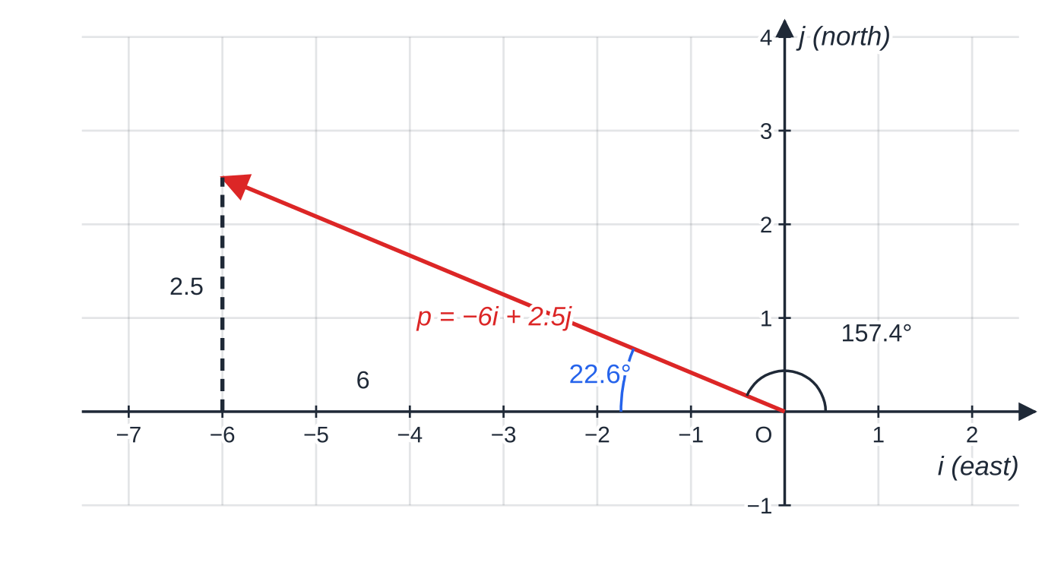
How do you find the magnitude and direction of a vector? (continued)
Section 2 of 11 · Worked example 2 · Medium · Find, write down
WORKED EXAMPLE · QUESTION
A kayak moves with velocity (-6i + 2.5j) km h⁻¹, where i and j are unit vectors due east and due north. (a) Find the speed of the kayak. (b) Find the bearing on which it is moving. (c) Write down a unit vector in the direction of its motion. (d) A second kayak moves at 12 km h⁻¹ on a bearing of 150°. Write its velocity in the form pi + qj, giving exact values.
p = -6i + 2.5j has magnitude 6.5. It makes 157.4° with i (anticlockwise) and 22.6° north of west, so it lies on a bearing of 292.6°.
Notes:
How do you find the magnitude and direction of a vector?: Worked example 2. Full notes: https://examinerprep.com/notes/edexcel-ial-maths/modelling-and-vectors-in-mechanics/

Slide 16
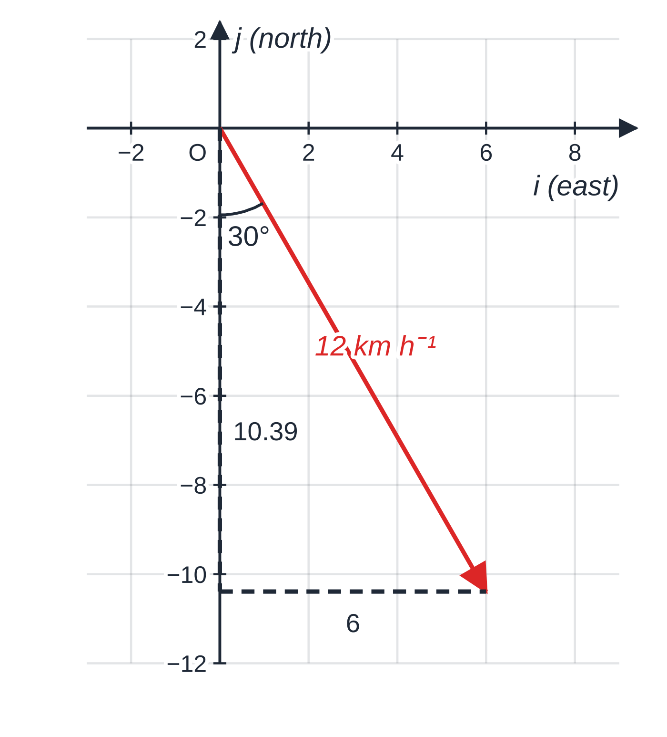
How do you find the magnitude and direction of a vector? (continued)
Section 2 of 11 · Worked example 2 · Medium · Find, write down (continued)
SOLUTION
(a) Speed = magnitude of the velocity: √((-6)² + 2.5²) = √42.25 = 6.5 km h⁻¹
(b) The sketch shows west and slightly north. Angle north of west: tan⁻¹(2.5 ÷6) = 22.62°, so bearing = 270° + 22.62° = 293° (292.6°)
(c) (1/6.5)(-6i + 2.5j) = -(12/13)i + (5/13)j
(d) The velocity makes 30° with south, towards east: 12sin 150° i + 12cos 150° j = (6i - 6√3 j) km h⁻¹ ≈(6i - 10.39j)
12 km h⁻¹ on a bearing of 150° is 30° east of south: 6 km h⁻¹ east and 10.39 km h⁻¹ south.
Notes:
How do you find the magnitude and direction of a vector?: Worked example 2. Full notes: https://examinerprep.com/notes/edexcel-ial-maths/modelling-and-vectors-in-mechanics/

Slide 17
How do you find the magnitude and direction of a vector? (continued)
Section 2 of 11
Common error
Typing tan⁻¹(2.5 ÷-6) and quoting −22.6° as the direction. That points east-south-east, the opposite way to the kayak. Always draw the vector before you name its angle.
Notes:
How do you find the magnitude and direction of a vector?. Full notes: https://examinerprep.com/notes/edexcel-ial-maths/modelling-and-vectors-in-mechanics/

Slide 18
How do you add and resolve vectors?
Section 3 of 11
Resultant = the single vector with the same effect as the vectors combined. Add the i-components, then the j-components.
On a vector diagram, draw the vectors tip to tail: the resultant runs from the first tail to the last tip. Forces in equilibrium close up into a polygon.
Resolving a vector of magnitude F at angle θ to i gives Fcos θ i + Fsin θ j.
Parallel: ai + bj is parallel to ci + dj when a/c = b/d. Parallel to i: the j-component is zero. Parallel to j: the i-component is zero.
Equilibrium: the resultant force is the zero vector, so the i-components and the j-components each sum to zero.
Notes:
How do you add and resolve vectors?. Full notes: https://examinerprep.com/notes/edexcel-ial-maths/modelling-and-vectors-in-mechanics/

Slide 19
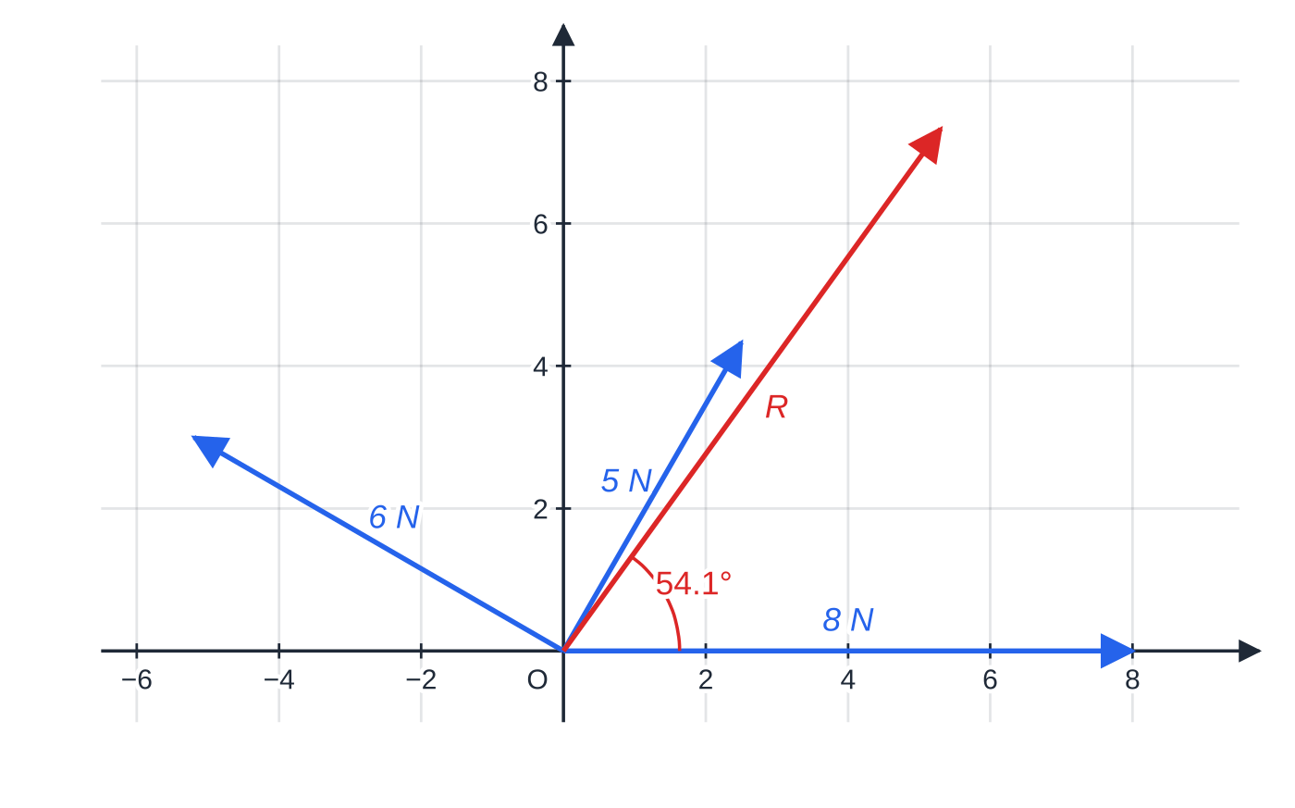
How do you add and resolve vectors? (continued)
Section 3 of 11 · Worked example 3 · Medium · Find
WORKED EXAMPLE · QUESTION
Three horizontal forces act on a particle: 8 N in the direction of i, 5 N at 60° to i and 6 N at 150° to i, both angles measured anticlockwise from i. Find the magnitude of the resultant force and the angle it makes with i.
The three forces drawn from the particle, to scale, with their resultant R.
Notes:
How do you add and resolve vectors?: Worked example 3. Full notes: https://examinerprep.com/notes/edexcel-ial-maths/modelling-and-vectors-in-mechanics/

Slide 20
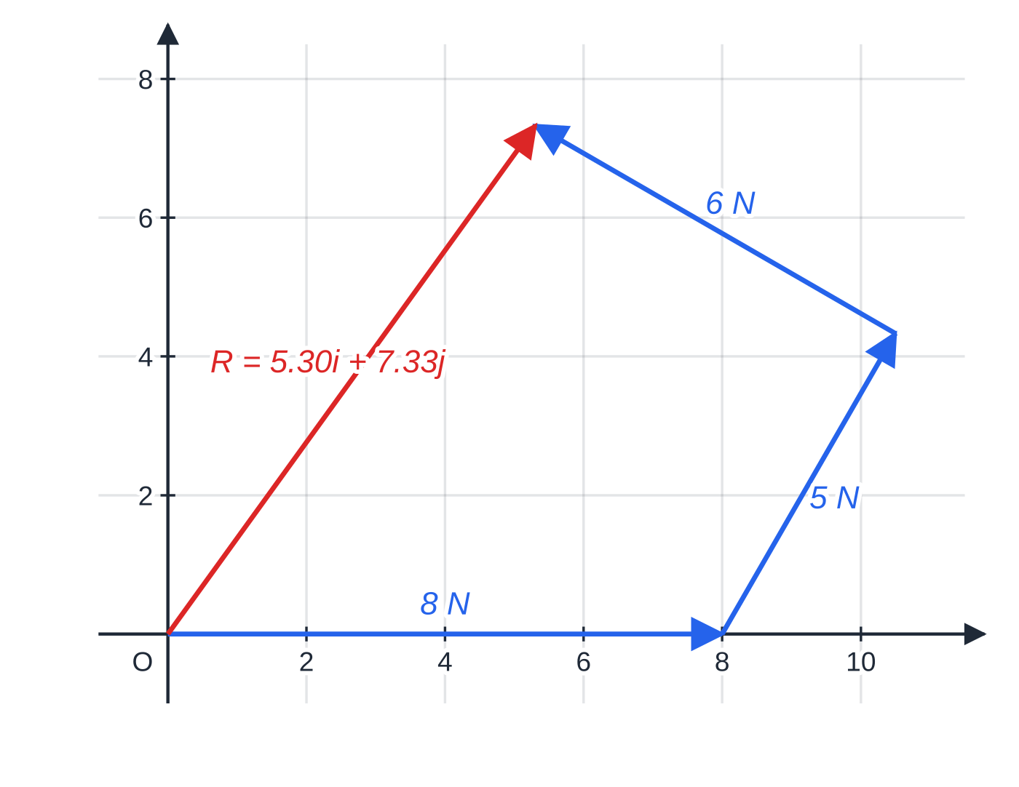
How do you add and resolve vectors? (continued)
Section 3 of 11 · Worked example 3 · Medium · Find (continued)
SOLUTION
Resolve each force: 8i; 5cos 60° i + 5sin 60° j = 2.5i + 4.33j; 6cos 150° i + 6sin 150° j = -5.20i + 3j.
Add components: R = (8 + 2.5 - 5.196)i + (4.330 + 3)j = 5.304i + 7.330j.
Magnitude and direction: |R| = √(5.304² + 7.330²) = 9.05 N; tan⁻¹(7.330 ÷5.304) = 54.1° to i
The same forces tip to tail. The resultant runs from the first tail to the last tip: 5.30i + 7.33j N.
Notes:
How do you add and resolve vectors?: Worked example 3. Full notes: https://examinerprep.com/notes/edexcel-ial-maths/modelling-and-vectors-in-mechanics/

Slide 21
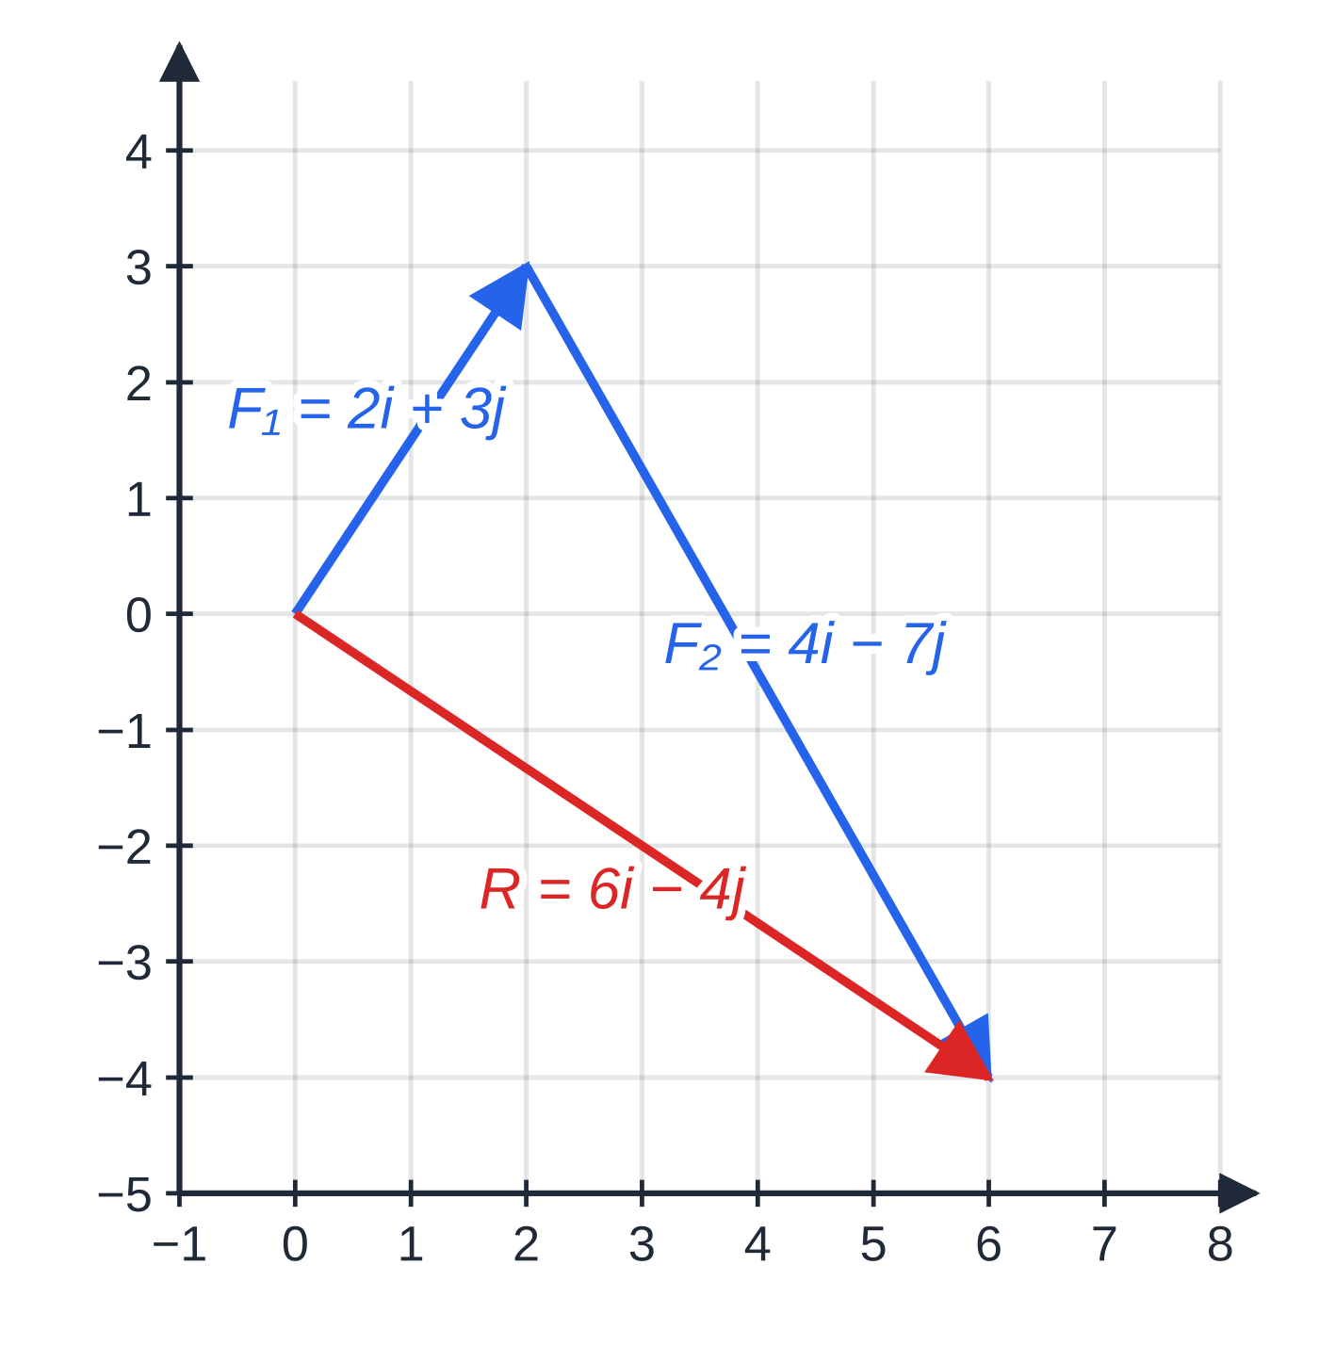
How do you add and resolve vectors? (continued)
Section 3 of 11 · Worked example 4 · Hard · Find, write down
WORKED EXAMPLE · QUESTION
Two forces, F₁ = (2i + 3j) N and F₂ = (pi - 7j) N, act on a particle of mass 0.5 kg. Their resultant is parallel to (3i - 2j). (a) Find p. (b) Find the magnitude of the resultant, in exact form. (c) A third force F₃ is added so that the particle is in equilibrium. Write down F₃. (d) Without F₃, find the magnitude of the acceleration of the particle.
SOLUTION
(a) R = (2 + p)i - 4j. Parallel means the components are in the same ratio: (2 + p)/3 = (-4)/(-2) = 2 ⇒ p = 4
(b) R = 6i - 4j, |R| = √(36 + 16) = √52 = 2√13 N (7.21 N)
(c) Equilibrium needs a zero resultant: F₃ = -R = (-6i + 4j) N
Worked example 4: with p = 4, F₁ + F₂ = 6i - 4j = 2(3i - 2j), parallel to the given direction.
Notes:
How do you add and resolve vectors?: Worked example 4. Full notes: https://examinerprep.com/notes/edexcel-ial-maths/modelling-and-vectors-in-mechanics/

Slide 22
How do you add and resolve vectors? (continued)
Section 3 of 11 · Worked example 4 · Hard · Find, write down (continued)
(d) a = (6i - 4j) ÷0.5 = 12i - 8j, |a| = 4√13 = 14.4 m s⁻²
Notes:
How do you add and resolve vectors?: Worked example 4. Full notes: https://examinerprep.com/notes/edexcel-ial-maths/modelling-and-vectors-in-mechanics/

Slide 23
How do you add and resolve vectors? (continued)
Section 3 of 11
Exam tip 1 — parallel means one equation
Write the resultant in components, then set the ratio equal to the ratio of the given direction. Check the signs as well as the sizes: (3i - 2j) and (-3i + 2j) are parallel but point opposite ways.
Notes:
How do you add and resolve vectors?. Full notes: https://examinerprep.com/notes/edexcel-ial-maths/modelling-and-vectors-in-mechanics/

Slide 24
How do you describe motion with constant velocity?
Section 4 of 11
The position vector r of a point is its displacement from a fixed origin O. The displacement from A to B is r_B - r_A (“to” minus “from”); the distance AB is its magnitude. With constant velocity v, the displacement after time t is vt, so the position is the starting position plus that displacement.
Constant velocity
r = r₀ + vt
r = position vector at time t; r₀ = position vector when t = 0; v = constant velocity; speed = |v|. Not in the formulae list: must be known. Keep the units consistent: km with km h⁻¹ and hours, or m with m s⁻¹ and seconds.
Notes:
How do you describe motion with constant velocity?. Full notes: https://examinerprep.com/notes/edexcel-ial-maths/modelling-and-vectors-in-mechanics/

Slide 25
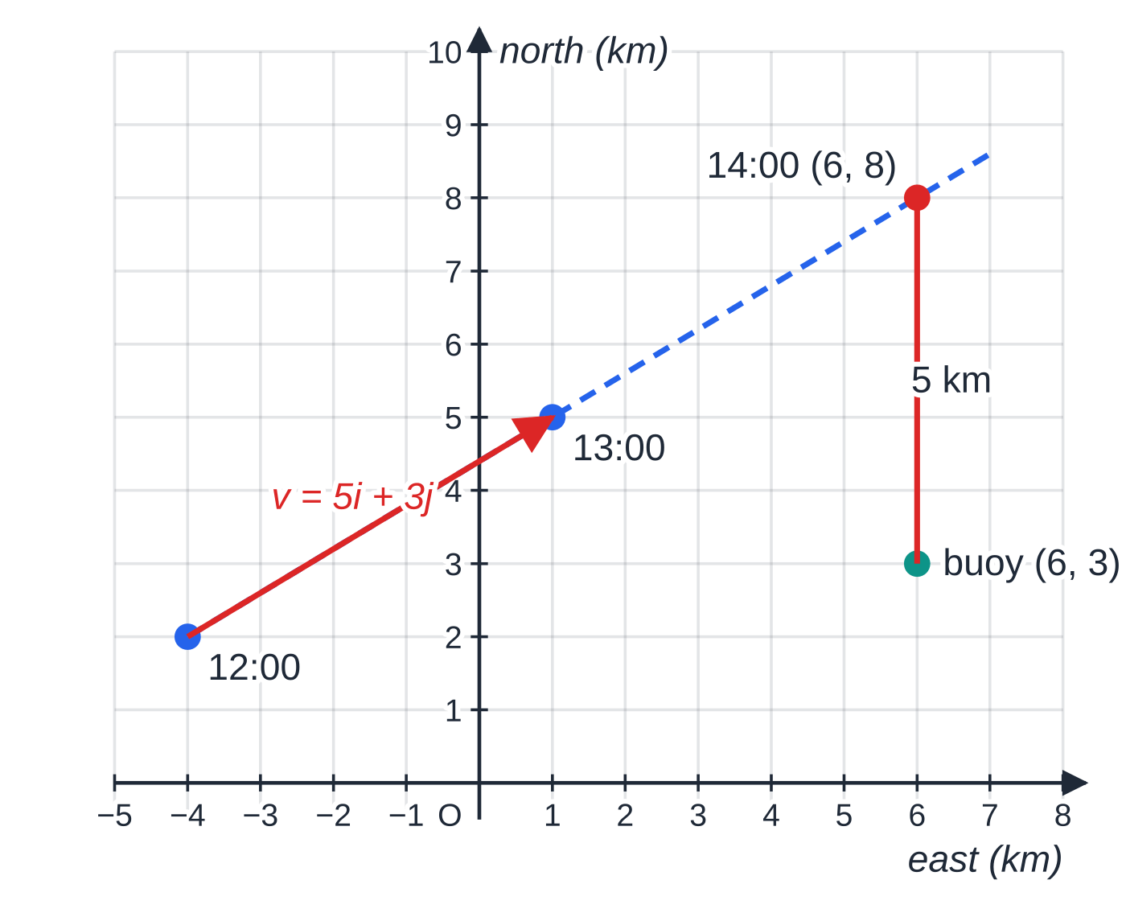
How do you describe motion with constant velocity? (continued)
Section 4 of 11 · Worked example 5 · Medium · Find, write down
WORKED EXAMPLE · QUESTION
At noon a ship is at the point with position vector (-4i + 2j) km relative to a harbour O, where i and j are due east and due north. It moves with constant velocity (5i + 3j) km h⁻¹. A buoy is at (6i + 3j) km. (a) Find the speed of the ship and the bearing on which it moves. (b) Write down the position vector of the ship t hours after noon. (c) Find the time at which the ship is due north of the buoy, and its distance from the buoy then.
SOLUTION
(a) |v| = √(25 + 9) = √34 = 5.83 km h⁻¹; bearing = tan⁻¹(5 ÷3) = 059.0° (the angle east of north).
(b) r = (-4 + 5t)i + (2 + 3t)j
The ship's track, with its position each hour. At 14:00 its i-component equals that of the buoy, so it is due north of the buoy, 5 km away.
Notes:
How do you describe motion with constant velocity?: Worked example 5. Full notes: https://examinerprep.com/notes/edexcel-ial-maths/modelling-and-vectors-in-mechanics/

Slide 26
How do you describe motion with constant velocity? (continued)
Section 4 of 11 · Worked example 5 · Medium · Find, write down (continued)
(c) Due north of the buoy means the same i-component: -4 + 5t = 6 ⇒t = 2. Then r = 6i + 8j, and the distance is 8 - 3 = 5 km. At 14:00, 5 km north of the buoy.
Notes:
How do you describe motion with constant velocity?: Worked example 5. Full notes: https://examinerprep.com/notes/edexcel-ial-maths/modelling-and-vectors-in-mechanics/

Slide 27
How do you describe motion with constant velocity? (continued)
Section 4 of 11
Common error
Writing r = vt and forgetting the starting position, or adding the speed (a number) instead of the velocity (a vector). The position vector needs r₀ and both components of v.
Notes:
How do you describe motion with constant velocity?. Full notes: https://examinerprep.com/notes/edexcel-ial-maths/modelling-and-vectors-in-mechanics/

Slide 28
How do you use F = ma and constant acceleration with vectors?
Section 5 of 11
Newton's second law works with whole vectors: the resultant force F and the acceleration a point in the same direction. If the forces are constant, a is constant, and the constant-acceleration formulae hold component by component. Read the wording carefully: “moving parallel to i” or “moving due east” refers to the velocity (the j-component of v is zero); “due east of O” refers to the position (the j-component of r is zero).
Constant acceleration and Newton's second law in vector form
v = u + at r = r₀ + ut + ½at² F = ma
u = initial velocity; v = velocity at time t; a = constant acceleration; F = resultant force (N); m = mass (kg). Not in the formulae list: must be known. Only for constant acceleration; if the acceleration varies with time you need calculus (M2).
Notes:
How do you use F = ma and constant acceleration with vectors?. Full notes: https://examinerprep.com/notes/edexcel-ial-maths/modelling-and-vectors-in-mechanics/

Slide 29
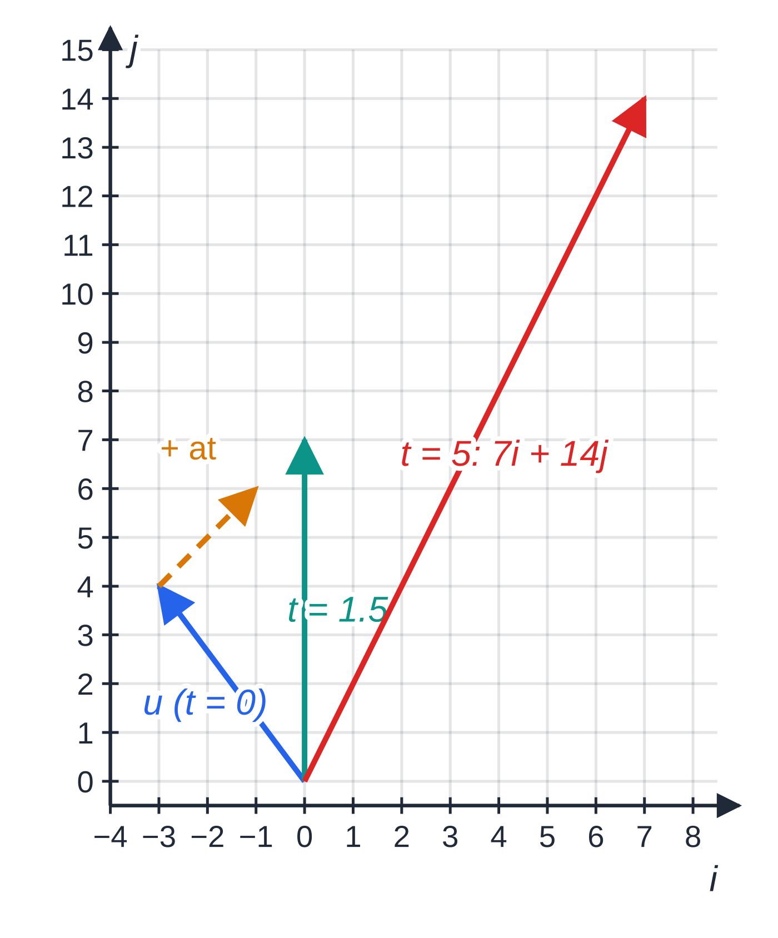
How do you use F = ma and constant acceleration with vectors? (continued)
Section 5 of 11 · Worked example 6 · Medium · Find
WORKED EXAMPLE · QUESTION
A puck of mass 2.5 kg moves on smooth horizontal ice. Two forces act on it: (6i - 2j) N and (-i + 7j) N. At t = 0 its velocity is (-3i + 4j) m s⁻¹. (a) Find the acceleration of the puck. (b) Find its speed when t = 3 s. (c) Find the time at which it is moving parallel to j. (d) Find the time at which it is moving in the direction of (i + 2j).
SOLUTION
(a) F = 5i + 5j, so a = (5i + 5j) ÷2.5 = (2i + 2j) m s⁻²
(b) v = (-3 + 2t)i + (4 + 2t)j; at t = 3: 3i + 10j, speed = √109 = 10.4 m s⁻¹
(c) Parallel to j: the i-component of v is zero, -3 + 2t = 0 ⇒ t = 1.5 s (then v = 7j).
(d) Direction (i + 2j): j-component = 2 × i-component, both positive.
The puck's velocity at t = 0, 1.5 and 5 s, drawn from one point. Each second adds a = 2i + 2j, so the velocity swings round towards the direction of the force.
Notes:
How do you use F = ma and constant acceleration with vectors?: Worked example 6. Full notes: https://examinerprep.com/notes/edexcel-ial-maths/modelling-and-vectors-in-mechanics/

Slide 30
How do you use F = ma and constant acceleration with vectors? (continued)
Section 5 of 11 · Worked example 6 · Medium · Find (continued)
4 + 2t = 2(-3 + 2t) ⇒ t = 5 s (then v = 7i + 14j ✓).
Notes:
How do you use F = ma and constant acceleration with vectors?: Worked example 6. Full notes: https://examinerprep.com/notes/edexcel-ial-maths/modelling-and-vectors-in-mechanics/

Slide 31
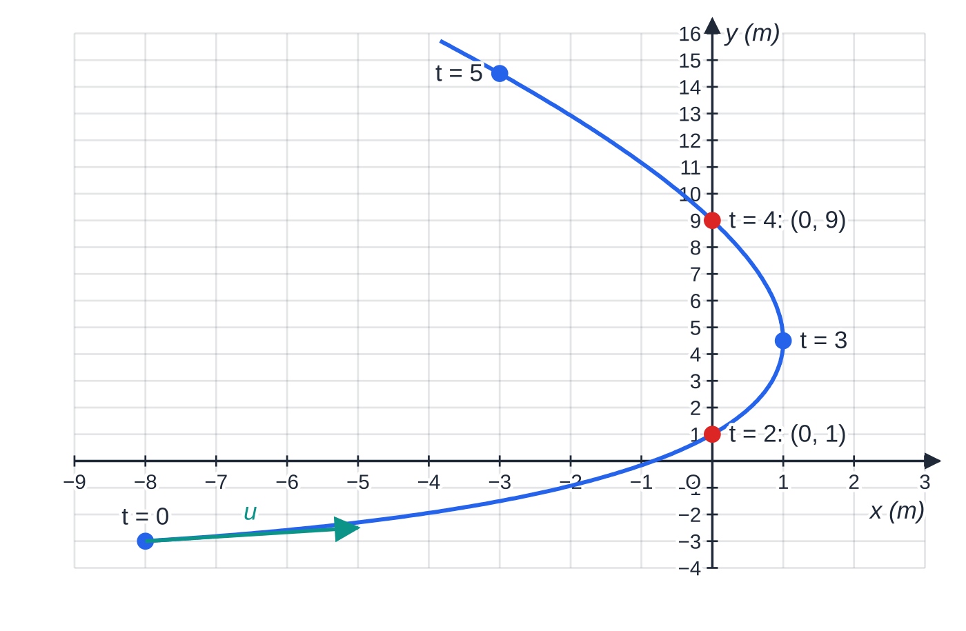
How do you use F = ma and constant acceleration with vectors? (continued)
Section 5 of 11 · Worked example 7 · Hard · Find
WORKED EXAMPLE · QUESTION
A particle P of mass 0.6 kg moves on a smooth horizontal plane with constant acceleration (-2i + j) m s⁻². At t = 0 it is at the point with position vector (-8i - 3j) m and has velocity (6i + j) m s⁻¹. (a) Find the magnitude of the resultant force on P. (b) Find the position vector of P at time t. (c) Find the times at which P is due north of O, and its distance from O at each. (d) Find the speed of P at the first of these times.
The path of P from r = r₀ + ut + ½at². It curves because a is not parallel to u, and crosses the y-axis (due north of O) at t = 2 and t = 4.
Notes:
How do you use F = ma and constant acceleration with vectors?: Worked example 7. Full notes: https://examinerprep.com/notes/edexcel-ial-maths/modelling-and-vectors-in-mechanics/

Slide 32
How do you use F = ma and constant acceleration with vectors? (continued)
Section 5 of 11 · Worked example 7 · Hard · Find (continued)
SOLUTION
(a) F = 0.6(-2i + j) = -1.2i + 0.6j, |F| = 1.34 N (1.342 N)
(b) r = r₀ + ut + ½at² = (-8 + 6t - t²)i + (-3 + t + ½ t²)j
(c) Due north of O: i-component zero (and j-component positive). t² - 6t + 8 = 0 ⇒(t - 2)(t - 4) = 0 ⇒t = 2 or 4. At t = 2: j-component = -3 + 2 + 2 = 1; at t = 4: -3 + 4 + 8 = 9 (both positive ✓). t = 2 s, 1 m from O; t = 4 s, 9 m from O.
(d) v = u + at = 2i + 3j at t = 2, speed = √13 = 3.61 m s⁻¹
Notes:
How do you use F = ma and constant acceleration with vectors?: Worked example 7. Full notes: https://examinerprep.com/notes/edexcel-ial-maths/modelling-and-vectors-in-mechanics/

Slide 33
How do you use F = ma and constant acceleration with vectors? (continued)
Section 5 of 11
Exam tip 2 — check the other component
After setting the i-component to zero, check the sign of the j-component. A negative value would mean due south of O, and that time must be rejected.
Notes:
How do you use F = ma and constant acceleration with vectors?. Full notes: https://examinerprep.com/notes/edexcel-ial-maths/modelling-and-vectors-in-mechanics/

Slide 34
When are two moving objects due north, colliding or closest?
Section 6 of 11
Write both position vectors in terms of the same t, then form r_B - r_A, the position of B relative to A. Everything follows from this one vector:
B due north of A: i-component of r_B - r_A is zero (and the j-component positive). Due east: j-component zero (and the i-component positive).
Collision: both components of r_B - r_A are zero at the same value of t. Paths that cross at different times do not collide.
Least distance: d² = |r_B - r_A|² is a quadratic in t. Complete the square: the minimum value of d² gives the least distance and the time it happens. No calculus is needed.
Notes:
When are two moving objects due north, colliding or closest?. Full notes: https://examinerprep.com/notes/edexcel-ial-maths/modelling-and-vectors-in-mechanics/

Slide 35
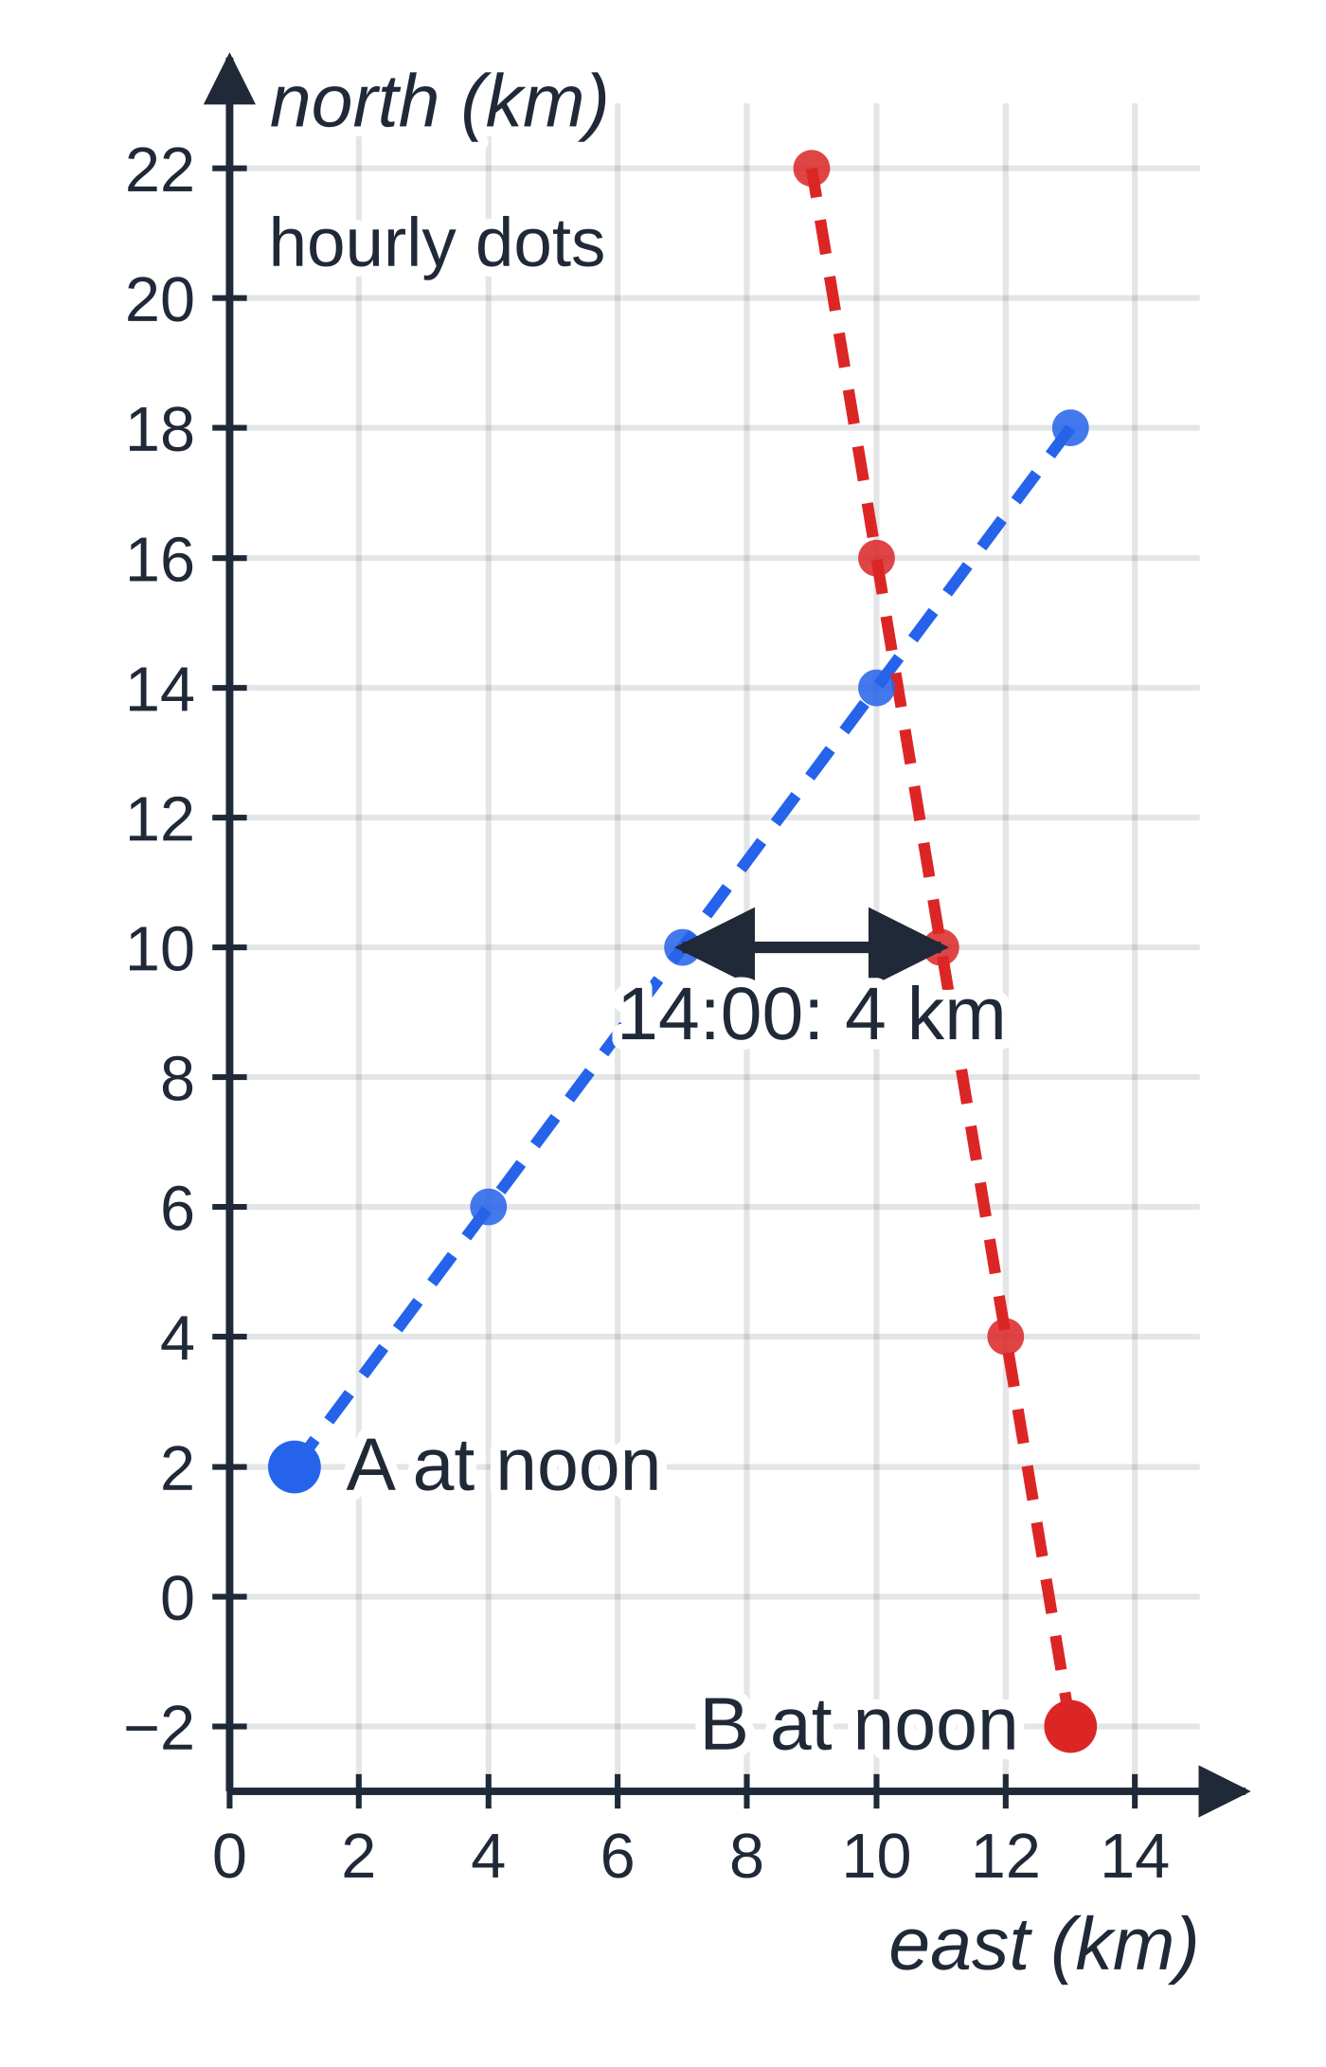
When are two moving objects due north, colliding or closest? (continued)
Section 6 of 11 · Worked example 8 · Hard · Show that, find
WORKED EXAMPLE · QUESTION
[i and j are unit vectors due east and due north; position vectors are relative to a fixed point O.] At noon ship A is at (i + 2j) km and ship B is at (13i - 2j) km. A moves with constant velocity (3i + 4j) km h⁻¹ and B with constant velocity (-i + 6j) km h⁻¹. (a) Find the speed of B. (b) Find, in terms of t, the position vector of each ship t hours after noon. (c) Show that B is due east of A at 14:00 and find the distance between them then. (d) Show that the ships do not collide. (e) Show that d² = 20t² - 112t + 160, where d km is the distance AB, and hence find the least distance between the ships and the time when it occurs.
Ships A (blue) and B (red), with dots each hour. The tracks cross, but the ships reach the crossing point at different times. At 14:00 B is 4 km due east of A.
Notes:
When are two moving objects due north, colliding or closest?: Worked example 8. Full notes: https://examinerprep.com/notes/edexcel-ial-maths/modelling-and-vectors-in-mechanics/

Slide 36
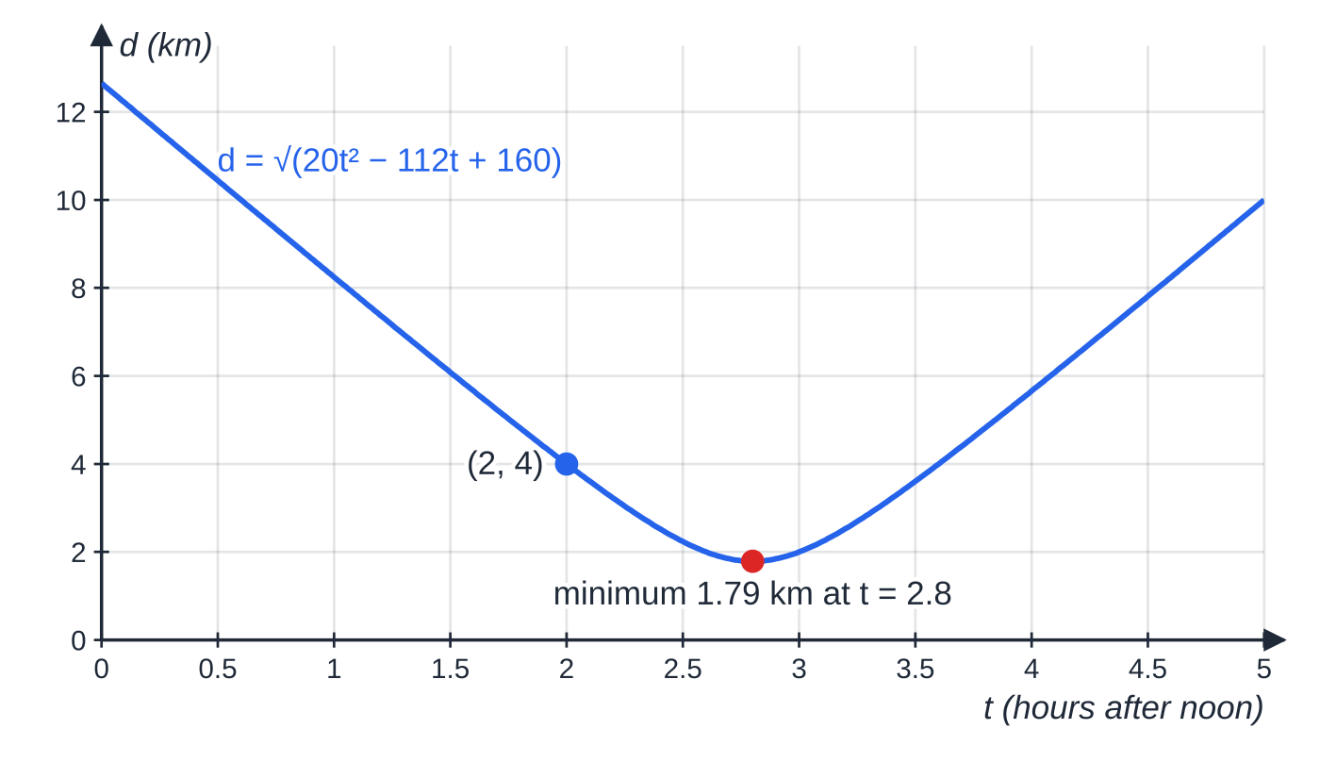
When are two moving objects due north, colliding or closest? (continued)
Section 6 of 11 · Worked example 8 · Hard · Show that, find (continued)
SOLUTION
(a) |-i + 6j| = √37 = 6.08 km h⁻¹
(b) r_A = (1 + 3t)i + (2 + 4t)j, r_B = (13 - t)i + (-2 + 6t)j.
(c) r_B - r_A = (12 - 4t)i + (-4 + 2t)j. The j-component is zero when t = 2 (14:00); then r_B - r_A = 4i. B is 4 km due east of A.
(d) The i-component is zero only at t = 3, the j-component only at t = 2: never together, so no collision.
(e) d² = (12 - 4t)² + (2t - 4)² = 144 - 96t + 16t² + 4t² - 16t + 16 = 20t² - 112t + 160 ✓.
The distance AB from d² = 20t² - 112t + 160: it falls to a minimum of 1.79 km at t = 2.8 and then rises again.
Notes:
When are two moving objects due north, colliding or closest?: Worked example 8. Full notes: https://examinerprep.com/notes/edexcel-ial-maths/modelling-and-vectors-in-mechanics/

Slide 37
When are two moving objects due north, colliding or closest? (continued)
Section 6 of 11 · Worked example 8 · Hard · Show that, find (continued)
Completing the square, d² = 20(t - 2.8)² + 3.2, so the least d = √3.2 = 1.79 km (1.7889) when t = 2.8, at 14:48.
Notes:
When are two moving objects due north, colliding or closest?: Worked example 8. Full notes: https://examinerprep.com/notes/edexcel-ial-maths/modelling-and-vectors-in-mechanics/

Slide 38
When are two moving objects due north, colliding or closest? (continued)
Section 6 of 11
Common error
Saying two ships collide because their paths cross. A collision needs r_A = r_B for one value of t.
Notes:
When are two moving objects due north, colliding or closest?. Full notes: https://examinerprep.com/notes/edexcel-ial-maths/modelling-and-vectors-in-mechanics/

Slide 39
Exam tips for M1.1
Section 7 of 11
Exam tip 3 — sketch before you calculate
A five-second sketch with i east and j north fixes the quadrant of every direction, shows whether “due north” is possible, and catches a sign error before it spreads.
Exam tip 4 — say which angle you mean
“The angle with i”, “the angle with j” and “the bearing” are different numbers for the same vector. Give the one asked for, and give bearings as three figures (059°, not 59°).
Exam tip 5 — position or velocity? Speed is a number
“Due north of O” is about r; “moving due north” is about v: say which vector you are using. A speed or distance ends with a magnitude and a unit; a velocity, displacement or force “as a vector” is given in i, j form.
Notes:
Exam tips for M1.1. Full notes: https://examinerprep.com/notes/edexcel-ial-maths/modelling-and-vectors-in-mechanics/

Slide 40
Exam tips for M1.1 (continued)
Section 7 of 11
Exam tip 6 — modelling answers in context
Link an assumption to the object in the question: “the sledge's size is ignored, so it can be treated as a point”, not just a dictionary definition. When asked how dropping it would change an answer, say which way (bigger or smaller) and why.
Notes:
Exam tips for M1.1. Full notes: https://examinerprep.com/notes/edexcel-ial-maths/modelling-and-vectors-in-mechanics/

Slide 41
Common misconceptions
Section 8 of 11
Misconception | Why it is wrong | Correct idea
A particle must be something small. | “Particle” is a modelling choice, not a size. | A ship or a car can be a particle when its size does not affect the motion being studied.
A light string makes connected particles move together. | That comes from the string being inextensible. | Light ⇒ same tension throughout; inextensible ⇒ same speed and size of acceleration.
Velocity 3i + 4j means a speed of 7. | Components are at right angles, so they do not add as numbers. | Speed = √(3² + 4²) = 5.
tan⁻¹(b/a) always gives the direction. | The calculator cannot tell ai + bj from -ai - bj. | Sketch the vector; add 180° when a <0.
Crossing paths means a collision. | The objects may pass the crossing point at different times. | Collision needs equal position vectors at the same t.
Notes:
Common misconceptions. Full notes: https://examinerprep.com/notes/edexcel-ial-maths/modelling-and-vectors-in-mechanics/

Slide 42
Common misconceptions (continued)
Section 8 of 11
Misconception | Why it is wrong | Correct idea
The force on a moving particle points the way it moves. | F = ma links force to acceleration, not to velocity. | F is parallel to a; the path bends towards a.
Notes:
Common misconceptions. Full notes: https://examinerprep.com/notes/edexcel-ial-maths/modelling-and-vectors-in-mechanics/

Slide 43
How this topic connects
Section 9 of 11
P1 Pure Mathematics
Pythagoras, surds, right-angled trigonometry and completing the square are the algebra behind magnitudes, exact answers and least-distance problems.
M1.2 Kinematics and the rest of M1
Straight-line kinematics is the one-component case of r = r₀ + ut + ½at². Resolving forces, statics, friction and connected particles (M1.3) all use the modelling words and components from this page; rods and laminas return in moments.
M2 Mechanics 2 and IAL Physics Unit 1
Projectiles are constant-acceleration vector motion with a = -gj; when a varies, v and r come from calculus. Adding vectors tip to tail and resolving forces are the same skills in IAL Physics.
Notes:
How this topic connects. Full notes: https://examinerprep.com/notes/edexcel-ial-maths/modelling-and-vectors-in-mechanics/

Slide 44
Key formulae
Section 10 of 11
Formula | Use | In the formulae list?
|ai + bj| = √(a² + b²) | Magnitude: speed, distance, size of a force | No — derive it
tan θ= b/a | Angle with i (check the quadrant) | No — derive it
Fcos θ i + Fsin θ j | Resolving a vector at angle θ to i | No — derive it
v/|v| | Unit vector in the direction of v | No — derive it
r = r₀ + vt | Position with constant velocity | No — must be known
v = u + at | Velocity with constant acceleration | No — must be known
r = r₀ + ut + ½at² | Position with constant acceleration | No — must be known
F = ma | Resultant force and acceleration | No — must be known
Notes:
Key formulae. Full notes: https://examinerprep.com/notes/edexcel-ial-maths/modelling-and-vectors-in-mechanics/

Slide 45
Check your understanding
Section 11 of 11
1. A load hangs from a light inextensible string. State what each of the two words tells you about the string.
2. Find the magnitude of (5i - 3j) and its bearing, where i is east and j is north.
3. A force of 20 N acts on a bearing of 240°. Write it in the form ai + bj.
4. A particle is at (i + 2j) m and moves with constant velocity (3i - j) m s⁻¹. Find its distance from O after 4 s.
5. A resultant force (6i - 8j) N acts on a 4 kg particle. Find the magnitude of its acceleration.
Notes:
Check your understanding: questions. Full notes: https://examinerprep.com/notes/edexcel-ial-maths/modelling-and-vectors-in-mechanics/

Slide 46
Check your understanding · answers
Section 11 of 11
1. Light: its mass is ignored, so the tension is the same throughout. Inextensible: it does not stretch, so anything attached to it moves with the same speed and the same size of acceleration.
2. √34 = 5.83. It points 31.0° below i (south of east), so the bearing is 090° + 31.0° = 121.0°.
3. 20sin 240° i + 20cos 240° j = -10√3 i - 10j ≈ (-17.3i - 10j) N.
4. r = (i + 2j) + 4(3i - j) = 13i - 2j; distance = √173 = 13.2 m.
5. a = (6i - 8j) ÷4 = 1.5i - 2j; |a| = √(2.25 + 4) = 2.5 m s⁻².
Notes:
Check your understanding: answers. Full notes: https://examinerprep.com/notes/edexcel-ial-maths/modelling-and-vectors-in-mechanics/

Slide 47
Practice questions
2 original exam-style questions. Answers at the end of the deck.

Slide 48
Question 1
7 marks
[In this question i and j are unit vectors due east and due north respectively.] A robotic lawnmower crosses a flat field in two straight stages. Its displacement in the first stage is a = (7i − 4j) m and in the second stage is b = (−2i + 9j) m.
(a) Find the magnitude of a. [2]
(b) Find the angle between a and the unit vector i. [2]
(c) Find the total displacement of the lawnmower. [1]
(d) Write down the bearing of the lawnmower's final position from its starting point. [1]
(e) Find a unit vector in the direction of the total displacement. [1]
Notes:
Online with the full mark scheme: https://examinerprep.com/ial-maths-m1-1-modelling-and-vectors-in-mechanics-questions#IALM-M1-1-B-02

Slide 49
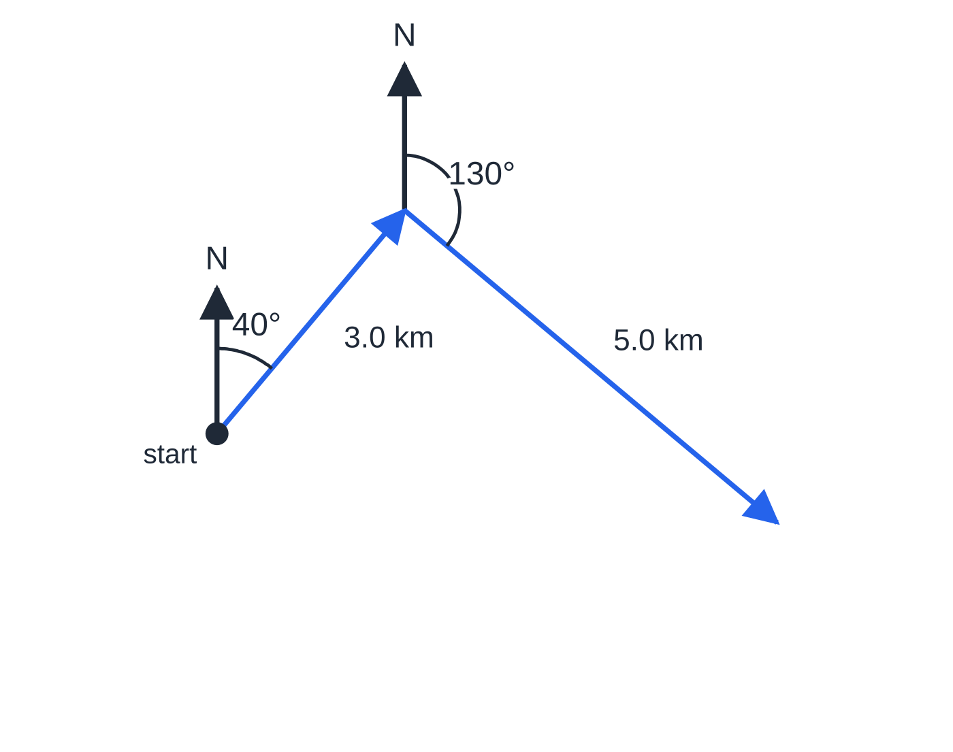
Question 2
7 marks
[In this question i and j are unit vectors due east and due north respectively.] A hiker walks 3.0 km on a bearing of 040° and then 5.0 km on a bearing of 130°.
Figure: the two stages of the walk, with bearings measured clockwise from north; not to scale.
(a) Write the displacement for the first part of the walk in the form (pi + qj) km, giving p and q to 3 significant figures. [2]
(b) Write the displacement for the second part of the walk in the same form. [1]
(c) Find the distance of the hiker from the starting point at the end of the walk. [2]
(d) Find the bearing of the hiker's final position from the starting point. [2]
Notes:
Online with the full mark scheme: https://examinerprep.com/ial-maths-m1-1-modelling-and-vectors-in-mechanics-questions#IALM-M1-1-B-03

Slide 50
Answers

Slide 51
Question 1 · answer
Mark scheme
√(7² + (−4)²) = √65
= 8.06 m
tan⁻¹(4 ÷ 7)
= 29.7° (below i, i.e. south of east)
a + b = (5i + 5j) m
045°
(5i + 5j) ÷ 5√2 = (1/√2)(i + j) or equivalent, e.g. (√2/2)i + (√2/2)j
Notes:
Full mark scheme: https://examinerprep.com/ial-maths-m1-1-modelling-and-vectors-in-mechanics-questions#IALM-M1-1-B-02

Slide 52
Question 2 · answer
Mark scheme
3.0 sin 40° i + 3.0 cos 40° j
= (1.93i + 2.30j) km
5.0 sin 130° i + 5.0 cos 130° j = (3.83i − 3.21j) km
resultant = 5.76i − 0.916j, then Pythagoras
5.83 km (√34; the two stages are at right angles)
angle below east = tan⁻¹(0.916 ÷ 5.76) = 9.04°, or 40° + tan⁻¹(5 ÷ 3)
bearing = 099° (99.0°)
Notes:
Full mark scheme: https://examinerprep.com/ial-maths-m1-1-modelling-and-vectors-in-mechanics-questions#IALM-M1-1-B-03

Slide 53
Keep practising
Notes for this topic
Questions on this topic
Build a printable test
ExaminerPrep is an independent tutoring service. It has been developed independently from and is not endorsed by the International Baccalaureate Organization. "International Baccalaureate", "IB" and "IB Diploma Programme" are registered trademarks of the IBO, used here for descriptive purposes only.
Pearson Edexcel and Cambridge are trademarks of their owners; ExaminerPrep is not affiliated with any exam board.

