Slide 1
EP
EDEXCEL IAL MATHS
P3.2 Modulus and transformations of graphs
The full notes page in 14 sections · practice questions with answers · simulations
ExaminerPrep is an independent tutoring service. It has been developed independently from and is not endorsed by the International Baccalaureate Organization. "International Baccalaureate", "IB" and "IB Diploma Programme" are registered trademarks of the IBO, used here for descriptive purposes only.
Pearson Edexcel and Cambridge are trademarks of their owners; ExaminerPrep is not affiliated with any exam board.
Notes:
P3.2 Modulus and transformations of graphs. Notes for this topic: https://examinerprep.com/notes/edexcel-ial-maths/modulus-and-transformations-of-graphs/

Slide 2
What this page covers
Overview
The modulus function |x| and the V-shaped graph of y = |ax + b|
Sketching y = |f(x)| by reflecting the negative parts in the x-axis
Sketching y = f(|x|) by reflecting the right-hand half in the y-axis
Solving |ax+b| = c, |ax+b| = cx + d and |ax+b| = |cx+d|, with a check for false roots
Solving modulus inequalities with a sketch and with algebra
Combined transformations such as y = 2f(3x), y = f(-x) + 1 and y = 3 - f(x)
What a combined transformation does to points, intercepts, turning points and asymptotes
Notes:
What this page covers. Full notes: https://examinerprep.com/notes/edexcel-ial-maths/modulus-and-transformations-of-graphs/

Slide 3
In one minute
Key points
1. The modulus |x| is the size of x without its sign, so y = |f(x)| is y = f(x) with every negative part reflected upwards, while y = f(|x|) keeps the part with x ≥0 and mirrors it in the y-axis.
2. |x| = x when x ≥0 and |x| = -x when x < 0; a modulus is never negative.
3. |A| = B means A = B or A = -B: solve both and check every root. |A| = |B| can be squared safely: A² = B².
4. |A| < c ⇔-c < A < c and |A| > c ⇔A < -c or A > c. Find critical values, then read the answer from a sketch.
5. Under y = af(bx) + c, the point (p, q) moves to (p/b, aq + c), and asymptotes move by the same rule.
Notes:
In one minute. Full notes: https://examinerprep.com/notes/edexcel-ial-maths/modulus-and-transformations-of-graphs/

Slide 4
What is the modulus function and what does y = |ax+b| look like?
Section 1 of 14
Many quantities in mathematics have a size but no direction: a distance, an error, a length. The modulus function captures exactly this idea. It takes any real number and throws away its sign, so that positive numbers are unchanged and negative numbers become positive. Geometrically, |x| is the distance of x from 0 on the number line, and so it can never be negative.
The modulus of a real number.
|x| = { x,, x ≥0; -x,, x < 0 } So |5| = 5, |-5| = 5 and |0| = 0. More generally, |x - m| is the distance between x and m on the number line.
The distance idea gives a quick way into simple inequalities. The statement |x - 2| < 5 says "x is less than 5 units away from 2", so x lies between 2 - 5 = -3 and 2 + 5 = 7. No algebra is needed once you read it as a distance.
Notes:
What is the modulus function and what does y = |ax+b| look like?. Full notes: https://examinerprep.com/notes/edexcel-ial-maths/modulus-and-transformations-of-graphs/

Slide 5
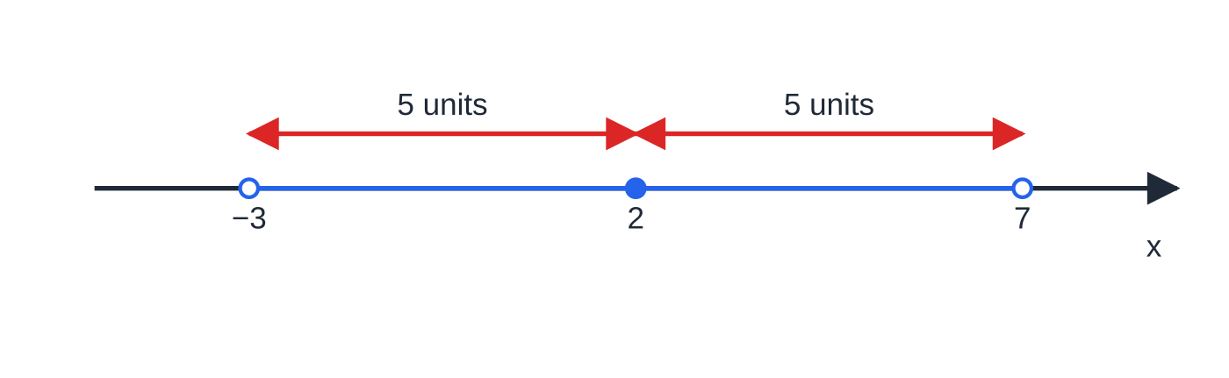
What is the modulus function and what does y = |ax+b| look like? (continued)
Section 1 of 14
Now apply the modulus to a linear expression. The graph of y = |ax + b| is the straight line y = ax + b with every point below the x-axis reflected upwards. The line crosses the axis where ax + b = 0, so the result is a V shape whose vertex sits on the x-axis at (-b/a, 0). The y-intercept is (0, |b|). One arm has gradient a and the other has gradient -a, so the V is symmetrical about the vertical line through its vertex.
|x − 2| < 5 means "within 5 of 2": the open interval −3 < x < 7. Hollow dots show that the end points are not included.
Notes:
What is the modulus function and what does y = |ax+b| look like?. Full notes: https://examinerprep.com/notes/edexcel-ial-maths/modulus-and-transformations-of-graphs/

Slide 6
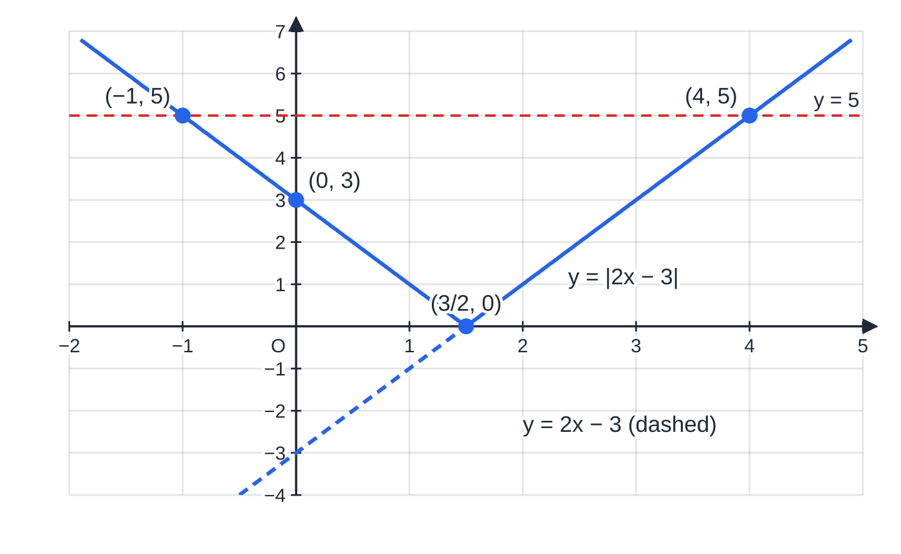
What is the modulus function and what does y = |ax+b| look like? (continued)
Section 1 of 14
y = |2x − 3|: the vertex is at (3/2, 0) and the y-intercept at (0, 3). The dashed part of y = 2x − 3 below the axis has been reflected. The line y = 5 meets the V twice, at x = −1 and x = 4.
Notes:
What is the modulus function and what does y = |ax+b| look like?. Full notes: https://examinerprep.com/notes/edexcel-ial-maths/modulus-and-transformations-of-graphs/

Slide 7
What is the modulus function and what does y = |ax+b| look like? (continued)
Section 1 of 14 · Worked example 1 · Easy · Sketch, solve
WORKED EXAMPLE · QUESTION
(a) Sketch the graph of y = |2x - 3|, stating the coordinates of the points where it meets the coordinate axes. (b) Solve |2x - 3| = 5.
SOLUTION
(a) The vertex is where 2x - 3 = 0, so x = (3/2). When x = 0, y = |-3| = 3. The graph is a V with vertex ((3/2), 0) and y-intercept (0, 3).
(b) Split into two cases. 2x - 3 = 5 ⇒x = 4, or 2x - 3 = -5 ⇒x = -1. Check: |2(4) - 3| = 5 and |2(-1) - 3| = |-5| = 5. x = -1 or x = 4. The sketch confirms two solutions, one on each arm.
Notes:
What is the modulus function and what does y = |ax+b| look like?: Worked example 1. Full notes: https://examinerprep.com/notes/edexcel-ial-maths/modulus-and-transformations-of-graphs/

Slide 8
How do you sketch y = |f(x)|?
Section 2 of 14
The modulus here is wrapped around the whole function, so it acts on the output y. Whatever height the graph of y = f(x) reaches, y = |f(x)| reaches the same height without the sign. Points that were already on or above the x-axis are unchanged; points below it are reflected in the x-axis. That gives a reliable three-step method.
Sketch y = f(x) first, lightly.
Keep every part that is on or above the x-axis.
Reflect every part that is below the x-axis in the x-axis.
Some consequences follow straight away. The x-intercepts stay where they are, because 0 is its own modulus. A minimum below the axis at (p, -q) becomes a maximum at (p, q). Where the original curve crossed the axis, the new graph has a sharp corner (a cusp), because a descending piece meets its own reflection. Where the original only touched the axis, nothing is reflected and the curve stays smooth. Finally, y = |f(x)| is never below the x-axis, so its range contains no negative values.
Notes:
How do you sketch y = |f(x)|?. Full notes: https://examinerprep.com/notes/edexcel-ial-maths/modulus-and-transformations-of-graphs/

Slide 9
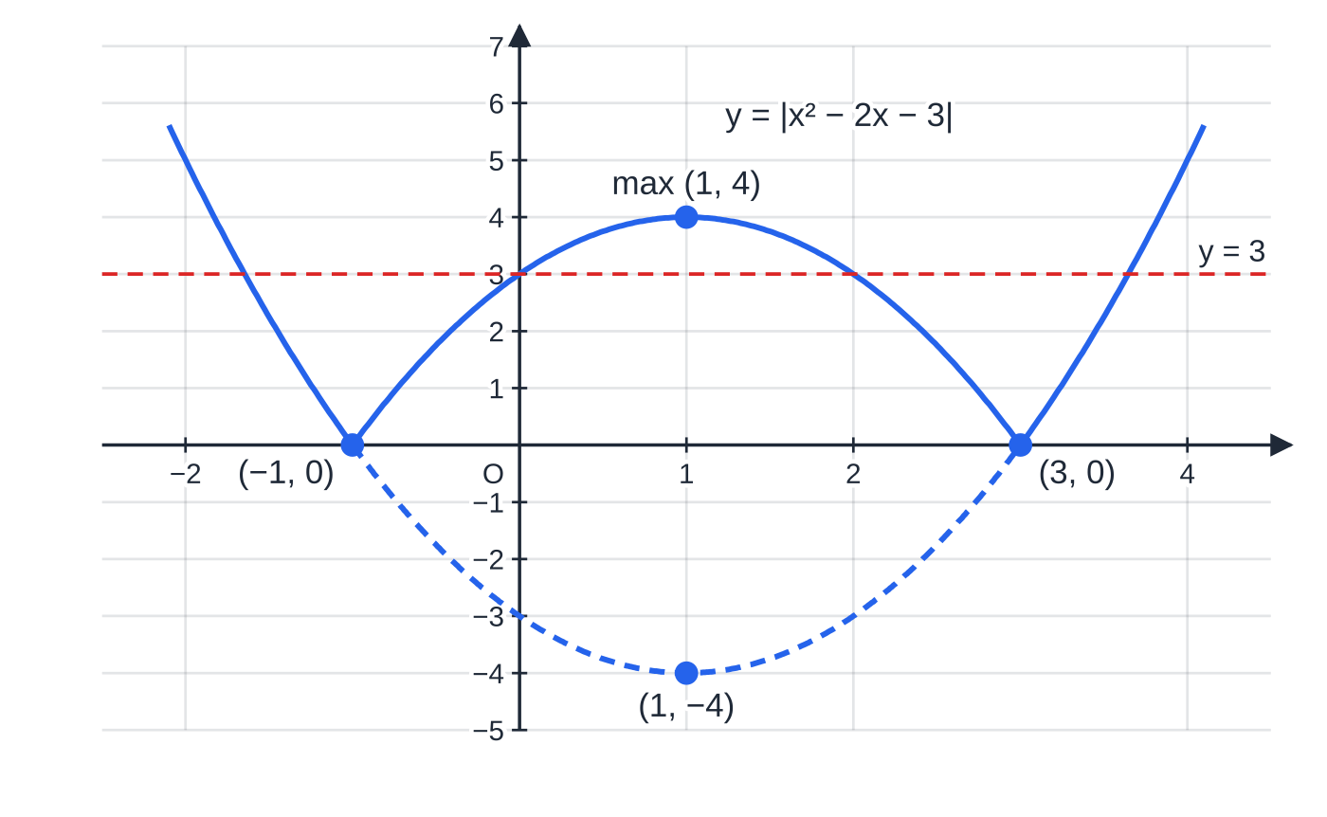
How do you sketch y = |f(x)|? (continued)
Section 2 of 14
A horizontal line y = k is a powerful tool with these graphs. The number of times it meets y = |f(x)| is the number of solutions of |f(x)| = k, so questions that ask "for which values of k are there exactly four solutions?" are answered by sliding a horizontal line up and down the sketch.
y = |x² − 2x − 3|. The roots −1 and 3 stay put; the minimum (1, −4) of the dashed parabola becomes a maximum (1, 4). The line y = 3 meets the graph at four points.
Notes:
How do you sketch y = |f(x)|?. Full notes: https://examinerprep.com/notes/edexcel-ial-maths/modulus-and-transformations-of-graphs/

Slide 10
How do you sketch y = |f(x)|? (continued)
Section 2 of 14 · Worked example 2 · Medium · Sketch, solve, find
WORKED EXAMPLE · QUESTION
(a) Sketch y = |x² - 2x - 3|, giving the coordinates of the points where it meets the axes and of its maximum point. (b) Solve |x² - 2x - 3| = 3. (c) Find the values of k for which |x² - 2x - 3| = k has exactly four solutions.
SOLUTION
(a) x² - 2x - 3 = (x - 3)(x + 1) = (x - 1)² - 4. The graph meets the axes at (-1, 0), (3, 0), (0, 3), and the minimum (1, -4) of the parabola reflects to the maximum (1, 4).
(b) Case 1: x² - 2x - 3 = 3 ⇒x² - 2x - 6 = 0 ⇒x = 1 ±√7. Case 2: x² - 2x - 3 = -3 ⇒x(x - 2) = 0 ⇒x = 0 or 2. x = 1 - √7, 0, 2, 1 + √7.
(c) A horizontal line y = k cuts the graph four times only when it lies strictly between the axis and the maximum: 0 < k < 4. At k = 4 the line touches the maximum (three solutions); for k > 4 there are two, and at k = 0 two (the roots).
Notes:
How do you sketch y = |f(x)|?: Worked example 2. Full notes: https://examinerprep.com/notes/edexcel-ial-maths/modulus-and-transformations-of-graphs/

Slide 11
How do you sketch y = f(|x|)?
Section 3 of 14
Now the modulus is around the x, so it acts on the input. For x ≥0 we have |x| = x, so f(|x|) = f(x): the right-hand half of the graph is unchanged. For x < 0 we have f(|x|) = f(-x), which takes the value the function had at the mirror-image point on the right. So the left half becomes a copy of the right half, reflected in the y-axis.
Delete everything to the left of the y-axis.
Reflect the part with x ≥0 in the y-axis.
The result is always symmetrical about the y-axis (an even function), and unlike |f(x)| it may go below the x-axis. Anything that happened only for x < 0 on the original graph, such as a root, a turning point or an asymptote, disappears completely, and anything on the right gains a mirror image.
The three figures below use the cubic f(x) = (x + 1)(x - 2)². Compare them carefully: the same original curve produces two quite different modulus graphs.
Notes:
How do you sketch y = f(|x|)?. Full notes: https://examinerprep.com/notes/edexcel-ial-maths/modulus-and-transformations-of-graphs/

Slide 12
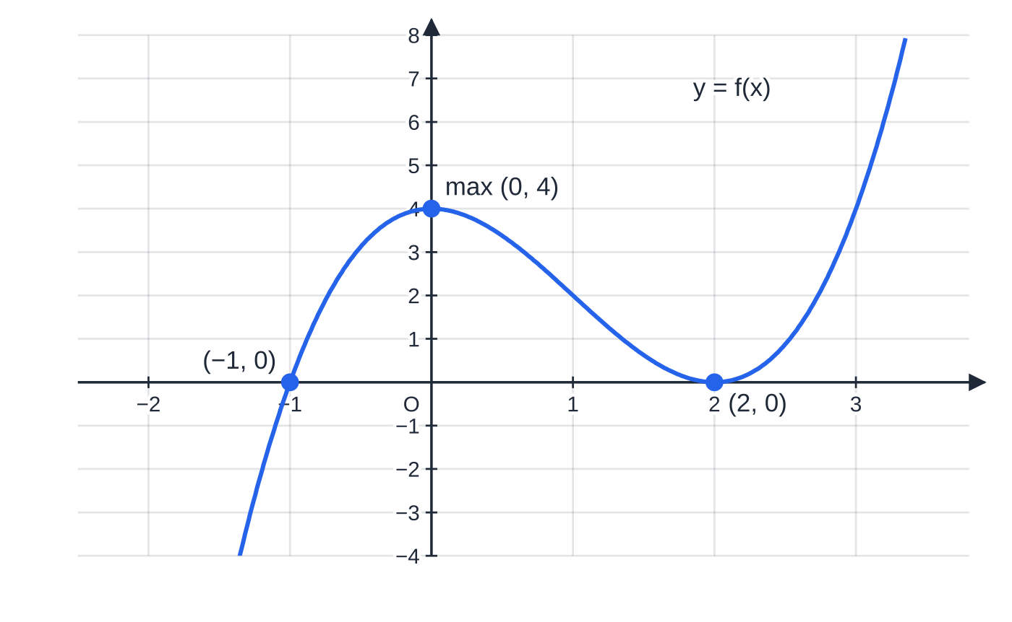
How do you sketch y = f(|x|)? (continued)
Section 3 of 14
(a) f(x) = (x + 1)(x − 2)²: a root at x = −1 where the curve crosses the axis, a maximum at (0, 4) and a minimum touching the axis at (2, 0).
Notes:
How do you sketch y = f(|x|)?. Full notes: https://examinerprep.com/notes/edexcel-ial-maths/modulus-and-transformations-of-graphs/

Slide 13
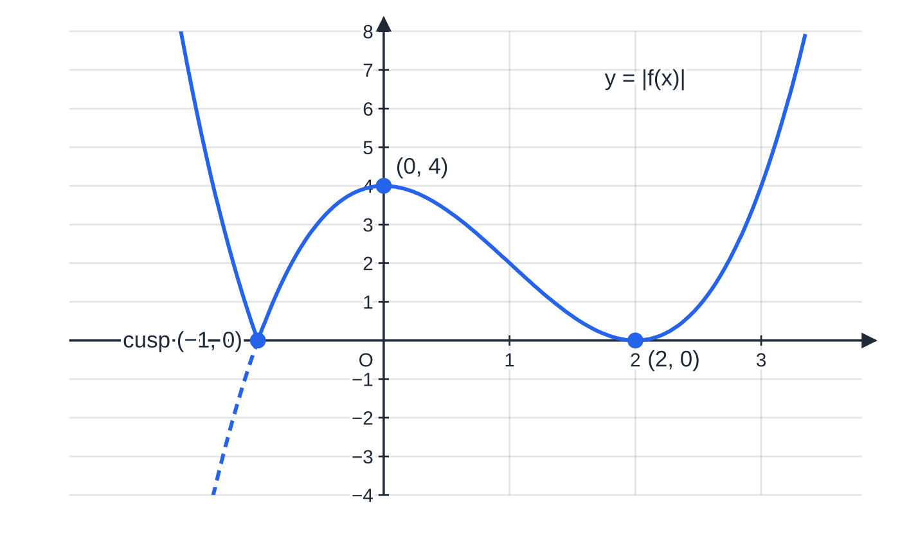
How do you sketch y = f(|x|)? (continued)
Section 3 of 14
(b) y = |f(x)|: only the part left of x = −1 was negative, so only that part flips upwards, leaving a cusp at (−1, 0). The touching point (2, 0) stays smooth.
Notes:
How do you sketch y = f(|x|)?. Full notes: https://examinerprep.com/notes/edexcel-ial-maths/modulus-and-transformations-of-graphs/

Slide 14
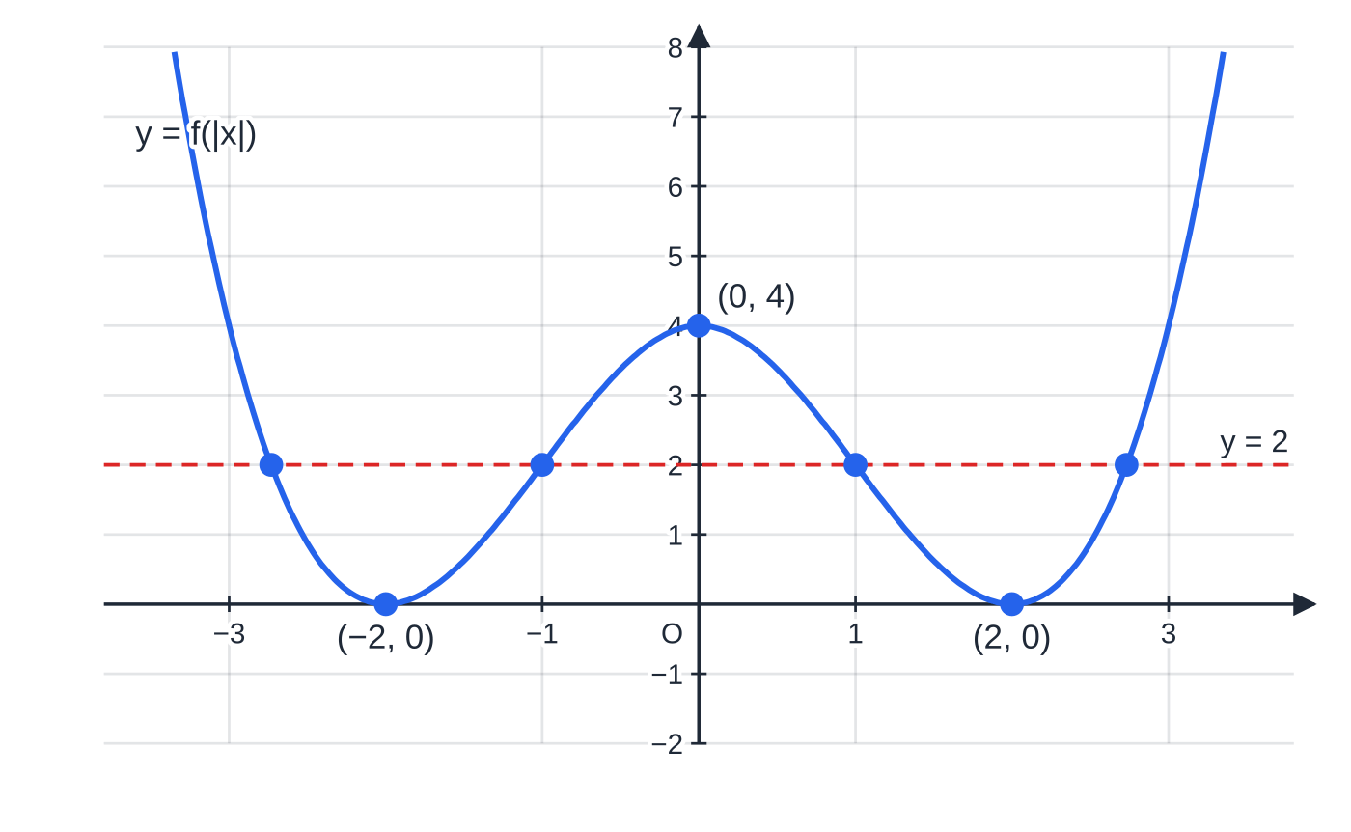
How do you sketch y = f(|x|)? (continued)
Section 3 of 14
(c) y = f(|x|): the root at −1 has gone, and the touching point (2, 0) has a mirror image (−2, 0). The line y = 2 meets this W shape four times, at x = ±1 and x = ±(1 + √3).
Notes:
How do you sketch y = f(|x|)?. Full notes: https://examinerprep.com/notes/edexcel-ial-maths/modulus-and-transformations-of-graphs/

Slide 15
How do you sketch y = f(|x|)? (continued)
Section 3 of 14 · Worked example 3 · Hard · Show that, sketch, solve
WORKED EXAMPLE · QUESTION
The function f is defined by f(x) = (x + 1)(x - 2)², x ∈ℝ. (a) Show that the curve y = f(x) has turning points at (0, 4) and (2, 0). (b) Sketch y = |f(x)| and y = f(|x|), labelling where each meets the axes. (c) Solve f(|x|) = 2, giving exact answers.
SOLUTION
(a) By the product rule, f′(x) = (x - 2)² + 2(x + 1)(x - 2) = (x - 2)[(x - 2) + 2(x + 1)] = 3x(x - 2). Setting f′(x) = 0 gives x = 0 or x = 2. Then f(0) = 1 ×4 = 4 and f(2) = 0, so the turning points are (0, 4) and (2, 0).
(b) f(x) < 0 only for x < -1, so y = |f(x)| flips just that part: it meets the axes at (-1, 0), (2, 0), (0, 4), with a cusp at (-1, 0). y = f(|x|) is a W shape meeting the axes at (-2, 0), (2, 0), (0, 4).
(c) Solve f(x) = 2 for x ≥0, then add the mirror images. (x + 1)(x - 2)² = 2 ⇒x³ - 3x² + 2 = 0. Since x = 1 is a root, (x - 1)(x² - 2x - 2) = 0, giving x = 1 or x = 1 ±√3. Reject 1 - √3 ≈-0.732, which is negative and so not on the kept half. Reflecting gives x = ±1, ±(1 + √3).
Notes:
How do you sketch y = f(|x|)?: Worked example 3. Full notes: https://examinerprep.com/notes/edexcel-ial-maths/modulus-and-transformations-of-graphs/

Slide 16
How do you sketch y = f(|x|)? (continued)
Section 3 of 14
Common error — mixing up the two graphs
|f(x)| acts on the output: it reflects in the x-axis and is never negative. f(|x|) acts on the input: it reflects in the y-axis and is always symmetrical. Ask yourself "is the modulus round the whole function, or round the x?" before you draw anything.
Notes:
How do you sketch y = f(|x|)?. Full notes: https://examinerprep.com/notes/edexcel-ial-maths/modulus-and-transformations-of-graphs/

Slide 17
How do you solve modulus equations?
Section 4 of 14
Every modulus equation is really two equations in disguise. If |A| = B, then A is either B or -B, so you solve both. The subtle point is that a modulus can never equal a negative number. When the right-hand side B contains x, a root from one of the cases might make B negative, and that root does not satisfy the original equation. It is called a false root, and it must be rejected.
Splitting a modulus equation.
|A| = B ⇒ A = B or A = -B |A| = |B| ⇔A² = B² ⇔A = ±B When B contains x, a root is valid only if B ≥0 there. Squaring is safe for |A| = |B| because both sides are already non-negative.
|ax + b| = c with a number c > 0: two solutions, from ax + b = ±c.
|ax + b| = cx + d: solve both cases, then substitute each root back and reject any that make cx + d negative. A sketch of the V and the line shows how many solutions to expect.
Notes:
How do you solve modulus equations?. Full notes: https://examinerprep.com/notes/edexcel-ial-maths/modulus-and-transformations-of-graphs/

Slide 18
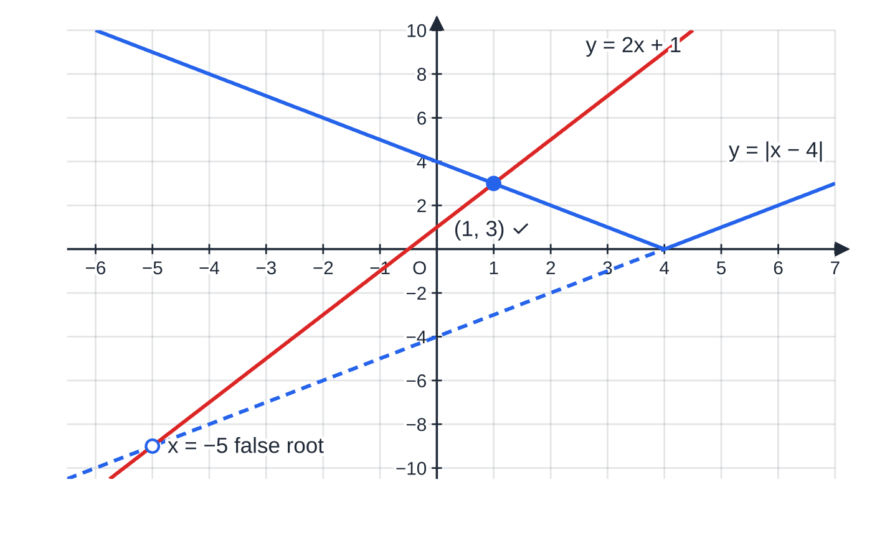
How do you solve modulus equations? (continued)
Section 4 of 14
|ax + b| = |cx + d|: square both sides and solve the quadratic, or solve ax + b = ±(cx + d).
The figure explains a false root visually. Solving the case x - 4 = 2x + 1 is the same as intersecting the line y = 2x + 1 with the full line y = x - 4. But the V only uses y = x - 4 for x ≥4; to the left it has been reflected away. The intersection at x = -5 lies on the dashed part, which is not on the graph of y = |x - 4|.
|x − 4| = 2x + 1. The case x − 4 = 2x + 1 gives x = −5, but there 2x + 1 = −9 is negative and the dashed line is not part of the V. The only solution is x = 1.
Notes:
How do you solve modulus equations?. Full notes: https://examinerprep.com/notes/edexcel-ial-maths/modulus-and-transformations-of-graphs/

Slide 19
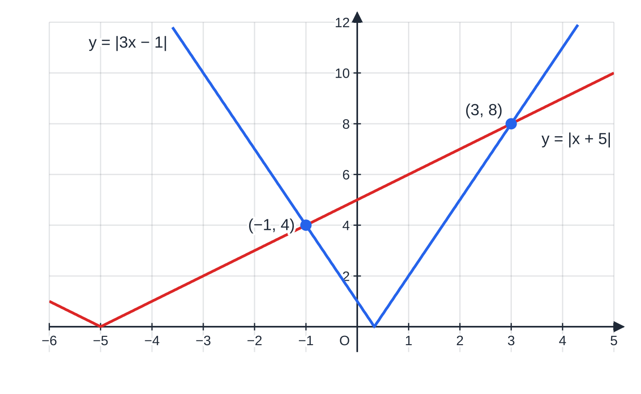
How do you solve modulus equations? (continued)
Section 4 of 14
|3x − 1| = |x + 5|: the two V shapes cross twice, at x = −1 and x = 3. Both solutions are genuine, since both sides are moduli.
Notes:
How do you solve modulus equations?. Full notes: https://examinerprep.com/notes/edexcel-ial-maths/modulus-and-transformations-of-graphs/

Slide 20
How do you solve modulus equations? (continued)
Section 4 of 14 · Worked example 4 · Medium · Solve
WORKED EXAMPLE · QUESTION
(a) Solve |x - 4| = 2x + 1. (b) Solve |3x - 1| = |x + 5|.
SOLUTION
(a) Case x - 4 = 2x + 1: x = -5, but then 2x + 1 = -9 < 0, so reject. Case -(x - 4) = 2x + 1: 4 - x = 2x + 1 ⇒3x = 3 ⇒x = 1. Check: |1 - 4| = 3 = 2(1) + 1. x = 1 only.
(b) Square both sides: 9x² - 6x + 1 = x² + 10x + 25 ⇒8x² - 16x - 24 = 0 ⇒x² - 2x - 3 = 0 ⇒(x - 3)(x + 1) = 0. x = 3 or x = -1. Check: |8| = |8| and |-4| = |4|. Squaring cannot create false roots here, because both sides were moduli.
Notes:
How do you solve modulus equations?: Worked example 4. Full notes: https://examinerprep.com/notes/edexcel-ial-maths/modulus-and-transformations-of-graphs/

Slide 21
How do you solve modulus equations? (continued)
Section 4 of 14
Common error — squaring the wrong equation
Squaring |x - 4| = 2x + 1 brings in x = -5, which does not satisfy the original equation, because the right-hand side can be negative. Square only when both sides are moduli (or are known to be non-negative), and check every root either way.
Notes:
How do you solve modulus equations?. Full notes: https://examinerprep.com/notes/edexcel-ial-maths/modulus-and-transformations-of-graphs/

Slide 22
How do you solve modulus inequalities?
Section 5 of 14
The distance picture from the first section gives the two basic rules. If |A| < c, then A is within c of zero, which is one interval. If |A| > c, then A is further than c from zero, on either side, which is two separate intervals.
Modulus inequalities with a constant c > 0.
|A| < c ⇔-c < A < c |A| > c ⇔A < -c or A > c "Less than" gives one interval; "greater than" gives two.
When both sides involve x, use a three-step method:
sketch both sides on the same axes;
find the critical values by solving the equation, with the false-root check;
read off the intervals where one graph is above the other.
Notes:
How do you solve modulus inequalities?. Full notes: https://examinerprep.com/notes/edexcel-ial-maths/modulus-and-transformations-of-graphs/

Slide 23
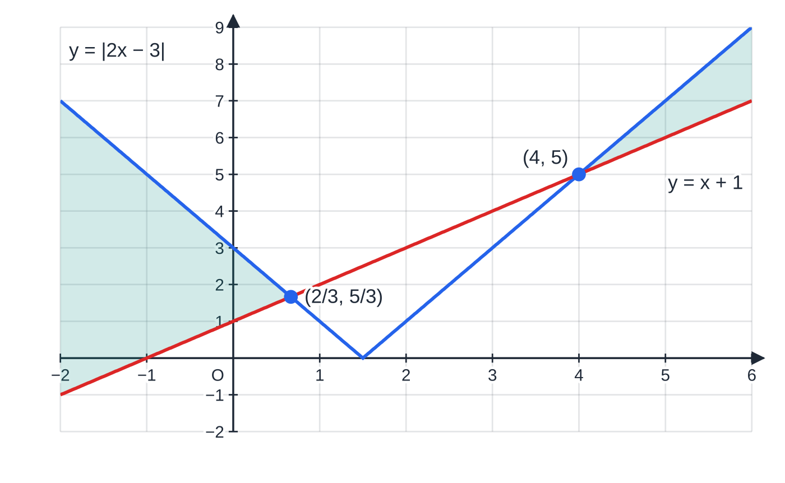
How do you solve modulus inequalities? (continued)
Section 5 of 14
For |A| < |B| or |A| > |B| you may square, because both sides are non-negative and squaring non-negative numbers preserves the order. The problem then becomes a quadratic inequality. Strict signs (<, >) give open intervals; ≤ and ≥ include the critical values.
|2x − 3| > x + 1. The graphs cross at x = 2/3 and x = 4; the V is above the line (shaded) to the left of the first crossing and to the right of the second.
Notes:
How do you solve modulus inequalities?. Full notes: https://examinerprep.com/notes/edexcel-ial-maths/modulus-and-transformations-of-graphs/

Slide 24
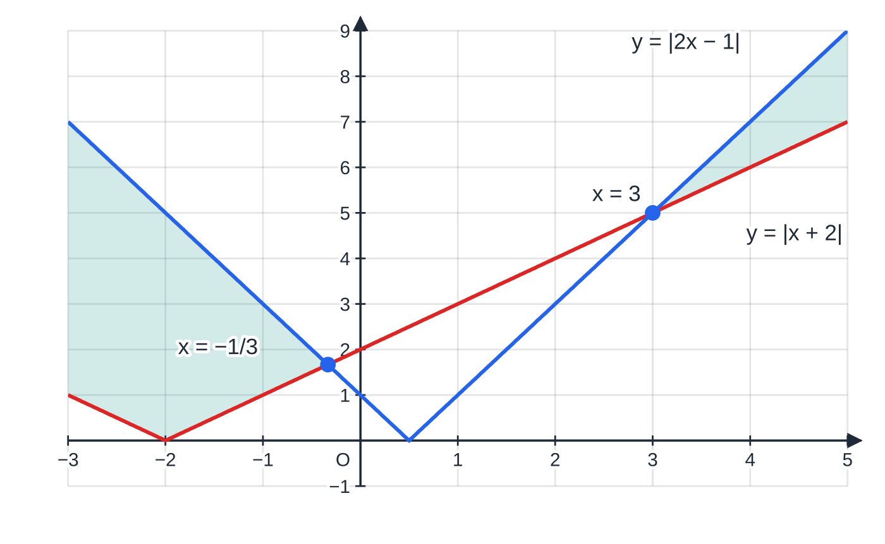
How do you solve modulus inequalities? (continued)
Section 5 of 14
|x + 2| ≤ |2x − 1| holds where the blue V is on or above the red V: x ≤ −1/3 or x ≥ 3 (shaded regions).
Notes:
How do you solve modulus inequalities?. Full notes: https://examinerprep.com/notes/edexcel-ial-maths/modulus-and-transformations-of-graphs/

Slide 25
How do you solve modulus inequalities? (continued)
Section 5 of 14 · Worked example 5 · Medium · Solve
WORKED EXAMPLE · QUESTION
(a) Solve |2x - 3| > x + 1. (b) Solve |x + 2| ≤|2x - 1|.
SOLUTION
(a) Critical values from |2x - 3| = x + 1: 2x - 3 = x + 1 ⇒x = 4 (right-hand side 5, valid); -(2x - 3) = x + 1 ⇒x = ⅔ (right-hand side (5/3), valid). From the sketch, the V is above the line outside the critical values: x < ⅔ or x > 4.
(b) Both sides are non-negative, so square: (x + 2)² ≤(2x - 1)² ⇒0 ≤3x² - 8x - 3 = (3x + 1)(x - 3). The critical values are -⅓ and 3, and a positive quadratic is ≥0 outside its roots: x ≤-⅓ or x ≥3. Test x = 0: |2| ≤|-1| is false, so the middle interval is correctly excluded.
Notes:
How do you solve modulus inequalities?: Worked example 5. Full notes: https://examinerprep.com/notes/edexcel-ial-maths/modulus-and-transformations-of-graphs/

Slide 26
What does each single transformation do?
Section 6 of 14
These come from P1. Every combined transformation is built from them, so they need to be automatic. The pattern is easy to remember: a change outside the function acts on y and does what it looks like; a change inside the bracket acts on x and does the opposite of what it looks like. Adding c inside moves the graph left, and multiplying x by b squeezes by 1/b, because the input reaches each value sooner.
Equation | Transformation of y = f(x) | Point (p, q) moves to
y = f(x) + c | translation c units up, vector (0, c) | (p, q + c)
y = f(x + c) | translation c units left, vector (-c, 0) | (p - c, q)
y = af(x) | stretch parallel to the y-axis, scale factor a | (p, aq)
y = f(bx) | stretch parallel to the x-axis, scale factor 1/b | (p/b, q)
y = -f(x) | reflection in the x-axis | (p, -q)
y = f(-x) | reflection in the y-axis | (-p, q)
Notes:
What does each single transformation do?. Full notes: https://examinerprep.com/notes/edexcel-ial-maths/modulus-and-transformations-of-graphs/

Slide 27
What does each single transformation do? (continued)
Section 6 of 14
A quick way to check any rule is substitution. On y = f(x + 3), put x = p - 3: you get y = f(p) = q, so (p - 3, q) lies on the new curve, and the graph has moved 3 to the left.
Notes:
What does each single transformation do?. Full notes: https://examinerprep.com/notes/edexcel-ial-maths/modulus-and-transformations-of-graphs/

Slide 28
How do you combine transformations?
Section 7 of 14
A combined transformation such as y = af(bx) + c changes x-coordinates and y-coordinates independently, so you can handle the two directions separately. Horizontally, the only change is the factor b: each x-coordinate is divided by b. Vertically, the output is first multiplied by a and then has c added, so in that direction the stretch (or reflection) comes before the translation.
Image of a point under y = af(bx) + c.
(p, q) ⟼ (p/b, aq + c) a is the vertical stretch (a negative a also reflects in the x-axis); b is the horizontal factor (a negative b also reflects in the y-axis); c is the vertical translation. In the vertical direction, apply the stretch or reflection first: y = 2f(x) - 1 doubles, then moves down 1.
y = 2f(3x): stretch parallel to the x-axis, scale factor ⅓, and stretch parallel to the y-axis, scale factor 2. (p, q) ↦(p/3, 2q).
Notes:
How do you combine transformations?. Full notes: https://examinerprep.com/notes/edexcel-ial-maths/modulus-and-transformations-of-graphs/

Slide 29
How do you combine transformations? (continued)
Section 7 of 14
y = f(-x) + 1: reflect in the y-axis, then translate 1 up. (p, q) ↦(-p, q + 1).
y = 3 - f(x) = -f(x) + 3: reflect in the x-axis, then translate 3 up. (p, q) ↦(p, 3 - q), so a maximum becomes a minimum.
A stationary point stays stationary under any of these, but a reflection in the x-axis swaps maximum and minimum. Points on the x-axis stay on the axis only if there is no vertical translation. To describe a combined transformation, name each single one fully (type, direction, scale factor or vector) and give the order where it matters.
The figures use f(x) = 4 - (x - 1)², which passes through A(-1, 0), B(1, 4), C(3, 0) and D(0, 3).
Notes:
How do you combine transformations?. Full notes: https://examinerprep.com/notes/edexcel-ial-maths/modulus-and-transformations-of-graphs/

Slide 30
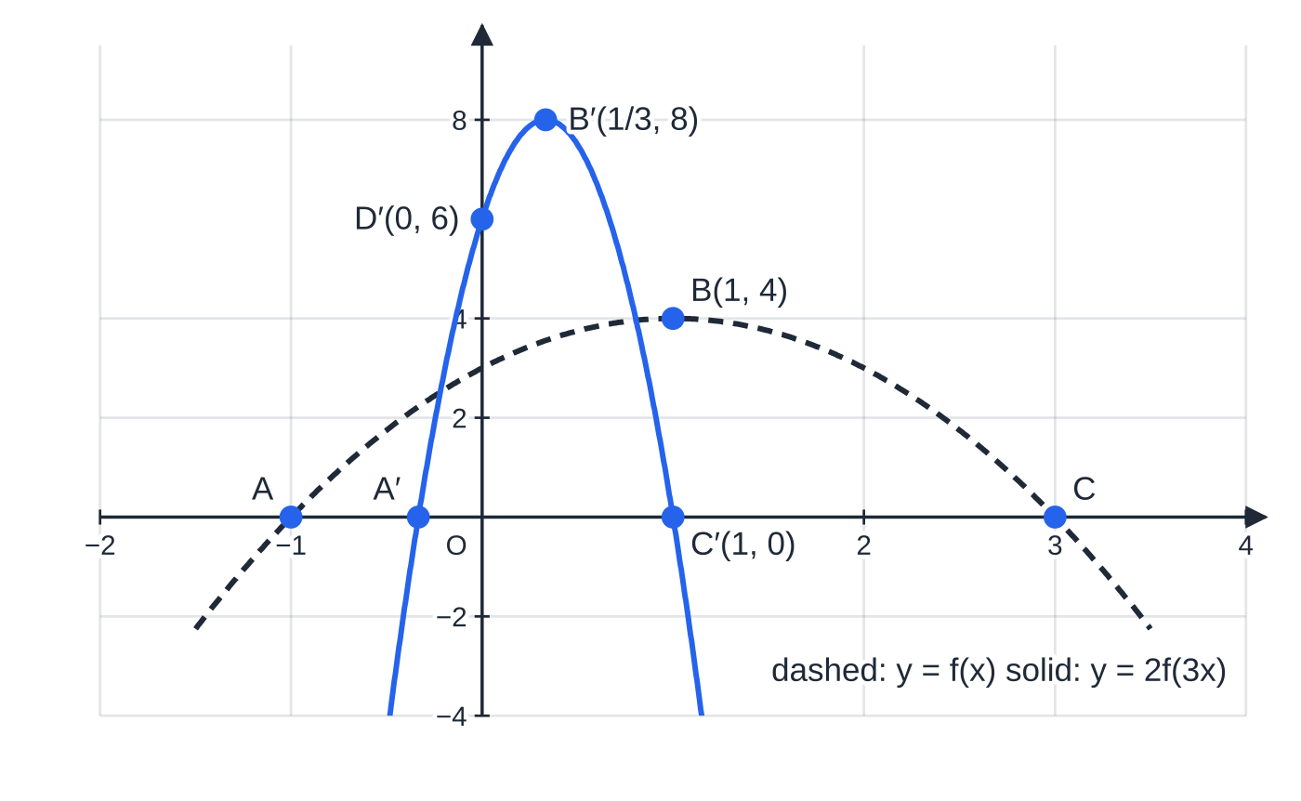
How do you combine transformations? (continued)
Section 7 of 14
Under y = 2f(3x) every x-coordinate is divided by 3 and every y-coordinate doubled: A(−1, 0) → A′(−1/3, 0), B(1, 4) → B′(1/3, 8), C(3, 0) → C′(1, 0), D(0, 3) → D′(0, 6).
Notes:
How do you combine transformations?. Full notes: https://examinerprep.com/notes/edexcel-ial-maths/modulus-and-transformations-of-graphs/

Slide 31
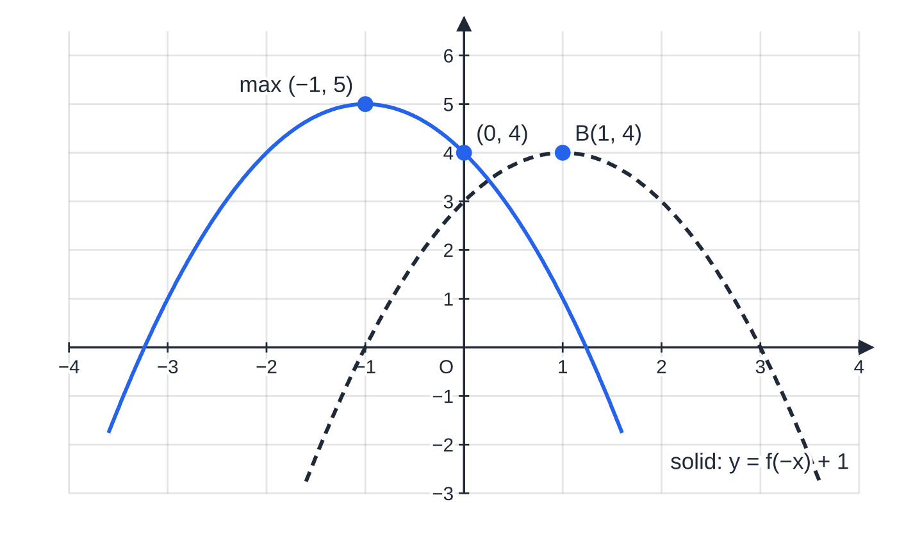
How do you combine transformations? (continued)
Section 7 of 14
Under y = f(−x) + 1 every x-coordinate changes sign and every y-coordinate goes up by 1: the maximum B(1, 4) moves to (−1, 5) and the y-intercept D(0, 3) moves to (0, 4).
Notes:
How do you combine transformations?. Full notes: https://examinerprep.com/notes/edexcel-ial-maths/modulus-and-transformations-of-graphs/

Slide 32
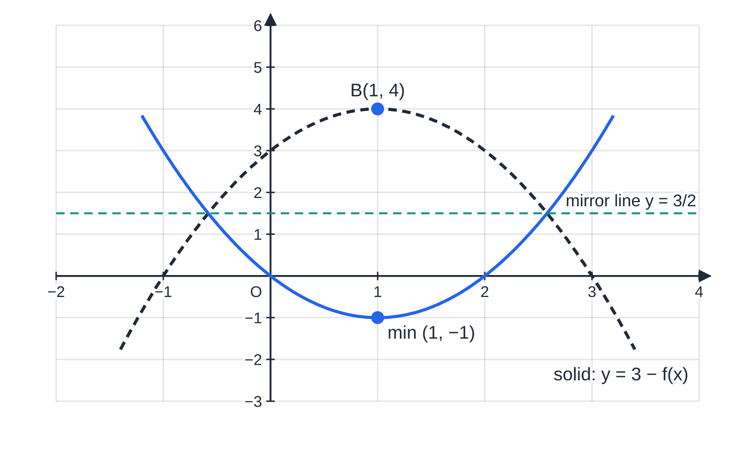
How do you combine transformations? (continued)
Section 7 of 14
y = 3 − f(x): reflect in the x-axis, then move up 3. Each height q becomes 3 − q, so the maximum (1, 4) becomes the minimum (1, −1). The net effect is a reflection in the line y = 3/2.
Notes:
How do you combine transformations?. Full notes: https://examinerprep.com/notes/edexcel-ial-maths/modulus-and-transformations-of-graphs/

Slide 33
How do you combine transformations? (continued)
Section 7 of 14 · Worked example 6 · Medium · Write down, state
WORKED EXAMPLE · QUESTION
The curve y = f(x) has a maximum at B(1, 4), meets the x-axis at A(-1, 0) and C(3, 0), and meets the y-axis at D(0, 3). (a) Write down the coordinates of the images of A, B, C and D on y = 2f(3x). (b) Write down the coordinates of the maximum point of y = f(-x) + 1 and of the point where it meets the y-axis. (c) State the coordinates of the turning point of y = 3 - f(x) and its nature.
SOLUTION
(a) (p, q) ↦(p/3, 2q): A′(-⅓, 0), B′(⅓, 8), C′(1, 0), D′(0, 6).
(b) (p, q) ↦(-p, q + 1): maximum (-1, 5); y-axis (0, 4).
(c) (p, q) ↦(p, 3 - q): B(1, 4) ↦ (1, -1), a minimum, because the reflection in the x-axis turns the maximum upside down.
Notes:
How do you combine transformations?: Worked example 6. Full notes: https://examinerprep.com/notes/edexcel-ial-maths/modulus-and-transformations-of-graphs/

Slide 34
How do you combine transformations? (continued)
Section 7 of 14
Common error — multiplying instead of dividing
For y = f(3x) the input is tripled, so the graph reaches each height three times sooner: the x-coordinate is divided by 3. Check by substituting: on y = 2f(3x) at x = ⅓, y = 2f(1) = 8.
Notes:
How do you combine transformations?. Full notes: https://examinerprep.com/notes/edexcel-ial-maths/modulus-and-transformations-of-graphs/

Slide 35
What happens to asymptotes under a transformation?
Section 8 of 14
An asymptote is just a line the curve approaches, so it moves exactly as the points near it do. Treat a vertical asymptote x = h with the x-rule and a horizontal asymptote y = v with the y-rule. Under y = af(bx) + c, x = h becomes x = h/b and y = v becomes y = av + c. Vertical changes never move a vertical asymptote, and horizontal changes never move a horizontal one.
The modulus operations have their own effects. Under y = |f(x)| a horizontal asymptote y = v becomes y = |v|. Under y = f(|x|) a vertical asymptote with h < 0 disappears, and one with h > 0 gains a mirror image at x = -h. In every case, find the new intercepts from the new equation: an intercept of the old graph need not map to an intercept of the new one.
Notes:
What happens to asymptotes under a transformation?. Full notes: https://examinerprep.com/notes/edexcel-ial-maths/modulus-and-transformations-of-graphs/

Slide 36
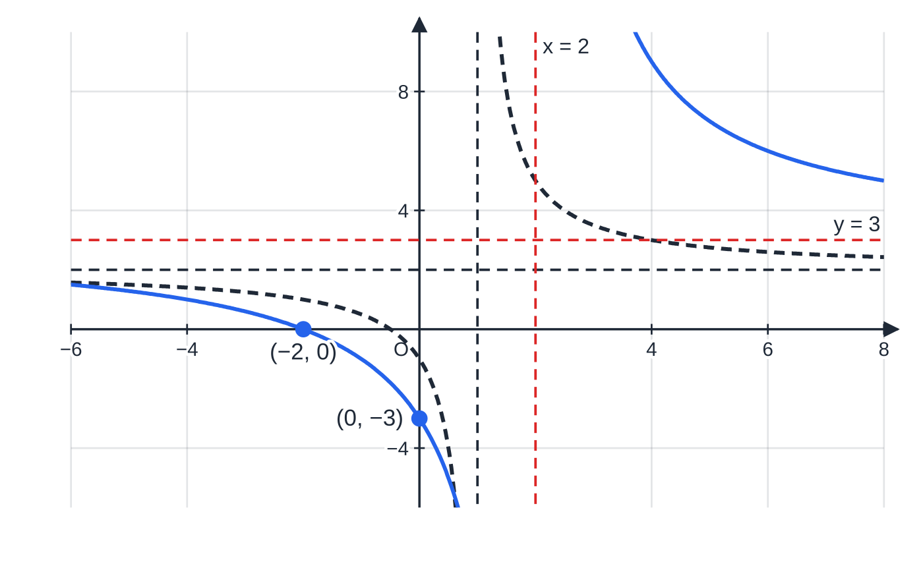
What happens to asymptotes under a transformation? (continued)
Section 8 of 14
f(x) = 2 + 3/(x − 1) (dashed, asymptotes x = 1 and y = 2) and y = 2f(½x) − 1 (solid). The horizontal stretch, scale factor 2, moves x = 1 to x = 2; the vertical stretch and translation move y = 2 to y = 3. The new curve meets the axes at (0, −3) and (−2, 0).
Notes:
What happens to asymptotes under a transformation?. Full notes: https://examinerprep.com/notes/edexcel-ial-maths/modulus-and-transformations-of-graphs/

Slide 37
What happens to asymptotes under a transformation? (continued)
Section 8 of 14 · Worked example 7 · Medium · State, find
WORKED EXAMPLE · QUESTION
The function f is defined by f(x) = 2 + 3/(x - 1), x ≠1. (a) State the equations of the asymptotes of y = f(x). (b) The curve y = f(x) is transformed to y = 2f(½x) - 1. Find the equations of the asymptotes of the new curve and the coordinates of the points where it meets the axes.
SOLUTION
(a) The denominator is zero at x = 1, and the fraction tends to 0 for large |x|: x = 1 and y = 2.
(b) The x-rule multiplies by 2; the y-rule doubles, then subtracts 1. So x = 2 ×1 = 2 and y = 2 ×2 - 1 = 3: x = 2, y = 3.
Intercepts from the new equation. When x = 0: y = 2f(0) - 1 = 2(-1) - 1 = -3, giving (0, -3). When y = 0: f(½x) = ½ ⇒2 + 3/(½x - 1) = ½ ⇒½x - 1 = -2 ⇒x = -2, giving (-2, 0).
Check by simplifying: 2f(½x) - 1 = 3 + 12/(x - 2), which has asymptotes x = 2 and y = 3.
Notes:
What happens to asymptotes under a transformation?: Worked example 7. Full notes: https://examinerprep.com/notes/edexcel-ial-maths/modulus-and-transformations-of-graphs/

Slide 38
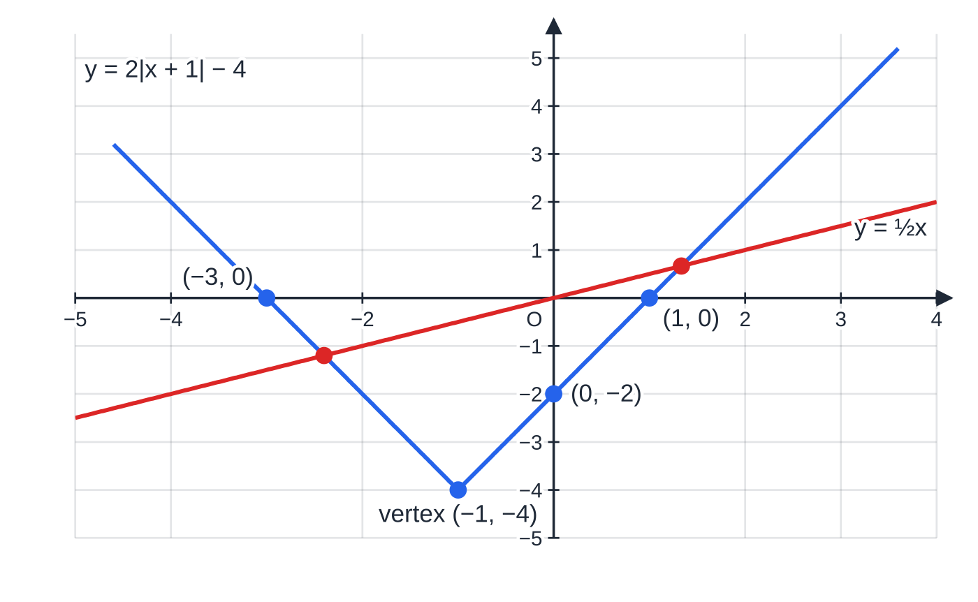
How do the pieces fit together in a full question?
Section 9 of 14
Longer questions usually start with a modulus graph, ask for the solutions of an equation (where the sketch tells you which cases are real), and finish with a transformation of the same graph. The function f(x) = 2|x + 1| - 4 is a typical example: it is itself a transformed modulus graph, the V of |x| moved left 1, stretched vertically by 2 and moved down 4.
y = 2|x + 1| − 4 with the line y = ½x through O. The line crosses each arm once, at x = −12/5 on the left arm and x = 4/3 on the right arm.
Notes:
How do the pieces fit together in a full question?. Full notes: https://examinerprep.com/notes/edexcel-ial-maths/modulus-and-transformations-of-graphs/

Slide 39
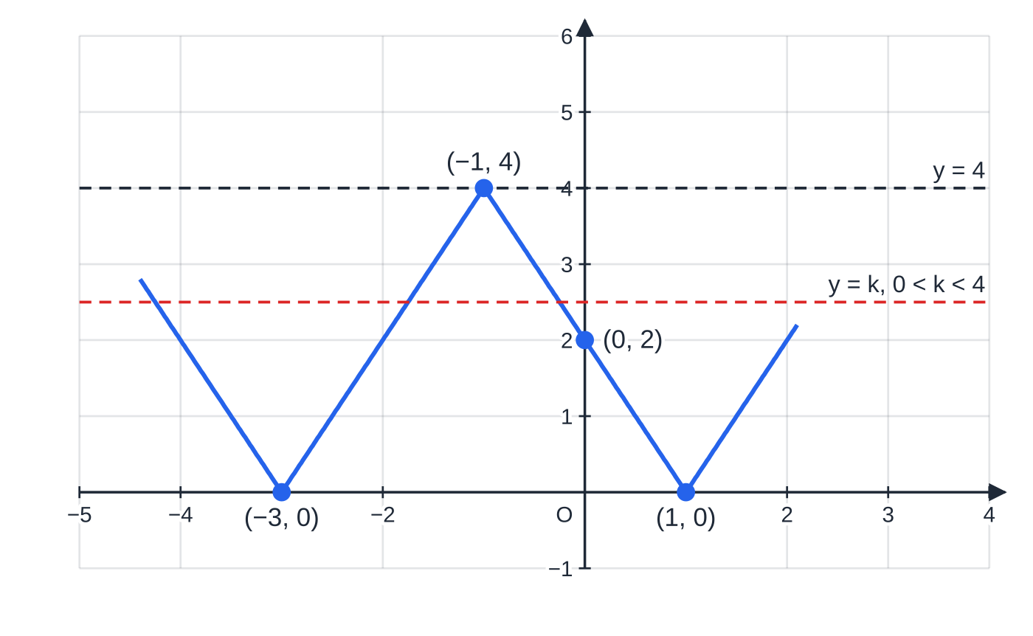
How do the pieces fit together in a full question? (continued)
Section 9 of 14
y = |f(x)| is a W shape: the part between x = −3 and x = 1 has been reflected up, giving a local maximum (−1, 4). A horizontal line between y = 0 and y = 4 meets it four times.
Notes:
How do the pieces fit together in a full question?. Full notes: https://examinerprep.com/notes/edexcel-ial-maths/modulus-and-transformations-of-graphs/

Slide 40
How do the pieces fit together in a full question? (continued)
Section 9 of 14 · Worked example 8 · Hard · Sketch, solve, find
WORKED EXAMPLE · QUESTION
The function f is defined by f(x) = 2|x + 1| - 4, x ∈ℝ. (a) Sketch the graph of y = f(x), giving the coordinates of its vertex and of the points where it meets the coordinate axes. (b) Solve f(x) = ½x. (c) Sketch y = |f(x)| and find the set of values of k for which |f(x)| = k has exactly four solutions. (d) Find the coordinates of the vertex of y = -½f(x) + 1, state whether it is a maximum or a minimum, and find where this graph meets the y-axis.
SOLUTION
(a) The V of 2|x + 1| has its vertex at x = -1, then moves down 4: vertex (-1, -4). 2|x + 1| = 4 ⇒x + 1 = ±2, giving (-3, 0) and (1, 0); f(0) = 2 - 4 = -2, giving (0, -2).
(b) Right arm (x ≥-1): 2(x + 1) - 4 = ½x ⇒2x - 2 = ½x ⇒(3/2)x = 2 ⇒x = (4/3), valid since (4/3) ≥-1. Left arm (x < -1): -2(x + 1) - 4 = ½x ⇒-2x - 6 = ½x ⇒-(5/2)x = 6 ⇒x = -(12/5), valid since -(12/5) < -1. x = -(12/5) or x = (4/3).
Notes:
How do the pieces fit together in a full question?: Worked example 8. Full notes: https://examinerprep.com/notes/edexcel-ial-maths/modulus-and-transformations-of-graphs/

Slide 41
How do the pieces fit together in a full question? (continued)
Section 9 of 14 · Worked example 8 · Hard · Sketch, solve, find (continued)
(c) Reflect the part between x = -3 and x = 1 upwards: a W shape through (-3, 0) and (1, 0), with local maximum (-1, 4) and y-intercept (0, 2). Four solutions when 0 < k < 4.
(d) (p, q) ↦(p, -½q + 1): (-1, -4) ↦ (-1, 3), a maximum (reflected in the x-axis); (0, -2) ↦ (0, 2).
In (b) each case is valid only on its own arm, so each root is checked against its condition. The sketch in (a) shows the line through O crossing both arms, so two roots are expected.
Notes:
How do the pieces fit together in a full question?: Worked example 8. Full notes: https://examinerprep.com/notes/edexcel-ial-maths/modulus-and-transformations-of-graphs/

Slide 42
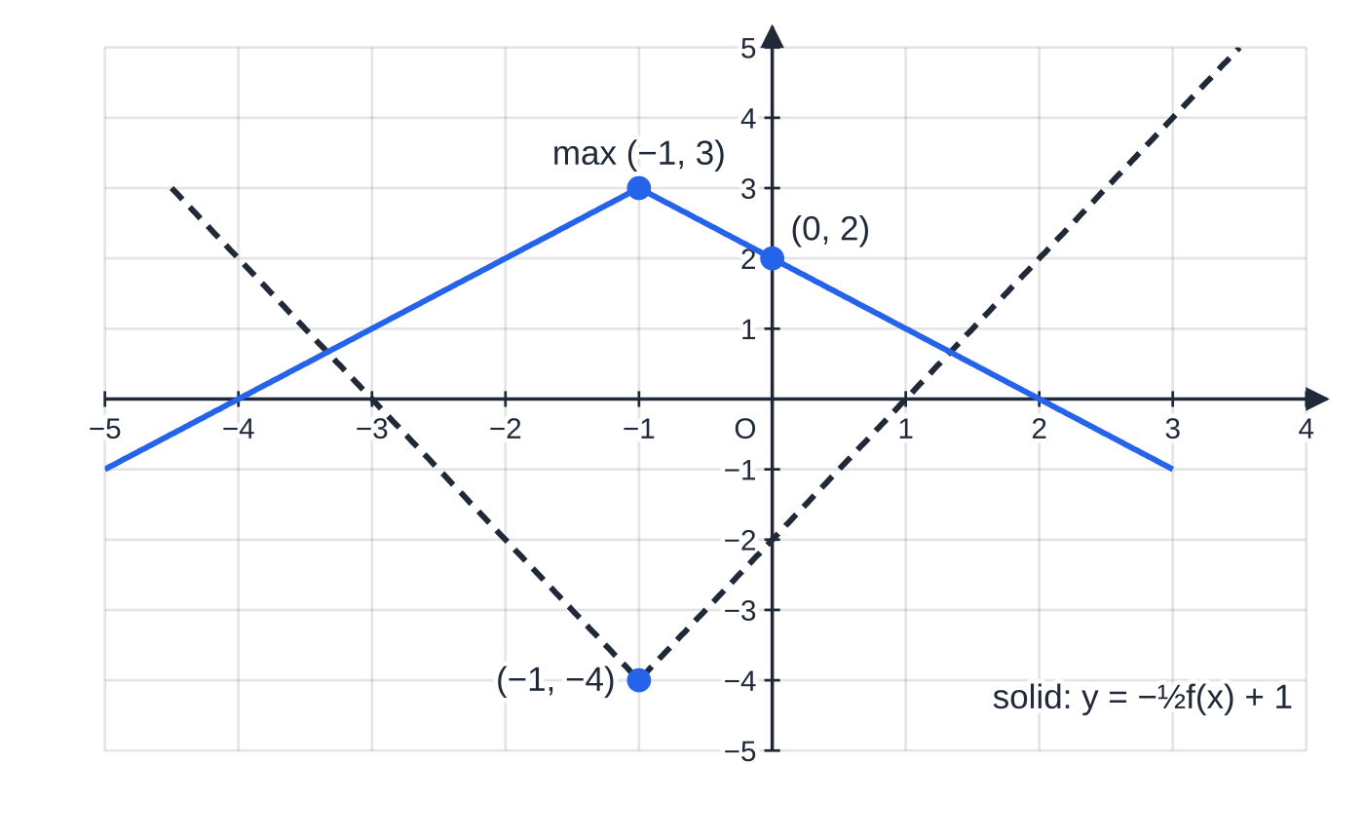
How do the pieces fit together in a full question? (continued)
Section 9 of 14
Part (d): y = −½f(x) + 1 simplifies to y = 3 − |x + 1|, an upside-down V with maximum (−1, 3) and y-intercept (0, 2). The dashed graph is y = f(x).
Notes:
How do the pieces fit together in a full question?. Full notes: https://examinerprep.com/notes/edexcel-ial-maths/modulus-and-transformations-of-graphs/

Slide 43
Exam tips for P3.2
Section 10 of 14
Exam tip 1 — sketch before you solve
A rough sketch of both sides tells you how many solutions to expect and which arm each lies on. If the algebra produces more roots than the sketch has intersections, one of them is false.
Exam tip 2 — show the check for every root
For |A| = B with B depending on x, substitute each root back and write "reject" for any that makes B negative. The rejection is part of the answer, not an optional extra.
Exam tip 3 — label what the question asks for
"Giving the coordinates of the points where the graph meets the axes" means every intercept, written as coordinates on the sketch. Draw vertices and cusps as sharp corners and asymptotes as dashed lines with their equations.
Notes:
Exam tips for P3.2. Full notes: https://examinerprep.com/notes/edexcel-ial-maths/modulus-and-transformations-of-graphs/

Slide 44
Exam tips for P3.2 (continued)
Section 10 of 14
Exam tip 4 — one coordinate at a time
For a combined transformation, write the rule (p, q) ↦(…, …) first, then apply it to every point and asymptote. Check one image by substituting it into the new equation.
Exam tip 5 — describe transformations fully
"Stretch" alone is not a description. Say "stretch parallel to the x-axis with scale factor ⅓" or "translation by the vector (0, 1)", and give the order when a stretch and a translation act in the same direction. Write a two-interval answer as two inequalities joined by "or", never as one impossible chain such as ⅔ > x > 4.
Notes:
Exam tips for P3.2. Full notes: https://examinerprep.com/notes/edexcel-ial-maths/modulus-and-transformations-of-graphs/

Slide 45
Common misconceptions
Section 11 of 14
Misconception | Why it is wrong | Correct idea
|x - 4| = 2x + 1 has two solutions because modulus equations always do. | A root of the wrong case can make the right-hand side negative, and a modulus cannot equal a negative number. | Solve both cases, then check each root; the sketch shows the true count.
y = f(|x|) is the same as y = |f(x)|. | One acts on the input, the other on the output. | |f(x)|: reflect negative parts in the x-axis. f(|x|): reflect the right half in the y-axis.
|A| > c means -c > A > c. | No number is both less than -c and greater than c. | A < -c or A > c: two separate intervals.
y = f(3x) moves (p, q) to (3p, q). | Changes inside the bracket act the opposite way on x. | (p, q) ↦(p/3, q): a squeeze towards the y-axis.
y = 3 - f(x) is f(x) moved down 3. | The minus sign reflects the graph; the 3 then moves it up. | (p, q) ↦(p, 3 - q); maxima become minima.
Notes:
Common misconceptions. Full notes: https://examinerprep.com/notes/edexcel-ial-maths/modulus-and-transformations-of-graphs/

Slide 46
Common misconceptions (continued)
Section 11 of 14
Misconception | Why it is wrong | Correct idea
A vertical stretch moves a vertical asymptote. | Stretching parallel to the y-axis does not change any x-coordinate. | Only horizontal changes move x = h; only vertical changes move y = v.
Notes:
Common misconceptions. Full notes: https://examinerprep.com/notes/edexcel-ial-maths/modulus-and-transformations-of-graphs/

Slide 47
How this topic connects
Section 12 of 14
P3.1 Algebraic fractions and functions
Range, composite and inverse functions use the same graphs. The range of |f(x)| never contains negative values, and the graph of an inverse is a reflection in y = x: another transformation, but one that swaps x and y.
P3.4 R-form and P3.5 Exponentials and logarithms
Rsin(x + α), y = eˣ + c and y = ln(bx) are transformations of standard graphs, and their maxima, intercepts and asymptotes move by the rules on this page.
P3.8 Numerical methods and earlier units
P1 introduced single transformations and quadratic inequalities, which reappear when you square a modulus inequality. Locating roots and iteration in P3.8 often start from a sketch of two graphs, just like the modulus equations here. In mechanics and statistics a distance is the modulus of a displacement, and a tolerance such as |L - 120| ≤0.5 is a modulus inequality.
Notes:
How this topic connects. Full notes: https://examinerprep.com/notes/edexcel-ial-maths/modulus-and-transformations-of-graphs/

Slide 48
Key formulae
Section 13 of 14
Formula | Use | In the formulae list?
|x| = x (x ≥0), |x| = -x (x < 0) | definition of the modulus | No — learn it
|A| = B ⇒A = ±B (check B ≥0) | modulus equal to an expression | No — learn it
|A| = |B| ⇔A² = B² | modulus on both sides | No — derive it
|A| < c ⇔-c < A < c; |A| > c ⇔A < -c or A > c | modulus inequalities | No — learn it
vertex of y = |ax + b| at (-b/a, 0) | sketching V graphs | No — derive it
y = af(bx) + c: (p, q) ↦(p/b, aq + c) | images of points and asymptotes | No — derive it
f(x + c), f(x) + c, af(x), f(bx), -f(x), f(-x) | single transformations | No — learn it
Notes:
Key formulae. Full notes: https://examinerprep.com/notes/edexcel-ial-maths/modulus-and-transformations-of-graphs/

Slide 49
Check your understanding
Section 14 of 14
1. Solve |x - 2| < 5.
2. Describe the difference between the graphs of y = |x - 3| and y = |x| - 3.
3. The point (4, -2) lies on y = f(x). Find its image on y = 3f(½x) + 1.
4. The curve y = f(x) has asymptotes x = 6 and y = -2. Find the asymptotes of y = ½f(3x) + 4.
5. Solve |x + 1| = 3x - 5.
6. Find the values of k for which |x² - 2x - 3| = k has exactly three solutions.
Notes:
Check your understanding: questions. Full notes: https://examinerprep.com/notes/edexcel-ial-maths/modulus-and-transformations-of-graphs/

Slide 50
Check your understanding · answers
Section 14 of 14
1. -5 < x - 2 < 5, so -3 < x < 7.
2. y = |x - 3| is a V with vertex (3, 0); it is |f(x)| for f(x) = x - 3. y = |x| - 3 is a V with vertex (0, -3); it is f(|x|) and crosses the x-axis at x = ±3.
3. x: 4 ÷½ = 8. y: 3(-2) + 1 = -5. The image is (8, -5).
4. x = 6 ÷3 = 2 and y = ½(-2) + 4 = 3.
5. x + 1 = 3x - 5 gives x = 3 (right-hand side 4, valid). -(x + 1) = 3x - 5 gives x = 1, but then 3x - 5 = -2 < 0: reject. So x = 3 only.
6. The graph has a local maximum at (1, 4). A horizontal line meets it exactly three times only when it touches that maximum, so k = 4. (Then x = 1 and x² - 2x - 7 = 0, i.e. x = 1 ±2√2.)
Notes:
Check your understanding: answers. Full notes: https://examinerprep.com/notes/edexcel-ial-maths/modulus-and-transformations-of-graphs/

Slide 51
Practice questions
2 original exam-style questions. Answers at the end of the deck.

Slide 52
Question 1
5 marks
Consider the modulus function f(x) = |5 − 2x|, defined for all real values of x.
(a) Sketch the graph of y = f(x), showing the coordinates of the points where the graph meets the coordinate axes. [2]
(b) Solve f(x) = 7. [2]
(c) Hence solve f(x) < 7. [1]
Notes:
Online with the full mark scheme: https://examinerprep.com/ial-maths-p3-2-modulus-and-transformations-of-graphs-questions#IALM-P3-2-B-01

Slide 53
Question 2
7 marks
The graphs of y = |2x − 1| and y = 3x − 4 are to be drawn on the same axes.
(a) Sketch both graphs on the same axes, showing the coordinates of the points where each graph meets the coordinate axes. [2]
(b) Solve |2x − 1| = 3x − 4. [4]
(c) Hence solve |2x − 1| < 3x − 4. [1]
Notes:
Online with the full mark scheme: https://examinerprep.com/ial-maths-p3-2-modulus-and-transformations-of-graphs-questions#IALM-P3-2-B-05

Slide 54
Answers

Slide 55
Question 1 · answer
Mark scheme
V shape with its vertex on the x-axis
vertex (⁵⁄₂, 0) and y-intercept (0, 5)
5 − 2x = 7 or 5 − 2x = −7
x = −1 or x = 6
−1 < x < 6, ft their critical values
Notes:
Full mark scheme: https://examinerprep.com/ial-maths-p3-2-modulus-and-transformations-of-graphs-questions#IALM-P3-2-B-01

Slide 56
Question 2 · answer
Mark scheme
V with vertex (½, 0) and y-intercept (0, 1)
line through (⁴⁄₃, 0) and (0, −4)
2x − 1 = 3x − 4 gives x = 3
−(2x − 1) = 3x − 4 gives x = 1
at x = 1, 3x − 4 = −1 < 0, so x = 1 is rejected
x = 3 only
x > 3
Notes:
Full mark scheme: https://examinerprep.com/ial-maths-p3-2-modulus-and-transformations-of-graphs-questions#IALM-P3-2-B-05

Slide 57
Keep practising
Notes for this topic
Questions on this topic
Build a printable test
ExaminerPrep is an independent tutoring service. It has been developed independently from and is not endorsed by the International Baccalaureate Organization. "International Baccalaureate", "IB" and "IB Diploma Programme" are registered trademarks of the IBO, used here for descriptive purposes only.
Pearson Edexcel and Cambridge are trademarks of their owners; ExaminerPrep is not affiliated with any exam board.

