Slide 1
EP
EDEXCEL IAL MATHS
M1.6 Moments
The full notes page in 11 sections · practice questions with answers · simulations
ExaminerPrep is an independent tutoring service. It has been developed independently from and is not endorsed by the International Baccalaureate Organization. "International Baccalaureate", "IB" and "IB Diploma Programme" are registered trademarks of the IBO, used here for descriptive purposes only.
Pearson Edexcel and Cambridge are trademarks of their owners; ExaminerPrep is not affiliated with any exam board.
Notes:
M1.6 Moments. Notes for this topic: https://examinerprep.com/notes/edexcel-ial-maths/moments/

Slide 2
What this page covers
Overview
The moment of a force about a point: magnitude, units and sense (clockwise or anticlockwise)
The two conditions for a rigid body to be in equilibrium under coplanar parallel forces
Choosing the best point to take moments about
Rods, beams and planks on two supports or hanging from two vertical strings, with loads and people on them
Bodies on the point of tilting or turning: the reaction (or tension) at one support becomes zero
Non-uniform rods: finding an unknown centre of mass or an unknown mass
Ranges of positions or loads for which equilibrium is possible
Notes:
What this page covers. Full notes: https://examinerprep.com/notes/edexcel-ial-maths/moments/

Slide 3
In one minute
Key points
1. The moment of a force about a point is the force times the perpendicular distance from the point to its line of action, measured in N m with a stated sense, and a rigid body is in equilibrium when the resultant force is zero and the total moment about any point is zero.
2. For parallel vertical forces this gives two equations: up = down, and clockwise moments = anticlockwise moments about a point of your choice.
3. Take moments about a point where an unknown force acts: that force then has no moment, and drops out.
4. A uniform rod has its weight at its midpoint. A non-uniform rod has its weight at an unknown point G: call AG = x.
5. On the point of tilting about D, the reaction at the other support is zero. That single fact is the extra equation.
6. A reaction can never be negative; a tension can never exceed a stated breaking limit.
Notes:
In one minute. Full notes: https://examinerprep.com/notes/edexcel-ial-maths/moments/

Slide 4
In one minute (continued)
Key points
These give ranges.
Notes:
In one minute. Full notes: https://examinerprep.com/notes/edexcel-ial-maths/moments/

Slide 5
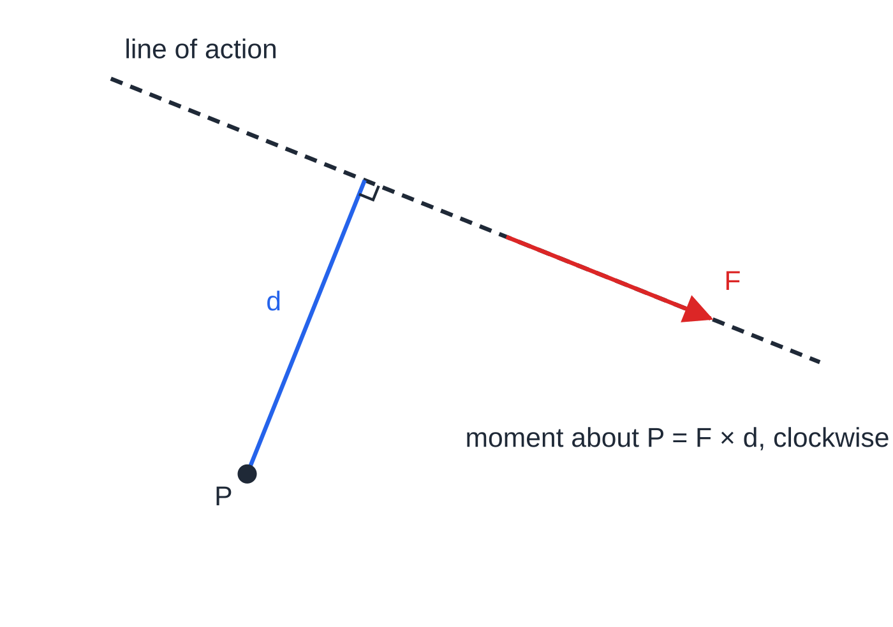
What is the moment of a force?
Section 1 of 11
Moment of a force. The moment of a force about a point P is the magnitude of the force × the perpendicular distance from P to the line of action of the force: moment = F ×d, in N m.
In M1 every force on a rod is perpendicular to the rod, so d is simply the distance along the rod from the point to where the force acts. A force whose line of action passes through P has zero moment about P.
A moment has a sense: it tends to turn the body clockwise or anticlockwise, and you must say which.
The distance in a moment is the perpendicular distance d from P to the line of action of the force, not the distance to the point where the force happens to be drawn.
Notes:
What is the moment of a force?. Full notes: https://examinerprep.com/notes/edexcel-ial-maths/moments/

Slide 6
What is the moment of a force? (continued)
Section 1 of 11
For a horizontal rod and a point P on it, a downward force to the right of P turns the rod clockwise, and a downward force to the left of P turns it anticlockwise; upward forces do the opposite. To find a resultant moment, choose one sense as positive and count the other as negative. The moment of a force depends on the point you choose.
Notes:
What is the moment of a force?. Full notes: https://examinerprep.com/notes/edexcel-ial-maths/moments/

Slide 7
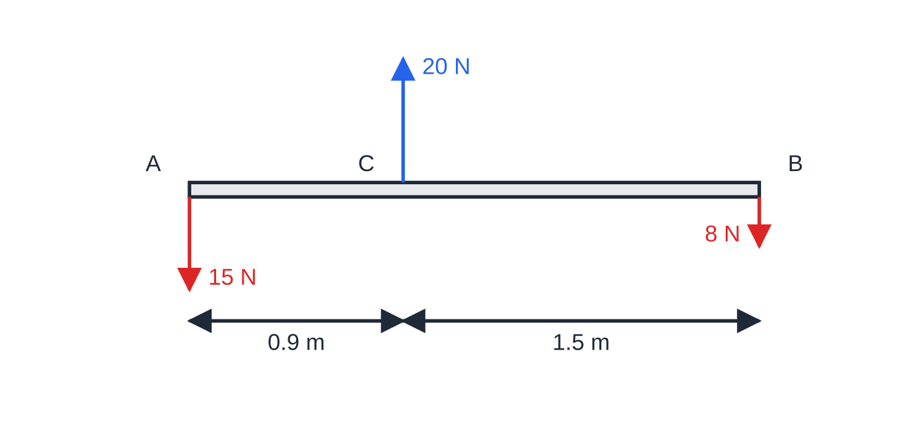
What is the moment of a force? (continued)
Section 1 of 11 · Worked example 1 · Easy · Find
WORKED EXAMPLE · QUESTION
A light rod AB has length 2.4 m. The point C is on the rod with AC = 0.9 m. Forces of 15 N and 8 N act vertically downwards at A and at B, and a force of 20 N acts vertically upwards at C. Find the resultant moment of the three forces (a) about A and (b) about C, stating its sense in each case.
SOLUTION
(a) About A, the 15 N force passes through A, so it has no moment. 20 ×0.9 = 18 N m anticlockwise and 8 ×2.4 = 19.2 N m clockwise. Clockwise positive: 19.2 - 18.
Three forces on a light rod, distances to scale. The resultant force is 3 N downwards, so the resultant moment is different about different points.
Notes:
What is the moment of a force?: Worked example 1. Full notes: https://examinerprep.com/notes/edexcel-ial-maths/moments/

Slide 8
What is the moment of a force? (continued)
Section 1 of 11 · Worked example 1 · Easy · Find (continued)
1.2 N m clockwise
(b) About C, the 20 N force has no moment. 15 ×0.9 = 13.5 N m anticlockwise and 8 ×1.5 = 12 N m clockwise, so 13.5 - 12. 1.5 N m anticlockwise
The answers differ because the forces are not balanced: 15 + 8 - 20 = 3 N downwards. In equilibrium, the resultant moment is zero about every point.
Notes:
What is the moment of a force?: Worked example 1. Full notes: https://examinerprep.com/notes/edexcel-ial-maths/moments/

Slide 9
What is the moment of a force? (continued)
Section 1 of 11
Common error — distances from the wrong point
Measuring every distance from the end A when you are taking moments about some other point. The distance in a moment is always measured from the point you are taking moments about.
Notes:
What is the moment of a force?. Full notes: https://examinerprep.com/notes/edexcel-ial-maths/moments/

Slide 10
When is a rigid body in equilibrium?
Section 2 of 11
Equilibrium of a rigid body. The resultant force on it is zero and the sum of the moments about any point is zero.
A particle only needs the first condition. An extended body also needs the second: two equal and opposite forces with different lines of action would leave it spinning. For the parallel vertical forces of M1 the two conditions become
total upward force = total downward force, Σclockwise moments = Σanticlockwise moments.
You may replace "resolve vertically" by a second moments equation about a different point: two moment equations, or one of each, are equally valid. The modelling words in the question tell you where the forces act.
Notes:
When is a rigid body in equilibrium?. Full notes: https://examinerprep.com/notes/edexcel-ial-maths/moments/

Slide 11
When is a rigid body in equilibrium? (continued)
Section 2 of 11
Word in the question | What it means for your working
rod, beam, plank | A rigid body with length only: it does not bend, so distances along it do not change
light rod | Its mass is negligible: no weight to include
uniform | Its mass is evenly spread: the weight acts at the midpoint
non-uniform | The weight acts at an unknown point G; give it a letter, e.g. AG = x m
person, child, load, box (a particle) | Its weight acts at a single point on the rod
support, trestle, knife-edge, peg | A single upward reaction at that point, which can never be negative
vertical string, rope, cable | An upward tension at the point of attachment; a string can pull but never push
Notes:
When is a rigid body in equilibrium?. Full notes: https://examinerprep.com/notes/edexcel-ial-maths/moments/

Slide 12
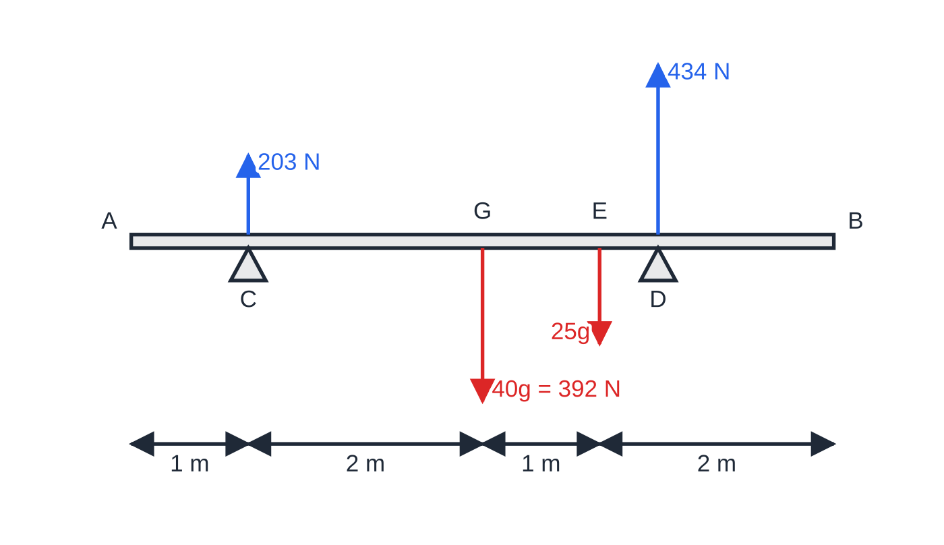
When is a rigid body in equilibrium? (continued)
Section 2 of 11 · Worked example 2 · Medium · Find
WORKED EXAMPLE · QUESTION
A uniform beam AB has length 6 m and mass 40 kg. It rests horizontally on two supports at C and D, where AC = 1 m and DB = 1.5 m. A load of mass 25 kg is placed on the beam at E, where AE = 4 m. The load is modelled as a particle. Find the magnitude of the reaction at each support.
SOLUTION
Distances from C: the weight 40g acts at the midpoint, 3 m from A, so 2 m from C. The load is 3 m from C, and D is 3.5 m from C.
Moments about C, so that R_C drops out:
Worked example 2 to scale. The two reactions (blue) add up to the two weights (red): 203 + 434 = 392 + 245 = 637 N.
Notes:
When is a rigid body in equilibrium?: Worked example 2. Full notes: https://examinerprep.com/notes/edexcel-ial-maths/moments/

Slide 13
When is a rigid body in equilibrium? (continued)
Section 2 of 11 · Worked example 2 · Medium · Find (continued)
R_D ×3.5 = 40g ×2 + 25g ×3 = 155g, so R_D = 434 N.
Resolve vertically: R_C + 434 = 65g = 637, so R_C = 203 N. R_C = 203 N, R_D = 434 N
Check by moments about D: 203 ×3.5 = 710.5 and 25g ×0.5 + 40g ×1.5 = 710.5.
Notes:
When is a rigid body in equilibrium?: Worked example 2. Full notes: https://examinerprep.com/notes/edexcel-ial-maths/moments/

Slide 14
When is a rigid body in equilibrium? (continued)
Section 2 of 11
Exam tip — keep g as a letter
Keep g as a letter until the last line: 155g/3.5 is exact, and you round only once. With g = 9.8, give the final answer to 2 or 3 significant figures.
Notes:
When is a rigid body in equilibrium?. Full notes: https://examinerprep.com/notes/edexcel-ial-maths/moments/

Slide 15
Which point should you take moments about?
Section 3 of 11
Any point gives a true equation, but a good point removes an unknown: take moments about the point where an unknown force acts. With two unknown support forces, moments about one support give the other directly; then resolve vertically, or take moments about the second support as a check. If the question asks for only one force, take moments about the point where the other unknown acts: one equation, one answer. When the question asks for a position x, choose a point that keeps x simple, often the end A.
Notes:
Which point should you take moments about?. Full notes: https://examinerprep.com/notes/edexcel-ial-maths/moments/

Slide 16
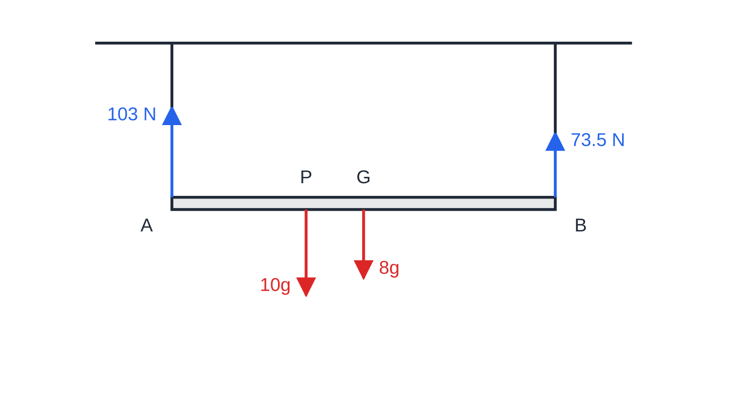
Which point should you take moments about? (continued)
Section 3 of 11 · Worked example 3 · Medium · Find
WORKED EXAMPLE · QUESTION
A uniform rod AB, of length 2.0 m and mass 8 kg, hangs in a horizontal position from two vertical ropes, one at A and one at B. A load of mass 10 kg hangs from the point P of the rod, where AP = 0.7 m. The ropes are light and inextensible. (a) Find the tension in each rope. (b) The load is moved to a new point Q so that the tension at A is twice the tension at B. Find AQ.
Worked example 3(a) to scale. The rope nearer the load carries the larger tension.
Notes:
Which point should you take moments about?: Worked example 3. Full notes: https://examinerprep.com/notes/edexcel-ial-maths/moments/

Slide 17
Which point should you take moments about? (continued)
Section 3 of 11 · Worked example 3 · Medium · Find (continued)
SOLUTION
(a) Moments about A: T_B ×2.0 = 8g ×1.0 + 10g ×0.7 = 15g, so T_B = 7.5g = 73.5 N. Resolve vertically: T_A = 18g - 7.5g = 10.5g = 102.9 N. T_A = 103 N, T_B = 73.5 N
(b) Resolve: T_A + T_B = 3T_B = 18g, so T_B = 6g. Moments about A, with AQ = x: 6g ×2.0 = 8g ×1.0 + 10g ×x, so x = 0.4. AQ = 0.4 m
Sense check: a larger share at A means the load must move towards A, and 0.4 m < 0.7 m.
Notes:
Which point should you take moments about?: Worked example 3. Full notes: https://examinerprep.com/notes/edexcel-ial-maths/moments/

Slide 18
Which point should you take moments about? (continued)
Section 3 of 11
Common error — forgetting the rod's own weight
Unless the rod is described as light, its weight acts at its centre of mass and must appear in both the resolving equation and every moments equation.
Notes:
Which point should you take moments about?. Full notes: https://examinerprep.com/notes/edexcel-ial-maths/moments/

Slide 19
What happens when a plank is about to tilt?
Section 4 of 11
As a load moves along a plank beyond one support, say D, the reaction at the other support C decreases. When the plank is on the point of tilting about D, it is just losing contact with C: R_C = 0. The plank is still in equilibrium at that instant, so both conditions still hold, with one fewer unknown. Take moments about D: only the weights have a moment, so "clockwise = anticlockwise" gives the answer at once. For a body hanging from two strings, the same idea reads: the tension in one string is zero (it is about to go slack). A reaction can never be negative; if your working gives one, that position is impossible.
Notes:
What happens when a plank is about to tilt?. Full notes: https://examinerprep.com/notes/edexcel-ial-maths/moments/

Slide 20
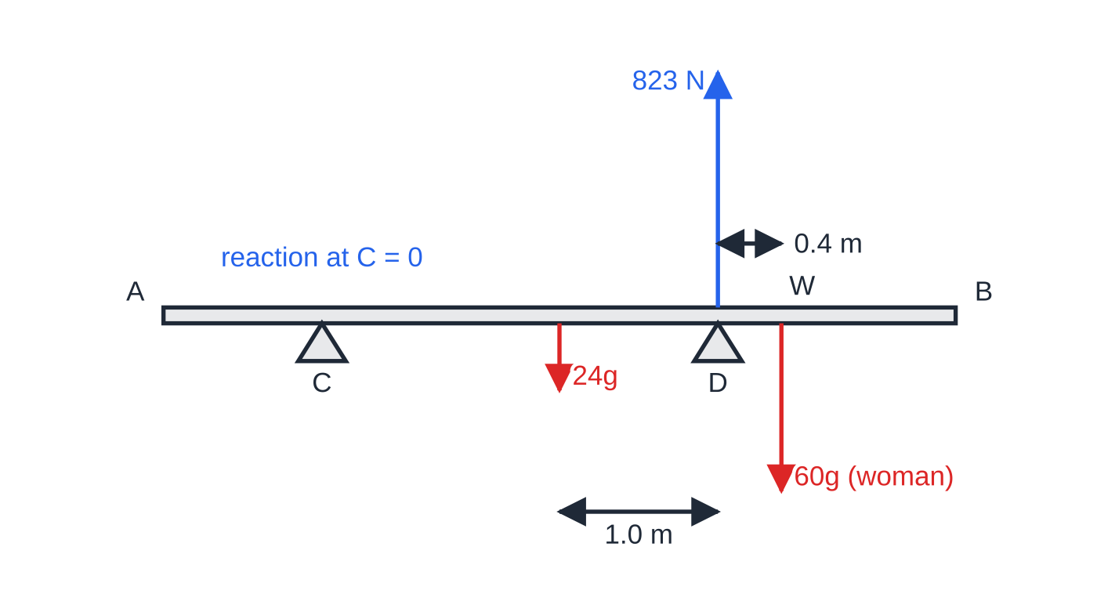
What happens when a plank is about to tilt? (continued)
Section 4 of 11 · Worked example 4 · Medium · Find
WORKED EXAMPLE · QUESTION
A uniform plank AB has length 5.0 m and mass 24 kg. It rests horizontally on two supports at C and D, where AC = 1.0 m and DB = 1.5 m. A woman of mass 60 kg stands on the plank. She is modelled as a particle. (a) She stands at the point W between D and B. Find the greatest possible distance DW. (b) Find the range of distances from A at which she can stand with the plank remaining in equilibrium.
Worked example 4 to scale: the woman is 0.4 m beyond D and the plank is on the point of tilting about D, so D carries the full 84g = 823 N.
Notes:
What happens when a plank is about to tilt?: Worked example 4. Full notes: https://examinerprep.com/notes/edexcel-ial-maths/moments/

Slide 21
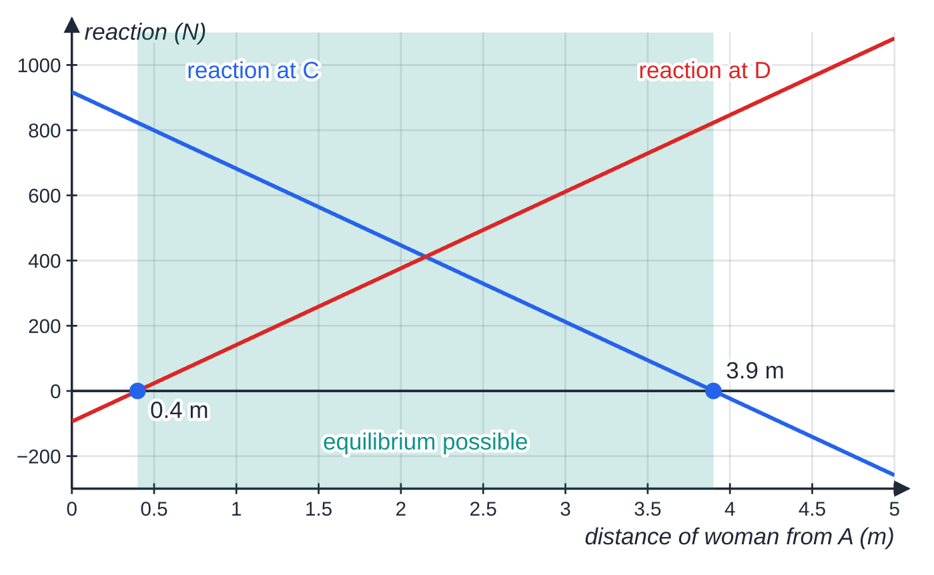
What happens when a plank is about to tilt? (continued)
Section 4 of 11 · Worked example 4 · Medium · Find (continued)
SOLUTION
(a) On the point of tilting about D, R_C = 0. The plank's weight acts 2.5 m from A, so 1.0 m from D. Moments about D: 24g ×1.0 = 60g ×DW. DW = 0.4 m
(b) The same idea at the other end: tilting about C, with R_D = 0. The weight is 1.5 m from C: 24g ×1.5 = 60g ×y, so y = 0.6 m to the left of C, i.e. 0.4 m from A. At the other end she can reach 3.5 + 0.4 = 3.9 m from A. 0.4 m ≤ distance from A ≤ 3.9 m
The reactions as the woman walks along. Both are straight lines (moments are linear in distance). Equilibrium is possible only where both are positive or zero, between 0.4 m and 3.9 m from A.
Notes:
What happens when a plank is about to tilt?: Worked example 4. Full notes: https://examinerprep.com/notes/edexcel-ial-maths/moments/

Slide 22
What happens when a plank is about to tilt? (continued)
Section 4 of 11 · Worked example 4 · Medium · Find (continued)
The g cancels in every line: the answer depends only on the masses and the distances.
Notes:
What happens when a plank is about to tilt?: Worked example 4. Full notes: https://examinerprep.com/notes/edexcel-ial-maths/moments/

Slide 23
What happens when a plank is about to tilt? (continued)
Section 4 of 11
Exam tip — write the condition in words
Make the first line of your answer "about to tilt about D, so R_C = 0". It states the key condition clearly and reminds you which point to take moments about.
Notes:
What happens when a plank is about to tilt?. Full notes: https://examinerprep.com/notes/edexcel-ial-maths/moments/

Slide 24
How do you find the centre of mass of a non-uniform rod?
Section 5 of 11
Let G be the centre of mass and write AG = x m; the weight Mg acts at G. Use the information given (a ratio of tensions, a reaction, or "about to tilt") to find the forces first by resolving. Then take moments about a point, usually A or a support, to get one linear equation in x. If both the mass and the position are unknown, you need two situations, for example two different loads, to get two equations. Check that G lies on the rod.
Notes:
How do you find the centre of mass of a non-uniform rod?. Full notes: https://examinerprep.com/notes/edexcel-ial-maths/moments/

Slide 25
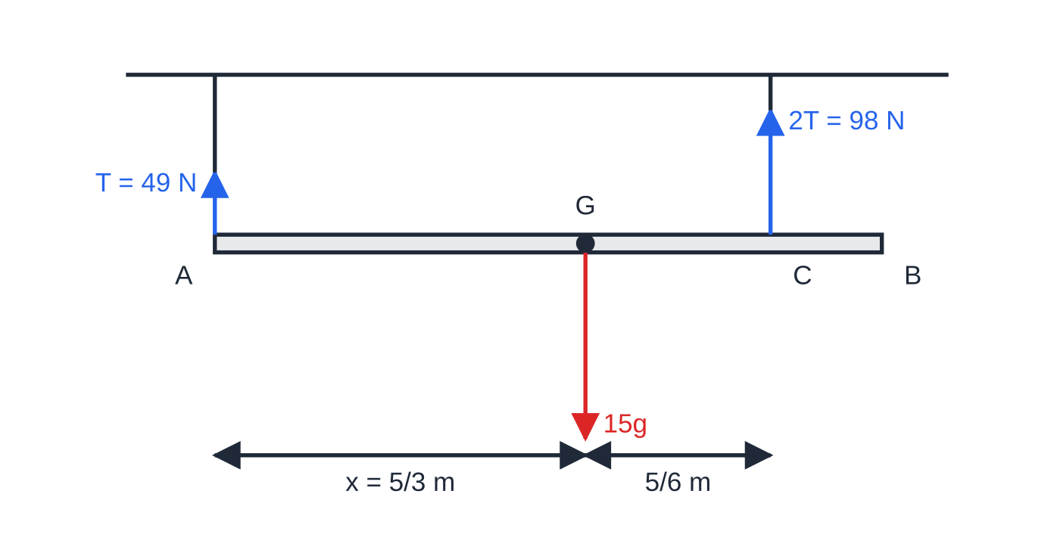
How do you find the centre of mass of a non-uniform rod? (continued)
Section 5 of 11 · Worked example 5 · Medium · Find
WORKED EXAMPLE · QUESTION
A non-uniform rod AB has length 3.0 m and mass 15 kg. It hangs in a horizontal position from two light vertical strings, one attached at A and the other at C, where CB = 0.5 m. The tension in the string at C is twice the tension in the string at A. (a) Find the distance from A of the centre of mass G of the rod. (b) A particle of mass m kg is attached at B. The rod is now on the point of turning about C. Find m.
Worked example 5(a) to scale. Because the tension at C is twice that at A, G is twice as far from A as from C: AG = 5/3 m.
Notes:
How do you find the centre of mass of a non-uniform rod?: Worked example 5. Full notes: https://examinerprep.com/notes/edexcel-ial-maths/moments/

Slide 26
How do you find the centre of mass of a non-uniform rod? (continued)
Section 5 of 11 · Worked example 5 · Medium · Find (continued)
SOLUTION
(a) Resolve vertically with tensions T and 2T: 3T = 15g, so T = 5g = 49 N and 2T = 98 N. Moments about A, with AG = x and AC = 2.5 m: 10g ×2.5 = 15g ×x, so x = (5/3). AG = 5/3 m = 1.67 m
(b) On the point of turning about C, the string at A is slack: its tension is 0. G is 2.5 - (5/3) = (5/6) m from C and B is 0.5 m from C. Moments about C: 15g ×(5/6) = mg ×0.5. m = 25
Then all 40g = 392 N is carried by the string at C.
Notes:
How do you find the centre of mass of a non-uniform rod?: Worked example 5. Full notes: https://examinerprep.com/notes/edexcel-ial-maths/moments/

Slide 27
How do you find the centre of mass of a non-uniform rod? (continued)
Section 5 of 11
Common error — weight at the midpoint of a non-uniform rod
"Non-uniform" is the signal that the centre of mass is not at the middle. Give it a letter and let the equations find it.
Notes:
How do you find the centre of mass of a non-uniform rod?. Full notes: https://examinerprep.com/notes/edexcel-ial-maths/moments/

Slide 28
How do you tackle a full-length moments question?
Section 6 of 11
Draw your own diagram with every force and every distance, even if one is printed: mark A, B, the supports, G and each load. Translate each sentence into an equation: "the reactions are equal" means R_C = R_D; "about to tilt about D" means R_C = 0; "the string breaks if the tension exceeds 600 N" means T ≤600. For a range, write each force in terms of the unknown position, then apply every limit: each reaction ≥0, each tension ≤ its maximum, and the position on the rod. When a later part changes a load, redraw.
Notes:
How do you tackle a full-length moments question?. Full notes: https://examinerprep.com/notes/edexcel-ial-maths/moments/

Slide 29
How do you tackle a full-length moments question? (continued)
Section 6 of 11 · Worked example 6 · Hard · Show that / Find
WORKED EXAMPLE · QUESTION
A non-uniform plank AB has length 6.0 m and mass 40 kg. It rests horizontally on two supports at C and D, where AC = 1.5 m and DB = 1.0 m. The centre of mass of the plank is G. When a box of mass 20 kg is placed at B, the plank is on the point of tilting about D. The box is modelled as a particle. (a) Show that AG = 4.5 m. (b) The box is removed and a man of mass 75 kg stands at the midpoint of AB. Find the reactions at C and at D. (c) Show that the man can walk all the way to A without the plank tilting. (d) The man stands at B. Find the smallest mass of a block placed at A that keeps the plank in equilibrium.
Notes:
How do you tackle a full-length moments question?: Worked example 6. Full notes: https://examinerprep.com/notes/edexcel-ial-maths/moments/

Slide 30
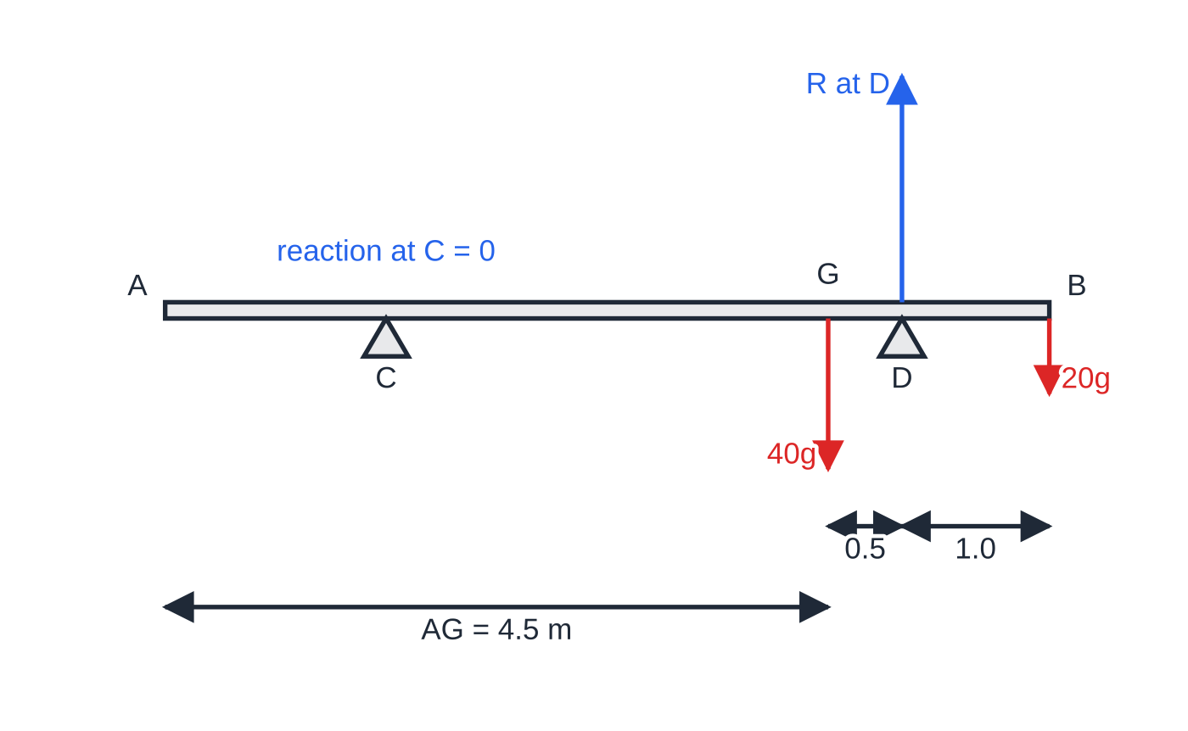
How do you tackle a full-length moments question? (continued)
Section 6 of 11 · Worked example 6 · Hard · Show that / Find (continued)
Part (a): with the box at B the plank is about to tilt about D, so the reaction at C is zero and the moments of 40g and 20g about D balance.
Notes:
How do you tackle a full-length moments question?: Worked example 6. Full notes: https://examinerprep.com/notes/edexcel-ial-maths/moments/

Slide 31
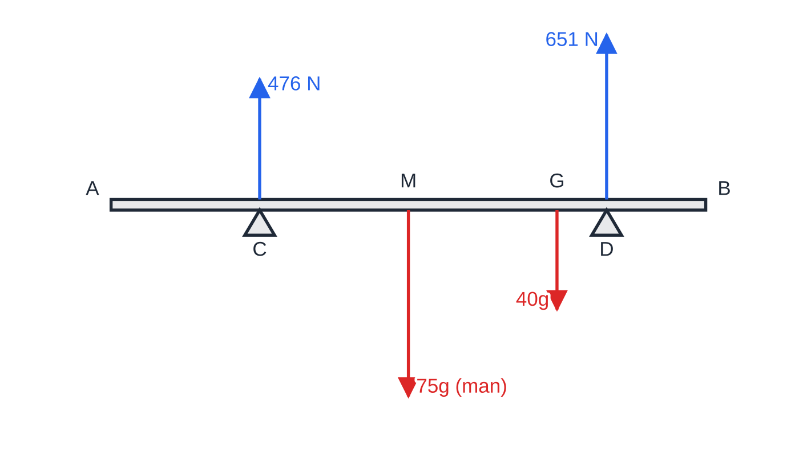
How do you tackle a full-length moments question? (continued)
Section 6 of 11 · Worked example 6 · Hard · Show that / Find (continued)
SOLUTION
(a) About to tilt about D, so R_C = 0. D is 5.0 m from A. Moments about D: 40g ×(5.0 - AG) = 20g ×1.0, so 5.0 - AG = 0.5 and AG = 4.5 m, as required.
(b) Moments about C (G is 3.0 m from C, the midpoint is 1.5 m from C, D is 3.5 m from C): R_D ×3.5 = 40g ×3.0 + 75g ×1.5 = 232.5g, so R_D = 651 N. Resolve: R_C = 115g - 651 = 476 N. R_C = 476 N, R_D = 651 N
(c) With the man at A (1.5 m to the left of C), moments about C: R_D ×3.5 = 40g ×3.0 - 75g ×1.5 = 7.5g, so R_D = 21.0 N > 0.
Part (b) to scale: the man at the midpoint M. D is nearer the heavy end G, so it carries more: 651 N against 476 N.
Notes:
How do you tackle a full-length moments question?: Worked example 6. Full notes: https://examinerprep.com/notes/edexcel-ial-maths/moments/

Slide 32
How do you tackle a full-length moments question? (continued)
Section 6 of 11 · Worked example 6 · Hard · Show that / Find (continued)
The reaction at D is still positive at A, so the plank does not tilt anywhere between the midpoint and A.
(d) The man at B on his own would tilt the plank about D, since 75g ×1.0 > 40g ×0.5. With the smallest block, R_C = 0. Moments about D: 40g ×0.5 + Mg ×5.0 = 75g ×1.0. M = 11 kg
Notes:
How do you tackle a full-length moments question?: Worked example 6. Full notes: https://examinerprep.com/notes/edexcel-ial-maths/moments/

Slide 33
How do you tackle a full-length moments question? (continued)
Section 6 of 11 · Worked example 7 · Hard · Show that / Find
WORKED EXAMPLE · QUESTION
A uniform beam AB has length 4.0 m and mass 50 kg. It hangs horizontally from two light vertical cables attached at C and D, where AC = 0.5 m and DB = 1.0 m. Either cable will break if its tension exceeds 600 N. A load of mass 30 kg is attached to the beam at P, where AP = x m. The load is modelled as a particle. (a) Show that the tension in the cable at D is 9.8(24 + 12x) N, and find the tension at C in terms of x. (b) Find the range of values of x for which neither cable breaks. (c) The 30 kg load is replaced by a load of mass M kg attached at B. Find the greatest value of M for which neither cable breaks.
Notes:
How do you tackle a full-length moments question?: Worked example 7. Full notes: https://examinerprep.com/notes/edexcel-ial-maths/moments/

Slide 34
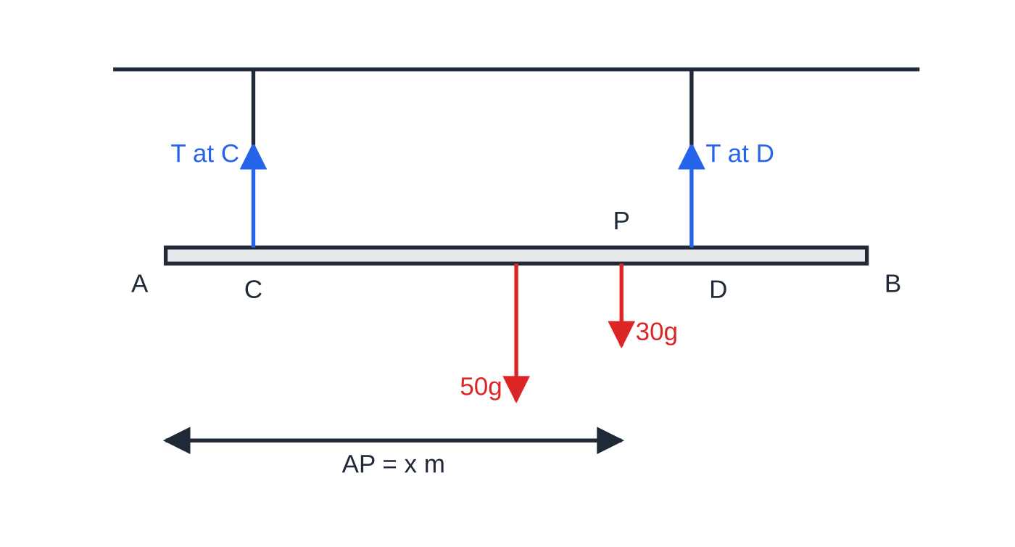
How do you tackle a full-length moments question? (continued)
Section 6 of 11 · Worked example 7 · Hard · Show that / Find (continued)
Worked example 7: the beam's weight acts at its midpoint, 1.5 m from C; the load is at a variable distance x from A.
Notes:
How do you tackle a full-length moments question?: Worked example 7. Full notes: https://examinerprep.com/notes/edexcel-ial-maths/moments/

Slide 35
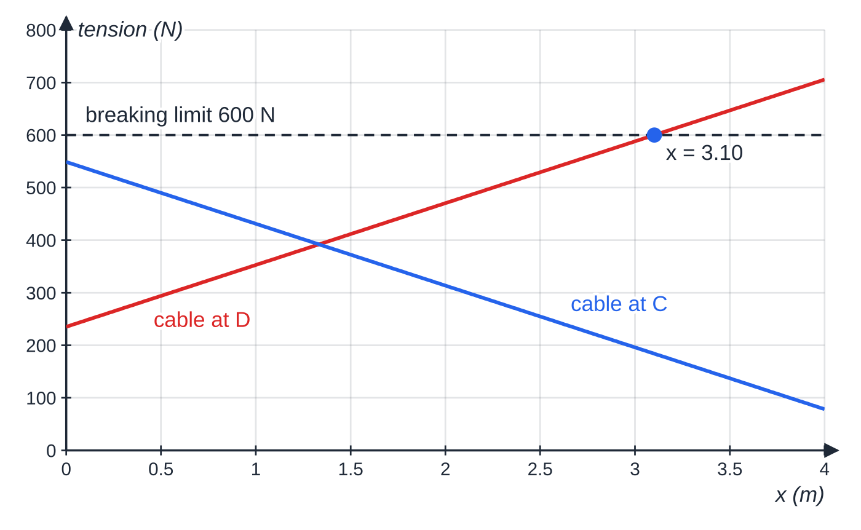
How do you tackle a full-length moments question? (continued)
Section 6 of 11 · Worked example 7 · Hard · Show that / Find (continued)
SOLUTION
(a) Moments about C: G is 1.5 m from C, P is (x - 0.5) m from C, D is 2.5 m from C. T_D ×2.5 = 50g ×1.5 + 30g(x - 0.5) = g(60 + 30x), so T_D = 9.8(24 + 12x) N, as required. Then T_C = 80g - T_D. T_C = 9.8(56 - 12x) N
(b) T_D ≤600: 24 + 12x ≤(600/9.8), so x ≤3.102. Also T_C ≤9.8 ×56 = 548.8 N < 600 N for every x ≥0, and T_C > 0 for every point on the beam, so only the cable at D limits x. 0 ≤ x ≤ 3.10
(c) Load at B, 3.5 m from C. Moments about C: T_D ×2.5 = 50g ×1.5 + Mg ×3.5.
Both tensions are linear in x. Only the cable at D ever reaches 600 N, at x = 3.10, so the load must stay within 3.10 m of A.
Notes:
How do you tackle a full-length moments question?: Worked example 7. Full notes: https://examinerprep.com/notes/edexcel-ial-maths/moments/

Slide 36
How do you tackle a full-length moments question? (continued)
Section 6 of 11 · Worked example 7 · Hard · Show that / Find (continued)
Set T_D = 600 for the greatest M: 75 + 3.5M = (600 ×2.5)/9.8 = 153.06, so M = 22.3. M = 22.3
Check the other cable: T_C = g(20 - 0.4M) = 108.6 N, positive and below 600 N.
Notes:
How do you tackle a full-length moments question?: Worked example 7. Full notes: https://examinerprep.com/notes/edexcel-ial-maths/moments/

Slide 37
Exam tips for M1.6
Section 7 of 11
Exam tip 1 — a labelled diagram first
Mark every force with its value or symbol and every distance from a common end. A wrong distance is the easiest slip on this topic, and a diagram makes distances easy to read off.
Exam tip 2 — say what you are doing
Head each equation with "M(C):" or "moments about C" and "R(↑):" or "resolving vertically". Each equation is then clearly a method, even if an arithmetic slip follows.
Exam tip 3 — one equation per unknown
Count the unknowns before you start. Two unknown forces need two equations; an unknown position as well needs a third piece of information: a ratio, a tilting condition or a second situation.
Notes:
Exam tips for M1.6. Full notes: https://examinerprep.com/notes/edexcel-ial-maths/moments/

Slide 38
Exam tips for M1.6 (continued)
Section 7 of 11
Exam tip 4 — "show that" answers
When the answer is printed, write the moments equation in full, with g, before simplifying, and end with the printed value.
Exam tip 5 — modelling questions
"State how you have used the fact that the rod is uniform" wants the consequence: the weight acts at the midpoint. "Light" means its weight is ignored; "rigid" means it does not bend; "particle" means the weight acts at one point.
Notes:
Exam tips for M1.6. Full notes: https://examinerprep.com/notes/edexcel-ial-maths/moments/

Slide 39
Common misconceptions
Section 8 of 11
Misconception | Why it is wrong | Correct idea
Zero resultant force means the body is in equilibrium. | Two equal, opposite forces along different lines turn a body. | A rigid body also needs zero total moment about every point.
Moments must be taken about the pivot or a support. | In equilibrium the moments balance about any point at all. | Choose the point that removes an unknown.
The two supports always share the weight equally. | That happens only when the loads are symmetrical about the midpoint between them. | The support nearer a load carries more of it.
On the point of tilting, both reactions are zero. | The plank is still supported at the pivot support. | Only the reaction at the other support is zero.
A negative reaction means the force acts downwards. | A support can only push up on a resting body. | A negative answer means that position is impossible: the body tilts.
Notes:
Common misconceptions. Full notes: https://examinerprep.com/notes/edexcel-ial-maths/moments/

Slide 40
Common misconceptions (continued)
Section 8 of 11
Misconception | Why it is wrong | Correct idea
The weight of a non-uniform rod acts at its midpoint. | Only a uniform rod has its centre of mass at the midpoint. | Call the distance AG = x and find it.
Notes:
Common misconceptions. Full notes: https://examinerprep.com/notes/edexcel-ial-maths/moments/

Slide 41
How this topic connects
Section 9 of 11
M1.5 Statics of a particle
Resolving forces to zero is the first equilibrium condition; moments add the second, needed once a body has size.
M2.3 Centres of mass and M2.6 Statics of rigid bodies
The same two conditions, with forces at angles: ladders against walls, hinged rods held by inclined strings, laminas suspended from a point, and bodies about to topple.
Algebra in P1 and P2
Moments questions with an unknown position lead to linear equations, simultaneous equations and linear inequalities. In IAL Physics Unit 1, the principle of moments uses g = 9.81 N kg⁻¹ rather than 9.8.
Notes:
How this topic connects. Full notes: https://examinerprep.com/notes/edexcel-ial-maths/moments/

Slide 42
Key formulae
Section 10 of 11
Formula | Use | In the formulae list?
moment = F ×d | Moment of a force about a point (d perpendicular to the force) | No — learn it
up = down | Resolving vertically for parallel forces in equilibrium | No — learn it
Σ clockwise moments = Σ anticlockwise moments | Rigid body in equilibrium, about any point | No — learn it
R_C = 0 | On the point of tilting about the other support D | No — learn it
W = mg at the midpoint | Weight of a uniform rod, beam or plank | No — learn it
T_D = (Σ moments of the weights about C) ÷CD | One support force from moments about the other | No — derive it
Notes:
Key formulae. Full notes: https://examinerprep.com/notes/edexcel-ial-maths/moments/

Slide 43
Check your understanding
Section 11 of 11
1. A force of 30 N acts at right angles to a rod at a point 0.25 m from the point P on the rod. Find the moment of the force about P.
2. A uniform rod of mass 6 kg rests horizontally on two supports, one at each end. Find the reaction at each support.
3. A light see-saw is pivoted at its centre. A child of mass 30 kg sits 1.6 m from the pivot. How far from the pivot, on the other side, must a child of mass 40 kg sit to balance it?
4. Why can you take moments about any point you like when a rigid body is in equilibrium?
5. A uniform plank of mass 5 kg rests on supports C and D. Its centre is 0.6 m from D, on the side of C. A cat stands on the plank 0.5 m beyond D, and the plank is about to tilt about D. State the reaction at C and find the mass of the cat.
Notes:
Check your understanding: questions. Full notes: https://examinerprep.com/notes/edexcel-ial-maths/moments/

Slide 44
Check your understanding · answers
Section 11 of 11
1. 30 ×0.25 = 7.5. 7.5 N m, in the sense in which the force tends to turn the rod about P.
2. By symmetry the reactions are equal: each is 3g. 29.4 N each
3. Moments about the pivot: 30g ×1.6 = 40g ×d. d = 1.2 m
4. Because the resultant force is zero, the total moment of the forces is the same about every point, and in equilibrium it is zero about one point, so it is zero about all of them. Choose the point that makes the algebra easiest.
5. The reaction at C is zero. Moments about D: 5g ×0.6 = mg ×0.5, so m = 6. R_C = 0; 6 kg (the reaction at D is then 11g).
Notes:
Check your understanding: answers. Full notes: https://examinerprep.com/notes/edexcel-ial-maths/moments/

Slide 45
Practice questions
2 original exam-style questions. Answers at the end of the deck.

Slide 46
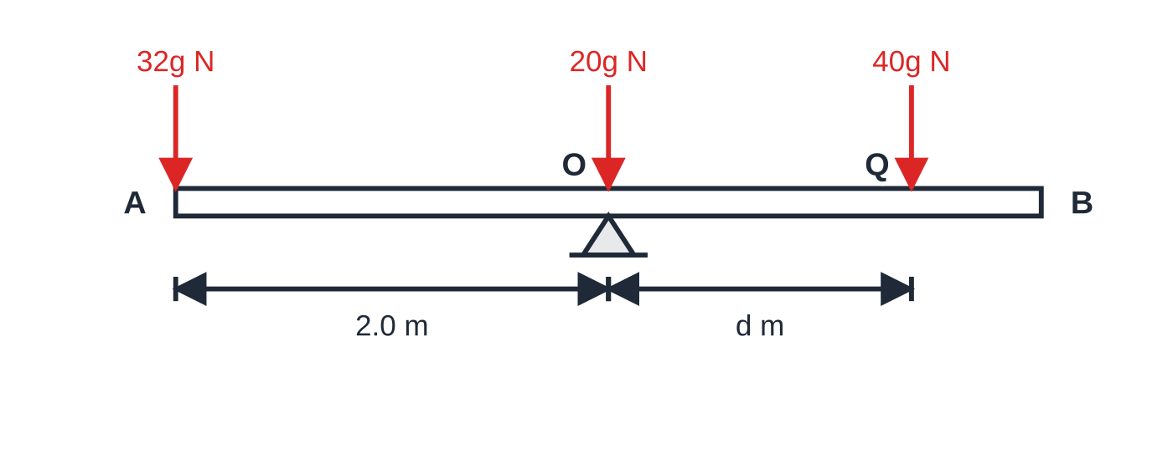
Question 1
5 marks
A playground see-saw is modelled as a uniform plank AB of length 4.0 m and mass 20 kg, pivoted at its midpoint O. A child P of mass 32 kg sits at A. A second child Q, of mass 40 kg, sits on the plank between O and B, at a distance d metres from O. The children are modelled as particles and the plank rests in equilibrium in a horizontal position.
Figure: the see-saw AB pivoted at O, with the weights acting on it; not to scale.
(a) Find the value of d. [3]
(b) Find the magnitude of the force exerted on the plank by the pivot. [2]
Notes:
Online with the full mark scheme: https://examinerprep.com/ial-maths-m1-6-moments-questions#IALM-M1-6-B-01

Slide 47
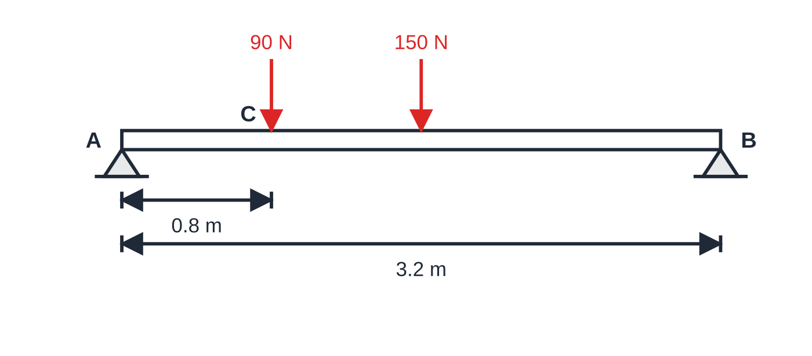
Question 2
6 marks
A workbench top is modelled as a uniform plank AB of length 3.2 m and weight 150 N. It rests horizontally on two trestles, one at A and one at B. A toolbox of weight 90 N is placed on the plank at C, where AC = 0.8 m. The toolbox is modelled as a particle.
Figure: the plank on trestles at A and B, with the toolbox at C; not to scale.
(a) Find the magnitude of the reaction on the plank at B. [3]
(b) Find the magnitude of the reaction on the plank at A. [1]
(c) A second toolbox, of weight 60 N, is now placed on the plank at E, so that the reactions at A and B are equal. Find the distance AE. [2]
Notes:
Online with the full mark scheme: https://examinerprep.com/ial-maths-m1-6-moments-questions#IALM-M1-6-B-02

Slide 48
Answers

Slide 49
Question 1 · answer
Mark scheme
takes moments about O; the weight of the plank acts at O so has no moment
32g × 2.0 = 40g × d
d = 1.6
resolving vertically: R = 20g + 32g + 40g
R = 92g = 902 N (accept 900 N)
Notes:
Full mark scheme: https://examinerprep.com/ial-maths-m1-6-moments-questions#IALM-M1-6-B-01

Slide 50
Question 2 · answer
Mark scheme
takes moments about A, with all three relevant terms
R_B × 3.2 = 150 × 1.6 + 90 × 0.8
R_B = 97.5 N
resolving vertically: R_A = 240 − 97.5 = 142.5 N (ft from (a))
each reaction = 300 ÷ 2 = 150 N, and moments about A: 150 × 3.2 = 150 × 1.6 + 90 × 0.8 + 60 × AE
AE = 2.8 m
Notes:
Full mark scheme: https://examinerprep.com/ial-maths-m1-6-moments-questions#IALM-M1-6-B-02

Slide 51
Keep practising
Notes for this topic
Questions on this topic
Build a printable test
ExaminerPrep is an independent tutoring service. It has been developed independently from and is not endorsed by the International Baccalaureate Organization. "International Baccalaureate", "IB" and "IB Diploma Programme" are registered trademarks of the IBO, used here for descriptive purposes only.
Pearson Edexcel and Cambridge are trademarks of their owners; ExaminerPrep is not affiliated with any exam board.

