Slide 1
EP
EDEXCEL IAL MATHS
M1.4 Momentum and impulse
The full notes page in 13 sections · practice questions with answers · simulations
ExaminerPrep is an independent tutoring service. It has been developed independently from and is not endorsed by the International Baccalaureate Organization. "International Baccalaureate", "IB" and "IB Diploma Programme" are registered trademarks of the IBO, used here for descriptive purposes only.
Pearson Edexcel and Cambridge are trademarks of their owners; ExaminerPrep is not affiliated with any exam board.
Notes:
M1.4 Momentum and impulse. Notes for this topic: https://examinerprep.com/notes/edexcel-ial-maths/momentum-and-impulse/

Slide 2
What this page covers
Overview
Momentum mv and impulse; the impulse–momentum principle I = mv - mu
The impulse of a constant force, I = Ft, and its link with F = ma and friction
Conservation of momentum for two particles colliding directly
Particles that coalesce, and particles that spring or explode apart
The sudden jerk when a slack string becomes taut
The pile driver: free fall, impact, then motion against a constant resistance
Multi-stage problems: slide, collide, slide on
Impulse and momentum as vectors in i, j form
Notes:
What this page covers. Full notes: https://examinerprep.com/notes/edexcel-ial-maths/momentum-and-impulse/

Slide 3
In one minute
Key points
1. Momentum is mass times velocity, mv, and impulse is the change in momentum, I = mv - mu, so with a positive direction and a before-and-after diagram every M1 collision question reduces to one or two short equations.
2. For a constant force acting for time t, the impulse is I = Ft.
3. In a collision the two particles receive equal and opposite impulses, so total momentum is conserved: m₁u₁ + m₂u₂ = m₁v₁ + m₂v₂.
4. Coalescing particles and a string that jerks tight both end with a common velocity; an explosion or a released spring starts from one.
5. Long problems come in stages: constant acceleration or friction before, momentum at the instant of impact, constant acceleration after.
6. In vector form, I = mv - mu, worked component by component.
Notes:
In one minute. Full notes: https://examinerprep.com/notes/edexcel-ial-maths/momentum-and-impulse/

Slide 4
What are momentum and impulse?
Section 1 of 13
Momentum combines how much matter is moving with how fast and in which direction it moves.
Momentum and impulse.
A particle of mass m moving with velocity v has momentum mv. Velocity carries a sign, so momentum does too: choose a positive direction and stick to it for the whole question.
When a force acts on the particle, its momentum changes. The impulse of the force is that change: I = mv - mu, where u is the velocity before and v the velocity after.
Impulse is measured in N s. Since 1 N = 1 kg m s⁻², 1 N s = 1 kg m s⁻¹, the unit of momentum.
The principle applies to one particle at a time, using the resultant force on it. The common trap is a particle that reverses: u and v have opposite signs, so in v - u the two speeds add.
Notes:
What are momentum and impulse?. Full notes: https://examinerprep.com/notes/edexcel-ial-maths/momentum-and-impulse/

Slide 5
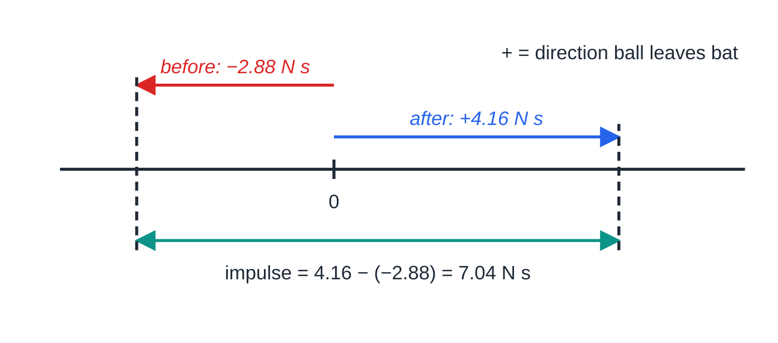
What are momentum and impulse? (continued)
Section 1 of 13 · Worked example 1 · Easy · Find
WORKED EXAMPLE · QUESTION
A ball of mass 0.16 kg moves horizontally at 18 m s⁻¹ towards a bat. The bat hits it straight back along the same line, and the ball leaves the bat at 26 m s⁻¹. (a) Find the magnitude of the impulse exerted by the bat on the ball. (b) The bat and ball are in contact for 0.032 s. Modelling the force of the bat on the ball as constant, find its magnitude.
SOLUTION
(a) Take the direction the ball leaves the bat as positive: u = -18 m s⁻¹, v = +26 m s⁻¹. Then I = 0.16 ×26 - 0.16 ×(-18) = 4.16 + 2.88.
Momentum to scale: from −2.88 N s to +4.16 N s, so the impulse is the whole gap, 7.04 N s.
Notes:
What are momentum and impulse?: Worked example 1. Full notes: https://examinerprep.com/notes/edexcel-ial-maths/momentum-and-impulse/

Slide 6
What are momentum and impulse? (continued)
Section 1 of 13 · Worked example 1 · Easy · Find (continued)
I = 7.04 N s
(b) For a constant force, I = Ft, so F = 7.04 ÷0.032. F = 220 N
Using 26 - 18 gives 1.28 N s: the reversal of direction has been ignored.
Notes:
What are momentum and impulse?: Worked example 1. Full notes: https://examinerprep.com/notes/edexcel-ial-maths/momentum-and-impulse/

Slide 7
How does impulse link to a constant force, and to friction?
Section 2 of 13
Suppose a constant force F acts on a particle for time t. Newton's second law gives F = ma, and the constant-acceleration formula v = u + at gives at = v - u. Multiply the first by t: Ft = mat = m(v - u) = mv - mu. So for a constant force, the impulse is simply force × time.
Impulse of a constant force. I = Ft, where F is the constant force (N) and t the time for which it acts (s). The impulse is in the same direction as the force. For a force that is not constant, M1 questions give you the impulse itself.
In a collision the force is large and very brief; we rarely know F or t separately, only their product. The impulse is the area under a force–time graph, so a peaked blow has the same effect as a constant force with the same area.
Notes:
How does impulse link to a constant force, and to friction?. Full notes: https://examinerprep.com/notes/edexcel-ial-maths/momentum-and-impulse/

Slide 8
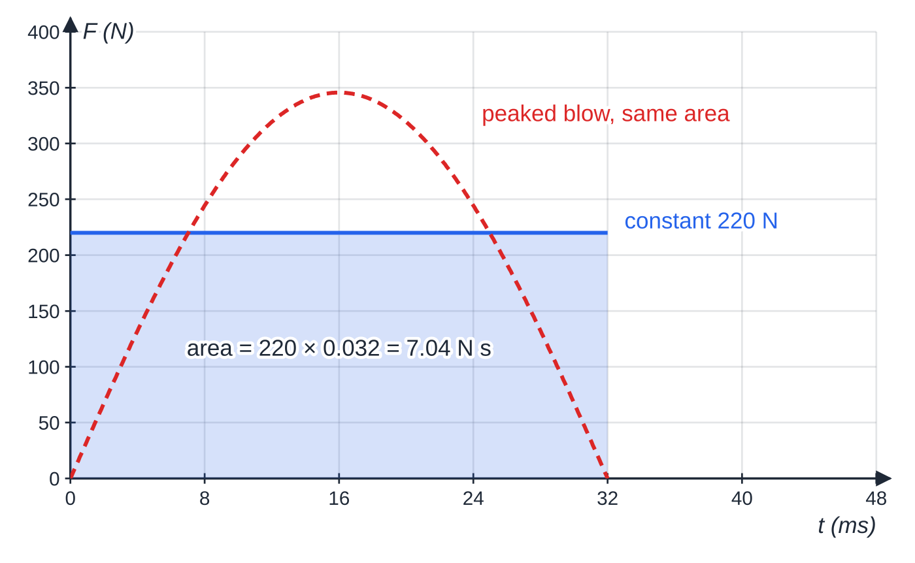
How does impulse link to a constant force, and to friction? (continued)
Section 2 of 13
Friction is a constant force too. Its impulse over the time a particle slides is Ft, and if the particle comes to rest, that impulse equals all the momentum the particle had. In the model, an impulse changes the velocity instantly; after it, the usual constant-acceleration formulae take over.
Impulse is the area under the force–time graph: the bat in worked example 1 as a constant 220 N for 32 ms, or a peaked force with the same area.
Notes:
How does impulse link to a constant force, and to friction?. Full notes: https://examinerprep.com/notes/edexcel-ial-maths/momentum-and-impulse/

Slide 9
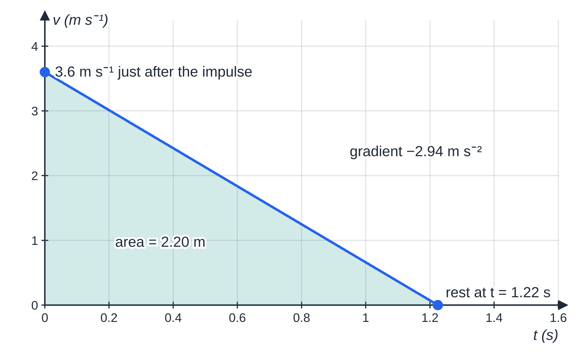
How does impulse link to a constant force, and to friction? (continued)
Section 2 of 13 · Worked example 2 · Medium · Find
WORKED EXAMPLE · QUESTION
A block of mass 2.5 kg rests on rough horizontal ground. The coefficient of friction between the block and the ground is 0.3. The block is given a horizontal impulse of magnitude 9 N s. Model the block as a particle. (a) Find the speed of the block immediately after the impulse. (b) Find the time for which the block slides. (c) Find the distance it slides before coming to rest.
SOLUTION
(a) Impulse = change in momentum, from rest: 9 = 2.5u - 0. u = 3.6 m s⁻¹
Worked example 2: the impulse sets the starting velocity, friction gives a constant deceleration, and the area is the 2.20 m slid.
Notes:
How does impulse link to a constant force, and to friction?: Worked example 2. Full notes: https://examinerprep.com/notes/edexcel-ial-maths/momentum-and-impulse/

Slide 10
How does impulse link to a constant force, and to friction? (continued)
Section 2 of 13 · Worked example 2 · Medium · Find (continued)
(b) Friction is limiting while the block slides: R = 2.5g = 24.5 N and F = 0.3 ×24.5 = 7.35 N. The impulse of friction removes all the momentum, so Ft = 9 and t = 9 ÷7.35 = 1.2244… t = 1.22 s (3 s.f.)
(c) Deceleration from F = ma: a = 7.35 ÷2.5 = 2.94 m s⁻². Then v² = u² + 2as gives 0 = 3.6² - 2 ×2.94 ×s, so s = 12.96 ÷5.88 = 2.204… s = 2.20 m (3 s.f.)
Notes:
How does impulse link to a constant force, and to friction?: Worked example 2. Full notes: https://examinerprep.com/notes/edexcel-ial-maths/momentum-and-impulse/

Slide 11
How do you use conservation of momentum in a direct collision?
Section 3 of 13
When particles A and B collide, A pushes on B and B pushes on A. By Newton's third law these forces are equal in size and opposite in direction, and they act for exactly the same time. So the impulses on A and on B are equal and opposite: the momentum A gains is exactly the momentum B loses. The total momentum is unchanged, provided no other impulse acts.
Conservation of momentum (two particles, one line). m₁u₁ + m₂u₂ = m₁v₁ + m₂v₂, where u₁, u₂ are the velocities before and v₁, v₂ the velocities after, all signed with the same positive direction. Valid when the only significant impulses are the ones the particles exert on each other.
"Directly" means along one straight line, so one positive direction covers everything. During the brief impact, weight and friction give negligible impulse, so momentum is conserved across the impact even on a rough surface.
Notes:
How do you use conservation of momentum in a direct collision?. Full notes: https://examinerprep.com/notes/edexcel-ial-maths/momentum-and-impulse/

Slide 12
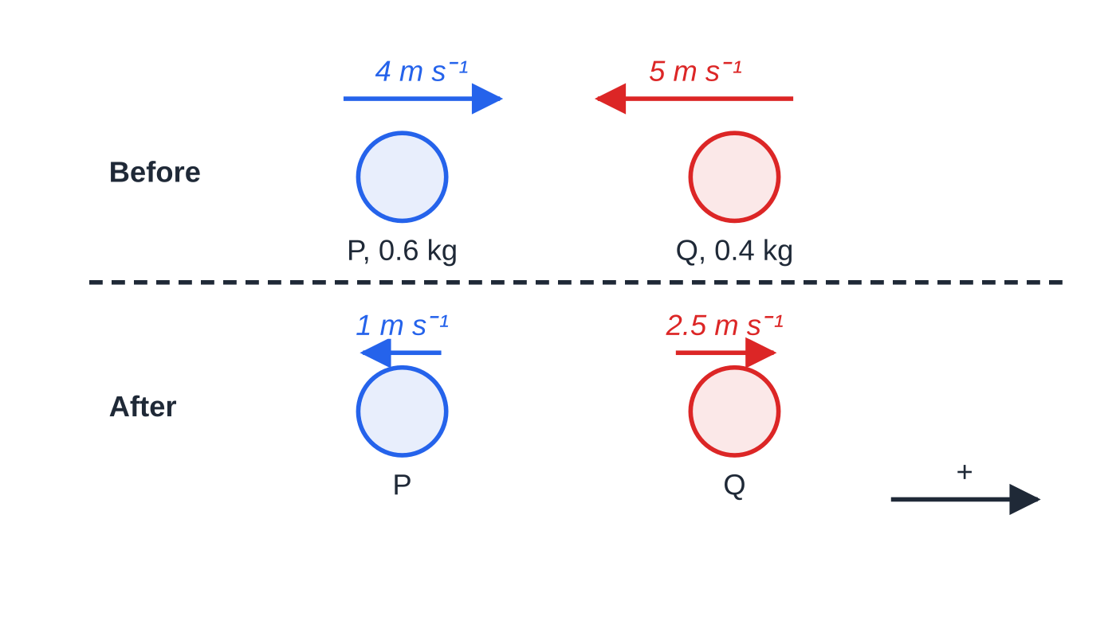
How do you use conservation of momentum in a direct collision? (continued)
Section 3 of 13 · Worked example 3 · Medium · Find
WORKED EXAMPLE · QUESTION
Two particles P and Q, of masses 0.6 kg and 0.4 kg, move towards each other along a straight line on a smooth horizontal surface. Just before they collide, P has speed 4 m s⁻¹ and Q has speed 5 m s⁻¹. Immediately after the collision Q moves with speed 2.5 m s⁻¹, its direction of motion reversed. (a) Find the velocity of P immediately after the collision. (b) Find the magnitude of the impulse exerted on Q by P, and show that P receives an impulse of the same size.
Worked example 3, positive in P's original direction. Both particles reverse; arrow lengths are proportional to speed.
Notes:
How do you use conservation of momentum in a direct collision?: Worked example 3. Full notes: https://examinerprep.com/notes/edexcel-ial-maths/momentum-and-impulse/

Slide 13
How do you use conservation of momentum in a direct collision? (continued)
Section 3 of 13 · Worked example 3 · Medium · Find (continued)
SOLUTION
(a) Positive in P's original direction, so u_Q = -5 and v_Q = +2.5. Conservation of momentum: 0.6 ×4 + 0.4 ×(-5) = 0.6v_P + 0.4 ×2.5, so 0.4 = 0.6v_P + 1.0 and v_P = -1. P moves at 1 m s⁻¹, its direction of motion reversed
(b) Impulse on Q = change in Q's momentum: I_Q = 0.4 ×2.5 - 0.4 ×(-5) = 3 N s. For P: I_P = 0.6 ×(-1) - 0.6 ×4 = -3 N s, the same size in the opposite direction. 3 N s on each, in opposite directions
A negative answer for an unknown velocity is not an error: it tells you the direction.
Notes:
How do you use conservation of momentum in a direct collision?: Worked example 3. Full notes: https://examinerprep.com/notes/edexcel-ial-maths/momentum-and-impulse/

Slide 14
How do you use conservation of momentum in a direct collision? (continued)
Section 3 of 13
Common error — speeds without signs
If Q's 5 m s⁻¹ goes in as +5, the momentum equation gives v_P = 5.67 m s⁻¹ forwards: P would have to pass straight through Q, which is impossible. Mark the positive direction on your diagram first, then sign every velocity against it.
Notes:
How do you use conservation of momentum in a direct collision?. Full notes: https://examinerprep.com/notes/edexcel-ial-maths/momentum-and-impulse/

Slide 15
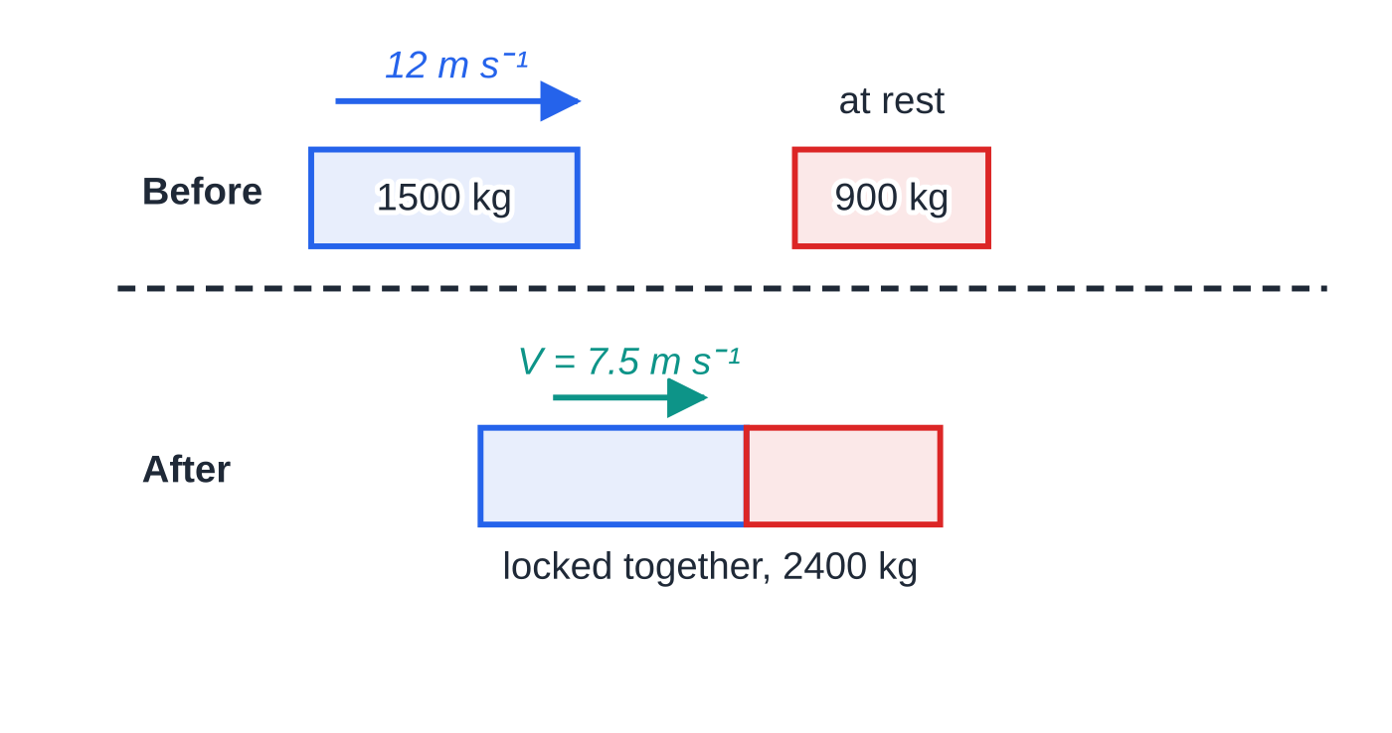
What changes when particles coalesce or spring apart?
Section 4 of 13
Coalescing. Particles that stick together after the collision (words such as couple, lock or join) move off with one common velocity V. The conservation equation becomes m₁u₁ + m₂u₂ = (m₁ + m₂)V. The heavier particle has more influence on V: it is a mass-weighted average of the velocities, not a simple average.
Separation or explosion. This is the reverse process. The particles start with a common velocity (often at rest), then a spring, a charge or a push sends them apart.
Coalescing: 1500 × 12 = 2400V, so the locked cars move at V = 7.5 m s⁻¹.
Notes:
What changes when particles coalesce or spring apart?. Full notes: https://examinerprep.com/notes/edexcel-ial-maths/momentum-and-impulse/

Slide 16
What changes when particles coalesce or spring apart? (continued)
Section 4 of 13
Total momentum after equals total momentum before, which is zero if they started at rest, so they must move off in opposite directions. A gun and its bullet, a person stepping off a boat, and two skaters pushing apart are all separations. In every case the particles receive equal and opposite impulses from each other.
Notes:
What changes when particles coalesce or spring apart?. Full notes: https://examinerprep.com/notes/edexcel-ial-maths/momentum-and-impulse/

Slide 17
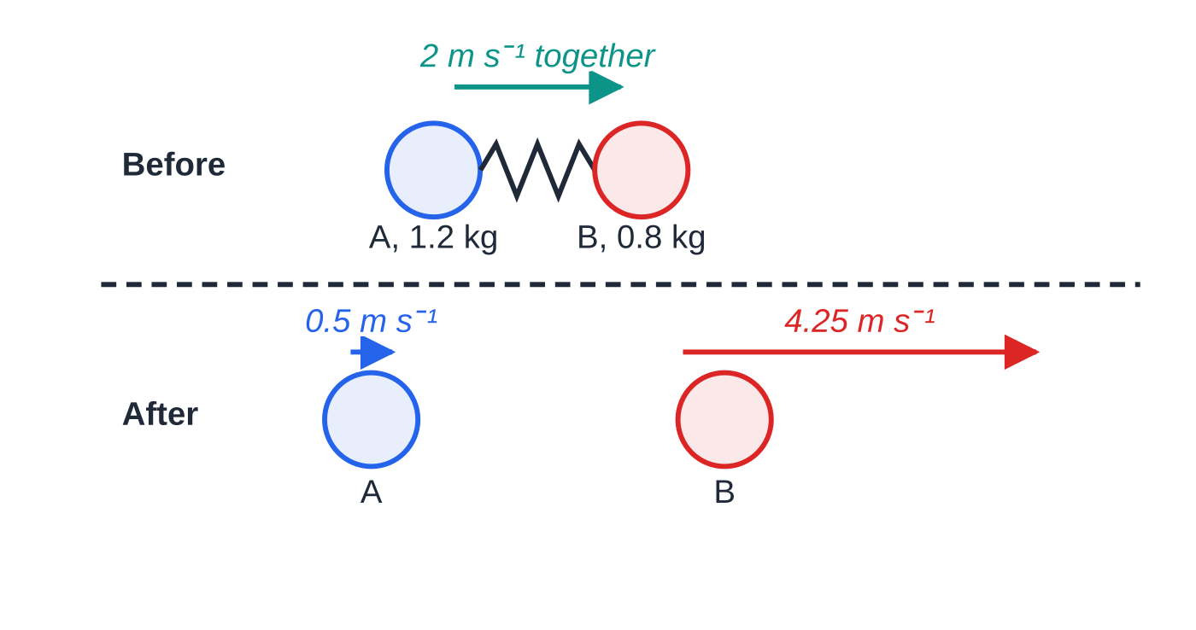
What changes when particles coalesce or spring apart? (continued)
Section 4 of 13 · Worked example 4 · Medium · Find
WORKED EXAMPLE · QUESTION
Particles A (1.2 kg) and B (0.8 kg) are held together against a compressed light spring and slide together on a smooth horizontal surface at 2 m s⁻¹. The spring is released. Immediately afterwards A is still moving in the original direction, with speed 0.5 m s⁻¹, and the spring falls away. (a) Find the velocity of B immediately after the release. (b) Find the magnitude and direction of the impulse exerted by the spring on A.
The spring gives A and B equal and opposite impulses; the total momentum stays 4.0 N s.
Notes:
What changes when particles coalesce or spring apart?: Worked example 4. Full notes: https://examinerprep.com/notes/edexcel-ial-maths/momentum-and-impulse/

Slide 18
What changes when particles coalesce or spring apart? (continued)
Section 4 of 13 · Worked example 4 · Medium · Find (continued)
SOLUTION
(a) Total momentum before (positive in the original direction): (1.2 + 0.8) ×2 = 4.0 N s. Conservation of momentum: 4.0 = 1.2 ×0.5 + 0.8v_B, so v_B = 3.4 ÷0.8. v_B = 4.25 m s⁻¹ in the original direction
(b) Impulse on A = change in A's momentum: I_A = 1.2 ×0.5 - 1.2 ×2 = -1.8 N s. 1.8 N s, opposite to the original direction
Check with B: 0.8 ×(4.25 - 2) = +1.8 N s. Equal and opposite, as it must be.
Notes:
What changes when particles coalesce or spring apart?: Worked example 4. Full notes: https://examinerprep.com/notes/edexcel-ial-maths/momentum-and-impulse/

Slide 19
What happens when a slack string jerks tight?
Section 5 of 13
While a light string is slack, its tension is zero and the particles move independently. The instant it becomes taut, a very large tension acts for a very short time: an impulsive tension. It acts along the string, pulling each particle towards the other. Because the string is inextensible, the particles then move with a common speed along the string.
On a straight line the tension impulses on the two particles are equal and opposite, so momentum is conserved and the jerk works exactly like coalescing. The impulse in the string is the change in momentum of either particle. If the string passes over a pulley, however, the two particles move in different directions and you cannot add their momenta. Then write impulse = change in momentum for each particle separately, with the same impulse J in both equations.
Notes:
What happens when a slack string jerks tight?. Full notes: https://examinerprep.com/notes/edexcel-ial-maths/momentum-and-impulse/

Slide 20
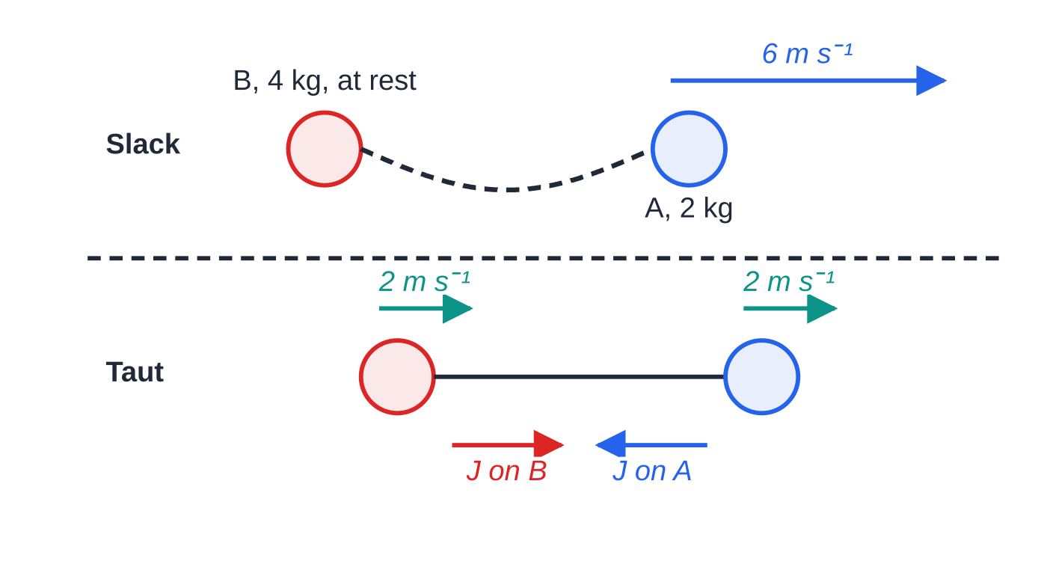
What happens when a slack string jerks tight? (continued)
Section 5 of 13 · Worked example 5 · Easy · Find
WORKED EXAMPLE · QUESTION
Particles A (2 kg) and B (4 kg) lie on a smooth horizontal table, connected by a light inextensible string that is initially slack. B is at rest. A is projected directly away from B with speed 6 m s⁻¹. (a) Find the common speed of the particles just after the string becomes taut. (b) Find the magnitude of the impulse in the string when it jerks tight.
SOLUTION
(a) Momentum is conserved along the line of the string: 2 ×6 + 4 ×0 = (2 + 4)v. v = 2 m s⁻¹
(b) Impulse on B = change in B's momentum:
Worked example 5. The impulsive tension slows A and starts B; afterwards they share one speed, 2 m s⁻¹.
Notes:
What happens when a slack string jerks tight?: Worked example 5. Full notes: https://examinerprep.com/notes/edexcel-ial-maths/momentum-and-impulse/

Slide 21
What happens when a slack string jerks tight? (continued)
Section 5 of 13 · Worked example 5 · Easy · Find (continued)
J = 4 ×2 - 0. J = 8 N s
Check with A: 2 ×(2 - 6) = -8 N s, the same size in the opposite direction.
Notes:
What happens when a slack string jerks tight?: Worked example 5. Full notes: https://examinerprep.com/notes/edexcel-ial-maths/momentum-and-impulse/

Slide 22
How do you model a pile driver?
Section 6 of 13
A pile driver drops a heavy block (the driver) onto a post (the pile). The question runs in three stages:
Stage 1, free fall. The driver falls from rest through height h: v² = 2gh.
Stage 2, impact. The driver hits the pile and usually they move on together. The impact is so short that the impulses of the weights and of the ground are negligible, so momentum is conserved and they coalesce.
Stage 3, driven in. Driver and pile move down together against a constant resistance R from the ground until they stop. Use constant-acceleration formulae for the deceleration, then F = ma with the weight included.
Notes:
How do you model a pile driver?. Full notes: https://examinerprep.com/notes/edexcel-ial-maths/momentum-and-impulse/

Slide 23
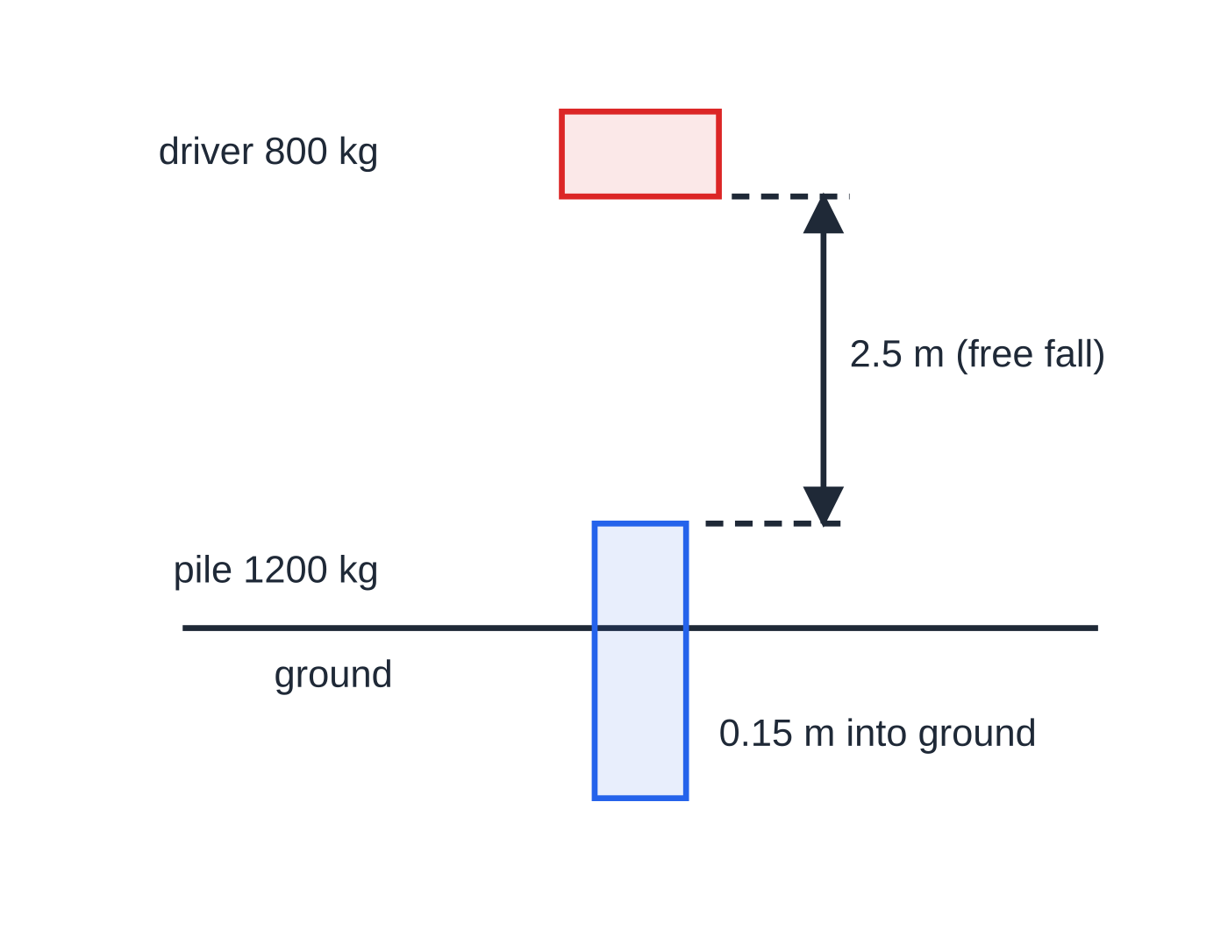
How do you model a pile driver? (continued)
Section 6 of 13
Worked example 6: a 2.5 m free fall, the impact, then 0.15 m into the ground.
Notes:
How do you model a pile driver?. Full notes: https://examinerprep.com/notes/edexcel-ial-maths/momentum-and-impulse/

Slide 24
How do you model a pile driver? (continued)
Section 6 of 13 · Worked example 6 · Hard · Find
WORKED EXAMPLE · QUESTION
A pile driver of mass 800 kg is released from rest 2.5 m vertically above the top of a pile of mass 1200 kg, which is at rest. The driver falls freely and strikes the pile. After the impact the driver and pile move downwards together and come to rest after moving 0.15 m into the ground. The resistance of the ground is constant. Model the driver and pile as particles. (a) Find the speed of the driver just before the impact. (b) Find the common speed just after the impact. (c) Find the magnitude of the impulse exerted by the driver on the pile. (d) Find the resistance of the ground. (e) Find the time for which the pile moves.
Notes:
How do you model a pile driver?: Worked example 6. Full notes: https://examinerprep.com/notes/edexcel-ial-maths/momentum-and-impulse/

Slide 25
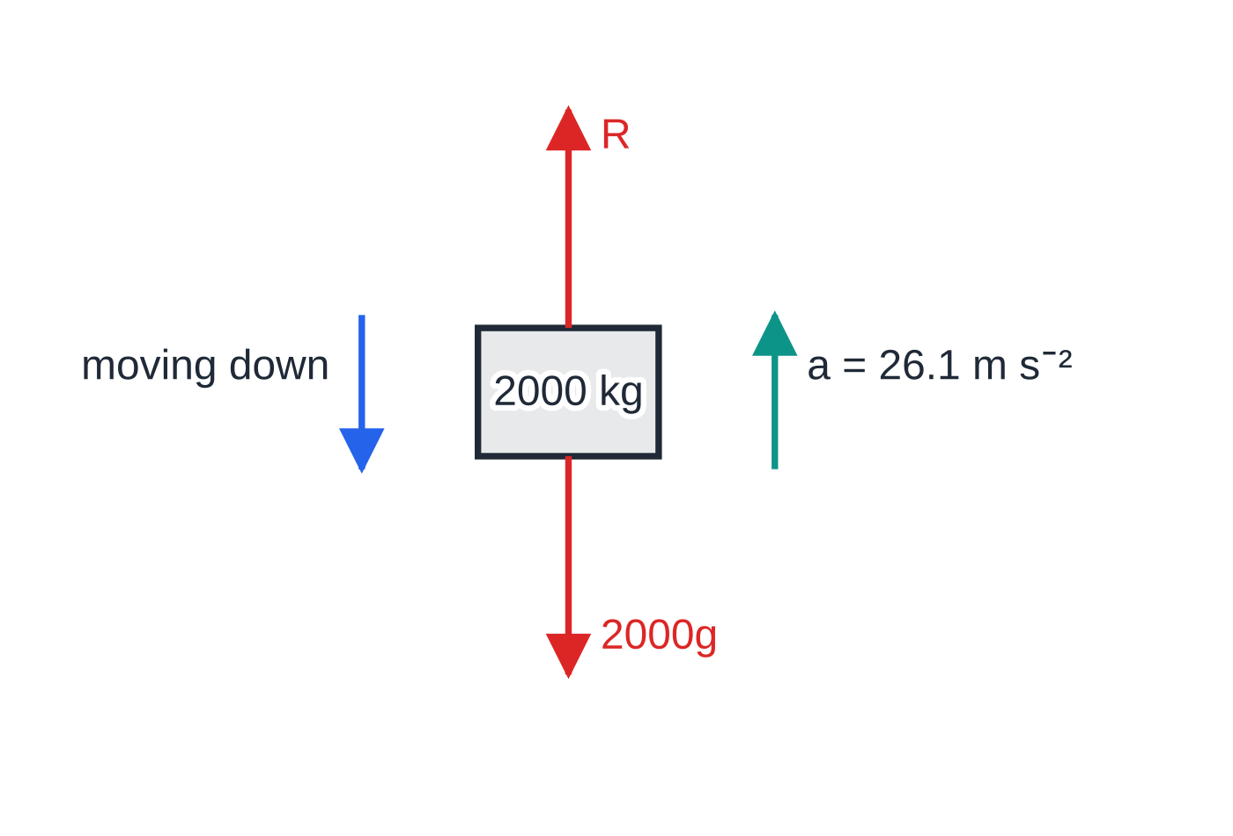
How do you model a pile driver? (continued)
Section 6 of 13 · Worked example 6 · Hard · Find (continued)
Stage 3: moving down but slowing, so the acceleration points up and R exceeds 2000g.
Notes:
How do you model a pile driver?: Worked example 6. Full notes: https://examinerprep.com/notes/edexcel-ial-maths/momentum-and-impulse/

Slide 26
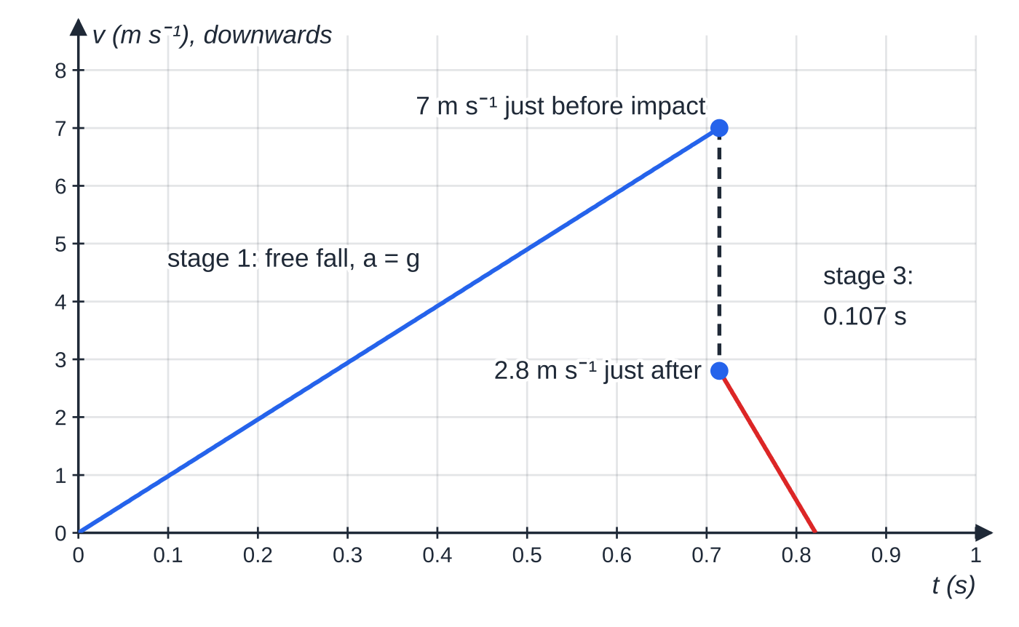
How do you model a pile driver? (continued)
Section 6 of 13 · Worked example 6 · Hard · Find (continued)
SOLUTION
(a) Free fall, v² = u² + 2as: U² = 2 ×9.8 ×2.5 = 49. U = 7 m s⁻¹
(b) Momentum is conserved at the impact and they coalesce: 800 ×7 = 2000V. V = 2.8 m s⁻¹
(c) Impulse on the pile = change in the pile's momentum: 1200 ×2.8 - 0. 3360 N s
(d) Deceleration over 0.15 m: 0 = 2.8² - 2a ×0.15, so a = 7.84 ÷0.3 = 26.13… m s⁻². Then F = ma for driver and pile together, downwards positive (acceleration -26.13):
Velocity–time graph for the pile driver, downwards positive. The vertical drop at t = 0.714 s is the instant change of velocity at the impact.
Notes:
How do you model a pile driver?: Worked example 6. Full notes: https://examinerprep.com/notes/edexcel-ial-maths/momentum-and-impulse/

Slide 27
How do you model a pile driver? (continued)
Section 6 of 13 · Worked example 6 · Hard · Find (continued)
2000g - R = 2000 ×(-26.13…), so R = 2000 ×(9.8 + 26.13…) = 71 866.7 R = 71 900 N (3 s.f.)
(e) v = u + at: 0 = 2.8 - 26.13…t, so t = 0.1071… t = 0.107 s (3 s.f.)
Leaving out the weight (writing R = 2000a) gives 52 300 N, wrong by 2000g = 19 600 N.
Notes:
How do you model a pile driver?: Worked example 6. Full notes: https://examinerprep.com/notes/edexcel-ial-maths/momentum-and-impulse/

Slide 28
How do you model a pile driver? (continued)
Section 6 of 13
Exam tip — include the weight
"Find the resistance" in a pile-driver question nearly always needs the weight of the moving bodies in the equation of motion. Draw a force diagram for the combined body in stage 3: weight down, resistance up, acceleration up, because it is slowing down while moving down.
Notes:
How do you model a pile driver?. Full notes: https://examinerprep.com/notes/edexcel-ial-maths/momentum-and-impulse/

Slide 29
How do you solve a slide–collide–slide problem?
Section 7 of 13
Split the motion at the instant of the collision.
Before: friction gives a constant deceleration, so use F = μR, F = ma and the constant-acceleration formulae to find the speed at impact.
At impact: conserve momentum (friction's impulse over the instant is negligible) and find the unknown velocity after.
After: each particle starts a new constant-acceleration stage with its own initial velocity.
Notes:
How do you solve a slide–collide–slide problem?. Full notes: https://examinerprep.com/notes/edexcel-ial-maths/momentum-and-impulse/

Slide 30
How do you solve a slide–collide–slide problem? (continued)
Section 7 of 13 · Worked example 7 · Hard · Show that / Find
WORKED EXAMPLE · QUESTION
A particle P of mass 0.5 kg is projected with speed 6 m s⁻¹ along a rough horizontal floor towards a particle Q of mass 0.3 kg, which is at rest 4 m away. The coefficient of friction between each particle and the floor is 0.25. P hits Q directly. Immediately after the collision Q moves with speed 3 m s⁻¹. (a) Show that the speed of P just before the collision is 4.05 m s⁻¹, to 3 significant figures. (b) Find the velocity of P immediately after the collision. (c) Find the magnitude of the impulse on Q in the collision. (d) Find the distance between P and Q when both have come to rest.
Notes:
How do you solve a slide–collide–slide problem?: Worked example 7. Full notes: https://examinerprep.com/notes/edexcel-ial-maths/momentum-and-impulse/

Slide 31
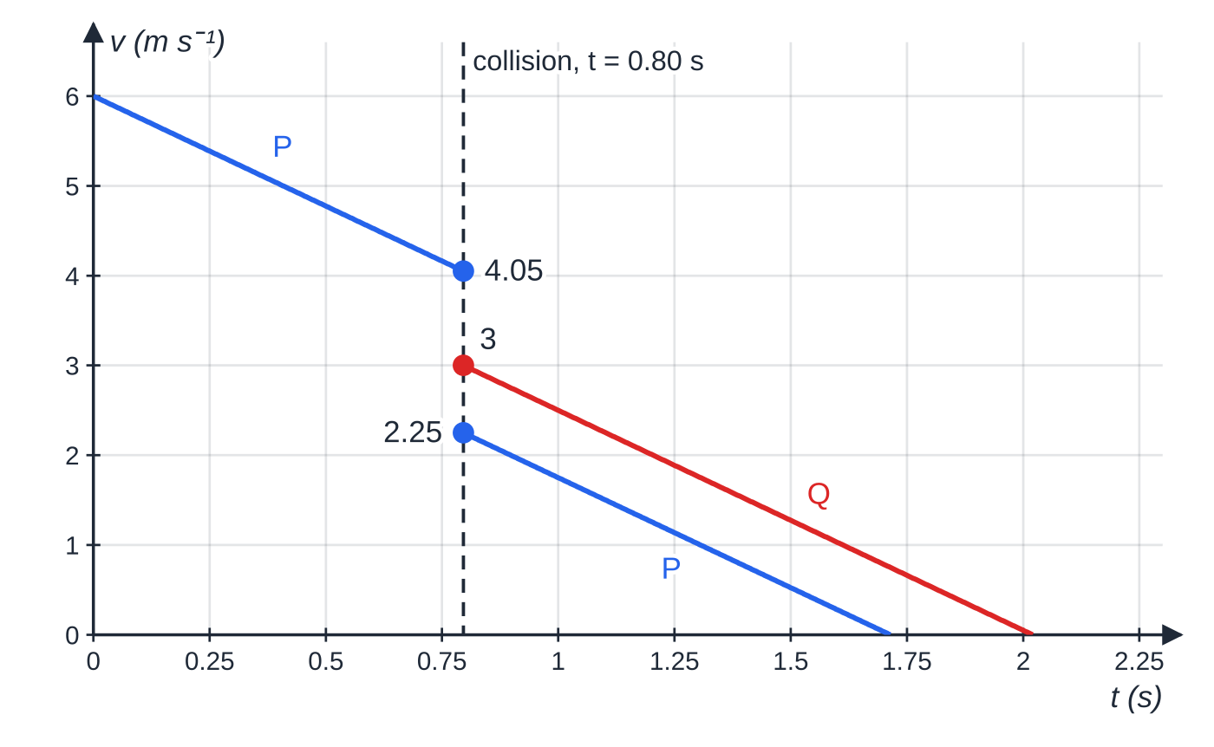
How do you solve a slide–collide–slide problem? (continued)
Section 7 of 13 · Worked example 7 · Hard · Show that / Find (continued)
SOLUTION
(a) Deceleration due to friction (the same for both particles): 0.25 ×0.5g = 0.5a, so a = 0.25g = 2.45 m s⁻². Then v² = 6² - 2 ×2.45 ×4 = 16.4 and v = √16.4 = 4.0497… v = 4.05 m s⁻¹ (3 s.f.)
(b) Momentum is conserved at the impact (positive towards Q): 0.5 ×4.0497…= 0.5v_P + 0.3 ×3, so v_P = 2.2497… 2.25 m s⁻¹, still moving in its original direction
(c) Impulse on Q: 0.3 ×3 - 0. 0.9 N s
Worked example 7: both velocities change instantly at 0.80 s; every sloping line has gradient −2.45 m s⁻².
Notes:
How do you solve a slide–collide–slide problem?: Worked example 7. Full notes: https://examinerprep.com/notes/edexcel-ial-maths/momentum-and-impulse/

Slide 32
How do you solve a slide–collide–slide problem? (continued)
Section 7 of 13 · Worked example 7 · Hard · Show that / Find (continued)
(d) Each particle slides to rest with deceleration 2.45 m s⁻². Q: 3² ÷(2 ×2.45) = 1.837 m. P: 2.2497² ÷(2 ×2.45) = 1.033 m. Distance apart = 1.837 - 1.033. 0.804 m (3 s.f.)
They cannot collide again: Q leaves faster than P and both slow at the same rate, so the gap grows until P stops, and Q stops later still.
Notes:
How do you solve a slide–collide–slide problem?: Worked example 7. Full notes: https://examinerprep.com/notes/edexcel-ial-maths/momentum-and-impulse/

Slide 33
How do you work with impulse in i, j form?
Section 8 of 13
Momentum and impulse are vectors. In a plane, I = mv - mu holds component by component: the i parts give one equation and the j parts another. Rearranged, v = u + I/m. Geometrically, mu + I = mv is a vector triangle: the momentum before, followed by the impulse, gives the momentum after.
Speed is √(a² + b²) for ai + bj; the direction is an angle from tan⁻¹, measured from a stated vector such as i, with a sketch to fix the quadrant. In M1 these questions involve one particle and one impulse.
Notes:
How do you work with impulse in i, j form?. Full notes: https://examinerprep.com/notes/edexcel-ial-maths/momentum-and-impulse/

Slide 34
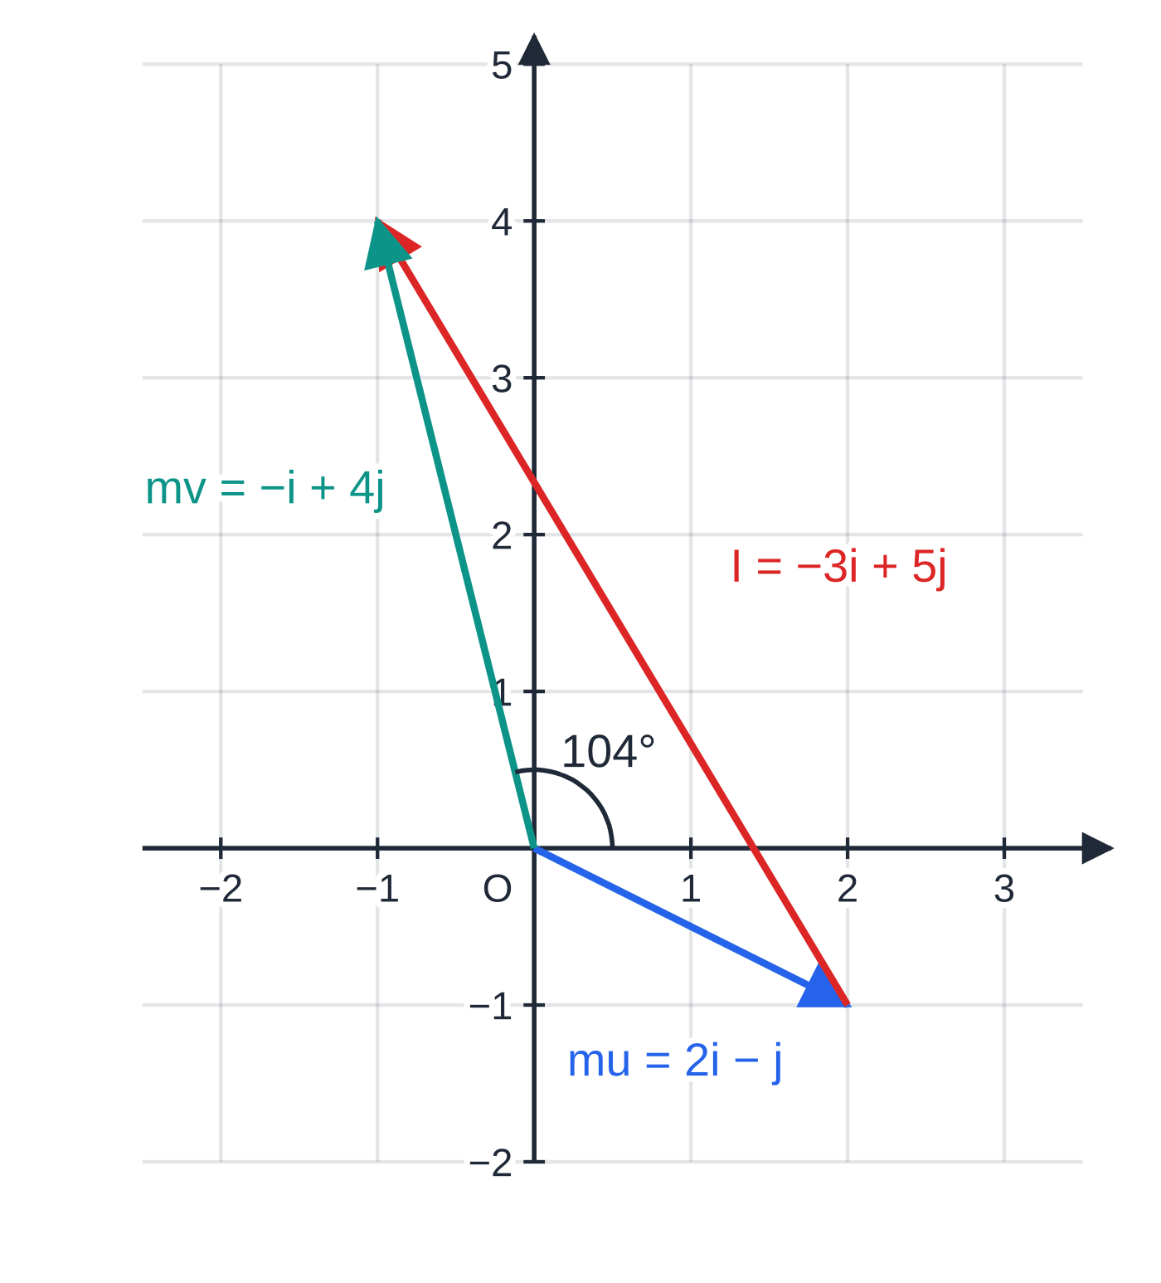
How do you work with impulse in i, j form? (continued)
Section 8 of 13 · Worked example 8 · Medium · Find
WORKED EXAMPLE · QUESTION
A particle of mass 0.5 kg is moving with velocity (4i - 2j) m s⁻¹ when it receives an impulse of (-3i + 5j) N s. (a) Find the velocity of the particle immediately after the impulse. (b) Find its speed, and the angle its direction of motion then makes with i. (c) Find the impulse that would instead have changed its velocity to 6i m s⁻¹, and the magnitude of that impulse.
SOLUTION
(a) I = mv - mu: -3i + 5j = 0.5v - (2i - j), so 0.5v = -i + 4j. v = (−2i + 8j) m s⁻¹
(b) Speed = √((-2)² + 8²) = √68 = 2√17 = 8.246… m s⁻¹. The velocity points up and to the left, so the angle with i is 180° - tan⁻¹(8 ÷2) = 104.0°. 8.25 m s⁻¹ (3 s.f.), 104° to i (3 s.f.)
Worked example 8 as a vector triangle on 1 N s squares: momentum before plus impulse gives momentum after.
Notes:
How do you work with impulse in i, j form?: Worked example 8. Full notes: https://examinerprep.com/notes/edexcel-ial-maths/momentum-and-impulse/

Slide 35
How do you work with impulse in i, j form? (continued)
Section 8 of 13 · Worked example 8 · Medium · Find (continued)
(c) Same principle, new final velocity: I = 0.5(6i) - 0.5(4i - 2j) = i + j, magnitude √2. (i + j) N s, magnitude 1.41 N s (3 s.f.)
Notes:
How do you work with impulse in i, j form?: Worked example 8. Full notes: https://examinerprep.com/notes/edexcel-ial-maths/momentum-and-impulse/

Slide 36
Exam tips for M1.4
Section 9 of 13
Exam tip 1 — draw before and after
Two rows, one for just before and one for just after, with masses and every velocity written beside an arrow, and the positive direction marked. Unknown velocities go in as positive; the sign of the answer gives the direction.
Exam tip 2 — impulse needs a direction
Work out the impulse on whichever particle has the simpler numbers, then state its direction in words ("towards A", "opposite to the original direction"). The other particle receives the same magnitude in the opposite direction.
Notes:
Exam tips for M1.4. Full notes: https://examinerprep.com/notes/edexcel-ial-maths/momentum-and-impulse/

Slide 37
Exam tips for M1.4 (continued)
Section 9 of 13
Exam tip 3 — split long problems into stages
Constant acceleration before, momentum at the instant of impact, constant acceleration after. The final velocity of one stage is the initial velocity of the next.
Exam tip 4 — rounding with g = 9.8
Give final answers to 2 or 3 significant figures, but carry full calculator values between stages. A speed rounded to 4.0 instead of 4.05 can move a later answer by more than you think.
Exam tip 5 — "show that" answers
When a value is given to 3 significant figures, show the line before it with more figures (for example √16.4 = 4.0497…) so it is clear you did not work backwards from the answer.
Notes:
Exam tips for M1.4. Full notes: https://examinerprep.com/notes/edexcel-ial-maths/momentum-and-impulse/

Slide 38
Common misconceptions
Section 10 of 13
Misconception | Why it is wrong | Correct idea
Momentum is conserved throughout a problem on a rough surface. | Friction acts on the particle the whole time it slides, so it changes the momentum. | Momentum is conserved across the instant of impact only; use friction and constant acceleration either side.
Speeds can go into the momentum equation without signs. | Momentum is a vector; particles moving in opposite directions have momenta of opposite sign. | Choose a positive direction and sign every velocity against it.
The two colliding particles receive the same impulse. | Newton's third law gives forces in opposite directions. | The impulses are equal in size and opposite in direction.
Impulse is a kind of force. | Impulse includes the time for which the force acts; its unit is N s, not N. | Impulse = change in momentum, and for a constant force I = Ft.
A slack string pulls on the particles. | A slack string has no tension at all. | Tension appears only when the string becomes taut, as an impulse that gives the particles a common speed.
Notes:
Common misconceptions. Full notes: https://examinerprep.com/notes/edexcel-ial-maths/momentum-and-impulse/

Slide 39
Common misconceptions (continued)
Section 10 of 13
Misconception | Why it is wrong | Correct idea
When particles coalesce, their speeds just add or average. | The heavier particle has more influence; the masses matter. | Use (m₁ + m₂)V = m₁u₁ + m₂u₂.
Notes:
Common misconceptions. Full notes: https://examinerprep.com/notes/edexcel-ial-maths/momentum-and-impulse/

Slide 40
How this topic connects
Section 11 of 13
M1.2 Kinematics and M1.3 Dynamics
The constant-acceleration formulae, F = ma and F = μR carry every stage before and after a collision; I = Ft is F = ma combined with v = u + at.
M1.1 Modelling and vectors
Impulse in vector form uses the same component skills as velocity and force vectors.
M2.5 Collisions and energy
Newton's law of restitution fixes the velocities after an impact, and the work–energy principle measures the kinetic energy lost.
Notes:
How this topic connects. Full notes: https://examinerprep.com/notes/edexcel-ial-maths/momentum-and-impulse/

Slide 41
Key formulae
Section 12 of 13
Formula | Use | In the formulae list?
momentum = mv | Momentum of a particle (unit N s) | No — must be known
I = mv - mu | Impulse on one particle; finding a velocity after a blow | No — must be known
I = Ft | Impulse of a constant force, including friction | No — must be known
m₁u₁ + m₂u₂ = m₁v₁ + m₂v₂ | Direct collisions, separations, jerks in strings | No — must be known
m₁u₁ + m₂u₂ = (m₁ + m₂)V | Coalescing particles; string jerking tight | No — derive it from conservation
I = mv - mu | Impulse in i, j form | No — must be known
v = u + at, v² = u² + 2as, … | Stages before and after a collision; free fall of a pile driver | No — must be known
F = μR, F = ma | Friction and resistance stages | No — must be known
Notes:
Key formulae. Full notes: https://examinerprep.com/notes/edexcel-ial-maths/momentum-and-impulse/

Slide 42
Check your understanding
Section 13 of 13
1. Show that the newton second and the kilogram metre per second are the same unit.
2. A 2 kg particle moving at 5 m s⁻¹ and a 3 kg particle moving at 4 m s⁻¹ travel towards each other and coalesce. Find their common velocity.
3. A ball of mass 0.2 kg is dropped from rest 2.5 m above the ground and rebounds vertically at 4.2 m s⁻¹. Find the impulse from the ground.
4. Two particles collide on a rough table. Why can you still use conservation of momentum for the collision?
5. A particle of mass 2 kg at rest receives an impulse of (6i - 8j) N s. Find its speed immediately afterwards.
Notes:
Check your understanding: questions. Full notes: https://examinerprep.com/notes/edexcel-ial-maths/momentum-and-impulse/

Slide 43
Check your understanding · answers
Section 13 of 13
1. 1 N = 1 kg m s⁻², so 1 N s = 1 kg m s⁻² × 1 s = 1 kg m s⁻¹.
2. Positive in the 2 kg particle's direction: 2 ×5 - 3 ×4 = 5V, so V = -0.4. The combined particle moves at 0.4 m s⁻¹ in the direction the 3 kg particle was moving.
3. Speed at the ground: √(2 ×9.8 ×2.5) = 7 m s⁻¹. Upwards positive: I = 0.2 ×4.2 - 0.2 ×(-7) = 2.24. 2.24 N s, upwards.
4. The collision lasts a very short time. Friction is a fixed, modest force, so its impulse over that time (Ft) is negligible compared with the large impulses the particles exert on each other. Over the instant of impact the total momentum is unchanged.
5. v = (6i - 8j) ÷2 = (3i - 4j) m s⁻¹, so the speed is √(3² + 4²). 5 m s⁻¹
Notes:
Check your understanding: answers. Full notes: https://examinerprep.com/notes/edexcel-ial-maths/momentum-and-impulse/

Slide 44
Practice questions
2 original exam-style questions. Answers at the end of the deck.

Slide 45
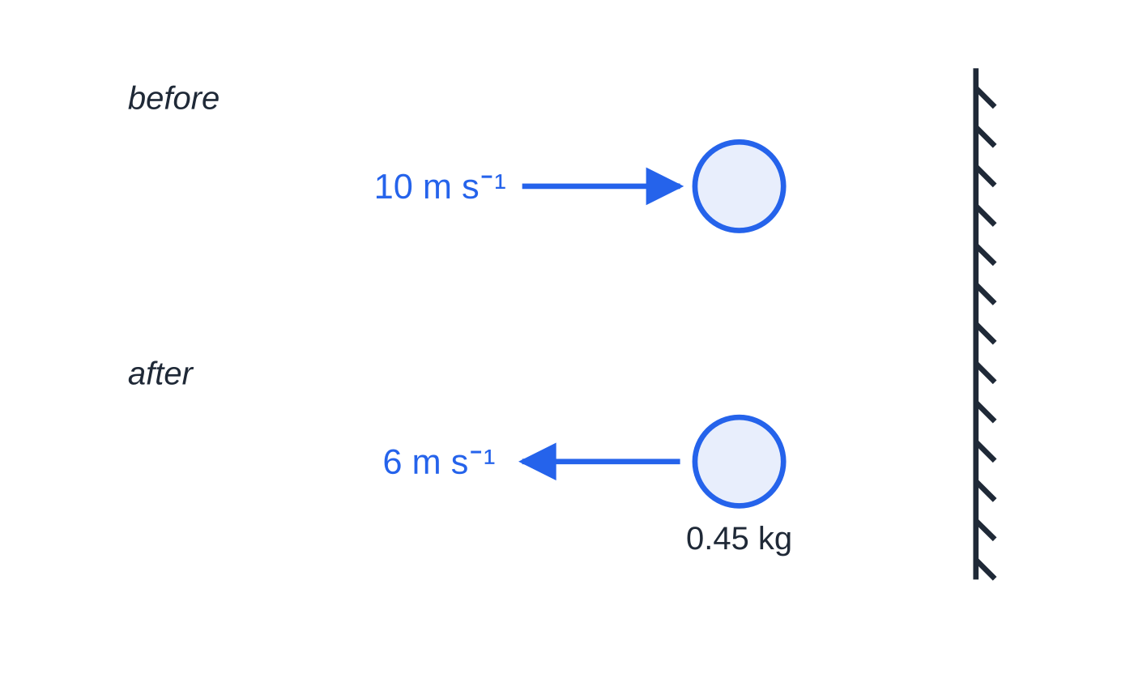
Question 1
5 marks
A football of mass 0.45 kg is kicked horizontally at a vertical wall. It hits the wall at right angles with speed 10 m s⁻¹ and rebounds along the same line with speed 6 m s⁻¹. The football is modelled as a particle.
Figure: the football just before and just after hitting the wall; not to scale.
(a) Find the magnitude of the impulse exerted by the wall on the football. [2]
(b) State the direction of this impulse. [1]
(c) The football is in contact with the wall for 0.08 s. Modelling the force of the wall on the football as constant, find its magnitude. [2]
Notes:
Online with the full mark scheme: https://examinerprep.com/ial-maths-m1-4-momentum-and-impulse-questions#IALM-M1-4-B-01

Slide 46
Question 2
6 marks
A particle P of mass 0.4 kg is moving on a smooth horizontal surface with velocity (5i + 2j) m s⁻¹, where i and j are perpendicular horizontal unit vectors. P receives an impulse of (−2.8i + 1.2j) N s.
(a) Find the velocity of P immediately after the impulse. [3]
(b) Find the speed of P immediately after the impulse. [1]
(c) Find the angle between the direction of motion of P immediately after the impulse and the vector i. [2]
Notes:
Online with the full mark scheme: https://examinerprep.com/ial-maths-m1-4-momentum-and-impulse-questions#IALM-M1-4-B-04

Slide 47
Answers

Slide 48
Question 1 · answer
Mark scheme
taking away from the wall as positive: I = 0.45 × 6 − 0.45 × (−10)
I = 7.2 N s
perpendicular to the wall, away from the wall (in the direction of the rebound)
7.2 = F × 0.08 ft their impulse
F = 90 N
Notes:
Full mark scheme: https://examinerprep.com/ial-maths-m1-4-momentum-and-impulse-questions#IALM-M1-4-B-01

Slide 49
Question 2 · answer
Mark scheme
−2.8i + 1.2j = 0.4v − 0.4(5i + 2j)
0.4v = −0.8i + 2j
v = (−2i + 5j) m s⁻¹
√((−2)² + 5²) = √29 = 5.39 m s⁻¹ (3 s.f.) ft their v
tan⁻¹(5 ÷ 2) = 68.2°
angle with i = 180° − 68.2° = 112° (3 s.f.)
Notes:
Full mark scheme: https://examinerprep.com/ial-maths-m1-4-momentum-and-impulse-questions#IALM-M1-4-B-04

Slide 50
Keep practising
Notes for this topic
Questions on this topic
Build a printable test
ExaminerPrep is an independent tutoring service. It has been developed independently from and is not endorsed by the International Baccalaureate Organization. "International Baccalaureate", "IB" and "IB Diploma Programme" are registered trademarks of the IBO, used here for descriptive purposes only.
Pearson Edexcel and Cambridge are trademarks of their owners; ExaminerPrep is not affiliated with any exam board.

