Slide 1
EP
EDEXCEL IAL MATHS
P3.8 Numerical methods
The full notes page in 13 sections · practice questions with answers · simulations
ExaminerPrep is an independent tutoring service. It has been developed independently from and is not endorsed by the International Baccalaureate Organization. "International Baccalaureate", "IB" and "IB Diploma Programme" are registered trademarks of the IBO, used here for descriptive purposes only.
Pearson Edexcel and Cambridge are trademarks of their owners; ExaminerPrep is not affiliated with any exam board.
Notes:
P3.8 Numerical methods. Notes for this topic: https://examinerprep.com/notes/edexcel-ial-maths/numerical-methods/

Slide 2
What this page covers
Overview
Locating a root of f(x) = 0 by a change of sign of a continuous function
The situations where the change-of-sign test misleads: asymptotes, two roots close together, repeated roots
Rearranging f(x) = 0 into the form x = g(x)
Carrying out an iteration xₙ₊₁ = g(xₙ) and giving the iterates to a stated accuracy
Proving that a root is correct to a given number of decimal places
Staircase and cobweb diagrams
Deciding (qualitatively) whether an iteration converges or diverges
Putting every step together in a full multi-part question
Notes:
What this page covers. Full notes: https://examinerprep.com/notes/edexcel-ial-maths/numerical-methods/

Slide 3
In one minute
Key points
1. If f is continuous on [a, b] and f(a) and f(b) have opposite signs, then f(x) = 0 has at least one root between a and b; this change-of-sign test, together with fixed-point iteration, lets you find roots of equations that have no algebraic solution.
2. The test misleads if f is not continuous on the interval (an asymptote), and it can miss roots if there are two (or a repeated root) inside the interval.
3. Iteration: rearrange f(x) = 0 as x = g(x), choose x₀, and compute x₁ = g(x₀), x₂ = g(x₁), … If the values settle down, they settle on a root.
4. Proving accuracy: to show α= 2.279 to 3 d.p., show that f changes sign between 2.2785 and 2.2795, then conclude.
5. Diagrams: a staircase approaches the root from one side; a cobweb spirals round it from alternate sides.
Notes:
In one minute. Full notes: https://examinerprep.com/notes/edexcel-ial-maths/numerical-methods/

Slide 4
In one minute (continued)
Key points
6. Convergence: near the root, if the curve y = g(x) is less steep than y = x, the iteration converges; if it is steeper, the iterates move away.
Notes:
In one minute. Full notes: https://examinerprep.com/notes/edexcel-ial-maths/numerical-methods/

Slide 5
How does a change of sign show that a root exists?
Section 1 of 13
Equations such as x³ - 3x - 5 = 0, ln x + 2x - 4 = 0 or e^(x/2) = 3x - 1 have no algebraic solution you can write down, yet you may still be asked for a root to three decimal places. Numerical methods give you two tools: the change-of-sign test, which traps a root in an interval, and fixed-point iteration, which homes in on it.
A root of f(x) = 0 is a value of x where the graph of y = f(x) meets the x-axis. If the graph is continuous (an unbroken curve) between x = a and x = b, and it is below the axis at one end and above it at the other, it must cross the axis somewhere in between. You cannot get from one side of a line to the other without crossing it.
Change-of-sign test. If f is continuous on [a, b] and f(a) f(b) < 0, then there is a root of f(x) = 0 in (a, b). The test tells you a root exists in the interval. It does not say where, or that there is only one.
Polynomials, eˣ, sin x and cos x are continuous everywhere; ln x is continuous for x > 0;
Notes:
How does a change of sign show that a root exists?. Full notes: https://examinerprep.com/notes/edexcel-ial-maths/numerical-methods/

Slide 6
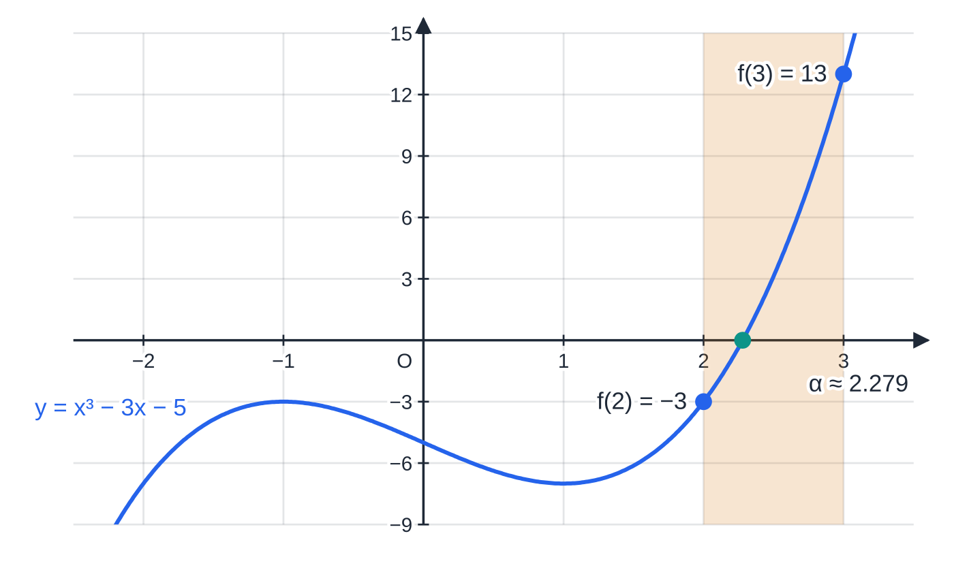
How does a change of sign show that a root exists? (continued)
Section 1 of 13
1/(x-k) and tan x have breaks. Always think about whether the interval contains a break before you use the test.
f(x) = x³ − 3x − 5 is negative at x = 2 and positive at x = 3. A polynomial is continuous, so the curve must cross the x-axis in the shaded interval, at the root α ≈ 2.279.
Notes:
How does a change of sign show that a root exists?. Full notes: https://examinerprep.com/notes/edexcel-ial-maths/numerical-methods/

Slide 7
How does a change of sign show that a root exists? (continued)
Section 1 of 13 · Worked example 1 · Easy · Show that
WORKED EXAMPLE · QUESTION
f(x) = x³ - 3x - 5. Show that the equation f(x) = 0 has a root α in the interval [2.2, 2.3].
SOLUTION
Evaluate f at both ends: f(2.2) = 10.648 - 6.6 - 5 = -0.952 and f(2.3) = 12.167 - 6.9 - 5 = 0.267.
f(2.2) < 0 and f(2.3) > 0, so there is a change of sign, and f is continuous because it is a polynomial. There is a root α with 2.2 < α< 2.3.
Notes:
How does a change of sign show that a root exists?: Worked example 1. Full notes: https://examinerprep.com/notes/edexcel-ial-maths/numerical-methods/

Slide 8
How does a change of sign show that a root exists? (continued)
Section 1 of 13
Exam tip 1 — write the values, not just their signs
Write "f(2.2) = -0.952 < 0, f(2.3) = 0.267 > 0". One or two significant figures are enough as long as the sign is right, but a bare "negative, positive" cannot be checked by the reader.
Notes:
How does a change of sign show that a root exists?. Full notes: https://examinerprep.com/notes/edexcel-ial-maths/numerical-methods/

Slide 9
When can a change of sign mislead you?
Section 2 of 13
The test has a condition (continuity) and a limitation (it counts crossings in pairs). Each gives a way to be misled.
A sign change with no root. If f has a vertical asymptote (or any break) inside the interval, f can jump from negative to positive without ever being zero. Typical culprits: fractions whose denominator is zero inside the interval, and tan x near π/2.
Roots with no sign change. If the interval contains two roots (or any even number), f goes down through the axis and back up, so f(a) and f(b) have the same sign. The same happens with a repeated root, where the curve only touches the axis.
The interval is too wide. A large interval may contain several roots, so a sign change tells you little. Sketch the curve first, or use smaller steps.
Notes:
When can a change of sign mislead you?. Full notes: https://examinerprep.com/notes/edexcel-ial-maths/numerical-methods/

Slide 10
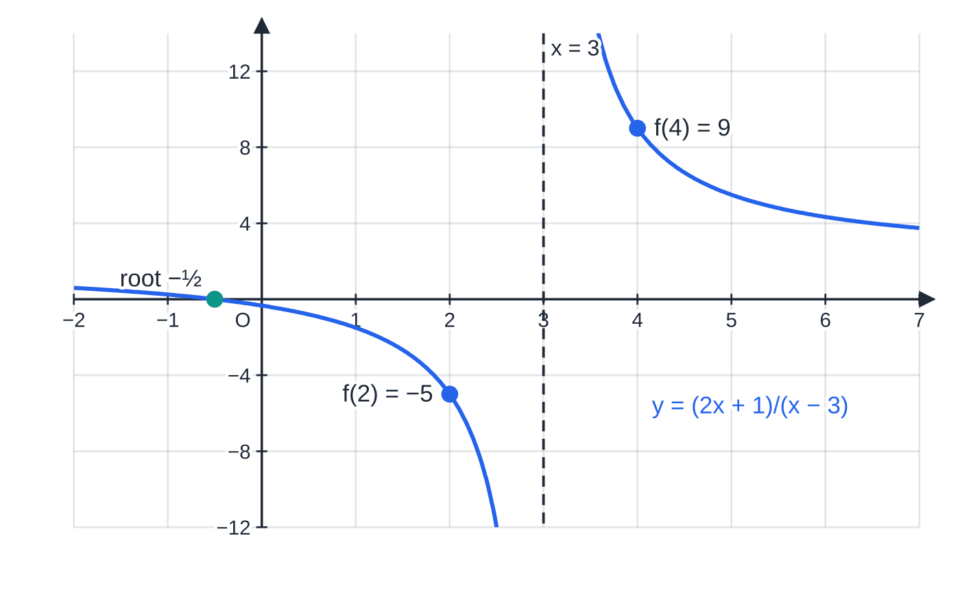
When can a change of sign mislead you? (continued)
Section 2 of 13
y = (2x + 1)/(x − 3) changes sign between 2 and 4 because of the asymptote x = 3, not because of a root. Its only root is x = −½.
Notes:
When can a change of sign mislead you?. Full notes: https://examinerprep.com/notes/edexcel-ial-maths/numerical-methods/

Slide 11
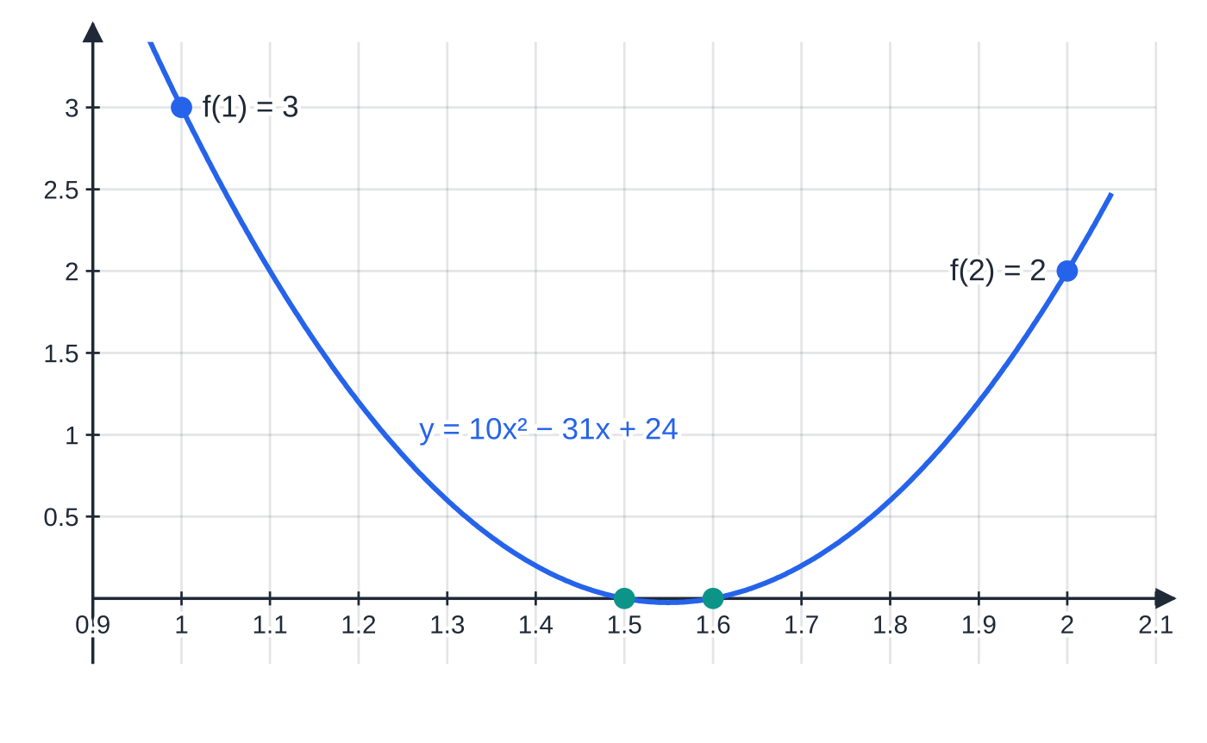
When can a change of sign mislead you? (continued)
Section 2 of 13
y = 10x² − 31x + 24 = (2x − 3)(5x − 8) is positive at both x = 1 and x = 2, yet it has two roots, 1.5 and 1.6, between them. No sign change does not mean no root.
Notes:
When can a change of sign mislead you?. Full notes: https://examinerprep.com/notes/edexcel-ial-maths/numerical-methods/

Slide 12
When can a change of sign mislead you? (continued)
Section 2 of 13 · Worked example 2 · Medium · Explain
WORKED EXAMPLE · QUESTION
f(x) = (2x+1)/(x-3), x ≠3. A student finds f(2) and f(4) and concludes that f(x) = 0 has a root between 2 and 4. (a) Find f(2) and f(4). (b) Explain why the student's conclusion is wrong. (c) Find the root of f(x) = 0.
SOLUTION
(a) f(2) = 5 ÷(-1) and f(4) = 9 ÷1. f(2) = -5, f(4) = 9
(b) Check the condition the test depends on. f is not continuous on [2, 4]: the denominator is zero at x = 3, where the graph has a vertical asymptote. The sign changes by jumping across the asymptote, not by crossing the x-axis.
(c) A fraction is zero when its numerator is zero: 2x + 1 = 0. x = -½, which is not in [2, 4].
Notes:
When can a change of sign mislead you?: Worked example 2. Full notes: https://examinerprep.com/notes/edexcel-ial-maths/numerical-methods/

Slide 13
When can a change of sign mislead you? (continued)
Section 2 of 13
Common error
Writing "there is a change of sign, so there is a root" without mentioning continuity. The continuity condition is exactly what fails in worked example 2, and it is part of the reasoning a full answer needs.
Notes:
When can a change of sign mislead you?. Full notes: https://examinerprep.com/notes/edexcel-ial-maths/numerical-methods/

Slide 14
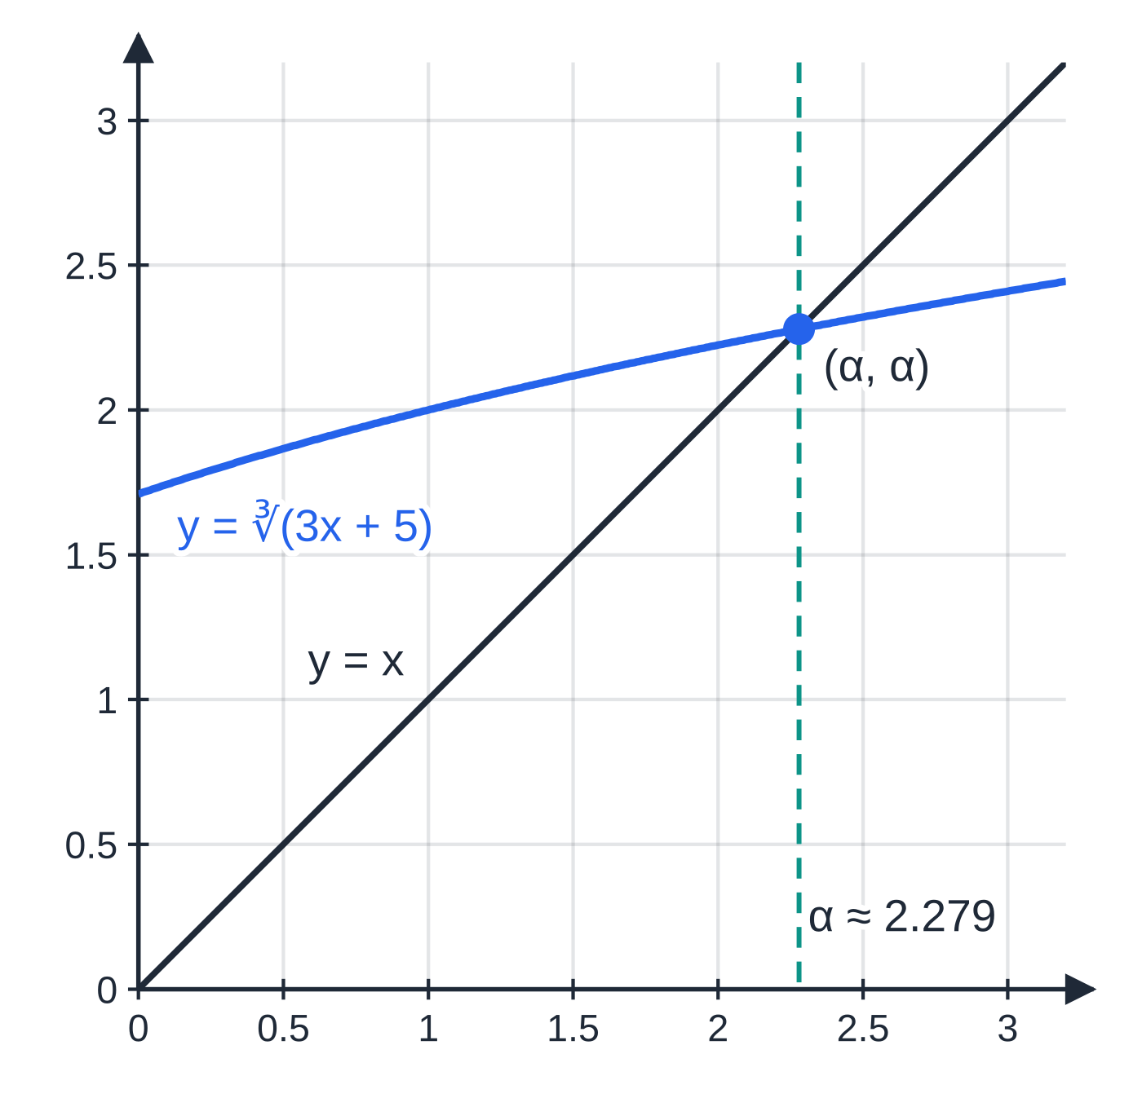
How do you rearrange f(x) = 0 into the form x = g(x)?
Section 3 of 13
Make x the subject of the equation in a way that leaves x on the right as well. Any value that satisfies x = g(x) is then a root of f(x) = 0: the two equations are equivalent. Geometrically, the root is where the line y = x meets the curve y = g(x).
One equation has many rearrangements. Common moves:
isolate a power and take a root: x³ = 3x + 5 ⇒x = ∛(3x+5)
divide through by a power of x: x² = 3 + 5/x ⇒x = √(3 + 5/x)
isolate a linear term: 3x = x³ - 5 ⇒x = (x³ - 5)/3
undo an exponential or a logarithm: e^(x/2) = 3x - 1 ⇒x = 2ln(3x - 1)
In practice the target form is almost always given ("Show that the equation can be written as …"). Your job is to get there with every step visible.
The root of x³ − 3x − 5 = 0 is the x-coordinate of the point where y = ∛(3x + 5) meets the line y = x. Rewriting the equation does not move the root; it changes the picture you use to find it.
Notes:
How do you rearrange f(x) = 0 into the form x = g(x)?. Full notes: https://examinerprep.com/notes/edexcel-ial-maths/numerical-methods/

Slide 15
How do you rearrange f(x) = 0 into the form x = g(x)? (continued)
Section 3 of 13 · Worked example 3 · Easy · Show that
WORKED EXAMPLE · QUESTION
Show that the equation x³ - 3x - 5 = 0 can be written as (a) x = ∛(3x+5); (b) x = √(3 + 5/x), x > 0.
SOLUTION
(a) Isolate x³, then take the cube root: x³ = 3x + 5 ⇒ x = ∛(3x+5)
(b) From x³ = 3x + 5, divide by x (allowed, as x ≠0): x² = 3 + 5/x. Taking the positive root as x > 0: x = √(3 + 5/x)
Both rearrangements have exactly the same positive root as the original cubic. Whether an iteration based on them actually finds it is a separate question, answered in the sections on diagrams and convergence.
Notes:
How do you rearrange f(x) = 0 into the form x = g(x)?: Worked example 3. Full notes: https://examinerprep.com/notes/edexcel-ial-maths/numerical-methods/

Slide 16
How do you carry out an iteration?
Section 4 of 13
Fixed-point iteration
xₙ₊₁ = g(xₙ)
Start from x₀, a value near the root; then x₁ = g(x₀), x₂ = g(x₁), … If the sequence converges to a limit α, then α= g(α), so α is a root of f(x) = 0. Not in the formulae list, so learn it.
Why does a limit have to be a root? If xₙ →α, then xₙ₊₁ →α too. Taking the limit of both sides of xₙ₊₁ = g(xₙ) (for continuous g) gives α= g(α), which is the rearranged equation. A good starting value comes from a sign-change interval or a sketch. The iteration is only useful if it converges.
Notes:
How do you carry out an iteration?. Full notes: https://examinerprep.com/notes/edexcel-ial-maths/numerical-methods/

Slide 17
How do you carry out an iteration? (continued)
Section 4 of 13
Using your calculator
Type the starting value and press =. Then type the formula with Ans in place of x (for example ∛(3 Ans + 5)) and press = repeatedly. Each press gives the next iterate, and the calculator keeps full accuracy.
Write down each iterate to the accuracy asked (usually 4 d.p.), but never round and re-type: rounded values fed back in can change later digits.
Angles in an iteration with sin, cos or tan are in radians. Check your calculator mode before you start.
Notes:
How do you carry out an iteration?. Full notes: https://examinerprep.com/notes/edexcel-ial-maths/numerical-methods/

Slide 18
How do you carry out an iteration? (continued)
Section 4 of 13 · Worked example 4 · Easy · Find
WORKED EXAMPLE · QUESTION
Use the iteration formula xₙ₊₁ = ∛(3xₙ + 5) with x₀ = 2 to find the values of x₁, x₂ and x₃, giving each to 4 decimal places.
SOLUTION
First iterate: x₁ = ∛(3 ×2 + 5) = ∛11 = 2.223980…
Feed back the unrounded value (Ans): x₂ = ∛(3 ×2.223980…+ 5) = 2.2684…, then x₃ = 2.2770… x₁ = 2.2240, x₂ = 2.2684, x₃ = 2.2770
The values are increasing towards the root α≈2.2790: each step closes most of the remaining gap. Writing x₁ as 2.224 (3 d.p.) instead of 2.2240 does not meet the "4 decimal places" instruction; trailing zeros count.
Notes:
How do you carry out an iteration?: Worked example 4. Full notes: https://examinerprep.com/notes/edexcel-ial-maths/numerical-methods/

Slide 19
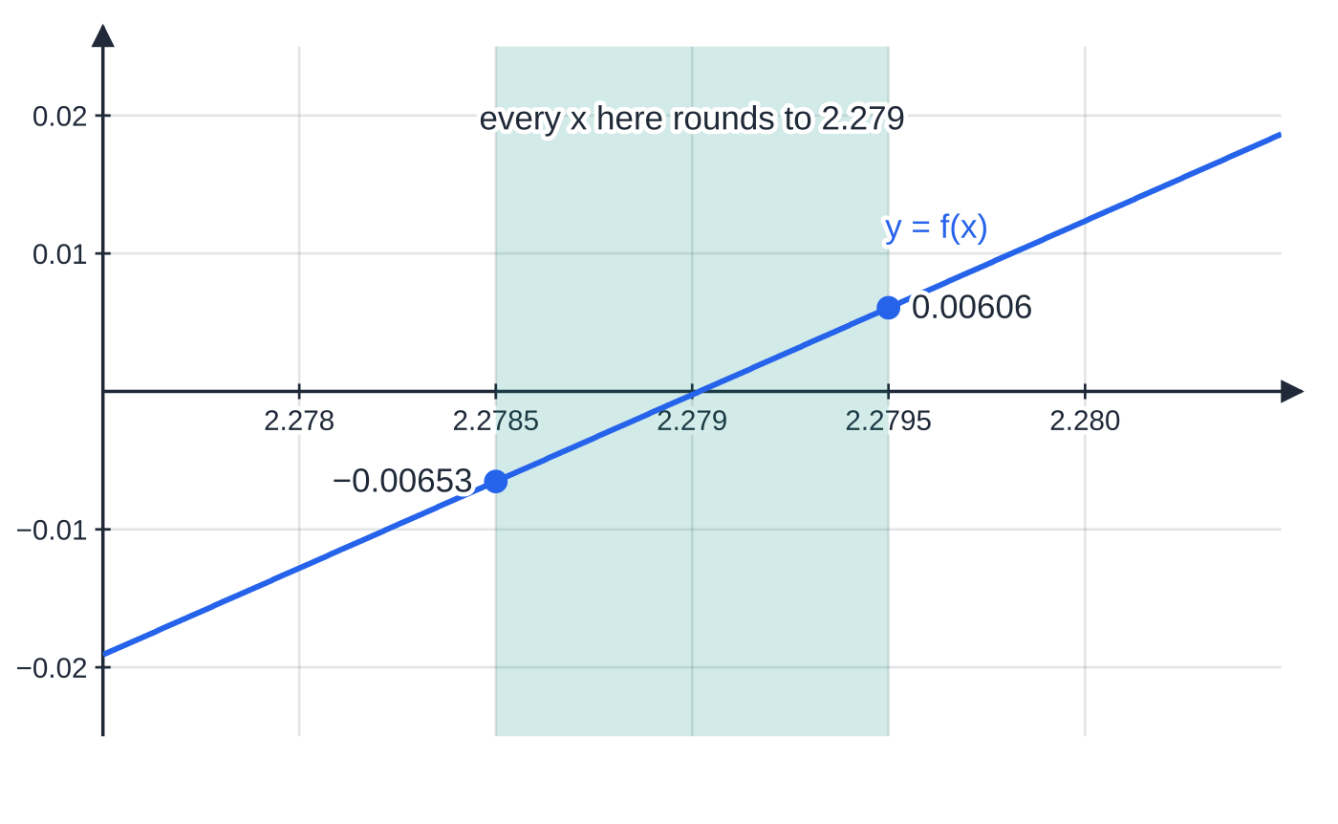
How do you show that a root is correct to a given accuracy?
Section 5 of 13
Iterates that agree to 3 d.p. strongly suggest the answer but do not prove it. The proof is a change of sign over the right interval.
"α= 2.279 correct to 3 d.p." means 2.2785 ≤α< 2.2795. So you evaluate f at the bounds 2.2785 and 2.2795, half a unit of the last decimal place either side. If f changes sign between the bounds (and f is continuous there), the root lies in [2.2785, 2.2795], and every number in that interval rounds to 2.279. For 2 d.p. the bounds are ±0.005; for 4 d.p., ±0.00005.
Zooming in on the root: f(2.2785) = −0.00653 and f(2.2795) = 0.00606. The sign change traps α inside the shaded band, and every number in the band rounds to 2.279. Testing 2.278 and 2.280 instead would trap α in an interval twice as wide.
Notes:
How do you show that a root is correct to a given accuracy?. Full notes: https://examinerprep.com/notes/edexcel-ial-maths/numerical-methods/

Slide 20
How do you show that a root is correct to a given accuracy? (continued)
Section 5 of 13 · Worked example 5 · Medium · Show that
WORKED EXAMPLE · QUESTION
Show that α= 2.279, correct to 3 decimal places, where α is the root of x³ - 3x - 5 = 0 in [2.2, 2.3].
SOLUTION
Choose the interval [2.2785, 2.2795]. Evaluate f at both bounds: f(2.2785) = -0.00653 and f(2.2795) = 0.00606.
There is a change of sign and f is continuous, so 2.2785 < α< 2.2795. Hence α= 2.279 to 3 d.p.
The values of f at the bounds are tiny, so give them to at least 1 or 2 significant figures; "−0.0065 and 0.0061" is fine, "0.00 and 0.01" is not.
Notes:
How do you show that a root is correct to a given accuracy?: Worked example 5. Full notes: https://examinerprep.com/notes/edexcel-ial-maths/numerical-methods/

Slide 21
How do you show that a root is correct to a given accuracy? (continued)
Section 5 of 13
Common error
Testing f(2.278) and f(2.280). A sign change there shows the root is between 2.278 and 2.280, which includes numbers such as 2.2782 that round to 2.278. Only the bounds 2.2785 and 2.2795 prove the 3 d.p. value.
Notes:
How do you show that a root is correct to a given accuracy?. Full notes: https://examinerprep.com/notes/edexcel-ial-maths/numerical-methods/

Slide 22
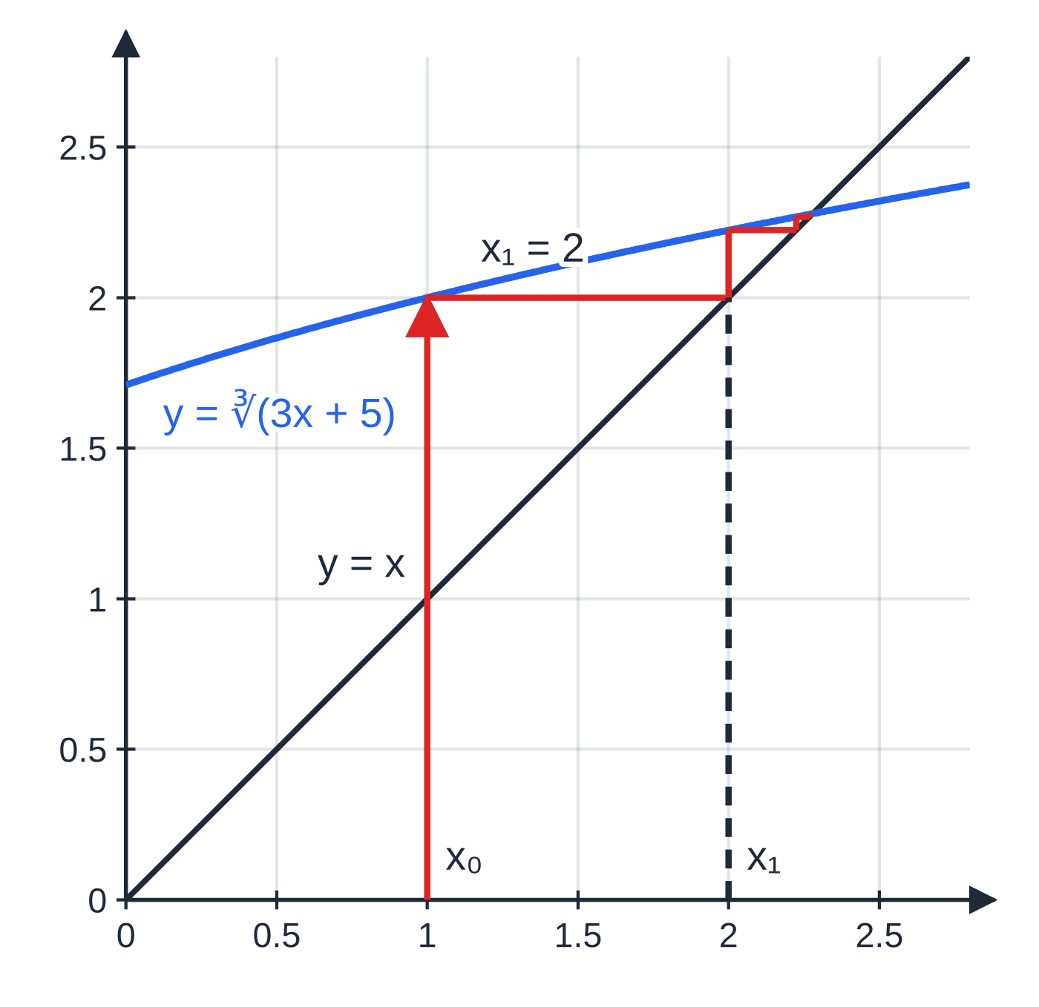
What do staircase and cobweb diagrams show?
Section 6 of 13
Draw y = g(x) and y = x on the same axes; the root is where they cross. From x₀ on the x-axis go vertically to the curve: the height there is g(x₀) = x₁. Then go horizontally to the line y = x: you are now directly above x₁ on the x-axis. Repeat: vertical to the curve, horizontal to the line.
Staircase: the path climbs (or descends) in steps on one side of the root. The iterates approach the root from one direction only. This happens when g is increasing near the root.
Cobweb: the path spirals round the crossing point. The iterates land alternately above and below the root. This happens when g is decreasing near the root.
A converging staircase for x₍ₙ₊₁₎ = ∛(3xₙ + 5) from x₀ = 1: x₁ = 2, x₂ = 2.224, x₃ = 2.268, … all below the root 2.279 and increasing towards it. The curve is increasing but shallow near the root.
Notes:
What do staircase and cobweb diagrams show?. Full notes: https://examinerprep.com/notes/edexcel-ial-maths/numerical-methods/

Slide 23
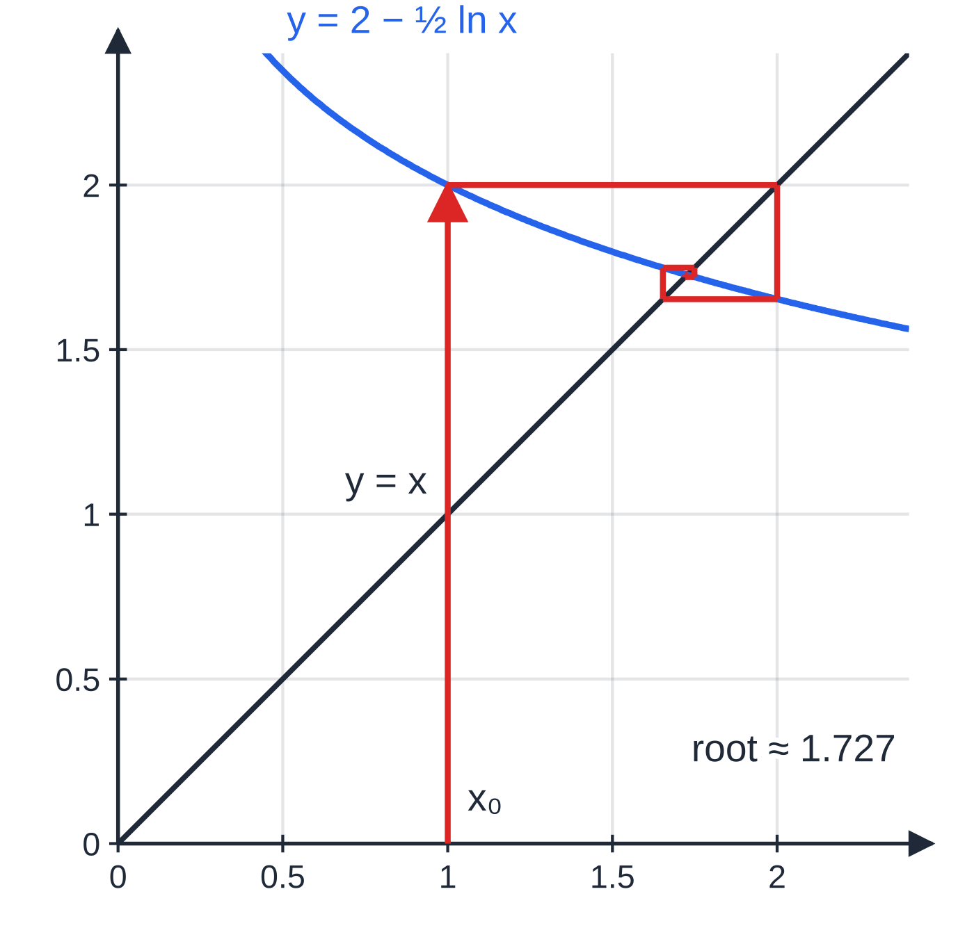
What do staircase and cobweb diagrams show? (continued)
Section 6 of 13
A converging cobweb for x₍ₙ₊₁₎ = 2 − ½ ln xₙ from x₀ = 1: x₁ = 2, x₂ = 1.653, x₃ = 1.749, … landing alternately either side of the root 1.727. The curve slopes downwards, but gently, near the root.
Notes:
What do staircase and cobweb diagrams show?. Full notes: https://examinerprep.com/notes/edexcel-ial-maths/numerical-methods/

Slide 24
What do staircase and cobweb diagrams show? (continued)
Section 6 of 13 · Worked example 6 · Medium · Show that, find, state
WORKED EXAMPLE · QUESTION
The equation ln x + 2x - 4 = 0 has a single root α. (a) Show that α lies between 1.7 and 1.8. (b) Show that the equation can be written as x = 2 - ½ln x. (c) Using xₙ₊₁ = 2 - ½ln xₙ with x₀ = 1, find x₁, x₂, x₃ and x₄ to 4 decimal places, and state whether a staircase or a cobweb diagram would show these iterates.
SOLUTION
(a) Let f(x) = ln x + 2x - 4, continuous for x > 0. f(1.7) = -0.0694 < 0 and f(1.8) = 0.188 > 0: change of sign and f continuous. 1.7 < α< 1.8
(b) Isolate the 2x term and divide by 2: 2x = 4 - ln x ⇒ x = 2 - ½ln x
(c) ln 1 = 0 makes the first step exact. x₁ = 2.0000, x₂ = 1.6534, x₃ = 1.7486, x₄ = 1.7206 The iterates are alternately above and below α (2.0000 > α, 1.6534 < α, 1.7486 > α, …), so the diagram is a cobweb.
Notes:
What do staircase and cobweb diagrams show?: Worked example 6. Full notes: https://examinerprep.com/notes/edexcel-ial-maths/numerical-methods/

Slide 25
Why do some iterations fail to converge?
Section 7 of 13
Different rearrangements of the same equation behave differently. What matters is how steep the curve y = g(x) is near the root, compared with the line y = x, which has gradient 1.
Less steep than y = x (gradient between −1 and 1): each step moves the iterate closer to the root, so the iteration converges (as long as x₀ is close enough). The flatter the curve, the faster it converges.
Steeper than y = x (gradient greater than 1, or less than −1): each step throws the iterate further away, so it diverges from that root, as a staircase going outwards or a cobweb unwinding.
With P3 differentiation you can check this: work out g′(x) near the root and see whether its size is less than 1. For ∛(3x+5) the gradient at the root is about 0.19; for (x³-5)/3 it is x² ≈5.2. A diverging iteration can also wander off to a different root, or stop working because g is undefined (a negative number inside a log or a square root). A good answer describes what actually happens to the numbers.
Notes:
Why do some iterations fail to converge?. Full notes: https://examinerprep.com/notes/edexcel-ial-maths/numerical-methods/

Slide 26
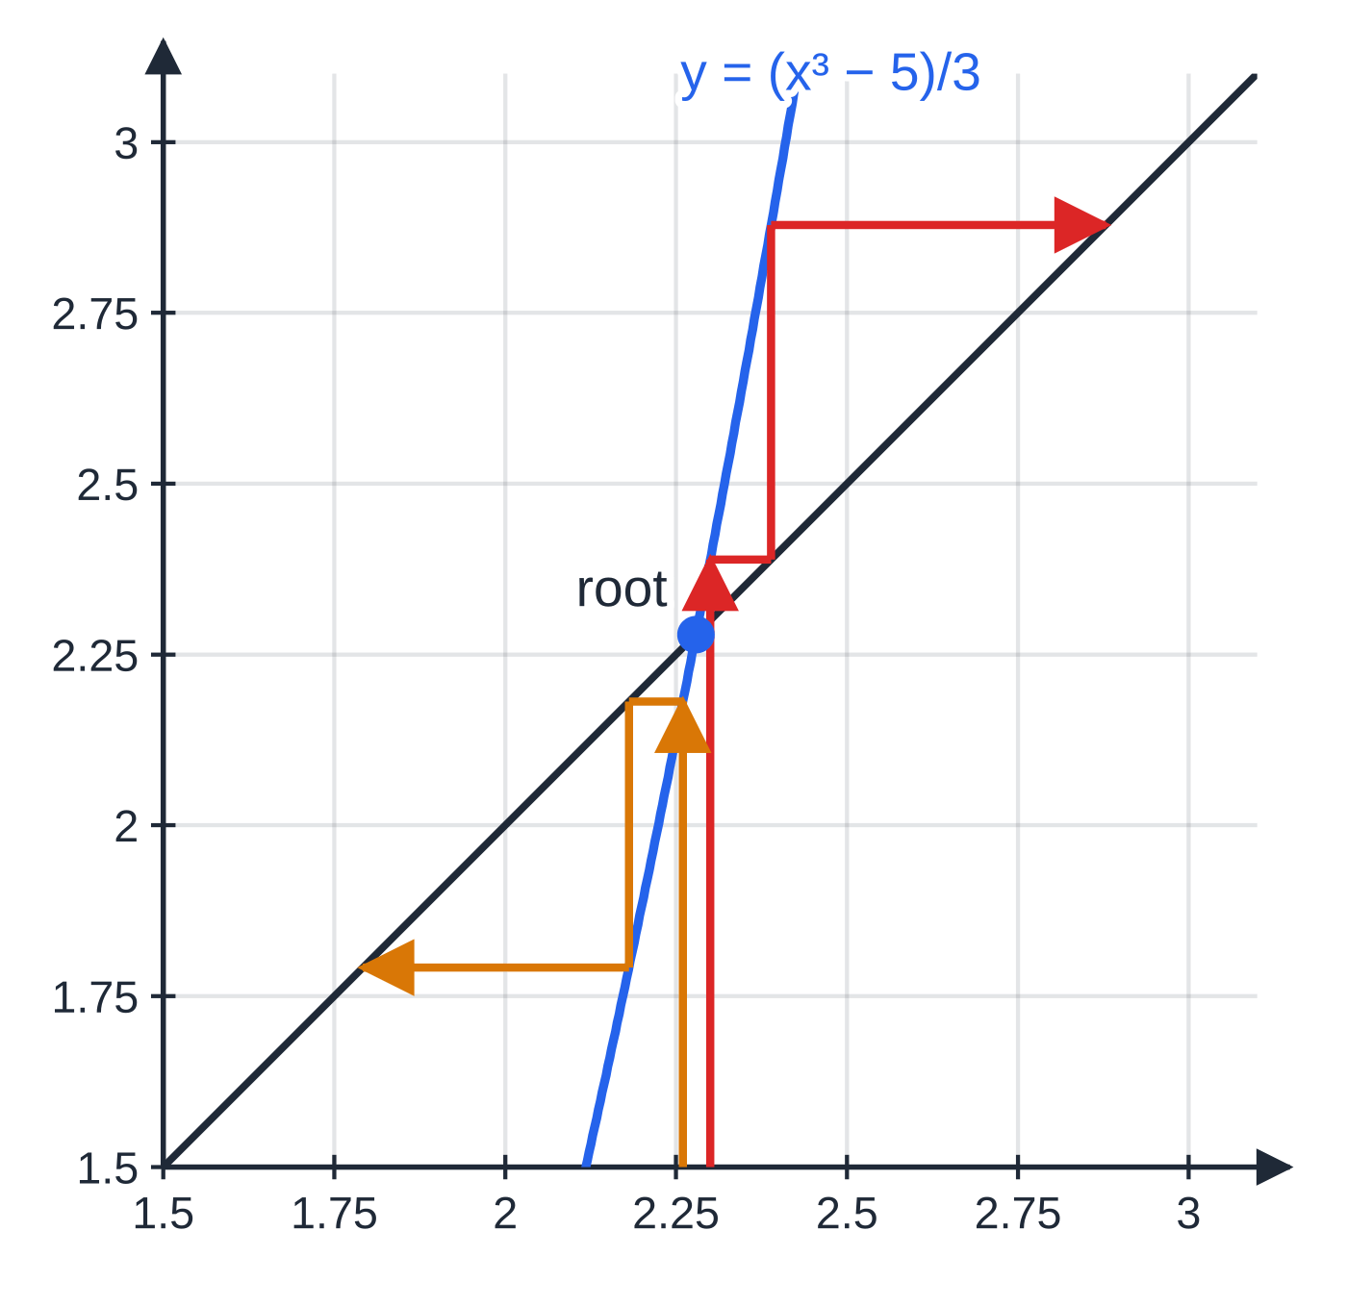
Why do some iterations fail to converge? (continued)
Section 7 of 13
x₍ₙ₊₁₎ = (xₙ³ − 5)/3 is a correct rearrangement of x³ − 3x − 5 = 0, but near the root the curve is far steeper than y = x. From x₀ = 2.3 (red): 2.3890, 2.8783, … climbs away; from x₀ = 2.26 (amber): 2.1811, 1.7918, … falls away. Even a start very close to the root fails.
Notes:
Why do some iterations fail to converge?. Full notes: https://examinerprep.com/notes/edexcel-ial-maths/numerical-methods/

Slide 27
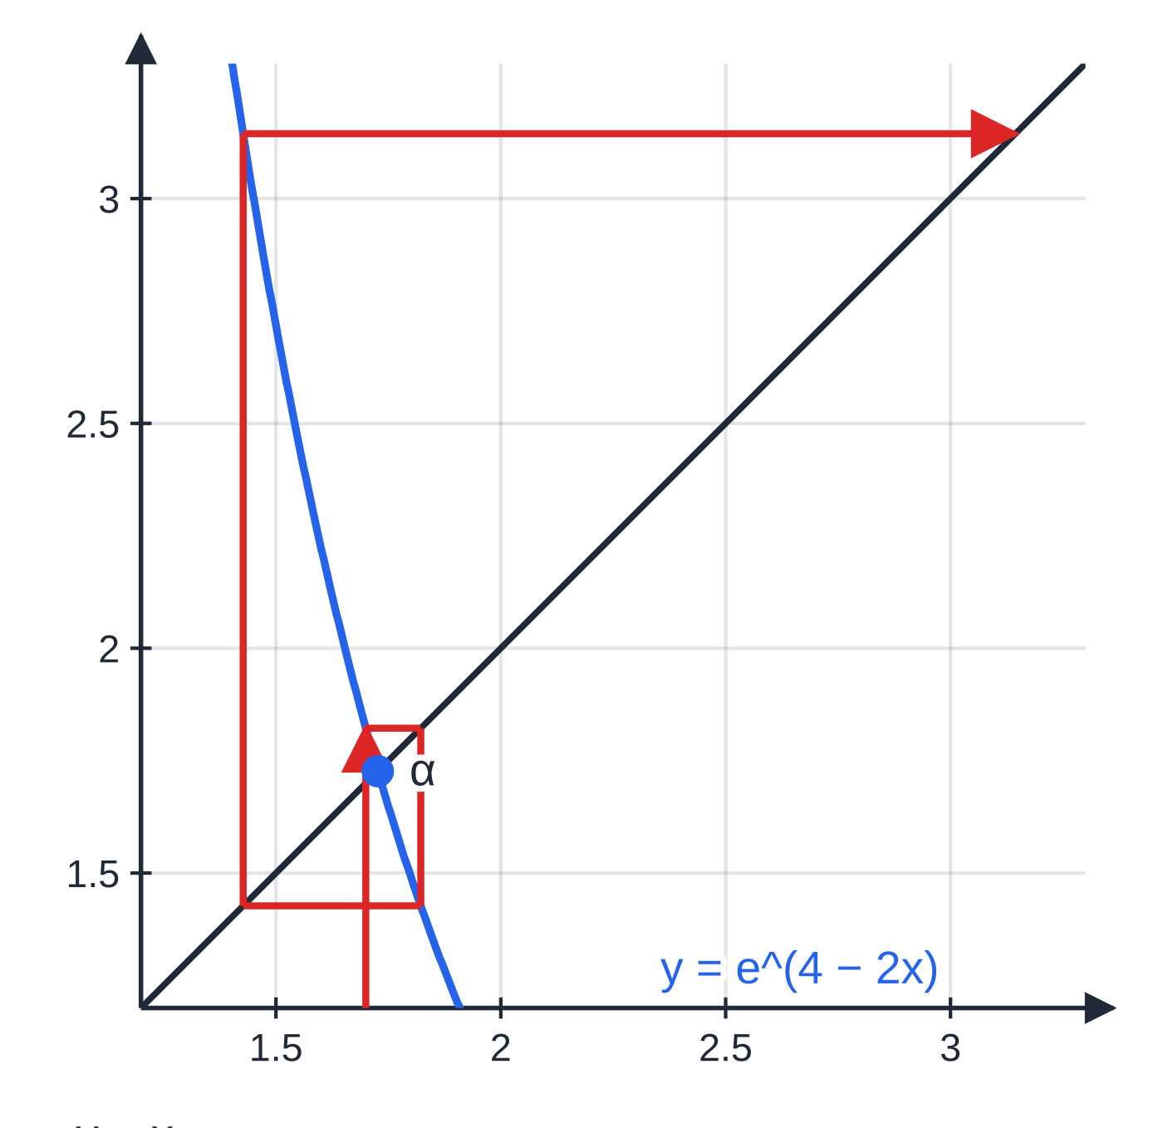
Why do some iterations fail to converge? (continued)
Section 7 of 13 · Worked example 7 · Hard · Show that, find, explain
WORKED EXAMPLE · QUESTION
The equation ln x + 2x - 4 = 0 from worked example 6, with root α≈1.727, can also be written as x = e⁴⁻²ˣ. (a) Show this. (b) Use xₙ₊₁ = e^(4-2xₙ) with x₀ = 1.7 to find x₁, x₂ and x₃ to 4 decimal places. (c) Explain why this iteration cannot be used to find α.
SOLUTION
(a) Isolate ln x, then exponentiate: ln x = 4 - 2x ⇒ x = e⁴⁻²ˣ
(b) x₁ = e^(0.6) = 1.8221, then x₂ = e^(4-2(1.8221…)) = 1.4273, then x₃ = 3.1439. x₁ = 1.8221, x₂ = 1.4273, x₃ = 3.1439
(c) The iterates jump from one side of α to the other and get further from α each time (x₀ is 0.027 from α, x₃ is more than 1.4 away).
An unwinding cobweb: x₀ = 1.7, x₁ = 1.8221, x₂ = 1.4273, x₃ = 3.1439. The curve y = e^(4 − 2x) has gradient about −3.45 at α, much steeper than y = x, so each step lands further from α on the opposite side.
Notes:
Why do some iterations fail to converge?: Worked example 7. Full notes: https://examinerprep.com/notes/edexcel-ial-maths/numerical-methods/

Slide 28
Why do some iterations fail to converge? (continued)
Section 7 of 13 · Worked example 7 · Hard · Show that, find, explain (continued)
The sequence diverges: the curve y = e⁴⁻²ˣ is much steeper than y = x near the root (its gradient there is -2α≈-3.45), giving an unwinding cobweb.
Compare x = 2 - ½ln x, whose gradient near the root is -1/2α ≈-0.29: a gentle slope, hence the converging cobweb in worked example 6.
Notes:
Why do some iterations fail to converge?: Worked example 7. Full notes: https://examinerprep.com/notes/edexcel-ial-maths/numerical-methods/

Slide 29
Why do some iterations fail to converge? (continued)
Section 7 of 13
Exam tip 2 — say what the numbers do
When asked to "comment on" or "explain" the behaviour of an iteration, say what the numbers do ("the values move further from 1.727, alternately above and below it") and give the conclusion ("the iteration diverges, so it cannot be used to find α"). A word such as "wrong" or "bad" is not an explanation.
Notes:
Why do some iterations fail to converge?. Full notes: https://examinerprep.com/notes/edexcel-ial-maths/numerical-methods/

Slide 30
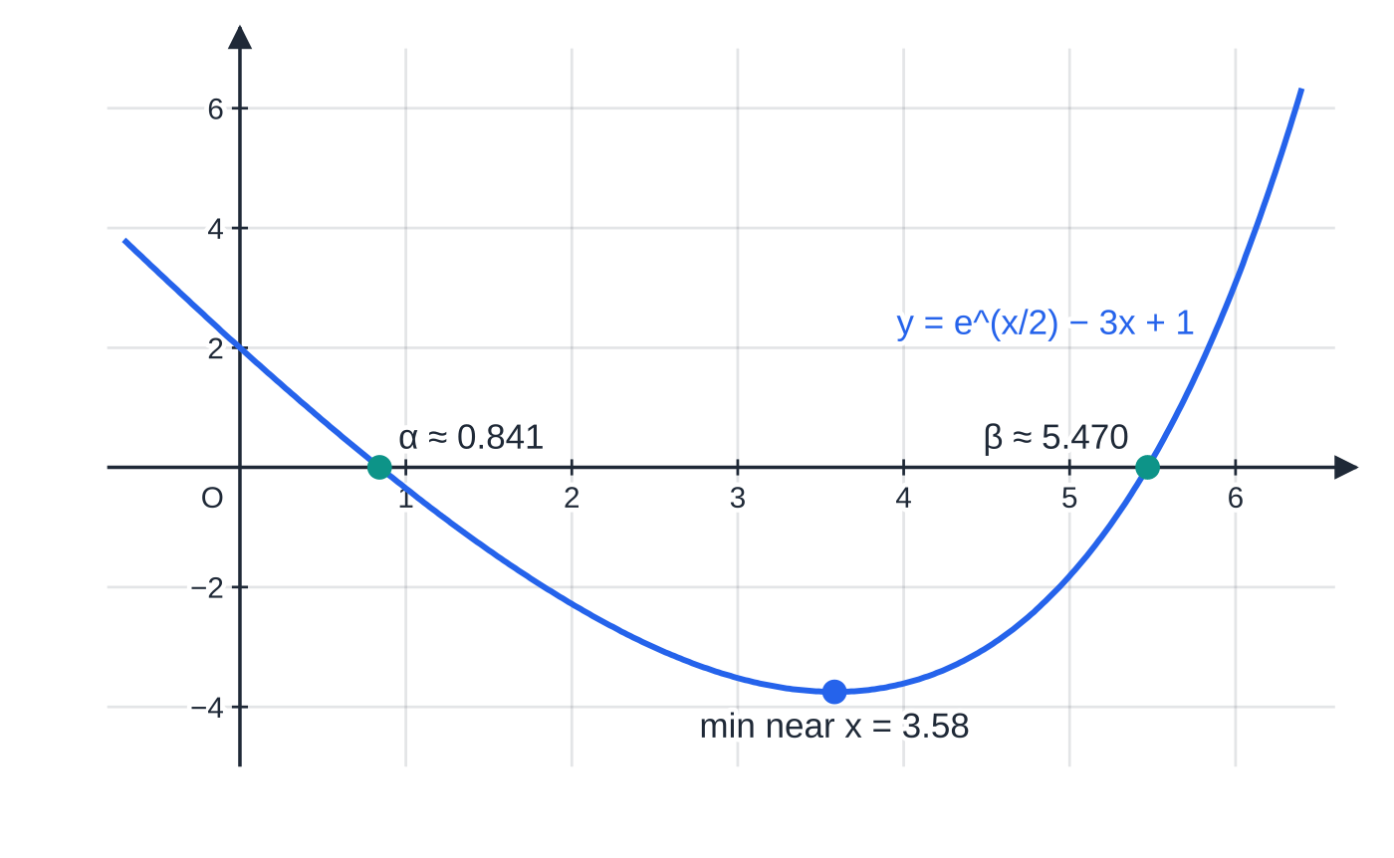
How does a full numerical methods question fit together?
Section 8 of 13
The last example strings every skill on this page together, at the length of a full question. Notice how each part feeds the next: the sign change gives an interval, the interval gives a starting value, the iteration gives an approximate value, and a second sign change proves it.
y = e^(x/2) − 3x + 1 crosses the x-axis twice: α ≈ 0.841 in [0, 1] and β ≈ 5.470 in [5, 6]. Between the roots the curve is below the axis. An iteration that converges to one root may run away from the other.
Notes:
How does a full numerical methods question fit together?. Full notes: https://examinerprep.com/notes/edexcel-ial-maths/numerical-methods/

Slide 31
How does a full numerical methods question fit together? (continued)
Section 8 of 13 · Worked example 8 · Hard · Full question
WORKED EXAMPLE · QUESTION
f(x) = e^(x/2) - 3x + 1. The equation f(x) = 0 has two roots, α and β, where α< β.
(a) Show that β lies in the interval [5, 6].
(b) Show that f(x) = 0 can be written as x = 2ln(3x - 1), x > ⅓.
(c) Use the iteration formula xₙ₊₁ = 2ln(3xₙ - 1) with x₀ = 5 to find x₁, x₂ and x₃, giving your answers to 4 decimal places.
(d) Show that β= 5.470 correct to 3 decimal places.
(e) A student tries instead xₙ₊₁ = ⅓(e^(xₙ/2) + 1) with x₀ = 5.5. Find x₁ and x₂ to 4 decimal places and explain why this iteration will not find β.
Notes:
How does a full numerical methods question fit together?: Worked example 8. Full notes: https://examinerprep.com/notes/edexcel-ial-maths/numerical-methods/

Slide 32
How does a full numerical methods question fit together? (continued)
Section 8 of 13 · Worked example 8 · Hard · Full question (continued)
SOLUTION
(a) f(5) = e^(2.5) - 14 = -1.82 < 0 and f(6) = e³ - 17 = 3.09 > 0. Change of sign and f is continuous, so 5 < β< 6.
(b) Isolate the exponential, then take logarithms: e^(x/2) = 3x - 1 ⇒x/2 = ln(3x - 1) ⇒ x = 2ln(3x - 1) (needs 3x - 1 > 0, i.e. x > ⅓).
(c) Iterate with Ans: x₁ = 2ln 14 = 5.2781, then x₂ = 5.3939, x₃ = 5.4402. x₁ = 5.2781, x₂ = 5.3939, x₃ = 5.4402
(d) Bounds 5.4695 and 5.4705: f(5.4695) = -0.00261 < 0 and f(5.4705) = 0.00210 > 0. Change of sign, f continuous, so 5.4695 < β< 5.4705. β= 5.470 to 3 d.p.
(e) x₁ = 5.5475, x₂ = 5.6730 x₀ = 5.5 is already above β≈5.470, and the iterates are increasing, moving away from β: the sequence diverges from β (a staircase going outwards), because near β the curve y = ⅓(e^(x/2) + 1) is much steeper than y = x (gradient about 2.57).
Notes:
How does a full numerical methods question fit together?: Worked example 8. Full notes: https://examinerprep.com/notes/edexcel-ial-maths/numerical-methods/

Slide 33
How does a full numerical methods question fit together? (continued)
Section 8 of 13 · Worked example 8 · Hard · Full question (continued)
The iterates in (c) increased steadily towards β: a converging staircase, since 2ln(3x - 1) is increasing but shallow near β (gradient about 0.39). The formula in (e) is not useless: from a small start such as x₀ = 0 it converges to the other root, α≈0.8409, where its curve is shallow.
Notes:
How does a full numerical methods question fit together?: Worked example 8. Full notes: https://examinerprep.com/notes/edexcel-ial-maths/numerical-methods/

Slide 34
Exam tips for P3.8
Section 9 of 13
Exam tip 3 — the three-part sign-change sentence
Values (with signs), "change of sign and f is continuous", and a conclusion naming the interval. Learn it as one sentence and write it the same way every time; it covers both "show that there is a root" and "show that the root is correct to 3 d.p.".
Exam tip 4 — show-that rearrangements need every line
The answer is printed in the question, so what counts is the steps in between. Write each operation on its own line (isolate, divide, take a root, take logs) and finish with the given form exactly.
Exam tip 5 — describe the behaviour, then explain it
For "comment on" an iteration, say whether the values converge or diverge, whether they approach from one side (staircase) or alternate (cobweb), and, if it fails, link it to the steepness of y = g(x) near the root.
Notes:
Exam tips for P3.8. Full notes: https://examinerprep.com/notes/edexcel-ial-maths/numerical-methods/

Slide 35
Common misconceptions
Section 10 of 13
Misconception | Why it is wrong | Correct idea
A change of sign always means there is a root. | Only for a continuous function; across an asymptote the sign can change with no root. | Check f is continuous on the interval and say so.
No change of sign means no root. | Two roots (or a repeated root) in the interval leave f with the same sign at both ends. | Use a sketch or smaller intervals when roots may be close together.
To show 2.279 to 3 d.p., test 2.278 and 2.280. | That interval contains values that round to 2.278 or 2.280. | Test the bounds 2.2785 and 2.2795.
Every correct rearrangement x = g(x) will find the root. | The rearrangement is equivalent, but the iteration converges only if g is shallow enough near the root. | Near the root, gradient of g between −1 and 1: converges; steeper than y = x: diverges.
Iterates that agree to 3 d.p. prove the root to 3 d.p. | Agreement is evidence, not proof; the sequence could still drift. | Prove it with a change of sign over the bounds.
Notes:
Common misconceptions. Full notes: https://examinerprep.com/notes/edexcel-ial-maths/numerical-methods/

Slide 36
Common misconceptions (continued)
Section 10 of 13
Misconception | Why it is wrong | Correct idea
Rounding each iterate before feeding it back makes no difference. | Rounding errors carry forward and can change the 4th decimal place. | Keep full accuracy with Ans; round only what you write down.
Notes:
Common misconceptions. Full notes: https://examinerprep.com/notes/edexcel-ial-maths/numerical-methods/

Slide 37
How this topic connects
Section 11 of 13
P1 Curve sketching and intersections
The number of roots of an equation such as e^(x/2) = 3x - 1 is the number of times two graphs cross; a quick sketch tells you how many roots to look for and roughly where.
P3 Exponentials, logarithms, trigonometry and differentiation
Most equations on this page mix eˣ, ln x or trigonometric functions with powers of x, which is exactly why they cannot be solved algebraically; the rearrangements use the laws of logarithms and inverse functions. Setting dy/dx = 0 for curves such as y = x² - 4sin x often produces an equation that needs iteration, and g′(x) near the root tells you whether an iteration will converge.
P2 The trapezium rule, and IAL Physics
The trapezium rule is the other numerical method in the course: it estimates an area that cannot be found exactly. In physics, equations from models that cannot be rearranged for the unknown are solved numerically in the same spirit.
Notes:
How this topic connects. Full notes: https://examinerprep.com/notes/edexcel-ial-maths/numerical-methods/

Slide 38
Key formulae
Section 12 of 13
Formula | Use | In the formulae list?
f continuous on [a, b] and f(a)f(b) < 0 ⇒ root in (a, b) | locating a root by a change of sign | No — learn it
xₙ₊₁ = g(xₙ) | fixed-point iteration from a rearrangement x = g(x) | No — learn it
α= c to n d.p.: test c ±0.5 ×10⁻ⁿ | bounds for proving the accuracy of a root | No — learn it
gradient of g near α between −1 and 1 ⇒ converges | judging whether an iteration will work (qualitative) | No — learn it
g increasing near α: staircase; g decreasing: cobweb | predicting the shape of the diagram | No — learn it
e^(ln x) = x, ln(eˣ) = x | rearranging equations with exponentials and logarithms | No — learn it
Notes:
Key formulae. Full notes: https://examinerprep.com/notes/edexcel-ial-maths/numerical-methods/

Slide 39
Check your understanding
Section 13 of 13
1. Show that √5 lies between 2.2 and 2.3 using a change of sign.
2. tan 1.5 ≈14.1 and tan 1.7 ≈-7.7. Does tan x = 0 have a root between 1.5 and 1.7?
3. An iteration gives 2.31, 2.27, 2.29, 2.28, 2.285, … Staircase or cobweb?
4. Which two values of x would you test to show that a root is 0.74 correct to 2 decimal places?
5. Why can x = (x³-5)/3 not be used to find the root 2.279 of x³ - 3x - 5 = 0?
6. Using xₙ₊₁ = ∛(3xₙ + 5) with x₀ = 1, find x₁ and x₂ and say what kind of diagram they give.
Notes:
Check your understanding: questions. Full notes: https://examinerprep.com/notes/edexcel-ial-maths/numerical-methods/

Slide 40
Check your understanding · answers
Section 13 of 13
1. Let f(x) = x² - 5. f(2.2) = -0.16 < 0 and f(2.3) = 0.29 > 0. f is continuous and changes sign, so the positive root of x² = 5, which is √5, lies between 2.2 and 2.3.
2. No. tan x has a vertical asymptote at x = π/2 ≈1.571, inside the interval, so it is not continuous there. The sign change comes from the asymptote; the roots of tan x = 0 are 0, π, 2π, …
3. Cobweb: the values land alternately above and below the limit (about 2.28), so they converge from alternate sides.
4. 0.735 and 0.745: half a unit of the second decimal place either side of 0.74.
5. Near the root the curve y = (x³-5)/3 has gradient x² ≈5.2, much steeper than y = x, so each iteration moves further from the root: the sequence diverges whatever starting value near the root you choose (except the root itself).
6. x₁ = ∛8 = 2 exactly, and x₂ = ∛11 = 2.2240 (4 d.p.). Both are below the root 2.279 and increasing, as g is increasing near the root, so the diagram is a converging staircase.
Notes:
Check your understanding: answers. Full notes: https://examinerprep.com/notes/edexcel-ial-maths/numerical-methods/

Slide 41
Practice questions
2 original exam-style questions. Answers at the end of the deck.

Slide 42
Question 1
5 marks
f(x) = x⁴ − 3x − 5. The equation f(x) = 0 has a positive root α.
(a) Show that α lies in the interval [1.7, 1.8]. [2]
(b) Show that α = 1.795 correct to 3 decimal places. [3]
Notes:
Online with the full mark scheme: https://examinerprep.com/ial-maths-p3-8-numerical-methods-questions#IALM-P3-8-B-01

Slide 43
Question 2
7 marks
The equation x³ − 4x − 3 = 0 has exactly one positive root, α.
(a) Show that the equation can be written in the form x = √(4 + 3/x), x > 0. [2]
(b) Using the iteration formula xₙ₊₁ = √(4 + 3/xₙ) with x₀ = 2, find the values of x₁, x₂ and x₃, giving each to 4 decimal places. [3]
(c) Show that x = −1 is a root of the equation, and hence find the exact value of α. [2]
Notes:
Online with the full mark scheme: https://examinerprep.com/ial-maths-p3-8-numerical-methods-questions#IALM-P3-8-B-02

Slide 44
Answers

Slide 45
Question 1 · answer
Mark scheme
f(1.7) = −1.75 and f(1.8) = 0.0976 (awrt 0.1), both attempted
change of sign and f continuous (polynomial), so 1.7 < α < 1.8
chooses the interval [1.7945, 1.7955]
f(1.7945) = −0.0136 and f(1.7955) = 0.00652 (1 s.f. or better, correct signs)
change of sign and f continuous, so 1.7945 < α < 1.7955 and α = 1.795 to 3 d.p.
Notes:
Full mark scheme: https://examinerprep.com/ial-maths-p3-8-numerical-methods-questions#IALM-P3-8-B-01

Slide 46
Question 2 · answer
Mark scheme
x³ = 4x + 3 and divides by x: x² = 4 + 3/x
takes the positive square root as x > 0: x = √(4 + 3/x)
attempts x₁ = √(4 + 3/2) = √5.5
x₁ = 2.3452
x₂ = 2.2977, x₃ = 2.3034
(−1)³ − 4(−1) − 3 = −1 + 4 − 3 = 0, so x + 1 is a factor and x³ − 4x − 3 = (x + 1)(x² − x − 3)
α = (1 + √13)/2 (≈ 2.3028, which the iterates approach)
Notes:
Full mark scheme: https://examinerprep.com/ial-maths-p3-8-numerical-methods-questions#IALM-P3-8-B-02

Slide 47
Keep practising
Notes for this topic
Questions on this topic
Build a printable test
ExaminerPrep is an independent tutoring service. It has been developed independently from and is not endorsed by the International Baccalaureate Organization. "International Baccalaureate", "IB" and "IB Diploma Programme" are registered trademarks of the IBO, used here for descriptive purposes only.
Pearson Edexcel and Cambridge are trademarks of their owners; ExaminerPrep is not affiliated with any exam board.

