Slide 1
EP
EDEXCEL IAL MATHS
P4.2 Parametric equations
The full notes page in 13 sections · practice questions with answers · simulations
ExaminerPrep is an independent tutoring service. It has been developed independently from and is not endorsed by the International Baccalaureate Organization. "International Baccalaureate", "IB" and "IB Diploma Programme" are registered trademarks of the IBO, used here for descriptive purposes only.
Pearson Edexcel and Cambridge are trademarks of their owners; ExaminerPrep is not affiliated with any exam board.
Notes:
P4.2 Parametric equations. Notes for this topic: https://examinerprep.com/notes/edexcel-ial-maths/parametric-equations/

Slide 2
What this page covers
Overview
What a parameter is; plotting a curve from a table of t-values and reading its direction
Eliminating the parameter algebraically to get a Cartesian equation
Eliminating the parameter with trigonometric identities: sin² + cos² = 1, double-angle formulae, sec² = 1 + tan², csc² = 1 + cot²
The domain and range of the Cartesian equation when the parameter is restricted
dy/dx = dy/dt ÷dx/dt; horizontal and vertical tangents
Equations of tangents and normals to a parametric curve
The area under a parametric curve, ∫ydx/dt dt, with the limits changed to values of t
Notes:
What this page covers. Full notes: https://examinerprep.com/notes/edexcel-ial-maths/parametric-equations/

Slide 3
In one minute
Key points
1. A parametric curve gives both coordinates in terms of a third variable, the parameter (usually t or θ), as x = f(t), y = g(t), so each value of t gives one point and the curve has a direction.
2. To get a Cartesian equation, eliminate t: make t the subject of one equation and substitute, or (with trigonometric functions) use an identity that links the two expressions.
3. Domain and range: the Cartesian equation may describe more points than the curve. The x-values and y-values the curve actually reaches come from the allowed values of t.
4. Gradient: dy/dx = dy/dt ÷dx/dt. Tangent horizontal where dy/dt = 0; vertical where dx/dt = 0.
5. Area: ∫y dx = ∫ydx/dt dt, with the x-limits replaced by the matching t-limits.
6. None of these results is in the formulae list. Learn them.
Notes:
In one minute. Full notes: https://examinerprep.com/notes/edexcel-ial-maths/parametric-equations/

Slide 4
What are parametric equations?
Section 1 of 13
Instead of linking y directly to x, both coordinates are given as functions of a third variable, the parameter: x = f(t), y = g(t). Each value of t gives exactly one point (f(t), g(t)). As t increases the point moves along the curve, so a parametric curve has a direction.
A parametric curve can do things that y = f(x) cannot: turn back on itself, have vertical tangents, or cross itself. To sketch a curve, make a table of t, x and y, plot the points in order of t and join them smoothly.
t | −2 | −1 | 0 | 1 | 2
x = t² | 4 | 1 | 0 | 1 | 4
y = t³ - 3t | −2 | 2 | 0 | −2 | 2
Notes:
What are parametric equations?. Full notes: https://examinerprep.com/notes/edexcel-ial-maths/parametric-equations/

Slide 5
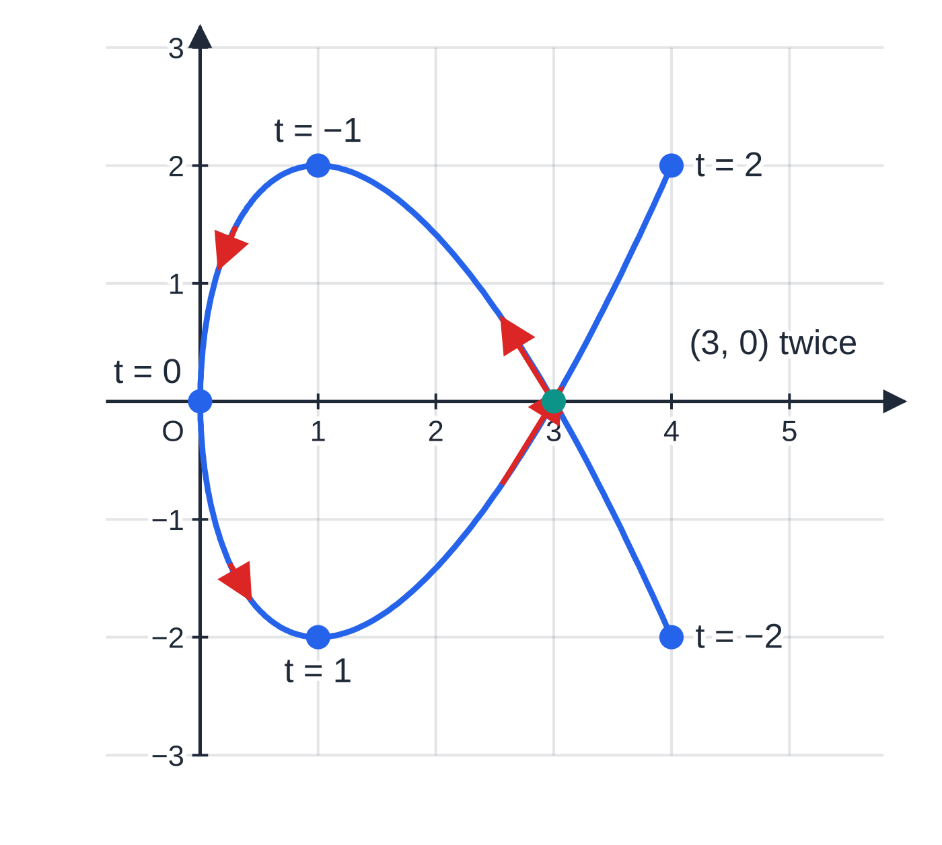
What are parametric equations? (continued)
Section 1 of 13
The most familiar parametric curve is the path of a projectile. Launched with horizontal speed 12 m s⁻¹ and vertical speed 9 m s⁻¹, its position after t seconds is x = 12t, y = 9t - 4.9t². Time is the parameter: it tells you when the projectile is at each point, which a Cartesian equation cannot. Eliminating t = x/12 gives the path y = ¾ x - (49/1440)x².
The curve x = t², y = t³ − 3t, −2 ≤ t ≤ 2, plotted from the table. Red arrows show the direction of increasing t. The curve passes through (3, 0) twice, at t = −√3 and t = √3. Its tangents are analysed in worked example 4.
Notes:
What are parametric equations?. Full notes: https://examinerprep.com/notes/edexcel-ial-maths/parametric-equations/

Slide 6
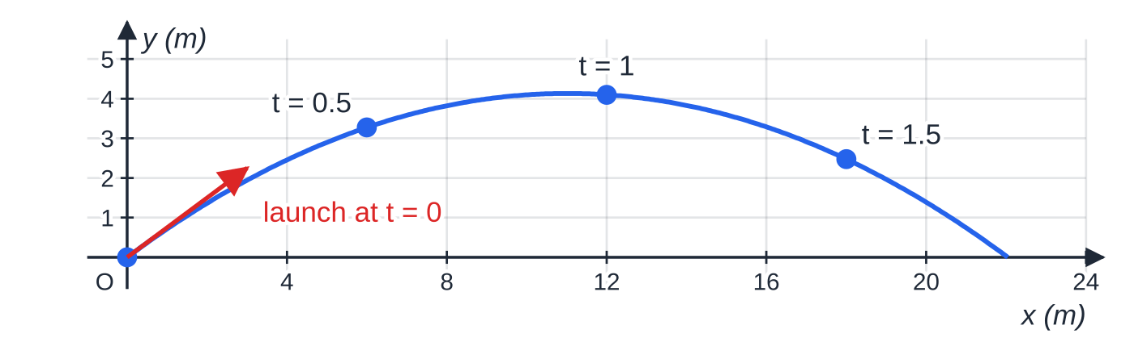
What are parametric equations? (continued)
Section 1 of 13
Common error
Joining the points in order of x instead of in order of t. In the table above t = -1 and t = 1 both give x = 1, but they are different points, (1, 2) and (1, -2), on different parts of the curve.
A projectile path as a parametric curve, x = 12t, y = 9t − 4.9t². Equal time steps of 0.5 s give equal horizontal steps of 6 m, but the vertical steps shrink and then reverse.
Notes:
What are parametric equations?. Full notes: https://examinerprep.com/notes/edexcel-ial-maths/parametric-equations/

Slide 7
How do you turn parametric equations into a Cartesian equation?
Section 2 of 13
A Cartesian equation links x and y only. To find it, you eliminate the parameter. When one equation is easy to rearrange (often a linear one such as x = 2t - 1), make t the subject and substitute into the other equation, then simplify into the form asked for. A fraction inside a fraction is cleared by multiplying top and bottom by the same thing.
Sometimes it is quicker to combine the equations directly. For example, if x = t² and y = t³ - 3t = t(t² - 3), then squaring gives y² = t²(t² - 3)² = x(x - 3)².
Notes:
How do you turn parametric equations into a Cartesian equation?. Full notes: https://examinerprep.com/notes/edexcel-ial-maths/parametric-equations/

Slide 8
How do you turn parametric equations into a Cartesian equation? (continued)
Section 2 of 13 · Worked example 1 · Easy · Show that, find
WORKED EXAMPLE · QUESTION
A curve C has parametric equations x = 2t - 1, y = t/(t+2), t ≠-2. (a) Show that a Cartesian equation of C is y = (x+1)/(x+5). (b) Find the coordinates of the point where C crosses the y-axis.
SOLUTION
(a) Make t the subject of the simpler equation: x = 2t - 1 ⇒t = (x+1)/2. Substitute, then multiply top and bottom by 2: y = ((x+1)/2)/((x+1)/2 + 2) = (x+1)/(x+1+4). y = (x+1)/(x+5) as required.
(b) On the y-axis x = 0, so t = ½ and y = (1/2)/(1/2 + 2) = ⅕. (0, ⅕) Check with the Cartesian equation: (0+1)/(0+5) = ⅕.
Notes:
How do you turn parametric equations into a Cartesian equation?: Worked example 1. Full notes: https://examinerprep.com/notes/edexcel-ial-maths/parametric-equations/

Slide 9
How do you eliminate a parameter inside trigonometric functions?
Section 3 of 13
You cannot sensibly make t the subject of x = 3sin t (you would get inverse functions). Instead, find an identity that connects the two trigonometric expressions. First isolate the trigonometric function in each equation, for example x = 2 + 3cos θ⇒cos θ= (x-2)/3; then substitute into the identity. Pick the identity by looking at what appears:
The equations contain… | Use the identity | Typical result
sin t and cos t | sin² t + cos² t = 1 | a circle or an ellipse
sin t (or cos t) and cos 2t | cos 2t = 1 - 2sin² t = 2cos² t - 1 | a parabola
sin t or cos t and sin 2t | sin 2t = 2sin tcos t, then sin² + cos² = 1 | often y² = …
tan t and sec t | sec² t = 1 + tan² t | a hyperbola-like curve
cot t and csc t | csc² t = 1 + cot² t | a hyperbola-like curve
Notes:
How do you eliminate a parameter inside trigonometric functions?. Full notes: https://examinerprep.com/notes/edexcel-ial-maths/parametric-equations/

Slide 10
How do you eliminate a parameter inside trigonometric functions? (continued)
Section 3 of 13 · Worked example 2 · Medium · Find, show that
WORKED EXAMPLE · QUESTION
(a) Find a Cartesian equation of the curve x = 2 + 3cos θ, y = 3sin θ- 1, 0 ≤θ< 2π, and describe the curve. (b) A curve has parametric equations x = 3sin t, y = 4cos 2t, -π/2 ≤t ≤π/2. Show that its Cartesian equation is y = 4 - (8/9) x².
SOLUTION
(a) Isolate: cos θ= (x-2)/3, sin θ= (y+1)/3. Use sin²θ+ cos²θ= 1 and multiply by 9. (x-2)² + (y+1)² = 9: a circle with centre (2, -1) and radius 3
(b) cos 2t is linked to sin t by a double-angle formula: y = 4(1 - 2sin² t) = 4 - 8sin² t. Substitute sin t = x/3: y = 4 - 8 ×x²/9. y = 4 - (8/9) x² as required. Choose cos 2t = 1 - 2sin² t because x involves sin t; the version with cos² t would need a second step.
Notes:
How do you eliminate a parameter inside trigonometric functions?: Worked example 2. Full notes: https://examinerprep.com/notes/edexcel-ial-maths/parametric-equations/

Slide 11
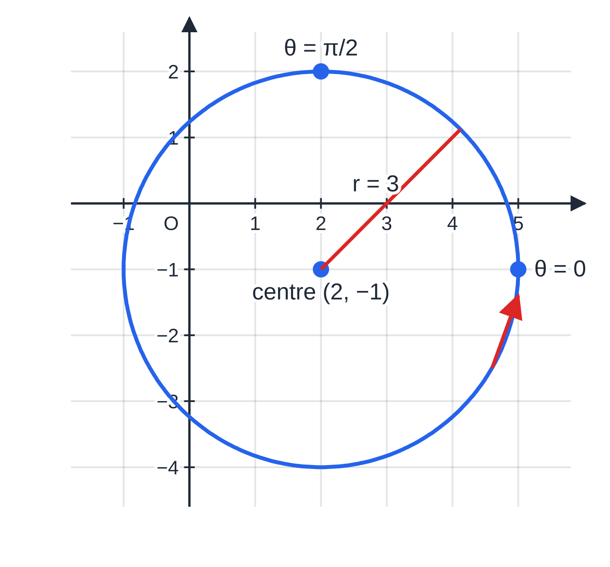
How do you eliminate a parameter inside trigonometric functions? (continued)
Section 3 of 13
Worked example 2(a): x = 2 + 3cos θ, y = 3sin θ − 1 is the circle with centre (2, −1) and radius 3, traced anticlockwise from (5, −1) as θ increases.
Notes:
How do you eliminate a parameter inside trigonometric functions?. Full notes: https://examinerprep.com/notes/edexcel-ial-maths/parametric-equations/

Slide 12
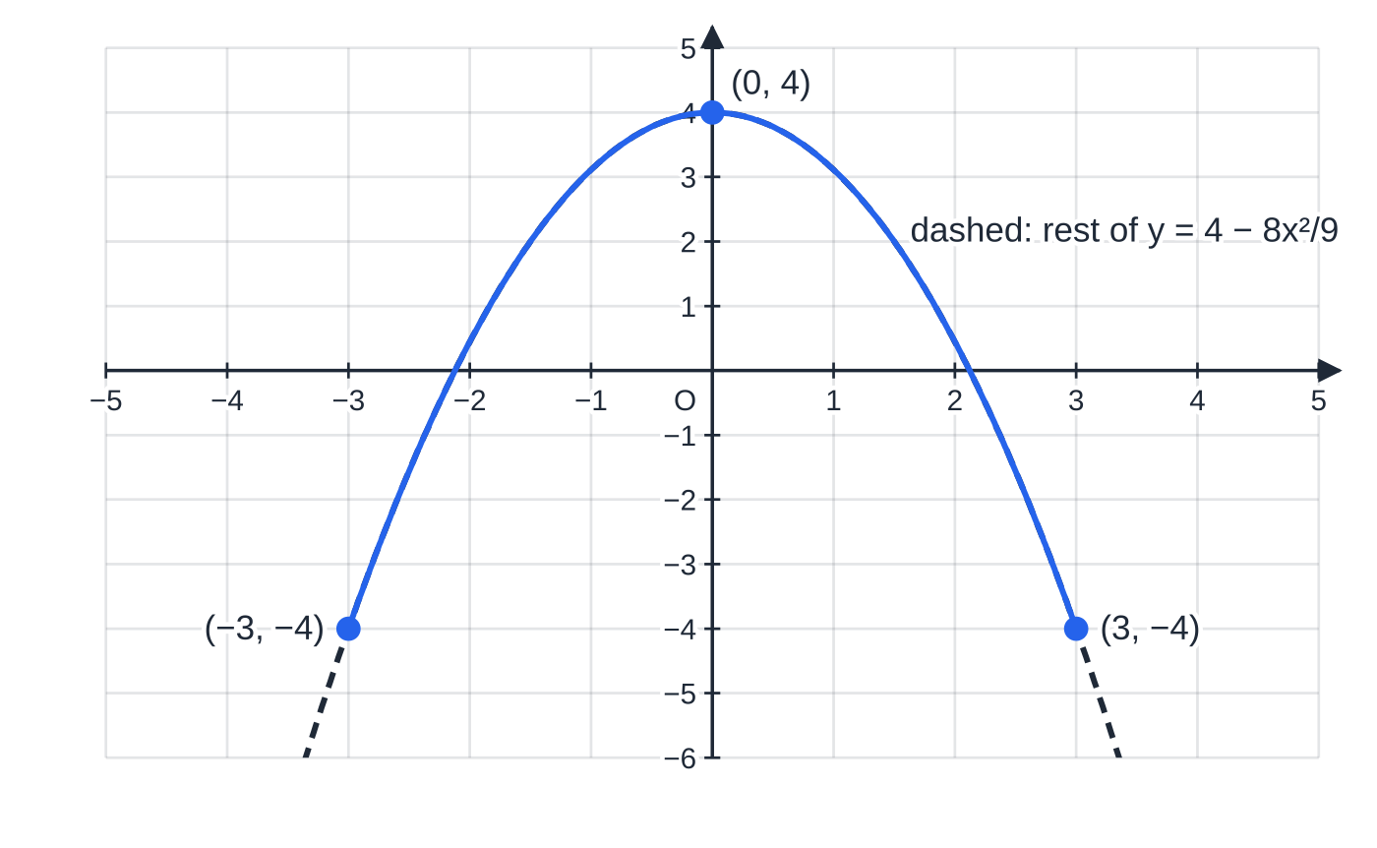
How do you eliminate a parameter inside trigonometric functions? (continued)
Section 3 of 13
Common error
Squaring and adding before isolating the trigonometric functions. From x = 2 + 3cos θ and y = 3sin θ- 1, writing x² + y² = 9 is wrong: the constants 2 and −1 must be moved to the other side first.
Worked example 2(b). The parametric curve x = 3sin t, y = 4cos 2t is only the solid arc of the parabola y = 4 − 8x²/9: since −1 ≤ sin t ≤ 1, it never goes beyond x = ±3.
Notes:
How do you eliminate a parameter inside trigonometric functions?. Full notes: https://examinerprep.com/notes/edexcel-ial-maths/parametric-equations/

Slide 13
Which values of x and y does the curve actually reach?
Section 4 of 13
The Cartesian equation can describe more than the parametric curve. In worked example 2(b), y = 4 - (8/9) x² is a whole parabola, but the curve is only the part with -3 ≤x ≤3. So a complete answer gives the Cartesian equation together with its domain, the set of x-values the curve reaches. The range is the set of y-values it reaches.
To find them, work out the values that x = f(t) and y = g(t) take over the allowed values of t. Use what you know about each function: -1 ≤sin t ≤1, eᵗ > 0, t² ≥0, sec t ≥1 for 0 ≤t < π/2, and so on. The restriction on t can also decide a sign: if y² = … and y is known to be positive, take the positive square root.
Notes:
Which values of x and y does the curve actually reach?. Full notes: https://examinerprep.com/notes/edexcel-ial-maths/parametric-equations/

Slide 14
Which values of x and y does the curve actually reach? (continued)
Section 4 of 13 · Worked example 3 · Medium · Find, state
WORKED EXAMPLE · QUESTION
A curve C has parametric equations x = tan t + 1, y = 3sec t, 0 ≤t < π/2. (a) Find a Cartesian equation of C in the form y = √(f(x)), where f(x) is a quadratic. (b) State the set of values of x (the domain) and of y (the range) on C.
SOLUTION
(a) Isolate: tan t = x - 1, sec t = y/3. Use sec² t = 1 + tan² t: y²/9 = 1 + (x-1)² ⇒y² = 9x² - 18x + 18. For 0 ≤t < π/2, sec t > 0, so y > 0. y = √(9x² - 18x + 18)
(b) As t runs from 0 towards π/2, tan t increases from 0 without limit and sec t increases from 1 without limit. Domain x ≥1; range y ≥3
Notes:
Which values of x and y does the curve actually reach?: Worked example 3. Full notes: https://examinerprep.com/notes/edexcel-ial-maths/parametric-equations/

Slide 15
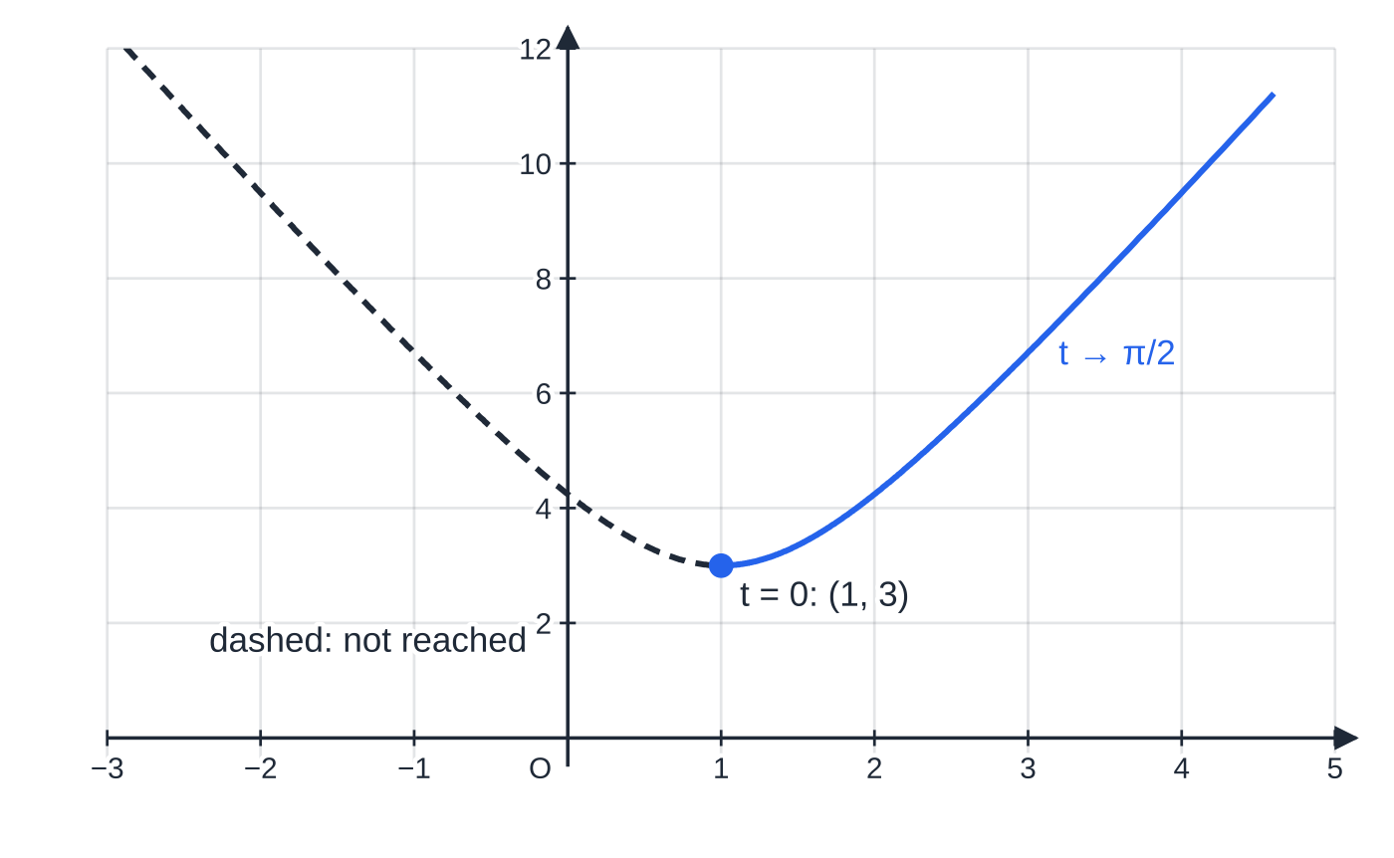
Which values of x and y does the curve actually reach? (continued)
Section 4 of 13
Exam tip 1 — the domain comes from x = f(t)
When a question says "state the domain of f" after you have found y = f(x), the answer comes from the parametric equation for x, not from the formula for f. A formula like √(9x² - 18x + 18) is defined for every x, but the curve only has x ≥1.
Worked example 3: the curve starts at (1, 3) when t = 0 and goes off to the upper right as t → π/2. The dashed left half also satisfies y = √(9x² − 18x + 18), but no allowed value of t reaches it.
Notes:
Which values of x and y does the curve actually reach?. Full notes: https://examinerprep.com/notes/edexcel-ial-maths/parametric-equations/

Slide 16
How do you find dy/dx for a parametric curve?
Section 5 of 13
Gradient of a parametric curve
dy/dx = dy/dt ÷dx/dt (provided dx/dt ≠0)
Differentiate x and y separately with respect to t, then divide; the answer is in terms of t. It follows from the chain rule: dy/dx = dy/dt ×dt/dx, and dt/dx = 1 ÷dx/dt. Not in the formulae list, so learn it.
To find the gradient at a point you need its value of t. If you are given the coordinates, find the t that gives both of them.
Horizontal tangent (gradient 0): dy/dt = 0 with dx/dt ≠0.
Vertical tangent (gradient undefined): dx/dt = 0 with dy/dt ≠0.
Simplify the quotient, especially with trigonometric functions: -2cos θ/4sin θ = -½cot θ.
Notes:
How do you find dy/dx for a parametric curve?. Full notes: https://examinerprep.com/notes/edexcel-ial-maths/parametric-equations/

Slide 17
How do you find dy/dx for a parametric curve? (continued)
Section 5 of 13 · Worked example 4 · Medium · Find
WORKED EXAMPLE · QUESTION
The curve C has parametric equations x = t², y = t³ - 3t. (a) Find dy/dx in terms of t. (b) Find the gradient of C at the point (4, 2). (c) Find the coordinates of the points where the tangent to C is horizontal, and of the point where it is vertical.
SOLUTION
(a) dx/dt = 2t, dy/dt = 3t² - 3. dy/dx = (3t² - 3)/2t
(b) Find t at (4, 2) using both coordinates: t² = 4 gives t = ±2; y = 2 only for t = 2 (t = -2 gives y = -2). Gradient = (3×4 - 3)/(2×2). (9/4)
(c) Horizontal where dy/dt = 0: 3t² - 3 = 0 ⇒t = ±1, and dx/dt = ±2 ≠0 there. (1, -2) and (1, 2) Vertical where dx/dt = 0: 2t = 0 ⇒t = 0, with dy/dt = -3 ≠0. (0, 0)
At the crossing point (3, 0) the two branches have gradients (3×3 - 3)/(±2√3) = ±√3: two different tangents through one point, which no curve y = f(x) can have.
Notes:
How do you find dy/dx for a parametric curve?: Worked example 4. Full notes: https://examinerprep.com/notes/edexcel-ial-maths/parametric-equations/

Slide 18
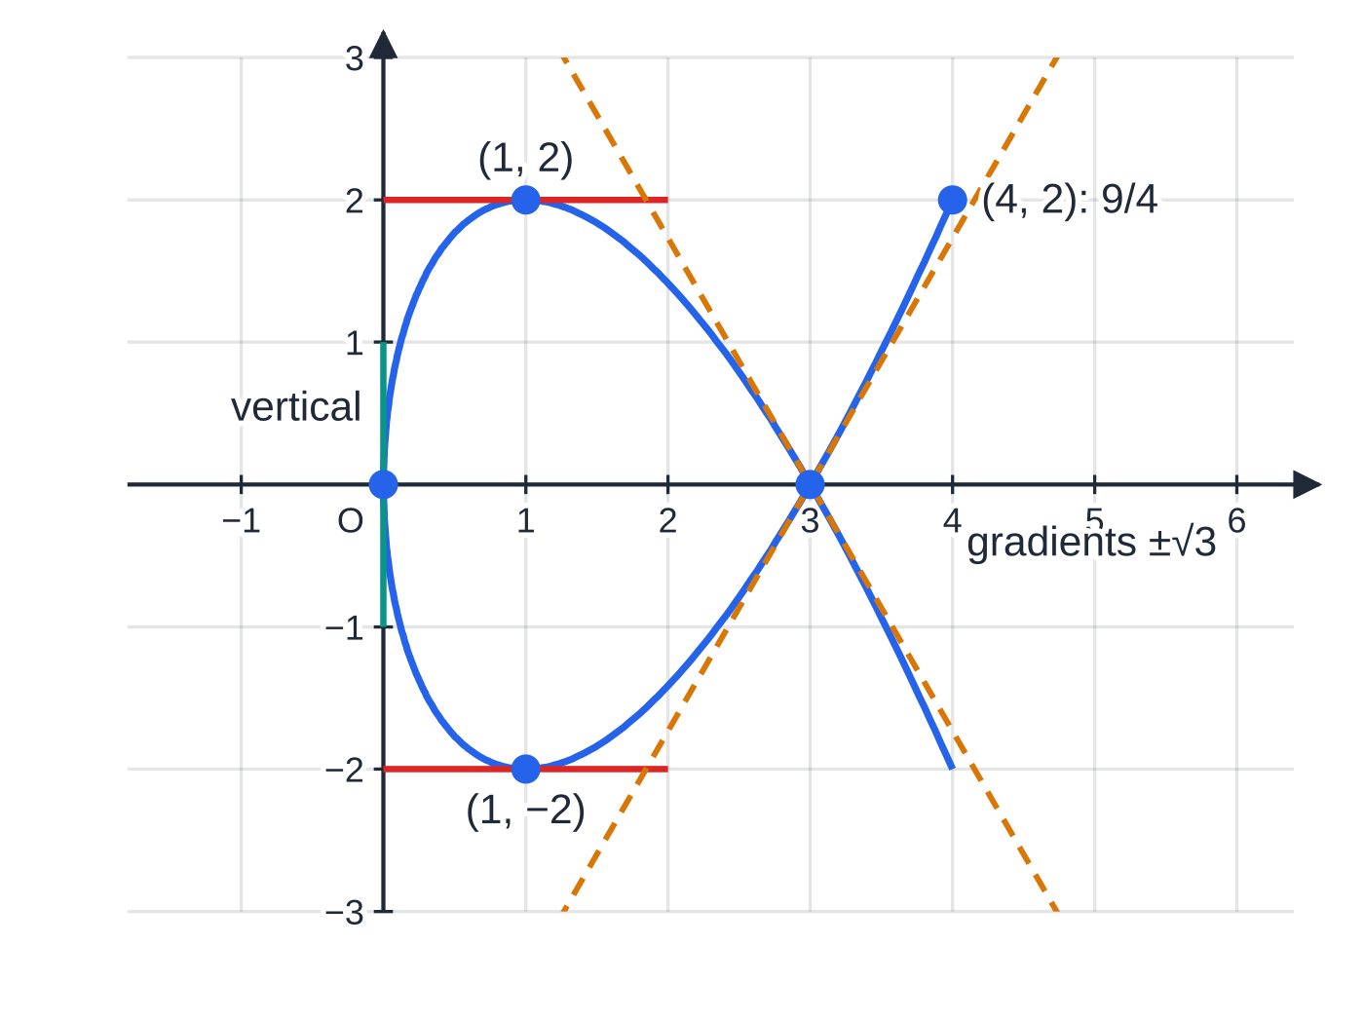
How do you find dy/dx for a parametric curve? (continued)
Section 5 of 13
Worked example 4 on the curve x = t², y = t³ − 3t: horizontal tangents at (1, ±2) where dy/dt = 0, a vertical tangent at O where dx/dt = 0, and two tangents with gradients ±√3 through the crossing point (3, 0).
Notes:
How do you find dy/dx for a parametric curve?. Full notes: https://examinerprep.com/notes/edexcel-ial-maths/parametric-equations/

Slide 19
How do you find the tangent and normal to a parametric curve?
Section 6 of 13
The method is the one from P1; only the gradient is found differently.
Find the point: substitute the value of t into both parametric equations.
Find the gradient m: substitute the same t into dy/dx. For the normal use -1/m.
Use y - y₁ = m(x - x₁), with x and y, never t, in the final equation.
Notes:
How do you find the tangent and normal to a parametric curve?. Full notes: https://examinerprep.com/notes/edexcel-ial-maths/parametric-equations/

Slide 20
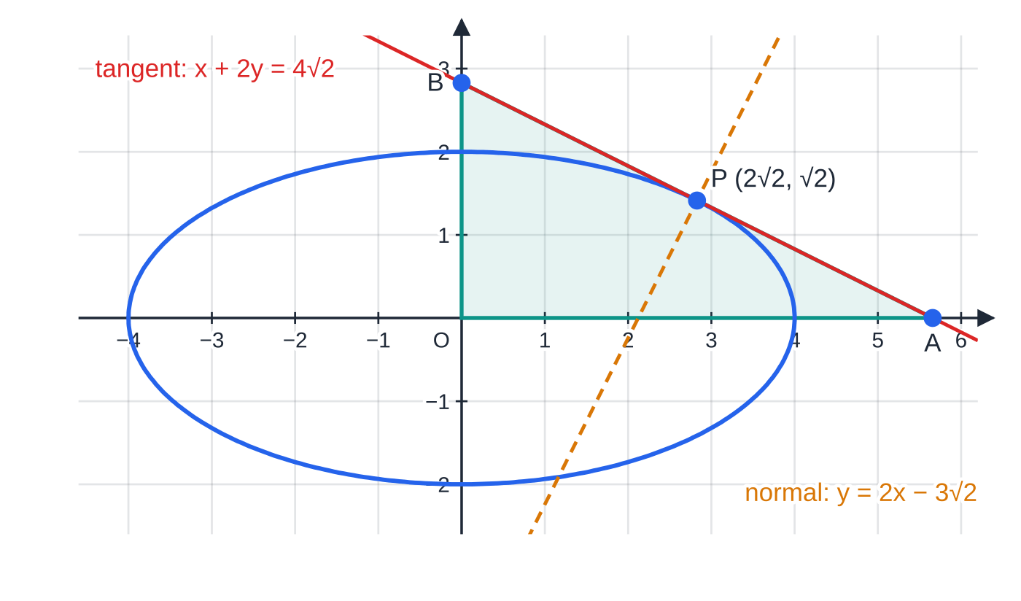
How do you find the tangent and normal to a parametric curve? (continued)
Section 6 of 13 · Worked example 5 · Hard · Show that, find
WORKED EXAMPLE · QUESTION
The ellipse E has parametric equations x = 4cos θ, y = 2sin θ, 0 ≤θ< 2π. The point P on E has parameter θ= π/4. (a) Show that dy/dx = -½cot θ. (b) Find an equation of the tangent to E at P, in the form x + ay = b, where a and b are exact constants. (c) Find an equation of the normal to E at P. (d) The tangent meets the x-axis at A and the y-axis at B. Find the area of triangle OAB.
SOLUTION
(a) dx/dθ = -4sin θ, dy/dθ = 2cos θ, so dy/dx = 2cos θ/(-4sin θ). -½cot θ as required.
The ellipse x = 4cos θ, y = 2sin θ with the tangent and normal at P (θ = π/4), drawn to equal scales so that the right angle is true. Triangle OAB has area 8. Note that θ is the parameter, not the angle between OP and the x-axis.
Notes:
How do you find the tangent and normal to a parametric curve?: Worked example 5. Full notes: https://examinerprep.com/notes/edexcel-ial-maths/parametric-equations/

Slide 21
How do you find the tangent and normal to a parametric curve? (continued)
Section 6 of 13 · Worked example 5 · Hard · Show that, find (continued)
(b) At θ= π/4: P = (4×√2/2, 2×√2/2) = (2√2, √2) and m = -½cot π/4 = -½. Then y - √2 = -½(x - 2√2) ⇒2y - 2√2 = -x + 2√2. x + 2y = 4√2
(c) Normal gradient -1 ÷(-½) = 2: y - √2 = 2(x - 2√2). y = 2x - 3√2
(d) Tangent intercepts: y = 0 gives x = 4√2, so A(4√2, 0); x = 0 gives y = 2√2, so B(0, 2√2). Area = ½ ×4√2 ×2√2 = ½ ×16. 8
Notes:
How do you find the tangent and normal to a parametric curve?: Worked example 5. Full notes: https://examinerprep.com/notes/edexcel-ial-maths/parametric-equations/

Slide 22
How do you find the tangent and normal to a parametric curve? (continued)
Section 6 of 13
Common error
Leaving θ (or t) in the equation of a tangent. The gradient -½cot θ is a formula; the tangent at P uses the number -½. A final answer such as y - √2 = -½cot θ (x - 2√2) is not a straight line.
Notes:
How do you find the tangent and normal to a parametric curve?. Full notes: https://examinerprep.com/notes/edexcel-ial-maths/parametric-equations/

Slide 23
How do you find the area under a parametric curve?
Section 7 of 13
Area under a parametric curve
Area = ∫ₓ₌ₐˣ⁼ᵇ y dx = ∫ₜ₌ₚ^(t=q) y dx/dt dt
p and q are the values of t at which x = a and x = b; y and dx/dt are both written in terms of t. It is integration by substitution: dx is replaced by dx/dt dt, and the limits change with it. Not in the formulae list, so learn it.
The curve must be above the x-axis for the result to be the area. Keep the limits in the order "t at the left end, x = a" to "t at the right end, x = b", even if the first is the larger number. The method:
find the t-values at the ends of the region (from the x-values given, or from where the curve meets an axis);
differentiate x with respect to t;
multiply y by dx/dt and simplify (this is often the step a "show that" part is testing);
Notes:
How do you find the area under a parametric curve?. Full notes: https://examinerprep.com/notes/edexcel-ial-maths/parametric-equations/

Slide 24
How do you find the area under a parametric curve? (continued)
Section 7 of 13
integrate with respect to t between the t-limits.
If x decreases as t increases, dx/dt is negative and the left-hand end has the larger t. Writing the limits in the correct order makes the answer positive; you can then swap them and change the sign of the integrand, as in worked example 7.
Notes:
How do you find the area under a parametric curve?. Full notes: https://examinerprep.com/notes/edexcel-ial-maths/parametric-equations/

Slide 25
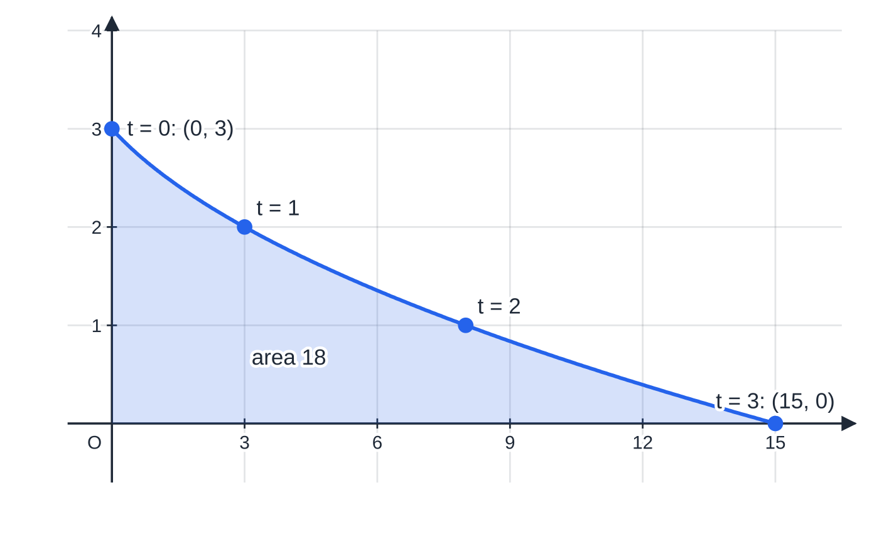
How do you find the area under a parametric curve? (continued)
Section 7 of 13 · Worked example 6 · Medium · Find
WORKED EXAMPLE · QUESTION
The curve C has parametric equations x = t² + 2t, y = 3 - t, 0 ≤t ≤3. Find the area of the region bounded by C and the coordinate axes.
SOLUTION
Ends of the region. t = 0 gives (0, 3), on the y-axis; t = 3 gives (15, 0), on the x-axis. x increases from 0 to 15 as t goes from 0 to 3.
Set up. dx/dt = 2t + 2, so Area = ∫₀³ (3 - t)(2t + 2) dt = ∫₀³ (6 + 4t - 2t²) dt.
Integrate. [6t + 2t² - ⅔ t³]₀³ = 18 + 18 - 18 - 0.
The region between x = t² + 2t, y = 3 − t and the coordinate axes. The left end (0, 3) has t = 0 and the right end (15, 0) has t = 3; the shaded area is 18.
Notes:
How do you find the area under a parametric curve?: Worked example 6. Full notes: https://examinerprep.com/notes/edexcel-ial-maths/parametric-equations/

Slide 26
How do you find the area under a parametric curve? (continued)
Section 7 of 13 · Worked example 6 · Medium · Find (continued)
18
Notes:
How do you find the area under a parametric curve?: Worked example 6. Full notes: https://examinerprep.com/notes/edexcel-ial-maths/parametric-equations/

Slide 27
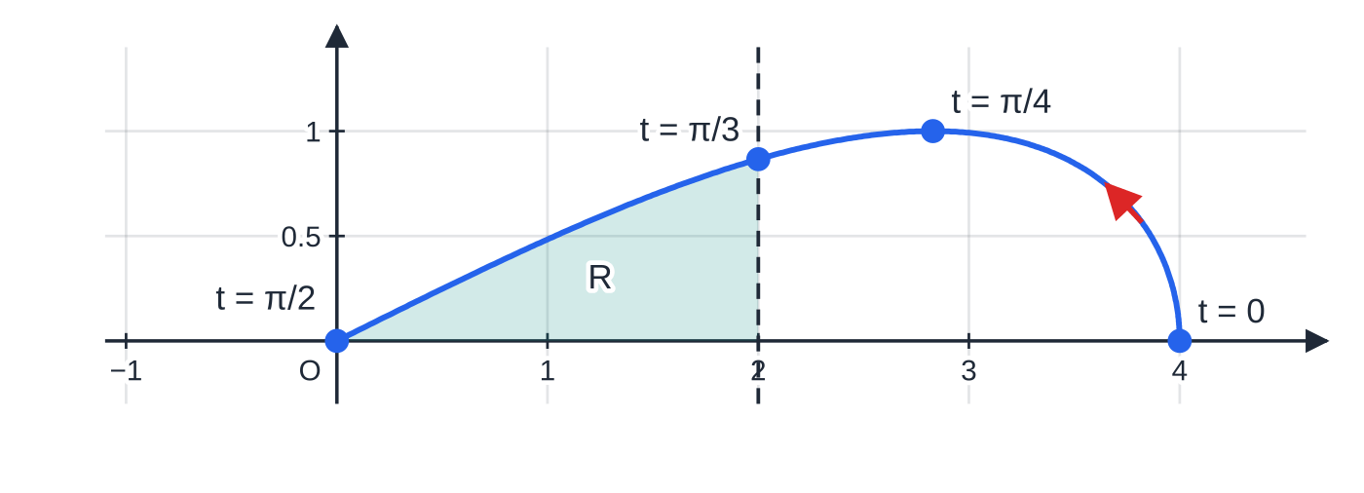
How do you find the area under a parametric curve? (continued)
Section 7 of 13 · Worked example 7 · Hard · Show that, find
WORKED EXAMPLE · QUESTION
The curve C has parametric equations x = 4cos t, y = sin 2t, 0 ≤t ≤π/2. The region R is bounded by C, the x-axis and the line x = 2. (a) Show that the area of R is given by ∫_(π/3)^(π/2) 8sin² tcos t dt. (b) Hence find the exact area of R.
SOLUTION
(a) R runs from x = 0 to x = 2. x = 0: cos t = 0, t = π/2; x = 2: cos t = ½, t = π/3. With the limits in x-order and sin 2t = 2sin tcos t: Area = ∫_(π/2)^(π/3) sin 2t ×(-4sin t) dt = ∫_(π/2)^(π/3) -8sin² tcos t dt.
As t increases from 0 to π/2 the point moves from (4, 0) back to the origin, so x decreases. The shaded region R, from x = 0 (t = π/2) to x = 2 (t = π/3), has area 8/3 − √3 ≈ 0.935.
Notes:
How do you find the area under a parametric curve?: Worked example 7. Full notes: https://examinerprep.com/notes/edexcel-ial-maths/parametric-equations/

Slide 28
How do you find the area under a parametric curve? (continued)
Section 7 of 13 · Worked example 7 · Hard · Show that, find (continued)
Swap the limits and change the sign: Area = ∫_(π/3)^(π/2) 8sin² tcos t dt as required.
(b) Integrate by recognition: the derivative of sin³ t is 3sin² tcos t. [(8/3)sin³ t]_(π/3)^(π/2) = (8/3)(1 - 3√3/8), using sin³π/3 = 3√3/8. (8/3) - √3 (≈ 0.935)
Notes:
How do you find the area under a parametric curve?: Worked example 7. Full notes: https://examinerprep.com/notes/edexcel-ial-maths/parametric-equations/

Slide 29
How do you find the area under a parametric curve? (continued)
Section 7 of 13
Common error
Putting the x-values 0 and 2 in as the limits of a t-integral. Once the integrand is in terms of t, the limits must be values of t (here π/2 and π/3). Mixing them spoils an otherwise correct integral.
Notes:
How do you find the area under a parametric curve?. Full notes: https://examinerprep.com/notes/edexcel-ial-maths/parametric-equations/

Slide 30
How do the pieces fit together in a full question?
Section 8 of 13
Longer questions on this topic usually combine a Cartesian equation (with its domain), a tangent or normal, and an area. The last example does all three.
Notes:
How do the pieces fit together in a full question?. Full notes: https://examinerprep.com/notes/edexcel-ial-maths/parametric-equations/

Slide 31
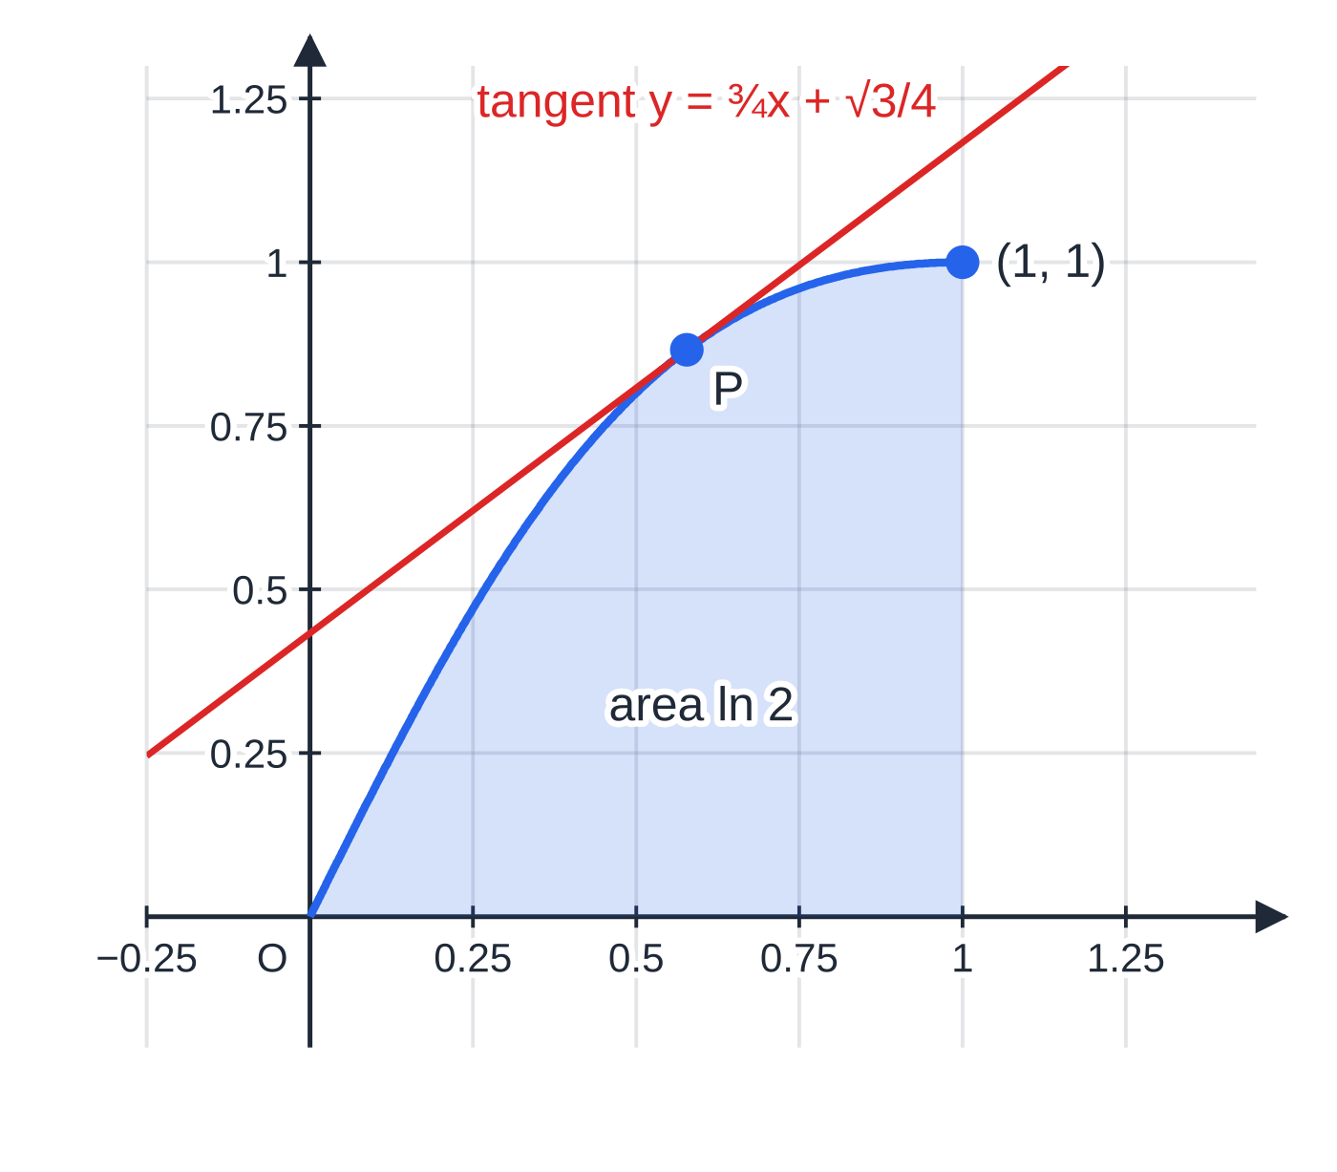
How do the pieces fit together in a full question? (continued)
Section 8 of 13 · Worked example 8 · Hard · Full question
WORKED EXAMPLE · QUESTION
The curve C has parametric equations x = tan t, y = sin 2t, 0 ≤t ≤π/4.
(a) Show that a Cartesian equation of C is y = 2x/(1+x²), and state the domain of x on C.
(b) Find dy/dx in terms of t.
(c) The point P on C has parameter t = π/6. Find an equation of the tangent to C at P, in the form y = mx + c, where m and c are exact constants.
(d) Find the exact area of the region bounded by C, the x-axis and the line x = 1.
Drawn to equal scales: the curve x = tan t, y = sin 2t, 0 ≤ t ≤ π/4, is the part of y = 2x/(1 + x²) from O to (1, 1). The tangent at P (t = π/6) has gradient 3/4 and the shaded area is ln 2.
Notes:
How do the pieces fit together in a full question?: Worked example 8. Full notes: https://examinerprep.com/notes/edexcel-ial-maths/parametric-equations/

Slide 32
How do the pieces fit together in a full question? (continued)
Section 8 of 13 · Worked example 8 · Hard · Full question (continued)
SOLUTION
(a) Write sin 2t in terms of tan t: sin 2t = 2sin tcos t = 2sin t/cos tcos² t = 2tan t/(sec² t) = 2tan t/(1 + tan² t). So y = 2x/(1+x²); tan t increases from 0 to 1 on 0 ≤t ≤π/4, so the domain is 0 ≤x ≤1.
(b) dx/dt = sec² t, dy/dt = 2cos 2t, so dy/dx = 2cos 2t/(sec² t). 2cos 2tcos² t
(c) P = (tan π/6, sin π/3) = (√3/3, √3/2) and m = 2 ×½ ×(√3/2)² = ¾. Then y - √3/2 = ¾(x - √3/3) ⇒y = ¾ x - √3/4 + √3/2. y = ¾ x + √3/4
(d) x = 0 at t = 0 and x = 1 at t = π/4. Area = ∫₀^(π/4) sin 2tsec² t dt = ∫₀^(π/4) 2sin tcos t/(cos² t) dt = ∫₀^(π/4) 2tan t dt = [2ln sec t]₀^(π/4) = 2ln √2 - 2ln 1. ln 2 As a check, ∫₀¹ 2x/(1+x²) dx = [ln(1+x²)]₀¹ = ln 2 as well.
Notes:
How do the pieces fit together in a full question?: Worked example 8. Full notes: https://examinerprep.com/notes/edexcel-ial-maths/parametric-equations/

Slide 33
Exam tips for P4.2
Section 9 of 13
Exam tip 2 — label your limits
Write the change of limits as a separate line: "x = 0 ⇒t = π/2, x = 2 ⇒t = π/3". It shows the step clearly on its own, and it stops you putting x-values into a t-integral.
Exam tip 3 — in "show that" area parts, show the product
If the target is an integral such as ∫8sin² tcos t dt, the working must show y ×dx/dt written out, any identity used (sin 2t = 2sin tcos t), and how the limits and sign were sorted out. Jumping straight to the printed answer proves nothing.
Exam tip 4 — one value of t must fit both coordinates
When you are given a point rather than a parameter, solve one equation for t and check each possible value in the other. With x = t², both t = 2 and t = -2 give x = 4, but only one of them gives the right y.
Notes:
Exam tips for P4.2. Full notes: https://examinerprep.com/notes/edexcel-ial-maths/parametric-equations/

Slide 34
Exam tips for P4.2 (continued)
Section 9 of 13
Exam tip 5 — simplify dy/dx, but leave it in terms of t
"Find dy/dx in terms of t" is complete once the quotient is simplified (-½cot θ, 2cos 2tcos² t). Do not try to convert it into x; that wastes time and invites errors.
Notes:
Exam tips for P4.2. Full notes: https://examinerprep.com/notes/edexcel-ial-maths/parametric-equations/

Slide 35
Common misconceptions
Section 10 of 13
Misconception | Why it is wrong | Correct idea
dy/dx = dx/dt ÷dy/dt. | That is dx/dy, the reciprocal of the gradient. | dy/dx = dy/dt ÷dx/dt: the variable you want on top goes on top.
The area under a parametric curve is ∫y dt. | The area is ∫y dx; changing the variable to t changes dx as well. | Area = ∫ydx/dt dt.
The limits of the t-integral are the x-values at the ends of the region. | After substitution everything is in terms of t, including the limits. | Convert each x-limit to its value of t first.
The Cartesian equation describes exactly the same points as the parametric equations. | The parameter's range can restrict the curve (-1 ≤sin t ≤1 keeps |x| ≤3 when x = 3sin t). | Give the Cartesian equation with the domain the parametric curve actually covers.
A vertical tangent occurs where dy/dt = 0. | dy/dt = 0 makes the gradient zero, so the tangent is horizontal. | Vertical tangent: dx/dt = 0 (with dy/dt ≠0).
Notes:
Common misconceptions. Full notes: https://examinerprep.com/notes/edexcel-ial-maths/parametric-equations/

Slide 36
Common misconceptions (continued)
Section 10 of 13
Misconception | Why it is wrong | Correct idea
If x = 2 + 3cos θ and y = 3sin θ, then x² + y² = 9. | The identity applies to cos θ and sin θ, not to x and y when constants have been added. | Isolate first: cos θ= (x-2)/3, so (x-2)² + y² = 9.
Notes:
Common misconceptions. Full notes: https://examinerprep.com/notes/edexcel-ial-maths/parametric-equations/

Slide 37
How this topic connects
Section 11 of 13
P3 Trigonometry and differentiation
Eliminating a parameter relies on the P3 identities (double-angle formulae, sec² = 1 + tan², csc² = 1 + cot²), and dy/dx = dy/dt ÷dx/dt is the chain rule. Tangents and normals use the straight-line work of P1; circles from P2 reappear as parametric curves.
P4.4 Implicit differentiation and P4.6 Integration
Implicit differentiation is the other way to differentiate a curve that is not written as y = f(x). The area formula is integration by substitution, and volumes of revolution use the same idea: π∫y²dx/dt dt.
Mechanics and IAL Physics
A projectile's position is a parametric curve with time as the parameter: x = (ucos α)t, y = (usin α)t - ½ gt². Eliminating t gives the equation of the path, and dy/dx gives the direction of motion. Position vectors such as r = f(t)i + g(t)j are the same idea, and projectile motion in IAL Physics Unit 1 treats horizontal and vertical motion separately in the same way.
Notes:
How this topic connects. Full notes: https://examinerprep.com/notes/edexcel-ial-maths/parametric-equations/

Slide 38
Key formulae
Section 12 of 13
Formula | Use | In the formulae list?
dy/dx = dy/dt ÷dx/dt | gradient of a parametric curve | No — learn it
Area = ∫ydx/dt dt, between t-limits | area between a parametric curve and the x-axis | No — learn it
sin² t + cos² t = 1 | eliminating t from sin and cos (circles, ellipses) | No — learn it
sin 2t = 2sin tcos t; cos 2t = 1 - 2sin² t = 2cos² t - 1 | eliminating t when a double angle appears | No — learn it
sec² t = 1 + tan² t; csc² t = 1 + cot² t | eliminating t from tan and sec, or cot and cosec | No — derive it from sin² + cos² = 1
y - y₁ = m(x - x₁); mₙₒᵣₘₐₗ = -1/m | equations of tangents and normals | No — learn it
∫tan t dt = ln|sec t| + c | a standard integral that is useful in parametric areas | Yes
Notes:
Key formulae. Full notes: https://examinerprep.com/notes/edexcel-ial-maths/parametric-equations/

Slide 39
Check your understanding
Section 13 of 13
1. Find a Cartesian equation of the curve x = 3t - 1, y = 2/t, t ≠0.
2. Show that the curve x = 1 + 2cos t, y = 2sin t - 3 is a circle, and state its centre and radius.
3. A curve has x = eᵗ, y = e²ᵗ + 1, t ∈ℝ. Find its Cartesian equation, its domain and its range.
4. For x = t³, y = t² + t, find the gradient of the curve at the point where t = 1.
5. A student finds the area under a parametric curve and gets a negative answer, although the curve is above the x-axis. What has probably gone wrong?
6. For the ellipse x = 4cos θ, y = 2sin θ, find the points where the tangent is horizontal.
Notes:
Check your understanding: questions. Full notes: https://examinerprep.com/notes/edexcel-ial-maths/parametric-equations/

Slide 40
Check your understanding · answers
Section 13 of 13
1. t = (x+1)/3, so y = 2 ÷(x+1)/3 = 6/(x+1), x ≠-1.
2. cos t = (x-1)/2 and sin t = (y+3)/2. Then sin² + cos² = 1 gives (x-1)² + (y+3)² = 4: centre (1, -3), radius 2.
3. e²ᵗ = (eᵗ)² = x², so y = x² + 1. Since eᵗ > 0, the domain is x > 0, and then the range is y > 1. It is only the right half of the parabola, without its vertex.
4. dy/dx = (2t+1)/3t² = (3/3) = 1 at t = 1 (the point (1, 2)).
5. x decreases as t increases, so dx/dt < 0, and the student has written the smaller t as the lower limit. The lower limit should be the value of t at the left-hand end of the region (the smaller x). With the limits in that order, the answer comes out positive.
6. dy/dθ = 2cos θ= 0 when θ= π/2 or 3π/2, and dx/dθ = -4sin θ≠0 there. The points are (0, 2) and (0, -2), the top and bottom of the ellipse.
Notes:
Check your understanding: answers. Full notes: https://examinerprep.com/notes/edexcel-ial-maths/parametric-equations/

Slide 41
Practice questions
2 original exam-style questions. Answers at the end of the deck.

Slide 42
Question 1
6 marks
A curve C has parametric equations x = 3t + 2, y = t² − 1, t ∈ ℝ.
(a) Find the coordinates of the point on C where t = 2. [1]
(b) Find a Cartesian equation of C in the form y = ax² + bx + c, where a, b and c are constants. [3]
(c) Find the x-coordinates of the points where C meets the x-axis. [2]
Notes:
Online with the full mark scheme: https://examinerprep.com/ial-maths-p4-2-parametric-equations-questions#IALM-P4-2-B-01

Slide 43
Question 2
7 marks
A curve C has parametric equations x = 5 cos θ − 2, y = 5 sin θ + 3, 0 ≤ θ ≤ π.
(a) Show that C is part of the circle with equation (x + 2)² + (y − 3)² = 25. [3]
(b) State the centre and the radius of this circle. [2]
(c) Find the set of values of x and the set of values of y on C. [2]
Notes:
Online with the full mark scheme: https://examinerprep.com/ial-maths-p4-2-parametric-equations-questions#IALM-P4-2-B-02

Slide 44
Answers

Slide 45
Question 1 · answer
Mark scheme
(8, 3)
t = (x − 2)/3
substitutes: y = ((x − 2)/3)² − 1
y = (1/9)x² − (4/9)x − 5/9
y = 0 ⇒ t² = 1 ⇒ t = ±1, or solves x² − 4x − 5 = 0
x = 5 and x = −1
Notes:
Full mark scheme: https://examinerprep.com/ial-maths-p4-2-parametric-equations-questions#IALM-P4-2-B-01

Slide 46
Question 2 · answer
Mark scheme
cos θ = (x + 2)/5 and sin θ = (y − 3)/5
uses sin² θ + cos² θ = 1
((x + 2)/5)² + ((y − 3)/5)² = 1 ⇒ (x + 2)² + (y − 3)² = 25 as required
centre (−2, 3)
radius 5
cos θ takes all values from 1 down to −1, so −7 ≤ x ≤ 3
sin θ takes all values from 0 to 1, so 3 ≤ y ≤ 8
Notes:
Full mark scheme: https://examinerprep.com/ial-maths-p4-2-parametric-equations-questions#IALM-P4-2-B-02

Slide 47
Keep practising
Notes for this topic
Questions on this topic
Build a printable test
ExaminerPrep is an independent tutoring service. It has been developed independently from and is not endorsed by the International Baccalaureate Organization. "International Baccalaureate", "IB" and "IB Diploma Programme" are registered trademarks of the IBO, used here for descriptive purposes only.
Pearson Edexcel and Cambridge are trademarks of their owners; ExaminerPrep is not affiliated with any exam board.

