Slide 1
EP
EDEXCEL IAL MATHS
P1.3 Polynomials, curve sketching and transformations
The full notes page in 12 sections · practice questions with answers · simulations
ExaminerPrep is an independent tutoring service. It has been developed independently from and is not endorsed by the International Baccalaureate Organization. "International Baccalaureate", "IB" and "IB Diploma Programme" are registered trademarks of the IBO, used here for descriptive purposes only.
Pearson Edexcel and Cambridge are trademarks of their owners; ExaminerPrep is not affiliated with any exam board.
Notes:
P1.3 Polynomials, curve sketching and transformations. Notes for this topic: https://examinerprep.com/notes/edexcel-ial-maths/polynomials-curve-sketching-and-transformations/

Slide 2
What this page covers
Overview
Expanding products of brackets and factorising cubics, using f(x) notation
Sketching cubic graphs, including repeated roots, with all axis intercepts
Sketching y=k/x and y=k/x² with their asymptotes, for positive and negative k
Using the points where two graphs meet to state the number of solutions of an equation
The transformations y=af(x), y=f(x)+a, y=f(x+a) and y=f(ax)
The effect of each transformation on intercepts, turning points and asymptotes
Applying the same transformations to the graphs of sin x, cos x and tan x
Notes:
What this page covers. Full notes: https://examinerprep.com/notes/edexcel-ial-maths/polynomials-curve-sketching-and-transformations/

Slide 3
In one minute
Key points
1. Once a cubic is factorised you can sketch it in seconds, and once you know how each transformation acts you can move that sketch anywhere; a pair of sketches then tells you how many solutions an equation has without solving it.
2. Factorise first: a cubic with no constant term has a common factor x; take it out and factorise the quadratic that is left.
3. Cubic shape: a positive x³ coefficient starts bottom left and ends top right; a negative one does the reverse. A single root crosses the axis; a squared (repeated) root touches it.
4. y=k/x and y=k/x² have asymptotes x=0 and y=0. For k>0, k/x is in the 1st and 3rd quadrants; k/x² is above the x-axis on both sides.
5. The number of solutions of f(x)=g(x) equals the number of points where y=f(x) and y=g(x) meet.
6. Outside the bracket acts on y as you expect: f(x)+a moves up a; af(x) multiplies y by a. Inside the bracket acts on x the opposite way: f(x+a) moves left a; f(ax) divides x by a.
Notes:
In one minute. Full notes: https://examinerprep.com/notes/edexcel-ial-maths/polynomials-curve-sketching-and-transformations/

Slide 4
How do you expand and factorise polynomials?
Section 1 of 12
A polynomial is a sum of terms of the form axⁿ, where each power n is a whole number ≥0. Its degree is the highest power: a cubic has degree 3, for example 2x³-3x²-23x+12.
Function notation f(x) names a polynomial so you can substitute into it. If f(x)=2x³-3x²-23x+12, then f(1)=2-3-23+12=-12. This notation is used throughout the course, and it is what makes transformations such as f(x+2) easy to write down.
Expanding three brackets
Multiply two of the brackets first, simplify, then multiply the result by the third. Every term of one bracket must meet every term of the other, so a bracket with two terms times a bracket with three terms gives six products before you collect like terms.
Notes:
How do you expand and factorise polynomials?. Full notes: https://examinerprep.com/notes/edexcel-ial-maths/polynomials-curve-sketching-and-transformations/

Slide 5
How do you expand and factorise polynomials? (continued)
Section 1 of 12
Factorising a cubic in P1
In this unit, cubics to factorise always have a common factor (usually x). Take it out, then factorise the quadratic that remains. Watch for two special patterns:
a difference of two squares, x²-a²=(x-a)(x+a);
a perfect square, such as x²-6x+9=(x-3)².
"Factorise completely" means that no bracket can be factorised any further.
Notes:
How do you expand and factorise polynomials?. Full notes: https://examinerprep.com/notes/edexcel-ial-maths/polynomials-curve-sketching-and-transformations/

Slide 6
How do you expand and factorise polynomials? (continued)
Section 1 of 12 · Worked example 1 · Easy · Expand
WORKED EXAMPLE · QUESTION
Expand and simplify (x+3)(2x-1)(x-4), giving your answer in the form ax³+bx²+cx+d.
SOLUTION
Multiply two brackets: (x+3)(x-4)=x²-4x+3x-12=x²-x-12.
Multiply by the third bracket, term by term: (2x-1)(x²-x-12)=2x³-2x²-24x-x²+x+12.
Collect like terms: 2x³-3x²-23x+12
Check with x=1: the brackets give 4×1×(-3)=-12, and the answer gives 2-3-23+12=-12 ✓. Calling this f(x), we also know f(-3)=f(4)=f(½)=0, because each value makes one bracket zero.
Notes:
How do you expand and factorise polynomials?: Worked example 1. Full notes: https://examinerprep.com/notes/edexcel-ial-maths/polynomials-curve-sketching-and-transformations/

Slide 7
How do you expand and factorise polynomials? (continued)
Section 1 of 12 · Worked example 2 · Medium · Factorise
WORKED EXAMPLE · QUESTION
Factorise completely (a) 3x³-12x (b) x³-6x²+9x (c) 2x³+5x²-3x.
SOLUTION
(a) Common factor 3x, then a difference of two squares: 3x(x²-4)= 3x(x-2)(x+2)
(b) Common factor x, then a perfect square: x(x²-6x+9)= x(x-3)²
(c) Common factor x. For 2x²+5x-3, find two numbers with product 2×(-3)=-6 and sum 5: they are 6 and -1. So x(2x²+6x-x-3)=x(2x(x+3)-(x+3))= x(2x-1)(x+3)
Notes:
How do you expand and factorise polynomials?: Worked example 2. Full notes: https://examinerprep.com/notes/edexcel-ial-maths/polynomials-curve-sketching-and-transformations/

Slide 8
How do you expand and factorise polynomials? (continued)
Section 1 of 12
Common error
Stopping at 3x(x²-4). The question says "completely", and x²-4 is a difference of two squares, so the answer is not finished until it is 3x(x-2)(x+2).
Notes:
How do you expand and factorise polynomials?. Full notes: https://examinerprep.com/notes/edexcel-ial-maths/polynomials-curve-sketching-and-transformations/

Slide 9
How do you sketch a cubic graph?
Section 2 of 12
A sketch is not a plot. It shows the correct shape and the key points, labelled with their coordinates, but it does not need to be to scale. For a cubic, the factorised form gives you almost everything at once.
What a sketch must show
The right shape. For ax³+… with a>0: as x→∞, y→∞, and as x→-∞, y→-∞. For a<0 the ends are reversed. Find the sign of a by multiplying the x-terms of each bracket.
Where it meets the x-axis: from the factorised form, set y=0.
Where it meets the y-axis: put x=0. For y=(x-p)(x-q)(x-r) this is -pqr.
Repeated roots. A factor (x-p)² means the curve touches the x-axis at x=p, with a turning point on the axis. A factor (x-p)³, as in y=(x-1)³, means the curve flattens and crosses there.
The turning points do not need exact coordinates in a sketch (finding them needs differentiation, P1.6), but a maximum must sit above the axis and a minimum below it wherever the roots force that.
Notes:
How do you sketch a cubic graph?. Full notes: https://examinerprep.com/notes/edexcel-ial-maths/polynomials-curve-sketching-and-transformations/

Slide 10
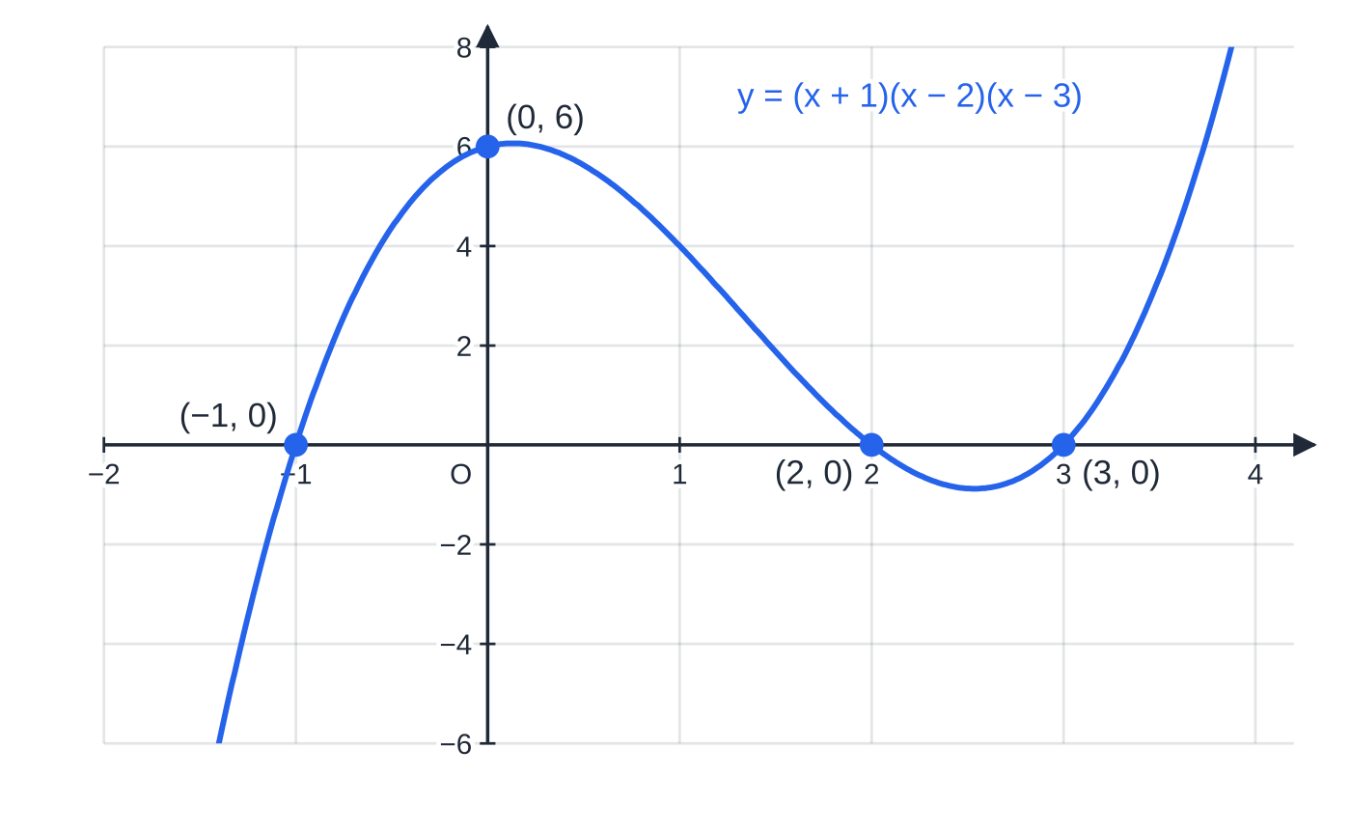
How do you sketch a cubic graph? (continued)
Section 2 of 12
Three different roots: the positive cubic y=(x+1)(x-2)(x-3) crosses the x-axis three times and meets the y-axis at (0, 6), since -(-1)(-2)(-3)=6.
Notes:
How do you sketch a cubic graph?. Full notes: https://examinerprep.com/notes/edexcel-ial-maths/polynomials-curve-sketching-and-transformations/

Slide 11
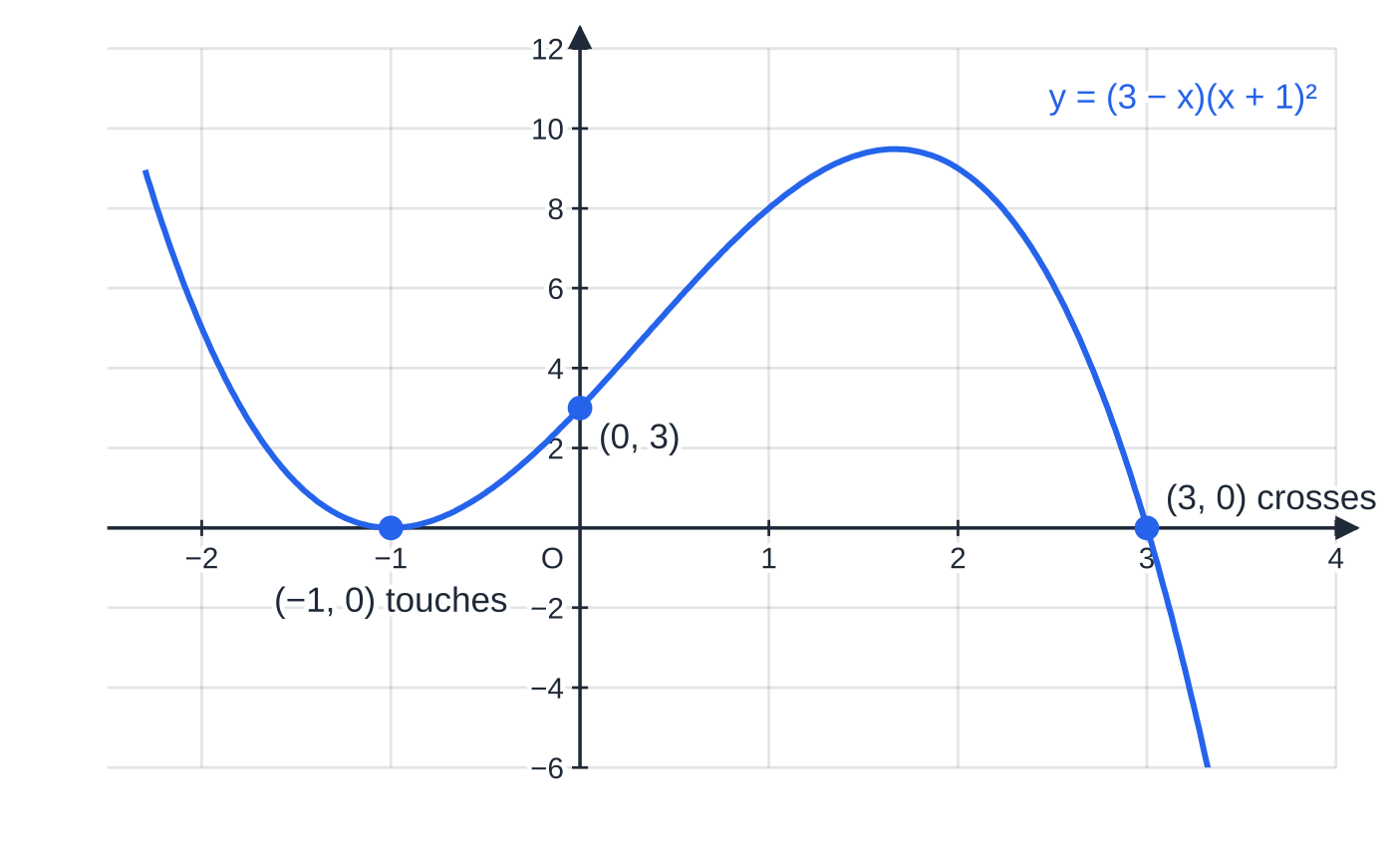
How do you sketch a cubic graph? (continued)
Section 2 of 12 · Worked example 3 · Medium · Sketch
WORKED EXAMPLE · QUESTION
Sketch the curve with equation y=(3-x)(x+1)², showing the coordinates of the points where it meets the axes.
SOLUTION
Shape. The x³ term is (-x)(x²)=-x³: a negative cubic, starting top left and ending bottom right.
x-axis, y=0. x=3 (single root: crosses) and x=-1, a repeated root (touches).
y-axis, x=0. y=3×1²=3, so (0, 3).
A negative cubic with a squared factor: it touches the axis at x=-1, where it has a minimum on the axis, and crosses at x=3.
Notes:
How do you sketch a cubic graph?: Worked example 3. Full notes: https://examinerprep.com/notes/edexcel-ial-maths/polynomials-curve-sketching-and-transformations/

Slide 12
How do you sketch a cubic graph? (continued)
Section 2 of 12 · Worked example 3 · Medium · Sketch (continued)
Draw it. The curve comes down from the top left, touches the axis at (-1, 0), rises through (0, 3) to a maximum and comes down to cross at (3, 0). Touches at (-1, 0), crosses at (3, 0), meets the y-axis at (0, 3)
Expanded, y=-x³+x²+5x+3: the constant term 3 confirms the y-intercept.
Notes:
How do you sketch a cubic graph?: Worked example 3. Full notes: https://examinerprep.com/notes/edexcel-ial-maths/polynomials-curve-sketching-and-transformations/

Slide 13
How do you sketch a cubic graph? (continued)
Section 2 of 12
Exam tip
At a touching root, draw the curve genuinely turning on the axis, like the vertex of a parabola: not crossing it and not stopping short of it. Write the coordinates on the sketch itself, not only in your working.
Notes:
How do you sketch a cubic graph?. Full notes: https://examinerprep.com/notes/edexcel-ial-maths/polynomials-curve-sketching-and-transformations/

Slide 14
What do the graphs of y = k/x and y = k/x² look like?
Section 3 of 12
An asymptote is a line that a curve approaches more and more closely, without reaching it, as x or y grows without limit.
 | y=k/x | y=k/x²
k>0 | two branches, 1st and 3rd quadrants | two branches, both above the x-axis (1st and 2nd quadrants)
k<0 | 2nd and 4th quadrants | both below the x-axis (3rd and 4th quadrants)
Asymptotes | x=0 and y=0 | x=0 and y=0
Symmetry | rotational, order 2, about O | reflection in the y-axis
Meets the axes? | never | never
Why x=0 is an asymptote: as x→0, the fraction becomes enormous, and x=0 itself gives no value. Why y=0 is an asymptote: as x→±∞ the fraction tends to 0 but never equals it, because k≠0.
Notes:
What do the graphs of y = k/x and y = k/x² look like?. Full notes: https://examinerprep.com/notes/edexcel-ial-maths/polynomials-curve-sketching-and-transformations/

Slide 15
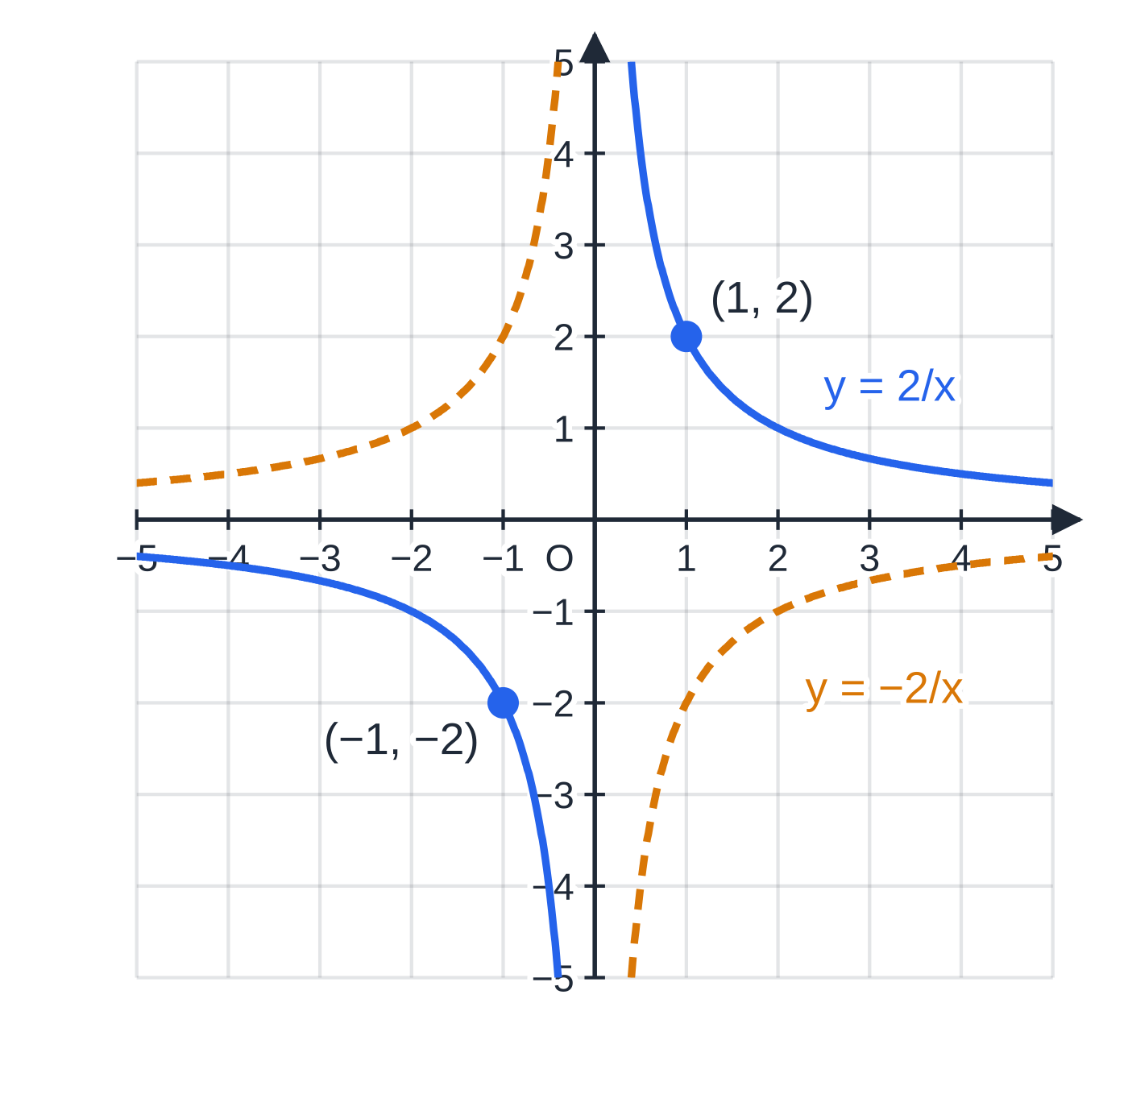
What do the graphs of y = k/x and y = k/x² look like? (continued)
Section 3 of 12
y=2/x (blue) and y=-2/x (amber, dashed). The coordinate axes are the asymptotes of both curves, and each curve has rotational symmetry about the origin.
Notes:
What do the graphs of y = k/x and y = k/x² look like?. Full notes: https://examinerprep.com/notes/edexcel-ial-maths/polynomials-curve-sketching-and-transformations/

Slide 16
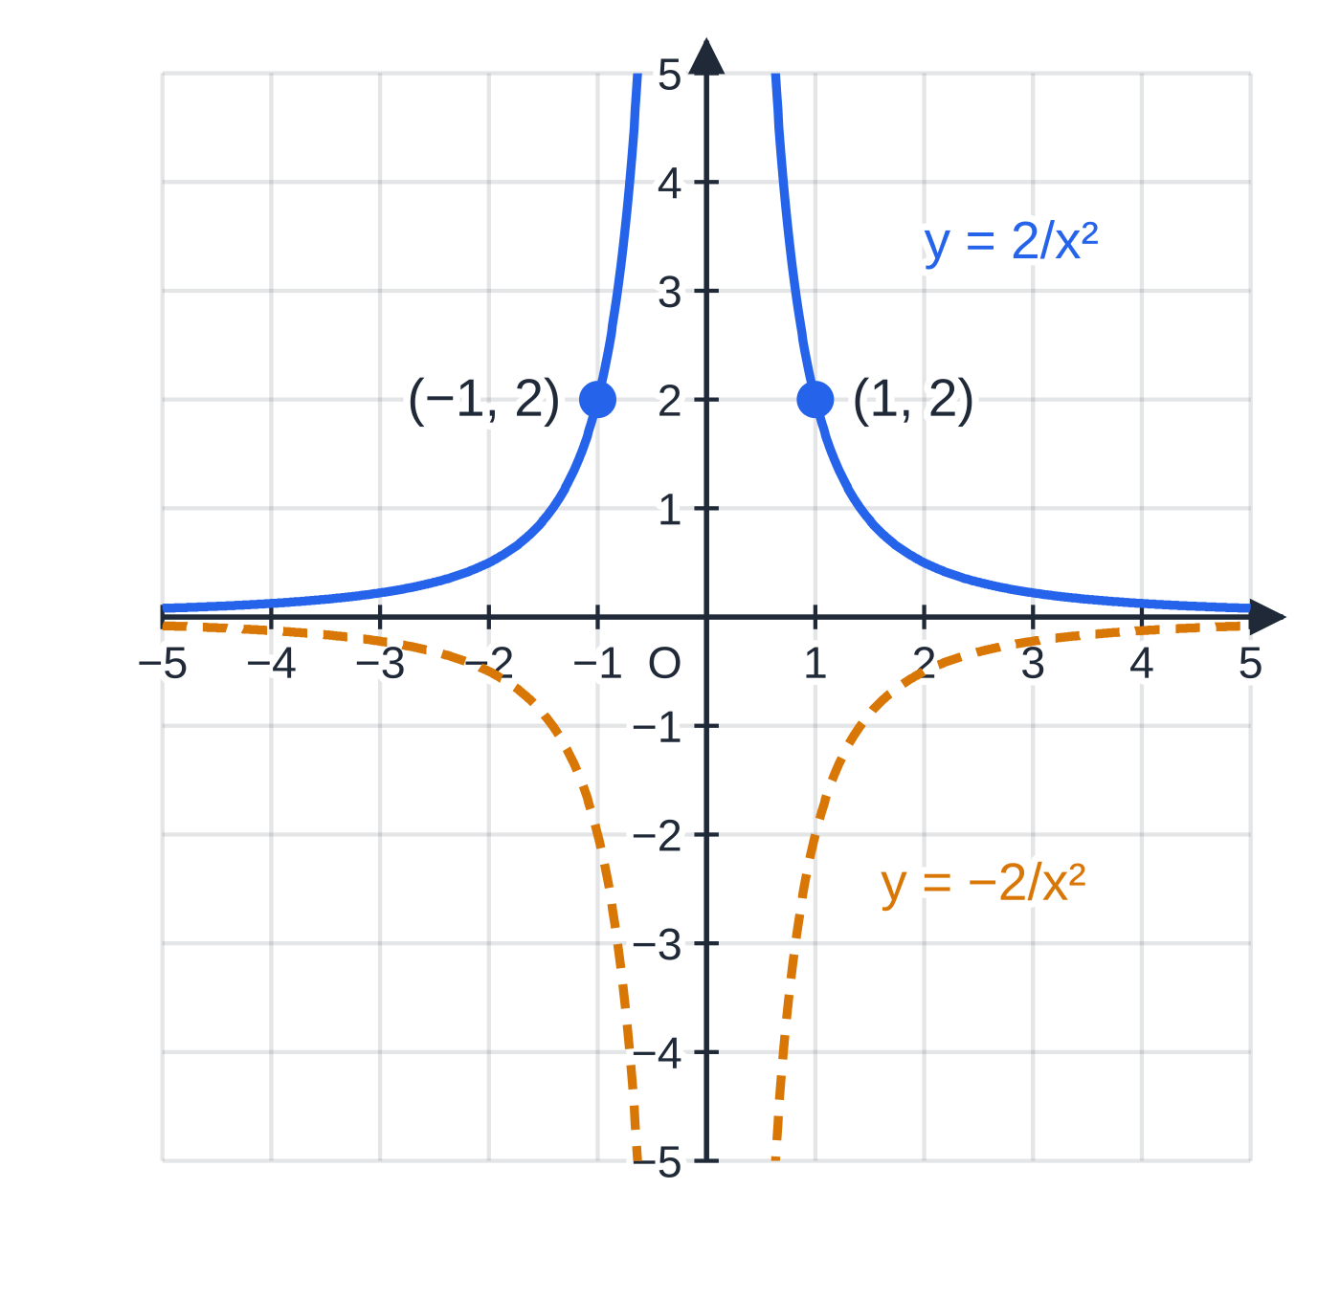
What do the graphs of y = k/x and y = k/x² look like? (continued)
Section 3 of 12
Compare the two families: y=k/x² falls away faster than y=k/x for |x|>1 and climbs faster near the y-axis. Both pass through (1, k).
y=2/x² and y=-2/x². Because x² is never negative, k/x² always has the sign of k, and each curve is symmetric in the y-axis.
Notes:
What do the graphs of y = k/x and y = k/x² look like?. Full notes: https://examinerprep.com/notes/edexcel-ial-maths/polynomials-curve-sketching-and-transformations/

Slide 17
How can a sketch tell you the number of solutions?
Section 4 of 12
Every point where y=f(x) and y=g(x) meet has an x-coordinate that satisfies f(x)=g(x). So the number of real solutions of f(x)=g(x) equals the number of intersection points, and you can count them without solving the equation.
Questions often hide this link. An equation such as x⁴-4x²-3=0 is really "cubic = reciprocal" after rearranging, and you are expected to show that rearrangement line by line. When you multiply through by x or x², note that x≠0: neither reciprocal curve exists at x=0, so no solutions are lost or gained.
Notes:
How can a sketch tell you the number of solutions?. Full notes: https://examinerprep.com/notes/edexcel-ial-maths/polynomials-curve-sketching-and-transformations/

Slide 18
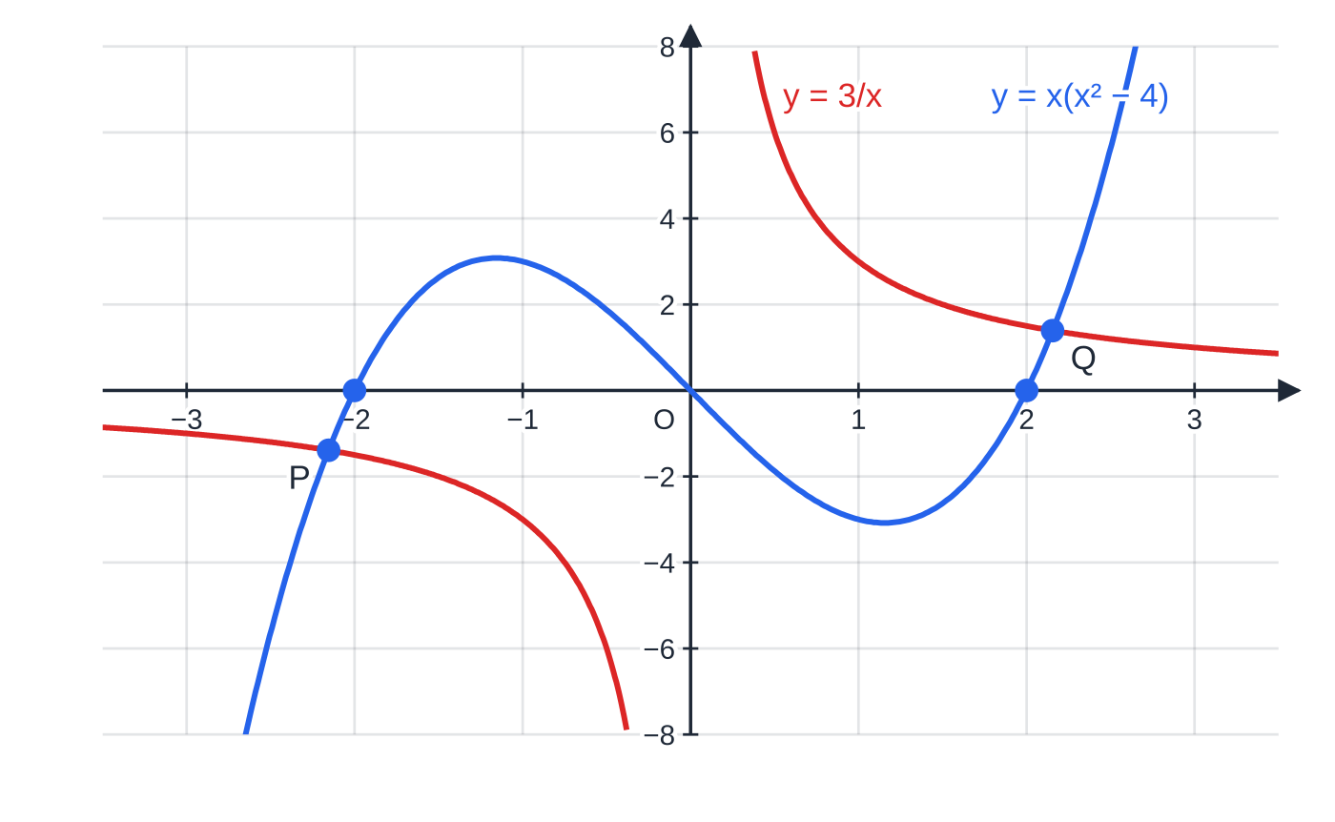
How can a sketch tell you the number of solutions? (continued)
Section 4 of 12 · Worked example 4 · Hard · Sketch, Show that, State
WORKED EXAMPLE · QUESTION
(a) On the same axes, sketch y=x(x²-4) and y=3/x.
(b) Show that the x-coordinates of the points of intersection satisfy x⁴-4x²-3=0.
(c) State the number of real solutions of this equation and find them exactly.
SOLUTION
(a) Cubic: x(x-2)(x+2), positive, roots -2, 0, 2. Reciprocal: 1st and 3rd quadrants, asymptotes the axes. See the figure.
y=x(x²-4) and y=3/x meet at exactly two points, P and Q, at x=±2.16. For -2<x<2 the two curves have opposite signs, so they can only meet where x<-2 or x>2.
Notes:
How can a sketch tell you the number of solutions?: Worked example 4. Full notes: https://examinerprep.com/notes/edexcel-ial-maths/polynomials-curve-sketching-and-transformations/

Slide 19
How can a sketch tell you the number of solutions? (continued)
Section 4 of 12 · Worked example 4 · Hard · Sketch, Show that, State (continued)
(b) Set the two expressions equal and multiply by x (x≠0): x(x²-4)=3/x⇒x⁴-4x²=3⇒x⁴-4x²-3=0 as required.
(c) The curves meet twice, so there are 2 real solutions. Solve as a quadratic in x²: x²=(4±√(16+12))/2=2±√7.
2-√7<0 is impossible for x², so x=±√(2+√7) (≈±2.16)
The algebra confirms the sketch: one positive and one negative solution, matching Q and P.
Notes:
How can a sketch tell you the number of solutions?: Worked example 4. Full notes: https://examinerprep.com/notes/edexcel-ial-maths/polynomials-curve-sketching-and-transformations/

Slide 20
How can a sketch tell you the number of solutions? (continued)
Section 4 of 12
Common error
Giving four solutions because a quartic "has four roots". A quartic has at most four real roots; here two values of x² are found, but one is negative, so it gives no real x.
Notes:
How can a sketch tell you the number of solutions?. Full notes: https://examinerprep.com/notes/edexcel-ial-maths/polynomials-curve-sketching-and-transformations/

Slide 21
How do the four transformations change a graph?
Section 5 of 12
New graph | Transformation | Point (x, y) moves to
y=f(x)+a | translation by a units in the positive y-direction (up if a>0) | (x, y+a)
y=f(x+a) | translation by a units in the negative x-direction (left if a>0) | (x-a, y)
y=af(x) | stretch parallel to the y-axis, scale factor a | (x, ay)
y=f(ax) | stretch parallel to the x-axis, scale factor 1/a | (x/a, y)
Outside the function (f(x)+a, af(x)) the change happens to y, exactly as written. Inside the function (f(x+a), f(ax)) the change happens to x, and it is the inverse: +a moves left, ×a divides by a. The reason: the new graph reaches the old height f(p) when x+a=p, that is at x=p-a, which is a units to the left.
a=-1 gives reflections: -f(x) reflects in the x-axis; f(-x) reflects in the y-axis.
Points on the axis that is not being stretched stay put: x-intercepts are unchanged by af(x); the y-intercept is unchanged by f(ax).
Notes:
How do the four transformations change a graph?. Full notes: https://examinerprep.com/notes/edexcel-ial-maths/polynomials-curve-sketching-and-transformations/

Slide 22
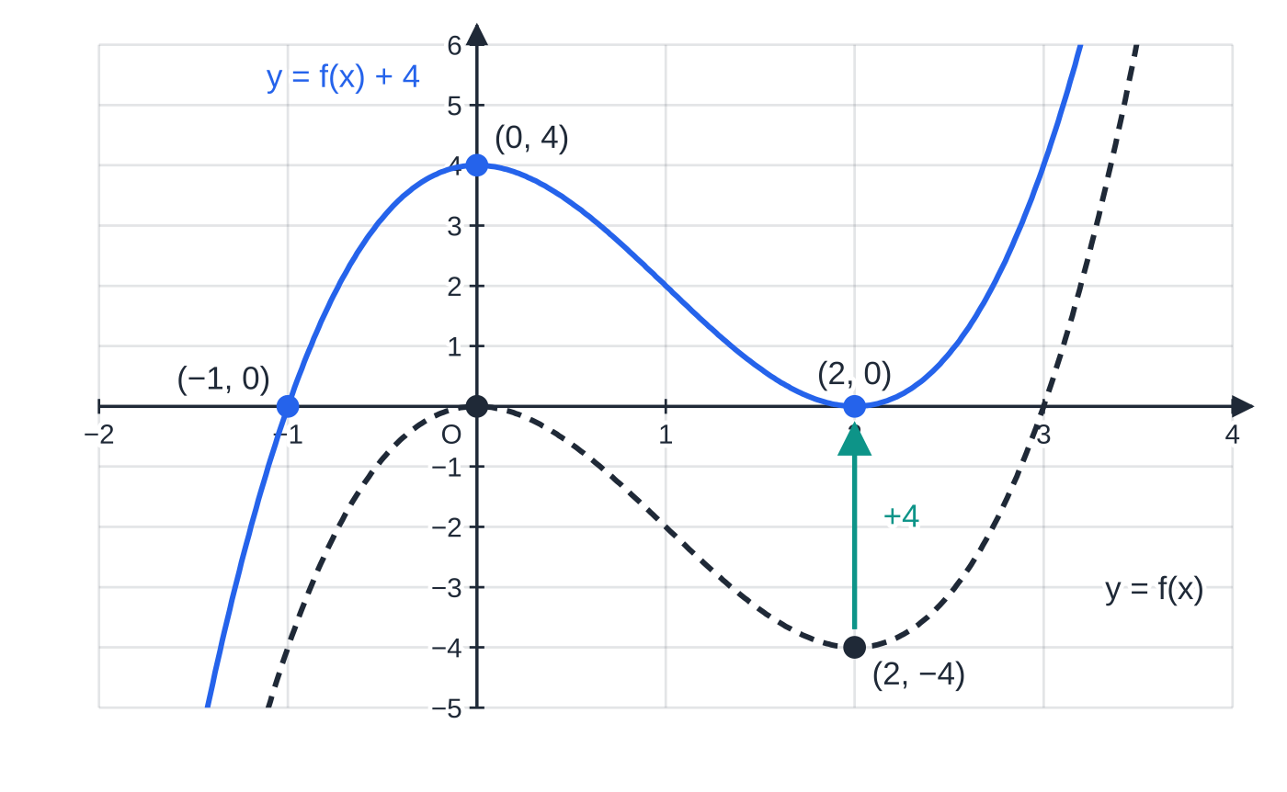
How do the four transformations change a graph? (continued)
Section 5 of 12
A turning point stays a turning point (a maximum stays a maximum unless a<0 flips it).
f(x)=x²(x-3) (dashed) has a maximum at (0, 0) and a minimum at (2, -4). Adding 4 lifts every point by 4, so the minimum lands on the axis: x²(x-3)+4=0 has a repeated root, and indeed it factorises as (x-2)²(x+1).
Notes:
How do the four transformations change a graph?. Full notes: https://examinerprep.com/notes/edexcel-ial-maths/polynomials-curve-sketching-and-transformations/

Slide 23
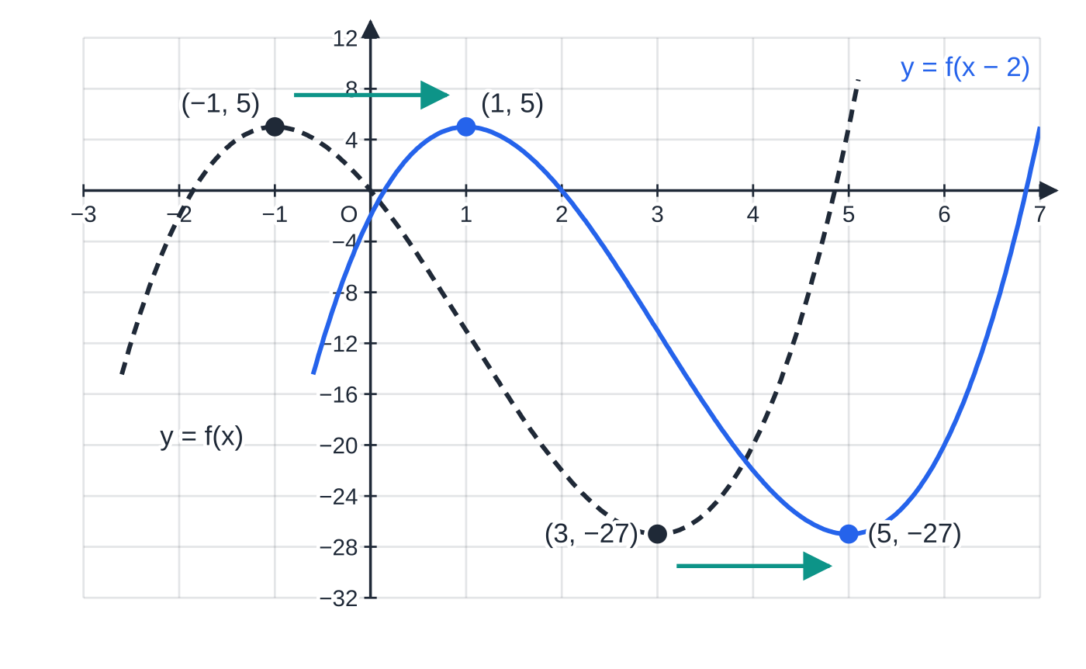
How do the four transformations change a graph? (continued)
Section 5 of 12 · Worked example 5 · Medium · Write down, Find
WORKED EXAMPLE · QUESTION
The curve y=f(x), where f(x)=x³-3x²-9x, passes through the origin, has a maximum at (-1, 5) and a minimum at (3, -27). Write down the coordinates of the turning points of (a) y=f(x-2) (b) y=3f(x) (c) y=f(½x). (d) Find the number of distinct real roots of f(x)+27=0.
SOLUTION
(a) Translation 2 units in the positive x-direction: maximum (1, 5), minimum (5, -27)
(b) Stretch parallel to the y-axis, scale factor 3: maximum (-1, 15), minimum (3, -81)
Part (a): y=f(x-2) is y=f(x) moved 2 units to the right, and both turning points move with it.
Notes:
How do the four transformations change a graph?: Worked example 5. Full notes: https://examinerprep.com/notes/edexcel-ial-maths/polynomials-curve-sketching-and-transformations/

Slide 24
How do the four transformations change a graph? (continued)
Section 5 of 12 · Worked example 5 · Medium · Write down, Find (continued)
(c) Stretch parallel to the x-axis, scale factor 1÷½=2: maximum (-2, 5), minimum (6, -27)
(d) y=f(x)+27 moves the minimum to (3, 0), on the axis, and the maximum to (-1, 32). The curve touches the axis at x=3 and crosses once to the left: 2 distinct roots
Check: x³-3x²-9x+27=(x-3)²(x+3), with roots 3 (repeated) and -3.
Notes:
How do the four transformations change a graph?: Worked example 5. Full notes: https://examinerprep.com/notes/edexcel-ial-maths/polynomials-curve-sketching-and-transformations/

Slide 25
How do the four transformations change a graph? (continued)
Section 5 of 12
Exam tip
To check an "inside the bracket" answer, substitute back: for y=f(x-2) at x=1, you get f(1-2)=f(-1)=5, the old maximum. If the substitution does not land on the old point, the shift went the wrong way.
Notes:
How do the four transformations change a graph?. Full notes: https://examinerprep.com/notes/edexcel-ial-maths/polynomials-curve-sketching-and-transformations/

Slide 26
What happens to asymptotes and trig graphs?
Section 6 of 12
Asymptotes move with the graph
A vertical asymptote x=c is moved by f(x+a) to x=c-a, and by f(ax) to x=c/a.
A horizontal asymptote y=d is moved by f(x)+a to y=d+a, and by af(x) to y=ad.
An asymptote along an axis that is being stretched towards stays where it is: y=0 is still an asymptote of 5/x, and x=0 is still one of 1/2x.
After moving the asymptotes, find any new intercepts by substitution: a translated reciprocal curve can now cross an axis.
Notes:
What happens to asymptotes and trig graphs?. Full notes: https://examinerprep.com/notes/edexcel-ial-maths/polynomials-curve-sketching-and-transformations/

Slide 27
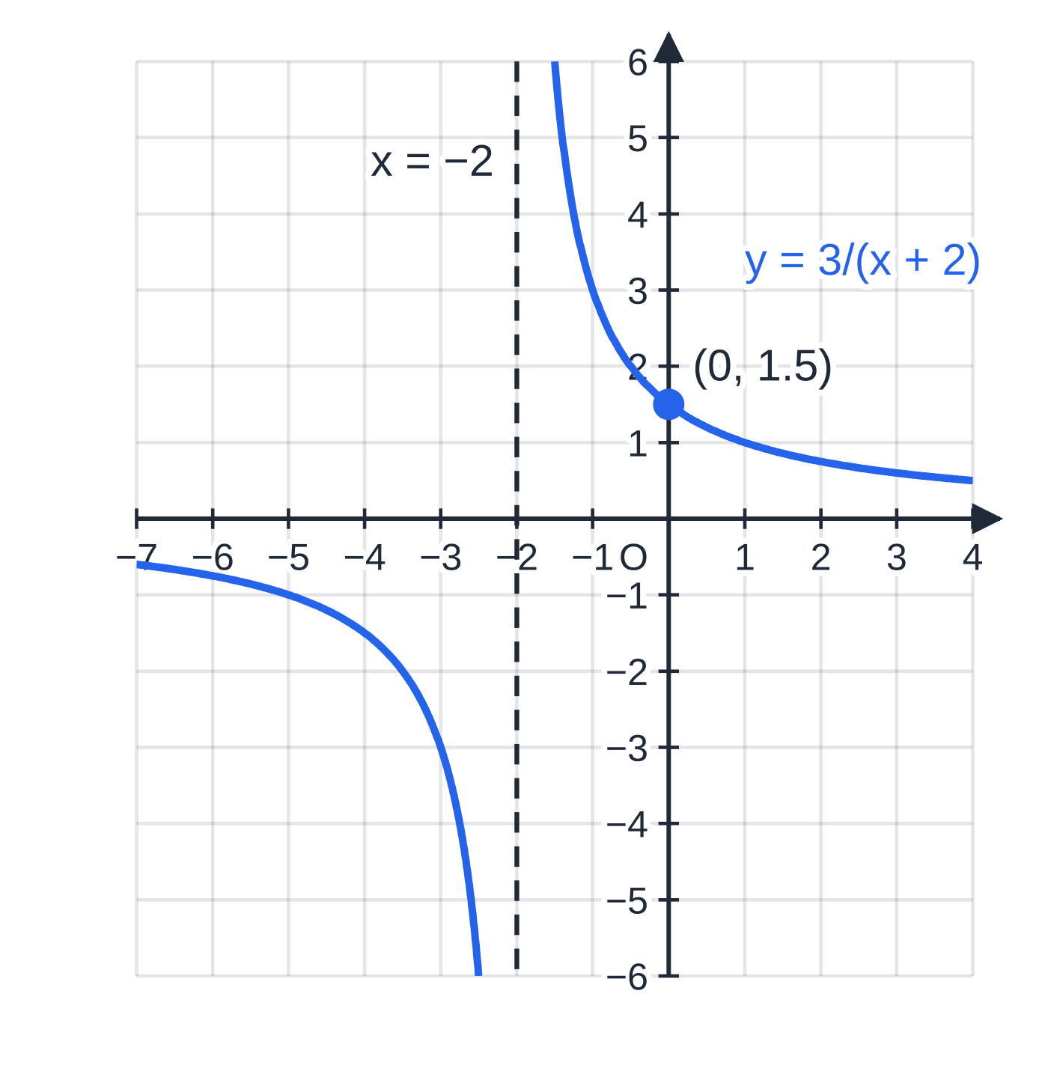
What happens to asymptotes and trig graphs? (continued)
Section 6 of 12 · Worked example 6 · Medium · State
WORKED EXAMPLE · QUESTION
For each curve, state the transformation of y=k/x or y=k/x², the equations of its asymptotes and the coordinates of any points where it meets the axes. (a) y=3/(x+2) (b) y=4/x²-1
(a) The translation f(x+2) moves the vertical asymptote to x=-2; the curve now meets the y-axis at (0, 1.5).
Notes:
What happens to asymptotes and trig graphs?: Worked example 6. Full notes: https://examinerprep.com/notes/edexcel-ial-maths/polynomials-curve-sketching-and-transformations/

Slide 28
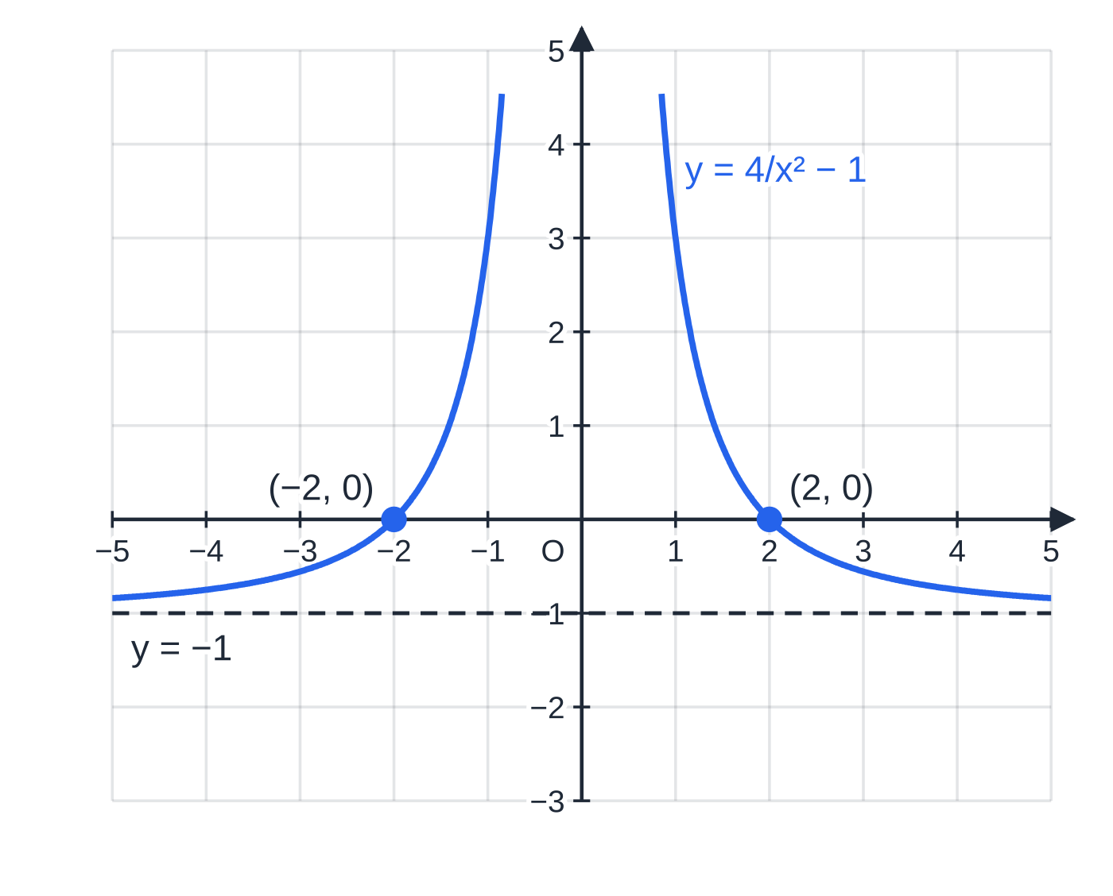
What happens to asymptotes and trig graphs? (continued)
Section 6 of 12 · Worked example 6 · Medium · State (continued)
SOLUTION
(a) f(x+2) with f(x)=3/x: a translation 2 units in the negative x-direction. Asymptotes x=-2 and y=0. x=0 gives y=(3/2). It never meets the x-axis, since 3 divided by anything is not 0. Asymptotes x=-2, y=0; meets the axes at (0, 1.5) only
(b) g(x)-1 with g(x)=4/x²: a translation 1 unit in the negative y-direction. Asymptotes x=0 and y=-1. y=0 gives x²=4. It never meets the y-axis, since x=0 is excluded. Asymptotes x=0, y=-1; meets the axes at (-2, 0) and (2, 0)
(b) Subtracting 1 moves the horizontal asymptote to y=-1, and the curve now crosses the x-axis where 4/x²=1, at x=±2.
Notes:
What happens to asymptotes and trig graphs?: Worked example 6. Full notes: https://examinerprep.com/notes/edexcel-ial-maths/polynomials-curve-sketching-and-transformations/

Slide 29
What happens to asymptotes and trig graphs? (continued)
Section 6 of 12
Trig graphs
The same four rules apply to y=sin x, cos x and tan x (in degrees here; radians work in the same way).
asin x: the amplitude becomes |a|.
sin ax: the period 360° is divided by a, so sin 2x has period 180°.
sin(x+a): the whole wave moves a° to the left; each zero, maximum and minimum moves with it.
The asymptotes of tan x at 90° and 270° move too: tan 2x has asymptotes every 90°, starting at 45°.
Notes:
What happens to asymptotes and trig graphs?. Full notes: https://examinerprep.com/notes/edexcel-ial-maths/polynomials-curve-sketching-and-transformations/

Slide 30
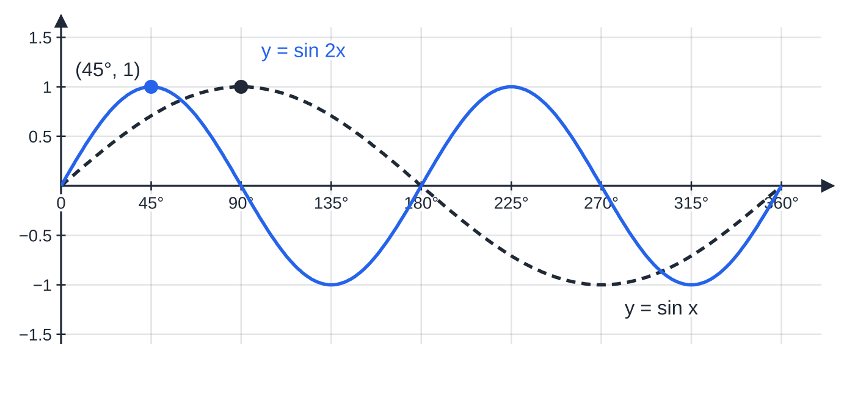
What happens to asymptotes and trig graphs? (continued)
Section 6 of 12
sin 2x fits two complete cycles into 0≤x≤360°; the first maximum moves from (90°, 1) to (45°, 1).
Notes:
What happens to asymptotes and trig graphs?. Full notes: https://examinerprep.com/notes/edexcel-ial-maths/polynomials-curve-sketching-and-transformations/

Slide 31
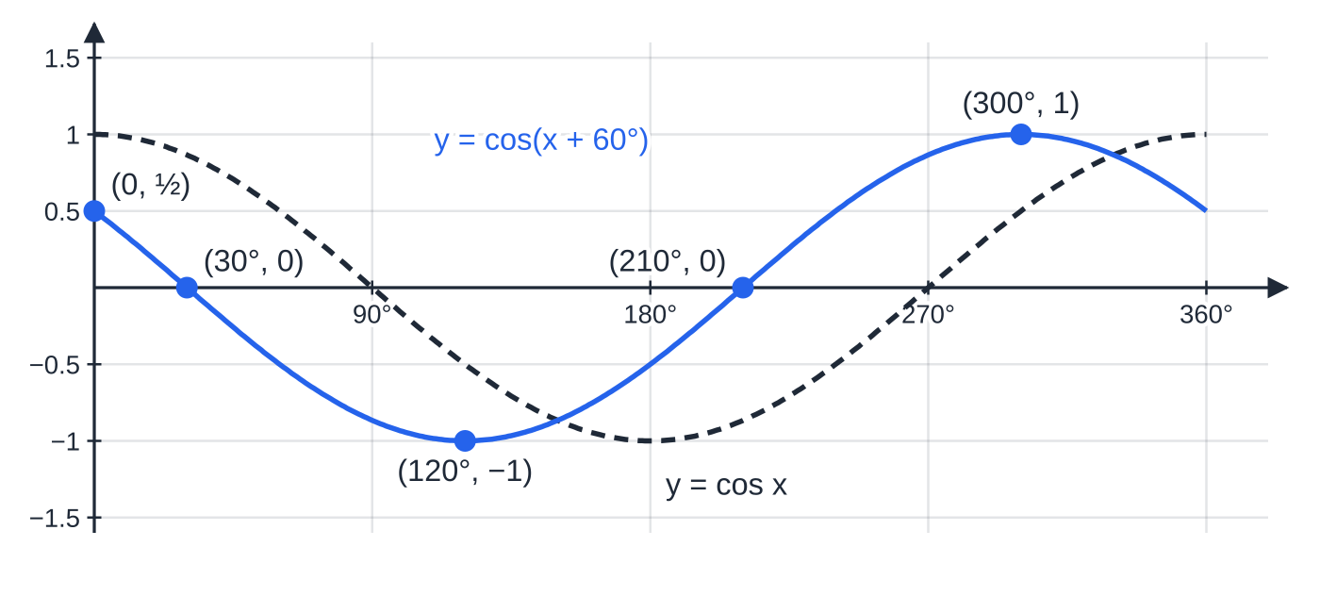
What happens to asymptotes and trig graphs? (continued)
Section 6 of 12 · Worked example 7 · Medium · Find, State
WORKED EXAMPLE · QUESTION
(a) For 0≤x≤360°, find the coordinates of the points where y=cos(x+60°) meets the axes, and of its maximum and minimum points.
(b) State the period of y=tan 2x and the equations of its asymptotes for 0≤x≤360°.
SOLUTION
(a) y-axis: x=0 gives cos 60°=½, so (0, ½).
x-axis: cos(x+60°)=0 when x+60°=90° or 270° (with 60°≤x+60°≤420°), so (30°, 0) and (210°, 0).
cos(x+60°) is cos x moved 60° to the left: the minimum moves from (180°, -1) to (120°, -1).
Notes:
What happens to asymptotes and trig graphs?: Worked example 7. Full notes: https://examinerprep.com/notes/edexcel-ial-maths/polynomials-curve-sketching-and-transformations/

Slide 32
What happens to asymptotes and trig graphs? (continued)
Section 6 of 12 · Worked example 7 · Medium · Find, State (continued)
Minimum where x+60°=180°; maximum where x+60°=360°. Minimum (120°, -1), maximum (300°, 1)
(b) A stretch parallel to the x-axis, scale factor ½: the period is 180°÷2. Period 90°; asymptotes x=45°, 135°, 225°, 315°
Notes:
What happens to asymptotes and trig graphs?: Worked example 7. Full notes: https://examinerprep.com/notes/edexcel-ial-maths/polynomials-curve-sketching-and-transformations/

Slide 33
What happens to asymptotes and trig graphs? (continued)
Section 6 of 12
Common error
Moving cos(x+60°) 60° to the right, or giving sin 2x a period of 720°. Both come from treating changes inside the bracket like changes outside it.
Notes:
What happens to asymptotes and trig graphs?. Full notes: https://examinerprep.com/notes/edexcel-ial-maths/polynomials-curve-sketching-and-transformations/

Slide 34
How do the ideas combine in a full question?
Section 7 of 12
A typical long question walks through the whole topic: factorise, sketch, add a second graph to count solutions, then transform. Each part feeds the next, so a correct sketch early on is worth the time.
Notes:
How do the ideas combine in a full question?. Full notes: https://examinerprep.com/notes/edexcel-ial-maths/polynomials-curve-sketching-and-transformations/

Slide 35
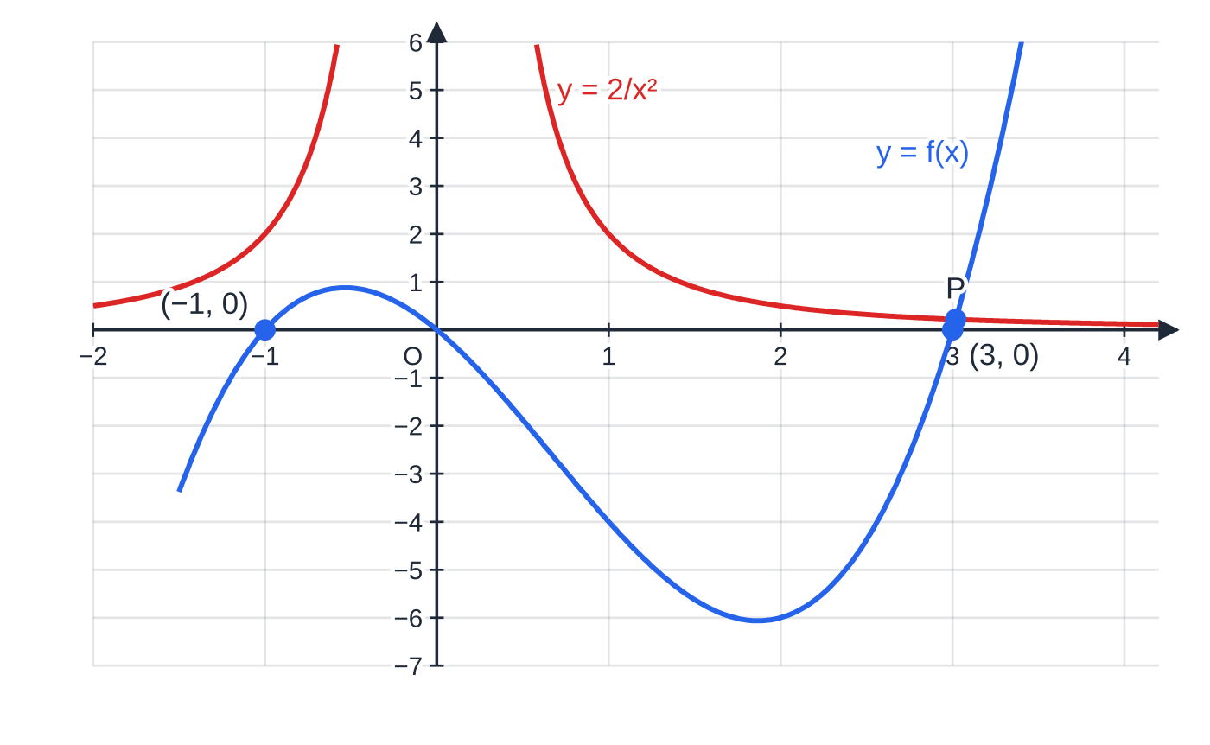
How do the ideas combine in a full question? (continued)
Section 7 of 12 · Worked example 8 · Hard · Factorise, Sketch, Hence
WORKED EXAMPLE · QUESTION
f(x)=x³-2x²-3x.
(a) Factorise f(x) completely.
(b) Sketch y=f(x), showing the coordinates of the points where the curve meets the axes.
(c) On the same axes, sketch y=2/x². Hence state, with a reason, the number of real solutions of x⁵-2x⁴-3x³-2=0.
(d) Sketch y=f(x+1), showing the coordinates of the points where it meets the axes.
Part (c): y=f(x) and y=2/x² meet once, at P, where x≈3.02.
Notes:
How do the ideas combine in a full question?: Worked example 8. Full notes: https://examinerprep.com/notes/edexcel-ial-maths/polynomials-curve-sketching-and-transformations/

Slide 36
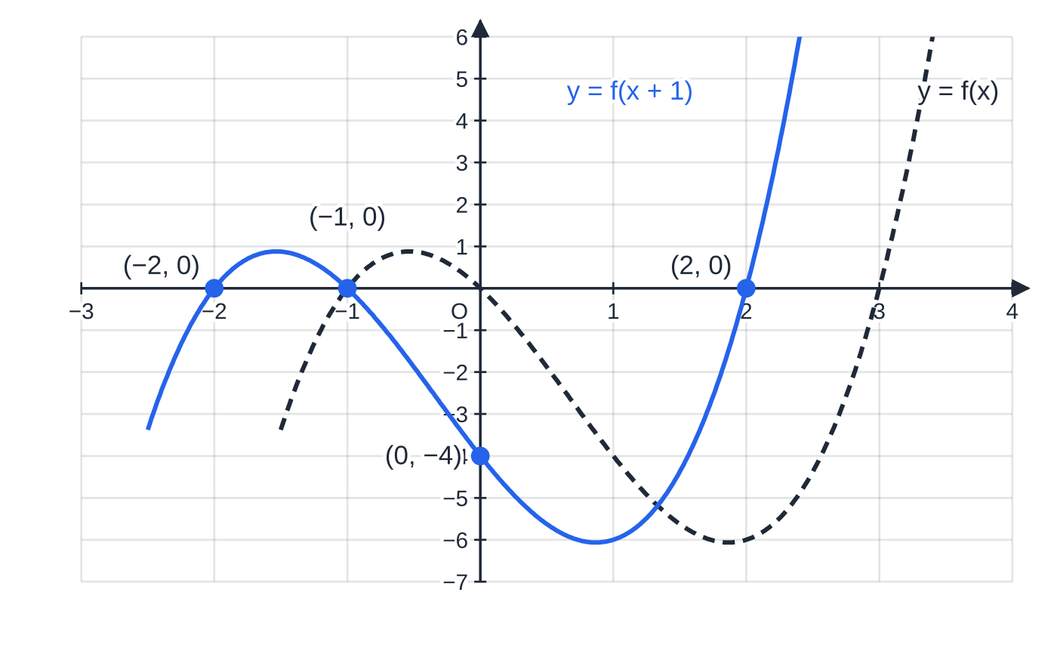
How do the ideas combine in a full question? (continued)
Section 7 of 12 · Worked example 8 · Hard · Factorise, Sketch, Hence (continued)
SOLUTION
(a) Common factor, then the quadratic: two numbers with product -3 and sum -2 are -3 and 1. f(x)=x(x-3)(x+1)
(b) Positive cubic; roots -1, 0, 3; it passes through the origin, so the y-intercept is (0, 0). Crosses at (-1, 0), (0, 0), (3, 0)
(c) 2/x²: two branches above the x-axis, asymptotes x=0 and y=0. Link the equation to the curves (x≠0): x³-2x²-3x=2/x²⇔x⁵-2x⁴-3x³-2=0.
Count the intersections.
Part (d): y=f(x+1) is the same cubic moved 1 unit to the left; it meets the y-axis at (0, f(1))=(0, -4).
Notes:
How do the ideas combine in a full question?: Worked example 8. Full notes: https://examinerprep.com/notes/edexcel-ial-maths/polynomials-curve-sketching-and-transformations/

Slide 37
How do the ideas combine in a full question? (continued)
Section 7 of 12 · Worked example 8 · Hard · Factorise, Sketch, Hence (continued)
For x<-1 and 0<x<3 the cubic is negative and the reciprocal positive: no meeting. For -1<x<0 the cubic stays below 1 (its maximum is about 0.88) while 2/x²>2: no meeting. For x>3 the cubic rises from 0 to ∞ while 2/x² falls towards 0: exactly one meeting. The curves meet once, so there is 1 real solution
(d) Translation 1 unit in the negative x-direction: subtract 1 from each root; the y-intercept is f(0+1)=f(1)=1-2-3=-4. Crosses at (-2, 0), (-1, 0), (2, 0); meets the y-axis at (0, -4)
Notes:
How do the ideas combine in a full question?: Worked example 8. Full notes: https://examinerprep.com/notes/edexcel-ial-maths/polynomials-curve-sketching-and-transformations/

Slide 38
How do the ideas combine in a full question? (continued)
Section 7 of 12
Exam tip
In a "hence" counting question, the reason is part of the answer. Write a sentence such as "the curves meet at one point, so the equation has one real solution", and show the algebra that turns the given equation into "curve 1 = curve 2".
Notes:
How do the ideas combine in a full question?. Full notes: https://examinerprep.com/notes/edexcel-ial-maths/polynomials-curve-sketching-and-transformations/

Slide 39
Exam tips for P1.3
Section 8 of 12
Exam tip 1 — label everything on the sketch
Write the coordinates of every axis crossing next to the point, and the equation of every asymptote next to its dashed line. A correct shape with no labels shows only part of the answer.
Exam tip 2 — read the ends from the leading term
Before plotting any roots, decide the sign of the x³ term (multiply the x-terms of each bracket). It fixes which corner the curve starts in, and the roots then decide the rest.
Exam tip 3 — inside does the opposite
Changes inside the bracket act on x the opposite way: f(x+3) moves left 3, f(4x) divides x-coordinates by 4. Outside the bracket, the change to y is exactly what you see.
Notes:
Exam tips for P1.3. Full notes: https://examinerprep.com/notes/edexcel-ial-maths/polynomials-curve-sketching-and-transformations/

Slide 40
Exam tips for P1.3 (continued)
Section 8 of 12
Exam tip 4 — check by substituting one point
After expanding, test x=1 in both forms. After transforming, put your new point into the new equation and confirm it gives the old y-value. Each check takes seconds.
Exam tip 5 — read the command word
"Sketch" means the correct shape with key points labelled, not plotted to scale. "Show that" needs every line of algebra leading to the given result. "Hence" means use the previous part, which here is usually the sketch.
Notes:
Exam tips for P1.3. Full notes: https://examinerprep.com/notes/edexcel-ial-maths/polynomials-curve-sketching-and-transformations/

Slide 41
Common misconceptions
Section 9 of 12
Misconception | Why it is wrong | Correct idea
f(x+2) moves the graph 2 units right. | The old value f(p) is now reached at x=p-2. | f(x+a) is a translation a units to the left.
f(2x) doubles every x-coordinate. | The old value f(p) is reached when 2x=p. | f(ax) divides x-coordinates by a: scale factor 1/a.
A repeated root is where the curve crosses twice. | A squared factor does not change sign either side of the root. | The curve touches the axis there; it is a turning point.
y=3/x² has a branch below the x-axis, like 3/x. | x²>0 for every x≠0. | Both branches are on the same side of the axis as the sign of k.
Asymptotes stay on the axes after a transformation. | The asymptote is part of the picture and moves with it. | Apply the same transformation to the asymptote's equation.
A stretch af(x) moves the roots. | 0×a=0, so points on the x-axis stay there. | Roots are unchanged by af(x); only the y-coordinates are scaled.
Notes:
Common misconceptions. Full notes: https://examinerprep.com/notes/edexcel-ial-maths/polynomials-curve-sketching-and-transformations/

Slide 42
How this topic connects
Section 10 of 12
P1.1 Quadratics and P1.6 Differentiation
The discriminant from P1.1 decides whether a line meets a curve; differentiation finds the exact turning points that a sketch here only shows roughly.
Factor theorem and algebraic division (P2); functions (P3)
When a cubic has no common factor of x, you find one root by trying values in f(x) and divide, then sketch exactly as here. Two or more transformations in sequence, modulus graphs |f(x)| and f(|x|), and inverse functions in P3 all build on the four rules on this page.
IAL Physics and Mechanics
Inverse-square laws (gravitational and electric field strength) follow y=k/x², and Boyle's law, p=k/V, is a y=k/x graph.
Notes:
How this topic connects. Full notes: https://examinerprep.com/notes/edexcel-ial-maths/polynomials-curve-sketching-and-transformations/

Slide 43
Key formulae
Section 11 of 12
Formula | Use | In the formulae list?
x²-a²=(x-a)(x+a) | difference of two squares when factorising | No – learn it
y=(x-p)(x-q)(x-r) | cubic with roots p, q, r; y-intercept -pqr | No – learn it
y=k/x, y=k/x² | reciprocal graphs; asymptotes x=0 and y=0 | No – learn it
y=f(x)+a | translation a units in the positive y-direction | No – learn it
y=f(x+a) | translation a units in the negative x-direction | No – learn it
y=af(x) | stretch parallel to the y-axis, scale factor a | No – learn it
y=f(ax) | stretch parallel to the x-axis, scale factor 1/a | No – learn it
Notes:
Key formulae. Full notes: https://examinerprep.com/notes/edexcel-ial-maths/polynomials-curve-sketching-and-transformations/

Slide 44
Check your understanding
Section 12 of 12
1. Expand (x-2)³.
2. State the equations of the asymptotes of y=5/(x-4).
3. The point (6, -2) lies on y=f(x). Write down its image on y=f(3x) and on y=f(x)-5.
4. How many times does y=x³ meet y=-1/x?
5. Write down the coordinates of the maximum and minimum points of y=4sin x for 0≤x≤360°.
6. Factorise x³-x²-12x completely and state where the curve y=x³-x²-12x meets the x-axis.
Notes:
Check your understanding: questions. Full notes: https://examinerprep.com/notes/edexcel-ial-maths/polynomials-curve-sketching-and-transformations/

Slide 45
Check your understanding · answers
Section 12 of 12
1. (x-2)²=x²-4x+4; multiplying by (x-2) gives x³-4x²+4x-2x²+8x-8= x³-6x²+12x-8.
2. It is 5/x translated 4 units in the positive x-direction: x=4 and y=0.
3. f(3x): divide the x-coordinate by 3, giving (2, -2). f(x)-5: subtract 5 from the y-coordinate, giving (6, -7).
4. Never. For x>0, x³ is positive and -1/x negative; for x<0 it is the other way round. The algebra agrees: x⁴=-1 has no real solution.
5. A stretch parallel to the y-axis, scale factor 4: maximum (90°, 4), minimum (270°, -4).
6. x(x²-x-12); two numbers with product -12 and sum -1 are -4 and 3, so x(x-4)(x+3). The curve crosses the x-axis at (-3, 0), (0, 0) and (4, 0).
Notes:
Check your understanding: answers. Full notes: https://examinerprep.com/notes/edexcel-ial-maths/polynomials-curve-sketching-and-transformations/

Slide 46
Practice questions
2 original exam-style questions. Answers at the end of the deck.

Slide 47
Question 1
7 marks
A cubic curve is given in factorised form. Its equation is y = (x − 4)(x + 1)(x + 3), and the curve is labelled C.
(a) Sketch C, showing the coordinates of the points where C meets the coordinate axes. [3]
(b) Show that the equation of C can be written as y = x³ − 13x − 12. [2]
(c) The line y = −12 meets C where C crosses the y-axis and at two other points. Find the exact x-coordinates of these two points. [2]
Notes:
Online with the full mark scheme: https://examinerprep.com/ial-maths-p1-3-polynomials-curve-sketching-and-transformations-questions#IALM-P1-3-B-02

Slide 48
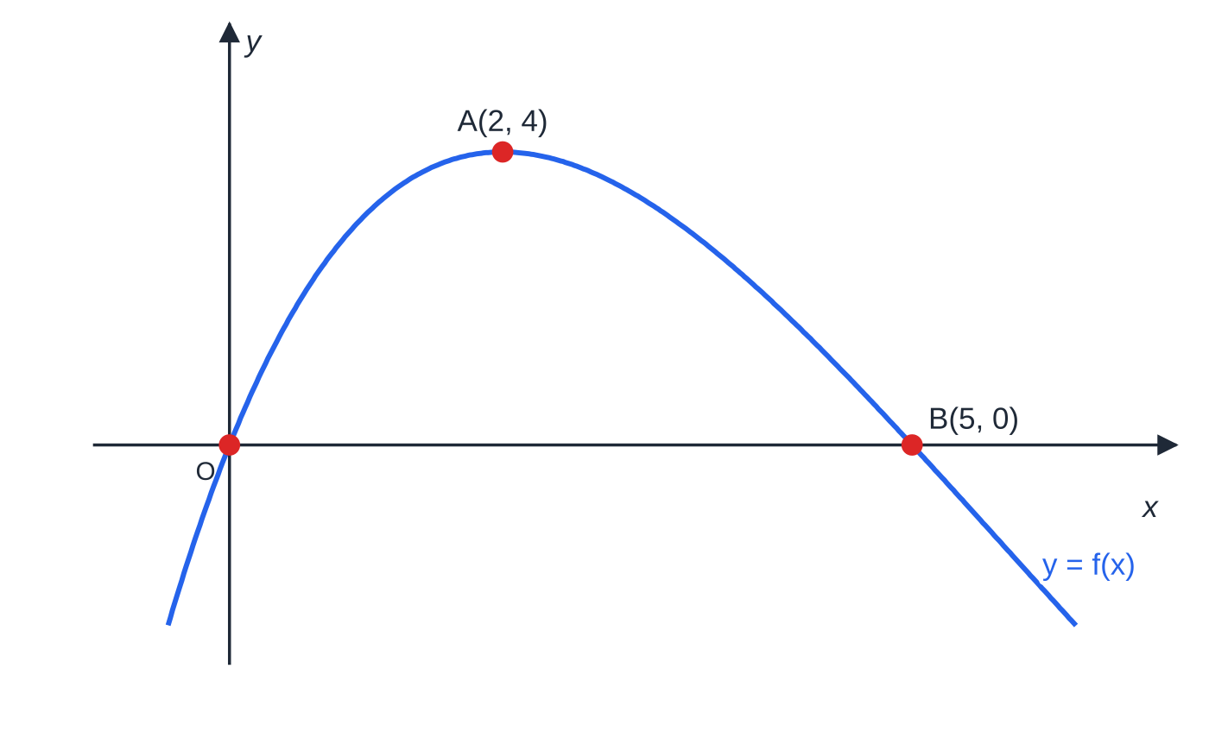
Question 2
7 marks
The curve with equation y = f(x) passes through the origin O, has a maximum point at A(2, 4) and meets the x-axis again at B(5, 0). The curve has no other turning points.
Figure: sketch of y = f(x)
(a) Write down the coordinates of the images of O, A and B on the curve y = f(x) − 4. [2]
(b) Write down the coordinates of the images of O, A and B on the curve y = f(x + 2). [2]
(c) Write down the coordinates of the maximum point of y = 3f(x). [1]
(d) Write down the coordinates of the images of A and B on the curve y = f(2x). [1]
(e) State, with a reason, the number of solutions of the equation f(x) = 4. [1]
Notes:
Online with the full mark scheme: https://examinerprep.com/ial-maths-p1-3-polynomials-curve-sketching-and-transformations-questions#IALM-P1-3-B-04

Slide 49
Answers

Slide 50
Question 1 · answer
Mark scheme
positive cubic shape: from bottom left to top right with a maximum and a minimum
crosses the x-axis at (−3, 0), (−1, 0) and (4, 0)
meets the y-axis at (0, −12)
(x + 1)(x + 3) = x² + 4x + 3
(x − 4)(x² + 4x + 3) = x³ + 4x² + 3x − 4x² − 16x − 12 = x³ − 13x − 12
x³ − 13x − 12 = −12, so x³ − 13x = 0, x(x² − 13) = 0
x = √13 and x = −√13
Notes:
Full mark scheme: https://examinerprep.com/ial-maths-p1-3-polynomials-curve-sketching-and-transformations-questions#IALM-P1-3-B-02

Slide 51
Question 2 · answer
Mark scheme
maximum at (2, 0)
(0, −4) and (5, −4)
maximum at (0, 4)
(−2, 0) and (3, 0)
(2, 12)
(1, 4) and (2.5, 0)
one solution, because the line y = 4 only touches the curve at its maximum A, the only turning point (accept: f(x) − 4 = 0 has its maximum on the x-axis, as in part (a))
Notes:
Full mark scheme: https://examinerprep.com/ial-maths-p1-3-polynomials-curve-sketching-and-transformations-questions#IALM-P1-3-B-04

Slide 52
Keep practising
Notes for this topic
Questions on this topic
Build a printable test
ExaminerPrep is an independent tutoring service. It has been developed independently from and is not endorsed by the International Baccalaureate Organization. "International Baccalaureate", "IB" and "IB Diploma Programme" are registered trademarks of the IBO, used here for descriptive purposes only.
Pearson Edexcel and Cambridge are trademarks of their owners; ExaminerPrep is not affiliated with any exam board.

