Slide 1
EP
EDEXCEL IAL MATHS
S1.3 Probability
The full notes page in 13 sections · practice questions with answers · simulations
ExaminerPrep is an independent tutoring service. It has been developed independently from and is not endorsed by the International Baccalaureate Organization. "International Baccalaureate", "IB" and "IB Diploma Programme" are registered trademarks of the IBO, used here for descriptive purposes only.
Pearson Edexcel and Cambridge are trademarks of their owners; ExaminerPrep is not affiliated with any exam board.
Notes:
S1.3 Probability. Notes for this topic: https://examinerprep.com/notes/edexcel-ial-maths/probability/

Slide 2
What this page covers
Overview
Experiments, outcomes, sample spaces and events; probabilities from equally likely outcomes
Set notation A′, A∩B, A∪B; complementary and mutually exclusive events
The addition law and the multiplication law
Conditional probability P(A|B) from formulae, Venn diagrams, two-way tables and tree diagrams
Testing whether two events are independent
Venn diagrams with two or three events, using counts or probabilities
Tree diagrams with and without replacement, and "reversed" conditional probabilities
Notes:
What this page covers. Full notes: https://examinerprep.com/notes/edexcel-ial-maths/probability/

Slide 3
In one minute
Key points
1. Probability measures how likely an event is on a scale from 0 to 1, and almost every S1 probability question is solved by three laws (complement, addition, multiplication) kept honest by a Venn diagram or a tree diagram.
2. Equally likely outcomes: P(A)=n(A)/n(S). Complement: P(A′)=1-P(A); use it for "at least one".
3. Addition law: P(A∪B)=P(A)+P(B)-P(A∩B). If A and B are mutually exclusive, P(A∩B)=0.
4. Conditional probability: P(A|B)=P(A∩B)/P(B): the given event B becomes the new whole.
5. Independence: A and B are independent if and only if P(A∩B)=P(A)×P(B) (equivalently P(A|B)=P(A)). Test it with numbers and state a conclusion.
6. Trees: multiply along branches, add between paths. Without replacement, the second set of branches changes.
Notes:
In one minute. Full notes: https://examinerprep.com/notes/edexcel-ial-maths/probability/

Slide 4
What are sample spaces, events and equally likely outcomes?
Section 1 of 13
Probability questions in S1 are short to state and easy to get wrong. Almost every error comes from adding when you should multiply, dividing by the wrong total, or forgetting that a second pick changes when the first is not replaced. The cure is to be precise about what can happen.
Sample space. The sample space S is the set of all possible outcomes of an experiment; an event is any set of these outcomes. When all outcomes are equally likely, P(A)=n(A)/n(S), and always 0≤P(A)≤1 (0 impossible, 1 certain).
An experiment is anything with an uncertain result: rolling a dice, choosing a person from a list, testing a component. An event such as "the score is even" is identified with the set of outcomes that make it happen. For a two-stage experiment, list the sample space as a grid, one stage across and one down: every cell is one equally likely outcome, so counting cells gives probabilities.
Notes:
What are sample spaces, events and equally likely outcomes?. Full notes: https://examinerprep.com/notes/edexcel-ial-maths/probability/

Slide 5
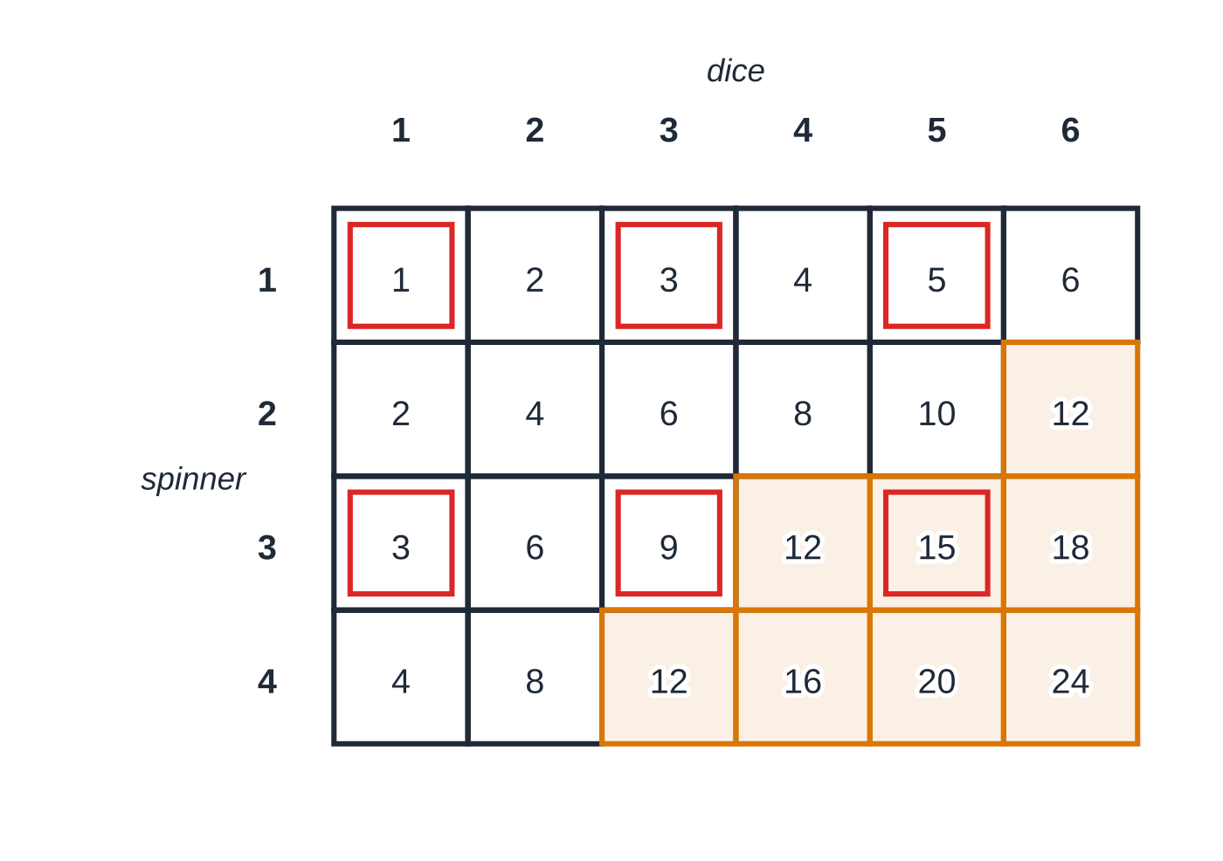
What are sample spaces, events and equally likely outcomes? (continued)
Section 1 of 13 · Worked example 1 · Easy · Find
WORKED EXAMPLE · QUESTION
A fair four-sided spinner numbered 1, 2, 3, 4 is spun and a fair six-sided dice is rolled. The score is the product of the two numbers. G is the event "the score is at least 12" and D is the event "the score is odd". (a) Find P(G) and P(D). (b) Find P(G∩D). (c) Find P(G∪D).
SOLUTION
(a) Count the cells: P(G)=(8/24)= ⅓, P(D)=(6/24)= ¼.
(b) An odd product needs both numbers odd; only 3×5=15 is also at least 12: P(G∩D)=(1/24).
The 24 equally likely outcomes, each cell showing the product. Shaded cells: product at least 12 (G). Red outlines: odd product (D). The two events share only the cell 3×5=15.
Notes:
What are sample spaces, events and equally likely outcomes?: Worked example 1. Full notes: https://examinerprep.com/notes/edexcel-ial-maths/probability/

Slide 6
What are sample spaces, events and equally likely outcomes? (continued)
Section 1 of 13 · Worked example 1 · Easy · Find (continued)
(c) Count cells in either event without counting 15 twice: (8/24)+(6/24)-(1/24)= (13/24). This is the addition law; counting the 13 marked cells directly agrees.
Notes:
What are sample spaces, events and equally likely outcomes?: Worked example 1. Full notes: https://examinerprep.com/notes/edexcel-ial-maths/probability/

Slide 7
What do complementary and mutually exclusive mean?
Section 2 of 13
Term | Meaning | Rule
Complement A′ | "A does not happen": every outcome not in A | P(A′)=1-P(A)
Intersection A∩B | "A and B": outcomes in both | from a diagram, the addition law or the multiplication law
Union A∪B | "A or B (or both)": outcomes in at least one | P(A∪B)=P(A)+P(B)-P(A∩B)
Mutually exclusive | A and B cannot both happen: A∩B=∅ | P(A∩B)=0, so P(A∪B)=P(A)+P(B)
Exhaustive | between them the events cover the whole sample space | P(A∪B)=1
Notes:
What do complementary and mutually exclusive mean?. Full notes: https://examinerprep.com/notes/edexcel-ial-maths/probability/

Slide 8
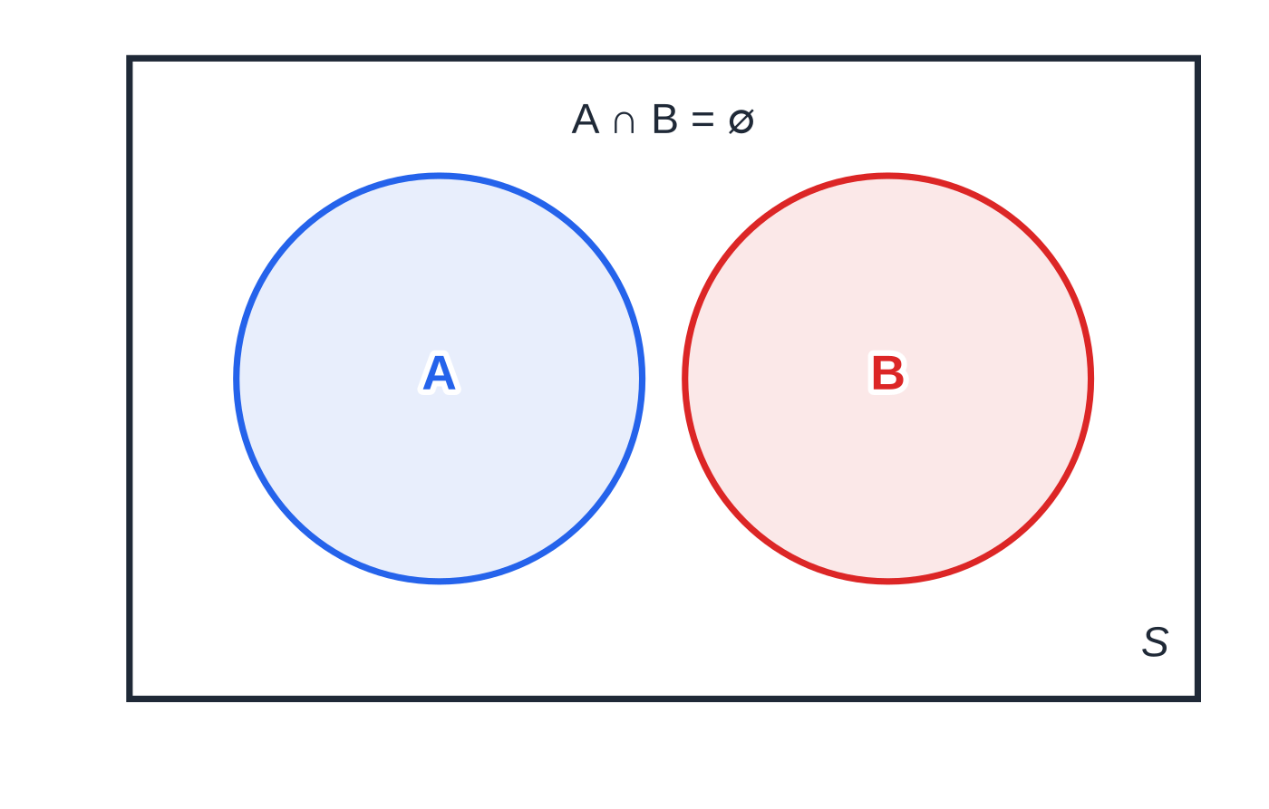
What do complementary and mutually exclusive mean? (continued)
Section 2 of 13
A and A′ are always mutually exclusive and exhaustive, which is why their probabilities add to 1. Three consequences are used constantly:
"At least one" is the complement of "none". For two fair dice, P(at least one six)=1-(5/6)²=(11/36). Adding ⅙+⅙ would count the double six twice.
A∩B′ means "A but not B", and P(A∩B′)=P(A)-P(A∩B).
"Neither A nor B" is A′∩B′, the complement of A∪B.
Mutually exclusive events: the circles do not overlap, so P(A∩B)=0 and the probabilities simply add.
Notes:
What do complementary and mutually exclusive mean?. Full notes: https://examinerprep.com/notes/edexcel-ial-maths/probability/

Slide 9
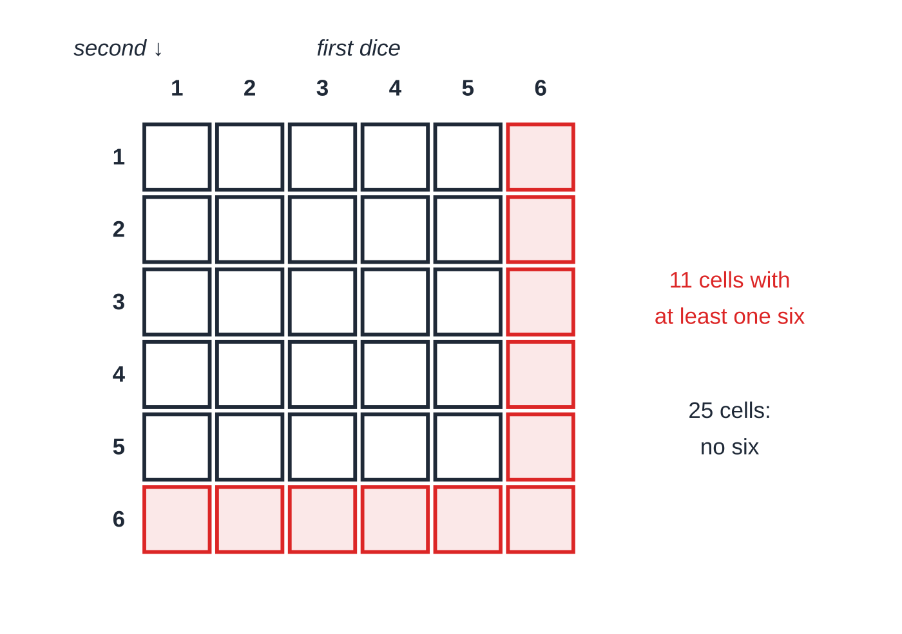
What do complementary and mutually exclusive mean? (continued)
Section 2 of 13
Common error
Writing "mutually exclusive" when the question means "independent", or the reverse. Mutually exclusive is about the events overlapping (P(A∩B)=0); independence is about one event changing the chance of the other. Two events with non-zero probabilities cannot be both.
Two fair dice: the 11 shaded cells contain at least one six. It is quicker to count the 25 unshaded cells ("no six") and use 1-(25/36)=(11/36).
Notes:
What do complementary and mutually exclusive mean?. Full notes: https://examinerprep.com/notes/edexcel-ial-maths/probability/

Slide 10
How does the addition law work?
Section 3 of 13
The addition law.
P(A∪B)=P(A)+P(B)-P(A∩B) P(A)+P(B) counts the overlap A∩B twice, so it is subtracted once.
Any three of the four quantities give the fourth, and a Venn diagram shows all of them at once. To fill a two-event Venn diagram, start with the intersection, subtract it from P(A) and P(B) to get "A only" and "B only", then the outside is 1 minus the other three. Always check that the four regions add to 1. The number inside circle A but outside B is P(A∩B′), not P(A).
Notes:
How does the addition law work?. Full notes: https://examinerprep.com/notes/edexcel-ial-maths/probability/

Slide 11
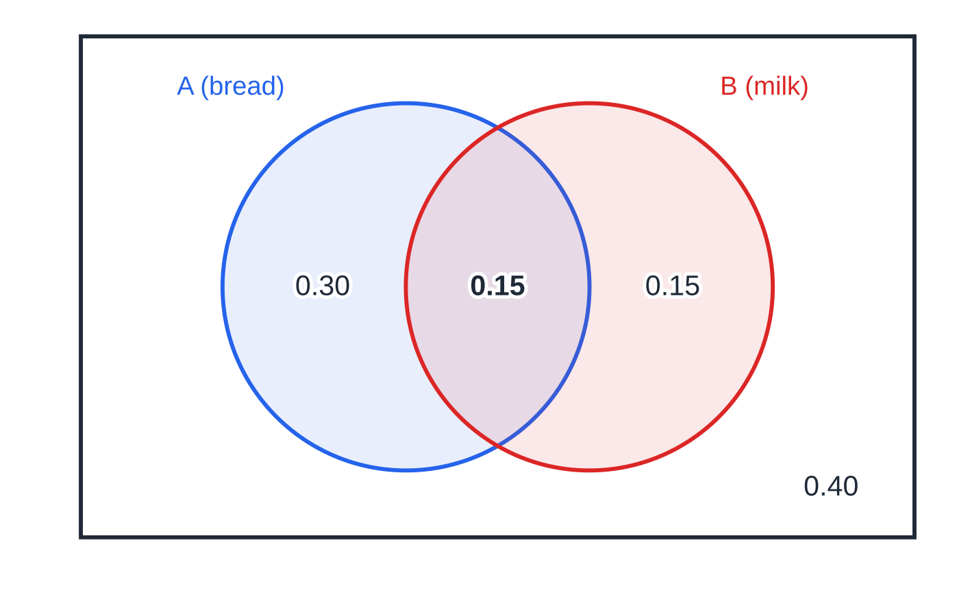
How does the addition law work? (continued)
Section 3 of 13 · Worked example 2 · Medium · Find, draw
WORKED EXAMPLE · QUESTION
A customer at a corner shop is chosen at random. A is the event that the customer buys bread and B the event that the customer buys milk. P(A)=0.45, P(B)=0.3 and P(A∪B)=0.6. (a) Find P(A∩B). (b) Draw a Venn diagram showing the probabilities. (c) Find the probability that the customer buys exactly one of bread and milk. (d) Find P(A′∪B′).
SOLUTION
(a) Rearrange the addition law: P(A∩B)=0.45+0.3-0.6= 0.15.
Worked example 2 as a Venn diagram. The rectangle is the sample space, so the four region values add to 1. Circle A holds 0.30+0.15=0.45 in total.
Notes:
How does the addition law work?: Worked example 2. Full notes: https://examinerprep.com/notes/edexcel-ial-maths/probability/

Slide 12
How does the addition law work? (continued)
Section 3 of 13 · Worked example 2 · Medium · Find, draw (continued)
(b) A only =0.45-0.15=0.3; B only =0.3-0.15=0.15; neither =1-0.6=0.4 (figure).
(c) Exactly one = A only + B only =0.3+0.15= 0.45.
(d) A′∪B′ is everything except A∩B: 1-0.15= 0.85.
Notes:
How does the addition law work?: Worked example 2. Full notes: https://examinerprep.com/notes/edexcel-ial-maths/probability/

Slide 13
How do you use a Venn diagram with three events?
Section 4 of 13
Three overlapping circles make eight regions: the centre (all three), three "exactly two" regions, three "one only" regions and the outside. Fill from the centre outwards: all three first, then each "two only" region (pair total minus centre), then each "one only" region. The diagram can hold counts or probabilities; with counts, divide by the right total at the end, either the whole rectangle or, for a conditional probability, the given event. An unknown x is usually found from a total: the eight regions add to the number surveyed (or to 1).
Notes:
How do you use a Venn diagram with three events?. Full notes: https://examinerprep.com/notes/edexcel-ial-maths/probability/

Slide 14
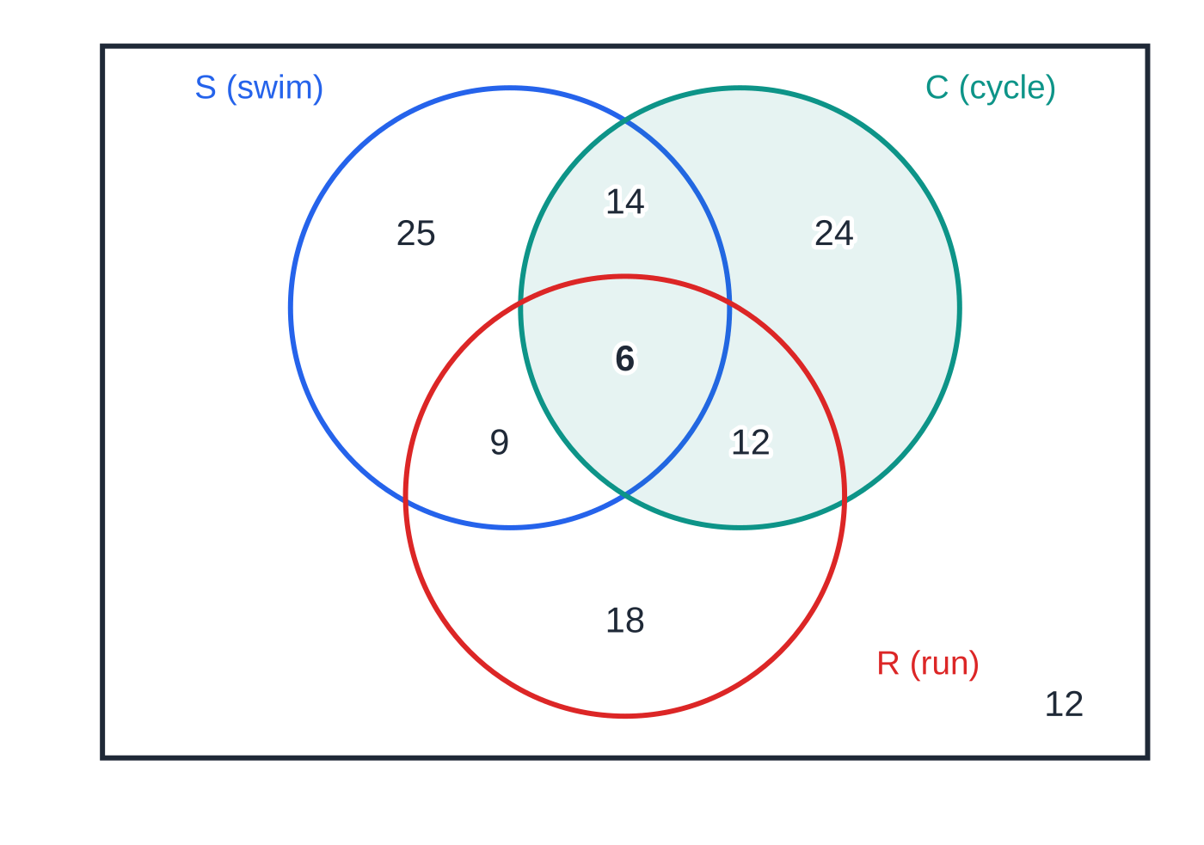
How do you use a Venn diagram with three events? (continued)
Section 4 of 13 · Worked example 3 · Hard · Find
WORKED EXAMPLE · QUESTION
Each of the 120 members of a sports club was asked whether they swim (S), cycle (C) or run (R). 6 do all three; 14 swim and cycle but do not run; 9 swim and run but do not cycle; x cycle and run but do not swim; 25 only swim; 18 only run; 12 do none of the three. The number who only cycle is twice the number who cycle and run but do not swim. (a) Find x. A member is chosen at random. Find the probability that the member (b) does exactly one of the activities, (c) swims, given that they cycle, (d) runs, given that they do at least two of the activities.
Worked example 3 after solving for x=12. Each number is the count in that region only; for P(S|C) the denominator is everything inside circle C (56).
Notes:
How do you use a Venn diagram with three events?: Worked example 3. Full notes: https://examinerprep.com/notes/edexcel-ial-maths/probability/

Slide 15
How do you use a Venn diagram with three events? (continued)
Section 4 of 13 · Worked example 3 · Hard · Find (continued)
SOLUTION
(a) The eight regions add to 120: 6+14+9+x+25+2x+18+12=120⇒84+3x=120⇒ x=12.
(b) The "only" regions: (25+24+18)/120= (67/120).
(c) The given event C is the new total: n(C)=14+6+12+24=56, so P(S|C)=(14+6)/56= (5/14).
(d) At least two activities: 14+9+12+6=41; of these the runners are 9+12+6=27: (27/41).
Notes:
How do you use a Venn diagram with three events?: Worked example 3. Full notes: https://examinerprep.com/notes/edexcel-ial-maths/probability/

Slide 16
What is conditional probability?
Section 5 of 13
Conditional probability.
P(A|B) is the probability that A happens, given that B is known to have happened. P(A|B)=P(A∩B)/P(B), P(A∩B)=P(A|B) P(B)=P(B|A) P(A) (with P(B)>0). The second form is the multiplication law, used along every branch of a tree diagram.
Why this formula? Knowing that B happened shrinks the sample space to B. Of that, the part where A also happens is A∩B. So the denominator is always the probability (or count) of the given event. From a Venn diagram or a two-way table of counts, P(A|B)=n(A∩B)÷n(B). Note that P(A|B) and P(B|A) are usually different: same numerator, different denominators. The words "given that", "if it is known that" and "of those who" all signal a conditional probability.
Notes:
What is conditional probability?. Full notes: https://examinerprep.com/notes/edexcel-ial-maths/probability/

Slide 17
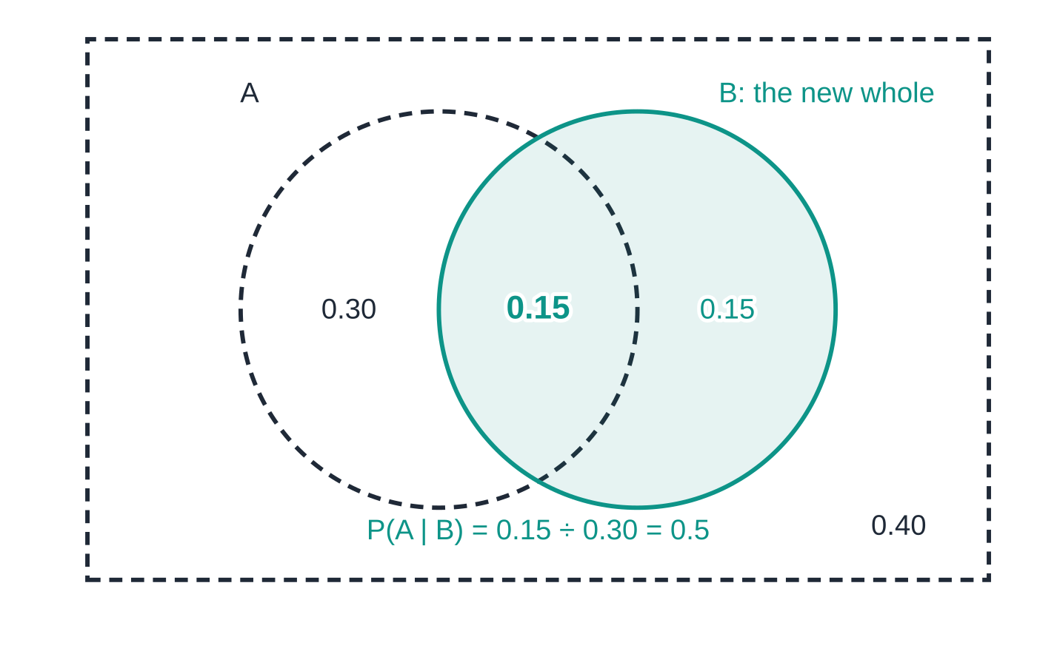
What is conditional probability? (continued)
Section 5 of 13
Using the shop data of Worked example 2: once we know the customer bought milk, only circle B (total 0.30) is left. The part also in A is 0.15, so P(A|B)=0.15÷0.30=0.5.
Notes:
What is conditional probability?. Full notes: https://examinerprep.com/notes/edexcel-ial-maths/probability/

Slide 18
What is conditional probability? (continued)
Section 5 of 13 · Worked example 4 · Medium · Find, determine
WORKED EXAMPLE · QUESTION
A museum recorded whether each of its visitors on one day hired an audio guide.
 | Hired a guide | Did not hire | Total
Adult | 72 | 88 | 160
Child | 18 | 72 | 90
Total | 90 | 160 | 250
One of these visitors is chosen at random. H is the event that the visitor hired a guide and D the event that the visitor is an adult. Find (a) P(H), (b) P(H|D), (c) P(D′|H). (d) Determine whether H and D are independent.
SOLUTION
(a) Column total over grand total: (90/250)= 0.36.
Notes:
What is conditional probability?: Worked example 4. Full notes: https://examinerprep.com/notes/edexcel-ial-maths/probability/

Slide 19
What is conditional probability? (continued)
Section 5 of 13 · Worked example 4 · Medium · Find, determine (continued)
(b) Restrict to the adult row: (72/160)= 0.45.
(c) Restrict to the "hired" column: (18/90)= 0.2.
(d) P(H|D)=0.45≠0.36=P(H), so H and D are not independent. Equivalently P(H∩D)=72/250=0.288, but P(H)×P(D)=0.36×0.64=0.2304.
Notes:
What is conditional probability?: Worked example 4. Full notes: https://examinerprep.com/notes/edexcel-ial-maths/probability/

Slide 20
How do you test whether two events are independent?
Section 6 of 13
Independent events. The occurrence of one does not change the probability of the other: P(A∩B)=P(A)×P(B). Equivalent tests (any one is enough): P(A∩B)=P(A)P(B), P(A|B)=P(A), P(B|A)=P(B).
Show the numbers on both sides and finish with a sentence: "0.2=0.4×0.5, so A and B are independent".
If A and B are independent, so are A and B′, A′ and B, A′ and B′.
Mutually exclusive events with P(A),P(B)>0 are never independent: P(A∩B)=0 but P(A)P(B)>0. If one happens, the other cannot, which is the strongest possible dependence.
Questions sometimes tell you that events are independent so that you can multiply; use that to set up an equation.
Notes:
How do you test whether two events are independent?. Full notes: https://examinerprep.com/notes/edexcel-ial-maths/probability/

Slide 21
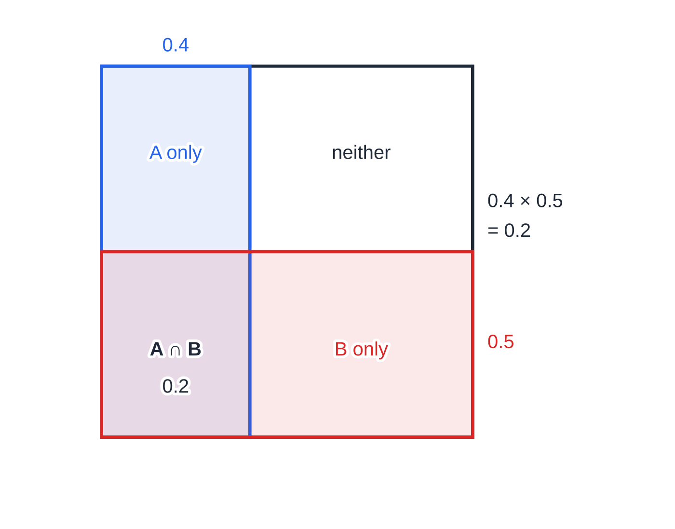
How do you test whether two events are independent? (continued)
Section 6 of 13
Independence as area. In a unit square, A is a strip of width 0.4 and B a strip of height 0.5. The overlap is a rectangle of area 0.4×0.5=0.2: knowing you are in B leaves the proportion in A at 0.4.
Notes:
How do you test whether two events are independent?. Full notes: https://examinerprep.com/notes/edexcel-ial-maths/probability/

Slide 22
How do you test whether two events are independent? (continued)
Section 6 of 13 · Worked example 5 · Medium · Find, comment
WORKED EXAMPLE · QUESTION
Events A and B are such that P(A)=0.4, P(B)=p and P(A∪B)=0.7. (a) Find p if A and B are mutually exclusive. (b) Find p if instead A and B are independent. (c) In the case of part (b), find P(A|B′) and comment on your answer.
SOLUTION
(a) The overlap is 0: 0.7=0.4+p⇒ p=0.3.
(b) The overlap is 0.4p: 0.7=0.4+p-0.4p⇒0.6p=0.3⇒ p=0.5.
(c) P(A∩B′)=0.4-0.2=0.2 and P(B′)=0.5, so P(A|B′)=(0.2/0.5)= 0.4 = P(A). As expected: A and B are independent, so A and B′ are too, and knowing B did not happen does not change the chance of A.
Notes:
How do you test whether two events are independent?: Worked example 5. Full notes: https://examinerprep.com/notes/edexcel-ial-maths/probability/

Slide 23
How do tree diagrams work, with and without replacement?
Section 7 of 13
A tree diagram organises an experiment in stages. Each set of branches from one point shows the outcomes of one stage, and the probabilities on those branches add to 1. Branches after the first stage carry conditional probabilities: the probability of the second outcome given the first. So:
multiply along a path to get the probability of that sequence (the multiplication law);
add the paths that make up an event (different paths are mutually exclusive);
for "at least one", use 1-P(none) rather than adding many paths.
With replacement (or independent stages) every set of branches is identical. Without replacement, the total goes down by 1 at each stage and so does the count of whatever was taken: the second stage depends on the first.
Notes:
How do tree diagrams work, with and without replacement?. Full notes: https://examinerprep.com/notes/edexcel-ial-maths/probability/

Slide 24
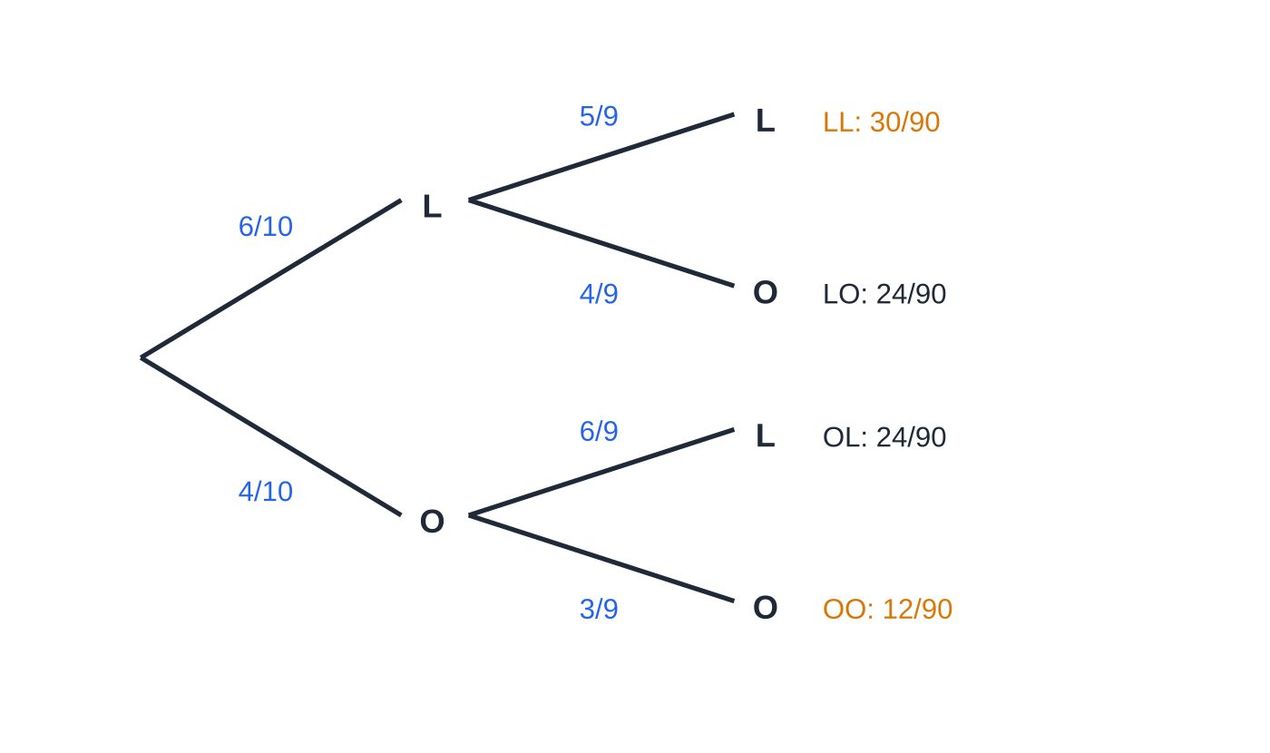
How do tree diagrams work, with and without replacement? (continued)
Section 7 of 13 · Worked example 6 · Medium · Find
WORKED EXAMPLE · QUESTION
A jar contains 6 lemon sweets and 4 orange sweets. Kai takes a sweet at random and eats it, then takes a second sweet at random. Find the probability that (a) both sweets are the same flavour, (b) at least one sweet is orange, (c) the second sweet is lemon. (d) Given that the second sweet is lemon, find the probability that the first was orange.
SOLUTION
(a) (6/10)×(5/9)+(4/10)×(3/9)=(30/90)+(12/90)= (7/15).
Two sweets without replacement from 6 lemon (L) and 4 orange (O). After a lemon there are 5 lemons in 9 sweets; after an orange, 6 lemons in 9. The four path probabilities add to 90/90 = 1. Amber: both the same flavour.
Notes:
How do tree diagrams work, with and without replacement?: Worked example 6. Full notes: https://examinerprep.com/notes/edexcel-ial-maths/probability/

Slide 25
How do tree diagrams work, with and without replacement? (continued)
Section 7 of 13 · Worked example 6 · Medium · Find (continued)
(b) Complement of "both lemon": 1-(30/90)= ⅔.
(c) Two paths end in lemon: (30/90)+(24/90)=(54/90)= (3/5).
(d) OL path over all paths ending in L: (24/90)/(54/90)= (4/9).
The answer to (c) equals (6/10): with no information about the first pick, each pick is equally likely to be any of the 10 sweets. With replacement, (a) would be 0.6²+0.4²=0.52, more than (7/15)≈0.467: removing a sweet makes a second of the same flavour less likely.
Notes:
How do tree diagrams work, with and without replacement?: Worked example 6. Full notes: https://examinerprep.com/notes/edexcel-ial-maths/probability/

Slide 26
How do tree diagrams work, with and without replacement? (continued)
Section 7 of 13
Common error
Keeping the denominator at 10 on the second branches, or reducing the denominator but forgetting to reduce the count of the flavour already taken. After a lemon is removed, it is 5 lemons out of 9, not 6 out of 9 or 5 out of 10.
Notes:
How do tree diagrams work, with and without replacement?. Full notes: https://examinerprep.com/notes/edexcel-ial-maths/probability/

Slide 27
How do you reverse a conditional probability on a tree?
Section 8 of 13
A tree is drawn in time order: first stage, then second stage given the first. Questions often ask the reverse: given the second outcome, what is the probability of the first? Use P(first|second)=P(first∩second)/P(second): the numerator is one path, the denominator is the sum of every path that gives the second outcome. Mark the paths that satisfy the given event first; the answer is "the paths you want" ÷ "all marked paths".
Notes:
How do you reverse a conditional probability on a tree?. Full notes: https://examinerprep.com/notes/edexcel-ial-maths/probability/

Slide 28
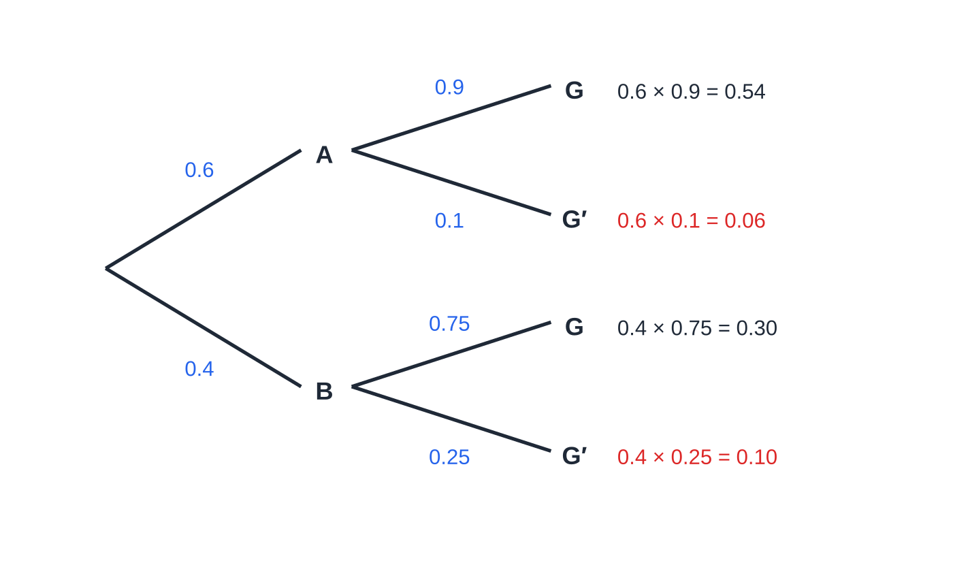
How do you reverse a conditional probability on a tree? (continued)
Section 8 of 13 · Worked example 7 · Medium · Find
WORKED EXAMPLE · QUESTION
A garden centre buys 60% of its seeds from supplier A and the rest from supplier B. A seed from A germinates with probability 0.9 and a seed from B with probability 0.75. A seed is chosen at random. (a) Find the probability that the seed germinates. (b) Given that the seed does not germinate, find the probability that it came from B. (c) Given that the seed germinates, find the probability that it came from A, to 3 significant figures.
SOLUTION
(a) P(G)=0.6×0.9+0.4×0.75=0.54+0.3= 0.84.
The red paths are the seeds that do not germinate (G′). Of their total 0.16, the path through B contributes 0.10, so a seed that fails is more likely to have come from B, even though B supplies fewer seeds.
Notes:
How do you reverse a conditional probability on a tree?: Worked example 7. Full notes: https://examinerprep.com/notes/edexcel-ial-maths/probability/

Slide 29
How do you reverse a conditional probability on a tree? (continued)
Section 8 of 13 · Worked example 7 · Medium · Find (continued)
(b) P(B|G′)=(0.4×0.25)/(1-0.84)=(0.1/0.16)= 0.625.
(c) P(A|G)=(0.54/0.84)=(9/14)= 0.643 (3 s.f.).
Notes:
How do you reverse a conditional probability on a tree?: Worked example 7. Full notes: https://examinerprep.com/notes/edexcel-ial-maths/probability/

Slide 30
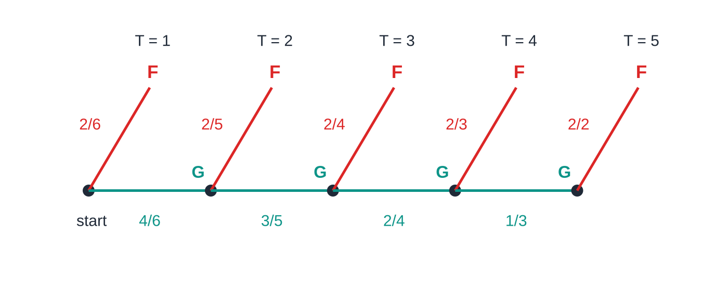
How do you reverse a conditional probability on a tree? (continued)
Section 8 of 13 · Worked example 8 · Hard · Find, show that, explain
WORKED EXAMPLE · QUESTION
A box contains 6 batteries, of which 2 are faulty. Batteries are taken at random, one at a time, and tested; a tested battery is not returned. Testing stops as soon as a faulty battery is found. T is the number of batteries tested. (a) Find P(T=1) and P(T=2). (b) Show that P(T=3)=⅕. (c) Find P(T>2). (d) Given that the first battery tested is not faulty, find the probability that exactly three batteries are tested. (e) Explain why T cannot be greater than 5.
The tree for testing without replacement, drawn as a chain: each good battery (G) leads to the next test; each faulty one (F) stops the testing. After four good batteries the fifth must be faulty.
Notes:
How do you reverse a conditional probability on a tree?: Worked example 8. Full notes: https://examinerprep.com/notes/edexcel-ial-maths/probability/

Slide 31
How do you reverse a conditional probability on a tree? (continued)
Section 8 of 13 · Worked example 8 · Hard · Find, show that, explain (continued)
SOLUTION
(a) P(T=1)=(2/6)= ⅓; P(T=2)=(4/6)×(2/5)= (4/15).
(b) Good, good, faulty: (4/6)×(3/5)×(2/4)=(24/120)=⅕ as required.
(c) 1-⅓-(4/15)= (2/5).
(d) The given event is T>1, probability 1-⅓=⅔, and T=3 lies inside it: (1/5)/(2/3)= (3/10).
(e) Only 4 batteries are good, so after at most 4 good ones the 5th tested must be faulty: T≤5. Check: P(T=4)=(2/15), P(T=5)=(1/15), and ⅓+(4/15)+⅕+(2/15)+(1/15)=1.
Notes:
How do you reverse a conditional probability on a tree?: Worked example 8. Full notes: https://examinerprep.com/notes/edexcel-ial-maths/probability/

Slide 32
How do you reverse a conditional probability on a tree? (continued)
Section 8 of 13
Exam tip — no new tree for "given"
In part (d), do not draw a new tree. The given information picks out part of the original sample space; divide the probability of the event you want (inside that part) by the probability of the whole part.
Notes:
How do you reverse a conditional probability on a tree?. Full notes: https://examinerprep.com/notes/edexcel-ial-maths/probability/

Slide 33
Exam tips for S1.3
Section 9 of 13
Exam tip 1 — draw the diagram
Whenever there are two or three events, draw a Venn diagram; whenever there are stages, draw a tree. Write every region or branch value on it, and check that the regions (or the branches from each point) add to 1.
Exam tip 2 — "given that" sets the denominator
Find the words "given that" (or "if", "of those who") and underline the event that follows: its probability or count is the denominator. Write P(A|B)=P(A∩B)/P(B) before substituting.
Exam tip 3 — independence needs numbers and a sentence
Calculate both P(A∩B) and P(A)×P(B), write them side by side with = or ≠, and state the conclusion in words. "They look unrelated" is not a test.
Notes:
Exam tips for S1.3. Full notes: https://examinerprep.com/notes/edexcel-ial-maths/probability/

Slide 34
Exam tips for S1.3 (continued)
Section 9 of 13
Exam tip 4 — with or without replacement?
If the item is not put back, change both the numerator and the denominator on later branches. Words such as "eats", "keeps", "chooses two different" and "is not returned" all mean without replacement.
Exam tip 5 — exact answers
Give probabilities as exact fractions in their simplest form or as exact decimals. If you round, give 3 significant figures and keep full accuracy until the final line.
Notes:
Exam tips for S1.3. Full notes: https://examinerprep.com/notes/edexcel-ial-maths/probability/

Slide 35
Common misconceptions
Section 10 of 13
Misconception | Why it is wrong | Correct idea
Mutually exclusive and independent mean the same thing. | Mutually exclusive events cannot happen together; independent events happen together with probability P(A)P(B)>0. | With non-zero probabilities, mutually exclusive events are always dependent.
P(A∪B)=P(A)+P(B) always. | The overlap is counted twice. | Subtract P(A∩B); it is only zero for mutually exclusive events.
P(A|B)=P(B|A). | Same numerator, different denominators. | In Worked example 7, P(G′|B)=0.25 but P(B|G′)=0.625.
P(A|B)=P(A∩B)÷P(A). | That divides by the wrong event. | Divide by the probability of the given event, P(B).
The number inside circle A on a Venn diagram is P(A). | It is only the part of A outside the other circles. | P(A) is the total of every region inside circle A.
P(at least one six from two dice) =⅙+⅙. | The double six is counted twice. | 1-(5/6)²=(11/36).
Notes:
Common misconceptions. Full notes: https://examinerprep.com/notes/edexcel-ial-maths/probability/

Slide 36
How this topic connects
Section 11 of 13
S1.5 Discrete random variables
Tree diagrams like Worked example 8 produce a probability distribution for a random variable such as T; its probabilities add to 1, and E(T) and Var(T) come next.
S2 The binomial distribution
A sequence of independent trials with the same probability of success, drawn as a tree with identical branches, is exactly the binomial model; the multiplication law gives pʳ(1-p)ⁿ⁻ʳ for each path.
S1.6 The Normal distribution
Every later probability, such as P(X>a) or a significance level, obeys the same complement and addition rules from this page.
Notes:
How this topic connects. Full notes: https://examinerprep.com/notes/edexcel-ial-maths/probability/

Slide 37
Key formulae
Section 12 of 13
Formula | Use | In the formulae list?
P(A)=n(A)/n(S) | probability from equally likely outcomes | No – learn it
P(A′)=1-P(A) | complement; "at least one" = 1 − P(none) | No – learn it
P(A∪B)=P(A)+P(B)-P(A∩B) | addition law | Yes
P(A∩B)=P(A|B)P(B) | multiplication law; multiplying along tree branches | Yes
P(A|B)=P(A∩B)/P(B) | conditional probability | Yes
P(A∩B)=0 | condition for mutually exclusive events | No – learn it
P(A∩B)=P(A)×P(B)⇔P(A|B)=P(A) | condition (and test) for independent events | No – learn it
P(A∩B′)=P(A)-P(A∩B) | "A but not B", the A-only region of a Venn diagram | No – derive it
Notes:
Key formulae. Full notes: https://examinerprep.com/notes/edexcel-ial-maths/probability/

Slide 38
Check your understanding
Section 13 of 13
1. P(A)=0.35, P(B)=0.5 and P(A∩B)=0.15. Find P(A∪B) and P(A|B).
2. Can two events, each with a non-zero probability, be both mutually exclusive and independent?
3. A bag holds 3 red and 2 white counters. Two are taken without replacement. Find the probability that they are different colours.
4. In a two-way table, 30 of the 80 people who own a bike also own a car. What is P(car | bike)?
5. P(A)=0.2, P(B|A)=0.6 and P(B|A′)=0.3. Find P(B) and P(A|B).
Notes:
Check your understanding: questions. Full notes: https://examinerprep.com/notes/edexcel-ial-maths/probability/

Slide 39
Check your understanding · answers
Section 13 of 13
1. P(A∪B)=0.35+0.5-0.15=0.7. P(A|B)=0.15÷0.5=0.3.
2. No. Mutually exclusive gives P(A∩B)=0, but independence needs P(A∩B)=P(A)P(B), which is greater than 0.
3. RW or WR: (3/5)×(2/4)+(2/5)×¾=(6/20)+(6/20)=(3/5).
4. The given event is "owns a bike", so the denominator is 80: 30/80=0.375.
5. P(B)=0.2×0.6+0.8×0.3=0.12+0.24=0.36. P(A|B)=0.12÷0.36=⅓.
Notes:
Check your understanding: answers. Full notes: https://examinerprep.com/notes/edexcel-ial-maths/probability/

Slide 40
Practice questions
2 original exam-style questions. Answers at the end of the deck.

Slide 41
Question 1
7 marks
Spinner P is fair and has three equal sectors numbered 1, 2 and 3. Spinner Q is fair and has five equal sectors numbered 1, 2, 3, 4 and 5. Both spinners are spun once and the score is the positive difference between the two numbers (for example, 2 and 5 give a score of 3, and 3 and 3 give a score of 0).
(a) Find the probability that the score is 0. [2]
(b) Find the probability that the score is at least 2. [2]
(c) Given that the score is not 0, find the probability that the score is 1. [3]
Notes:
Online with the full mark scheme: https://examinerprep.com/ial-maths-s1-3-probability-questions#IALM-S1-3-B-01

Slide 42
Question 2
7 marks
A guest staying at a hotel is chosen at random. G is the event that the guest uses the gym and W is the event that the guest uses the swimming pool. P(G) = 0.55, P(W) = 0.35 and the probability that the guest uses neither the gym nor the pool is 0.25.
(a) Find P(G ∪ W). [1]
(b) Find P(G ∩ W). [2]
(c) Find the probability that the guest uses exactly one of the gym and the pool. [2]
(d) Find the probability that the guest uses the pool, given that the guest uses the gym. [2]
Notes:
Online with the full mark scheme: https://examinerprep.com/ial-maths-s1-3-probability-questions#IALM-S1-3-B-02

Slide 43
Answers

Slide 44
Question 1 · answer
Mark scheme
sample space of 3 × 5 = 15 equally likely outcomes, e.g. a grid of differences
3 outcomes give 0 (1,1; 2,2; 3,3), so 3/15 = 1/5
counts outcomes with difference 2, 3 or 4: (1,3), (1,4), (1,5), (2,4), (2,5), (3,1), (3,5)
7/15
P(score = 1) = 5/15 (from (1,2), (2,1), (2,3), (3,2), (3,4))
divides by P(score ≠ 0) = 12/15
5/12
Notes:
Full mark scheme: https://examinerprep.com/ial-maths-s1-3-probability-questions#IALM-S1-3-B-01

Slide 45
Question 2 · answer
Mark scheme
1 − 0.25 = 0.75
uses the addition law: 0.75 = 0.55 + 0.35 − P(G ∩ W)
0.15
P(G only) = 0.55 − 0.15 = 0.4 and P(W only) = 0.35 − 0.15 = 0.2, or 0.75 − 0.15
0.6 ft on their (b)
P(W | G) = P(G ∩ W) ÷ P(G) = 0.15 ÷ 0.55
= 3/11 (0.273 to 3 s.f.)
Notes:
Full mark scheme: https://examinerprep.com/ial-maths-s1-3-probability-questions#IALM-S1-3-B-02

Slide 46
Keep practising
Notes for this topic
Questions on this topic
Build a printable test
ExaminerPrep is an independent tutoring service. It has been developed independently from and is not endorsed by the International Baccalaureate Organization. "International Baccalaureate", "IB" and "IB Diploma Programme" are registered trademarks of the IBO, used here for descriptive purposes only.
Pearson Edexcel and Cambridge are trademarks of their owners; ExaminerPrep is not affiliated with any exam board.

