Slide 1
EP
EDEXCEL IAL MATHS
M2.1 Projectiles
The full notes page in 13 sections · practice questions with answers · simulations
ExaminerPrep is an independent tutoring service. It has been developed independently from and is not endorsed by the International Baccalaureate Organization. "International Baccalaureate", "IB" and "IB Diploma Programme" are registered trademarks of the IBO, used here for descriptive purposes only.
Pearson Edexcel and Cambridge are trademarks of their owners; ExaminerPrep is not affiliated with any exam board.
Notes:
M2.1 Projectiles. Notes for this topic: https://examinerprep.com/notes/edexcel-ial-maths/projectiles/

Slide 2
What this page covers
Overview
Modelling a projectile as a particle moving in a vertical plane with constant acceleration g = 9.8 m s⁻² downwards
Horizontal and vertical components of the initial velocity and of the motion
Time of flight, range and greatest height, and deriving the general results
Speed and direction of motion at a given time
Projection from a height, and projection to pass through or hit a given point
Finding the angle of projection: a quadratic in tan θ using sec²θ= 1 + tan²θ
The equation of the trajectory, and position and velocity vectors in terms of i and j
Notes:
What this page covers. Full notes: https://examinerprep.com/notes/edexcel-ial-maths/projectiles/

Slide 3
In one minute
Key points
1. A projectile's horizontal and vertical motions are independent: horizontally the velocity never changes, vertically there is a constant acceleration g downwards, and time is the only thing the two directions share.
2. Split the initial velocity: horizontal ucos θ, vertical usin θ.
3. Horizontally x = (ucos θ)t; vertically use the constant-acceleration formulae with a = -9.8 (upwards positive).
4. On level ground: time of flight 2usin θ/g, range u²sin 2θ/g, greatest height u²sin²θ/(2g). None is in the formulae booklet: derive them.
5. Velocity at time t: combine the components with Pythagoras and tan, and say whether the direction is above or below the horizontal.
6. Trajectory: y = xtan θ- gx²/2u²cos²θ. Writing 1/cos²θ= 1 + tan²θ gives a quadratic in tan θ.
Notes:
In one minute. Full notes: https://examinerprep.com/notes/edexcel-ial-maths/projectiles/

Slide 4
How do you model the motion of a projectile?
Section 1 of 13
Projectile. A particle that, once launched, moves freely under gravity alone, in a vertical plane.
The modelling assumptions are: the body is a particle (size and spin ignored); there is no air resistance, so the only force after launch is the weight mg; and g is constant at 9.8 m s⁻². So the acceleration is g vertically downwards, the same for every mass, and the path lies in the vertical plane containing the initial velocity.
A particle projected with speed u at angle θ above the horizontal (the angle of projection) has initial velocity components ucos θ horizontally and usin θ vertically.
Notes:
How do you model the motion of a projectile?. Full notes: https://examinerprep.com/notes/edexcel-ial-maths/projectiles/

Slide 5
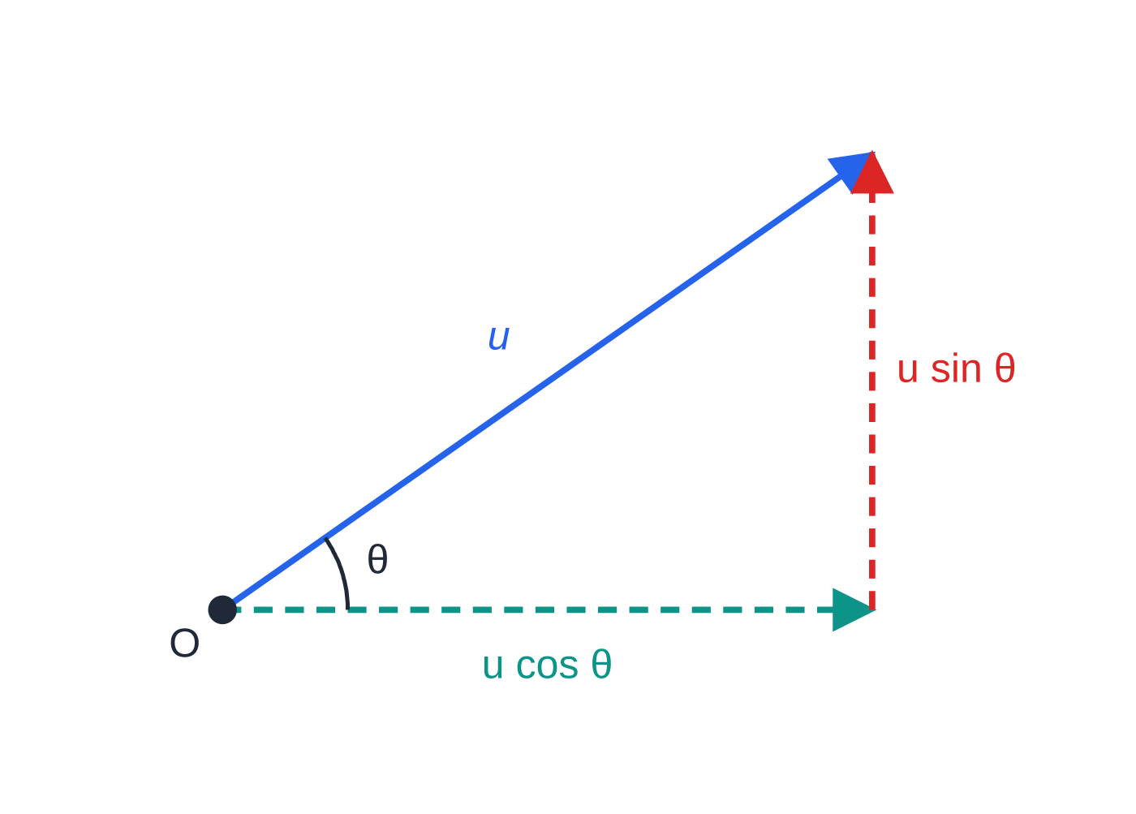
How do you model the motion of a projectile? (continued)
Section 1 of 13
Resolving the initial velocity. The horizontal component never changes; only the vertical component is affected by gravity.
Notes:
How do you model the motion of a projectile?. Full notes: https://examinerprep.com/notes/edexcel-ial-maths/projectiles/

Slide 6
How do you model the motion of a projectile? (continued)
Section 1 of 13
 | Horizontal (→) | Vertical (↑ positive)
Initial velocity | ucos θ | usin θ
Acceleration | 0 | -g = -9.8 m s⁻²
Velocity at time t | ucos θ (constant) | usin θ- gt
Displacement at time t | x = (ucos θ)t | y = (usin θ)t - ½gt²
The vertical column is just the M1 constant-acceleration formulae with a = -g; v² = u² + 2as and s = ½(u + v)t are available too. Time links the two directions: find t from one direction, then use it in the other.
Notes:
How do you model the motion of a projectile?. Full notes: https://examinerprep.com/notes/edexcel-ial-maths/projectiles/

Slide 7
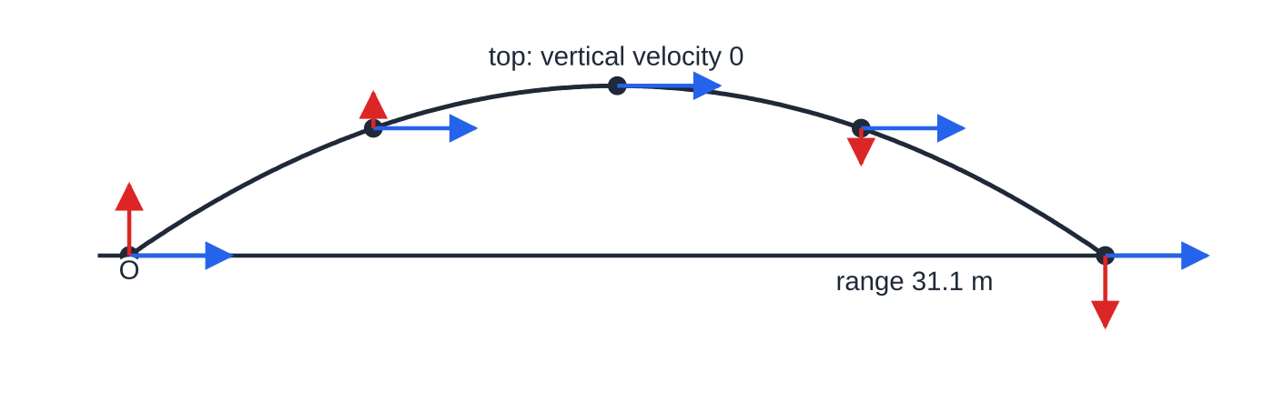
How do you model the motion of a projectile? (continued)
Section 1 of 13
Common error — "the velocity is zero at the top"
Only the vertical component is zero there. The particle is still moving horizontally with speed ucos θ, which is its least speed during the flight.
A ball projected at 18 m s⁻¹ at 35°, to scale, with velocity components at five equally spaced times. The horizontal arrow (blue) never changes; the vertical arrow (red) falls by 9.8 × 0.527 = 5.16 m s⁻¹ in each interval and is zero at the top.
Notes:
How do you model the motion of a projectile?. Full notes: https://examinerprep.com/notes/edexcel-ial-maths/projectiles/

Slide 8
How do you find the time of flight, range and greatest height?
Section 2 of 13
At the greatest height the vertical velocity is zero: use v² = u² + 2as vertically with v = 0. For the time of flight back to launch level, the vertical displacement is zero: use s = ut + ½at² with s = 0 and take the non-zero root. The range is the horizontal distance travelled in that time. On level ground the path is symmetrical, so the time to the top is half the time of flight.
Notes:
How do you find the time of flight, range and greatest height?. Full notes: https://examinerprep.com/notes/edexcel-ial-maths/projectiles/

Slide 9
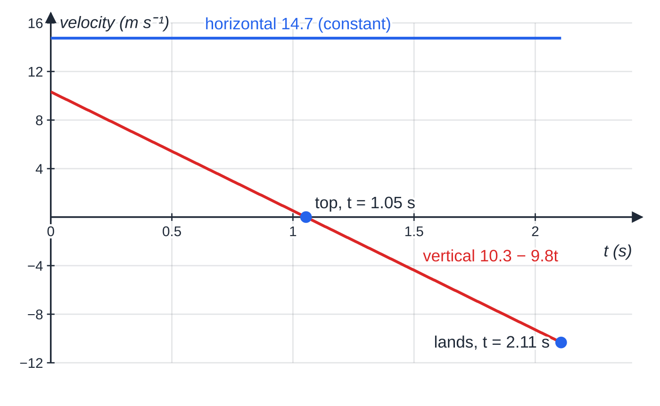
How do you find the time of flight, range and greatest height? (continued)
Section 2 of 13 · Worked example 1 · Easy · Find
WORKED EXAMPLE · QUESTION
A football is kicked from a point O on horizontal ground with speed 18 m s⁻¹ at 35° above the horizontal. The ball is modelled as a particle moving freely under gravity. Find (a) the greatest height of the ball above the ground, (b) the time for which the ball is in the air, (c) the horizontal distance from O to the point where the ball first lands.
SOLUTION
Components: horizontal 18cos 35° = 14.745 m s⁻¹, vertical 18sin 35° = 10.324 m s⁻¹.
(a) At the top v = 0:
Velocity components against time for worked example 1. The vertical component falls steadily with gradient −9.8 and passes through zero at the top.
Notes:
How do you find the time of flight, range and greatest height?: Worked example 1. Full notes: https://examinerprep.com/notes/edexcel-ial-maths/projectiles/

Slide 10
How do you find the time of flight, range and greatest height? (continued)
Section 2 of 13 · Worked example 1 · Easy · Find (continued)
0 = 10.324² - 2 ×9.8 ×h, so h = 5.438. 5.44 m
(b) Vertically s = 0 when it lands: 0 = 10.324t - 4.9t² = t(10.324 - 4.9t), so t = 10.324 ÷4.9 = 2.107. 2.11 s
(c) Horizontally: x = 14.745 ×2.107 = 31.07. 31.1 m
Check with symmetry: time to the top = 10.324 ÷9.8 = 1.054 s, exactly half of 2.107 s.
Notes:
How do you find the time of flight, range and greatest height?: Worked example 1. Full notes: https://examinerprep.com/notes/edexcel-ial-maths/projectiles/

Slide 11
How do you find the time of flight, range and greatest height? (continued)
Section 2 of 13
The general results (level ground)
From 0 = (usin θ)t - ½gt², the non-zero root is T = 2usin θ/g. Then R = ucos θ×2usin θ/g = u²sin 2θ/g, using the double-angle identity from P3. From 0 = (usin θ)² - 2gH, H = u²sin²θ/2g. None of the three is in the formulae booklet, and they are valid only when the particle lands at the level it was launched from; a "show that" needs the derivation.
For a fixed speed, sin 2θ is greatest when 2θ= 90°, so the maximum range is u²/g, at θ= 45°. Since sin 2θ= sin(180° - 2θ), the angles θ and 90° - θ give the same range, with different heights and times.
Notes:
How do you find the time of flight, range and greatest height?. Full notes: https://examinerprep.com/notes/edexcel-ial-maths/projectiles/

Slide 12
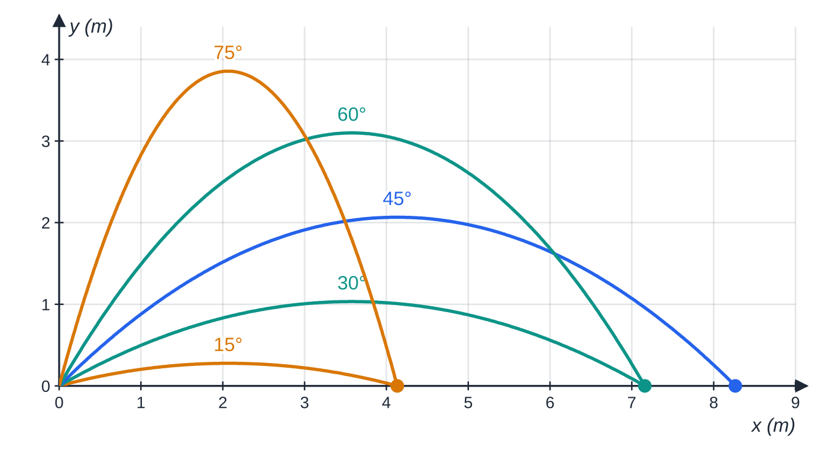
How do you find the time of flight, range and greatest height? (continued)
Section 2 of 13
Water drops at 9.0 m s⁻¹ from ground level at five angles, to scale. 45° gives the greatest range, 8.27 m; 30° and 60° both reach 7.16 m, and 15° and 75° both reach 4.13 m.
Notes:
How do you find the time of flight, range and greatest height?. Full notes: https://examinerprep.com/notes/edexcel-ial-maths/projectiles/

Slide 13
How do you find the time of flight, range and greatest height? (continued)
Section 2 of 13 · Worked example 2 · Medium · Show that / Find
WORKED EXAMPLE · QUESTION
A sprinkler at ground level projects water drops with speed 9.0 m s⁻¹. The angle of projection can be adjusted. The drops are modelled as particles and the lawn is horizontal. (a) Show that the range R m at angle θ is given by R = 81sin 2θ/9.8. (b) Find the greatest possible range. (c) Find the two angles of projection that give a range of 7.0 m.
SOLUTION
(a) Vertically 0 = (9sin θ)t - 4.9t², so t = 9sin θ/4.9. Then R = 9cos θ×9sin θ/4.9 = (81 ×2sin θcos θ)/9.8 = 81sin 2θ/9.8, as required.
(b) The greatest value of sin 2θ is 1, at θ= 45°: R_(max) = 81 ÷9.8. 8.27 m
(c) sin 2θ= 7.0 ×9.8 ÷81 = 0.8469, so 2θ= 57.88° or 122.12°. θ = 28.9° or 61.1°
The two answers add to 90°, as they must.
Notes:
How do you find the time of flight, range and greatest height?: Worked example 2. Full notes: https://examinerprep.com/notes/edexcel-ial-maths/projectiles/

Slide 14
How do you find the velocity at a given time?
Section 3 of 13
The horizontal component is vₓ = ucos θ (unchanged) and the vertical component is v_y = usin θ- gt: positive means moving upwards, negative means moving downwards. The speed is √(vₓ² + v_y²), and the direction makes angle α with the horizontal where tan α= |v_y| ÷vₓ, stated as above or below. The velocity is always along the tangent to the path. To find a speed at a given height without the time, use v² = u² + 2as vertically, then combine with the horizontal component.
Notes:
How do you find the velocity at a given time?. Full notes: https://examinerprep.com/notes/edexcel-ial-maths/projectiles/

Slide 15
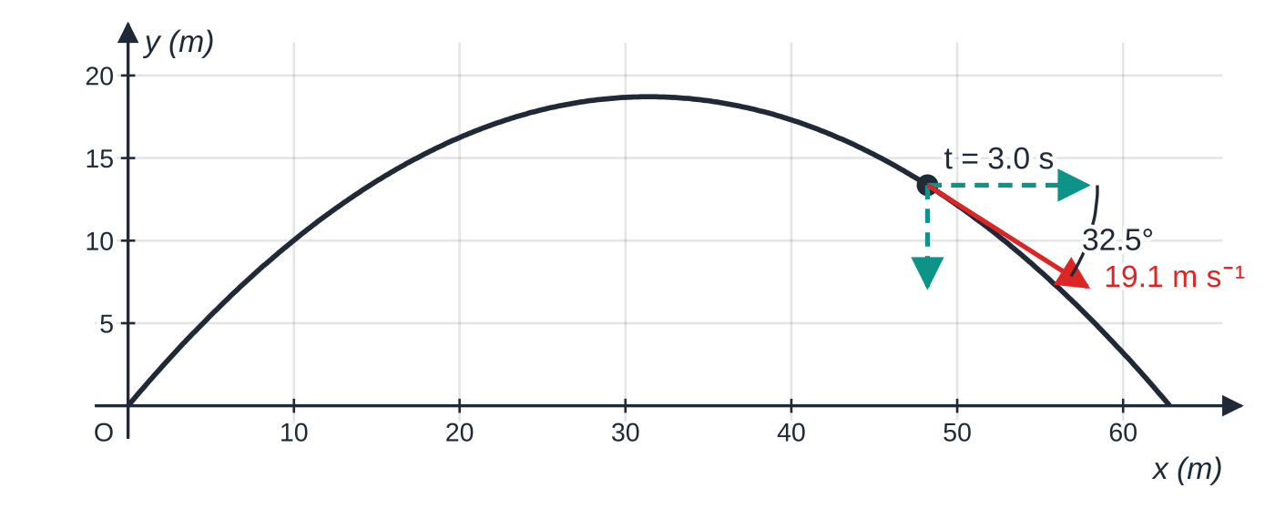
How do you find the velocity at a given time? (continued)
Section 3 of 13 · Worked example 3 · Medium · Find
WORKED EXAMPLE · QUESTION
A particle P is projected from a point on horizontal ground with speed 25 m s⁻¹ at an angle of 50° above the horizontal. (a) Find the speed of P and its direction of motion 3.0 s after projection. (b) Find the two times at which P is moving in a direction at 20° to the horizontal.
SOLUTION
Components: 25cos 50° = 16.070 m s⁻¹ and 25sin 50° = 19.151 m s⁻¹.
(a) v_y = 19.151 - 9.8 ×3.0 = -10.249 m s⁻¹ (moving downwards).
Worked example 3 to scale. After 3.0 s the velocity has components 16.1 m s⁻¹ horizontally and 10.2 m s⁻¹ downwards: 19.1 m s⁻¹ at 32.5° below the horizontal, along the tangent.
Notes:
How do you find the velocity at a given time?: Worked example 3. Full notes: https://examinerprep.com/notes/edexcel-ial-maths/projectiles/

Slide 16
How do you find the velocity at a given time? (continued)
Section 3 of 13 · Worked example 3 · Medium · Find (continued)
Speed = √(16.070² + 10.249²) = 19.06 and tan α= 10.249 ÷16.070 gives α= 32.5°. 19.1 m s⁻¹ at 32.5° below the horizontal
(b) At 20°, |v_y| = 16.070tan 20° = 5.849 m s⁻¹. Moving up: 19.151 - 9.8t = 5.849, t = 1.36. Moving down: 19.151 - 9.8t = -5.849, t = 2.55. t = 1.36 s and 2.55 s
The two times are symmetrical about the time of the top, 19.151 ÷9.8 = 1.95 s.
Notes:
How do you find the velocity at a given time?: Worked example 3. Full notes: https://examinerprep.com/notes/edexcel-ial-maths/projectiles/

Slide 17
How do you find the velocity at a given time? (continued)
Section 3 of 13
Exam tip — direction needs a reference
"Direction of motion" needs an angle and a reference: "32.5° below the horizontal". An angle on its own leaves the answer incomplete.
Notes:
How do you find the velocity at a given time?. Full notes: https://examinerprep.com/notes/edexcel-ial-maths/projectiles/

Slide 18
What changes when a projectile is launched from a height?
Section 4 of 13
Take the point of projection as the origin with upwards positive; landing h metres below the launch point means vertical displacement -h. The time comes from a quadratic, -h = (usin θ)t - 4.9t²; reject the negative root, which describes a time before the launch. The range formula does not apply, because launch and landing are at different levels. Projected horizontally, the initial vertical velocity is zero and -h = -4.9t² gives the time directly; projected below the horizontal, the initial vertical component is -usin θ.
Notes:
What changes when a projectile is launched from a height?. Full notes: https://examinerprep.com/notes/edexcel-ial-maths/projectiles/

Slide 19
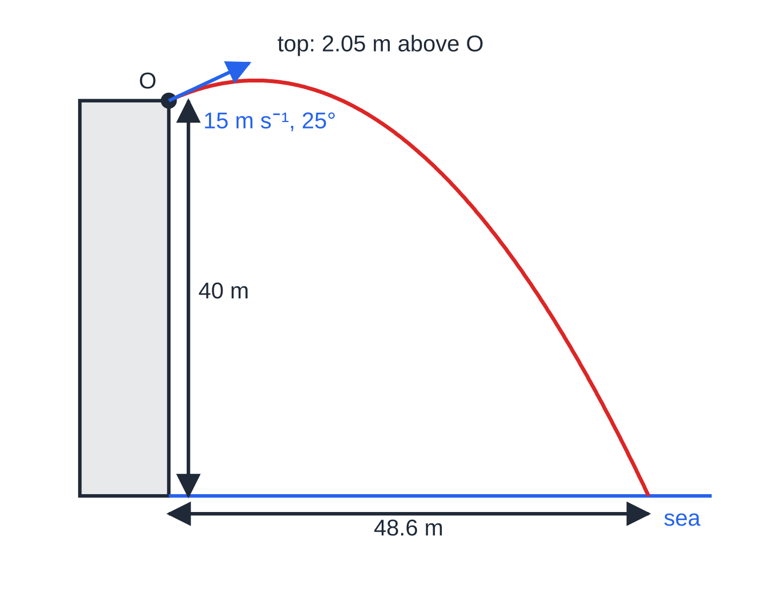
What changes when a projectile is launched from a height? (continued)
Section 4 of 13 · Worked example 4 · Medium · Find
WORKED EXAMPLE · QUESTION
A stone is thrown from a point O at the top of a vertical cliff. O is 40 m above the sea. The stone is thrown with speed 15 m s⁻¹ at 25° above the horizontal and moves freely under gravity until it hits the sea. Find (a) the time taken for the stone to reach the sea, (b) the horizontal distance from the foot of the cliff to the point where the stone hits the sea, (c) the speed of the stone as it hits the sea and the angle its path then makes with the horizontal.
SOLUTION
Components: 15cos 25° = 13.595 m s⁻¹ and 15sin 25° = 6.339 m s⁻¹.
Worked example 4 to scale. The stone rises only 2.05 m above the cliff top before falling to the sea 48.6 m out.
Notes:
What changes when a projectile is launched from a height?: Worked example 4. Full notes: https://examinerprep.com/notes/edexcel-ial-maths/projectiles/

Slide 20
What changes when a projectile is launched from a height? (continued)
Section 4 of 13 · Worked example 4 · Medium · Find (continued)
(a) Vertically, upwards positive, s = -40: 4.9t² - 6.339t - 40 = 0, so t = (6.339 ±√(6.339² + 4 ×4.9 ×40))/9.8 = 3.576 (the other root, -2.28, is rejected). 3.58 s
(b) x = 13.595 ×3.576 = 48.62. 48.6 m
(c) v_y = 6.339 - 9.8 ×3.576 = -28.71 m s⁻¹. Speed = √(13.595² + 28.71²) = 31.76, and tan α= 28.71 ÷13.595 gives α= 64.7°. 31.8 m s⁻¹ at 64.7° below the horizontal
Check without the time: v² = 15² + 2 ×9.8 ×40 = 1009, so v = 31.76 m s⁻¹; the speed depends only on the drop, not on the angle.
Notes:
What changes when a projectile is launched from a height?: Worked example 4. Full notes: https://examinerprep.com/notes/edexcel-ial-maths/projectiles/

Slide 21
What changes when a projectile is launched from a height? (continued)
Section 4 of 13
Common error — mixed signs
Writing +40 for the vertical displacement while also using −9.8 for the acceleration. With upwards positive, both the displacement to the sea (−40) and the acceleration (−9.8) are negative.
Notes:
What changes when a projectile is launched from a height?. Full notes: https://examinerprep.com/notes/edexcel-ial-maths/projectiles/

Slide 22
How do you aim a projectile at a target?
Section 5 of 13
A target a m horizontally and b m vertically from the point of projection gives two conditions: x = a and y = b at the same time. With a known velocity, find t from the horizontal motion and substitute in the vertical equation. With an unknown speed or angle, eliminate t using t = a ÷(ucos θ); this is where the trajectory equation comes from. The sign of v_y at that time tells you whether the particle is rising or falling, and to check whether it clears an obstacle, compare its height at the obstacle's horizontal distance with the obstacle's height.
Notes:
How do you aim a projectile at a target?. Full notes: https://examinerprep.com/notes/edexcel-ial-maths/projectiles/

Slide 23
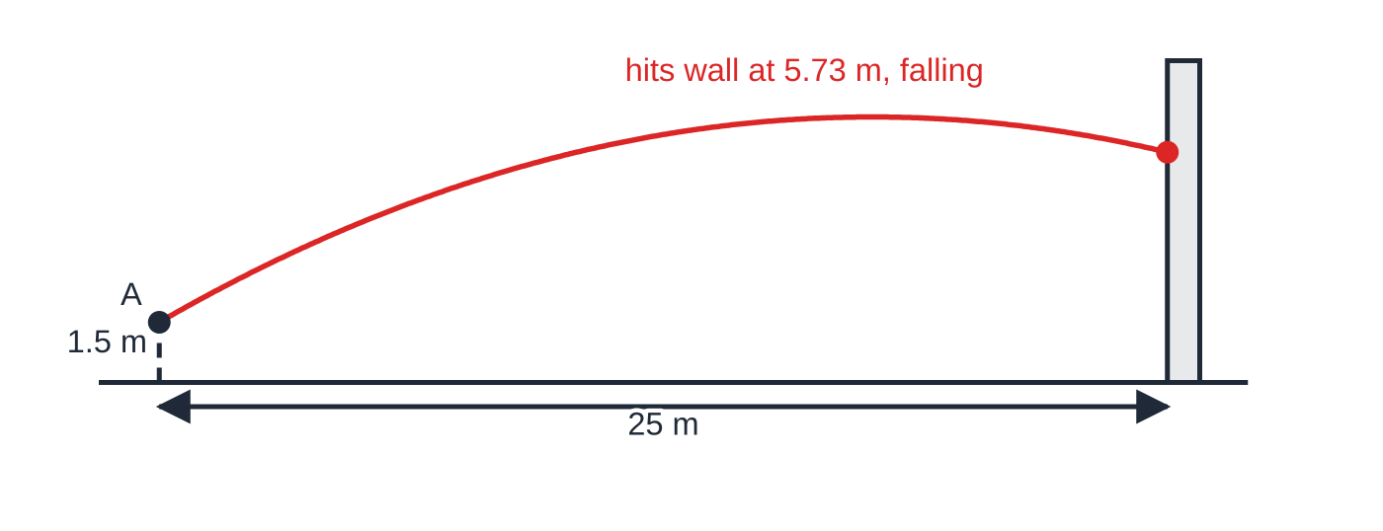
How do you aim a projectile at a target? (continued)
Section 5 of 13 · Worked example 5 · Medium · Find
WORKED EXAMPLE · QUESTION
A ball is thrown from a point A, 1.5 m above horizontal ground, towards a vertical wall. The wall is 25 m horizontally from A. The ball is thrown with speed 20 m s⁻¹ at 30° above the horizontal, in a vertical plane perpendicular to the wall. (a) Find the time taken for the ball to reach the wall. (b) Find the height above the ground at which the ball hits the wall. (c) Determine whether the ball is rising or falling when it hits the wall, and find its speed at that instant.
Worked example 5 to scale. The ball passes its highest point (6.60 m above the ground) before reaching the wall, so it is falling when it hits.
Notes:
How do you aim a projectile at a target?: Worked example 5. Full notes: https://examinerprep.com/notes/edexcel-ial-maths/projectiles/

Slide 24
How do you aim a projectile at a target? (continued)
Section 5 of 13 · Worked example 5 · Medium · Find (continued)
SOLUTION
(a) Horizontally, 20cos 30° = 17.321 m s⁻¹, so t = 25 ÷17.321 = 1.4434. 1.44 s
(b) Vertically, initial component 20sin 30° = 10 m s⁻¹: y = 10 ×1.4434 - 4.9 ×1.4434² = 4.225 m above A, so 4.225 + 1.5 above the ground. 5.73 m
(c) v_y = 10 - 9.8 ×1.4434 = -4.15 m s⁻¹, negative, so the ball is falling. Speed = √(17.321² + 4.15²) = 17.81. falling, 17.8 m s⁻¹
Keep t = 1.4434 s unrounded in later parts; rounding it to 1.44 first would shift the height in the third significant figure.
Notes:
How do you aim a projectile at a target?: Worked example 5. Full notes: https://examinerprep.com/notes/edexcel-ial-maths/projectiles/

Slide 25
What is the equation of the trajectory?
Section 6 of 13
Eliminate t between the two displacements. From x = (ucos θ)t, t = x ÷(ucos θ); substitute into y = (usin θ)t - ½gt²:
y = xtan θ- gx²/2u²cos²θ = xtan θ- gx²/2u²(1 + tan²θ).
The origin is the point of projection, with y vertically upwards; the second form uses 1/cos²θ= sec²θ= 1 + tan²θ. It is not in the formulae booklet, and questions often ask you to show it. For fixed u and θ this is y = px - qx²: the path is a parabola.
Notes:
What is the equation of the trajectory?. Full notes: https://examinerprep.com/notes/edexcel-ial-maths/projectiles/

Slide 26
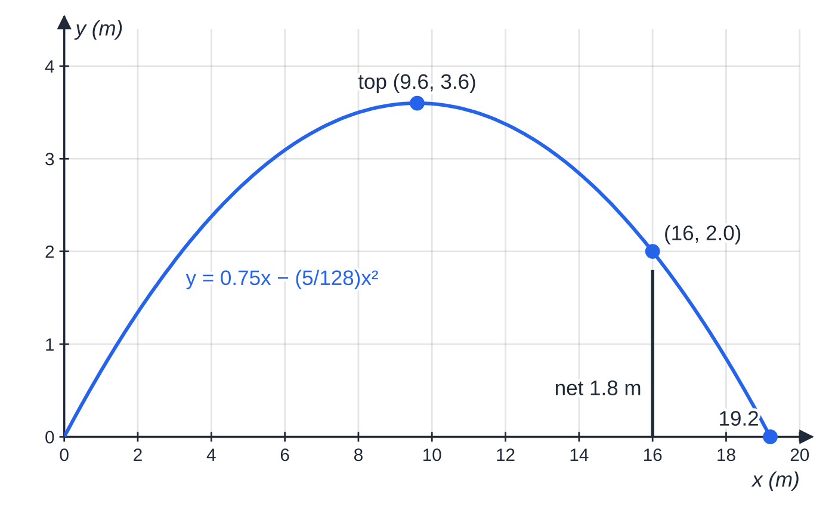
What is the equation of the trajectory? (continued)
Section 6 of 13 · Worked example 6 · Medium · Show that / Determine
WORKED EXAMPLE · QUESTION
A tennis ball is struck from a point O with speed 14 m s⁻¹ at an angle θ above the horizontal, where tan θ= ¾. Take O as the origin, with x and y measured horizontally and vertically upwards in metres. (a) Show that the equation of the path is y = ¾x - (5/128)x². (b) Use the equation to find the range on the horizontal plane through O and the greatest height. (c) Determine whether the ball passes over a net 1.8 m high at a horizontal distance of 16 m from O.
The path of worked example 6 is a parabola, symmetrical about x = 9.6. At the net it is 2.0 m high, just clearing 1.8 m.
Notes:
What is the equation of the trajectory?: Worked example 6. Full notes: https://examinerprep.com/notes/edexcel-ial-maths/projectiles/

Slide 27
What is the equation of the trajectory? (continued)
Section 6 of 13 · Worked example 6 · Medium · Show that / Determine (continued)
SOLUTION
(a) tan θ= ¾ gives sin θ= 0.6, cos θ= 0.8. Then y = ¾x - 9.8x²/(2 ×14² ×0.8²) = ¾x - (9.8/250.88)x² = ¾x - (5/128)x², as required.
(b) Range: y = 0, x ≠0: x = ¾ ×(128/5) = 19.2. The greatest height is at the midpoint, x = 9.6: y = 7.2 - 3.6 = 3.6. range 19.2 m, greatest height 3.6 m
(c) At x = 16: y = 12 - (5/128) ×256 = 12 - 10 = 2.0 m > 1.8 m. It passes over the net, by 0.2 m
Check (b) with the general results: 14² ×2(0.6)(0.8) ÷9.8 = 19.2 and (14 ×0.6)² ÷19.6 = 3.6.
Notes:
What is the equation of the trajectory?: Worked example 6. Full notes: https://examinerprep.com/notes/edexcel-ial-maths/projectiles/

Slide 28
How do you find the angle of projection?
Section 7 of 13
If the speed u is known and the path must pass through a point (a, b), substitute into the second form of the trajectory equation. It becomes a quadratic in tan θ:
ga²/2u²tan²θ- atan θ+ (b + ga²/2u²) = 0.
Two positive roots give two possible angles: a low, fast-arriving path and a high, slow "lob". One repeated root means the point is just within reach at that speed; no real roots means it cannot be reached at speed u. Derive this from the trajectory equation each time; learn the identity sec²θ= 1 + tan²θ.
Notes:
How do you find the angle of projection?. Full notes: https://examinerprep.com/notes/edexcel-ial-maths/projectiles/

Slide 29
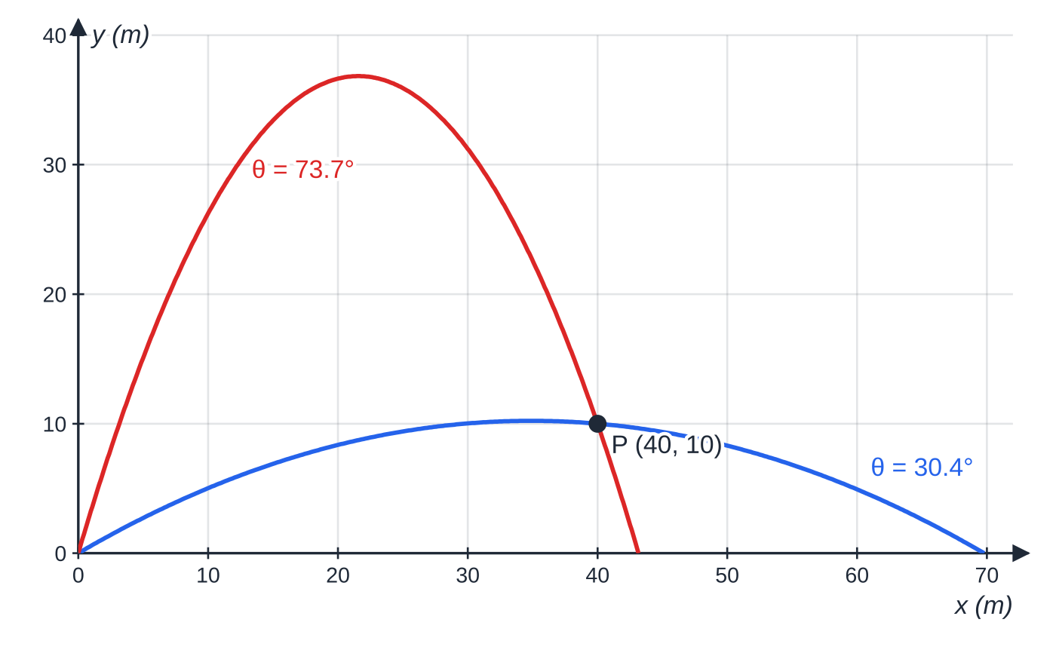
How do you find the angle of projection? (continued)
Section 7 of 13 · Worked example 7 · Hard · Show that / Hence
WORKED EXAMPLE · QUESTION
A particle is projected from a point O with speed 28 m s⁻¹ at an angle θ above the horizontal. It passes through the point P, which is 40 m horizontally from O and 10 m above the level of O. (a) Show that tan²θ- 4tan θ+ 2 = 0. (b) Hence find the two possible values of θ, giving tan θ in exact form. (c) For the smaller value of θ, find the time taken to reach P and state, with a reason, whether the particle is rising or falling at P.
Two paths at 28 m s⁻¹ through P(40, 10), to scale: the lower one reaches P after 1.66 s, the high lob after 5.08 s.
Notes:
How do you find the angle of projection?: Worked example 7. Full notes: https://examinerprep.com/notes/edexcel-ial-maths/projectiles/

Slide 30
How do you find the angle of projection? (continued)
Section 7 of 13 · Worked example 7 · Hard · Show that / Hence (continued)
SOLUTION
(a) Horizontally t = 40 ÷(28cos θ). Vertically: 10 = 28sin θ×40/28cos θ - 4.9 ×40²/28²cos²θ = 40tan θ- 10sec²θ. With sec²θ= 1 + tan²θ: 10 = 40tan θ- 10 - 10tan²θ, so tan²θ- 4tan θ+ 2 = 0, as required.
(b) tan θ= (4 ±√8)/2 = 2 ±√2. tan θ = 2 ± √2, θ = 30.4° or 73.7°
(c) θ= 30.36°, horizontal component 28cos θ= 24.160 m s⁻¹, so t = 40 ÷24.160 = 1.656. Then v_y = 28sin θ- 9.8 ×1.656 = -2.07 m s⁻¹ < 0. 1.66 s; falling, because v_y < 0
It is just past its highest point, which is 10.2 m above O.
Notes:
How do you find the angle of projection?: Worked example 7. Full notes: https://examinerprep.com/notes/edexcel-ial-maths/projectiles/

Slide 31
How do you find the angle of projection? (continued)
Section 7 of 13
Exam tip — spot the sec²θ
When a "show that" answer is a quadratic in tan θ, the cos²θ in the denominator is the clue: replace 1/cos²θ by 1 + tan²θ and multiply out. Show the line with sec²θ before simplifying.
Notes:
How do you find the angle of projection?. Full notes: https://examinerprep.com/notes/edexcel-ial-maths/projectiles/

Slide 32
How do you describe a projectile with vectors?
Section 8 of 13
Take i and j as unit vectors horizontally and vertically upwards. The initial velocity is u = (ucos θ)i + (usin θ)j and the acceleration is -gj. The vector constant-acceleration formulae from M1 give, with the origin at the point of projection,
r = ut - ½gt²j, v = u - gtj.
If the particle starts at position vector r₀, add r₀. The i-component is the horizontal motion and the j-component the vertical motion. "Moving parallel to i" means the j-component of v is zero; "moving at 45° below the horizontal" means the j-component equals minus the i-component.
Notes:
How do you describe a projectile with vectors?. Full notes: https://examinerprep.com/notes/edexcel-ial-maths/projectiles/

Slide 33
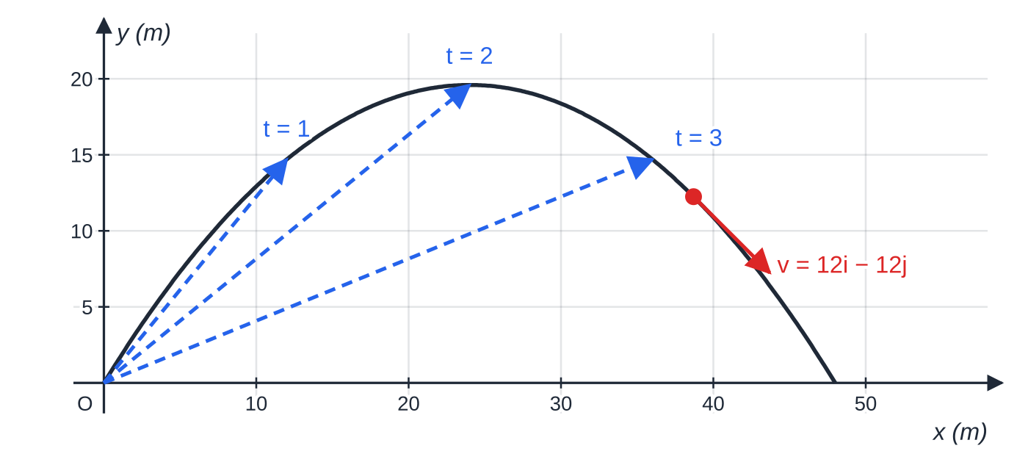
How do you describe a projectile with vectors? (continued)
Section 8 of 13 · Worked example 8 · Medium · Find
WORKED EXAMPLE · QUESTION
A particle P is projected from a point O on horizontal ground with velocity (12i + 19.6j) m s⁻¹, where i and j are horizontal and vertically upward unit vectors. P moves freely under gravity. (a) Find the speed of projection and the angle of projection. (b) Find, in terms of t, the position vector and the velocity of P at time t seconds. (c) Find the time at which P is moving at 45° below the horizontal. (d) Find the distance OP at that time.
Worked example 8 to scale. Dashed arrows are position vectors after 1, 2 and 3 s; at t = 3.22 s the velocity 12i − 12j points 45° below the horizontal.
Notes:
How do you describe a projectile with vectors?: Worked example 8. Full notes: https://examinerprep.com/notes/edexcel-ial-maths/projectiles/

Slide 34
How do you describe a projectile with vectors? (continued)
Section 8 of 13 · Worked example 8 · Medium · Find (continued)
SOLUTION
(a) Speed = √(12² + 19.6²) = 22.98; tan θ= 19.6 ÷12 gives θ= 58.5°. 23.0 m s⁻¹ at 58.5° above the horizontal
(b) r = 12t i + (19.6t − 4.9t²) j, v = 12 i + (19.6 − 9.8t) j
(c) At 45° below the horizontal the j-component is -12: 19.6 - 9.8t = -12, so t = 31.6 ÷9.8 = 3.2245. It lands when 19.6t - 4.9t² = 0, at t = 4, so it is still in the air. 3.22 s
(d) r = 38.69i + 12.25j, so OP = √(38.69² + 12.25²) = 40.59. 40.6 m
Notes:
How do you describe a projectile with vectors?: Worked example 8. Full notes: https://examinerprep.com/notes/edexcel-ial-maths/projectiles/

Slide 35
Exam tips for M2.1
Section 9 of 13
Exam tip 1 — two headed columns
Write "→" and "↑" as headings and list s, u, v, a, t for each direction before choosing a formula. The time is the only entry the two columns share.
Exam tip 2 — fix the positive direction once
With upwards positive, a = -9.8, and any point below the launch level has a negative vertical displacement. Say which direction is positive in your first line.
Exam tip 3 — derive, do not just quote
Range, time of flight, greatest height and the trajectory equation are not in the formulae booklet. A short derivation is quick and safe; in a "show that" it is essential.
Notes:
Exam tips for M2.1. Full notes: https://examinerprep.com/notes/edexcel-ial-maths/projectiles/

Slide 36
Exam tips for M2.1 (continued)
Section 9 of 13
Exam tip 4 — accuracy with g = 9.8
Give final answers to 2 or 3 significant figures, carrying full calculator values between parts.
Exam tip 5 — read "hence" and "exact"
"Hence" means use the result you have just shown, such as a quadratic in tan θ. "Exact" means leave surds, as in tan θ= 2 ±√2, before any decimal angle.
Notes:
Exam tips for M2.1. Full notes: https://examinerprep.com/notes/edexcel-ial-maths/projectiles/

Slide 37
Common misconceptions
Section 10 of 13
Misconception | Why it is wrong | Correct idea
At the greatest height the particle is momentarily at rest. | Only the vertical component of velocity is zero there. | The speed at the top is ucos θ, the least speed of the flight.
The horizontal velocity slowly decreases. | In the model there is no horizontal force. | The horizontal component is constant throughout.
A heavier projectile falls faster. | Weight mg gives acceleration g for every mass. | Mass does not appear anywhere in the projectile equations.
Range = u²sin 2θ/g works for a throw from a cliff. | It assumes the particle lands at the level it started from. | From a height, find the time from a quadratic, then use x = (ucos θ)t.
45° always gives the greatest range. | That result needs level ground (and no air resistance). | From a height, the best angle is less than 45°.
The negative root of the time quadratic is just "wrong". | It solves the equation for a time before launch. | Reject it with a reason; when both roots are positive, both can be meaningful.
Notes:
Common misconceptions. Full notes: https://examinerprep.com/notes/edexcel-ial-maths/projectiles/

Slide 38
How this topic connects
Section 11 of 13
M1.2 Kinematics and M1.1 Vectors
The vertical motion is straight-line motion with constant acceleration, and vector form uses v = u + at and r = ut + ½at².
M2.2 Variable acceleration
Differentiating r = ut - ½gt²j gives v = u - gtj and then a = -gj: projectiles are the constant-acceleration case of calculus-based motion.
M2.4 Work, energy and power
With no air resistance, ½mv² - ½mu² = mgh gives the speed at any height, a fast check on worked example 4. P3 supplies sec²θ= 1 + tan²θ and sin 2θ= 2sin θcos θ.
Notes:
How this topic connects. Full notes: https://examinerprep.com/notes/edexcel-ial-maths/projectiles/

Slide 39
Key formulae
Section 12 of 13
Formula | Use | In the formulae list?
v = u + at, s = ut + ½at², v² = u² + 2as, s = ½(u + v)t, s = vt - ½at² | Vertical motion, a = -9.8 (upwards positive) | No — must be known
x = (ucos θ)t | Horizontal motion, constant velocity | No — derive it
T = 2usin θ/g, R = u²sin 2θ/g, H = u²sin²θ/(2g) | Time of flight, range and greatest height on level ground | No — derive it
y = xtan θ- gx²/(2u²cos²θ) | Equation of the trajectory | No — derive it
sec²θ= 1 + tan²θ | Turning the trajectory into a quadratic in tan θ | No — learn it (P3)
r = ut - ½gt²j, v = u - gtj | Vector form of position and velocity | No — derive it
Notes:
Key formulae. Full notes: https://examinerprep.com/notes/edexcel-ial-maths/projectiles/

Slide 40
Check your understanding
Section 13 of 13
1. A ball is projected horizontally at 6 m s⁻¹ from a table top 4.9 m above the floor. How long does it take to land, and how far from the table does it land?
2. Explain why the horizontal component of a projectile's velocity stays constant.
3. Find the greatest range on horizontal ground of a particle projected at 21 m s⁻¹.
4. A stone projected at 20° above horizontal ground has range 30 m. At what other angle, with the same speed, would it have the same range?
5. A particle has initial velocity (5i + 7j) m s⁻¹. Find its velocity and speed after 2 s.
Notes:
Check your understanding: questions. Full notes: https://examinerprep.com/notes/edexcel-ial-maths/projectiles/

Slide 41
Check your understanding · answers
Section 13 of 13
1. Vertically: 4.9 = 4.9t², so t = 1 s. Horizontally: 6 ×1 = 6 m. 1 s; 6 m
2. In the model the only force is the weight, which is vertical. With no horizontal force there is no horizontal acceleration, so the horizontal velocity does not change.
3. Maximum range = u²/g at 45°: 21² ÷9.8. 45 m
4. sin 2θ= sin(180° - 2θ), so angles θ and 90° - θ give equal ranges. 70°
5. v = 5i + (7 - 9.8 ×2)j = 5i - 12.6j m s⁻¹; speed = √(25 + 12.6²). 13.6 m s⁻¹
Notes:
Check your understanding: answers. Full notes: https://examinerprep.com/notes/edexcel-ial-maths/projectiles/

Slide 42
Practice questions
2 original exam-style questions. Answers at the end of the deck.

Slide 43
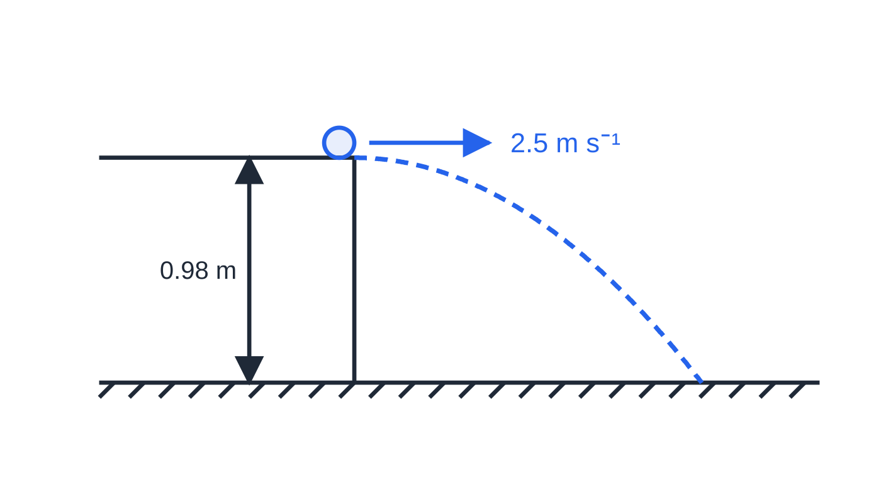
Question 1
6 marks
A marble rolls off the edge of a horizontal table top with speed 2.5 m s⁻¹. The table top is 0.98 m above a horizontal floor. The marble is modelled as a particle moving freely under gravity from the moment it leaves the table. Take g = 9.8 m s⁻².
Figure: the marble leaves the edge of the table horizontally; not to scale.
(a) Find the time taken for the marble to reach the floor. [2]
(b) Find the horizontal distance from the edge of the table to the point where the marble hits the floor. [1]
(c) Find the speed of the marble as it hits the floor. [3]
Notes:
Online with the full mark scheme: https://examinerprep.com/ial-maths-m2-1-projectiles-questions#IALM-M2-1-B-01

Slide 44
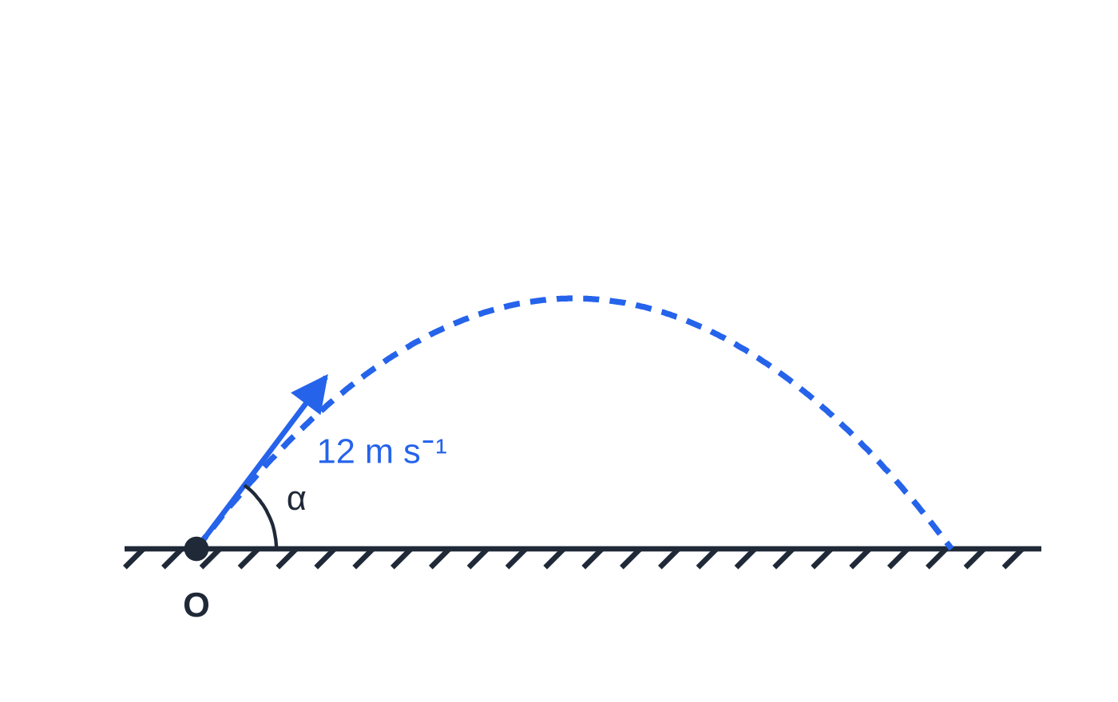
Question 2
6 marks
A pebble is flicked from a point O on horizontal ground with speed 12 m s⁻¹ at an angle α above the horizontal, where tan α = ⁴/₃. The pebble is modelled as a particle moving freely under gravity. Take g = 9.8 m s⁻².
Figure: the pebble projected from O at angle α to the horizontal, where tan α = 4/3; not to scale.
(a) Find the time taken for the pebble to reach its greatest height. [2]
(b) Find the greatest height of the pebble above the ground. [2]
(c) Find the distance from O to the point where the pebble first hits the ground. [2]
Notes:
Online with the full mark scheme: https://examinerprep.com/ial-maths-m2-1-projectiles-questions#IALM-M2-1-B-02

Slide 45
Answers

Slide 46
Question 1 · answer
Mark scheme
vertically, initial vertical velocity 0: 0.98 = ½ × 9.8 × t²
t = √0.2 = 0.447 s (accept 0.45 s)
2.5 × 0.447 = 1.12 m (accept 1.1 m; ft their t)
vertical component: v = 0 + 9.8 × 0.447 = 4.38 m s⁻¹ (or v² = 2 × 9.8 × 0.98)
speed = √(2.5² + 4.38²)
= 5.05 m s⁻¹ (accept 5.0)
Notes:
Full mark scheme: https://examinerprep.com/ial-maths-m2-1-projectiles-questions#IALM-M2-1-B-01

Slide 47
Question 2 · answer
Mark scheme
vertical component 12 × 0.8 = 9.6 m s⁻¹; at the top 0 = 9.6 − 9.8t
t = 0.980 s (accept 0.98 s)
0 = 9.6² − 2 × 9.8 × h
h = 4.70 m (accept 4.7 m)
time of flight = 2 × 0.980 = 1.96 s and horizontal component 12 × 0.6 = 7.2 m s⁻¹; distance = 7.2 × 1.96
= 14.1 m
Notes:
Full mark scheme: https://examinerprep.com/ial-maths-m2-1-projectiles-questions#IALM-M2-1-B-02

Slide 48
Keep practising
Notes for this topic
Questions on this topic
Build a printable test
ExaminerPrep is an independent tutoring service. It has been developed independently from and is not endorsed by the International Baccalaureate Organization. "International Baccalaureate", "IB" and "IB Diploma Programme" are registered trademarks of the IBO, used here for descriptive purposes only.
Pearson Edexcel and Cambridge are trademarks of their owners; ExaminerPrep is not affiliated with any exam board.

