Slide 1
EP
EDEXCEL IAL MATHS
P2.1 Proof and algebraic division
The full notes page in 12 sections · practice questions with answers · simulations
ExaminerPrep is an independent tutoring service. It has been developed independently from and is not endorsed by the International Baccalaureate Organization. "International Baccalaureate", "IB" and "IB Diploma Programme" are registered trademarks of the IBO, used here for descriptive purposes only.
Pearson Edexcel and Cambridge are trademarks of their owners; ExaminerPrep is not affiliated with any exam board.
Notes:
P2.1 Proof and algebraic division. Notes for this topic: https://examinerprep.com/notes/edexcel-ial-maths/proof-and-algebraic-division/

Slide 2
What this page covers
Overview
The structure of a mathematical proof: what you assume, the logical steps, and the conclusion
Proof by deduction for algebraic results, including completing the square and simple inequalities
Proof by exhaustion: checking every member of a finite set, or splitting into cases that cover every possibility
Disproof by counterexample
Dividing a polynomial (up to a cubic) by a linear expression (ax + b) or (ax - b)
The remainder theorem and the factor theorem
Factorising a cubic fully and finding unknown coefficients
Notes:
What this page covers. Full notes: https://examinerprep.com/notes/edexcel-ial-maths/proof-and-algebraic-division/

Slide 3
In one minute
Key points
1
A proof starts from facts you are allowed to assume, moves through steps that each follow logically, and ends with a conclusion that restates what was to be proved.
4
Counterexample: one specific case where a statement is false is enough to disprove it. Checking many cases where it is true never proves it.
2
Deduction: write the general case in algebra (an even number is 2n, an odd number is 2n + 1) and manipulate it into the required form.
5
Division identity: f(x) ≡(ax - b) q(x) + r, where the remainder r is a constant.
3
Exhaustion: split every possibility into a finite number of cases (even/odd, remainders on division by 3, …) and prove the result in each case.
6
Remainder theorem: r = f(b/a). Factor theorem: (ax - b) is a factor ⇔f(b/a) = 0.
Notes:
In one minute: the key points of this topic.

Slide 4
What does a mathematical proof need?
Section 1 of 12
This page joins two skills that look different but share one habit: every line must follow from the line before. A proof is a chain of justified steps that ends in a stated conclusion; algebraic division is a chain of exact subtractions that ends in a quotient and a remainder. The factor and remainder theorems then turn a long division into a single substitution.
A proof is a logical argument that shows a statement is true in every case it claims to cover.
Every proof, however short, has the same three parts. If any part is missing, the reader cannot be sure the argument covers everything.
Part of the proof | What it contains | Example
Assumptions (the starting point) | definitions and facts you may use; what the variables stand for | "Let n be an integer. Then 2n + 1 is any odd integer."
Notes:
What does a mathematical proof need?. Full notes: https://examinerprep.com/notes/edexcel-ial-maths/proof-and-algebraic-division/

Slide 5
What does a mathematical proof need? (continued)
Section 1 of 12
Part of the proof | What it contains | Example
Logical steps | algebra or reasoning in which each line follows from the previous ones | expanding, factorising, using that a square is never negative
Conclusion | a sentence that states what has been shown, linked back to the original claim | "3(2n + 1) is a multiple of 3, so the sum is always a multiple of 3."
Language and notation you will use
Integer forms: any integer n; even 2n; odd 2n + 1 (or 2n - 1); consecutive integers n, n + 1, n + 2; a multiple of 5 is 5k; a number leaving remainder 2 on division by 3 is 3k + 2.
Different letters for different numbers. Two odd numbers need 2m + 1 and 2n + 1. Using the same letter only covers two equal odd numbers.
⇒ "implies": if the left is true, the right is true. ⇔ "if and only if": each implies the other. ∴ "therefore".
Identity ≡: true for every value of the variable, e.g. (x + 1)² ≡x² + 2x + 1.
Notes:
What does a mathematical proof need?. Full notes: https://examinerprep.com/notes/edexcel-ial-maths/proof-and-algebraic-division/

Slide 6
What does a mathematical proof need? (continued)
Section 1 of 12
Rational number: can be written as p/q with p, q integers and q ≠0. A prime has exactly two factors, 1 and itself (so 1 is not prime).
Common error
Checking a few numbers and writing "so it is always true". Examples can suggest a result, but they only prove it when they cover every possible case, which is exactly what proof by exhaustion does.
Notes:
What does a mathematical proof need?. Full notes: https://examinerprep.com/notes/edexcel-ial-maths/proof-and-algebraic-division/

Slide 7
How do you prove a result by deduction?
Section 2 of 12
Proof by deduction: start from known facts or a general algebraic form and reach the result by a chain of logical steps.
The key move is the first one: turning words into algebra that represents every case at once. "Three consecutive odd numbers" is not 1, 3, 5; it is 2n - 1, 2n + 1, 2n + 3 for an unknown integer n. Whatever you prove about these expressions is then true for every choice of n.
A reliable method
1. Translate the words into algebra: name a general integer, an odd number, a function.
2. Manipulate: expand, collect, factorise, complete the square.
3. Reach a form that shows the property: a factor of 3 outside a bracket shows a multiple of 3; 2(…) + 1 shows odd; (…)² plus a positive number shows positive.
4. Write the conclusion in words.
Notes:
How do you prove a result by deduction?. Full notes: https://examinerprep.com/notes/edexcel-ial-maths/proof-and-algebraic-division/

Slide 8
How do you prove a result by deduction? (continued)
Section 2 of 12 · Worked example 1 · Easy · Prove
WORKED EXAMPLE · QUESTION
Prove that the sum of any three consecutive odd numbers is a multiple of 3.
SOLUTION
Step 1. Let the numbers be 2n - 1, 2n + 1 and 2n + 3, where n is an integer.
Step 2. Add and factorise: (2n - 1) + (2n + 1) + (2n + 3) = 6n + 3 = 3(2n + 1).
Step 3. 2n + 1 is an integer, so the sum is 3 × an integer, a multiple of 3.
Consecutive odd numbers differ by 2, not 1; that is why the terms are 2n - 1, 2n + 1, 2n + 3.
Notes:
How do you prove a result by deduction?: Worked example 1. Full notes: https://examinerprep.com/notes/edexcel-ial-maths/proof-and-algebraic-division/

Slide 9
How do you prove a result by deduction? (continued)
Section 2 of 12
Proving an expression is always positive
Completing the square is the standard tool, because it rewrites a quadratic as "a square plus a constant", and a square has a known sign.
Complete the square: x² + bx + c = (x + b/2)² + c - b²/4.
A real number squared is never negative: (…)² ≥0 for every real x.
So if the constant left over is positive, the whole expression is positive for every x.
Notes:
How do you prove a result by deduction?. Full notes: https://examinerprep.com/notes/edexcel-ial-maths/proof-and-algebraic-division/

Slide 10
How do you prove a result by deduction? (continued)
Section 2 of 12 · Worked example 2 · Medium · Prove
WORKED EXAMPLE · QUESTION
Prove that x² - 6x + 11 > 0 for all real values of x.
SOLUTION
Step 1. Complete the square: x² - 6x + 11 = (x - 3)² - 9 + 11 = (x - 3)² + 2.
Step 2. (x - 3)² ≥0 for all real x, so (x - 3)² + 2 ≥2.
Step 3. 2 > 0, so x² - 6x + 11 > 0 for all real x.
The least value of the expression is 2, when x = 3.
Notes:
How do you prove a result by deduction?: Worked example 2. Full notes: https://examinerprep.com/notes/edexcel-ial-maths/proof-and-algebraic-division/

Slide 11
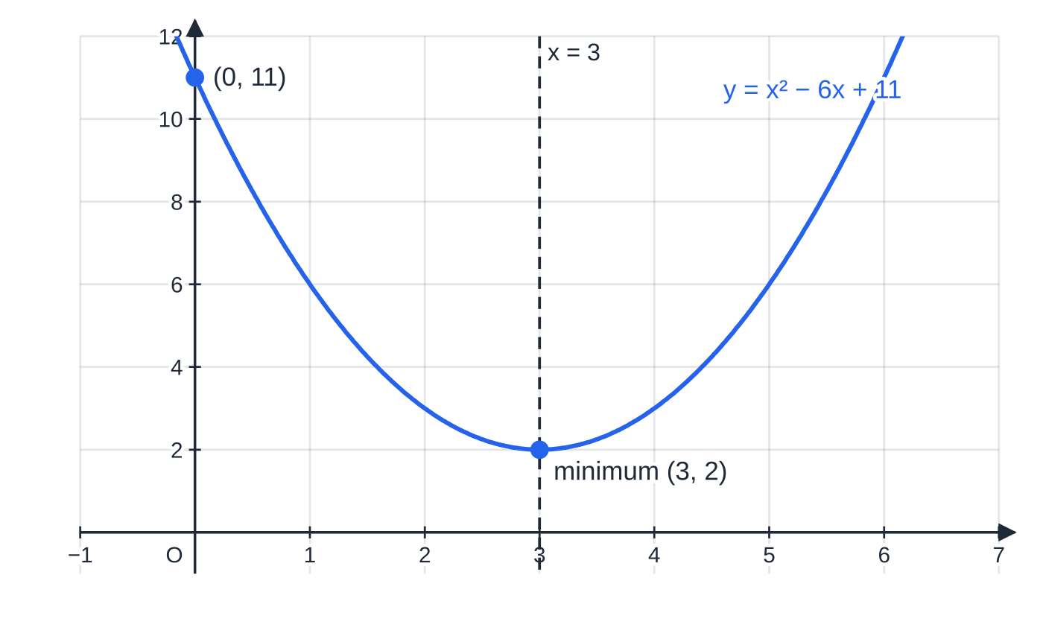
How do you prove a result by deduction? (continued)
Section 2 of 12
Proving an inequality
Start from something known to be true, usually "a square is ≥0", and work towards the inequality.
If you found the idea by working backwards from the result, rewrite the proof forwards, or make sure every step is reversible (⇔), and state any conditions (such as a, b > 0) that you used.
Multiplying or dividing an inequality by a negative number reverses it, so check the signs of anything you divide by.
Completing the square gives (x − 3)² + 2, so the minimum point is (3, 2) and the curve never reaches the x-axis. The graph illustrates the result; the algebra proves it.
Notes:
How do you prove a result by deduction?. Full notes: https://examinerprep.com/notes/edexcel-ial-maths/proof-and-algebraic-division/

Slide 12
How do you prove a result by deduction? (continued)
Section 2 of 12 · Worked example 3 · Hard · Prove
WORKED EXAMPLE · QUESTION
Prove that for all positive real numbers a and b, (a + b)/2 ≥√(ab), and state when equality holds.
SOLUTION
Step 1. Start from a true statement. As a, b > 0, √a and √b are real, so (√a - √b)² ≥0.
Step 2. Expand: a - 2√a√b + b ≥0, so a + b ≥2√(ab).
Step 3. Divide by 2 (positive, so the inequality is unchanged): (a + b)/2 ≥√(ab) for all positive a, b.
Step 4. Equality ⇔(√a - √b)² = 0 ⇔ a = b.
Notes:
How do you prove a result by deduction?: Worked example 3. Full notes: https://examinerprep.com/notes/edexcel-ial-maths/proof-and-algebraic-division/

Slide 13
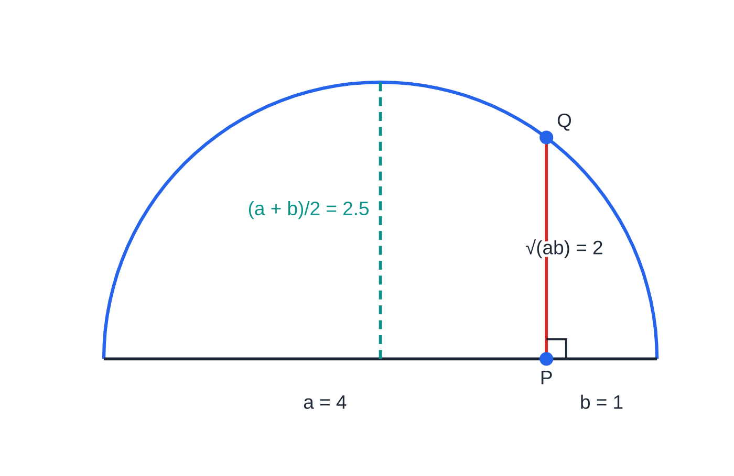
How do you prove a result by deduction? (continued)
Section 2 of 12
Drawn to scale with a = 4 and b = 1: a semicircle on a diameter of length a + b has radius (a + b)/2 = 2.5, and the perpendicular PQ has length √(ab) = 2. PQ is half of a chord, and no half-chord can be longer than the radius: a picture of Worked example 3, with equality only when P is at the centre (a = b).
Notes:
How do you prove a result by deduction?. Full notes: https://examinerprep.com/notes/edexcel-ial-maths/proof-and-algebraic-division/

Slide 14
How do you prove a result by exhaustion?
Section 3 of 12
Proof by exhaustion: split the situation into a set of cases that together cover every possibility, and prove the result in each case.
Finite set: if the statement is about a small, listed set of numbers, check every one of them. Every member must be checked.
Infinite set split into cases: every integer is even or odd (2k or 2k + 1); every integer is 3k, 3k + 1 or 3k + 2; and so on. A proof for each case covers all integers.
Say clearly why the cases are exhaustive (nothing is left out) and finish with a conclusion that covers them all.
Notes:
How do you prove a result by exhaustion?. Full notes: https://examinerprep.com/notes/edexcel-ial-maths/proof-and-algebraic-division/

Slide 15
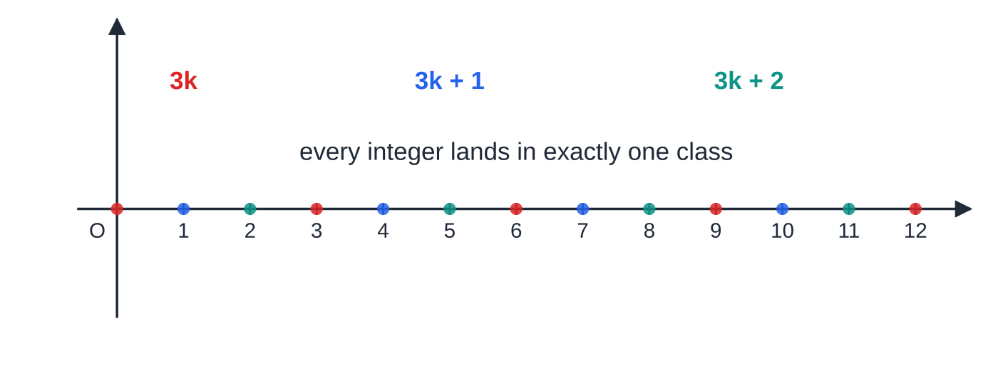
How do you prove a result by exhaustion? (continued)
Section 3 of 12
A finite example: is 97 prime?
If 97 had a factor other than 1 and itself, it would have a prime factor no bigger than √97 ≈9.85, so only 2, 3, 5 and 7 need checking.
97 = 2 ×48 + 1, 97 = 3 ×32 + 1, 97 = 5 ×19 + 2, 97 = 7 ×13 + 6: none divides exactly, so 97 is prime.
Splitting the integers by their remainder on division by 3. Red points are multiples of 3, blue leave remainder 1 and teal leave remainder 2. Three cases cover every integer, so a proof for each case is a complete proof.
Notes:
How do you prove a result by exhaustion?. Full notes: https://examinerprep.com/notes/edexcel-ial-maths/proof-and-algebraic-division/

Slide 16
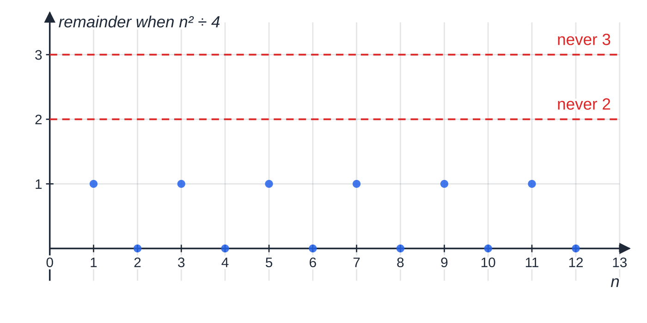
How do you prove a result by exhaustion? (continued)
Section 3 of 12
The remainder when n² is divided by 4, computed for n = 1 to 12. Only 0 and 1 appear. Twelve values are not a proof, but splitting every integer into the two cases "even" and "odd" is, as Worked example 4 shows.
Notes:
How do you prove a result by exhaustion?. Full notes: https://examinerprep.com/notes/edexcel-ial-maths/proof-and-algebraic-division/

Slide 17
How do you prove a result by exhaustion? (continued)
Section 3 of 12 · Worked example 4 · Medium · Prove
WORKED EXAMPLE · QUESTION
(a) Prove that the square of any integer is either a multiple of 4 or one more than a multiple of 4. (b) Hence show that 1 000 003 is not a square number.
SOLUTION
(a) Every integer is even or odd, so two cases cover everything.
Case 1, n even: let n = 2k, k an integer. Then n² = 4k², a multiple of 4.
Case 2, n odd: let n = 2k + 1. Then n² = 4k² + 4k + 1 = 4(k² + k) + 1, one more than a multiple of 4.
In both cases the result holds, so every square is 4m or 4m + 1 for some integer m.
(b) 1 000 003 = 4 ×250 000 + 3, which is three more than a multiple of 4. By (a) no square has this form, so 1 000 003 is not a square number.
Notes:
How do you prove a result by exhaustion?: Worked example 4. Full notes: https://examinerprep.com/notes/edexcel-ial-maths/proof-and-algebraic-division/

Slide 18
How do you prove a result by exhaustion? (continued)
Section 3 of 12
Exam tip
In an exhaustion proof, name each case before you work on it ("Case 1: n is even, n = 2k") and finish with one sentence that brings the cases together. A conclusion for only one case leaves the proof incomplete.
Notes:
How do you prove a result by exhaustion?. Full notes: https://examinerprep.com/notes/edexcel-ial-maths/proof-and-algebraic-division/

Slide 19
How do you disprove a statement?
Section 4 of 12
A counterexample is one specific example that satisfies the conditions of a statement but for which the statement is false.
A statement about "all" or "every" is disproved by one counterexample.
Give the actual values, show the working that makes the statement fail, and say clearly that the statement is therefore false.
Good places to look: 0, 1, negative numbers, fractions between 0 and 1, and the number that appears in the expression itself.
Notes:
How do you disprove a statement?. Full notes: https://examinerprep.com/notes/edexcel-ial-maths/proof-and-algebraic-division/

Slide 20
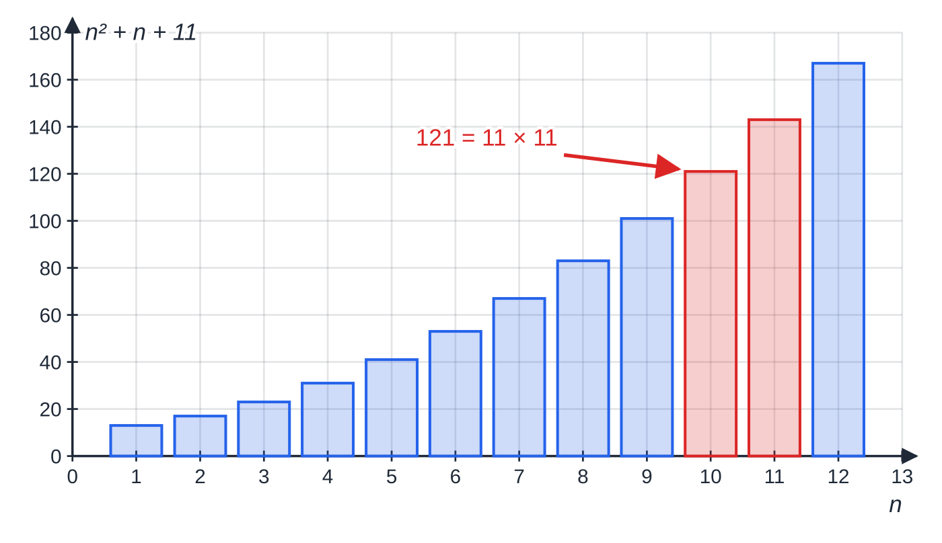
How do you disprove a statement? (continued)
Section 4 of 12
Values of n² + n + 11 for n = 1 to 12. The first nine values are all prime (blue), but n = 10 gives 121 = 11 × 11, a counterexample to "n² + n + 11 is always prime". (n = 11 gives 143 = 11 × 13, another one.)
Notes:
How do you disprove a statement?. Full notes: https://examinerprep.com/notes/edexcel-ial-maths/proof-and-algebraic-division/

Slide 21
How do you disprove a statement? (continued)
Section 4 of 12 · Worked example 5 · Easy · Disprove
WORKED EXAMPLE · QUESTION
Disprove each statement by giving a counterexample. (a) n² + n + 11 is prime for every positive integer n. (b) x³ > x² for every positive real number x.
SOLUTION
(a) Choose n so that 11 is a common factor: try n = 10. 10² + 10 + 11 = 121 = 11 ×11, which is not prime, so the statement is false.
(b) Try a number between 0 and 1, x = ½: (½)³ = ⅛ and (½)² = ¼; ⅛ < ¼, so the statement is false.
Showing that statement (a) holds for n = 1, 2, …, 9 proves nothing, and here it is wrong at n = 10.
Notes:
How do you disprove a statement?: Worked example 5. Full notes: https://examinerprep.com/notes/edexcel-ial-maths/proof-and-algebraic-division/

Slide 22
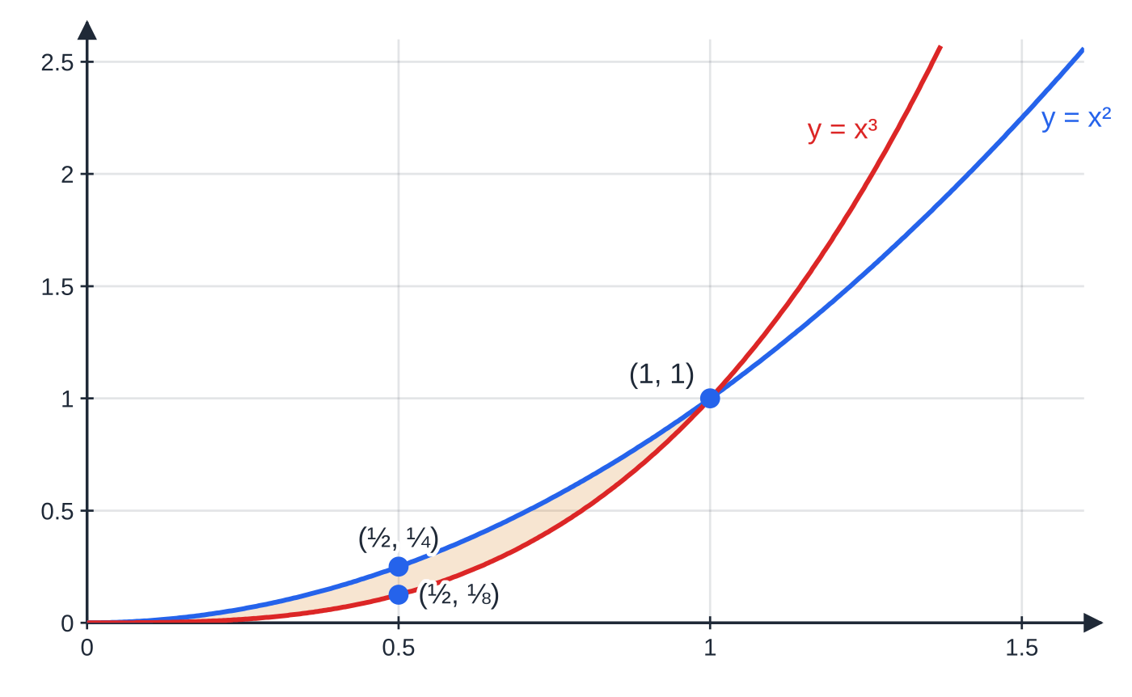
How do you disprove a statement? (continued)
Section 4 of 12
Common error
Stating a counterexample without the evidence. "n = 10" alone is not enough; you need the value 121, its factorisation 11 ×11, and the sentence "so the statement is false".
y = x³ lies below y = x² for 0 < x < 1 (shaded), so every x in that interval is a counterexample to "x³ > x² for all positive x". The claim is only true for x > 1.
Notes:
How do you disprove a statement?. Full notes: https://examinerprep.com/notes/edexcel-ial-maths/proof-and-algebraic-division/

Slide 23
How do you divide a polynomial by (ax + b)?
Section 5 of 12
Dividing polynomials works like dividing whole numbers. 23 ÷5 is 4 remainder 3 because 23 = 5 ×4 + 3. In the same way, dividing f(x) by a linear expression gives a quotient and a remainder that satisfy an identity.
The division identity
f(x) ≡(ax + b) q(x) + r
f(x) is the polynomial being divided (the dividend), (ax + b) is the divisor, q(x) is the quotient, one degree lower than f, and r is the remainder, a constant.
In the formulae list? Not in the formulae booklet: learn it.
If r = 0 the divisor is a factor of f(x). Dividing a cubic by a linear expression always gives a quadratic quotient, and the remainder is a constant because it must have a lower degree than the divisor.
Notes:
How do you divide a polynomial by (ax + b)?. Full notes: https://examinerprep.com/notes/edexcel-ial-maths/proof-and-algebraic-division/

Slide 24
How do you divide a polynomial by (ax + b)? (continued)
Section 5 of 12
Long division, step by step
1. Write f(x) in descending powers, with a 0 for any missing power (e.g. x³ + 0x² - 7x + 6).
2. Divide the leading term of what is left by the leading term of the divisor: this gives the next term of the quotient.
3. Multiply the whole divisor by that term and subtract. Watch the signs on every term.
4. Bring down the next term and repeat until what is left has a lower degree than the divisor: that is the remainder.
Alternative: compare coefficients in f(x) ≡(ax + b)(px² + qx + s) + r. This is often quicker when you only need the quotient.
Notes:
How do you divide a polynomial by (ax + b)?. Full notes: https://examinerprep.com/notes/edexcel-ial-maths/proof-and-algebraic-division/

Slide 25
How do you divide a polynomial by (ax + b)? (continued)
Section 5 of 12 · Worked example 6 · Medium · Divide
WORKED EXAMPLE · QUESTION
Divide f(x) = 4x³ + 4x² - 5x + 3 by (2x + 1), giving the quotient and the remainder. Check the remainder by substitution.
SOLUTION
Step 1. 4x³ ÷2x = 2x²; subtract 2x²(2x + 1) = 4x³ + 2x²: (4x³ + 4x²) - (4x³ + 2x²) = 2x². Bring down -5x: 2x² - 5x.
Step 2. 2x² ÷2x = x; subtract x(2x + 1) = 2x² + x: (2x² - 5x) - (2x² + x) = -6x. Bring down +3: -6x + 3.
Step 3. -6x ÷2x = -3; subtract -3(2x + 1) = -6x - 3: (-6x + 3) - (-6x - 3) = 6.
Step 4. Quotient 2x² + x - 3, remainder 6: f(x) ≡(2x + 1)(2x² + x - 3) + 6.
Step 5. Check: put 2x + 1 = 0, i.e. x = -½, so the first term vanishes. f(-½) = 4(-⅛) + 4(¼) + (5/2) + 3 = -½ + 1 + (5/2) + 3 = 6. ✓
Notes:
How do you divide a polynomial by (ax + b)?: Worked example 6. Full notes: https://examinerprep.com/notes/edexcel-ial-maths/proof-and-algebraic-division/

Slide 26
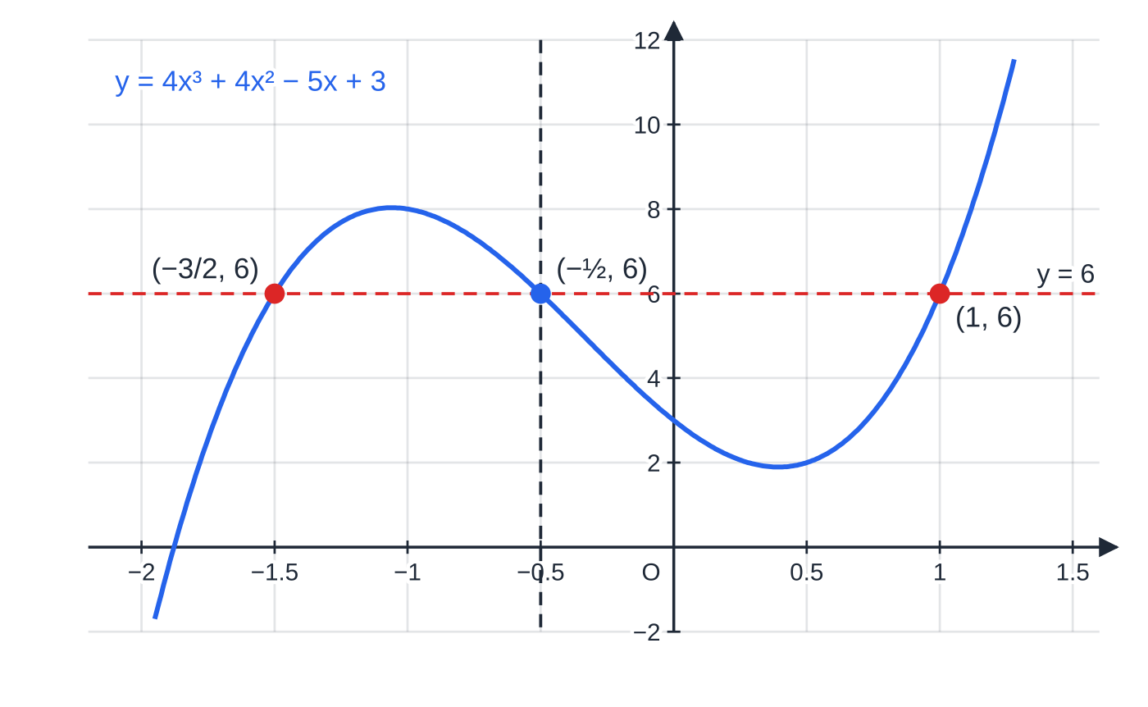
How do you divide a polynomial by (ax + b)? (continued)
Section 5 of 12
The curve passes through (−½, 6): its height at the root of the divisor is the remainder. The line y = 6 meets the curve again where 2x² + x − 3 = (2x + 3)(x − 1) = 0, at x = −3/2 and x = 1.
Notes:
How do you divide a polynomial by (ax + b)?. Full notes: https://examinerprep.com/notes/edexcel-ial-maths/proof-and-algebraic-division/

Slide 27
What do the remainder and factor theorems say?
Section 6 of 12
Step 5 of Worked example 6 is the whole idea. In the division identity, choose the value of x that makes the divisor zero. The product term disappears and only the remainder is left. You can find a remainder without dividing at all.
Remainder theorem. When f(x) is divided by (ax - b), the remainder is f(b/a).
Why: in f(x) ≡(ax - b) q(x) + r, put x = b/a; the bracket becomes 0, leaving f(b/a) = r.
Divisor (x - 3): use f(3). Divisor (x + 3): use f(-3). Divisor (2x + 1): use f(-½).
In the formulae list? Not in the formulae booklet: learn it.
Factor theorem. (ax - b) is a factor of f(x) ⇔ f(b/a) = 0.
It is the remainder theorem with remainder 0, and it works both ways: to show a factor, and to find one.
In the formulae list? Not in the formulae booklet: learn it.
Notes:
What do the remainder and factor theorems say?. Full notes: https://examinerprep.com/notes/edexcel-ial-maths/proof-and-algebraic-division/

Slide 28
What do the remainder and factor theorems say? (continued)
Section 6 of 12
For a cubic with integer coefficients, any integer root divides the constant term, so try the factors of the constant first (±1, ±2, …).
Factorising a cubic fully
1. Find one root p with f(p) = 0, given in the question or found by trial.
2. Divide by (x - p), by long division or comparing coefficients, to get a quadratic.
3. Factorise the quadratic. If it will not factorise, check its discriminant: b² - 4ac < 0 means no more real roots.
4. "Fully" means a product of linear factors where possible: leaving (x - 2)(3x² + 13x + 4) is not finished.
Notes:
What do the remainder and factor theorems say?. Full notes: https://examinerprep.com/notes/edexcel-ial-maths/proof-and-algebraic-division/

Slide 29
What do the remainder and factor theorems say? (continued)
Section 6 of 12 · Worked example 7 · Medium · Show that
WORKED EXAMPLE · QUESTION
f(x) = 3x³ + 7x² - 22x - 8. (a) Use the factor theorem to show that (x - 2) is a factor of f(x). (b) Factorise f(x) completely. (c) Hence solve f(x) = 0.
SOLUTION
(a) f(2) = 3(8) + 7(4) - 22(2) - 8 = 24 + 28 - 44 - 8 = 0. Since f(2) = 0, (x - 2) is a factor.
(b) Compare coefficients in (x - 2)(3x² + px + 4); the 3 and the 4 make the x³ term and the constant -8 right. x²: p - 6 = 7, so p = 13. Check x: 4 - 2p = -22. ✓
Factorise the quadratic: 3x² + 13x + 4 = (3x + 1)(x + 4), so f(x) = (x - 2)(3x + 1)(x + 4).
(c) Each factor equal to zero: x = 2, x = -⅓, x = -4.
Notes:
What do the remainder and factor theorems say?: Worked example 7. Full notes: https://examinerprep.com/notes/edexcel-ial-maths/proof-and-algebraic-division/

Slide 30
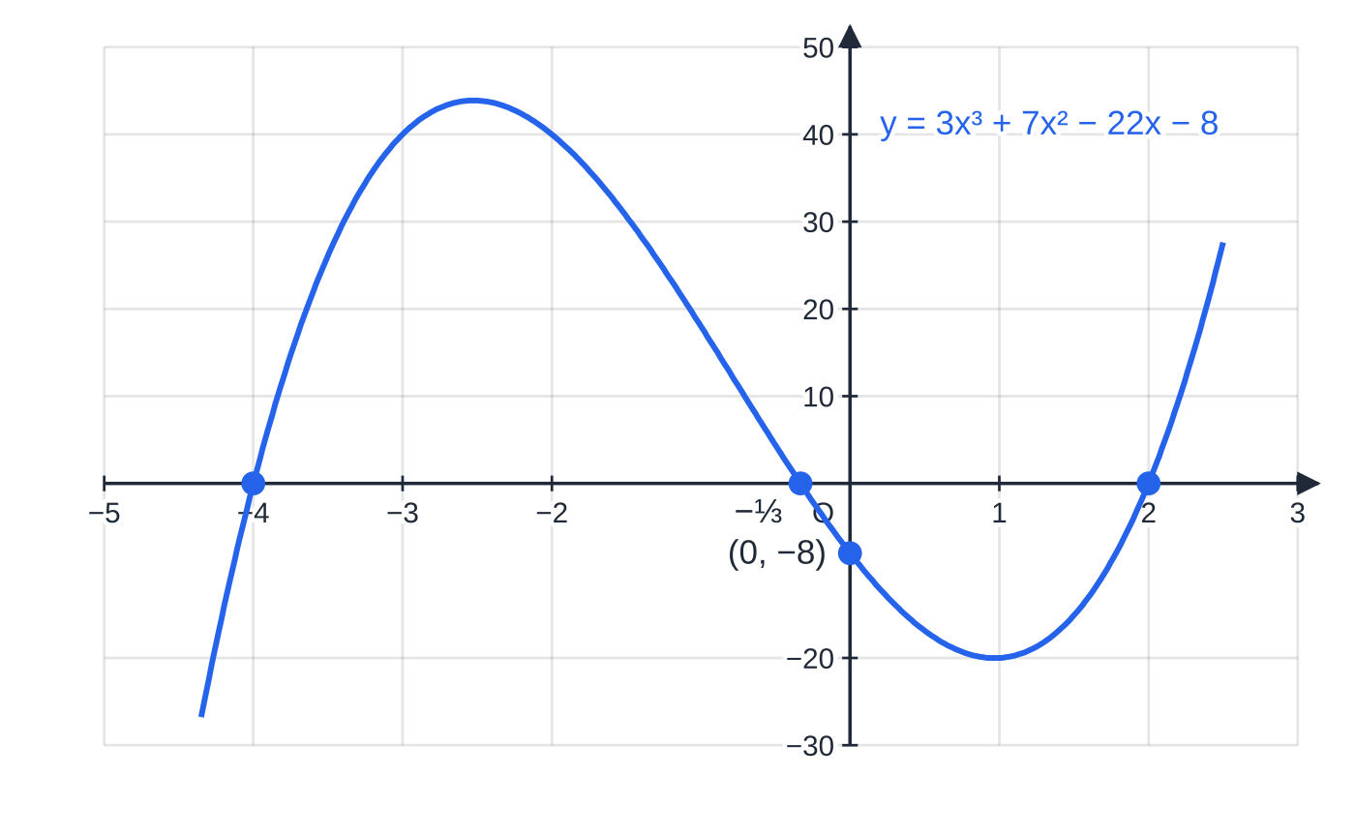
What do the remainder and factor theorems say? (continued)
Section 6 of 12
Common error
Getting the sign wrong in the factor theorem. f(3) = 0 means (x - 3) is a factor, not (x + 3); and for (3x + 1) you substitute x = -⅓, not x = -1 or x = -3.
Each linear factor gives one x-intercept: (x + 4) gives −4, (3x + 1) gives −⅓, (x − 2) gives 2. The y-intercept is the constant term, −8.
Notes:
What do the remainder and factor theorems say?. Full notes: https://examinerprep.com/notes/edexcel-ial-maths/proof-and-algebraic-division/

Slide 31
How do you find unknown coefficients?
Section 7 of 12
When a polynomial contains unknown constants, each fact you are told about it becomes an equation. The factor theorem gives an equation equal to zero; the remainder theorem gives an equation equal to the stated remainder.
"(x + 2) is a factor" ⇒f(-2) = 0; "the remainder on dividing by (x - 1) is -6" ⇒f(1) = -6.
One unknown needs one condition; two unknowns need two conditions, then solve simultaneously.
Simplify each equation (divide through by any common factor) before solving, and check your values in both conditions.
Notes:
How do you find unknown coefficients?. Full notes: https://examinerprep.com/notes/edexcel-ial-maths/proof-and-algebraic-division/

Slide 32
How do you find unknown coefficients? (continued)
Section 7 of 12 · Worked example 8 · Hard · Find
WORKED EXAMPLE · QUESTION
f(x) = ax³ + bx² - 11x + 6, where a and b are constants. (x + 2) is a factor of f(x), and when f(x) is divided by (x - 1) the remainder is -6.
(a) Find the values of a and b. (b) Factorise f(x) completely. (c) Find the remainder when f(x) is divided by (2x + 1).
SOLUTION
(a) Factor theorem, f(-2) = 0: -8a + 4b + 22 + 6 = 0, so 2a - b = 7.
Remainder theorem, f(1) = -6: a + b - 11 + 6 = -6, so a + b = -1.
Add the two equations: 3a = 6, so a = 2, b = -3.
(b) Divide 2x³ - 3x² - 11x + 6 by (x + 2): 2x³ - 3x² - 11x + 6 = (x + 2)(2x² - 7x + 3), so f(x) = (x + 2)(2x - 1)(x - 3).
Notes:
How do you find unknown coefficients?: Worked example 8. Full notes: https://examinerprep.com/notes/edexcel-ial-maths/proof-and-algebraic-division/

Slide 33
How do you find unknown coefficients? (continued)
Section 7 of 12 · Worked example 8 · Hard · Find (continued)
(c) Remainder theorem with x = -½: f(-½) = 2(-⅛) - 3(¼) - 11(-½) + 6 = -¼ - ¾ + (11/2) + 6 = (21/2).
Check (a): f(1) = 2 - 3 - 11 + 6 = -6 ✓ and f(-2) = -16 - 12 + 22 + 6 = 0 ✓.
Notes:
How do you find unknown coefficients?: Worked example 8. Full notes: https://examinerprep.com/notes/edexcel-ial-maths/proof-and-algebraic-division/

Slide 34
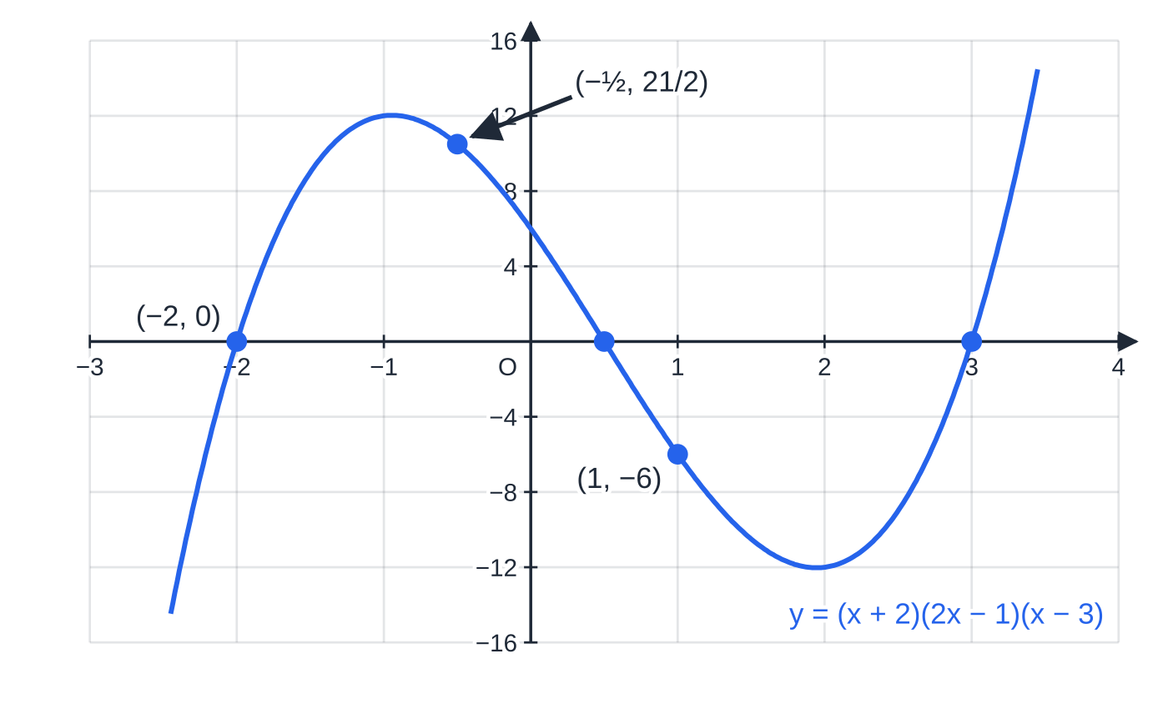
How do you find unknown coefficients? (continued)
Section 7 of 12
Exam tip
Write each condition as "f(-2) = 0" or "f(1) = -6" before substituting. It shows which theorem you are using, and it stops you equating the remainder to 0 by habit.
The cubic found in Worked example 8. The two given conditions are visible on the graph: it passes through (−2, 0), a factor, and through (1, −6), the remainder on dividing by (x − 1). The point (−½, 21/2) is the answer to part (c).
Notes:
How do you find unknown coefficients?. Full notes: https://examinerprep.com/notes/edexcel-ial-maths/proof-and-algebraic-division/

Slide 35
Exam tips for P2.1
Section 8 of 12
Exam tip 1 — define your letters
Start every algebraic proof by saying what the letters are: "Let n be an integer." Then the forms 2n, 2n + 1 or 3k + 2 have a meaning, and the conclusion can refer back to them.
Exam tip 2 — end with a sentence
A proof is not finished when the algebra stops. Finish with a statement such as "so the sum is always a multiple of 3" or "so the statement is false", using the words of the question.
Exam tip 3 — show that means show all
When a result is given ("show that (x - 2) is a factor"), the working is the whole answer: write the substitution, each value, the total 0, and the conclusion.
Notes:
Exam tips for P2.1. Full notes: https://examinerprep.com/notes/edexcel-ial-maths/proof-and-algebraic-division/

Slide 36
Exam tips for P2.1 (continued)
Section 8 of 12
Exam tip 4 — check a division
After a long division, check the remainder with the remainder theorem, or multiply back: (divisor) × (quotient) + remainder must give the original polynomial term by term.
Exam tip 5 — "completely" means linear factors
"Factorise completely" is only finished when the quadratic factor has been factorised too (or shown not to factorise). "Hence" in the next part means use those factors; do not start again.
Notes:
Exam tips for P2.1. Full notes: https://examinerprep.com/notes/edexcel-ial-maths/proof-and-algebraic-division/

Slide 37
Common misconceptions
Section 9 of 12
Misconception | Why it is wrong | Correct idea
A result that works for lots of examples is proved. | A later case may fail: n² + n + 11 is prime for n = 1 to 9 but not for 10. | Examples prove a result only when they exhaust every possible case.
Two odd numbers can be written 2n + 1 and 2n + 1. | That describes the same number twice. | Use different letters: 2m + 1 and 2n + 1.
One counterexample is not enough to disprove a statement. | A statement about "all" cases is false if a single case fails. | One clearly worked counterexample is a complete disproof.
If f(3) = 0 then (x + 3) is a factor. | Substituting x = 3 makes (x - 3) zero, not (x + 3). | f(p) = 0 ⇔(x - p) is a factor.
The remainder when dividing by (2x - 1) is f(1) or f(2). | The divisor is zero at x = ½. | Remainder = f(½).
Dividing a cubic by a linear expression can leave a remainder in x. | The remainder always has a lower degree than the divisor. | Dividing by a linear divisor leaves a constant remainder.
Notes:
Common misconceptions. Full notes: https://examinerprep.com/notes/edexcel-ial-maths/proof-and-algebraic-division/

Slide 38
How this topic connects
Section 10 of 12
P1 algebra and graphs
Completing the square, the discriminant and sketching cubics from their factors all feed straight into this page: a fully factorised cubic gives its x-intercepts at once.
P2.3 Sequences and series
The sum formulae for arithmetic and geometric series are proved by deduction: write the sum forwards and backwards, or multiply by r and subtract.
Later pure units (P3, P4), mechanics and physics
Polynomial division reappears when simplifying algebraic fractions (P3) and splitting them into partial fractions (P4), and proof by contradiction (for example, that √2 is irrational) completes the set of proof methods in P4. Cubic and quadratic models in mechanics are solved with the factor theorem, and "show that" derivations in M1, M2 and IAL Physics need the same complete chain of reasoning.
Notes:
How this topic connects. Full notes: https://examinerprep.com/notes/edexcel-ial-maths/proof-and-algebraic-division/

Slide 39
Key formulae
Section 11 of 12
Formula | Use | In the formulae list?
f(x) ≡(ax - b) q(x) + r | division identity: quotient q(x), constant remainder r | No — learn it
r = f(b/a) | remainder theorem: remainder on division by (ax - b) | No — learn it
f(b/a) = 0 ⇔(ax - b) is a factor | factor theorem: showing or finding factors | No — learn it
2n, 2n + 1, n, n + 1, n + 2 | even, odd and consecutive integers in a proof | No — learn it
x² + bx + c = (x + b/2)² + c - b²/4 | completing the square to prove an expression is positive | No — derive it
(√a - √b)² ≥0 ⇒(a + b)/2 ≥√(ab) | a standard starting point for inequality proofs (a, b > 0) | No — derive it
Notes:
Key formulae. Full notes: https://examinerprep.com/notes/edexcel-ial-maths/proof-and-algebraic-division/

Slide 40
Check your understanding
Section 12 of 12
1. Prove that the sum of any two consecutive integers is odd.
2. Disprove: "if n is an odd positive integer, then n² + 4 is prime".
3. Find the remainder when x³ - 2x² + 5 is divided by (x + 2).
4. (2x - 3) is a factor of 2x³ - x² + kx - 6. Find k and the quadratic factor.
5. A student checks that n² + n + 1 is odd for n = 1 to 50 and says this proves it for all integers. Explain what is missing and give a proof.
6. Find the quotient and remainder when x³ + 0x² - 7x + 6 is divided by (x - 3). What does the result tell you?
Notes:
Check your understanding: questions. Full notes: https://examinerprep.com/notes/edexcel-ial-maths/proof-and-algebraic-division/

Slide 41
Check your understanding · answers
Section 12 of 12
1. Let the integers be n and n + 1, where n is an integer. Their sum is 2n + 1, which is one more than a multiple of 2, so it is odd for every integer n.
2. Try odd values: 1 →5, 3 →13, 5 →29, 7 →53 are prime, but n = 9 gives 81 + 4 = 85 = 5 ×17, which is not prime. So the statement is false.
3. Remainder theorem: f(-2) = -8 - 8 + 5. The remainder is -11.
4. f(3/2) = (27/4) - (9/4) + (3/2) k - 6 = (3/2) k - (3/2) = 0, so k = 1. Then 2x³ - x² + x - 6 = (2x - 3)(x² + x + 2); the quadratic has discriminant 1 - 8 < 0, so it has no real roots. k = 1; quadratic factor x² + x + 2.
5. Fifty values do not cover every integer, so this is not a proof. Exhaustion with two cases does: if n = 2k, then n² + n + 1 = 4k² + 2k + 1 = 2(2k² + k) + 1; if n = 2k + 1, then it equals 4k² + 6k + 3 = 2(2k² + 3k + 1) + 1. Both are odd, and every integer is even or odd, so n² + n + 1 is always odd.
6. x³ ÷x = x²; subtract x³ - 3x² to leave 3x² - 7x. 3x² ÷x = 3x; subtract 3x² - 9x to leave 2x + 6. 2x ÷x = 2; subtract 2x - 6 to leave 12. Quotient x² + 3x + 2, remainder 12, so (x - 3) is not a factor.
Notes:
Check your understanding: answers. Full notes: https://examinerprep.com/notes/edexcel-ial-maths/proof-and-algebraic-division/

Slide 42
Check your understanding · answers (continued)
Section 12 of 12
Check: f(3) = 27 - 21 + 6 = 12. ✓
Notes:
Check your understanding: answers. Full notes: https://examinerprep.com/notes/edexcel-ial-maths/proof-and-algebraic-division/

Slide 43
Practice questions
2 original exam-style questions. Answers at the end of the deck.

Slide 44
Question 1
8 marks
A cubic polynomial is defined by h(x) = 6x³ − x² − 5x + 7. In this question you divide it by a linear expression whose leading coefficient is not 1.
(a) Use algebraic long division to find the quotient and the remainder when h(x) is divided by (3x − 2). [4]
(b) Use the remainder theorem to verify your remainder. [2]
(c) Hence factorise h(x) − 5 completely. [2]
Notes:
Online with the full mark scheme: https://examinerprep.com/ial-maths-p2-1-proof-and-algebraic-division-questions#IALM-P2-1-B-07

Slide 45
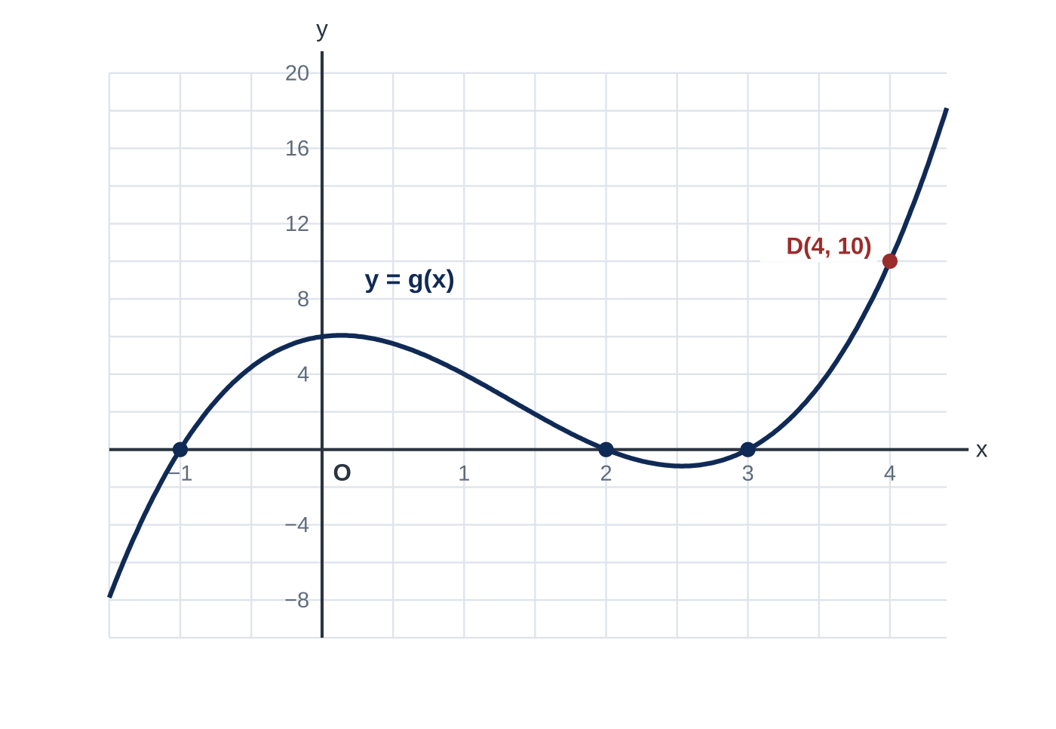
Question 2
7 marks
Figure 1 shows part of the curve with equation y = g(x), where g(x) = x³ − 4x² + x + 6. The point D(4, 10) lies on the curve, and the curve crosses the x-axis at three points whose x-coordinates are integers.
(a) Using the point D and the remainder theorem, write down the remainder when g(x) is divided by (x − 4). [2]
(b) Use algebraic long division to divide g(x) by (x − 4). State the quotient and confirm the remainder. [3]
(c) Use the factor theorem to show that (x − 3) is a factor of g(x). Hence, using Figure 1, write g(x) as a product of three linear factors. [2]
Notes:
Online with the full mark scheme: https://examinerprep.com/ial-maths-p2-1-proof-and-algebraic-division-questions#IALM-P2-1-FB-02

Slide 46
Answers

Slide 47
Question 1 · answer
Mark scheme
long division with first term 2x² and a subtraction carried out: 6x³ − x² − (6x³ − 4x²) = 3x²
second term + x: 3x² − 5x − (3x² − 2x) = −3x
third term −1: −3x + 7 − (−3x + 2) = 5, so quotient 2x² + x − 1
remainder 5
h(⅔) = 6(8/27) − 4/9 − 10/3 + 7
= 16/9 − 4/9 − 30/9 + 63/9 = 45/9 = 5 ✓
h(x) − 5 = (3x − 2)(2x² + x − 1) (ft their quotient)
= (3x − 2)(2x − 1)(x + 1)
Notes:
Full mark scheme: https://examinerprep.com/ial-maths-p2-1-proof-and-algebraic-division-questions#IALM-P2-1-B-07

Slide 48
Question 2 · answer
Mark scheme
by the remainder theorem the remainder is g(4)
D(4, 10) lies on the curve, so g(4) = 10: remainder = 10
first term x²: (x³ − 4x²) − (x³ − 4x²) = 0, bring down x + 6
next terms 0x and + 1: (x + 6) − (x − 4) = 10
quotient x² + 1, remainder 10, so g(x) = (x − 4)(x² + 1) + 10
g(3) = 27 − 36 + 3 + 6 = 0, so (x − 3) is a factor
the curve also crosses the axis at x = −1 and x = 2: g(x) = (x + 1)(x − 2)(x − 3)
Notes:
Full mark scheme: https://examinerprep.com/ial-maths-p2-1-proof-and-algebraic-division-questions#IALM-P2-1-FB-02

Slide 49
Keep practising
Notes for this topic
Questions on this topic
Build a printable test
ExaminerPrep is an independent tutoring service. It has been developed independently from and is not endorsed by the International Baccalaureate Organization. "International Baccalaureate", "IB" and "IB Diploma Programme" are registered trademarks of the IBO, used here for descriptive purposes only.
Pearson Edexcel and Cambridge are trademarks of their owners; ExaminerPrep is not affiliated with any exam board.

