Slide 1
EP
EDEXCEL IAL MATHS
P4.1 Proof by contradiction and partial fractions
The full notes page in 13 sections · practice questions with answers · simulations
ExaminerPrep is an independent tutoring service. It has been developed independently from and is not endorsed by the International Baccalaureate Organization. "International Baccalaureate", "IB" and "IB Diploma Programme" are registered trademarks of the IBO, used here for descriptive purposes only.
Pearson Edexcel and Cambridge are trademarks of their owners; ExaminerPrep is not affiliated with any exam board.
Notes:
P4.1 Proof by contradiction and partial fractions. Notes for this topic: https://examinerprep.com/notes/edexcel-ial-maths/proof-by-contradiction-and-partial-fractions/

Slide 2
What this page covers
Overview
The structure of a proof by contradiction, and how to write the negation of a statement correctly
The proof that √2 is irrational, including the step "if a² is even then a is even"
The proof that there are infinitely many prime numbers
Proof by contradiction for unfamiliar statements: rational and irrational numbers, equations with no integer solutions, "no greatest" results
Partial fractions with distinct linear factors in the denominator (two or three factors)
Partial fractions with a repeated linear factor
Improper fractions: divide first, then split
Notes:
What this page covers. Full notes: https://examinerprep.com/notes/edexcel-ial-maths/proof-by-contradiction-and-partial-fractions/

Slide 3
In one minute
Key points
1. A proof by contradiction assumes the statement is false, reasons correctly from that assumption to something impossible, and concludes that the statement must be true; partial fractions do the reverse of adding fractions, writing one complicated fraction as a sum of simple ones.
2. √2 is irrational: assume √2 = a/b in its simplest form; squaring shows a and b are both even, a common factor, which contradicts "simplest form".
3. Infinitely many primes: assume a complete finite list; the product of the list plus 1 is not divisible by any prime in the list, so a prime is missing.
4. Distinct linear factors: f(x)/((x-p)(x-q)) ≡A/(x-p) + B/(x-q); a repeated factor needs both B/(x-p) and C/((x-p)²).
5. Improper fraction (degree of numerator ≥ degree of denominator): divide first, then split the proper remainder fraction.
Notes:
In one minute. Full notes: https://examinerprep.com/notes/edexcel-ial-maths/proof-by-contradiction-and-partial-fractions/

Slide 4
How does a proof by contradiction work?
Section 1 of 13
This page contains the last proof method of the course and the algebra tool that the rest of P4 leans on. In P2 you proved statements directly (deduction), by checking every case (exhaustion), and disproved them with a counterexample. Some statements resist all three, usually because they say something cannot happen: a number is not a fraction, a list never ends, an equation has no solution. For these, it is easier to imagine that the statement fails and show that this imagined world is impossible.
Proof by contradiction: assume the statement you want to prove is false, show that this assumption leads to a contradiction, and conclude that the statement is true.
Notes:
How does a proof by contradiction work?. Full notes: https://examinerprep.com/notes/edexcel-ial-maths/proof-by-contradiction-and-partial-fractions/

Slide 5
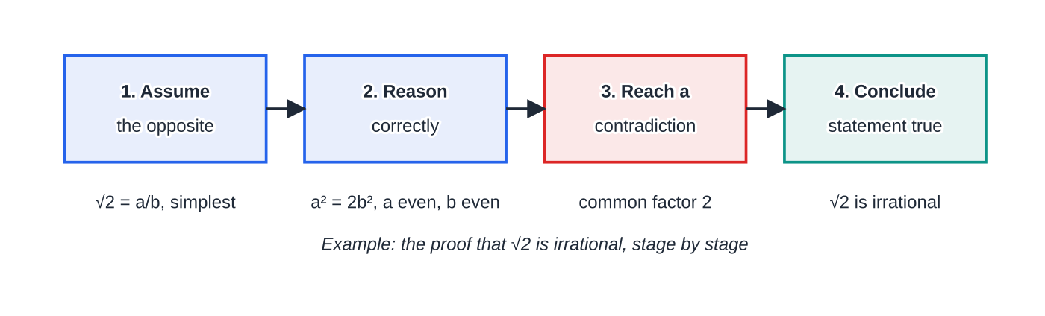
How does a proof by contradiction work? (continued)
Section 1 of 13
Stage 1 is where most proofs go wrong, so it pays to practise writing the negation of a statement.
The four stages of every proof by contradiction, with the √2 proof as the running example. Stage 3 always means two statements that cannot both be true.
Notes:
How does a proof by contradiction work?. Full notes: https://examinerprep.com/notes/edexcel-ial-maths/proof-by-contradiction-and-partial-fractions/

Slide 6
How does a proof by contradiction work? (continued)
Section 1 of 13
Statement to prove | Assume, for contradiction, that …
√2 is irrational | √2 is rational: √2 = a/b with a, b integers with no common factor, b ≠0
There are infinitely many primes | there are finitely many primes, p₁, p₂, …, pₙ (a complete list)
There is no greatest even integer | there is a greatest even integer, N
If n² is even, then n is even | n² is even and n is odd
There are no integers x, y with x² - y² = 10 | there are integers x, y with x² - y² = 10
The negation of "every … has property P" is "at least one … does not have property P", and the negation of "there is no …" is "there is at least one …". The negation of "if P then Q" is "P is true and Q is false": keep the condition, deny the result.
A quick example: there is no greatest even integer. Assume N is the greatest even integer. Then N + 2 is even and N + 2 > N, which contradicts N being the greatest. So there is no greatest even integer.
Notes:
How does a proof by contradiction work?. Full notes: https://examinerprep.com/notes/edexcel-ial-maths/proof-by-contradiction-and-partial-fractions/

Slide 7
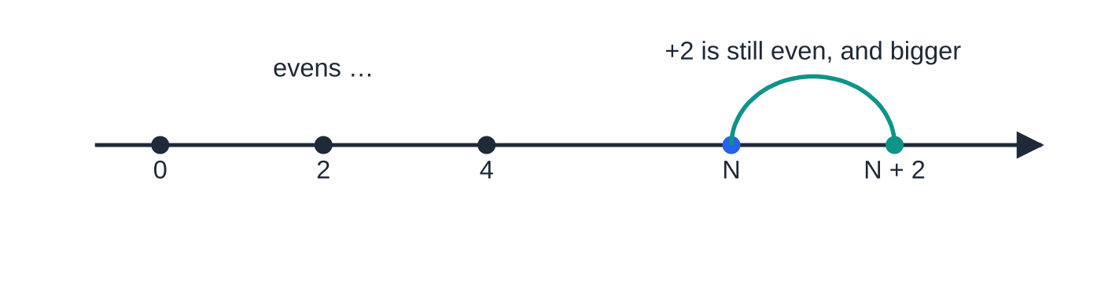
How does a proof by contradiction work? (continued)
Section 1 of 13
Common error
Negating "if n² is even then n is even" as "if n² is odd then n is odd". That is a different statement altogether. The correct starting point keeps the condition and denies the conclusion: "n² is even and n is odd".
If N were the greatest even integer, N + 2 would be an even integer to its right. The assumption contradicts itself, so there is no greatest even integer.
Notes:
How does a proof by contradiction work?. Full notes: https://examinerprep.com/notes/edexcel-ial-maths/proof-by-contradiction-and-partial-fractions/

Slide 8
How do you prove that √2 is irrational?
Section 2 of 13
An irrational number is a real number that cannot be written as a/b where a and b are integers and b ≠0.
You need one small result first: if a² is even, then a is even. It is itself a proof by contradiction. Assume a² is even and a is odd, so a = 2k + 1 for some integer k. Then a² = 4k² + 4k + 1 = 2(2k² + 2k) + 1, which is odd, contradicting "a² is even". So if a² is even, a is even. Quote this result (or prove it) inside the √2 proof.
Notes:
How do you prove that √2 is irrational?. Full notes: https://examinerprep.com/notes/edexcel-ial-maths/proof-by-contradiction-and-partial-fractions/

Slide 9
How do you prove that √2 is irrational? (continued)
Section 2 of 13 · Worked example 1 · Medium · Prove
WORKED EXAMPLE · QUESTION
Prove by contradiction that √2 is irrational.
SOLUTION
Assume the opposite. Assume √2 is rational: √2 = a/b, where a and b are integers, b ≠0, and a and b have no common factor other than 1.
Square and rearrange. 2 = a²/b² ⇒a² = 2b², so a² is even, and therefore a is even.
Write a = 2c and substitute. (2c)² = 2b² ⇒4c² = 2b² ⇒b² = 2c², so b² is even and b is even.
Contradiction. a and b are both even, so they have a common factor 2. This contradicts the assumption that a/b is in its simplest form.
Conclude. The assumption is false, so √2 is irrational.
Every rational number can be written in simplest form, so assuming this costs nothing, and it is exactly what the contradiction breaks.
Notes:
How do you prove that √2 is irrational?: Worked example 1. Full notes: https://examinerprep.com/notes/edexcel-ial-maths/proof-by-contradiction-and-partial-fractions/

Slide 10
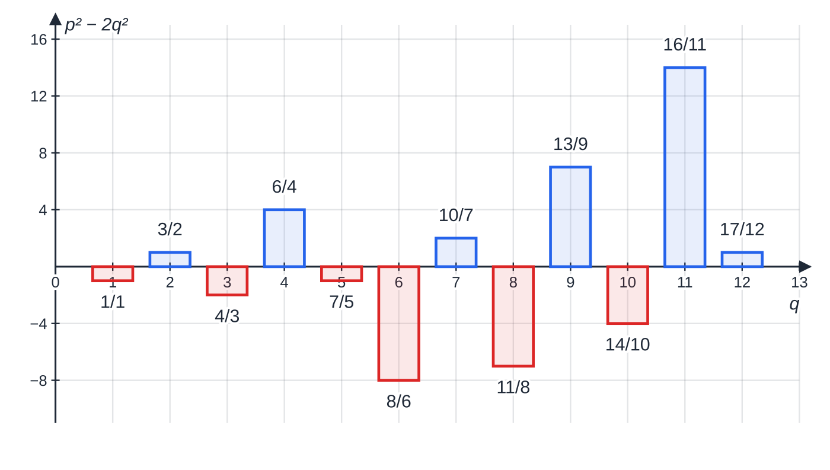
How do you prove that √2 is irrational? (continued)
Section 2 of 13
Exam tip 1 — the same proof for √3, √5, √7
Replace "even" by "a multiple of 3" (or 5, or 7). You then need the matching result, if a² is a multiple of 3 then a is a multiple of 3, which you can prove by considering a = 3k + 1 and a = 3k + 2. Do not try it for √4: the argument breaks, because 4 is a square.
For each q from 1 to 12, p is the whole number nearest to q√2 and the bar shows p² − 2q². Some fractions come close (17/12 gives p² − 2q² = 1), but the value is never 0, so p² = 2q² never happens. Twelve cases only illustrate the idea; worked example 1 proves it for every fraction.
Notes:
How do you prove that √2 is irrational?. Full notes: https://examinerprep.com/notes/edexcel-ial-maths/proof-by-contradiction-and-partial-fractions/

Slide 11
How do you prove there are infinitely many primes?
Section 3 of 13
This proof is over two thousand years old and is a model of the method: assume the list of primes is finite, then build a number the list cannot account for.
Notes:
How do you prove there are infinitely many primes?. Full notes: https://examinerprep.com/notes/edexcel-ial-maths/proof-by-contradiction-and-partial-fractions/

Slide 12
How do you prove there are infinitely many primes? (continued)
Section 3 of 13 · Worked example 2 · Medium · Prove
WORKED EXAMPLE · QUESTION
Prove by contradiction that there are infinitely many prime numbers.
SOLUTION
Assume the opposite. Assume there are only finitely many primes, and that p₁, p₂, …, pₙ is the complete list of them.
Build a new number. Let N = p₁ p₂ ⋯pₙ + 1. Then N > 1 and N is greater than every prime in the list.
Test N against the list. Dividing N by any pᵢ leaves a remainder of 1, so no prime in the list is a factor of N.
Contradiction. Every integer greater than 1 is either prime or has a prime factor. If N is prime, it is a prime not in the list; if not, its prime factors are not in the list. Either way the list was not complete.
Conclude. The assumption is false, so there are infinitely many primes.
Notes:
How do you prove there are infinitely many primes?: Worked example 2. Full notes: https://examinerprep.com/notes/edexcel-ial-maths/proof-by-contradiction-and-partial-fractions/

Slide 13
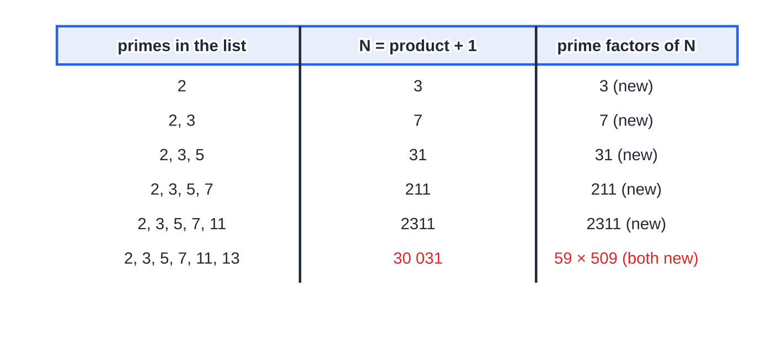
How do you prove there are infinitely many primes? (continued)
Section 3 of 13
Common error
Writing "N = p₁ p₂ ⋯pₙ + 1 is prime, so it is a new prime". N need not be prime (30 031 is not). The correct argument is that N has some prime factor, and that factor cannot be in the list.
The construction in worked example 2 for the first few primes. For the first five lists N happens to be prime itself; for 2, 3, 5, 7, 11, 13 it is 30 031 = 59 × 509, which is not prime, but its prime factors 59 and 509 are still missing from the list. The proof never claims that N is prime.
Notes:
How do you prove there are infinitely many primes?. Full notes: https://examinerprep.com/notes/edexcel-ial-maths/proof-by-contradiction-and-partial-fractions/

Slide 14
How do you tackle an unfamiliar statement?
Section 4 of 13
Write the negation precisely, with every letter defined: "Assume there exist integers x and y such that …", "Assume a + b is rational, so a + b = r/s …".
Choose the tool the statement suggests: even/odd (parity), multiples and remainders, the definition of a rational number, or comparing sizes.
Stop at a clear impossibility: an odd number equal to an even one, a number both rational and irrational, a largest number with something larger.
Conclude in words that refer back to the original statement.
Notes:
How do you tackle an unfamiliar statement?. Full notes: https://examinerprep.com/notes/edexcel-ial-maths/proof-by-contradiction-and-partial-fractions/

Slide 15
How do you tackle an unfamiliar statement? (continued)
Section 4 of 13 · Worked example 3 · Medium · Prove, explain
WORKED EXAMPLE · QUESTION
Given that a is rational and b is irrational, prove by contradiction that a + b is irrational. Hence explain why 3 + √2 is irrational.
SOLUTION
Assume a + b is rational: a + b = r/s, and a = p/q, with p, q, r, s integers and q, s ≠0.
Make b the subject: b = r/s - p/q = (rq - ps)/sq. Here rq - ps and sq are integers and sq ≠0, so b is rational, contradicting "b is irrational".
So a + b is irrational. With a = 3 (rational) and b = √2 (irrational, worked example 1), 3 + √2 is irrational.
Notes:
How do you tackle an unfamiliar statement?: Worked example 3. Full notes: https://examinerprep.com/notes/edexcel-ial-maths/proof-by-contradiction-and-partial-fractions/

Slide 16
How do you tackle an unfamiliar statement? (continued)
Section 4 of 13 · Worked example 4 · Hard · Prove
WORKED EXAMPLE · QUESTION
Prove by contradiction that there are no integers x and y such that x² - y² = 10.
SOLUTION
Assume integers x, y exist with x² - y² = 10; then (x - y)(x + y) = 10.
Compare the two factors: (x + y) - (x - y) = 2y, which is even, so x - y and x + y are both odd or both even.
Both odd: the product of two odd numbers is odd, but 10 is even. Impossible.
Both even: write them as 2m and 2n; the product is 4mn, a multiple of 4, but 10 = 4 ×2 + 2 is not. Impossible.
Every case gives a contradiction, so there are no integers x, y with x² - y² = 10. The same argument shows that no number of the form 4k + 2 is a difference of two squares.
Notes:
How do you tackle an unfamiliar statement?: Worked example 4. Full notes: https://examinerprep.com/notes/edexcel-ial-maths/proof-by-contradiction-and-partial-fractions/

Slide 17
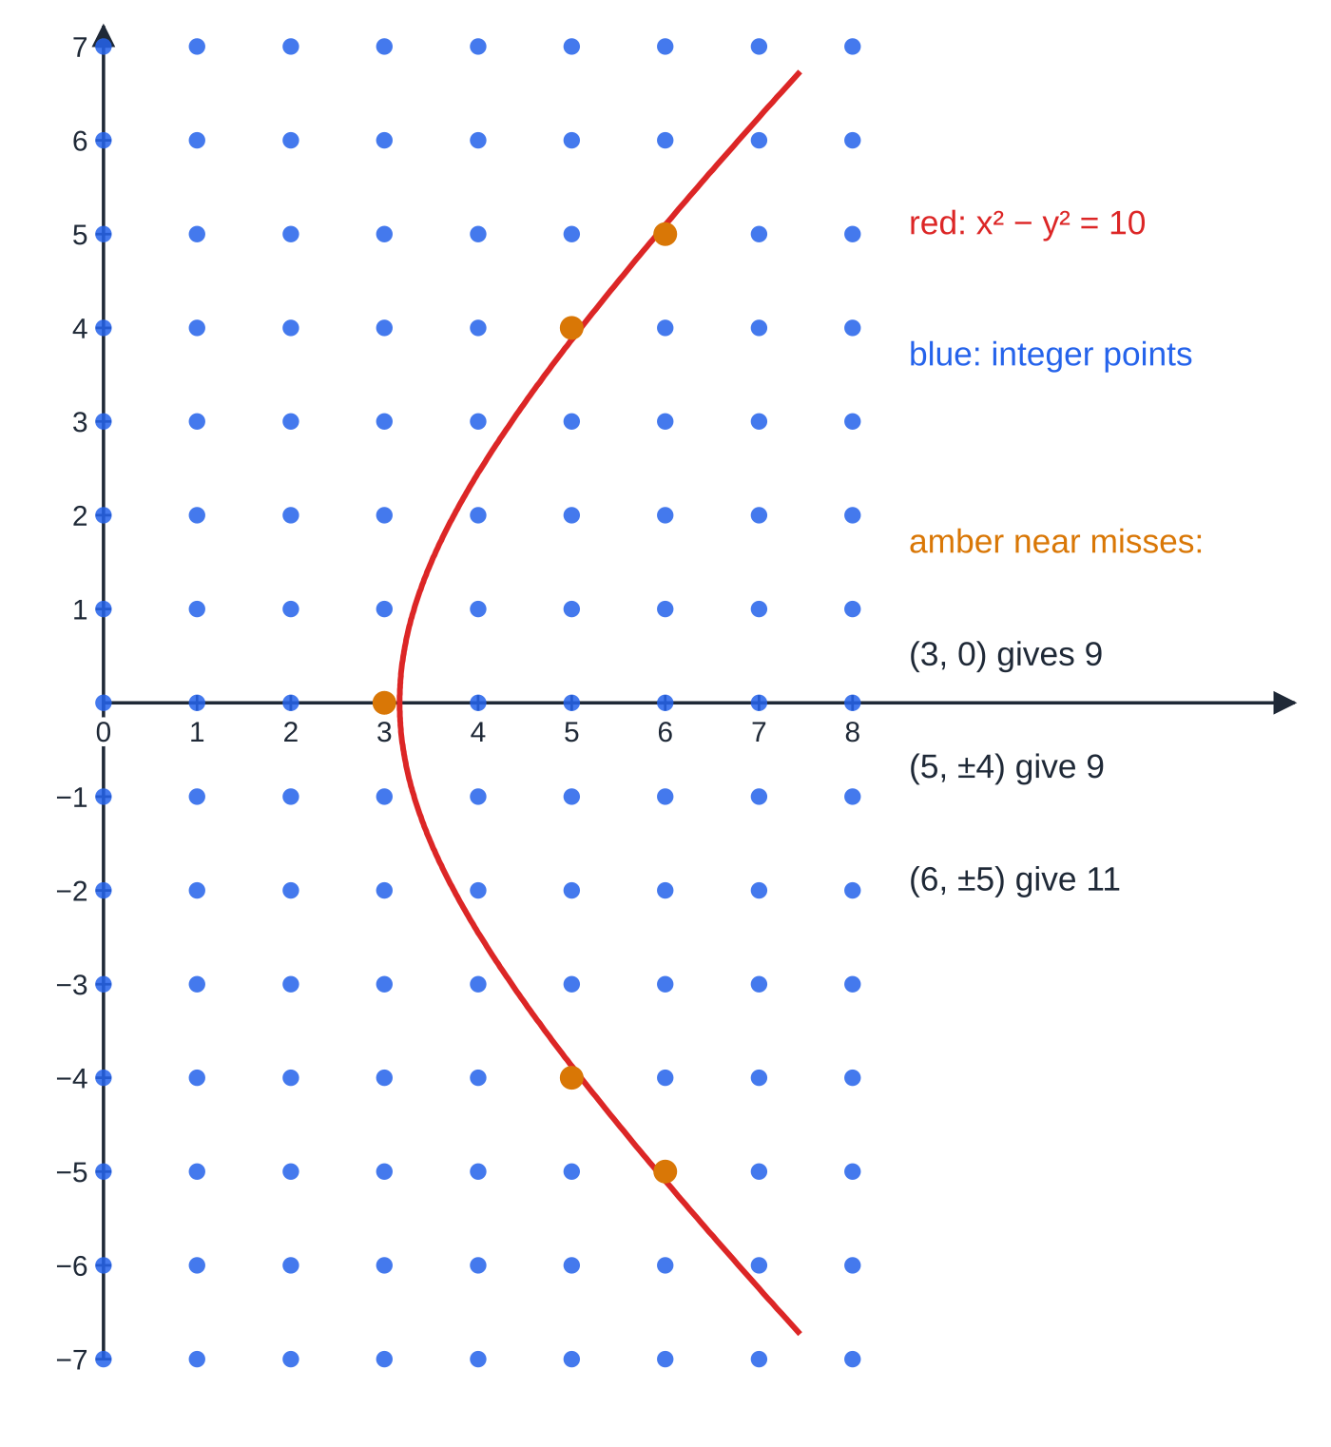
How do you tackle an unfamiliar statement? (continued)
Section 4 of 13
Exam tip 2 — parity first
When the statement is about integers, look at parity first. Factorising (a difference of two squares, a common factor) and asking "odd or even?" about each factor finishes many unfamiliar proofs in a few lines.
The right-hand branch of x² − y² = 10 threads between the points with integer coordinates without passing through any. Near misses such as (3, 0) and (5, ±4) give 9, and (6, ±5) give 11. The picture shows only a small window; the parity argument in worked example 4 covers every integer pair.
Notes:
How do you tackle an unfamiliar statement?. Full notes: https://examinerprep.com/notes/edexcel-ial-maths/proof-by-contradiction-and-partial-fractions/

Slide 18
How do you split a fraction with distinct linear factors?
Section 5 of 13
You know how to add 2/(x-1) + 3/(2x+1) into a single fraction. Partial fractions run that process backwards. The reason to bother: a single fraction such as (7x-1)/((x-1)(2x+1)) is hard to integrate or expand, while each simple piece is easy.
Partial fractions — distinct linear factors
f(x)/((ax+b)(cx+d)) ≡A/(ax+b) + B/(cx+d)
Valid when the fraction is proper (the degree of f(x) is less than the degree of the denominator); A, B are constants; three distinct factors give three terms, with constants A, B and C. Not in the formulae list, so learn it.
Finding the constants. Multiply both sides by the whole denominator to get an identity between numerators, for example 7x - 1 ≡A(2x+1) + B(x-1). Then:
Notes:
How do you split a fraction with distinct linear factors?. Full notes: https://examinerprep.com/notes/edexcel-ial-maths/proof-by-contradiction-and-partial-fractions/

Slide 19
How do you split a fraction with distinct linear factors? (continued)
Section 5 of 13
Substitution: an identity is true for every x, so choose the values that make a bracket zero; each one isolates a single constant.
Comparing coefficients: equate the coefficients of x², x and the constant terms on both sides; useful when no convenient substitution is left.
Factorise the denominator first if it is given expanded, e.g. 2x² + 5x + 2 = (2x+1)(x+2).
Notes:
How do you split a fraction with distinct linear factors?. Full notes: https://examinerprep.com/notes/edexcel-ial-maths/proof-by-contradiction-and-partial-fractions/

Slide 20
How do you split a fraction with distinct linear factors? (continued)
Section 5 of 13 · Worked example 5 · Medium · Express
WORKED EXAMPLE · QUESTION
Express in partial fractions (a) (7x-1)/((x-1)(2x+1)) (b) (x² + 11x - 6)/(x(x-2)(x+3)).
SOLUTION
(a) 7x - 1 ≡A(2x+1) + B(x-1). Substitute the roots of each factor: x = 1: 6 = 3A ⇒A = 2; x = -½: -(9/2) = -(3/2) B ⇒B = 3. 2/(x-1) + 3/(2x+1)
(b) Three factors, three constants: x² + 11x - 6 ≡A(x-2)(x+3) + Bx(x+3) + Cx(x-2). x = 0: -6 = -6A ⇒A = 1; x = 2: 20 = 10B ⇒B = 2; x = -3: -30 = 15C ⇒C = -2. 1/x + 2/(x-2) - 2/(x+3) Check by comparing x² coefficients: A + B + C = 1 + 2 - 2 = 1.
Notes:
How do you split a fraction with distinct linear factors?: Worked example 5. Full notes: https://examinerprep.com/notes/edexcel-ial-maths/proof-by-contradiction-and-partial-fractions/

Slide 21
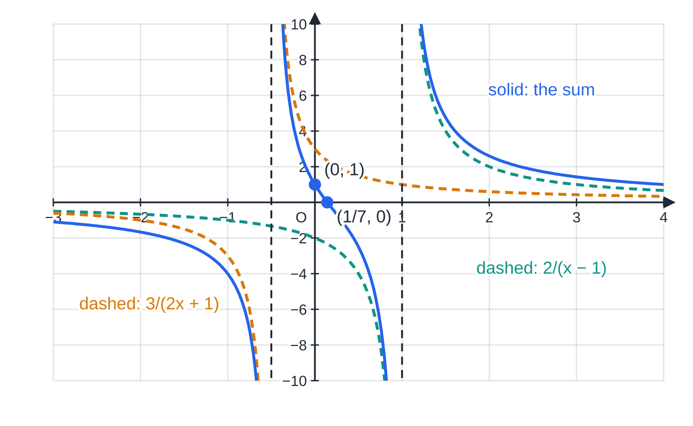
How do you split a fraction with distinct linear factors? (continued)
Section 5 of 13
Common error
Substituting the wrong value for a factor such as (2x+1). The bracket is zero when x = -½, not when x = -1 or -2. Fractional values are normal here; work them through carefully.
y = (7x − 1)/((x − 1)(2x + 1)) (solid) with its two partial fractions 2/(x − 1) and 3/(2x + 1) (dashed). At every x the solid curve is the sum of the two dashed curves. Each factor of the denominator gives a vertical asymptote: x = 1 and x = −½.
Notes:
How do you split a fraction with distinct linear factors?. Full notes: https://examinerprep.com/notes/edexcel-ial-maths/proof-by-contradiction-and-partial-fractions/

Slide 22
What changes when a factor is repeated?
Section 6 of 13
Partial fractions — a repeated linear factor
f(x)/((ax+b)²(cx+d)) ≡A/(ax+b) + B/((ax+b)²) + C/(cx+d)
A squared factor needs two terms, one over the factor and one over its square; the degree of f(x) must be at most 2 (proper fraction). Not in the formulae list, so learn it.
Multiplying through by (ax+b)²(cx+d) gives f(x) ≡A(ax+b)(cx+d) + B(cx+d) + C(ax+b)². Substituting the two roots finds B and C, but there is no root left to isolate A. Find A by comparing the coefficients of x² (quickest) or by substituting any other value, such as x = 0. Use one further value as a check: it costs a line and catches most slips.
Notes:
What changes when a factor is repeated?. Full notes: https://examinerprep.com/notes/edexcel-ial-maths/proof-by-contradiction-and-partial-fractions/

Slide 23
What changes when a factor is repeated? (continued)
Section 6 of 13 · Worked example 6 · Medium · Express
WORKED EXAMPLE · QUESTION
Express (3x² + 6)/((x-1)²(x+2)) in partial fractions.
SOLUTION
Form: A/(x-1) + B/((x-1)²) + C/(x+2), so 3x² + 6 ≡A(x-1)(x+2) + B(x+2) + C(x-1)².
Substitute the roots: x = 1: 9 = 3B ⇒B = 3; x = -2: 18 = 9C ⇒C = 2. Compare coefficients of x²: 3 = A + C ⇒A = 1.
Check with x = 0: 6 = -2A + 2B + C = -2 + 6 + 2 = 6. 1/(x-1) + 3/((x-1)²) + 2/(x+2)
Notes:
What changes when a factor is repeated?: Worked example 6. Full notes: https://examinerprep.com/notes/edexcel-ial-maths/proof-by-contradiction-and-partial-fractions/

Slide 24
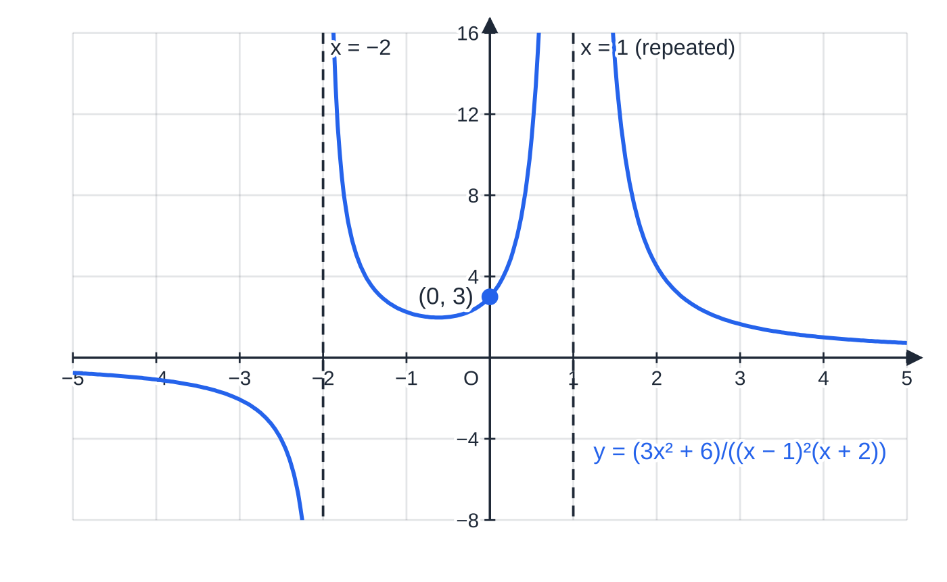
What changes when a factor is repeated? (continued)
Section 6 of 13
Common error
Leaving out the A/(x-1) term and writing only B/((x-1)²) + C/(x+2). Two constants cannot match a numerator with three coefficients, so the equations become inconsistent or give a wrong answer.
Near the repeated factor the 3/(x − 1)² term dominates, and a square is never negative, so the curve rises to +∞ on both sides of x = 1. At the single factor (x + 2) the sign changes from one side to the other. The curve crosses the y-axis at (0, 3).
Notes:
What changes when a factor is repeated?. Full notes: https://examinerprep.com/notes/edexcel-ial-maths/proof-by-contradiction-and-partial-fractions/

Slide 25
What do you do with an improper fraction?
Section 7 of 13
An improper algebraic fraction is one in which the degree of the numerator is greater than or equal to the degree of the denominator.
Divide first: numerator ≡ (denominator) ×Q(x) + R(x), so the fraction = Q(x) + R(x)/denominator, with the degree of R less than the degree of the denominator. Then split the proper fraction R(x)/denominator as before. With the same degree on top and bottom the quotient is a constant, e.g. (x²+1)/((x-1)(x+1)) = 1 + 2/(x²-1) = 1 + 1/(x-1) - 1/(x+1). Alternatively, write the full form at once (e.g. Ax + B + C/… + D/…), multiply through and compare coefficients.
Notes:
What do you do with an improper fraction?. Full notes: https://examinerprep.com/notes/edexcel-ial-maths/proof-by-contradiction-and-partial-fractions/

Slide 26
What do you do with an improper fraction? (continued)
Section 7 of 13 · Worked example 7 · Hard · Express
WORKED EXAMPLE · QUESTION
Express (2x³ + 3x² - 2x + 6)/((x-1)(x+2)) in the form Ax + B + C/(x-1) + D/(x+2).
SOLUTION
Divide. (x-1)(x+2) = x² + x - 2. 2x³ ÷x² = 2x; subtract 2x(x² + x - 2) to leave x² + 2x + 6. x² ÷x² = 1; subtract (x² + x - 2) to leave x + 8. Quotient 2x + 1, remainder x + 8, so the fraction = 2x + 1 + (x+8)/((x-1)(x+2)).
Split the proper part. x + 8 ≡C(x+2) + D(x-1): x = 1: 9 = 3C ⇒C = 3; x = -2: 6 = -3D ⇒D = -2.
Assemble. A = 2, B = 1, C = 3, D = -2: 2x + 1 + 3/(x-1) - 2/(x+2)
Notes:
What do you do with an improper fraction?: Worked example 7. Full notes: https://examinerprep.com/notes/edexcel-ial-maths/proof-by-contradiction-and-partial-fractions/

Slide 27
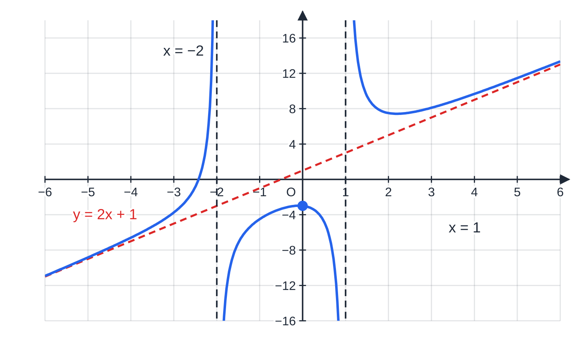
What do you do with an improper fraction? (continued)
Section 7 of 13
Exam tip 3 — compare degrees first
If the top has degree 3 and the bottom degree 2, the quotient is linear (Ax + B); if the degrees are equal, the quotient is a constant. Forgetting the quotient makes every later constant wrong.
The improper fraction in worked example 7. The quotient 2x + 1 is the dashed sloping line; the leftover fractions 3/(x − 1) − 2/(x + 2) tend to 0 as x grows, so the curve approaches that line far from the origin. The vertical asymptotes x = 1 and x = −2 come from the denominator; the curve crosses the y-axis at (0, −3).
Notes:
What do you do with an improper fraction?. Full notes: https://examinerprep.com/notes/edexcel-ial-maths/proof-by-contradiction-and-partial-fractions/

Slide 28
How do the two ideas combine in a longer question?
Section 8 of 13
Once a fraction is in partial fractions, each term is simple: its sign, its derivative and its behaviour for large x can be read off directly. That makes proofs about the function short, including proofs by contradiction.
Notes:
How do the two ideas combine in a longer question?. Full notes: https://examinerprep.com/notes/edexcel-ial-maths/proof-by-contradiction-and-partial-fractions/

Slide 29
How do the two ideas combine in a longer question? (continued)
Section 8 of 13 · Worked example 8 · Hard · Express, show that, prove
WORKED EXAMPLE · QUESTION
f(x) = (x³ + 8x² + 20x + 19)/((x+1)²(x+3)), x > -1. (a) Express f(x) in the form A + B/(x+1) + C/((x+1)²) + D/(x+3). (b) Hence show that f is decreasing for x > -1. (c) Prove by contradiction that there is no value of x > -1 for which f(x) ≤1.
SOLUTION
(a) Degrees are equal, so divide: (x+1)²(x+3) = x³ + 5x² + 7x + 3, so A = 1 and the remainder is 3x² + 13x + 16. Then 3x² + 13x + 16 ≡B(x+1)(x+3) + C(x+3) + D(x+1)². x = -1: 6 = 2C ⇒C = 3; x = -3: 4 = 4D ⇒D = 1; x²: 3 = B + D ⇒B = 2. Check x = 0: 3B + 3C + D = 6 + 9 + 1 = 16. f(x) = 1 + 2/(x+1) + 3/((x+1)²) + 1/(x+3)
(b) Differentiate term by term: f′(x) = -2/((x+1)²) - 6/((x+1)³) - 1/((x+3)²). For x > -1, x + 1 > 0 and x + 3 > 0, so every term is negative. f′(x) < 0, so f is decreasing.
(c) Assume some x > -1 has f(x) ≤1; then 2/(x+1) + 3/((x+1)²) + 1/(x+3) ≤0. But for x > -1 each of these terms is positive, so their sum is positive: a contradiction. So f(x) > 1 for every x > -1.
Notes:
How do the two ideas combine in a longer question?: Worked example 8. Full notes: https://examinerprep.com/notes/edexcel-ial-maths/proof-by-contradiction-and-partial-fractions/

Slide 30
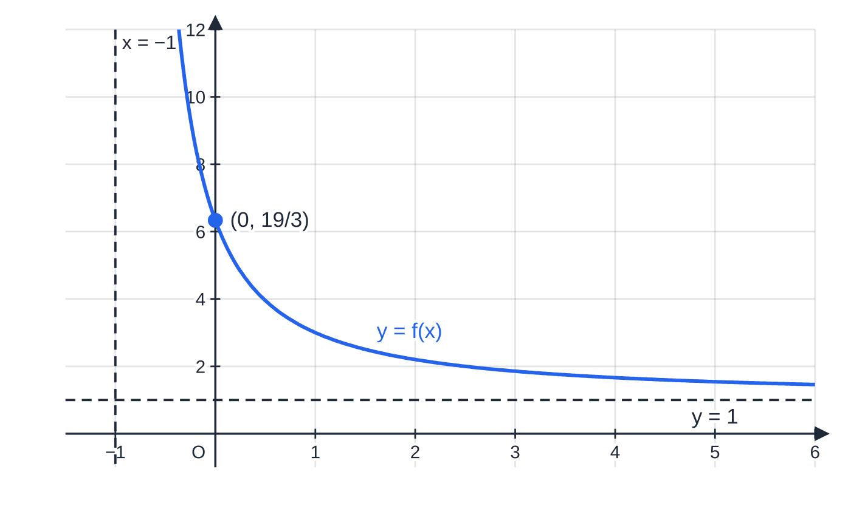
How do the two ideas combine in a longer question? (continued)
Section 8 of 13
The function of worked example 8 for x > −1. The curve falls throughout, passes through (0, 19/3), and approaches the horizontal asymptote y = 1 (the constant A) without reaching it: the two results proved in parts (b) and (c).
Notes:
How do the two ideas combine in a longer question?. Full notes: https://examinerprep.com/notes/edexcel-ial-maths/proof-by-contradiction-and-partial-fractions/

Slide 31
Exam tips for P4.1
Section 9 of 13
Exam tip 4 — announce the method
Open with "Assume, for contradiction, that …" and close with "This is a contradiction, so …". The first line shows which method you are using; the last line shows you know what the contradiction proves.
Exam tip 5 — define every letter
"√2 = a/b" is not enough. Say that a and b are integers, b ≠0, and the fraction is in its simplest form: the contradiction depends on that last condition.
Exam tip 6 — identity first, then values
Write the numerator identity in full before substituting. It shows the method even if an arithmetic slip follows, and it makes comparing coefficients easy when a constant cannot be found by substitution. Then check with a spare value, often x = 0.
Notes:
Exam tips for P4.1. Full notes: https://examinerprep.com/notes/edexcel-ial-maths/proof-by-contradiction-and-partial-fractions/

Slide 32
Exam tips for P4.1 (continued)
Section 9 of 13
Exam tip 7 — keep the answer in the form asked
If the question asks for A + B/… + C/…, give all the constants and the assembled expression. Partial fractions are usually the first part of a longer question, and the later parts use exactly that form.
Notes:
Exam tips for P4.1. Full notes: https://examinerprep.com/notes/edexcel-ial-maths/proof-by-contradiction-and-partial-fractions/

Slide 33
Common misconceptions
Section 10 of 13
Misconception | Why it is wrong | Correct idea
To prove "if P then Q" by contradiction, assume "if not P then not Q". | That is a different statement; it does not deny what you want to prove. | Assume P is true and Q is false.
In the √2 proof, "simplest form" is an optional extra. | Without it, finding that a and b are both even contradicts nothing. | State the simplest-form condition in the assumption.
p₁ p₂ ⋯pₙ + 1 is always prime. | 2 ×3 ×5 ×7 ×11 ×13 + 1 = 30 031 = 59 ×509. | It has a prime factor that is not in the list.
f(x)/((x-1)²(x+2)) needs only B/((x-1)²) + C/(x+2). | A repeated factor contributes two terms. | Include A/(x-1) as well.
Any fraction can be split straight away. | For an improper fraction the forms do not match the degrees. | Divide first when the degree of the numerator ≥ the degree of the denominator.
Notes:
Common misconceptions. Full notes: https://examinerprep.com/notes/edexcel-ial-maths/proof-by-contradiction-and-partial-fractions/

Slide 34
Common misconceptions (continued)
Section 10 of 13
Misconception | Why it is wrong | Correct idea
Substitution only works for values that appear in the question. | The numerator equation is an identity, true for all x. | Any value may be substituted; roots of the factors are simply the most efficient.
Notes:
Common misconceptions. Full notes: https://examinerprep.com/notes/edexcel-ial-maths/proof-by-contradiction-and-partial-fractions/

Slide 35
How this topic connects
Section 11 of 13
P2 Proof and algebraic division
Proof by deduction, exhaustion and counterexample complete the set of proof methods with contradiction; algebraic long division is the first step for every improper fraction.
P3 Algebraic fractions and differentiation
Simplifying and adding algebraic fractions is the reverse of partial fractions, and differentiating each term (as in worked example 8) uses the chain rule from P3. The factors of a denominator give the vertical asymptotes of a curve, as for transformations of 1/x.
P4.3 The binomial series and P4.6 Integration
Partial fractions turn a fraction into terms that integrate to logarithms, and into terms that can each be expanded with the binomial series. In IAL Physics, resistors in parallel combine as a sum of reciprocals, 1/R = 1/R₁ + 1/R₂: adding fractions, the reverse of splitting them.
Notes:
How this topic connects. Full notes: https://examinerprep.com/notes/edexcel-ial-maths/proof-by-contradiction-and-partial-fractions/

Slide 36
Key formulae
Section 12 of 13
Formula | Use | In the formulae list?
f(x)/((ax+b)(cx+d)) ≡A/(ax+b) + B/(cx+d) | partial fractions, distinct linear factors (proper fraction) | No — learn it
f(x)/((ax+b)²(cx+d)) ≡A/(ax+b) + B/((ax+b)²) + C/(cx+d) | partial fractions with a repeated linear factor | No — learn it
N(x)/D(x) = Q(x) + R(x)/D(x), deg R < deg D | improper fractions: divide before splitting | No — learn it
f(x) ≡A(cx+d) + B(ax+b) | numerator identity used to find the constants | No — derive it
a odd ⇒a² = 2(2k² + 2k) + 1 odd; so a² even ⇒a even | the parity step inside the √2 proof | No — derive it
N = p₁ p₂ ⋯pₙ + 1 | the new number in the proof that there are infinitely many primes | No — learn it
Notes:
Key formulae. Full notes: https://examinerprep.com/notes/edexcel-ial-maths/proof-by-contradiction-and-partial-fractions/

Slide 37
Check your understanding
Section 13 of 13
1. Prove by contradiction that there is no greatest multiple of 7.
2. Prove by contradiction that if n² is odd, then n is odd.
3. Express 5/((x-1)(x+4)) in partial fractions.
4. Write down the form of the partial fractions of (2x+3)/(x²(x-5)), then find the constants.
5. Why must (x²+4)/((x+1)(x-3)) be divided before it is split, and what is the result?
6. Prove by contradiction that √2 - 5 is irrational.
Notes:
Check your understanding: questions. Full notes: https://examinerprep.com/notes/edexcel-ial-maths/proof-by-contradiction-and-partial-fractions/

Slide 38
Check your understanding · answers
Section 13 of 13
1. Assume there is a greatest multiple of 7, M = 7k for some integer k. Then M + 7 = 7(k+1) is also a multiple of 7, and M + 7 > M. This contradicts M being the greatest, so there is no greatest multiple of 7.
2. Assume n² is odd and n is even, so n = 2k. Then n² = 4k² = 2(2k²), which is even: a contradiction. So if n² is odd, n is odd.
3. 5 ≡A(x+4) + B(x-1). x = 1: 5 = 5A, A = 1; x = -4: 5 = -5B, B = -1. So 1/(x-1) - 1/(x+4).
4. x² is a repeated factor (x twice), so the form is A/x + B/x² + C/(x-5). From 2x + 3 ≡Ax(x-5) + B(x-5) + Cx²: x = 0 gives B = -(3/5); x = 5 gives 13 = 25C, C = (13/25); the x² terms give A + C = 0, so A = -(13/25).
5. The numerator and denominator both have degree 2, so the fraction is improper. x² + 4 = (x² - 2x - 3) + (2x + 7), giving 1 + (2x+7)/((x+1)(x-3)). Then 2x + 7 ≡A(x-3) + B(x+1): x = -1 gives A = -(5/4), x = 3 gives B = (13/4). Result: 1 - 5/(4(x+1)) + 13/(4(x-3)).
6. Assume √2 - 5 = r/s with r, s integers, s ≠0.
Notes:
Check your understanding: answers. Full notes: https://examinerprep.com/notes/edexcel-ial-maths/proof-by-contradiction-and-partial-fractions/

Slide 39
Check your understanding · answers (continued)
Section 13 of 13
Then √2 = r/s + 5 = (r + 5s)/s, a ratio of integers, so √2 would be rational. This contradicts worked example 1, so √2 - 5 is irrational.
Notes:
Check your understanding: answers. Full notes: https://examinerprep.com/notes/edexcel-ial-maths/proof-by-contradiction-and-partial-fractions/

Slide 40
Practice questions
2 original exam-style questions. Answers at the end of the deck.

Slide 41
Question 1
6 marks
Give each answer as a sum of partial fractions.
(a) Express (5x + 1)/((x − 1)(x + 2)) in partial fractions. [3]
(b) Express (x + 5)/(2x² + 5x + 2) in partial fractions. [3]
Notes:
Online with the full mark scheme: https://examinerprep.com/ial-maths-p4-1-proof-by-contradiction-and-partial-fractions-questions#IALM-P4-1-B-01

Slide 42
Question 2
5 marks
Use proof by contradiction in both parts.
(a) Prove that there is no greatest odd integer. [2]
(b) Prove that there is no smallest positive rational number. [3]
Notes:
Online with the full mark scheme: https://examinerprep.com/ial-maths-p4-1-proof-by-contradiction-and-partial-fractions-questions#IALM-P4-1-B-02

Slide 43
Answers

Slide 44
Question 1 · answer
Mark scheme
5x + 1 ≡ A(x + 2) + B(x − 1)
x = 1: 6 = 3A, so A = 2
x = −2: −9 = −3B, so B = 3, giving 2/(x − 1) + 3/(x + 2)
2x² + 5x + 2 = (2x + 1)(x + 2)
x + 5 ≡ A(x + 2) + B(2x + 1), substituting x = −½ or x = −2
A = 3, B = −1: 3/(2x + 1) − 1/(x + 2)
Notes:
Full mark scheme: https://examinerprep.com/ial-maths-p4-1-proof-by-contradiction-and-partial-fractions-questions#IALM-P4-1-B-01

Slide 45
Question 2 · answer
Mark scheme
assume there is a greatest odd integer, N
N + 2 is odd and N + 2 > N, which contradicts N being the greatest, so there is no greatest odd integer
assume there is a smallest positive rational number r = p/q, with p, q positive integers
r/2 = p/(2q) is a ratio of integers, so it is rational, and it is positive
r/2 < r, which contradicts r being the smallest, so there is no smallest positive rational number
Notes:
Full mark scheme: https://examinerprep.com/ial-maths-p4-1-proof-by-contradiction-and-partial-fractions-questions#IALM-P4-1-B-02

Slide 46
Keep practising
Notes for this topic
Questions on this topic
Build a printable test
ExaminerPrep is an independent tutoring service. It has been developed independently from and is not endorsed by the International Baccalaureate Organization. "International Baccalaureate", "IB" and "IB Diploma Programme" are registered trademarks of the IBO, used here for descriptive purposes only.
Pearson Edexcel and Cambridge are trademarks of their owners; ExaminerPrep is not affiliated with any exam board.

