Slide 1
EP
EDEXCEL IAL MATHS
P3.3 Reciprocal and inverse trigonometric functions
The full notes page in 13 sections · practice questions with answers · simulations
ExaminerPrep is an independent tutoring service. It has been developed independently from and is not endorsed by the International Baccalaureate Organization. "International Baccalaureate", "IB" and "IB Diploma Programme" are registered trademarks of the IBO, used here for descriptive purposes only.
Pearson Edexcel and Cambridge are trademarks of their owners; ExaminerPrep is not affiliated with any exam board.
Notes:
P3.3 Reciprocal and inverse trigonometric functions. Notes for this topic: https://examinerprep.com/notes/edexcel-ial-maths/reciprocal-and-inverse-trigonometric-functions/

Slide 2
What this page covers
Overview
The definitions of sec, cosec and cot, with exact values in degrees and radians
The graphs of y = sec x, y = cosec x and y = cot x: asymptotes, turning points, period and range
Simple transformations of the reciprocal graphs
Solving equations such as cot θ= -0.4 and sec 2x = 3 in a given interval
arcsin, arccos and arctan: restricted domains, ranges and graphs as reflections in y = x
The identities sec²θ= 1 + tan²θ and cosec²θ= 1 + cot²θ
Exact values, quadratic-type equations and identity proofs using these identities
Notes:
What this page covers. Full notes: https://examinerprep.com/notes/edexcel-ial-maths/reciprocal-and-inverse-trigonometric-functions/

Slide 3
In one minute
Key points
1. The reciprocal functions are sec θ= 1/cos θ, cosecθ= 1/sin θ and cot θ= cos θ/sin θ, and the inverse functions arcsin, arccos and arctan undo sin, cos and tan on restricted domains, giving one angle only.
2. Pair the reciprocals by the third letter: sec with cos, cosec with sin, cot with tan.
3. Each reciprocal graph has a vertical asymptote wherever the original function is zero. sec and cosec have period 2π and never take values strictly between -1 and 1; cot has period π.
4. arcsin x ∈[-π/2, π/2] and arccos x ∈[0, π] for -1 ≤x ≤1; arctan x ∈(-π/2, π/2) for all x.
5. sec²θ= 1 + tan²θ and cosec²θ= 1 + cot²θ both come from sin²θ+ cos²θ= 1.
6. For equations, use an identity to leave one function only, solve the quadratic, then convert back to sin, cos or tan to find every angle in the interval.
Notes:
In one minute. Full notes: https://examinerprep.com/notes/edexcel-ial-maths/reciprocal-and-inverse-trigonometric-functions/

Slide 4
What are sec, cosec and cot?
Section 1 of 13
The three new functions are not really new at all: each one is "one over" a function you already know. Their value is that they make many expressions shorter, and they turn up naturally in calculus (the derivative of tan x is sec² x). Once you rewrite them in terms of sin, cos and tan, every technique from P2 applies.
The reciprocal trigonometric functions.
sec θ= 1/cos θ cosecθ= 1/sin θ cot θ= 1/tan θ = cos θ/sin θ sec is short for secant, cosec for cosecant (sometimes written csc) and cot for cotangent. Each is undefined where the function underneath is zero: sec where cos θ= 0, cosec and cot where sin θ= 0.
Because a number and its reciprocal always have the same sign, the quadrant signs from the CAST diagram carry over: sec is positive wherever cos is, cosec wherever sin is, and cot wherever tan is.
Notes:
What are sec, cosec and cot?. Full notes: https://examinerprep.com/notes/edexcel-ial-maths/reciprocal-and-inverse-trigonometric-functions/

Slide 5
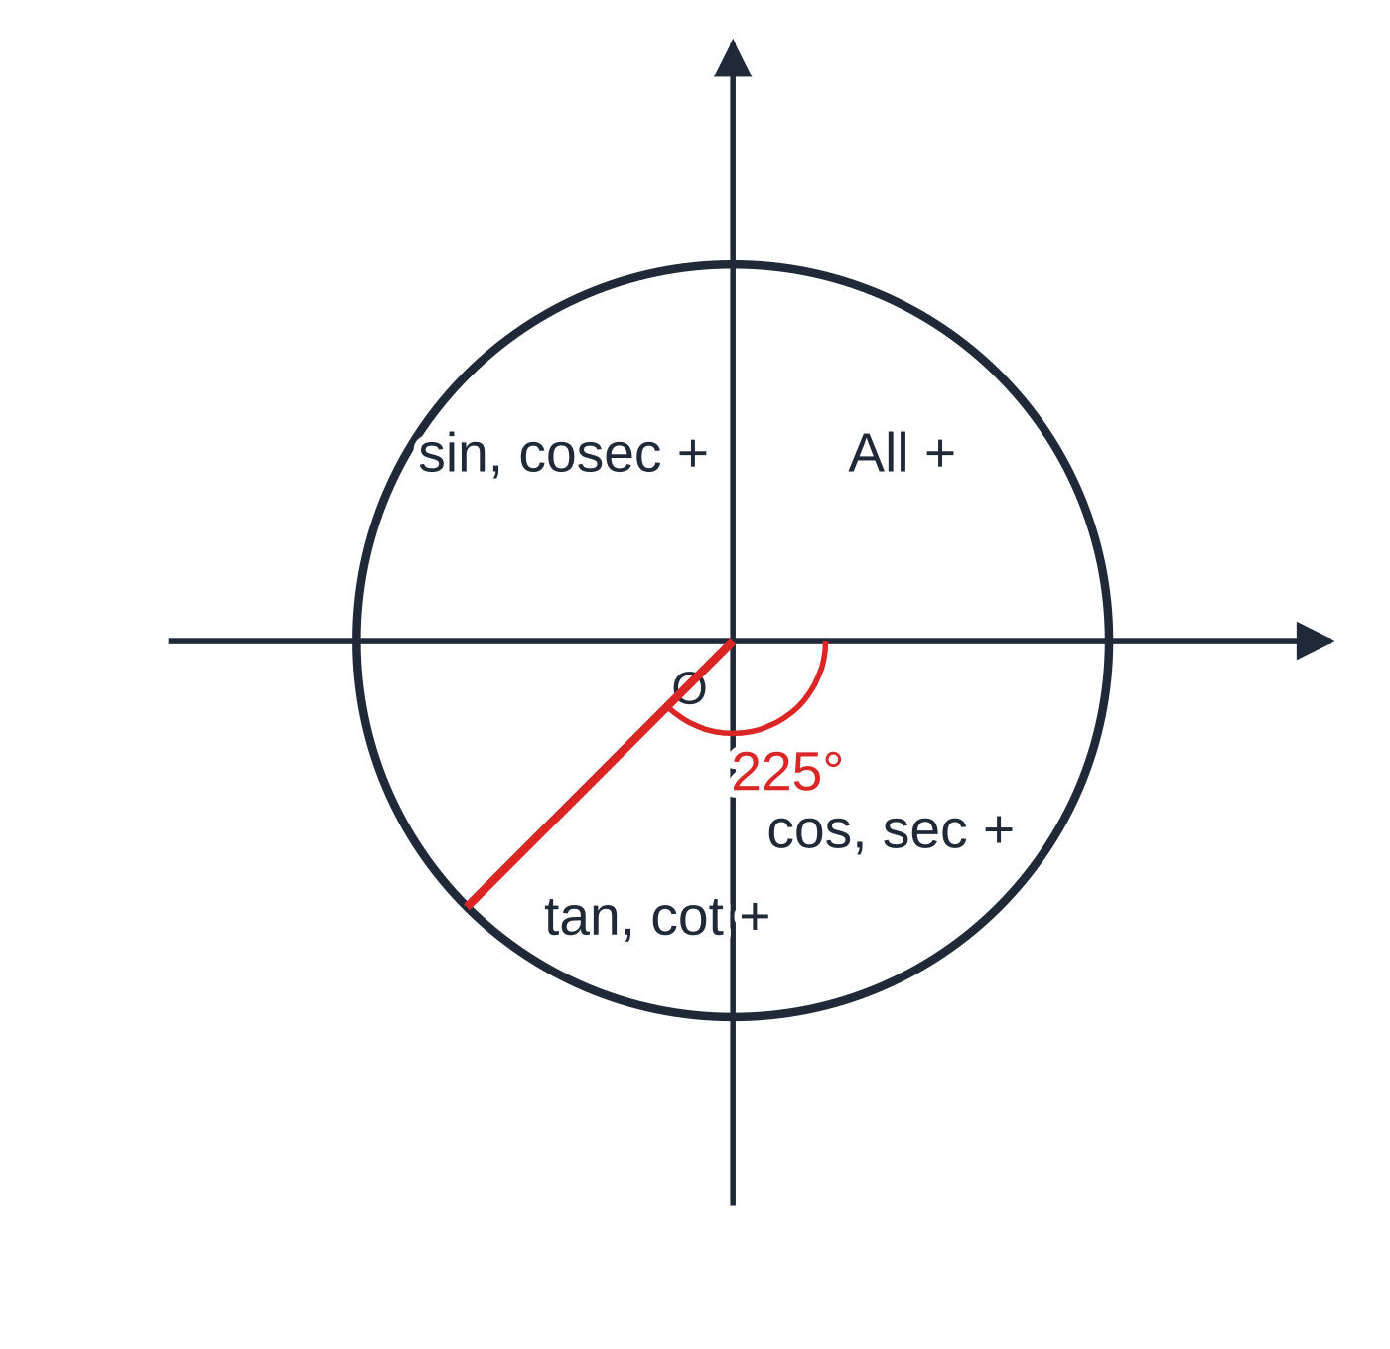
What are sec, cosec and cot? (continued)
Section 1 of 13
Calculators have no sec, cosec or cot keys, so find cos, sin or tan first and then press the reciprocal key.
The CAST signs apply to the reciprocals too. At 225° (third quadrant) only tan and cot are positive, so cosec 225° must be negative.
Notes:
What are sec, cosec and cot?. Full notes: https://examinerprep.com/notes/edexcel-ial-maths/reciprocal-and-inverse-trigonometric-functions/

Slide 6
What are sec, cosec and cot? (continued)
Section 1 of 13 · Worked example 1 · Easy · Find
WORKED EXAMPLE · QUESTION
(a) Find the exact values of sec 2π/3, cosec 225° and cot 5π/6. (b) Find sec 1.2 and cot 40°, giving each to 3 significant figures.
SOLUTION
(a) Rewrite each in terms of cos, sin and tan, then use exact values and the quadrant signs. sec 2π/3 = 1/(cos 2π/3) = 1/(-½) = -2. cosec225° = 1/sin 225° = 1/(-√2/2) = -2/√2 = -√2. cot 5π/6 = (cos 5π/6)/(sin 5π/6) = (-√3/2)/½ = -√3.
(b) Radian mode for 1.2: sec 1.2 = 1 ÷cos 1.2 = 1 ÷0.3624 = 2.76 (2.7597…). Degree mode for 40°: cot 40° = 1 ÷tan 40° = 1 ÷0.8391 = 1.19 (1.1918…).
Notes:
What are sec, cosec and cot?: Worked example 1. Full notes: https://examinerprep.com/notes/edexcel-ial-maths/reciprocal-and-inverse-trigonometric-functions/

Slide 7
What are sec, cosec and cot? (continued)
Section 1 of 13
Common error — pairing by the first letter
sec and sin both start with "s", but sec is 1/cos. Use the third letter: sec ↔ cos, cosec ↔ sin, cot ↔ tan.
Notes:
What are sec, cosec and cot?. Full notes: https://examinerprep.com/notes/edexcel-ial-maths/reciprocal-and-inverse-trigonometric-functions/

Slide 8
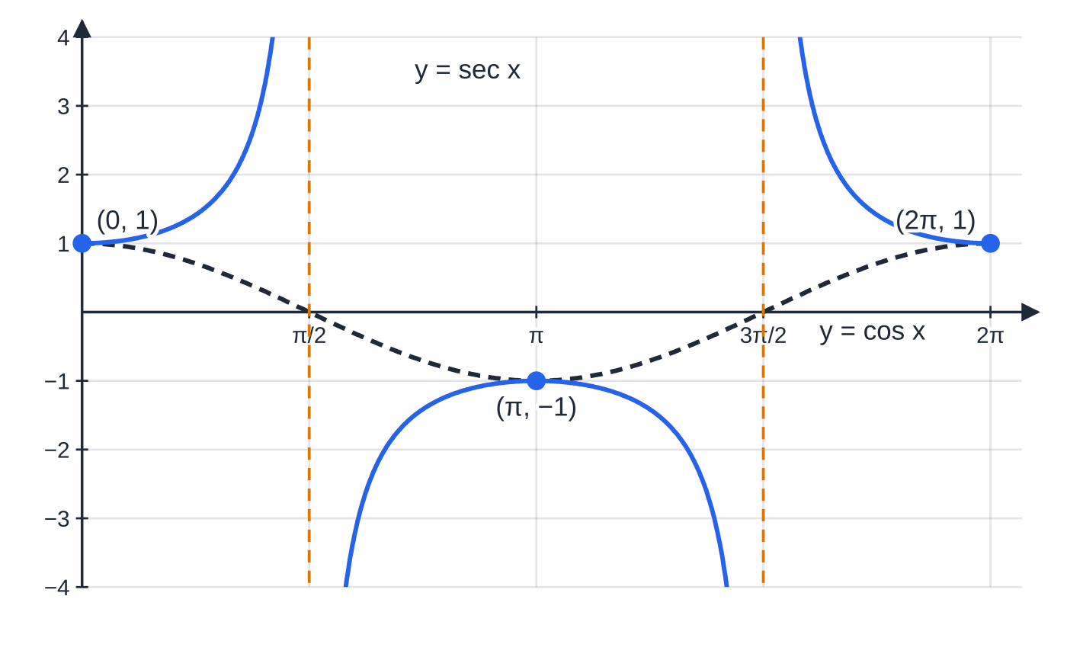
What do the graphs of sec, cosec and cot look like?
Section 2 of 13
You can sketch any reciprocal graph from the original using three facts. Where the original function is zero, the reciprocal has a vertical asymptote, because dividing by a tiny number gives a huge result. Where the original is ±1, the reciprocal is also ±1, so the two graphs touch there; for sec and cosec these are the turning points. And where the original is small, the reciprocal is large, and the other way round.
y = sec x for 0 ≤ x ≤ 2π with y = cos x dashed. The asymptotes x = π/2 and x = 3π/2 sit at the zeros of cos; the curves touch where cos x = ±1.
Notes:
What do the graphs of sec, cosec and cot look like?. Full notes: https://examinerprep.com/notes/edexcel-ial-maths/reciprocal-and-inverse-trigonometric-functions/

Slide 9
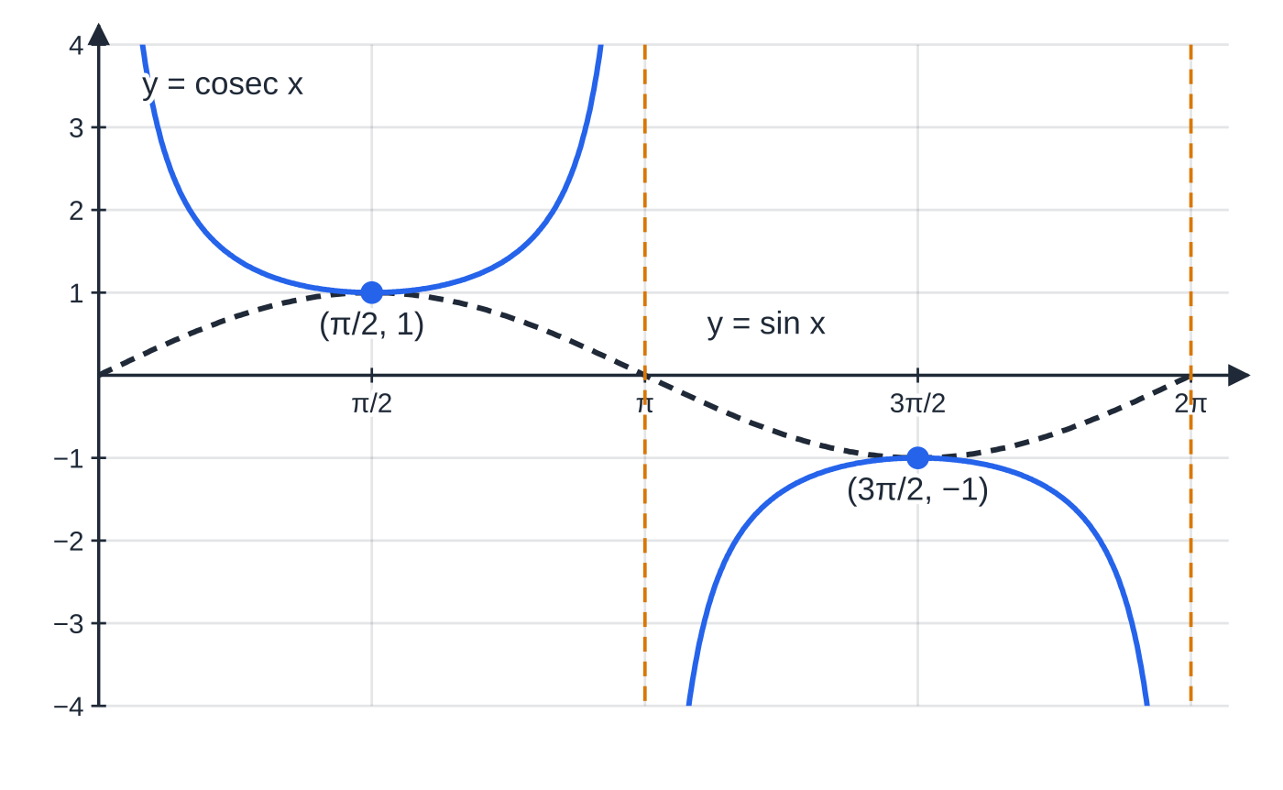
What do the graphs of sec, cosec and cot look like? (continued)
Section 2 of 13
y = cosec x with y = sin x dashed. The asymptotes are at x = 0, π and 2π, the zeros of sin. The minimum (π/2, 1) and maximum (3π/2, −1) are where sin x = ±1.
Notes:
What do the graphs of sec, cosec and cot look like?. Full notes: https://examinerprep.com/notes/edexcel-ial-maths/reciprocal-and-inverse-trigonometric-functions/

Slide 10
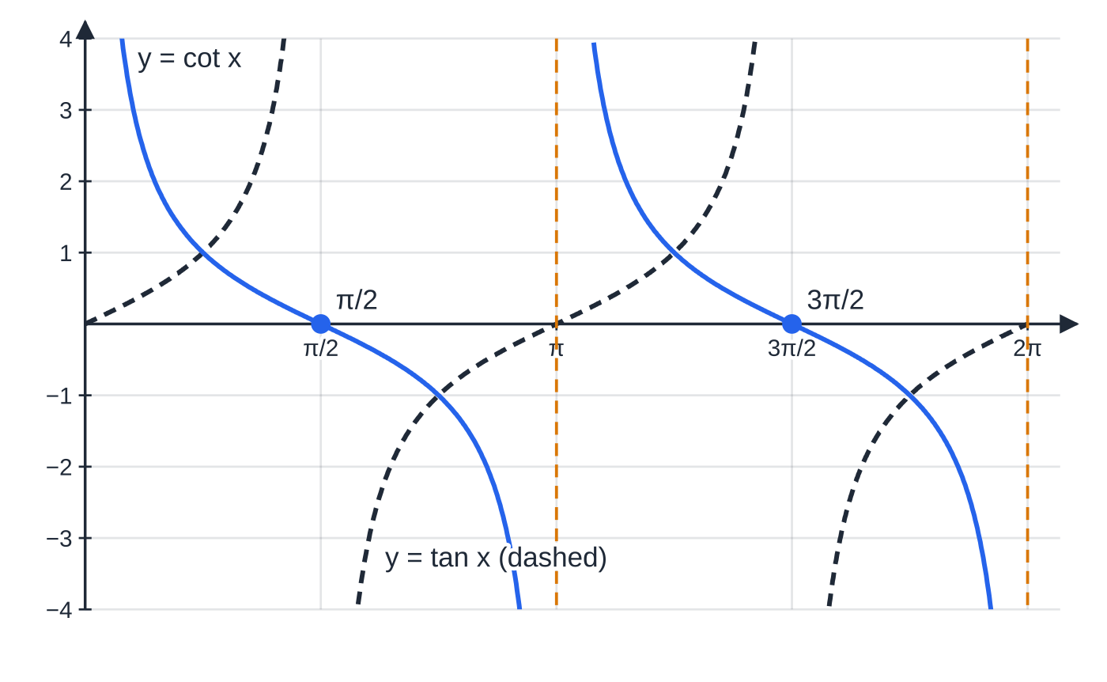
What do the graphs of sec, cosec and cot look like? (continued)
Section 2 of 13
y = cot x with y = tan x dashed. Each curve has its zeros where the other has its asymptotes; cot x decreases between asymptotes and repeats every π.
Notes:
What do the graphs of sec, cosec and cot look like?. Full notes: https://examinerprep.com/notes/edexcel-ial-maths/reciprocal-and-inverse-trigonometric-functions/

Slide 11
What do the graphs of sec, cosec and cot look like? (continued)
Section 2 of 13
 | y = sec x | y = cosec x | y = cot x
Asymptotes | x = π/2 + nπ (90°, 270°, …) | x = nπ (0°, 180°, 360°, …) | x = nπ
Period | 2π (360°) | 2π (360°) | π (180°)
Range | y ≤-1 or y ≥1 | y ≤-1 or y ≥1 | all real numbers
Turning points (0 to 2π) | min (0, 1), (2π, 1); max (π, -1) | min (π/2, 1); max (3π/2, -1) | none
Zeros | none | none | x = π/2, 3π/2, …
Symmetry | even: symmetric about the y-axis | odd: rotational symmetry about the origin | odd
Transformations work exactly as for any graph (P3.2). y = asec x + b stretches by scale factor a parallel to the y-axis and then translates by b. The asymptotes do not move, because no x-coordinate changes, but the turning points and the "gap" in the range do.
Notes:
What do the graphs of sec, cosec and cot look like?. Full notes: https://examinerprep.com/notes/edexcel-ial-maths/reciprocal-and-inverse-trigonometric-functions/

Slide 12
What do the graphs of sec, cosec and cot look like? (continued)
Section 2 of 13 · Worked example 2 · Medium · Write down, find, solve
WORKED EXAMPLE · QUESTION
The curve C has equation y = 2sec x - 1, 0 ≤x ≤2π. (a) Write down the equations of the asymptotes of C. (b) Find the coordinates of the turning points of C. (c) State the range of values of y on C. (d) Solve 2sec x - 1 = 4, giving answers to 3 significant figures. (e) Find the set of values of k for which 2sec x - 1 = k has no solutions.
SOLUTION
(a) Asymptotes where cos x = 0; the stretch and translation do not move them: x = π/2 and x = 3π/2.
(b) The turning points of sec x are (0, 1), (π, -1), (2π, 1); apply y ↦2y - 1. Minimum points (0, 1) and (2π, 1); maximum point (π, -3).
(c) sec x ≤-1 or sec x ≥1, so y ≤-3 or y ≥1.
(d) sec x = (5/2) ⇒cos x = 0.4 ⇒x = 1.1593 or 2π- 1.1593 = 5.1239: x = 1.16 or x = 5.12.
(e) The line y = k misses the curve exactly when it lies in the gap: -3 < k < 1.
Notes:
What do the graphs of sec, cosec and cot look like?: Worked example 2. Full notes: https://examinerprep.com/notes/edexcel-ial-maths/reciprocal-and-inverse-trigonometric-functions/

Slide 13
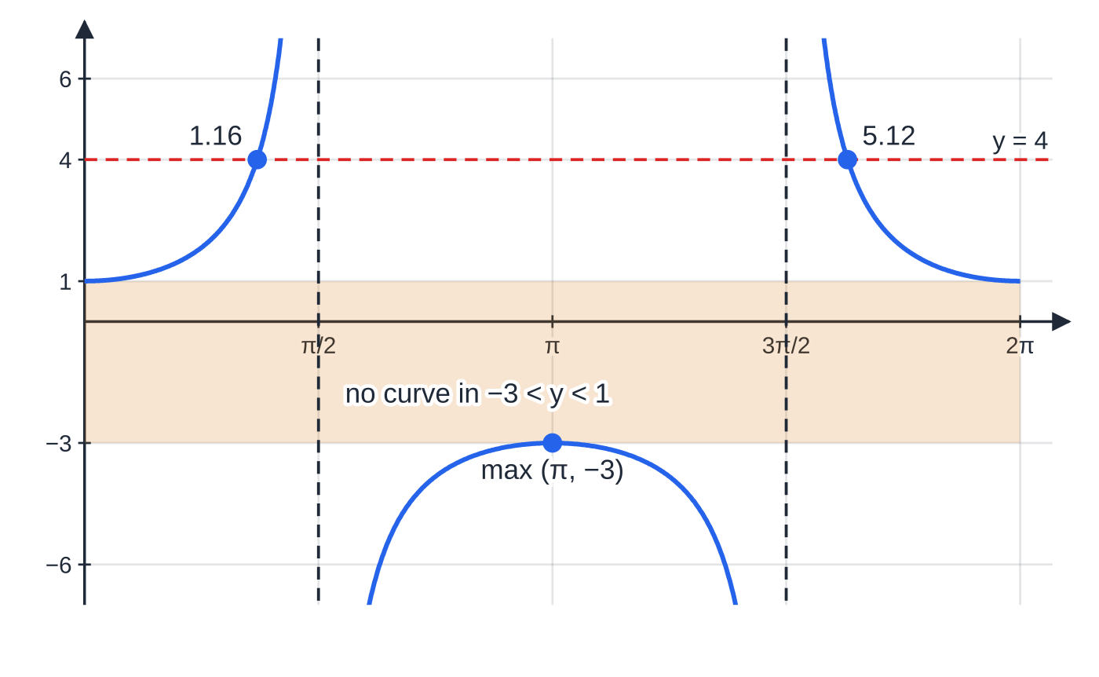
What do the graphs of sec, cosec and cot look like? (continued)
Section 2 of 13
Worked example 2: y = 2 sec x − 1. The shaded band −3 < y < 1 contains no part of the curve; the line y = 4 meets it at x ≈ 1.16 and 5.12.
Notes:
What do the graphs of sec, cosec and cot look like?. Full notes: https://examinerprep.com/notes/edexcel-ial-maths/reciprocal-and-inverse-trigonometric-functions/

Slide 14
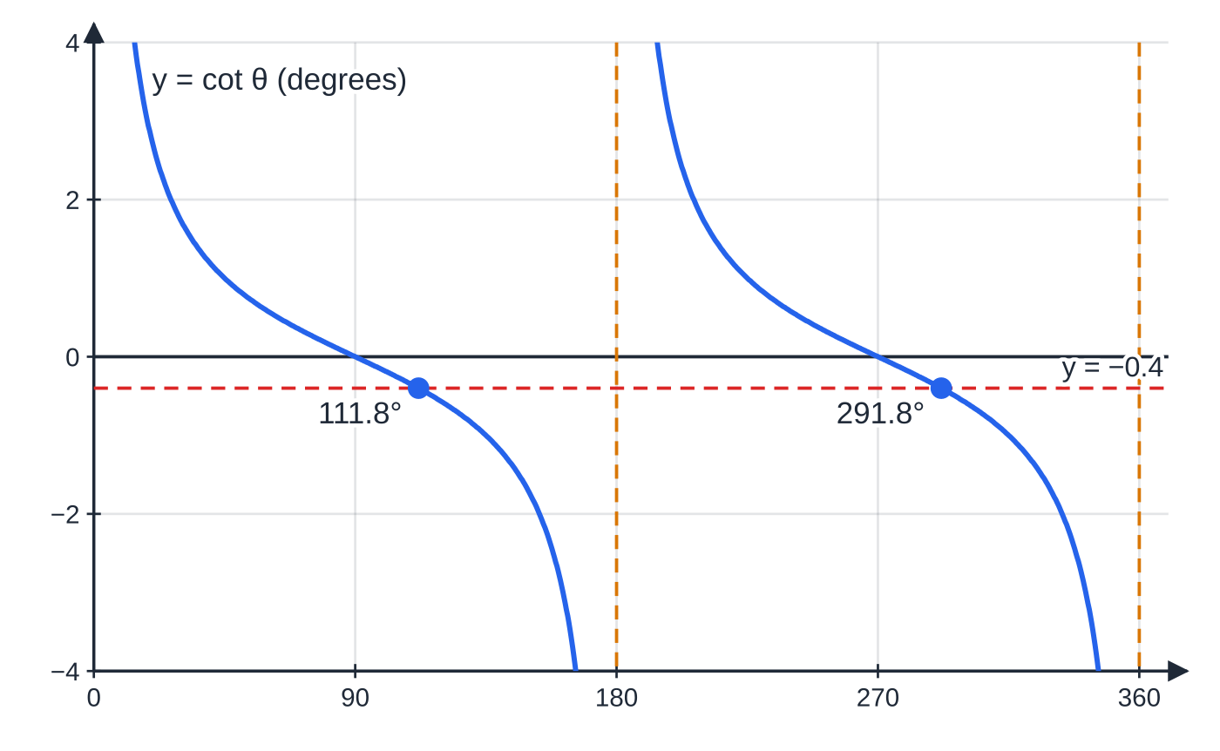
How do you solve equations in sec, cosec and cot?
Section 3 of 13
Take reciprocals first: sec θ= k ⇔cos θ= 1/k, and similarly for the others. That single step turns an unfamiliar equation into a P2 equation. Then find the principal value, use the symmetry of the graph (or CAST) for the other angles, and keep only answers in the interval.
Two warnings. First, sec θ= k and cosecθ= k have no solutions when -1 < k < 1, because the reciprocal would have to be bigger than 1 in size. Second, for an equation like sec(ax + b) = k, change the interval before solving: if 0 ≤x ≤π, then 0 ≤2x ≤2π.
cot θ = −0.4 on 0° ≤ θ < 360°: one solution in each 180° branch of the cot curve, 180° apart.
Notes:
How do you solve equations in sec, cosec and cot?. Full notes: https://examinerprep.com/notes/edexcel-ial-maths/reciprocal-and-inverse-trigonometric-functions/

Slide 15
How do you solve equations in sec, cosec and cot? (continued)
Section 3 of 13 · Worked example 3 · Medium · Solve
WORKED EXAMPLE · QUESTION
(a) Solve cot θ= -0.4 for 0° ≤θ< 360°, giving answers to 1 decimal place. (b) Solve sec 2x = 3 for 0 ≤x ≤π, giving answers to 3 significant figures.
SOLUTION
(a) tan θ= 1 ÷(-0.4) = -2.5, principal value tan⁻¹(-2.5) = -68.2°. tan repeats every 180°, so add 180° until the answers are in range: θ= 111.8° or 291.8°.
(b) cos 2x = ⅓ on the new interval 0 ≤2x ≤2π: 2x = 1.2310 or 2π- 1.2310 = 5.0522. Halve: x = 0.615 or x = 2.53. The next value, 2x = 2π+ 1.2310, gives x > π, so there are exactly two solutions.
Notes:
How do you solve equations in sec, cosec and cot?: Worked example 3. Full notes: https://examinerprep.com/notes/edexcel-ial-maths/reciprocal-and-inverse-trigonometric-functions/

Slide 16
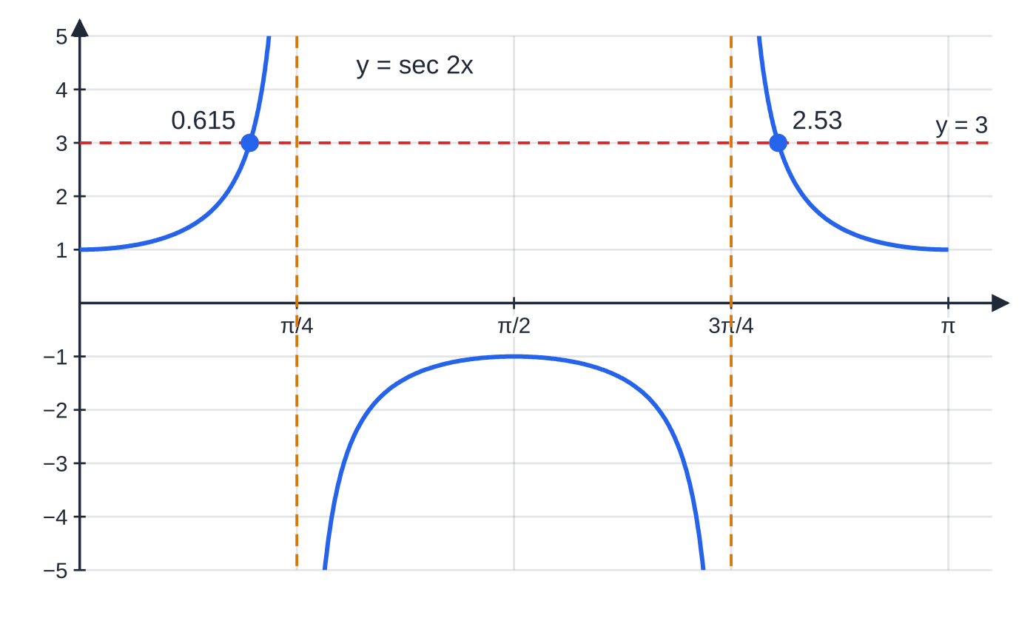
How do you solve equations in sec, cosec and cot? (continued)
Section 3 of 13
Exam tip — write the reciprocal step
Put the reciprocal step on its own line ("cos 2x = ⅓"). It is the step that turns an unfamiliar equation into a familiar one, and it makes the rest of your working easy to follow.
y = sec 2x has period π, so on 0 ≤ x ≤ π it shows one full cycle. The line y = 3 meets it twice, at the two answers of Worked example 3(b).
Notes:
How do you solve equations in sec, cosec and cot?. Full notes: https://examinerprep.com/notes/edexcel-ial-maths/reciprocal-and-inverse-trigonometric-functions/

Slide 17
What are arcsin, arccos and arctan?
Section 4 of 13
Only a one-one function has an inverse. sin, cos and tan are many-one: sin x = ½ has infinitely many solutions, so "the angle whose sine is ½" is ambiguous. To fix this, each function is first restricted to an interval on which it takes every value exactly once. The inverse then returns the single angle in that interval, so its range is the restricted domain.
Function | Restriction of the original | Domain of the inverse | Range of the inverse
y = arcsin x | sin x on -π/2 ≤x ≤π/2 | -1 ≤x ≤1 | -π/2 ≤y ≤π/2
y = arccos x | cos x on 0 ≤x ≤π | -1 ≤x ≤1 | 0 ≤y ≤π
y = arctan x | tan x on -π/2 < x < π/2 | all real x | -π/2 < y < π/2
The notation sin⁻¹x means arcsin x, the inverse function, not 1/sin x (that is cosec). Answers are normally given in radians; in degrees the ranges are −90° to 90°, 0° to 180° and −90° to 90°.
Notes:
What are arcsin, arccos and arctan?. Full notes: https://examinerprep.com/notes/edexcel-ial-maths/reciprocal-and-inverse-trigonometric-functions/

Slide 18
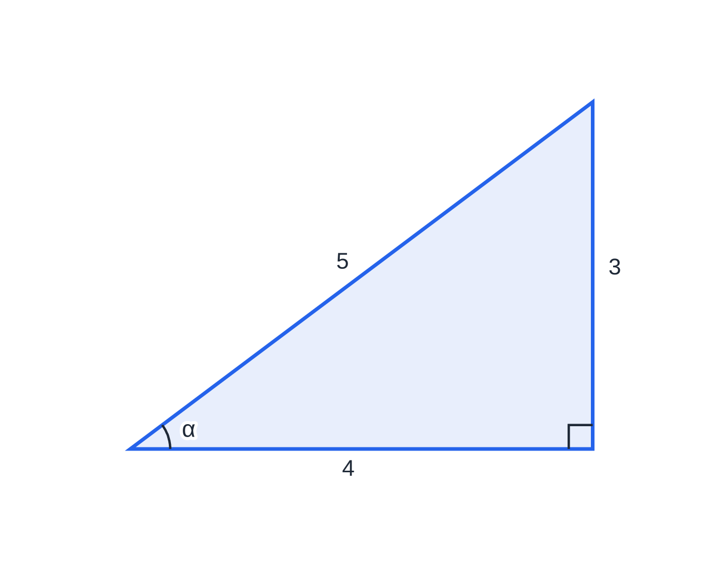
What are arcsin, arccos and arctan? (continued)
Section 4 of 13
A useful trick for mixed expressions such as cos(arcsin(3/5)) is to call the angle α, draw a right-angled triangle, and use the range to decide the sign.
If α = arcsin(3/5), then sin α = 3/5: opposite 3, hypotenuse 5, so the adjacent side is 4 and cos α = 4/5. Since −π/2 ≤ α ≤ π/2, cos α is not negative.
Notes:
What are arcsin, arccos and arctan?. Full notes: https://examinerprep.com/notes/edexcel-ial-maths/reciprocal-and-inverse-trigonometric-functions/

Slide 19
What are arcsin, arccos and arctan? (continued)
Section 4 of 13 · Worked example 4 · Medium · Find
WORKED EXAMPLE · QUESTION
Find, in radians, the exact values of (a) arcsin(-√3/2), (b) arccos(-½), (c) arctan(-1), (d) arcsin(sin 5π/6). (e) Find the exact value of cos(arcsin(3/5)).
SOLUTION
(a) The angle in [-π/2, π/2] whose sine is -√3/2: -π/3.
(b) The angle in [0, π] whose cosine is -½; it must be obtuse: π- π/3 = 2π/3.
(c) -π/4, not 3π/4, which is outside the range.
(d) sin 5π/6 = ½, and the angle in [-π/2, π/2] with sine ½ is π/6, not 5π/6, which is outside the range of arcsin.
(e) Let α= arcsin(3/5), so sin α= (3/5) and -π/2 ≤α≤π/2, where cos α≥0. Then cos α= √(1 - (9/25)) = (4/5), as the 3–4–5 triangle shows.
Notes:
What are arcsin, arccos and arctan?: Worked example 4. Full notes: https://examinerprep.com/notes/edexcel-ial-maths/reciprocal-and-inverse-trigonometric-functions/

Slide 20
What are arcsin, arccos and arctan? (continued)
Section 4 of 13
Common error — "arcsin undoes sin" for every angle
arcsin(sin θ) = θ only when θ is already in the range of arcsin, -π/2 ≤θ≤π/2. Similarly arccos(cos θ) = θ only for 0 ≤θ≤π.
Notes:
What are arcsin, arccos and arctan?. Full notes: https://examinerprep.com/notes/edexcel-ial-maths/reciprocal-and-inverse-trigonometric-functions/

Slide 21
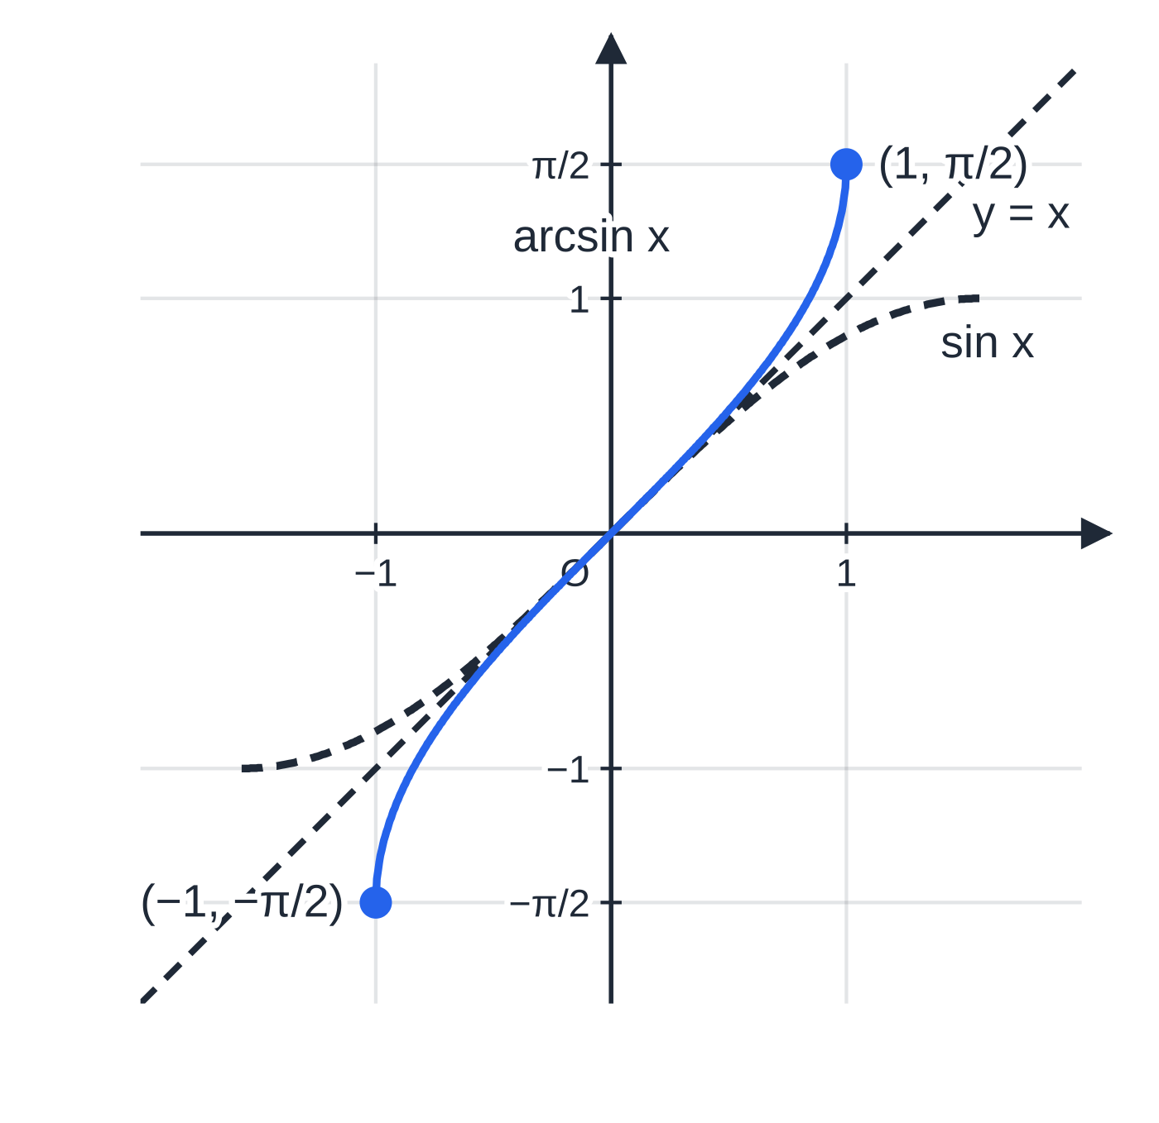
What do the inverse trig graphs look like?
Section 5 of 13
The graph of an inverse function is the reflection of the (restricted) original in the line y = x, so the domain and range swap over. To see the reflection true to shape, the axes need equal scales.
y = arcsin x runs from (-1, -π/2) through the origin to (1, π/2); it is increasing and has rotational symmetry about the origin.
y = arccos x runs from (-1, π) through (0, π/2) to (1, 0); it is decreasing and is not symmetric about the y-axis.
y = arctan x is defined for every x and has horizontal asymptotes y = ±π/2.
The graphs of arcsin and arccos are finite pieces with end points: draw them with closed dots, not arrows.
y = arcsin x (solid) is the reflection of y = sin x on [−π/2, π/2] (dashed) in the line y = x. Equal scales keep the reflection true to shape.
Notes:
What do the inverse trig graphs look like?. Full notes: https://examinerprep.com/notes/edexcel-ial-maths/reciprocal-and-inverse-trigonometric-functions/

Slide 22
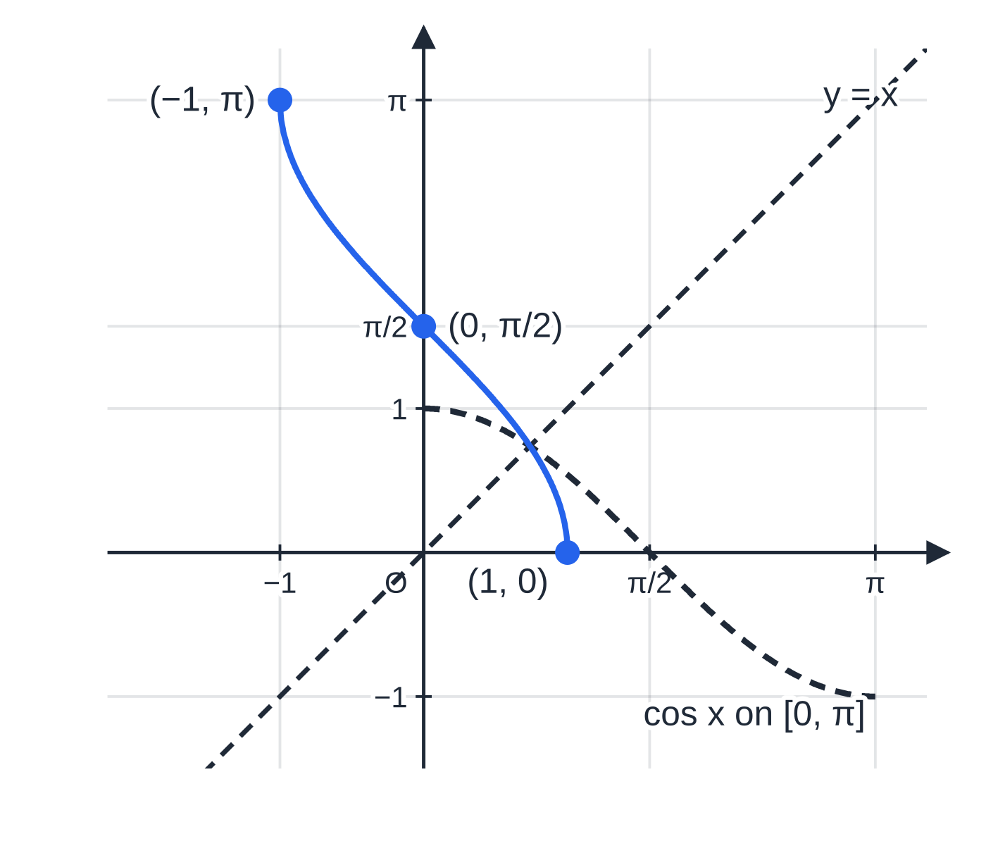
What do the inverse trig graphs look like? (continued)
Section 5 of 13
y = arccos x (solid) is the reflection of y = cos x on [0, π] (dashed). It decreases from (−1, π) to (1, 0) and is not symmetric about the y-axis.
Notes:
What do the inverse trig graphs look like?. Full notes: https://examinerprep.com/notes/edexcel-ial-maths/reciprocal-and-inverse-trigonometric-functions/

Slide 23
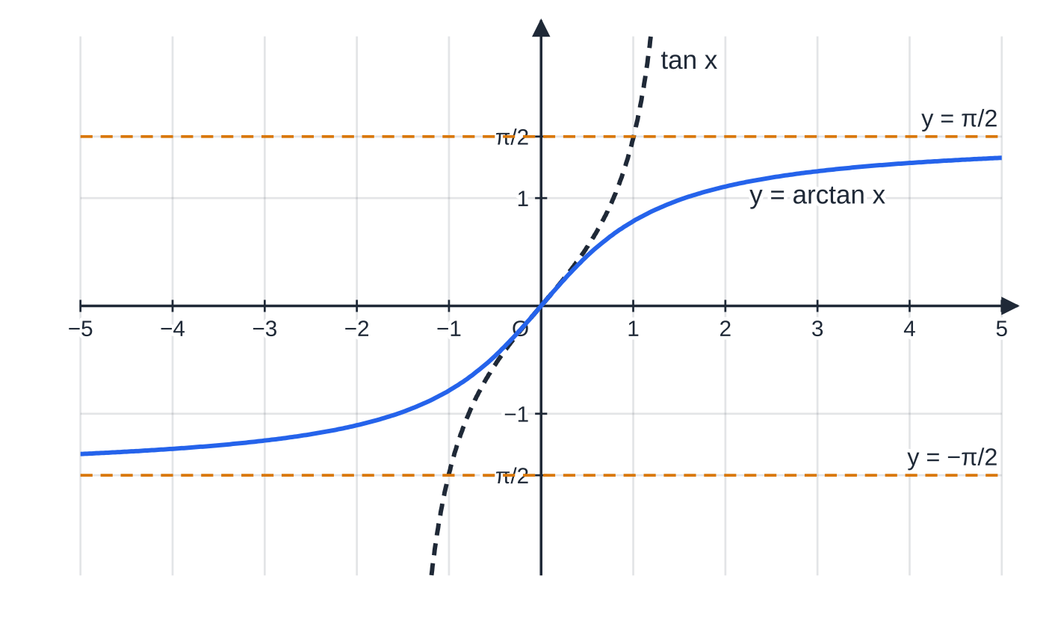
What do the inverse trig graphs look like? (continued)
Section 5 of 13
y = arctan x is defined for every x. The vertical asymptotes of tan on (−π/2, π/2) become the horizontal asymptotes y = ±π/2 of arctan.
Notes:
What do the inverse trig graphs look like?. Full notes: https://examinerprep.com/notes/edexcel-ial-maths/reciprocal-and-inverse-trigonometric-functions/

Slide 24
What do the inverse trig graphs look like? (continued)
Section 5 of 13 · Worked example 5 · Hard · Find, solve
WORKED EXAMPLE · QUESTION
The function f is defined by f(x) = 2arcsin(x - 1) for its largest possible domain. (a) Find the domain of f. (b) Find the range of f. (c) Solve f(x) = π/3. (d) Find f⁻¹(x), stating its domain.
SOLUTION
(a) arcsin needs an input between −1 and 1: -1 ≤x - 1 ≤1 ⇒ 0 ≤x ≤2.
(b) arcsin(x - 1) runs from -π/2 to π/2; doubling gives -π≤f(x) ≤π.
(c) arcsin(x - 1) = π/6 ⇒x - 1 = sin π/6 = ½ ⇒ x = (3/2).
(d) Swap and rearrange: x = 2arcsin(y - 1) ⇒y - 1 = sin x/2. So f⁻¹(x) = 1 + sin x/2, domain -π≤x ≤π (the range of f).
Notes:
What do the inverse trig graphs look like?: Worked example 5. Full notes: https://examinerprep.com/notes/edexcel-ial-maths/reciprocal-and-inverse-trigonometric-functions/

Slide 25
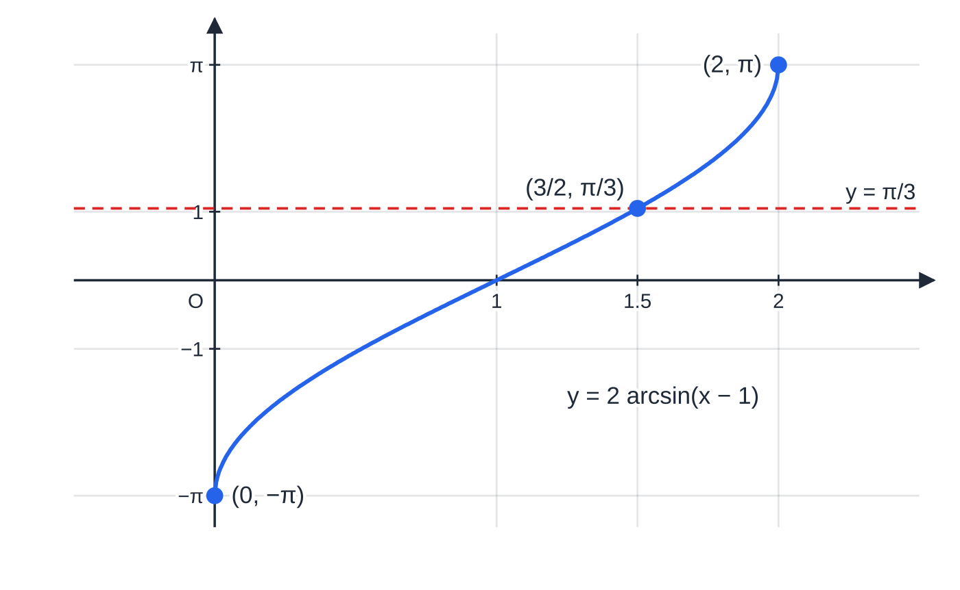
What do the inverse trig graphs look like? (continued)
Section 5 of 13
Worked example 5: y = 2 arcsin(x − 1) is y = arcsin x translated 1 to the right and stretched by scale factor 2 parallel to the y-axis. Its domain is 0 ≤ x ≤ 2 and it meets y = π/3 at x = 3/2.
Notes:
What do the inverse trig graphs look like?. Full notes: https://examinerprep.com/notes/edexcel-ial-maths/reciprocal-and-inverse-trigonometric-functions/

Slide 26
Where do the two new identities come from?
Section 6 of 13
Start from sin²θ+ cos²θ≡1 (P2) and divide every term by cos²θ, or by sin²θ. Each division produces one of the new functions, and the identities appear in one line.
The Pythagorean identities.
sin²θ/cos²θ + cos²θ/cos²θ ≡1/cos²θ ⇒ tan²θ+ 1 ≡sec²θ sin²θ/sin²θ + cos²θ/sin²θ ≡1/sin²θ ⇒ 1 + cot²θ≡cosec²θ The rearranged forms tan²θ= sec²θ- 1 and cot²θ= cosec²θ- 1 are used most. They hold for every θ where both sides are defined.
The identities only tell you the square of a ratio. To get the ratio itself you must choose a sign, using the quadrant of the angle or the range of an inverse function.
Notes:
Where do the two new identities come from?. Full notes: https://examinerprep.com/notes/edexcel-ial-maths/reciprocal-and-inverse-trigonometric-functions/

Slide 27
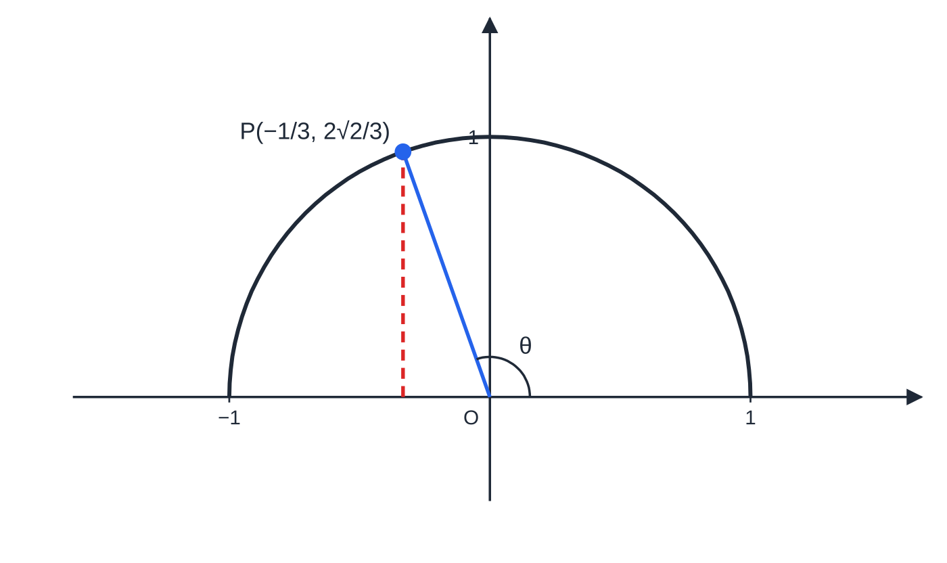
Where do the two new identities come from? (continued)
Section 6 of 13
An obtuse angle θ with cos θ = −1/3: the point P on the unit circle has a negative x-coordinate and a positive y-coordinate, so sec θ < 0 and cosec θ > 0.
Notes:
Where do the two new identities come from?. Full notes: https://examinerprep.com/notes/edexcel-ial-maths/reciprocal-and-inverse-trigonometric-functions/

Slide 28
Where do the two new identities come from? (continued)
Section 6 of 13 · Worked example 6 · Medium · Find
WORKED EXAMPLE · QUESTION
(a) Given that θ is obtuse and tan θ= -2√2, find the exact values of sec θ, cos θ and cosecθ. (b) Find the exact value of sec(arctan √5/2).
SOLUTION
(a) sec²θ= 1 + tan²θ= 1 + 8 = 9, so sec θ= ±3. θ is obtuse, so cos θ< 0 and therefore sec θ= -3, cos θ= -⅓. Next, cot θ= -1/2√2 and cosec²θ= 1 + ⅛ = (9/8). sin θ> 0 for an obtuse angle, so cosecθ= 3/2√2 = 3√2/4. Check: sin θ= tan θcos θ= (-2√2)(-⅓) = 2√2/3, and 1/sin θ = 3/2√2.
(b) Let β= arctan √5/2, so tan β= √5/2 and -π/2 < β< π/2, where cos β> 0. Then sec²β= 1 + (5/4) = (9/4), so sec(arctan √5/2) = (3/2).
Notes:
Where do the two new identities come from?: Worked example 6. Full notes: https://examinerprep.com/notes/edexcel-ial-maths/reciprocal-and-inverse-trigonometric-functions/

Slide 29
How do you solve equations with these identities?
Section 7 of 13
Look at what the equation contains. tan² with sec (or sec² with tan) calls for sec²θ= 1 + tan²θ; cot² with cosec (or cosec² with cot) calls for cosec²θ= 1 + cot²θ. Replace the squared term so that only one function is left, collect everything on one side, and solve the quadratic. Reject impossible values (such as sec θ= ½), then convert each remaining value to cos, sin or tan and find every angle in the interval.
Never divide both sides by a trig function that could be zero; factorise instead, or you lose solutions.
Notes:
How do you solve equations with these identities?. Full notes: https://examinerprep.com/notes/edexcel-ial-maths/reciprocal-and-inverse-trigonometric-functions/

Slide 30
How do you solve equations with these identities? (continued)
Section 7 of 13 · Worked example 7 · Hard · Solve
WORKED EXAMPLE · QUESTION
(a) Solve 2tan²θ+ sec θ= 1 for 0° ≤θ< 360°, giving answers to 1 decimal place where appropriate. (b) Solve 3cosec² x - 5cot x = 5 for 0 < x < 2π, giving answers to 3 significant figures.
SOLUTION
(a) tan²θ= sec²θ- 1: 2(sec²θ- 1) + sec θ= 1 ⇒2sec²θ+ sec θ- 3 = 0 ⇒(2sec θ+ 3)(sec θ- 1) = 0. So sec θ= 1 or sec θ= -(3/2). cos θ= 1 gives θ= 0°; cos θ= -⅔ gives θ= 131.8° or 360° - 131.8° = 228.2°. θ= 0°, 131.8°, 228.2°.
(b) cosec² x = 1 + cot² x: 3 + 3cot² x - 5cot x = 5 ⇒3cot² x - 5cot x - 2 = 0 ⇒(3cot x + 1)(cot x - 2) = 0. So tan x = ½ or tan x = -3. tan x = ½: x = 0.4636 or π+ 0.4636. tan x = -3: x = π- 1.2490 or 2π- 1.2490. x = 0.464, 1.89, 3.61, 5.03.
Notes:
How do you solve equations with these identities?: Worked example 7. Full notes: https://examinerprep.com/notes/edexcel-ial-maths/reciprocal-and-inverse-trigonometric-functions/

Slide 31
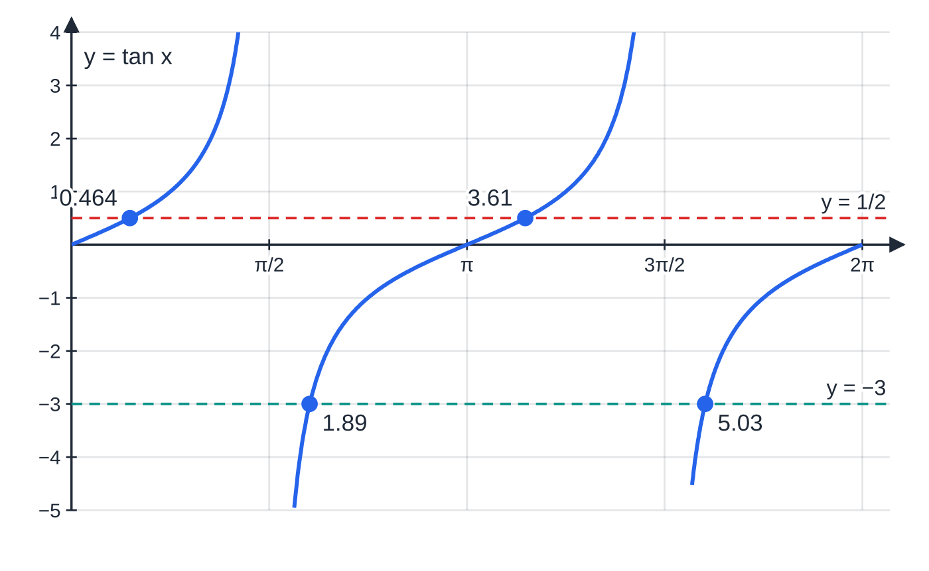
How do you solve equations with these identities? (continued)
Section 7 of 13
Common error — the wrong sign in the identity
Writing tan²θ= 1 - sec²θ, or sec²θ= tan²θ- 1. If you are unsure, re-derive the identity by dividing sin² + cos² = 1 by cos², or test it with θ= 0: sec² 0 = 1 and tan² 0 = 0.
Worked example 7(b): each of tan x = 1/2 and tan x = −3 meets the two branches of tan x in (0, 2π) once, giving four solutions.
Notes:
How do you solve equations with these identities?. Full notes: https://examinerprep.com/notes/edexcel-ial-maths/reciprocal-and-inverse-trigonometric-functions/

Slide 32
How do you prove a trigonometric identity?
Section 8 of 13
Start from one side, usually the more complicated one, and work until you reach the other side. Do not work on both sides at once, and never start by assuming the result. Useful moves are: rewrite sec, cosec and cot in terms of sin and cos; combine fractions over a common denominator; factorise a difference of two squares; and use the Pythagorean identities in whichever direction helps. Finish with a clear statement such as "= RHS, as required".
A model proof.
Prove that (cosecx - cot x)² ≡(1 - cos x)/(1 + cos x). LHS = (1/sin x - cos x/sin x)² = ((1 - cos x)²)/(sin² x) = ((1 - cos x)²)/(1 - cos² x) = ((1 - cos x)²)/((1 - cos x)(1 + cos x)) = (1 - cos x)/(1 + cos x) = RHS The key steps: everything in sin and cos, sin² x = 1 - cos² x, then the difference of two squares lets a factor cancel.
Notes:
How do you prove a trigonometric identity?. Full notes: https://examinerprep.com/notes/edexcel-ial-maths/reciprocal-and-inverse-trigonometric-functions/

Slide 33
How do you prove a trigonometric identity? (continued)
Section 8 of 13 · Worked example 8 · Hard · Prove, hence solve
WORKED EXAMPLE · QUESTION
(a) Prove that sec⁴θ- tan⁴θ≡sec²θ+ tan²θ. (b) Hence solve sec⁴θ- tan⁴θ= 4 - tan θ for 0 ≤θ< 2π, giving exact answers where possible and other answers to 3 significant figures.
SOLUTION
(a) Difference of two squares: LHS = (sec²θ- tan²θ)(sec²θ+ tan²θ). By the identity, sec²θ- tan²θ= 1, so LHS = sec²θ+ tan²θ= RHS.
(b) Using (a), then sec²θ= 1 + tan²θ: 1 + 2tan²θ= 4 - tan θ⇒2tan²θ+ tan θ- 3 = 0 ⇒(2tan θ+ 3)(tan θ- 1) = 0. tan θ= 1 gives θ= π/4 or 5π/4. tan θ= -(3/2) has principal value -0.9828, so θ= π- 0.9828 or 2π- 0.9828. θ= π/4, 5π/4, 2.16, 5.30.
"Hence" means part (a) must be used: replacing sec⁴ - tan⁴ by sec² + tan² is what makes the quadratic appear.
Notes:
How do you prove a trigonometric identity?: Worked example 8. Full notes: https://examinerprep.com/notes/edexcel-ial-maths/reciprocal-and-inverse-trigonometric-functions/

Slide 34
Exam tips for P3.3
Section 9 of 13
Exam tip 1 — get back to sin, cos and tan
Whenever you are stuck, rewrite sec, cosec and cot as 1/cos, 1/sin and cos/sin. Equations become familiar, and proofs often simplify to a single fraction.
Exam tip 2 — let the equation choose the identity
tan and sec together: sec² = 1 + tan². cot and cosec together: cosec² = 1 + cot². Replace the squared term so that only one function remains, and you will usually see a quadratic.
Exam tip 3 — use signs, not just squares
When an identity gives sec²θ= 9, the answer is ±3 until you decide. Use the quadrant (obtuse, reflex, "θ in the third quadrant") or the range of an inverse function to choose the sign, and say why.
Notes:
Exam tips for P3.3. Full notes: https://examinerprep.com/notes/edexcel-ial-maths/reciprocal-and-inverse-trigonometric-functions/

Slide 35
Exam tips for P3.3 (continued)
Section 9 of 13
Exam tip 4 — inverse functions give one value, in radians
arcsin, arccos and arctan each return a single angle in their own range. Unless the question uses degrees, give the answer in radians, exactly where possible (-π/3, 2π/3, -π/4).
Exam tip 5 — adjust the interval for 2x, x + a and so on
Before solving sec 2x = 3 on 0 ≤x ≤π, rewrite the interval as 0 ≤2x ≤2π and find every value of 2x in it. Then divide. In a proof, write every line as a full expression joined by "=" and finish with "= RHS".
Notes:
Exam tips for P3.3. Full notes: https://examinerprep.com/notes/edexcel-ial-maths/reciprocal-and-inverse-trigonometric-functions/

Slide 36
Common misconceptions
Section 10 of 13
Misconception | Why it is wrong | Correct idea
sec x = 1/sin x. | The pairs are matched by the third letter, not the first. | sec ↔ cos, cosec ↔ sin, cot ↔ tan.
sin⁻¹x means 1/sin x. | The −1 here is function-inverse notation. | sin⁻¹x = arcsin x; 1/sin x = (sin x)⁻¹ = cosecx.
arcsin(sin θ) = θ always. | arcsin only returns angles in [-π/2, π/2]. | arcsin(sin 5π/6) = π/6. The rule holds only when θ is in the range.
sec x = 0.5 has two solutions in [0, 2π]. | It needs cos x = 2, which is impossible. | sec and cosec never lie strictly between −1 and 1.
tan²θ= 1 - sec²θ. | The sign is wrong: at θ= π/4 this gives 1 = -1. | tan²θ= sec²θ- 1.
Dividing sec θtan θ= 2tan θ by tan θ is fine. | It throws away every solution of tan θ= 0. | Factorise: tan θ(sec θ- 2) = 0, then solve both factors.
Notes:
Common misconceptions. Full notes: https://examinerprep.com/notes/edexcel-ial-maths/reciprocal-and-inverse-trigonometric-functions/

Slide 37
How this topic connects
Section 11 of 13
P2 trigonometry and P3.1 functions
The identities here come straight from sin²θ+ cos²θ= 1, and every equation finishes with the P2 method of principal value plus symmetry. arcsin, arccos and arctan are the clearest example of restricting a domain to make a one-one function, with graphs reflected in y = x.
P3.4 Compound angles, double angles and R-form
The compound-angle and double-angle formulae are combined with sec, cosec and cot in harder identities and equations.
P3.6 Differentiation and P4 integration
The derivative of tan x is sec² x, and the derivatives of sec x, cosec x and cot x are written in terms of these functions. In P4, ∫tan² x dx is found by rewriting tan² x = sec² x - 1, and substitutions such as x = sin θ lead to arcsin in the answer.
Notes:
How this topic connects. Full notes: https://examinerprep.com/notes/edexcel-ial-maths/reciprocal-and-inverse-trigonometric-functions/

Slide 38
Key formulae
Section 12 of 13
Formula | Use | In the formulae list?
sec θ= 1/cos θ | definition of secant | No — learn it
cosecθ= 1/sin θ | definition of cosecant | No — learn it
cot θ= 1/tan θ = cos θ/sin θ | definition of cotangent | No — learn it
sec²θ≡1 + tan²θ | equations and proofs with tan and sec | No — learn it
cosec²θ≡1 + cot²θ | equations and proofs with cot and cosec | No — learn it
-π/2 ≤arcsin x ≤π/2, 0 ≤arccos x ≤π, -π/2 < arctan x < π/2 | ranges of the inverse functions (domains -1 ≤x ≤1 for arcsin and arccos) | No — learn it
cos(arcsin x) = √(1 - x²) | exact values of mixed expressions | No — derive it
Notes:
Key formulae. Full notes: https://examinerprep.com/notes/edexcel-ial-maths/reciprocal-and-inverse-trigonometric-functions/

Slide 39
Check your understanding
Section 13 of 13
1. Find the exact values of cosec(-π/6) and sec 300°.
2. State the domain and range of y = arccos x, and the range of y = arctan x.
3. Given that cot θ= ¾ and 180° < θ< 270°, find the exact value of cosecθ.
4. Explain why the equation cosecx = 0.6 has no solutions.
5. Solve tan²θ= 2sec θ+ 2 for 0° ≤θ< 360°.
6. Find the exact value of tan(arccos(-(5/13))).
Notes:
Check your understanding: questions. Full notes: https://examinerprep.com/notes/edexcel-ial-maths/reciprocal-and-inverse-trigonometric-functions/

Slide 40
Check your understanding · answers
Section 13 of 13
1. sin(-π/6) = -½, so cosec(-π/6) = -2. cos 300° = ½, so sec 300° = 2.
2. arccos: domain -1 ≤x ≤1, range 0 ≤y ≤π. arctan: range -π/2 < y < π/2 (its domain is all real numbers).
3. cosec²θ= 1 + (9/16) = (25/16). In the third quadrant sin θ< 0, so cosecθ= -(5/4).
4. It would need sin x = (1/0.6) = (5/3) > 1, which is impossible. The range of cosec is y ≤-1 or y ≥1.
5. sec²θ- 1 = 2sec θ+ 2 ⇒sec²θ- 2sec θ- 3 = 0 ⇒(sec θ- 3)(sec θ+ 1) = 0. cos θ= ⅓ gives θ= 70.5° or 289.5°; cos θ= -1 gives θ= 180°.
6. Let γ= arccos(-(5/13)), so cos γ= -(5/13) and 0 ≤γ≤π; here γ is obtuse, so sin γ= +√(1 - (25/169)) = (12/13). Then tan γ= (12/13)/(-5/13) = -(12/5).
Notes:
Check your understanding: answers. Full notes: https://examinerprep.com/notes/edexcel-ial-maths/reciprocal-and-inverse-trigonometric-functions/

Slide 41
Practice questions
2 original exam-style questions. Answers at the end of the deck.

Slide 42
Question 1
5 marks
This question is about the values of the reciprocal trigonometric functions. Answer parts (a) to (c) without a calculator, showing your working.
(a) Find the exact value of cosec(4π/3), giving your answer with a rational denominator. [2]
(b) Find the exact value of sec 135°. [1]
(c) Find the exact value of cot(7π/4). [1]
(d) Find the value of cosec 2.5, giving your answer to 3 significant figures. [1]
Notes:
Online with the full mark scheme: https://examinerprep.com/ial-maths-p3-3-reciprocal-and-inverse-trigonometric-functions-questions#IALM-P3-3-B-01

Slide 43
Question 2
6 marks
Give each answer to this question as an exact value in radians or as an exact number. The inverse trigonometric functions arcsin, arccos and arctan take their usual ranges.
(a) Write down the value of arcsin(½). [1]
(b) Write down the value of arccos(−√3/2). [1]
(c) Write down the value of arctan(−√3). [1]
(d) Find the exact value of sin(arccos(−5/13)). [2]
(e) Find the value of arccos(cos(4π/3)). [1]
Notes:
Online with the full mark scheme: https://examinerprep.com/ial-maths-p3-3-reciprocal-and-inverse-trigonometric-functions-questions#IALM-P3-3-B-02

Slide 44
Answers

Slide 45
Question 1 · answer
Mark scheme
cosec(4π/3) = 1/sin(4π/3) = 1/(−√3/2)
= −2/√3 = −2√3/3
1/cos 135° = 1/(−√2/2) = −√2
1/tan(7π/4) = 1/(−1) = −1
1/sin 2.5 = 1/0.5985 = 1.67 (radian mode)
Notes:
Full mark scheme: https://examinerprep.com/ial-maths-p3-3-reciprocal-and-inverse-trigonometric-functions-questions#IALM-P3-3-B-01

Slide 46
Question 2 · answer
Mark scheme
π/6
5π/6
−π/3
let α = arccos(−5/13); 0 ≤ α ≤ π so sin α ≥ 0 and sin α = √(1 − 25/169)
= 12/13
cos(4π/3) = −½, so arccos(−½) = 2π/3
Notes:
Full mark scheme: https://examinerprep.com/ial-maths-p3-3-reciprocal-and-inverse-trigonometric-functions-questions#IALM-P3-3-B-02

Slide 47
Keep practising
Notes for this topic
Questions on this topic
Build a printable test
ExaminerPrep is an independent tutoring service. It has been developed independently from and is not endorsed by the International Baccalaureate Organization. "International Baccalaureate", "IB" and "IB Diploma Programme" are registered trademarks of the IBO, used here for descriptive purposes only.
Pearson Edexcel and Cambridge are trademarks of their owners; ExaminerPrep is not affiliated with any exam board.

