Slide 1
EP
EDEXCEL IAL MATHS
S1.1 Representing data
The full notes page in 12 sections · practice questions with answers · simulations
ExaminerPrep is an independent tutoring service. It has been developed independently from and is not endorsed by the International Baccalaureate Organization. "International Baccalaureate", "IB" and "IB Diploma Programme" are registered trademarks of the IBO, used here for descriptive purposes only.
Pearson Edexcel and Cambridge are trademarks of their owners; ExaminerPrep is not affiliated with any exam board.
Notes:
S1.1 Representing data. Notes for this topic: https://examinerprep.com/notes/edexcel-ial-maths/representing-data/

Slide 2
What this page covers
Overview
What a statistical model is, the modelling cycle, and the advantages and limitations of models in context
Class boundaries, class widths and frequency density
Histograms with unequal class widths, the modal class and estimating a frequency from part of a class
Histogram scale problems, where a bar is given in centimetres
Stem-and-leaf diagrams (including back-to-back) and quartiles from raw data
Box plots, the interquartile range and outliers using the rule stated in the question
Skewness from quartiles, from mean, median and mode, and from a coefficient given in a question
Comparing two distributions: location, spread, skewness and outliers, always in context
Notes:
What this page covers. Full notes: https://examinerprep.com/notes/edexcel-ial-maths/representing-data/

Slide 3
In one minute
Key points
1. Data are represented so that their shape, centre and spread can be seen at a glance: a histogram shows grouped data through area, a stem-and-leaf diagram keeps every value, and a box plot reduces a data set to five numbers and flags anything unusual.
2. A statistical model is a simplified description of a real situation. It is quick and cheap and makes predictions, but it rests on assumptions; data are collected to test it, and the model is refined if it does not fit.
3. In a histogram the area of each bar is proportional to the frequency. With frequency density on the vertical axis, frequency density = frequency ÷ class width, and area = frequency.
4. For n raw values, Q₁, Q₂, Q₃ sit at positions n/4, n/2, 3n/4: a whole number means average that value and the next; otherwise round up.
5. An outlier is a value beyond the fences given in the question, often Q₁-1.5×IQR and Q₃+1.5×IQR; plot it as a cross and end the whisker at the last value inside.
Notes:
In one minute. Full notes: https://examinerprep.com/notes/edexcel-ial-maths/representing-data/

Slide 4
In one minute (continued)
Key points
6. Positive skew: Q₃-Q₂>Q₂-Q₁, or mode < median < mean. Negative skew: the reverse. Compare distributions using a measure of location and a measure of spread, in context.
Notes:
In one minute. Full notes: https://examinerprep.com/notes/edexcel-ial-maths/representing-data/

Slide 5
What is a statistical model, and why use one?
Section 1 of 12
Real situations are too complicated to describe exactly, so statistics replaces them with something simpler that still captures what matters: a model.
Statistical model. A simplified description of a real-world situation, built on assumptions, that can be used to make predictions.
Examples: "each face of this dice is equally likely", "the proportion of seeds that germinate is 0.8", "heights of adult men are spread symmetrically about their mean". None is exactly true, but each is useful and makes predictions that can be checked.
Predictions are compared with real data; if the fit is poor, the model is refined and tested again: the modelling cycle.
Notes:
What is a statistical model, and why use one?. Full notes: https://examinerprep.com/notes/edexcel-ial-maths/representing-data/

Slide 6
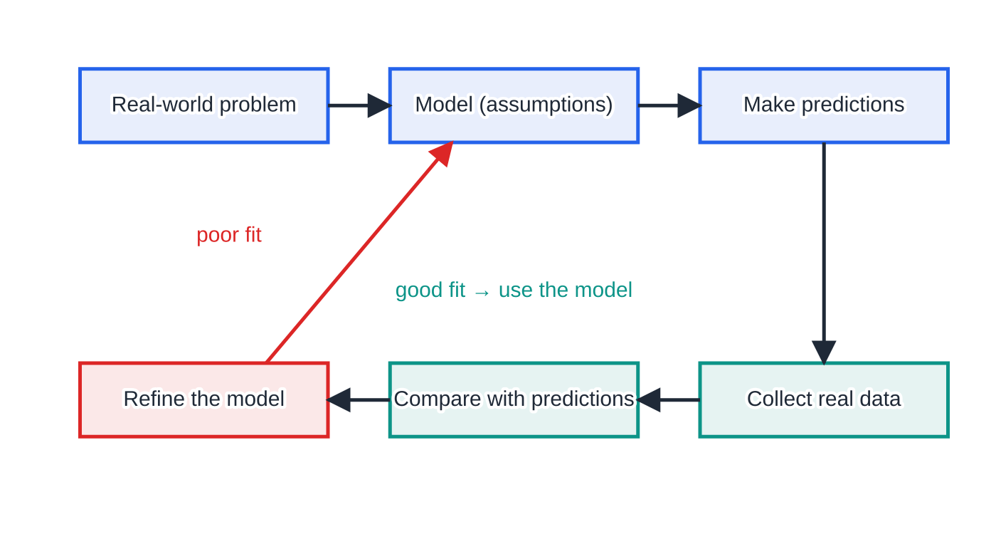
What is a statistical model, and why use one? (continued)
Section 1 of 12
The modelling cycle. Each comparison with new data can lead to a refinement, and the refined model is used to predict again.
Notes:
What is a statistical model, and why use one?. Full notes: https://examinerprep.com/notes/edexcel-ial-maths/representing-data/

Slide 7
What is a statistical model, and why use one? (continued)
Section 1 of 12
Advantages of a model | Limitations of a model
quick and cheap compared with experimenting on the real situation | it simplifies reality, so its predictions are only approximate
gives predictions, which help decision-making and planning | it rests on assumptions that may be wrong or may stop being true
helps us understand the situation and which factors matter | it may only work for a restricted range of values or situations
can be changed and re-run easily when conditions change | it needs to be tested against real data before it can be trusted
Notes:
What is a statistical model, and why use one?. Full notes: https://examinerprep.com/notes/edexcel-ial-maths/representing-data/

Slide 8
What is a statistical model, and why use one? (continued)
Section 1 of 12 · Worked example 1 · Easy · Give, predict, comment
WORKED EXAMPLE · QUESTION
A seed company models the probability that one of its seeds germinates as 0.8, and assumes that seeds germinate independently. (a) Give two advantages of using this model. (b) Give one limitation. (c) Use the model to predict the number of seeds that germinate when 250 are planted. (d) In a trial, 171 of 250 seeds germinate. Comment on the model and describe the next stage of the modelling process.
SOLUTION
(a) Any two, in context: it is quick and cheap to make predictions without planting large batches; it helps the company plan how many seeds to put in each packet.
(b) The germination rate depends on soil, temperature and the age of the seed, which the single value 0.8 ignores.
(c) 0.8×250=200, so 200 seeds.
(d) 171 is well below 200 (proportion 171/250=0.684), so the model does not fit these data well.
Notes:
What is a statistical model, and why use one?: Worked example 1. Full notes: https://examinerprep.com/notes/edexcel-ial-maths/representing-data/

Slide 9
What is a statistical model, and why use one? (continued)
Section 1 of 12 · Worked example 1 · Easy · Give, predict, comment (continued)
Refine it, for example by using a probability nearer 0.68, then collect more data to test the refined model.
Notes:
What is a statistical model, and why use one?: Worked example 1. Full notes: https://examinerprep.com/notes/edexcel-ial-maths/representing-data/

Slide 10
What is a statistical model, and why use one? (continued)
Section 1 of 12
Common error
Writing a generic answer such as "models are simplified". Advantages and limitations count only when they refer to the situation in the question: the seeds, the packets, the conditions they are grown in.
Notes:
What is a statistical model, and why use one?. Full notes: https://examinerprep.com/notes/edexcel-ial-maths/representing-data/

Slide 11
How do you draw and read a histogram?
Section 2 of 12
A histogram is the picture for continuous grouped data (lengths, times, masses), so the bars touch. The key idea: the area of each bar is proportional to the frequency. With equal widths, area and height go together; with unequal widths they do not.
Class boundaries and widths
Class boundaries are where one class ends and the next begins. They depend on how the data were recorded. For lengths recorded to the nearest mm, the class "20–24" contains every length that rounds to 20, 21, 22, 23 or 24, so its boundaries are 19.5 and 24.5. For ages in completed years, "20–24" means 20≤age<25, because a person aged 24 years and 11 months still says they are 24.
Notes:
How do you draw and read a histogram?. Full notes: https://examinerprep.com/notes/edexcel-ial-maths/representing-data/

Slide 12
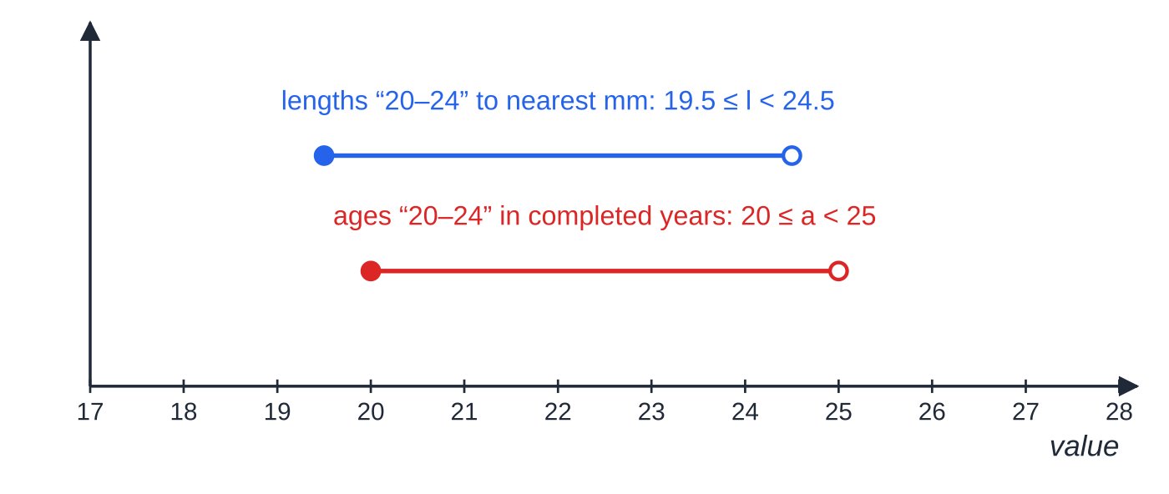
How do you draw and read a histogram? (continued)
Section 2 of 12
Class width = upper boundary − lower boundary.
Frequency density.
frequency density=frequency/(class width), area of bar=k×frequency. With frequency density on the vertical axis, k=1 and area = frequency. In a scale problem, find k from one bar whose frequency you know.
The same label "20–24" gives different boundaries. Both classes have width 5, but they start in different places.
Notes:
How do you draw and read a histogram?. Full notes: https://examinerprep.com/notes/edexcel-ial-maths/representing-data/

Slide 13
How do you draw and read a histogram? (continued)
Section 2 of 12
The class with the tallest bar, that is the largest frequency density, is the modal class. It is not necessarily the class with the largest frequency: a wide class can collect many values without being crowded.
To estimate how many values lie in part of a class, assume the values are spread evenly across the class. Then the number in the part is the area of that part of the bar: frequency ≈ frequency density × width of the part.
Notes:
How do you draw and read a histogram?. Full notes: https://examinerprep.com/notes/edexcel-ial-maths/representing-data/

Slide 14
How do you draw and read a histogram? (continued)
Section 2 of 12 · Worked example 2 · Medium · Calculate, estimate
WORKED EXAMPLE · QUESTION
The table shows the journey times, t minutes, of 100 commuters.
Time t (min) | 0≤t<10 | 10≤t<15 | 15≤t<20 | 20≤t<30 | 30≤t<50
Frequency | 12 | 18 | 25 | 30 | 15
(a) Calculate the frequency density of each class. (b) State the modal class. (c) Estimate the number of commuters whose journeys took between 12 and 25 minutes.
Notes:
How do you draw and read a histogram?: Worked example 2. Full notes: https://examinerprep.com/notes/edexcel-ial-maths/representing-data/

Slide 15
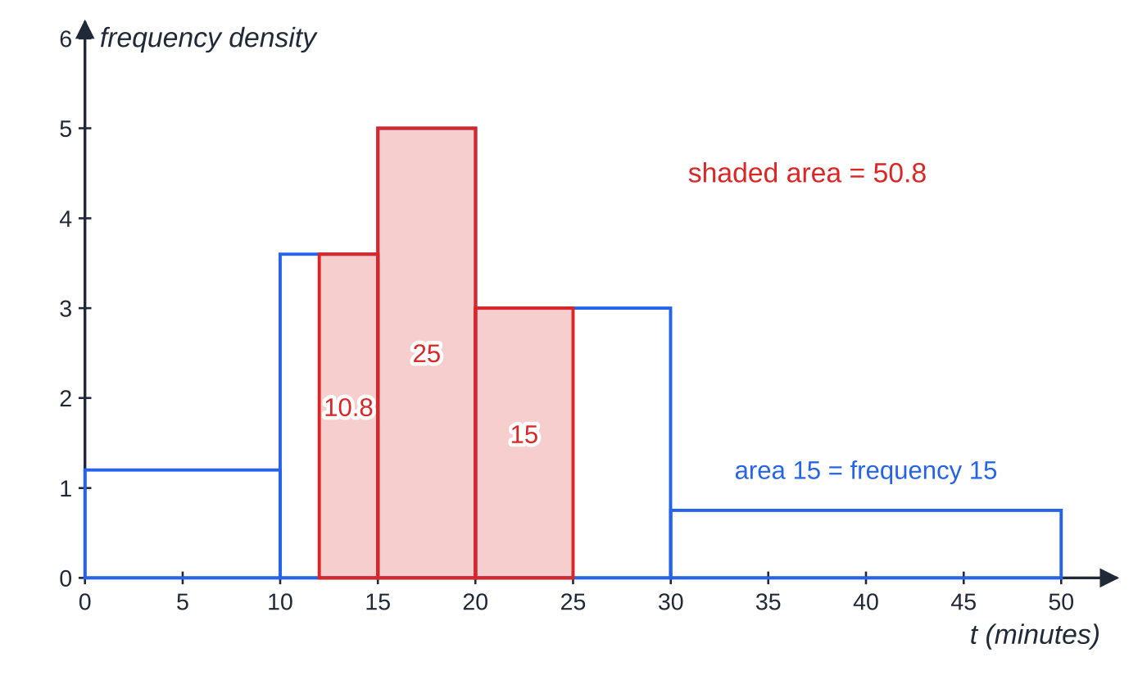
How do you draw and read a histogram? (continued)
Section 2 of 12 · Worked example 2 · Medium · Calculate, estimate (continued)
SOLUTION
(a) Divide each frequency by its class width: 12÷10=1.2, 18÷5=3.6, 25÷5=5, 30÷10=3, 15÷20=0.75.
(b) The largest frequency density is 5, so the modal class is 15≤t<20, even though 20≤t<30 has the largest frequency.
(c) Add the areas between 12 and 25: (15-12)×3.6+25+(25-20)×3=10.8+25+15=50.8, so about 51 commuters.
Each bar's height is its frequency density, so its area is its frequency. The shaded area between 12 and 25 minutes is 50.8.
Notes:
How do you draw and read a histogram?: Worked example 2. Full notes: https://examinerprep.com/notes/edexcel-ial-maths/representing-data/

Slide 16
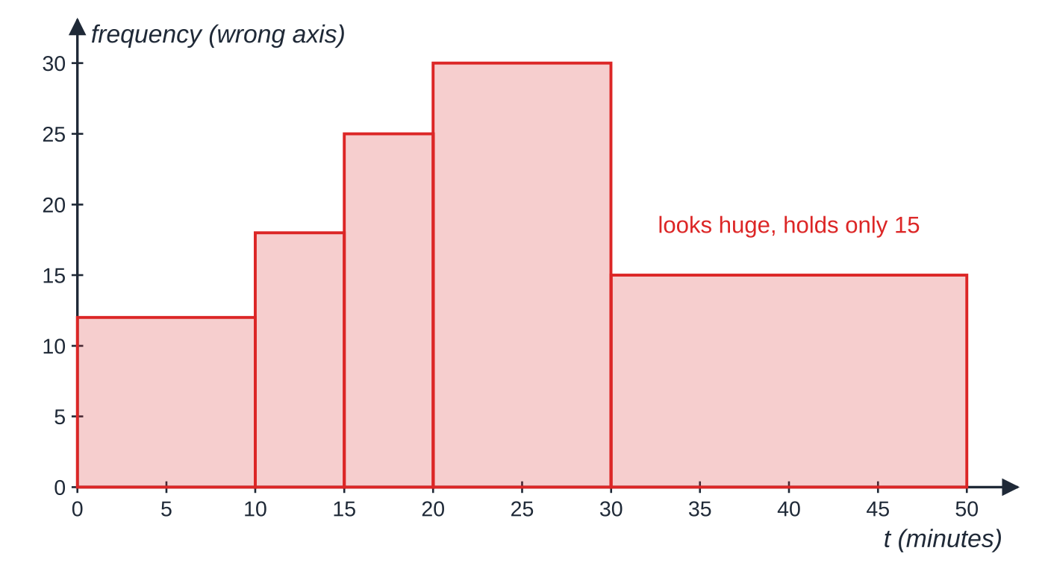
How do you draw and read a histogram? (continued)
Section 2 of 12
Draw the same data with frequency as the height and the picture lies: the class 30≤t<50 holds only 15 commuters but gets one of the largest areas.
A misleading "histogram" of the same data with frequency on the vertical axis. The wide classes look far too important; this is why unequal classes need frequency density.
Notes:
How do you draw and read a histogram?. Full notes: https://examinerprep.com/notes/edexcel-ial-maths/representing-data/

Slide 17
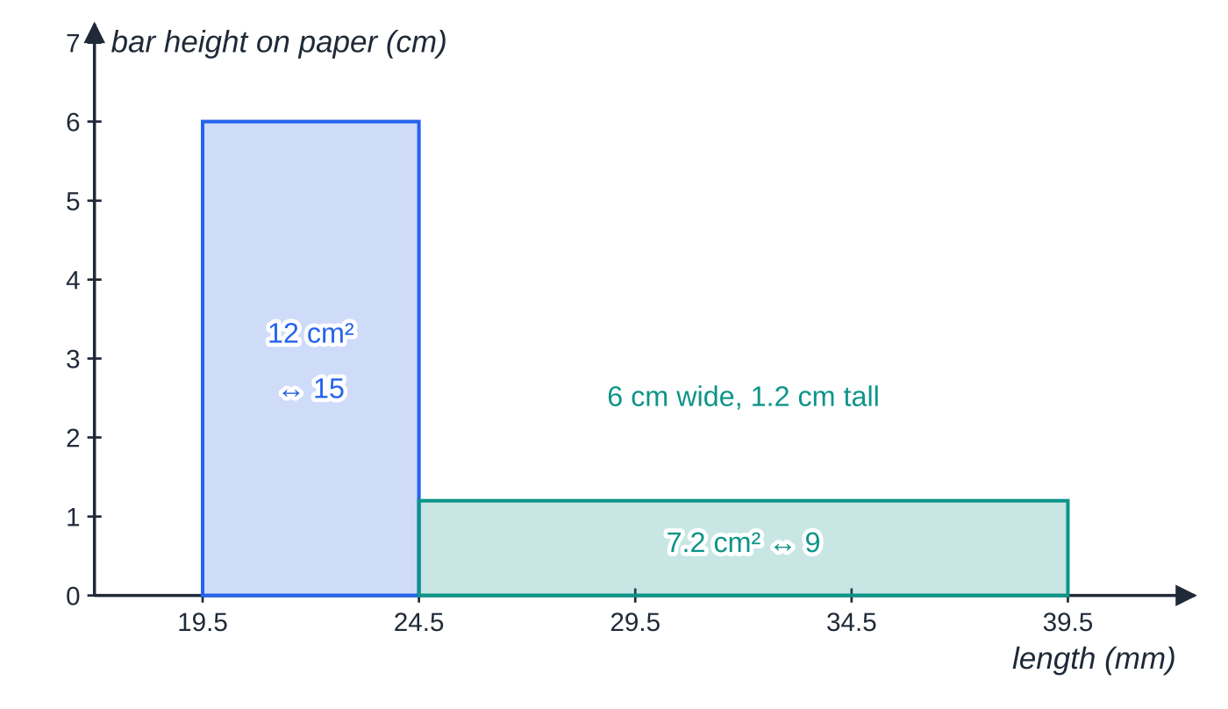
How do you draw and read a histogram? (continued)
Section 2 of 12 · Worked example 3 · Medium · Find
WORKED EXAMPLE · QUESTION
The lengths of seedlings were measured to the nearest millimetre and grouped. On a histogram, the class 20–24 mm, which has frequency 15, is drawn as a bar 2 cm wide and 6 cm tall. The class 25–39 mm has frequency 9. (a) Write down the class boundaries of the class 25–39. (b) Find the width and the height of the bar for the class 25–39.
The two bars of Worked example 3 drawn to the paper scale. The known bar fixes both the width scale (0.4 cm per mm) and the area scale (0.8 cm² per seedling).
Notes:
How do you draw and read a histogram?: Worked example 3. Full notes: https://examinerprep.com/notes/edexcel-ial-maths/representing-data/

Slide 18
How do you draw and read a histogram? (continued)
Section 2 of 12 · Worked example 3 · Medium · Find (continued)
SOLUTION
(a) Lengths are rounded to the nearest mm, so the boundaries are 24.5 mm and 39.5 mm (width 15 mm).
(b) Horizontal scale from the known bar: 20–24 has width 24.5-19.5=5 mm, drawn as 2 cm, so 1 mm ↔ 0.4 cm. The new width is 15×0.4=6 cm.
Area scale from the known bar: 2×6=12 cm² represents 15 seedlings, so 1 seedling ↔ 0.8 cm². The new area is 9×0.8=7.2 cm², so the height is 7.2÷6=1.2 cm.
Width 6 cm, height 1.2 cm.
Notes:
How do you draw and read a histogram?: Worked example 3. Full notes: https://examinerprep.com/notes/edexcel-ial-maths/representing-data/

Slide 19
How do you draw and read a histogram? (continued)
Section 2 of 12
Exam tip — two scales
In every scale problem, work out two separate scales from the bar you know: width (cm per unit of the variable) and area (cm² per unit of frequency). Height then comes from area ÷ width.
Notes:
How do you draw and read a histogram?. Full notes: https://examinerprep.com/notes/edexcel-ial-maths/representing-data/

Slide 20
How do you build a stem-and-leaf diagram and find quartiles from it?
Section 3 of 12
A stem-and-leaf diagram keeps every value. Each value splits into a stem (leading digits) and a leaf (last digit), with leaves in order, smallest next to the stem: a sorted list that also shows the shape.
Every diagram needs a key, for example "2 | 3 means 23 seconds". Without it, 2 | 3 could be 2.3 or 230. In a back-to-back diagram two data sets share the stems: leaves on the right are read left to right as usual, leaves on the left are read from right to left (smallest nearest the stem), and the key must say how to read each side.
Because the values are in order, the median and quartiles can be read off directly. S1 uses a fixed rule for raw (ungrouped) data.
Quartiles of n raw values. Q₁ is at position n/4, Q₂ at n/2, Q₃ at 3n/4. If the position is a whole number r, take the mean of the rth and (r+1)th values; if it is not, round up to the next whole number. The interquartile range is IQR=Q₃-Q₁.
Notes:
How do you build a stem-and-leaf diagram and find quartiles from it?. Full notes: https://examinerprep.com/notes/edexcel-ial-maths/representing-data/

Slide 21
How do you build a stem-and-leaf diagram and find quartiles from it? (continued)
Section 3 of 12
For grouped data the quartiles are estimated by interpolation instead; that method is on the S1.2 page.
Notes:
How do you build a stem-and-leaf diagram and find quartiles from it?. Full notes: https://examinerprep.com/notes/edexcel-ial-maths/representing-data/

Slide 22
How do you build a stem-and-leaf diagram and find quartiles from it? (continued)
Section 3 of 12 · Worked example 4 · Medium · Draw, find
WORKED EXAMPLE · QUESTION
The times, in seconds, taken by 19 people to solve a puzzle were
41, 27, 53, 35, 64, 23, 45, 38, 91, 50, 31, 44, 56, 36, 42, 58, 34, 47, 39
(a) Draw an ordered stem-and-leaf diagram. (b) Find the median and the quartiles.
SOLUTION
(a) Order the values, then split into stems (tens) and leaves (units).
Stem | Leaf
2 | 3 7
3 | 1 4 5 6 8 9
4 | 1 2 4 5 7
Notes:
How do you build a stem-and-leaf diagram and find quartiles from it?: Worked example 4. Full notes: https://examinerprep.com/notes/edexcel-ial-maths/representing-data/

Slide 23
How do you build a stem-and-leaf diagram and find quartiles from it? (continued)
Section 3 of 12 · Worked example 4 · Medium · Draw, find (continued)
Stem | Leaf
5 | 0 3 6 8
6 | 4
7
8
9 | 1
Key: 2 | 3 means 23 seconds. Empty stems 7 and 8 must be shown, or the gap before 91 disappears.
(b) Positions for n=19: 19/4=4.75→ 5th value; 19/2=9.5→ 10th; 3×19/4=14.25→ 15th.
Q₁=35, Q₂=42, Q₃=53 seconds.
Notes:
How do you build a stem-and-leaf diagram and find quartiles from it?: Worked example 4. Full notes: https://examinerprep.com/notes/edexcel-ial-maths/representing-data/

Slide 24
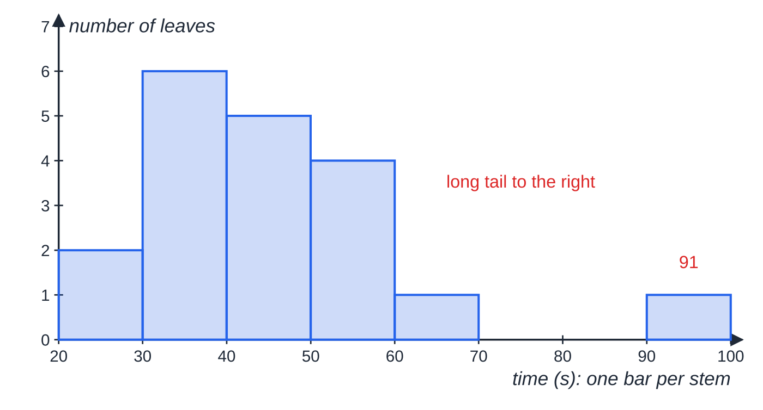
How do you build a stem-and-leaf diagram and find quartiles from it? (continued)
Section 3 of 12
Common error
Averaging two values when the position is not a whole number: for 19/4=4.75, taking the mean of the 4th and 5th values instead of the 5th value. Average only when the position is a whole number; otherwise round up, and write the position down so the method is clear.
Turn the stem-and-leaf diagram on its side and it becomes a bar chart of the puzzle times: a peak at 30–39 s, a tail to the right and one value far from the rest.
Notes:
How do you build a stem-and-leaf diagram and find quartiles from it?. Full notes: https://examinerprep.com/notes/edexcel-ial-maths/representing-data/

Slide 25
How do you draw a box plot and identify outliers?
Section 4 of 12
A box plot is drawn against a labelled scale: a box from Q₁ to Q₃, a line across it at the median, and whiskers out to the smallest and largest values that are not outliers. The box holds the middle half of the data, so its length is the IQR.
An outlier is an extreme value that lies outside a stated range. The question always gives the rule: most often outside Q₁-1.5×IQR to Q₃+1.5×IQR, sometimes outside mean ± 2 × standard deviation. Use exactly the rule and multiplier you are given.
Outlier fences (when the question uses this rule). lower fence =Q₁-1.5×IQR, upper fence =Q₃+1.5×IQR. Outliers are plotted individually as crosses (×). They may be recording errors, or genuine but unusual values; if asked whether to remove one, say which you think and why.
Notes:
How do you draw a box plot and identify outliers?. Full notes: https://examinerprep.com/notes/edexcel-ial-maths/representing-data/

Slide 26
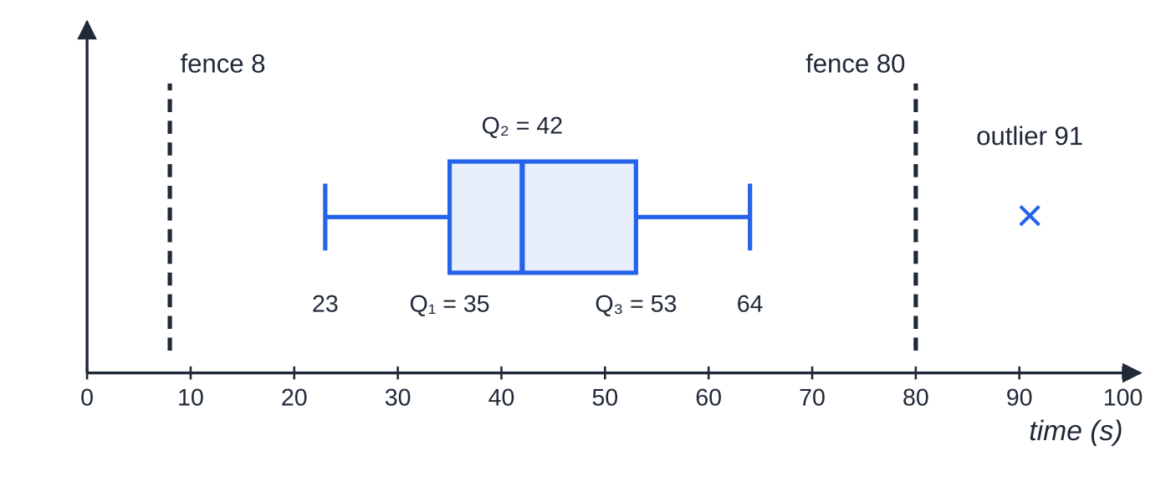
How do you draw a box plot and identify outliers? (continued)
Section 4 of 12 · Worked example 5 · Medium · Show that, draw, describe
WORKED EXAMPLE · QUESTION
For the puzzle times in Worked example 4, an outlier is a value less than Q₁-1.5×IQR or greater than Q₃+1.5×IQR. (c) Show that there is exactly one outlier. (d) Draw a box plot. (e) Describe the skewness of the data, giving a reason.
SOLUTION
(c) IQR=53-35=18 and 1.5×18=27. Lower fence 35-27=8; upper fence 53+27=80. No value is below 8; only 91>80, so 91 is the one outlier.
Box plot of the puzzle times. The fences at 8 and 80 are not part of the box plot; they are shown dashed only to explain why 91 is a cross and the upper whisker stops at 64.
Notes:
How do you draw a box plot and identify outliers?: Worked example 5. Full notes: https://examinerprep.com/notes/edexcel-ial-maths/representing-data/

Slide 27
How do you draw a box plot and identify outliers? (continued)
Section 4 of 12 · Worked example 5 · Medium · Show that, draw, describe (continued)
(d) The whiskers go to the last values inside the fences: lower whisker to 23, upper whisker to 64, and a cross at 91 (figure below).
(e) Q₃-Q₂=11>Q₂-Q₁=7, so the data are positively skewed.
Notes:
How do you draw a box plot and identify outliers?: Worked example 5. Full notes: https://examinerprep.com/notes/edexcel-ial-maths/representing-data/

Slide 28
How do you draw a box plot and identify outliers? (continued)
Section 4 of 12
Common error
Drawing the upper whisker all the way to the outlier, or stopping it at the fence (80). The whisker ends at the largest value that is not an outlier, here 64.
Notes:
How do you draw a box plot and identify outliers?. Full notes: https://examinerprep.com/notes/edexcel-ial-maths/representing-data/

Slide 29
How do you compare two distributions?
Section 5 of 12
Make at least two comparisons: one of location (median or mean) and one of spread (IQR, range or standard deviation). Add skewness or outliers if they differ between the groups.
Compare like with like: medians with IQRs, means with standard deviations; with skew or outliers prefer the median and IQR, which extreme values do not affect. Every comparison must be in context: not "B has a higher median" but "group B's reaction times were generally slower".
Notes:
How do you compare two distributions?. Full notes: https://examinerprep.com/notes/edexcel-ial-maths/representing-data/

Slide 30
How do you compare two distributions? (continued)
Section 5 of 12 · Worked example 6 · Hard · Find, identify, compare
WORKED EXAMPLE · QUESTION
The reaction times, in hundredths of a second, of 16 students who play a racket sport (group A) and 16 who do not (group B) are shown in the back-to-back stem-and-leaf diagram.
Group A | Stem | Group B
9 | 1
8 8 7 5 4 2 | 2 | 6 9
8 6 4 3 1 0 | 3 | 1 3 4 5 6 7 7 8 9
9 5 1 | 4 | 0 1 2 4
 | 5
 | 6 | 1
Notes:
How do you compare two distributions?: Worked example 6. Full notes: https://examinerprep.com/notes/edexcel-ial-maths/representing-data/

Slide 31
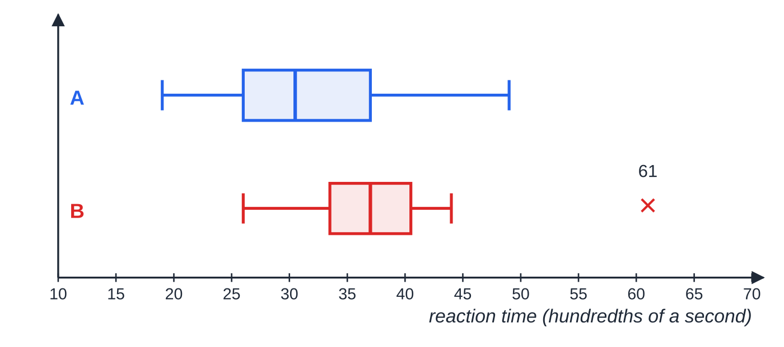
How do you compare two distributions? (continued)
Section 5 of 12 · Worked example 6 · Hard · Find, identify, compare (continued)
Key: 9 | 1 | 2 means 19 for group A and 12 for group B (hundredths of a second).
(a) Find the median and interquartile range of each group. (b) An outlier is a value more than 1.5×IQR beyond the nearer quartile. Identify any outliers. (c) Compare the reaction times of the two groups.
SOLUTION
(a) With n=16: Q₁ = mean of the 4th and 5th values, Q₂ = mean of the 8th and 9th, Q₃ = mean of the 12th and 13th.
A:
Comparative box plots on one scale: A's box sits further left (faster) but is wider (more variable); B has one outlier at 61.
Notes:
How do you compare two distributions?: Worked example 6. Full notes: https://examinerprep.com/notes/edexcel-ial-maths/representing-data/

Slide 32
How do you compare two distributions? (continued)
Section 5 of 12 · Worked example 6 · Hard · Find, identify, compare (continued)
Q₁=26, Q₂=30.5, Q₃=37, so median 30.5, IQR 11.
B: Q₁=33.5, Q₂=37, Q₃=40.5, so median 37, IQR 7.
(b) A: fences 26-16.5=9.5 and 37+16.5=53.5; values run from 19 to 49, so no outliers. B: fences 33.5-10.5=23 and 40.5+10.5=51; 61 is an outlier.
(c) Median A < median B: group A generally reacted faster. IQR A > IQR B: group A's times were more variable; group B was more consistent (apart from one slow time). A is positively skewed (6.5>4.5); B is symmetrical between the quartiles (3.5=3.5).
Notes:
How do you compare two distributions?: Worked example 6. Full notes: https://examinerprep.com/notes/edexcel-ial-maths/representing-data/

Slide 33
How do you compare two distributions? (continued)
Section 5 of 12
Exam tip — one scale
Draw comparative box plots on the same scale, one above the other, and label each. A scale that differs between the two plots makes the picture misleading even if every number is right.
Notes:
How do you compare two distributions?. Full notes: https://examinerprep.com/notes/edexcel-ial-maths/representing-data/

Slide 34
How do you describe skewness?
Section 6 of 12
Skewness describes which way a distribution leans. The key rule is that skew is named after the long tail, not after the peak. A long tail of high values pulls the mean upwards more than the median, and the median more than the mode.
Shape | Tail | Quartiles | Averages
Symmetrical | none | Q₃-Q₂=Q₂-Q₁ | mode = median = mean
Positive skew | long tail to the right (high values) | Q₃-Q₂>Q₂-Q₁ | mode < median < mean
Negative skew | long tail to the left (low values) | Q₃-Q₂<Q₂-Q₁ | mean < median < mode
Notes:
How do you describe skewness?. Full notes: https://examinerprep.com/notes/edexcel-ial-maths/representing-data/

Slide 35
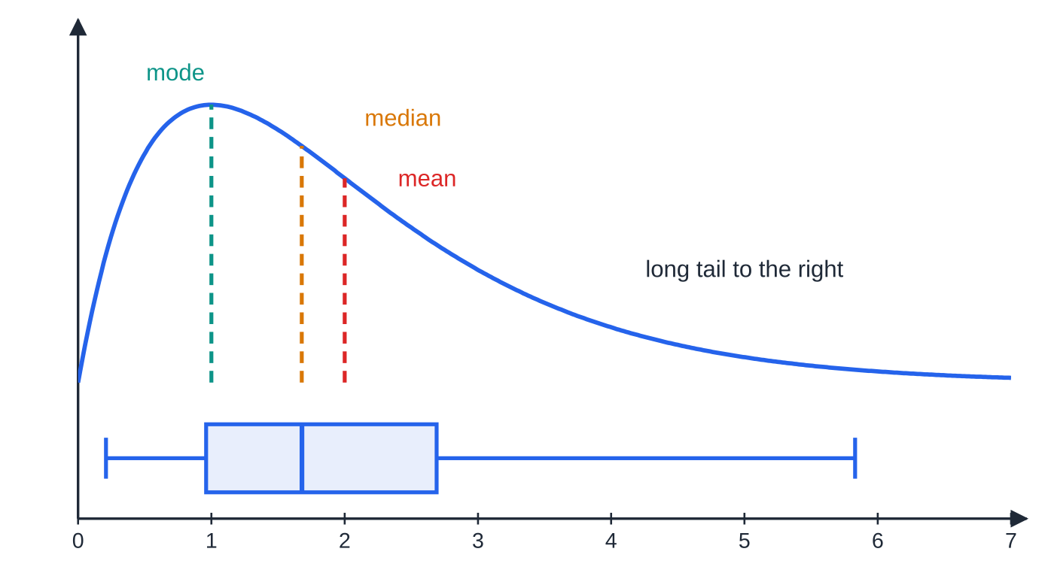
How do you describe skewness? (continued)
Section 6 of 12
Positive skew: the curve peaks at the mode (1), the median is 1.68 and the mean is 2. In the box plot underneath, the right half of the box and the right whisker are longer.
Notes:
How do you describe skewness?. Full notes: https://examinerprep.com/notes/edexcel-ial-maths/representing-data/

Slide 36
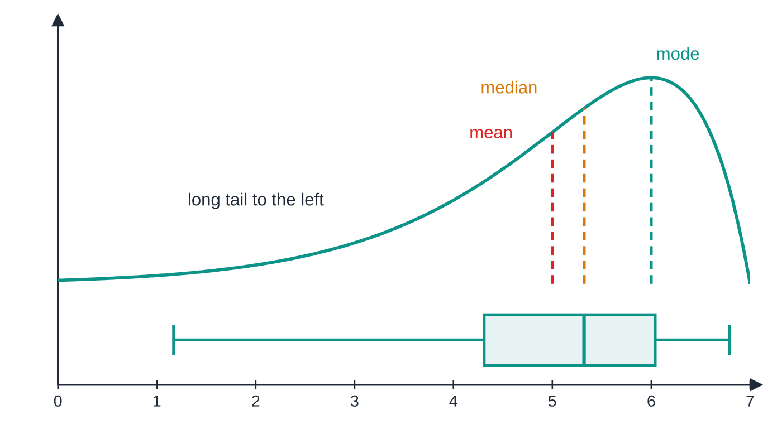
How do you describe skewness? (continued)
Section 6 of 12
A question may define a skewness coefficient, such as (3(mean-median))/(standard deviation). Evaluate it exactly as given: a positive value means positive skew, a negative value means negative skew, and a value near 0 means roughly symmetrical.
Negative skew is the mirror image: mean (5) < median (5.32) < mode (6), and the left half of the box is the longer one.
Notes:
How do you describe skewness?. Full notes: https://examinerprep.com/notes/edexcel-ial-maths/representing-data/

Slide 37
How do you describe skewness? (continued)
Section 6 of 12 · Worked example 7 · Medium · Show that, evaluate, determine
WORKED EXAMPLE · QUESTION
For a sample of weekly rents, in pounds, the mean is 186, the median is 172, the mode is 160, the standard deviation is 42, Q₁=148 and Q₃=214. (a) Show, in two different ways, that the rents are positively skewed. (b) One measure of skewness is (3(mean-median))/(standard deviation). Evaluate it. (c) A rent is an outlier if it is more than 2 standard deviations from the mean. Determine whether a rent of £295 is an outlier. (d) State, with a reason, whether the mean or the median is the better average for these rents.
SOLUTION
(a) Quartiles: Q₃-Q₂=42>Q₂-Q₁=24. Averages: mode 160 < median 172 < mean 186. Both show positive skew.
(b) (3(186-172))/42=(42/42)= 1, positive, confirming positive skew.
(c) Upper limit 186+2×42=270. Since 295>270, £295 is an outlier.
Notes:
How do you describe skewness?: Worked example 7. Full notes: https://examinerprep.com/notes/edexcel-ial-maths/representing-data/

Slide 38
How do you describe skewness? (continued)
Section 6 of 12 · Worked example 7 · Medium · Show that, evaluate, determine (continued)
(d) The median: the data are skewed (with a high outlier), which pulls the mean upwards but hardly affects the median.
Notes:
How do you describe skewness?: Worked example 7. Full notes: https://examinerprep.com/notes/edexcel-ial-maths/representing-data/

Slide 39
How do you describe skewness? (continued)
Section 6 of 12
Common error
Describing skew from where the peak is: "the peak is on the left, so it is negatively skewed". The skew is named after the long tail. A peak on the left with a tail to the right is positive skew.
Notes:
How do you describe skewness?. Full notes: https://examinerprep.com/notes/edexcel-ial-maths/representing-data/

Slide 40
How do you tackle a full data-representation question?
Section 7 of 12
Longer questions join several skills: recover a frequency from a histogram, rescale a bar, estimate part of a class, then judge skew and outliers. Label each step.
Notes:
How do you tackle a full data-representation question?. Full notes: https://examinerprep.com/notes/edexcel-ial-maths/representing-data/

Slide 41
How do you tackle a full data-representation question? (continued)
Section 7 of 12 · Worked example 8 · Hard · Find, estimate, describe
WORKED EXAMPLE · QUESTION
The lengths, t minutes, of the 136 calls made from an office in one week are summarised below.
Length t (min) | 0≤t<2 | 2≤t<4 | 4≤t<6 | 6≤t<10 | 10≤t<20
Frequency | 26 | x | 30 | 28 | 16
On a histogram of these data the bar for 0≤t<2 is 6.5 cm tall and the bar for 2≤t<4 is 9 cm tall. (a) Find x. (b) Find the height of the bar for 10≤t<20. (c) Estimate the number of calls longer than 8 minutes. (d) Estimates of the quartiles are Q₁=2.44, Q₂=4.40 and Q₃=7.43. Describe, with a reason, the skewness of the call lengths. (e) The shortest call lasted 0.3 min, and the two longest lasted 13.6 min and 19.2 min. An outlier is a value greater than Q₃+1.5×IQR or less than Q₁-1.5×IQR. Show that exactly one call is an outlier. (f) Describe the box plot of these data.
Notes:
How do you tackle a full data-representation question?: Worked example 8. Full notes: https://examinerprep.com/notes/edexcel-ial-maths/representing-data/

Slide 42
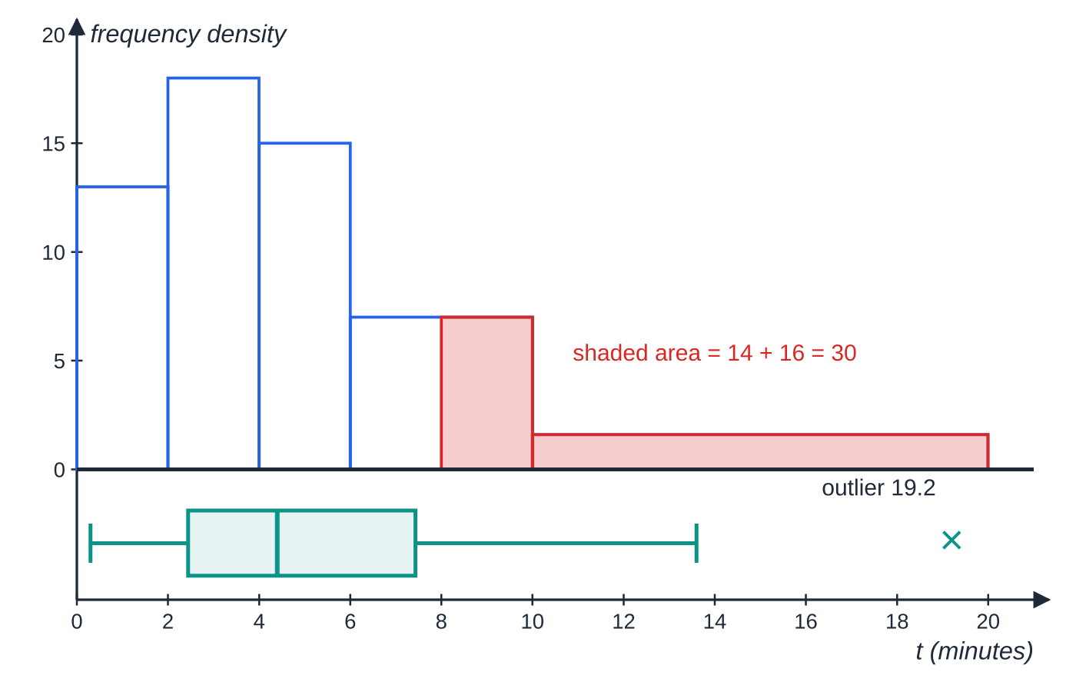
How do you tackle a full data-representation question? (continued)
Section 7 of 12 · Worked example 8 · Hard · Find, estimate, describe (continued)
SOLUTION
(a) The two bars have equal widths, so frequency ∝ height: x/26=(9/6.5)⇒ x=36. (Check: 26+36+30+28+16=136.)
(b) First bar: fd =26÷2=13 ↔ 6.5 cm, so 1 unit of fd ↔ 0.5 cm. Last bar: fd =16÷10=1.6, height =1.6×0.5= 0.8 cm.
(c) Part of the 6–10 class (fd 28÷4=7) plus the whole 10–20 class: (10-8)×7+16=14+16= 30 calls.
(d) Q₃-Q₂=3.03>Q₂-Q₁=1.96, so positive skew (a long tail of long calls).
(e) IQR=7.43-2.44=4.99, 1.5×4.99=7.485.
Worked example 8 on one time scale. Top: the histogram (heights are frequency densities); the shaded area beyond 8 minutes is 30 calls. Bottom: the box plot with whiskers at 0.3 and 13.6 and the outlier at 19.2.
Notes:
How do you tackle a full data-representation question?: Worked example 8. Full notes: https://examinerprep.com/notes/edexcel-ial-maths/representing-data/

Slide 43
How do you tackle a full data-representation question? (continued)
Section 7 of 12 · Worked example 8 · Hard · Find, estimate, describe (continued)
Upper fence 7.43+7.485=14.915; lower fence 2.44-7.485=-5.045. 19.2>14.915, an outlier; 13.6<14.915 and no call is shorter than 0, so 19.2 is the only outlier.
(f) A box from 2.44 to 7.43 with the median at 4.40; whiskers to 0.3 and 13.6; a cross at 19.2.
Notes:
How do you tackle a full data-representation question?: Worked example 8. Full notes: https://examinerprep.com/notes/edexcel-ial-maths/representing-data/

Slide 44
How do you tackle a full data-representation question? (continued)
Section 7 of 12
Exam tip — never assume height = frequency
When a histogram is given with a scale in centimetres, use one bar you know to fix the link between height and frequency density (or between area and frequency), and state that link in a line of working.
Notes:
How do you tackle a full data-representation question?. Full notes: https://examinerprep.com/notes/edexcel-ial-maths/representing-data/

Slide 45
Exam tips for S1.1
Section 8 of 12
Exam tip 1 — boundaries first
Before any histogram calculation, write the class boundaries and widths in a column. "10–14" for lengths to the nearest cm is 9.5 to 14.5; for ages it is 10 to 15. Most wrong frequency densities start with a wrong width.
Exam tip 2 — show the position
For quartiles from a list or a stem-and-leaf diagram, write "n/4=4.75→ 5th value" before the answer. The rule is easy to apply and the position line makes your method visible.
Exam tip 3 — fences are not whiskers
Show the fence calculation, list which values lie beyond it, and then end each whisker at the last value inside. Plot each outlier as its own cross.
Notes:
Exam tips for S1.1. Full notes: https://examinerprep.com/notes/edexcel-ial-maths/representing-data/

Slide 46
Exam tips for S1.1 (continued)
Section 8 of 12
Exam tip 4 — two comparisons, in context
"Compare" needs a measure of location and a measure of spread, each with a sentence about the real situation: "the median time for A is lower, so A generally reacted faster".
Exam tip 5 — justify the skew
"Positive skew" alone is rarely enough. Add the reason: the quartile comparison with numbers, or the order of mode, median and mean.
Notes:
Exam tips for S1.1. Full notes: https://examinerprep.com/notes/edexcel-ial-maths/representing-data/

Slide 47
Common misconceptions
Section 9 of 12
Misconception | Why it is wrong | Correct idea
The height of a histogram bar is the frequency. | With unequal widths a wide class would look too important. | Area is proportional to frequency; height is frequency density.
The modal class is the class with the largest frequency. | A wide class collects more values without being more crowded. | The modal class has the largest frequency density.
The whisker goes to the outlier. | Outliers are plotted separately. | The whisker ends at the most extreme value that is not an outlier.
A peak on the left means negative skew. | Skew is named after the tail, not the peak. | Peak on the left with a long right tail is positive skew.
An outlier is an error and should be removed. | Many outliers are genuine, just unusual. | Remove it only if there is a reason to think it is a mistake; otherwise keep it and say so.
A model that fails one test is useless. | Refining is a normal stage of modelling. | Use the data to adjust the assumptions, then test again.
Notes:
Common misconceptions. Full notes: https://examinerprep.com/notes/edexcel-ial-maths/representing-data/

Slide 48
How this topic connects
Section 10 of 12
S1.2 Measures of location and dispersion
Means, standard deviations, coding and medians of grouped data by interpolation supply the numbers that this page draws and interprets.
S1.6 The Normal distribution
A Normal model is symmetrical, with mean = median = mode; checking a data set's skew is one way to decide whether a Normal model is reasonable. The "mean ± 2 standard deviations" outlier rule comes from the same idea.
Notes:
How this topic connects. Full notes: https://examinerprep.com/notes/edexcel-ial-maths/representing-data/

Slide 49
Key formulae
Section 11 of 12
Formula | Use | In the formulae list?
class width = upper boundary − lower boundary | widths of histogram bars | No – learn it
frequency density = frequency ÷ class width | heights of histogram bars | No – learn it
area of bar = k × frequency | histogram scale problems; estimating part of a class | No – learn it
Q₁, Q₂, Q₃ at positions n/4, n/2, 3n/4 (whole number: average with the next; otherwise round up) | quartiles of raw data, e.g. from a stem-and-leaf diagram | No – learn it
IQR=Q₃-Q₁ | spread, unaffected by extreme values | No – learn it
Q₁-1.5×IQR, Q₃+1.5×IQR | outlier fences | No – learn it
Q₃-Q₂>Q₂-Q₁ ⇔ positive skew | skewness from quartiles | No – learn it
mode < median < mean ⇔ positive skew | skewness from averages | No – learn it
Notes:
Key formulae. Full notes: https://examinerprep.com/notes/edexcel-ial-maths/representing-data/

Slide 50
Check your understanding
Section 12 of 12
1. Ages are recorded in completed years. Give the class boundaries and width of the class "40–49".
2. The class 2.5≤x<4 has frequency 21. Find its frequency density.
3. A stem-and-leaf diagram shows 27 values. Which values give Q₁, Q₂ and Q₃?
4. Q₁=12, Q₂=15, Q₃=22. Using the 1.5×IQR rule, is 40 an outlier? Describe the skew.
5. A data set has mean 52, median 55 and mode 58. Describe its skewness.
Notes:
Check your understanding: questions. Full notes: https://examinerprep.com/notes/edexcel-ial-maths/representing-data/

Slide 51
Check your understanding · answers
Section 12 of 12
1. 40 and 50 (someone aged 49 years 11 months is still "49"), so the width is 10.
2. Width 4-2.5=1.5, so frequency density =21÷1.5=14.
3. 27/4=6.75→ 7th; 27/2=13.5→ 14th; 3×27/4=20.25→ 21st.
4. IQR=10, fences 12-15=-3 and 22+15=37; 40>37, so yes. Q₃-Q₂=7>Q₂-Q₁=3, so positive skew.
5. mean < median < mode, so negative skew (a long tail of low values).
Notes:
Check your understanding: answers. Full notes: https://examinerprep.com/notes/edexcel-ial-maths/representing-data/

Slide 52
Practice questions
2 original exam-style questions. Answers at the end of the deck.

Slide 53
Question 1
6 marks
The masses, m grams, of 80 apples from an orchard are summarised in the table. A histogram is drawn to represent these data.
(a) Calculate the frequency density for each class. [2]
(b) State the modal class. [1]
(c) Estimate the number of apples with a mass between 125 g and 160 g. [3]
Mass m (g) | Frequency
100 ≤ m < 120 | 8
120 ≤ m < 130 | 14
130 ≤ m < 140 | 22
140 ≤ m < 150 | 20
150 ≤ m < 180 | 16
Notes:
Online with the full mark scheme: https://examinerprep.com/ial-maths-s1-1-representing-data-questions#IALM-S1-1-B-02

Slide 54
Question 2
6 marks
The numbers of emails received in one day by 22 employees of a small firm were
24, 8, 36, 17, 29, 45, 15, 33, 21, 67, 26, 12, 38, 24, 31, 19, 42, 28, 17, 35, 51, 23
(a) Draw an ordered stem-and-leaf diagram to show these data, including a key. [3]
(b) Find the median. [1]
(c) Find the lower quartile and the upper quartile. [2]
Notes:
Online with the full mark scheme: https://examinerprep.com/ial-maths-s1-1-representing-data-questions#IALM-S1-1-B-03

Slide 55
Answers

Slide 56
Question 1 · answer
Mark scheme
frequency ÷ class width, e.g. 8 ÷ 20
0.4, 1.4, 2.2, 2.0, 0.533 (16/30)
130 ≤ m < 140 (largest frequency density)
(130 − 125) × 1.4 = 7 and (160 − 150) × 16/30 = 5.33
7 + 22 + 20 + 5.33
= 54.3, so about 54 apples
Notes:
Full mark scheme: https://examinerprep.com/ial-maths-s1-1-representing-data-questions#IALM-S1-1-B-02

Slide 57
Question 2 · answer
Mark scheme
stems 0 to 6 with the leaves attached to the correct stems
leaves in order: 0 | 8; 1 | 2 5 7 7 9; 2 | 1 3 4 4 6 8 9; 3 | 1 3 5 6 8; 4 | 2 5; 5 | 1; 6 | 7
a key, e.g. 2 | 4 means 24 emails
22/2 = 11, so the mean of the 11th and 12th values: (26 + 28)/2 = 27
22/4 = 5.5 → 6th value: Q₁ = 19
3 × 22/4 = 16.5 → 17th value: Q₃ = 36
Notes:
Full mark scheme: https://examinerprep.com/ial-maths-s1-1-representing-data-questions#IALM-S1-1-B-03

Slide 58
Keep practising
Notes for this topic
Questions on this topic
Build a printable test
ExaminerPrep is an independent tutoring service. It has been developed independently from and is not endorsed by the International Baccalaureate Organization. "International Baccalaureate", "IB" and "IB Diploma Programme" are registered trademarks of the IBO, used here for descriptive purposes only.
Pearson Edexcel and Cambridge are trademarks of their owners; ExaminerPrep is not affiliated with any exam board.

