Slide 1
EP
EDEXCEL IAL MATHS
S2.4 Sampling and hypothesis testing
The full notes page in 13 sections · practice questions with answers · simulations
ExaminerPrep is an independent tutoring service. It has been developed independently from and is not endorsed by the International Baccalaureate Organization. "International Baccalaureate", "IB" and "IB Diploma Programme" are registered trademarks of the IBO, used here for descriptive purposes only.
Pearson Edexcel and Cambridge are trademarks of their owners; ExaminerPrep is not affiliated with any exam board.
Notes:
S2.4 Sampling and hypothesis testing. Notes for this topic: https://examinerprep.com/notes/edexcel-ial-maths/sampling-and-hypothesis-testing/

Slide 2
What this page covers
Overview
Population, census, sample, sampling unit and sampling frame; advantages and disadvantages of a census and of a sample
Statistics and their sampling distributions, found by listing every possible sample in small cases
Null and alternative hypotheses, test statistic and significance level
Critical region, critical value and actual significance level
One-tailed and two-tailed tests
Tests for the proportion p of a binomial distribution and the mean λ of a Poisson distribution, using tables
Tests using a Normal approximation with a continuity correction, and conclusions in context
Notes:
What this page covers. Full notes: https://examinerprep.com/notes/edexcel-ial-maths/sampling-and-hypothesis-testing/

Slide 3
In one minute
Key points
1. A hypothesis test assumes a value for a population parameter, works out how likely the observed data would be under that assumption, and rejects the assumption only if the data would be unlikely enough.
2. Census: every member of the population is observed. Sample: only some are, chosen from a sampling frame (a list of the sampling units).
3. A statistic is a quantity calculated from the sample alone (no unknown parameters); its probability distribution over all possible samples is its sampling distribution.
4. H₀ states a value of the parameter, e.g. p=0.15 or λ=4. H₁ says how it may differ: <, > (one-tailed) or ≠ (two-tailed).
5. The critical region is the set of values so unlikely under H₀ that we reject it. The actual significance level is the probability of landing in it when H₀ is true; for discrete distributions it is rarely exactly the stated level.
Notes:
In one minute. Full notes: https://examinerprep.com/notes/edexcel-ial-maths/sampling-and-hypothesis-testing/

Slide 4
In one minute (continued)
Key points
6. Conclude in two parts: a decision (reject H₀ or not) and a sentence in context with no certainty: "there is (in)sufficient evidence to suggest …".
Notes:
In one minute. Full notes: https://examinerprep.com/notes/edexcel-ial-maths/sampling-and-hypothesis-testing/

Slide 5
What are a population, a census and a sample?
Section 1 of 13
Population: the whole collection of people or items you want information about.
Census: observes or measures every member of the population. A sample observes only part of it, and uses that part to draw conclusions about the whole.
Sampling unit: one individual member that could be chosen (one student, one bolt, one household, one 10 m length of cable).
Sampling frame: the list (or map, or register) of the sampling units from which the sample is actually drawn.
Units missing from the frame can never be chosen, so a poor frame biases the sample, however carefully it is randomised.
Notes:
What are a population, a census and a sample?. Full notes: https://examinerprep.com/notes/edexcel-ial-maths/sampling-and-hypothesis-testing/

Slide 6
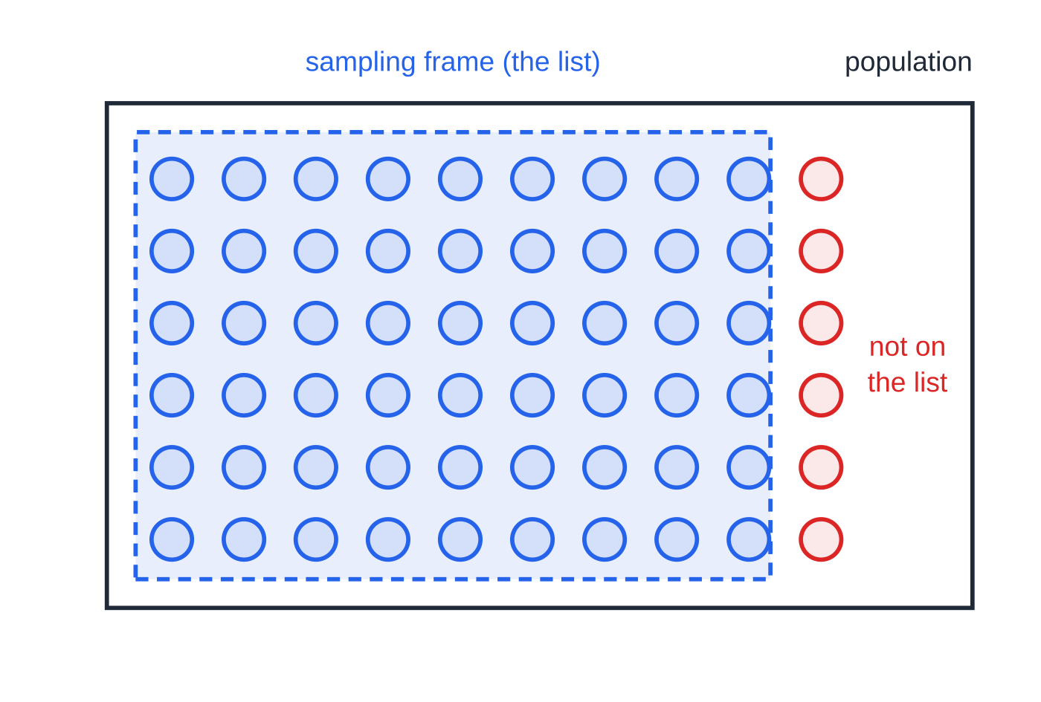
What are a population, a census and a sample? (continued)
Section 1 of 13
The sampling frame (dashed) lists the units that can be chosen. The 6 red units are not on the list, so no sample drawn from this frame can include them.
Notes:
What are a population, a census and a sample?. Full notes: https://examinerprep.com/notes/edexcel-ial-maths/sampling-and-hypothesis-testing/

Slide 7
What are a population, a census and a sample? (continued)
Section 1 of 13
 | Advantages | Disadvantages
Census | Every member is included, so the result is exact and unbiased | Slow and expensive for a large population; lots of data to process; impossible when testing destroys the item
Sample | Cheaper and quicker; less data; the only option when testing is destructive | Sampling variation; may not be representative if the frame is incomplete or selection is not random
Notes:
What are a population, a census and a sample?. Full notes: https://examinerprep.com/notes/edexcel-ial-maths/sampling-and-hypothesis-testing/

Slide 8
What are a population, a census and a sample? (continued)
Section 1 of 13 · Worked example 1 · Easy · Identify, state, give
WORKED EXAMPLE · QUESTION
A sports centre has 3200 registered members. The manager wants to know what members think of proposed new opening hours. She has an up-to-date list of the names of all registered members. (a) Identify the population and a suitable sampling frame. (b) State the sampling unit. (c) Give one advantage and one disadvantage of asking every member (a census) rather than a sample.
SOLUTION
(a) Population = everyone the question is about; frame = the list you draw from. Population: the 3200 registered members; sampling frame: the list of names of registered members
(b) One item that could be selected: a registered member
(c) Advantage: every member's opinion is included, so the result is exact for the centre. Disadvantage: contacting 3200 members and processing their replies takes a long time and costs a lot.
Notes:
What are a population, a census and a sample?: Worked example 1. Full notes: https://examinerprep.com/notes/edexcel-ial-maths/sampling-and-hypothesis-testing/

Slide 9
What are a population, a census and a sample? (continued)
Section 1 of 13
Common error — unit or frame?
The unit is one member (or item); the frame is the list of all units that could be chosen.
Notes:
What are a population, a census and a sample?. Full notes: https://examinerprep.com/notes/edexcel-ial-maths/sampling-and-hypothesis-testing/

Slide 10
What is a statistic, and what is its sampling distribution?
Section 2 of 13
A statistic is a quantity calculated only from the observations in a sample: the sample mean, the median, the total, the largest value, the number of successes. It must not contain unknown parameters, so X̄-μ (with μ unknown) is not a statistic.
Different samples give different values, so a statistic is a random variable; its distribution over all possible samples is its sampling distribution. For a small population, list every possible sample, find its probability (multiply, and count the arrangements), calculate the statistic, and collect equal values.
Notes:
What is a statistic, and what is its sampling distribution?. Full notes: https://examinerprep.com/notes/edexcel-ial-maths/sampling-and-hypothesis-testing/

Slide 11
What is a statistic, and what is its sampling distribution? (continued)
Section 2 of 13 · Worked example 2 · Medium · List, find
WORKED EXAMPLE · QUESTION
A large box contains discs, each labelled 1, 2 or 5, in the proportions 60%, 30% and 10% respectively. A random sample of three discs is taken (the box is large enough to treat the draws as independent). (a) List all the possible samples. (b) Find the sampling distribution of the median, M, of the sample.
SOLUTION
(a) The different samples, ignoring order (10 of them): {1,1,1}, {1,1,2}, {1,1,5}, {1,2,2}, {1,2,5}, {1,5,5}, {2,2,2}, {2,2,5}, {2,5,5}, {5,5,5}.
Probability of each (count the orders: 1, 3 or 6): {1,1,1}: 0.6³=0.216; {1,1,2}: 3(0.6²)(0.3)=0.324; {1,1,5}: 3(0.6²)(0.1)=0.108; {1,2,2}: 3(0.6)(0.3²)=0.162; {1,2,5}: 6(0.6)(0.3)(0.1)=0.108; {1,5,5}: 3(0.6)(0.1²)=0.018; {2,2,2}: 0.027; {2,2,5}: 0.027; {2,5,5}: 0.009; {5,5,5}: 0.001.
(b) The median is the middle value; add the probabilities for each median:
m | 1 | 2 | 5
Notes:
What is a statistic, and what is its sampling distribution?: Worked example 2. Full notes: https://examinerprep.com/notes/edexcel-ial-maths/sampling-and-hypothesis-testing/

Slide 12
What is a statistic, and what is its sampling distribution? (continued)
Section 2 of 13 · Worked example 2 · Medium · List, find (continued)
P(M=m) | 0.216 + 0.324 + 0.108 = 0.648 | 0.162 + 0.108 + 0.027 + 0.027 = 0.324 | 0.018 + 0.009 + 0.001 = 0.028
Check: 0.648+0.324+0.028=1. E(M)=1.436: a sample median is near the population median, 1, but not always equal to it.
Notes:
What is a statistic, and what is its sampling distribution?: Worked example 2. Full notes: https://examinerprep.com/notes/edexcel-ial-maths/sampling-and-hypothesis-testing/

Slide 13
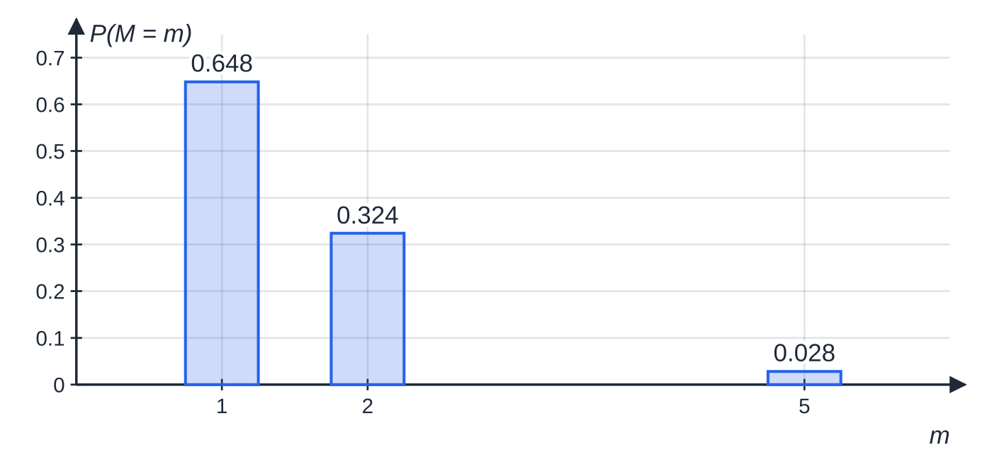
What is a statistic, and what is its sampling distribution? (continued)
Section 2 of 13
Exam tip — check the list adds to 1
The probabilities of all listed samples must add up to 1. If they do not, an arrangement factor (the 3 in 3(0.6²)(0.3), or the 6) is usually missing.
The sampling distribution of the median of three discs. Most samples have median 1, but about one sample in three has median 2.
Notes:
What is a statistic, and what is its sampling distribution?. Full notes: https://examinerprep.com/notes/edexcel-ial-maths/sampling-and-hypothesis-testing/

Slide 14
What is a hypothesis test?
Section 3 of 13
A hypothesis test asks "could this result just be chance?". Assume nothing has changed, and abandon that assumption only if the data would be surprising enough.
A hypothesis is a statement about a population parameter: the probability p in B(n,p), or the mean λ in Po(λ).
The null hypothesis H₀ is the claim being tested, assumed true unless the data give enough evidence against it. It always contains "=": H₀: p=0.15.
The alternative hypothesis H₁ says how the parameter is believed to differ. Read the question: "increased" → p>0.15; "decreased / lower" → p<0.15 (both one-tailed); "changed / different" → p≠0.15 (two-tailed).
The test statistic is the statistic used to decide, e.g. X = the number of successes in the sample.
The significance level (e.g. 5%) sets how unlikely a result must be, assuming H₀, before we reject H₀; a two-tailed test splits it between the tails.
Notes:
What is a hypothesis test?. Full notes: https://examinerprep.com/notes/edexcel-ial-maths/sampling-and-hypothesis-testing/

Slide 15
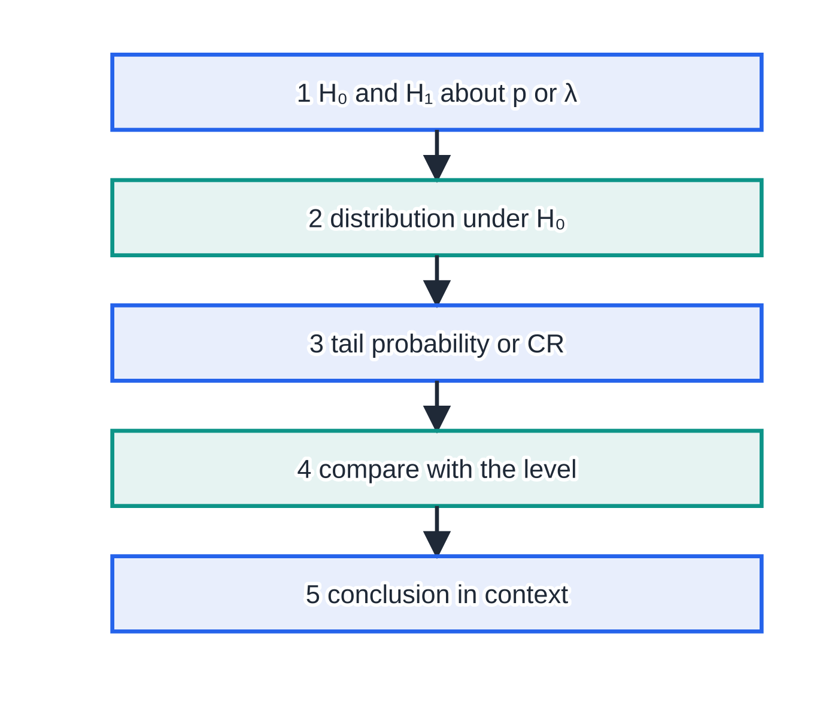
What is a hypothesis test? (continued)
Section 3 of 13
Hypotheses are about the population, never the sample. Every test follows the same five-step routine.
The routine for every binomial or Poisson test. Only step 3 changes: exact tables, or a Normal approximation with a continuity correction.
Notes:
What is a hypothesis test?. Full notes: https://examinerprep.com/notes/edexcel-ial-maths/sampling-and-hypothesis-testing/

Slide 16
What is a hypothesis test? (continued)
Section 3 of 13 · Worked example 3 · Easy · Define, write down
WORKED EXAMPLE · QUESTION
A machine fills bags of flour. Over a long period 15% of the bags have been underweight. After the machine is serviced, an engineer takes a random sample of 20 bags to test whether the proportion of underweight bags has changed. (a) Define a suitable test statistic and state its distribution under the null hypothesis. (b) Write down suitable hypotheses and state whether the test is one-tailed or two-tailed.
SOLUTION
(a) A count of "successes" in a fixed number of independent trials: X = the number of underweight bags in the sample of 20; under H₀, X~B(20,0.15)
(b) Hypotheses about the population proportion p of underweight bags: H₀: p=0.15, H₁: p≠0.15; two-tailed, because the engineer is looking for a change in either direction.
Writing "H₀: X=3" or "H₀:
Notes:
What is a hypothesis test?: Worked example 3. Full notes: https://examinerprep.com/notes/edexcel-ial-maths/sampling-and-hypothesis-testing/

Slide 17
What is a hypothesis test? (continued)
Section 3 of 13 · Worked example 3 · Easy · Define, write down (continued)
15% are underweight in the sample" is wrong: hypotheses are about the parameter p.
Notes:
What is a hypothesis test?: Worked example 3. Full notes: https://examinerprep.com/notes/edexcel-ial-maths/sampling-and-hypothesis-testing/

Slide 18
How do you find a critical region and the actual significance level?
Section 4 of 13
The critical region (CR) is the set of values of the test statistic that would lead you to reject H₀. The critical value is the boundary value: the first value inside the critical region.
For a discrete distribution the tail probabilities jump, so the question tells you which rule to use. Read it and follow it:
"as close as possible to 5% without exceeding 5%" (or "should not exceed 5%"): take the largest region whose probability is at most the level;
"as close as possible to 5%": take the region whose probability is nearest to the level, even if it is slightly above it — compare the distances of the two probabilities either side of the level.
The two rules often agree, but not always (Worked example 4). In a two-tailed test apply the rule to each tail with half the level. Lower tail: read P(X≤c) directly; upper tail: P(X≥c)=1-P(X≤c-1).
Notes:
How do you find a critical region and the actual significance level?. Full notes: https://examinerprep.com/notes/edexcel-ial-maths/sampling-and-hypothesis-testing/

Slide 19
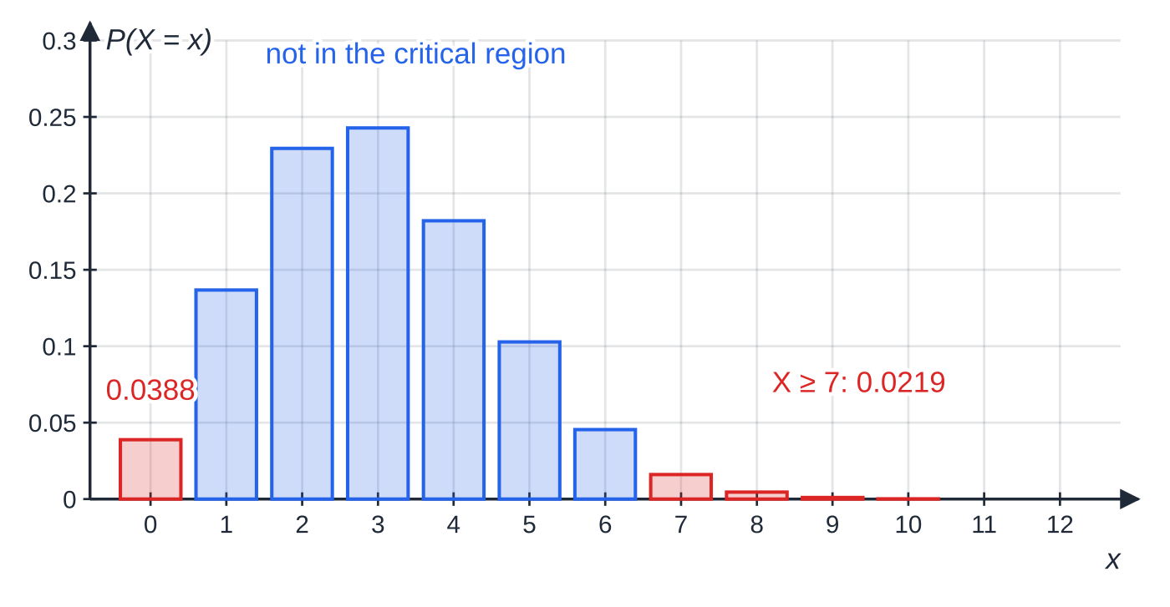
How do you find a critical region and the actual significance level? (continued)
Section 4 of 13
The actual significance level is P(X in CR) when H₀ is true: the probability that the test rejects a true H₀. For a two-tailed test, add the two tail probabilities.
B(20,0.15): the critical region for a two-tailed test at the 10% level is X=0 or X≥7 (red). Each tail is the largest one with probability at most 5%; together they give an actual significance level of 0.0607.
Notes:
How do you find a critical region and the actual significance level?. Full notes: https://examinerprep.com/notes/edexcel-ial-maths/sampling-and-hypothesis-testing/

Slide 20
How do you find a critical region and the actual significance level? (continued)
Section 4 of 13 · Worked example 4 · Medium · Find, state, comment
WORKED EXAMPLE · QUESTION
For the test in Worked example 3, using a 10% level of significance: (a) find the critical region, given that the probability in each tail should be as close as possible to 5% without exceeding 5%; (b) state the actual significance level; (c) the engineer finds 6 underweight bags. Comment on this result.
SOLUTION
(a) Lower tail, X~B(20,0.15), compare with 0.05: P(X=0)=0.0388≤0.05, P(X≤1)=0.1756>0.05, so the lower part is X=0. Upper tail: P(X≥6)=1-0.9327=0.0673>0.05, P(X≥7)=1-0.9781=0.0219≤0.05, so the upper part is X≥7. Critical region: X=0 or X≥7
(b) Add the two tails: 0.0388+0.0219= 0.0607 (6.07%)
(c) 6 is not in the critical region, so do not reject H₀: there is insufficient evidence to suggest that the proportion of underweight bags has changed.
6 out of 20 is double the old rate, yet with only 20 bags it would occur fairly often by chance.
Notes:
How do you find a critical region and the actual significance level?: Worked example 4. Full notes: https://examinerprep.com/notes/edexcel-ial-maths/sampling-and-hypothesis-testing/

Slide 21
How do you find a critical region and the actual significance level? (continued)
Section 4 of 13 · Worked example 4 · Medium · Find, state, comment (continued)
The rule matters: under "as close as possible to 5%" the upper tail would be X≥6 (0.0673 is 0.0173 from 0.05; 0.0219 is 0.0281 away), and 6 would then be significant.
Notes:
How do you find a critical region and the actual significance level?: Worked example 4. Full notes: https://examinerprep.com/notes/edexcel-ial-maths/sampling-and-hypothesis-testing/

Slide 22
How do you find a critical region and the actual significance level? (continued)
Section 4 of 13
Common error — off by one
Using P(X≥7)=1-P(X≤7). The event X≥7 is the complement of X≤6, so the table value needed is P(X≤6). Off-by-one slips like this move the critical value.
Notes:
How do you find a critical region and the actual significance level?. Full notes: https://examinerprep.com/notes/edexcel-ial-maths/sampling-and-hypothesis-testing/

Slide 23
How do you test a binomial proportion?
Section 5 of 13
There are two equivalent ways to carry out step 3 of the routine, and they always give the same decision:
Probability method: find the probability of the observed value or anything more extreme in the direction of H₁, and compare it with the significance level (with half the level in a two-tailed test).
Critical region method: find the CR as in the previous section and see whether the observed value lies in it.
If the question does not say which, the probability method is usually quicker.
"More extreme" means in the direction of H₁: for H₁: p<0.45 with 8 observed, find P(X≤8).
If the probability is less than or equal to the significance level, the result is significant: reject H₀. Otherwise do not reject H₀.
p greater than 0.5: the tables only go up to p=0.5. Count failures instead: if X~B(n,p) then Y=n-X~B(n,1-p), and P(X≤k)=P(Y≥n-k).
Notes:
How do you test a binomial proportion?. Full notes: https://examinerprep.com/notes/edexcel-ial-maths/sampling-and-hypothesis-testing/

Slide 24
How do you test a binomial proportion? (continued)
Section 5 of 13 · Worked example 5 · Medium · Test
WORKED EXAMPLE · QUESTION
The owner of a café knows that, in the past, 45% of her customers ordered a hot drink. After introducing a range of iced drinks she believes this proportion has fallen. In a random sample of 30 customers, 8 ordered a hot drink. Test, at the 5% level of significance, whether there is evidence to support her belief. State your hypotheses clearly.
SOLUTION
Hypotheses (one-tailed: "fallen"): H₀: p=0.45, H₁: p<0.45.
Distribution under H₀: X = number of hot-drink orders in the sample, X~B(30,0.45).
Probability of 8 or fewer (the direction of H₁): P(X≤8)=0.0312.
0.0312<0.05, so the result is significant: reject H₀. There is sufficient evidence to suggest that the proportion of customers ordering a hot drink has fallen.
Critical region method: P(X≤8)=0.0312≤0.05 but P(X≤9)=0.0694>0.05, so the CR is X≤8, and 8 lies in it.
Notes:
How do you test a binomial proportion?: Worked example 5. Full notes: https://examinerprep.com/notes/edexcel-ial-maths/sampling-and-hypothesis-testing/

Slide 25
How do you test a binomial proportion? (continued)
Section 5 of 13 · Worked example 5 · Medium · Test (continued)
Same decision.
Notes:
How do you test a binomial proportion?: Worked example 5. Full notes: https://examinerprep.com/notes/edexcel-ial-maths/sampling-and-hypothesis-testing/

Slide 26
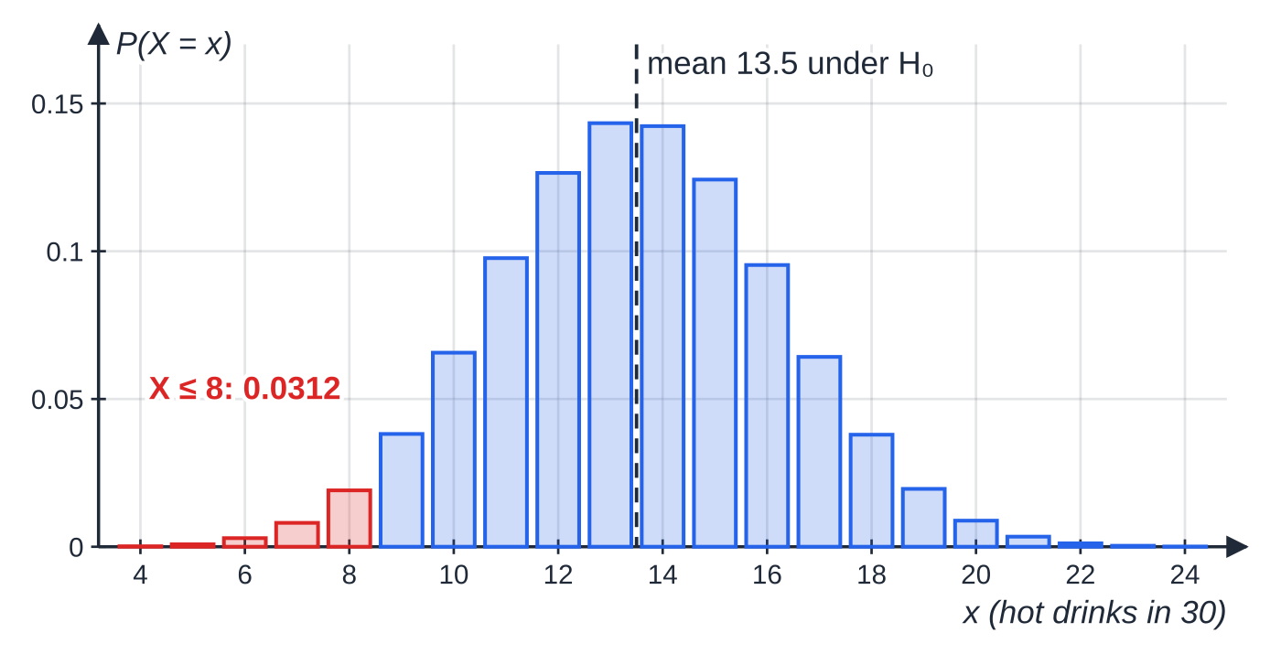
How do you test a binomial proportion? (continued)
Section 5 of 13
Exam tip — compare a tail, not a single value
The probability you compare must be a tail probability, P(X≤8), not P(X=8). A single probability is small for almost any value in a large sample, so comparing it with 5% gives meaningless results.
Under H₀, X~B(30,0.45) is centred on 13.5. The observed 8 is far in the lower tail: P(X≤8)=0.0312, below 5%.
Notes:
How do you test a binomial proportion?. Full notes: https://examinerprep.com/notes/edexcel-ial-maths/sampling-and-hypothesis-testing/

Slide 27
How do you test a Poisson mean?
Section 6 of 13
The parameter is the mean rate λ. Hypotheses look like H₀: λ=0.8 (per hour), H₁: λ>0.8, or <, or ≠. Scale the mean to the period observed: events at a mean rate of 0.8 per hour give, over 5 hours, X~Po(5×0.8)=Po(4), and you read the tables for the scaled mean. The hypotheses may be written for the original rate (λ=0.8) or the scaled one (λ=4), as long as you are consistent and say which period it refers to. Otherwise the routine is identical.
Notes:
How do you test a Poisson mean?. Full notes: https://examinerprep.com/notes/edexcel-ial-maths/sampling-and-hypothesis-testing/

Slide 28
How do you test a Poisson mean? (continued)
Section 6 of 13 · Worked example 6 · Medium · Test, find
WORKED EXAMPLE · QUESTION
Calls to a garage's breakdown line arrive at random at a mean rate of 0.8 per hour. After a local advertising campaign, the manager records 8 calls in a 5-hour period. (a) Test, at the 5% level of significance, whether the mean rate of calls has increased. (b) Find the critical region for this test.
SOLUTION
(a) H₀: λ=0.8, H₁: λ>0.8 (per hour); over 5 hours, under H₀: X~Po(4).
P(X≥8)=1-P(X≤7)=1-0.9489=0.0511.
0.0511>0.05: not significant, do not reject H₀. There is insufficient evidence to suggest that the mean rate of calls has increased.
(b) P(X≥8)=0.0511>0.05 and P(X≥9)=1-0.9786=0.0214≤0.05, so CR: X≥9
Notes:
How do you test a Poisson mean?: Worked example 6. Full notes: https://examinerprep.com/notes/edexcel-ial-maths/sampling-and-hypothesis-testing/

Slide 29
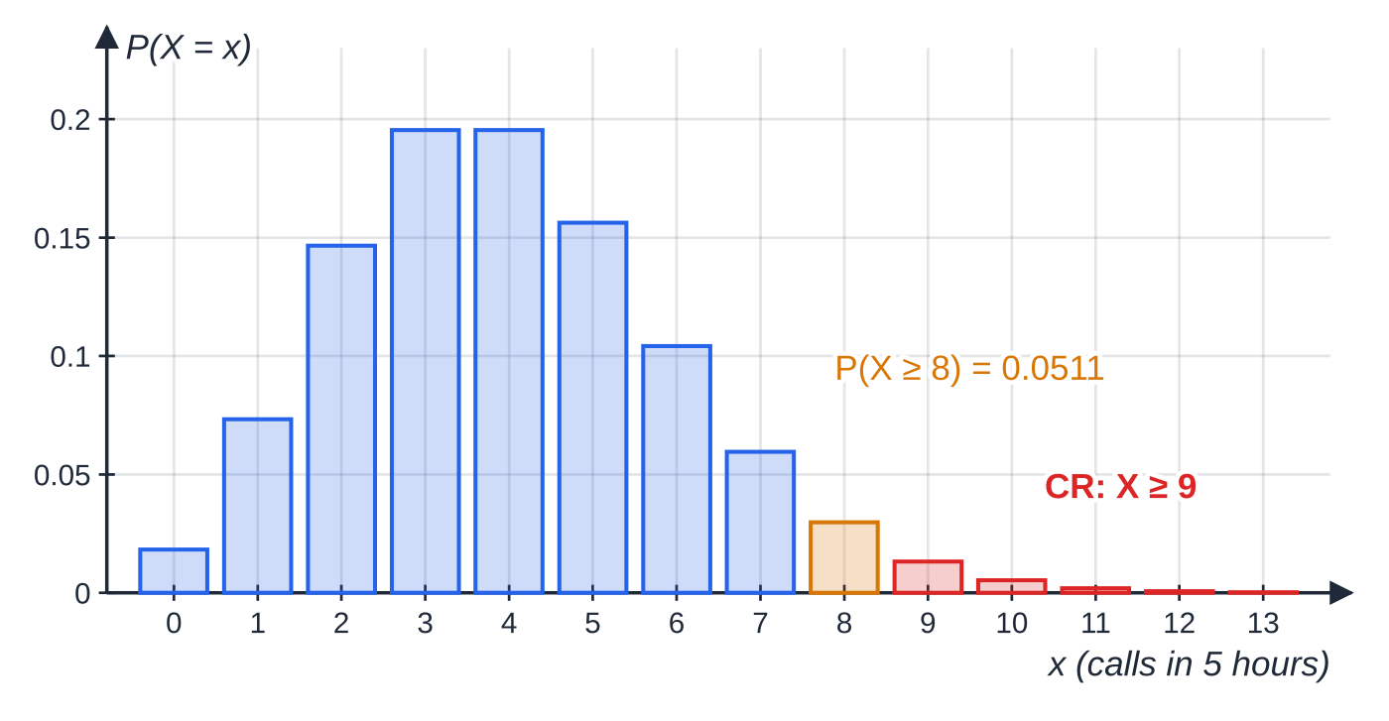
How do you test a Poisson mean? (continued)
Section 6 of 13
Common error — the unscaled mean
Using Po(0.8) for a 5-hour count. The Poisson mean must match the interval in which the events were counted, so it is 0.8×5=4.
Under H₀, X~Po(4). The observed value 8 (amber) gives a tail probability of 0.0511, just over 5%, so it is not significant; the critical region (red) starts at 9.
Notes:
How do you test a Poisson mean?. Full notes: https://examinerprep.com/notes/edexcel-ial-maths/sampling-and-hypothesis-testing/

Slide 30
When and how do you use a Normal approximation in a test?
Section 7 of 13
When n or λ is beyond the tables, approximate the test statistic by a Normal distribution with the same mean and variance (S2.3):
B(n,p)≈N(np,np(1-p)) when n is large and p is close to 0.5 (in practice, np and n(1-p) both comfortably above 5);
Po(λ)≈N(λ,λ) when λ is large (say above 10).
Apply a continuity correction, because the original distribution is discrete: P(X≥72)≈P(Y>71.5) and P(X≤25)≈P(Y<25.5). Then standardise, round z to 2 d.p. and use Φ(z); for a critical region use the percentage points table (1.6449 for 5% in one tail, 1.9600 for 2.5%). Hypotheses are still about p or λ.
Notes:
When and how do you use a Normal approximation in a test?. Full notes: https://examinerprep.com/notes/edexcel-ial-maths/sampling-and-hypothesis-testing/

Slide 31
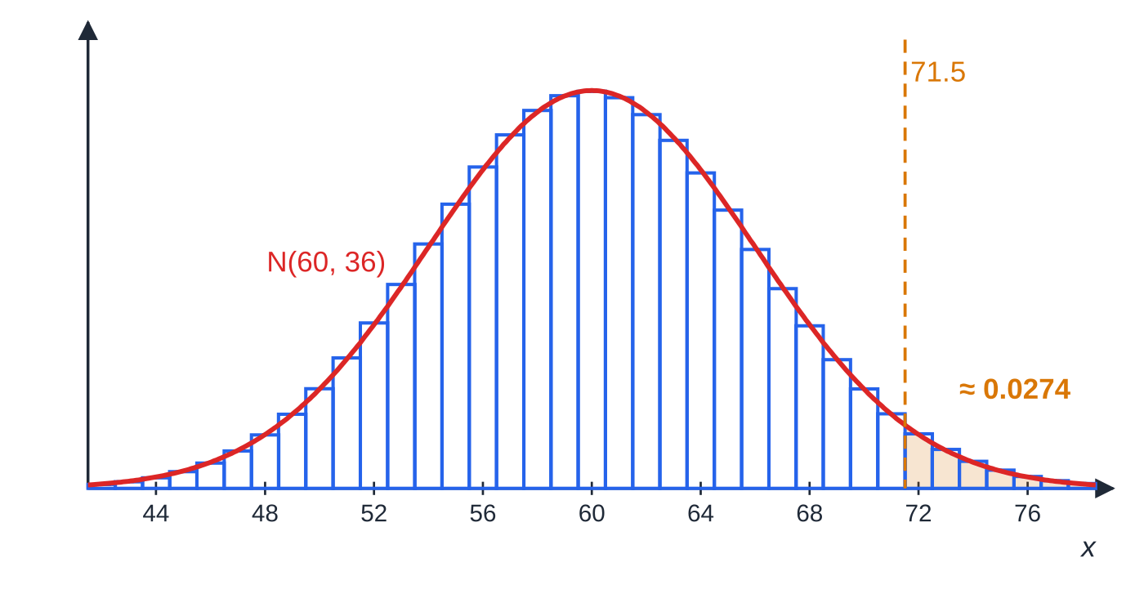
When and how do you use a Normal approximation in a test? (continued)
Section 7 of 13
The bars are B(150,0.4); the curve is N(60,36) with the same mean and variance. The bars from 72 upwards occupy the region from 71.5, so the shaded area beyond 71.5 approximates P(X≥72).
Notes:
When and how do you use a Normal approximation in a test?. Full notes: https://examinerprep.com/notes/edexcel-ial-maths/sampling-and-hypothesis-testing/

Slide 32
When and how do you use a Normal approximation in a test? (continued)
Section 7 of 13 · Worked example 7 · Medium · Test
WORKED EXAMPLE · QUESTION
In the past, 40% of visitors to a museum bought something from the museum shop. After the shop is redesigned, a random sample of 150 visitors is taken and 72 of them buy something. Using a suitable approximation, test at the 5% level of significance whether the proportion of visitors buying something has increased.
SOLUTION
Hypotheses and exact distribution: H₀: p=0.4, H₁: p>0.4; under H₀, X~B(150,0.4).
Normal approximation (n large, p not far from 0.5): np=60, np(1-p)=36⇒Y~N(60,6²).
Continuity correction and standardise:
P(X≥72)≈P(Y≥71.5)=P(Z≥(71.5-60)/6)=P(Z≥1.92)=1-0.9726=0.0274.
Notes:
When and how do you use a Normal approximation in a test?: Worked example 7. Full notes: https://examinerprep.com/notes/edexcel-ial-maths/sampling-and-hypothesis-testing/

Slide 33
When and how do you use a Normal approximation in a test? (continued)
Section 7 of 13 · Worked example 7 · Medium · Test (continued)
0.0274<0.05: significant, reject H₀. There is sufficient evidence to suggest that the proportion of visitors buying something from the shop has increased.
Critical region version: (x-0.5-60)/6≥1.6449⇒x≥70.37, so CR X≥71. The exact tail is about 0.028.
Notes:
When and how do you use a Normal approximation in a test?: Worked example 7. Full notes: https://examinerprep.com/notes/edexcel-ial-maths/sampling-and-hypothesis-testing/

Slide 34
When and how do you use a Normal approximation in a test? (continued)
Section 7 of 13
Exam tip — continuity correction on its own line
Write "P(X≥72)≈P(Y>71.5)" before you standardise. It is a step of the method in its own right, and it is easy to lose when it is folded silently into the z calculation.
Notes:
When and how do you use a Normal approximation in a test?. Full notes: https://examinerprep.com/notes/edexcel-ial-maths/sampling-and-hypothesis-testing/

Slide 35
How does a full hypothesis-testing question fit together?
Section 8 of 13
A long question often combines a critical region from the tables with a later test where the mean is too large for the tables. Only the source of the probabilities changes.
Notes:
How does a full hypothesis-testing question fit together?. Full notes: https://examinerprep.com/notes/edexcel-ial-maths/sampling-and-hypothesis-testing/

Slide 36
How does a full hypothesis-testing question fit together? (continued)
Section 8 of 13 · Worked example 8 · Hard · State, find, test
WORKED EXAMPLE · QUESTION
Requests for a technician at an office building arrive at random at a mean rate of 3 per day. After a new computer system is installed, the facilities manager wishes to test whether the rate of requests has changed. (a) State suitable null and alternative hypotheses. (b) Using a 2-day period and a 5% level of significance, find the critical region for the test. The probability in each tail should be as close as possible to 2.5%. (c) Find the actual significance level of the test. (d) In a 2-day period there are 11 requests. State, with a reason, the conclusion of the test. (e) The manager now suspects that the rate has increased. Over the next 20 days there are 75 requests. Using a suitable approximation, test at the 5% level whether the rate has increased.
SOLUTION
(a) Two-tailed, because the question says "changed": H₀: λ=3, H₁: λ≠3 (requests per day)
(b) Under H₀, over 2 days X~Po(6). Lower tail, nearest to 0.025: P(X≤1)=0.0174 (0.0076 from 0.025) and P(X≤2)=0.0620 (0.0370 from 0.025), so X≤1. Upper tail:
Notes:
How does a full hypothesis-testing question fit together?: Worked example 8. Full notes: https://examinerprep.com/notes/edexcel-ial-maths/sampling-and-hypothesis-testing/

Slide 37
How does a full hypothesis-testing question fit together? (continued)
Section 8 of 13 · Worked example 8 · Hard · State, find, test (continued)
P(X≥11)=1-0.9574=0.0426 (0.0176 from 0.025) and P(X≥12)=1-0.9799=0.0201 (0.0049 from 0.025), so X≥12. Critical region: X≤1 or X≥12
(c) Add the tails: 0.0174+0.0201= 0.0375
(d) 11 is not in the critical region, so do not reject H₀: there is insufficient evidence that the rate of requests has changed.
(e) One-tailed now; over 20 days the mean is 60, too large for the tables. H₀: λ=3, H₁: λ>3; X~Po(60) under H₀, approximated by Y~N(60,60).
P(X≥75)≈P(Y>74.5)=P(Z>(74.5-60)/√60)=P(Z>1.87)=1-0.9693=0.0307
0.0307<0.05: significant, reject H₀. There is sufficient evidence to suggest that the rate of requests for a technician has increased.
Notes:
How does a full hypothesis-testing question fit together?: Worked example 8. Full notes: https://examinerprep.com/notes/edexcel-ial-maths/sampling-and-hypothesis-testing/

Slide 38
How does a full hypothesis-testing question fit together? (continued)
Section 8 of 13 · Worked example 8 · Hard · State, find, test (continued)
Equivalently, the CR is X≥74, since 60+0.5+1.6449√60=73.24. 11 in two days was not enough evidence; 75 in twenty days is: larger samples can detect smaller changes.
Notes:
How does a full hypothesis-testing question fit together?: Worked example 8. Full notes: https://examinerprep.com/notes/edexcel-ial-maths/sampling-and-hypothesis-testing/

Slide 39
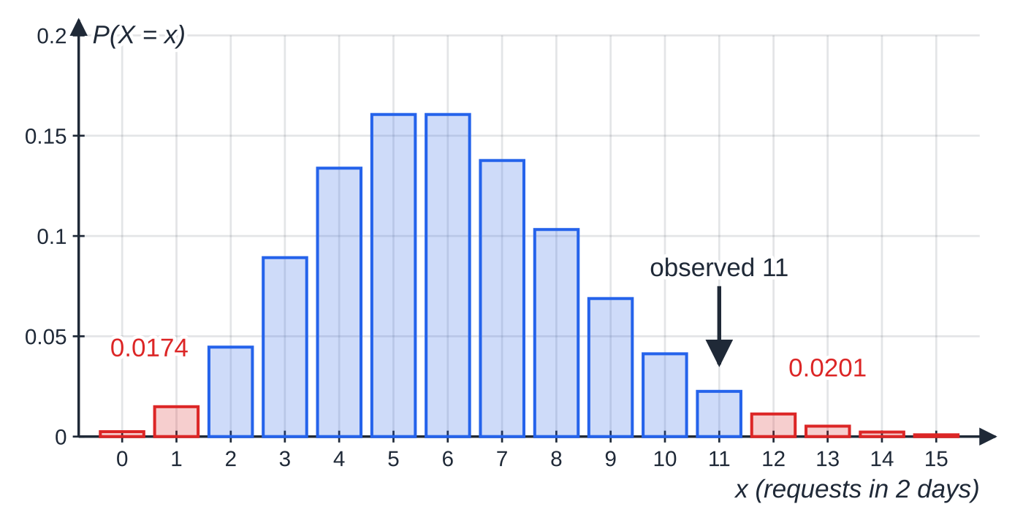
How does a full hypothesis-testing question fit together? (continued)
Section 8 of 13
Parts (b)–(d): under H₀, X~Po(6). The red bars form the two-tailed critical region X≤1 or X≥12; the observed 11 lies just outside it.
Notes:
How does a full hypothesis-testing question fit together?. Full notes: https://examinerprep.com/notes/edexcel-ial-maths/sampling-and-hypothesis-testing/

Slide 40
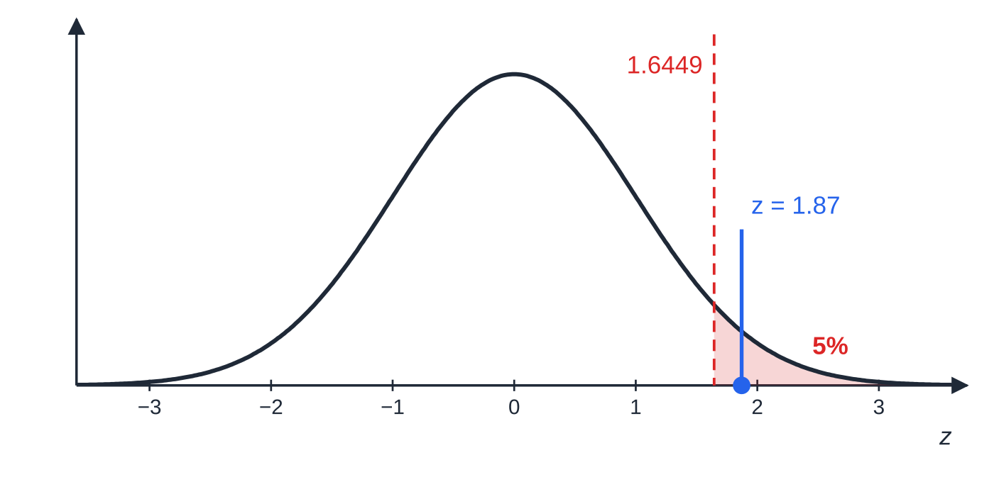
How does a full hypothesis-testing question fit together? (continued)
Section 8 of 13
Part (e): the critical region of the one-tailed test is the top 5% of the standard Normal distribution, z≥1.6449. The test statistic z=1.87 lies inside it.
Notes:
How does a full hypothesis-testing question fit together?. Full notes: https://examinerprep.com/notes/edexcel-ial-maths/sampling-and-hypothesis-testing/

Slide 41
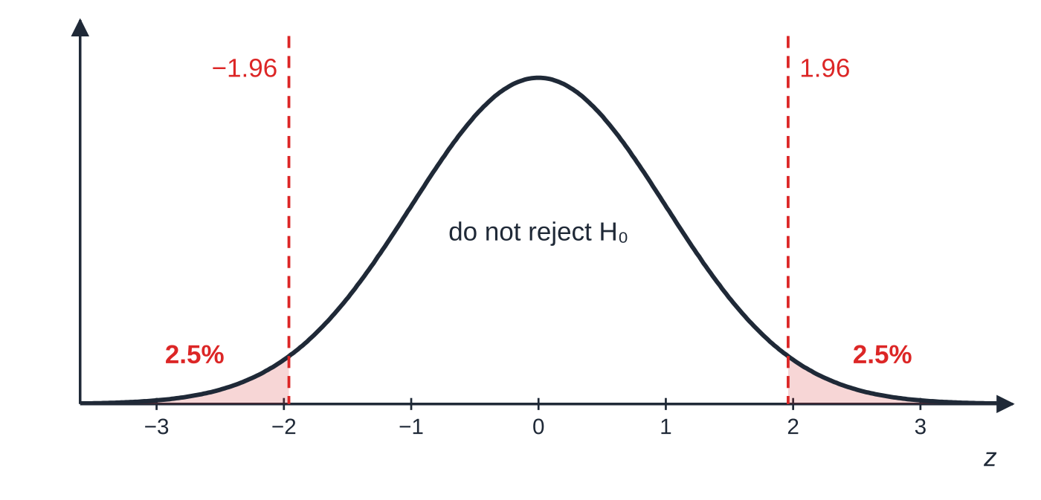
How does a full hypothesis-testing question fit together? (continued)
Section 8 of 13
A two-tailed test at 5% puts 2.5% in each tail, at ±1.96: there, z=1.87 would not be significant.
Notes:
How does a full hypothesis-testing question fit together?. Full notes: https://examinerprep.com/notes/edexcel-ial-maths/sampling-and-hypothesis-testing/

Slide 42
Exam tips for S2.4
Section 9 of 13
Exam tip 1 — hypotheses use the parameter
Write H₀: p=0.45 and H₁: p<0.45, or H₀: λ=3 and H₁: λ≠3. Hypotheses written with X, a sample proportion or words alone are incomplete, and so is an H₁ that does not match the direction in the question.
Exam tip 2 — state the distribution under H₀
Write "X~B(30,0.45)" or "X~Po(4)" before any probability; for Poisson it shows the mean is scaled to the right period.
Exam tip 3 — show both sides of every critical value
First read the rule the question gives: "as close as possible to 2.5%" or "as close as possible to 2.5% without exceeding 2.5%". Then quote the probability on each side of the level: "P(X≥12)=0.0201, P(X≥11)=0.0426". That pair justifies the boundary.
Notes:
Exam tips for S2.4. Full notes: https://examinerprep.com/notes/edexcel-ial-maths/sampling-and-hypothesis-testing/

Slide 43
Exam tips for S2.4 (continued)
Section 9 of 13
Exam tip 4 — halve the level in a two-tailed test
For a two-tailed test at 5%, compare each tail with 2.5% (and a probability-method tail probability with 0.025). Then add both tails for the actual significance level.
Exam tip 5 — a two-part conclusion, never certain
First the decision ("0.0307<0.05, reject H₀"), then the context in the words of the question: "there is sufficient evidence to suggest that the rate has increased". Never "proves", "accept H₁" or "H₀ is true".
Notes:
Exam tips for S2.4. Full notes: https://examinerprep.com/notes/edexcel-ial-maths/sampling-and-hypothesis-testing/

Slide 44
Common misconceptions
Section 10 of 13
Misconception | Why it is wrong | Correct idea
Not rejecting H₀ proves H₀ is true. | The data may simply be too few to show a real change (Worked example 4: 6 out of 20). | Say "insufficient evidence to suggest …", not "the proportion is 0.15".
The actual significance level equals the stated level. | Discrete tail probabilities jump, so the CR probability is rarely exactly the stated level. | Actual significance level = P(test statistic in CR|H₀ true), e.g. 0.0607 for a 10% test.
P(X≥7)=1-P(X≤7). | X≥7 and X≤7 overlap at 7; the complement of X≥7 is X≤6. | P(X≥c)=1-P(X≤c-1).
Compare P(X=observed) with the significance level. | The test needs the probability of a result at least as extreme, not of one exact value. | Use the tail in the direction of H₁.
A census is always better than a sample. | A census may be too costly or slow, and impossible when testing destroys the item. | Choose a sample when cost, time or destructive testing make a census impractical.
Notes:
Common misconceptions. Full notes: https://examinerprep.com/notes/edexcel-ial-maths/sampling-and-hypothesis-testing/

Slide 45
Common misconceptions (continued)
Section 10 of 13
Misconception | Why it is wrong | Correct idea
Any calculated quantity from a sample is a statistic. | A quantity involving an unknown parameter, such as X̄-μ, cannot be calculated from the data. | A statistic uses the sample values only (and known constants).
Notes:
Common misconceptions. Full notes: https://examinerprep.com/notes/edexcel-ial-maths/sampling-and-hypothesis-testing/

Slide 46
How this topic connects
Section 11 of 13
S2.1 Binomial and Poisson distributions
Every test here assumes a binomial or Poisson model; the conditions, the cumulative tables and the switch to n-X for p>0.5 come from S2.1.
S1.6 and S2.3 — the Normal distribution and approximations
Standardising, Φ(z) and the percentage points table from S1 are exactly what the approximate tests use, together with the continuity correction from S2.3.
P2 binomial expansion
Counting arrangements when listing samples uses the same coefficients C(n, r) as (a+b)ⁿ.
Notes:
How this topic connects. Full notes: https://examinerprep.com/notes/edexcel-ial-maths/sampling-and-hypothesis-testing/

Slide 47
Key formulae
Section 12 of 13
Formula | Use | In the formulae list?
P(X=x)=C(n, x)pˣ(1-p)ⁿ⁻ˣ; mean np, variance np(1-p) | binomial test statistic X~B(n,p) under H₀ | Yes
P(X=x)=(e^(-λ)λˣ)/x!; mean = variance = λ | Poisson test statistic X~Po(λ) under H₀ | Yes
cumulative tables P(X≤x) | tail probabilities and critical regions | Yes
P(X≥c)=1-P(X≤c-1) | upper-tail probabilities from cumulative tables | No – learn it
Y=n-X~B(n,1-p) | tests with p>0.5 (beyond the tables) | No – derive it
rate λ per unit ⇒Po(kλ) over k units | scaling a Poisson mean to the period observed | No – learn it
actual significance level = P(test statistic in CR|H₀ true) | probability of rejecting a true H₀ | No – learn it
B(n,p)≈N(np,np(1-p)); Po(λ)≈N(λ,λ) | tests when n or λ is beyond the tables | No – learn it
Notes:
Key formulae. Full notes: https://examinerprep.com/notes/edexcel-ial-maths/sampling-and-hypothesis-testing/

Slide 48
Key formulae (continued)
Section 12 of 13
Formula | Use | In the formulae list?
P(X≥a)≈P(Y>a-½), P(X≤a)≈P(Y<a+½) | continuity correction | No – learn it
z=(y-μ)/σ | standardising for Φ(z) and the percentage points | No – learn it
Notes:
Key formulae. Full notes: https://examinerprep.com/notes/edexcel-ial-maths/sampling-and-hypothesis-testing/

Slide 49
Check your understanding
Section 13 of 13
1. A factory tests the burning time of its candles by burning them until they go out. Why must it use a sample rather than a census?
2. Faults on a cable occur at random at a mean rate of 2.5 per kilometre. What is the distribution of the number of faults on a 4 km length?
3. H₀: p=0.8, H₁: p<0.8, n=10, and 5 successes are observed. Find the probability needed for the test.
4. A random sample X₁,X₂,X₃ is taken from a population with unknown mean μ. Is X₁+X₂+X₃ a statistic? Is X₁-μ?
5. A test at the 5% level has critical region X≥9 with P(X≥9)=0.0214. What is the probability of rejecting H₀ when it is true?
Notes:
Check your understanding: questions. Full notes: https://examinerprep.com/notes/edexcel-ial-maths/sampling-and-hypothesis-testing/

Slide 50
Check your understanding · answers
Section 13 of 13
1. The test destroys each candle. A census would leave no candles to sell, so only a sample can be tested.
2. Po(10): the mean scales with the length, 2.5×4=10.
3. Count failures: Y=10-X~B(10,0.2) under H₀. P(X≤5)=P(Y≥5)=1-P(Y≤4)=1-0.9672=0.0328, which is significant at 5%.
4. The sum is a statistic: it uses only the sample values. X₁-μ is not, because μ is unknown and so it cannot be calculated from the data.
5. 0.0214: the actual significance level, the probability of falling in the critical region when H₀ is true. It is less than 5% because the distribution is discrete.
Notes:
Check your understanding: answers. Full notes: https://examinerprep.com/notes/edexcel-ial-maths/sampling-and-hypothesis-testing/

Slide 51
Practice questions
2 original exam-style questions. Answers at the end of the deck.

Slide 52
Question 1
6 marks
A university has 9600 enrolled students. The students' union wants to find out how students travel to the campus. The university registry holds an up-to-date list of all enrolled students.
(a) Identify the population. [1]
(b) Suggest a suitable sampling frame and state the sampling unit. [2]
(c) Give one advantage and one disadvantage of the students' union taking a census rather than a sample. [2]
(d) The university's engineering laboratory receives a delivery of 500 concrete test cubes. The crushing strength of a cube is measured by loading it until it breaks. Explain why the laboratory must use a sample rather than a census to check the crushing strength of the delivery. [1]
Notes:
Online with the full mark scheme: https://examinerprep.com/ial-maths-s2-4-sampling-and-hypothesis-testing-questions#IALM-S2-4-B-01

Slide 53
Question 2
7 marks
Records at a clinic show that the number of nights a patient stays after a minor operation is 1, 2 or 3, with probabilities ½, ⅓ and ⅙ respectively. A random sample of the records of three patients is taken, and M is the largest number of nights in the sample. The three values may be treated as independent.
(a) Explain why M is a statistic. [1]
(b) Show that P(M = 1) = ⅛. [1]
(c) Find the sampling distribution of M. [3]
(d) Find E(M). [2]
Notes:
Online with the full mark scheme: https://examinerprep.com/ial-maths-s2-4-sampling-and-hypothesis-testing-questions#IALM-S2-4-B-03

Slide 54
Answers

Slide 55
Question 1 · answer
Mark scheme
the 9600 students enrolled at the university
sampling frame: the registry's list of enrolled students
sampling unit: an enrolled student
advantage: every student is included, so the result is exact for the university (no sampling variation)
disadvantage: contacting 9600 students and processing their replies would take a long time / cost a lot
the test destroys each cube, so testing all 500 would leave none to use
Notes:
Full mark scheme: https://examinerprep.com/ial-maths-s2-4-sampling-and-hypothesis-testing-questions#IALM-S2-4-B-01

Slide 56
Question 2 · answer
Mark scheme
M is calculated from the sample values only and involves no unknown parameters
all three stays are 1 night: (½)³ = ⅛
P(M ≤ 2) = (⅚)³ = 125/216, or a full listing of samples
P(M = 2) = 125/216 − 27/216 = 49/108
P(M = 3) = 1 − 125/216 = 91/216, with P(M = 1) = 1/8
1 × ⅛ + 2 × 49/108 + 3 × 91/216
E(M) = 62/27 (≈ 2.30)
Notes:
Full mark scheme: https://examinerprep.com/ial-maths-s2-4-sampling-and-hypothesis-testing-questions#IALM-S2-4-B-03

Slide 57
Keep practising
Notes for this topic
Questions on this topic
Build a printable test
ExaminerPrep is an independent tutoring service. It has been developed independently from and is not endorsed by the International Baccalaureate Organization. "International Baccalaureate", "IB" and "IB Diploma Programme" are registered trademarks of the IBO, used here for descriptive purposes only.
Pearson Edexcel and Cambridge are trademarks of their owners; ExaminerPrep is not affiliated with any exam board.

