Slide 1
EP
EDEXCEL IAL MATHS
P2.3 Sequences and series
The full notes page in 13 sections · practice questions with answers · simulations
ExaminerPrep is an independent tutoring service. It has been developed independently from and is not endorsed by the International Baccalaureate Organization. "International Baccalaureate", "IB" and "IB Diploma Programme" are registered trademarks of the IBO, used here for descriptive purposes only.
Pearson Edexcel and Cambridge are trademarks of their owners; ExaminerPrep is not affiliated with any exam board.
Notes:
P2.3 Sequences and series. Notes for this topic: https://examinerprep.com/notes/edexcel-ial-maths/sequences-and-series/

Slide 2
What this page covers
Overview
Sequences defined by a formula for the nth term, or by a recurrence relation uₙ₊₁ = f(uₙ)
Increasing, decreasing and periodic sequences
Arithmetic sequences and series: the nth term, the sum of the first n terms (with proof), and the sum of the first n natural numbers
Sigma (Σ) notation for sums
Geometric sequences and series: the nth term and the sum of the first n terms (with proof)
The sum to infinity when |r| < 1
Using logarithms to find n, for example the first term or the first sum to exceed a given value
Notes:
What this page covers. Full notes: https://examinerprep.com/notes/edexcel-ial-maths/sequences-and-series/

Slide 3
In one minute
Key points
1. A sequence can be defined by an nth-term formula such as uₙ = 3n + 2, or by a recurrence such as uₙ₊₁ = 2uₙ - 1 together with a first term, and every question starts by deciding what kind of sequence it is.
2. Behaviour: increasing if uₙ₊₁ > uₙ for all n, decreasing if uₙ₊₁ < uₙ, periodic of order p if the terms repeat every p terms.
3. Arithmetic: uₙ = a + (n - 1)d and Sₙ = ½ n[2a + (n - 1)d] = ½ n(a + l).
4. Geometric: uₙ = arⁿ⁻¹ and Sₙ = (a(1 - rⁿ))/(1 - r); if |r| < 1, S_∞ = a/(1 - r).
5. Finding n: set up an inequality such as arⁿ⁻¹ > k, take logs of both sides, solve, and give the smallest integer that works.
Notes:
In one minute. Full notes: https://examinerprep.com/notes/edexcel-ial-maths/sequences-and-series/

Slide 4
How can a sequence be defined?
Section 1 of 13
Every sequence question begins with the same questions. Is the sequence given by a formula for the nth term or by a rule linking each term to the one before? Does it go up, go down or repeat? Is it arithmetic (add d) or geometric (multiply by r)? Once you know, a small set of formulae answers almost everything.
A sequence is an ordered list of numbers, called terms, made by a rule; u₁ is the first term and uₙ the nth term.
By a formula for the nth term
The rule gives any term directly from its position: for uₙ = n² + 1, the terms are 2, 5, 10, 17, …, and u₁₀ = 101 without working out the terms in between.
To test whether a number is a term, set the formula equal to it and check that n comes out as a positive integer. Is 145 a term of n² + 1? n² = 144, so n = 12: yes, it is the 12th term.
Notes:
How can a sequence be defined?. Full notes: https://examinerprep.com/notes/edexcel-ial-maths/sequences-and-series/

Slide 5
How can a sequence be defined? (continued)
Section 1 of 13
By a recurrence relation
A recurrence relation gives each term from the one before: uₙ₊₁ = f(uₙ). It needs a starting value, such as u₁ = 3, or it does not define a single sequence.
Generate terms one at a time by substituting: with uₙ₊₁ = 2uₙ - 1 and u₁ = 3, you get 3, 5, 9, 17, …
A recurrence with an unknown constant, such as uₙ₊₁ = kuₙ - 3, makes each term an expression in k. A given term then gives an equation for k.
The same rule from a different starting value gives a different sequence, and possibly very different behaviour.
Notes:
How can a sequence be defined?. Full notes: https://examinerprep.com/notes/edexcel-ial-maths/sequences-and-series/

Slide 6
How can a sequence be defined? (continued)
Section 1 of 13 · Worked example 1 · Medium · Find
WORKED EXAMPLE · QUESTION
A sequence is defined by uₙ₊₁ = kuₙ - 3, u₁ = 2, where k is a constant.
(a) Find u₂ and u₃ in terms of k. (b) Given that u₃ = 6, find the possible values of k. (c) Given also that k > 0, find Σᵣ₌₁⁴ uᵣ.
SOLUTION
(a) Substitute one term at a time: u₂ = 2k - 3 and u₃ = k(2k - 3) - 3 = 2k² - 3k - 3.
(b) Set u₃ = 6: 2k² - 3k - 9 = 0, so (2k + 3)(k - 3) = 0, giving k = 3 or k = -(3/2).
(c) With k = 3, the first four terms are 2, 3, 6, 15, so the sum is 26. Check: u₃ = 6 is in the list, as it must be.
Notes:
How can a sequence be defined?: Worked example 1. Full notes: https://examinerprep.com/notes/edexcel-ial-maths/sequences-and-series/

Slide 7
How do you tell if a sequence is increasing, decreasing or periodic?
Section 2 of 13
Type | Condition (for all n ≥1) | Example
Increasing | uₙ₊₁ > uₙ | uₙ = 4 - 3/n: 1, 2.5, 3, 3.25, …
Decreasing | uₙ₊₁ < uₙ | uₙ = 6 ×0.75ⁿ⁻¹: 6, 4.5, 3.375, …
Periodic, order p | uₙ₊ₚ = uₙ, with p the smallest such positive integer | uₙ₊₁ = 1/(1 - uₙ), u₁ = 2: 2, −1, ½, 2, −1, ½, …
To prove a sequence is increasing, show that uₙ₊₁ - uₙ > 0 for every n, not just for the first few terms.
A sequence can be neither: uₙ = n² - 4n + 7 gives 4, 3, 4, 7, … Here uₙ₊₁ - uₙ = 2n - 3, which is negative for n = 1 and positive for n ≥2.
For a periodic sequence, generate terms until the first term reappears; the number of steps is the order (period). To add many terms, count the complete cycles and then the terms left over.
Notes:
How do you tell if a sequence is increasing, decreasing or periodic?. Full notes: https://examinerprep.com/notes/edexcel-ial-maths/sequences-and-series/

Slide 8
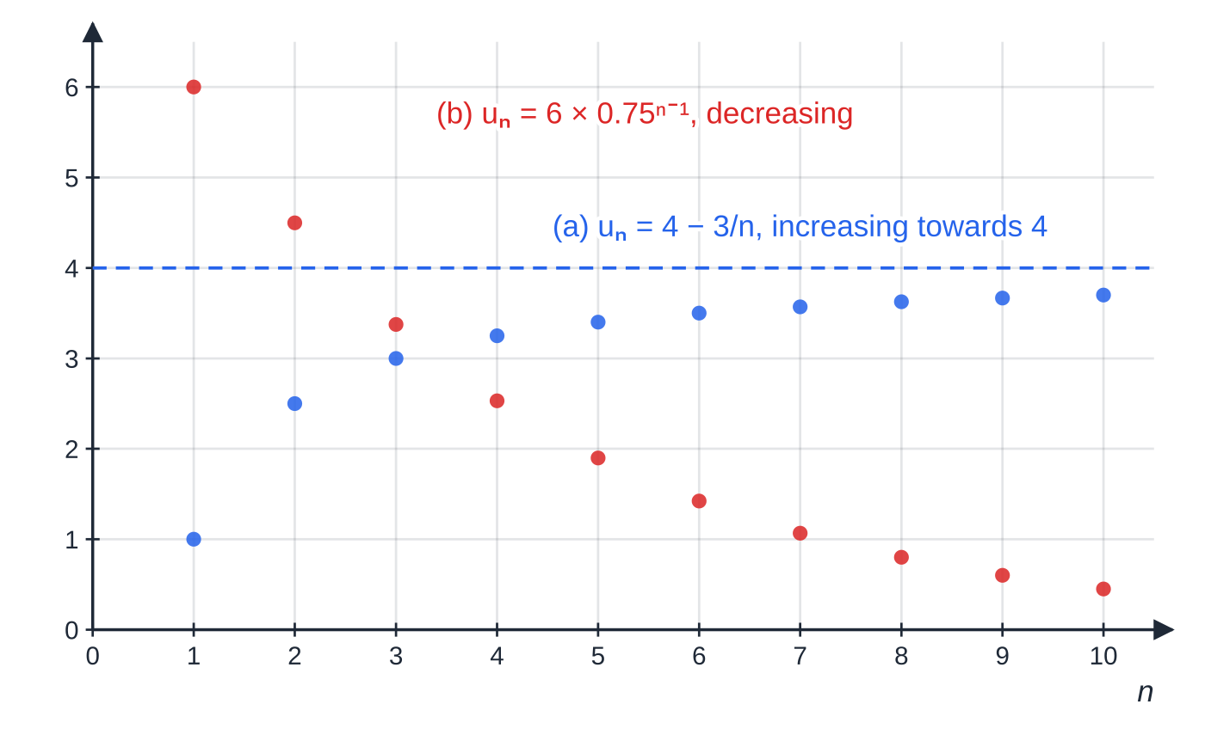
How do you tell if a sequence is increasing, decreasing or periodic? (continued)
Section 2 of 13
Two sequences plotted as separate points (a sequence is only defined at whole-number n). (a) climbs towards 4 without reaching it; (b) falls towards 0.
Notes:
How do you tell if a sequence is increasing, decreasing or periodic?. Full notes: https://examinerprep.com/notes/edexcel-ial-maths/sequences-and-series/

Slide 9
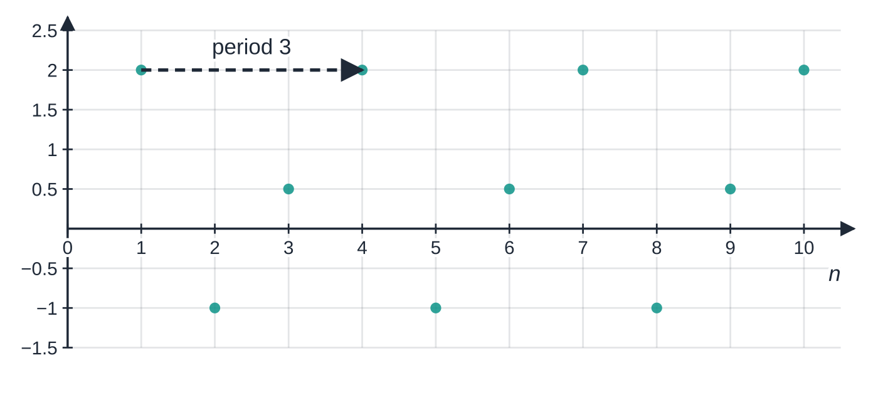
How do you tell if a sequence is increasing, decreasing or periodic? (continued)
Section 2 of 13
A recurrence can also settle down. With xₙ₊₁ = 0.5xₙ + 3 and x₁ = 1 the terms are 1, 3.5, 4.75, 5.375, 5.6875, …: each one halves the gap to 6, so the sequence is increasing and gets closer and closer to 6. The staircase diagram shows why: move up to the line y = 0.5x + 3 to get the next term, then across to y = x to use it as the next input.
(c) uₙ₊₁ = 1/(1 − uₙ), u₁ = 2 repeats 2, −1, ½ for ever: a periodic sequence of order 3.
Notes:
How do you tell if a sequence is increasing, decreasing or periodic?. Full notes: https://examinerprep.com/notes/edexcel-ial-maths/sequences-and-series/

Slide 10
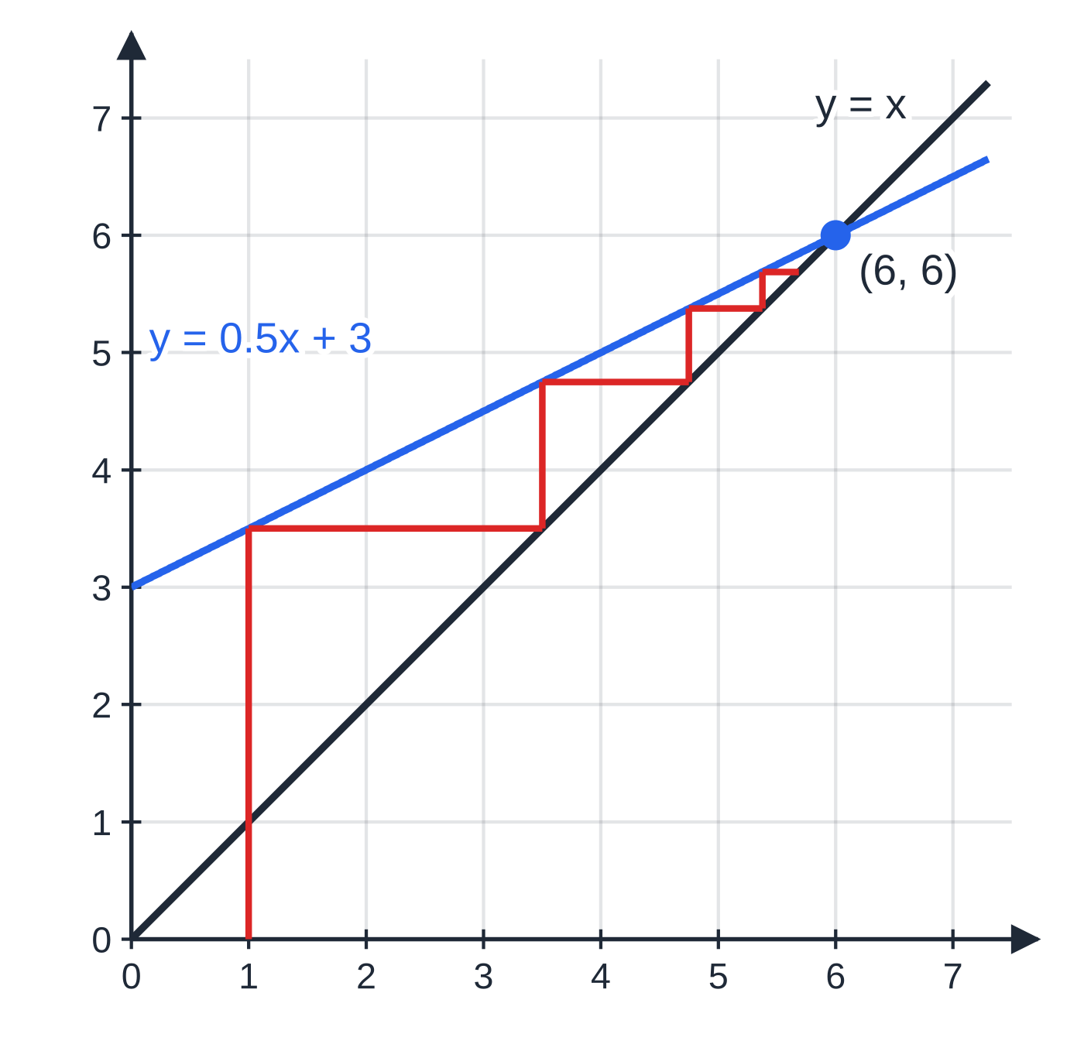
How do you tell if a sequence is increasing, decreasing or periodic? (continued)
Section 2 of 13
Staircase for xₙ₊₁ = 0.5xₙ + 3, x₁ = 1, drawn from the actual terms 1, 3.5, 4.75, 5.375, 5.6875. The steps shrink towards 6, where the line y = 0.5x + 3 meets y = x (6 = 0.5 × 6 + 3).
Notes:
How do you tell if a sequence is increasing, decreasing or periodic?. Full notes: https://examinerprep.com/notes/edexcel-ial-maths/sequences-and-series/

Slide 11
How do you tell if a sequence is increasing, decreasing or periodic? (continued)
Section 2 of 13 · Worked example 2 · Medium · Find
WORKED EXAMPLE · QUESTION
A sequence is defined by uₙ₊₁ = (uₙ + 3)/(uₙ - 1), u₁ = 2.
(a) Find u₂, u₃ and u₄. (b) Describe the behaviour of the sequence. (c) Find Σᵣ₌₁²⁵ uᵣ.
SOLUTION
(a) u₂ = (2 + 3)/(2 - 1) = 5, u₃ = (5 + 3)/(5 - 1) = 2, u₄ = 5: 5, 2, 5.
(b) The first term has come back after two steps, so the sequence is periodic with order 2: 2, 5, 2, 5, …
(c) Odd-numbered terms are 2, even-numbered terms are 5. In 25 terms there are 13 odd and 12 even positions: 13 ×2 + 12 ×5 = 86.
Notes:
How do you tell if a sequence is increasing, decreasing or periodic?: Worked example 2. Full notes: https://examinerprep.com/notes/edexcel-ial-maths/sequences-and-series/

Slide 12
How do you tell if a sequence is increasing, decreasing or periodic? (continued)
Section 2 of 13
Common error
Writing 25 ÷2 = 12.5 cycles and multiplying 12.5 by the cycle total 7. That gives 87.5, which cannot be the sum of whole numbers. Count complete cycles (12, contributing 84) and then add the leftover term (the 25th term is 2).
Notes:
How do you tell if a sequence is increasing, decreasing or periodic?. Full notes: https://examinerprep.com/notes/edexcel-ial-maths/sequences-and-series/

Slide 13
What is an arithmetic sequence?
Section 3 of 13
An arithmetic sequence
is a sequence in which each term is the previous term plus a fixed number, the common difference d.
uₙ = a + (n - 1)d
a = first term, d = common difference (uₙ₊₁ - uₙ), n = position of the term (a positive integer).
In the formulae list? In the formulae booklet: printed, but you will use it in almost every question, so know it without looking.
To reach the nth term from the first you take n - 1 steps, not n. The terms lie on a straight line when plotted against n, with gradient d: d > 0 increasing, d < 0 decreasing, d = 0 constant.
Three consecutive terms x, y, z are in arithmetic progression exactly when y - x = z - y, i.e. 2y = x + z: the middle term is the mean of its neighbours.
Notes:
What is an arithmetic sequence?. Full notes: https://examinerprep.com/notes/edexcel-ial-maths/sequences-and-series/

Slide 14
What is an arithmetic sequence? (continued)
Section 3 of 13
Two given terms give two linear equations in a and d; subtract them to find d first.
Notes:
What is an arithmetic sequence?. Full notes: https://examinerprep.com/notes/edexcel-ial-maths/sequences-and-series/

Slide 15
What is an arithmetic sequence? (continued)
Section 3 of 13 · Worked example 3 · Easy · Find
WORKED EXAMPLE · QUESTION
The 5th term of an arithmetic sequence is 23 and the 12th term is 51. (a) Find the first term and the common difference. (b) Find the number of the first term that is greater than 200.
SOLUTION
(a) a + 4d = 23 and a + 11d = 51. Subtract: 7d = 28, so d = 4, a = 7.
(b) 7 + 4(n - 1) > 200, so 4n > 197 and n > 49.25. n must be a whole number: n = 50 (check: u₄₉ = 199, u₅₀ = 203).
Notes:
What is an arithmetic sequence?: Worked example 3. Full notes: https://examinerprep.com/notes/edexcel-ial-maths/sequences-and-series/

Slide 16
How do you sum an arithmetic series, and why does the formula work?
Section 4 of 13
A series is the sum of the terms of a sequence; Sₙ means the sum of the first n terms. The proof of the formula is short and you may be asked for it: write the sum forwards and backwards, then add.
Proof of the arithmetic series formula
Sₙ = a + (a + d) + (a + 2d) + …+ [a + (n - 1)d]
Sₙ = [a + (n - 1)d] + [a + (n - 2)d] + …+ a (the same terms in reverse order)
Adding the two lines term by term, each of the n pairs adds to 2a + (n - 1)d:
2Sₙ = n[2a + (n - 1)d] ⇒ Sₙ = n/2[2a + (n - 1)d] = n/2(a + l)
l = a + (n - 1)d is the last term.
In the formulae list? In the formulae booklet both forms of Sₙ are printed, but the proof is not, and you may be asked for it.
Notes:
How do you sum an arithmetic series, and why does the formula work?. Full notes: https://examinerprep.com/notes/edexcel-ial-maths/sequences-and-series/

Slide 17
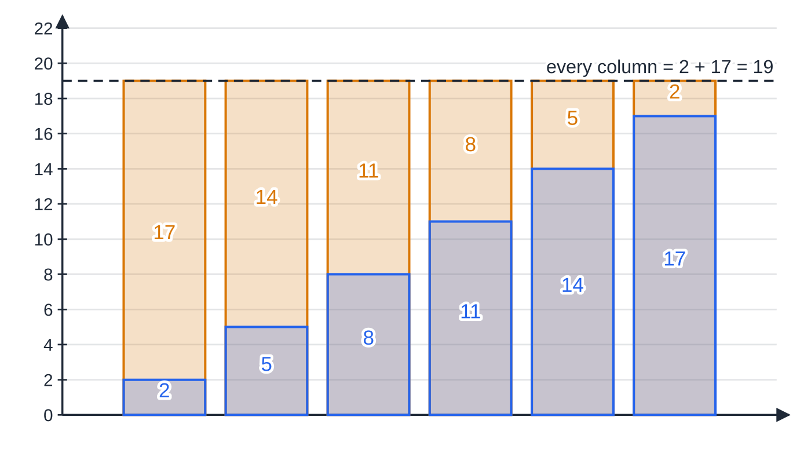
How do you sum an arithmetic series, and why does the formula work? (continued)
Section 4 of 13
The sum of the first n natural numbers. 1 + 2 + 3 + …+ n is arithmetic with a = 1, d = 1, l = n, so Σᵣ₌₁ⁿ r = ½ n(n + 1). For example 1 + 2 + …+ 100 = 50 ×101 = 5050.
Reverse and add for 2 + 5 + 8 + 11 + 14 + 17. Each blue term sits under its partner from the reversed list (amber); every column totals first + last = 19, so two copies of the sum fill a 6 × 19 rectangle and the sum is half of 114, i.e. 57.
Notes:
How do you sum an arithmetic series, and why does the formula work?. Full notes: https://examinerprep.com/notes/edexcel-ial-maths/sequences-and-series/

Slide 18
How do you sum an arithmetic series, and why does the formula work? (continued)
Section 4 of 13 · Worked example 4 · Hard · Find
WORKED EXAMPLE · QUESTION
A runner plans her training so that she runs 3 km on day 1 and, on each day after that, 0.4 km more than on the day before. (a) Find the distance she runs on day 30. (b) Find the total distance she runs in the first 30 days. (c) Find the day on which her total distance first exceeds 200 km.
SOLUTION
(a) a = 3, d = 0.4, n = 30: u₃₀ = 3 + 29 ×0.4 = 14.6 km.
(b) S₃₀ = ½ ×30 ×(3 + 14.6) = 15 ×17.6 = 264 km.
(c) Sₙ = n/2[6 + 0.4(n - 1)] = 0.2n² + 2.8n > 200, so n² + 14n - 1000 > 0. Critical value n = (-14 + √4196)/2 = 25.39.
Smallest whole number above it: day 26 (S₂₅ = 195 km, S₂₆ = 208 km). The other root of the quadratic is negative, so it has no meaning here.
Notes:
How do you sum an arithmetic series, and why does the formula work?: Worked example 4. Full notes: https://examinerprep.com/notes/edexcel-ial-maths/sequences-and-series/

Slide 19
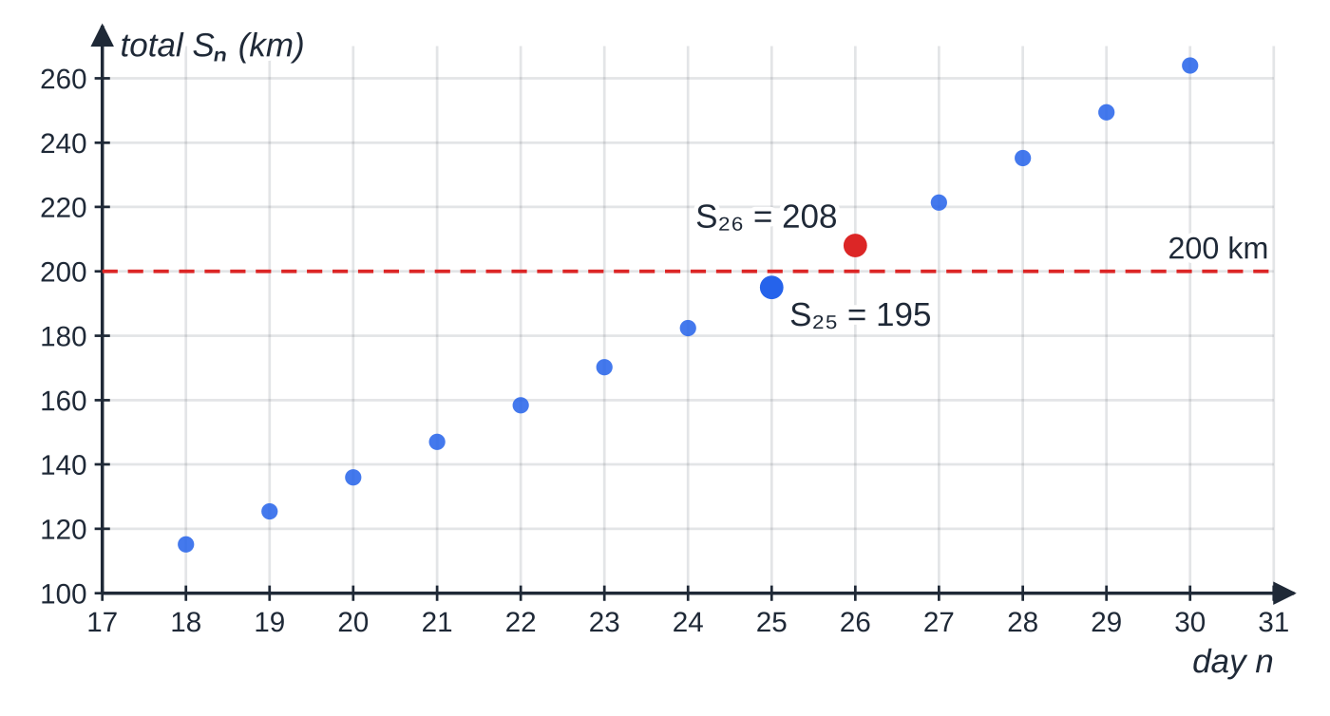
How do you sum an arithmetic series, and why does the formula work? (continued)
Section 4 of 13
Common error
Answering part (c) with the day on which she runs more than some distance; that uses uₙ. "Total distance" means the sum Sₙ. Read whether a question is about a single term or a running total before you choose the formula.
Running totals Sₙ = 0.2n² + 2.8n for Worked example 4. The total is still below 200 km after day 25 and first passes it on day 26.
Notes:
How do you sum an arithmetic series, and why does the formula work?. Full notes: https://examinerprep.com/notes/edexcel-ial-maths/sequences-and-series/

Slide 20
How does sigma notation work?
Section 5 of 13
Σᵣ₌₁ⁿ f(r) means: substitute r = 1, 2, 3, …, n into f(r) and add the results.
The number of terms in Σᵣ₌ₚ^q is q - p + 1. From r = 11 to r = 30 there are 20 terms, not 19.
If f(r) is linear in r the sum is arithmetic; if it is of the form A ×Bʳ it is geometric. Write out the first two or three terms to find a and d (or r).
Useful rules: Σᵣ₌₁ⁿ c = cn; Σᵣ₌₁ⁿ (pr + q) = p ×½ n(n + 1) + qn; Σᵣ₌ₚ^q = Σᵣ₌₁^q - Σᵣ₌₁ᵖ⁻¹.
Notes:
How does sigma notation work?. Full notes: https://examinerprep.com/notes/edexcel-ial-maths/sequences-and-series/

Slide 21
How does sigma notation work? (continued)
Section 5 of 13 · Worked example 5 · Medium · Find
WORKED EXAMPLE · QUESTION
Find (a) Σᵣ₌₁⁴⁰ (5r - 2) and (b) Σᵣ₌₁₁³⁰ (3r + 1).
SOLUTION
(a) Split the sum and use ½ n(n + 1): 5 ×½ ×40 ×41 - 2 ×40 = 5 ×820 - 80 = 4020.
(b) Arithmetic with first term 3(11) + 1 = 34, last term 3(30) + 1 = 91 and 30 - 11 + 1 = 20 terms: ½ ×20 ×(34 + 91) = 1250.
Check (b) another way: Σᵣ₌₁³⁰ - Σᵣ₌₁¹⁰ = 1425 - 175 = 1250. ✓
Notes:
How does sigma notation work?: Worked example 5. Full notes: https://examinerprep.com/notes/edexcel-ial-maths/sequences-and-series/

Slide 22
What is a geometric sequence, and how do you sum a geometric series?
Section 6 of 13
A geometric sequence
is a sequence in which each term is the previous term multiplied by a fixed non-zero number, the common ratio r.
uₙ = arⁿ⁻¹, r = uₙ₊₁/uₙ
a = first term, r = common ratio, n = position of the term.
In the formulae list? In the formulae booklet: printed, but know it without looking.
r > 1 (with a > 0): increasing; 0 < r < 1: decreasing towards 0; r < 0: the terms alternate in sign; r = -1: periodic with order 2.
Three consecutive terms x, y, z are in geometric progression exactly when y/x = z/y, i.e. y² = xz.
Two given terms: divide one equation by the other to eliminate a. For u₅ and u₂, you get r³.
Notes:
What is a geometric sequence, and how do you sum a geometric series?. Full notes: https://examinerprep.com/notes/edexcel-ial-maths/sequences-and-series/

Slide 23
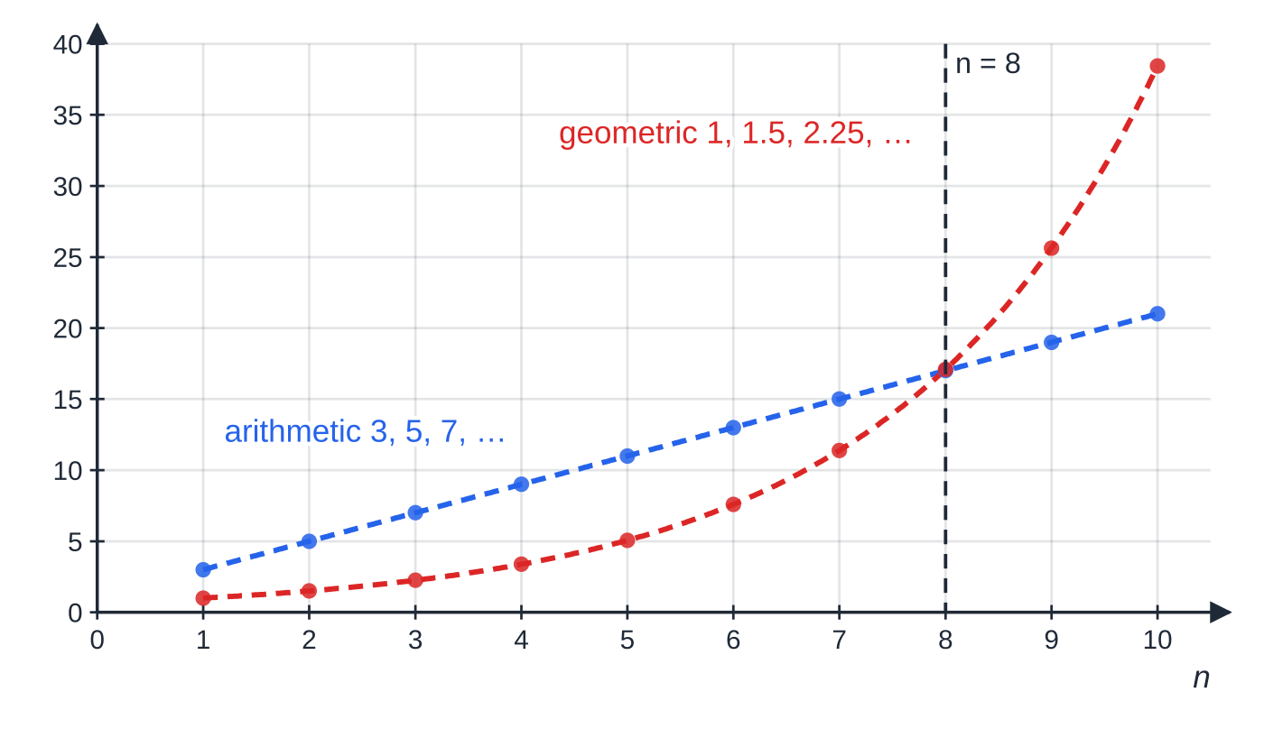
What is a geometric sequence, and how do you sum a geometric series? (continued)
Section 6 of 13
Proof of the geometric series formula
Sₙ = a + ar + ar² + …+ arⁿ⁻¹
rSₙ = ar + ar² + …+ arⁿ⁻¹ + arⁿ (multiply every term by r)
Subtracting, every term cancels except the first of the top line and the last of the bottom line:
Sₙ - rSₙ = a - arⁿ ⇒ Sₙ = (a(1 - rⁿ))/(1 - r) = (a(rⁿ - 1))/(r - 1), r ≠1
Arithmetic terms (3, 5, 7, …) rise by the same amount each time and lie on a straight line. Geometric terms (1, 1.5, 2.25, …) rise by the same factor and lie on an exponential curve, which starts lower but overtakes the line at n = 8 (17.09 > 17).
Notes:
What is a geometric sequence, and how do you sum a geometric series?. Full notes: https://examinerprep.com/notes/edexcel-ial-maths/sequences-and-series/

Slide 24
What is a geometric sequence, and how do you sum a geometric series? (continued)
Section 6 of 13
In the formulae list? In the formulae booklet the result is printed; the proof is not.
The two forms are equal (multiply top and bottom by -1). Use the first when |r| < 1 and the second when r > 1, to keep the numbers positive.
Notes:
What is a geometric sequence, and how do you sum a geometric series?. Full notes: https://examinerprep.com/notes/edexcel-ial-maths/sequences-and-series/

Slide 25
What is a geometric sequence, and how do you sum a geometric series? (continued)
Section 6 of 13 · Worked example 6 · Medium · Find
WORKED EXAMPLE · QUESTION
The second term of a geometric series is 60 and the fifth term is 3.84. (a) Find the common ratio and the first term. (b) Find the sum of the first 6 terms, giving your answer to 3 significant figures.
SOLUTION
(a) Divide to eliminate a: ar⁴/ar = (3.84/60), so r³ = 0.064, giving r = 0.4, a = 60 ÷0.4 = 150.
(b) Use the |r| < 1 form: S₆ = (150(1 - 0.4⁶))/(1 - 0.4) = 248.976 = 249 (3 s.f.).
Notes:
What is a geometric sequence, and how do you sum a geometric series?: Worked example 6. Full notes: https://examinerprep.com/notes/edexcel-ial-maths/sequences-and-series/

Slide 26
When does a geometric series have a sum to infinity?
Section 7 of 13
If |r| < 1, then rⁿ →0 as n →∞, so Sₙ = (a(1 - rⁿ))/(1 - r) gets closer and closer to a/(1 - r). The series is convergent. If |r| ≥1, the terms do not shrink and the sums do not settle: there is no sum to infinity (the series is divergent). The sum to infinity is a limit: no finite number of terms reaches it (for a ≠0 and r ≠0), but Sₙ can be made as close to it as you like.
Sum to infinity of a geometric series
S_∞ = a/(1 - r), |r| < 1
|r| < 1 means -1 < r < 1.
In the formulae list? In the formulae booklet, with the condition |r| < 1.
For Worked example 6: S_∞ = 150 ÷0.6 = 250, and S₆ is already within 1.024 of it.
Notes:
When does a geometric series have a sum to infinity?. Full notes: https://examinerprep.com/notes/edexcel-ial-maths/sequences-and-series/

Slide 27
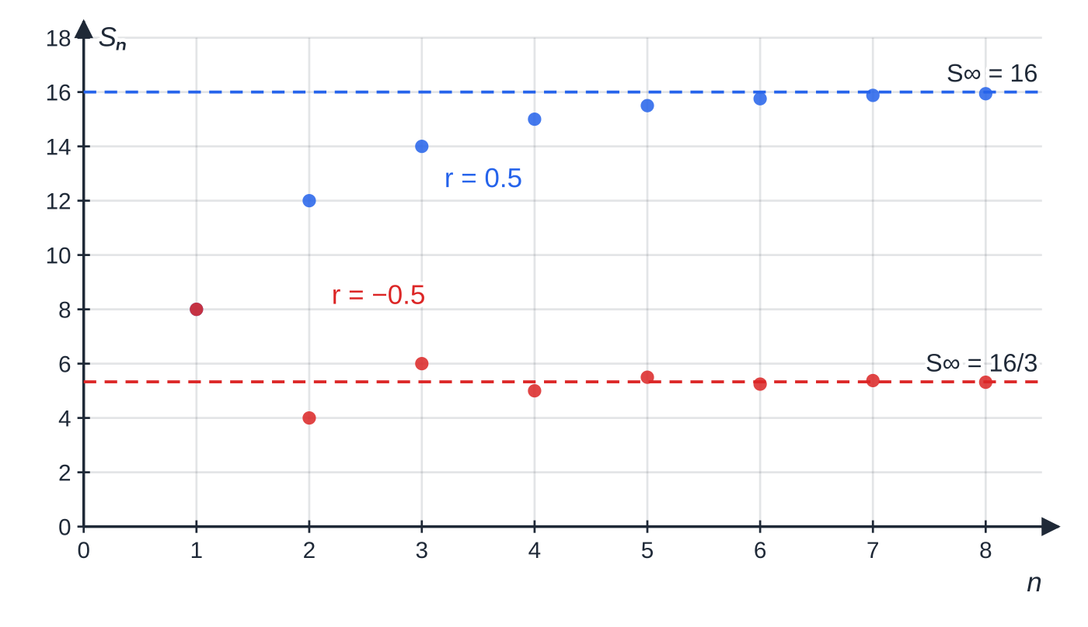
When does a geometric series have a sum to infinity? (continued)
Section 7 of 13
Partial sums of two geometric series with first term 8. With r = 0.5 they rise towards S∞ = 8/0.5 = 16; with r = −0.5 they jump above and below S∞ = 8/1.5 = 16/3 ≈ 5.33, getting closer each time.
Notes:
When does a geometric series have a sum to infinity?. Full notes: https://examinerprep.com/notes/edexcel-ial-maths/sequences-and-series/

Slide 28
When does a geometric series have a sum to infinity? (continued)
Section 7 of 13 · Worked example 7 · Hard · Find
WORKED EXAMPLE · QUESTION
A geometric series has second term 6 and sum to infinity 32. Find the two possible values of the common ratio, and the corresponding first terms.
SOLUTION
Two equations: ar = 6 and a/(1 - r) = 32.
Substitute a = 32(1 - r) into ar = 6: 32r(1 - r) = 6, so 16r² - 16r + 3 = 0, giving (4r - 1)(4r - 3) = 0.
Both roots satisfy |r| < 1, so both are valid: r = ¼, a = 24 or r = ¾, a = 8.
Always test each value of r against |r| < 1. A root such as r = 1.5 would have to be rejected, because then the sum to infinity would not exist.
Notes:
When does a geometric series have a sum to infinity?: Worked example 7. Full notes: https://examinerprep.com/notes/edexcel-ial-maths/sequences-and-series/

Slide 29
When does a geometric series have a sum to infinity? (continued)
Section 7 of 13
Common error
Using S_∞ = a/(1 - r) when r = 1.2 and getting a negative "sum" of positive terms. The formula only applies when |r| < 1; state the condition every time you use it.
Notes:
When does a geometric series have a sum to infinity?. Full notes: https://examinerprep.com/notes/edexcel-ial-maths/sequences-and-series/

Slide 30
How do you use logarithms to find n?
Section 8 of 13
Questions such as "the first term greater than 50 000" or "the least number of terms for the sum to exceed …" give an inequality with n in the power.
Rearrange to the form rⁿ > k (or rⁿ⁻¹ > k), take logs of both sides and divide by log r. Any base works, as long as you use the same one on both sides.
Direction of the inequality: if 0 < r < 1 then log r < 0, so dividing by it reverses the inequality. For example 0.9ⁿ < 0.01 gives nlog 0.9 < log 0.01, so n > log 0.01/log 0.9 = 43.7, and n = 44.
n is a whole number. Give the smallest integer that satisfies the inequality, and check it and the integer below it if the critical value is close to a whole number.
Notes:
How do you use logarithms to find n?. Full notes: https://examinerprep.com/notes/edexcel-ial-maths/sequences-and-series/

Slide 31
How do you use logarithms to find n? (continued)
Section 8 of 13 · Worked example 8 · Hard · Find
WORKED EXAMPLE · QUESTION
A factory produces 24 000 units in its first year. A model assumes that its output then increases by 5% each year. Using the model, (a) find the output in year 10, to 3 significant figures; (b) find the total output over the first 10 years, to 3 significant figures; (c) find the first year in which the output exceeds 50 000 units; (d) find the number of complete years needed for the total output to exceed 1 000 000 units.
SOLUTION
(a) Geometric with a = 24 000, r = 1.05: u₁₀ = 24 000 ×1.05⁹ = 37 231.9 = 37 200 units.
(b) The r > 1 form: S₁₀ = (24 000(1.05¹⁰ - 1))/(1.05 - 1) = 301 869.4 = 302 000 units.
(c) 24 000 ×1.05ⁿ⁻¹ > 50 000, so 1.05ⁿ⁻¹ > (25/12) and (n - 1)log 1.05 > log(25/12). Then n - 1 > 15.04, so n > 16.04: year 17.
Notes:
How do you use logarithms to find n?: Worked example 8. Full notes: https://examinerprep.com/notes/edexcel-ial-maths/sequences-and-series/

Slide 32
How do you use logarithms to find n? (continued)
Section 8 of 13 · Worked example 8 · Hard · Find (continued)
(d) (24 000(1.05ⁿ - 1))/0.05 > 1 000 000, so 1.05ⁿ > 1 + 50 000/24 000 = 3.0833. n > log 3.0833/log 1.05 = 23.08: 24 years.
Check: S₂₃ ≈994 331 < 1 000 000 < S₂₄ ≈1 068 048. ✓
Notes:
How do you use logarithms to find n?: Worked example 8. Full notes: https://examinerprep.com/notes/edexcel-ial-maths/sequences-and-series/

Slide 33
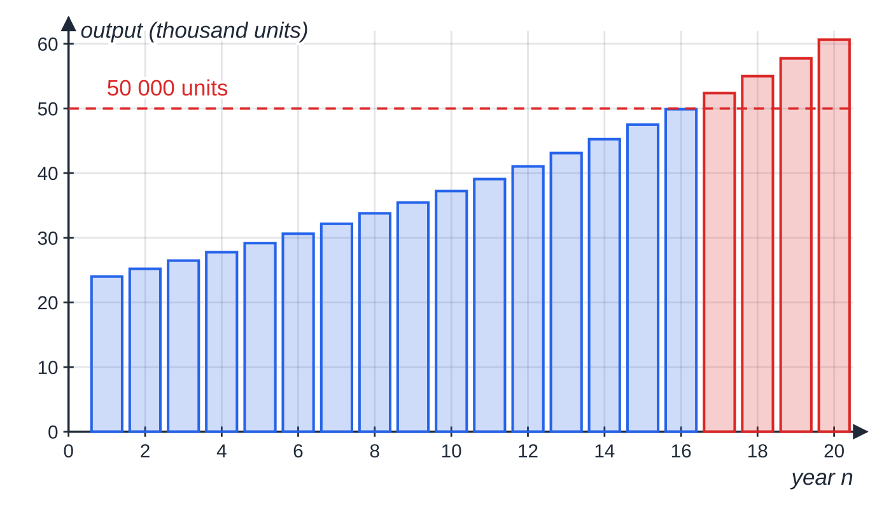
How do you use logarithms to find n? (continued)
Section 8 of 13
Exam tip
Keep the exact fraction (here (25/12)) or the full calculator value until the end. Rounding 1.05ⁿ > 3.08 too early can move a critical value across a whole number and change the answer.
Worked example 8: output of 24 000 in year 1, growing by 5% a year (r = 1.05). The log calculation gives n − 1 > 15.04, so the first year above 50 000 is year 17 (red); the bar for year 16 (49 890) is just short.
Notes:
How do you use logarithms to find n?. Full notes: https://examinerprep.com/notes/edexcel-ial-maths/sequences-and-series/

Slide 34
Exam tips for P2.3
Section 9 of 13
Exam tip 1 — identify the sequence first
Before using any formula, write down which type it is and the values of a and d (or a and r). Find d as a difference of consecutive terms and r as a ratio; check with a second pair.
Exam tip 2 — term or sum?
"The amount in year 10" is a term, u₁₀. "The total over 10 years" is a sum, S₁₀. Underline which one the question asks for.
Exam tip 3 — proofs: every line visible
For "prove that the sum of the first n terms is …", write Sₙ out in full (first terms, "…", last term), write the second line (reversed, or multiplied by r), add or subtract, and divide. End with the formula you were asked to prove.
Notes:
Exam tips for P2.3. Full notes: https://examinerprep.com/notes/edexcel-ial-maths/sequences-and-series/

Slide 35
Exam tips for P2.3 (continued)
Section 9 of 13
Exam tip 4 — integer answers need a reason
After solving an inequality for n, state the integer and why: "n > 49.25, so n = 50". If the question says "show that" or the critical value is close to an integer, substitute both neighbouring values to confirm.
Exam tip 5 — count the terms in sigma notation
Σᵣ₌ₚ^q has q - p + 1 terms. Write out the first and last terms of the sum before using a formula.
Notes:
Exam tips for P2.3. Full notes: https://examinerprep.com/notes/edexcel-ial-maths/sequences-and-series/

Slide 36
Common misconceptions
Section 10 of 13
Misconception | Why it is wrong | Correct idea
The nth term of an arithmetic sequence is a + nd. | The first term already counts as one term: only n - 1 steps of d are needed to reach the nth. | uₙ = a + (n - 1)d; similarly uₙ = arⁿ⁻¹.
Any geometric series has a sum to infinity. | If |r| ≥1, the terms do not shrink and the partial sums do not settle. | S_∞ exists only when |r| < 1.
A sequence that rises for the first few terms is increasing. | The definition is "for all n"; a few terms are only evidence. | Show uₙ₊₁ - uₙ > 0 for every n.
Σᵣ₌₁₁³⁰ has 19 terms. | Both ends are included. | 30 - 11 + 1 = 20 terms.
Dividing by log 0.9 keeps the inequality the same way round. | log 0.9 is negative. | Dividing by a negative number reverses the inequality.
A recurrence relation on its own defines the sequence. | Different first terms give different sequences from the same rule. | A recurrence needs a starting value such as u₁ = 2.
Notes:
Common misconceptions. Full notes: https://examinerprep.com/notes/edexcel-ial-maths/sequences-and-series/

Slide 37
How this topic connects
Section 11 of 13
P1 algebra and P2.1 proof
Questions on "the least n for which Sₙ > …" in arithmetic series become quadratic inequalities, solved with the methods from the P1 quadratics and inequalities pages. Both sum formulae are proofs by deduction.
P2 exponentials and logarithms, and P2.4 the binomial expansion
Finding n in a geometric sequence is solving aˣ = b; the binomial expansion is another way of writing out the terms of a finite series.
P3 numerical methods, P4 binomial series and IAL Physics
The staircase diagram is the same picture used for iteration xₙ₊₁ = g(xₙ) in P3. In P4, (1 - x)⁻¹ = 1 + x + x² + … is the geometric series with sum to infinity 1/(1 - x) for |x| < 1. In physics, radioactive decay halves the number of nuclei every half-life, a geometric sequence with r = ½.
Notes:
How this topic connects. Full notes: https://examinerprep.com/notes/edexcel-ial-maths/sequences-and-series/

Slide 38
Key formulae
Section 12 of 13
Formula | Use | In the formulae list?
uₙ = a + (n - 1)d | nth term of an arithmetic sequence | Yes
Sₙ = ½ n[2a + (n - 1)d] = ½ n(a + l) | sum of the first n terms of an arithmetic series | Yes (proof: no — learn it)
Σᵣ₌₁ⁿ r = ½ n(n + 1) | sum of the first n natural numbers | No — derive it (arithmetic, a = d = 1)
uₙ = arⁿ⁻¹ | nth term of a geometric sequence | Yes
Sₙ = (a(1 - rⁿ))/(1 - r) = (a(rⁿ - 1))/(r - 1) | sum of the first n terms of a geometric series, r ≠1 | Yes (proof: no — learn it)
S_∞ = a/(1 - r), |r| < 1 | sum to infinity of a convergent geometric series | Yes
rⁿ > k ⇒n > log k/log r (r > 1); reversed if 0 < r < 1 | finding n with logarithms | No — derive it
2y = x + z; y² = xz | x, y, z consecutive terms of an arithmetic / a geometric sequence | No — derive it
Notes:
Key formulae. Full notes: https://examinerprep.com/notes/edexcel-ial-maths/sequences-and-series/

Slide 39
Check your understanding
Section 13 of 13
1. For the arithmetic sequence 8, 5, 2, …, find the 20th term and the sum of the first 20 terms.
2. Explain why the series 3 + 3.6 + 4.32 + … has no sum to infinity.
3. A sequence has uₙ₊₁ = 4 - uₙ and u₁ = 1. Find Σᵣ₌₁⁹⁹ uᵣ.
4. Find the sum to infinity of 81 - 27 + 9 - 3 + …
5. Find the smallest integer n for which 2ⁿ > 100 000.
6. The numbers x, 12, x + 18 are consecutive terms of a geometric sequence with x > 0. Find x and the common ratio.
Notes:
Check your understanding: questions. Full notes: https://examinerprep.com/notes/edexcel-ial-maths/sequences-and-series/

Slide 40
Check your understanding · answers
Section 13 of 13
1. a = 8, d = -3. u₂₀ = 8 + 19(-3) = -49. S₂₀ = 10 ×(8 + (-49)). u₂₀ = -49, S₂₀ = -410.
2. It is geometric with r = 3.6 ÷3 = 1.2. Since |r| > 1 the terms grow without limit, so the partial sums do not approach a finite value.
3. The terms are 1, 3, 1, 3, … (period 2). The 99 terms contain 50 ones and 49 threes: 50 + 147. The sum is 197.
4. a = 81 and r = -(27/81) = -⅓, so |r| < 1 and S_∞ = 81 ÷(1 + ⅓) = 81 ×¾. S_∞ = 60.75.
5. nlog 2 > log 100 000, so n > 5/log 2 = 16.61. n = 17. Check: 2¹⁶ = 65 536, 2¹⁷ = 131 072.
6. y² = xz: 144 = x(x + 18), so x² + 18x - 144 = 0, giving (x + 24)(x - 6) = 0. With x > 0, x = 6 and r = 12 ÷6 = 2 (check: x + 18 = 24 = 12 ×2). x = 6, r = 2.
Notes:
Check your understanding: answers. Full notes: https://examinerprep.com/notes/edexcel-ial-maths/sequences-and-series/

Slide 41
Practice questions
2 original exam-style questions. Answers at the end of the deck.

Slide 42
Question 1
7 marks
This question is about the series whose rth term is 4r + 3.
(a) Find the value of Σᵣ₌₁³⁰(4r + 3). [3]
(b) Show that Σᵣ₌₁ⁿ(4r + 3) = 2n² + 5n. [2]
(c) Given that Σᵣ₌₁ⁿ(4r + 3) = 1272, find the value of n. [2]
Notes:
Online with the full mark scheme: https://examinerprep.com/ial-maths-p2-3-sequences-and-series-questions#IALM-P2-3-B-04

Slide 43
Question 2
9 marks
An arithmetic series has first term a and common difference d.
(a) Prove that the sum of the first n terms of the series is Sₙ = ½n[2a + (n − 1)d]. [4]
(b) For a different arithmetic series, the sum of the first n terms is 3n² + 2n for every positive integer n. Find the first term and the common difference of this series. [3]
(c) Find which term of this series is equal to 101. [2]
Notes:
Online with the full mark scheme: https://examinerprep.com/ial-maths-p2-3-sequences-and-series-questions#IALM-P2-3-B-06

Slide 44
Answers

Slide 45
Question 1 · answer
Mark scheme
identifies an arithmetic series with first term 7 and last term 123, or splits the sum as 4 × (sum of r) + 3 × 30
uses ½n(a + l) = 15 × 130, or 4 × ½ × 30 × 31 + 90
1950
uses ½n[2 × 7 + 4(n − 1)] or 4 × ½n(n + 1) + 3n
simplifies correctly to 2n² + 5n
2n² + 5n − 1272 = 0, solved e.g. (n − 24)(2n + 53) = 0
n = 24 (the other root is negative)
Notes:
Full mark scheme: https://examinerprep.com/ial-maths-p2-3-sequences-and-series-questions#IALM-P2-3-B-04

Slide 46
Question 2 · answer
Mark scheme
Sₙ = a + (a + d) + … + [a + (n − 1)d], with first terms and last term shown
Sₙ = [a + (n − 1)d] + [a + (n − 2)d] + … + a, the same terms reversed
adds: 2Sₙ = n[2a + (n − 1)d], with each of the n pairs equal to 2a + (n − 1)d
divides by 2 to reach the given result, with a conclusion
first term = S₁ = 3 + 2 = 5
S₂ = 16, so the second term is 16 − 5 = 11
d = 11 − 5 = 6
5 + 6(n − 1) = 101
Notes:
Full mark scheme: https://examinerprep.com/ial-maths-p2-3-sequences-and-series-questions#IALM-P2-3-B-06

Slide 47
Keep practising
Notes for this topic
Questions on this topic
Build a printable test
ExaminerPrep is an independent tutoring service. It has been developed independently from and is not endorsed by the International Baccalaureate Organization. "International Baccalaureate", "IB" and "IB Diploma Programme" are registered trademarks of the IBO, used here for descriptive purposes only.
Pearson Edexcel and Cambridge are trademarks of their owners; ExaminerPrep is not affiliated with any exam board.

