Slide 1
EP
EDEXCEL IAL MATHS
P1.2 Simultaneous equations and inequalities
The full notes page in 12 sections · practice questions with answers · simulations
ExaminerPrep is an independent tutoring service. It has been developed independently from and is not endorsed by the International Baccalaureate Organization. "International Baccalaureate", "IB" and "IB Diploma Programme" are registered trademarks of the IBO, used here for descriptive purposes only.
Pearson Edexcel and Cambridge are trademarks of their owners; ExaminerPrep is not affiliated with any exam board.
Notes:
P1.2 Simultaneous equations and inequalities. Notes for this topic: https://examinerprep.com/notes/edexcel-ial-maths/simultaneous-equations-and-inequalities/

Slide 2
What this page covers
Overview
Solving one linear and one quadratic equation simultaneously by substitution
Reading the solutions as the intersection points of a line and a curve
Using the discriminant to decide whether a line crosses, touches or misses a curve
Linear inequalities, including ones with brackets and fractions
Quadratic inequalities, including ones that need expanding first
Inequalities in a parameter such as k that come from a discriminant condition
Combining inequalities and writing solution sets in set notation
Regions on a graph: solid and dashed boundaries, and describing a region with inequalities
Notes:
What this page covers. Full notes: https://examinerprep.com/notes/edexcel-ial-maths/simultaneous-equations-and-inequalities/

Slide 3
In one minute
Key points
1. To solve a linear and a quadratic equation together, make one variable the subject of the linear equation, substitute into the quadratic, solve the resulting quadratic, and then use the linear equation to find the partner of each value.
2. Each solution pair is a point where the line meets the curve; after substituting, the discriminant b²-4ac of the quadratic tells you how many: positive gives two points, zero means the line is a tangent, negative means no points.
3. Linear inequalities are solved like equations, except that multiplying or dividing by a negative number reverses the inequality sign.
4. Quadratic inequalities: rearrange to f(x)>0 or f(x)<0, find the critical values (the roots), sketch, and read off where the curve is above or below the x-axis.
5. Set notation: {x: x<-4}∪{x: x>2} for "or"; {x: -(3/2)≤x<1} for a single interval.
6. Regions: a solid boundary is included (≤, ≥); a dashed boundary is not (<, >).
Notes:
In one minute. Full notes: https://examinerprep.com/notes/edexcel-ial-maths/simultaneous-equations-and-inequalities/

Slide 4
How do you solve a linear and a quadratic equation simultaneously?
Section 1 of 12
Solving simultaneously means finding every pair (x, y) that makes both equations true at the same time.
With two linear equations you can often add or subtract to eliminate a variable. When one equation contains x², y² or xy, elimination usually fails: the squared and product terms do not cancel. The method that always works is substitution. The linear equation gives one variable in terms of the other with no squares at all, so you can replace that variable everywhere in the quadratic and be left with a single equation in one unknown.
The substitution method
1. Rearrange the linear equation to make x or y the subject. Choose the one that avoids fractions: if a variable has coefficient 1, use it.
2. Substitute into the quadratic equation and expand carefully. Put brackets round the whole substituted expression before squaring or multiplying.
Notes:
How do you solve a linear and a quadratic equation simultaneously?. Full notes: https://examinerprep.com/notes/edexcel-ial-maths/simultaneous-equations-and-inequalities/

Slide 5
How do you solve a linear and a quadratic equation simultaneously? (continued)
Section 1 of 12
3. Solve the resulting quadratic in one variable: factorise, complete the square or use the formula.
4. Find the partner of each value by substituting into the linear equation. The linear equation gives exactly one partner each time; the quadratic might give two, and one of them would be false.
5. Pair the answers: write them as coordinates or as matched statements x=…, y=….
If both equations already have y as the subject, step 1 is free: set the two right-hand sides equal to each other.
Notes:
How do you solve a linear and a quadratic equation simultaneously?. Full notes: https://examinerprep.com/notes/edexcel-ial-maths/simultaneous-equations-and-inequalities/

Slide 6
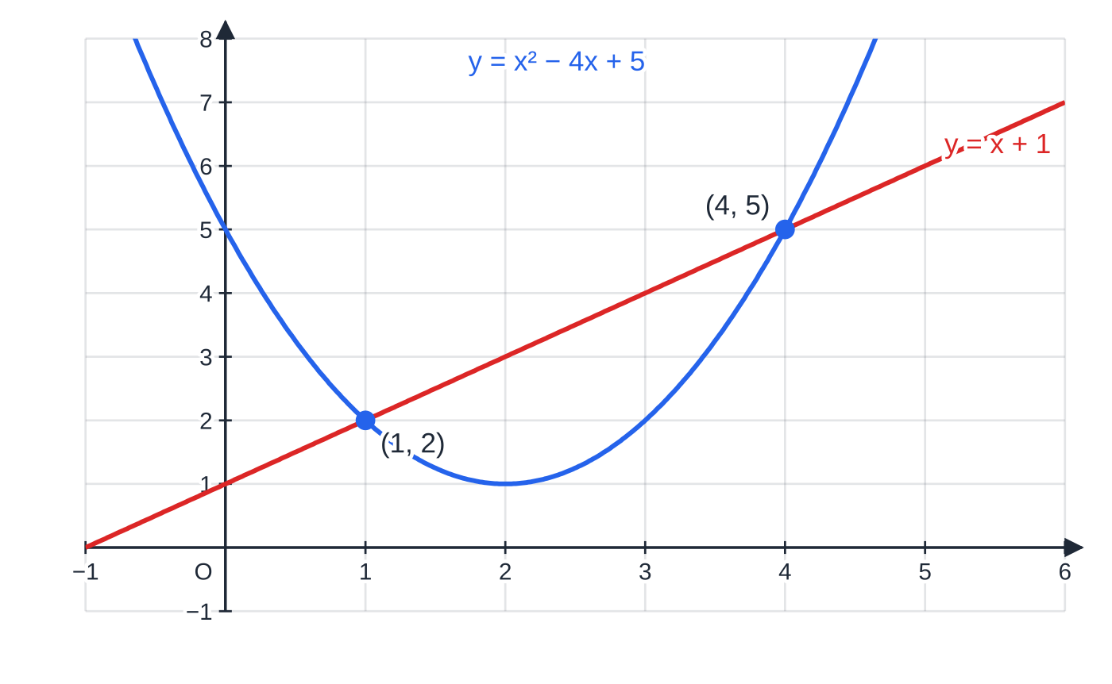
How do you solve a linear and a quadratic equation simultaneously? (continued)
Section 1 of 12 · Worked example 1 · Easy · Solve
WORKED EXAMPLE · QUESTION
Solve the simultaneous equations y=x²-4x+5 and y=x+1.
SOLUTION
Both expressions equal y, so set them equal: x²-4x+5=x+1, which gives x²-5x+4=0.
Factorise: (x-1)(x-4)=0, so x=1 or x=4.
Use the linear equation y=x+1 for the partners: x=1 gives y=2, and x=4 gives y=5.
Check in the quadratic: 1-4+5=2 ✓ and 16-16+5=5 ✓. x=1, y=2 and x=4, y=5
The two solution pairs of Worked example 1 are the two points where the line meets the parabola.
Notes:
How do you solve a linear and a quadratic equation simultaneously?: Worked example 1. Full notes: https://examinerprep.com/notes/edexcel-ial-maths/simultaneous-equations-and-inequalities/

Slide 7
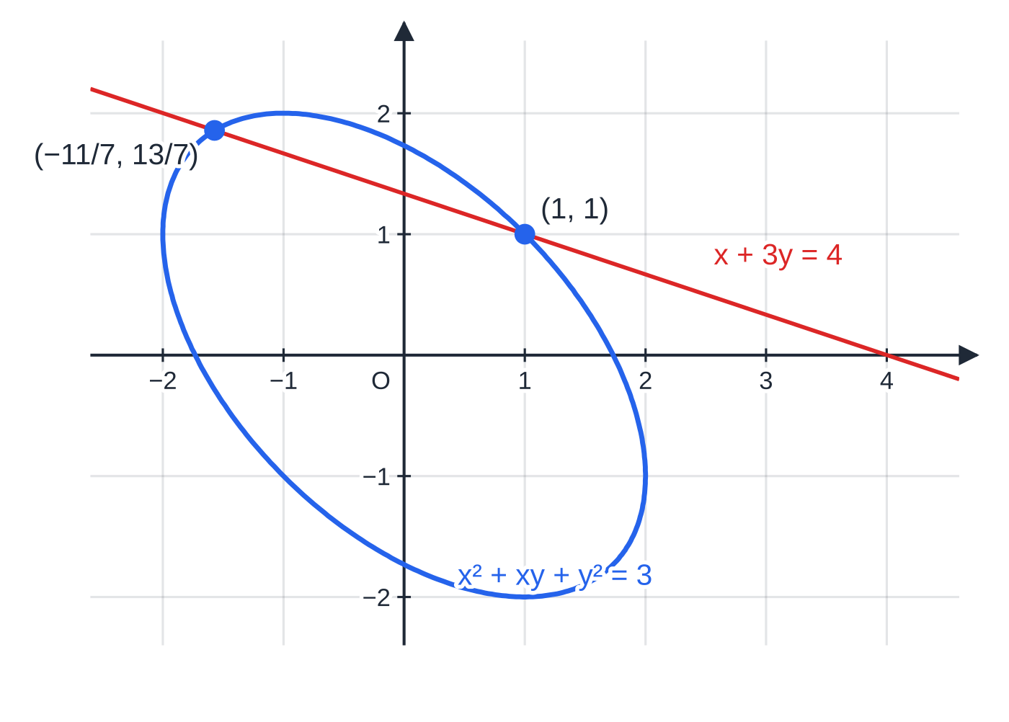
How do you solve a linear and a quadratic equation simultaneously? (continued)
Section 1 of 12 · Worked example 2 · Medium · Solve
WORKED EXAMPLE · QUESTION
Solve the simultaneous equations x+3y=4 and x²+xy+y²=3.
SOLUTION
Choose the subject. x has coefficient 1 in the linear equation, so x=4-3y (no fractions that way).
Substitute, with brackets, and expand. (4-3y)²+(4-3y)y+y²=3, so 16-24y+9y²+4y-3y²+y²=3, which simplifies to 7y²-20y+13=0.
Solve. (y-1)(7y-13)=0, so y=1 or y=(13/7).
Partners from x=4-3y. y=1 gives x=1; y=(13/7) gives x=4-(39/7)=-(11/7).
The curve x²+xy+y²=3 is a tilted oval (an ellipse). The line meets it at exactly the two points found in Worked example 2.
Notes:
How do you solve a linear and a quadratic equation simultaneously?: Worked example 2. Full notes: https://examinerprep.com/notes/edexcel-ial-maths/simultaneous-equations-and-inequalities/

Slide 8
How do you solve a linear and a quadratic equation simultaneously? (continued)
Section 1 of 12 · Worked example 2 · Medium · Solve (continued)
x=1, y=1 and x=-(11/7), y=(13/7)
Notes:
How do you solve a linear and a quadratic equation simultaneously?: Worked example 2. Full notes: https://examinerprep.com/notes/edexcel-ial-maths/simultaneous-equations-and-inequalities/

Slide 9
How do you solve a linear and a quadratic equation simultaneously? (continued)
Section 1 of 12
Common error
Writing (4-3y)² as 16+9y², or dropping the brackets so that -3y×y loses its sign. Expand (a-b)²=a²-2ab+b² in full on its own line before collecting terms.
Notes:
How do you solve a linear and a quadratic equation simultaneously?. Full notes: https://examinerprep.com/notes/edexcel-ial-maths/simultaneous-equations-and-inequalities/

Slide 10
What do the solutions tell you about a line and a curve?
Section 2 of 12
Every real solution pair is a point that lies on both graphs, so it is a point where the line meets the curve. After you substitute, everything about the intersection is stored in one quadratic equation. Its number of real roots is the number of intersection points, and the discriminant b²-4ac of that quadratic counts the roots without solving it.
After substituting | Roots of the quadratic | The line…
b²-4ac>0 | two distinct real roots | crosses the curve at two points
b²-4ac=0 | one repeated root | touches the curve at one point: it is a tangent
b²-4ac<0 | no real roots | does not meet the curve
This is the key idea of the whole page. A geometric question ("does the line touch the curve?") becomes an algebraic one ("is this discriminant zero?"). The idea comes back with circles in P2 and with tangents in calculus.
Notes:
What do the solutions tell you about a line and a curve?. Full notes: https://examinerprep.com/notes/edexcel-ial-maths/simultaneous-equations-and-inequalities/

Slide 11
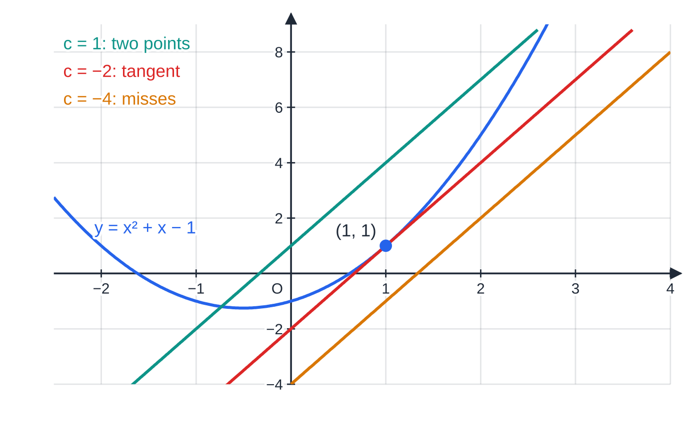
What do the solutions tell you about a line and a curve? (continued)
Section 2 of 12
The curve y=x²+x-1 with three parallel lines y=3x+c. Substituting gives x²-2x-1-c=0, whose discriminant is 8+4c: positive for c=1, zero for c=-2, negative for c=-4.
Notes:
What do the solutions tell you about a line and a curve?. Full notes: https://examinerprep.com/notes/edexcel-ial-maths/simultaneous-equations-and-inequalities/

Slide 12
What do the solutions tell you about a line and a curve? (continued)
Section 2 of 12 · Worked example 3 · Medium · Show that, Find
WORKED EXAMPLE · QUESTION
The curve C has equation y=x²+x-1.
(a) Show that the line y=3x-2 is a tangent to C, and find the point of contact.
(b) Find the set of values of c for which the line y=3x+c meets C at two distinct points.
SOLUTION
(a) Substitute: x²+x-1=3x-2, so x²-2x+1=0. For a tangent we need b²-4ac=0: here (-2)²-4(1)(1)=0, so there is a repeated root and the line is a tangent.
Point of contact: (x-1)²=0 gives x=1, and then y=3(1)-2=1. Point of contact (1, 1)
(b) Substitute the general line: x²+x-1=3x+c, so x²-2x-(1+c)=0. Two distinct points means discriminant >0:
(-2)²-4(1)(-(1+c))=4+4(1+c)=8+4c>0, so c>-2. {c: c>-2}
Notes:
What do the solutions tell you about a line and a curve?: Worked example 3. Full notes: https://examinerprep.com/notes/edexcel-ial-maths/simultaneous-equations-and-inequalities/

Slide 13
What do the solutions tell you about a line and a curve? (continued)
Section 2 of 12 · Worked example 3 · Medium · Show that, Find (continued)
This is consistent with (a): c=-2 gives the tangent itself, the boundary case.
Notes:
What do the solutions tell you about a line and a curve?: Worked example 3. Full notes: https://examinerprep.com/notes/edexcel-ial-maths/simultaneous-equations-and-inequalities/

Slide 14
What do the solutions tell you about a line and a curve? (continued)
Section 2 of 12
Exam tip
When a question says "show that the line is a tangent", write the condition in words before the numbers ("for a tangent, b²-4ac=0"), then substitute and conclude in a sentence. When the letter c is already used in the question, rename the quadratic's coefficients (or write the discriminant out in full) so the two meanings do not get mixed up.
Notes:
What do the solutions tell you about a line and a curve?. Full notes: https://examinerprep.com/notes/edexcel-ial-maths/simultaneous-equations-and-inequalities/

Slide 15
How do you solve a linear inequality?
Section 3 of 12
An inequality such as 3x-1<8 describes a whole range of values, not a single number. You solve it with the same steps as a linear equation: expand brackets, collect terms, divide. Almost every step keeps the inequality sign exactly as it was:
Adding or subtracting the same quantity on both sides never changes the sign.
Multiplying or dividing by a positive number keeps the sign.
Multiplying or dividing by a negative number reverses it: -2x<6 gives x>-3.
Why the reversal? Multiplying by -1 reflects the number line about 0, so the order of every pair of numbers flips: 2<5 but -2>-5. With fractions, multiply every term by the lowest common denominator first; it is a positive number, so the sign is safe. You can avoid dividing by a negative altogether by collecting the x terms on the side where their coefficient ends up positive.
Notes:
How do you solve a linear inequality?. Full notes: https://examinerprep.com/notes/edexcel-ial-maths/simultaneous-equations-and-inequalities/

Slide 16
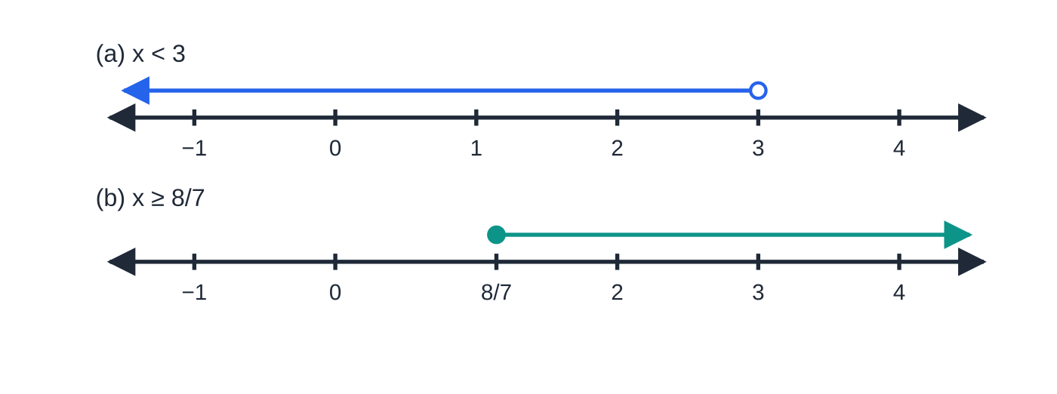
How do you solve a linear inequality? (continued)
Section 3 of 12 · Worked example 4 · Easy · Find
WORKED EXAMPLE · QUESTION
Find the set of values of x for which (a) 5-3(x-1)>2x-7 (b) (2x-1)/3-(x+4)/4≤x-2.
SOLUTION
(a) Expand: 5-3x+3>2x-7, so 8-3x>2x-7. Collect the x terms on the right, where they are positive: 15>5x. Divide by 5: x<3
(b) Multiply every term by 12: 4(2x-1)-3(x+4)≤12x-24, so 8x-4-3x-12≤12x-24, giving 5x-16≤12x-24.
Collect on the right and divide by the positive number 7: 8≤7x. {x: x≥(8/7)}
The answers to Worked example 4 on number lines. An open circle means the end value is not included (<); a filled circle means it is (≥).
Notes:
How do you solve a linear inequality?: Worked example 4. Full notes: https://examinerprep.com/notes/edexcel-ial-maths/simultaneous-equations-and-inequalities/

Slide 17
How do you solve a linear inequality? (continued)
Section 3 of 12
Common error
Multiplying only the fractions by 12 and forgetting the other terms, or writing -3(x+4) as -3x+12. Every term on both sides is multiplied, and a minus sign in front of a bracket changes the sign of everything inside it.
Notes:
How do you solve a linear inequality?. Full notes: https://examinerprep.com/notes/edexcel-ial-maths/simultaneous-equations-and-inequalities/

Slide 18
How do you solve a quadratic inequality?
Section 4 of 12
You cannot solve x²+2x-8>0 by "moving things across" in the same way, because the sign of a quadratic changes at its roots. The reliable method uses a sketch.
Four steps
1. Rearrange so that one side is zero: f(x)>0, <0, ≥0 or ≤0. Expand any brackets first.
2. Find the critical values: solve f(x)=0.
3. Sketch y=f(x), marking the roots on the x-axis.
4. Read off where the curve is above the axis (f(x)>0) or below it (f(x)<0).
For a positive x² coefficient and roots α<β, the curve is a ∪-shape, so:
f(x)<0 for α<x<β: one interval, between the roots;
f(x)>0 for x<α or x>β: two separate intervals, outside the roots.
For "≤" or "≥" the critical values themselves are included, because there f(x)=0.
Notes:
How do you solve a quadratic inequality?. Full notes: https://examinerprep.com/notes/edexcel-ial-maths/simultaneous-equations-and-inequalities/

Slide 19
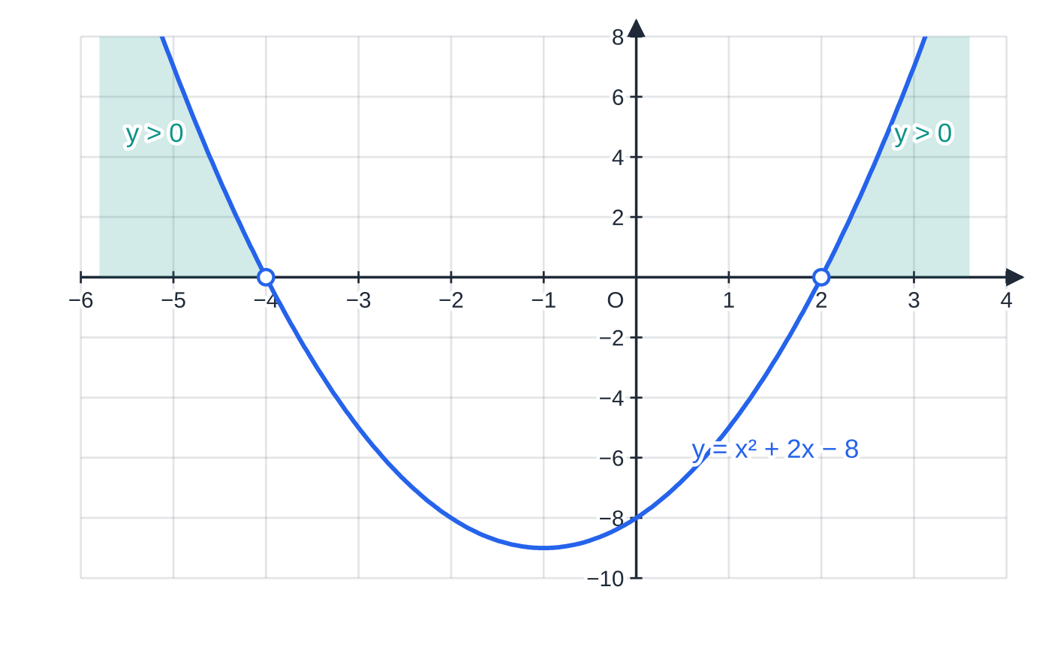
How do you solve a quadratic inequality? (continued)
Section 4 of 12 · Worked example 5 · Medium · Solve
WORKED EXAMPLE · QUESTION
Solve the inequality (x-1)(x+5)>2x+3.
SOLUTION
Expand and rearrange to compare with zero: x²+4x-5>2x+3, so x²+2x-8>0.
Critical values: (x+4)(x-2)=0, so x=-4 or x=2.
The graph is ∪-shaped, and we want the parts above the axis, which are outside the roots. x<-4 or x>2
The graph of y=x²+2x-8 from Worked example 5. The inequality is strict, so the critical values -4 and 2 are not included (open circles); the shaded parts are where y>0.
Notes:
How do you solve a quadratic inequality?: Worked example 5. Full notes: https://examinerprep.com/notes/edexcel-ial-maths/simultaneous-equations-and-inequalities/

Slide 20
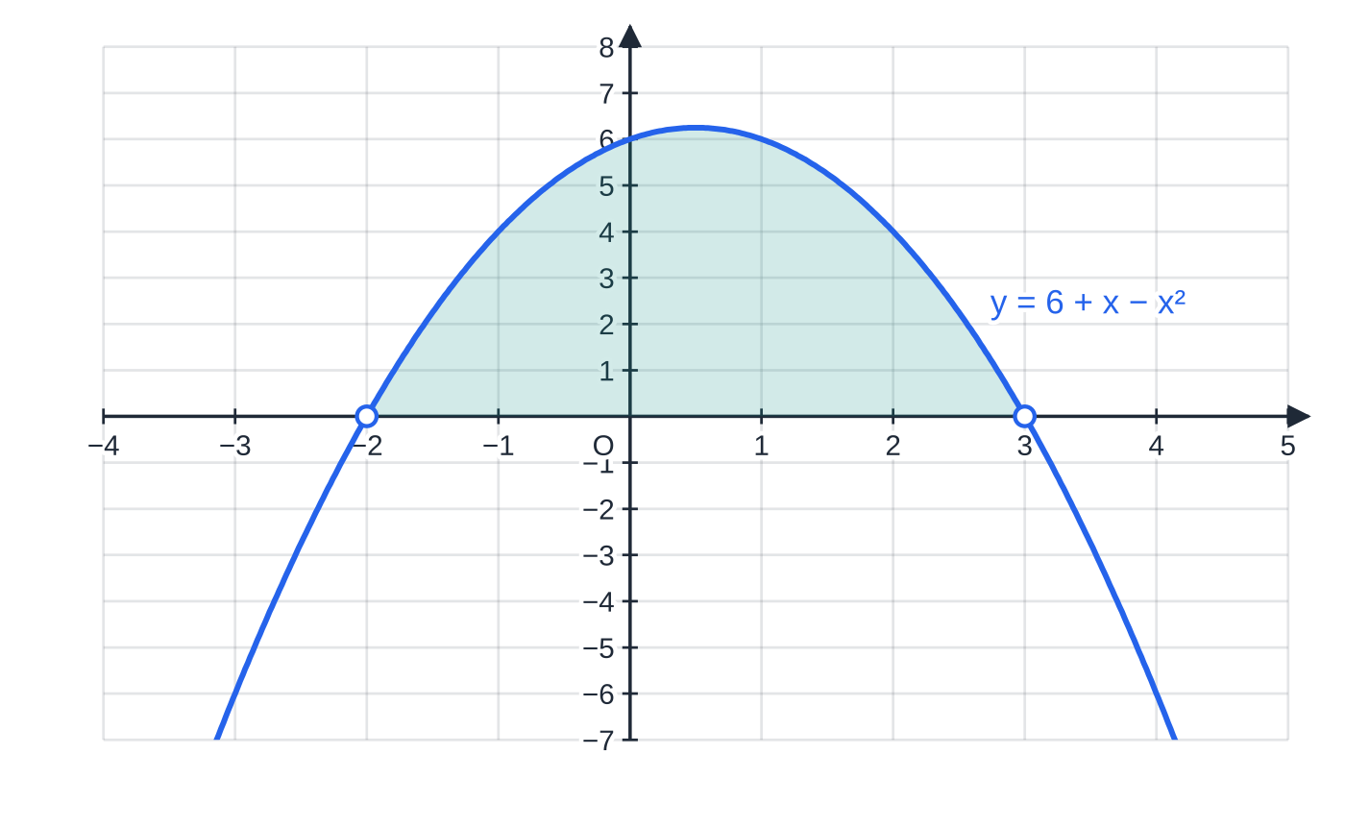
How do you solve a quadratic inequality? (continued)
Section 4 of 12
If the x² coefficient is negative, either sketch the ∩-shape directly or multiply through by -1 first and reverse the sign. For example, 6+x-x²>0 becomes x²-x-6<0, that is (x-3)(x+2)<0, so -2<x<3. Both routes give the same answer, as the sketch shows.
The ∩-shaped graph of y=6+x-x² is above the axis only between its roots, so 6+x-x²>0 for -2<x<3.
Notes:
How do you solve a quadratic inequality?. Full notes: https://examinerprep.com/notes/edexcel-ial-maths/simultaneous-equations-and-inequalities/

Slide 21
What if the inequality is in a constant such as k?
Section 5 of 12
Discriminant questions often end in a quadratic inequality, not in x but in a constant such as k. The condition "the line misses the curve" means b²-4ac<0, and b or c contains k, so the discriminant is itself a quadratic in k. Solve it in exactly the same way: critical values, then a sketch, now with k on the horizontal axis.
Notes:
What if the inequality is in a constant such as k?. Full notes: https://examinerprep.com/notes/edexcel-ial-maths/simultaneous-equations-and-inequalities/

Slide 22
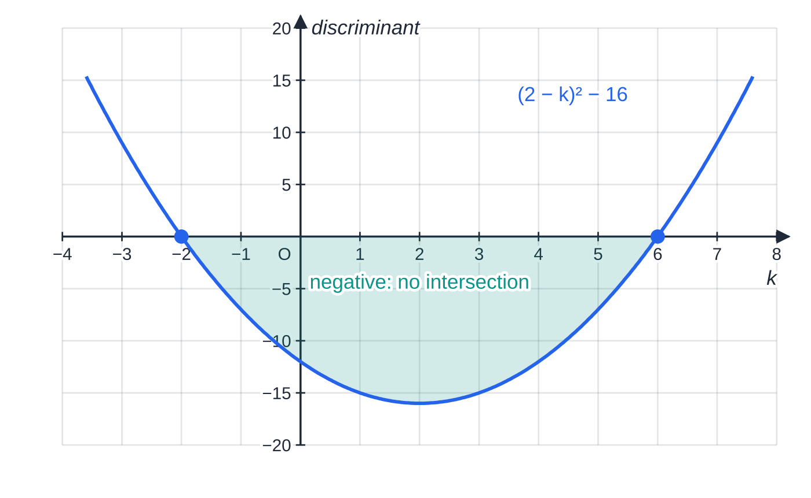
What if the inequality is in a constant such as k? (continued)
Section 5 of 12 · Worked example 6 · Hard · Find
WORKED EXAMPLE · QUESTION
The line y=kx+1, where k is a constant, does not meet the curve y=x²+2x+5. Find the set of possible values of k.
The discriminant from Worked example 6 plotted against k. It is negative only between the critical values -2 and 6, which is exactly where the line misses the curve.
Notes:
What if the inequality is in a constant such as k?: Worked example 6. Full notes: https://examinerprep.com/notes/edexcel-ial-maths/simultaneous-equations-and-inequalities/

Slide 23
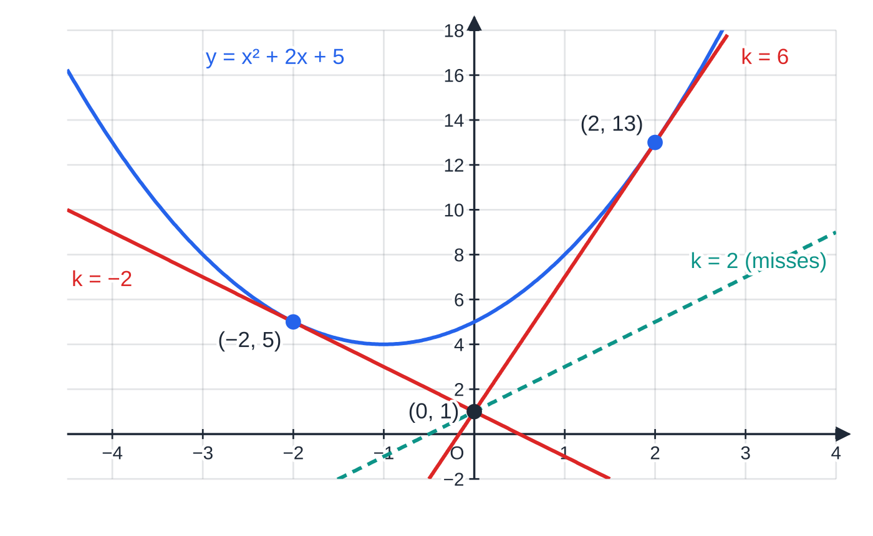
What if the inequality is in a constant such as k? (continued)
Section 5 of 12 · Worked example 6 · Hard · Find (continued)
SOLUTION
Substitute and collect into a quadratic in x: x²+2x+5=kx+1, so x²+(2-k)x+4=0.
No intersection means no real roots, so b²-4ac<0: (2-k)²-4(1)(4)<0, which expands to k²-4k-12<0.
Critical values: (k-6)(k+2)=0, so k=-2 or k=6.
"<0" on a ∪-shaped graph is between the roots. {k: -2<k<6}
At the critical values the line is a tangent: k=-2 touches the curve at (-2, 5) and k=6 touches it at (2, 13).
Every line y=kx+1 passes through (0, 1). As k increases from -2 to 6 the line swings between the two tangents without touching the curve; k=2 is one such line.
Notes:
What if the inequality is in a constant such as k?: Worked example 6. Full notes: https://examinerprep.com/notes/edexcel-ial-maths/simultaneous-equations-and-inequalities/

Slide 24
What if the inequality is in a constant such as k? (continued)
Section 5 of 12
Common error
Writing "k<-2, k<6" or "k<6 and k<-2" because the inequality sign was "<". The sign tells you which part of the graph you want, not which way to point each answer. Sketch it every time.
Notes:
What if the inequality is in a constant such as k?. Full notes: https://examinerprep.com/notes/edexcel-ial-maths/simultaneous-equations-and-inequalities/

Slide 25
How do you combine inequalities and use set notation?
Section 6 of 12
When x must satisfy two inequalities at once, the answer is the overlap of the two solution sets. The safest way to find it is to draw both on number lines stacked above each other and read off where both are shaded. A filled circle marks an end value that is included (≤, ≥); an open circle one that is not (<, >).
An answer that is one interval, such as -(3/2)≤x<1, can be written as a single double inequality. An answer in two separate pieces needs the word "or", or a union symbol in set notation. The braces {x: …} are read "the set of all x such that…".
Meaning | Inequality form | Set notation
one interval | -(3/2)≤x<1 | {x: -(3/2)≤x<1}
two pieces ("or") | x<-4 or x>2 | {x: x<-4}∪{x: x>2}
both at once ("and") | x>-3 and x≤4 | {x: x>-3}∩{x: x≤4}={x: -3<x≤4}
Notes:
How do you combine inequalities and use set notation?. Full notes: https://examinerprep.com/notes/edexcel-ial-maths/simultaneous-equations-and-inequalities/

Slide 26
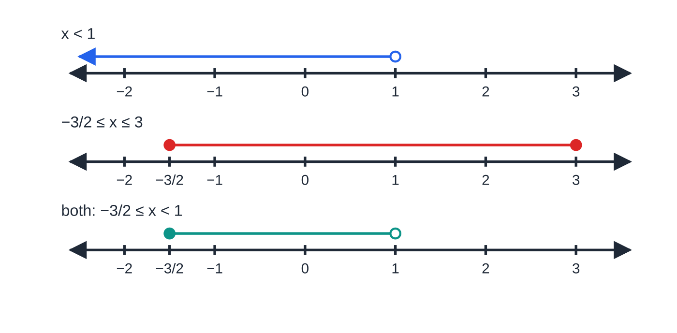
How do you combine inequalities and use set notation? (continued)
Section 6 of 12 · Worked example 7 · Medium · Find
WORKED EXAMPLE · QUESTION
Find the set of values of x for which both 4(x+2)<3x+9 and 2x²-3x-9≤0. Give your answer in set notation.
SOLUTION
Linear inequality. 4x+8<3x+9, so x<1.
Quadratic inequality. Critical values: (2x+3)(x-3)=0, so x=-(3/2) or x=3. "≤0" on a ∪-shape is between the roots, with the roots included: -(3/2)≤x≤3.
Worked example 7 on number lines. Only values on both of the first two lines survive into the third.
Notes:
How do you combine inequalities and use set notation?: Worked example 7. Full notes: https://examinerprep.com/notes/edexcel-ial-maths/simultaneous-equations-and-inequalities/

Slide 27
How do you combine inequalities and use set notation? (continued)
Section 6 of 12 · Worked example 7 · Medium · Find (continued)
Overlap. The lower end comes from the quadratic and is included; the upper end comes from the linear inequality and is excluded. {x: -(3/2)≤x<1}
Notes:
How do you combine inequalities and use set notation?: Worked example 7. Full notes: https://examinerprep.com/notes/edexcel-ial-maths/simultaneous-equations-and-inequalities/

Slide 28
How do you combine inequalities and use set notation? (continued)
Section 6 of 12
Exam tip
When the question asks for set notation, give your final answer in set notation, not just as inequalities. Use ∪ between two pieces; writing -4>x>2 says something no number can satisfy.
Notes:
How do you combine inequalities and use set notation?. Full notes: https://examinerprep.com/notes/edexcel-ial-maths/simultaneous-equations-and-inequalities/

Slide 29
How do you show inequalities as regions on a graph?
Section 7 of 12
An inequality in x and y, such as y>x²-4, is satisfied by a whole region of the plane. To draw it:
Draw the boundary by replacing the inequality sign with "=".
Use a solid boundary for ≤ or ≥ (points on it are included) and a dashed boundary for < or > (not included).
y>f(x) is the region above the curve y=f(x); y<f(x) is below it.
If you are unsure which side, test a point that is not on the boundary; the origin is often easiest.
Shade and label the region you are asked for, unless the question gives a different instruction.
The same picture answers one-variable questions too: f(x)<g(x) holds for the x-values where the graph of f is below the graph of g, which is either between or outside their intersection points.
Notes:
How do you show inequalities as regions on a graph?. Full notes: https://examinerprep.com/notes/edexcel-ial-maths/simultaneous-equations-and-inequalities/

Slide 30
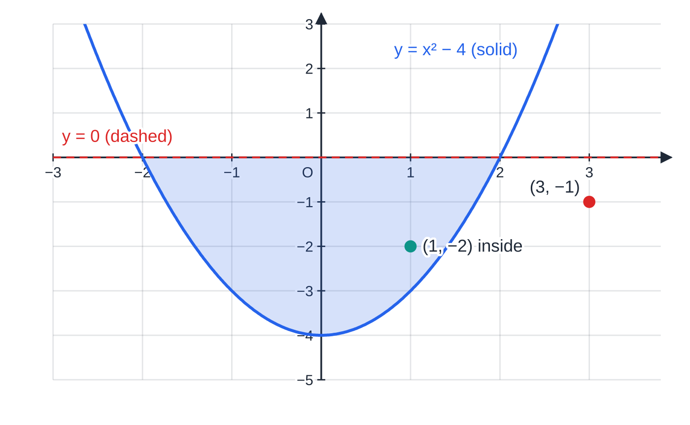
How do you show inequalities as regions on a graph? (continued)
Section 7 of 12
The region y≥x²-4, y<0 is shaded. The curve is solid (included) and the x-axis is dashed (excluded). The point (1, -2) is inside; (3, -1) is below the curve, so it is outside.
Notes:
How do you show inequalities as regions on a graph?. Full notes: https://examinerprep.com/notes/edexcel-ial-maths/simultaneous-equations-and-inequalities/

Slide 31
How do you show inequalities as regions on a graph? (continued)
Section 7 of 12 · Worked example 8 · Hard · Find, Hence
WORKED EXAMPLE · QUESTION
The curve C has equation y=x²-2x-3 and the line L has equation y=x+1.
(a) Find the coordinates of the points where L meets C.
(b) The region R lies above C and below L. Points on C are included in R; points on L are not. Write down inequalities that define R.
(c) The line y=x+k is a tangent to C. Find the value of k and the coordinates of the point of contact.
(d) Hence, or otherwise, find the set of values of x for which x²-2x-3<x+1.
Notes:
How do you show inequalities as regions on a graph?: Worked example 8. Full notes: https://examinerprep.com/notes/edexcel-ial-maths/simultaneous-equations-and-inequalities/

Slide 32
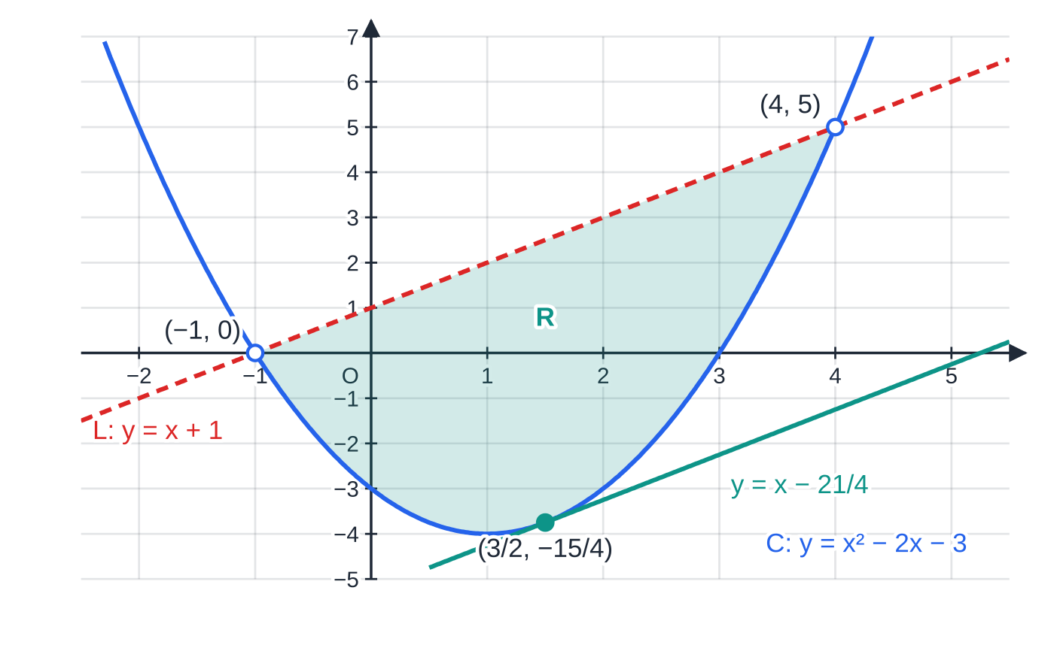
How do you show inequalities as regions on a graph? (continued)
Section 7 of 12 · Worked example 8 · Hard · Find, Hence (continued)
SOLUTION
(a) x²-2x-3=x+1, so x²-3x-4=0, so (x+1)(x-4)=0. Then y=x+1 gives (-1, 0) and (4, 5)
(b) Above C with the curve included (≤); below L with the line excluded (<): x²-2x-3≤y<x+1
(c) Substitute y=x+k: x²-3x-(3+k)=0. Tangent means discriminant =0: 9+4(3+k)=0, so 21+4k=0 and k=-(21/4).
The repeated root is x=-b/2a=(3/2), and y=(3/2)-(21/4)=-(15/4). Check on the curve: (9/4)-3-3=-(15/4) ✓.
Worked example 8. The boundary of R on the curve is solid (included); on the line it is dashed (excluded). The teal line is the parallel tangent from part (c).
Notes:
How do you show inequalities as regions on a graph?: Worked example 8. Full notes: https://examinerprep.com/notes/edexcel-ial-maths/simultaneous-equations-and-inequalities/

Slide 33
How do you show inequalities as regions on a graph? (continued)
Section 7 of 12 · Worked example 8 · Hard · Find, Hence (continued)
k=-(21/4), point of contact ((3/2), -(15/4))
(d) The curve is below the line between the intersection points from (a). {x: -1<x<4}
Notes:
How do you show inequalities as regions on a graph?: Worked example 8. Full notes: https://examinerprep.com/notes/edexcel-ial-maths/simultaneous-equations-and-inequalities/

Slide 34
How do you show inequalities as regions on a graph? (continued)
Section 7 of 12
Common error
Describing a region with only one inequality, or with the right inequalities but the wrong strict or non-strict signs. Every boundary needs its own inequality, and the sign must match how that boundary is drawn.
Notes:
How do you show inequalities as regions on a graph?. Full notes: https://examinerprep.com/notes/edexcel-ial-maths/simultaneous-equations-and-inequalities/

Slide 35
Exam tips for P1.2
Section 8 of 12
Exam tip 1 — substitute from the linear equation
Always rearrange the linear equation and substitute into the quadratic, never the other way round. Pick the variable whose coefficient is 1 if there is one, so that no fractions appear.
Exam tip 2 — give complete pairs
A simultaneous-equation answer is a set of pairs. Find each partner from the linear equation (substituting into the quadratic can produce extra, false partners) and present the answers as coordinates or as matched x=…, y=….
Notes:
Exam tips for P1.2. Full notes: https://examinerprep.com/notes/edexcel-ial-maths/simultaneous-equations-and-inequalities/

Slide 36
Exam tips for P1.2 (continued)
Section 8 of 12
Exam tip 3 — critical values, then a sketch
For any quadratic inequality, write the critical values first, then draw a quick sketch with them marked. A two-second sketch decides between "between the roots" and "outside the roots" far more reliably than a rule remembered under pressure.
Exam tip 4 — state the discriminant condition
In parameter questions, say which condition you are using (b²-4ac>0, =0 or <0) and why, before substituting. In a "show that" part, every line of that working should be visible.
Exam tip 5 — match the answer form to the question
"Find the set of values" wants inequalities; "in set notation" wants braces; "state the integer values" wants a list. Check whether the end values are included and use the correct strict or non-strict sign.
Notes:
Exam tips for P1.2. Full notes: https://examinerprep.com/notes/edexcel-ial-maths/simultaneous-equations-and-inequalities/

Slide 37
Common misconceptions
Section 9 of 12
Misconception | Why it is wrong | Correct idea
From x²>4x, divide by x to get x>4. | x could be negative or zero; dividing by it may reverse the sign or lose solutions. | x²-4x>0⇒x(x-4)>0⇒x<0 or x>4.
x²>9 means x>3. | Negative values such as -5 also satisfy it. | x<-3 or x>3.
Two separate intervals can be written as -4>x>2. | No number is less than -4 and greater than 2 at once. | x<-4 or x>2, or a union in set notation.
A zero discriminant means the line misses the curve. | Zero means one repeated root, so there is one point of contact. | Zero discriminant ⇔ tangent; negative ⇔ no intersection.
Any y-value that satisfies the quadratic can be paired with any x. | Each solution pair must satisfy both equations. | Find each partner from the linear equation and keep the pairs together.
A dashed boundary means the region is on the other side. | Dashed or solid says nothing about which side is the region. | Dashed: boundary not included (<, >). Solid: boundary included (≤, ≥).
Notes:
Common misconceptions. Full notes: https://examinerprep.com/notes/edexcel-ial-maths/simultaneous-equations-and-inequalities/

Slide 38
How this topic connects
Section 10 of 12
P1.1 Indices, surds and quadratics
Factorising, completing the square and b²-4ac are the tools used at every step here; this page applies them to two equations at once.
P1.3 Curve sketching and P1.4 Straight-line graphs
Sketches show how many times graphs meet, and perpendicular lines and intersection points use the same substitution method.
Circles (P2) and linear programming (D1)
A line meets a circle at two, one or no points, decided by exactly the same discriminant test; a tangent to a circle is the case b²-4ac=0. In Decision Mathematics, a set of linear inequalities defines a feasible region on a graph, with the same boundary and shading conventions.
Notes:
How this topic connects. Full notes: https://examinerprep.com/notes/edexcel-ial-maths/simultaneous-equations-and-inequalities/

Slide 39
Key formulae
Section 11 of 12
Formula | Use | In the formulae list?
x=(-b±√(b²-4ac))/2a | solving the quadratic after substituting, when it does not factorise | No – learn it
b²-4ac>0, =0, <0 | line crosses (two points), touches (tangent), misses the curve | No – learn it
x=-b/2a | the repeated root, giving the point of contact of a tangent | No – derive it from the formula with b²-4ac=0
(x-α)(x-β)<0⇔α<x<β; >0⇔x<α or x>β (α<β) | reading a quadratic inequality | No – derive it from a sketch
a<b and m<0⇒ma>mb | multiplying or dividing an inequality by a negative number | No – learn it
Notes:
Key formulae. Full notes: https://examinerprep.com/notes/edexcel-ial-maths/simultaneous-equations-and-inequalities/

Slide 40
Check your understanding
Section 12 of 12
1. Solve the simultaneous equations y=2x and x²+y²=20.
2. Solve 3-2x≥11.
3. Solve x²<9x.
4. Find the value of k for which y=x+k is a tangent to y=x²-3x+1, and the point of contact.
5. Which of the points (1, -2) and (3, -1) lie in the region defined by y≥x²-4 and y<0?
6. Find the set of values of p for which the equation x²+px+p+3=0 has two distinct real roots.
Notes:
Check your understanding: questions. Full notes: https://examinerprep.com/notes/edexcel-ial-maths/simultaneous-equations-and-inequalities/

Slide 41
Check your understanding · answers
Section 12 of 12
1. Substitute y=2x: x²+4x²=20, so x²=4 and x=±2. Using y=2x for the partners: (2, 4) and (-2, -4).
2. -2x≥8. Dividing by -2 reverses the sign: x≤-4.
3. x²-9x<0, so x(x-9)<0. Critical values 0 and 9; the ∪-shaped curve is below the axis between them: 0<x<9. (Dividing by x would have lost the lower limit.)
4. x²-3x+1=x+k, so x²-4x+1-k=0. Tangent: 16-4(1-k)=0, so 12+4k=0 and k=-3. Then x²-4x+4=0, (x-2)²=0, x=2, y=2-3=-1. k=-3, point of contact (2, -1).
5. (1, -2): -2≥1-4=-3 ✓ and -2<0 ✓, so it is inside. (3, -1): -1≥9-4=5 is false, so it is outside. Only (1, -2).
6. Two distinct roots: p²-4(p+3)>0, so p²-4p-12>0, (p-6)(p+2)>0. Critical values -2 and 6; ">0" on a ∪-shape is outside the roots: {p: p<-2}∪{p: p>6}.
Notes:
Check your understanding: answers. Full notes: https://examinerprep.com/notes/edexcel-ial-maths/simultaneous-equations-and-inequalities/

Slide 42
Practice questions
2 original exam-style questions. Answers at the end of the deck.

Slide 43
Question 1
6 marks
Two equations connect the real numbers x and y:
y − 3x = 1
2x² + y² = 18
(a) Show that substituting the first equation into the second gives 11x² + 6x − 17 = 0. [2]
(b) Hence solve the simultaneous equations, giving any non-integer values as exact fractions. [4]
Notes:
Online with the full mark scheme: https://examinerprep.com/ial-maths-p1-2-simultaneous-equations-and-inequalities-questions#IALM-P1-2-B-01

Slide 44
Question 2
7 marks
Solve the pair of simultaneous equations
2x + y = 3
4x² + xy − y² = 4
(a) Show that eliminating y leads to 2x² − 15x + 13 = 0. [3]
(b) Hence find all pairs of values (x, y) that satisfy both equations. [4]
Notes:
Online with the full mark scheme: https://examinerprep.com/ial-maths-p1-2-simultaneous-equations-and-inequalities-questions#IALM-P1-2-B-09

Slide 45
Answers

Slide 46
Question 1 · answer
Mark scheme
y = 3x + 1 substituted: 2x² + (3x + 1)² = 18
2x² + 9x² + 6x + 1 = 18, so 11x² + 6x − 17 = 0 (given answer, no errors seen)
(x − 1)(11x + 17) = 0, or formula
x = 1 or x = −17/11
uses y = 3x + 1 for at least one y-value
x = 1, y = 4 and x = −17/11, y = −40/11
Notes:
Full mark scheme: https://examinerprep.com/ial-maths-p1-2-simultaneous-equations-and-inequalities-questions#IALM-P1-2-B-01

Slide 47
Question 2 · answer
Mark scheme
y = 3 − 2x
4x² + x(3 − 2x) − (3 − 2x)² = 4
4x² + 3x − 2x² − 9 + 12x − 4x² = 4 ⇒ 2x² − 15x + 13 = 0 (given answer, correct expansion seen)
(x − 1)(2x − 13) = 0
x = 1 or x = 13/2
uses y = 3 − 2x
(1, 1) and (13/2, −10)
Notes:
Full mark scheme: https://examinerprep.com/ial-maths-p1-2-simultaneous-equations-and-inequalities-questions#IALM-P1-2-B-09

Slide 48
Keep practising
Notes for this topic
Questions on this topic
Build a printable test
ExaminerPrep is an independent tutoring service. It has been developed independently from and is not endorsed by the International Baccalaureate Organization. "International Baccalaureate", "IB" and "IB Diploma Programme" are registered trademarks of the IBO, used here for descriptive purposes only.
Pearson Edexcel and Cambridge are trademarks of their owners; ExaminerPrep is not affiliated with any exam board.

