Slide 1
EP
EDEXCEL IAL MATHS
M1.5 Statics of a particle
The full notes page in 13 sections · practice questions with answers · simulations
ExaminerPrep is an independent tutoring service. It has been developed independently from and is not endorsed by the International Baccalaureate Organization. "International Baccalaureate", "IB" and "IB Diploma Programme" are registered trademarks of the IBO, used here for descriptive purposes only.
Pearson Edexcel and Cambridge are trademarks of their owners; ExaminerPrep is not affiliated with any exam board.
Notes:
M1.5 Statics of a particle. Notes for this topic: https://examinerprep.com/notes/edexcel-ial-maths/statics-of-a-particle/

Slide 2
What this page covers
Overview
Forces as vectors: components, resultants, magnitude and direction, forces written with i and j
The forces met in M1 statics: weight, normal reaction, tension, thrust and friction
Equilibrium of a particle by resolving in two perpendicular directions
The triangle of forces for three forces
Particles suspended by two strings, and particles on inclined planes held by horizontal forces or strings
Friction in equilibrium: F ≤μR, limiting equilibrium, about to slide up or down a rough plane
The least force needed to move a particle on a rough surface
Notes:
What this page covers. Full notes: https://examinerprep.com/notes/edexcel-ial-maths/statics-of-a-particle/

Slide 3
In one minute
Key points
1. A particle is in equilibrium when the resultant force on it is zero, so every statics question is solved by drawing the forces, resolving in two perpendicular directions and setting each sum to zero.
2. A force F at angle θ to a direction has component Fcos θ along it and Fsin θ perpendicular to it.
3. Two directions give two equations, so at most two unknowns can be found.
4. On a plane, resolve along and perpendicular to the plane. The normal reaction is not mgcos α if another force has a component perpendicular to the plane.
5. Friction opposes the motion the particle would have: F ≤μR. In limiting equilibrium (about to move), F = μR.
6. With friction there is usually a range of forces that keep a particle at rest: one end with friction acting down the plane, the other with it acting up.
Notes:
In one minute. Full notes: https://examinerprep.com/notes/edexcel-ial-maths/statics-of-a-particle/

Slide 4
Which forces act on a particle at rest?
Section 1 of 13
Equilibrium of a particle. A particle is in equilibrium when the resultant of all the forces acting on it is zero.
Before you can add forces you must find them all. In M1 statics there are only five kinds, and each has a fixed direction rule.
Force | Where it comes from | Direction
Weight mg | Gravity, with g = 9.8 m s⁻² | Vertically downwards
Normal reaction R | A surface the particle rests on | Perpendicular to the surface, away from it
Tension T | A taut string, rope or cable | Along the string, away from the particle (a pull)
Thrust | A light rod pushing on the particle | Along the rod, towards the particle (a push)
Friction F | A rough surface | Along the surface, opposing the motion that would happen without it
Notes:
Which forces act on a particle at rest?. Full notes: https://examinerprep.com/notes/edexcel-ial-maths/statics-of-a-particle/

Slide 5
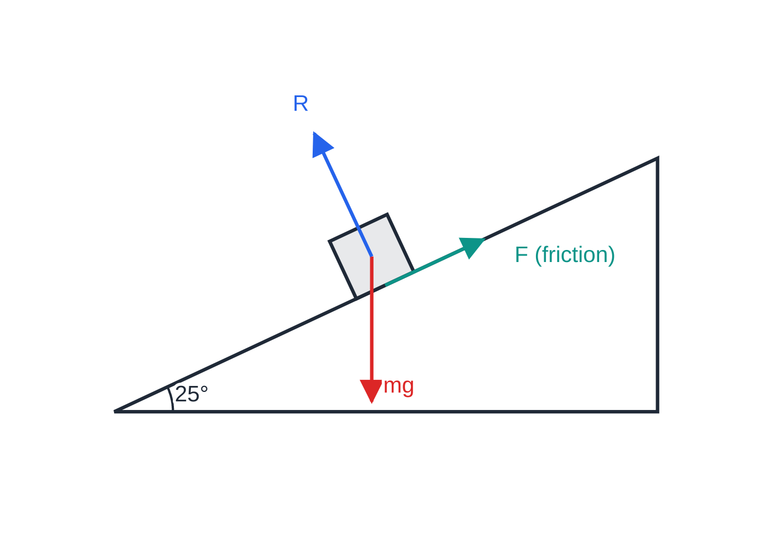
Which forces act on a particle at rest? (continued)
Section 1 of 13
The modelling words matter. A particle has all its forces acting at one point, so there is no turning and only resolving is needed. A light string or rod has no weight, so its tension or thrust is the same all along it. Inextensible means it does not stretch. A smooth surface gives no friction at all; a rough surface can give friction up to a maximum μR. A rod can pull (tension) or push (thrust), but a string can only pull: a negative tension in a string means the set-up is impossible.
A particle resting on a rough slope. The normal reaction is perpendicular to the surface, friction acts along it (here up the slope, because the particle would slide down), and the weight is vertical.
Notes:
Which forces act on a particle at rest?. Full notes: https://examinerprep.com/notes/edexcel-ial-maths/statics-of-a-particle/

Slide 6
Which forces act on a particle at rest? (continued)
Section 1 of 13
Common error — directions relative to the surface
Drawing a vertical normal reaction on an inclined plane, or a horizontal friction force. Both act relative to the surface: the normal reaction at right angles to it, friction along it.
Notes:
Which forces act on a particle at rest?. Full notes: https://examinerprep.com/notes/edexcel-ial-maths/statics-of-a-particle/

Slide 7
How do you resolve forces and find a resultant?
Section 2 of 13
Any force can be replaced by two perpendicular components. If a force F makes angle θ with a chosen direction, its component along that direction is Fcos θ and its component perpendicular to it is Fsin θ. To add several forces, add their components separately: X in one direction and Y in the other. Then the resultant has magnitude √(X² + Y²) and makes angle φ with the X-direction, where tan φ= Y/X.
A force written as (pi + qj) N already shows its components, and its magnitude is √(p² + q²). Use a sketch to fix the sign of each component (a force pointing left has a negative i-component), and always give a direction as an angle to a stated line, such as "49.1° above the direction of i".
Notes:
How do you resolve forces and find a resultant?. Full notes: https://examinerprep.com/notes/edexcel-ial-maths/statics-of-a-particle/

Slide 8
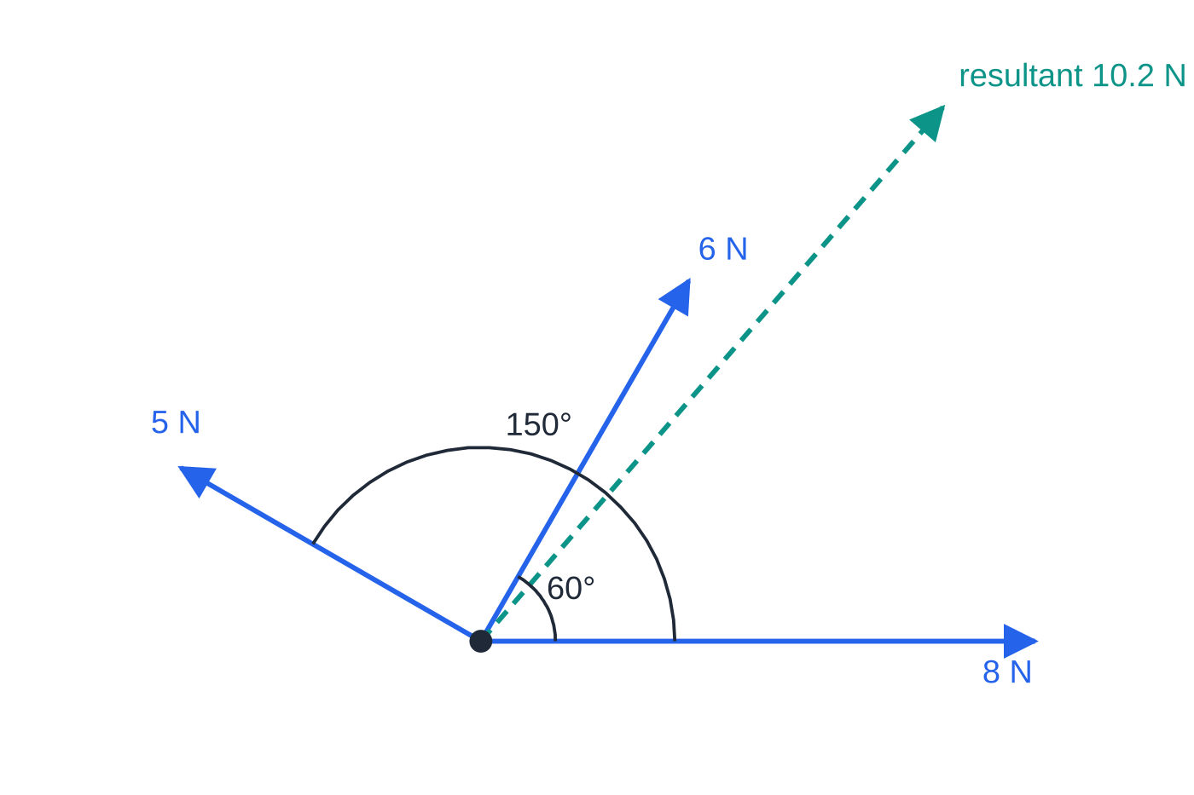
How do you resolve forces and find a resultant? (continued)
Section 2 of 13 · Worked example 1 · Medium · Find
WORKED EXAMPLE · QUESTION
Three horizontal forces act on a particle: 8 N in the direction of i, 6 N at 60° to i, and 5 N at 150° to i, each angle measured anticlockwise from i. Find the magnitude of the resultant force and the angle it makes with i.
The three forces of worked example 1, to scale, with their resultant (dashed) at 49.1° to i.
Notes:
How do you resolve forces and find a resultant?: Worked example 1. Full notes: https://examinerprep.com/notes/edexcel-ial-maths/statics-of-a-particle/

Slide 9
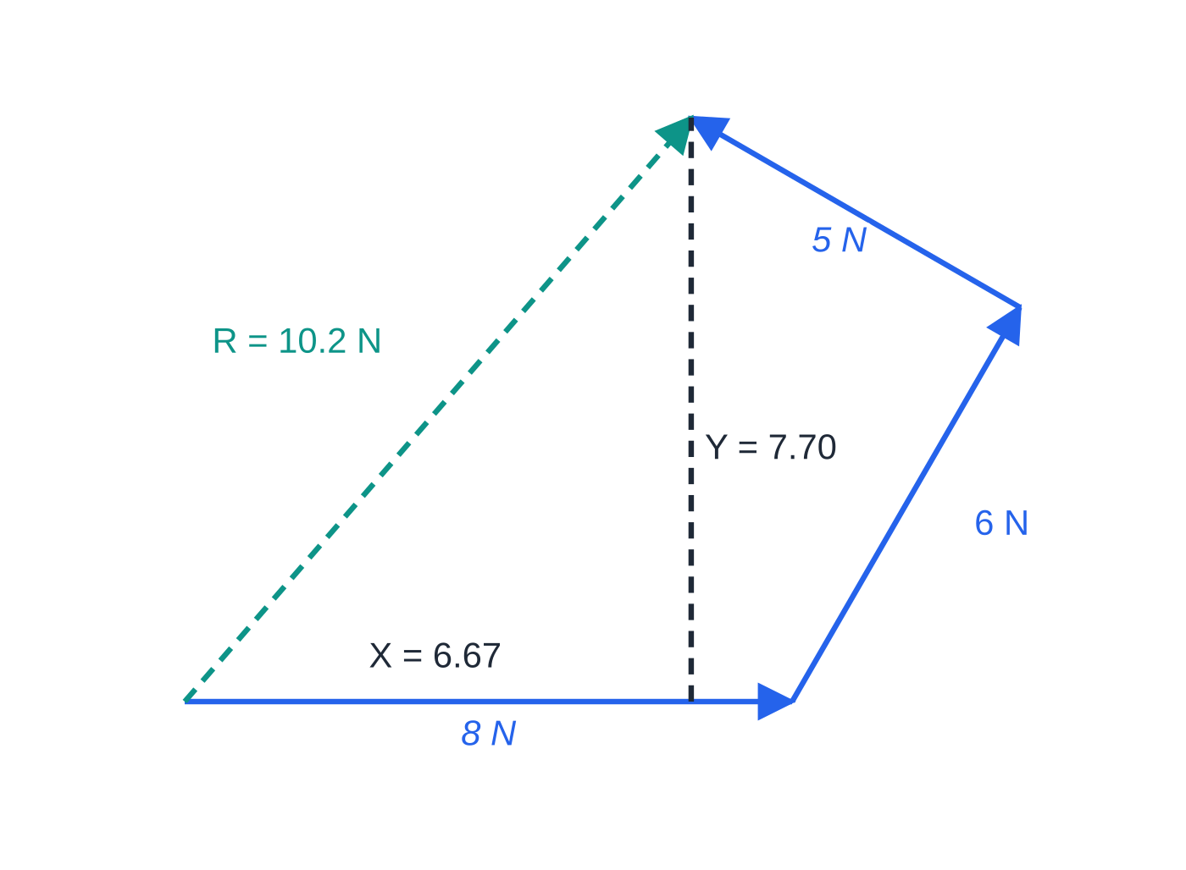
How do you resolve forces and find a resultant? (continued)
Section 2 of 13 · Worked example 1 · Medium · Find (continued)
SOLUTION
Components parallel to i: X = 8 + 6cos 60° + 5cos 150° = 8 + 3 - 4.330 = 6.670 N.
Components parallel to j: Y = 0 + 6sin 60° + 5sin 150° = 5.196 + 2.5 = 7.696 N.
Magnitude √(6.670² + 7.696²) = 10.18 N, and tan φ= 7.696 ÷6.670 gives φ= 49.1°. Both components are positive, so the resultant points into the first quadrant. 10.2 N at 49.1° to i
Drawn tip to tail, the forces form a polygon closed by the resultant. The order does not matter; the components X and Y are the same.
Notes:
How do you resolve forces and find a resultant?: Worked example 1. Full notes: https://examinerprep.com/notes/edexcel-ial-maths/statics-of-a-particle/

Slide 10
How do you solve an equilibrium problem by resolving?
Section 3 of 13
The method is the same every time:
1. Draw a clear diagram with every force on the particle, labelled, and the given angles marked.
2. Choose two perpendicular directions, usually horizontal and vertical, or along and perpendicular to a plane. Pick them so that the unknown forces have as few components as possible.
3. Resolve in each direction, writing "R(→)" or "R(↑)" so the direction of each equation is clear.
4. Solve the two equations simultaneously.
For forces given as vectors, equilibrium means the vector sum is 0: the i-components and the j-components each add to zero. A useful consequence: if one force is removed from a set in equilibrium, the rest add up to a force equal and opposite to the one removed.
Notes:
How do you solve an equilibrium problem by resolving?. Full notes: https://examinerprep.com/notes/edexcel-ial-maths/statics-of-a-particle/

Slide 11
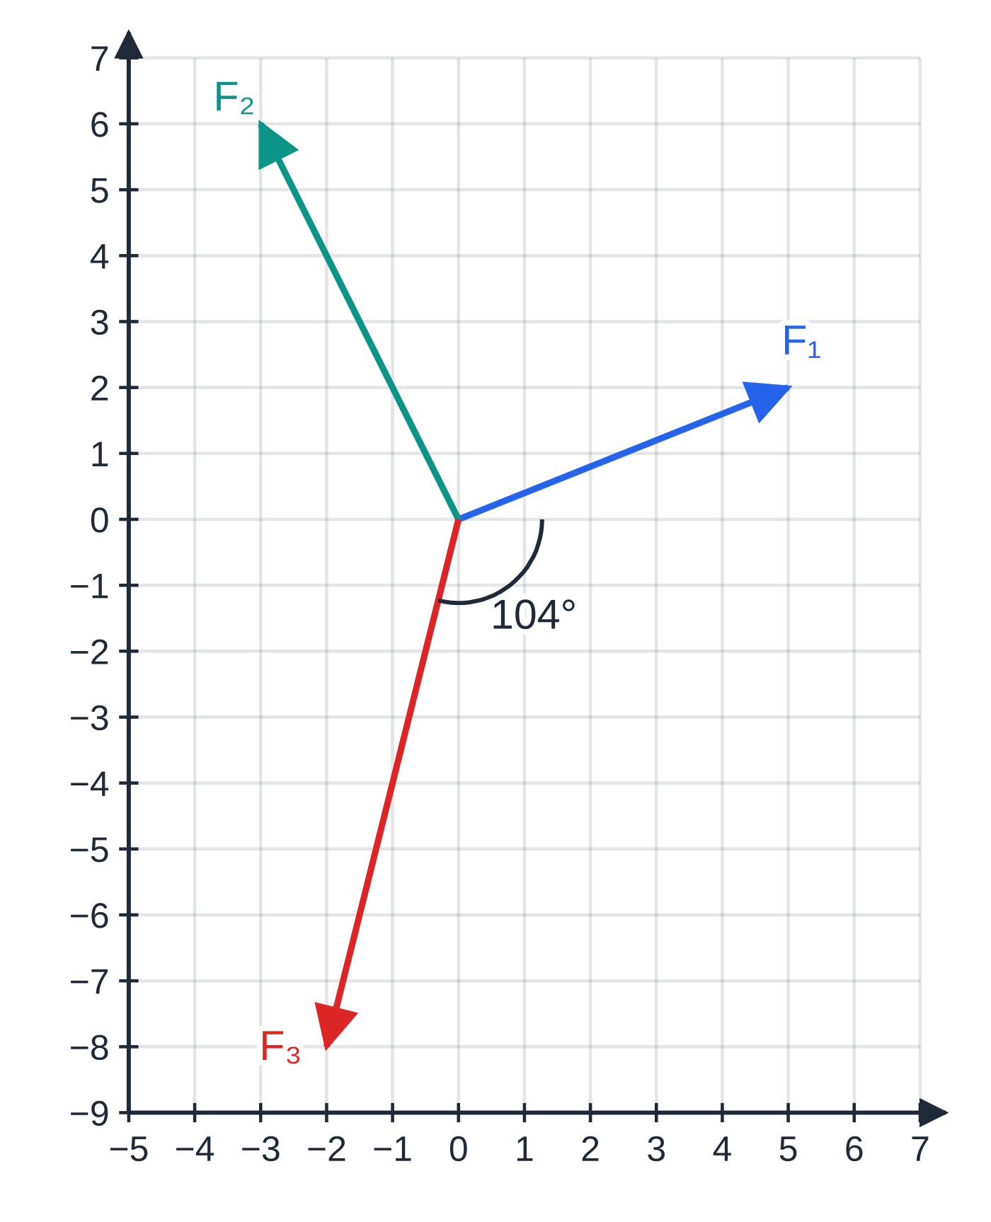
How do you solve an equilibrium problem by resolving? (continued)
Section 3 of 13 · Worked example 2 · Easy · Find
WORKED EXAMPLE · QUESTION
A particle is in equilibrium under three forces: F₁ = (5i + 2j) N, F₂ = (-3i + 6j) N and F₃. (a) Find F₃, its magnitude, and the angle it makes with i. (b) F₂ is removed. Find the magnitude of the resultant of the two forces that remain.
SOLUTION
(a) The forces add to zero: F₃ = -(F₁ + F₂) = -(2i + 8j). Magnitude √(2² + 8²) = √68 = 2√17 = 8.25 N. The force points left and down, at tan⁻¹(8 ÷2) = 76.0° below -i, so the angle with i is 180° - 76.0°. F₃ = (−2i − 8j) N, 8.25 N, 104.0° to i (clockwise)
(b) F₁ + F₃ = -F₂ = (3i - 6j) N, magnitude √45 = 3√5. 6.71 N
The three forces of worked example 2. F₃ points left and down; it makes 104.0° with i, measured clockwise.
Notes:
How do you solve an equilibrium problem by resolving?: Worked example 2. Full notes: https://examinerprep.com/notes/edexcel-ial-maths/statics-of-a-particle/

Slide 12
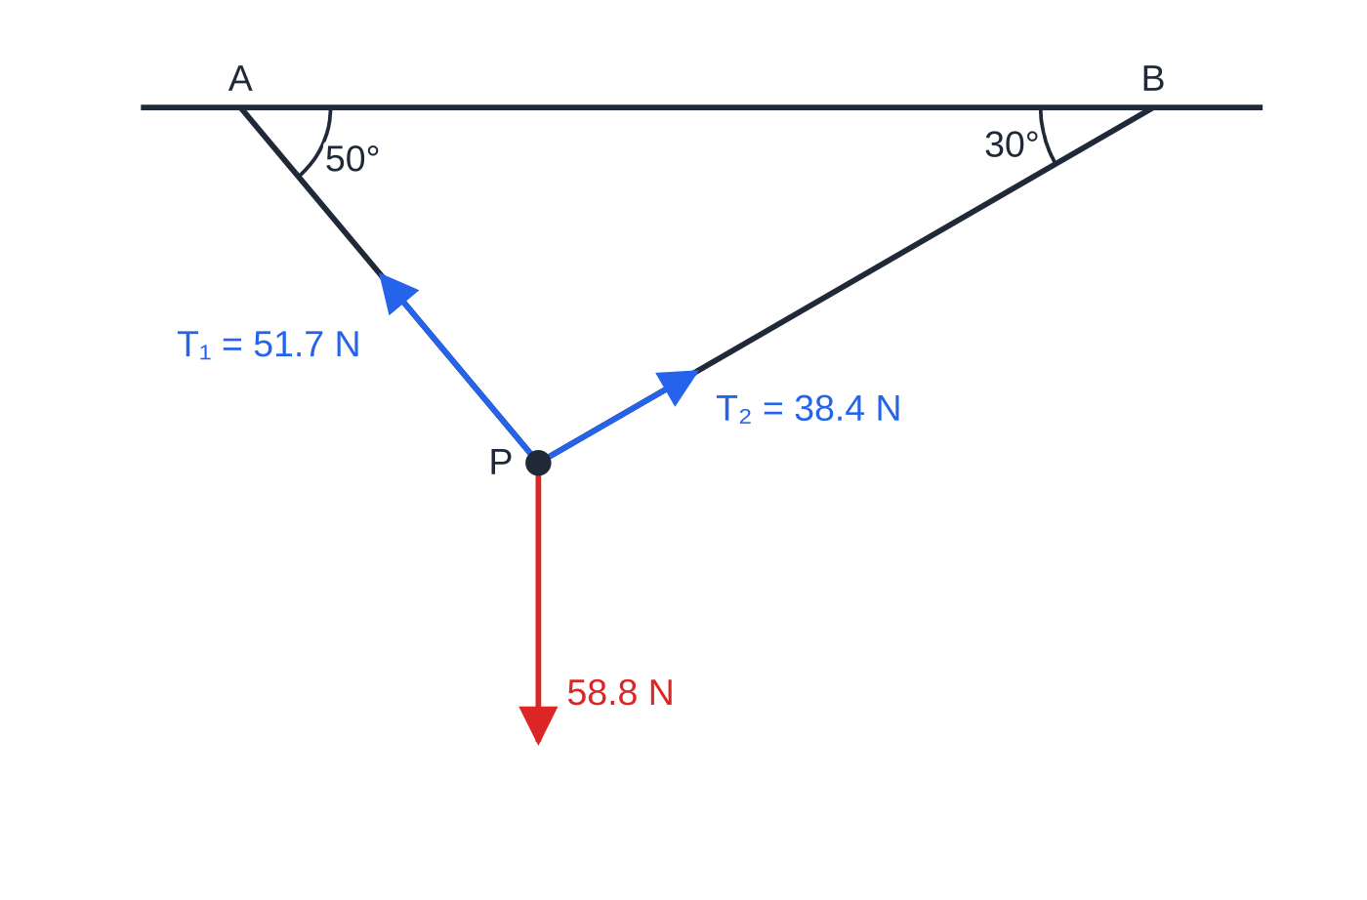
How do you solve an equilibrium problem by resolving? (continued)
Section 3 of 13 · Worked example 3 · Medium · Find
WORKED EXAMPLE · QUESTION
A particle P of mass 6 kg hangs in equilibrium from two light inextensible strings AP and BP. The ends A and B are fixed to a horizontal ceiling. AP makes an angle of 50° with the horizontal and BP makes an angle of 30° with the horizontal. Find the tension in each string.
SOLUTION
R(→), with tension T₁ in AP and T₂ in BP: T₁cos 50° = T₂cos 30°, so T₁ = 1.3473 T₂.
R(↑): T₁sin 50° + T₂sin 30° = 6 ×9.8 = 58.8.
Tensions and weight to scale. The steeper string carries the larger tension.
Notes:
How do you solve an equilibrium problem by resolving?: Worked example 3. Full notes: https://examinerprep.com/notes/edexcel-ial-maths/statics-of-a-particle/

Slide 13
How do you solve an equilibrium problem by resolving? (continued)
Section 3 of 13 · Worked example 3 · Medium · Find (continued)
Substitute: (1.3473sin 50° + sin 30°)T₂ = 58.8, so T₂ = 38.38 N and T₁ = 1.3473 ×38.38 = 51.71 N. T₁ = 51.7 N, T₂ = 38.4 N
Keep unrounded values between steps; rounding T₂ to 38 first would move T₁ to 51.2 N.
Notes:
How do you solve an equilibrium problem by resolving?: Worked example 3. Full notes: https://examinerprep.com/notes/edexcel-ial-maths/statics-of-a-particle/

Slide 14
When is a triangle of forces quicker?
Section 4 of 13
When exactly three forces keep a particle in equilibrium, drawing them tip to tail gives a closed triangle of forces. The sides are proportional to the forces, so the sine rule gives the unknown magnitudes without simultaneous equations. The angle inside the triangle between two sides is 180° minus the angle between those two forces on the force diagram, so sketch carefully. Resolving twice always works too; the triangle is just faster when the angles are awkward. (Lami's theorem is the same sine rule in another form; it is not needed.)
Notes:
When is a triangle of forces quicker?. Full notes: https://examinerprep.com/notes/edexcel-ial-maths/statics-of-a-particle/

Slide 15
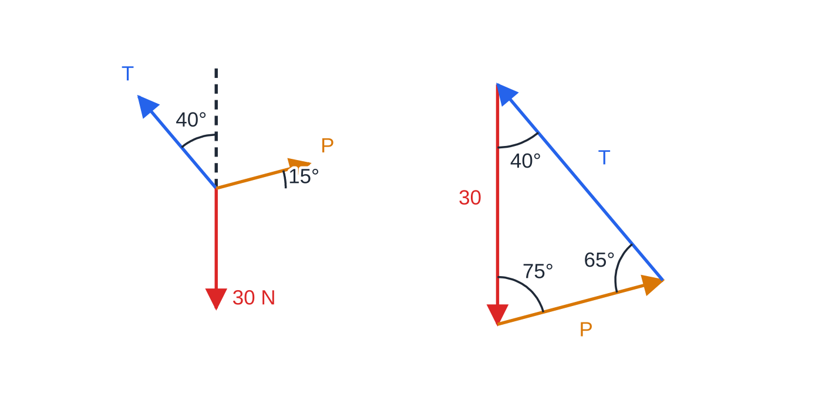
When is a triangle of forces quicker? (continued)
Section 4 of 13 · Worked example 4 · Medium · Find
WORKED EXAMPLE · QUESTION
A particle of weight 30 N is held in equilibrium by a light string and a force of magnitude P newtons. The string makes an angle of 40° with the upward vertical. The force P acts on the other side of the vertical, at 15° above the horizontal. Find the tension in the string and the value of P.
SOLUTION
Left: the force diagram. Right: the same forces tip to tail form a closed triangle with angles 65°, 75° and 40° opposite W, T and P.
Notes:
When is a triangle of forces quicker?: Worked example 4. Full notes: https://examinerprep.com/notes/edexcel-ial-maths/statics-of-a-particle/

Slide 16
When is a triangle of forces quicker? (continued)
Section 4 of 13 · Worked example 4 · Medium · Find (continued)
Angles in the triangle (180° minus the angle between each pair of forces): between T and P the angle is 180° - 50° - 15° = 115°, so 65° is opposite W; between W and P it is 105°, so 75° is opposite T; between W and T it is 140°, so 40° is opposite P.
Sine rule: 30/sin 65° = T/sin 75° = P/sin 40° = 33.10. So T = 33.10sin 75° = 31.97 and P = 33.10sin 40° = 21.28. T = 32.0 N, P = 21.3 N
Check by resolving horizontally: Tsin 40° = 20.55 and Pcos 15° = 20.55.
Notes:
When is a triangle of forces quicker?: Worked example 4. Full notes: https://examinerprep.com/notes/edexcel-ial-maths/statics-of-a-particle/

Slide 17
How do you deal with a particle on a smooth inclined plane?
Section 5 of 13
Resolve parallel and perpendicular to the plane: then the normal reaction (and friction, if any) need no resolving. For a plane at angle α to the horizontal, the weight has components mgsin α down the plane and mgcos α into the plane. A horizontal force P pushing towards the plane makes angle α with the plane: Pcos α up the plane and Psin α into it, so it increases the normal reaction. A string at angle β to the plane, pulling up the slope, gives Tcos β up the plane and Tsin β away from it, so it reduces the normal reaction.
Notes:
How do you deal with a particle on a smooth inclined plane?. Full notes: https://examinerprep.com/notes/edexcel-ial-maths/statics-of-a-particle/

Slide 18
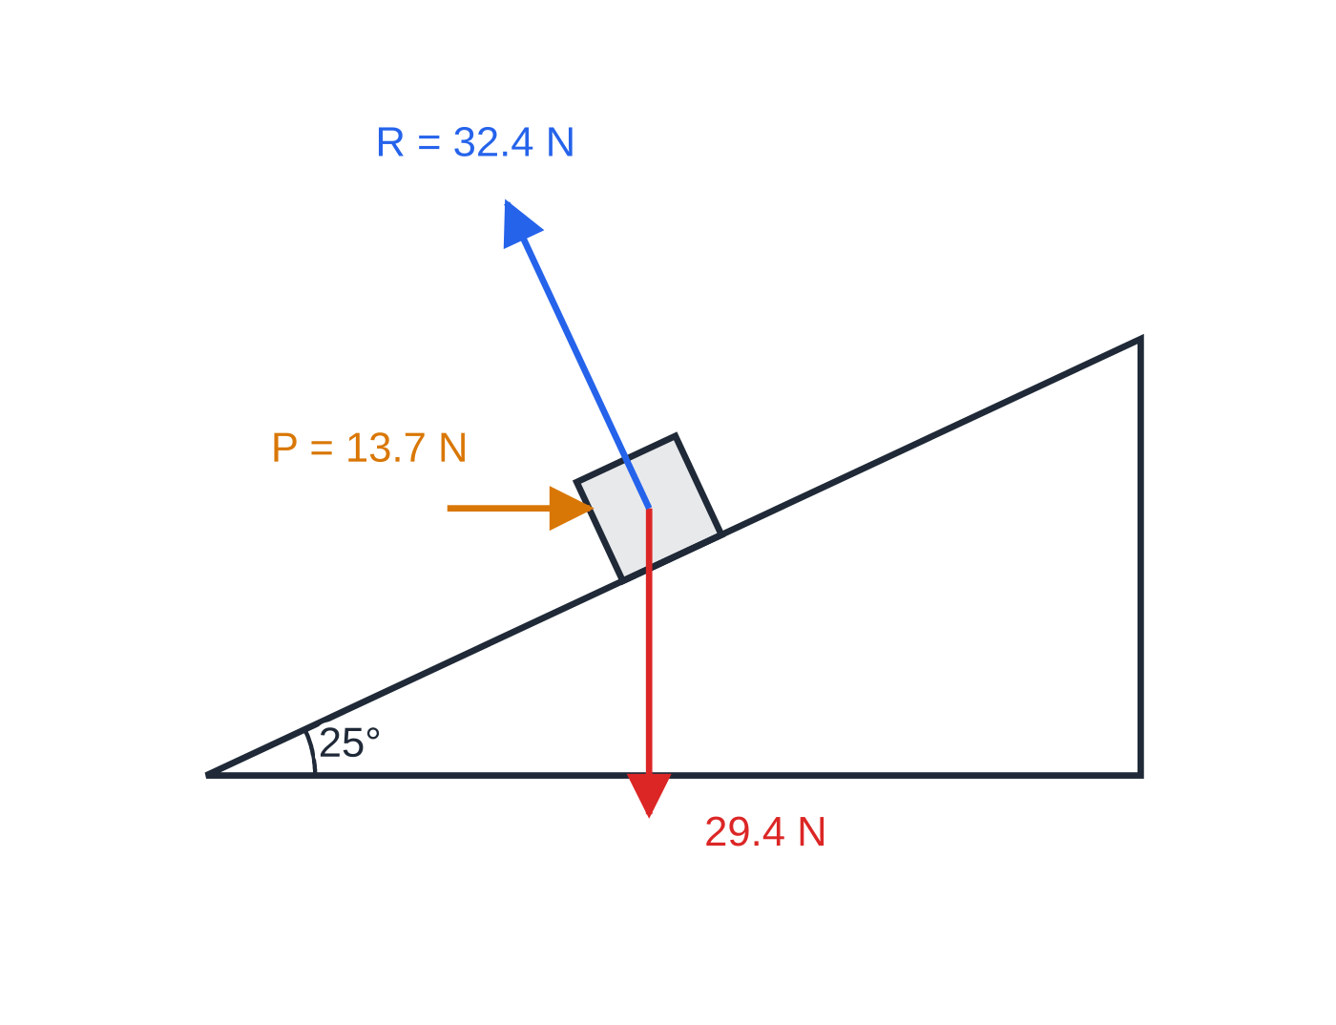
How do you deal with a particle on a smooth inclined plane? (continued)
Section 5 of 13 · Worked example 5 · Medium · Find
WORKED EXAMPLE · QUESTION
A particle of mass 3 kg rests on a smooth plane inclined at 25° to the horizontal. It is held in equilibrium by a horizontal force of magnitude P newtons, acting in the vertical plane containing a line of greatest slope. (a) Find P. (b) Find the normal reaction. (c) The horizontal force is replaced by a force acting up the line of greatest slope. Find the magnitude of this force and the new normal reaction.
SOLUTION
(a) R(parallel to the plane): Pcos 25° = 3 ×9.8 ×sin 25°, so P = 29.4tan 25° = 13.71. P = 13.7 N
(b) R(perpendicular to the plane):
Worked example 5, to scale. The normal reaction (32.4 N) is larger than the weight (29.4 N), because P also pushes the particle into the plane.
Notes:
How do you deal with a particle on a smooth inclined plane?: Worked example 5. Full notes: https://examinerprep.com/notes/edexcel-ial-maths/statics-of-a-particle/

Slide 19
How do you deal with a particle on a smooth inclined plane? (continued)
Section 5 of 13 · Worked example 5 · Medium · Find (continued)
R = 29.4cos 25° + Psin 25° = 32.44. R = 32.4 N
(c) A force along the plane has no perpendicular component: force = 29.4sin 25° = 12.4 N and R = 29.4cos 25° = 26.6 N. 12.4 N; R = 26.6 N
Check for (b): P, the weight and R form a right-angled triangle, so R = 29.4 ÷cos 25° = 32.44 N.
Notes:
How do you deal with a particle on a smooth inclined plane?: Worked example 5. Full notes: https://examinerprep.com/notes/edexcel-ial-maths/statics-of-a-particle/

Slide 20
How do you deal with a particle on a smooth inclined plane? (continued)
Section 5 of 13
Common error — R = mg cos α out of habit
That is only true when no force other than the weight has a component perpendicular to the plane. Always resolve perpendicular to the plane in full.
Notes:
How do you deal with a particle on a smooth inclined plane?. Full notes: https://examinerprep.com/notes/edexcel-ial-maths/statics-of-a-particle/

Slide 21
How does friction behave when a particle is at rest?
Section 6 of 13
Friction in equilibrium. F ≤μR, with F = μR when the particle is on the point of moving. μ is the coefficient of friction between the surfaces: a number with no units, usually between 0 and 1; μ= 0 is a smooth surface.
Friction is only as large as it needs to be. While the particle stays at rest, F is found by resolving, not from μR. The maximum available friction is μR; when F reaches it, the particle is in limiting equilibrium. "On the point of sliding", "about to move" and "just" all mean F = μR. Friction acts along the surface, opposite to the direction the particle would move if the surface were smooth. If the friction needed is greater than μR, the particle cannot stay at rest.
Notes:
How does friction behave when a particle is at rest?. Full notes: https://examinerprep.com/notes/edexcel-ial-maths/statics-of-a-particle/

Slide 22
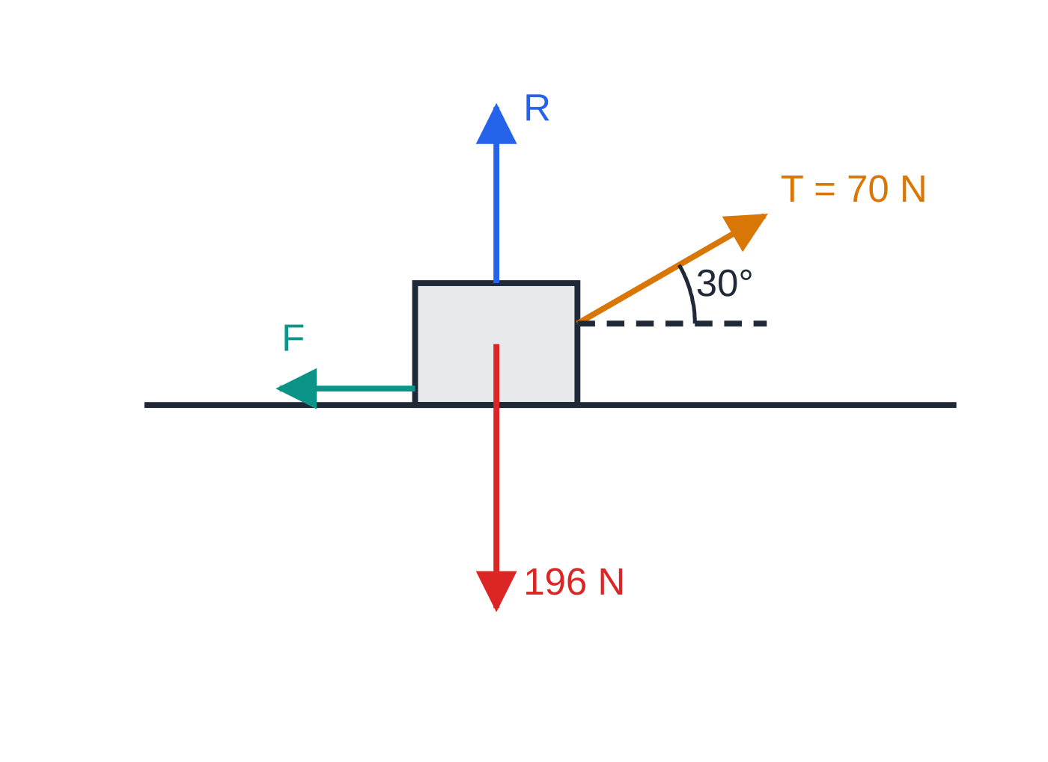
How does friction behave when a particle is at rest? (continued)
Section 6 of 13 · Worked example 6 · Medium · Find / Show that
WORKED EXAMPLE · QUESTION
A crate of mass 20 kg, modelled as a particle, rests on rough horizontal ground. A rope attached to the crate makes an angle of 30° above the horizontal. When the tension in the rope is 70 N, the crate is on the point of sliding. (a) Find the coefficient of friction. (b) Find the friction force when the tension is 40 N, and show that the crate does not move.
The crate in limiting equilibrium (not to scale). The rope lifts part of the weight, so R = 161 N, less than 196 N.
Notes:
How does friction behave when a particle is at rest?: Worked example 6. Full notes: https://examinerprep.com/notes/edexcel-ial-maths/statics-of-a-particle/

Slide 23
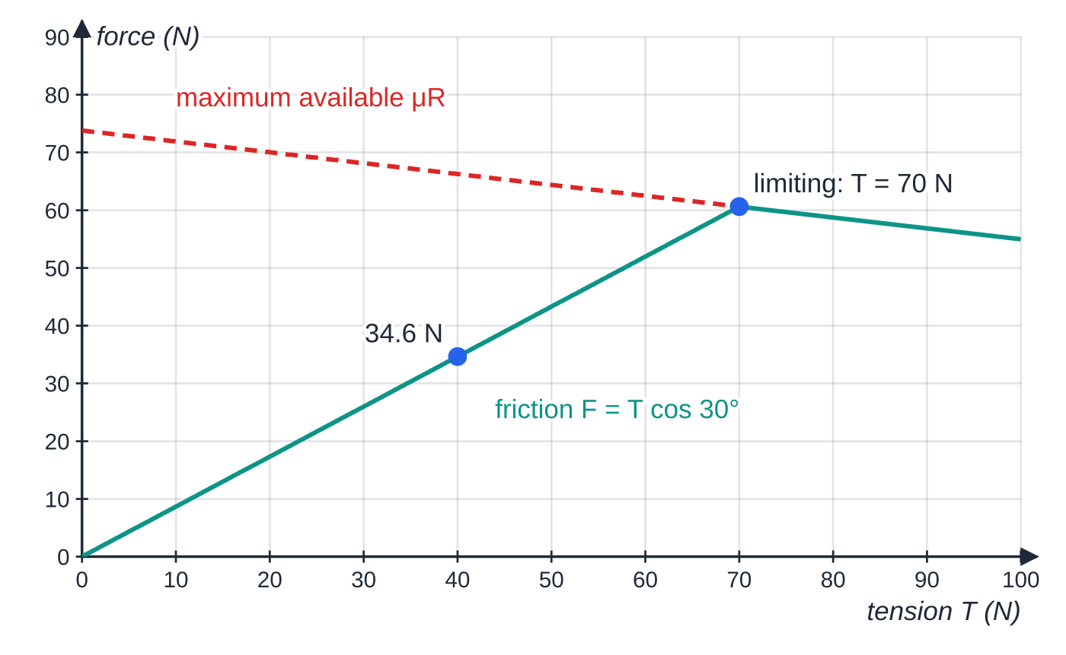
How does friction behave when a particle is at rest? (continued)
Section 6 of 13 · Worked example 6 · Medium · Find / Show that (continued)
SOLUTION
(a) R(↑): R + 70sin 30° = 20 ×9.8, so R = 196 - 35 = 161 N. R(→), limiting so F = μR: F = 70cos 30° = 60.62 N, and μ= 60.62 ÷161 = 0.3765… μ = 0.38 (2 s.f.)
(b) At 40 N, friction balances the horizontal pull: F = 40cos 30° = 34.6 N. Now R = 196 - 40sin 30° = 176 N, so μR = 0.3765 ×176 = 66.3 N > 34.6 N. F = 34.6 N; the crate stays at rest
In (b) the friction is not μR: the crate is not on the point of moving.
As the tension rises, friction grows exactly with T cos 30° until it reaches μR at T = 70 N. Beyond that the crate slides (μR falls slightly, because the rope lifts more of the weight).
Notes:
How does friction behave when a particle is at rest?: Worked example 6. Full notes: https://examinerprep.com/notes/edexcel-ial-maths/statics-of-a-particle/

Slide 24
What happens on a rough inclined plane?
Section 7 of 13
With no applied force, a particle on a rough plane at angle α stays at rest only if friction can hold the weight component: mgsin α≤μmgcos α, that is μ≥tan α, whatever the mass.
With a holding force there are two limiting cases. About to slide down: friction acts up the plane and F = μR; this gives the smallest force that holds the particle. About to slide up: friction acts down the plane and F = μR; this gives the largest force before it moves up. Any force between the two keeps the particle at rest. Re-resolve for each case: the normal reaction usually changes too.
Notes:
What happens on a rough inclined plane?. Full notes: https://examinerprep.com/notes/edexcel-ial-maths/statics-of-a-particle/

Slide 25
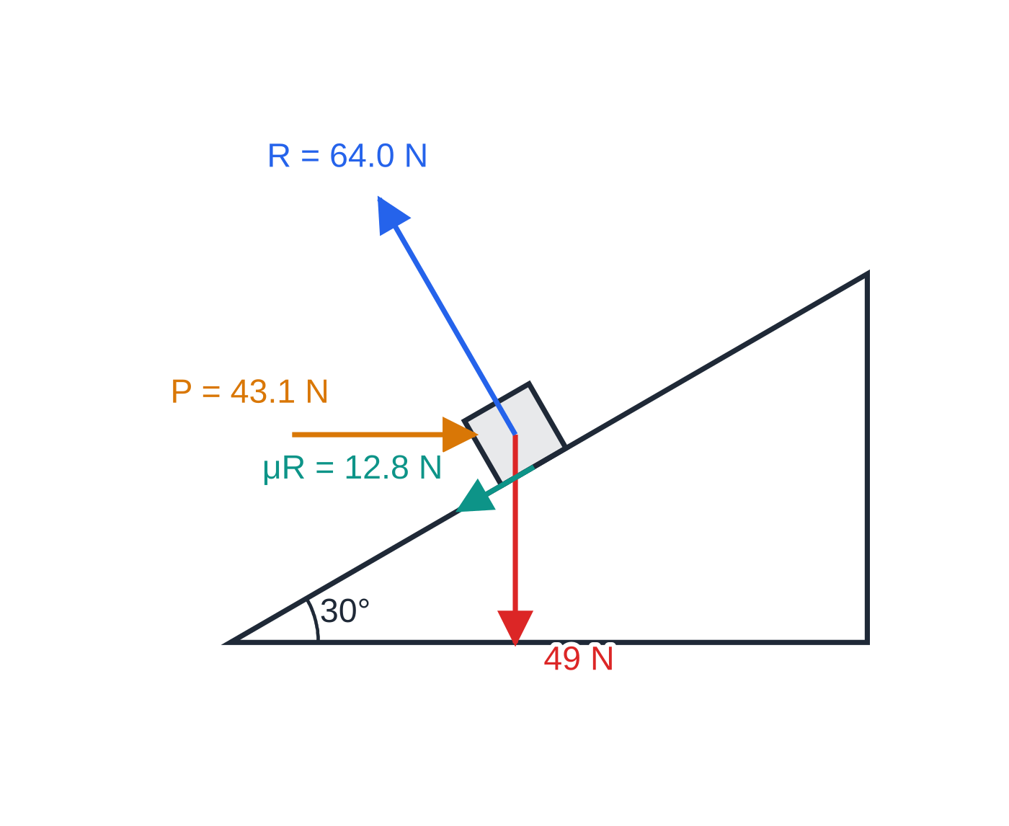
What happens on a rough inclined plane? (continued)
Section 7 of 13 · Worked example 7 · Hard · Show that / Find
WORKED EXAMPLE · QUESTION
A particle of mass 5 kg is placed on a rough plane inclined at 30° to the horizontal. The coefficient of friction between the particle and the plane is 0.2. A horizontal force of magnitude P newtons acts on the particle, in the vertical plane containing a line of greatest slope, pushing towards the plane. (a) Show that without the force the particle would slide down the plane. (b) Find P when the particle is on the point of sliding up the plane. (c) Find P when the particle is on the point of sliding down the plane. (d) State the range of values of P for which the particle stays at rest.
(b) About to slide up: friction μR acts down the plane, and P must be 43.1 N. Forces to scale.
Notes:
What happens on a rough inclined plane?: Worked example 7. Full notes: https://examinerprep.com/notes/edexcel-ial-maths/statics-of-a-particle/

Slide 26
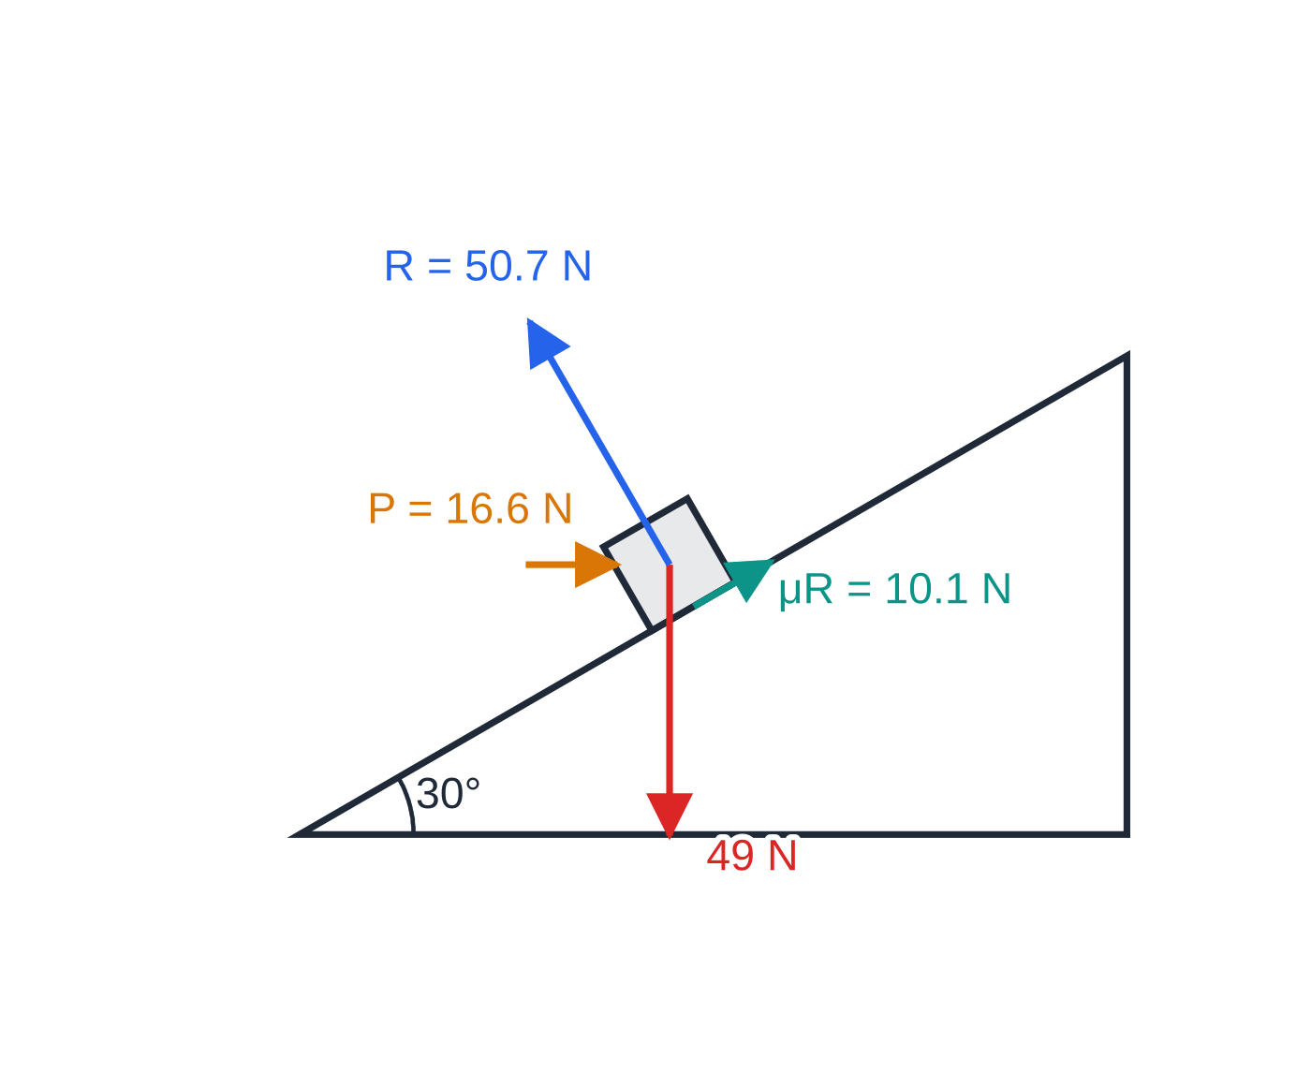
What happens on a rough inclined plane? (continued)
Section 7 of 13 · Worked example 7 · Hard · Show that / Find (continued)
SOLUTION
(a) Down the plane: 49sin 30° = 24.5 N. Maximum friction: μR = 0.2 ×49cos 30° = 8.49 N < 24.5 N, so it slides (equivalently tan 30° = 0.577 > 0.2).
(b) About to slide up, friction μR down the plane. R(perpendicular): R = 49cos 30° + Psin 30°. R(parallel): Pcos 30° = 49sin 30° + 0.2R. So P(cos 30° - 0.2sin 30°) = 49(sin 30° + 0.2cos 30°), and P = 49 ×0.6732 ÷0.766 = 43.06. P = 43.1 N
(c) About to slide down, friction μR up the plane: Pcos 30° + 0.2R = 49sin 30°, with the same R. So P(cos 30° + 0.2sin 30°) = 49(sin 30° - 0.2cos 30°), and P = 49 ×0.3268 ÷0.966 = 16.58. P = 16.6 N
(c) About to slide down: friction reverses and acts up the plane, so only 16.6 N is needed. R is smaller too.
Notes:
What happens on a rough inclined plane?: Worked example 7. Full notes: https://examinerprep.com/notes/edexcel-ial-maths/statics-of-a-particle/

Slide 27
What happens on a rough inclined plane? (continued)
Section 7 of 13 · Worked example 7 · Hard · Show that / Find (continued)
(d) 16.6 ≤ P ≤ 43.1
The normal reaction is 64.0 N in (b) and 50.7 N in (c): a single value of R for both cases would be wrong.
Notes:
What happens on a rough inclined plane?: Worked example 7. Full notes: https://examinerprep.com/notes/edexcel-ial-maths/statics-of-a-particle/

Slide 28
What happens on a rough inclined plane? (continued)
Section 7 of 13
Exam tip — which way would it move?
Before resolving on a rough plane, ask "which way would it move if the surface were smooth?" and draw friction the other way. In a range question, state the direction of friction and "F = μR" in words for each case.
Notes:
What happens on a rough inclined plane?. Full notes: https://examinerprep.com/notes/edexcel-ial-maths/statics-of-a-particle/

Slide 29
What is the least force needed to move a particle?
Section 8 of 13
On rough horizontal ground, pulling at angle θ above the horizontal has two effects. The horizontal part, Pcos θ, is smaller; but the vertical part, Psin θ, lifts some of the weight, so R and the maximum friction μR are smaller too. In limiting equilibrium, Pcos θ= μ(mg - Psin θ), so
P = μmg/(cos θ+ μsin θ).
A neat way to find the minimum: combine R and F = μR into one total contact force S, which makes angle λ with the normal, where tan λ= μ (λ is the angle of friction). The particle is then held by three forces, mg, S and P. In the triangle of forces mg is fixed and S has a fixed direction, so P is shortest when it is perpendicular to S: at angle λ above the horizontal, with P_(min) = mgsin λ.
Notes:
What is the least force needed to move a particle?. Full notes: https://examinerprep.com/notes/edexcel-ial-maths/statics-of-a-particle/

Slide 30
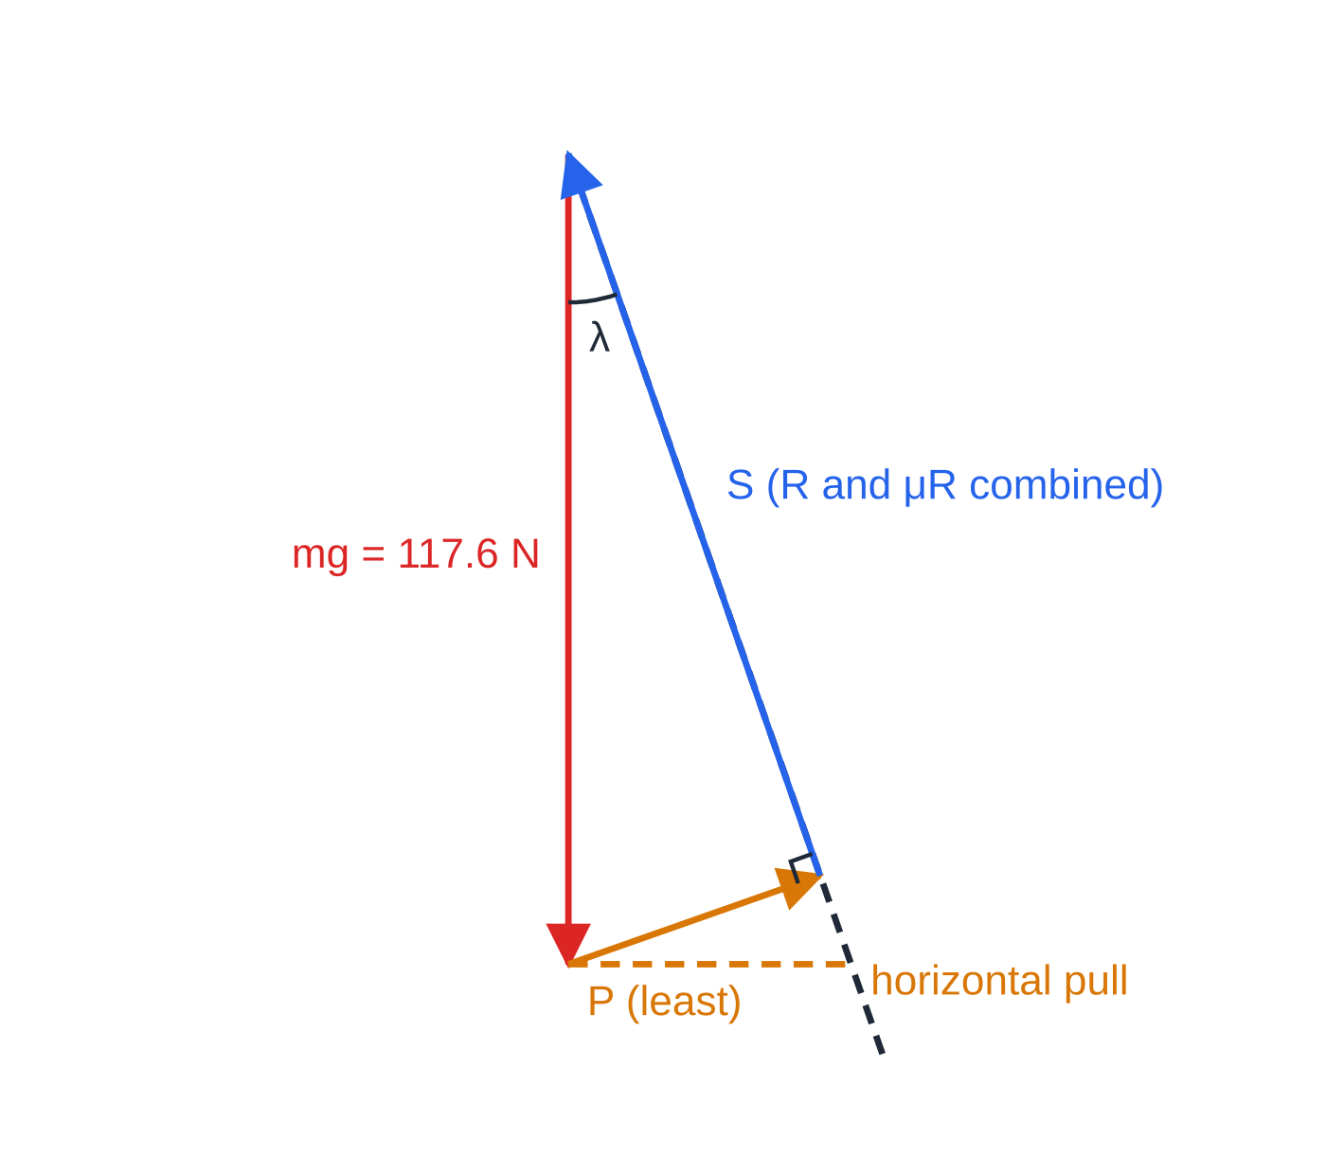
What is the least force needed to move a particle? (continued)
Section 8 of 13
Triangle of forces for worked example 8, to scale. S must lie along the dashed line, so the shortest P that closes the triangle is perpendicular to S.
Notes:
What is the least force needed to move a particle?. Full notes: https://examinerprep.com/notes/edexcel-ial-maths/statics-of-a-particle/

Slide 31
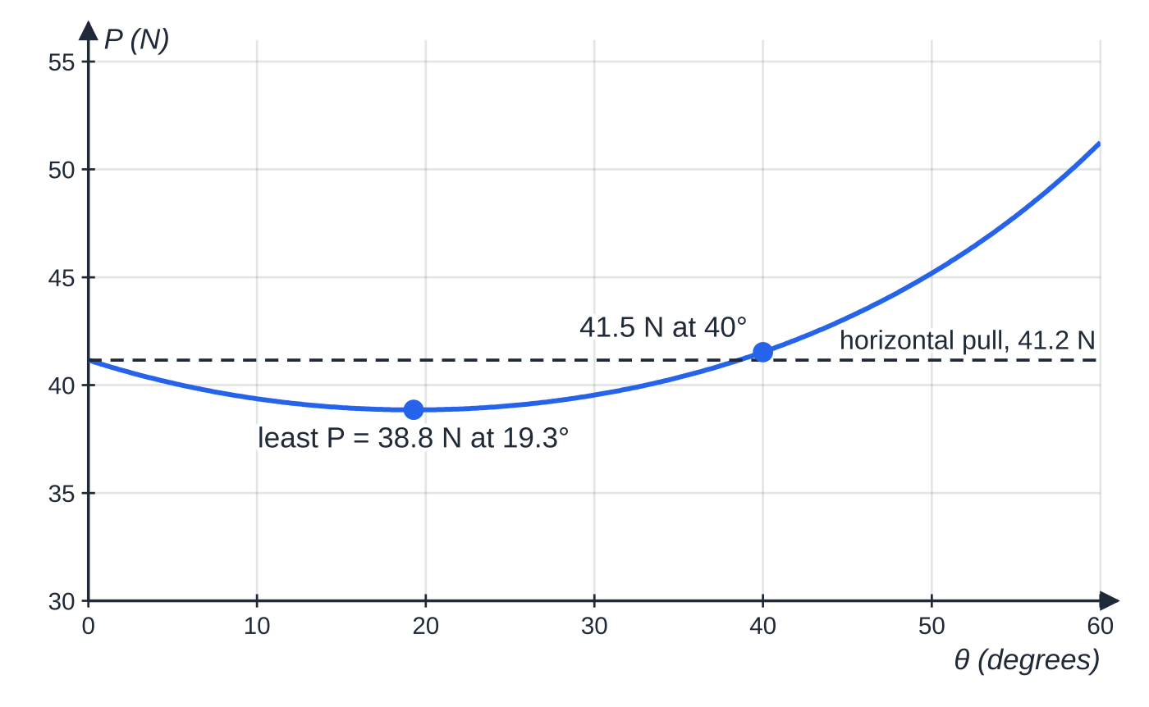
What is the least force needed to move a particle? (continued)
Section 8 of 13 · Worked example 8 · Hard · Show that / Find
WORKED EXAMPLE · QUESTION
A particle of mass 12 kg rests on rough horizontal ground. The coefficient of friction is 0.35. A force of magnitude P newtons is applied at an angle θ above the horizontal, and the particle is on the point of moving. (a) Show that P = 41.16/(cos θ+ 0.35sin θ). (b) Find P when the force is horizontal and when θ= 40°. (c) Find the least possible value of P and the angle at which it acts.
The pull needed, from P = 41.16 ÷ (cos θ + 0.35 sin θ). The minimum is at tan θ = μ; pulling much more steeply needs more force than pulling horizontally.
Notes:
What is the least force needed to move a particle?: Worked example 8. Full notes: https://examinerprep.com/notes/edexcel-ial-maths/statics-of-a-particle/

Slide 32
What is the least force needed to move a particle? (continued)
Section 8 of 13 · Worked example 8 · Hard · Show that / Find (continued)
SOLUTION
(a) R(↑): R = 117.6 - Psin θ. R(→) with F = μR: Pcos θ= 0.35(117.6 - Psin θ), so P(cos θ+ 0.35sin θ) = 41.16, as required.
(b) θ= 0: P = 41.16. θ= 40°: P = 41.16 ÷(cos 40° + 0.35sin 40°) = 41.53. 41.2 N; 41.5 N
(c) The least force acts at the angle of friction: tan λ= 0.35 gives θ= 19.3°, and P_(min) = 117.6sin 19.3° = 117.6 ×0.330 = 38.85. 38.8 N at 19.3° above the horizontal
Check in the formula from (a): 41.16 ÷(cos 19.3° + 0.35sin 19.3°) = 38.85 N.
Notes:
What is the least force needed to move a particle?: Worked example 8. Full notes: https://examinerprep.com/notes/edexcel-ial-maths/statics-of-a-particle/

Slide 33
What is the least force needed to move a particle? (continued)
Section 8 of 13
Common error — the least force is not always horizontal
A slightly upward pull reduces the normal reaction, and so the friction, by more than it loses from its horizontal part, up to the angle where tan θ= μ.
Notes:
What is the least force needed to move a particle?. Full notes: https://examinerprep.com/notes/edexcel-ial-maths/statics-of-a-particle/

Slide 34
Exam tips for M1.5
Section 9 of 13
Exam tip 1 — a diagram first, every time
Draw your own diagram even when one is printed, with every force and every angle. A force left out, or drawn the wrong way, spoils every equation that follows.
Exam tip 2 — label each resolving equation
Start each equation with its direction, e.g. "R(parallel to plane):", and write it as one complete equation before simplifying. An equation with the right terms, each with the correct sin or cos, shows a sound method, and a sign slip is easier to spot.
Exam tip 3 — "show that" answers
When the answer is given, show the resolved equations, the substitution and a final line that matches the printed result. Then use the printed value in later parts.
Notes:
Exam tips for M1.5. Full notes: https://examinerprep.com/notes/edexcel-ial-maths/statics-of-a-particle/

Slide 35
Exam tips for M1.5 (continued)
Section 9 of 13
Exam tip 4 — accuracy with g = 9.8
Give final answers to 2 or 3 significant figures, keeping full calculator values between steps. 16.58 N is better written as 16.6 N.
Exam tip 5 — read the friction words
"On the point of", "about to", "just" and "limiting" mean F = μR. "Rests in equilibrium" with no such phrase means only F ≤μR: find F by resolving. "Smooth" means no friction at all.
Notes:
Exam tips for M1.5. Full notes: https://examinerprep.com/notes/edexcel-ial-maths/statics-of-a-particle/

Slide 36
Common misconceptions
Section 10 of 13
Misconception | Why it is wrong | Correct idea
Friction always equals μR. | μR is the maximum; friction only provides what is needed. | F ≤μR; F = μR only in limiting equilibrium (or when sliding).
On a plane, R = mgcos α always. | Other forces can push into or pull away from the plane. | Resolve perpendicular to the plane with every force included.
Friction always acts up a slope. | It opposes the motion that would happen. | About to slide up → friction down the plane, and vice versa.
The tension is the same in both strings holding a particle. | Only true for a symmetrical arrangement. | Resolve horizontally: the steeper string carries more.
A heavier particle needs a larger μ to stay at rest on a slope. | Both the weight component and μR are proportional to m. | With no other force, it rests if μ≥tan α, whatever its mass.
Pulling horizontally is always the easiest way to move a particle. | An upward component reduces R and so the friction. | The least force acts at angle λ above the horizontal, tan λ= μ.
Notes:
Common misconceptions. Full notes: https://examinerprep.com/notes/edexcel-ial-maths/statics-of-a-particle/

Slide 37
How this topic connects
Section 11 of 13
M1.1 Vectors in mechanics
Forces in i, j form, magnitudes and angles with i are the same tools as for displacement and velocity.
M1.3 Dynamics
When the resultant is not zero, the same resolving gives ΣF = ma; friction on a sliding particle is μR.
M1.6 Moments, and rigid bodies in M2
An extended body also needs zero total moment; ladders and rods with friction combine both conditions. The sine rule from P1 trigonometry drives the triangle of forces.
Notes:
How this topic connects. Full notes: https://examinerprep.com/notes/edexcel-ial-maths/statics-of-a-particle/

Slide 38
Key formulae
Section 12 of 13
Formula | Use | In the formulae list?
Fcos θ, Fsin θ | Components of a force along and perpendicular to a direction | No — learn it
R = √(X² + Y²), tan φ= Y/X | Magnitude and direction of a resultant | No — learn it
ΣFₓ = 0, ΣF_y = 0 | Equilibrium of a particle (any two perpendicular directions) | No — learn it
a/sin A = b/sin B = c/sin C | Triangle of forces for three forces | No — learn it
F ≤μR; F = μR when limiting | Friction in equilibrium | No — learn it
mgsin α, mgcos α | Components of weight on a plane at angle α | No — derive it
μ≥tan α | Particle at rest on a rough plane with no other force | No — derive it
P_(min) = mgsin λ, tan λ= μ | Least force to move a particle on rough horizontal ground | No — derive it
Notes:
Key formulae. Full notes: https://examinerprep.com/notes/edexcel-ial-maths/statics-of-a-particle/

Slide 39
Check your understanding
Section 13 of 13
1. Forces of 5 N and 12 N act on a particle at right angles to each other. Find the magnitude of the resultant and its angle with the 5 N force.
2. A 2 kg particle rests on rough horizontal ground (μ= 0.5). A horizontal force of 6 N acts on it and it does not move. What is the friction force?
3. A particle rests on a rough plane inclined at 20° with no other force applied. What is the least possible value of μ?
4. A particle is in equilibrium under (2i - 3j) N, (pi + j) N and (-5i + qj) N. Find p and q.
5. A particle of weight W hangs on a string and is pulled aside by a horizontal force of size W. Find the angle of the string to the vertical and the tension.
Notes:
Check your understanding: questions. Full notes: https://examinerprep.com/notes/edexcel-ial-maths/statics-of-a-particle/

Slide 40
Check your understanding · answers
Section 13 of 13
1. √(5² + 12²) = 13 N; tan⁻¹(12 ÷5) = 67.4°. 13 N at 67.4° to the 5 N force
2. The maximum available is μR = 0.5 ×19.6 = 9.8 N, but friction only balances the 6 N applied. 6 N
3. μ≥tan 20°. 0.364
4. i: 2 + p - 5 = 0. j: -3 + 1 + q = 0. p = 3, q = 2
5. tan θ= W/W = 1, so 45°; T = √(W² + W²) = W√2. 45°, T ≈ 1.41W
Notes:
Check your understanding: answers. Full notes: https://examinerprep.com/notes/edexcel-ial-maths/statics-of-a-particle/

Slide 41
Practice questions
2 original exam-style questions. Answers at the end of the deck.

Slide 42
Question 1
6 marks
Two tugs pull a barge across a harbour. The barge is modelled as a particle and all forces act in a horizontal plane, in which i and j are perpendicular unit vectors. The first tug pulls with a force (9i − 4j) kN and the second with a force (−2i + 7j) kN.
(a) Find the resultant of the two pulls, in the form (pi + qj) kN. [1]
(b) Find the magnitude of this resultant. [2]
(c) Find the angle between the resultant and the vector i. [2]
(d) The barge moves at constant velocity, so it is in equilibrium. Find the total resistance of the water on the barge as a vector. [1]
Notes:
Online with the full mark scheme: https://examinerprep.com/ial-maths-m1-5-statics-of-a-particle-questions#IALM-M1-5-B-01

Slide 43
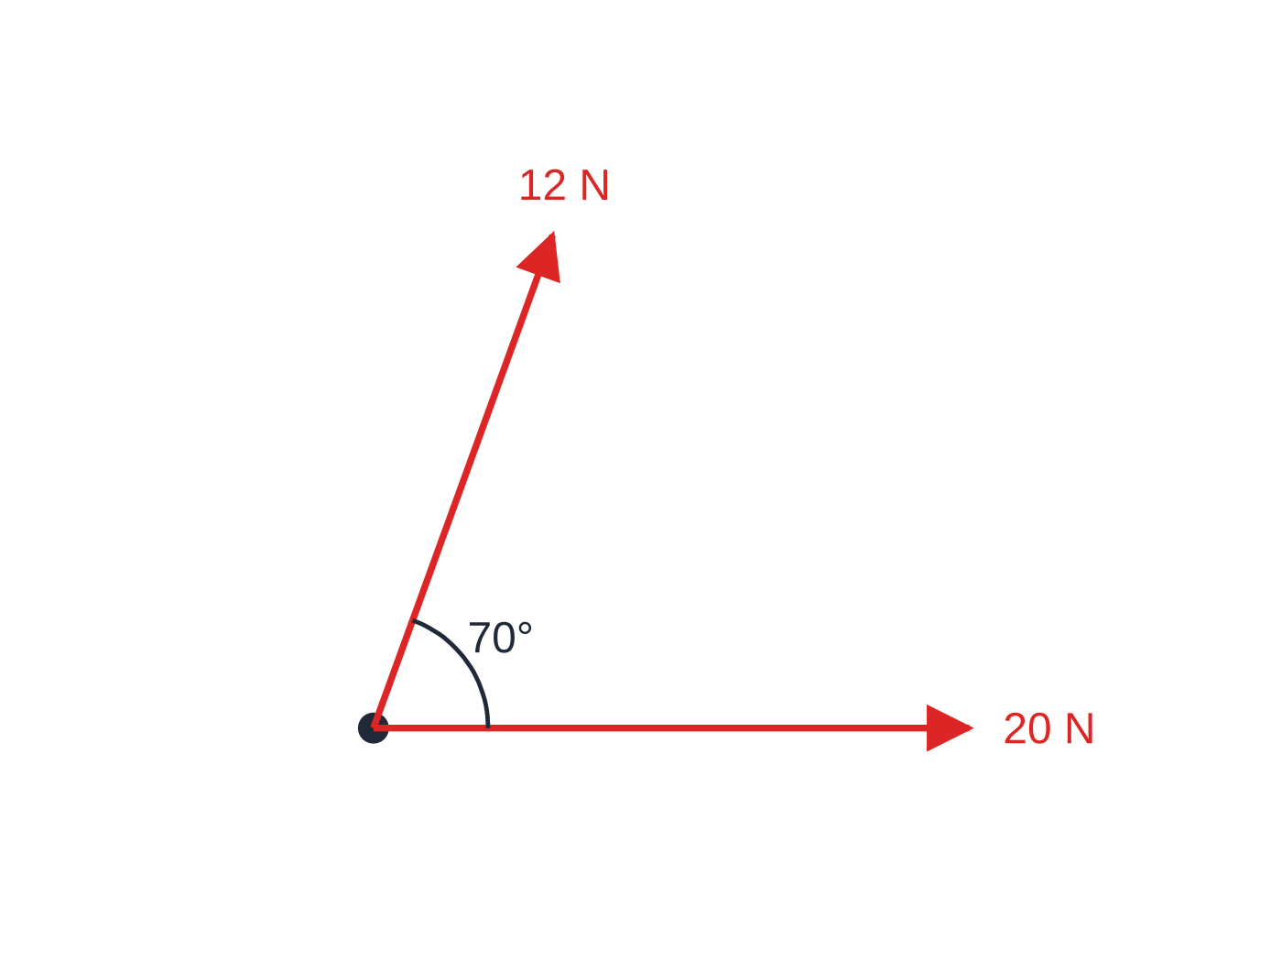
Question 2
5 marks
A sledge on horizontal ice is modelled as a particle. Two children pull it with horizontal ropes. One rope has a tension of 20 N and the other a tension of 12 N, and the angle between the two ropes is 70°.
Figure: the two rope tensions acting on the sledge (viewed from above); not to scale.
(a) Taking the direction of the 20 N rope as the x-direction, find the components of the resultant of the two tensions parallel and perpendicular to this direction. [2]
(b) Find the magnitude of the resultant. [2]
(c) Find the angle between the resultant and the 20 N rope. [1]
Notes:
Online with the full mark scheme: https://examinerprep.com/ial-maths-m1-5-statics-of-a-particle-questions#IALM-M1-5-B-02

Slide 44
Answers

Slide 45
Question 1 · answer
Mark scheme
(9 − 2)i + (−4 + 7)j = (7i + 3j) kN
√(7² + 3²)
= √58 = 7.62 kN
tan⁻¹(3 ÷ 7)
= 23.2° (anticlockwise from i, towards j)
−(7i + 3j) = (−7i − 3j) kN
Notes:
Full mark scheme: https://examinerprep.com/ial-maths-m1-5-statics-of-a-particle-questions#IALM-M1-5-B-01

Slide 46
Question 2 · answer
Mark scheme
parallel: 20 + 12 cos 70° = 24.1 N
perpendicular: 12 sin 70° = 11.3 N
√(24.10² + 11.28²)
= 26.6 N
tan⁻¹(11.28 ÷ 24.10) = 25.1°
Notes:
Full mark scheme: https://examinerprep.com/ial-maths-m1-5-statics-of-a-particle-questions#IALM-M1-5-B-02

Slide 47
Keep practising
Notes for this topic
Questions on this topic
Build a printable test
ExaminerPrep is an independent tutoring service. It has been developed independently from and is not endorsed by the International Baccalaureate Organization. "International Baccalaureate", "IB" and "IB Diploma Programme" are registered trademarks of the IBO, used here for descriptive purposes only.
Pearson Edexcel and Cambridge are trademarks of their owners; ExaminerPrep is not affiliated with any exam board.

