Slide 1
EP
EDEXCEL IAL MATHS
M2.6 Statics of rigid bodies
The full notes page in 12 sections · practice questions with answers · simulations
ExaminerPrep is an independent tutoring service. It has been developed independently from and is not endorsed by the International Baccalaureate Organization. "International Baccalaureate", "IB" and "IB Diploma Programme" are registered trademarks of the IBO, used here for descriptive purposes only.
Pearson Edexcel and Cambridge are trademarks of their owners; ExaminerPrep is not affiliated with any exam board.
Notes:
M2.6 Statics of rigid bodies. Notes for this topic: https://examinerprep.com/notes/edexcel-ial-maths/statics-of-rigid-bodies/

Slide 2
What this page covers
Overview
The moment of a force about a point, using the perpendicular distance or by splitting the force into components
The two conditions for a rigid body to be in equilibrium, for parallel and for non-parallel coplanar forces
Beams on supports, including the point at which a beam is about to tilt
Rods hinged to a wall and held by a string: the tension, and the magnitude and direction of the force at the hinge
Ladders against smooth or rough walls on rough ground: limiting equilibrium, the least coefficient of friction, and how far a person can climb
Rods resting on smooth pegs with one end on rough ground
Notes:
What this page covers. Full notes: https://examinerprep.com/notes/edexcel-ial-maths/statics-of-rigid-bodies/

Slide 3
In one minute
Key points
1. Every statics question in M2 is solved by one method: draw the forces, resolve in two directions and take moments about one well-chosen point, giving three equations for at most three unknowns.
2. The moment of a force about a point is force × perpendicular distance from the point to the line of action, in N m, with a sense: clockwise or anticlockwise.
3. For a force at an angle, either find the perpendicular distance with trigonometry, or split the force into components and add the moments of the components.
4. A hinge can push or pull in any direction: give it two unknown components X and Y, then combine them for the magnitude and direction.
5. A smooth surface or peg gives only a normal reaction (perpendicular to the surface, or to the rod at a peg). A rough surface adds friction, with F≤μR, and F=μR when slipping is about to happen.
6. Friction opposes the way the contact point would slide. For a ladder, the foot tends to slide away from the wall and the top tends to slide down.
Notes:
In one minute. Full notes: https://examinerprep.com/notes/edexcel-ial-maths/statics-of-rigid-bodies/

Slide 4
What is the moment of a force?
Section 1 of 12
Moment of a force about a point = the magnitude of the force × the perpendicular distance from the point to the line of action of the force.
moment=Fd=Flsin θ
Here F is the magnitude of the force in N and d the perpendicular distance from the point to the line of action in m. In the second form, l is the distance from the point to where the force acts and θ is the angle between the force and that line. This is not in the formulae booklet: learn it.
A moment has a sense: clockwise or anticlockwise. A force whose line of action passes through the point has zero moment about that point. The line of action is the infinite straight line through the force, and you may slide a force along its line of action without changing its moment.
Why sin θ? Only the part of the force perpendicular to the rod turns it.
Notes:
What is the moment of a force?. Full notes: https://examinerprep.com/notes/edexcel-ial-maths/statics-of-rigid-bodies/

Slide 5
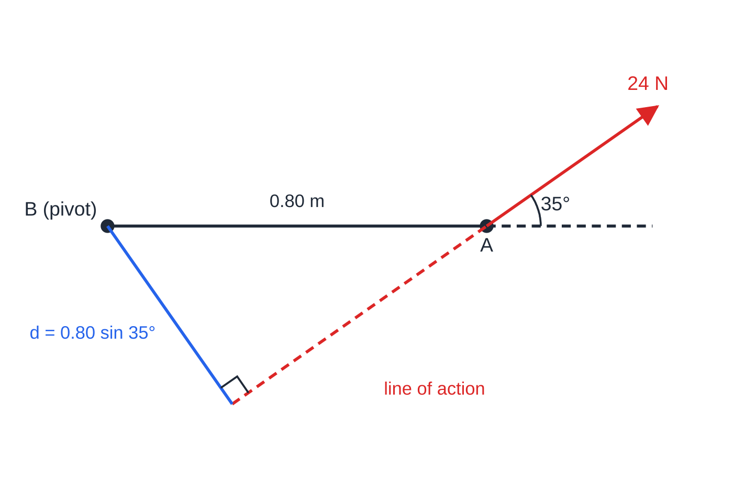
What is the moment of a force? (continued)
Section 1 of 12
The part along the rod pushes or pulls along a line through the pivot, so its moment is zero. Choose one sense as positive (say anticlockwise) and stick to it for every force in the same equation.
Worked example 1, drawn to scale: a 24 N force at 35° to a rod AB of length 0.80 m. The perpendicular from B to the line of action has length 0.80 sin 35°, so both routes give the same moment about B, 11.01 N m.
Notes:
What is the moment of a force?. Full notes: https://examinerprep.com/notes/edexcel-ial-maths/statics-of-rigid-bodies/

Slide 6
What is the moment of a force? (continued)
Section 1 of 12 · Worked example 1 · Easy · Find
WORKED EXAMPLE · QUESTION
A light rod AB of length 0.80 m is smoothly pivoted at B. A force of magnitude 24 N acts at A, in the plane of the rod, making an angle of 35° with AB produced. Find the moment of the force about B.
SOLUTION
Method 1 Perpendicular distance from B to the line of action: d=0.80sin 35°=0.4589 m, so moment =24×0.4589= 11.0 N m
Method 2 Components at A: perpendicular to AB, 24sin 35°=13.766 N; along AB, 24cos 35°=19.660 N (moment 0). Moment =13.766×0.80= 11.0 N m (11.013 N m)
Both methods are the same calculation, 24×0.80×sin 35°, arranged differently.
Notes:
What is the moment of a force?: Worked example 1. Full notes: https://examinerprep.com/notes/edexcel-ial-maths/statics-of-rigid-bodies/

Slide 7
What is the moment of a force? (continued)
Section 1 of 12
Common error
Multiplying the force by the distance along the rod, 24×0.80=19.2 N m, when the force is not perpendicular to the rod. The distance must be perpendicular to the line of action, or the force must be the perpendicular component.
Notes:
What is the moment of a force?. Full notes: https://examinerprep.com/notes/edexcel-ial-maths/statics-of-rigid-bodies/

Slide 8
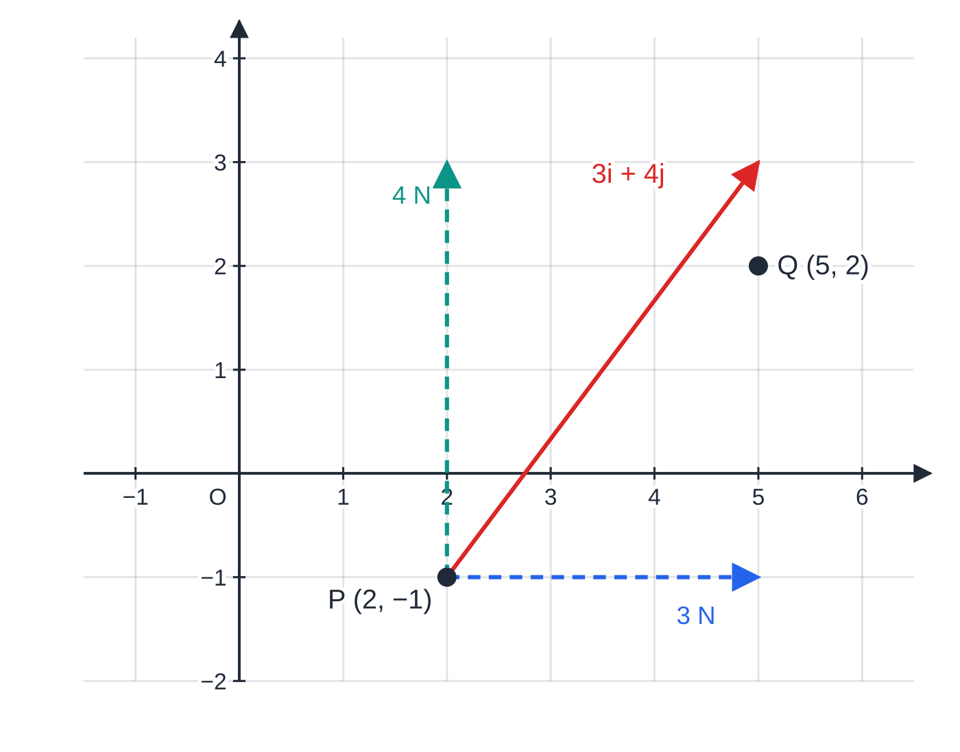
How do you find a moment using components?
Section 2 of 12
Split the force into horizontal and vertical components (or i and j components). Each component has its own moment; add them with signs. For a force Xi+Yj acting at a point whose position relative to the pivot is xi+yj, the moment, anticlockwise positive, is
xY-yX.
You do not need to learn this as a formula: picture each component and decide whether it turns the body clockwise or anticlockwise. This is the quickest method when a force acts at a corner of a frame or lamina, or when the perpendicular distance is awkward to find.
Worked example 2: the force 3i + 4j acting at P, split into its components. About O, the 4 N component turns anticlockwise with arm 2 m and the 3 N component turns anticlockwise with arm 1 m.
Notes:
How do you find a moment using components?. Full notes: https://examinerprep.com/notes/edexcel-ial-maths/statics-of-rigid-bodies/

Slide 9
How do you find a moment using components? (continued)
Section 2 of 12 · Worked example 2 · Medium · Find
WORKED EXAMPLE · QUESTION
A force (3i+4j) N acts at the point P with position vector (2i-j) m. The unit vectors i and j are horizontal and vertical. Find the moment of the force about (a) the origin O and (b) the point Q with position vector (5i+2j) m, stating the sense in each case.
SOLUTION
(a) The vertical component, 4 N, acts 2 m to the right of O: 4×2=8 N m anticlockwise. The horizontal component, 3 N to the right, acts 1 m below O: 3×1=3 N m anticlockwise (a force to the right, below the pivot, turns anticlockwise). Total =8+3= 11 N m anticlockwise
(b) Position of P relative to Q: (2-5)i+(-1-2)j=-3i-3j. Moment, anticlockwise positive: (-3)(4)-(-3)(3)=-12+9=-3, so 3 N m clockwise
The same force has different moments about different points — always say which point.
Notes:
How do you find a moment using components?: Worked example 2. Full notes: https://examinerprep.com/notes/edexcel-ial-maths/statics-of-rigid-bodies/

Slide 10
When is a rigid body in equilibrium?
Section 3 of 12
Equilibrium of a rigid body: the resultant force on it is zero and the total moment about any point is zero.
In two dimensions this gives three independent equations: resolve in two directions and take moments about one point. So at most three unknowns can be found. You may replace a resolving equation by a second moments equation about a different point, which is useful when it removes an unknown.
Take moments about the point where the most unknown forces act: their moments are zero there.
Parallel forces (all vertical): the resolving equation and one moments equation are enough.
About to tilt about one support means the beam is just losing contact with the other: set the reaction there to zero.
For a uniform rod the weight acts at the midpoint. For a non-uniform rod the centre of mass is wherever the question puts it, and often it is the unknown.
Notes:
When is a rigid body in equilibrium?. Full notes: https://examinerprep.com/notes/edexcel-ial-maths/statics-of-rigid-bodies/

Slide 11
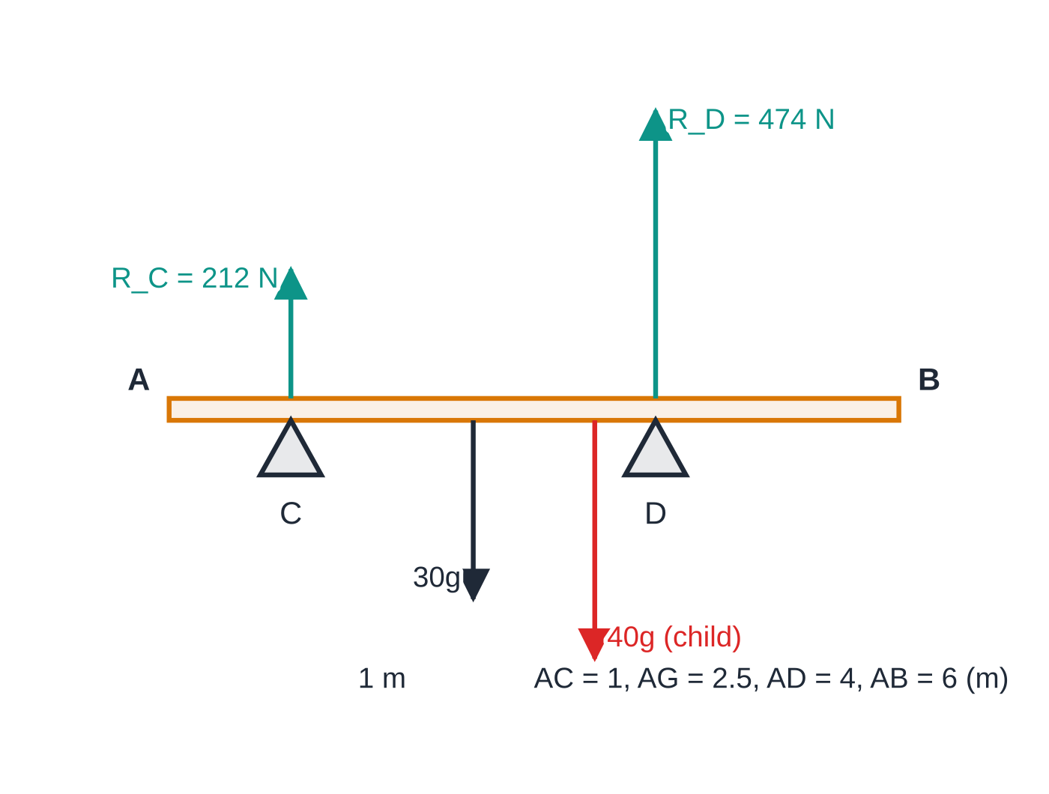
When is a rigid body in equilibrium? (continued)
Section 3 of 12
Worked example 3(a), forces to scale: the non-uniform 30 kg plank with its centre of mass 2.5 m from A, the 40 kg child at 3.5 m, and the two upward reactions.
Notes:
When is a rigid body in equilibrium?. Full notes: https://examinerprep.com/notes/edexcel-ial-maths/statics-of-rigid-bodies/

Slide 12
When is a rigid body in equilibrium? (continued)
Section 3 of 12 · Worked example 3 · Medium · Find
WORKED EXAMPLE · QUESTION
A non-uniform plank AB has length 6 m and mass 30 kg. Its centre of mass is 2.5 m from A. The plank rests horizontally on two supports at C and D, where AC = 1 m and AD = 4 m. A child of mass 40 kg stands on the plank. Model the plank as a rod and the child as a particle. (a) The child stands 3.5 m from A. Find the reactions at C and D. (b) The child walks towards B. Find the distance from A at which the plank is about to tilt.
SOLUTION
(a) Moments about D (removes R_D): R_C×3=30g×1.5+40g×0.5=65g, so R_C=65g÷3= 212 N (212.3 N). Resolve vertically: R_D=70g-212.3= 474 N (473.7 N)
(b) About to tilt about D, so R_C=0. Moments about D with the child x m from A: 30g×(4-2.5)=40g×(x-4), so 45=40x-160 and x=5.125 m from A (so 0.875 m from B)
g cancels in part (b): keep it as a symbol until the end and the answer is exact.
Notes:
When is a rigid body in equilibrium?: Worked example 3. Full notes: https://examinerprep.com/notes/edexcel-ial-maths/statics-of-rigid-bodies/

Slide 13
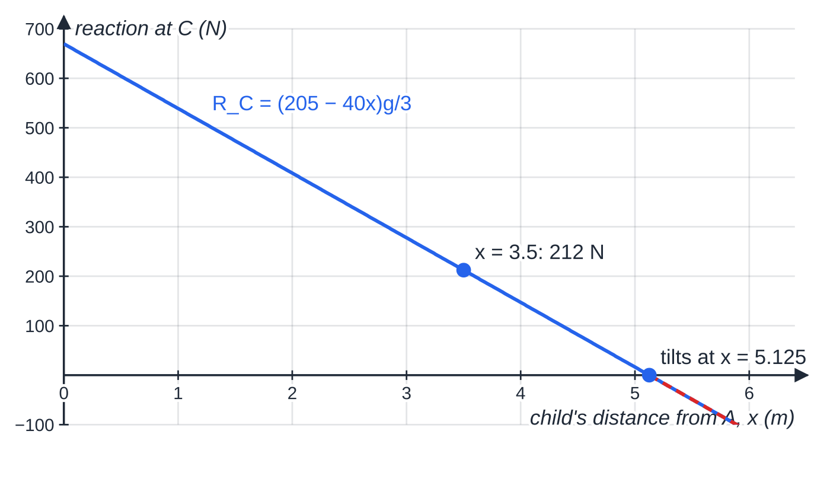
When is a rigid body in equilibrium? (continued)
Section 3 of 12
Exam tip
Check a moments answer by taking moments about a second point. In worked example 3, moments about C: 473.67×3=30g×1.5+40g×2.5=145g=1421.0. It agrees.
The reaction at C as the child walks along the plank. It falls steadily and reaches zero at x = 5.125 m; beyond that a negative reaction would be needed, which a support cannot give, so the plank tilts about D.
Notes:
When is a rigid body in equilibrium?. Full notes: https://examinerprep.com/notes/edexcel-ial-maths/statics-of-rigid-bodies/

Slide 14
How do you find the force at a hinge?
Section 4 of 12
A smooth hinge exerts a single force whose direction is unknown. Model it as a horizontal component X and a vertical component Y, each with an assumed direction. Then:
1. Take moments about the hinge first: X and Y both vanish, leaving one equation for the tension.
2. Resolve horizontally and vertically for X and Y. A negative answer just means that component acts the other way.
3. Magnitude R=√(X²+Y²); direction tan⁻¹(Y/X) above or below the horizontal — say which.
The force at the hinge is not along the rod in general. It is along the rod only for a light rod with forces at its two ends. A useful check: if exactly three non-parallel forces act on a body in equilibrium, their lines of action pass through one point.
Notes:
How do you find the force at a hinge?. Full notes: https://examinerprep.com/notes/edexcel-ial-maths/statics-of-rigid-bodies/

Slide 15
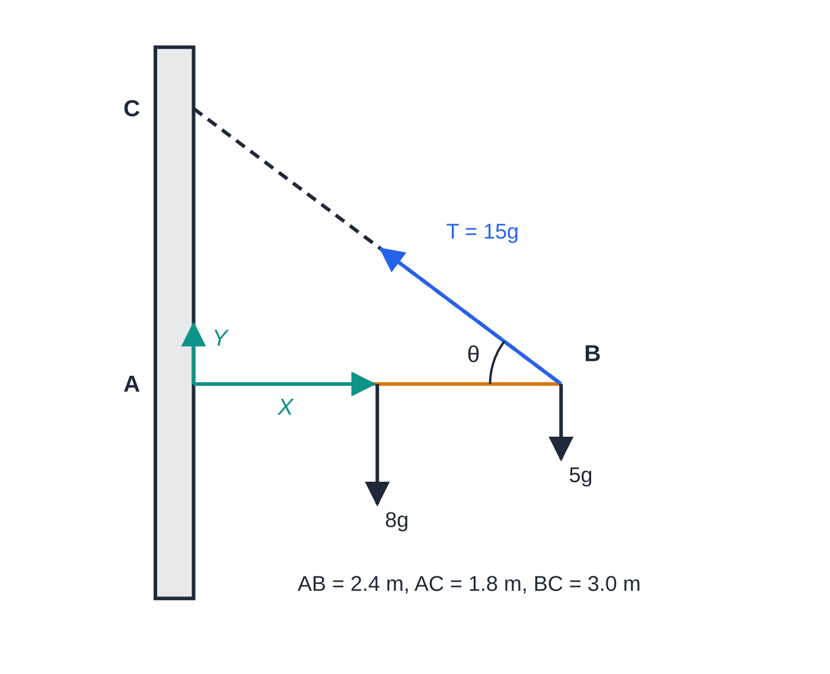
How do you find the force at a hinge? (continued)
Section 4 of 12
Worked example 4, forces to scale: the uniform 8 kg rod hinged at A and held horizontal by the string BC, with a 5 kg particle at B. The hinge force is shown as its two components X and Y.
Notes:
How do you find the force at a hinge?. Full notes: https://examinerprep.com/notes/edexcel-ial-maths/statics-of-rigid-bodies/

Slide 16
How do you find the force at a hinge? (continued)
Section 4 of 12 · Worked example 4 · Medium · Find
WORKED EXAMPLE · QUESTION
A uniform rod AB has length 2.4 m and mass 8 kg. The end A is freely hinged to a vertical wall. The rod is held horizontal by a light inextensible string joining B to the point C on the wall, 1.8 m vertically above A. A particle of mass 5 kg hangs from B. The rod and the string lie in a vertical plane perpendicular to the wall. Find (a) the tension in the string and (b) the magnitude and direction of the force exerted on the rod at A.
SOLUTION
Geometry BC=√(2.4²+1.8²)=3.0 m, so the angle θ between the string and the rod has sin θ=1.8/3.0=0.6 and cos θ=2.4/3.0=0.8.
(a) Moments about A: T×0.6×2.4=8g×1.2+5g×2.4=21.6g, so T=21.6g÷1.44=15g= 147 N
(b) Resolve horizontally (X away from the wall) and vertically (Y upwards): X=Tcos θ=12g=117.6 N; Y+Tsin θ=13g, so Y=4g=39.2 N.
Notes:
How do you find the force at a hinge?: Worked example 4. Full notes: https://examinerprep.com/notes/edexcel-ial-maths/statics-of-rigid-bodies/

Slide 17
How do you find the force at a hinge? (continued)
Section 4 of 12 · Worked example 4 · Medium · Find (continued)
Then R=g√(12²+4²)=4√10 g= 124 N (123.96 N), at tan⁻¹(4/12)= 18.4° above the horizontal, away from the wall
Notes:
How do you find the force at a hinge?: Worked example 4. Full notes: https://examinerprep.com/notes/edexcel-ial-maths/statics-of-rigid-bodies/

Slide 18
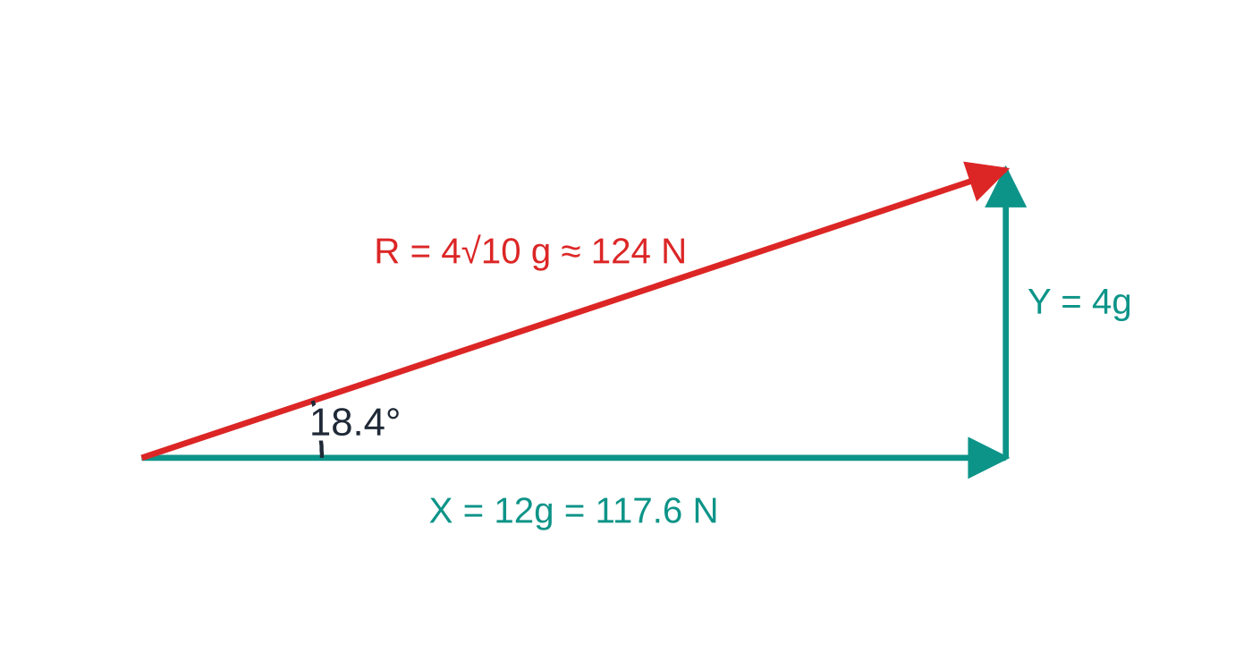
How do you find the force at a hinge? (continued)
Section 4 of 12
Common error
Assuming the hinge force acts along the rod, or that its vertical component simply equals the total weight. The string carries part of the weight: here only 4g of the 13g is taken by the hinge.
Combining the hinge components of worked example 4: X = 12g and Y = 4g give a force of 4√10 g ≈ 124 N at 18.4° above the horizontal — clearly not along the rod.
Notes:
How do you find the force at a hinge?. Full notes: https://examinerprep.com/notes/edexcel-ial-maths/statics-of-rigid-bodies/

Slide 19
How do you solve a ladder problem?
Section 5 of 12
A ladder is modelled as a rod; uniform means its weight acts at the midpoint. People are particles at a stated distance along it.
At a smooth vertical wall: one force, the normal reaction S, horizontal and away from the wall.
On rough horizontal ground: the normal reaction R upwards and friction F horizontally towards the wall (the foot tends to slide away).
The standard set of equations: resolve vertically, R = total weight; resolve horizontally, F=S; take moments about the foot A, which removes both R and F; and in limiting equilibrium F=μR (in general F≤μR). For a ladder of length l at angle α to the horizontal, the top is lsin α above A and the midpoint is l/2cos α from A horizontally.
Notes:
How do you solve a ladder problem?. Full notes: https://examinerprep.com/notes/edexcel-ial-maths/statics-of-rigid-bodies/

Slide 20
How do you solve a ladder problem? (continued)
Section 5 of 12 · Worked example 5 · Medium · Find
WORKED EXAMPLE · QUESTION
A uniform ladder of mass 20 kg and length l rests with its foot on rough horizontal ground and its top against a smooth vertical wall. The ladder makes an angle of 65° with the ground and is in equilibrium. Find the least possible value of the coefficient of friction between the ladder and the ground.
SOLUTION
Step 1 Moments about the foot: S×lsin 65°=20g×l/2cos 65°, so S=20g/2tan 65°=45.70 N.
Step 2 Resolve: F=S=45.70 N and R=20g=196 N.
Step 3 F≤μR, so μ≥45.70÷196=1/2tan 65°=0.2332. The least μ is 0.233
The mass and the length both cancel: for a uniform ladder on its own, the least μ depends only on the angle.
Notes:
How do you solve a ladder problem?: Worked example 5. Full notes: https://examinerprep.com/notes/edexcel-ial-maths/statics-of-rigid-bodies/

Slide 21
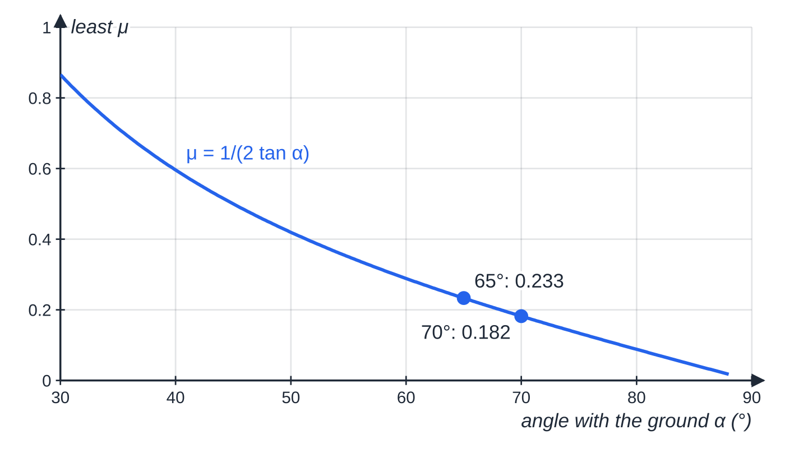
How do you solve a ladder problem? (continued)
Section 5 of 12
For a uniform ladder alone against a smooth wall, the least coefficient of friction is 1/(2 tan α). A steeper ladder needs much less friction.
Notes:
How do you solve a ladder problem?. Full notes: https://examinerprep.com/notes/edexcel-ial-maths/statics-of-rigid-bodies/

Slide 22
How do you solve a ladder problem? (continued)
Section 5 of 12 · Worked example 6 · Hard · Find
WORKED EXAMPLE · QUESTION
A uniform ladder AB has length 6 m and mass 15 kg. The end A rests on rough horizontal ground and the end B rests against a smooth vertical wall. The ladder is in a vertical plane perpendicular to the wall and makes an angle of 60° with the ground. The coefficient of friction between the ladder and the ground is 0.35. A decorator of mass 75 kg climbs slowly up the ladder. Model the decorator as a particle. (a) Find the distance the decorator can climb along the ladder from A before it slips. (b) Find the least coefficient of friction that would allow her to reach the top.
SOLUTION
(a) Resolve vertically: R=90g=882 N. Limiting friction: F=0.35×90g=31.5g=308.7 N. Resolve horizontally: S=F=31.5g. Moments about A, decorator x m from A: S×6sin 60°=15g×3cos 60°+75g×xcos 60°. Dividing by gcos 60°: 189tan 60°=45+75x, so 75x=282.36 and x=3.76 m (3.7648 m)
(b) At the top, x=6. Moments about A: S×6sin 60°=(15×3+75×6)gcos 60°, so S=495g/6tan 60°=47.63g. With F=S and R=90g: μ≥47.63÷90= 0.529
Notes:
How do you solve a ladder problem?: Worked example 6. Full notes: https://examinerprep.com/notes/edexcel-ial-maths/statics-of-rigid-bodies/

Slide 23
How do you solve a ladder problem? (continued)
Section 5 of 12 · Worked example 6 · Hard · Find (continued)
Climbing higher increases the moment about A, so the wall pushes harder and more friction is needed; R does not change.
Notes:
How do you solve a ladder problem?: Worked example 6. Full notes: https://examinerprep.com/notes/edexcel-ial-maths/statics-of-rigid-bodies/

Slide 24
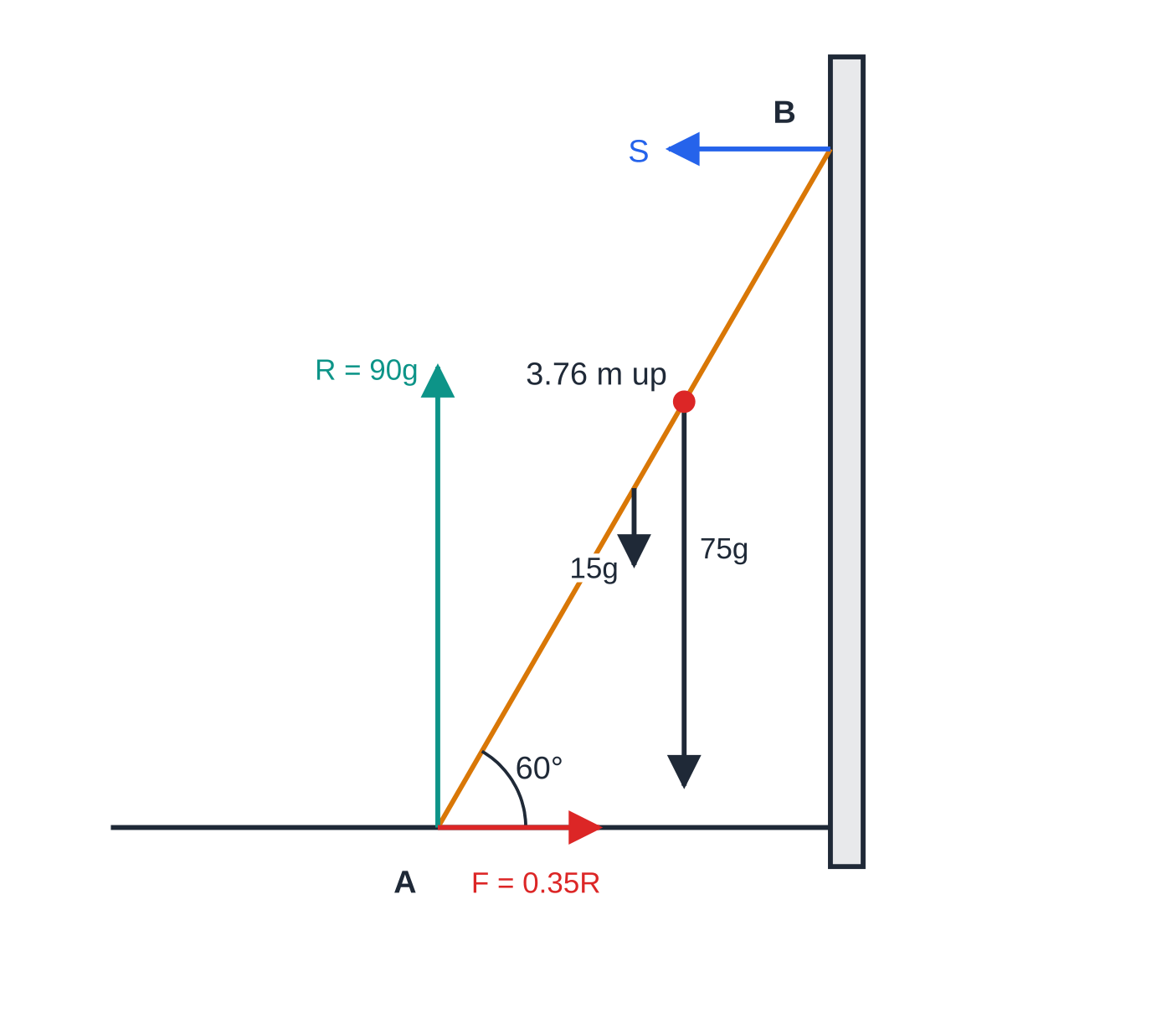
How do you solve a ladder problem? (continued)
Section 5 of 12
Exam tip
Write "limiting, so F=μR" as a separate line. It shows which contact is on the point of slipping, and it is the step that turns an inequality into an equation.
Worked example 6 at the instant of slipping, forces to scale: a 15 kg ladder at 60° with a 75 kg person 3.76 m up it. Friction at the foot has reached its limit, 0.35 × 882 = 308.7 N, and the wall reaction S equals it.
Notes:
How do you solve a ladder problem?. Full notes: https://examinerprep.com/notes/edexcel-ial-maths/statics-of-rigid-bodies/

Slide 25
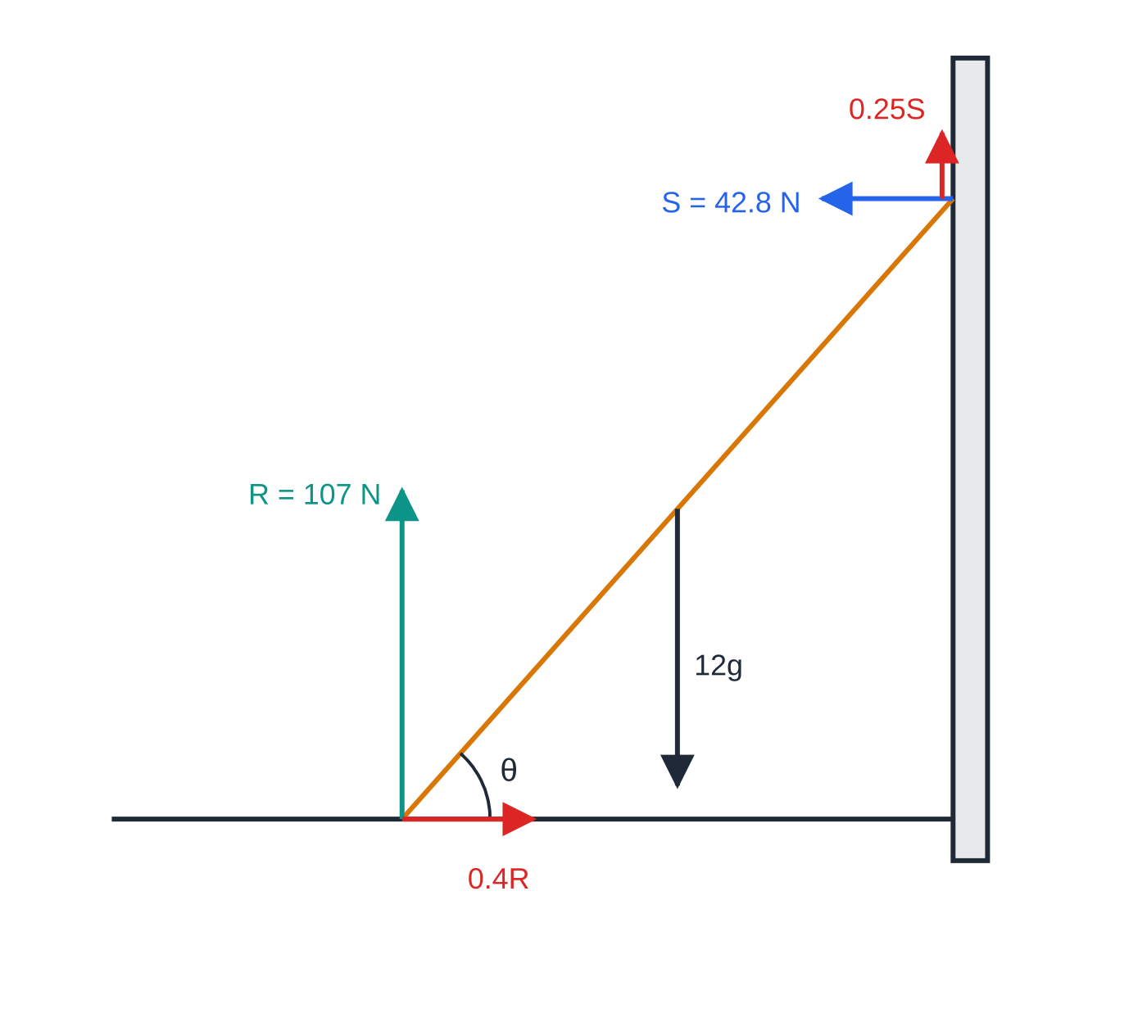
What changes when the wall is rough as well?
Section 6 of 12
The wall now gives a normal reaction S and a friction force. As the foot slides away, the top slides down the wall, so the wall's friction on the ladder acts upwards. "About to slip" for a ladder means slipping at both ends at once (the ladder cannot slide at one end only), so both frictions are limiting: F₁=μ₁ R and F₂=μ₂ S.
Wall friction now appears in the vertical equation, so R is less than the total weight. Moments about the foot now include the wall friction too: its moment arm is the horizontal distance from A to the wall.
Worked example 7: a uniform 12 kg ladder about to slip, with μ₁ = 0.4 at the ground and μ₂ = 0.25 at the wall, at θ = 48.4°. Reactions and ground friction to scale (wall friction drawn twice size so it shows; the weight shortened). The small upward wall friction still reduces R.
Notes:
What changes when the wall is rough as well?. Full notes: https://examinerprep.com/notes/edexcel-ial-maths/statics-of-rigid-bodies/

Slide 26
What changes when the wall is rough as well? (continued)
Section 6 of 12 · Worked example 7 · Hard · Find
WORKED EXAMPLE · QUESTION
A uniform ladder of mass 12 kg rests with its foot on rough horizontal ground and its top against a rough vertical wall. The coefficient of friction is 0.4 at the ground and 0.25 at the wall. The ladder is about to slip when it makes an angle θ with the ground. (a) Find the normal reactions at the ground and at the wall. (b) Find θ.
SOLUTION
(a) Limiting at both ends. Resolve horizontally: S=0.4R. Resolve vertically, with wall friction 0.25S upwards: R+0.25S=12g, so R+0.1R=12g. Then R=12g÷1.1= 107 N (106.91 N) and S=0.4R= 42.8 N (42.76 N)
(b) Moments about the foot, ladder length 2a: S×2asin θ+0.25S×2acos θ=12g×acos θ. Divide by 2acos θ: S(tan θ+0.25)=6g, so tan θ=(6×9.8÷42.764)-0.25=1.375-0.25=1.125 and θ=48.4°
Notes:
What changes when the wall is rough as well?: Worked example 7. Full notes: https://examinerprep.com/notes/edexcel-ial-maths/statics-of-rigid-bodies/

Slide 27
What changes when the wall is rough as well? (continued)
Section 6 of 12 · Worked example 7 · Hard · Find (continued)
In general, for a uniform ladder limiting at both ends, tan θ=(1-μ₁μ₂)÷(2μ₁) — derive it each time; do not quote it.
Notes:
What changes when the wall is rough as well?: Worked example 7. Full notes: https://examinerprep.com/notes/edexcel-ial-maths/statics-of-rigid-bodies/

Slide 28
What changes when the wall is rough as well? (continued)
Section 6 of 12
Common error
Drawing the wall friction downwards, or leaving it out of the moments equation. Ask which way the top of the ladder would move, and put friction the opposite way.
Notes:
What changes when the wall is rough as well?. Full notes: https://examinerprep.com/notes/edexcel-ial-maths/statics-of-rigid-bodies/

Slide 29
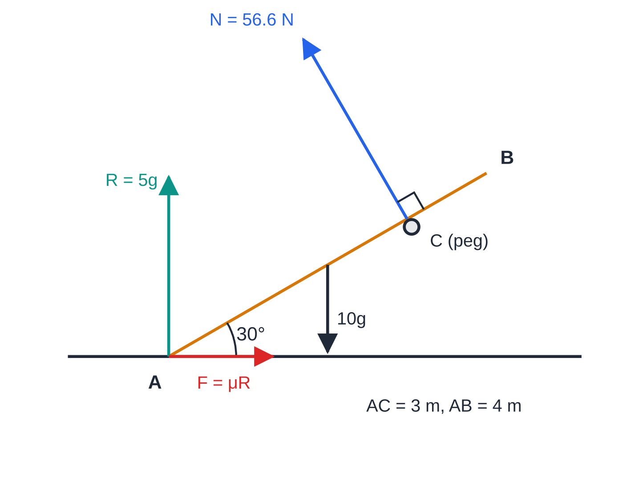
How do you handle a rod resting on a peg?
Section 7 of 12
A smooth peg (or a smooth rail or edge touching the rod along its length) gives a normal reaction perpendicular to the rod — not vertical. If the rod is at angle α to the horizontal, the peg reaction N makes angle α with the vertical, with components Ncos α up and Nsin α horizontally.
Take moments about the foot of the rod: only N and the weight have moments, and N acts perpendicular to the rod, so its moment is simply N × (distance along the rod). Friction at the foot opposes the slide: the horizontal part of N pushes the foot away from the peg, so friction acts towards the peg.
Worked example 8: a uniform 10 kg rod on a smooth peg at 30° to the horizontal, on the point of slipping. The peg reaction is perpendicular to the rod; friction at A acts towards the peg (weight arrow shortened to fit).
Notes:
How do you handle a rod resting on a peg?. Full notes: https://examinerprep.com/notes/edexcel-ial-maths/statics-of-rigid-bodies/

Slide 30
How do you handle a rod resting on a peg? (continued)
Section 7 of 12 · Worked example 8 · Medium · Find
WORKED EXAMPLE · QUESTION
A uniform rod AB has length 4 m and mass 10 kg. The end A rests on rough horizontal ground and the rod rests on a smooth peg C, where AC = 3 m. The rod is in a vertical plane and makes an angle of 30° with the ground. The rod is about to slip. (a) Find the force exerted on the rod by the peg. (b) Find the coefficient of friction between the rod and the ground, giving your answer in exact form.
SOLUTION
(a) Moments about A (N is perpendicular to the rod): N×3=10g×2cos 30°=10√3 g, so N=10√3 g/3=10g/√3= 56.6 N, perpendicular to the rod
(b) Resolve vertically: R+Ncos 30°=10g, so R=10g-5g=5g=49 N. Resolve horizontally: F=Nsin 30°=5g/√3=28.29 N. Limiting, F=μR: μ=(5g/√3)/5g=1/√3= √3/3 (≈ 0.577)
Keeping g as a symbol makes the exact answer drop out cleanly.
Notes:
How do you handle a rod resting on a peg?: Worked example 8. Full notes: https://examinerprep.com/notes/edexcel-ial-maths/statics-of-rigid-bodies/

Slide 31
Exam tips for M2.6
Section 8 of 12
Exam tip 1 — a full force diagram first
Mark every force with a letter, including both components at a hinge and friction at every rough contact. A force left off the diagram cannot be recovered later by careful algebra.
Exam tip 2 — choose the moments point deliberately
Take moments about the point where most unknown forces act — the hinge, or the foot of a ladder. Write the point at the start, "M(A):", then state the equation before you simplify it.
Exam tip 3 — the direction of a hinge force needs a reference
"18.4°" on its own is incomplete. Write "18.4° above the horizontal" or "at 71.6° to the wall". If Y comes out negative, the force points below the horizontal — say so.
Notes:
Exam tips for M2.6. Full notes: https://examinerprep.com/notes/edexcel-ial-maths/statics-of-rigid-bodies/

Slide 32
Exam tips for M2.6 (continued)
Section 8 of 12
Exam tip 4 — keep g until the end
Work with g as a symbol: it often cancels (least μ, angles, distances), and the arithmetic stays exact. Substitute g=9.8 only for a force, and then give 2 or 3 significant figures.
Exam tip 5 — "least μ" means an inequality
Find F and R from equilibrium alone, then use F≤μR, so μ≥F/R. If the question says "about to slip", write F=μR at the limiting contact — at both contacts for a ladder with two rough ends.
Notes:
Exam tips for M2.6. Full notes: https://examinerprep.com/notes/edexcel-ial-maths/statics-of-rigid-bodies/

Slide 33
Common misconceptions
Section 9 of 12
Misconception | Why it is wrong | Correct idea
Moment = force × distance along the rod. | Only the perpendicular distance to the line of action counts. | Moment =Flsin θ, or use the perpendicular component.
The force at a hinge acts along the rod. | A heavy rod, or one with a load part-way along, needs a hinge force in another direction. | Find components X and Y; the direction comes out of the working.
Friction always equals μR. | μR is only the maximum available. | F≤μR; equality only when slipping is about to happen.
A peg pushes vertically upwards. | A smooth contact can only push perpendicular to the surfaces in contact. | The reaction at a smooth peg is perpendicular to the rod.
The ground reaction on a ladder always equals the total weight. | That is true only if the wall is smooth. | With a rough wall, R = weight − wall friction.
Notes:
Common misconceptions. Full notes: https://examinerprep.com/notes/edexcel-ial-maths/statics-of-rigid-bodies/

Slide 34
Common misconceptions (continued)
Section 9 of 12
Misconception | Why it is wrong | Correct idea
A beam about to tilt has equal reactions at its supports. | On the point of tilting the beam is just leaving one support. | The reaction at the support it lifts off is zero.
Notes:
Common misconceptions. Full notes: https://examinerprep.com/notes/edexcel-ial-maths/statics-of-rigid-bodies/

Slide 35
How this topic connects
Section 10 of 12
M1 Moments and M1 Statics of a particle
This page extends M1 moments of parallel forces to forces at any angle, and uses the M1 friction model F≤μR and resolving in two directions.
M2.3 Centres of mass
Non-uniform rods and laminas need the position of the centre of mass before you can take moments; uniform shapes have results in the formulae booklet, and a lamina hanging freely in equilibrium uses the same moments idea.
P1–P3 trigonometry and IAL Physics
Ladder and peg questions lead to equations in tan θ, exact values such as sin 30° and cos 30°, and occasionally identities to tidy an answer. In IAL Physics Unit 1 the principle of moments and the centre of gravity are the same ideas, applied to beams, levers and cranes.
Notes:
How this topic connects. Full notes: https://examinerprep.com/notes/edexcel-ial-maths/statics-of-rigid-bodies/

Slide 36
Key formulae
Section 11 of 12
Formula | Use | In the formulae list?
moment =Fd=Flsin θ | moment of a force about a point | No — learn it
xY-yX | moment (anticlockwise) of Xi+Yj acting at xi+yj relative to the point | No — derive it from the components
ΣFₓ=0, ΣF_y=0, ΣM=0 | equilibrium of a rigid body | No — learn it
F≤μR; F=μR when limiting | friction at a rough contact | No — learn it
R=√(X²+Y²), tan φ=Y/X | magnitude and direction of a hinge force | No — derive it
μ≥1/(2tan α) | uniform ladder alone, smooth wall, rough ground | No — derive it
Notes:
Key formulae. Full notes: https://examinerprep.com/notes/edexcel-ial-maths/statics-of-rigid-bodies/

Slide 37
Check your understanding
Section 12 of 12
1. A force of 50 N acts at one end of a rod of length 1.2 m, at 40° to the rod. Find its moment about the other end.
2. A uniform rod AB of weight 40 N is hinged at A to a wall and held horizontal by a string attached at B, making 30° with the rod. Find the tension and the force at the hinge.
3. A uniform ladder rests against a smooth wall at 70° to rough ground. Find the least coefficient of friction.
4. A rod rests on a smooth peg. In what direction does the peg push on the rod, and why?
5. A ladder rests against a rough wall on rough ground and is about to slip. In which direction does friction act at each end?
6. A uniform beam AB of length 5 m and mass 20 kg rests horizontally on supports at A and B. A person of mass 30 kg stands 1 m from A. Find the reactions.
Notes:
Check your understanding: questions. Full notes: https://examinerprep.com/notes/edexcel-ial-maths/statics-of-rigid-bodies/

Slide 38
Check your understanding · answers
Section 12 of 12
1. 50×1.2sin 40°=38.6 N m (38.57 N m).
2. M(A): Tsin 30°×l=40×l/2, so T=40 N. X=40cos 30°=34.6 N, Y=40-20=20 N, so the hinge force is 40 N at 30° above the horizontal — the three forces meet at the point above the midpoint.
3. M(foot): Ssin 70°=½ Wcos 70°, so F=S=W/(2tan 70°) and R=W. μ≥1/(2tan 70°)=0.182.
4. Perpendicular to the rod. A smooth contact cannot exert any force along the surface of the rod, so only the normal reaction remains.
5. At the ground, towards the wall (the foot tends to slide away). At the wall, upwards (the top tends to slide down). Both frictions are limiting.
6. M(A): R_B×5=20g×2.5+30g×1=80g, so R_B=16g=157 N. Resolve: R_A=50g-16g=34g=333 N (3 s.f.).
Notes:
Check your understanding: answers. Full notes: https://examinerprep.com/notes/edexcel-ial-maths/statics-of-rigid-bodies/

Slide 39
Practice questions
1 original exam-style questions. Answers at the end of the deck.

Slide 40
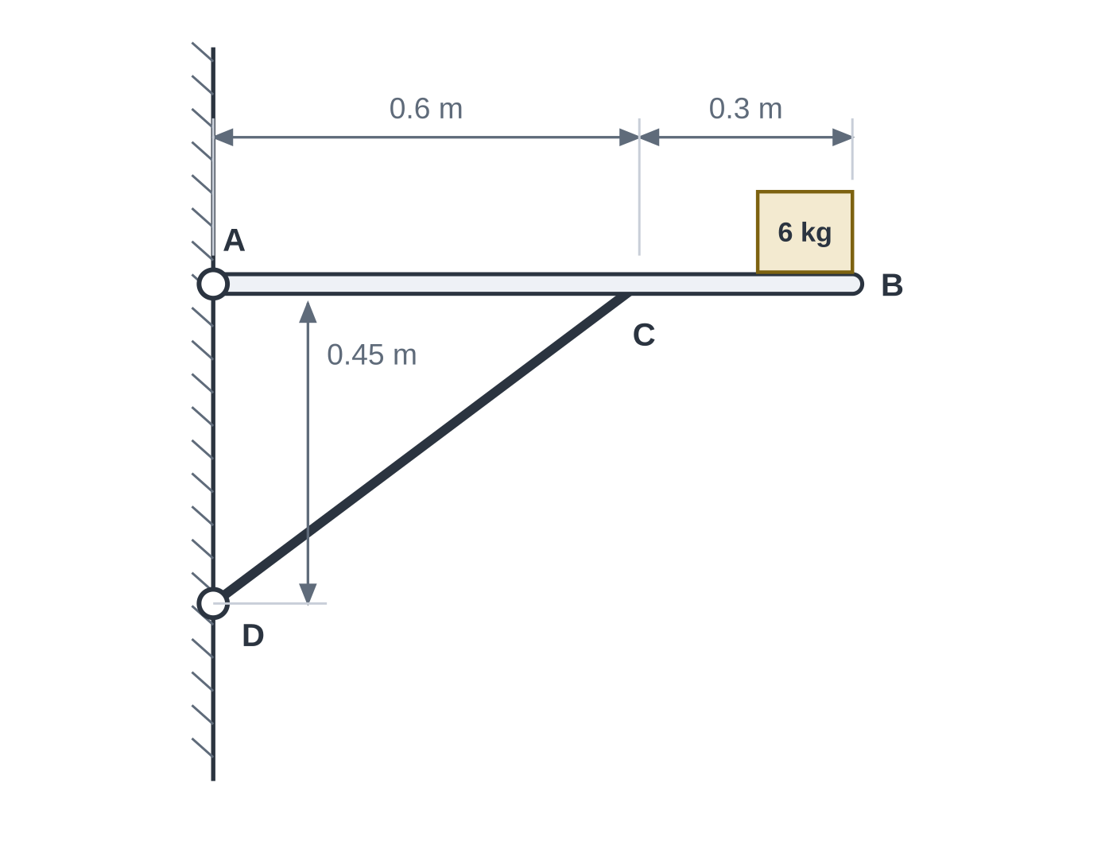
Question 1
6 marks
A shelf AB is modelled as a uniform rod of length 0.9 m and mass 4 kg, freely hinged at A to a vertical wall. The shelf is held horizontal, perpendicular to the wall, by a light rigid strut CD, freely jointed to the shelf at C and to the wall at D, as shown in Figure 1. A box of mass 6 kg, modelled as a particle, rests on the shelf at B. The shelf and the strut lie in a vertical plane. g = 9.8 m s⁻².
(a) Find the thrust in the strut. [3]
(b) Find the magnitude of the force exerted on the shelf by the hinge at A. [3]
Notes:
Online with the full mark scheme: https://examinerprep.com/ial-maths-m2-6-statics-of-rigid-bodies-questions#IALM-M2-6-FB-04

Slide 41
Answers

Slide 42
Question 1 · answer
Mark scheme
CD = 0.75 m, so the strut makes an angle with sine 0.45/0.75 = 0.6 with the shelf
moments about A: T × 0.6 × 0.6 = 4g × 0.45 + 6g × 0.9
T = 20g = 196 N
horizontally: X = 0.8T = 156.8 N, towards the wall
vertically: Y = 10g − 0.6T = −2g, so 19.6 N downwards
magnitude √(156.8² + 19.6²) = 158 N
Notes:
Full mark scheme: https://examinerprep.com/ial-maths-m2-6-statics-of-rigid-bodies-questions#IALM-M2-6-FB-04

Slide 43
Keep practising
Notes for this topic
Questions on this topic
Build a printable test
ExaminerPrep is an independent tutoring service. It has been developed independently from and is not endorsed by the International Baccalaureate Organization. "International Baccalaureate", "IB" and "IB Diploma Programme" are registered trademarks of the IBO, used here for descriptive purposes only.
Pearson Edexcel and Cambridge are trademarks of their owners; ExaminerPrep is not affiliated with any exam board.

