Slide 1
EP
EDEXCEL IAL MATHS
P2.7 Stationary points and optimisation
The full notes page in 11 sections · practice questions with answers · simulations
ExaminerPrep is an independent tutoring service. It has been developed independently from and is not endorsed by the International Baccalaureate Organization. "International Baccalaureate", "IB" and "IB Diploma Programme" are registered trademarks of the IBO, used here for descriptive purposes only.
Pearson Edexcel and Cambridge are trademarks of their owners; ExaminerPrep is not affiliated with any exam board.
Notes:
P2.7 Stationary points and optimisation. Notes for this topic: https://examinerprep.com/notes/edexcel-ial-maths/stationary-points-and-optimisation/

Slide 2
What this page covers
Overview
Stationary points: where dy/dx = 0, and how to find their coordinates
Deciding whether a stationary point is a maximum or a minimum with the second derivative
Using the sign of the gradient either side when the second derivative is zero
Stationary points of inflection
Increasing and decreasing functions, including showing that a function is increasing for all x
Using stationary points and intercepts to sketch a curve
Practical optimisation: setting up a formula for an area, volume or cost, then finding and justifying its maximum or minimum
Notes:
What this page covers. Full notes: https://examinerprep.com/notes/edexcel-ial-maths/stationary-points-and-optimisation/

Slide 3
In one minute
Key points
1
A stationary point is a point where dy/dx = 0, so the tangent is horizontal; solve dy/dx = 0 for x, then substitute into the equation of the curve for y.
4
Sketching: stationary points, intercepts and behaviour for large |x| (and any asymptotes) fix the shape.
2
Nature: d²y/dx² < 0 ⇒ maximum; d²y/dx² > 0 ⇒ minimum. If d²y/dx² = 0 the test tells you nothing: check the sign of dy/dx either side.
5
Optimising: one formula in one variable, differentiate, set to zero, solve, justify max or min, then answer the question asked.
3
f′(x) > 0 means f is increasing; f′(x) < 0 means f is decreasing. Solve the inequality.
Notes:
In one minute: the key points of this topic.

Slide 4
What is a stationary point and how do I find one?
Section 1 of 11
The derivative dy/dx gives the gradient of a curve at every point. Where the curve is climbing the gradient is positive, where it is falling the gradient is negative, and at the top of a hill or the bottom of a valley it is momentarily zero. Those flat points are what this page is about.
Stationary point. A point on a curve where the gradient is zero, dy/dx = 0, so the tangent there is horizontal.
A (local) maximum is a stationary point where the curve changes from going up to going down; a (local) minimum is where it changes from going down to going up. Together they are called turning points.
"Local" matters: a local maximum is the highest point near it, not necessarily the highest point of the whole curve.
Notes:
What is a stationary point and how do I find one?. Full notes: https://examinerprep.com/notes/edexcel-ial-maths/stationary-points-and-optimisation/

Slide 5
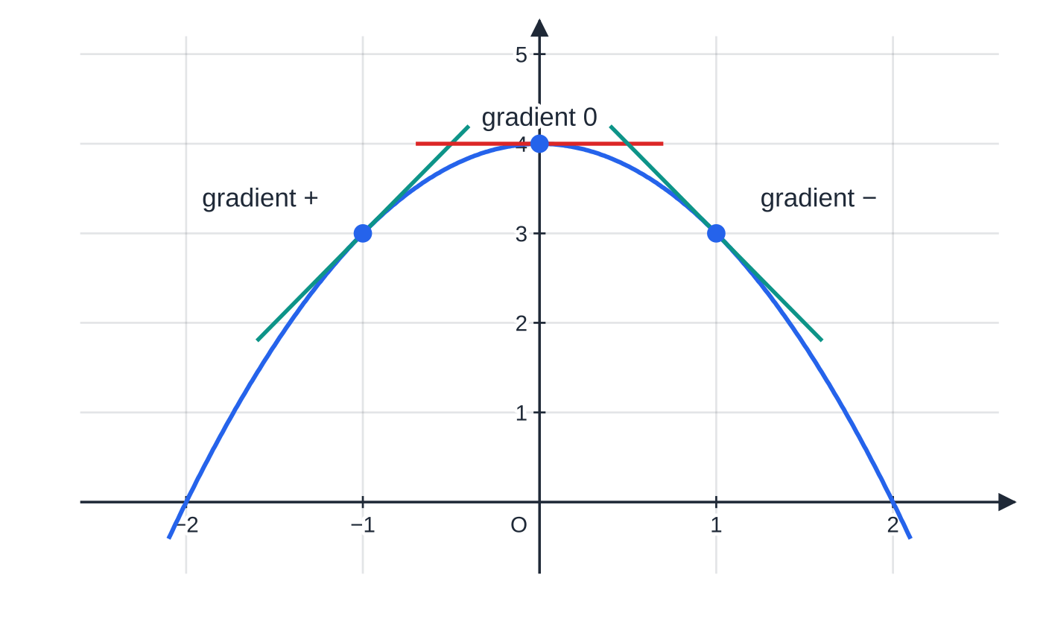
What is a stationary point and how do I find one? (continued)
Section 1 of 11
A stationary point where the curve does not turn (it keeps going up, or keeps going down) is a stationary point of inflection.
The method is short, and every step can go wrong in a predictable way:
1. Differentiate to find dy/dx (write every term as a power of x first).
2. Set dy/dx = 0 and solve for x, usually by factorising.
3. Substitute each x into the equation of the curve (not into dy/dx) to get the y-coordinate.
Through a maximum the gradient changes from positive, through zero, to negative. The tangent at the top is horizontal: that is the stationary point.
Notes:
What is a stationary point and how do I find one?. Full notes: https://examinerprep.com/notes/edexcel-ial-maths/stationary-points-and-optimisation/

Slide 6
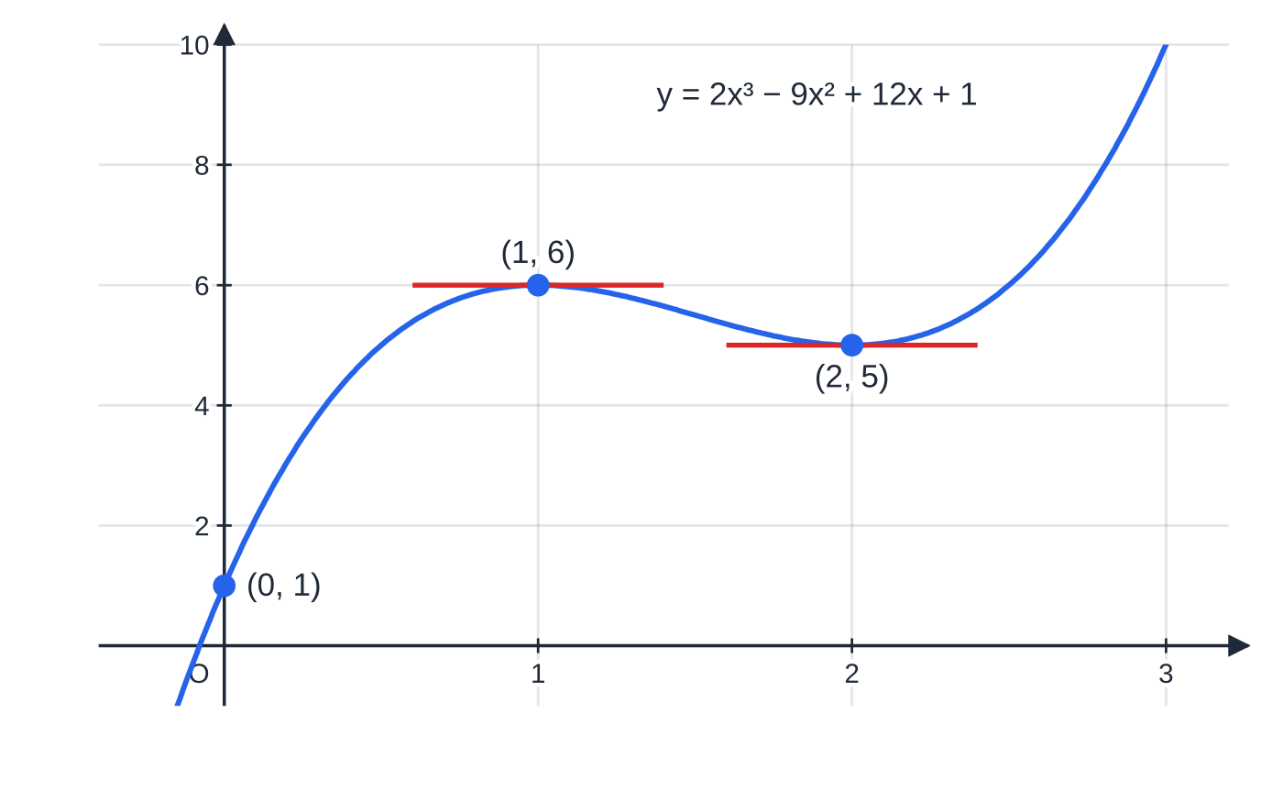
What is a stationary point and how do I find one? (continued)
Section 1 of 11 · Worked example 1 · Easy · Find
WORKED EXAMPLE · QUESTION
Find the coordinates of the stationary points on the curve y = 2x³ - 9x² + 12x + 1.
SOLUTION
Differentiate: dy/dx = 6x² - 18x + 12.
Set equal to zero and factorise: 6(x² - 3x + 2) = 6(x - 1)(x - 2) = 0, so x = 1 or x = 2.
Substitute into the curve: x = 1: y = 2 - 9 + 12 + 1 = 6; x = 2: y = 16 - 36 + 24 + 1 = 5. (1, 6) and (2, 5)
The tangent is horizontal at (1, 6) and (2, 5). The curve rises to (1, 6), falls to (2, 5) and then rises again, so (1, 6) is a maximum and (2, 5) a minimum, even though the two y-values differ by only 1.
Notes:
What is a stationary point and how do I find one?: Worked example 1. Full notes: https://examinerprep.com/notes/edexcel-ial-maths/stationary-points-and-optimisation/

Slide 7
What is a stationary point and how do I find one? (continued)
Section 1 of 11
Common error
Substituting the x-values back into dy/dx. That always gives 0, because that is how you found them. The y-coordinate comes from the equation of the curve.
Notes:
What is a stationary point and how do I find one?. Full notes: https://examinerprep.com/notes/edexcel-ial-maths/stationary-points-and-optimisation/

Slide 8
Is it a maximum or a minimum?
Section 2 of 11
The second derivative d²y/dx² is the rate of change of the gradient. At a maximum the gradient goes from positive, through zero, to negative, so the gradient is decreasing: d²y/dx² < 0. At a minimum the gradient goes from negative to positive, so it is increasing: d²y/dx² > 0. A helpful picture: positive second derivative means the curve bends like a cup, which holds water at the bottom, a minimum.
The second derivative test
(not in the booklet: learn it). At a stationary point:
d²y/dx² < 0 ⇒maximum d²y/dx² > 0 ⇒minimum
Substitute the x-coordinate of the stationary point into d²y/dx²; only the sign matters. If d²y/dx² = 0 there, the test is inconclusive.
The alternative test is always valid: find the sign of dy/dx just to the left and just to the right of the point. + then - is a maximum; - then + is a minimum.
Notes:
Is it a maximum or a minimum?. Full notes: https://examinerprep.com/notes/edexcel-ial-maths/stationary-points-and-optimisation/

Slide 9
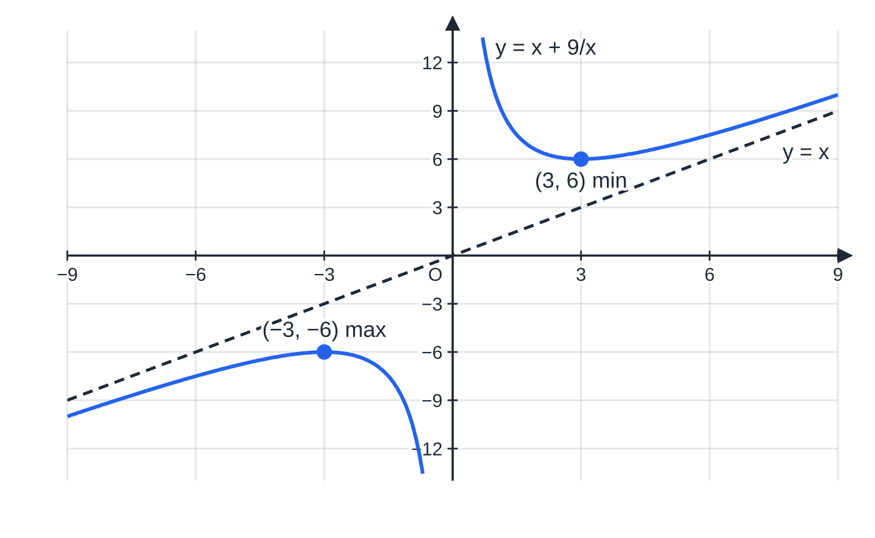
Is it a maximum or a minimum? (continued)
Section 2 of 11 · Worked example 2 · Medium · Find / Determine
WORKED EXAMPLE · QUESTION
The curve C has equation y = x + 9/x, x ≠0. Find the coordinates of the stationary points of C and determine the nature of each.
SOLUTION
Powers first, then differentiate: y = x + 9x⁻¹, so dy/dx = 1 - 9x⁻² = 1 - 9/x².
Solve dy/dx = 0: 9/x² = 1 ⇒x² = 9 ⇒x = 3 or x = -3; then y = 3 + 3 = 6 and y = -3 - 3 = -6.
Second derivative: d²y/dx² = 18x⁻³ = 18/x³. At x = 3: (18/27) = ⅔ > 0, so minimum. At x = -3: -⅔ < 0, so maximum. (3, 6) minimum; (-3, -6) maximum
y = x + 9/x. The maximum (−3, −6) is lower than the minimum (3, 6): "maximum" and "minimum" describe the shape of the curve near each point, not which is higher. The curve approaches the asymptotes x = 0 and y = x (dashed).
Notes:
Is it a maximum or a minimum?: Worked example 2. Full notes: https://examinerprep.com/notes/edexcel-ial-maths/stationary-points-and-optimisation/

Slide 10
Is it a maximum or a minimum? (continued)
Section 2 of 11 · Worked example 2 · Medium · Find / Determine (continued)
Remember both square roots: x² = 9 has two solutions, and the negative one is easy to lose.
Notes:
Is it a maximum or a minimum?: Worked example 2. Full notes: https://examinerprep.com/notes/edexcel-ial-maths/stationary-points-and-optimisation/

Slide 11
Is it a maximum or a minimum? (continued)
Section 2 of 11
Exam tip
Write the conclusion with its reason: "d²y/dx² = ⅔ > 0, so minimum". A bare "minimum" with no sign stated shows no method.
Notes:
Is it a maximum or a minimum?. Full notes: https://examinerprep.com/notes/edexcel-ial-maths/stationary-points-and-optimisation/

Slide 12
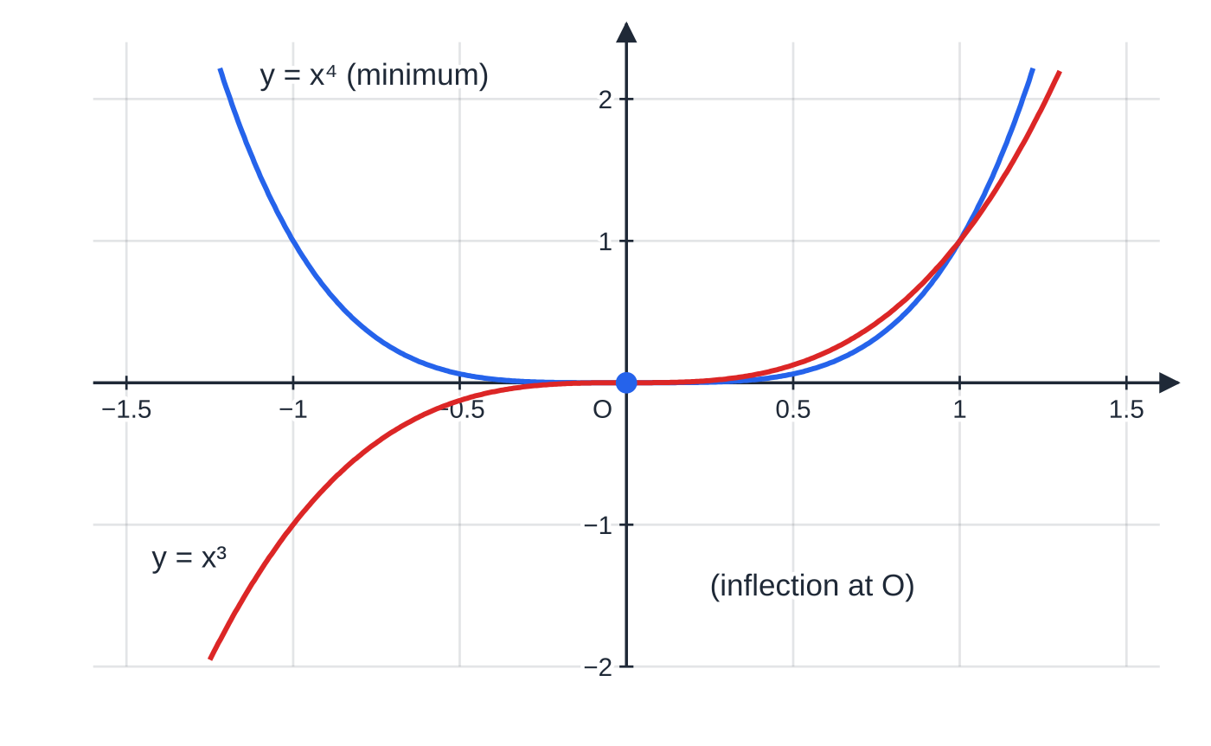
What if the second derivative is zero?
Section 3 of 11
If d²y/dx² = 0 at a stationary point, the point could be a maximum, a minimum or a stationary point of inflection. For example, y = x⁴ has a minimum at the origin, yet d²y/dx² = 12x² = 0 there; and y = x³ has a stationary point of inflection at the origin, where d²y/dx² = 6x = 0 as well. The test cannot tell them apart, so go back to the gradient and test its sign on each side.
Both curves have dy/dx = 0 and d²y/dx² = 0 at the origin. y = x⁴ turns there (a minimum); y = x³ flattens and carries on rising (a stationary point of inflection). Only the gradient either side tells them apart.
Notes:
What if the second derivative is zero?. Full notes: https://examinerprep.com/notes/edexcel-ial-maths/stationary-points-and-optimisation/

Slide 13
What if the second derivative is zero? (continued)
Section 3 of 11
Sign of dy/dx: left, at, right | Shape | Nature
+ 0 - | up, flat, down | maximum
- 0 + | down, flat, up | minimum
+ 0 + or - 0 - | flattens, then carries on | stationary point of inflection
Choose test values close to the point and between it and any neighbouring stationary point, and show the values you substitute.
Notes:
What if the second derivative is zero?. Full notes: https://examinerprep.com/notes/edexcel-ial-maths/stationary-points-and-optimisation/

Slide 14
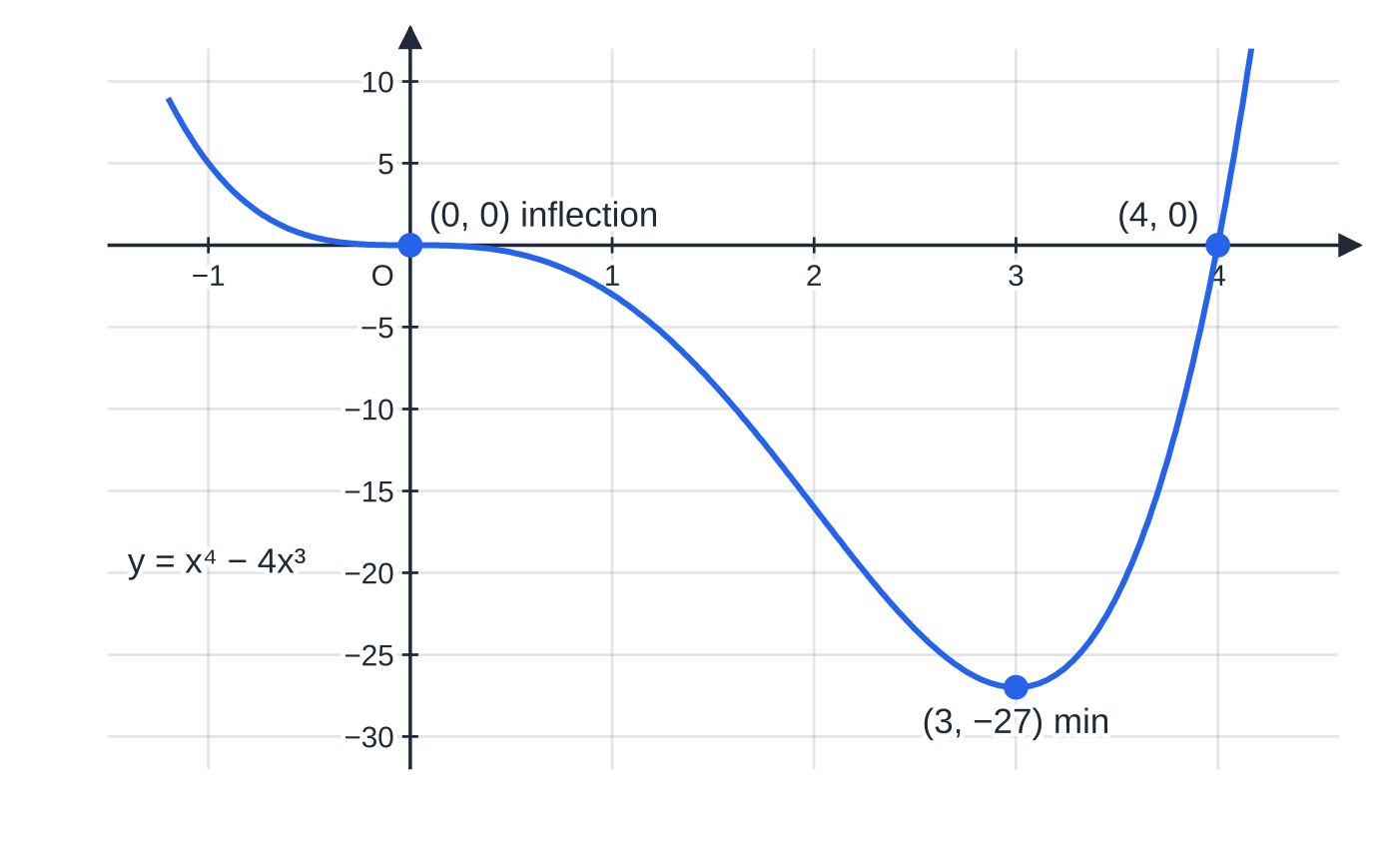
What if the second derivative is zero? (continued)
Section 3 of 11 · Worked example 3 · Medium · Determine
WORKED EXAMPLE · QUESTION
Find the stationary points of y = x⁴ - 4x³ and determine their nature.
y = x⁴ − 4x³. The curve flattens at the origin but keeps falling, down to the minimum (3, −27), then rises through (4, 0).
Notes:
What if the second derivative is zero?: Worked example 3. Full notes: https://examinerprep.com/notes/edexcel-ial-maths/stationary-points-and-optimisation/

Slide 15
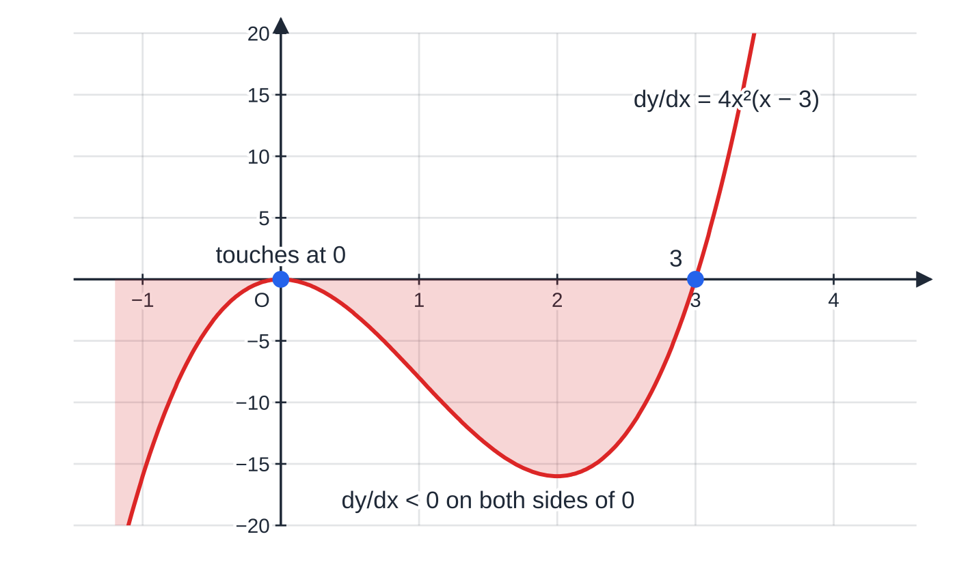
What if the second derivative is zero? (continued)
Section 3 of 11 · Worked example 3 · Medium · Determine (continued)
SOLUTION
Differentiate and factorise: dy/dx = 4x³ - 12x² = 4x²(x - 3) = 0, so x = 0 or x = 3; the points are (0, 0) and (3, -27).
Second derivative: d²y/dx² = 12x² - 24x. At x = 3: 108 - 72 = 36 > 0, so (3, -27) is a minimum. At x = 0: d²y/dx² = 0, which is inconclusive.
Gradient either side of x = 0: at x = -0.5, 4(0.25)(-3.5) = -3.5 < 0; at x = 0.5, 4(0.25)(-2.5) = -2.5 < 0. - then -: the curve does not turn. (0, 0) stationary point of inflection; (3, -27) minimum
The gradient function 4x²(x − 3). The factor x² never changes sign, so the graph only touches the axis at x = 0: the gradient is negative on both sides, which is why the origin is an inflection, not a turning point.
Notes:
What if the second derivative is zero?: Worked example 3. Full notes: https://examinerprep.com/notes/edexcel-ial-maths/stationary-points-and-optimisation/

Slide 16
What if the second derivative is zero? (continued)
Section 3 of 11
Common error
Concluding "d²y/dx² = 0, so it is a point of inflection". A zero second derivative only means this test cannot decide. y = x⁴ is the counterexample: zero second derivative, but a minimum.
Notes:
What if the second derivative is zero?. Full notes: https://examinerprep.com/notes/edexcel-ial-maths/stationary-points-and-optimisation/

Slide 17
Where is a function increasing or decreasing?
Section 4 of 11
Increasing and decreasing. f is increasing on an interval if f′(x) > 0 throughout it, and decreasing if f′(x) < 0 throughout it.
To find where f is increasing or decreasing, solve an inequality in f′(x): find the critical values where f′(x) = 0, then decide which side(s) you need. A sketch of f′(x) helps, exactly as with P1 quadratic inequalities.
To show that f is increasing for all x, prove that f′(x) > 0 for every x. Completing the square is the standard tool.
Some texts use f′(x) ≥0 for "increasing" and keep f′(x) > 0 for "strictly increasing"; follow the wording of the question.
Notes:
Where is a function increasing or decreasing?. Full notes: https://examinerprep.com/notes/edexcel-ial-maths/stationary-points-and-optimisation/

Slide 18
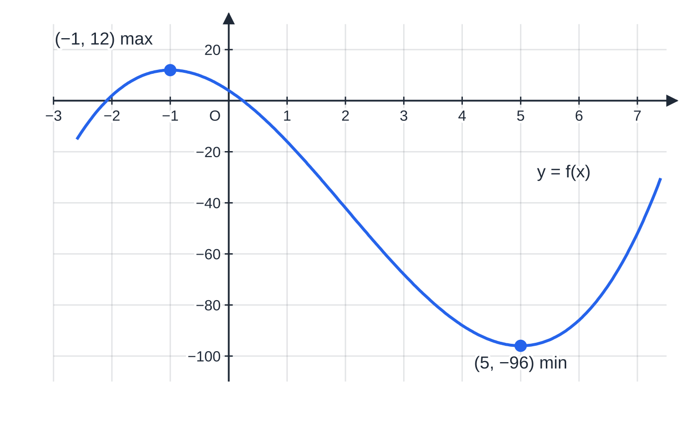
Where is a function increasing or decreasing? (continued)
Section 4 of 11 · Worked example 4 · Medium · Find
WORKED EXAMPLE · QUESTION
Find the set of values of x for which f(x) = x³ - 6x² - 15x + 4 is decreasing.
f(x) = x³ − 6x² − 15x + 4 has a maximum at (−1, 12) and a minimum at (5, −96). Between them the curve is falling.
Notes:
Where is a function increasing or decreasing?: Worked example 4. Full notes: https://examinerprep.com/notes/edexcel-ial-maths/stationary-points-and-optimisation/

Slide 19
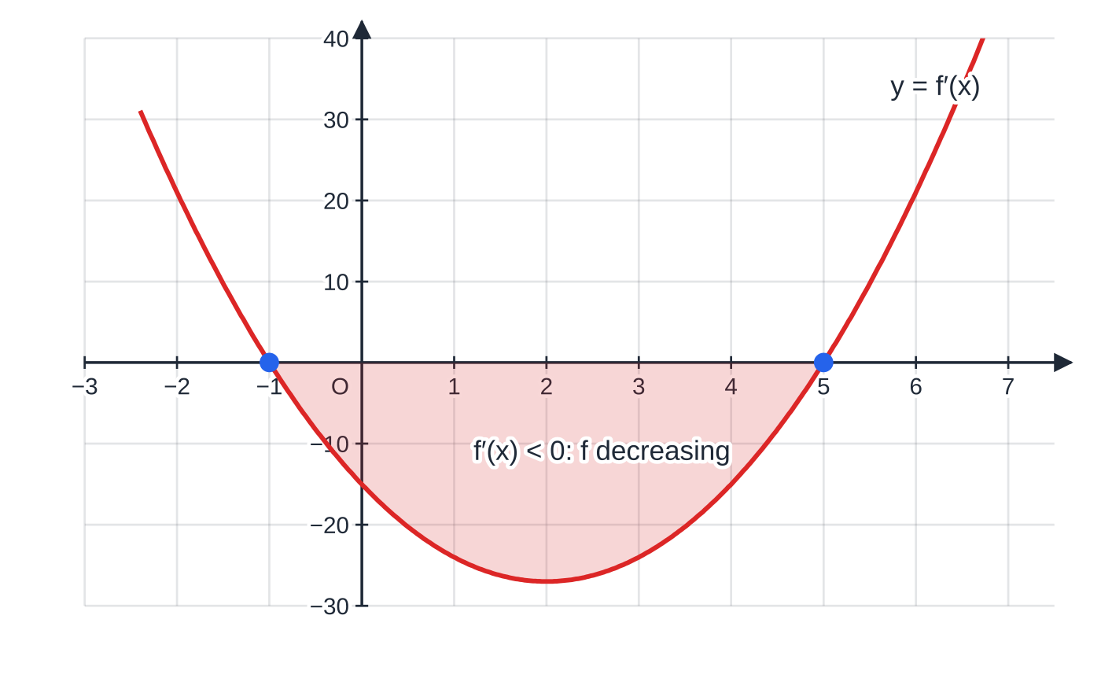
Where is a function increasing or decreasing? (continued)
Section 4 of 11 · Worked example 4 · Medium · Find (continued)
SOLUTION
Differentiate: f′(x) = 3x² - 12x - 15 = 3(x² - 4x - 5) = 3(x - 5)(x + 1).
Critical values: f′(x) = 0 at x = -1 and x = 5. The parabola f′ opens upwards, so f′(x) < 0 between the roots. -1 < x < 5
f′(x) = 3(x − 5)(x + 1). In the shaded interval −1 < x < 5 the gradient function is below the axis, so f is decreasing there.
Notes:
Where is a function increasing or decreasing?: Worked example 4. Full notes: https://examinerprep.com/notes/edexcel-ial-maths/stationary-points-and-optimisation/

Slide 20
Where is a function increasing or decreasing? (continued)
Section 4 of 11 · Worked example 5 · Medium · Show that
WORKED EXAMPLE · QUESTION
Show that f(x) = x³ + 3x² + 5x - 7 is an increasing function.
SOLUTION
Differentiate: f′(x) = 3x² + 6x + 5.
Complete the square: 3(x² + 2x) + 5 = 3(x + 1)² - 3 + 5 = 3(x + 1)² + 2.
Conclude, with the reason: (x + 1)² ≥0 for all x, so f′(x) ≥2 > 0 for all x. Hence f is increasing
The discriminant works too: 36 - 60 = -24 < 0 and the coefficient of x² is positive, so 3x² + 6x + 5 is always positive.
Notes:
Where is a function increasing or decreasing?: Worked example 5. Full notes: https://examinerprep.com/notes/edexcel-ial-maths/stationary-points-and-optimisation/

Slide 21
Where is a function increasing or decreasing? (continued)
Section 4 of 11
Exam tip
In a "show that f is increasing" question the final sentence carries weight: state that the square is never negative, so f′(x) > 0 for all x, therefore f is increasing.
Notes:
Where is a function increasing or decreasing?. Full notes: https://examinerprep.com/notes/edexcel-ial-maths/stationary-points-and-optimisation/

Slide 22
How do stationary points help me sketch a curve?
Section 5 of 11
A sketch is not an accurate plot; it must show the right shape and the key points, labelled with their coordinates. Collect three kinds of information before you draw:
the stationary points and their nature;
where the curve crosses the axes (put x = 0; put y = 0 and solve). A repeated root means the curve touches the x-axis there;
what happens as x →±∞, and any asymptotes (for example x = 0 when there is a 1/x term).
Notes:
How do stationary points help me sketch a curve?. Full notes: https://examinerprep.com/notes/edexcel-ial-maths/stationary-points-and-optimisation/

Slide 23
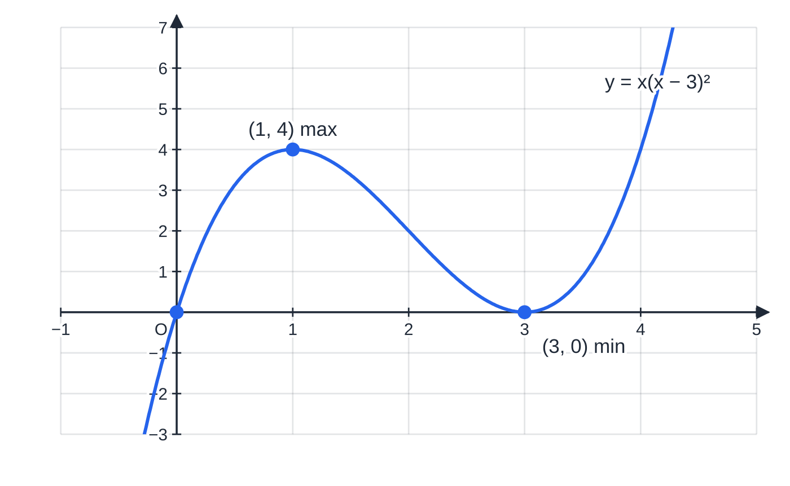
How do stationary points help me sketch a curve? (continued)
Section 5 of 11 · Worked example 6 · Medium · Find / Sketch
WORKED EXAMPLE · QUESTION
The curve C has equation y = x(x - 3)². (a) Find the coordinates of the stationary points of C and determine their nature. (b) Sketch C, showing the coordinates of the points where C meets the axes.
SOLUTION
(a) Expand, then differentiate: y = x³ - 6x² + 9x, so dy/dx = 3x² - 12x + 9 = 3(x - 1)(x - 3). At x = 1: y = 1 ×4 = 4; at x = 3: y = 0. d²y/dx² = 6x - 12: -6 at x = 1 and +6 at x = 3. (1, 4) maximum; (3, 0) minimum
The sketch of y = x(x − 3)². The minimum (3, 0) lies on the x-axis because x = 3 is a repeated root, so the axis is a tangent there; the maximum is (1, 4).
Notes:
How do stationary points help me sketch a curve?: Worked example 6. Full notes: https://examinerprep.com/notes/edexcel-ial-maths/stationary-points-and-optimisation/

Slide 24
How do stationary points help me sketch a curve? (continued)
Section 5 of 11 · Worked example 6 · Medium · Find / Sketch (continued)
(b) y = 0 at x = 0 (crosses) and x = 3 (repeated root: touches). Positive cubic: y →-∞ as x →-∞ and y →+∞ as x →+∞. The curve rises through O to the maximum (1, 4), falls to touch the x-axis at (3, 0), then rises.
Notes:
How do stationary points help me sketch a curve?: Worked example 6. Full notes: https://examinerprep.com/notes/edexcel-ial-maths/stationary-points-and-optimisation/

Slide 25
How do stationary points help me sketch a curve? (continued)
Section 5 of 11
Exam tip
Check that your stationary points and intercepts agree before you draw: a maximum must sit between two lower points, and a cubic with a positive x³ coefficient has its maximum to the left of its minimum.
Notes:
How do stationary points help me sketch a curve?. Full notes: https://examinerprep.com/notes/edexcel-ial-maths/stationary-points-and-optimisation/

Slide 26
How do I solve an optimisation problem?
Section 6 of 11
Practical problems ask for the largest area, the greatest volume or the least cost. The calculus is the same as above; the work is in setting up the formula.
1. Name the variables and write the quantity to be optimised (area, volume, cost) in terms of them.
2. Use the constraint (fixed perimeter, fixed volume, fixed amount of material) to eliminate one variable, so the formula has one variable. This is usually the "show that" part.
3. Differentiate, set equal to zero and solve. Reject values that make no physical sense (negative lengths, or a box with no base).
4. Justify that it is a maximum or minimum (second derivative), then answer the actual question: the maximum area, the dimensions, the cost.
Notes:
How do I solve an optimisation problem?. Full notes: https://examinerprep.com/notes/edexcel-ial-maths/stationary-points-and-optimisation/

Slide 27
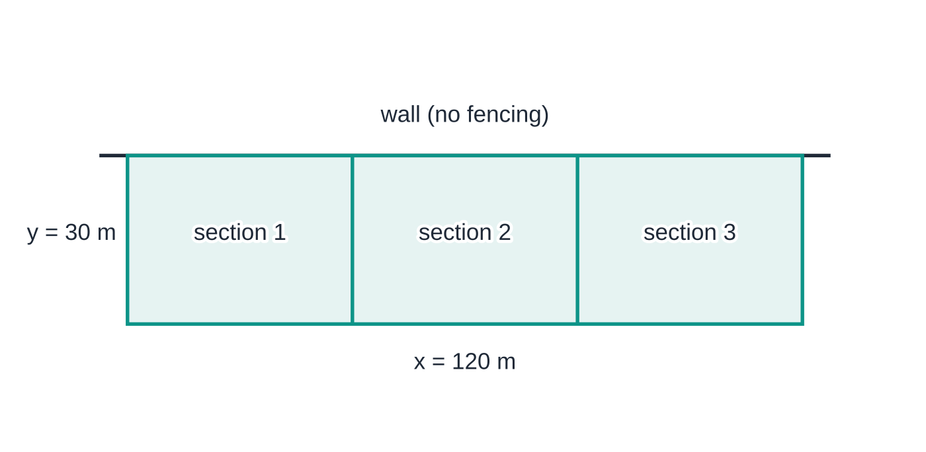
How do I solve an optimisation problem? (continued)
Section 6 of 11 · Worked example 7 · Medium · Show that / Find
WORKED EXAMPLE · QUESTION
A farmer has 240 m of fencing to build a rectangular pen against a long straight wall. The wall forms one long side, so needs no fencing. The fencing forms the other long side, of length x metres, the two ends, each of length y metres, and two internal fences parallel to the ends that divide the pen into three sections. All 240 m is used. (a) Show that the area A m² of the pen is given by A = 60x - x²/4. (b) Use calculus to find the maximum area, justifying that it is a maximum.
The best pen, drawn to scale: 120 m along the wall and 30 m deep. Fencing used: one length x plus four lengths y, 120 + 4 × 30 = 240 m.
Notes:
How do I solve an optimisation problem?: Worked example 7. Full notes: https://examinerprep.com/notes/edexcel-ial-maths/stationary-points-and-optimisation/

Slide 28
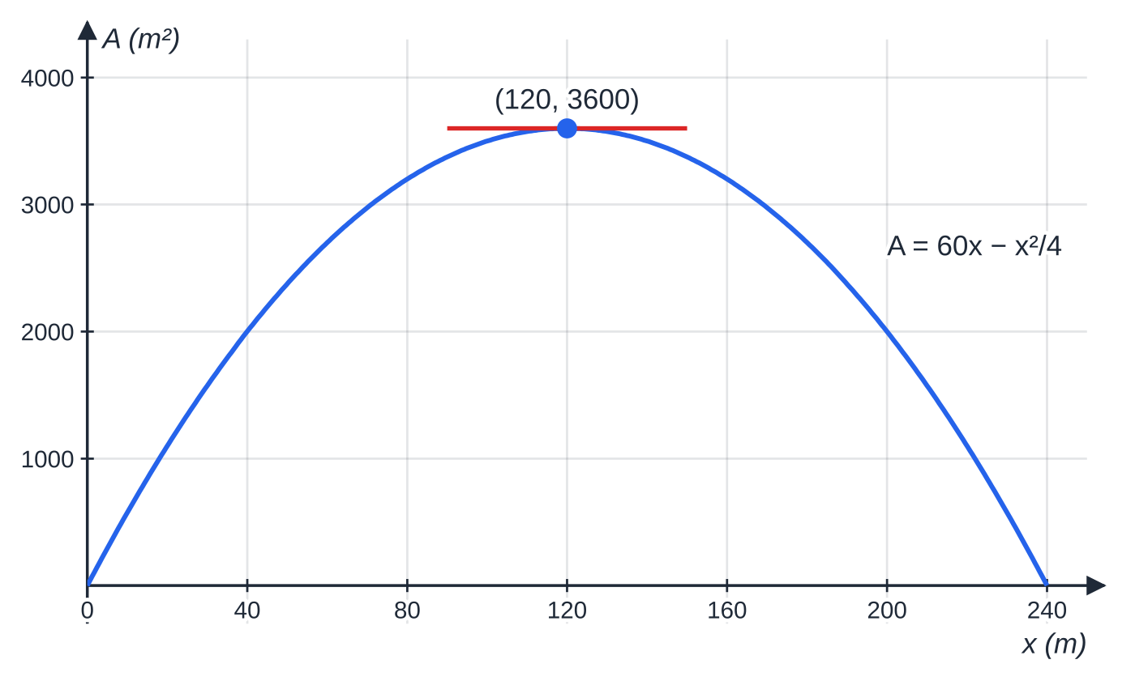
How do I solve an optimisation problem? (continued)
Section 6 of 11 · Worked example 7 · Medium · Show that / Find (continued)
SOLUTION
(a) Constraint, one long side and four lengths y: x + 4y = 240, so y = (240 - x)/4. Area in terms of x only: A = xy = (x(240 - x))/4 = 60x - x²/4, as required.
(b) dA/dx = 60 - x/2 = 0 ⇒x = 120, so y = 30. d²A/dx² = -½ < 0, so maximum. A = 60(120) - (14400/4) = 3600. Maximum area 3600 m²
A = 60x − x²/4 for 0 < x < 240. The area is zero at both ends of the range and greatest, 3600 m², where the gradient is zero.
Notes:
How do I solve an optimisation problem?: Worked example 7. Full notes: https://examinerprep.com/notes/edexcel-ial-maths/stationary-points-and-optimisation/

Slide 29
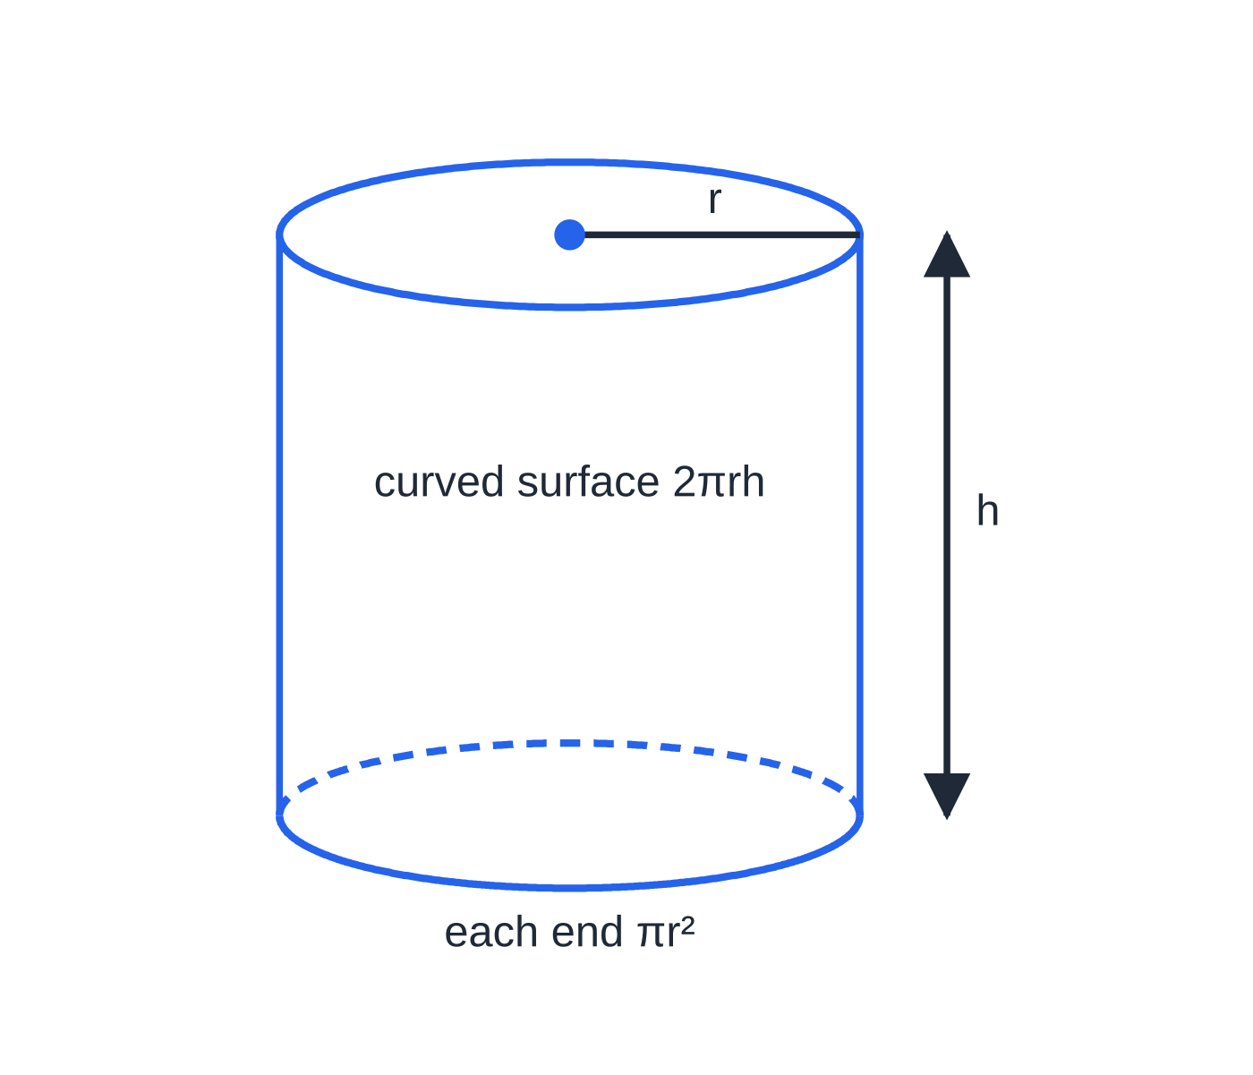
How do I solve an optimisation problem? (continued)
Section 6 of 11 · Worked example 8 · Hard · Show that / Find / Justify
WORKED EXAMPLE · QUESTION
A closed cylindrical container of radius r cm and height h cm has volume 2000 cm³. The material for the curved surface costs 1p per cm² and the material for the two circular ends costs 2p per cm². The total cost of the material is C pence. (a) Show that C = 4πr² + 4000/r. (b) Use calculus to find the value of r for which C is a minimum, giving your answer to 3 significant figures. (c) Justify that this value of r gives a minimum. (d) Find the minimum cost, and show that at the minimum h = 4r.
The closed cylinder: two circular ends of area πr² each and a curved surface of area 2πrh, which unrolls into a rectangle 2πr by h.
Notes:
How do I solve an optimisation problem?: Worked example 8. Full notes: https://examinerprep.com/notes/edexcel-ial-maths/stationary-points-and-optimisation/

Slide 30
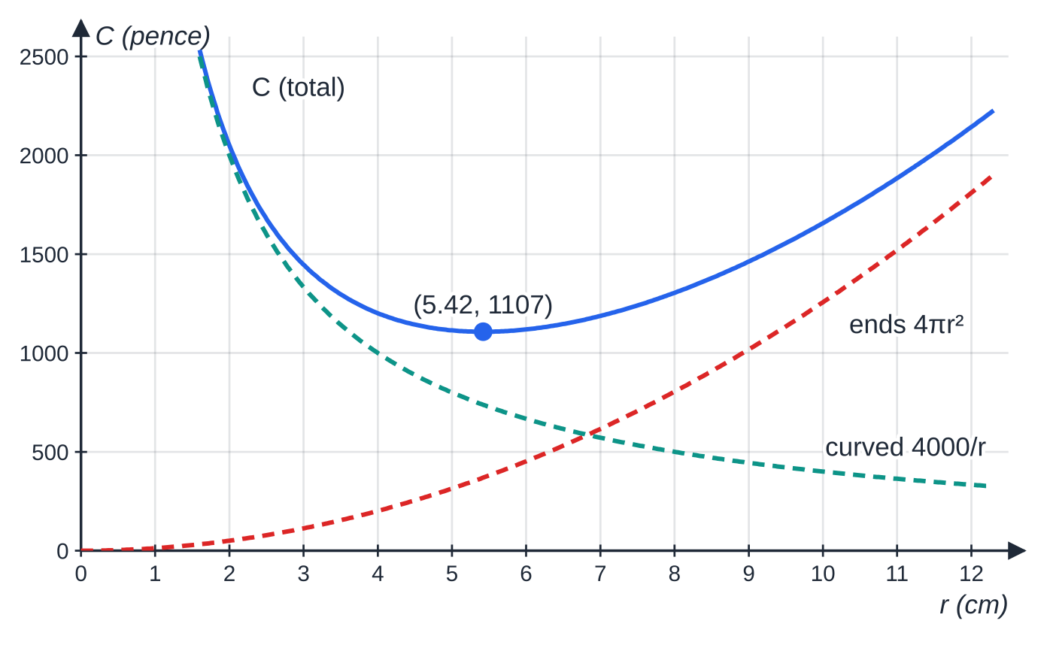
How do I solve an optimisation problem? (continued)
Section 6 of 11 · Worked example 8 · Hard · Show that / Find / Justify (continued)
SOLUTION
(a) The constraint gives h: πr² h = 2000 ⇒h = 2000/πr². Cost = 2 × (area of ends) + 1 × (curved area):
C = 2(2πr²) + 2πr h = 4πr² + 2πr ×2000/πr² = 4πr² + 4000/r
as required.
(b) dC/dr = 8πr - 4000/r² = 0 ⇒r³ = 500/π ⇒r = 5.4193… r = 5.42
(c) d²C/dr² = 8π+ 8000/r³ > 0 for every r > 0, so minimum.
The cost C = 4πr² + 4000/r (solid) is the sum of the cost of the ends (rising) and the cost of the curved surface (falling). A thin, tall can wastes money on the curved surface; a wide, flat one on the ends. The minimum is at r ≈ 5.42, C ≈ 1107.
Notes:
How do I solve an optimisation problem?: Worked example 8. Full notes: https://examinerprep.com/notes/edexcel-ial-maths/stationary-points-and-optimisation/

Slide 31
How do I solve an optimisation problem? (continued)
Section 6 of 11 · Worked example 8 · Hard · Show that / Find / Justify (continued)
(d) Use the unrounded r: C = 4π(5.4193…)² + 4000/5.4193… = 1107.16… pence. Minimum cost £11.07 (to the nearest penny)
Height at the minimum: h = 2000/πr² = 2000r/πr³ = 2000r/500 = 4r (using πr³ = 500), so h ≈21.7 cm.
Notes:
How do I solve an optimisation problem?: Worked example 8. Full notes: https://examinerprep.com/notes/edexcel-ial-maths/stationary-points-and-optimisation/

Slide 32
How do I solve an optimisation problem? (continued)
Section 6 of 11
Common error
Stopping at "r = 5.42". The question asked for the minimum cost as well; finding the variable is only half of an optimisation problem. Use the unrounded r in the final calculation, or the cost can come out a penny or two out.
Notes:
How do I solve an optimisation problem?. Full notes: https://examinerprep.com/notes/edexcel-ial-maths/stationary-points-and-optimisation/

Slide 33
Exam tips for P2.7
Section 7 of 11
Exam tip 1 — powers before differentiating
Rewrite 9/x as 9x⁻¹ and √x as x^(1/2) before you differentiate, and expand any brackets. Almost every wrong stationary point starts with a wrong derivative.
Exam tip 2 — find every solution
dy/dx = 0 often gives a quadratic or an equation like x² = 9 with two solutions. Keep both unless the question restricts x (for example x > 0, or a length that must be positive), and say why you reject one.
Exam tip 3 — state the sign, then the nature
Write the value of d²y/dx² (or the signs of dy/dx either side), then "< 0 so maximum". If d²y/dx² = 0, switch to the gradient either side and show the numbers you used.
Notes:
Exam tips for P2.7. Full notes: https://examinerprep.com/notes/edexcel-ial-maths/stationary-points-and-optimisation/

Slide 34
Exam tips for P2.7 (continued)
Section 7 of 11
Exam tip 4 — "show that" formulas
In a set-up part, write the constraint, rearrange it, substitute, and simplify to the given form. Every step should be visible: you are told the answer, so the working is what counts.
Exam tip 5 — finish the problem
After finding the stationary value, re-read the question: does it want the value of x, the maximum area, the dimensions, or a cost in pounds? Give units and the accuracy asked for.
Notes:
Exam tips for P2.7. Full notes: https://examinerprep.com/notes/edexcel-ial-maths/stationary-points-and-optimisation/

Slide 35
Common misconceptions
Section 8 of 11
Misconception | Why it is wrong | Correct idea
A maximum is always higher than a minimum. | They are local features. On y = x + 9/x the maximum is at y = -6 and the minimum at y = 6. | "Maximum" means the curve turns from up to down there.
d²y/dx² = 0 means a point of inflection. | y = x⁴ has d²y/dx² = 0 at a minimum. | d²y/dx² = 0 means the test is inconclusive: check the gradient either side.
The y-coordinate comes from putting x into dy/dx. | dy/dx = 0 there by definition. | Substitute into the equation of the curve.
A positive second derivative means a maximum, because positive is "up". | d²y/dx² > 0 means the gradient is increasing: the curve is shaped like a cup. | d²y/dx² > 0 ⇒ minimum; d²y/dx² < 0 ⇒ maximum.
You can differentiate an area formula that still has two variables. | dA/dx is not defined until A depends on x alone. | Use the constraint to eliminate the second variable first.
Notes:
Common misconceptions. Full notes: https://examinerprep.com/notes/edexcel-ial-maths/stationary-points-and-optimisation/

Slide 36
Common misconceptions (continued)
Section 8 of 11
Misconception | Why it is wrong | Correct idea
Showing f′(x) = 0 has no solutions proves f is increasing. | f′ could be negative everywhere: f would then be decreasing. | Show f′(x) > 0 for all x, for example by completing the square.
Notes:
Common misconceptions. Full notes: https://examinerprep.com/notes/edexcel-ial-maths/stationary-points-and-optimisation/

Slide 37
How this topic connects
Section 9 of 11
Differentiation and quadratics (P1)
The derivative of xⁿ, tangents and normals come from P1, and so do the quadratic inequalities and completing the square used for increasing and decreasing functions.
Further calculus (P3 and P4)
Stationary points of curves involving eˣ, ln x, sin x and cos x use the same method with the chain, product and quotient rules (P3); P4 adds rates of change in context and stationary points of implicit and parametric curves.
Mechanics (M1, M2) and IAL Physics
In M2, velocity is greatest when dv/dt = 0, a stationary point of v(t); a particle is momentarily at rest at a stationary point of its displacement. In physics, the maximum power delivered to a load occurs where the derivative of the power with respect to the load resistance is zero.
Notes:
How this topic connects. Full notes: https://examinerprep.com/notes/edexcel-ial-maths/stationary-points-and-optimisation/

Slide 38
Key formulae
Section 10 of 11
Formula | Use | In the formulae list?
dy/dx = 0 | condition for a stationary point | No — learn it
d²y/dx² < 0 ⇒ maximum; d²y/dx² > 0 ⇒ minimum | second derivative test for the nature of a stationary point | No — learn it
f′(x) > 0 ⇒ increasing; f′(x) < 0 ⇒ decreasing | finding or proving where a function increases or decreases | No — learn it
d/dx(axⁿ) = anxⁿ⁻¹ | differentiating each term (P1) | No — learn it
Cylinder: V = πr² h, curved surface 2πrh, each end πr² | setting up volume and surface-area formulas | No — learn it
Cuboid: V = lwh, surface area 2(lw + lh + wh) | box problems (omit faces that are open) | No — derive it
Notes:
Key formulae. Full notes: https://examinerprep.com/notes/edexcel-ial-maths/stationary-points-and-optimisation/

Slide 39
Check your understanding
Section 11 of 11
1. Find the coordinates of the stationary point of y = x² - 8x + 3.
2. At a stationary point, d²y/dx² = -5. What kind of stationary point is it?
3. Find the set of values of x for which y = 12x - x³ is increasing.
4. y = x³ has a stationary point at the origin. What kind is it, and how do you know?
5. An open box has a square base of side x cm and volume 32 cm³. Show that its outer surface area is S = x² + 128/x and find the least value of S.
6. Find the stationary point of y = 2√x - x, x > 0, and show that it is a maximum.
Notes:
Check your understanding: questions. Full notes: https://examinerprep.com/notes/edexcel-ial-maths/stationary-points-and-optimisation/

Slide 40
Check your understanding · answers
Section 11 of 11
1. dy/dx = 2x - 8 = 0 ⇒x = 4; y = 16 - 32 + 3 = -13. The point is (4, -13), a minimum (d²y/dx² = 2 > 0).
2. A maximum: the second derivative is negative, so the gradient is decreasing as it passes through zero (from + to -).
3. dy/dx = 12 - 3x² = 3(2 - x)(2 + x) > 0 ⇒-2 < x < 2.
4. d²y/dx² = 6x = 0 at x = 0, so test the gradient: 3x² is positive on both sides (e.g. 0.03 at x = ±0.1). + then +: a stationary point of inflection.
5. Height = 32/x²; S = x² + 4x ·32/x² = x² + 128/x. dS/dx = 2x - 128/x² = 0 ⇒x³ = 64 ⇒x = 4; d²S/dx² = 2 + 256/x³ > 0, so the least value is S = 16 + 32 = 48 cm².
6. y = 2x^(1/2) - x, so dy/dx = x^(-1/2) - 1 = 0 ⇒x = 1, y = 2 - 1 = 1. d²y/dx² = -½ x^(-3/2) = -½ < 0 at x = 1, so (1, 1) is a maximum.
Notes:
Check your understanding: answers. Full notes: https://examinerprep.com/notes/edexcel-ial-maths/stationary-points-and-optimisation/

Slide 41
Practice questions
2 original exam-style questions. Answers at the end of the deck.

Slide 42
Question 1
6 marks
A cubic curve C is defined for every real value of x by y = x³ − 12x + 5. It has two turning points.
(a) Find dy/dx. [1]
(b) Find the coordinates of the stationary points of C. [3]
(c) Use the second derivative to determine the nature of each stationary point. [2]
Notes:
Online with the full mark scheme: https://examinerprep.com/ial-maths-p2-7-stationary-points-and-optimisation-questions#IALM-P2-7-B-01

Slide 43
Question 2
9 marks
The curve C has equation y = 3x⁵ − 5x³.
(a) Find the x-coordinates of the stationary points of C. [3]
(b) Find the coordinates of the two stationary points with x ≠ 0, and use the second derivative to determine their nature. [3]
(c) Show that the second derivative test gives no conclusion at the origin, and determine the nature of the stationary point there. [3]
Notes:
Online with the full mark scheme: https://examinerprep.com/ial-maths-p2-7-stationary-points-and-optimisation-questions#IALM-P2-7-B-05

Slide 44
Answers

Slide 45
Question 1 · answer
Mark scheme
3x² − 12
sets 3x² − 12 = 0
x = 2 and x = −2
(2, −11) and (−2, 21)
d²y/dx² = 6x, substituting both x-values
at x = 2: 12 > 0 so (2, −11) is a minimum; at x = −2: −12 < 0 so (−2, 21) is a maximum
Notes:
Full mark scheme: https://examinerprep.com/ial-maths-p2-7-stationary-points-and-optimisation-questions#IALM-P2-7-B-01

Slide 46
Question 2 · answer
Mark scheme
dy/dx = 15x⁴ − 15x²
15x²(x² − 1) = 0
x = 0, 1, −1
(1, −2) and (−1, 2)
d²y/dx² = 60x³ − 30x
at x = 1: 30 > 0, (1, −2) minimum; at x = −1: −30 < 0, (−1, 2) maximum
d²y/dx² = 0 at x = 0, so the test is inconclusive
gradient either side, e.g. at x = ±0.5: 15(0.0625) − 15(0.25) = −2.8125
Notes:
Full mark scheme: https://examinerprep.com/ial-maths-p2-7-stationary-points-and-optimisation-questions#IALM-P2-7-B-05

Slide 47
Keep practising
Notes for this topic
Questions on this topic
Build a printable test
ExaminerPrep is an independent tutoring service. It has been developed independently from and is not endorsed by the International Baccalaureate Organization. "International Baccalaureate", "IB" and "IB Diploma Programme" are registered trademarks of the IBO, used here for descriptive purposes only.
Pearson Edexcel and Cambridge are trademarks of their owners; ExaminerPrep is not affiliated with any exam board.

