Slide 1
EP
EDEXCEL IAL MATHS
P2.4 The binomial expansion
The full notes page in 13 sections · practice questions with answers · simulations
ExaminerPrep is an independent tutoring service. It has been developed independently from and is not endorsed by the International Baccalaureate Organization. "International Baccalaureate", "IB" and "IB Diploma Programme" are registered trademarks of the IBO, used here for descriptive purposes only.
Pearson Edexcel and Cambridge are trademarks of their owners; ExaminerPrep is not affiliated with any exam board.
Notes:
P2.4 The binomial expansion. Notes for this topic: https://examinerprep.com/notes/edexcel-ial-maths/the-binomial-expansion/

Slide 2
What this page covers
Overview
Factorials n!, the notation C(n, r) and its meaning as a number of choices
Pascal's triangle and its addition rule
Expanding (a + bx)ⁿ fully, or its first few terms in ascending powers of x
Finding one particular term or coefficient with the general term
Finding an unknown constant, or the power n itself, from given coefficients
Using the first few terms to approximate a value such as 0.995¹⁰
Coefficients in the product of a short bracket and a binomial expansion
Notes:
What this page covers. Full notes: https://examinerprep.com/notes/edexcel-ial-maths/the-binomial-expansion/

Slide 3
In one minute
Key points
1
The binomial expansion writes (a + b)ⁿ as n + 1 terms, aⁿ + C(n, 1)aⁿ⁻¹b + C(n, 2)aⁿ⁻²b² + …+ bⁿ, with the powers of a falling as the powers of b rise.
4
General term: C(n, r)aⁿ⁻ʳ(bx)ʳ is the term in xʳ. Keep the bracket: the sign and the number inside are both raised to the power.
2
n! = n ×(n - 1) ×…×2 ×1, with 0! = 1; C(n, r) = n!/(r!(n - r)!) counts the ways to choose r objects from n.
5
Given coefficients turn into equations in the unknowns; solve them like any other simultaneous equations.
3
Row n of Pascal's triangle lists C(n, 0), C(n, 1), …, C(n, n); each entry is the sum of the two above it.
6
For a small x the terms shrink fast, so the first few terms give an accurate approximation.
Notes:
In one minute: the key points of this topic.

Slide 4
What do n! and C(n, r) count?
Section 1 of 13
This page rests on one formula, the general term C(n, r)aⁿ⁻ʳbʳ, and on three habits that make it reliable: brackets round every power of the second term, signs carried through, and a quick check on the size of each coefficient. Expansions, single coefficients, unknowns and approximations then all follow the same pattern. First, the numbers that appear as coefficients.
Factorials and choices
n! = n(n - 1)(n - 2)⋯2 ×1, C(n, r) = ⁿCᵣ = n!/(r! (n - r)!)
n! ("n factorial") is the number of ways to arrange n different objects in a line: for example 5! = 5 ×4 ×3 ×2 ×1 = 120. By definition 0! = 1, which keeps the formulas working when r = 0 or r = n.
C(n, r) (also written ⁿCᵣ, read "n choose r") is the number of ways to choose r objects from n when order does not matter: C(5, 2) = 10.
Symmetry: choosing r to take is the same as choosing n - r to leave, so C(n, r) = C(n, n - r).
Notes:
What do n! and C(n, r) count?. Full notes: https://examinerprep.com/notes/edexcel-ial-maths/the-binomial-expansion/

Slide 5
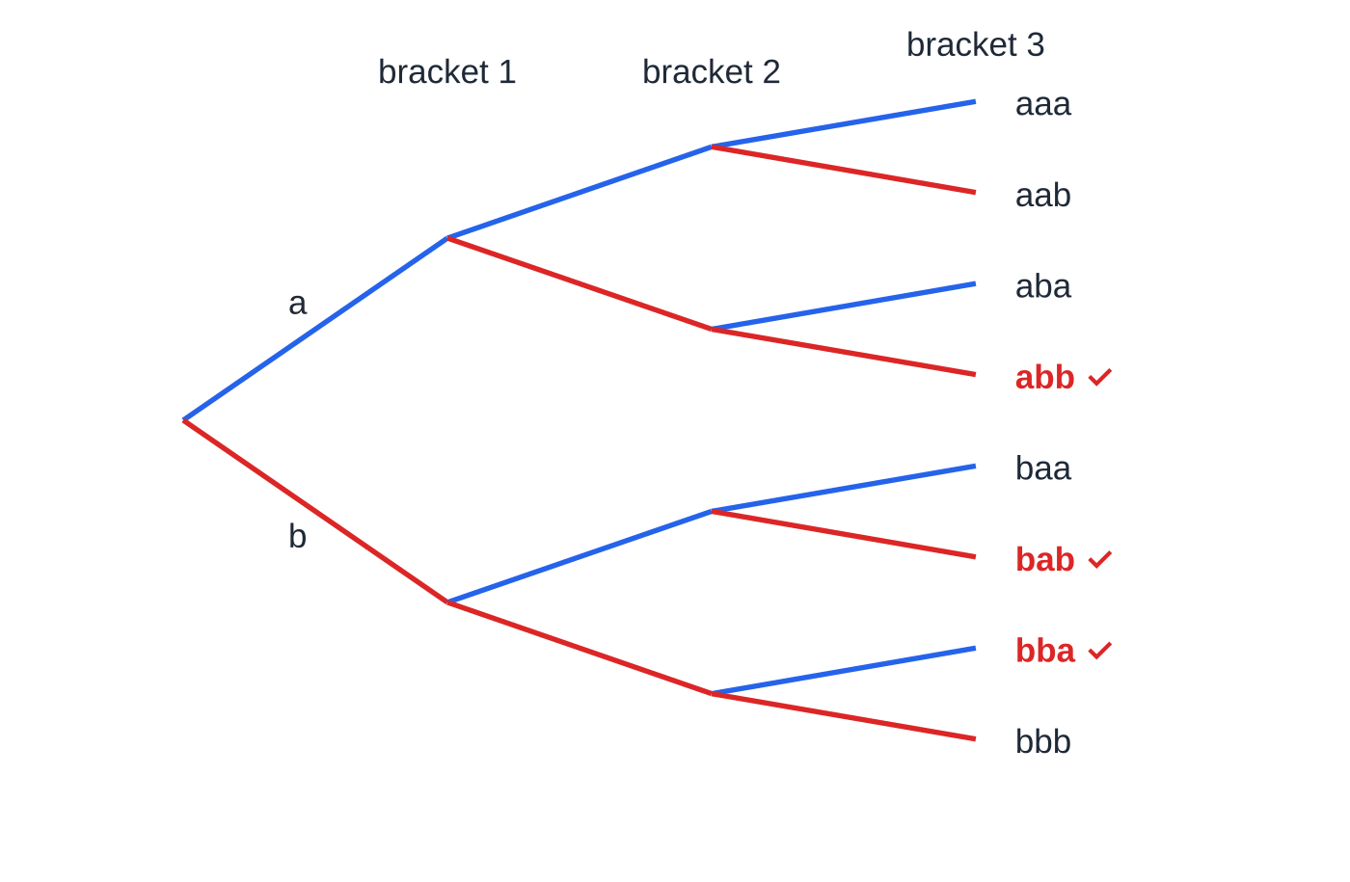
What do n! and C(n, r) count? (continued)
Section 1 of 13
For example C(10, 7) = C(10, 3) = 120.
Why choices give coefficients: multiplying out (a + b)ⁿ means picking a or b from each of the n brackets. A term aⁿ⁻ʳbʳ arises once for every way of choosing which r brackets supply the b, so its coefficient is C(n, r).
Multiplying out (a + b)³ as a tree of choices: blue branches pick a, red branches pick b. Of the 8 paths, exactly ³C₂ = 3 contain two b's, so the coefficient of ab² is 3.
Notes:
What do n! and C(n, r) count?. Full notes: https://examinerprep.com/notes/edexcel-ial-maths/the-binomial-expansion/

Slide 6
What do n! and C(n, r) count? (continued)
Section 1 of 13 · Worked example 1 · Medium · Find
WORKED EXAMPLE · QUESTION
(a) Use the definition in terms of factorials to evaluate C(7, 3). (b) Show that C(n, 2) = ½ n(n - 1), and hence find the positive integer n for which C(n, 2) = 66. (c) Without evaluating each term separately, find C(7, 3) + C(7, 4).
SOLUTION
(a) Write out the factorials and cancel: C(7, 3) = 7!/3! 4! = (7 ×6 ×5)/(3 ×2 ×1) = (210/6) = 35.
(b) Cancel (n - 2)! from n!: C(n, 2) = n!/(2! (n - 2)!) = (n(n - 1))/2. Then ½ n(n - 1) = 66, so n² - n - 132 = 0, (n - 12)(n + 11) = 0, giving n = 12. (n = -11 is rejected: n counts objects, so it must be a positive integer.)
(c) Two neighbours in row 7 add to the entry below them in row 8: C(7, 3) + C(7, 4) = C(8, 4) = 70.
Notes:
What do n! and C(n, r) count?: Worked example 1. Full notes: https://examinerprep.com/notes/edexcel-ial-maths/the-binomial-expansion/

Slide 7
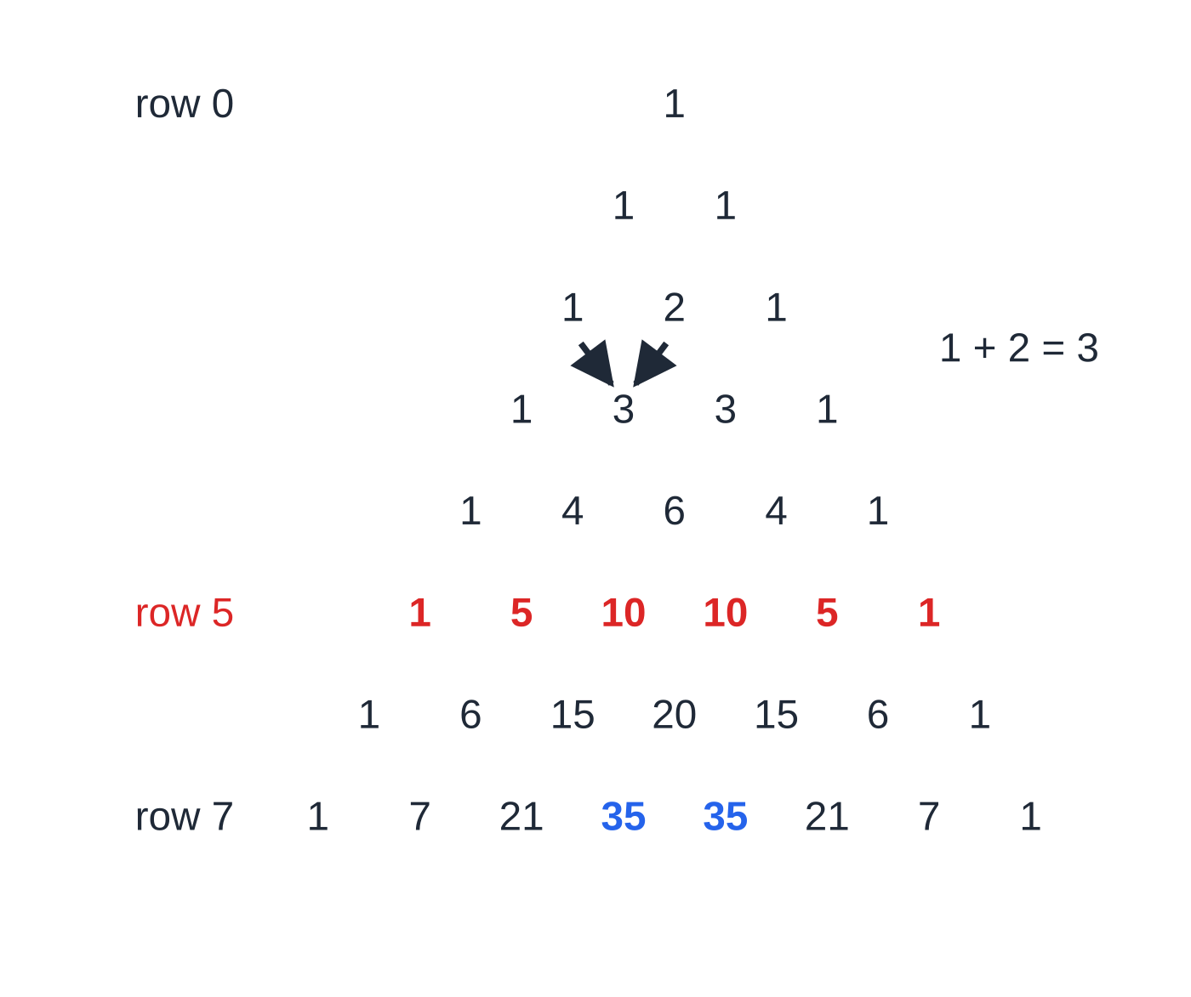
How does Pascal's triangle give the coefficients?
Section 2 of 13
Write 1 at the top (row 0). Each later row starts and ends with 1, and every other entry is the sum of the two entries above it.
Row n lists C(n, 0), C(n, 1), …, C(n, n): the coefficients of (a + b)ⁿ. The addition rule is the identity C(n, r) + C(n, r+1) = C(n+1, r+1).
Why the rule works: in (a + b)ⁿ⁺¹ = (a + b)(a + b)ⁿ, each term of the new row collects one contribution from the a and one from the b, which are the two coefficients above it.
The triangle is quickest for small powers (up to about 7). For larger n, or for a single term, use C(n, r) on a calculator.
Pascal's triangle, rows 0 to 7, built with the addition rule (arrows: 1 + 2 = 3). Row 5 (red) gives the coefficients in Worked example 2; the two 35s in row 7 (blue) are ⁷C₃ and ⁷C₄ from Worked example 1.
Notes:
How does Pascal's triangle give the coefficients?. Full notes: https://examinerprep.com/notes/edexcel-ial-maths/the-binomial-expansion/

Slide 8
How does Pascal's triangle give the coefficients? (continued)
Section 2 of 13 · Worked example 2 · Easy · Expand
WORKED EXAMPLE · QUESTION
Expand (2 + x)⁵ fully, simplifying each term.
SOLUTION
Coefficients from row 5; powers of 2 fall from 5 to 0 while powers of x rise from 0 to 5:
1(2⁵) + 5(2⁴)x + 10(2³)x² + 10(2²)x³ + 5(2)x⁴ + x⁵
Simplify each term: (2 + x)⁵ = 32 + 80x + 80x² + 40x³ + 10x⁴ + x⁵
Check: put x = 1. The left side is 3⁵ = 243 and the coefficients add to 243. ✓
Notes:
How does Pascal's triangle give the coefficients?: Worked example 2. Full notes: https://examinerprep.com/notes/edexcel-ial-maths/the-binomial-expansion/

Slide 9
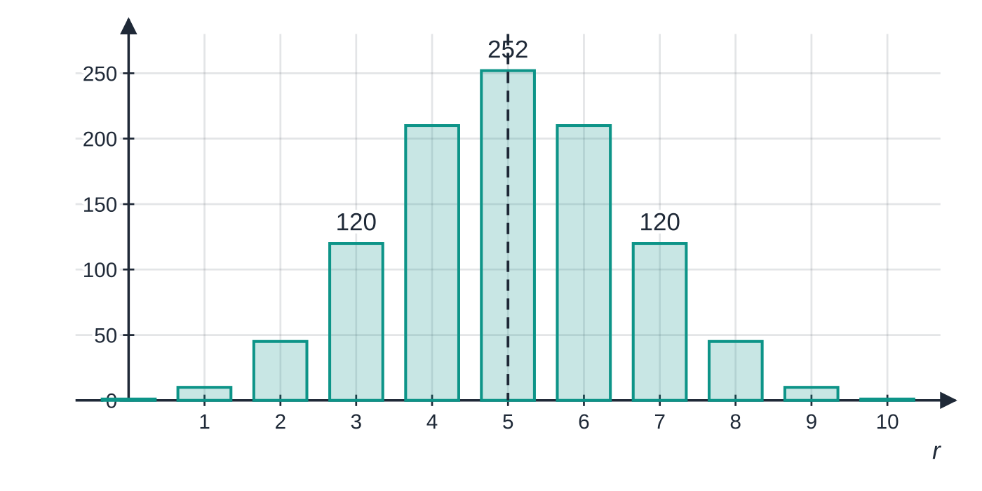
How does Pascal's triangle give the coefficients? (continued)
Section 2 of 13
The coefficients ¹⁰Cᵣ of (a + b)¹⁰. The row is symmetric about r = 5 because ¹⁰Cᵣ = ¹⁰C₁₀₋ᵣ (for example ¹⁰C₃ = ¹⁰C₇ = 120), and the largest coefficient is in the middle.
Notes:
How does Pascal's triangle give the coefficients?. Full notes: https://examinerprep.com/notes/edexcel-ial-maths/the-binomial-expansion/

Slide 10
How do you expand (a + bx)ⁿ in ascending powers of x?
Section 3 of 13
Binomial expansion, positive integer n
(a + b)ⁿ = aⁿ + C(n, 1)aⁿ⁻¹b + C(n, 2)aⁿ⁻²b² + …+ C(n, r)aⁿ⁻ʳbʳ + …+ bⁿ
C(n, r) = n!/(r!(n - r)!); n a positive integer; there are n + 1 terms.
In the formulae list? In the formulae booklet: learn how to apply it.
For (a + bx)ⁿ, replace b by the whole second term (bx), bracket and sign included.
"Ascending powers of x" means the constant first, then x, x², …. "The first four terms" therefore stops at x³.
Write each term as coefficient × power of a × (second term)ᵖᵒʷᵉʳ, then simplify. Doing the bracketed power in one step, such as (-2x)³ = -8x³, avoids most sign errors.
If the second term is negative the signs alternate; if the first term is not 1, its powers multiply every coefficient.
Notes:
How do you expand (a + bx)ⁿ in ascending powers of x?. Full notes: https://examinerprep.com/notes/edexcel-ial-maths/the-binomial-expansion/

Slide 11
How do you expand (a + bx)ⁿ in ascending powers of x? (continued)
Section 3 of 13 · Worked example 3 · Medium · Find
WORKED EXAMPLE · QUESTION
Find the first four terms, in ascending powers of x, of the binomial expansion of (3 - 2x)⁶, giving each term in its simplest form.
SOLUTION
Here a = 3 and the second term is (-2x):
3⁶ + C(6, 1)(3⁵)(-2x) + C(6, 2)(3⁴)(-2x)² + C(6, 3)(3³)(-2x)³
= 729 + 6(243)(-2x) + 15(81)(4x²) + 20(27)(-8x³)
= 729 - 2916x + 4860x² - 4320x³
Notes:
How do you expand (a + bx)ⁿ in ascending powers of x?: Worked example 3. Full notes: https://examinerprep.com/notes/edexcel-ial-maths/the-binomial-expansion/

Slide 12
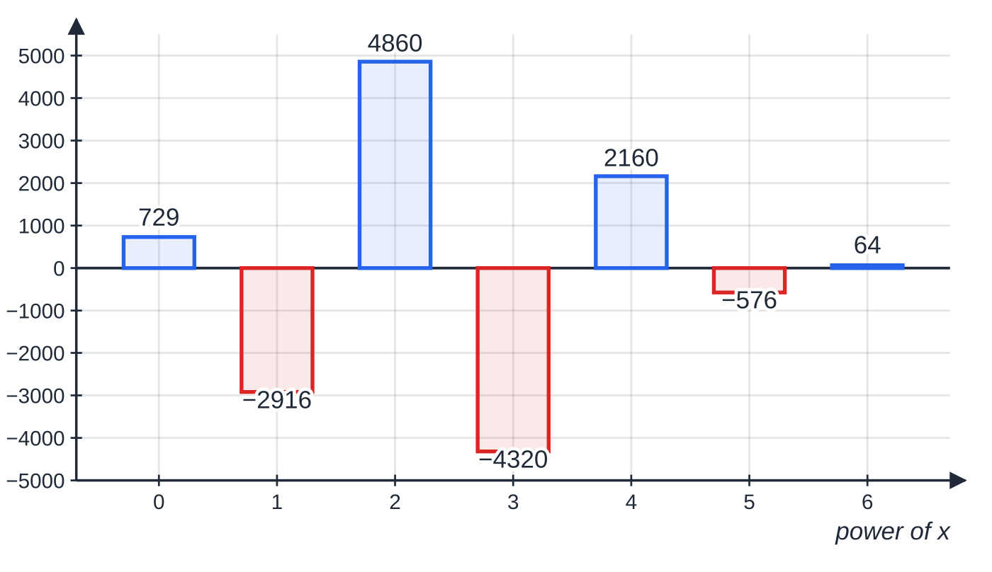
How do you expand (a + bx)ⁿ in ascending powers of x? (continued)
Section 3 of 13
Common error
Writing -2x² for (-2x)². The bracket means the -2 is squared too, giving 4x². Without it the third term above becomes -2430x² instead of +4860x²: wrong in both sign and size.
All seven coefficients of (3 − 2x)⁶, computed from the general term. The signs alternate because the second term is negative; the first four are the answer to Worked example 3.
Notes:
How do you expand (a + bx)ⁿ in ascending powers of x?. Full notes: https://examinerprep.com/notes/edexcel-ial-maths/the-binomial-expansion/

Slide 13
How do you find one particular term or coefficient?
Section 4 of 13
The general term. The term in xʳ of (a + bx)ⁿ is C(n, r)aⁿ⁻ʳ(bx)ʳ.
The power of x tells you r directly. The term in xʳ is the (r + 1)th term, because the expansion starts with x⁰.
Term and coefficient are different answers: the term includes the power of x, the coefficient is just the number in front of it.
You never need the earlier terms: go straight to the r you want.
Notes:
How do you find one particular term or coefficient?. Full notes: https://examinerprep.com/notes/edexcel-ial-maths/the-binomial-expansion/

Slide 14
How do you find one particular term or coefficient? (continued)
Section 4 of 13 · Worked example 4 · Medium · Find
WORKED EXAMPLE · QUESTION
In the binomial expansion of (2 + x/4)⁹, find (a) the coefficient of x⁴, (b) the coefficient of x⁵, giving each as an exact fraction.
SOLUTION
(a) Term in x⁴, so r = 4: C(9, 4) ×2⁵ ×(x/4)⁴ = 126 ×32 ×(1/256)x⁴. Coefficient = (4032/256) = (63/4).
(b) Term in x⁵, so r = 5: C(9, 5) ×2⁴ ×(x/4)⁵ = 126 ×16 ×(1/1024)x⁵. Coefficient = (2016/1024) = (63/32).
Check by ratio: from one coefficient to the next, multiply by (n - r)/(r + 1) ×b/a. Here (5/5) ×(1/4)/2 = ⅛, and (63/4) ×⅛ = (63/32). ✓
Notes:
How do you find one particular term or coefficient?: Worked example 4. Full notes: https://examinerprep.com/notes/edexcel-ial-maths/the-binomial-expansion/

Slide 15
How do you find an unknown from given coefficients?
Section 5 of 13
Write each coefficient you are told about in terms of the unknowns, using the general term, then set it equal to its given value.
One unknown needs one equation. Two unknowns, such as n and k in (1 + kx)ⁿ, need two coefficients.
When n is unknown, write C(n, 2) = (n(n - 1))/2 and C(n, 3) = (n(n - 1)(n - 2))/6. Dividing one equation by the other often cancels the awkward factors.
Use the conditions in the question to reject solutions: n must be a positive integer, and the question may say a constant is positive or non-zero.
Notes:
How do you find an unknown from given coefficients?. Full notes: https://examinerprep.com/notes/edexcel-ial-maths/the-binomial-expansion/

Slide 16
How do you find an unknown from given coefficients? (continued)
Section 5 of 13 · Worked example 5 · Hard · Find
WORKED EXAMPLE · QUESTION
In the binomial expansion of (1 + kx)ⁿ, where n is a positive integer and k is a constant, the coefficient of x is 24 and the coefficient of x² is 252. (a) Find n and k. (b) Find the coefficient of x³.
SOLUTION
(a) Coefficients in terms of n and k: nk = 24 and (n(n - 1))/2k² = 252.
Divide the second equation by the first: ((n - 1)k)/2 = (252/24) = (21/2), so (n - 1)k = 21.
Subtract from nk = 24: nk - (n - 1)k = k = 24 - 21, so k = 3, n = 8.
(b) Term in x³: C(8, 3) ×3³ = 56 ×27 = 1512.
Check: (1 + 3x)⁸ = 1 + 24x + 252x² + 1512x³ + … ✓
Notes:
How do you find an unknown from given coefficients?: Worked example 5. Full notes: https://examinerprep.com/notes/edexcel-ial-maths/the-binomial-expansion/

Slide 17
How do you find an unknown from given coefficients? (continued)
Section 5 of 13
Exam tip
"The coefficients of x² and x³ are equal" is an equation too. In (2 + ax)⁶ they are 15 ×2⁴a² = 240a² and 20 ×2³a³ = 160a³. Setting them equal and dividing by 80a² (allowed because a ≠0) gives 3 = 2a, so a = (3/2) and both coefficients are 540. Divide by the common factor rather than cancelling it silently.
Notes:
How do you find an unknown from given coefficients?. Full notes: https://examinerprep.com/notes/edexcel-ial-maths/the-binomial-expansion/

Slide 18
How do you use an expansion to approximate a value?
Section 6 of 13
When x is small, each power xʳ is much smaller than the one before, so the later terms hardly change the total. The first three or four terms give a good approximation.
To approximate a number such as 0.995¹⁰, match it to the bracket: 1 - x/4 = 0.995 gives x = 0.02. Then substitute that x into your terms.
The approximation is good only near x = 0. Away from it, the neglected terms are no longer small and the polynomial peels away from the true curve.
To judge accuracy, compare with a calculator value, or look at the size of the first term you left out.
Notes:
How do you use an expansion to approximate a value?. Full notes: https://examinerprep.com/notes/edexcel-ial-maths/the-binomial-expansion/

Slide 19
How do you use an expansion to approximate a value? (continued)
Section 6 of 13 · Worked example 6 · Medium · Hence
WORKED EXAMPLE · QUESTION
(a) Find the first four terms, in ascending powers of x, of the binomial expansion of (1 - x/4)¹⁰. (b) Use your expansion, with a suitable value of x, to find an approximate value of 0.995¹⁰. Give your answer to 5 decimal places.
SOLUTION
(a) General term with a = 1 and second term -x/4: 1 + 10(-x/4) + 45(-x/4)² + 120(-x/4)³
= 1 - (5/2) x + (45/16)x² - (15/8)x³
(b) Choose x: 1 - x/4 = 0.995, so x = 0.02. Then 1 - 0.05 + 0.001125 - 0.000015 = 0.95111 (5 d.p.).
A calculator gives 0.995¹⁰ = 0.951110130…: the four-term estimate is out by about 1.3 ×10⁻⁷, a percentage error of about 1.4 ×10⁻⁵ %.
Notes:
How do you use an expansion to approximate a value?: Worked example 6. Full notes: https://examinerprep.com/notes/edexcel-ial-maths/the-binomial-expansion/

Slide 20
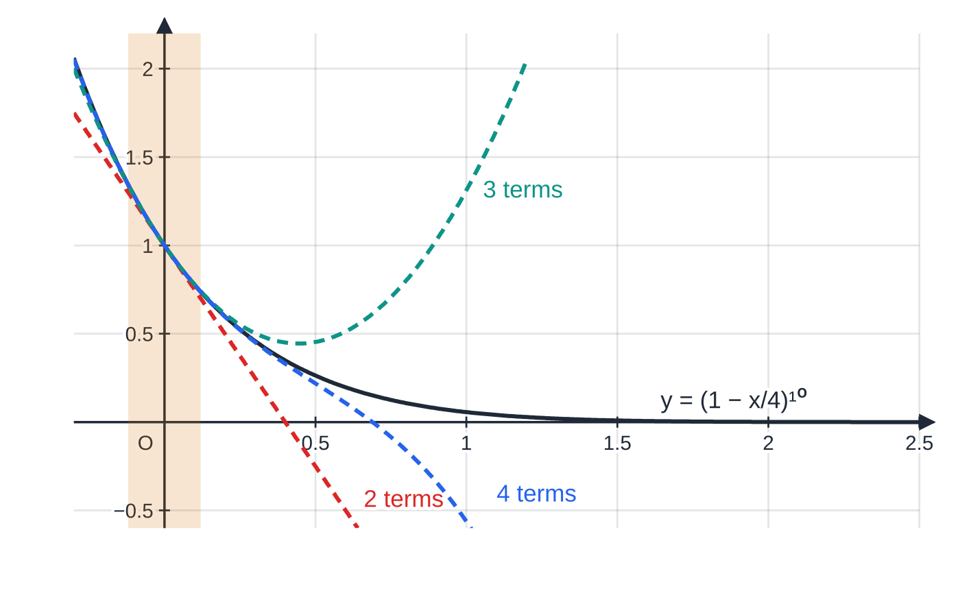
How do you use an expansion to approximate a value? (continued)
Section 6 of 13
The curve y = (1 − x/4)¹⁰ and the polynomials from its first two, three and four terms. Inside the shaded band near x = 0 they are almost indistinguishable; further out each polynomial peels away from the curve.
Notes:
How do you use an expansion to approximate a value?. Full notes: https://examinerprep.com/notes/edexcel-ial-maths/the-binomial-expansion/

Slide 21
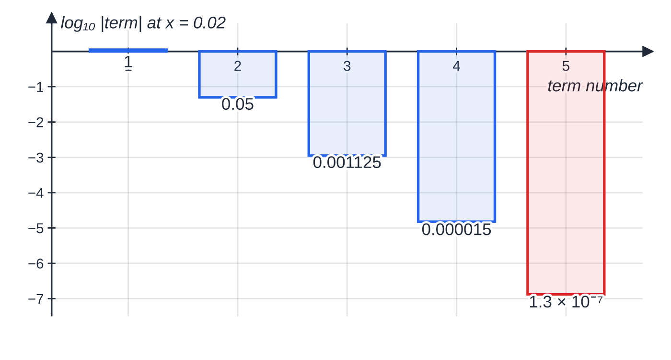
How do you use an expansion to approximate a value? (continued)
Section 6 of 13
The size of each term of the expansion at x = 0.02, on a logarithmic scale (bar depth = log₁₀ of the size). Each term is between about 20 and 170 times smaller than the one before, so the fifth term (red, left out) is already below 10⁻⁶ and four terms are plenty.
Notes:
How do you use an expansion to approximate a value?. Full notes: https://examinerprep.com/notes/edexcel-ial-maths/the-binomial-expansion/

Slide 22
How do you find a coefficient in a product of two brackets?
Section 7 of 13
For (p + qx)(a + bx)ⁿ, expand the binomial only as far as you need, then multiply by the short bracket.
An xʳ term can arise in more than one way: the constant p times the xʳ term, plus qx times the xʳ⁻¹ term. Add all the pairs whose powers sum to r.
To reach x³ in the product you need the binomial terms up to x³; terms beyond that can never contribute.
Notes:
How do you find a coefficient in a product of two brackets?. Full notes: https://examinerprep.com/notes/edexcel-ial-maths/the-binomial-expansion/

Slide 23
How do you find a coefficient in a product of two brackets? (continued)
Section 7 of 13 · Worked example 7 · Medium · Hence
WORKED EXAMPLE · QUESTION
(a) Find the first four terms, in ascending powers of x, of the binomial expansion of (1 + 2x)⁸. (b) Hence find the coefficient of x² and the coefficient of x³ in the expansion of (3 - x)(1 + 2x)⁸.
SOLUTION
(a) General term with second term 2x: 1 + 8(2x) + 28(2x)² + 56(2x)³ = 1 + 16x + 112x² + 448x³.
(b) x²: 3 ×112x² and -x ×16x, so the coefficient is 3 ×112 - 16 = 320.
x³: 3 ×448x³ and -x ×112x², so the coefficient is 3 ×448 - 112 = 1232.
"Hence" means use part (a): no new expansion is needed, only the right pairs of terms.
Notes:
How do you find a coefficient in a product of two brackets?: Worked example 7. Full notes: https://examinerprep.com/notes/edexcel-ial-maths/the-binomial-expansion/

Slide 24
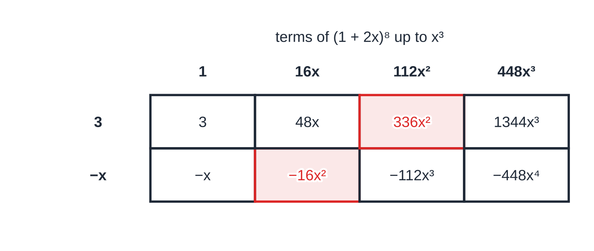
How do you find a coefficient in a product of two brackets? (continued)
Section 7 of 13
Worked example 7 as a grid: each cell is the product of its row (from 3 − x) and column (from (1 + 2x)⁸). The two shaded cells are the only ways to make x², giving 336 − 16 = 320.
Notes:
How do you find a coefficient in a product of two brackets?. Full notes: https://examinerprep.com/notes/edexcel-ial-maths/the-binomial-expansion/

Slide 25
How do longer binomial questions fit together?
Section 8 of 13
A typical longer question builds in layers: an expansion with an unknown, an equation from a given coefficient, a further coefficient, then a numerical use of the result. Keep the unknown in your terms until you have its value, then substitute once into simplified coefficients. For an approximation from a product, find the x that makes both brackets match the numbers you are given.
Notes:
How do longer binomial questions fit together?. Full notes: https://examinerprep.com/notes/edexcel-ial-maths/the-binomial-expansion/

Slide 26
How do longer binomial questions fit together? (continued)
Section 8 of 13 · Worked example 8 · Hard · Find
WORKED EXAMPLE · QUESTION
(a) Find the first four terms, in ascending powers of x, of the binomial expansion of (1 + px)⁸, where p is a constant. (b) In the expansion of (2 - x)(1 + px)⁸, the coefficient of x² is 10. Given that p > 0, find p. (c) Find the coefficient of x³ in the expansion of (2 - x)(1 + px)⁸. (d) Use your answers, with a suitable value of x, to estimate 1.98 ×1.01⁸, giving your answer to 6 decimal places.
SOLUTION
(a) (1 + px)⁸ = 1 + 8px + 28p²x² + 56p³x³ + …
(b) Pairs that give x²: 2 ×28p² and -1 ×8p. So 56p² - 8p = 10, 28p² - 4p - 5 = 0, (14p + 5)(2p - 1) = 0. p > 0, so p = ½ (reject p = -(5/14)).
(c) Pairs that give x³: 2 ×56p³ and -1 ×28p²: 2 ×56 ×⅛ - 28 ×¼ = 14 - 7 = 7.
(d) Full product to x³ with p = ½; the x coefficient is 2 ×4 - 1 = 7: (2 - x)(1 + x/2)⁸ ≈2 + 7x + 10x² + 7x³.
x = 0.02 gives 2 - x = 1.98 and 1 + x/2 = 1.01, so both brackets match:
Notes:
How do longer binomial questions fit together?: Worked example 8. Full notes: https://examinerprep.com/notes/edexcel-ial-maths/the-binomial-expansion/

Slide 27
How do longer binomial questions fit together? (continued)
Section 8 of 13 · Worked example 8 · Hard · Find (continued)
2 + 0.14 + 0.004 + 0.000056 = 2.144056.
A calculator gives 1.98 ×1.01⁸ = 2.144056277…, so the estimate is correct to 6 decimal places.
Notes:
How do longer binomial questions fit together?: Worked example 8. Full notes: https://examinerprep.com/notes/edexcel-ial-maths/the-binomial-expansion/

Slide 28
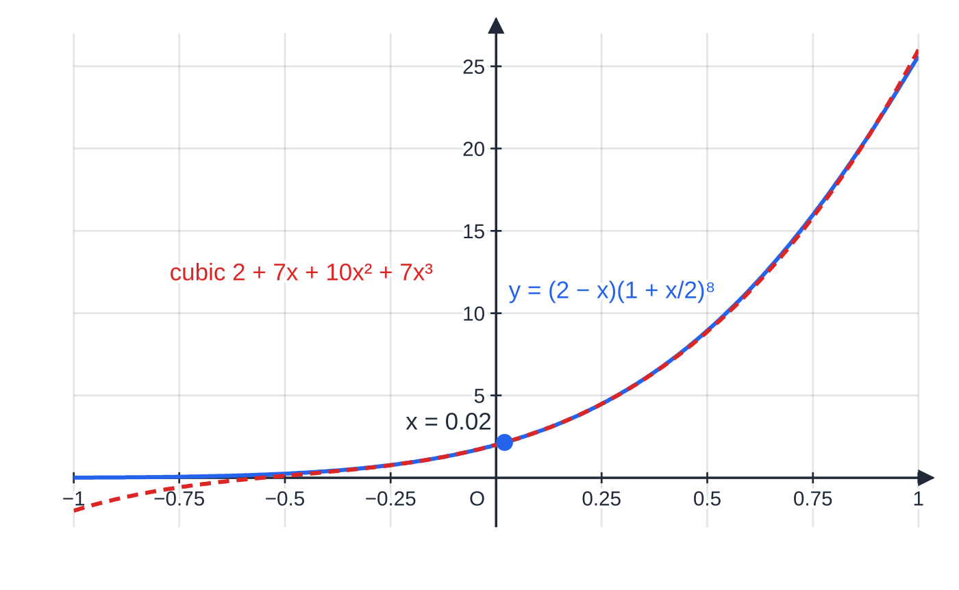
How do longer binomial questions fit together? (continued)
Section 8 of 13
Same method, different numbers: if a question gives a negative or fractional power, the series never stops. That is the P4 binomial series, valid only for |x| small enough.
Worked example 8. Near x = 0 the cubic from the expansion is almost identical to the product, so x = 0.02 gives an excellent estimate. At x = −1 the cubic gives −2 while the true value is about 0.012: far from 0 the approximation fails.
Notes:
How do longer binomial questions fit together?. Full notes: https://examinerprep.com/notes/edexcel-ial-maths/the-binomial-expansion/

Slide 29
Exam tips for P2.4
Section 9 of 13
Exam tip 1 — write the unsimplified line first
One line of the form C(n, r) ×aⁿ⁻ʳ ×(second term)ʳ for each term shows your method clearly, so a slip in the arithmetic afterwards costs as little as possible.
Exam tip 2 — coefficient or term?
Read which one is asked for. "The term in x³" wants -4320x³; "the coefficient of x³" wants -4320. Leave fractions exact unless a decimal is requested.
Exam tip 3 — approximations: say which x you used
Show the equation that fixes x (for example 1 - x/4 = 0.995), then the substituted terms, then the answer to the accuracy asked for.
Notes:
Exam tips for P2.4. Full notes: https://examinerprep.com/notes/edexcel-ial-maths/the-binomial-expansion/

Slide 30
Exam tips for P2.4 (continued)
Section 9 of 13
Exam tip 4 — check with x = 1
Substituting x = 1 into a full expansion must give the bracket's value, for example (2 + 1)⁵ = 243. For a partial expansion, check one coefficient again with the general term.
Exam tip 5 — unknown powers
When n is unknown, write C(n, 2) and C(n, 3) as products in n straight away. Divide one coefficient equation by another before expanding: it usually removes the highest power of the unknown constant.
Notes:
Exam tips for P2.4. Full notes: https://examinerprep.com/notes/edexcel-ial-maths/the-binomial-expansion/

Slide 31
Common misconceptions
Section 10 of 13
Misconception | Why it is wrong | Correct idea
(a + b)² = a² + b², and similarly for higher powers. | Multiplying out produces cross terms such as 2ab. | (a + b)ⁿ has n + 1 terms with coefficients C(n, 0), …, C(n, n).
(-2x)³ = -2x³. | The power applies to everything in the bracket. | (-2x)³ = -8x³: cube the number and the sign as well.
The term in x⁴ uses r = 5, because it is the fifth term. | The expansion starts with x⁰, so term numbers are one ahead of powers. | The term in xʳ uses C(n, r).
The coefficient of x in (3 + 2x)⁵ is just C(5, 1) = 5. | The first and second terms also contribute their powers. | 5 ×3⁴ ×2 = 810: every coefficient includes aⁿ⁻ʳbʳ.
The coefficient of x² in a product is the product of the two x² coefficients. | x² also comes from x ×x and from a constant times x². | Add every pair of terms whose powers sum to 2.
The first few terms give a good approximation for any x. | For larger x the neglected terms are not small. | Use a small x, close to 0; compare with a calculator value if asked about accuracy.
Notes:
Common misconceptions. Full notes: https://examinerprep.com/notes/edexcel-ial-maths/the-binomial-expansion/

Slide 32
How this topic connects
Section 11 of 13
P1 algebra and P2.3 sequences and series
Expanding brackets and solving quadratics, used here to find n or a constant from a coefficient, are P1 skills. The ratio of successive coefficients, and the idea that later terms of a series can become negligible, link to geometric series and their sums.
P4 the binomial series
(1 + x)ⁿ extends to negative and fractional n as an infinite series, valid for |x| < 1, and is used for approximations and with partial fractions.
S2 the binomial distribution
The probability of r successes in n trials is C(n, r)pʳ(1 - p)ⁿ⁻ʳ: one term of the expansion of (q + p)ⁿ.
Notes:
How this topic connects. Full notes: https://examinerprep.com/notes/edexcel-ial-maths/the-binomial-expansion/

Slide 33
Key formulae
Section 12 of 13
Formula | Use | In the formulae list?
n! = n(n - 1)⋯2 ×1, 0! = 1 | factorials; cancelling in C(n, r) | No — learn it
C(n, r) = n!/(r!(n - r)!) | number of choices; binomial coefficients | Yes, with the binomial expansion
C(n, r) = C(n, n - r) | symmetry of each row | No — derive it
C(n, r) + C(n, r+1) = C(n+1, r+1) | building Pascal's triangle | No — learn it
(a + b)ⁿ = aⁿ + C(n, 1)aⁿ⁻¹b + …+ C(n, r)aⁿ⁻ʳbʳ + …+ bⁿ | full or partial expansions, positive integer n | Yes
term in xʳ: C(n, r)aⁿ⁻ʳ(bx)ʳ | one particular term or coefficient | Yes, as the general term of the expansion
C(n, 2) = (n(n - 1))/2, C(n, 3) = (n(n - 1)(n - 2))/6 | equations when n is unknown | No — derive it
Notes:
Key formulae. Full notes: https://examinerprep.com/notes/edexcel-ial-maths/the-binomial-expansion/

Slide 34
Check your understanding
Section 13 of 13
1. Why must 0! equal 1 for the formula for C(n, r) to work?
2. Find the coefficient of x² in the expansion of (1 - 3x)⁵.
3. Evaluate C(20, 17) without a calculator.
4. You have the first three terms of (1 + x/2)⁶. What value of x would you use to estimate 1.03⁶?
5. Find the coefficient of x in the expansion of (1 + x)(1 - x)⁷.
6. Find the coefficient of x³ in the expansion of (2 - x)⁷.
Notes:
Check your understanding: questions. Full notes: https://examinerprep.com/notes/edexcel-ial-maths/the-binomial-expansion/

Slide 35
Check your understanding · answers
Section 13 of 13
1. C(n, 0) counts the ways of choosing nothing, which is 1. The formula gives n!/0! n! = 1/0!, which equals 1 only if 0! = 1.
2. C(5, 2) ×(-3)² = 10 ×9. The coefficient is 90.
3. C(20, 17) = C(20, 3) = (20 ×19 ×18)/6. 1140. Choosing 17 to take is the same as choosing 3 to leave.
4. 1 + x/2 = 1.03, so x = 0.06. It is small, so the first few terms give a good estimate.
5. (1 - x)⁷ = 1 - 7x + …. The x terms come from 1 ×(-7x) and x ×1, so the coefficient is -7 + 1 = -6.
6. C(7, 3) ×2⁴ ×(-1)³ = 35 ×16 ×(-1). The coefficient is -560.
Notes:
Check your understanding: answers. Full notes: https://examinerprep.com/notes/edexcel-ial-maths/the-binomial-expansion/

Slide 36
Practice questions
2 original exam-style questions. Answers at the end of the deck.

Slide 37
Question 1
5 marks
The first few terms of the binomial expansion of (2 + 5x)⁵ are required, together with its last term.
(a) Find the first four terms, in ascending powers of x, giving each term in its simplest form. [4]
(b) Write down the coefficient of x⁵. [1]
Notes:
Online with the full mark scheme: https://examinerprep.com/ial-maths-p2-4-the-binomial-expansion-questions#IALM-P2-4-B-03

Slide 38
Question 2
7 marks
In this question k is a non-zero constant. Consider the binomial expansion of (3 + kx)⁵.
(a) Find the first three terms, in ascending powers of x, giving each term in terms of k and x. [3]
(b) Given that the coefficient of x² is 1080 and that k < 0, find the value of k. [2]
(c) Find the coefficient of x³. [2]
Notes:
Online with the full mark scheme: https://examinerprep.com/ial-maths-p2-4-the-binomial-expansion-questions#IALM-P2-4-B-05

Slide 39
Answers

Slide 40
Question 1 · answer
Mark scheme
correct structure, e.g. ⁵C₂(2³)(5x)² for the third term
32 + 400x
+ 2000x²
+ 5000x³, giving 32 + 400x + 2000x² + 5000x³
5⁵ = 3125
Notes:
Full mark scheme: https://examinerprep.com/ial-maths-p2-4-the-binomial-expansion-questions#IALM-P2-4-B-03

Slide 41
Question 2 · answer
Mark scheme
correct structure, e.g. ⁵C₂(3³)(kx)²
243 + 405kx
+ 270k²x²
270k² = 1080, so k² = 4
k = −2
⁵C₃(3²)k³ = 90k³
90 × (−8) = −720 ft from their k
Notes:
Full mark scheme: https://examinerprep.com/ial-maths-p2-4-the-binomial-expansion-questions#IALM-P2-4-B-05

Slide 42
Keep practising
Notes for this topic
Questions on this topic
Build a printable test
ExaminerPrep is an independent tutoring service. It has been developed independently from and is not endorsed by the International Baccalaureate Organization. "International Baccalaureate", "IB" and "IB Diploma Programme" are registered trademarks of the IBO, used here for descriptive purposes only.
Pearson Edexcel and Cambridge are trademarks of their owners; ExaminerPrep is not affiliated with any exam board.

