Slide 1
EP
EDEXCEL IAL MATHS
P4.3 The binomial series
The full notes page in 11 sections · practice questions with answers · simulations
ExaminerPrep is an independent tutoring service. It has been developed independently from and is not endorsed by the International Baccalaureate Organization. "International Baccalaureate", "IB" and "IB Diploma Programme" are registered trademarks of the IBO, used here for descriptive purposes only.
Pearson Edexcel and Cambridge are trademarks of their owners; ExaminerPrep is not affiliated with any exam board.
Notes:
P4.3 The binomial series. Notes for this topic: https://examinerprep.com/notes/edexcel-ial-maths/the-binomial-series/

Slide 2
What this page covers
Overview
The binomial series for (1 + x)ⁿ when n is any rational number, and why it is infinite unless n is a positive integer
The range of validity |x| < 1, and |bx/a| < 1 for (a + bx)ⁿ
Expanding (a + bx)ⁿ by taking out aⁿ
Expanding products such as (3 - x)(1 + 2x)^(-1/2)
Finding unknown constants from given coefficients, and finding a particular coefficient
Using a truncated series to approximate a root or a value, and judging its accuracy
Expanding a rational function by first splitting it into partial fractions
Notes:
What this page covers. Full notes: https://examinerprep.com/notes/edexcel-ial-maths/the-binomial-series/

Slide 3
In one minute
Key points
1. For any rational n, (1 + x)ⁿ = 1 + nx + (n(n-1))/2!x² + (n(n-1)(n-2))/3!x³ + ⋯; if n is a positive integer the series stops, otherwise it is infinite and only valid for |x| < 1.
2. Replace x by the whole term: in (1 - 3x)⁻², use (-3x), so (-3x)² = 9x²; validity becomes |3x| < 1.
3. (a + bx)ⁿ = aⁿ(1 + b/ax)ⁿ, valid for |x| < |a/b|. Do not forget the aⁿ outside.
4. For approximations choose x small and inside the range of validity; each term is then much smaller than the one before.
5. A rational function: split into partial fractions, expand each one, add like terms; the whole expansion is valid where every part is valid (the narrowest range).
Notes:
In one minute. Full notes: https://examinerprep.com/notes/edexcel-ial-maths/the-binomial-series/

Slide 4
What is the binomial series for (1 + x)ⁿ?
Section 1 of 11
In P2 the binomial expansion of (1 + x)ⁿ stopped after n + 1 terms. When n is negative or a fraction, the same coefficient pattern never stops: you get an infinite series that equals the function only for small enough x. Three skills follow from that one formula: writing out the first few terms correctly, stating where they are valid, and putting them to use.
The binomial series
(1 + x)ⁿ = 1 + nx + (n(n-1))/(1 ×2)x² + ⋯+ (n(n-1)⋯(n-r+1))/(1 ×2 ×⋯×r)xʳ + ⋯
n is any rational number (negative, fractional or a positive integer); x is the variable, or any expression in its place. The term in xʳ has r factors on top, starting at n and going down by 1 each time, and r! underneath. In the formulae list, given with the condition |x| < 1.
It is valid for |x| < 1 when n is not a positive integer.
Notes:
What is the binomial series for (1 + x)ⁿ?. Full notes: https://examinerprep.com/notes/edexcel-ial-maths/the-binomial-series/

Slide 5
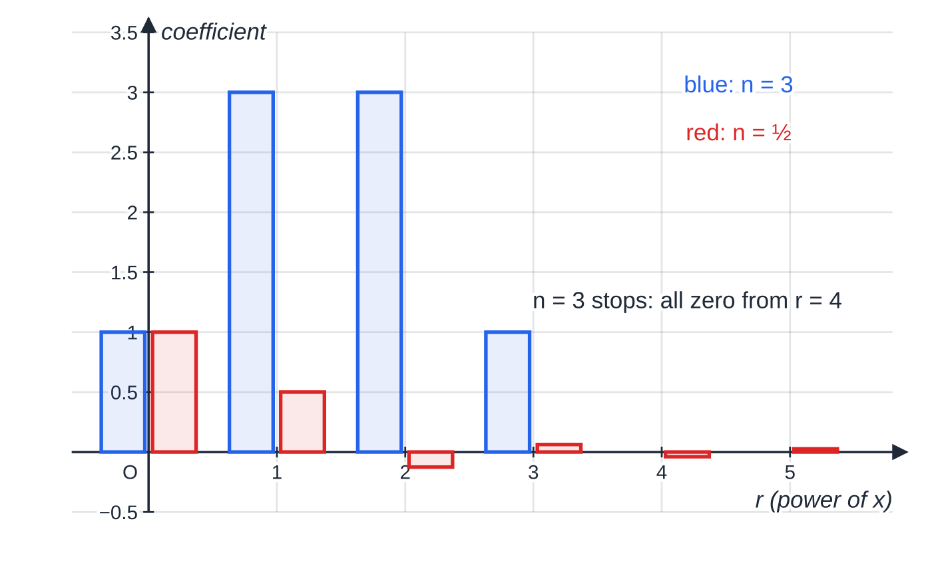
What is the binomial series for (1 + x)ⁿ? (continued)
Section 1 of 11
When n is a positive integer, the factor (n - n) = 0 appears and every later term is zero, so you get the finite P2 expansion, valid for all x.
Why the series is infinite
For n = 3 the coefficients are 1, 3, (3×2)/2 = 3, (3×2×1)/6 = 1 and then (3×2×1×0)/24 = 0: the expansion stops, giving (1 + x)³ = 1 + 3x + 3x² + x³. For n = ½ the factors on top are ½, -½, -(3/2), -(5/2), … and none of them is ever 0, so the terms never stop. The ⁿCᵣ key on a calculator only works for positive whole n; for rational n, build each coefficient by hand from the pattern.
Coefficients of x^r in (1 + x)³ (blue) and (1 + x)^½ (red). For n = 3 a factor of zero appears at r = 4 and every later coefficient vanishes. For n = ½ the coefficients 1, ½, −1/8, 1/16, −5/128, 7/256, … alternate in sign and shrink, but never become zero.
Notes:
What is the binomial series for (1 + x)ⁿ?. Full notes: https://examinerprep.com/notes/edexcel-ial-maths/the-binomial-series/

Slide 6
What is the binomial series for (1 + x)ⁿ? (continued)
Section 1 of 11
A reliable layout is to write each term as "coefficient pattern × (whole term)":
Term | Coefficient pattern | Bracket the whole term
constant | 1 | —
x | n | ×(t)
x² | (n(n-1))/2 | ×(t)²
x³ | (n(n-1)(n-2))/6 | ×(t)³
Here t is whatever replaces x inside (1 + t)ⁿ, such as 4x, -3x or -x/4, always with its sign and in a bracket.
Notes:
What is the binomial series for (1 + x)ⁿ?. Full notes: https://examinerprep.com/notes/edexcel-ial-maths/the-binomial-series/

Slide 7
What is the binomial series for (1 + x)ⁿ? (continued)
Section 1 of 11 · Worked example 1 · Easy · Find
WORKED EXAMPLE · QUESTION
Find the binomial expansion of √(1 + 4x), in ascending powers of x, up to and including the term in x³. Simplify each coefficient.
SOLUTION
Write it as a power: √(1 + 4x) = (1 + 4x)^(1/2), so n = ½ and t = 4x.
Substitute, keeping 4x in brackets: 1 + (½)(4x) + ((½)(-½))/2(4x)² + ((½)(-½)(-(3/2)))/6(4x)³.
Simplify each term: (½)(4x) = 2x; (-⅛)(16x²) = -2x²; (1/16)(64x³) = 4x³. √(1 + 4x) = 1 + 2x - 2x² + 4x³ + ⋯, valid for |4x| < 1, i.e. |x| < ¼.
Notes:
What is the binomial series for (1 + x)ⁿ?: Worked example 1. Full notes: https://examinerprep.com/notes/edexcel-ial-maths/the-binomial-series/

Slide 8
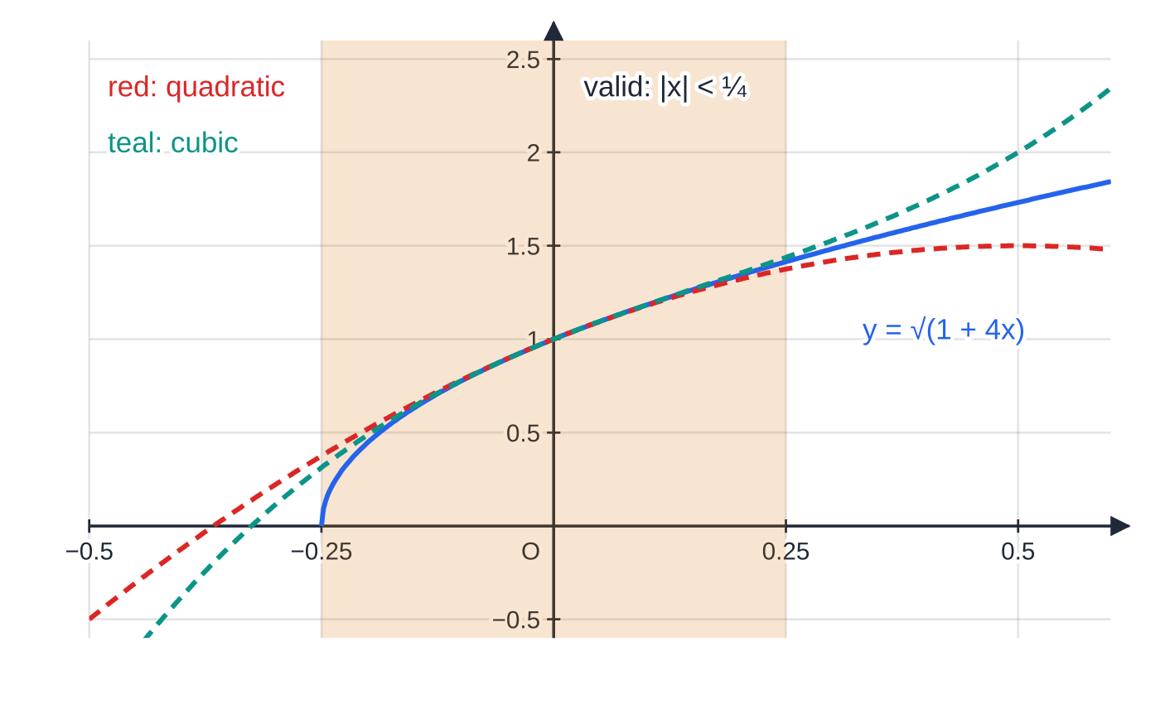
What is the binomial series for (1 + x)ⁿ? (continued)
Section 1 of 11
Common error
Writing 4x² instead of (4x)² = 16x². The power applies to the whole term, coefficient and sign included: (-3x)³ = -27x³.
The curve y = √(1 + 4x) with its quadratic and cubic approximations. All three agree closely near x = 0, where the higher powers are tiny; towards the edges of the valid strip |x| < ¼ they separate, and for x < −¼ the square root does not exist even though the polynomials do.
Notes:
What is the binomial series for (1 + x)ⁿ?. Full notes: https://examinerprep.com/notes/edexcel-ial-maths/the-binomial-series/

Slide 9
When is the expansion valid?
Section 2 of 11
The range of validity is the set of values of x for which the infinite series adds up to the function. For (1 + t)ⁿ, it is all x with |t| < 1. For (1 + kx)ⁿ: |kx| < 1 ⇔|x| < 1/|k|, which can also be written -1/|k| < x < 1/|k|.
The simplest case shows why. 1/(1-x) = (1 - x)⁻¹ = 1 + x + x² + x³ + ⋯ is a geometric series with ratio x, which converges only when |x| < 1. Inside the range, adding more terms gets closer to the true value: at x = ½, 1 + ½ + ¼ + ⅛ = (15/8), approaching 2. Outside it, the terms grow and the sums run away. When n is a positive integer there is no restriction: the expansion is finite and true for all x.
Notes:
When is the expansion valid?. Full notes: https://examinerprep.com/notes/edexcel-ial-maths/the-binomial-series/

Slide 10
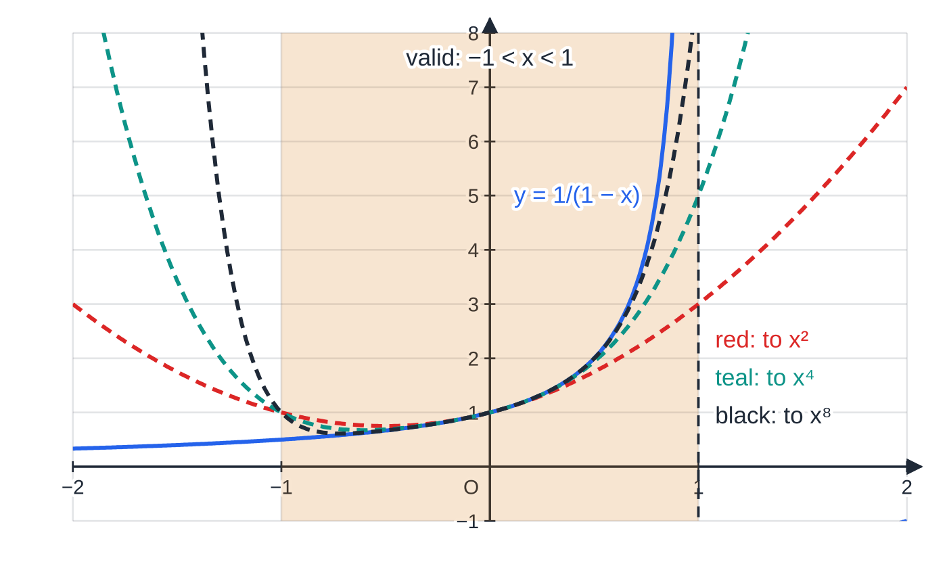
When is the expansion valid? (continued)
Section 2 of 11
y = 1/(1 − x) and partial sums of its series 1 + x + x² + …. In the shaded strip −1 < x < 1 each extra term brings the polynomial closer to the curve; outside it, more terms make the error worse. At x = −1.5 the curve is at 0.4 but the sum up to x⁸ is above 6 (about 15.8).
Notes:
When is the expansion valid?. Full notes: https://examinerprep.com/notes/edexcel-ial-maths/the-binomial-series/

Slide 11
When is the expansion valid? (continued)
Section 2 of 11 · Worked example 2 · Medium · Expand, state
WORKED EXAMPLE · QUESTION
(a) Expand 1/((1 - 3x)²) in ascending powers of x, up to and including the term in x³. (b) State the range of values of x for which the expansion is valid.
SOLUTION
(a) Write as (1 - 3x)⁻²: n = -2, t = -3x. Substitute: 1 + (-2)(-3x) + ((-2)(-3))/2(-3x)² + ((-2)(-3)(-4))/6(-3x)³ = 1 + 6x + 3(9x²) + (-4)(-27x³). 1 + 6x + 27x² + 108x³ + ⋯
(b) |-3x| < 1 ⇒ |x| < ⅓, i.e. -⅓ < x < ⅓
Two negatives make every term positive here: (-2)(-3x) = +6x and (-4)(-27x³) = +108x³. Count the minus signs in each term before you simplify.
Notes:
When is the expansion valid?: Worked example 2. Full notes: https://examinerprep.com/notes/edexcel-ial-maths/the-binomial-series/

Slide 12
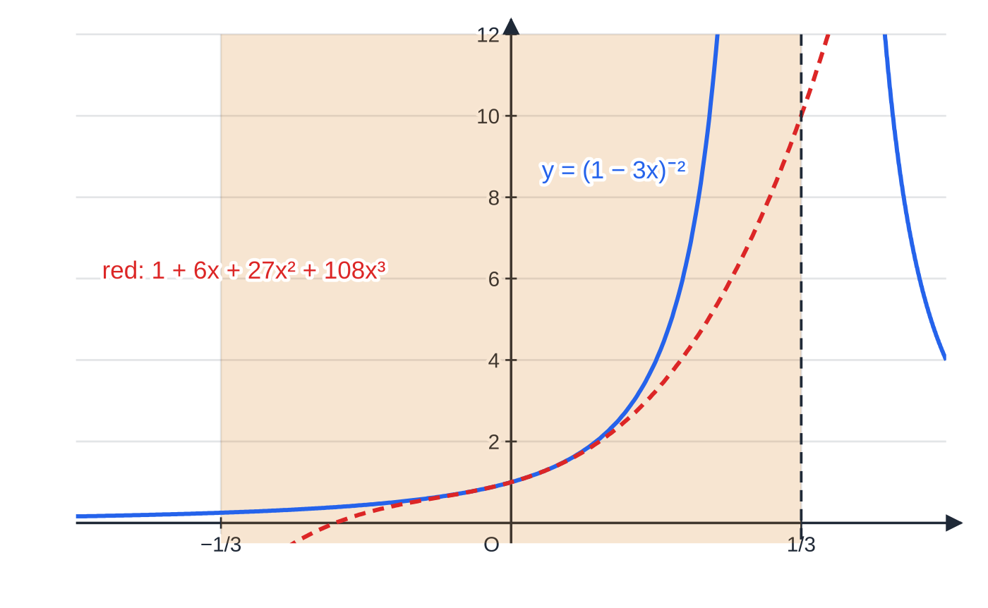
When is the expansion valid? (continued)
Section 2 of 11
Worked example 2: (1 − 3x)⁻² and its cubic approximation agree near x = 0. The curve has an asymptote at x = ⅓, the edge of the valid range; on the left the cubic plunges negative while the curve stays positive.
Notes:
When is the expansion valid?. Full notes: https://examinerprep.com/notes/edexcel-ial-maths/the-binomial-series/

Slide 13
How do you expand (a + bx)ⁿ?
Section 3 of 11
The series in the formulae list needs a 1 in front. If the bracket starts with any other number, factor it out first.
Taking out the constant first
(a + bx)ⁿ = aⁿ(1 + bx/a)ⁿ
a is the constant term (it must become 1 inside the bracket); aⁿ is the factor taken outside, e.g. 4^(-1/2) = ½, 8^(1/3) = 2, 3⁻² = (1/9); and t = bx/a. Valid for |bx/a| < 1, i.e. |x| < |a/b|. Not in the formulae list in this form (it gives only (1 + x)ⁿ): derive it.
Notes:
How do you expand (a + bx)ⁿ?. Full notes: https://examinerprep.com/notes/edexcel-ial-maths/the-binomial-series/

Slide 14
How do you expand (a + bx)ⁿ? (continued)
Section 3 of 11 · Worked example 3 · Medium · Find, state
WORKED EXAMPLE · QUESTION
Find the first four terms, in ascending powers of x, of the binomial expansion of 1/(√(4 - x)), giving each coefficient as a simplified fraction, and state the range of validity.
SOLUTION
Write as a power and take out 4^(-1/2): (4 - x)^(-1/2) = 4^(-1/2)(1 - x/4)^(-1/2) = ½(1 - x/4)^(-1/2).
Expand the bracket with n = -½, t = -x/4: 1 + (-½)(-x/4) + ((-½)(-(3/2)))/2(-x/4)² + ((-½)(-(3/2))(-(5/2)))/6(-x/4)³ = 1 + x/8 + 3x²/128 + 5x³/1024.
Multiply by ½: 1/(√(4 - x)) = ½ + x/16 + 3x²/256 + 5x³/2048 + ⋯ Validity: |-x/4| < 1 ⇒ |x| < 4
Notes:
How do you expand (a + bx)ⁿ?: Worked example 3. Full notes: https://examinerprep.com/notes/edexcel-ial-maths/the-binomial-series/

Slide 15
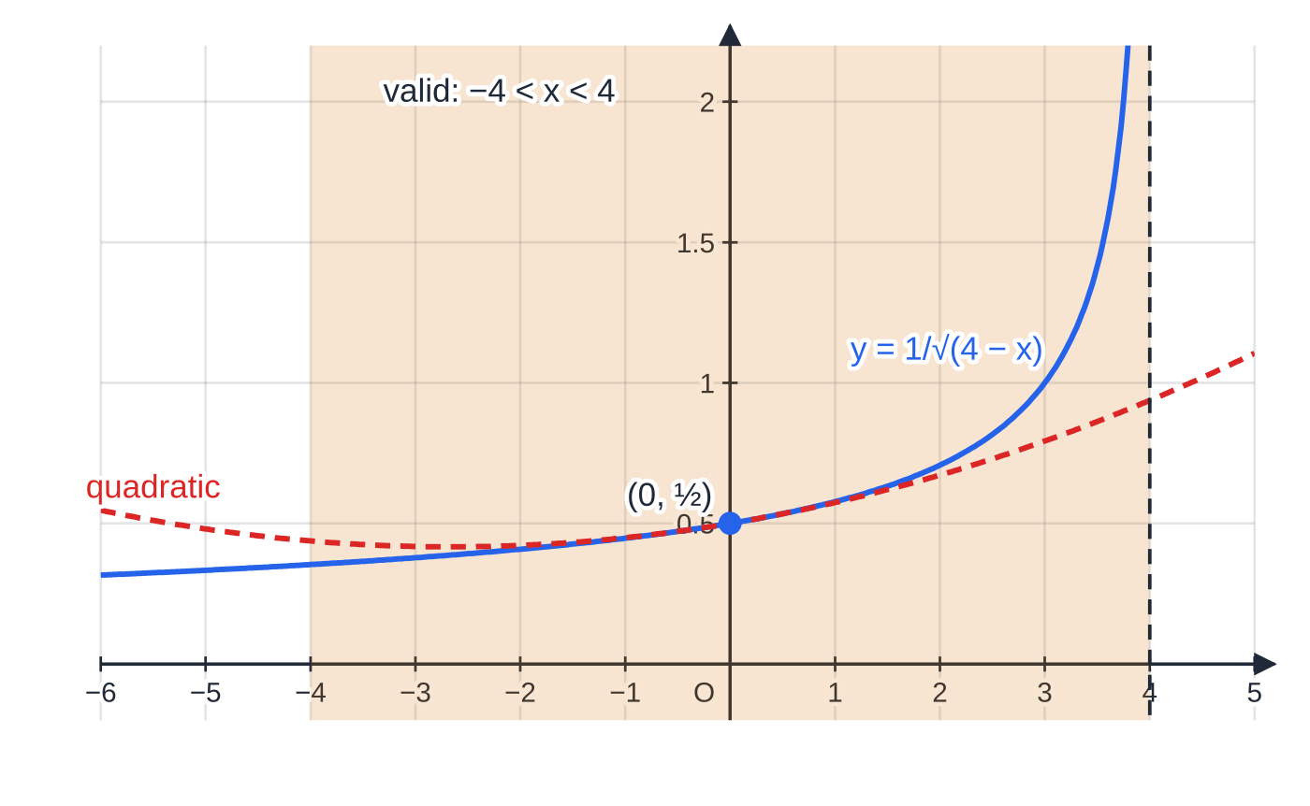
How do you expand (a + bx)ⁿ? (continued)
Section 3 of 11
Products of a polynomial and a series
Expand the binomial part first, up to the power you need. Multiply by each term of the polynomial and collect only the terms up to the required power: terms beyond it are not needed and are not accurate anyway. The range of validity is that of the binomial part; multiplying by a polynomial does not change it.
y = (4 − x)^(−½) and the quadratic from worked example 3. The curve crosses the y-axis at 4^(−½) = ½, which is why that factor sits outside the bracket. The series is valid for −4 < x < 4, ending at the asymptote x = 4.
Notes:
How do you expand (a + bx)ⁿ?. Full notes: https://examinerprep.com/notes/edexcel-ial-maths/the-binomial-series/

Slide 16
How do you expand (a + bx)ⁿ? (continued)
Section 3 of 11 · Worked example 4 · Medium · Show that
WORKED EXAMPLE · QUESTION
Show that, for small x, (3 - x)/(√(1 + 2x)) ≈3 - 4x + (11/2)x², and state the values of x for which the expansion is valid.
SOLUTION
Expand (1 + 2x)^(-1/2) to the x² term: 1 + (-½)(2x) + ((-½)(-(3/2)))/2(2x)² = 1 - x + (3/8)(4x²) = 1 - x + (3/2) x².
Multiply by (3 - x), keeping terms up to x²: 3(1 - x + (3/2) x²) - x(1 - x) = 3 - 3x + (9/2) x² - x + x². 3 - 4x + (11/2)x² as required. Validity: |2x| < 1 ⇒ |x| < ½
Notes:
How do you expand (a + bx)ⁿ?: Worked example 4. Full notes: https://examinerprep.com/notes/edexcel-ial-maths/the-binomial-series/

Slide 17
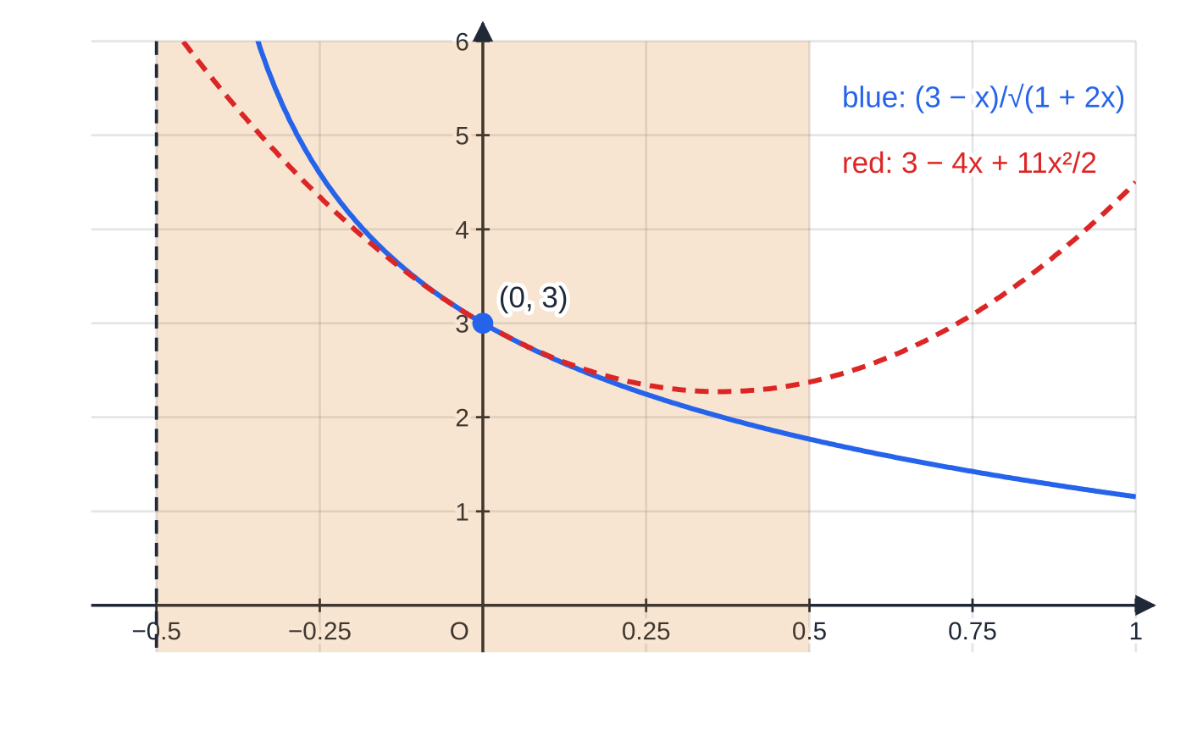
How do you expand (a + bx)ⁿ? (continued)
Section 3 of 11
Worked example 4: near x = 0 the quadratic 3 − 4x + 11x²/2 follows (3 − x)/√(1 + 2x) closely. The function has an asymptote at x = −½, the edge of the valid range |x| < ½; multiplying by (3 − x) has not changed that range.
Notes:
How do you expand (a + bx)ⁿ?. Full notes: https://examinerprep.com/notes/edexcel-ial-maths/the-binomial-series/

Slide 18
How do you find unknown constants and coefficients?
Section 4 of 11
Write the general expansion with the unknowns left in: (1 + kx)ⁿ = 1 + nkx + (n(n-1))/2k²x² + ⋯. Equate coefficients with the given ones: each matching power of x gives one equation. Two unknowns need two equations. When one equation contains nk and another n(n-1)k², square the first and divide to eliminate k. To find a single coefficient, you only need that one term: the coefficient of xʳ in (1 + t)ⁿ uses r factors on top and r! underneath.
Notes:
How do you find unknown constants and coefficients?. Full notes: https://examinerprep.com/notes/edexcel-ial-maths/the-binomial-series/

Slide 19
How do you find unknown constants and coefficients? (continued)
Section 4 of 11 · Worked example 5 · Hard · Find, state
WORKED EXAMPLE · QUESTION
The binomial expansion of (1 + kx)ⁿ, where k and n are constants and n is not a positive integer, begins 1 - 2x + 6x² + ⋯. (a) Find the values of n and k. (b) Find the coefficient of x³. (c) State the range of validity.
SOLUTION
(a) Equate coefficients. x: nk = -2. x²: (n(n-1))/2k² = 6, so n(n-1)k² = 12. Eliminate k using n²k² = (-2)² = 4: (n(n-1)k²)/n²k² = (12/4) ⇒(n-1)/n = 3 ⇒n - 1 = 3n. Then k = (-2)/n = (-2)/(-1/2). n = -½, k = 4
(b) The x³ term of (1 + 4x)^(-1/2): ((-½)(-(3/2))(-(5/2)))/6(4x)³ = (-(5/16))(64x³). −20
(c) |4x| < 1 ⇒ |x| < ¼ Check: (1 + 4x)^(-1/2) = 1 - 2x + 6x² - 20x³ + ⋯ reproduces both given coefficients.
Notes:
How do you find unknown constants and coefficients?: Worked example 5. Full notes: https://examinerprep.com/notes/edexcel-ial-maths/the-binomial-series/

Slide 20
How do you find unknown constants and coefficients? (continued)
Section 4 of 11
Exam tip 1 — check both equations
When you divide one coefficient equation by another, check that the values you find satisfy both original equations. Squaring nk = -2 throws away its sign, so the sign of k must come from nk = -2 itself.
Notes:
How do you find unknown constants and coefficients?. Full notes: https://examinerprep.com/notes/edexcel-ial-maths/the-binomial-series/

Slide 21
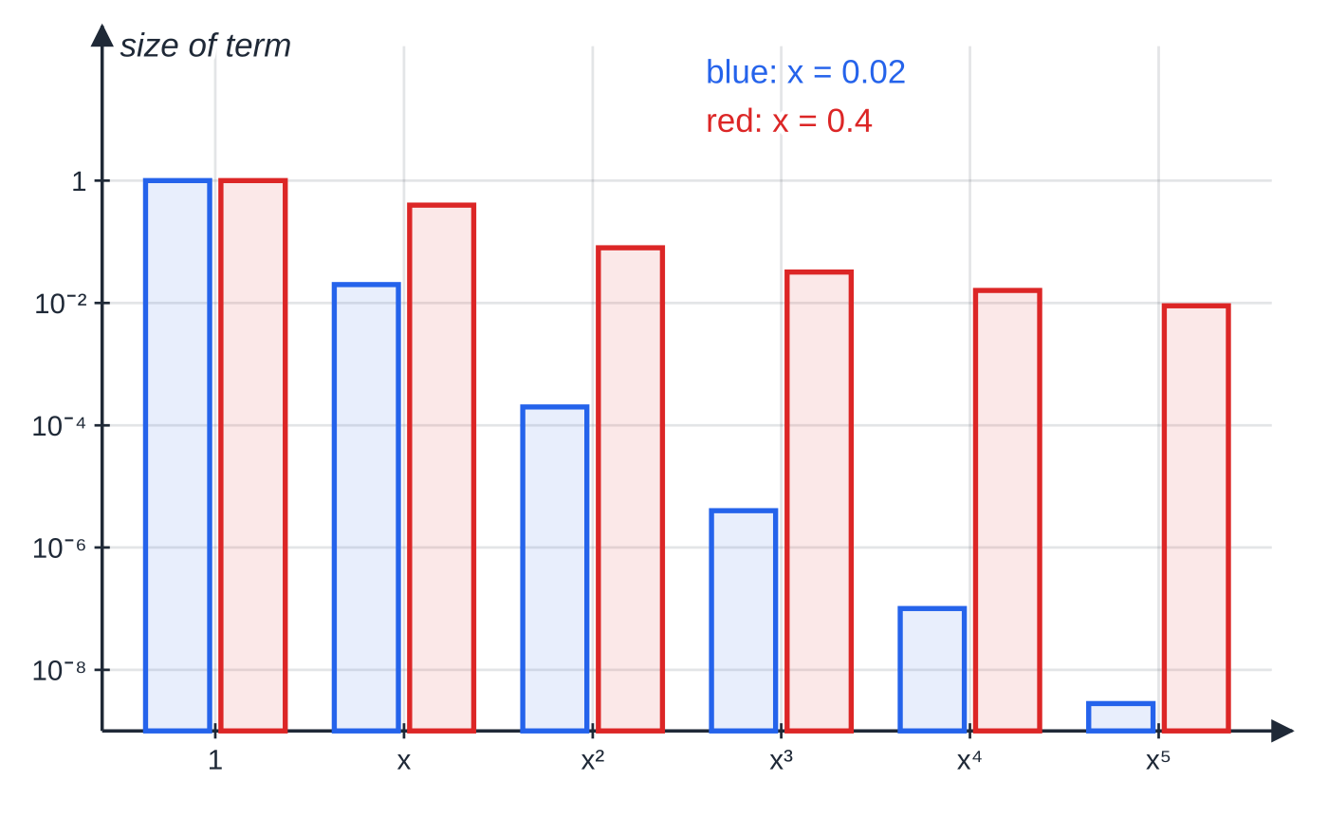
How do you use the series to approximate?
Section 5 of 11
Choose a value of x that turns the bracket into the number you want, and that lies inside the range of validity; the smaller |x|, the better. Substitute into the truncated series: with |x| small each term is much smaller than the one before, so the first few terms give an accurate value. To find a surd such as √6, find a number close to 1 whose square root is a simple multiple of √6, e.g. 0.96 = (96/100) = (16 ×6)/100. Judge accuracy with
percentage error = (|approximation - true value|)/(true value) ×100%.
The size of each term of the series for √(1 − 2x), on a logarithmic scale. At x = 0.02 the terms are 1, 0.02, 0.0002, 0.000004, …: after four terms the next one changes only the seventh decimal place. At x = 0.4 the terms 1, 0.4, 0.08, 0.032, … shrink slowly, so the same four terms give a much poorer approximation.
Notes:
How do you use the series to approximate?. Full notes: https://examinerprep.com/notes/edexcel-ial-maths/the-binomial-series/

Slide 22
How do you use the series to approximate? (continued)
Section 5 of 11 · Worked example 6 · Medium · Expand, find
WORKED EXAMPLE · QUESTION
(a) Expand √(1 - 2x) in ascending powers of x, up to and including the term in x³. (b) By substituting x = 0.02 into your expansion, find an approximation for √6, giving your answer to 5 decimal places.
SOLUTION
(a) n = ½, t = -2x: 1 + (½)(-2x) + ((½)(-½))/2(-2x)² + ((½)(-½)(-(3/2)))/6(-2x)³ = 1 - x - ⅛(4x²) + (1/16)(-8x³). 1 - x - ½x² - ½x³
(b) Check validity: |2 ×0.02| = 0.04 < 1. Simplify the left-hand side: √(1 - 0.04) = √0.96 = √((16 ×6)/100) = 4√6/10 = 2√6/5. Evaluate the series: 1 - 0.02 - 0.0002 - 0.000004 = 0.979796. So 2√6/5 ≈0.979796 ⇒√6 ≈(5/2) ×0.979796. √6 ≈2.44949
A calculator gives √6 = 2.449490 to 6 d.p.; the percentage error is only about 1 ×10⁻⁵%, because x = 0.02 is so small.
Notes:
How do you use the series to approximate?: Worked example 6. Full notes: https://examinerprep.com/notes/edexcel-ial-maths/the-binomial-series/

Slide 23
How do you use the series to approximate? (continued)
Section 5 of 11
Common error
Substituting a value outside the range of validity. With √(1 + 4x) and x = 1 you would be estimating √5 from 1 + 2 - 2 + 4 = 5, nowhere near √5 ≈2.24. The series only represents the function when |4x| < 1.
Notes:
How do you use the series to approximate?. Full notes: https://examinerprep.com/notes/edexcel-ial-maths/the-binomial-series/

Slide 24
How do partial fractions help you expand?
Section 6 of 11
A rational function such as (1 + 8x)/((1 - 2x)(2 + x)) has no single binomial form, but each partial fraction does: A/(1 - 2x) = A(1 - 2x)⁻¹. Split into partial fractions, expand each one with the binomial series, then add the coefficients of each power. A repeated factor gives a term like C/((1 + 2x)²) = C(1 + 2x)⁻²: still one binomial expansion. Each piece has its own range of validity; the sum is valid only where all of them are valid, so take the smallest range.
Notes:
How do partial fractions help you expand?. Full notes: https://examinerprep.com/notes/edexcel-ial-maths/the-binomial-series/

Slide 25
How do partial fractions help you expand? (continued)
Section 6 of 11 · Worked example 7 · Medium · Express, find, state
WORKED EXAMPLE · QUESTION
f(x) = (1 + 8x)/((1 - 2x)(2 + x)). (a) Express f(x) in partial fractions. (b) Hence find the series expansion of f(x) in ascending powers of x, up to and including the term in x². (c) State the range of validity.
SOLUTION
(a) 1 + 8x ≡A(2 + x) + B(1 - 2x). x = ½: 5 = (5/2) A ⇒A = 2; x = -2: -15 = 5B ⇒B = -3. f(x) = 2/(1 - 2x) - 3/(2 + x)
(b) First fraction, n = -1, t = -2x: 2(1 - 2x)⁻¹ = 2(1 + 2x + 4x² + ⋯) = 2 + 4x + 8x². Second, taking out 2⁻¹: 3(2 + x)⁻¹ = (3/2)(1 + x/2)⁻¹ = (3/2)(1 - x/2 + x²/4 - ⋯) = (3/2) - 3x/4 + 3x²/8. Subtract and collect: (2 - (3/2)) + (4 + ¾)x + (8 - (3/8))x². ½ + (19/4)x + (61/8)x²
(c) |2x| < 1 ⇒|x| < ½; |x/2| < 1 ⇒|x| < 2. Both hold when |x| < ½ Check: f(0) = 1/(1 ×2) = ½, the constant term.
Notes:
How do partial fractions help you expand?: Worked example 7. Full notes: https://examinerprep.com/notes/edexcel-ial-maths/the-binomial-series/

Slide 26
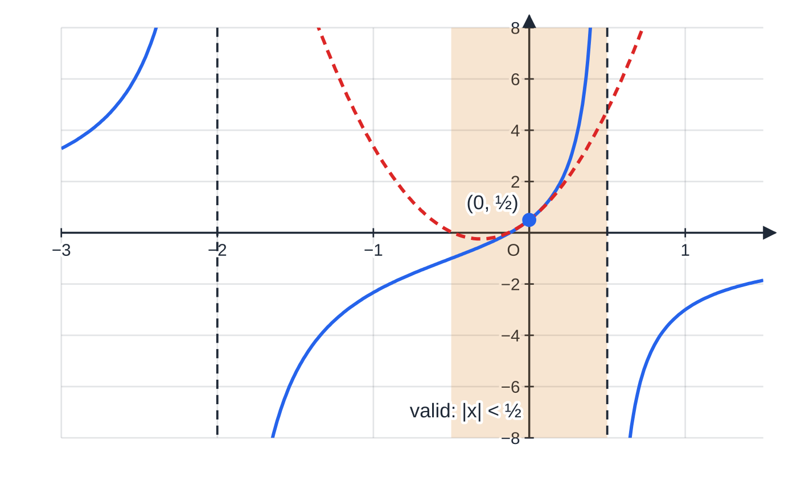
How do partial fractions help you expand? (continued)
Section 6 of 11
y = f(x) from worked example 7 (blue) with its quadratic approximation ½ + 19x/4 + 61x²/8 (red, dashed). The asymptotes x = −2 and x = ½ come from the two factors, and the series is valid only up to the nearer one: |x| < ½.
Notes:
How do partial fractions help you expand?. Full notes: https://examinerprep.com/notes/edexcel-ial-maths/the-binomial-series/

Slide 27
How do partial fractions help you expand? (continued)
Section 6 of 11 · Worked example 8 · Hard · Find, state, estimate
WORKED EXAMPLE · QUESTION
g(x) = (6 + 2x + 10x²)/((2 - x)(1 + 2x)²). (a) Given that g(x) = A/(2 - x) + B/(1 + 2x) + C/((1 + 2x)²), find A, B and C. (b) Hence, or otherwise, find the series expansion of g(x) up to and including the term in x², simplifying each coefficient. (c) State the range of validity. (d) Use your expansion to estimate g(0.01) and compare it with the exact value.
SOLUTION
(a) 6 + 2x + 10x² ≡A(1 + 2x)² + B(2 - x)(1 + 2x) + C(2 - x). x = 2: 6 + 4 + 40 = 25A ⇒A = 2. x = -½: 6 - 1 + (5/2) = (5/2) C ⇒C = 3. Constant terms: 6 = A + 2B + 2C = 2 + 2B + 6. A = 2, B = -1, C = 3
(b) 2/(2 - x) = (1 - x/2)⁻¹ = 1 + x/2 + x²/4; -1/(1 + 2x) = -(1 - 2x + 4x²) = -1 + 2x - 4x²; 3(1 + 2x)⁻² = 3(1 + (-2)(2x) + ((-2)(-3))/2(2x)²) = 3 - 12x + 36x². Add: (1 - 1 + 3) + (½ + 2 - 12)x + (¼ - 4 + 36)x². 3 - (19/2)x + (129/4)x²
(c) |x/2| < 1 gives |x| < 2; |2x| < 1 gives |x| < ½. |x| < ½
Notes:
How do partial fractions help you expand?: Worked example 8. Full notes: https://examinerprep.com/notes/edexcel-ial-maths/the-binomial-series/

Slide 28
How do partial fractions help you expand? (continued)
Section 6 of 11 · Worked example 8 · Hard · Find, state, estimate (continued)
(d) Series: 3 - 0.095 + 0.003225 = 2.908225. Exact: 6.021/(1.99 ×1.0404) = 2.908139 (6 d.p.). Both round to 2.908; the percentage error is about 0.003%
Notes:
How do partial fractions help you expand?: Worked example 8. Full notes: https://examinerprep.com/notes/edexcel-ial-maths/the-binomial-series/

Slide 29
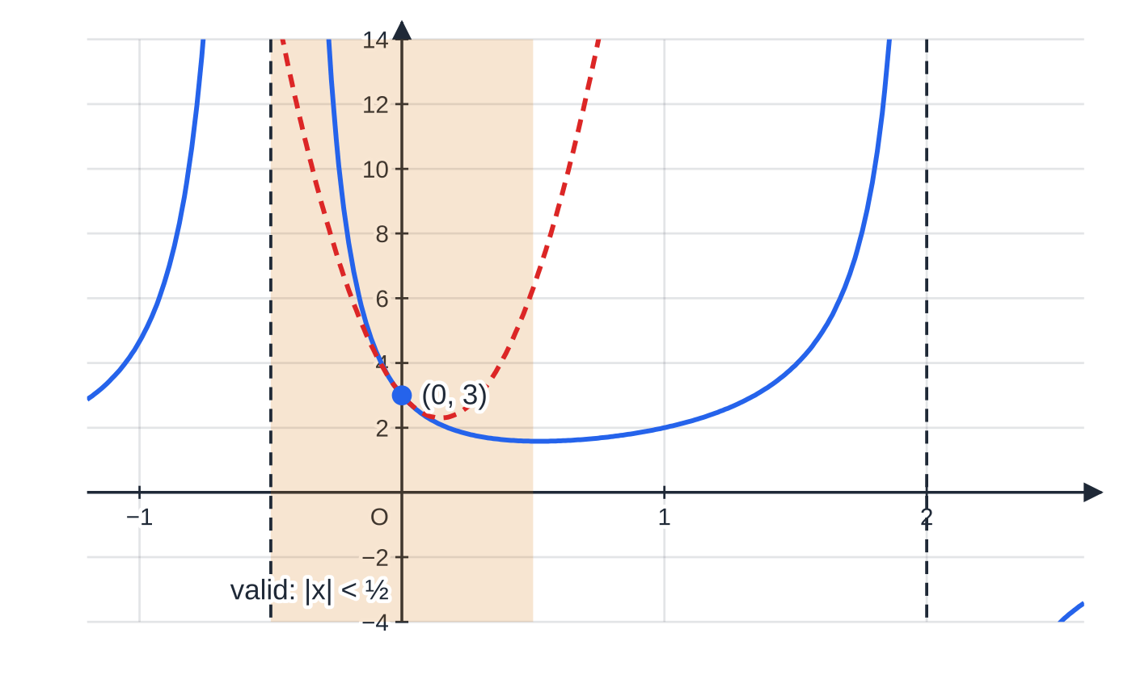
How do partial fractions help you expand? (continued)
Section 6 of 11
Exam tip 2 — check the constant term
Check your expansion of a rational function by putting x = 0: the constant term must equal f(0). Here g(0) = 6/(2 ×1) = 3, the first term of the series. It catches most sign slips in the partial fractions.
y = g(x) from worked example 8 (blue) and its quadratic approximation 3 − 19x/2 + 129x²/4 (red, dashed). The repeated factor (1 + 2x)² makes the curve go to +∞ on both sides of x = −½; that asymptote is the nearer one to the origin, so it fixes the range of validity |x| < ½.
Notes:
How do partial fractions help you expand?. Full notes: https://examinerprep.com/notes/edexcel-ial-maths/the-binomial-series/

Slide 30
Exam tips for P4.3
Section 7 of 11
Exam tip 3 — brackets round every term
Write (-x/4)² and (2x)³ in full before simplifying. Most lost accuracy in this topic comes from a coefficient or a minus sign left outside the power.
Exam tip 4 — the constant must be 1
The series in the formulae list is for (1 + x)ⁿ. If the bracket starts with any other number, take out aⁿ first, and remember to multiply every term by it at the end.
Exam tip 5 — always give the validity
If a question asks for the range of validity, give it as |x| < … or as a double inequality. For a sum of several expansions, state the narrowest range, and show where it comes from.
Notes:
Exam tips for P4.3. Full notes: https://examinerprep.com/notes/edexcel-ial-maths/the-binomial-series/

Slide 31
Exam tips for P4.3 (continued)
Section 7 of 11
Exam tip 6 — show the substitution in approximations
Say which value of x you use, check it is inside the range of validity, and show how the left-hand side becomes the number you want (√0.96 = 2√6/5). The answer alone does not show the method.
Exam tip 7 — "hence" means use the partial fractions
After "hence" in a partial-fraction question, expand each fraction separately. Multiplying three separate series together instead takes far longer and gives more chances for slips.
Notes:
Exam tips for P4.3. Full notes: https://examinerprep.com/notes/edexcel-ial-maths/the-binomial-series/

Slide 32
Common misconceptions
Section 8 of 11
Misconception | Why it is wrong | Correct idea
(1 + 3x)⁻¹ = 1 - 3x + 3x² - ⋯ | The power is applied only to x, not to 3x. | (1 + 3x)⁻¹ = 1 - 3x + 9x² - 27x³ + ⋯
(4 + x)^(1/2) = 4(1 + x/4)^(1/2) | The factor taken out must be raised to the power n. | (4 + x)^(1/2) = 4^(1/2)(1 + x/4)^(1/2) = 2(1 + x/4)^(1/2)
The expansion of (1 - 3x)⁻² is valid for |x| < 1. | The condition applies to the whole term -3x. | |3x| < 1, i.e. |x| < ⅓.
The series for a rational function is valid for the widest of the separate ranges. | Outside a narrower range one of the pieces diverges, so the sum does too. | Take the narrowest range: where every piece is valid.
Any value of x can be substituted into the expansion. | Outside the range the series does not add up to the function. | Choose a small x inside the range of validity.
ⁿCᵣ on a calculator gives the coefficients for n = -2 or n = ½. | ⁿCᵣ is defined there only for whole numbers n ≥r ≥0. | Use (n(n-1)⋯(n-r+1))/r! written out by hand.
Notes:
Common misconceptions. Full notes: https://examinerprep.com/notes/edexcel-ial-maths/the-binomial-series/

Slide 33
How this topic connects
Section 9 of 11
P2 Binomial expansion and series
The coefficient pattern is the same as ⁿCᵣ, and the geometric series and its sum to infinity explain why 1/(1-x) needs |x| < 1.
P4.1 Partial fractions and P4.6 Integration
Partial fractions turn a rational function into pieces you can expand (this page) or integrate (to logarithms). Ideas such as √(1 + x) ≈1 + x/2 for small x sit alongside the small-angle approximations of trigonometry, and are a first look at the power series of later courses.
IAL Physics
Binomial approximations simplify formulas when one quantity is much smaller than another, for example (1 + h/R)⁻² ≈1 - 2h/R for gravitational field strength a small height h above a planet of radius R.
Notes:
How this topic connects. Full notes: https://examinerprep.com/notes/edexcel-ial-maths/the-binomial-series/

Slide 34
Key formulae
Section 10 of 11
Formula | Use | In the formulae list?
(1 + x)ⁿ = 1 + nx + (n(n-1))/2!x² + (n(n-1)(n-2))/3!x³ + ⋯, |x| < 1, n ∈ℚ | the binomial series for any rational power | Yes
(a + b)ⁿ = aⁿ + ⁿC₁ aⁿ⁻¹b + ⋯+ bⁿ, n ∈ℕ | finite expansion for a positive integer power (from P2) | Yes
(a + bx)ⁿ = aⁿ(1 + bx/a)ⁿ | reduce to the (1 + t)ⁿ form before expanding | No — derive it
|bx/a| < 1 ⇔|x| < |a/b| | range of validity of (a + bx)ⁿ | No — derive it
(1 - x)⁻¹ = 1 + x + x² + x³ + ⋯, |x| < 1 | the quickest expansion, used with every partial fraction of the form A/(1 - kx) | No — derive it
percentage error = (|approx - true|)/true ×100% | judging the accuracy of an approximation | No — learn it
Notes:
Key formulae. Full notes: https://examinerprep.com/notes/edexcel-ial-maths/the-binomial-series/

Slide 35
Check your understanding
Section 11 of 11
1. Write down the first three terms of the expansion of (1 + x)⁻⁴.
2. For which values of x is the binomial expansion of (5 - 2x)^(1/3) valid?
3. Find the coefficient of x² in the expansion of 1/(√(1 - x)).
4. A student puts x = 1 into 1 + 2x - 2x² + 4x³ to estimate √5. What has gone wrong?
5. Use partial fractions to expand 1/((1 - x)(1 + x)) up to the term in x⁴.
6. Find the coefficient of x³ in the expansion of (1 + x)⁻⁴.
Notes:
Check your understanding: questions. Full notes: https://examinerprep.com/notes/edexcel-ial-maths/the-binomial-series/

Slide 36
Check your understanding · answers
Section 11 of 11
1. 1 + (-4)x + ((-4)(-5))/2x² = 1 - 4x + 10x², valid for |x| < 1.
2. (5 - 2x)^(1/3) = 5^(1/3)(1 - 2x/5)^(1/3), so it needs |2x/5| < 1, i.e. |x| < (5/2).
3. n = -½, t = -x: ((-½)(-(3/2)))/2(-x)² = (3/8) x², so the coefficient is (3/8).
4. The series for √(1 + 4x) is valid only for |x| < ¼. At x = 1 the terms grow instead of shrinking and the sum, 5, is nothing like √5 ≈2.24. Rewrite √5 using a number close to 1 instead, as in worked example 6.
5. 1/((1-x)(1+x)) = (1/2)/(1-x) + (1/2)/(1+x) = ½(1 + x + x² + x³ + x⁴) + ½(1 - x + x² - x³ + x⁴) = 1 + x² + x⁴ + ⋯, valid for |x| < 1. The odd powers cancel, as they must: the function is unchanged when x is replaced by -x.
6. ((-4)(-5)(-6))/3! = (-120)/6 = -20. So (1 + x)⁻⁴ = 1 - 4x + 10x² - 20x³ + ⋯.
Notes:
Check your understanding: answers. Full notes: https://examinerprep.com/notes/edexcel-ial-maths/the-binomial-series/

Slide 37
Practice questions
2 original exam-style questions. Answers at the end of the deck.

Slide 38
Question 1
7 marks
f(x) = 1/(1 − x)³, which can be written as (1 − x)⁻³.
(a) Find the binomial expansion of (1 − x)⁻³ in ascending powers of x, up to and including the term in x³. [4]
(b) State the range of values of x for which this expansion is valid. [1]
(c) Hence find the coefficient of x² in the expansion of (1 + 2x)/(1 − x)³. [2]
Notes:
Online with the full mark scheme: https://examinerprep.com/ial-maths-p4-3-the-binomial-series-questions#IALM-P4-3-B-01

Slide 39
Question 2
7 marks
g(x) = ∛(1 + 6x).
(a) Find the binomial expansion of g(x) in ascending powers of x, up to and including the term in x³, simplifying each coefficient. [4]
(b) State the values of x for which the expansion is valid. [1]
(c) Use your expansion with x = 0.01 to find an approximation for ∛1.06, giving your answer to 5 decimal places. [2]
Notes:
Online with the full mark scheme: https://examinerprep.com/ial-maths-p4-3-the-binomial-series-questions#IALM-P4-3-B-02

Slide 40
Answers

Slide 41
Question 1 · answer
Mark scheme
1 + (−3)(−x) + [(−3)(−4)/2](−x)² + [(−3)(−4)(−5)/6](−x)³, with n = −3 and −x in place of x
1 + 3x
+ 6x²
+ 10x³
|x| < 1
(1 + 2x)(1 + 3x + 6x² + …): x² terms are 1 × 6x² and 2x × 3x
coefficient = 6 + 6 = 12
Notes:
Full mark scheme: https://examinerprep.com/ial-maths-p4-3-the-binomial-series-questions#IALM-P4-3-B-01

Slide 42
Question 2 · answer
Mark scheme
(1 + 6x)^⅓ = 1 + (⅓)(6x) + [(⅓)(−⅔)/2](6x)² + [(⅓)(−⅔)(−5/3)/6](6x)³
= 1 + 2x
− 4x²
+ (40/3)x³
|6x| < 1, so |x| < 1/6
1 + 0.02 − 0.0004 + (40/3)(0.000001) = 1.019613…
∛1.06 ≈ 1.01961
Notes:
Full mark scheme: https://examinerprep.com/ial-maths-p4-3-the-binomial-series-questions#IALM-P4-3-B-02

Slide 43
Keep practising
Notes for this topic
Questions on this topic
Build a printable test
ExaminerPrep is an independent tutoring service. It has been developed independently from and is not endorsed by the International Baccalaureate Organization. "International Baccalaureate", "IB" and "IB Diploma Programme" are registered trademarks of the IBO, used here for descriptive purposes only.
Pearson Edexcel and Cambridge are trademarks of their owners; ExaminerPrep is not affiliated with any exam board.

