Slide 1
EP
EDEXCEL IAL MATHS
S1.6 The Normal distribution
The full notes page in 12 sections · practice questions with answers · simulations
ExaminerPrep is an independent tutoring service. It has been developed independently from and is not endorsed by the International Baccalaureate Organization. "International Baccalaureate", "IB" and "IB Diploma Programme" are registered trademarks of the IBO, used here for descriptive purposes only.
Pearson Edexcel and Cambridge are trademarks of their owners; ExaminerPrep is not affiliated with any exam board.
Notes:
S1.6 The Normal distribution. Notes for this topic: https://examinerprep.com/notes/edexcel-ial-maths/the-normal-distribution/

Slide 2
What this page covers
Overview
The Normal distribution N(μ,σ²): its bell shape, its symmetry about the mean, and what μ and σ do to the curve
Standardising with Z=(X-μ)/σ and the standard Normal distribution Z~N(0,1²)
Reading the table of Φ(z)=P(Z<z), including negative values of z by symmetry
Probabilities above, below and between values for any Normal variable, including conditional probabilities and independent repeats
Working backwards with the percentage points table: the value with a given probability above or below it
Finding an unknown mean or an unknown standard deviation from one probability
Finding the mean and the standard deviation together from two probabilities (simultaneous equations)
Notes:
What this page covers. Full notes: https://examinerprep.com/notes/edexcel-ial-maths/the-normal-distribution/

Slide 3
In one minute
Key points
1
X~N(μ,σ²) is a bell-shaped, symmetrical distribution centred on the mean μ; the second number is the variance, so the standard deviation is its square root.
4
Backwards: from a probability find z (percentage points table, or the Φ table read in reverse), then x=μ+zσ.
2
Standardise: z=(x-μ)/σ counts how many standard deviations x is from the mean, and then P(X<x)=Φ(z).
5
Unknown μ or σ: each given probability gives one equation (x-μ)/σ=z; two unknowns need two such equations.
3
Symmetry: P(Z>z)=1-Φ(z) and Φ(-z)=1-Φ(z).
6
Use z to 2 d.p. with the Φ table, quote table values to 4 d.p., and give final probabilities to 3 s.f. A calculator value is just as acceptable.
Notes:
In one minute: the key points of this topic.

Slide 4
What does a Normal distribution look like?
Section 1 of 12
Weigh a few hundred apples from one orchard, or time the same bus journey every morning for a year. The values pile up around a typical value and become rarer the further you go from it, in either direction, at about the same rate. A histogram of such data, drawn with narrow classes, looks like a bell. The Normal distribution is the smooth model of that bell. It is used for continuous quantities: lengths of manufactured parts, masses of fruit, journey times, reaction times.
The Normal distribution N(μ,σ²) is a continuous distribution with a symmetrical bell-shaped curve, mean μ and variance σ². We write X~N(μ,σ²); the standard deviation is σ.
Several facts follow straight from the shape, and you will use them in almost every question:
The curve is symmetrical about μ, so mean = median = mode = μ, and P(X<μ)=P(X>μ)=0.5.
Probabilities are areas under the curve, and the total area is 1.
Notes:
What does a Normal distribution look like?. Full notes: https://examinerprep.com/notes/edexcel-ial-maths/the-normal-distribution/

Slide 5
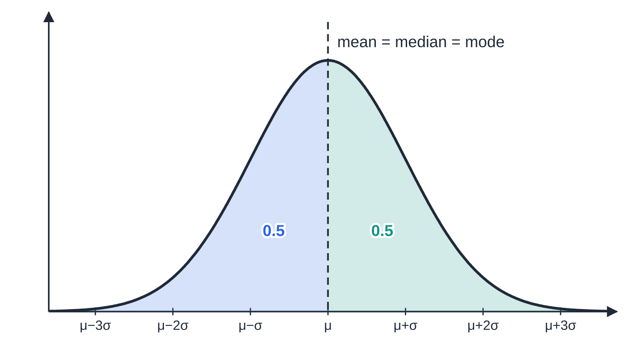
What does a Normal distribution look like? (continued)
Section 1 of 12
The curve never touches the axis, but values more than 3 standard deviations from the mean are very rare.
For a continuous variable P(X=a)=0: a single value has no width, so no area. Hence P(X<a) and P(X≤a) are the same number.
Changing μ slides the curve along the axis without changing its shape. Changing σ changes the spread: doubling σ makes the curve twice as wide and half as tall, so that the total area stays 1.
The curve is symmetrical about the mean, so exactly half of the area lies on each side of μ. Ticks are one standard deviation apart.
Notes:
What does a Normal distribution look like?. Full notes: https://examinerprep.com/notes/edexcel-ial-maths/the-normal-distribution/

Slide 6
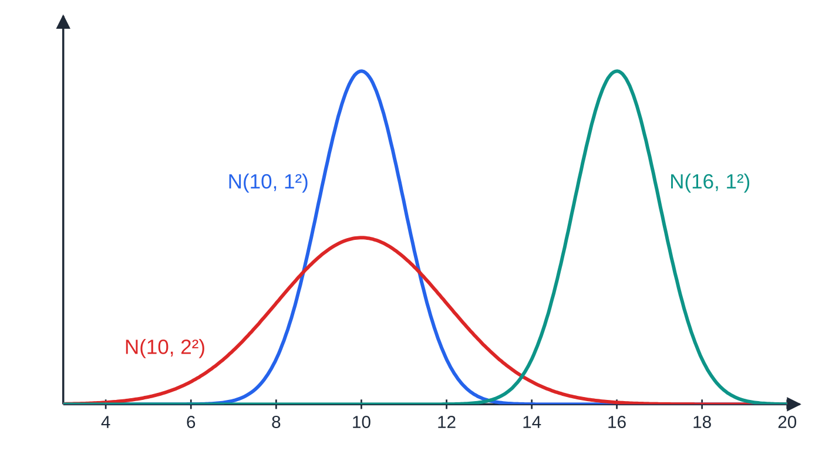
What does a Normal distribution look like? (continued)
Section 1 of 12
This is why you cannot compare two Normal curves by height alone — a flatter curve is not "less likely", it is just more spread out.
Whatever the values of μ and σ, about 68.3% of the distribution lies within one standard deviation of the mean, 95.4% within two and 99.7% within three. These percentages are worth knowing as a sense check rather than as a method:
A value 2 standard deviations above the mean has only about 2.3% of the distribution above it, so a tail probability beyond z=2 should come out small.
Blue and red share the mean 10, but red has twice the standard deviation, so it is twice as wide and half as tall. Teal is blue moved 6 units to the right.
Notes:
What does a Normal distribution look like?. Full notes: https://examinerprep.com/notes/edexcel-ial-maths/the-normal-distribution/

Slide 7
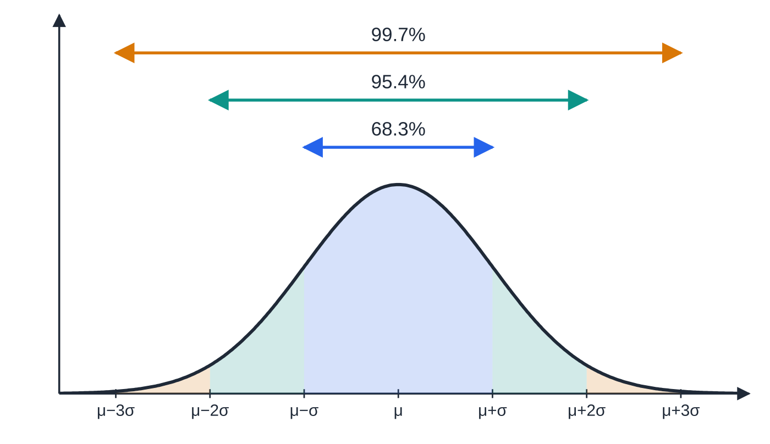
What does a Normal distribution look like? (continued)
Section 1 of 12
They also tell you when a Normal model is not suitable. If a quantity cannot be negative but μ-2σ is well below zero, a Normal model gives a noticeable probability to impossible values.
Common error — variance or standard deviation?
Reading X~N(50,16) as "standard deviation 16". The second parameter is the variance, so σ=√16=4. Writing the distribution as N(50,4²) avoids the slip.
The proportions within 1, 2 and 3 standard deviations of the mean are the same for every Normal distribution.
Notes:
What does a Normal distribution look like?. Full notes: https://examinerprep.com/notes/edexcel-ial-maths/the-normal-distribution/

Slide 8
How do you standardise a Normal variable?
Section 2 of 12
There are infinitely many Normal distributions, one for each pair μ,σ, but only one of them has printed tables: the standard Normal distribution Z~N(0,1²), with mean 0 and standard deviation 1. The trick is that every Normal variable can be turned into Z. Subtract the mean, so the centre moves to 0; then divide by the standard deviation, so the spread becomes 1.
Standardising.
If X~N(μ,σ²) then Z=(X-μ)/σ~N(0,1²), and
P(X<x)=P(Z<(x-μ)/σ)=Φ((x-μ)/σ).
Here σ is the standard deviation (not the variance) and Φ(z)=P(Z<z). This result is
not in the formulae booklet: learn it; only the tables are printed.
The z-value of x has a simple meaning: it is the number of standard deviations that x lies above the mean. A negative z means below the mean.
Notes:
How do you standardise a Normal variable?. Full notes: https://examinerprep.com/notes/edexcel-ial-maths/the-normal-distribution/

Slide 9
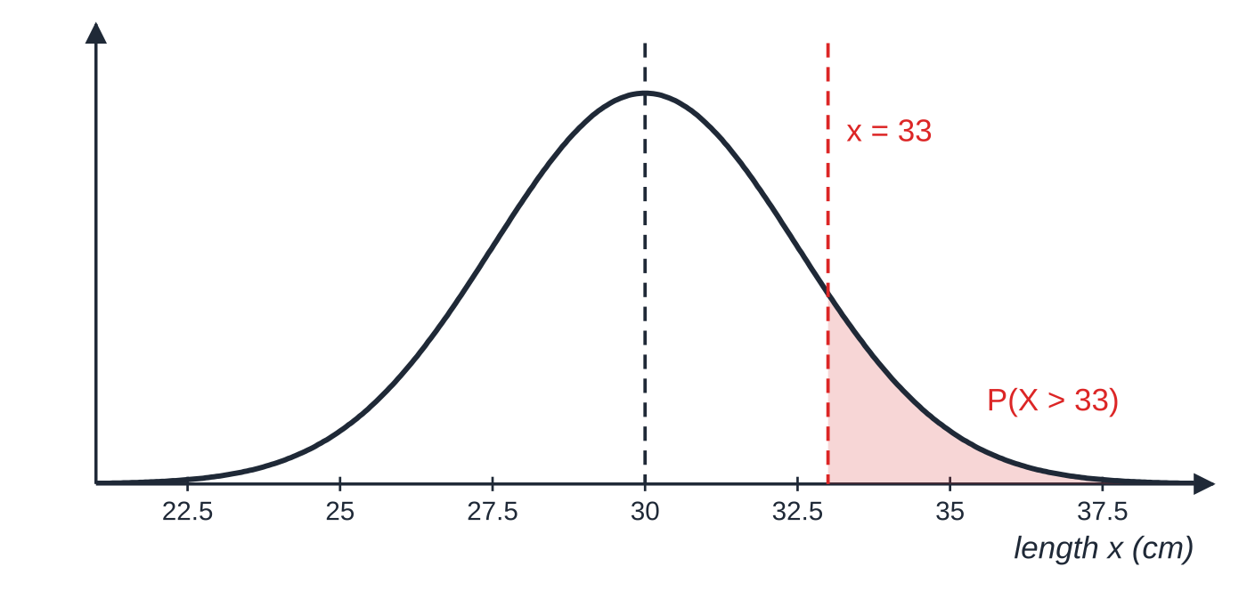
How do you standardise a Normal variable? (continued)
Section 2 of 12
Rearranged, the same link reads x=μ+zσ, which is the form you need when you work backwards from a probability.
Standardising relabels the axis without changing any area. Take cucumber lengths X~N(30,2.5²) in cm. The value 33 is 3÷2.5=1.2 standard deviations above the mean, so P(X>33) is exactly the same area as P(Z>1.2). The two figures below have the same shape and the same shaded proportion; only the numbers on the axis differ.
X~N(30,2.5²): the shaded tail is the proportion of cucumbers longer than 33 cm.
Notes:
How do you standardise a Normal variable?. Full notes: https://examinerprep.com/notes/edexcel-ial-maths/the-normal-distribution/

Slide 10
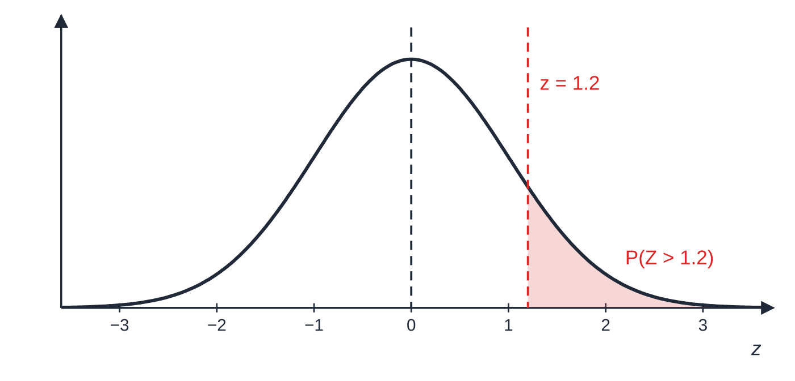
How do you standardise a Normal variable? (continued)
Section 2 of 12
The same area on the standard Normal curve: 33 is 1.2 standard deviations above 30, so P(X>33)=P(Z>1.2).
Notes:
How do you standardise a Normal variable?. Full notes: https://examinerprep.com/notes/edexcel-ial-maths/the-normal-distribution/

Slide 11
How do you read the Φ(z) table?
Section 3 of 12
The printed table gives Φ(z)=P(Z<z), the area to the left of z, for z≥0 in steps of 0.01. Round z to 2 d.p. before you look it up. Every other area comes from that one table by two ideas: the total area is 1, and the curve is symmetrical about 0. The method is always the same — draw the curve, shade the area you want, and decide which rule matches the picture.
You want | Use | Why
P(Z<a), a>0 | Φ(a) | straight from the table
P(Z>a) | 1-Φ(a) | total area is 1
P(Z<-a) | 1-Φ(a) | symmetry: the left tail beyond -a equals the right tail beyond a
P(Z>-a) | Φ(a) | symmetry
P(a<Z<b) | Φ(b)-Φ(a) | area to the left of b minus the area to the left of a
Notes:
How do you read the Φ(z) table?. Full notes: https://examinerprep.com/notes/edexcel-ial-maths/the-normal-distribution/

Slide 12
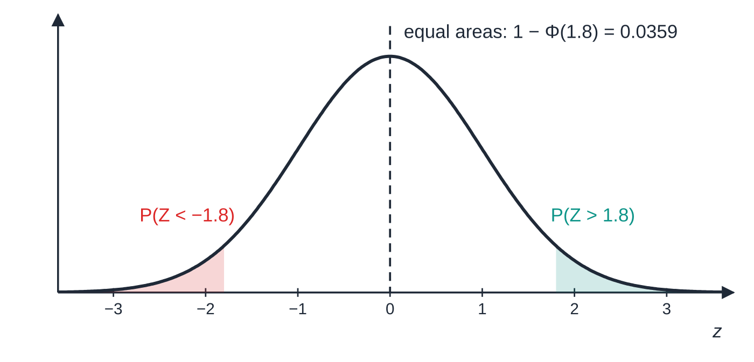
How do you read the Φ(z) table? (continued)
Section 3 of 12
Symmetry about 0: the left tail beyond −1.8 is the mirror image of the right tail beyond 1.8, so both equal 1-Φ(1.8).
Notes:
How do you read the Φ(z) table?. Full notes: https://examinerprep.com/notes/edexcel-ial-maths/the-normal-distribution/

Slide 13
How do you read the Φ(z) table? (continued)
Section 3 of 12 · Worked example 1 · Easy · Find
WORKED EXAMPLE · QUESTION
The random variable Z~N(0,1²). Find (a) P(Z<1.23), (b) P(Z>0.4), (c) P(Z<-1.8), (d) P(-0.5<Z<1.2).
SOLUTION
(a) Straight from the table: P(Z<1.23)=Φ(1.23)= 0.8907
(b) The area to the right is 1 minus the area to the left: 1-Φ(0.40)=1-0.6554= 0.3446
(c) The left tail beyond −1.8 equals the right tail beyond 1.8: 1-Φ(1.80)=1-0.9641= 0.0359
(d) Φ(1.2)-Φ(-0.5), with Φ(-0.5)=1-Φ(0.5): 0.8849-(1-0.6915)=0.8849-0.3085= 0.5764
These come straight from the table, so the 4 d.p. table values are the answers; to 3 s.f. they are 0.891, 0.345, 0.0359 and 0.576.
Notes:
How do you read the Φ(z) table?: Worked example 1. Full notes: https://examinerprep.com/notes/edexcel-ial-maths/the-normal-distribution/

Slide 14
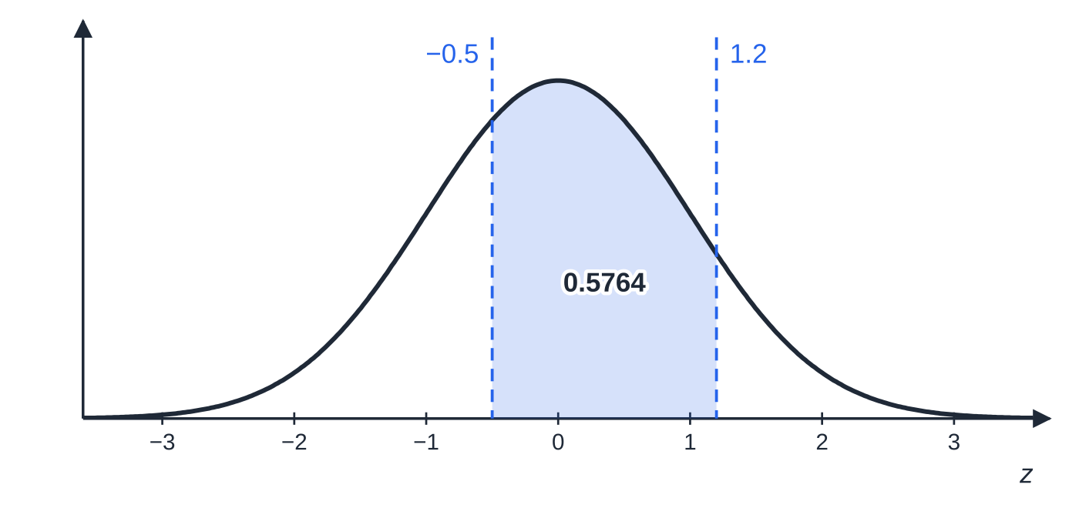
How do you read the Φ(z) table? (continued)
Section 3 of 12
Part (d): the area between −0.5 and 1.2 is everything left of 1.2 minus everything left of −0.5. Only Φ of a positive number is ever read from the table.
Notes:
How do you read the Φ(z) table?. Full notes: https://examinerprep.com/notes/edexcel-ial-maths/the-normal-distribution/

Slide 15
How do you find probabilities for any Normal variable?
Section 4 of 12
For a variable that is not already standard, add one step in front of the table work. The full method is:
1. Write the probability in terms of X.
2. Sketch the curve, mark the mean and shade the area you want.
3. Standardise each boundary.
4. Use the table rules from the previous section.
Write the standardising step out in full, for example P(X>33)=P(Z>(33-30)/2.5)=P(Z>1.2). This line carries the method, and it shows anyone reading your work that you divided by σ and not by σ².
Two further ideas from S1 probability often appear in the same question. For "at least one of …" or "all three …", find the single probability first and then combine with the multiplication rule for independent events. For a conditional probability use P(A|B)=P(A∩B)/P(B). With Normal tails, A∩B is usually just the smaller tail: if a value is above 68, it is certainly above 60.
Notes:
How do you find probabilities for any Normal variable?. Full notes: https://examinerprep.com/notes/edexcel-ial-maths/the-normal-distribution/

Slide 16
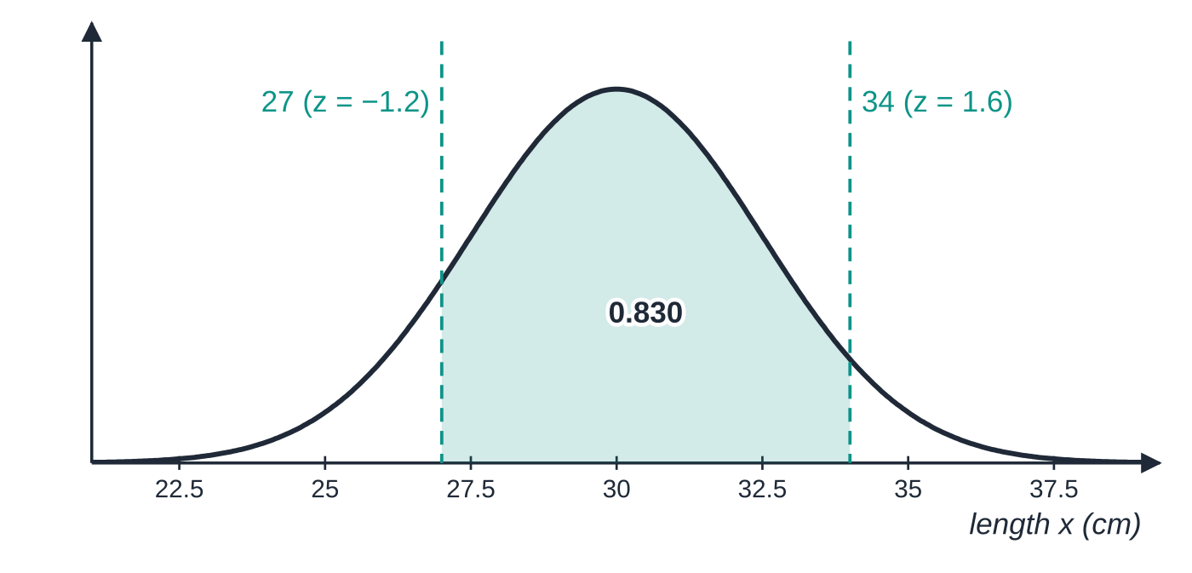
How do you find probabilities for any Normal variable? (continued)
Section 4 of 12 · Worked example 2 · Easy · Find
WORKED EXAMPLE · QUESTION
The length X cm of a cucumber from a greenhouse is modelled by X~N(30,2.5²). Find (a) P(X>33), (b) P(27<X<34).
SOLUTION
(a) Standardise: P(X>33)=P(Z>(33-30)/2.5)=P(Z>1.2). Then 1-Φ(1.20)=1-0.8849=0.1151= 0.115 (3 s.f.)
(b) Standardise both ends: P((27-30)/2.5<Z<(34-30)/2.5)=P(-1.2<Z<1.6). Then Φ(1.6)-Φ(-1.2)=0.9452-(1-0.8849)=0.9452-0.1151=0.8301= 0.830 (3 s.f.)
Part (b): both boundaries are standardised; 27 is below the mean, so its z-value is negative.
Notes:
How do you find probabilities for any Normal variable?: Worked example 2. Full notes: https://examinerprep.com/notes/edexcel-ial-maths/the-normal-distribution/

Slide 17
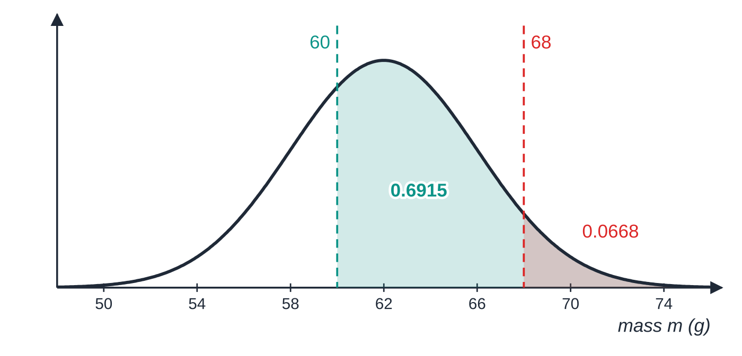
How do you find probabilities for any Normal variable? (continued)
Section 4 of 12 · Worked example 3 · Medium · Find
WORKED EXAMPLE · QUESTION
The mass M grams of an egg from a farm is modelled by M~N(62,4²). An egg is graded "large" if its mass is more than 68 g. (a) Find the proportion of eggs that are large. (b) An egg is known to have a mass of more than 60 g. Find the probability that it is large. (c) Two eggs are chosen at random. Find the probability that at least one of them is large.
SOLUTION
(a) P(M>68)=P(Z>(68-62)/4)=P(Z>1.5)=1-0.9332= 0.0668
The red tail (more than 68 g) lies entirely inside the teal region (more than 60 g), so "large and over 60 g" is just "large". The whole teal region, including the red tail, has area 0.6915.
Notes:
How do you find probabilities for any Normal variable?: Worked example 3. Full notes: https://examinerprep.com/notes/edexcel-ial-maths/the-normal-distribution/

Slide 18
How do you find probabilities for any Normal variable? (continued)
Section 4 of 12 · Worked example 3 · Medium · Find (continued)
(b) Every egg over 68 g is also over 60 g, so the intersection is just P(M>68). P(M>60)=P(Z>-0.5)=Φ(0.5)=0.6915, so
P(M>68|M>60)=(0.0668/0.6915)=
0.0966 (3 s.f.)
(c) "At least one" =1-P(neither), and the eggs are independent: 1-0.9332²= 0.129 (3 s.f.)
Notes:
How do you find probabilities for any Normal variable?: Worked example 3. Full notes: https://examinerprep.com/notes/edexcel-ial-maths/the-normal-distribution/

Slide 19
How do you find probabilities for any Normal variable? (continued)
Section 4 of 12
Common error — dividing by the variance
For M~N(62,16), z=(68-62)/4, not (68-62)/16. A z-value that seems far too small for a value that is clearly in the tail is the warning sign.
Notes:
How do you find probabilities for any Normal variable?. Full notes: https://examinerprep.com/notes/edexcel-ial-maths/the-normal-distribution/

Slide 20
How do you find a value from a probability?
Section 5 of 12
Now the area is given and the boundary is unknown. Reverse the steps: find the z-value first, then convert it to x with x=μ+zσ.
There are two ways to find z. The percentage points table gives the z-value with a stated probability p above it, P(Z>z)=p, for p=0.5, 0.4, 0.3, 0.2, 0.15, 0.1, 0.05, 0.025, 0.01, 0.005, 0.001, 0.0005. For example p=0.05 gives z=1.6449. If your probability is in that list, use it: the values are more accurate than reading the Φ table backwards. Otherwise, read the Φ table in reverse: find the probability inside the body of the table and read off z. If it falls between two entries, use the nearer one — no interpolation is needed.
p=P(Z>z) | 0.3 | 0.2 | 0.1 | 0.05 | 0.025 | 0.01
z | 0.5244 | 0.8416 | 1.2816 | 1.6449 | 1.9600 | 2.3263
The sign of z is the step that goes wrong most often.
Notes:
How do you find a value from a probability?. Full notes: https://examinerprep.com/notes/edexcel-ial-maths/the-normal-distribution/

Slide 21
How do you find a value from a probability? (continued)
Section 5 of 12
A value in the lower part of the distribution has a negative z. Sketch first: if the shaded area to the left of the boundary is less than 0.5, the boundary is below the mean and z<0.
Notes:
How do you find a value from a probability?. Full notes: https://examinerprep.com/notes/edexcel-ial-maths/the-normal-distribution/

Slide 22
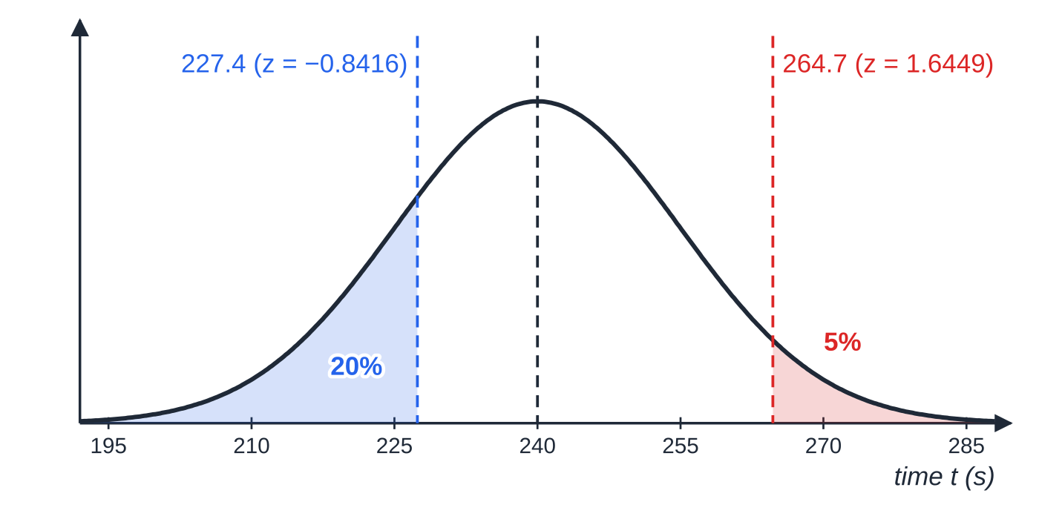
How do you find a value from a probability? (continued)
Section 5 of 12 · Worked example 4 · Medium · Find
WORKED EXAMPLE · QUESTION
The time T seconds for a kettle to boil a full load of water is modelled by T~N(240,15²). Find (a) the time exceeded by 5% of boils, (b) the time below which 20% of boils finish, (c) the limits of the middle 95% of times, symmetrical about the mean.
SOLUTION
(a) Upper 5% point from the percentage points table, p=0.05: (t-240)/15=1.6449⇒t=240+1.6449×15=264.67= 264.7 s
The upper 5% point is 1.6449 standard deviations above the mean; the lower 20% point is 0.8416 standard deviations below it, so its z-value is negative.
Notes:
How do you find a value from a probability?: Worked example 4. Full notes: https://examinerprep.com/notes/edexcel-ial-maths/the-normal-distribution/

Slide 23
How do you find a value from a probability? (continued)
Section 5 of 12 · Worked example 4 · Medium · Find (continued)
(b) 20% below means 20% of the area is to the left, so z is negative. The table gives 0.8416 for p=0.2: (t-240)/15=-0.8416⇒t=240-0.8416×15=227.38= 227.4 s
(c) The middle 95% leaves 2.5% in each tail; p=0.025 gives z=1.9600. So 240±1.96×15, giving 210.6 s to 269.4 s
Notes:
How do you find a value from a probability?: Worked example 4. Full notes: https://examinerprep.com/notes/edexcel-ial-maths/the-normal-distribution/

Slide 24
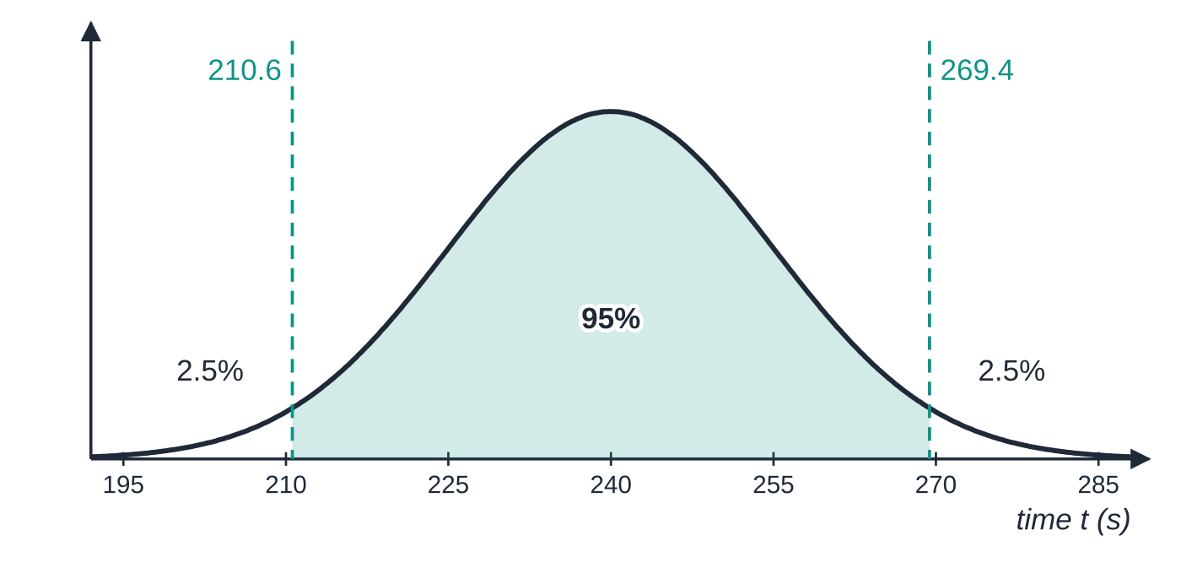
How do you find a value from a probability? (continued)
Section 5 of 12
Exam tip — decide the sign first
Write the equation in the form (x-μ)/σ=z with the sign of z already decided, then solve. A quick check: if the value you find is on the wrong side of the mean for the area you shaded, the sign of z is wrong.
Part (c): a symmetrical middle 95% leaves 2.5% in each tail, so the limits are μ±1.96σ.
Notes:
How do you find a value from a probability?. Full notes: https://examinerprep.com/notes/edexcel-ial-maths/the-normal-distribution/

Slide 25
How do you find an unknown mean or standard deviation?
Section 6 of 12
A statement such as P(X>92)=0.0228 tells you how far 92 is from the mean in standard deviations: it gives the z-value of 92. Writing (92-μ)/σ=z gives one equation, and one equation is enough for one unknown.
Two habits make this reliable. First, turn the given probability into "area to the left" before reading the Φ table in reverse: P(X>92)=0.0228 means Φ(z)=0.9772. Second, check whether the probability is in the percentage points table (0.1, 0.05, 0.01, …): if it is, use that exact z-value.
Notes:
How do you find an unknown mean or standard deviation?. Full notes: https://examinerprep.com/notes/edexcel-ial-maths/the-normal-distribution/

Slide 26
How do you find an unknown mean or standard deviation? (continued)
Section 6 of 12 · Worked example 5 · Medium · Find
WORKED EXAMPLE · QUESTION
The random variable X~N(80,σ²). Given that P(X>92)=0.0228, find (a) the value of σ, (b) P(X<74).
SOLUTION
(a) The area to the left of 92 is 1-0.0228=0.9772. Reading the Φ table in reverse, Φ(z)=0.9772⇒z=2.00. So (92-80)/σ=2.00⇒ σ=6
(b) Standardise with the value just found: P(Z<(74-80)/6)=P(Z<-1)=1-0.8413=0.1587= 0.159 (3 s.f.)
Notes:
How do you find an unknown mean or standard deviation?: Worked example 5. Full notes: https://examinerprep.com/notes/edexcel-ial-maths/the-normal-distribution/

Slide 27
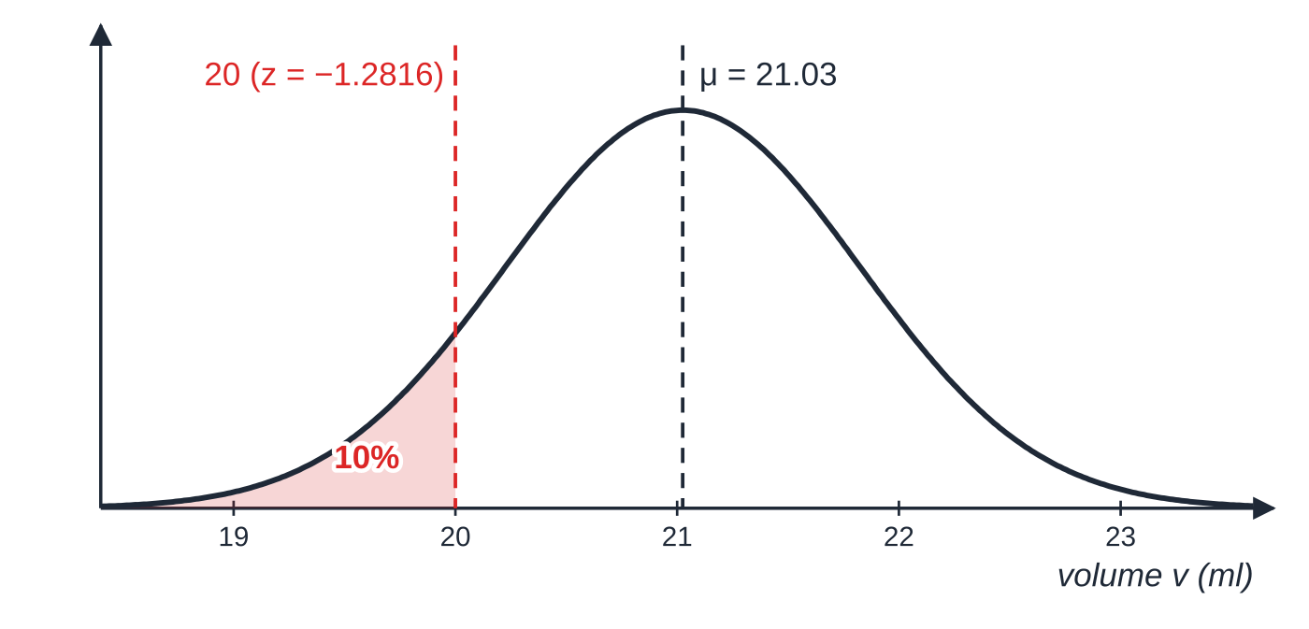
How do you find an unknown mean or standard deviation? (continued)
Section 6 of 12 · Worked example 6 · Medium · Find
WORKED EXAMPLE · QUESTION
The volume of liquid in a small bottle is V ml, where V~N(μ,0.8²). Exactly 10% of bottles contain less than 20 ml. Find μ.
SOLUTION
10% is below 20 ml, so 20 is below the mean and its z-value is negative. Percentage points table, p=0.1: (20-μ)/0.8=-1.2816.
Solve: μ=20+1.2816×0.8=21.02528= 21.03 ml (4 s.f.)
Only 10% of bottles are below 20 ml, so 20 is in the lower tail and the mean must be above 20.
Notes:
How do you find an unknown mean or standard deviation?: Worked example 6. Full notes: https://examinerprep.com/notes/edexcel-ial-maths/the-normal-distribution/

Slide 28
How do you find an unknown mean or standard deviation? (continued)
Section 6 of 12 · Worked example 6 · Medium · Find (continued)
Check: the mean is above 20 ml, as it must be when only 10% of bottles are below 20 ml.
Notes:
How do you find an unknown mean or standard deviation?: Worked example 6. Full notes: https://examinerprep.com/notes/edexcel-ial-maths/the-normal-distribution/

Slide 29
How do you find an unknown mean or standard deviation? (continued)
Section 6 of 12
Common error — the sign of z
Writing (20-μ)/0.8=+1.2816 and getting μ=18.97, below 20. Then 90% of bottles would be below 20 ml, not 10%. The sign of z comes from the sketch.
Notes:
How do you find an unknown mean or standard deviation?. Full notes: https://examinerprep.com/notes/edexcel-ial-maths/the-normal-distribution/

Slide 30
How do you find the mean and the standard deviation together?
Section 7 of 12
With two unknowns you need two probability statements. Each one gives an equation of the form x-μ=zσ. Write both as
μ+z₁σ=x₁, μ+z₂σ=x₂,
then subtract to eliminate μ: σ=(x₂-x₁)/(z₂-z₁). There is a nice way to see this: the gap between the two values, measured in standard deviations, is z₂-z₁, and the same gap in the units of x is x₂-x₁. Dividing one by the other gives the size of one standard deviation.
Always check the result: σ must come out positive, and μ should lie on the correct side of each given value.
Notes:
How do you find the mean and the standard deviation together?. Full notes: https://examinerprep.com/notes/edexcel-ial-maths/the-normal-distribution/

Slide 31
How do you find the mean and the standard deviation together? (continued)
Section 7 of 12 · Worked example 7 · Medium · Find
WORKED EXAMPLE · QUESTION
The length L cm of a leaf from a species of shrub is modelled by a Normal distribution. 30% of leaves are shorter than 17 cm and 10% are longer than 25 cm. Find the mean and the standard deviation of L.
SOLUTION
Both probabilities are in the percentage points table. 17 is in the lower tail, so its z is negative:
(17-μ)/σ=-0.5244, (25-μ)/σ=1.2816.
Rearrange and subtract: μ-0.5244σ=17 and μ+1.2816σ=25, so 1.8060σ=8.
σ=4.43 cm, μ=17+0.5244×4.4297…=19.3 cm (3 s.f.)
Keep the unrounded σ=4.4297… in the calculator when finding μ.
Notes:
How do you find the mean and the standard deviation together?: Worked example 7. Full notes: https://examinerprep.com/notes/edexcel-ial-maths/the-normal-distribution/

Slide 32
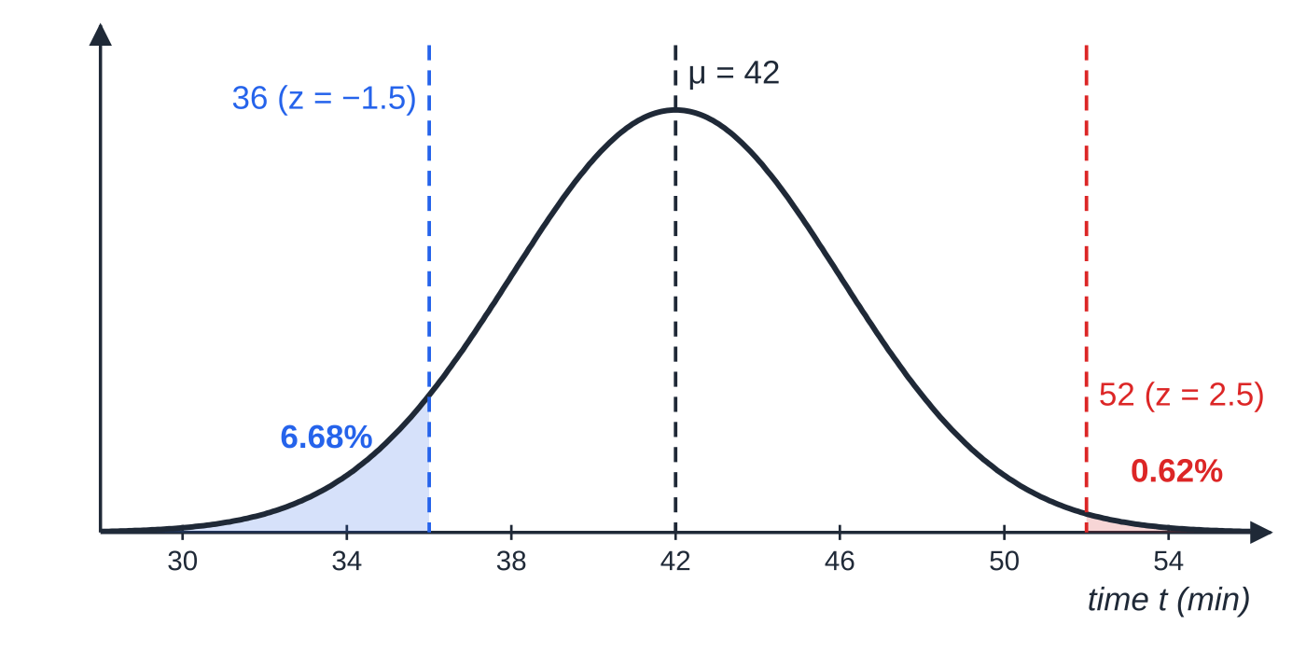
How do you find the mean and the standard deviation together? (continued)
Section 7 of 12 · Worked example 8 · Hard · Show that, find
WORKED EXAMPLE · QUESTION
The time T minutes for a ferry crossing is modelled by a Normal distribution with mean μ and standard deviation σ. Records show that 6.68% of crossings take less than 36 minutes and 0.62% take more than 52 minutes. (a) Show that σ=4 and find μ. (b) Find P(40<T<48). (c) A crossing has already lasted 44 minutes. Find the probability that it lasts more than 48 minutes. (d) The operator wants to state a time that 99% of crossings finish within. Find this time.
The two given tails fix both z-values. The values 36 and 52 are 16 minutes apart and their z-values differ by 4, so σ=16÷4=4 and μ=42.
Notes:
How do you find the mean and the standard deviation together?: Worked example 8. Full notes: https://examinerprep.com/notes/edexcel-ial-maths/the-normal-distribution/

Slide 33
How do you find the mean and the standard deviation together? (continued)
Section 7 of 12 · Worked example 8 · Hard · Show that, find (continued)
SOLUTION
(a) Turn both statements into areas to the left and read the Φ table in reverse. Φ(z)=1-0.0668=0.9332⇒z=1.50; 36 is in the lower tail, so its z-value is -1.50. Φ(z)=1-0.0062=0.9938⇒z=2.50 for 52. Two equations: μ-1.5σ=36 and μ+2.5σ=52. Subtract: 4σ=16, so σ=4, μ=42
(b) Standardise both ends: P(-0.5<Z<1.5)=0.9332-(1-0.6915)=0.6247= 0.625 (3 s.f.)
(c) Conditional probability; more than 48 already implies more than 44:
P(T>48|T>44)=(P(T>48))/(P(T>44))=(1-Φ(1.5))/(1-Φ(0.5))=(0.0668/0.3085)=
0.217 (3 s.f.)
Notes:
How do you find the mean and the standard deviation together?: Worked example 8. Full notes: https://examinerprep.com/notes/edexcel-ial-maths/the-normal-distribution/

Slide 34
How do you find the mean and the standard deviation together? (continued)
Section 7 of 12 · Worked example 8 · Hard · Show that, find (continued)
(d) 1% above the stated time, so p=0.01 in the percentage points table: t=42+2.3263×4=51.31= 51.3 minutes
In part (a) the result is printed, so the working has to be complete: both z-values with their signs, both equations, and the solution.
Notes:
How do you find the mean and the standard deviation together?: Worked example 8. Full notes: https://examinerprep.com/notes/edexcel-ial-maths/the-normal-distribution/

Slide 35
How do you find the mean and the standard deviation together? (continued)
Section 7 of 12
Exam tip — show the look-up
When the probability given is not one of the percentage points, write down the table value you used and the z you read: "Φ(z)=0.9938, z=2.50". Showing the look-up is part of the method.
Notes:
How do you find the mean and the standard deviation together?. Full notes: https://examinerprep.com/notes/edexcel-ial-maths/the-normal-distribution/

Slide 36
Exam tips for S1.6
Section 8 of 12
Exam tip 1 — sketch before you calculate
A small bell curve with the mean marked and the required area shaded takes seconds and settles the two decisions where slips happen: "Φ or 1-Φ?" and "is z positive or negative?".
Exam tip 2 — show the standardising line
Write P(X>33)=P(Z>(33-30)/2.5) with the numbers substituted, then quote the table value to 4 d.p. If a later step goes wrong, this line still shows the method.
Exam tip 3 — use the percentage points table when you can
For probabilities such as 0.1, 0.05, 0.025 and 0.01, the percentage points table gives z to 4 d.p. (1.2816, 1.6449, 1.9600, 2.3263). Reading the Φ table backwards for these gives a less accurate z.
Notes:
Exam tips for S1.6. Full notes: https://examinerprep.com/notes/edexcel-ial-maths/the-normal-distribution/

Slide 37
Exam tips for S1.6 (continued)
Section 8 of 12
Exam tip 4 — standard deviation, not variance
Before you standardise, write σ=… on its own. N(μ,25) has σ=5; N(μ,5²) is the same distribution.
Exam tip 5 — sense-check every answer
A probability must lie between 0 and 1; a tail beyond z=2 is small (about 0.02); a value with more than half the distribution below it lies above the mean. A value of σ you find must be positive.
Notes:
Exam tips for S1.6. Full notes: https://examinerprep.com/notes/edexcel-ial-maths/the-normal-distribution/

Slide 38
Common misconceptions
Section 9 of 12
Misconception | Why it is wrong | Correct idea
In N(50,16) the standard deviation is 16. | The second parameter is the variance. | σ=√16=4.
Φ(-1.2) can be read from the table. | The table only lists z≥0. | Φ(-1.2)=1-Φ(1.2), by symmetry.
P(X≤33) is different from P(X<33). | X is continuous, so P(X=33)=0. | The two are equal; no continuity correction is needed in S1.
The percentage points table gives the area to the left of z. | It gives the probability above z. | P(Z>z)=p; for a lower-tail value use -z.
A z-value is a probability. | z is a number of standard deviations and can be negative or bigger than 1. | The probability is the area Φ(z), between 0 and 1.
Two probabilities are needed to find μ when σ is known. | One equation is enough for one unknown. | One probability per unknown: one for μ or σ, two for both.
Notes:
Common misconceptions. Full notes: https://examinerprep.com/notes/edexcel-ial-maths/the-normal-distribution/

Slide 39
How this topic connects
Section 10 of 12
S1 probability and discrete random variables
Conditional probability, "at least one" and independent repeats all reappear here, applied to Normal areas. The mean and variance of a Normal variable mean the same as E(X) and Var(X) for a discrete one.
S2 approximations and hypothesis tests
In S2 the Normal distribution approximates the binomial and the Poisson distributions for large parameters, with a continuity correction (S2.3), and is used to carry out the tests that follow (S2.4). The formula for the Normal probability density function is not needed in S1, and neither are continuous random variables defined by a density function (S2.2).
P1 transformations of graphs
Notes:
How this topic connects. Full notes: https://examinerprep.com/notes/edexcel-ial-maths/the-normal-distribution/

Slide 40
How this topic connects (continued)
Section 10 of 12
X=μ+σZ corresponds to a stretch of the standard curve by factor σ parallel to the x-axis (with a stretch by factor 1/σ parallel to the y-axis, so the area stays 1) followed by a translation of μ — the change of shape seen in the second figure. In IAL Physics practical work, repeated readings scatter roughly symmetrically about a central value, which is why their mean is taken as the best estimate.
Notes:
How this topic connects. Full notes: https://examinerprep.com/notes/edexcel-ial-maths/the-normal-distribution/

Slide 41
Key formulae
Section 11 of 12
Formula | Use | In the formulae list?
X~N(μ,σ²) | notation: mean μ, variance σ² | No – learn it
Z=(X-μ)/σ, Z~N(0,1²) | standardising any Normal variable | No – learn it
Φ(z)=P(Z<z) | cumulative probabilities for z≥0 | Yes (table)
P(Z>z)=p | percentage points: the z-value for a given upper-tail probability | Yes (table)
Φ(-z)=1-Φ(z), P(Z>z)=1-Φ(z) | negative z and upper tails | No – derive it (symmetry)
P(a<X<b)=Φ(z_b)-Φ(zₐ) | probability between two values | No – derive it
x=μ+zσ | value from a probability; equations for unknown μ, σ | No – derive it
P(A|B)=P(A∩B)/P(B) | conditional probabilities with Normal tails | Yes
Notes:
Key formulae. Full notes: https://examinerprep.com/notes/edexcel-ial-maths/the-normal-distribution/

Slide 42
Check your understanding
Section 12 of 12
1. X~N(50,16). State the standard deviation of X and the value of P(X>50).
2. Find P(Z>-1.15).
3. X~N(12,0.5²). Find P(X<11.3).
4. Find the value of a such that P(Z<a)=0.01.
5. X~N(μ,5²) and P(X<70)=0.9. Find μ.
6. IQ-style test scores are modelled by X~N(100,15²). Find the proportion of scores above 120.
Notes:
Check your understanding: questions. Full notes: https://examinerprep.com/notes/edexcel-ial-maths/the-normal-distribution/

Slide 43
Check your understanding · answers
Section 12 of 12
1. σ=√16=4. The curve is symmetrical about the mean 50, so P(X>50)=0.5.
2. By symmetry, P(Z>-1.15)=P(Z<1.15)=Φ(1.15)=0.8749.
3. z=(11.3-12)/0.5=-1.4, so P=1-Φ(1.4)=1-0.9192=0.0808.
4. Only 1% is below a, so a is negative. The percentage points table gives 2.3263 for p=0.01, so a=-2.3263.
5. 10% is above 70, so (70-μ)/5=1.2816 and μ=70-6.408=63.6 (3 s.f.).
6. z=(120-100)/15=1.333…, which rounds to 1.33 for the table. P(X>120)=1-Φ(1.33)=1-0.9082=0.0918 (3 s.f.). A calculator gives 0.0912; either is acceptable as a table/calculator value.
Notes:
Check your understanding: answers. Full notes: https://examinerprep.com/notes/edexcel-ial-maths/the-normal-distribution/

Slide 44
Practice questions
2 original exam-style questions. Answers at the end of the deck.

Slide 45
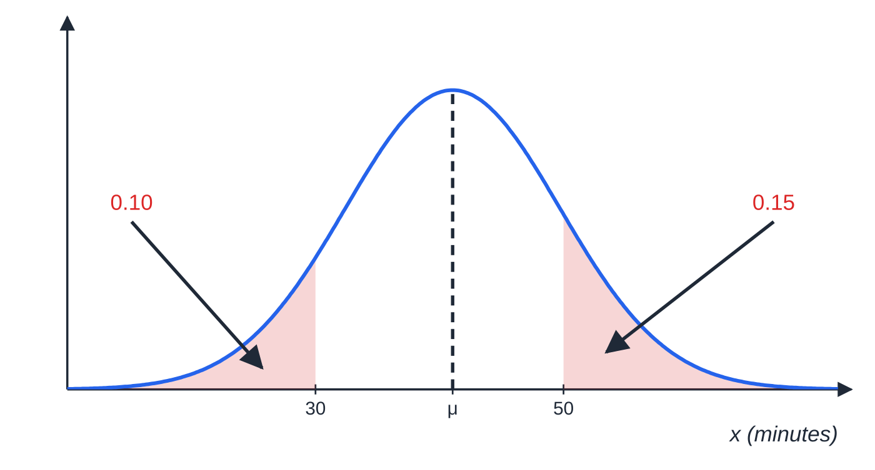
Question 1
8 marks
The time, X minutes, taken by adults to complete a logic puzzle is modelled by a Normal distribution with mean μ and standard deviation σ. 15% of adults take longer than 50 minutes and 10% take less than 30 minutes.
Figure: X ~ N(μ, σ²) with the two given tail areas shaded; not to scale
(a) Write down two equations in μ and σ. [2]
(b) Find the values of μ and σ. [4]
(c) Find the probability that a randomly chosen adult takes less than 40 minutes. [2]
Notes:
Online with the full mark scheme: https://examinerprep.com/ial-maths-s1-6-the-normal-distribution-questions#IALM-S1-6-B-07

Slide 46
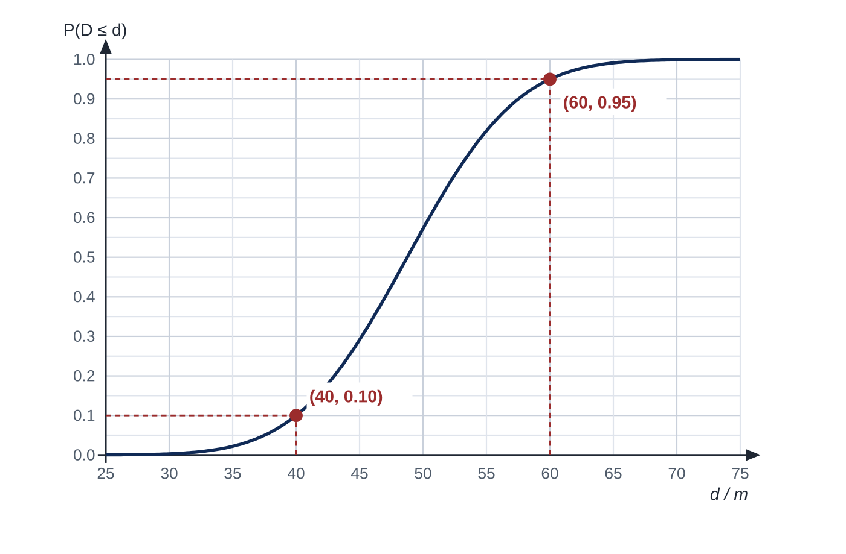
Question 2
9 marks
The distance, D metres, that a club athlete throws a javelin is modelled by a Normal distribution with mean μ and standard deviation σ. Figure 1 shows the graph of P(D ≤ d) against d for this model. Two points on the curve are marked.
(a) Use the two marked points to write down two equations in μ and σ. [2]
(b) Find the values of μ and σ. [4]
(c) Find the probability that a throw is longer than 50 m. [2]
(d) Use Figure 1 to estimate the median throw, and explain why it should be close to your value of μ. [1]
Notes:
Online with the full mark scheme: https://examinerprep.com/ial-maths-s1-6-the-normal-distribution-questions#IALM-S1-6-FB-05

Slide 47
Answers

Slide 48
Question 1 · answer
Mark scheme
(50 − μ)/σ = 1.0364
(30 − μ)/σ = −1.2816
subtracts to eliminate μ: 20 = 2.318σ
σ = 8.628… = 8.63 (3 s.f.)
substitutes back, e.g. μ = 50 − 1.0364 × 8.628
μ = 41.06… = 41.1 (3 s.f.)
P(Z < (40 − 41.06)/8.628) = P(Z < −0.12) ft on their μ, σ
1 − 0.5478 = 0.4522 (awrt 0.451 or 0.452)
Notes:
Full mark scheme: https://examinerprep.com/ial-maths-s1-6-the-normal-distribution-questions#IALM-S1-6-B-07

Slide 49
Question 2 · answer
Mark scheme
(40 − μ)/σ = −1.2816
(60 − μ)/σ = 1.6449
subtracts to eliminate μ: 20 = 2.9265σ
σ = 6.834… = 6.83 (3 s.f.)
substitutes back, e.g. μ = 40 + 1.2816 × 6.834
μ = 48.76… = 48.8 (3 s.f.)
P(Z > (50 − 48.76)/6.834) = P(Z > 0.18) ft
1 − 0.5714 = 0.4286 (awrt 0.428 or 0.429)
Notes:
Full mark scheme: https://examinerprep.com/ial-maths-s1-6-the-normal-distribution-questions#IALM-S1-6-FB-05

Slide 50
Keep practising
Notes for this topic
Questions on this topic
Build a printable test
ExaminerPrep is an independent tutoring service. It has been developed independently from and is not endorsed by the International Baccalaureate Organization. "International Baccalaureate", "IB" and "IB Diploma Programme" are registered trademarks of the IBO, used here for descriptive purposes only.
Pearson Edexcel and Cambridge are trademarks of their owners; ExaminerPrep is not affiliated with any exam board.

