Slide 1
EP
EDEXCEL IAL MATHS
P2.6 Trigonometric identities and equations
The full notes page in 13 sections · practice questions with answers · simulations
ExaminerPrep is an independent tutoring service. It has been developed independently from and is not endorsed by the International Baccalaureate Organization. "International Baccalaureate", "IB" and "IB Diploma Programme" are registered trademarks of the IBO, used here for descriptive purposes only.
Pearson Edexcel and Cambridge are trademarks of their owners; ExaminerPrep is not affiliated with any exam board.
Notes:
P2.6 Trigonometric identities and equations. Notes for this topic: https://examinerprep.com/notes/edexcel-ial-maths/trigonometric-identities-and-equations/

Slide 2
What this page covers
Overview
The identities tan θ≡sin θ/cos θ and sin²θ+ cos²θ≡1: where they come from and how to rearrange them
Exact values of sin, cos and tan from one given ratio and the quadrant of the angle
Proving simple identities by working from one side to the other
Solving sin θ= k, cos θ= k and tan θ= k in a given interval, in degrees or radians
Equations containing both sin and cos: dividing to get tan, and factorising instead of cancelling
Equations of the form sin(nθ+ α) = k and the cos and tan versions
Quadratic equations in sin θ, cos θ or tan θ, including those that need sin²θ+ cos²θ= 1 first
Notes:
What this page covers. Full notes: https://examinerprep.com/notes/edexcel-ial-maths/trigonometric-identities-and-equations/

Slide 3
In one minute
Key points
1. The two identities tan θ≡sin θ/cos θ and sin²θ+ cos²θ≡1 let you write any expression in terms of one function, and the symmetry of the sine, cosine and tangent graphs turns the calculator's single answer into every solution in an interval.
2. To prove an identity, start from one side and transform it, step by step, into the other. Never work on both sides at once.
3. sin θ= k: α and 180° - α. cos θ= k: α and 360° - α (or -α). tan θ= k: α and α+ 180°. Then add or subtract 360° (or 2π) until you leave the interval.
4. For sin(nθ+ α) = k, change the interval first: if 0 ≤θ< 360°, then α≤nθ+ α< 360n° + α. Solve for the whole bracket, then convert back.
5. Never divide both sides by sin θ or cos θ: factorise, or you lose the solutions where that factor is zero.
Notes:
In one minute. Full notes: https://examinerprep.com/notes/edexcel-ial-maths/trigonometric-identities-and-equations/

Slide 4
In one minute (continued)
Key points
6. A quadratic in sin or cos can give impossible roots: sin θ= 2 or cos θ= -3 has no solutions, because -1 ≤sin θ, cos θ≤1.
Notes:
In one minute. Full notes: https://examinerprep.com/notes/edexcel-ial-maths/trigonometric-identities-and-equations/

Slide 5
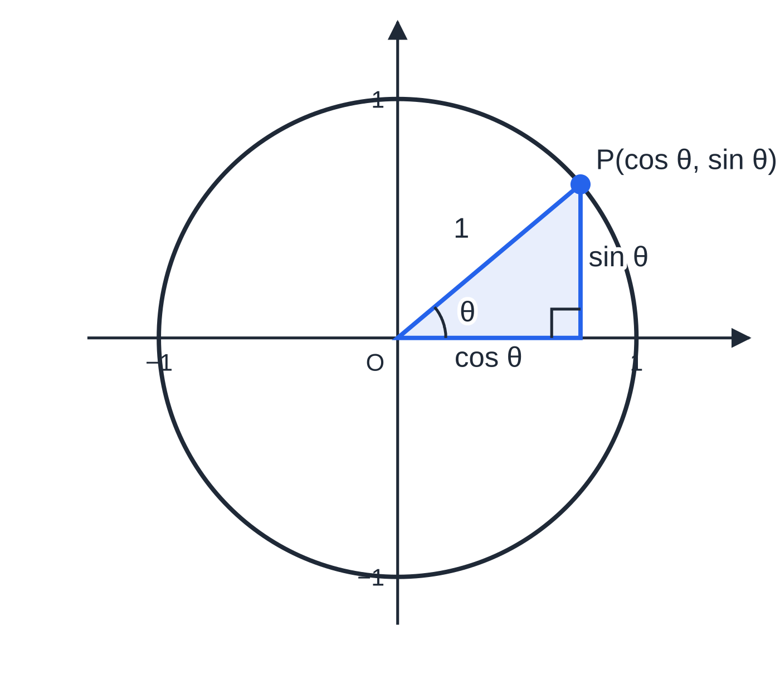
Where do the two identities come from?
Section 1 of 13
Draw a circle of radius 1 centred at the origin. A radius turned through an angle θ anticlockwise from the positive x-axis meets the circle at a point P. For any angle, cos θ is defined as the x-coordinate of P and sin θ as its y-coordinate. For acute angles this agrees with SOH CAH TOA, because the hypotenuse is 1; for larger angles it is what extends sin and cos to every angle.
Pythagoras. P is 1 unit from O, so x² + y² = 1, which is sin²θ+ cos²θ≡1. Here sin²θ means (sin θ)².
Gradient. The gradient of OP is y/x, which is the definition of tan θ, so tan θ≡sin θ/cos θ. It is undefined where cos θ= 0 (at 90°, 270°, …).
The sign ≡ means "identically equal": true for every value of θ, not just for particular solutions.
The point P on a unit circle has coordinates (cos θ, sin θ). The shaded right-angled triangle has hypotenuse 1, so sin²θ + cos²θ = 1; the gradient of OP is sin θ ÷ cos θ = tan θ. For θ = 40°: 0.766² + 0.643² = 1 to the accuracy shown.
Notes:
Where do the two identities come from?. Full notes: https://examinerprep.com/notes/edexcel-ial-maths/trigonometric-identities-and-equations/

Slide 6
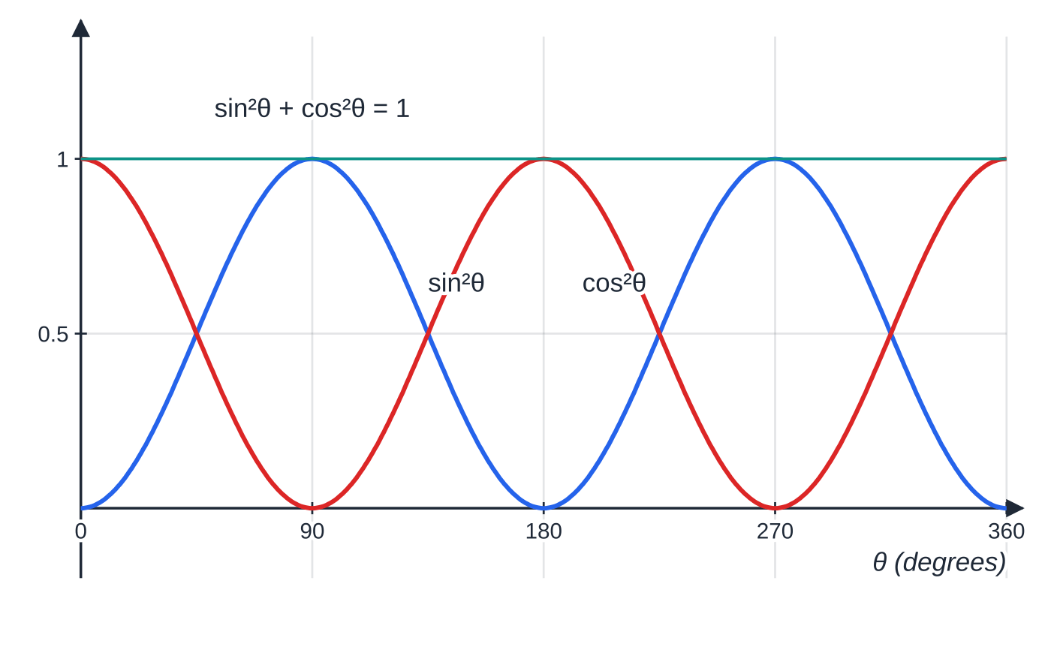
Where do the two identities come from? (continued)
Section 1 of 13
The Pythagorean identity rearranges into two forms that you will use constantly: sin²θ≡1 - cos²θ and cos²θ≡1 - sin²θ.
The two identities
(not in the formulae booklet: learn both, and both rearrangements of the second):
tan θ≡sin θ/cos θ sin²θ+ cos²θ≡1
Valid for every angle in degrees or radians; the first needs cos θ≠0.
sin²θ (blue) and cos²θ (red) rise and fall in opposite ways: wherever one is large the other is small, and at every angle their sum is exactly 1 (the teal line).
Notes:
Where do the two identities come from?. Full notes: https://examinerprep.com/notes/edexcel-ial-maths/trigonometric-identities-and-equations/

Slide 7
How do I find exact values from one known ratio?
Section 2 of 13
If you know one ratio, sin²θ+ cos²θ= 1 gives the size of the other, and the quadrant of θ decides its sign. The signs follow from the unit circle: in the first quadrant (0° to 90°) all three are positive; in the second (90° to 180°) only sin is positive; in the third (180° to 270°) only tan; in the fourth (270° to 360°) only cos. Then tan θ= sin θ÷cos θ. "Exact" means surds and fractions, so rationalise the denominator if asked for simplest form.
Given tan θ= k instead, write sin θ= kcos θ and substitute into the Pythagorean identity. A right-angled triangle with opposite side k and adjacent side 1 is an equally good method, as long as you attach the signs afterwards.
Notes:
How do I find exact values from one known ratio?. Full notes: https://examinerprep.com/notes/edexcel-ial-maths/trigonometric-identities-and-equations/

Slide 8
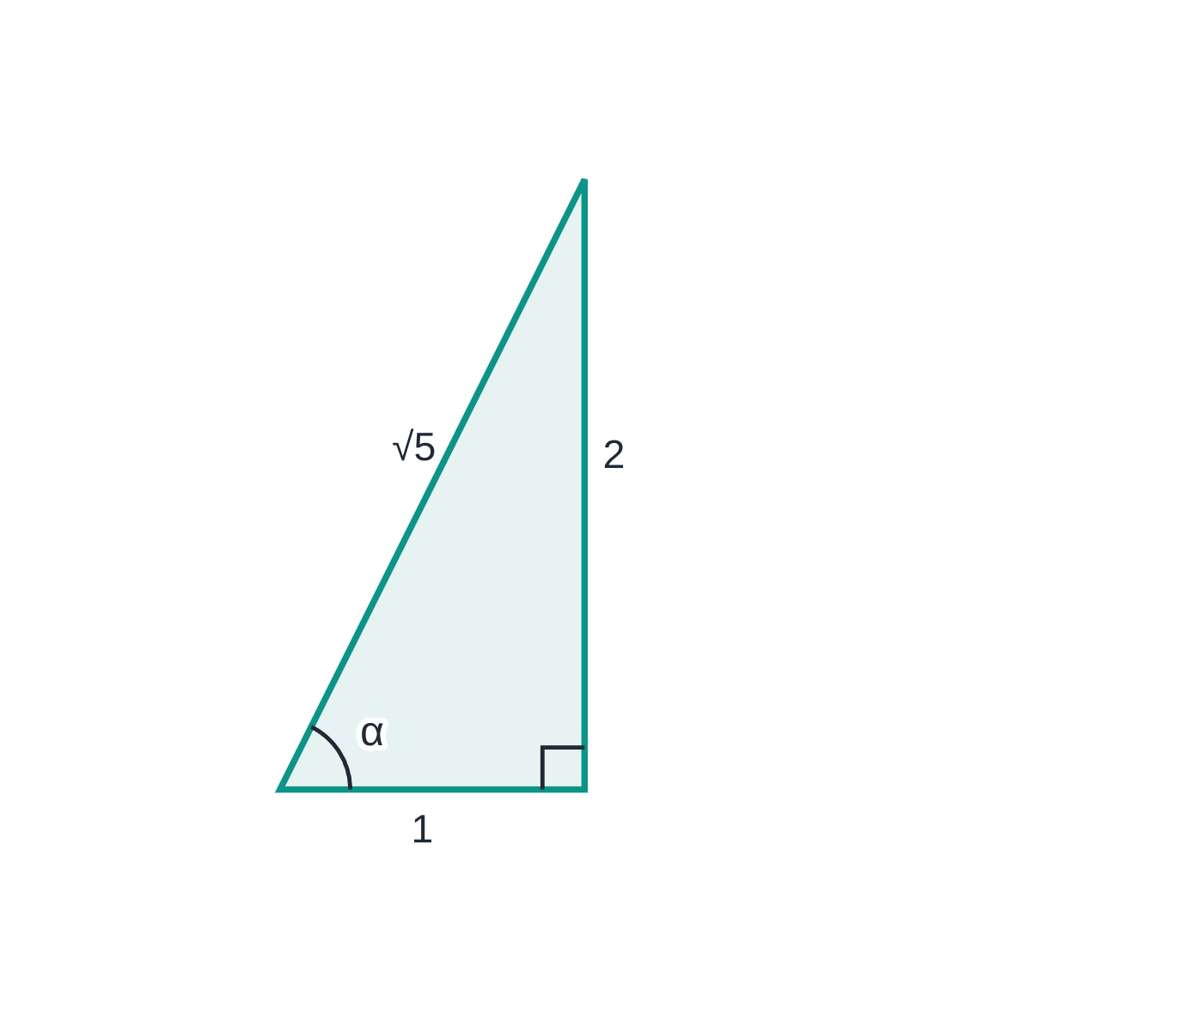
How do I find exact values from one known ratio? (continued)
Section 2 of 13 · Worked example 1 · Medium · Find
WORKED EXAMPLE · QUESTION
(a) Given that sin θ= (2/7) and that θ is obtuse, find the exact values of cos θ and tan θ. (b) Given that tan x = -2 and 270° < x < 360°, find the exact values of cos x and sin x.
SOLUTION
(a) cos²θ= 1 - sin²θ= 1 - (4/49) = (45/49), so cos θ= ±√45/7 = ±3√5/7. An obtuse angle is in the second quadrant, where cos is negative: cos θ= -3√5/7. Then tan θ= (2/7) ÷(-3√5/7) = -2/3√5 = -2√5/15. cos θ= -3√5/7, tan θ= -2√5/15
(b) sin x = -2cos x, substituted into the identity: 4cos² x + cos² x = 1, so cos² x = ⅕. In the fourth quadrant cos is positive and sin is negative. cos x = √5/5, sin x = -2√5/5
Part (b) with a triangle: tan α = 2 ÷ 1, so the hypotenuse is √(1² + 2²) = √5. This gives the sizes cos α = 1/√5 and sin α = 2/√5; the fourth quadrant then makes sin negative.
Notes:
How do I find exact values from one known ratio?: Worked example 1. Full notes: https://examinerprep.com/notes/edexcel-ial-maths/trigonometric-identities-and-equations/

Slide 9
How do I find exact values from one known ratio? (continued)
Section 2 of 13 · Worked example 1 · Medium · Find (continued)
Check (b): sin x ÷cos x = -2 ✓, and (4/5) + ⅕ = 1 ✓.
Notes:
How do I find exact values from one known ratio?: Worked example 1. Full notes: https://examinerprep.com/notes/edexcel-ial-maths/trigonometric-identities-and-equations/

Slide 10
How do I prove a trigonometric identity?
Section 3 of 13
An identity is a statement that must be true for every angle, so checking one or two values proves nothing: they could agree by chance. A proof is a chain of equal expressions that starts at one side and ends at the other.
Start with the more complicated side and transform it into the other side. Write "LHS =" at the start and finish with "= RHS".
Useful first moves: replace tan θ with sin θ/cos θ; combine fractions over a common denominator; expand brackets; look for sin²θ+ cos²θ and replace it with 1.
Factorising helps too: a² - b² = (a - b)(a + b) is common with fourth powers.
Do not start from the statement you are trying to prove and manipulate both sides: that assumes the result.
Notes:
How do I prove a trigonometric identity?. Full notes: https://examinerprep.com/notes/edexcel-ial-maths/trigonometric-identities-and-equations/

Slide 11
How do I prove a trigonometric identity? (continued)
Section 3 of 13 · Worked example 2 · Medium · Prove
WORKED EXAMPLE · QUESTION
Prove that (a) (sin θ+ cos θ)² + (sin θ- cos θ)² ≡2; (b) tan θ+ 1/tan θ ≡1/sin θcos θ; (c) cos⁴θ- sin⁴θ≡2cos²θ- 1.
SOLUTION
(a) Expand both squares from the LHS: (sin²θ+ 2sin θcos θ+ cos²θ) + (sin²θ- 2sin θcos θ+ cos²θ) = 2(sin²θ+ cos²θ) = 2 ×1 = 2. = RHS
(b) Write tan in terms of sin and cos, then use a common denominator:
LHS = sin θ/cos θ + cos θ/sin θ = (sin²θ+ cos²θ)/sin θcos θ = 1/sin θcos θ
= RHS
(c) Difference of two squares: LHS = (cos²θ- sin²θ)(cos²θ+ sin²θ) = cos²θ- sin²θ.
Notes:
How do I prove a trigonometric identity?: Worked example 2. Full notes: https://examinerprep.com/notes/edexcel-ial-maths/trigonometric-identities-and-equations/

Slide 12
How do I prove a trigonometric identity? (continued)
Section 3 of 13 · Worked example 2 · Medium · Prove (continued)
Replace sin²θ with 1 - cos²θ: cos²θ- (1 - cos²θ) = 2cos²θ- 1. = RHS
In (c) the bracket around 1 - cos²θ matters: subtracting it changes both signs.
Notes:
How do I prove a trigonometric identity?: Worked example 2. Full notes: https://examinerprep.com/notes/edexcel-ial-maths/trigonometric-identities-and-equations/

Slide 13
How do I prove a trigonometric identity? (continued)
Section 3 of 13
Common error
Writing sin²θ+ cos²θ= 1 as sin θ+ cos θ= 1. Square roots do not split over addition: at θ= 45° the left side is √2, not 1.
Notes:
How do I prove a trigonometric identity?. Full notes: https://examinerprep.com/notes/edexcel-ial-maths/trigonometric-identities-and-equations/

Slide 14
How do I find every solution of sin θ = k, cos θ = k or tan θ = k?
Section 4 of 13
The calculator's inverse function returns one angle, the principal value α: sin⁻¹ and tan⁻¹ give an angle from -90° to 90°, and cos⁻¹ gives one from 0° to 180°. That value may not even be in your interval. The graphs repeat and are symmetric, which gives a second angle in each cycle:
sin θ= k: α and 180° - α (the sine curve is symmetric about 90°).
cos θ= k: α and 360° - α, equivalently -α (the cosine curve is symmetric about 0°).
tan θ= k: α and α+ 180° (the tangent repeats every 180°).
Then add or subtract the period (360° for sin and cos, 180° for tan) until every solution in the interval has been listed. If |k| > 1, sin θ= k and cos θ= k have no solutions; tan θ= k always has solutions. Give degrees to 1 decimal place unless told otherwise, but carry the full calculator value through any later working.
Notes:
How do I find every solution of sin θ = k, cos θ = k or tan θ = k?. Full notes: https://examinerprep.com/notes/edexcel-ial-maths/trigonometric-identities-and-equations/

Slide 15
How do I find every solution of sin θ = k, cos θ = k or tan θ = k? (continued)
Section 4 of 13
θ | 0° | 30° | 45° | 60° | 90°
sin θ | 0 | ½ | √2/2 | √3/2 | 1
cos θ | 1 | √3/2 | √2/2 | ½ | 0
tan θ | 0 | √3/3 | 1 | √3 | undefined
These exact values must be known. In radians the angles are 0, π/6, π/4, π/3 and π/2.
Notes:
How do I find every solution of sin θ = k, cos θ = k or tan θ = k?. Full notes: https://examinerprep.com/notes/edexcel-ial-maths/trigonometric-identities-and-equations/

Slide 16
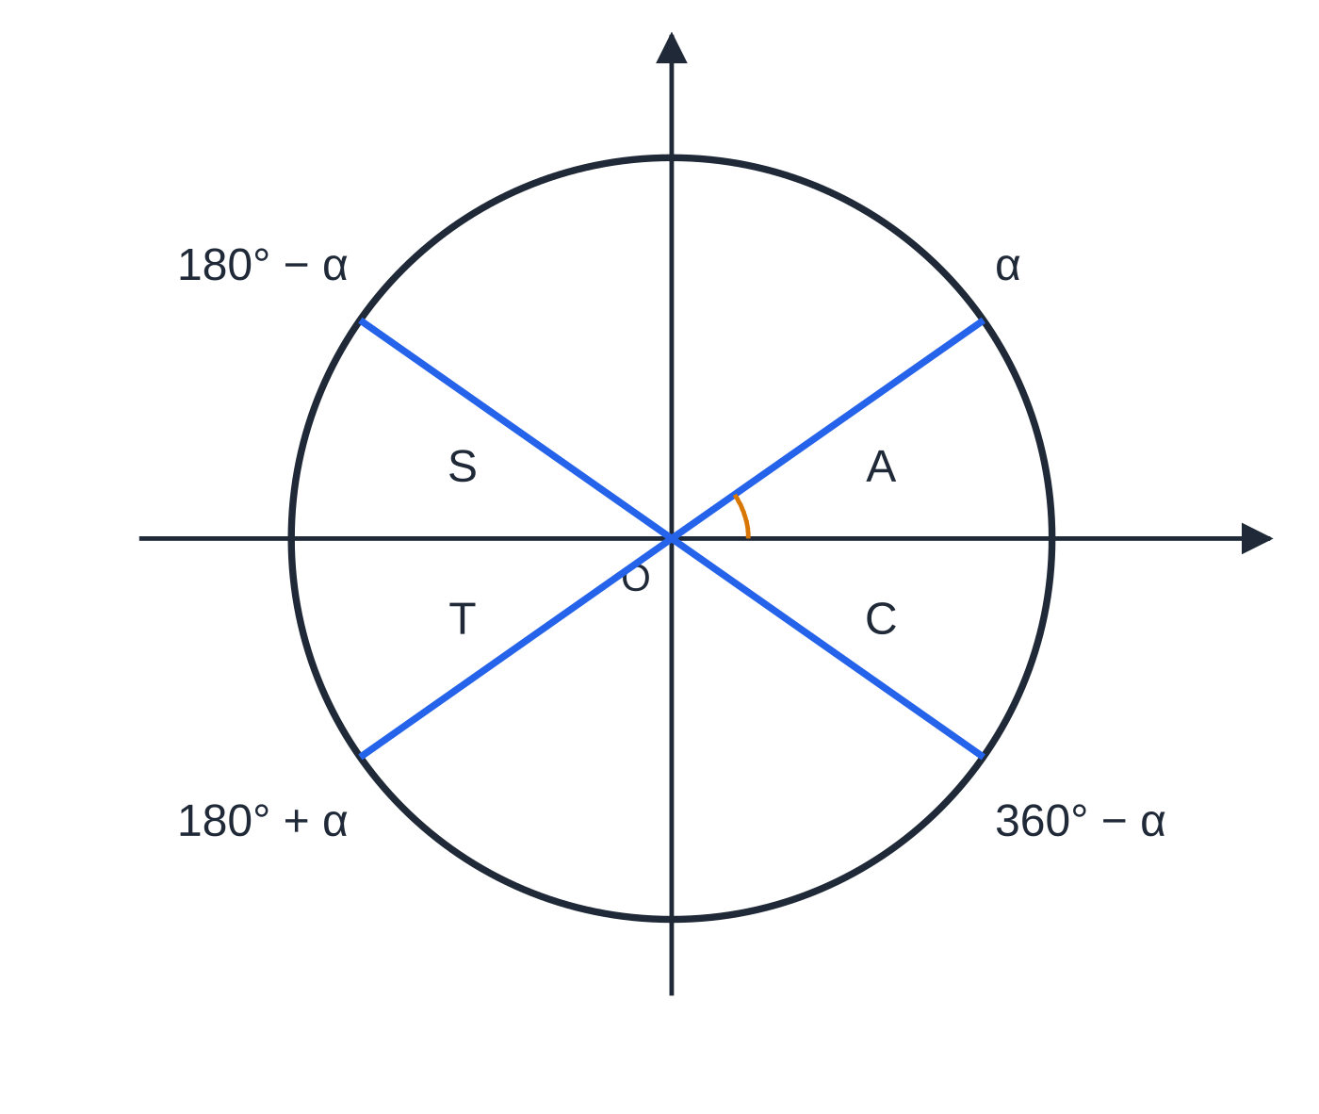
How do I find every solution of sin θ = k, cos θ = k or tan θ = k? (continued)
Section 4 of 13
The four angles α, 180° − α, 180° + α and 360° − α (drawn for α = 35°) all make the same acute angle with the x-axis, so sin, cos and tan have the same size at all four; only the signs change. A: all positive, S: sin, T: tan, C: cos.
Notes:
How do I find every solution of sin θ = k, cos θ = k or tan θ = k?. Full notes: https://examinerprep.com/notes/edexcel-ial-maths/trigonometric-identities-and-equations/

Slide 17
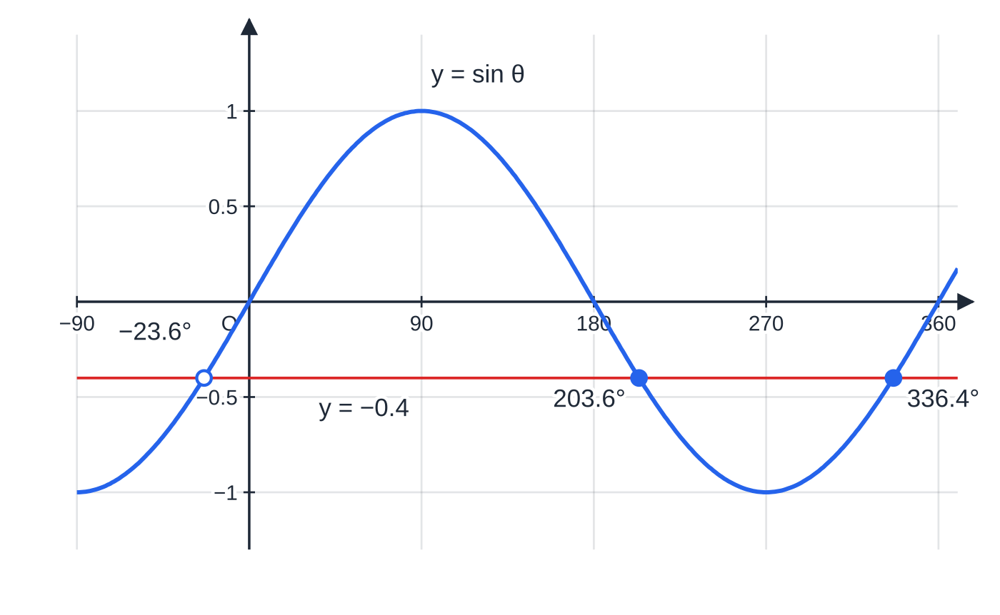
How do I find every solution of sin θ = k, cos θ = k or tan θ = k? (continued)
Section 4 of 13 · Worked example 3 · Easy · Solve
WORKED EXAMPLE · QUESTION
Solve, giving answers to 1 decimal place: (a) sin θ= -0.4 for 0° ≤θ< 360°; (b) cos θ= -0.65 for -180° ≤θ≤180°; (c) tan θ= 2.5 for -180° ≤θ≤180°.
(a) The calculator gives −23.6°, outside the interval (hollow dot). Symmetry gives 180° − (−23.6°) = 203.6°, and adding 360° to the calculator value gives 336.4°.
Notes:
How do I find every solution of sin θ = k, cos θ = k or tan θ = k?: Worked example 3. Full notes: https://examinerprep.com/notes/edexcel-ial-maths/trigonometric-identities-and-equations/

Slide 18
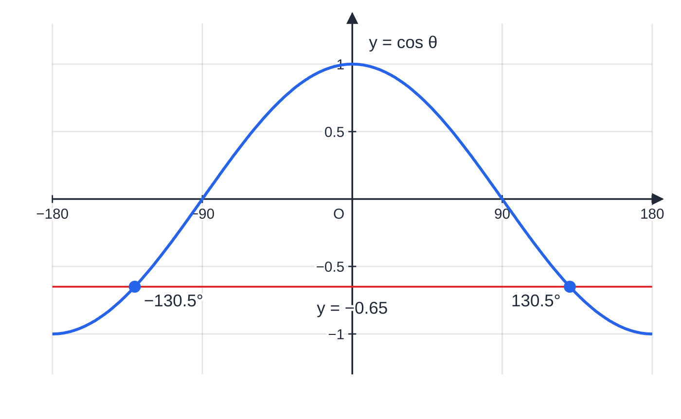
How do I find every solution of sin θ = k, cos θ = k or tan θ = k? (continued)
Section 4 of 13 · Worked example 3 · Easy · Solve (continued)
(b) The cosine curve is symmetric about the vertical axis, so the two solutions are ±130.5°.
Notes:
How do I find every solution of sin θ = k, cos θ = k or tan θ = k?: Worked example 3. Full notes: https://examinerprep.com/notes/edexcel-ial-maths/trigonometric-identities-and-equations/

Slide 19
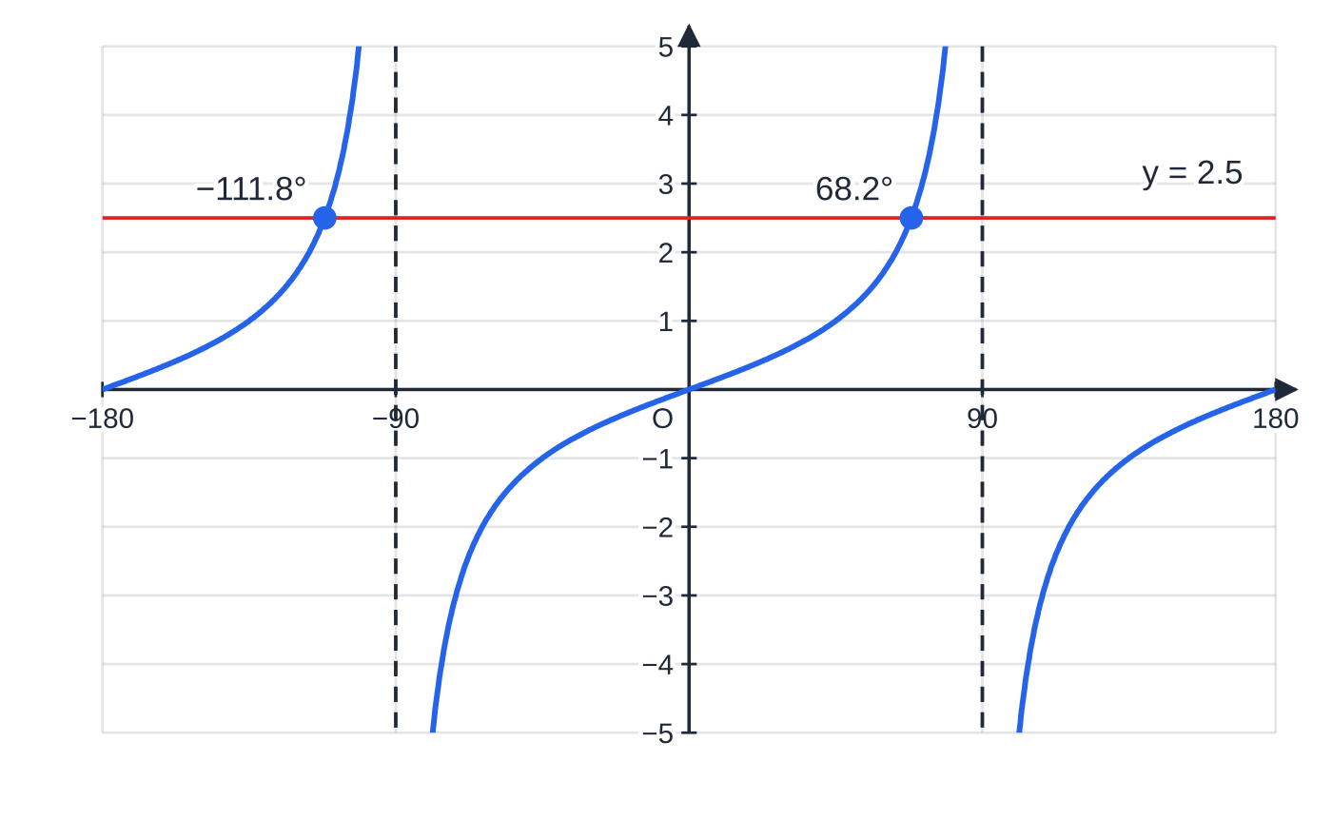
How do I find every solution of sin θ = k, cos θ = k or tan θ = k? (continued)
Section 4 of 13 · Worked example 3 · Easy · Solve (continued)
SOLUTION
(a) sin⁻¹(-0.4) = -23.58° (not in the interval). Then 180° - (-23.58°) = 203.58° and -23.58° + 360° = 336.42°. θ= 203.6° or 336.4°
(b) The cosine curve is symmetric about θ= 0°: cos⁻¹(-0.65) = 130.54°. θ= ±130.5°
(c) The tangent repeats every 180°: tan⁻¹(2.5) = 68.20°, and 68.20° - 180° = -111.80°. (68.2° + 180° = 248.2° is outside the interval.) θ= 68.2° or -111.8°
Check every answer by putting it back into the calculator.
(c) The tangent graph has period 180° and asymptotes where cos θ = 0 (dashed), so its two solutions in this interval are exactly 180° apart: 68.2° and −111.8°.
Notes:
How do I find every solution of sin θ = k, cos θ = k or tan θ = k?: Worked example 3. Full notes: https://examinerprep.com/notes/edexcel-ial-maths/trigonometric-identities-and-equations/

Slide 20
What do I do when an equation contains both sin and cos?
Section 5 of 13
There are three common shapes, and each has its own safe move.
Linear in both, such as asin θ= bcos θ: divide both sides by cos θ to get tan θ= b/a. This is safe, because cos θ= 0 would force sin θ= 0 as well, which never happens at the same angle.
A common factor, such as sin θcos θ= ksin θ: do not divide by sin θ. Bring everything to one side and factorise: sin θ(cos θ- k) = 0. Then solve each factor = 0.
Squares of one, first powers of the other: use sin²θ+ cos²θ= 1 to reach a quadratic in one function (see the last teaching section).
Notes:
What do I do when an equation contains both sin and cos?. Full notes: https://examinerprep.com/notes/edexcel-ial-maths/trigonometric-identities-and-equations/

Slide 21
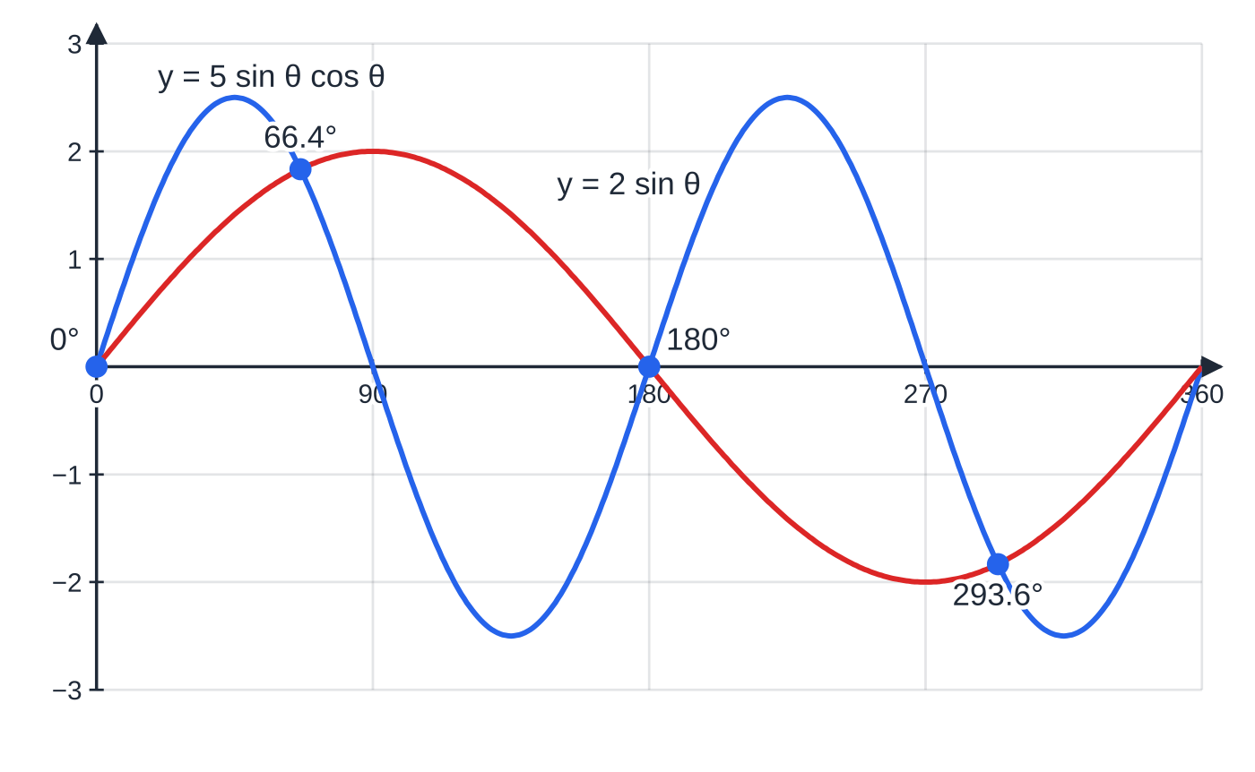
What do I do when an equation contains both sin and cos? (continued)
Section 5 of 13 · Worked example 4 · Medium · Solve
WORKED EXAMPLE · QUESTION
Solve, for 0° ≤θ< 360°, giving answers to 1 decimal place where appropriate: (a) 3sin θ+ 7cos θ= 0; (b) 5sin θcos θ= 2sin θ.
SOLUTION
(a) Rearrange and divide by cos θ: 3sin θ= -7cos θ⇒tan θ= -(7/3). Tan is negative in the second and fourth quadrants: tan⁻¹(-(7/3)) = -66.80°; add 180° and 360°. θ= 113.2° or 293.2°
(b) One side zero, then factorise: 5sin θcos θ- 2sin θ= 0 ⇒sin θ(5cos θ- 2) = 0.
(b) The two sides of the equation as graphs cross four times in 0° ≤ θ < 360°. The crossings at 0° and 180° are the sin θ = 0 solutions that cancelling would throw away.
Notes:
What do I do when an equation contains both sin and cos?: Worked example 4. Full notes: https://examinerprep.com/notes/edexcel-ial-maths/trigonometric-identities-and-equations/

Slide 22
What do I do when an equation contains both sin and cos? (continued)
Section 5 of 13 · Worked example 4 · Medium · Solve (continued)
Solve each factor: sin θ= 0 ⇒θ= 0°, 180°; cos θ= 0.4 ⇒θ= 66.42° or 360° - 66.42° = 293.58°. θ= 0°, 66.4°, 180°, 293.6°
Dividing (b) by sin θ would give only the two cos θ= 0.4 answers. 360° is excluded because the interval is 0° ≤θ< 360°.
Notes:
What do I do when an equation contains both sin and cos?: Worked example 4. Full notes: https://examinerprep.com/notes/edexcel-ial-maths/trigonometric-identities-and-equations/

Slide 23
How do I solve sin(nθ + α) = k in a given interval?
Section 6 of 13
Let u = nθ+ α. The graph of sin(nθ+ α) has period 360°/n, so there are about n times as many solutions in the interval as for sin θ= k. The method has three steps:
1. Transform the interval. Apply the same operations to the end points: 0° ≤θ< 360° becomes α≤u < 360n° + α.
2. Solve for u in the new interval exactly as before, adding 360° until you pass the upper limit (and checking below the lower limit too).
3. Convert back: θ= (u - α)/n for every value of u.
Changing the interval first is what stops you missing solutions; dividing by n at the end, using unrounded values, keeps the answers accurate.
Notes:
How do I solve sin(nθ + α) = k in a given interval?. Full notes: https://examinerprep.com/notes/edexcel-ial-maths/trigonometric-identities-and-equations/

Slide 24
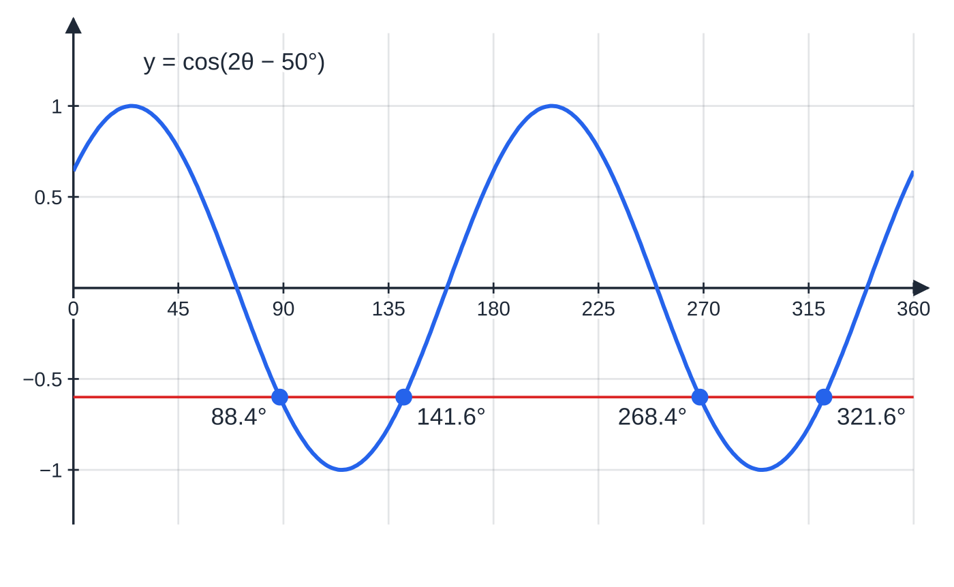
How do I solve sin(nθ + α) = k in a given interval? (continued)
Section 6 of 13 · Worked example 5 · Medium · Solve
WORKED EXAMPLE · QUESTION
Solve cos(2θ- 50°) = -0.6 for 0° ≤θ< 360°, giving your answers to 1 decimal place.
SOLUTION
New variable and interval: u = 2θ- 50°, so -50° ≤u < 670°.
Principal value and the symmetry of cos: cos⁻¹(-0.6) = 126.87°, and 360° - 126.87° = 233.13°. Add 360° to each while still below 670°: u = 126.87°, 233.13°, 486.87°, 593.13°. (-126.87° is below -50°, and 846.87° is above 670°, so neither is used.)
y = cos(2θ − 50°) has period 180°, so it completes two cycles between 0° and 360° and meets y = −0.6 four times.
Notes:
How do I solve sin(nθ + α) = k in a given interval?: Worked example 5. Full notes: https://examinerprep.com/notes/edexcel-ial-maths/trigonometric-identities-and-equations/

Slide 25
How do I solve sin(nθ + α) = k in a given interval? (continued)
Section 6 of 13 · Worked example 5 · Medium · Solve (continued)
Convert back with θ= (u + 50°)/2. θ= 88.4°, 141.6°, 268.4°, 321.6°
Four answers: two cycles of the curve, each crossing the line twice. Solutions for u differ by 360°, so the answers for θ come in pairs 180° apart.
Notes:
How do I solve sin(nθ + α) = k in a given interval?: Worked example 5. Full notes: https://examinerprep.com/notes/edexcel-ial-maths/trigonometric-identities-and-equations/

Slide 26
How does the same method work in radians?
Section 7 of 13
If the interval is written with π (such as 0 ≤x < 2π), the answers must be in radians, so set the calculator to radian mode. The rules are the same with 180° replaced by π: sin gives α and π- α; cos gives α and 2π- α; tan gives α and α+ π; the period of sin and cos is 2π.
Exact answers are multiples of π, from the exact-value table; other answers are usually given to 3 significant figures. For sin(nx + α) = k, transform the interval exactly as before. It helps to write the end points with a common denominator, e.g. π/4 ≤3x + π/4 ≤13π/4.
Notes:
How does the same method work in radians?. Full notes: https://examinerprep.com/notes/edexcel-ial-maths/trigonometric-identities-and-equations/

Slide 27
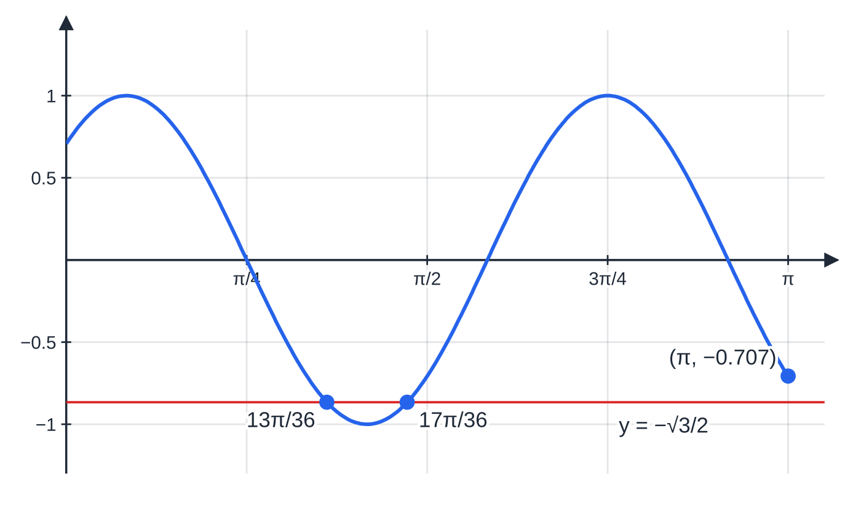
How does the same method work in radians? (continued)
Section 7 of 13 · Worked example 6 · Hard · Solve
WORKED EXAMPLE · QUESTION
(a) Solve sin(3x + π/4) = -√3/2 for 0 ≤x ≤π, giving exact answers. (b) Solve tan 2x = 3 for 0 ≤x < π, giving answers to 3 significant figures.
SOLUTION
(a) New interval: u = 3x + π/4, so π/4 ≤u ≤13π/4. For sin u = -√3/2 the reference angle is π/3, and sin is negative in the third and fourth quadrants: u = π+ π/3 = 4π/3 and u = 2π- π/3 = 5π/3. The next one is 4π/3 + 2π= 10π/3 > 13π/4 (over 12 they are 40π/12 and 39π/12), so stop.
(a) y = sin(3x + π/4) for 0 ≤ x ≤ π meets y = −√3/2 only at 13π/36 and 17π/36. At the end of the interval the curve has only fallen to −√2/2 ≈ −0.707, above −√3/2 ≈ −0.866, so there is no third solution.
Notes:
How does the same method work in radians?: Worked example 6. Full notes: https://examinerprep.com/notes/edexcel-ial-maths/trigonometric-identities-and-equations/

Slide 28
How does the same method work in radians? (continued)
Section 7 of 13 · Worked example 6 · Hard · Solve (continued)
Convert back with x = (u - π/4) ÷3: 13π/12 ÷3 and 17π/12 ÷3. x = 13π/36 or 17π/36
(b) 0 ≤2x < 2π, and tan repeats every π: 2x = tan⁻¹3 = 1.2490 or 1.2490 + π= 4.3906. x = 0.625 or 2.20
Notes:
How does the same method work in radians?: Worked example 6. Full notes: https://examinerprep.com/notes/edexcel-ial-maths/trigonometric-identities-and-equations/

Slide 29
How do I solve a quadratic equation in sin, cos or tan?
Section 8 of 13
An equation such as 2sin²θ- sin θ- 1 = 0 is a quadratic in sin θ. Factorise (or use the formula) as if sin θ were a single letter s. If the equation mixes sin²θ with cos θ, or cos²θ with sin θ, first replace the square using sin²θ= 1 - cos²θ or cos²θ= 1 - sin²θ, so that only one function remains.
Each root gives a basic equation of the kind solved above. Reject any value of sin or cos outside -1 to 1, and say why. Expect up to four solutions in a 360° interval: two from each root.
Notes:
How do I solve a quadratic equation in sin, cos or tan?. Full notes: https://examinerprep.com/notes/edexcel-ial-maths/trigonometric-identities-and-equations/

Slide 30
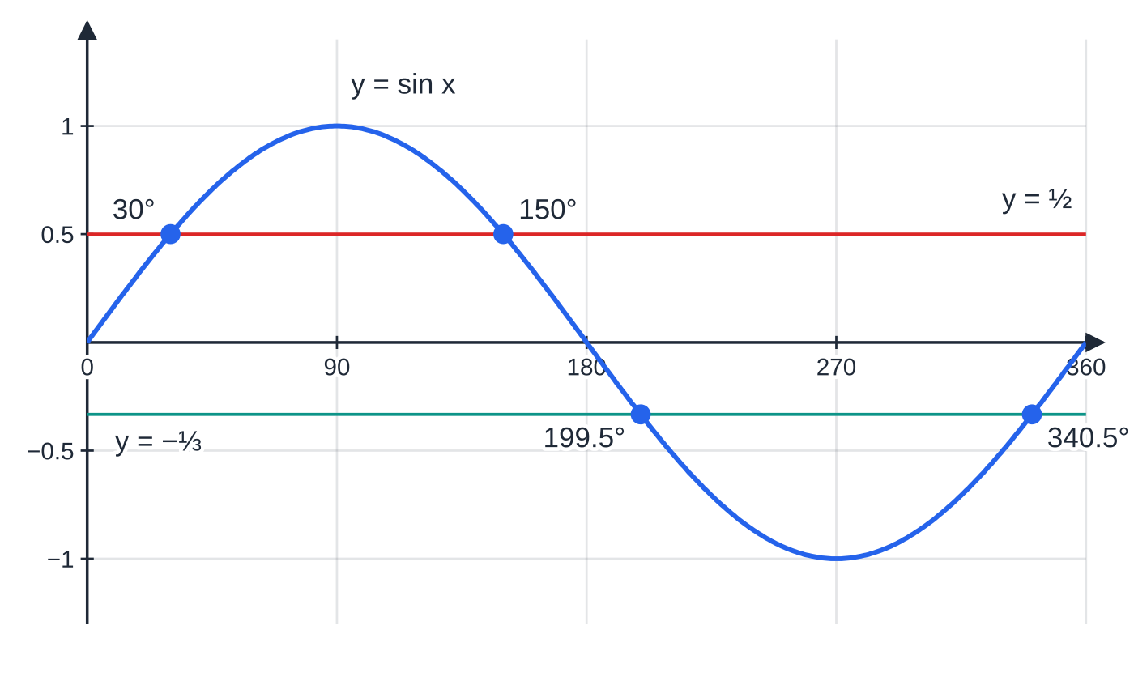
How do I solve a quadratic equation in sin, cos or tan? (continued)
Section 8 of 13 · Worked example 7 · Medium · Solve
WORKED EXAMPLE · QUESTION
(a) Solve 6cos² x + sin x - 5 = 0 for 0° ≤x < 360°. (b) Solve tan²θ- 2tan θ- 3 = 0 for 0° ≤θ< 180°. Give answers to 1 decimal place where appropriate.
SOLUTION
(a) Replace cos² x to leave only sin x: 6(1 - sin² x) + sin x - 5 = 0 ⇒6sin² x - sin x - 1 = 0. Factorise: (2sin x - 1)(3sin x + 1) = 0, so sin x = ½ or sin x = -⅓.
sin x = ½: x = 30°, 150°. sin x = -⅓: sin⁻¹(-⅓) = -19.47°, so x = 180° + 19.47° or 360° - 19.47°. x = 30°, 150°, 199.5°, 340.5°
Worked example 7(a): the factorised equation becomes two horizontal lines. y = ½ cuts y = sin x at 30° and 150°; y = −⅓ cuts it at 199.5° and 340.5°.
Notes:
How do I solve a quadratic equation in sin, cos or tan?: Worked example 7. Full notes: https://examinerprep.com/notes/edexcel-ial-maths/trigonometric-identities-and-equations/

Slide 31
How do I solve a quadratic equation in sin, cos or tan? (continued)
Section 8 of 13 · Worked example 7 · Medium · Solve (continued)
(b) Factorise as a quadratic in tan θ: (tan θ- 3)(tan θ+ 1) = 0, so tan θ= 3 ⇒θ= 71.6°, or tan θ= -1 ⇒θ= -45° + 180° = 135°. θ= 71.6° or 135°
In (b) the interval is only 180° long, one period of tan, so each root gives exactly one solution.
Notes:
How do I solve a quadratic equation in sin, cos or tan?: Worked example 7. Full notes: https://examinerprep.com/notes/edexcel-ial-maths/trigonometric-identities-and-equations/

Slide 32
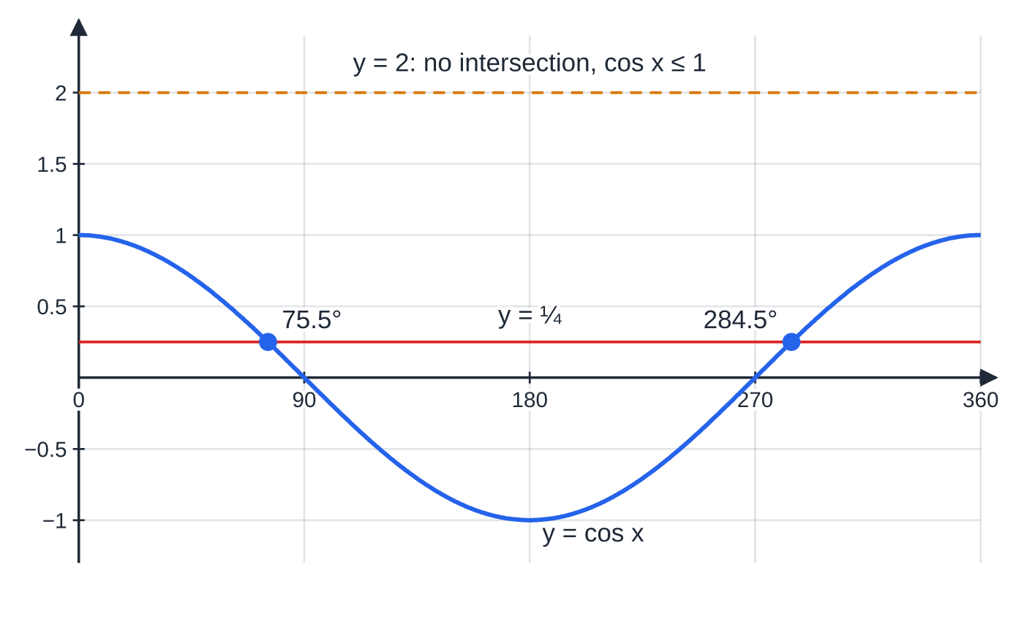
How do I solve a quadratic equation in sin, cos or tan? (continued)
Section 8 of 13 · Worked example 8 · Hard · Show that / Hence
WORKED EXAMPLE · QUESTION
(a) Show that the equation 4sin² x + 9cos x = 6 can be written as 4cos² x - 9cos x + 2 = 0. (b) Hence solve 4sin² x + 9cos x = 6 for 0° ≤x < 360°, giving your answers to 1 decimal place. (c) Hence find the solutions of 4sin² 2θ+ 9cos 2θ= 6 for 0° ≤θ< 180°, to 1 decimal place.
SOLUTION
(a) Replace sin² x: 4(1 - cos² x) + 9cos x = 6 ⇒4 - 4cos² x + 9cos x - 6 = 0. Multiplying by -1: 4cos² x - 9cos x + 2 = 0 ✓
(b) Factorise:
Worked example 8(b): cos x = ¼ gives two solutions; the line y = 2 lies entirely above the cosine curve, which is why the root cos x = 2 is rejected.
Notes:
How do I solve a quadratic equation in sin, cos or tan?: Worked example 8. Full notes: https://examinerprep.com/notes/edexcel-ial-maths/trigonometric-identities-and-equations/

Slide 33
How do I solve a quadratic equation in sin, cos or tan? (continued)
Section 8 of 13 · Worked example 8 · Hard · Show that / Hence (continued)
(4cos x - 1)(cos x - 2) = 0, so cos x = ¼ or cos x = 2. cos x = 2 has no solutions, since -1 ≤cos x ≤1. cos⁻¹(¼) = 75.52°, and 360° - 75.52° = 284.48°. x = 75.5° or 284.5°
(c) The same equation with x = 2θ, and 0° ≤2θ< 360°: 2θ= 75.52° or 284.48° (the next value, 435.52°, is outside the interval). θ= 37.8° or 142.2°
"Hence" in (c) means reuse the values from (b). Halving the rounded answer 284.5 gives 142.25, which rounds to 142.3 instead of the correct 142.2; halve the unrounded values.
Notes:
How do I solve a quadratic equation in sin, cos or tan?: Worked example 8. Full notes: https://examinerprep.com/notes/edexcel-ial-maths/trigonometric-identities-and-equations/

Slide 34
Exam tips for P2.6
Section 9 of 13
Exam tip 1 — sketch before you list
A quick sketch of the graph over the stated interval, with the horizontal line y = k, tells you how many solutions to expect before you find any of them. If your list has a different number, look again.
Exam tip 2 — change the interval first
For sin(nθ+ α) = k, write the new interval for nθ+ α as your first line of working. It shows the method clearly and it is the step that finds all the solutions.
Exam tip 3 — degrees or radians, and how accurate
An interval written with π means radians: switch the calculator mode and give answers in radians, exact (in terms of π) or to 3 s.f. Degrees are normally given to 1 d.p. Never mix the two in one answer.
Notes:
Exam tips for P2.6. Full notes: https://examinerprep.com/notes/edexcel-ial-maths/trigonometric-identities-and-equations/

Slide 35
Exam tips for P2.6 (continued)
Section 9 of 13
Exam tip 4 — factorise, never cancel
When a trigonometric factor appears on both sides, collect everything on one side and factorise. Each factor equal to zero gives its own set of solutions.
Exam tip 5 — proofs read from one side to the other
Start at one side, quote each identity as you use it, and end with the other side written out exactly. In a "show that" equation such as Worked example 8(a), the target line is given, so every step to it must be visible.
Notes:
Exam tips for P2.6. Full notes: https://examinerprep.com/notes/edexcel-ial-maths/trigonometric-identities-and-equations/

Slide 36
Common misconceptions
Section 10 of 13
Misconception | Why it is wrong | Correct idea
sin²θ means sin(θ²). | The index belongs to the value of the sine, not to the angle. | sin²θ= (sin θ)²; at θ= 30° it is ¼.
sin 2θ= 2sin θ, so sin 2θ= 0.6 means sin θ= 0.3. | sin is not a multiplier: sin 60° ≠2sin 30°. | Let u = 2θ, solve sin u = 0.6, then halve.
The second solution of tan θ= k is 180° - α. | That is the rule for sine; tan(180° - α) = -tan α. | tan repeats every 180°: α, α+ 180°, …
The calculator answer is the answer. | The inverse gives only the principal value, which may lie outside the interval. | Use the symmetry of the graph, then add or subtract the period.
sin θ= 1.5 means there was an error earlier. | A quadratic can produce a root that is out of range even when all the working is right. | State that sin θ= 1.5 has no solutions because -1 ≤sin θ≤1, and continue with the other root.
Checking an identity at θ= 30° proves it. | One value can agree by chance; an identity must hold for every angle. | Transform one side into the other using known identities.
Notes:
Common misconceptions. Full notes: https://examinerprep.com/notes/edexcel-ial-maths/trigonometric-identities-and-equations/

Slide 37
How this topic connects
Section 11 of 13
Trigonometry in P1
Radians, the exact values and the graphs of sin, cos and tan with their transformations are the starting point here. The ambiguous case of the sine rule is the equation sin θ= k with its two solutions α and 180° - α.
Trigonometry in P3
sec, cosec and cot, the identities 1 + tan²θ≡sec²θ and 1 + cot²θ≡csc²θ, compound and double angle formulae and Rcos(θ- α) all reduce equations to the forms solved on this page. Differentiating and integrating sin and cos (P3, P4) uses radians, and sin² t + cos² t = 1 eliminates the parameter from curves such as x = 3cos t, y = 2sin t.
Notes:
How this topic connects. Full notes: https://examinerprep.com/notes/edexcel-ial-maths/trigonometric-identities-and-equations/

Slide 38
How this topic connects (continued)
Section 11 of 13
Mechanics and IAL Physics
Resolving forces leads to equations such as tan θ= 0.75 or sin θ= k; oscillations and waves use sin(ωt + φ) = k, solved for t by the interval method on this page.
Notes:
How this topic connects. Full notes: https://examinerprep.com/notes/edexcel-ial-maths/trigonometric-identities-and-equations/

Slide 39
Key formulae
Section 12 of 13
Formula | Use | In the formulae list?
tan θ≡sin θ/ cos θ | replacing tan; turning asin θ= bcos θ into tan θ= b/a | No — learn it
sin²θ+ cos²θ≡1 | exact values from one ratio; proofs; converting to a quadratic in one function | No — learn it
sin²θ≡1 - cos²θ, cos²θ≡1 - sin²θ | replacing a square to leave one function | No — derive it from the identity
sin θ= k: θ= α, 180° - α (±360°) | all solutions of a sine equation | No — derive it from the graph
cos θ= k: θ= ±α (±360°) | all solutions of a cosine equation | No — derive it from the graph
tan θ= k: θ= α (±180°) | all solutions of a tangent equation | No — derive it from the graph
Notes:
Key formulae. Full notes: https://examinerprep.com/notes/edexcel-ial-maths/trigonometric-identities-and-equations/

Slide 40
Key formulae (continued)
Section 12 of 13
Formula | Use | In the formulae list?
sin 30° = ½, sin 45° = √2/2, sin 60° = √3/2 (and the cos, tan values) | exact answers in degrees or multiples of π | No — learn it
Notes:
Key formulae. Full notes: https://examinerprep.com/notes/edexcel-ial-maths/trigonometric-identities-and-equations/

Slide 41
Check your understanding
Section 13 of 13
1. Given that cos θ= -0.8 and 180° < θ< 270°, find sin θ and tan θ.
2. Solve sin θcos θ= sin θ for 0° ≤θ≤360°.
3. How many solutions does sin 3θ= 0.2 have for 0° ≤θ< 360°?
4. Solve cos x = ½ for 0 ≤x < 2π, giving exact answers.
5. Why does 2sin²θ- 5sin θ+ 2 = 0 have only two solutions for 0° ≤θ< 360°?
6. Prove that (1 - cos²θ)/sin θcos θ ≡tan θ.
Notes:
Check your understanding: questions. Full notes: https://examinerprep.com/notes/edexcel-ial-maths/trigonometric-identities-and-equations/

Slide 42
Check your understanding · answers
Section 13 of 13
1. sin²θ= 1 - 0.64 = 0.36, and sin is negative in the third quadrant, so sin θ= -0.6. Then tan θ= -0.6 ÷-0.8 = 0.75 (positive, as expected in the third quadrant).
2. sin θ(cos θ- 1) = 0. sin θ= 0 gives 0°, 180°, 360°; cos θ= 1 gives 0°, 360°. The solutions are 0°, 180° and 360°. Dividing by sin θ would have lost 180°.
3. With u = 3θ, 0° ≤u < 1080°: three full cycles, each meeting y = 0.2 twice. Six solutions.
4. The principal value is π/3; the other solution is 2π- π/3. So x = π/3 or 5π/3.
5. It factorises as (2sin θ- 1)(sin θ- 2) = 0. sin θ= 2 is impossible, so only sin θ= ½ remains, giving θ= 30° and 150°.
6. LHS = sin²θ/sin θcos θ = sin θ/cos θ = tan θ= RHS, using 1 - cos²θ≡sin²θ and then tan θ≡sin θ/cos θ.
Notes:
Check your understanding: answers. Full notes: https://examinerprep.com/notes/edexcel-ial-maths/trigonometric-identities-and-equations/

Slide 43
Practice questions
2 original exam-style questions. Answers at the end of the deck.

Slide 44
Question 1
5 marks
Prove each of the following identities, showing every step of your working.
(a) (1 − sin²θ) tan θ ≡ sin θ cos θ [2]
(b) (cos θ + 2 sin θ)² + (2 cos θ − sin θ)² ≡ 5 [3]
Notes:
Online with the full mark scheme: https://examinerprep.com/ial-maths-p2-6-trigonometric-identities-and-equations-questions#IALM-P2-6-B-03

Slide 45
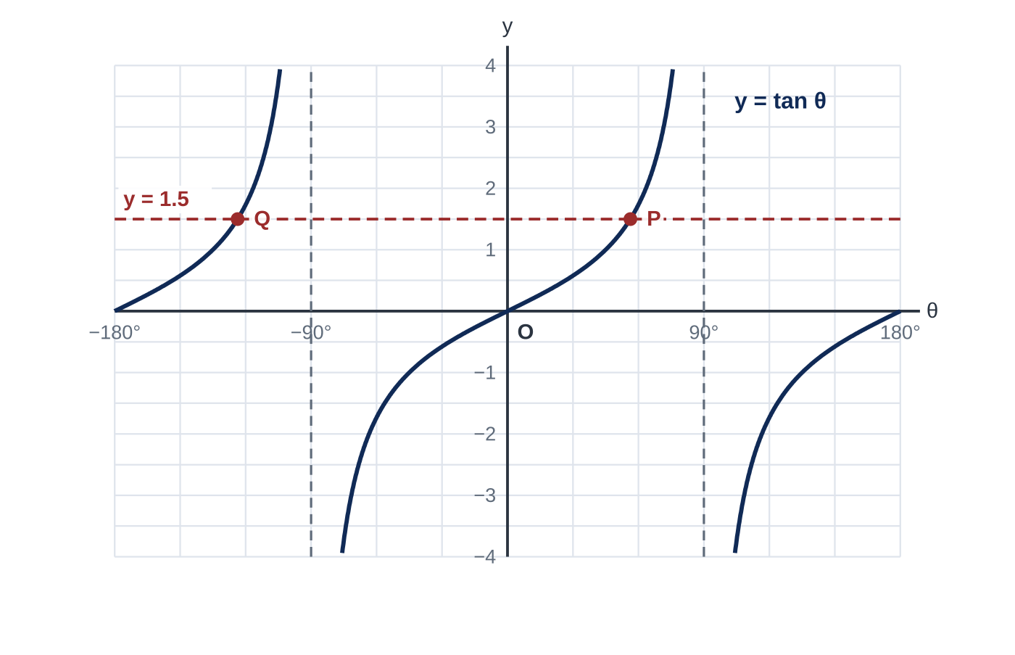
Question 2
6 marks
Figure 1 shows the graph of y = tan θ for −180° ≤ θ ≤ 180°, together with the line y = 1.5. The line meets the curve at P and at Q.
(a) Write down the equations of the two vertical asymptotes shown in Figure 1. [1]
(b) Find the values of θ at P and at Q, giving your answers to 1 decimal place. [3]
(c) Hence solve tan θ = −1.5 for −180° ≤ θ ≤ 180°, giving your answers to 1 decimal place. [2]
Notes:
Online with the full mark scheme: https://examinerprep.com/ial-maths-p2-6-trigonometric-identities-and-equations-questions#IALM-P2-6-FB-03

Slide 46
Answers

Slide 47
Question 1 · answer
Mark scheme
1 − sin²θ = cos²θ and tan θ = sin θ ⁄ cos θ used
cos²θ × sin θ ⁄ cos θ = sin θ cos θ, conclusion stated
both brackets expanded: cos²θ + 4 sin θ cos θ + 4 sin²θ + 4 cos²θ − 4 sin θ cos θ + sin²θ
5 cos²θ + 5 sin²θ
= 5(sin²θ + cos²θ) = 5, conclusion stated
Notes:
Full mark scheme: https://examinerprep.com/ial-maths-p2-6-trigonometric-identities-and-equations-questions#IALM-P2-6-B-03

Slide 48
Question 2 · answer
Mark scheme
θ = −90° and θ = 90°
tan⁻¹ 1.5 = 56.31°
P: θ = 56.3°
Q: θ = 56.31° − 180° = −123.7°
θ = −56.3°
θ = 180° − 56.31° = 123.7° ft
Notes:
Full mark scheme: https://examinerprep.com/ial-maths-p2-6-trigonometric-identities-and-equations-questions#IALM-P2-6-FB-03

Slide 49
Keep practising
Notes for this topic
Questions on this topic
Build a printable test
ExaminerPrep is an independent tutoring service. It has been developed independently from and is not endorsed by the International Baccalaureate Organization. "International Baccalaureate", "IB" and "IB Diploma Programme" are registered trademarks of the IBO, used here for descriptive purposes only.
Pearson Edexcel and Cambridge are trademarks of their owners; ExaminerPrep is not affiliated with any exam board.

