Slide 1
EP
EDEXCEL IAL MATHS
P1.5 Trigonometry: triangles, radians and graphs
The full notes page in 13 sections · practice questions with answers · simulations
ExaminerPrep is an independent tutoring service. It has been developed independently from and is not endorsed by the International Baccalaureate Organization. "International Baccalaureate", "IB" and "IB Diploma Programme" are registered trademarks of the IBO, used here for descriptive purposes only.
Pearson Edexcel and Cambridge are trademarks of their owners; ExaminerPrep is not affiliated with any exam board.
Notes:
P1.5 Trigonometry: triangles, radians and graphs. Notes for this topic: https://examinerprep.com/notes/edexcel-ial-maths/trigonometry-triangles-radians-and-graphs/

Slide 2
What this page covers
Overview
The sine rule for sides and for angles, including the ambiguous case where two triangles fit the data
The cosine rule for a side or an angle
The area of a triangle as ½absin C
Bearings problems solved with the sine and cosine rules
Radian measure and converting between radians and degrees
Arc length rθ, sector area ½r²θ, segment areas and composite shapes
The graphs of y=sin x, cos x and tan x: shape, period and symmetry
Simple transformations such as 3sin x, sin(x+π/6) and sin 2x
Notes:
What this page covers. Full notes: https://examinerprep.com/notes/edexcel-ial-maths/trigonometry-triangles-radians-and-graphs/

Slide 3
In one minute
Key points
1. This page gives you the tools for any triangle that is not right-angled, a second unit for measuring angles that makes circle formulae simple, and the three trig graphs you need to sketch from memory.
2. Sine rule: a/sin A=b/sin B=c/sin C. Use it when you know a side and the angle opposite it. Finding an angle from its sine gives θ and 180°-θ; both can be valid, so check the angle sum.
3. Cosine rule: a²=b²+c²-2bccos A. Use it for two sides and the included angle, or for three sides.
4. Area =½absin C, where C is the angle between sides a and b.
5. Radians: π rad=180°. With θ in radians, arc length =rθ and sector area =½r²θ.
6. Graphs: sin and cos have period 2π and range -1 to 1; tan has period π and asymptotes where cos x=0.
Notes:
In one minute. Full notes: https://examinerprep.com/notes/edexcel-ial-maths/trigonometry-triangles-radians-and-graphs/

Slide 4
How do you use the sine rule?
Section 1 of 13
Label the triangle with capital letters for the angles and the matching small letter for the side opposite each angle. Then, in any triangle,
a/sin A=b/sin B=c/sin C or sin A/a=sin B/b=sin C/c
Use the first form to find a side and the second form to find an angle, so that the unknown sits on top.
You need one complete "pair": a side and the angle opposite it.
The sine rule is not in the formulae list, so learn it; you will use it constantly.
Why it works: drop a perpendicular from C to AB. Its height is bsin A from one side and asin B from the other, so bsin A=asin B. In a right-angled triangle the rule reduces to sin = opposite ÷ hypotenuse, because sin 90°=1.
Notes:
How do you use the sine rule?. Full notes: https://examinerprep.com/notes/edexcel-ial-maths/trigonometry-triangles-radians-and-graphs/

Slide 5
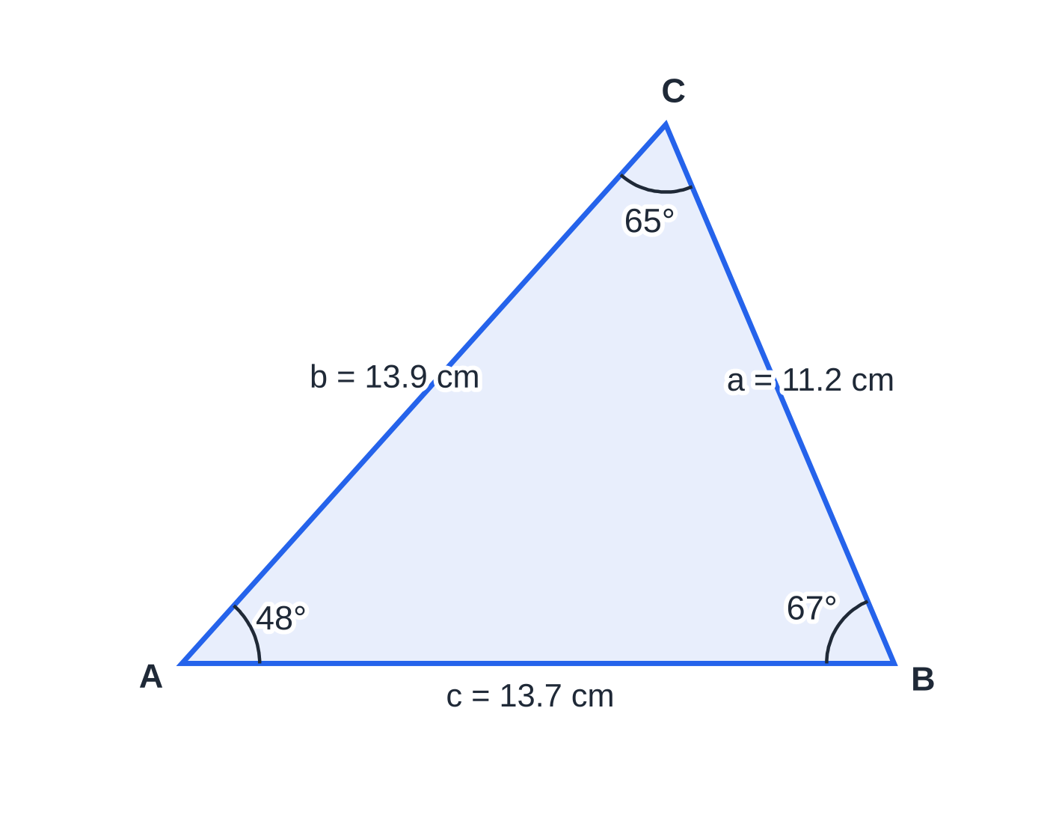
How do you use the sine rule? (continued)
Section 1 of 13 · Worked example 1 · Easy · Find
WORKED EXAMPLE · QUESTION
In triangle ABC, angle A=48°, angle B=67° and BC=11.2 cm. Find the lengths of AC and AB, giving each to 3 significant figures.
SOLUTION
The third angle: C=180°-48°-67°=65°.
AC=b is opposite B; the known pair is a=11.2, A=48°. So b=11.2sin 67°/sin 48°=13.873… AC=13.9 cm
AB=c is opposite C: c=11.2sin 65°/sin 48°=13.659… AB=13.7 cm
The triangle of Worked example 1, drawn to scale from the solved lengths. The given pair is a=11.2 cm with A=48°.
Notes:
How do you use the sine rule?: Worked example 1. Full notes: https://examinerprep.com/notes/edexcel-ial-maths/trigonometry-triangles-radians-and-graphs/

Slide 6
How do you use the sine rule? (continued)
Section 1 of 13 · Worked example 1 · Easy · Find (continued)
Sense check: the longest side, b, is opposite the largest angle, 67°; the shortest, a, is opposite the smallest, 48°.
Notes:
How do you use the sine rule?: Worked example 1. Full notes: https://examinerprep.com/notes/edexcel-ial-maths/trigonometry-triangles-radians-and-graphs/

Slide 7
How do you use the sine rule? (continued)
Section 1 of 13
Exam tip
Keep full calculator values for lengths you will reuse (store them in memory) and round only the final answers. Rounding b to 13.9 and using it again can change the third significant figure of a later answer.
Notes:
How do you use the sine rule?. Full notes: https://examinerprep.com/notes/edexcel-ial-maths/trigonometry-triangles-radians-and-graphs/

Slide 8
When does the sine rule give two triangles?
Section 2 of 13
sin θ=sin(180°-θ), so an equation such as sin R=0.82 has an acute solution and an obtuse one. The calculator only shows the acute one, and you must decide whether the obtuse one also works.
The obtuse angle is valid whenever it still leaves room in the triangle: (given angle) + (obtuse angle) <180°.
This can only happen when you are given two sides and an angle that is not between them, and the side opposite the given angle is the shorter of the two given sides.
If the side opposite the given angle is the longer one, the obtuse option always fails the angle sum and there is one triangle.
Notes:
When does the sine rule give two triangles?. Full notes: https://examinerprep.com/notes/edexcel-ial-maths/trigonometry-triangles-radians-and-graphs/

Slide 9
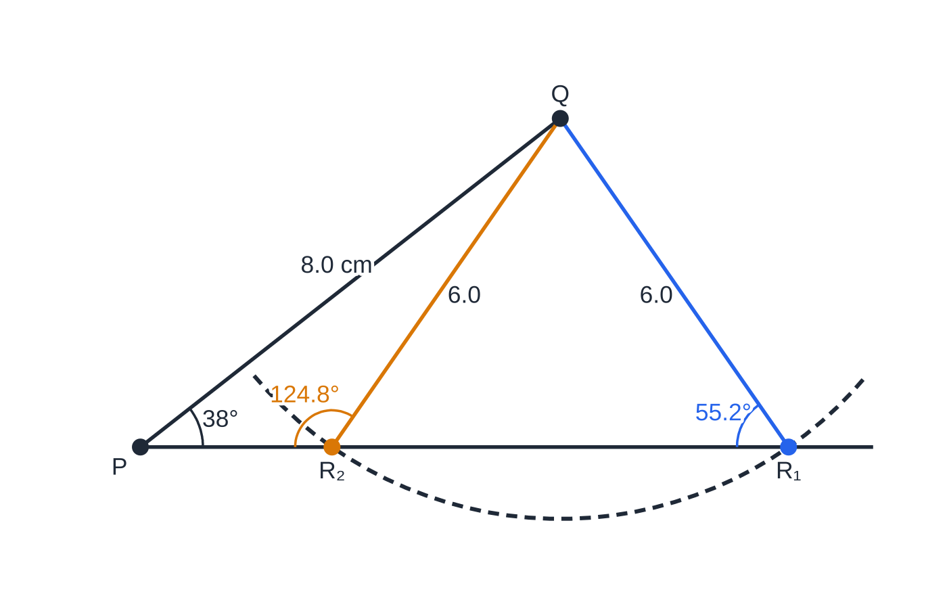
When does the sine rule give two triangles? (continued)
Section 2 of 13
Why two triangles fit: the side QR=6.0 cm can swing so that R lands on the line from P at two points. Triangle PQR₁ (blue) has R=55.2°; triangle PQR₂ (amber) has R=124.8°.
Notes:
When does the sine rule give two triangles?. Full notes: https://examinerprep.com/notes/edexcel-ial-maths/trigonometry-triangles-radians-and-graphs/

Slide 10
When does the sine rule give two triangles? (continued)
Section 2 of 13 · Worked example 2 · Hard · Find
WORKED EXAMPLE · QUESTION
In triangle PQR, PQ=8.0 cm, QR=6.0 cm and angle QPR=38°. (a) Find the two possible sizes of angle PRQ. (b) Find the two possible lengths of PR.
SOLUTION
(a) QR is opposite P and PQ is opposite R: sin R=8.0sin 38°/6.0=0.8209.
Both solutions in the range 0° to 180°: R=55.2° or R=180°-55.2°=124.8°
Check both fit: 38°+124.8°=162.8°<180° ✓. So the third angle is Q=86.8° or Q=17.2°.
(b) PR is opposite Q: PR=6.0sin 86.8°/sin 38° or 6.0sin 17.2°/sin 38°. PR=9.73 cm or 2.88 cm
Notes:
When does the sine rule give two triangles?: Worked example 2. Full notes: https://examinerprep.com/notes/edexcel-ial-maths/trigonometry-triangles-radians-and-graphs/

Slide 11
When does the sine rule give two triangles? (continued)
Section 2 of 13
Common error
Stopping at the calculator's value of sin⁻¹. When a question says "find the possible values", or the given angle is opposite the shorter given side, always test 180° minus your answer as well.
Notes:
When does the sine rule give two triangles?. Full notes: https://examinerprep.com/notes/edexcel-ial-maths/trigonometry-triangles-radians-and-graphs/

Slide 12
How do you use the cosine rule and the area formula?
Section 3 of 13
a²=b²+c²-2bccos A cos A=(b²+c²-a²)/2bc
First form: two sides and the angle between them give the third side.
Second form: three sides give any angle. A negative cosine means an obtuse angle, and there is never any ambiguity, because cos⁻¹ gives a unique angle between 0° and 180°.
The cosine rule is in the formulae list in its side form; be ready to rearrange it for cos A.
When A=90°, cos A=0 and the rule becomes Pythagoras' theorem: the term -2bccos A is the correction for a non-right angle.
Area of a triangle =½absin C, where a and b are two sides and C is the angle between them (the included angle). It is not in the formulae list, so learn it. It is ½× base × height with the height written as bsin C.
Notes:
How do you use the cosine rule and the area formula?. Full notes: https://examinerprep.com/notes/edexcel-ial-maths/trigonometry-triangles-radians-and-graphs/

Slide 13
How do you use the cosine rule and the area formula? (continued)
Section 3 of 13
You know | Use | To find
a side and its opposite angle, plus one more side or angle | sine rule | another side or angle (watch for the ambiguous case)
two sides and the included angle | cosine rule | the third side
three sides | cosine rule (cos form) | any angle; find the largest (opposite the longest side) first
two sides and the included angle | ½absin C | the area
Notes:
How do you use the cosine rule and the area formula?. Full notes: https://examinerprep.com/notes/edexcel-ial-maths/trigonometry-triangles-radians-and-graphs/

Slide 14
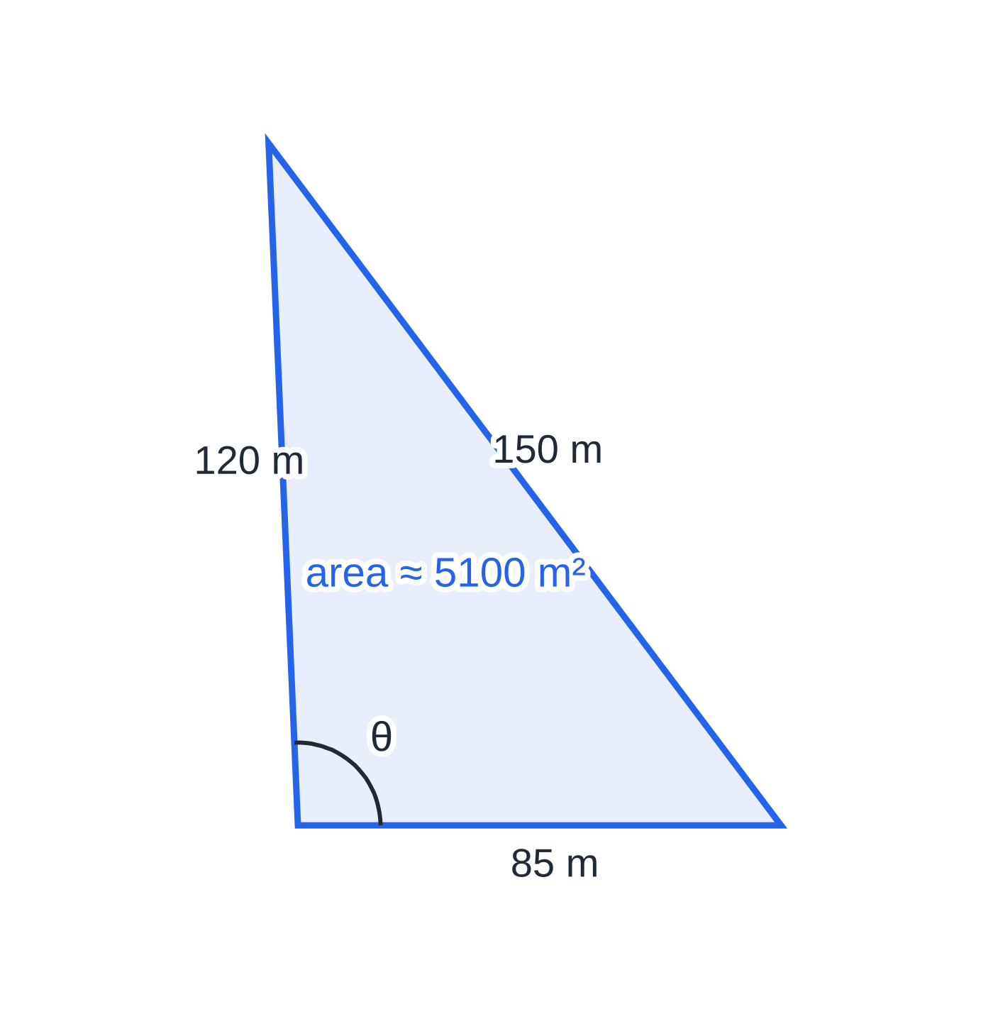
How do you use the cosine rule and the area formula? (continued)
Section 3 of 13 · Worked example 3 · Medium · Find
WORKED EXAMPLE · QUESTION
A triangular field has sides of length 85 m, 120 m and 150 m. (a) Find the largest angle of the field. (b) Find the area of the field.
SOLUTION
(a) The largest angle is opposite the longest side, 150 m: cos θ=(85²+120²-150²)/(2×85×120)=(-875)/20 400=-0.04289. θ=92.5°
(b) Use ½absin C with the two sides that enclose θ: Area =½×85×120×sin 92.5°=5095.3… 5100 m² (3 s.f.)
The negative cosine signals an obtuse angle; the calculator handles this automatically with cos⁻¹.
The field drawn to scale. The largest angle is always opposite the longest side, so find that one first: once it is known, the other two must be acute.
Notes:
How do you use the cosine rule and the area formula?: Worked example 3. Full notes: https://examinerprep.com/notes/edexcel-ial-maths/trigonometry-triangles-radians-and-graphs/

Slide 15
How do you solve a bearings problem?
Section 4 of 13
A bearing is measured clockwise from north and written with three figures: 072°, 195°.
Draw a north line at every point you measure from.
The bearing of A from B and the bearing of B from A differ by exactly 180° (the back bearing).
North lines are parallel, so use alternate and co-interior angles to find the angles inside the triangle, then use the sine or cosine rule.
Notes:
How do you solve a bearings problem?. Full notes: https://examinerprep.com/notes/edexcel-ial-maths/trigonometry-triangles-radians-and-graphs/

Slide 16
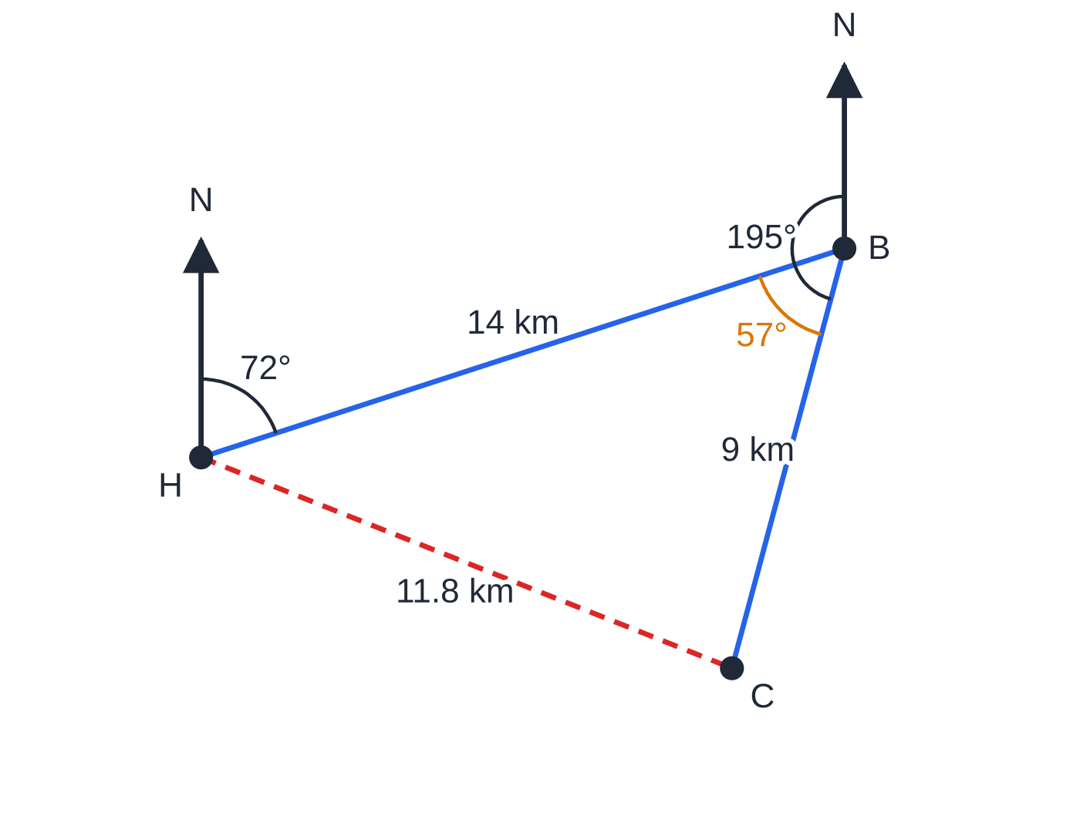
How do you solve a bearings problem? (continued)
Section 4 of 13 · Worked example 4 · Hard · Show that, Find
WORKED EXAMPLE · QUESTION
A yacht leaves harbour H and sails 14 km on a bearing of 072° to a buoy B. It then sails 9 km on a bearing of 195° to a point C. (a) Show that angle HBC=57°. (b) Find the distance HC. (c) Find the bearing of C from H. (d) Write down the bearing on which the yacht must sail to return directly from C to H.
SOLUTION
(a) The bearing of H from B is the back bearing: 72°+180°=252°, so angle HBC=252°-195°=57° as required.
(b) Two sides and the included angle, so use the cosine rule:
Worked example 4 to scale. The angle inside the triangle at B (amber) is the back bearing 252° minus 195°. The dashed line HC is 11.8 km on a bearing of 111.7° from H.
Notes:
How do you solve a bearings problem?: Worked example 4. Full notes: https://examinerprep.com/notes/edexcel-ial-maths/trigonometry-triangles-radians-and-graphs/

Slide 17
How do you solve a bearings problem? (continued)
Section 4 of 13 · Worked example 4 · Hard · Show that, Find (continued)
HC²=14²+9²-2×14×9×cos 57°=139.75, so HC=11.822… HC=11.8 km
(c) Angle BHC by the sine rule (it is opposite the 9 km side, so it is acute): sin BHC=9sin 57°/11.822, so angle BHC=39.7°. Bearing of C from H=072°+39.7°= 111.7°
(d) Back bearing: 111.7°+180°= 291.7°
Notes:
How do you solve a bearings problem?: Worked example 4. Full notes: https://examinerprep.com/notes/edexcel-ial-maths/trigonometry-triangles-radians-and-graphs/

Slide 18
How do you solve a bearings problem? (continued)
Section 4 of 13
Common error
Using the bearing itself as an angle in the triangle. A bearing is an angle from north, not between two legs of the journey: always draw the north lines and work out the angle inside the triangle first.
Notes:
How do you solve a bearings problem?. Full notes: https://examinerprep.com/notes/edexcel-ial-maths/trigonometry-triangles-radians-and-graphs/

Slide 19
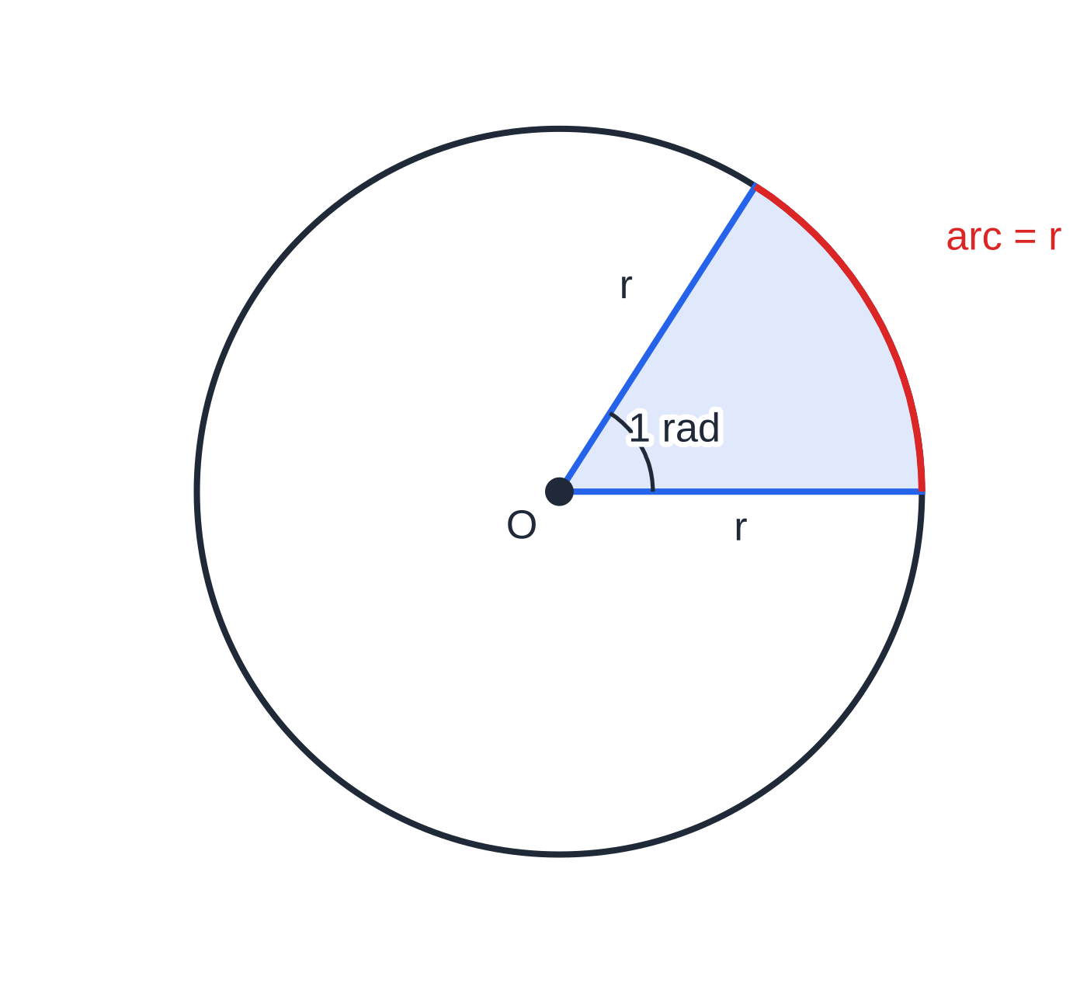
What is a radian?
Section 5 of 13
One radian is the angle at the centre of a circle subtended by an arc whose length equals the radius.
A full turn is an arc of 2πr, which is 2π radii, so 2π rad=360° and π rad=180°.
Degrees → radians: multiply by π/180. Radians → degrees: multiply by 180/π.
1 rad=180°/π≈57.3°.
"rad" is often left out: an angle written without the ° symbol is in radians.
Set your calculator to radian mode whenever the angles are in radians, including inside the sine and cosine rules.
An arc of length r subtends an angle of 1 radian at the centre, whatever the size of the circle. That is why radians make arc and sector formulae so simple.
Notes:
What is a radian?. Full notes: https://examinerprep.com/notes/edexcel-ial-maths/trigonometry-triangles-radians-and-graphs/

Slide 20
What is a radian? (continued)
Section 5 of 13
Degrees | 30° | 45° | 60° | 90° | 120° | 135° | 180° | 270° | 360°
Radians | π/6 | π/4 | π/3 | π/2 | 2π/3 | 3π/4 | π | 3π/2 | 2π
Notes:
What is a radian?. Full notes: https://examinerprep.com/notes/edexcel-ial-maths/trigonometry-triangles-radians-and-graphs/

Slide 21
How do you find arc lengths, sectors and segments?
Section 6 of 13
With θ in radians, r the radius, s the arc length and A the sector area:
s=rθ A=½r²θ
Neither is in the formulae list, so learn both. They come from fractions of a circle: the sector is θ/2π of the whole, so s=θ/2π×2πr and A=θ/2π×πr². In degrees you would need extra factors of π/180.
Notes:
How do you find arc lengths, sectors and segments?. Full notes: https://examinerprep.com/notes/edexcel-ial-maths/trigonometry-triangles-radians-and-graphs/

Slide 22
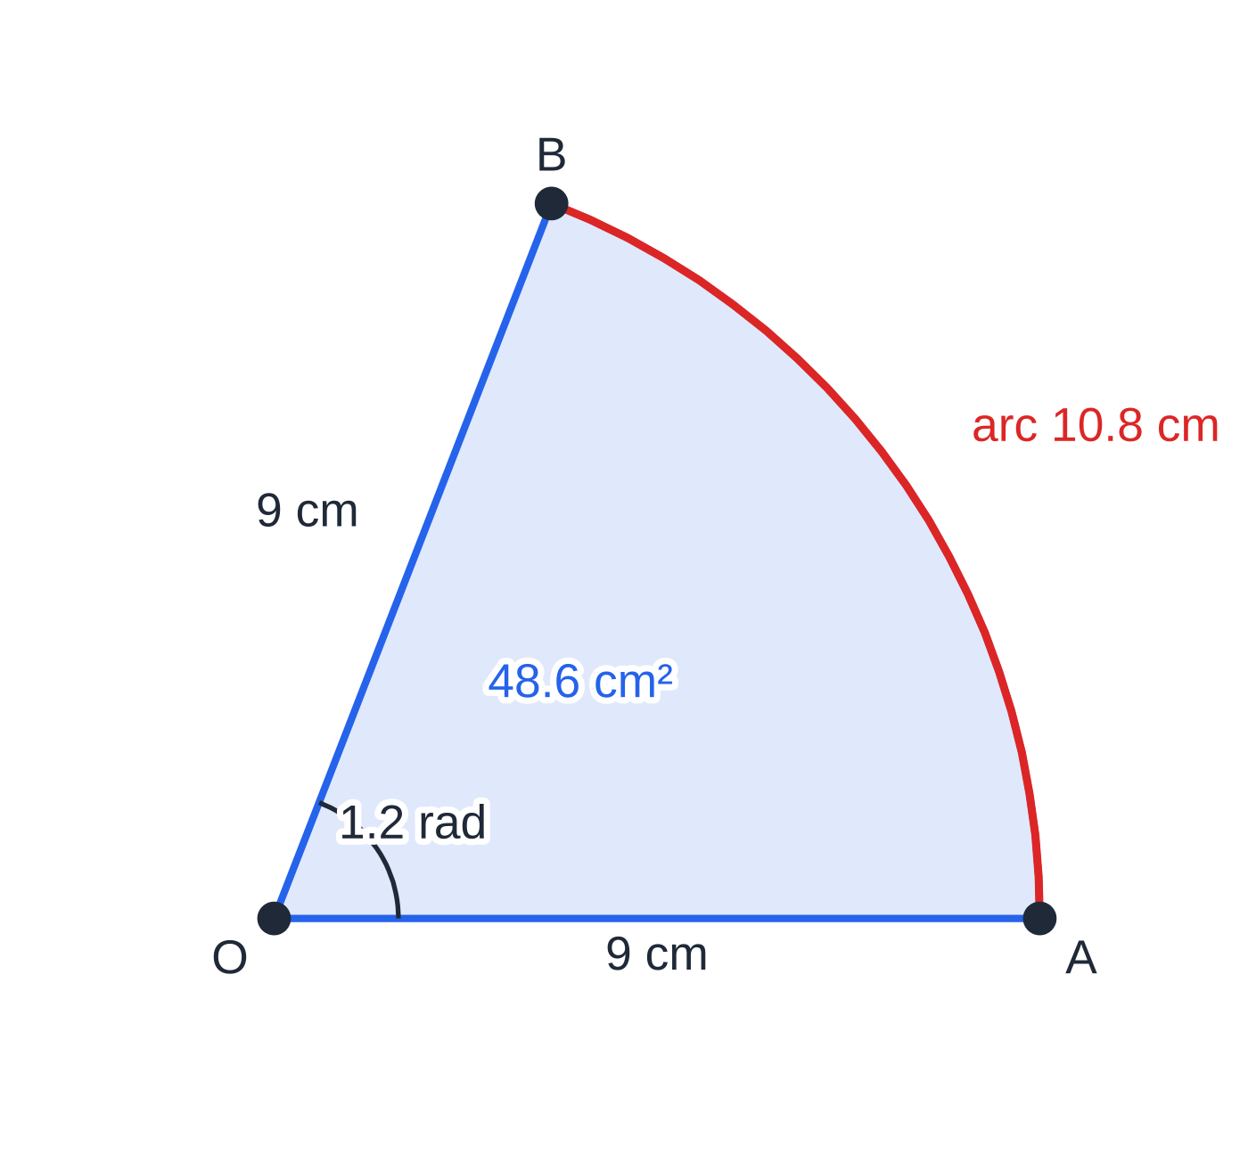
How do you find arc lengths, sectors and segments? (continued)
Section 6 of 13 · Worked example 5 · Easy · Write, Find
WORKED EXAMPLE · QUESTION
(a) Write 135° in radians as an exact multiple of π, and 2.4 rad in degrees. (b) A sector OAB has radius 9 cm and angle AOB=1.2 rad. Find its arc length, perimeter and area.
SOLUTION
(a) 135×π/180= 3π/4 and 2.4×180/π=137.51… 137.5°
(b) Arc length s=9×1.2= 10.8 cm. The perimeter includes both radii: 9+9+10.8= 28.8 cm. Area =½×9²×1.2= 48.6 cm²
The sector of Worked example 5. Its perimeter is two radii plus the arc, which is why 28.8 cm is much more than the arc alone.
Notes:
How do you find arc lengths, sectors and segments?: Worked example 5. Full notes: https://examinerprep.com/notes/edexcel-ial-maths/trigonometry-triangles-radians-and-graphs/

Slide 23
How do you find arc lengths, sectors and segments? (continued)
Section 6 of 13
Segments
A segment is the region between a chord and its arc.
Segment = sector - triangle: ½r²θ-½r²sin θ=½r²(θ-sin θ).
The triangle is isosceles with two sides r and the included angle θ, so its area is ½r²sin θ (with sin of an angle in radians).
The perimeter of a segment is the chord plus the arc.
Notes:
How do you find arc lengths, sectors and segments?. Full notes: https://examinerprep.com/notes/edexcel-ial-maths/trigonometry-triangles-radians-and-graphs/

Slide 24
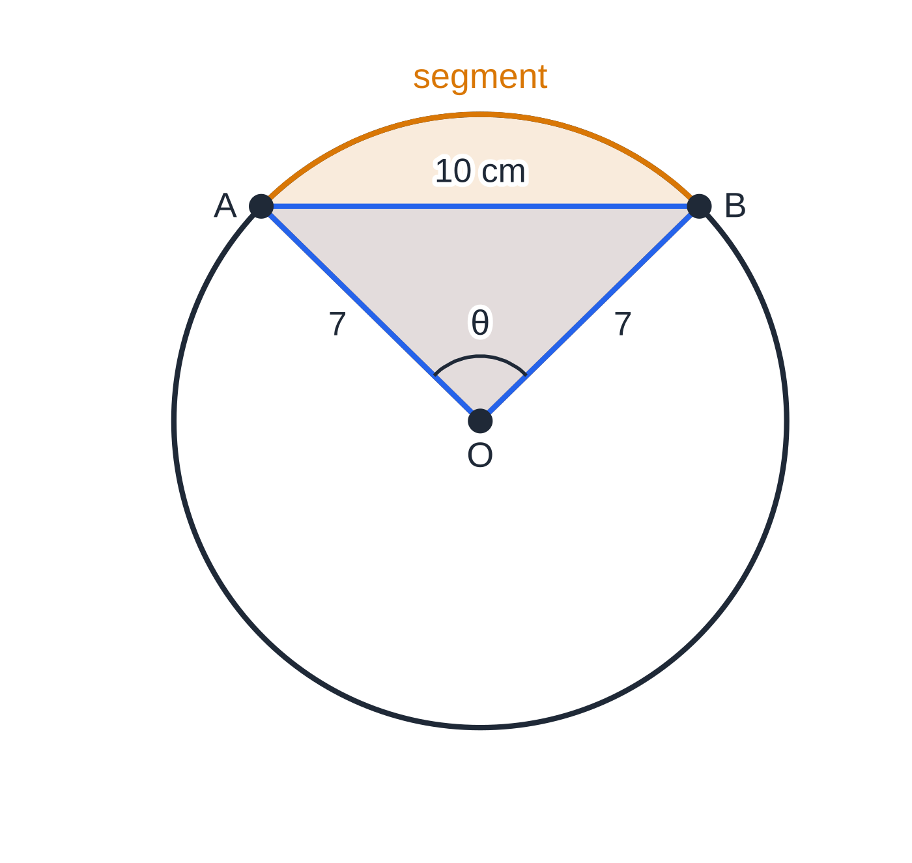
How do you find arc lengths, sectors and segments? (continued)
Section 6 of 13 · Worked example 6 · Medium · Show that, Find
WORKED EXAMPLE · QUESTION
A chord AB of length 10 cm is drawn in a circle with centre O and radius 7 cm. Angle AOB=θ radians. (a) Show that θ=1.591 to 4 significant figures. (b) Find the area of the minor segment cut off by AB. (c) Find the perimeter of this segment.
SOLUTION
(a) Cosine rule in triangle OAB: cos θ=(7²+7²-10²)/(2×7×7)=(-2)/98=-(1/49). So θ=cos⁻¹(-(1/49))=1.59121…=1.591 (4 s.f.) as required.
(b) Sector minus triangle, calculator in radians: ½×7²×1.5912-½×7²×sin 1.5912=38.98-24.49=14.490… 14.5 cm²
(c) Chord plus arc: 10+7×1.5912=21.138… 21.1 cm
Worked example 6 to scale: radius 7 cm, chord 10 cm, θ=1.591 rad. The sector is the triangle (blue) plus the segment (amber).
Notes:
How do you find arc lengths, sectors and segments?: Worked example 6. Full notes: https://examinerprep.com/notes/edexcel-ial-maths/trigonometry-triangles-radians-and-graphs/

Slide 25
How do you find arc lengths, sectors and segments? (continued)
Section 6 of 13 · Worked example 6 · Medium · Show that, Find (continued)
A quicker route to (a): half the chord gives sin θ/2=(5/7), so θ=2sin⁻¹(5/7), the same value.
Notes:
How do you find arc lengths, sectors and segments?: Worked example 6. Full notes: https://examinerprep.com/notes/edexcel-ial-maths/trigonometry-triangles-radians-and-graphs/

Slide 26
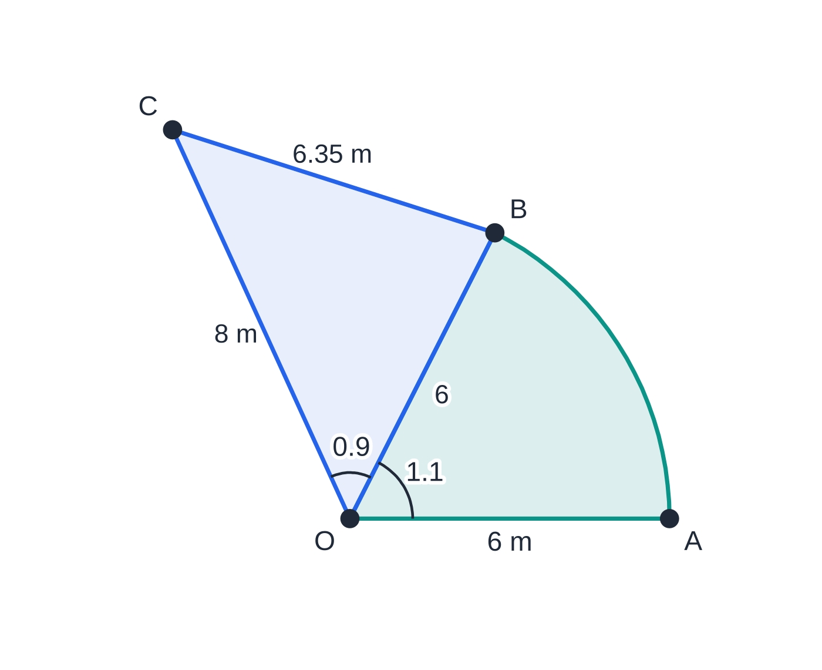
How do you find arc lengths, sectors and segments? (continued)
Section 6 of 13 · Worked example 7 · Hard · Find
WORKED EXAMPLE · QUESTION
A flower bed is made from a sector OAB of a circle, centre O, radius 6 m, with angle AOB=1.1 rad, joined along OB to a triangle OBC in which OC=8 m and angle BOC=0.9 rad. The two pieces do not overlap. (a) Find the length BC. (b) Find the area of the flower bed. (c) Find the perimeter of the flower bed.
SOLUTION
(a) Cosine rule with the angle in radians (calculator in radian mode): BC²=6²+8²-2×6×8×cos 0.9=40.325, so BC=6.350… BC=6.35 m
(b) Sector + triangle: ½×6²×1.1+½×6×8×sin 0.9=19.8+18.80= 38.6 m²
The flower bed: a sector (teal) joined along OB to a triangle (blue). OB lies inside the shape, so it is not part of the perimeter.
Notes:
How do you find arc lengths, sectors and segments?: Worked example 7. Full notes: https://examinerprep.com/notes/edexcel-ial-maths/trigonometry-triangles-radians-and-graphs/

Slide 27
How do you find arc lengths, sectors and segments? (continued)
Section 6 of 13 · Worked example 7 · Hard · Find (continued)
(c) Boundary =OA+ arc AB+BC+CO (OB is inside the bed): 6+6×1.1+6.350+8=26.95… 27.0 m
In degree mode, cos 0.9 would be the cosine of 0.9°, and BC would come out as about 2.00 m: a quick way to spot a mode error.
Notes:
How do you find arc lengths, sectors and segments?: Worked example 7. Full notes: https://examinerprep.com/notes/edexcel-ial-maths/trigonometry-triangles-radians-and-graphs/

Slide 28
How do you find arc lengths, sectors and segments? (continued)
Section 6 of 13
Exam tip
For a composite shape, sketch it and mark which lines are on the outside. Radii and chords that lie inside the shape are not part of the perimeter, but they are often the key to splitting the area into sectors and triangles.
Notes:
How do you find arc lengths, sectors and segments?. Full notes: https://examinerprep.com/notes/edexcel-ial-maths/trigonometry-triangles-radians-and-graphs/

Slide 29
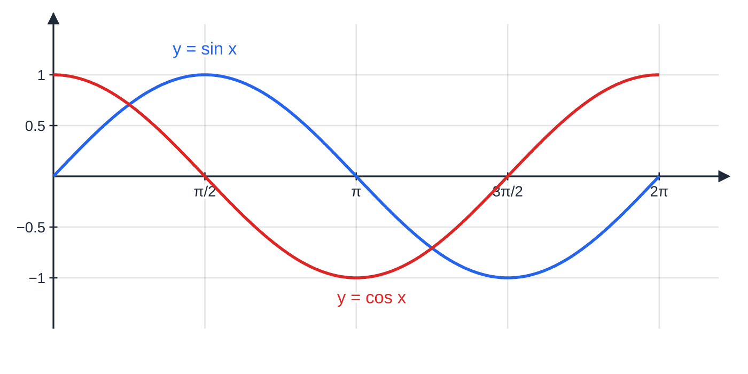
What do the graphs of sin, cos and tan look like?
Section 7 of 13
y=sin x and y=cos x for 0≤x≤2π. The cosine curve is the sine curve shifted π/2 to the left.
Notes:
What do the graphs of sin, cos and tan look like?. Full notes: https://examinerprep.com/notes/edexcel-ial-maths/trigonometry-triangles-radians-and-graphs/

Slide 30
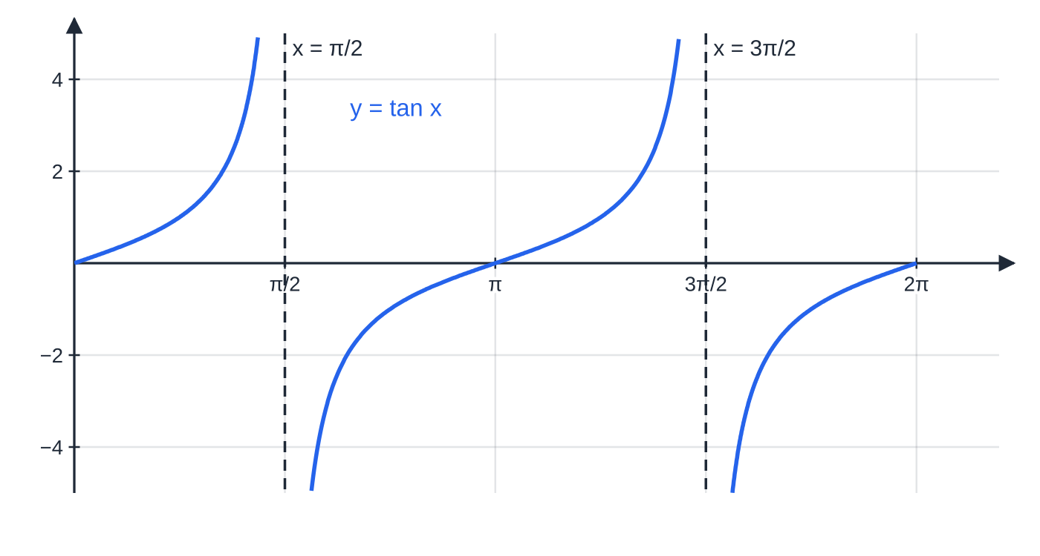
What do the graphs of sin, cos and tan look like? (continued)
Section 7 of 13
y=tan x for 0≤x≤2π. It rises through every interval between its asymptotes at x=π/2 and x=3π/2, and repeats every π.
Notes:
What do the graphs of sin, cos and tan look like?. Full notes: https://examinerprep.com/notes/edexcel-ial-maths/trigonometry-triangles-radians-and-graphs/

Slide 31
What do the graphs of sin, cos and tan look like? (continued)
Section 7 of 13
 | y=sin x | y=cos x | y=tan x
Period | 2π (360°) | 2π (360°) | π (180°)
Range | -1≤y≤1 | -1≤y≤1 | all real numbers
Zeros | 0, π, 2π, … | π/2, 3π/2, … | 0, π, 2π, …
Maximum / minimum | 1 at π/2; -1 at 3π/2 | 1 at 0, 2π; -1 at π | none
Asymptotes | none | none | x=π/2, 3π/2, …
Symmetry | sin(π-x)=sin x; odd: sin(-x)=-sin x | cos(2π-x)=cos x; even: cos(-x)=cos x | tan(π+x)=tan x; odd
Exact values to know
 | 0 | π/6 (30°) | π/4 (45°) | π/3 (60°) | π/2 (90°)
sin | 0 | ½ | √2/2 | √3/2 | 1
Notes:
What do the graphs of sin, cos and tan look like?. Full notes: https://examinerprep.com/notes/edexcel-ial-maths/trigonometry-triangles-radians-and-graphs/

Slide 32
What do the graphs of sin, cos and tan look like? (continued)
Section 7 of 13
 | 0 | π/6 (30°) | π/4 (45°) | π/3 (60°) | π/2 (90°)
cos | 1 | √3/2 | √2/2 | ½ | 0
tan | 0 | √3/3 | 1 | √3 | undefined
Using symmetry: from the graph, sin 5π/6=sin(π-π/6)=½ and cos 4π/3=-cos π/3=-½. The curves repeat, so sin(x+2π)=sin x. The number of solutions of an equation like sin x=k in an interval is the number of times the line y=k crosses the curve there.
Common error
Drawing tan x with a maximum and minimum like sin x, or letting it cross its asymptotes. The tan curve rises through every interval between asymptotes and repeats every π, not every 2π.
Notes:
What do the graphs of sin, cos and tan look like?. Full notes: https://examinerprep.com/notes/edexcel-ial-maths/trigonometry-triangles-radians-and-graphs/

Slide 33
How do simple transformations change a trig graph?
Section 8 of 13
Equation | Transformation of y=sin x | Effect
y=3sin x | stretch parallel to the y-axis, scale factor 3 | range -3≤y≤3; zeros and period unchanged
y=sin x+2 | translation 2 up | range 1≤y≤3
y=sin(x+π/6) | translation π/6 to the left | every point moves left by π/6; period unchanged
y=sin 2x | stretch parallel to the x-axis, scale factor ½ | period 2π÷2=π; range unchanged
y=-sin x | reflection in the x-axis | maxima become minima
Changes outside the function act on y as you expect; changes inside act on x the "opposite" way: +π/6 moves left, ×2 squashes.
For y=sin bx and y=cos bx the period is 2π/b; for y=tan bx it is π/b.
To find new key points, solve "inside = old key value": the maximum of sin(x+π/6) is where x+π/6=π/2, so x=π/3.
Notes:
How do simple transformations change a trig graph?. Full notes: https://examinerprep.com/notes/edexcel-ial-maths/trigonometry-triangles-radians-and-graphs/

Slide 34
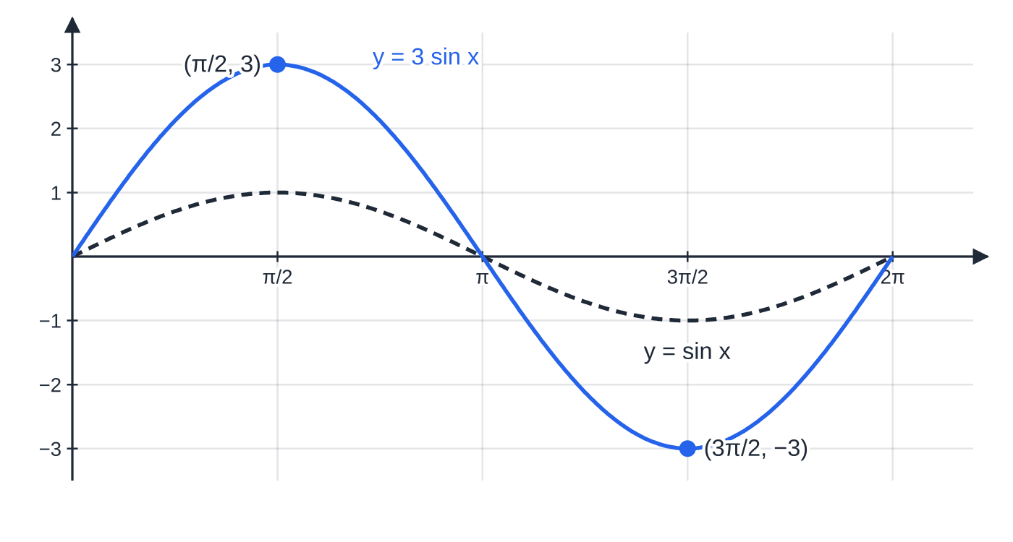
How do simple transformations change a trig graph? (continued)
Section 8 of 13
y=3sin x over y=sin x (dashed): only the height changes. The zeros at 0, π and 2π stay where they were.
Notes:
How do simple transformations change a trig graph?. Full notes: https://examinerprep.com/notes/edexcel-ial-maths/trigonometry-triangles-radians-and-graphs/

Slide 35
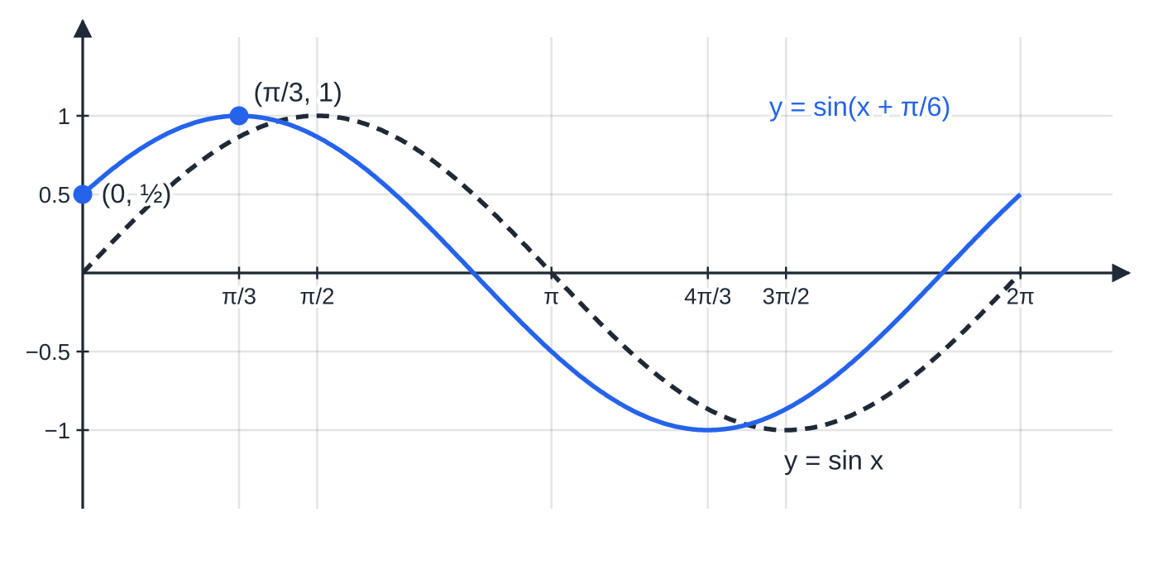
How do simple transformations change a trig graph? (continued)
Section 8 of 13
y=sin(x+π/6) over y=sin x (dashed): only the position changes. The maximum moves from π/2 to π/3, and the curve now meets the y-axis at (0, ½).
Notes:
How do simple transformations change a trig graph?. Full notes: https://examinerprep.com/notes/edexcel-ial-maths/trigonometry-triangles-radians-and-graphs/

Slide 36
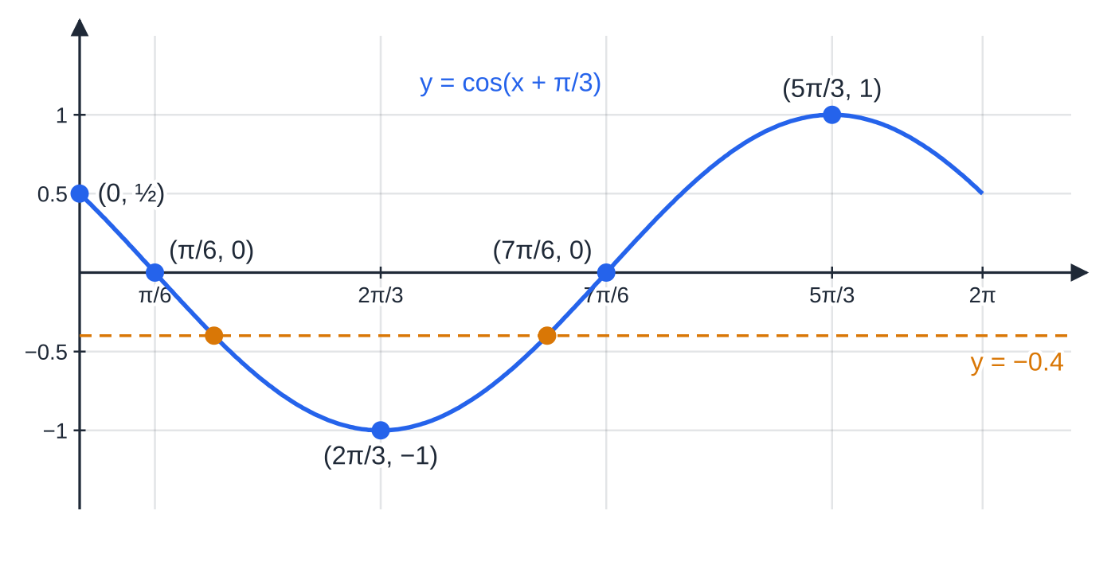
How do simple transformations change a trig graph? (continued)
Section 8 of 13 · Worked example 8 · Hard · Describe, Find, State
WORKED EXAMPLE · QUESTION
The curve C has equation y=cos(x+π/3), 0≤x≤2π. (a) Describe fully the transformation that maps y=cos x onto C. (b) Find the exact coordinates of the points where C meets the coordinate axes. (c) Find the coordinates of the maximum and minimum points of C. (d) State the number of solutions of cos(x+π/3)=-0.4 in the interval 0≤x≤2π.
SOLUTION
(a) A translation by π/3 in the negative x-direction, vector (-π/3, 0)
Worked example 8 plotted from y=cos(x+π/3). The amber points are the 2 intersections with y=-0.4, at x≈0.935 and 3.254.
Notes:
How do simple transformations change a trig graph?: Worked example 8. Full notes: https://examinerprep.com/notes/edexcel-ial-maths/trigonometry-triangles-radians-and-graphs/

Slide 37
How do simple transformations change a trig graph? (continued)
Section 8 of 13 · Worked example 8 · Hard · Describe, Find, State (continued)
(b) y-axis: put x=0, so y=cos π/3=½, giving (0, ½). x-axis: cos =0 when the inside is π/2 or 3π/2, so x+π/3=π/2 or 3π/2. (0, ½), (π/6, 0) and (7π/6, 0)
(c) The inside runs from π/3 to 7π/3. cos =-1 when the inside is π; cos =1 when the inside is 2π. Minimum (2π/3, -1), maximum (5π/3, 1)
(d) The line y=-0.4 cuts the curve on either side of the minimum: 2 solutions
Notes:
How do simple transformations change a trig graph?: Worked example 8. Full notes: https://examinerprep.com/notes/edexcel-ial-maths/trigonometry-triangles-radians-and-graphs/

Slide 38
How do simple transformations change a trig graph? (continued)
Section 8 of 13
Exam tip
When you sketch a transformed trig graph, label every intercept with the axis and every maximum and minimum with exact coordinates, and make the curve start and stop exactly at the ends of the stated interval.
Notes:
How do simple transformations change a trig graph?. Full notes: https://examinerprep.com/notes/edexcel-ial-maths/trigonometry-triangles-radians-and-graphs/

Slide 39
Exam tips for P1.5
Section 9 of 13
Exam tip 1 — check the mode before you start
Degrees for triangles given in degrees and for bearings; radians for arcs, sectors and graphs on 0≤x≤2π. Glance at the question for a ° symbol or a π and set the calculator first.
Exam tip 2 — choose the rule from what you know
Before writing anything, mark the given information on a sketch. A complete opposite pair means the sine rule; two sides with the angle between them, or three sides, means the cosine rule.
Exam tip 3 — exact means exact
"Give your answer in the form aπ+b√3" or "exact" means keep π and surds: use the exact values sin π/3=√3/2 and so on, and do not switch to decimals.
Notes:
Exam tips for P1.5. Full notes: https://examinerprep.com/notes/edexcel-ial-maths/trigonometry-triangles-radians-and-graphs/

Slide 40
Exam tips for P1.5 (continued)
Section 9 of 13
Exam tip 4 — show-that answers need more accuracy
To show that θ=1.591, write a value to more figures (1.5912…) before rounding. Simply quoting the target value does not show anything.
Exam tip 5 — read the command word
"Sketch" needs the correct shape with key points labelled, not an accurate plot; "write down" or "state" means little or no working is needed; "find" and "calculate" need visible working; "show that" needs every step.
Notes:
Exam tips for P1.5. Full notes: https://examinerprep.com/notes/edexcel-ial-maths/trigonometry-triangles-radians-and-graphs/

Slide 41
Common misconceptions
Section 10 of 13
Misconception | Why it is wrong | Correct idea
The sine rule only ever gives one angle. | sin θ=sin(180°-θ), and the calculator shows only the acute value. | Test the obtuse value 180°-θ against the angle sum.
½absin C works with any angle. | The formula needs the angle between sides a and b. | Use the included angle, or find it first.
A bearing is the angle between two paths. | Bearings are measured clockwise from north. | Draw north lines, then find the interior angles.
s=rθ works with θ in degrees. | The formula comes from 2πr for 2π radians. | Convert to radians first (or use θ/360×2πr).
sin(x+π/6) is sin x moved π/6 to the right. | The new curve reaches each value when x+π/6 equals the old x, that is π/6 earlier. | + inside the bracket moves the graph left.
sin 2x has twice the period of sin x. | The inside reaches 2π when x=π. | Period 2π/2=π: the curve is squashed horizontally.
Notes:
Common misconceptions. Full notes: https://examinerprep.com/notes/edexcel-ial-maths/trigonometry-triangles-radians-and-graphs/

Slide 42
How this topic connects
Section 11 of 13
P2 Pure Mathematics 2
The graphs and symmetries here are what you use to find every solution of a trigonometric equation in an interval, and the identities tan x=sin x/cos x and sin²x+cos²x=1 build on the same unit-circle ideas.
P1.3 Transformations, P3 and P4
The four transformation rules of P1.3 are exactly the ones used on trig graphs here. Radians are essential in calculus: the derivative of sin x is cos x only when x is in radians, and combined transformations such as Rsin(x+α) extend the last section.
M1 Mechanics and IAL Physics
Resolving forces, finding resultants and velocity triangles use the sine and cosine rules and bearings-style directions. Angular displacement and angular speed in circular motion are measured in radians, and oscillations follow sine and cosine graphs.
Notes:
How this topic connects. Full notes: https://examinerprep.com/notes/edexcel-ial-maths/trigonometry-triangles-radians-and-graphs/

Slide 43
Key formulae
Section 12 of 13
Formula | Use | In the formulae list?
a/sin A=b/sin B=c/sin C | sine rule: sides and angles in any triangle | No – learn it
a²=b²+c²-2bccos A | cosine rule: third side, or an angle from three sides | Yes
Area =½absin C | area of a triangle from two sides and the included angle | No – learn it
π rad=180° | converting between radians and degrees | No – learn it
s=rθ | arc length, θ in radians | No – learn it
A=½r²θ | sector area, θ in radians | No – learn it
½r²(θ-sin θ) | segment area | No – derive it
period 2π/b (sin, cos); π/b (tan) | period of sin bx, cos bx, tan bx | No – derive it
Notes:
Key formulae. Full notes: https://examinerprep.com/notes/edexcel-ial-maths/trigonometry-triangles-radians-and-graphs/

Slide 44
Check your understanding
Section 13 of 13
1. Write 225° in radians as an exact multiple of π, and convert 0.6 rad to degrees.
2. Find the area of a triangle with sides 7 cm and 9 cm and an angle of 110° between them.
3. A triangle has sides 5, 6 and 8 units. Find its largest angle.
4. A sector of radius 5 cm has area 15 cm². Find the angle of the sector and its arc length.
5. State the period of y=sin 3x and of y=tan 2x, and the exact value of sin 5π/6.
6. In triangle XYZ, XY=10 cm, YZ=12 cm and angle X=50°. Explain why there is only one possible triangle.
Notes:
Check your understanding: questions. Full notes: https://examinerprep.com/notes/edexcel-ial-maths/trigonometry-triangles-radians-and-graphs/

Slide 45
Check your understanding · answers
Section 13 of 13
1. 225×π/180= 5π/4. 0.6×180/π= 34.4°.
2. ½×7×9×sin 110°=29.60…= 29.6 cm² (3 s.f.).
3. Opposite the side of 8: cos θ=(25+36-64)/60=-0.05, so θ=92.9°.
4. ½×25×θ=15 gives θ=1.2 rad; arc =5×1.2= 6 cm.
5. 2π/3 and π/2. By symmetry, sin 5π/6=sin(π-π/6)=sin π/6= ½.
6. The side opposite the given angle (YZ=12) is the longer of the two given sides. sin Z=10sin 50°/12=0.638, so Z=39.7° or 140.3°; but 50°+140.3°>180°, so only Z=39.7° works and there is one triangle.
Notes:
Check your understanding: answers. Full notes: https://examinerprep.com/notes/edexcel-ial-maths/trigonometry-triangles-radians-and-graphs/

Slide 46
Practice questions
2 original exam-style questions. Answers at the end of the deck.

Slide 47
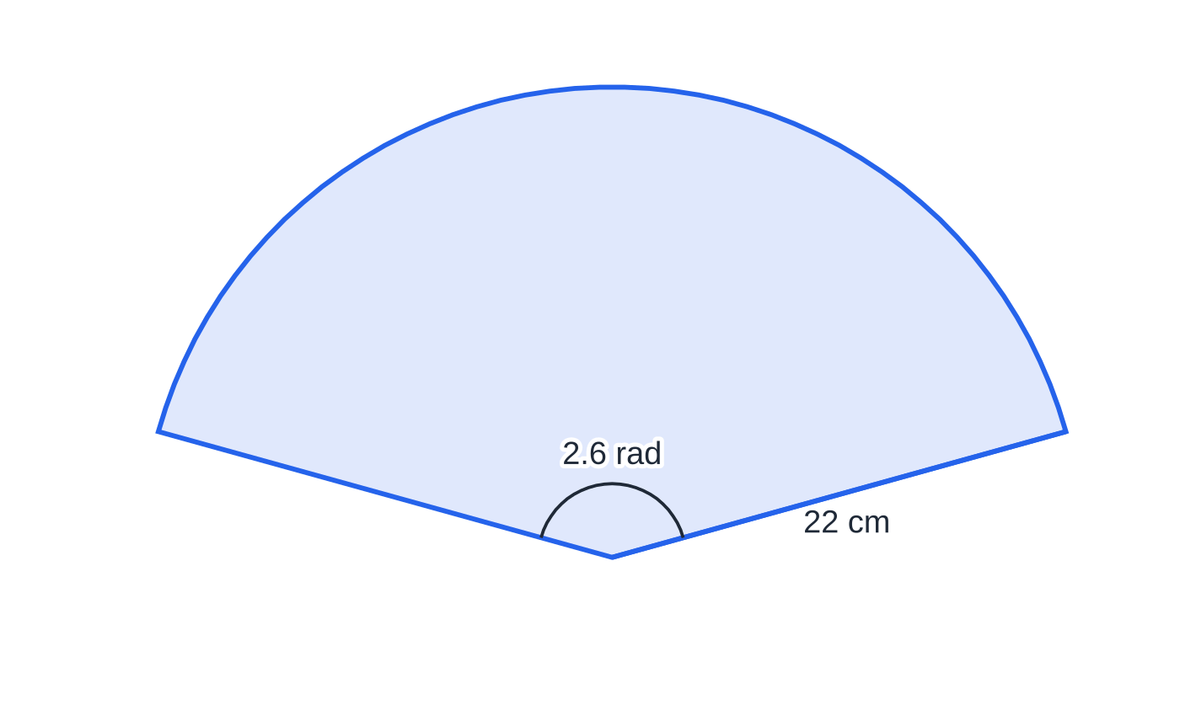
Question 1
5 marks
When a paper hand fan is fully open, it forms a sector of a circle with radius 22 cm and angle 2.6 radians at the centre.
Figure: the open fan as a sector (not to scale)
(a) Convert 2.6 radians to degrees, giving your answer to 1 decimal place. [1]
(b) Find the length of the curved edge of the open fan. [2]
(c) Find the area of the open fan. [2]
Notes:
Online with the full mark scheme: https://examinerprep.com/ial-maths-p1-5-trigonometry-triangles-radians-and-graphs-questions#IALM-P1-5-B-02

Slide 48
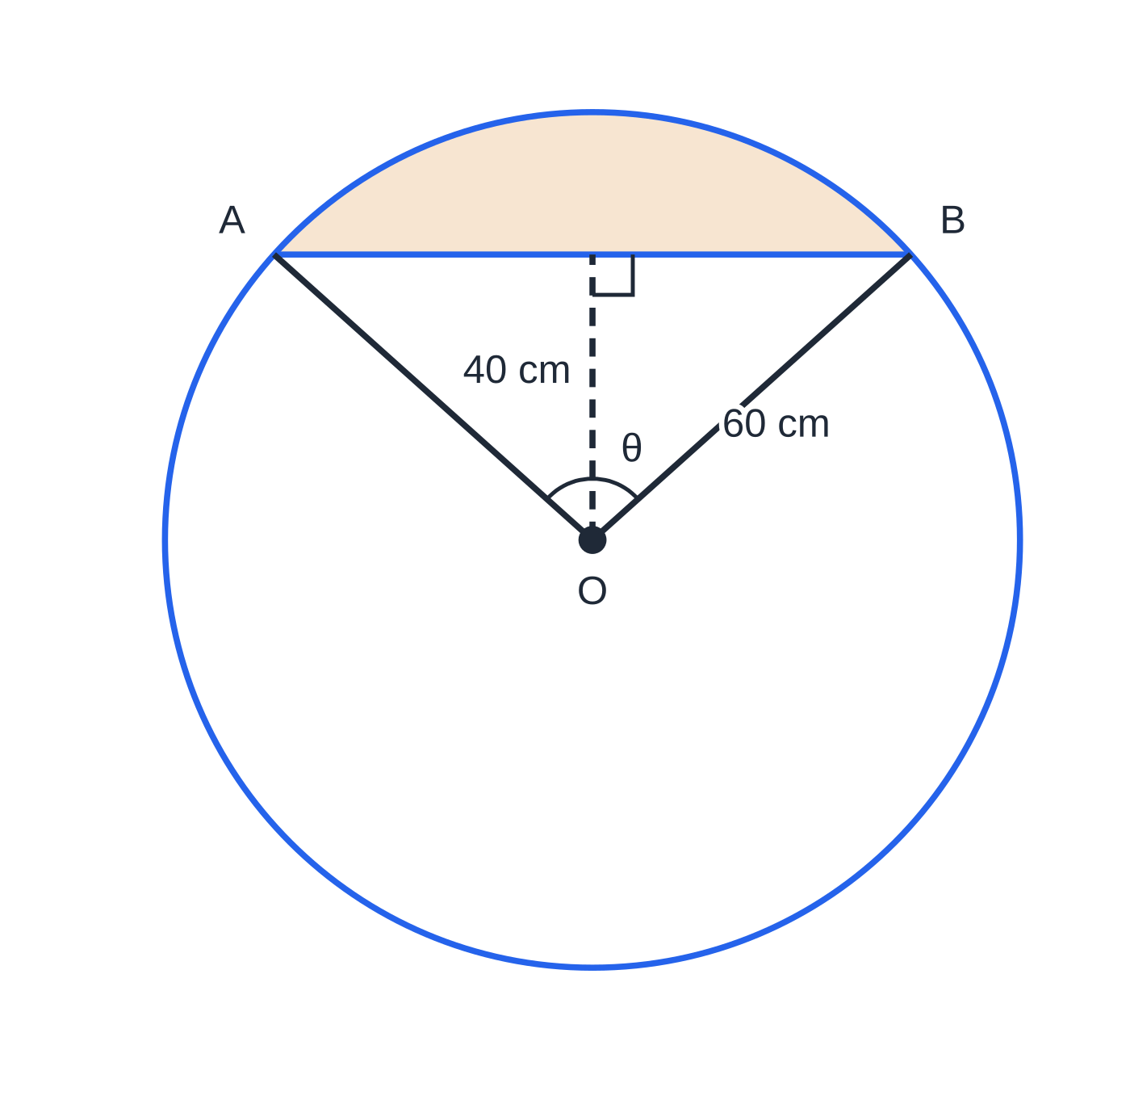
Question 2
7 marks
A circular tabletop has centre O and radius 60 cm. To fit it against a wall, a straight cut is made along a chord AB whose perpendicular distance from O is 40 cm. The smaller piece is removed. Angle AOB = θ radians.
Figure: the tabletop with the removed piece shaded (not to scale)
(a) Show that θ = 1.682 to 3 decimal places. [2]
(b) Find the area of the piece that is removed. [3]
(c) Find the percentage of the area of the original tabletop that is removed. [2]
Notes:
Online with the full mark scheme: https://examinerprep.com/ial-maths-p1-5-trigonometry-triangles-radians-and-graphs-questions#IALM-P1-5-B-07

Slide 49
Answers

Slide 50
Question 1 · answer
Mark scheme
2.6 × 180/π = 149.0° (148.97…)
s = rθ = 22 × 2.6
= 57.2 cm
½ × 22² × 2.6
= 629 cm² (629.2)
Notes:
Full mark scheme: https://examinerprep.com/ial-maths-p1-5-trigonometry-triangles-radians-and-graphs-questions#IALM-P1-5-B-02

Slide 51
Question 2 · answer
Mark scheme
cos(θ/2) = 40/60
θ = 2 cos⁻¹(2/3) = 1.68213… = 1.682
sector: ½ × 60² × 1.6821 (= 3027.8)
triangle: ½ × 60² × sin 1.6821 (= 1788.9)
segment = 1240 cm² (1239.0)
1239.0 ÷ (π × 60²) × 100
= 11.0%
Notes:
Full mark scheme: https://examinerprep.com/ial-maths-p1-5-trigonometry-triangles-radians-and-graphs-questions#IALM-P1-5-B-07

Slide 52
Keep practising
Notes for this topic
Questions on this topic
Build a printable test
ExaminerPrep is an independent tutoring service. It has been developed independently from and is not endorsed by the International Baccalaureate Organization. "International Baccalaureate", "IB" and "IB Diploma Programme" are registered trademarks of the IBO, used here for descriptive purposes only.
Pearson Edexcel and Cambridge are trademarks of their owners; ExaminerPrep is not affiliated with any exam board.

