Slide 1
EP
EDEXCEL IAL MATHS
M2.2 Variable acceleration and vectors with calculus
The full notes page in 12 sections · practice questions with answers · simulations
ExaminerPrep is an independent tutoring service. It has been developed independently from and is not endorsed by the International Baccalaureate Organization. "International Baccalaureate", "IB" and "IB Diploma Programme" are registered trademarks of the IBO, used here for descriptive purposes only.
Pearson Edexcel and Cambridge are trademarks of their owners; ExaminerPrep is not affiliated with any exam board.
Notes:
M2.2 Variable acceleration and vectors with calculus. Notes for this topic: https://examinerprep.com/notes/edexcel-ial-maths/variable-acceleration-and-vectors-with-calculus/

Slide 2
What this page covers
Overview
Finding velocity and acceleration by differentiating displacement with respect to time
Finding velocity and displacement by integrating, using initial conditions to fix the constants
When a particle is at rest, its greatest (or least) velocity, and the distance travelled when it changes direction
Polynomial functions of time and powers of t (including negative and fractional powers), and motion defined in stages
Position, velocity and acceleration vectors in i, j form: v = dr/dt, a = dv/dt, and integrating back
Speed at a given time, moving due north or east, moving parallel to a given vector, and the force from F = ma
Notes:
What this page covers. Full notes: https://examinerprep.com/notes/edexcel-ial-maths/variable-acceleration-and-vectors-with-calculus/

Slide 3
In one minute
Key points
1. When acceleration changes with time the constant-acceleration formulae stop working, so you differentiate to go from displacement to velocity to acceleration and integrate to come back, doing the same to each component of a vector.
2. Differentiate down: v = dx/dt and a = dv/dt = d²x/dt².
3. Integrate up: v = ∫a dt and x = ∫v dt. Every integration needs a constant, fixed by an initial condition.
4. At rest: v = 0. Greatest or least velocity: dv/dt = 0, i.e. a = 0, and check the end points of the interval.
5. Distance travelled: find when v = 0, split the interval there, and add the sizes of the displacements on each piece.
6. Vectors: treat the i and j components separately. Speed = |v| = √(p² + q²); due north means i-component 0 and j-component positive; force F = ma.
Notes:
In one minute. Full notes: https://examinerprep.com/notes/edexcel-ial-maths/variable-acceleration-and-vectors-with-calculus/

Slide 4
How do you get velocity and acceleration from displacement?
Section 1 of 12
A particle P moves along a straight line, and its displacement x from a fixed point O on the line is a function of time t; positive and negative x are on opposite sides of O. Velocity is the rate of change of displacement and acceleration is the rate of change of velocity, so you differentiate once for velocity and twice for acceleration.
Differentiating down the chain. v = dx/dt and a = dv/dt = d²x/dt², with x in m, v in m s⁻¹, a in m s⁻² and t in s. Dot notation is also used: ẋ = dx/dt, ẍ = d²x/dt².
On a displacement–time graph the velocity is the gradient; on a velocity–time graph the acceleration is the gradient. The particle is instantaneously at rest when v = 0, and if v changes sign there, it changes direction. The constant-acceleration formulae need a to be constant: if a depends on t, they give wrong answers.
Notes:
How do you get velocity and acceleration from displacement?. Full notes: https://examinerprep.com/notes/edexcel-ial-maths/variable-acceleration-and-vectors-with-calculus/

Slide 5
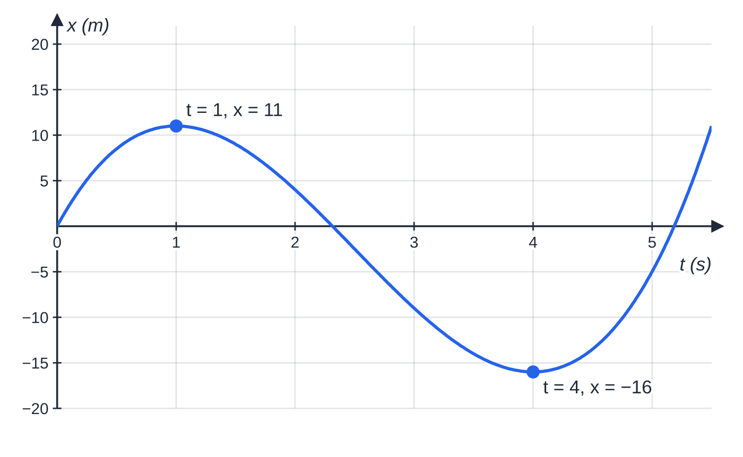
How do you get velocity and acceleration from displacement? (continued)
Section 1 of 12 · Worked example 1 · Easy · Find
WORKED EXAMPLE · QUESTION
A particle P moves along a straight line. At time t seconds, its displacement from a fixed point O on the line is x metres, where x = 2t³ - 15t² + 24t, t ≥0. (a) Find expressions for the velocity and the acceleration of P at time t. (b) Find the times at which P is instantaneously at rest, and its displacement from O at each of these times. (c) Find the acceleration of P at each of these times.
Displacement–time graph for worked example 1. It is flat (gradient zero) at t = 1 and t = 4, where P is momentarily at rest.
Notes:
How do you get velocity and acceleration from displacement?: Worked example 1. Full notes: https://examinerprep.com/notes/edexcel-ial-maths/variable-acceleration-and-vectors-with-calculus/

Slide 6
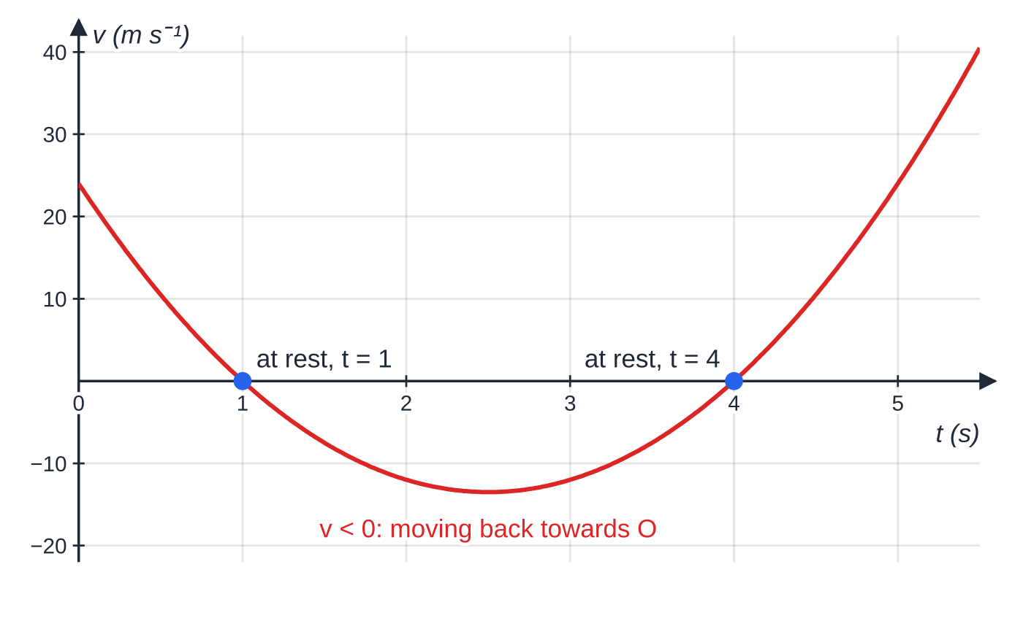
How do you get velocity and acceleration from displacement? (continued)
Section 1 of 12 · Worked example 1 · Easy · Find (continued)
SOLUTION
(a) v = 6t² - 30t + 24, a = 12t - 30
(b) v = 6(t² - 5t + 4) = 6(t - 1)(t - 4) = 0, so t = 1 or t = 4. Then x(1) = 2 - 15 + 24 = 11 and x(4) = 128 - 240 + 96 = -16. t = 1 s, x = 11 m; t = 4 s, x = −16 m
(c) a(1) = 12 - 30 and a(4) = 48 - 30. −18 m s⁻² and 18 m s⁻²
At t = 4, P is 16 m on the negative side of O: a displacement is a position, not a distance travelled.
The velocity–time graph crosses zero exactly where the x–t graph is flat. Between t = 1 and t = 4, v < 0 and P moves back towards, and past, O.
Notes:
How do you get velocity and acceleration from displacement?: Worked example 1. Full notes: https://examinerprep.com/notes/edexcel-ial-maths/variable-acceleration-and-vectors-with-calculus/

Slide 7
How do you work back from acceleration to velocity and displacement?
Section 2 of 12
Integration reverses differentiation: v = ∫a dt and x = ∫v dt. Each indefinite integral has a constant of integration, found from an initial condition such as "starts from rest" (v = 0 when t = 0) or "passes through O when t = 0" (x = 0 when t = 0). The condition may be at a later time, e.g. "v = 5 when t = 2": substitute and solve for the constant. A definite integral ∫_(t₁)^(t₂) v dt gives the change in displacement between two times, the signed area under the v–t graph.
For the greatest or least velocity, solve dv/dt = 0, that is a = 0. If a changes from positive to negative there, v has a maximum; also check the ends of the time interval. If a is constant, integrating twice gives v = u + at and s = ut + ½at², so the M1 formulae are a special case.
Notes:
How do you work back from acceleration to velocity and displacement?. Full notes: https://examinerprep.com/notes/edexcel-ial-maths/variable-acceleration-and-vectors-with-calculus/

Slide 8
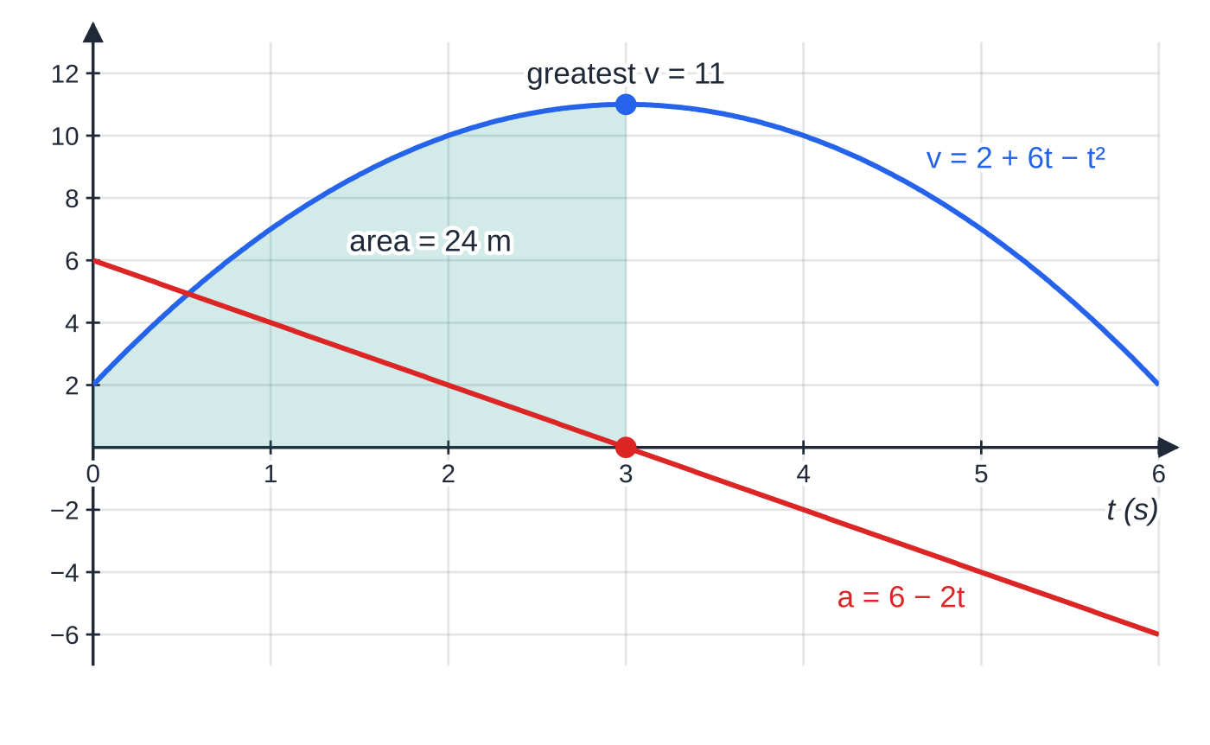
How do you work back from acceleration to velocity and displacement? (continued)
Section 2 of 12 · Worked example 2 · Medium · Find
WORKED EXAMPLE · QUESTION
A particle moves along a straight line. At time t seconds its acceleration is (6 - 2t) m s⁻². When t = 0 the particle is at the point O on the line and its velocity is 2 m s⁻¹. (a) Find the greatest velocity of the particle. (b) Find its displacement from O at the time when this greatest velocity is reached.
SOLUTION
(a) v = 6t - t² + c, and v = 2 when t = 0 gives c = 2: v = 2 + 6t - t². Greatest velocity where a = 0: 6 - 2t = 0, t = 3, and v = 2 + 18 - 9 = 11.
Worked example 2: the acceleration line crosses zero at t = 3, exactly where the velocity curve has its maximum. The shaded area under the v–t curve from 0 to 3 is the displacement, 24 m.
Notes:
How do you work back from acceleration to velocity and displacement?: Worked example 2. Full notes: https://examinerprep.com/notes/edexcel-ial-maths/variable-acceleration-and-vectors-with-calculus/

Slide 9
How do you work back from acceleration to velocity and displacement? (continued)
Section 2 of 12 · Worked example 2 · Medium · Find (continued)
It is a maximum: a > 0 before t = 3 and a < 0 after (or d²v/dt² = -2 < 0). 11 m s⁻¹
(b) Integrate again; x = 0 when t = 0 gives a zero constant: x = 2t + 3t² - t³/3. At t = 3: x = 6 + 27 - 9. 24 m
Notes:
How do you work back from acceleration to velocity and displacement?: Worked example 2. Full notes: https://examinerprep.com/notes/edexcel-ial-maths/variable-acceleration-and-vectors-with-calculus/

Slide 10
How do you work back from acceleration to velocity and displacement? (continued)
Section 2 of 12
Common error — the missing constant
Leaving out the constant of integration, or assuming it is zero. "Starts with velocity 2 m s⁻¹" means c = 2 in the velocity, not 0. Write "+ c" every time and then find it.
Notes:
How do you work back from acceleration to velocity and displacement?. Full notes: https://examinerprep.com/notes/edexcel-ial-maths/variable-acceleration-and-vectors-with-calculus/

Slide 11
How do you find the distance travelled when a particle turns round?
Section 3 of 12
∫v dt gives the displacement: motion backwards counts as negative and cancels some of the forward motion. The distance travelled counts every metre, forwards or backwards. So find the times in the interval when v = 0 (and v changes sign), find the displacement at each of these times and at the ends of the interval, and add the sizes of the changes in displacement on each piece. On the v–t graph this is the total area between the curve and the time axis, with areas below the axis counted as positive. A sketch of the motion on a line keeps track of where the particle is and which way it is going.
Notes:
How do you find the distance travelled when a particle turns round?. Full notes: https://examinerprep.com/notes/edexcel-ial-maths/variable-acceleration-and-vectors-with-calculus/

Slide 12
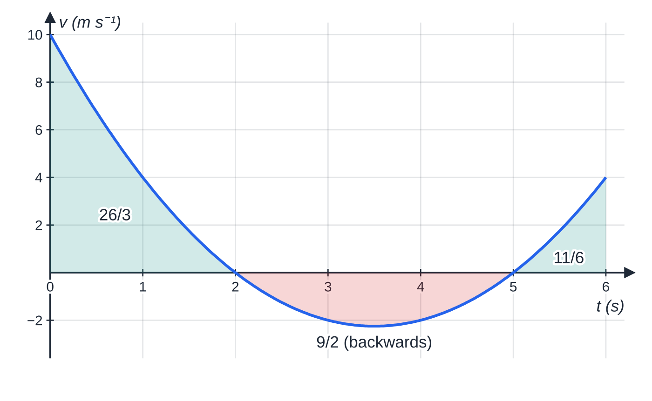
How do you find the distance travelled when a particle turns round? (continued)
Section 3 of 12 · Worked example 3 · Medium · Find
WORKED EXAMPLE · QUESTION
A particle P starts at O and moves along a straight line. At time t seconds its velocity is v m s⁻¹, where v = t² - 7t + 10. Find the total distance travelled by P in the interval 0 ≤t ≤6.
Areas between the v–t curve and the axis for worked example 3. The red area (below the axis) is backward motion, counted as positive for distance.
Notes:
How do you find the distance travelled when a particle turns round?: Worked example 3. Full notes: https://examinerprep.com/notes/edexcel-ial-maths/variable-acceleration-and-vectors-with-calculus/

Slide 13
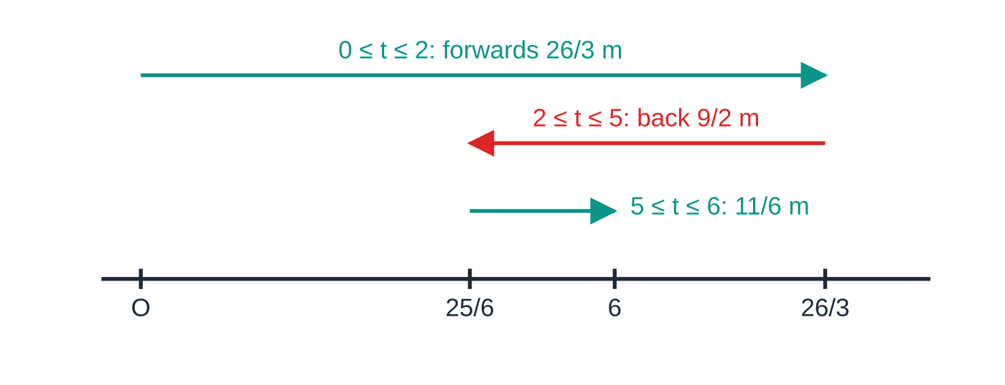
How do you find the distance travelled when a particle turns round? (continued)
Section 3 of 12 · Worked example 3 · Medium · Find (continued)
SOLUTION
At rest: (t - 2)(t - 5) = 0, so t = 2 and t = 5, and v changes sign at each.
Displacement, with x = 0 when t = 0: x = t³/3 - 7t²/2 + 10t, so x(2) = (26/3), x(5) = (25/6) and x(6) = 6.
Distance = (26/3) + ((26/3) - (25/6)) + (6 - (25/6)) = (52/6) + (27/6) + (11/6). 15 m
∫₀⁶ v dt = 6 m is the displacement, not the distance; it only equals the distance if v never changes sign.
The same motion drawn on the line, positions to scale. Distance = 26/3 + 9/2 + 11/6 = 15 m, but P finishes only 6 m from O.
Notes:
How do you find the distance travelled when a particle turns round?: Worked example 3. Full notes: https://examinerprep.com/notes/edexcel-ial-maths/variable-acceleration-and-vectors-with-calculus/

Slide 14
How do you find the distance travelled when a particle turns round? (continued)
Section 3 of 12
Exam tip — check for v = 0 first
If a question asks for "the distance travelled", check whether v = 0 inside the interval before you integrate. If it does, show the split explicitly: "P changes direction at t = 2, so distance = |x(2) - x(0)| + |x(5) - x(2)| + …".
Notes:
How do you find the distance travelled when a particle turns round?. Full notes: https://examinerprep.com/notes/edexcel-ial-maths/variable-acceleration-and-vectors-with-calculus/

Slide 15
What changes for negative powers and stage-by-stage motion?
Section 4 of 12
Nothing in the method changes, only the powers of t. Use the results from P1 and P2: d/dt(tⁿ) = ntⁿ⁻¹ for any rational n, e.g. d/dt(t⁻²) = -2t⁻³ and d/dt(t^(3/2)) = (3/2)t^(1/2); and ∫tⁿ dt = tⁿ⁺¹/(n+1) + c for n ≠-1. Rewrite fractions first: 48/t² = 48t⁻² and √t = t^(1/2). A velocity such as 12 - 48t⁻² approaches a limiting value (12) but never reaches it, because 48t⁻² > 0 for every t.
Motion is often defined in stages, e.g. one formula for 0 ≤t ≤3 and another for t > 3. Work each stage with its own formula; the velocity and displacement at the change-over time link the stages. (Exponential or trigonometric functions of time need P3 and P4 calculus and are not in M2.)
Notes:
What changes for negative powers and stage-by-stage motion?. Full notes: https://examinerprep.com/notes/edexcel-ial-maths/variable-acceleration-and-vectors-with-calculus/

Slide 16
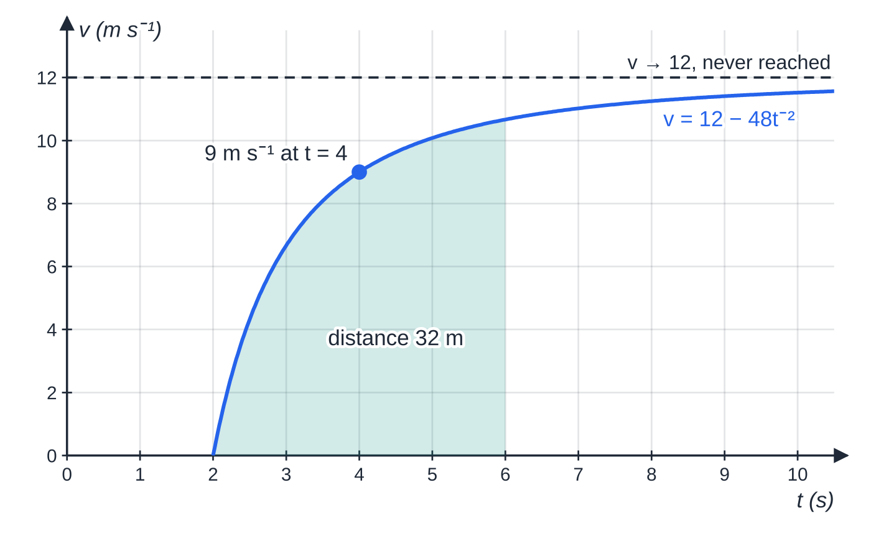
What changes for negative powers and stage-by-stage motion? (continued)
Section 4 of 12 · Worked example 4 · Medium · Find / Explain
WORKED EXAMPLE · QUESTION
A small electric cart moves along a straight track. It is released from rest at O when t = 2, and for t ≥2 its velocity is v m s⁻¹, where v = 12 - 48t⁻². (a) Find the acceleration of the cart when t = 2. (b) Explain why the speed of the cart never reaches 12 m s⁻¹. (c) Find the time at which the speed is 9 m s⁻¹. (d) Find the distance travelled between t = 2 and t = 6.
SOLUTION
(a) a = -48 ×(-2)t⁻³ = 96t⁻³; at t = 2, a = 96 ÷8. 12 m s⁻²
Worked example 4: the gradient (acceleration) is greatest at the start and dies away; the velocity approaches 12 m s⁻¹. The shaded area is the 32 m travelled from t = 2 to t = 6.
Notes:
What changes for negative powers and stage-by-stage motion?: Worked example 4. Full notes: https://examinerprep.com/notes/edexcel-ial-maths/variable-acceleration-and-vectors-with-calculus/

Slide 17
What changes for negative powers and stage-by-stage motion? (continued)
Section 4 of 12 · Worked example 4 · Medium · Find / Explain (continued)
(b) 48t⁻² > 0 for all t, so v < 12 at every time.
(c) 12 - 48t⁻² = 9 gives 48t⁻² = 3, t² = 16. t = 4 s (t = -4 is rejected)
(d) v ≥0 for t ≥2 (since t² ≥4), so distance = displacement: ∫₂⁶ (12 - 48t⁻²) dt = [12t + 48t⁻¹]₂⁶ = (72 + 8) - (24 + 24). 32 m
Notes:
What changes for negative powers and stage-by-stage motion?: Worked example 4. Full notes: https://examinerprep.com/notes/edexcel-ial-maths/variable-acceleration-and-vectors-with-calculus/

Slide 18
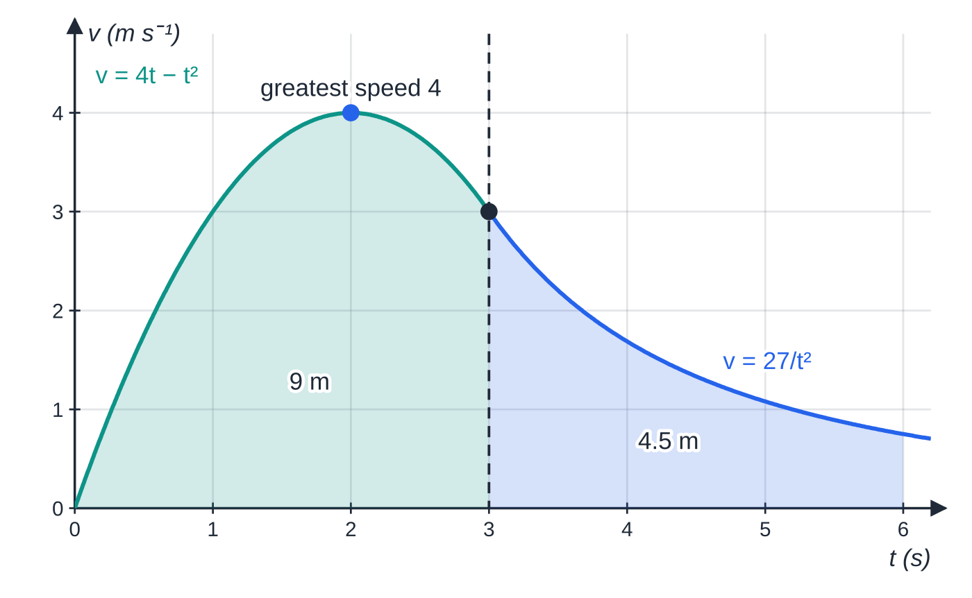
What changes for negative powers and stage-by-stage motion? (continued)
Section 4 of 12 · Worked example 5 · Hard · Find
WORKED EXAMPLE · QUESTION
A particle P moves along a straight line, starting from rest at O. At time t seconds its velocity is v m s⁻¹, where v = 4t - t² for 0 ≤t ≤3 and v = 27/t² for t > 3. (a) Find the greatest speed of P for 0 ≤t ≤3. (b) Find the distance travelled by P in the first 3 s. (c) Find the acceleration of P when t = 6. (d) Find the total distance travelled by P in the first 6 s.
SOLUTION
(a) dv/dt = 4 - 2t = 0 gives t = 2 and v = 8 - 4 = 4; at the ends v = 0 (t = 0) and 3 (t = 3). 4 m s⁻¹
Worked example 5: two formulae meeting at t = 3 with the same velocity, 3 m s⁻¹. The two shaded areas are the 9 m and 4.5 m travelled in each stage.
Notes:
What changes for negative powers and stage-by-stage motion?: Worked example 5. Full notes: https://examinerprep.com/notes/edexcel-ial-maths/variable-acceleration-and-vectors-with-calculus/

Slide 19
What changes for negative powers and stage-by-stage motion? (continued)
Section 4 of 12 · Worked example 5 · Hard · Find (continued)
(b) v = t(4 - t) ≥0 on 0 ≤t ≤3, so there is no change of direction: ∫₀³ (4t - t²) dt = [2t² - t³/3]₀³ = 18 - 9. 9 m
(c) For t > 3, v = 27t⁻², so a = -54t⁻³; at t = 6, a = -54 ÷216. −0.25 m s⁻² (a deceleration of 0.25 m s⁻²)
(d) For t > 3, v > 0, so again no change of direction: ∫₃⁶ 27t⁻² dt = [-27t⁻¹]₃⁶ = -4.5 + 9 = 4.5. Total = 9 + 4.5. 13.5 m
Both formulae give v = 3 at t = 3, so the velocity is continuous at the change-over: a useful check.
Notes:
What changes for negative powers and stage-by-stage motion?: Worked example 5. Full notes: https://examinerprep.com/notes/edexcel-ial-maths/variable-acceleration-and-vectors-with-calculus/

Slide 20
How do you differentiate a position vector?
Section 5 of 12
For motion in a plane, the position vector of P relative to O is r = xi + yj, with x and y functions of t; often i points east and j north. The unit vectors are constant, so differentiate each component separately: v = ẋi + ẏj and a = ẍi + ÿj.
Calculus with vectors. v = dr/dt, a = dv/dt = d²r/dt², F = ma. For v = pi + qj, speed = |v| = √(p² + q²); the magnitude of a force is found the same way.
The direction of motion is the direction of v, e.g. the angle tan⁻¹(q/p) with i, taking care with the quadrant. Moving due east: j-component of v zero and i-component positive. Due north: i-component zero and j-component positive. (Due west and south: the other component negative.)
Notes:
How do you differentiate a position vector?. Full notes: https://examinerprep.com/notes/edexcel-ial-maths/variable-acceleration-and-vectors-with-calculus/

Slide 21
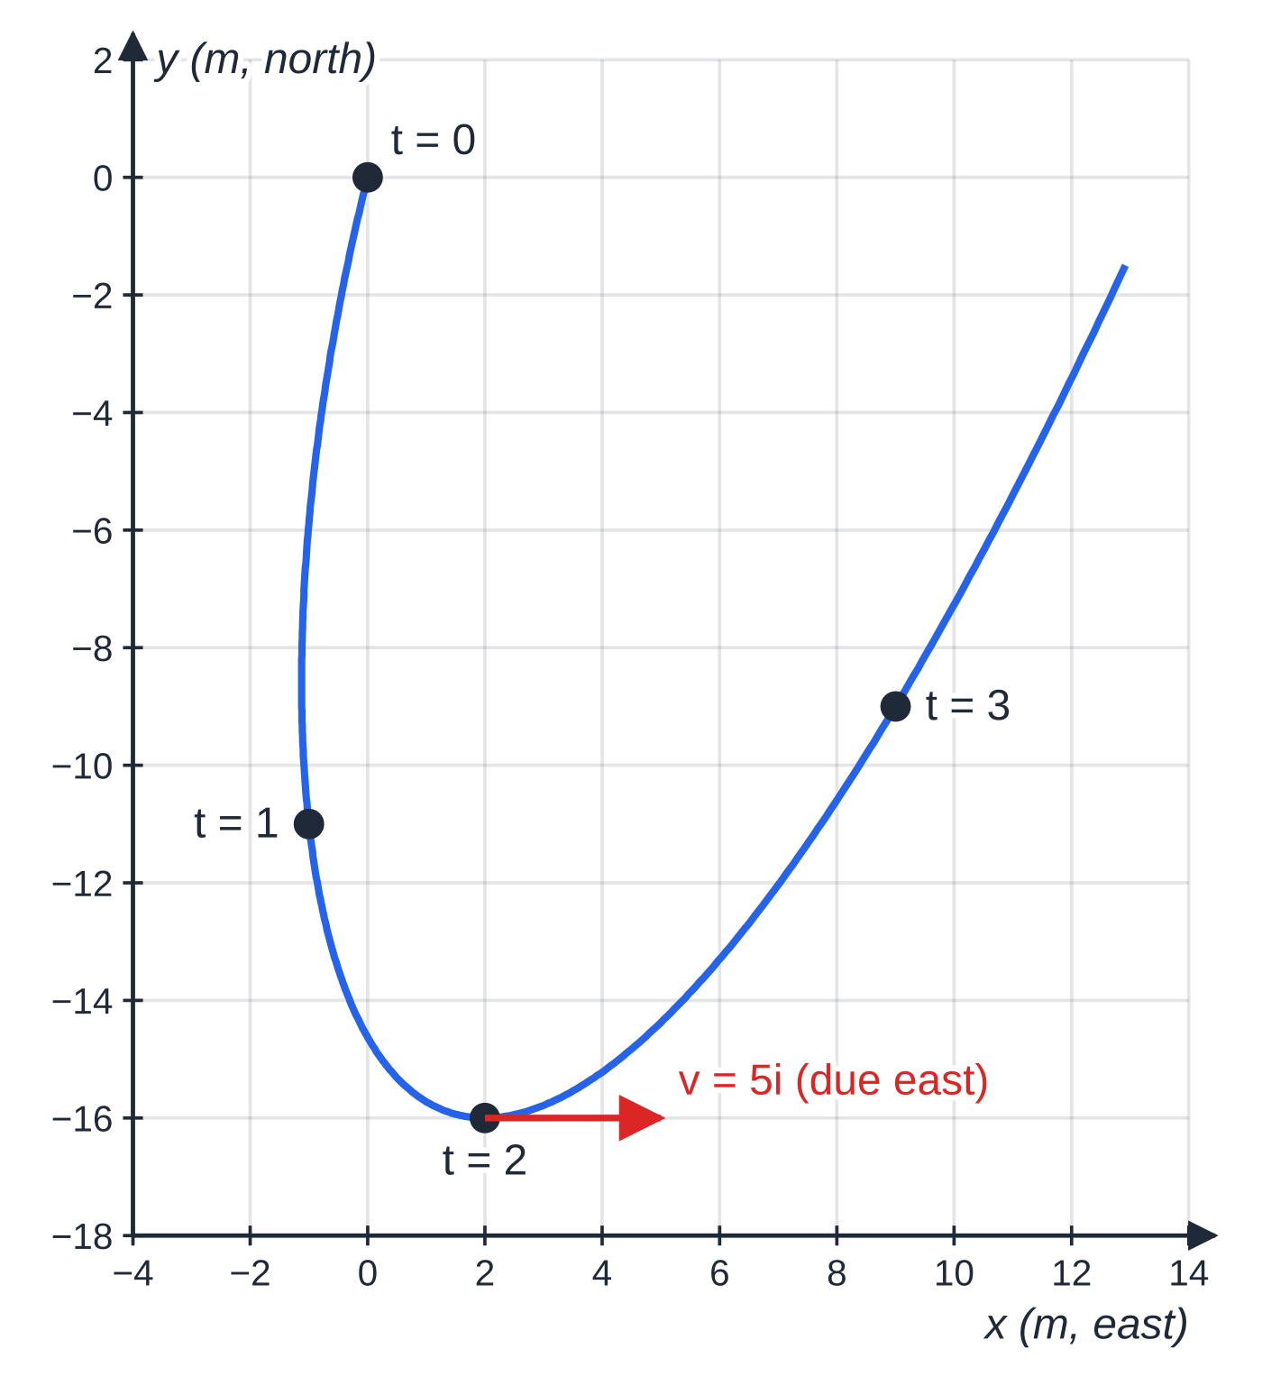
How do you differentiate a position vector? (continued)
Section 5 of 12 · Worked example 6 · Medium · Find
WORKED EXAMPLE · QUESTION
A particle P of mass 0.5 kg moves in a horizontal plane. At time t seconds its position vector relative to a fixed point O is r metres, where r = (2t² - 3t)i + (t³ - 12t)j, t ≥0. The unit vectors i and j are directed due east and due north. (a) Find the speed of P when t = 1. (b) Find the time at which P is moving due east. (c) Find the magnitude of the resultant force on P at that time.
SOLUTION
(a) v = (4t - 3)i + (3t² - 12)j; at t = 1, v = i - 9j, speed = √(1² + 9²) = √82. 9.06 m s⁻¹
(b) Due east needs the j-component zero: 3t² - 12 = 0, t = 2 (t = -2 rejected). At t = 2 the i-component is 5 > 0. t = 2 s
The path of P in worked example 6 for 0 ≤ t ≤ 3.4. The velocity is along the tangent; at t = 2 it is 5i, so P is moving due east at its most southerly point.
Notes:
How do you differentiate a position vector?: Worked example 6. Full notes: https://examinerprep.com/notes/edexcel-ial-maths/variable-acceleration-and-vectors-with-calculus/

Slide 22
How do you differentiate a position vector? (continued)
Section 5 of 12 · Worked example 6 · Medium · Find (continued)
(c) a = 4i + 6tj; at t = 2, a = 4i + 12j and F = 0.5(4i + 12j) = 2i + 6j, so |F| = √40. 6.32 N
Notes:
How do you differentiate a position vector?: Worked example 6. Full notes: https://examinerprep.com/notes/edexcel-ial-maths/variable-acceleration-and-vectors-with-calculus/

Slide 23
How do you integrate a vector with initial conditions?
Section 6 of 12
Integrate each component separately. The constant of integration is now a constant vector, c = c₁i + c₂j, found from the given initial velocity or position. If you are given the force instead of the acceleration, divide by the mass first: a = F/m. The distance of P from O at a given time is |r|.
Notes:
How do you integrate a vector with initial conditions?. Full notes: https://examinerprep.com/notes/edexcel-ial-maths/variable-acceleration-and-vectors-with-calculus/

Slide 24
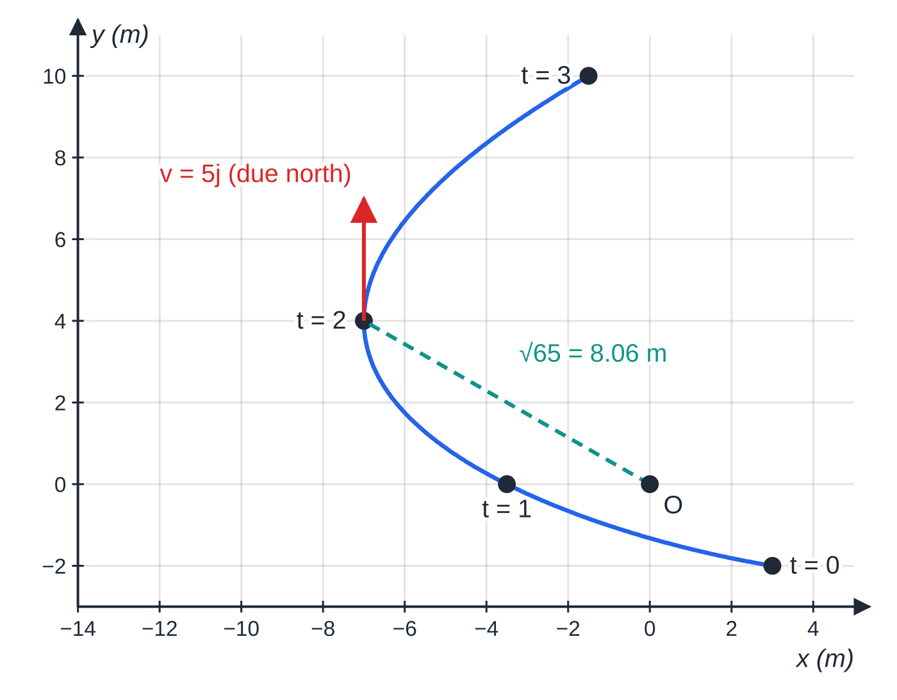
How do you integrate a vector with initial conditions? (continued)
Section 6 of 12 · Worked example 7 · Medium · Show that / Find
WORKED EXAMPLE · QUESTION
A particle of mass 2 kg moves in a horizontal plane under the action of a single force F newtons, where F = (12t - 6)i + 4j at time t seconds. When t = 0 the particle has velocity (-6i + j) m s⁻¹ and position vector (3i - 2j) m relative to a fixed point O. The unit vectors i and j are directed due east and due north. (a) Find the velocity at time t. (b) Show that the particle is moving due north when t = 2. (c) Find the distance of the particle from O when t = 2.
SOLUTION
(a) a = (6t - 3)i + 2j, so v = (3t² - 3t)i + 2tj + c, and t = 0 gives c = -6i + j. v = (3t² - 3t - 6)i + (2t + 1)j
Worked example 7: the path from (3, −2) for 0 ≤ t ≤ 3. At t = 2 the particle is at (−7, 4), moving due north, √65 m from O.
Notes:
How do you integrate a vector with initial conditions?: Worked example 7. Full notes: https://examinerprep.com/notes/edexcel-ial-maths/variable-acceleration-and-vectors-with-calculus/

Slide 25
How do you integrate a vector with initial conditions? (continued)
Section 6 of 12 · Worked example 7 · Medium · Show that / Find (continued)
(b) At t = 2: v = (12 - 6 - 6)i + 5j = 5j: i-component zero and j-component positive, so due north.
(c) Integrate, with r = 3i - 2j when t = 0: r = (t³ - (3/2)t² - 6t + 3)i + (t² + t - 2)j. At t = 2, r = -7i + 4j, distance = √(7² + 4²) = √65. 8.06 m
Notes:
How do you integrate a vector with initial conditions?: Worked example 7. Full notes: https://examinerprep.com/notes/edexcel-ial-maths/variable-acceleration-and-vectors-with-calculus/

Slide 26
How do you integrate a vector with initial conditions? (continued)
Section 6 of 12
Common error — one constant for two integrations
Using the initial velocity as the constant for the position, or forgetting the second constant. The first constant comes from the initial velocity, the second from the initial position.
Notes:
How do you integrate a vector with initial conditions?. Full notes: https://examinerprep.com/notes/edexcel-ial-maths/variable-acceleration-and-vectors-with-calculus/

Slide 27
How do you tell when a particle moves parallel to a vector?
Section 7 of 12
v = pi + qj is parallel to αi + βj when v = k(αi + βj) for some number k, i.e. when βp = αq. That gives an equation in t. Solve it, then check the sign of k: if k > 0 the particle moves in the direction of the vector; if k < 0 it moves the opposite way. "Moving parallel to j" is the case p = 0. The resultant force at any time is F = ma, with magnitude √(Fₓ² + F_y²).
Notes:
How do you tell when a particle moves parallel to a vector?. Full notes: https://examinerprep.com/notes/edexcel-ial-maths/variable-acceleration-and-vectors-with-calculus/

Slide 28
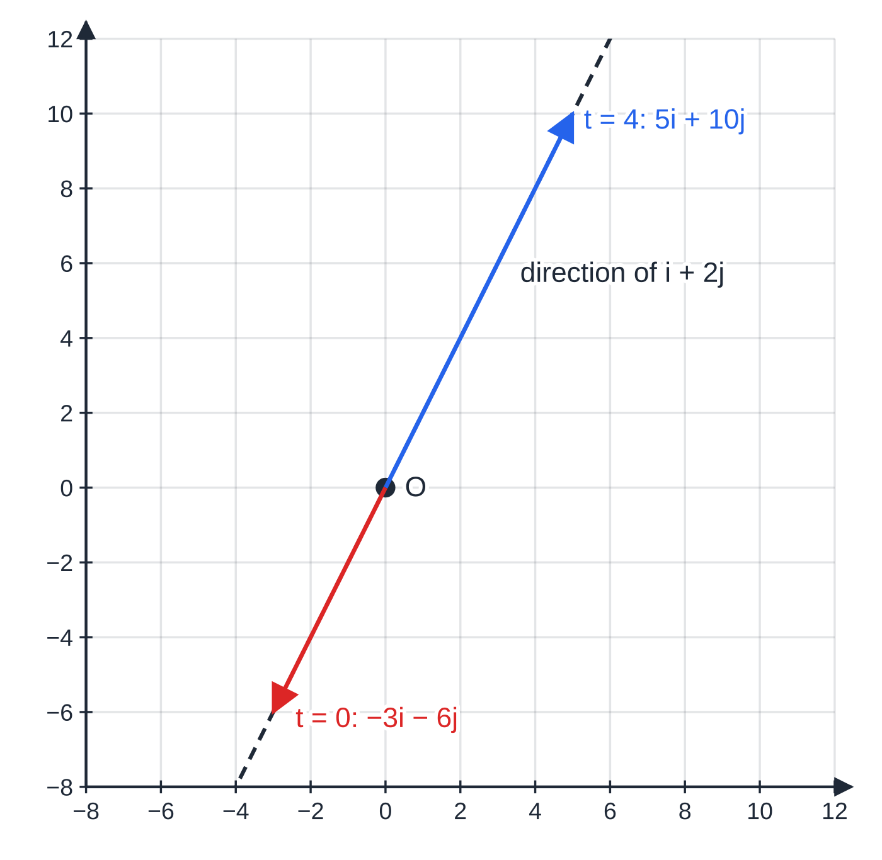
How do you tell when a particle moves parallel to a vector? (continued)
Section 7 of 12 · Worked example 8 · Hard · Find
WORKED EXAMPLE · QUESTION
A particle P of mass 0.4 kg moves in a horizontal plane. At time t seconds its velocity is v m s⁻¹, where v = (2t - 3)i + (t² - 6)j, t ≥0. When t = 0, P is at the point with position vector (2i + 5j) m relative to O. The unit vectors i and j are directed due east and due north. (a) Find the values of t for which P is moving parallel to (i + 2j), and state for which of them P moves in the direction of i + 2j. (b) Find the magnitude of the resultant force on P at that time. (c) Find the time at which P is moving due east. (d) Find the distance of P from O when t = 3.
Worked example 8: at t = 0 and t = 4 the velocity lies along the dashed direction of i + 2j. At t = 4 it points the same way as i + 2j; at t = 0 the opposite way.
Notes:
How do you tell when a particle moves parallel to a vector?: Worked example 8. Full notes: https://examinerprep.com/notes/edexcel-ial-maths/variable-acceleration-and-vectors-with-calculus/

Slide 29
How do you tell when a particle moves parallel to a vector? (continued)
Section 7 of 12 · Worked example 8 · Hard · Find (continued)
SOLUTION
(a) The j-component is twice the i-component: t² - 6 = 2(2t - 3), so t² - 4t = 0, t = 0 or t = 4. At t = 0, v = -3i - 6j = -3(i + 2j); at t = 4, v = 5i + 10j = 5(i + 2j). t = 0 and t = 4; in the direction of i + 2j at t = 4
(b) a = 2i + 2tj; at t = 4, a = 2i + 8j and F = 0.8i + 3.2j, so |F| = √10.88. 3.30 N
(c) Due east: t² - 6 = 0 and 2t - 3 > 0. t = √6 (negative root rejected), and 2√6 - 3 = 1.90 > 0. t = √6 ≈ 2.45 s
(d) r = (t² - 3t + 2)i + (t³/3 - 6t + 5)j; at t = 3, r = 2i - 4j, distance = √20 = 2√5. 4.47 m
Notes:
How do you tell when a particle moves parallel to a vector?: Worked example 8. Full notes: https://examinerprep.com/notes/edexcel-ial-maths/variable-acceleration-and-vectors-with-calculus/

Slide 30
How do you tell when a particle moves parallel to a vector? (continued)
Section 7 of 12
Exam tip — test every root
A "parallel to" or "due north" equation often gives two roots. Reject negative times, a root where the other component has the wrong sign, and a root where the velocity is zero (a particle at rest is not moving in any direction).
Notes:
How do you tell when a particle moves parallel to a vector?. Full notes: https://examinerprep.com/notes/edexcel-ial-maths/variable-acceleration-and-vectors-with-calculus/

Slide 31
Exam tips for M2.2
Section 8 of 12
Exam tip 1 — differentiate or integrate?
Going from x →v →a, differentiate. Going from a →v →x, integrate and add a constant. Write the chain in the margin before you start.
Exam tip 2 — no constant-acceleration formulae here
If the acceleration contains t, v = u + at and the other M1 formulae do not apply, even when the numbers look reasonable.
Exam tip 3 — "greatest speed" is not always where a = 0
dv/dt = 0 finds a turning point of v. The greatest speed may be at an end of the interval, or where v is most negative. Compare the values at the turning points and at both ends.
Notes:
Exam tips for M2.2. Full notes: https://examinerprep.com/notes/edexcel-ial-maths/variable-acceleration-and-vectors-with-calculus/

Slide 32
Exam tips for M2.2 (continued)
Section 8 of 12
Exam tip 4 — distance needs a sign check
Before integrating for a distance, solve v = 0, state whether the particle changes direction in the interval, and split the integral if it does.
Exam tip 5 — vector or magnitude?
"Find the force" wants a vector, e.g. (2i + 6j) N. "Find the magnitude of the force" or "find the speed" wants a single positive number from Pythagoras.
Notes:
Exam tips for M2.2. Full notes: https://examinerprep.com/notes/edexcel-ial-maths/variable-acceleration-and-vectors-with-calculus/

Slide 33
Common misconceptions
Section 9 of 12
Misconception | Why it is wrong | Correct idea
∫v dt over an interval always gives the distance travelled. | Backward motion gives negative contributions that cancel forward motion. | Split the interval where v = 0 and add the sizes of the displacements.
If v = 0 the acceleration must be zero too. | In worked example 1, v = 0 at t = 1 but a = -18 m s⁻². | A particle can be instantaneously at rest while accelerating; that is how it turns round.
The greatest velocity is always where a = 0. | a = 0 gives a stationary value of v, which could be a minimum, and ignores the ends of the interval. | Check the nature of the turning point and compare with the end values.
The constant of integration can be left out because it is "just a number". | It carries the initial velocity or position, which changes every later answer. | Include +c (or +c for vectors) and find it from the conditions given.
Speed is the sum of the i and j components of v. | The components are perpendicular, so they combine by Pythagoras. | Speed = √(p² + q²).
Notes:
Common misconceptions. Full notes: https://examinerprep.com/notes/edexcel-ial-maths/variable-acceleration-and-vectors-with-calculus/

Slide 34
Common misconceptions (continued)
Section 9 of 12
Misconception | Why it is wrong | Correct idea
Any root of "v parallel to αi + βj" means motion in that direction. | The multiple k can be negative, giving motion the opposite way. | Substitute each root and check the sign of k.
Notes:
Common misconceptions. Full notes: https://examinerprep.com/notes/edexcel-ial-maths/variable-acceleration-and-vectors-with-calculus/

Slide 35
How this topic connects
Section 10 of 12
Pure Mathematics P1–P2
Differentiating and integrating powers of t, including negative and fractional powers, are exactly the tools used here; finding maxima with dv/dt = 0 is the stationary-point method.
M1.2 Kinematics and M1.1 Vectors
Constant acceleration is the special case where integrating a gives the familiar formulae; r = r₀ + vt is what you get by integrating a constant velocity vector.
M2.1 Projectiles and M2.4 Work, energy and power
Integrating a = -9.8j twice gives the vector form of projectile motion; power P = Fv uses a velocity that may be a function of time.
Notes:
How this topic connects. Full notes: https://examinerprep.com/notes/edexcel-ial-maths/variable-acceleration-and-vectors-with-calculus/

Slide 36
Key formulae
Section 11 of 12
Formula | Use | In the formulae list?
v = dx/dt, a = dv/dt = d²x/dt² | Velocity and acceleration from displacement | No — learn it
v = ∫a dt, x = ∫v dt (+ constants) | Velocity and displacement from acceleration, with initial conditions | No — learn it
distance = Σ|x(tₖ₊₁) - x(tₖ)|, split where v = 0 | Distance travelled when the particle changes direction | No — derive it
v = dr/dt, a = dv/dt; v = ∫a dt, r = ∫v dt | Motion in a plane, component by component | No — learn it
speed = |v| = √(p² + q²) | Speed from a velocity vector pi + qj | No — learn it
pi + qj ∥αi + βj ⇔βp = αq | Moving parallel to a given vector | No — derive it
F = ma | Resultant force from a variable acceleration | No — learn it
Notes:
Key formulae. Full notes: https://examinerprep.com/notes/edexcel-ial-maths/variable-acceleration-and-vectors-with-calculus/

Slide 37
Key formulae (continued)
Section 11 of 12
Formula | Use | In the formulae list?
v = u + at, s = ut + ½at², … | Only when a is constant, not for the variable acceleration on this page | No — must be known
Notes:
Key formulae. Full notes: https://examinerprep.com/notes/edexcel-ial-maths/variable-acceleration-and-vectors-with-calculus/

Slide 38
Check your understanding
Section 12 of 12
1. A particle has displacement x = 4t^(3/2) metres at time t seconds, t > 0. Find its velocity and acceleration at time t, and their values when t = 4.
2. A particle has velocity v = 3t² - 4t m s⁻¹ and is 5 m from O, on the positive side, when t = 0. Find its displacement from O when t = 2.
3. Why can you not use s = ut + ½at² for a particle whose acceleration is 6t m s⁻²?
4. A particle has position vector r = t²i + (4t - t²)j. When is it moving parallel to i + j, and what is its speed then?
5. A particle starts at O with velocity v = (t - 2)(t - 6) m s⁻¹. Find the distance it travels for 0 ≤t ≤8.
Notes:
Check your understanding: questions. Full notes: https://examinerprep.com/notes/edexcel-ial-maths/variable-acceleration-and-vectors-with-calculus/

Slide 39
Check your understanding · answers
Section 12 of 12
1. v = 6t^(1/2) m s⁻¹ and a = 3t^(-1/2) m s⁻². When t = 4: v = 6 ×2 and a = 3 ÷2. 12 m s⁻¹ and 1.5 m s⁻²
2. x = t³ - 2t² + c with c = 5, so x = 8 - 8 + 5. 5 m (it has moved, but is back where it started).
3. That formula comes from integrating a constant acceleration. Here a changes with time, so integrate 6t itself: v = 3t² + c, and so on.
4. v = 2ti + (4 - 2t)j. Equal components: 2t = 4 - 2t, so t = 1 and v = 2i + 2j. t = 1; speed 2√2 ≈2.83 m s⁻¹
5. x = t³/3 - 4t² + 12t. x(2) = (32/3), x(6) = 0, x(8) = (32/3). Distance = (32/3) + (32/3) + (32/3). 32 m, although the final displacement is only (32/3) m.
Notes:
Check your understanding: answers. Full notes: https://examinerprep.com/notes/edexcel-ial-maths/variable-acceleration-and-vectors-with-calculus/

Slide 40
Practice questions
2 original exam-style questions. Answers at the end of the deck.

Slide 41
Question 1
7 marks
A drone takes off from rest from level ground and rises vertically. At time t seconds after take-off its velocity is v m s⁻¹ upwards, where
v = 2.4t − 0.3t², 0 ≤ t ≤ 8.
The drone is modelled as a particle.
(a) Find the acceleration of the drone when t = 2. [2]
(b) Find the greatest speed of the drone. [2]
(c) Find the height of the drone above the ground when t = 8. [3]
Notes:
Online with the full mark scheme: https://examinerprep.com/ial-maths-m2-2-variable-acceleration-and-vectors-with-calculus-questions#IALM-M2-2-B-02

Slide 42
Question 2
6 marks
A model boat moves on a pond. At time t seconds its position vector relative to a fixed point O is r metres, where
r = (3t² − 2t)i + (5 + 4t − t²)j.
The boat is modelled as a particle.
(a) Find the velocity of the boat at time t seconds. [2]
(b) Find the speed of the boat when t = 1. [2]
(c) Show that the acceleration of the boat is constant, and find its magnitude. [2]
Notes:
Online with the full mark scheme: https://examinerprep.com/ial-maths-m2-2-variable-acceleration-and-vectors-with-calculus-questions#IALM-M2-2-B-03

Slide 43
Answers

Slide 44
Question 1 · answer
Mark scheme
a = dv/dt = 2.4 − 0.6t
t = 2: a = 1.2 m s⁻²
a = 0 gives t = 4
v = 9.6 − 4.8 = 4.8 m s⁻¹
integrates v, at least one power of t increased by one
h = 1.2t² − 0.1t³, constant zero since h = 0 when t = 0
h = 76.8 − 51.2 = 25.6 m
Notes:
Full mark scheme: https://examinerprep.com/ial-maths-m2-2-variable-acceleration-and-vectors-with-calculus-questions#IALM-M2-2-B-02

Slide 45
Question 2 · answer
Mark scheme
differentiates both components
v = (6t − 2)i + (4 − 2t)j
v = 4i + 2j, uses Pythagoras
speed = √20 = 4.47 m s⁻¹
differentiates again: a = 6i − 2j
no t appears, so constant; |a| = √40 = 6.32 m s⁻²
Notes:
Full mark scheme: https://examinerprep.com/ial-maths-m2-2-variable-acceleration-and-vectors-with-calculus-questions#IALM-M2-2-B-03

Slide 46
Keep practising
Notes for this topic
Questions on this topic
Build a printable test
ExaminerPrep is an independent tutoring service. It has been developed independently from and is not endorsed by the International Baccalaureate Organization. "International Baccalaureate", "IB" and "IB Diploma Programme" are registered trademarks of the IBO, used here for descriptive purposes only.
Pearson Edexcel and Cambridge are trademarks of their owners; ExaminerPrep is not affiliated with any exam board.

